Slide 1


INTC-P-702:
Studying N=28 with argon isotopes
CRIS collaboration meeting 2025
Abi McGlone
Jessica Warbinek

Slide 2
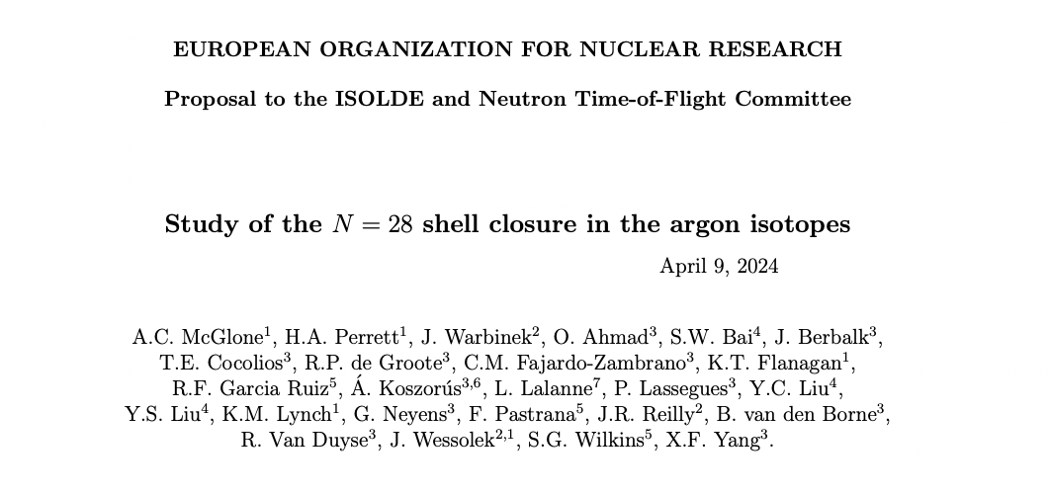
Status
Defended to INTC in May 2024. https://cds.cern.ch/record/2894938/files/INTC-P-702.pdf
21 total shifts approved (3 stable beam setup, 18 radioactive)
Requested for scheduling April/May 2025

Slide 3
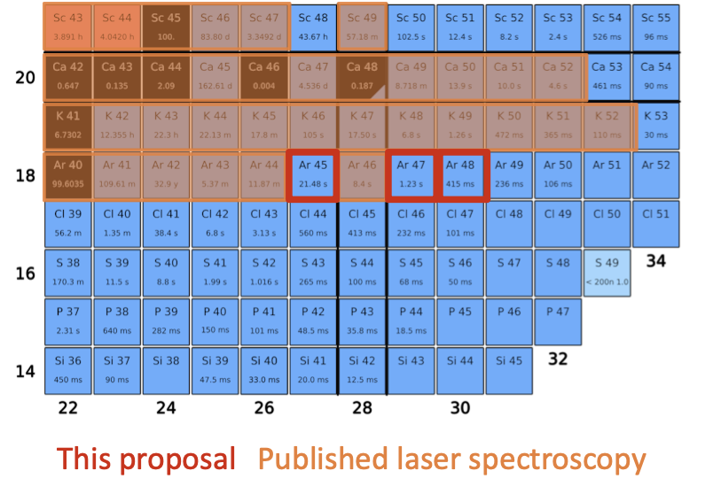
Status
Persistence of N=28 shell closure below 48Ca​
Complete disappearance in 42Si​
Signatures of shape coexistence in 44S​
Study onset of collectivity​

Slide 4
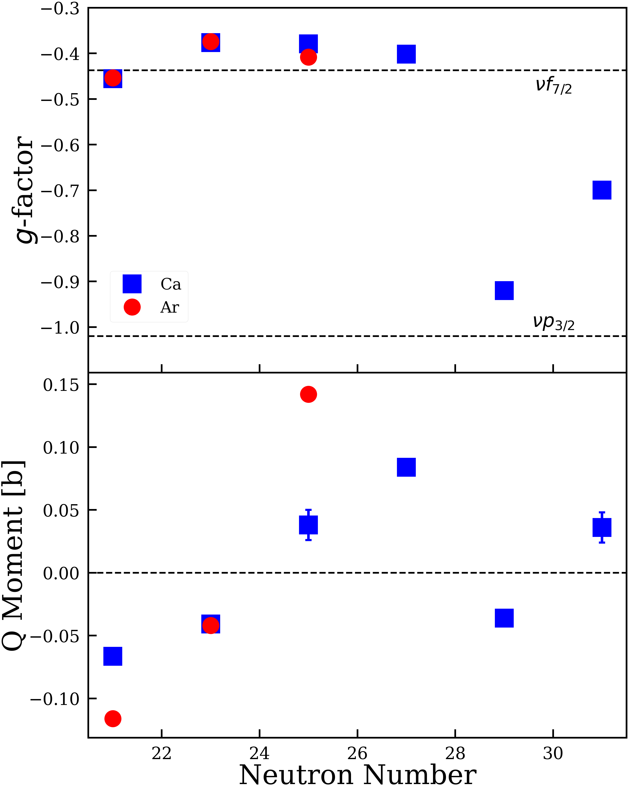
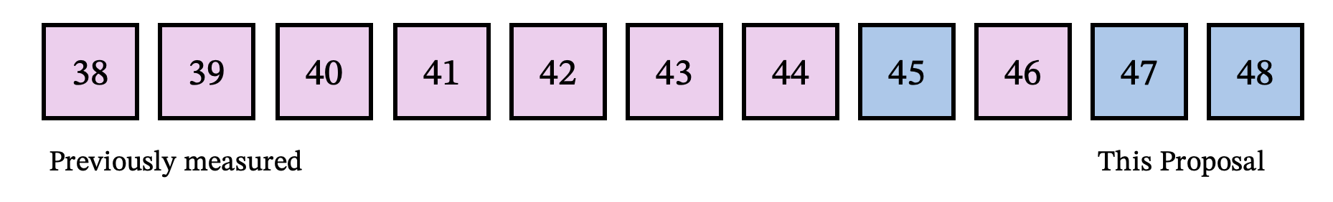
Physics goals
Crossing N=28, want to complete the picture with complete moments
Determine strength of closure in Ar
Experimental g-factors and q moments for Ar follow the same trend as Ca
Moments of ^{45,47}Ar will be sensitive to the presence of mixed configurations

Slide 5
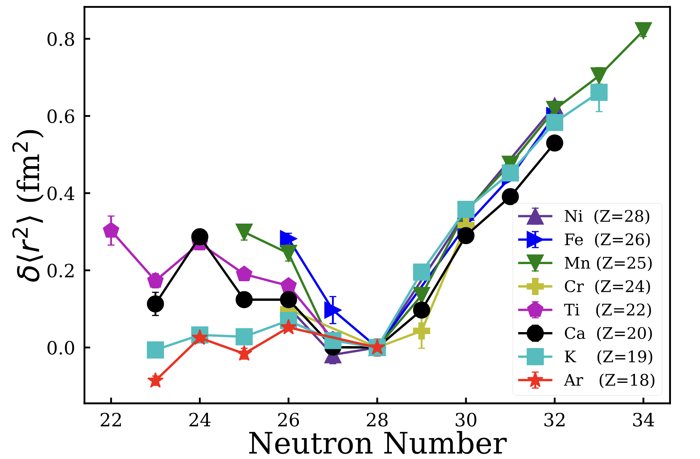
Physics goals
Crossing N=28, want to complete the picture with complete moments
Determine strength of closure in Ar
Investigate charge radii crossing N=28 towards N=32
Predicted bubble nuclei for ⁴⁶Ar
K. Blaum et al., Nucl. Phys. A 799, 30–45 (2008).​
I. Angeli, K.P. Marinova. J. Phys. G, 42, 055108 (2015).​
H. Heylen et al., Phys. Rev. C, 94, 054321 (2016).​
K. Minamisono et al., Phys. Rev. Lett., 117, 252501 (2016).​
F. Sommer et al., Phys. Rev. Lett., 129, 132501 (2022). ​
A. Koszorus, X. Yang, et al., Nature Phys., 17, 1–5 (2021).
5/2⁻, 7/2⁻
(3/2)⁻

Slide 6
Physics goals
Crossing N=28, want to complete the picture with complete moments
Determine strength of closure in Ar
Investigate charge radii crossing N=28 towards N=32
Predicted bubble nuclei
5/2⁻, 7/2⁻
(3/2)⁻
Side quest: Kr and Xe from same target / ion source

Slide 7
Laser Schemes
Ar:
IP
Populate metastable state in CEC with K vapour.
Typical TiSa + Dye + 1064 scheme
1064 nm
127 109.64 cm⁻¹
583.2 nm
4p²_{3/2}
TriLi/
Innolas
OPO
PDL
JyvIS
106 237.55 cm⁻¹
Rhodamine 6G
763.5 nm
4s²_{3/2}
93 143.76 cm⁻¹

Slide 8
Laser Schemes
Similarity in Scheme with K means easy swap between commissioning and Ar experiment
Ar:
K:
IP
IP
1064 nm
127 109.64 cm⁻¹
583.2 nm
355 nm
4p²_{3/2}
4p²_{3/2}
106 237.55 cm⁻¹
12 985.19 cm⁻¹
763.5 nm
769 nm
4s²_{3/2}
4s²_{1/2}
93 143.76 cm⁻¹
0 cm⁻¹

Slide 9
Laser Schemes
Other options:
Produced by the same ion source: Kr and Xe
Kr:
Xe:
IP
IP
5p²_{3/2}
6p²_{3/2}
159 BiBO
26, 37 BBO
Fundamental TiSa
Doubled 904nm TiSa
760 nm
452 nm
5s²_{3/2}
6s²_{3/2}

Slide 10
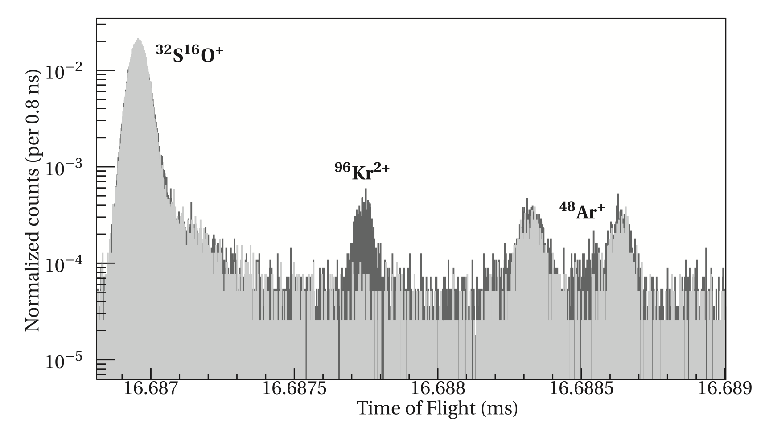
Contamination
Expected contamination from Kr2+ and Xe3+.
ISOLTRAP observed several stable molecular contaminants
  ³⁴S¹²C+
  ³⁴S¹²C+
Narrow beam gate required for reduction of intensity
M. Mougeot Phys. Rev. C 102, 014301

Slide 11
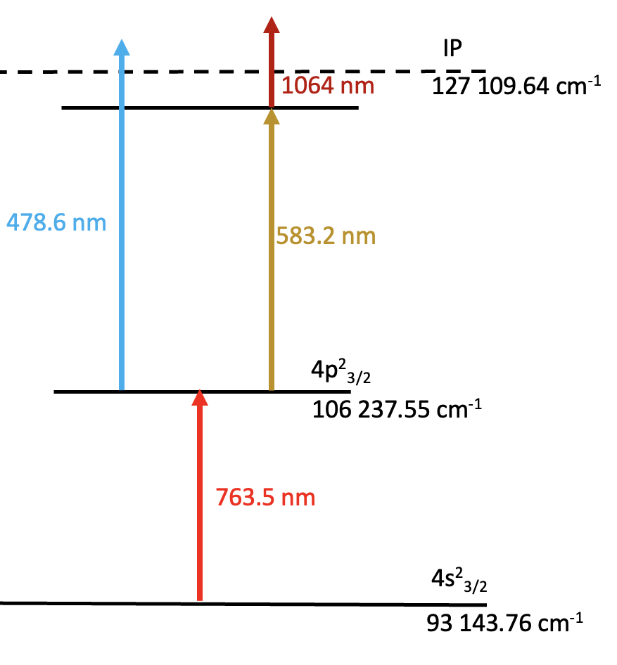
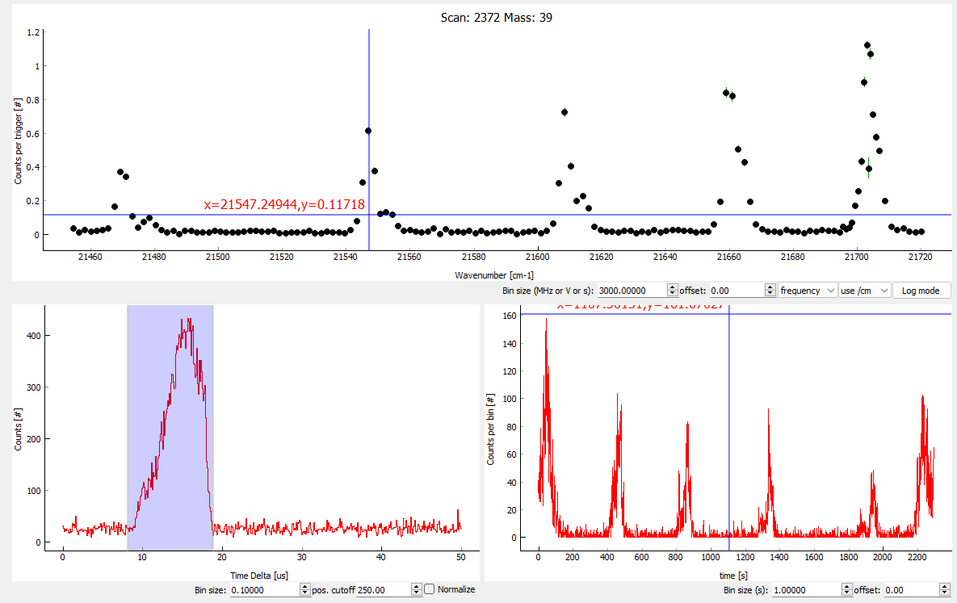
FIU
FIU
FIU
Using OPO to scan across the Rydberg scheme
Suppress laser related background, use deflectors
OPO for Rydberg scanning
20500-20900 cm⁻¹
20 500-20 900 cm⁻¹

Slide 12
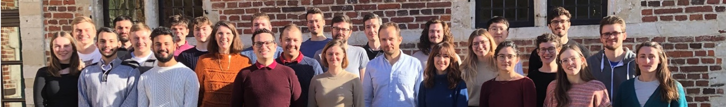

Thank You

Slide 14
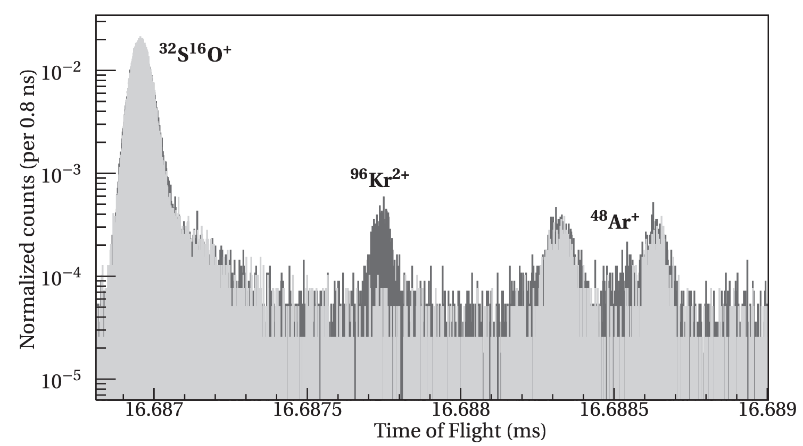
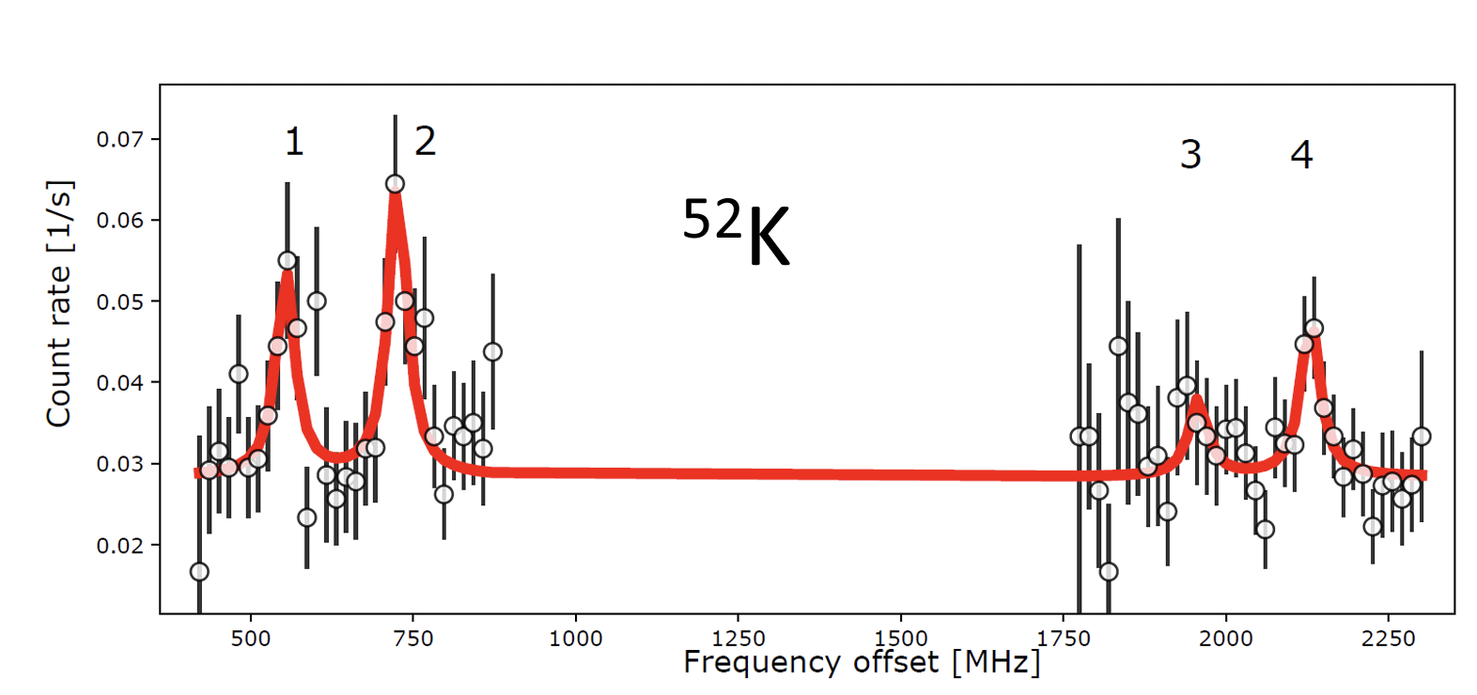
Yields and contaminations
ISOLTRAP measurements on ⁴⁸Ar
Expect similar level of contamination
Mostly ³²S¹⁶O⁺, ⁹⁶Kr⁺
Narrow beam gate required to reduce contamination
Shifts estimated from worst case of expected background in CRIS
M. Mougeot et al., Phys. Rev. C 102, 014301 (2020).
Contributions for shift estimate:
Reduction of yield due to narrow beam gate
CRIS efficiency
Population of metastable state, hyperfine structure
Time needed for multiple scans (strongly dependent on signal-to-background ratio)
360 ions/s
A. Koszorus et al., Nature Phys. 17 439–443 (2021).

Slide 15
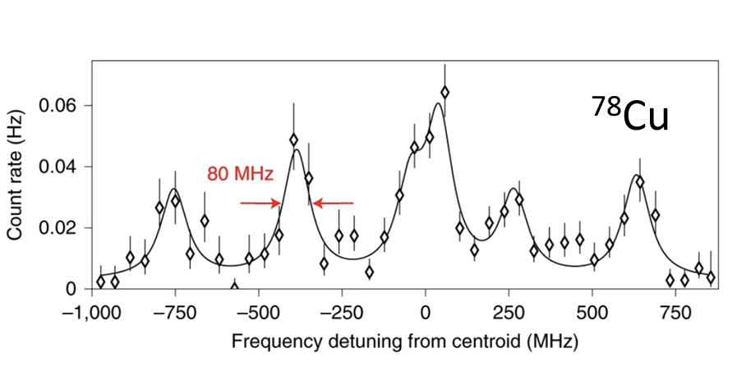
Shift request
 | Half live | Yields (/μC) | Shifts | New results
³⁸⁻⁴⁴Ar | > 8s | 10⁶-10⁷* | 3 | -
⁴⁶Ar | 8.4 s | 1.11 × 10⁵* | 2 | -
⁴⁵Ar | 21.48(15) s | 3.49 × 10⁵* | 2 | I, μ, Q_{s}, δ〈r²〉
⁴⁷Ar | 1.23(3) s | 7.72 × 10³* | 6 | I, μ, Q_{s}, δ〈r²〉
⁴⁸Ar | 415(15) ms | 1.58 × 10³* | 5 | δ〈r²〉
Stable |  | CRIS setup | 3 (no protons)
UCx target + FEBIAD plasma ion source
Yields (extrapolated) sufficient for CRIS
Contamination known (ISOLTRAP)
Measurements feasible down to ⁴⁸Ar
20 ions/s
360 ions/s
R.P. de Groote et al., Nature Phys. 16, 620–624 (2020).
A. Koszorus et al., Nature Phys. 17 439–443 (2021).

Slide 16
Shift request
 | Half live | Yields (/μC) | Shifts | New results
³⁸⁻⁴⁴Ar | > 8s | 10⁶-10⁷* | 3 | -
⁴⁶Ar | 8.4 s | 1.11 × 10⁵* | 2 | -
⁴⁵Ar | 21.48(15) s | 3.49 × 10⁵* | 2 | I, μ, Q_{s}, δ〈r²〉
⁴⁷Ar | 1.23(3) s | 7.72 × 10³* | 6 | I, μ, Q_{s}, δ〈r²〉
⁴⁸Ar | 415(15) ms | 1.58 × 10³* | 5 | δ〈r²〉
Stable |  | CRIS setup | 3 (no protons)
UCx target + FEBIAD plasma ion source
Yields (extrapolated) sufficient for CRIS
Contamination known (ISOLTRAP)
Measurements feasible down to ⁴⁸Ar
Stable beamtuning for CRIS setup: 3 shifts
Reference measurements throughout experiment, calibration of voltage drifts and systematic effects: 5 shifts
Laser spectroscopy of ⁴⁵Ar: 2 shifts, Laser spectroscopy of ^{47,48}Ar: 11 shifts
Shifts requested account for expected contamination and reduction of yields by using a narrow beamgate
TAC comments: The TAC does not foresee any serious issues with this proposal.

