Slide 1

RILIS @ CRIS Collab
Jan 2025
J. R. Reilly, A. Ajayakumar, M. Au, J. Berbalk, C. Bernerd, H. Büker, K. Chrysalidis, M. Elle, V. Fedosseev, L. T. Glöggler , M. V. U. Gonzalez, R. Heinke, A. A. H. Jaradat, R. Mancheva, R. Rossel, S. Rothe, A. Schmidt, J. Wessolek

Slide 2
Overview
The RILIS Team
RILIS in 2024 (Tm, Lu, Hg)
Developmental labs: YOL2, LARIS
Online: RILIS
What’s coming up

Slide 3
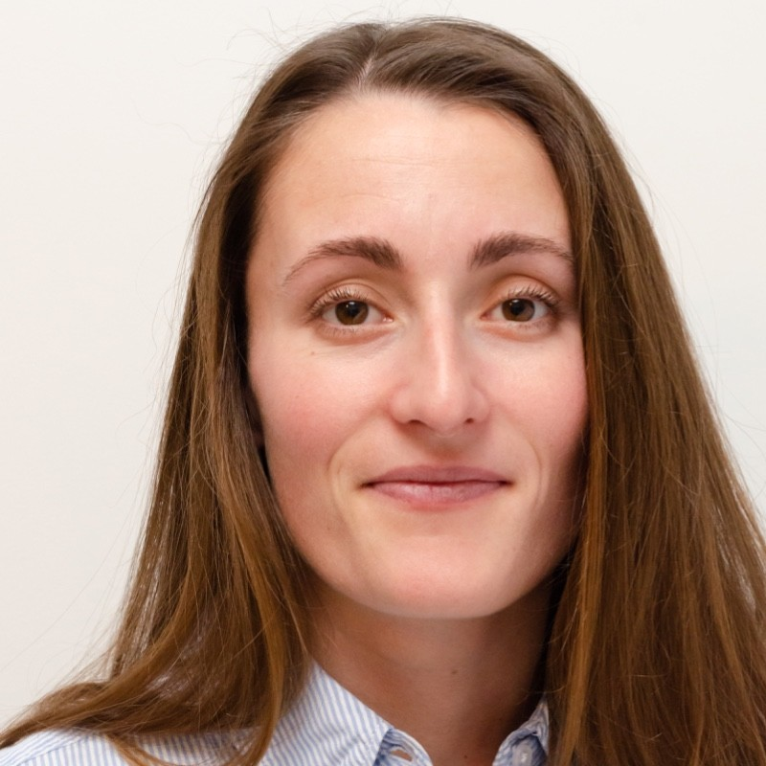




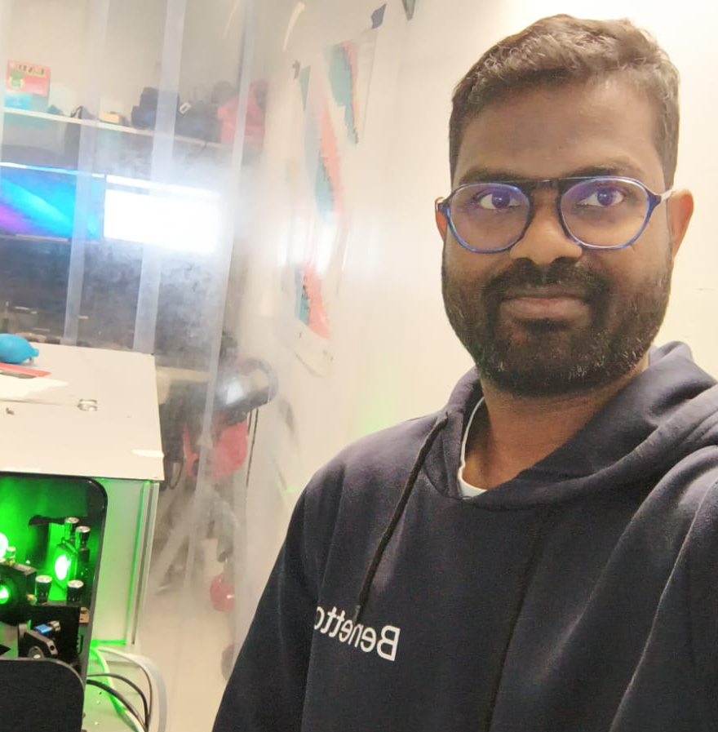




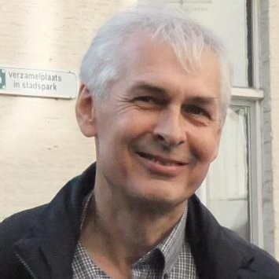
The RILIS Team
Staff
Fellows
PIJAS
PhD Students
Legacy Member

Slide 4
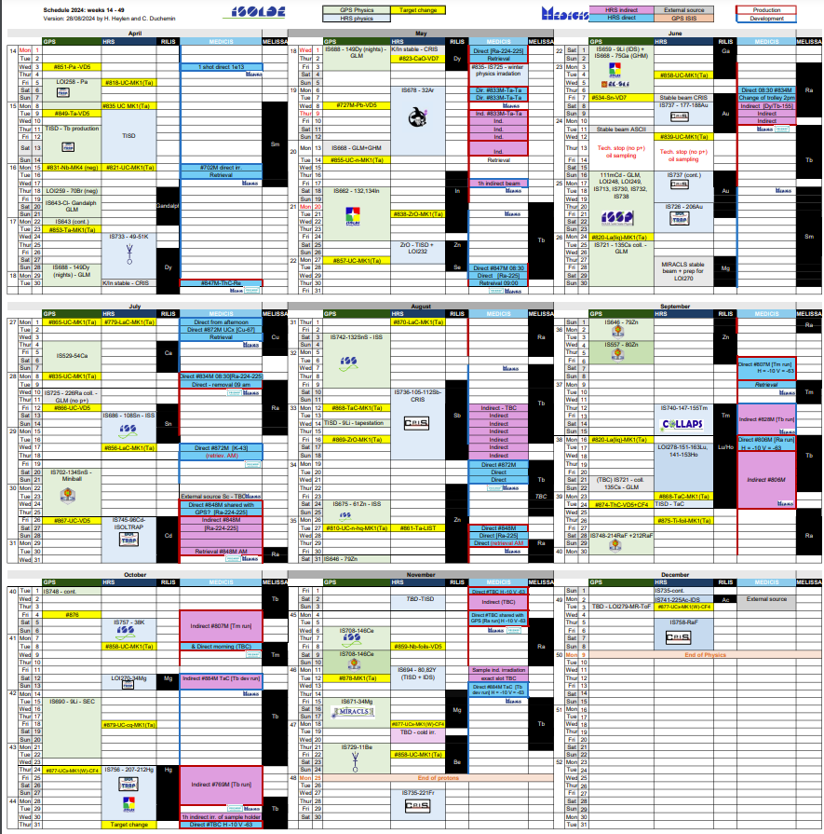
RILIS Online Period
Resonance Ionization Laser Ion Source
22 experiments requiring laser ionized species
60% of campaigns throughout the running period and winter physics
Cl, Dy, In, Zn, Se, Ga, Au, Mg, Ca, Sn, Cd, Sb, Tm, Lu, Ho, Hg, Sr, Al, Be, Ac
1 x 3:00 am Chiller substitution
1 x LIST/PI-LIST campaign (Tm/Lu)
1 x 12-hour LIST target construction and change
1 x In-source spectroscopy campaign (Hg)
Many collaborative efforts with TISD/ISOLTRAP/IDS

Slide 5
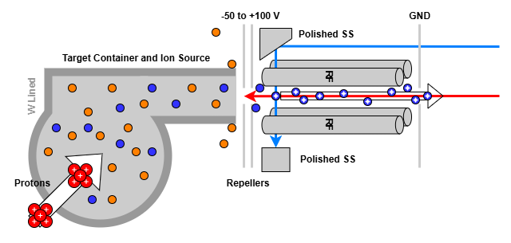
PI-LIST: Ever growing demand!
Perpendicular Illumination Laser Ion Source and Trap
Extension to the standard Ion source
Perpendicular illumination in the LIST interaction region
Repellers to suppress surface ionization (x10⁶)
RILIS → LIST: 100 Loss factor
RILIS → PI-LIST (opt): 2000 Loss factor
Each PI-LIST target requires thorough troubleshooting
Offline 2
ISOLDE
Construction of the LIST container
Coupling to ISOLDE target container
Vacuum Tests
Temperature calibration + Mechanical durability
Electronics and RF set up
Surface ion extraction and RF guiding
Laser access and laser ion extraction
Surface ion suppression: Ion guide mode vs LIST mode
PI-LIST configuration access
Electronics and RF set up
Surface ion extraction and RF guiding
Laser access and laser ion extraction
Surface ion suppression: Ion guide mode vs LIST mode
PI-LIST configuration access
Transport

Slide 6
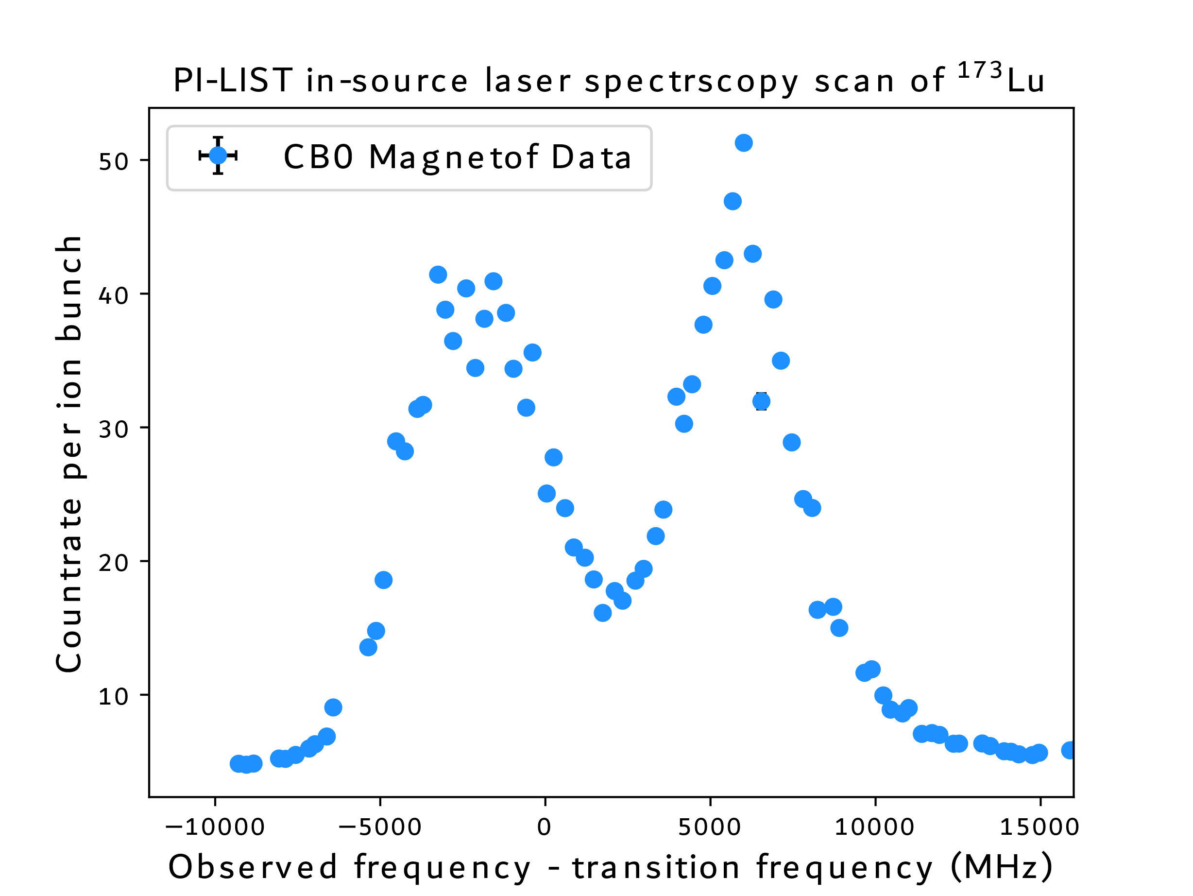
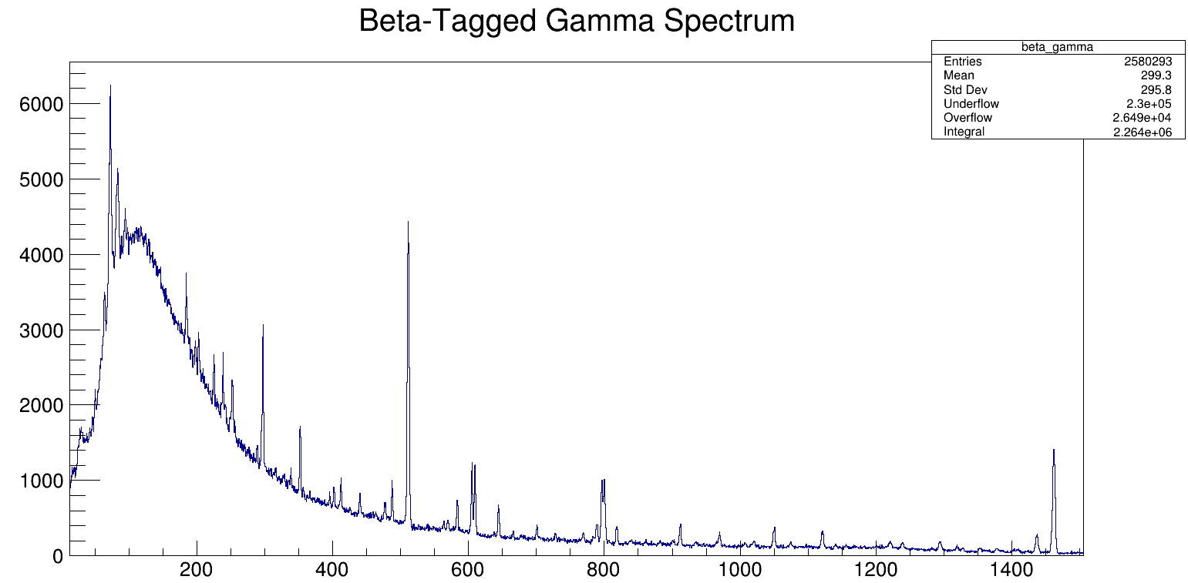
RILIS Results 2024
Courtesy of Kara Lynch!
PI-LIST & In-source Campaigns on Lu, Tm and Hg
RILIS + IDS + ISOLTRAP
Tm: COLLAPS run towards shell closure (Sept 2024)
Lu: Scheme development and yield checks (Sep 2024)
Hg: New laser spec and decay spec on neutron-rich side (Oct 2024)
²⁰⁹Hg!
Courtesy of Josh Wilson!

Slide 7
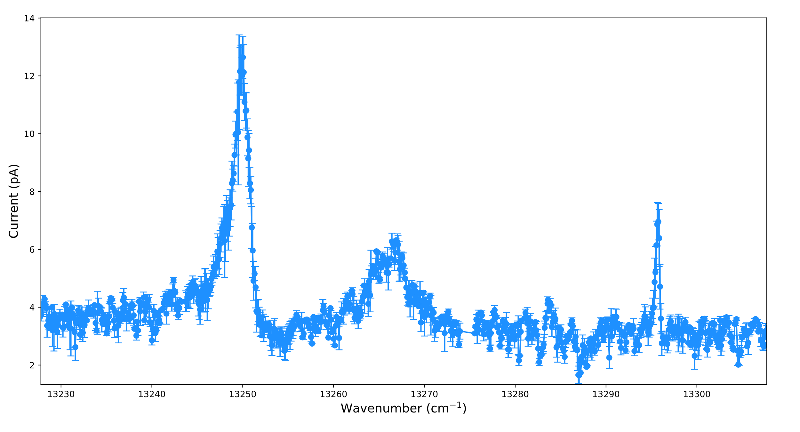
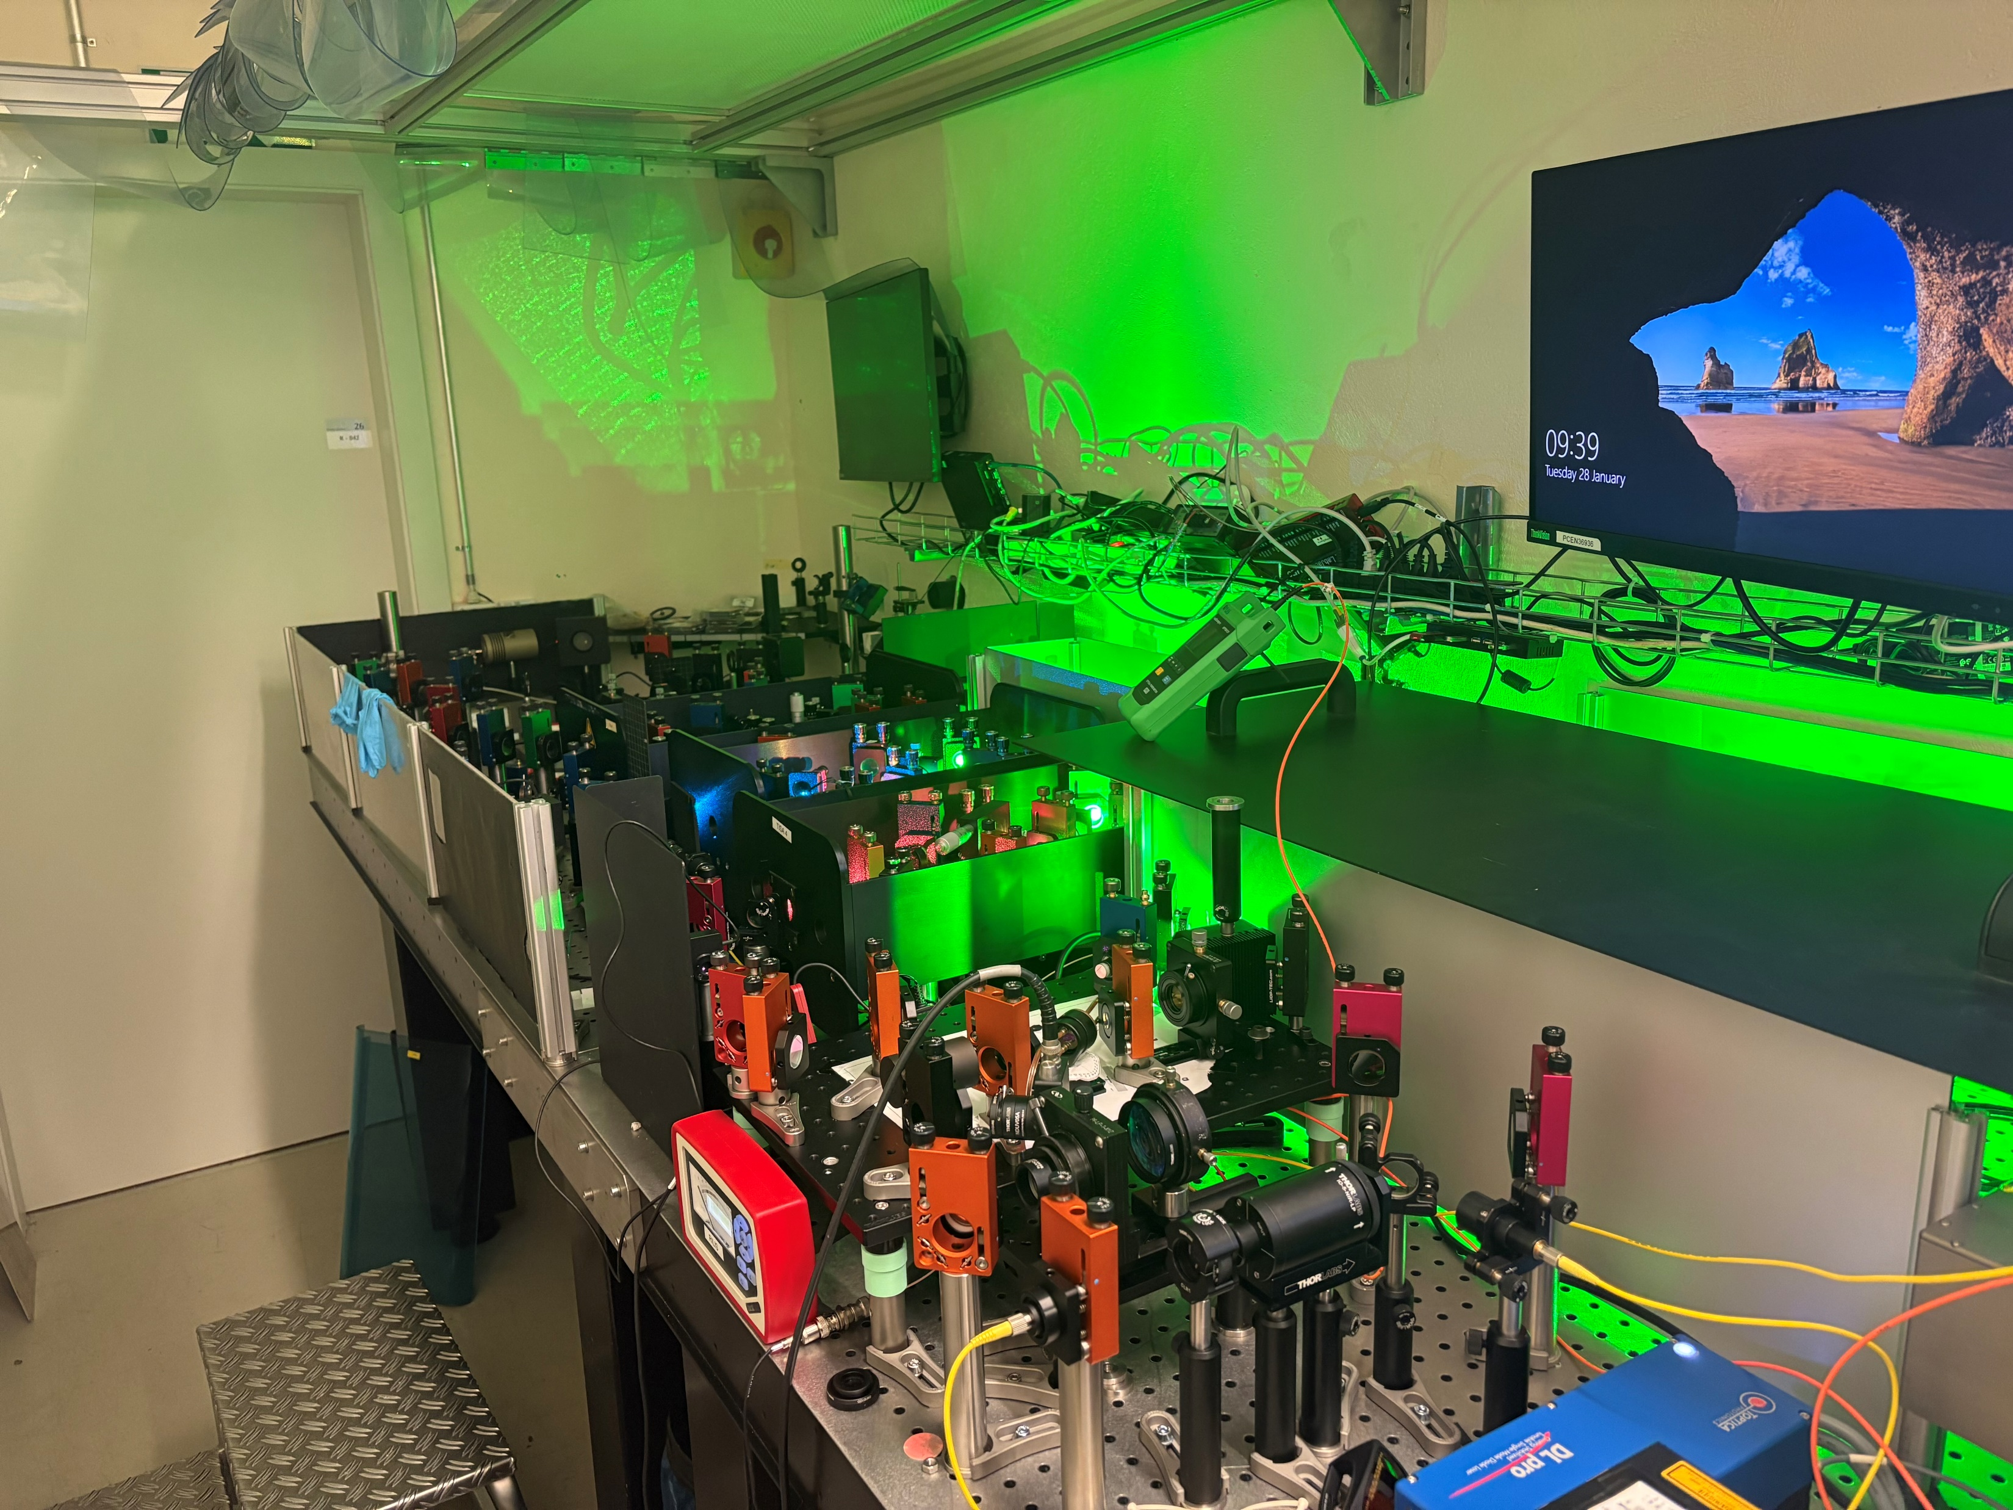
Offline 2
Measured in Oct!
Upgrading the YOL2 Laser Lab!
Oct 2024: Ni Scheme development – New AIs found with spectroscopy transition
December 2024: Accepted proposal to study Ni online with PI-LIST – investigate resolution limit in medium mass region offline
Providing more laser capabilities in YOL2 for Ni development as well as future endeavors:
4 x TiSa cavities ( 2 x BiFi + etalon, 1 x Grating, 1 x injection-seeded)
2 x Pump lasers
1 x Non-res 1064/532/355
2 x Diode lasers
New autoionizing states found in Ni!
To meet the demands in YOL2, we had to borrow Grating from MEDICIS – temporary solution

Slide 8
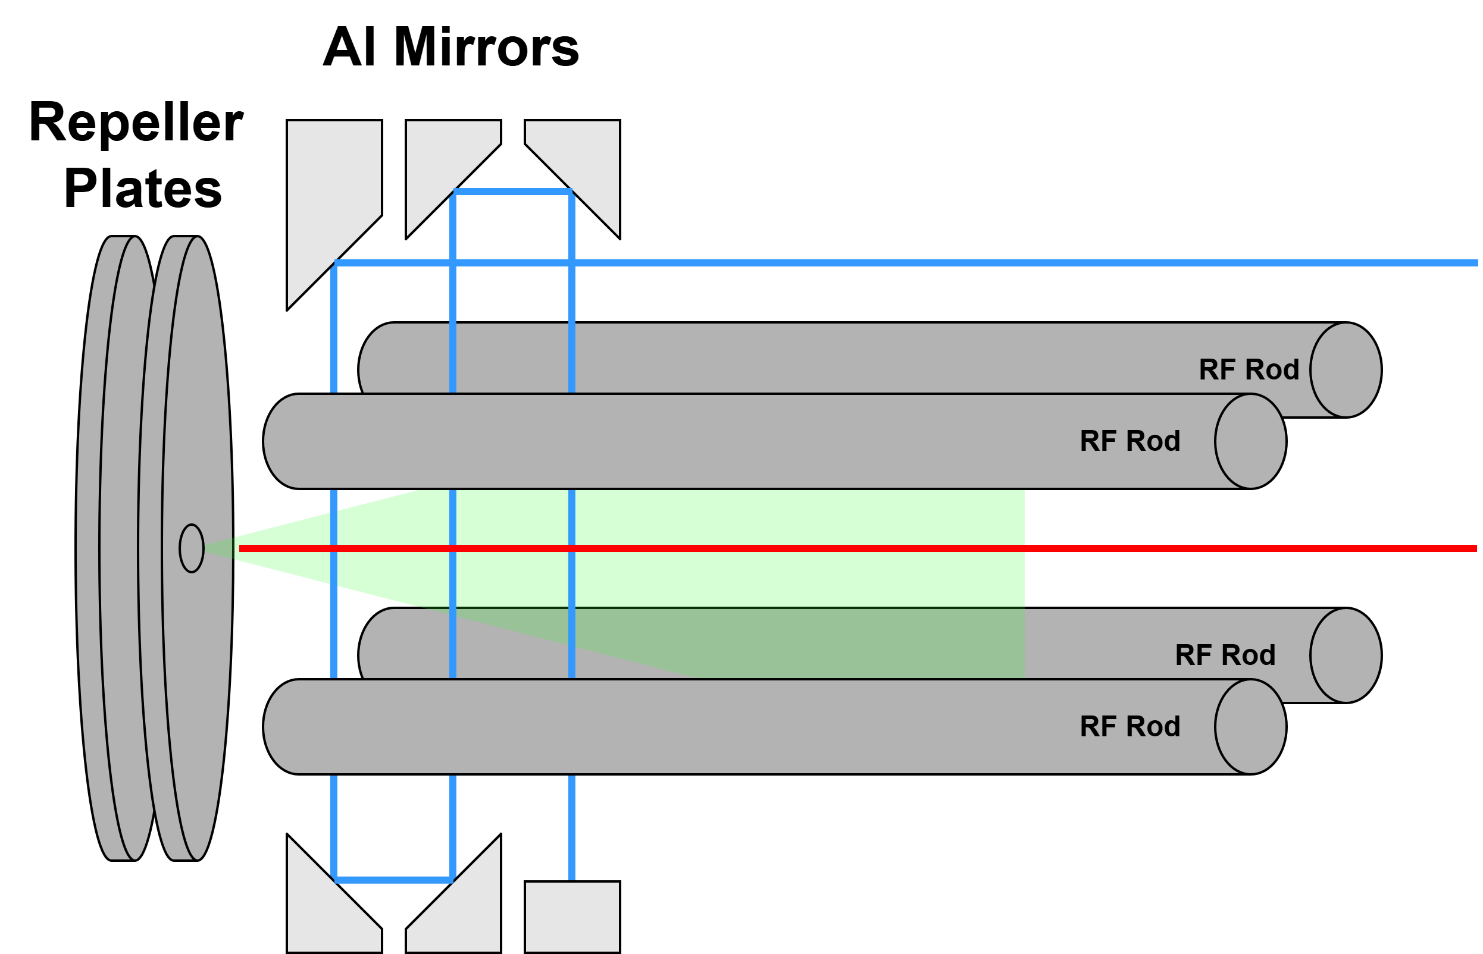
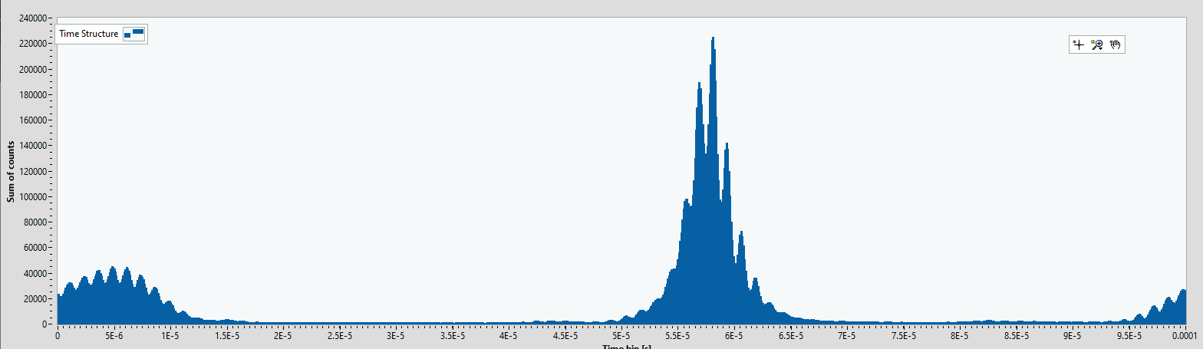
Offline 2
Not only lasers!
Also investigating PI-LIST developments:
RF + laser pulse synchronisation (Summer 2024)
Single pass vs Triple pass (Feb 2025)
Voltage offset: deployed online for Tm (Autumn 2024)
H-bridge current switching (Spring/Summer 2025)
New Transducer box (Manchester collaboration)
Also aim to duplicate electronics this year to have a permanent ISOLDE and YOL2 set-up

Slide 9
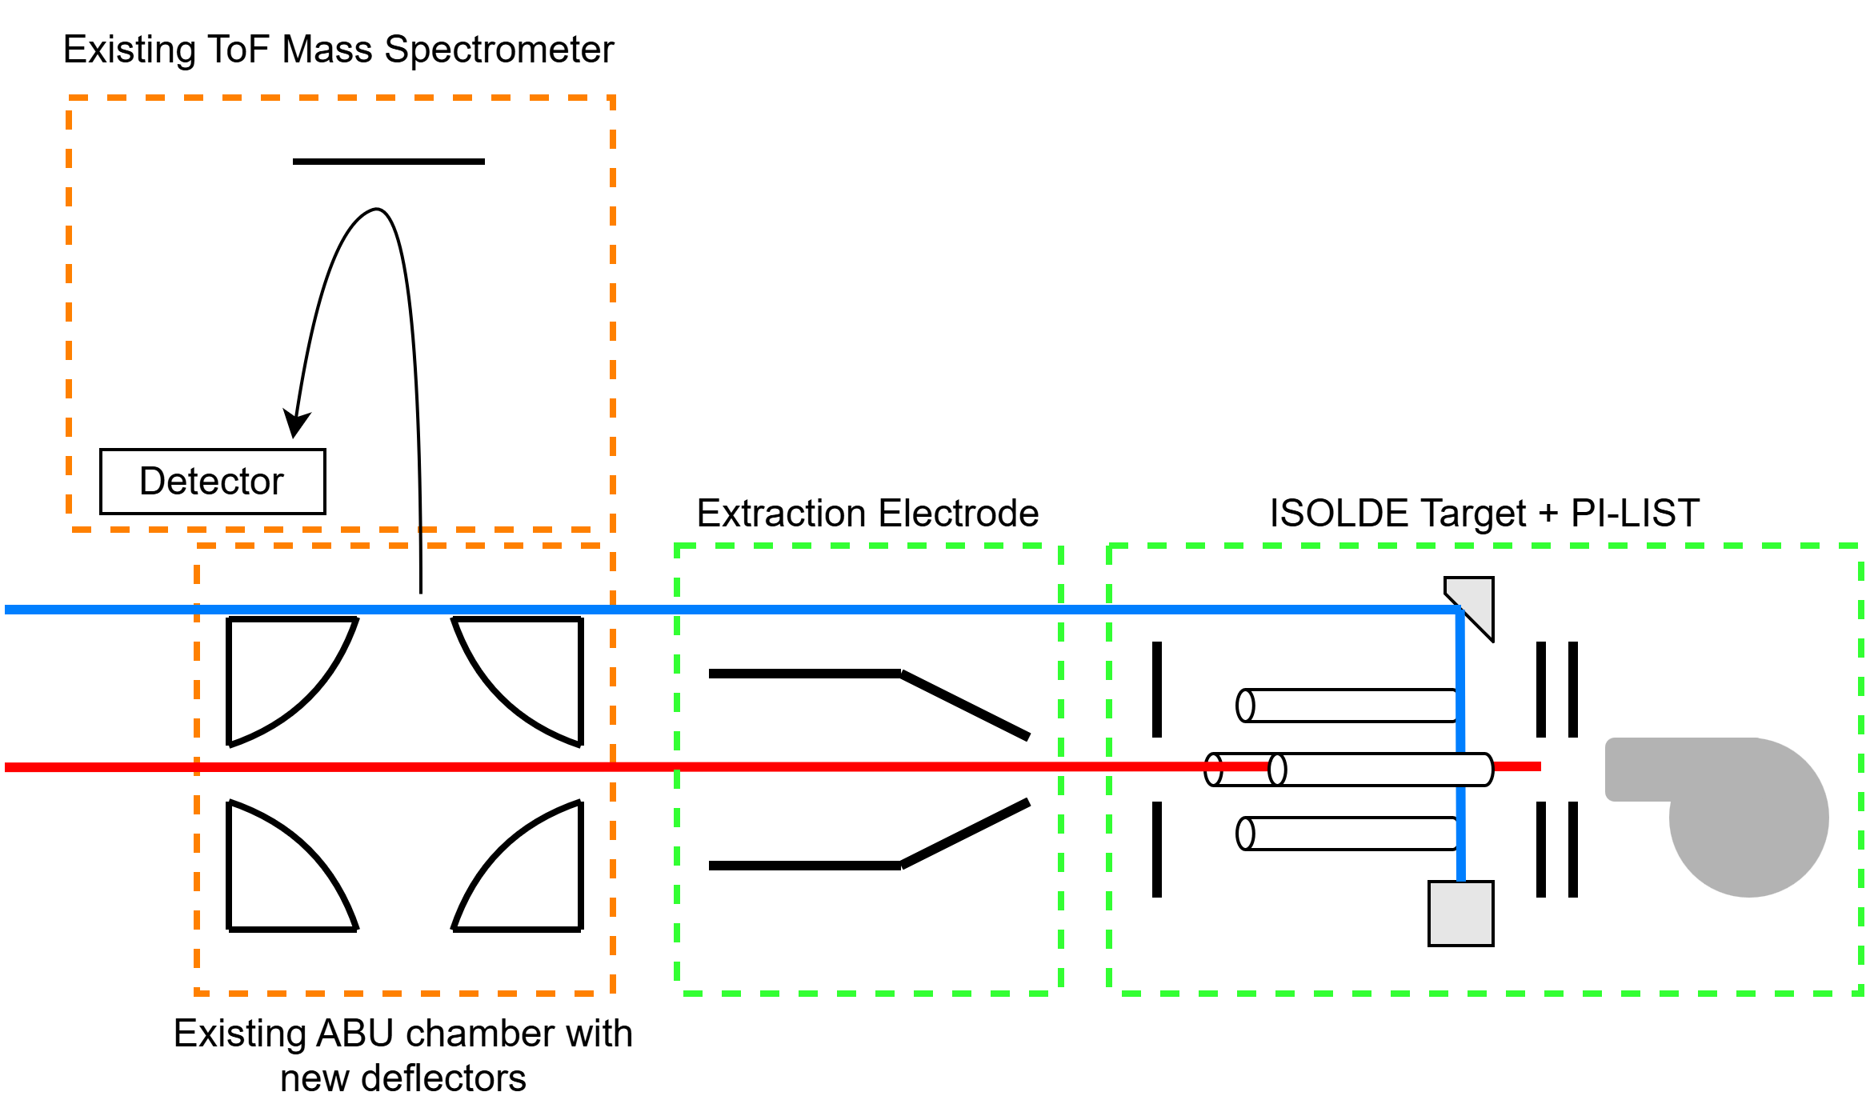
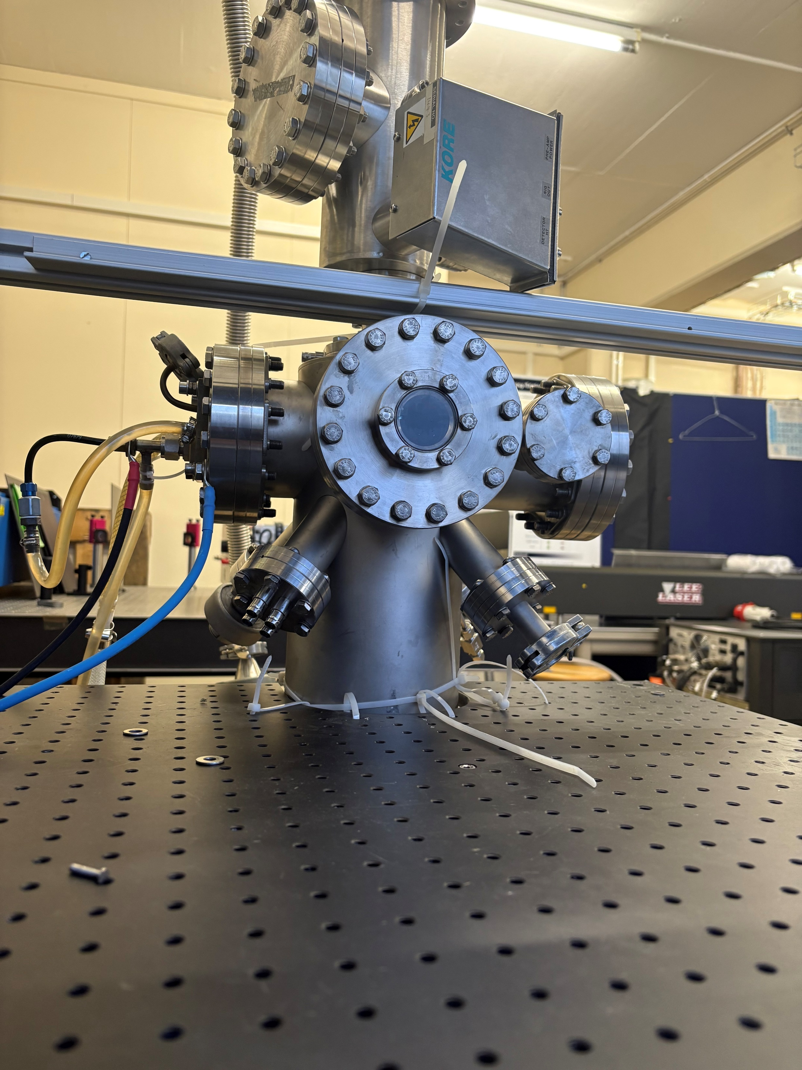
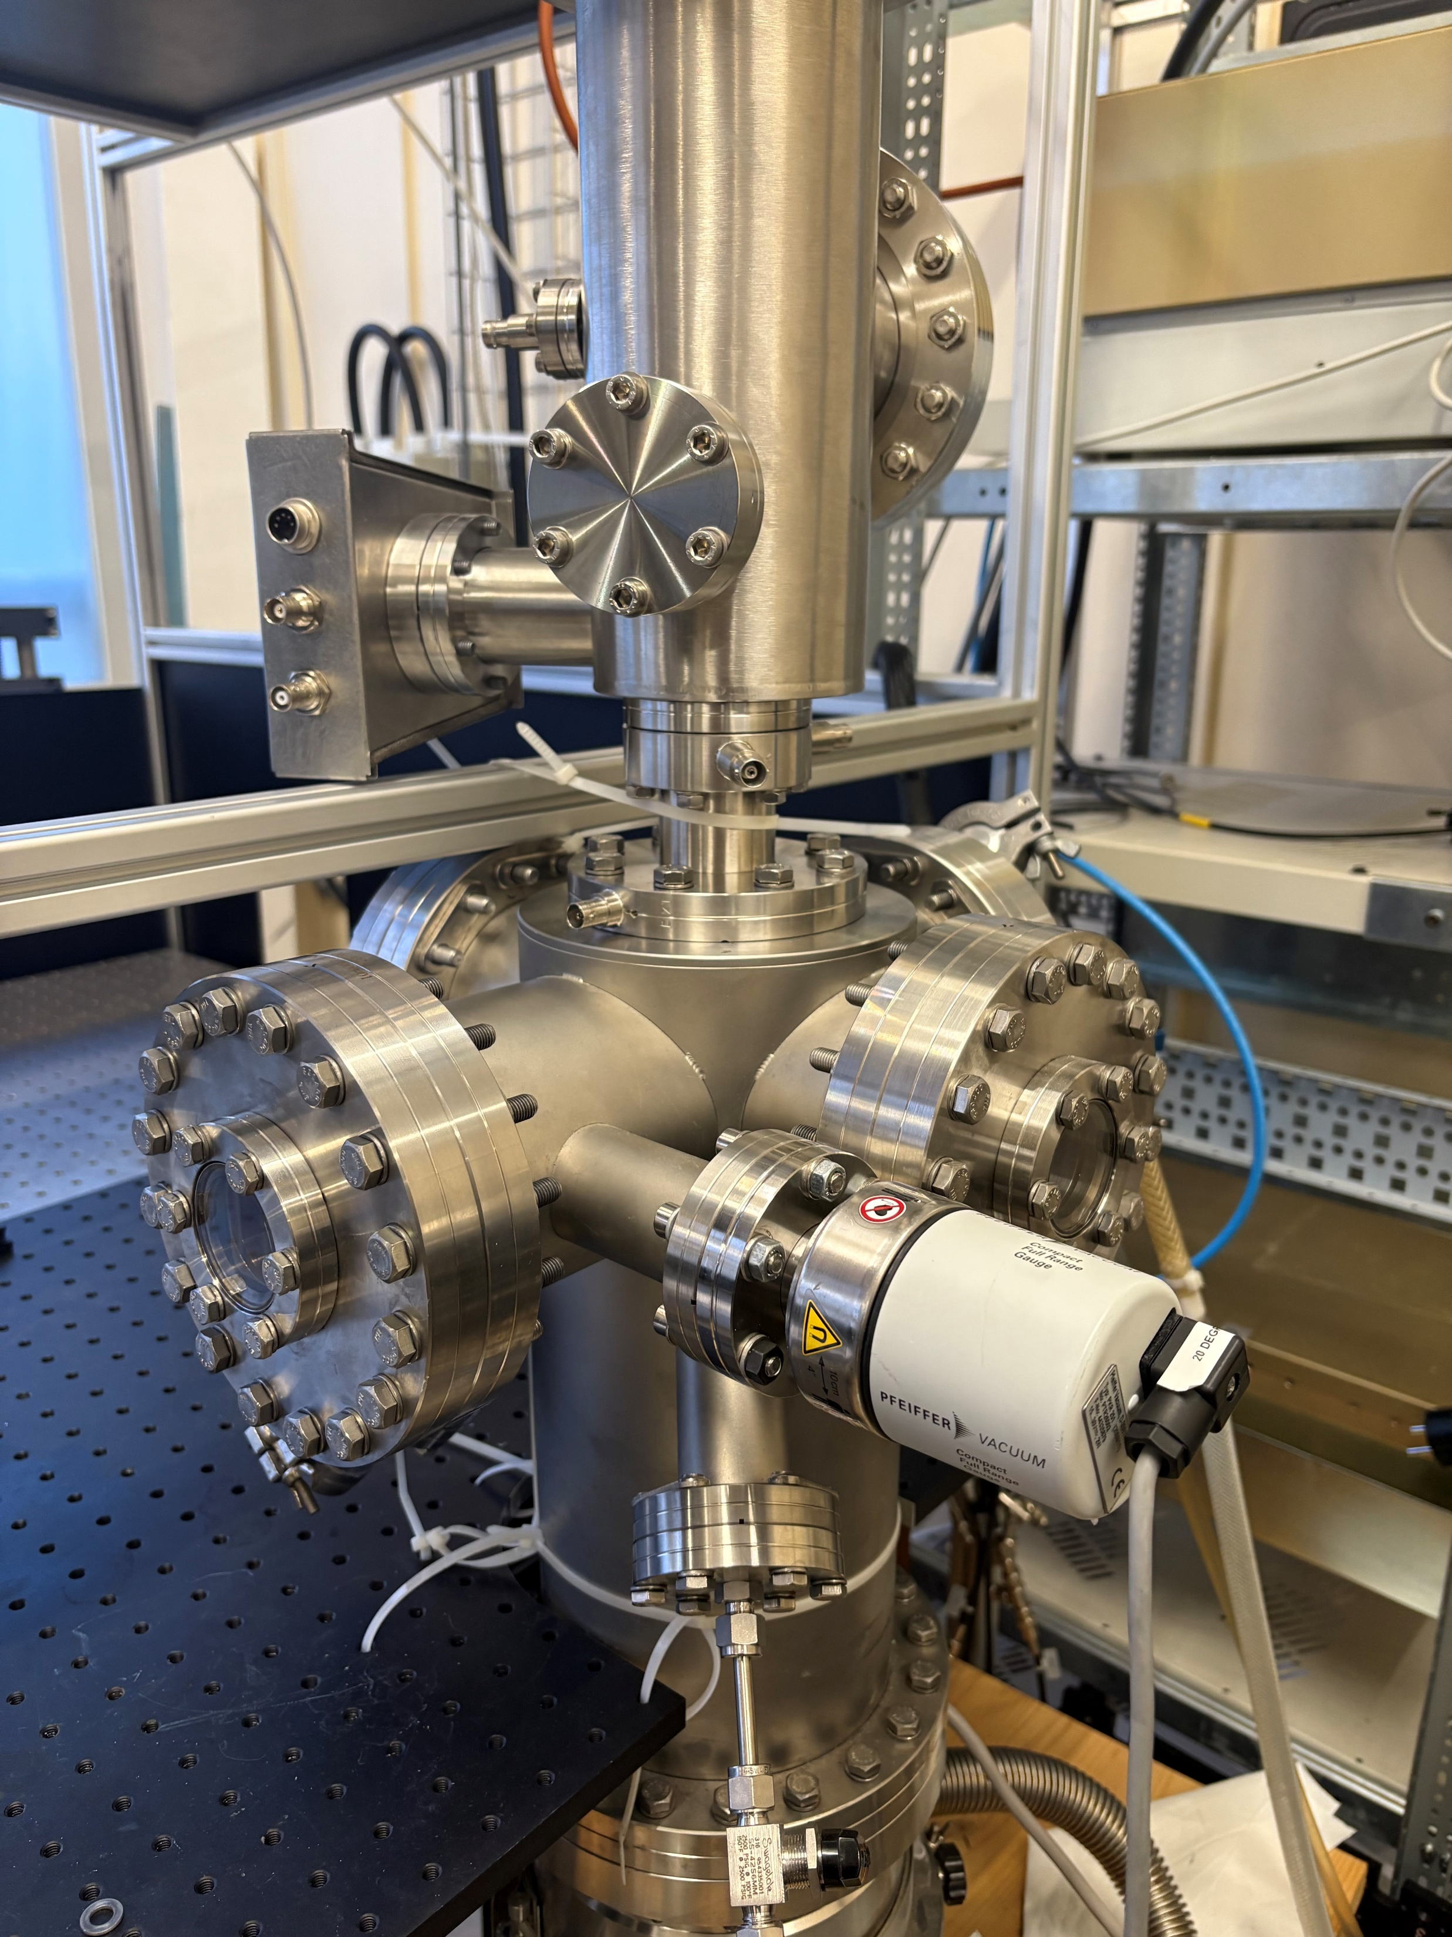
LARIS
Returning ABU to its former glory!
Plans to add an extension to existing and new design:
deflectors/bending plates added to existing chamber
Retractable extraction electrode
ISOLDE target coupling capabilities
Anti-collinear access
Decrease demand on Offline 2
Not only LIST but other ISOLDE targets!

Slide 10
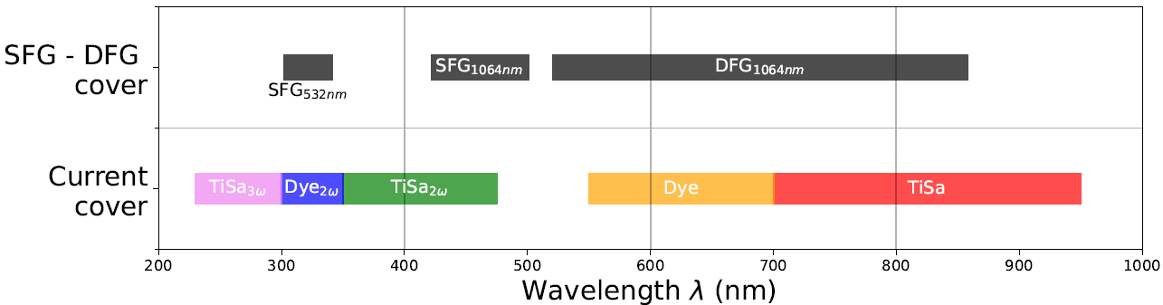
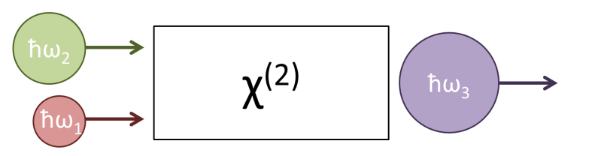
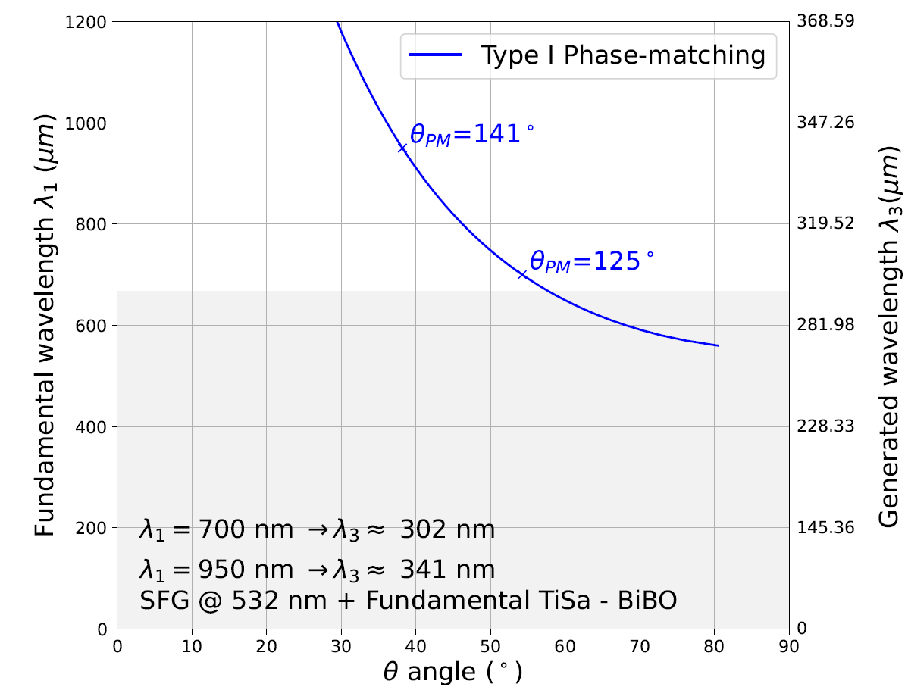
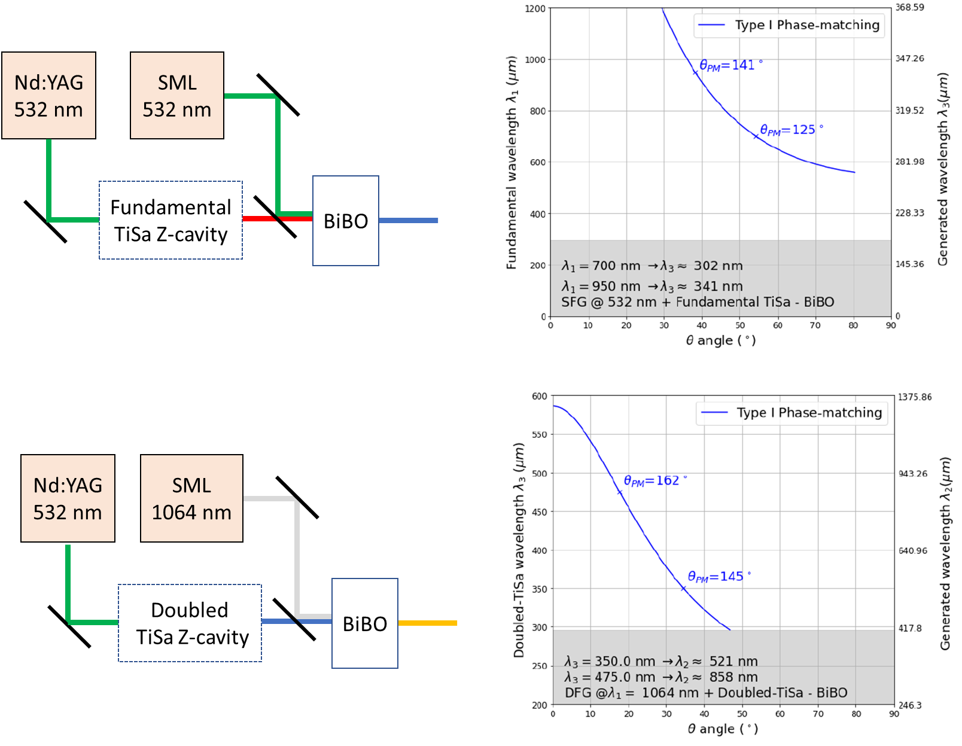
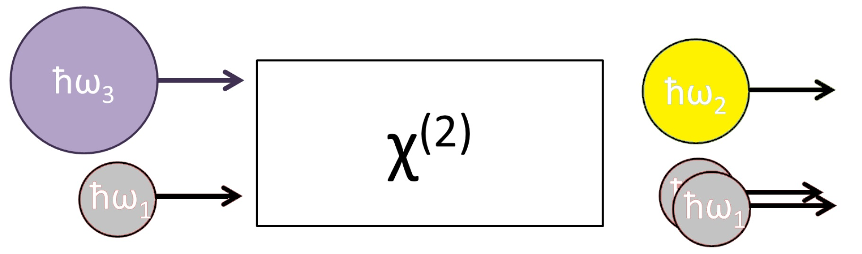
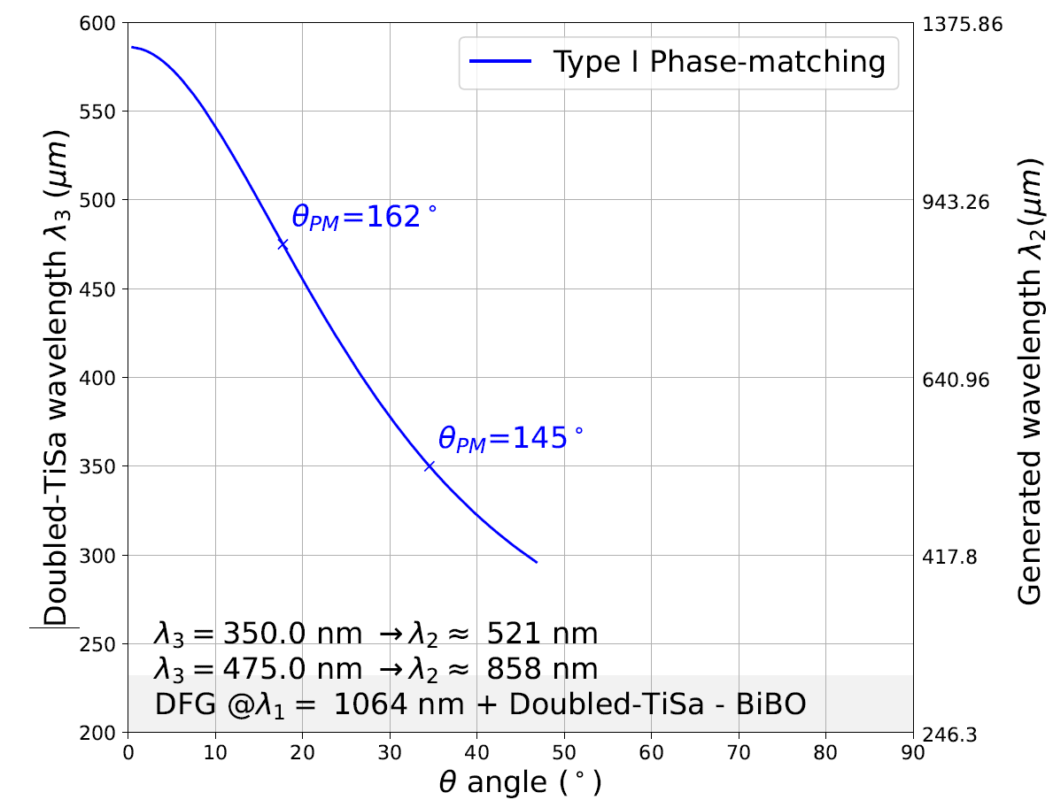
LARIS
Slide provided by Cyril!
Frequency mixing: Covering Dye laser wavelengths with solid-state systems & non-linear optics
Process
Schematics
Phase-matching BiBO
Potential coverage :
Sum frequency generation
SFG
SFG tested at RILIS and CRIS in 2023 Ag (532nm SM not stabilized)
Proof of principle with broadband 1064nm MIRUS laser from Mainz in LARIS in 2025
Test for intra-cavity frequency mixing
If successful : stabilized 1064nm SML → call for tender
Difference frequency generation
DFG
ħω₂

Slide 11
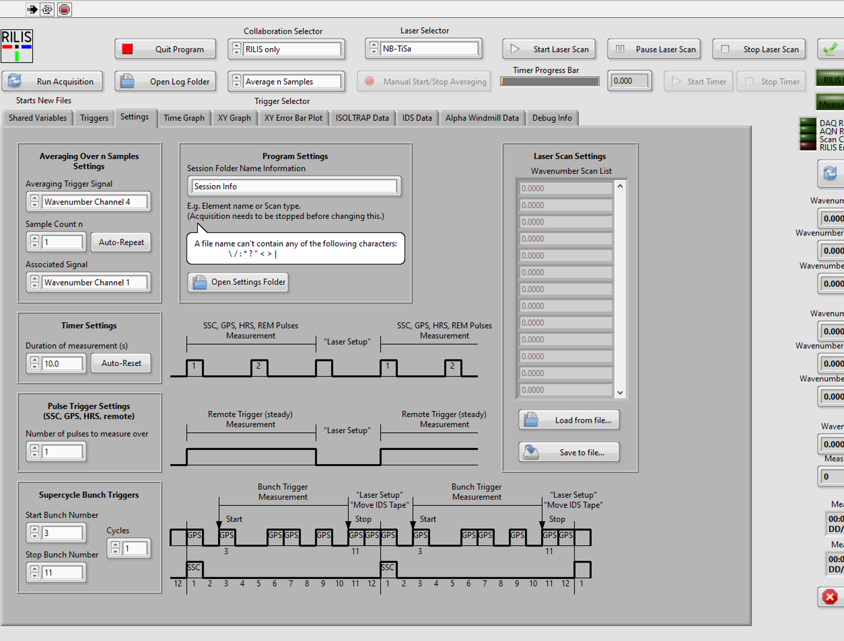
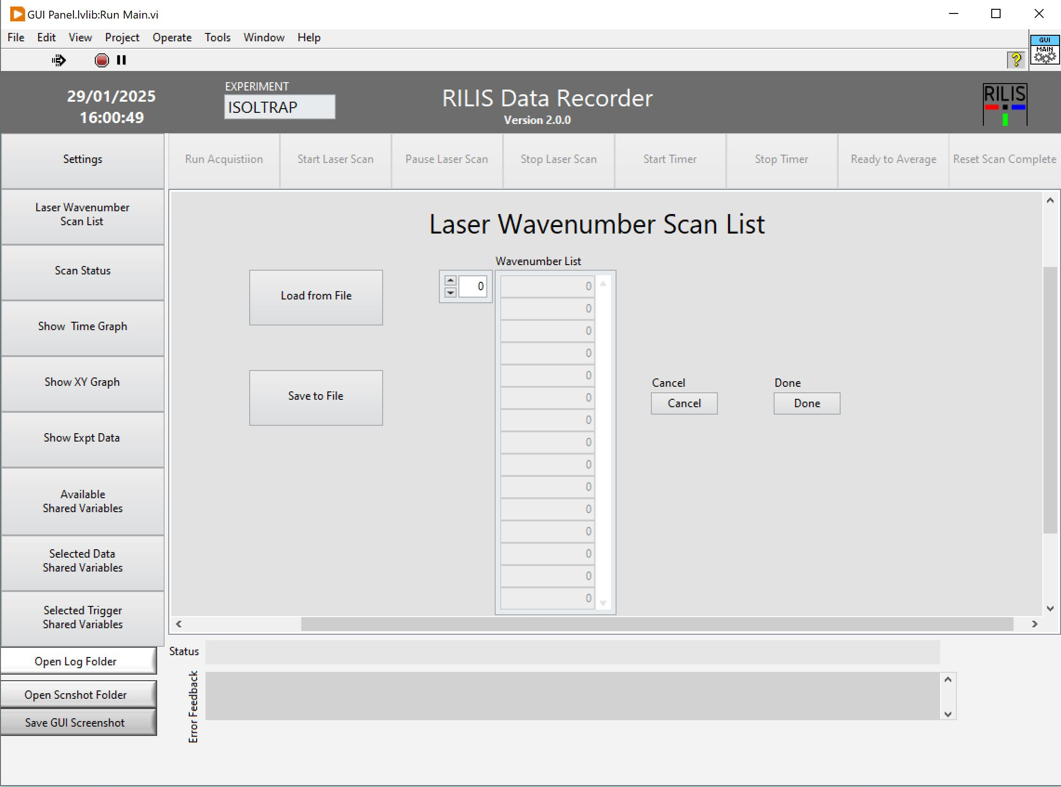
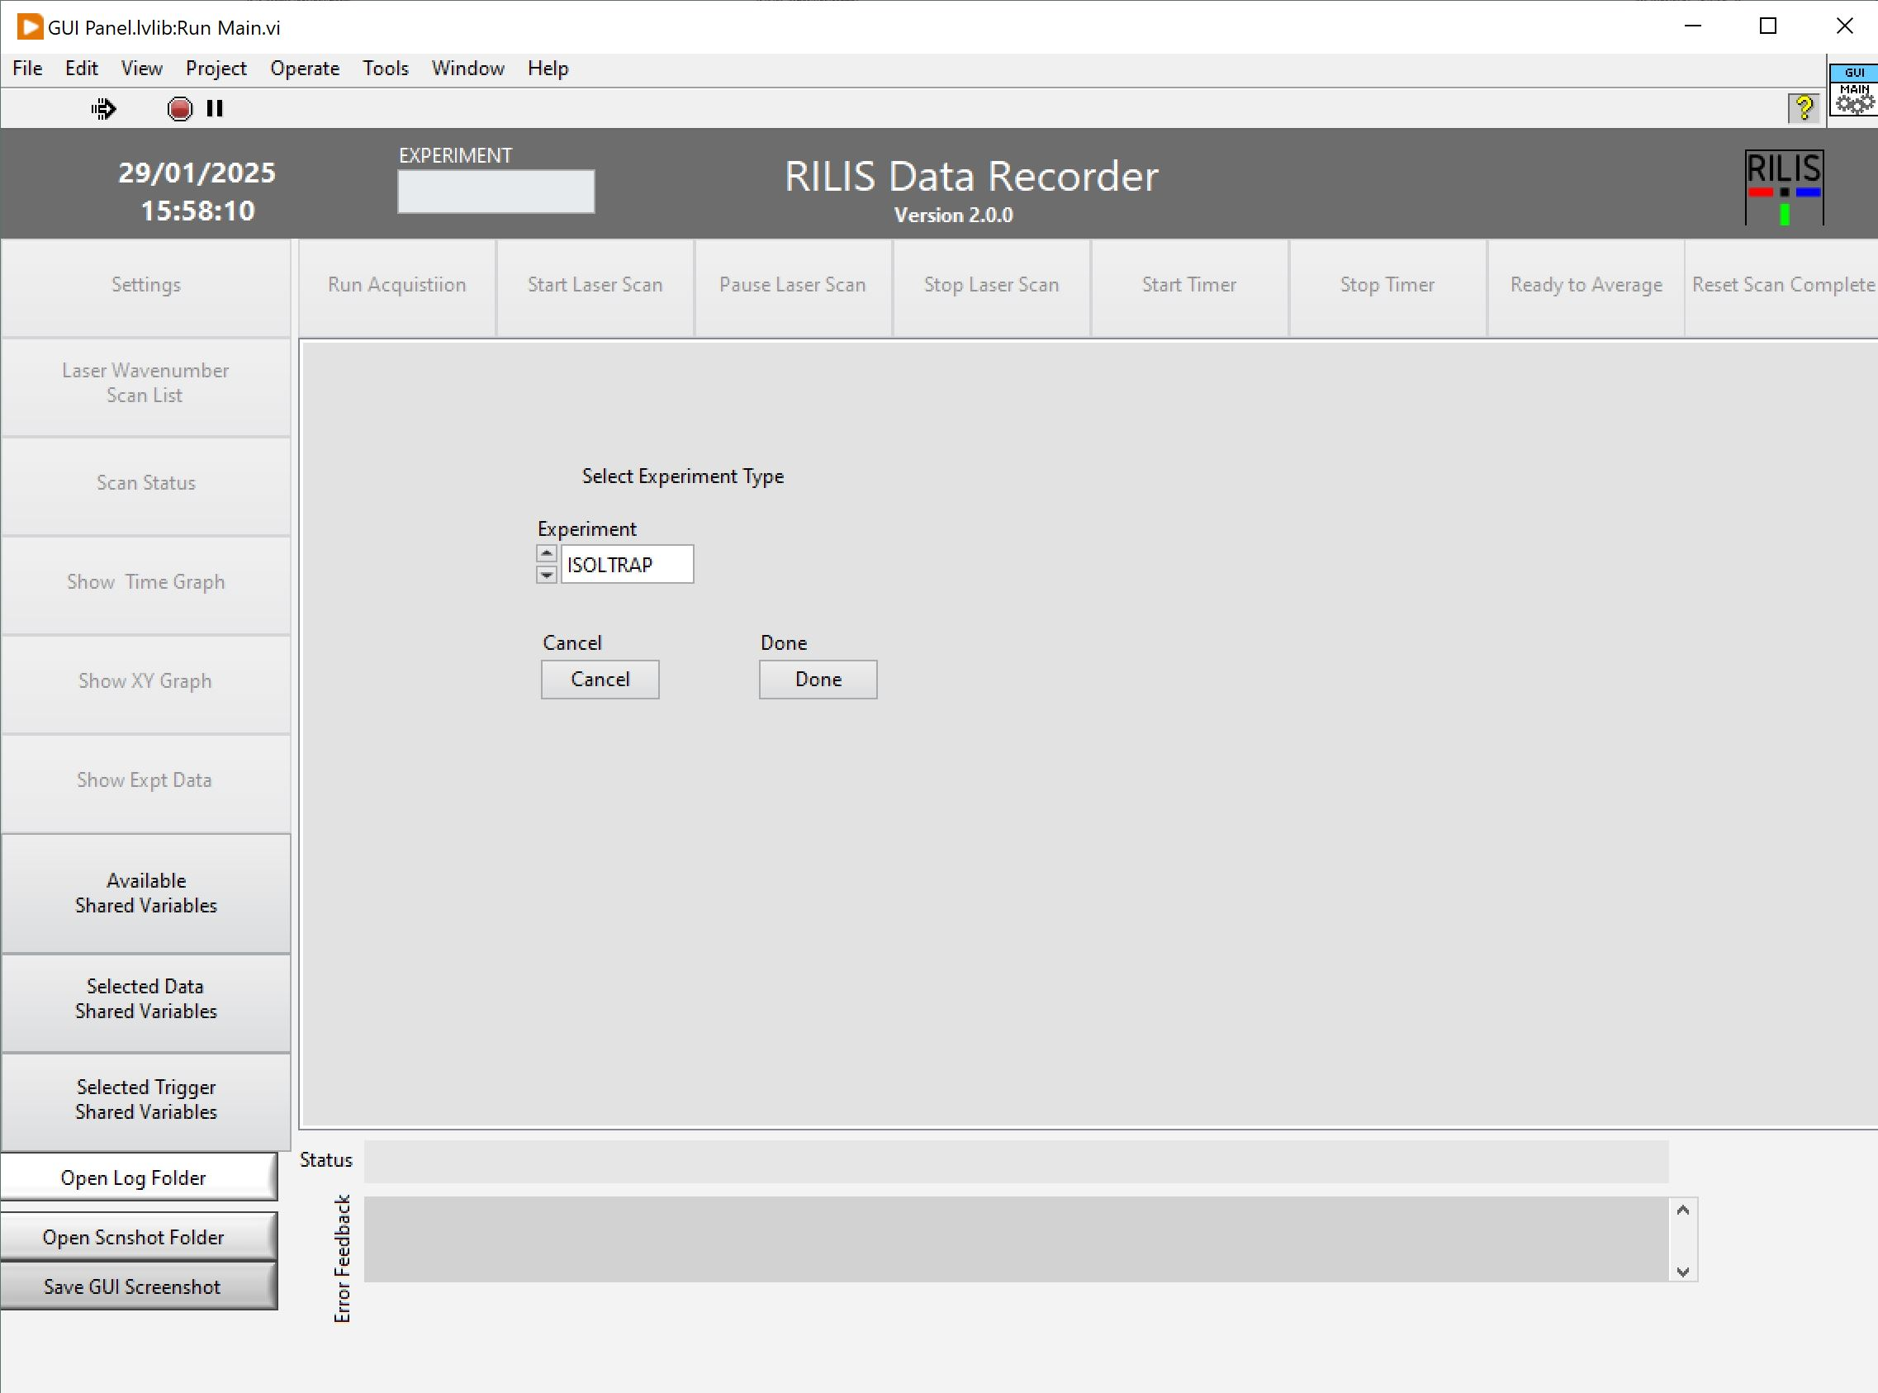
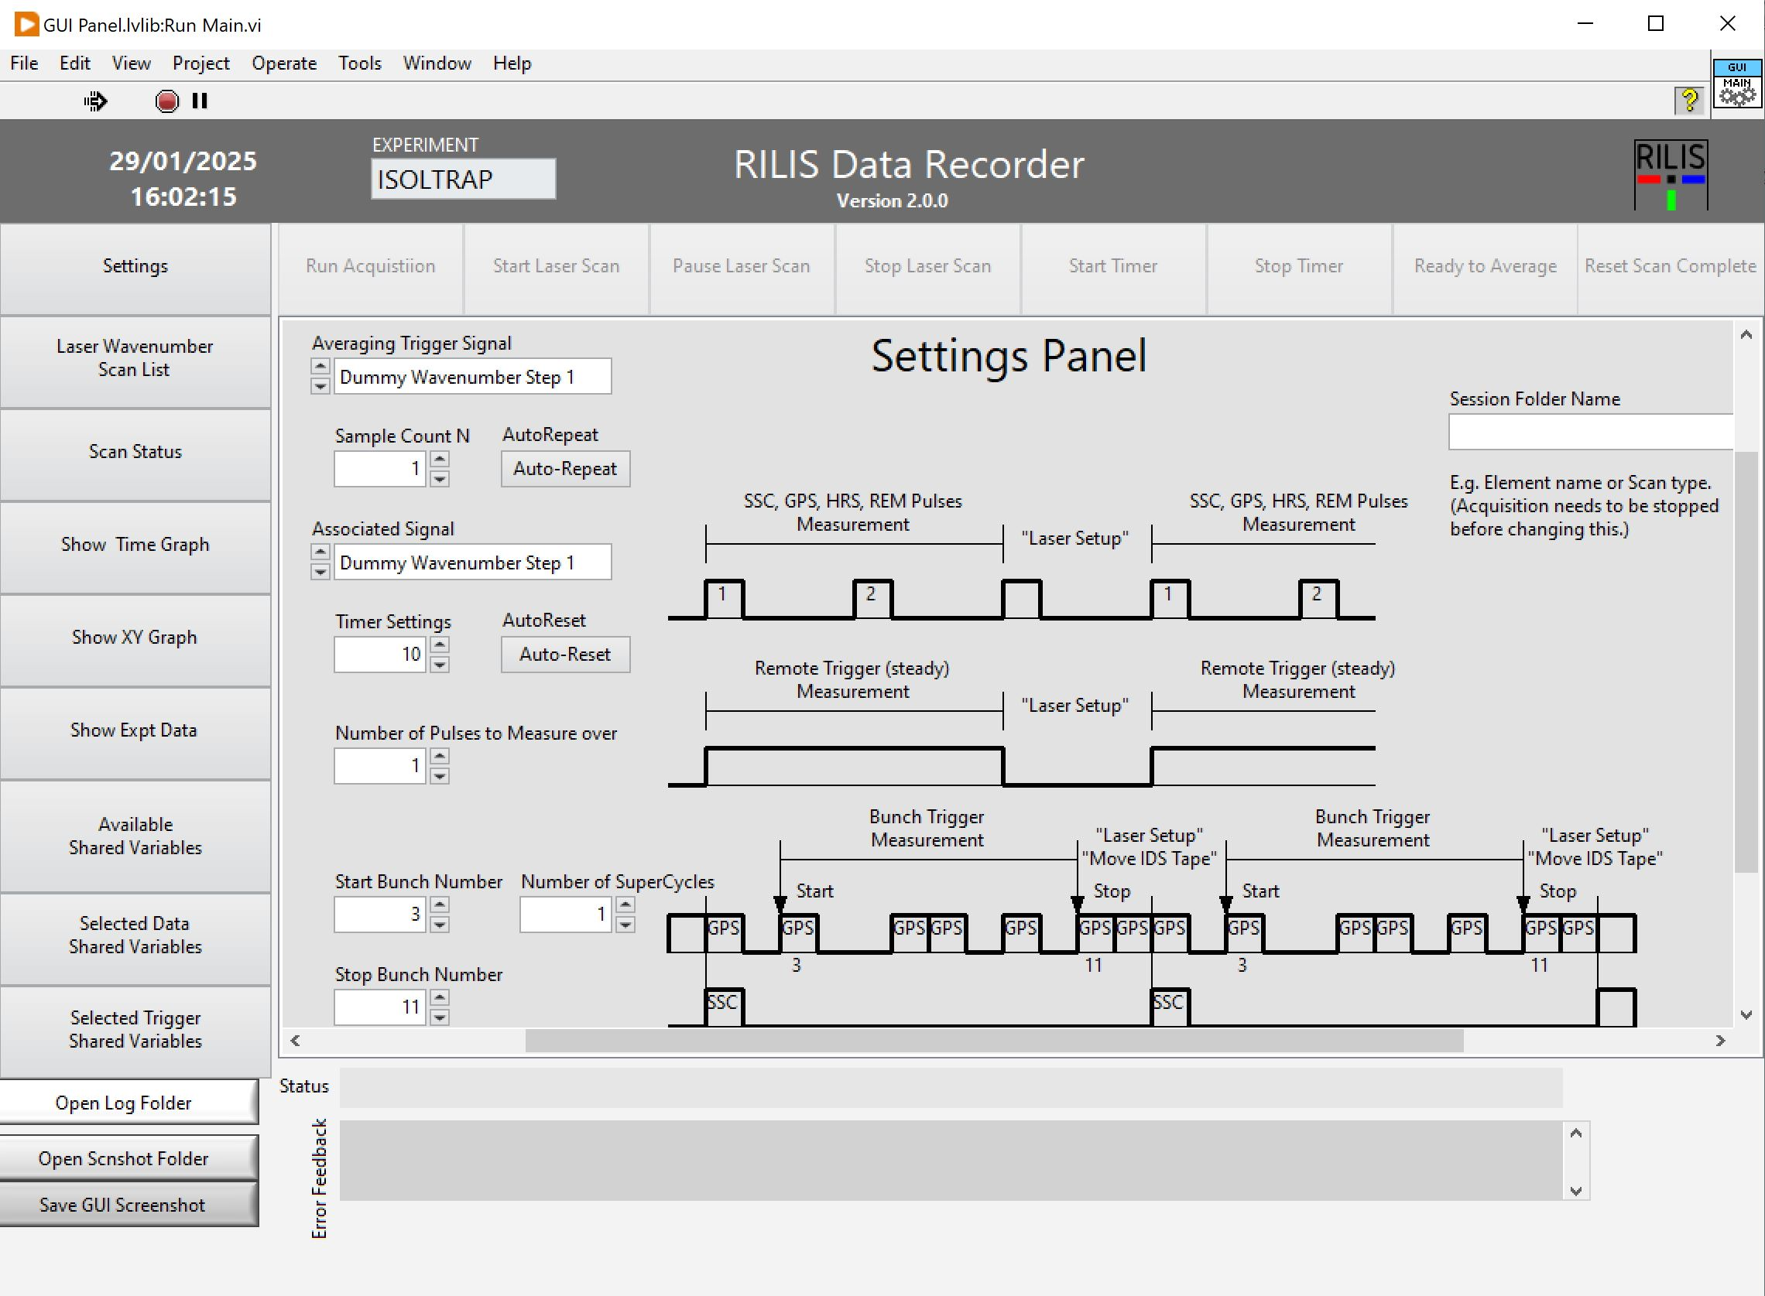
RILIS DAQ: Spectroscopy
Slide provided by Cyril!
General upgrade of the RILIS Labview software environnent (contract with ANGARA)
Upgrade of the RILIS DAQ software for in-source spectroscopy:
  Work in progress by ANGARA
  Testing and debugging in February-March – To be ready for use in April
  Possibility to add new trigger configuration (time, proton bunch, supercycle…). Any suggestions ?
Old version
New version

Slide 12
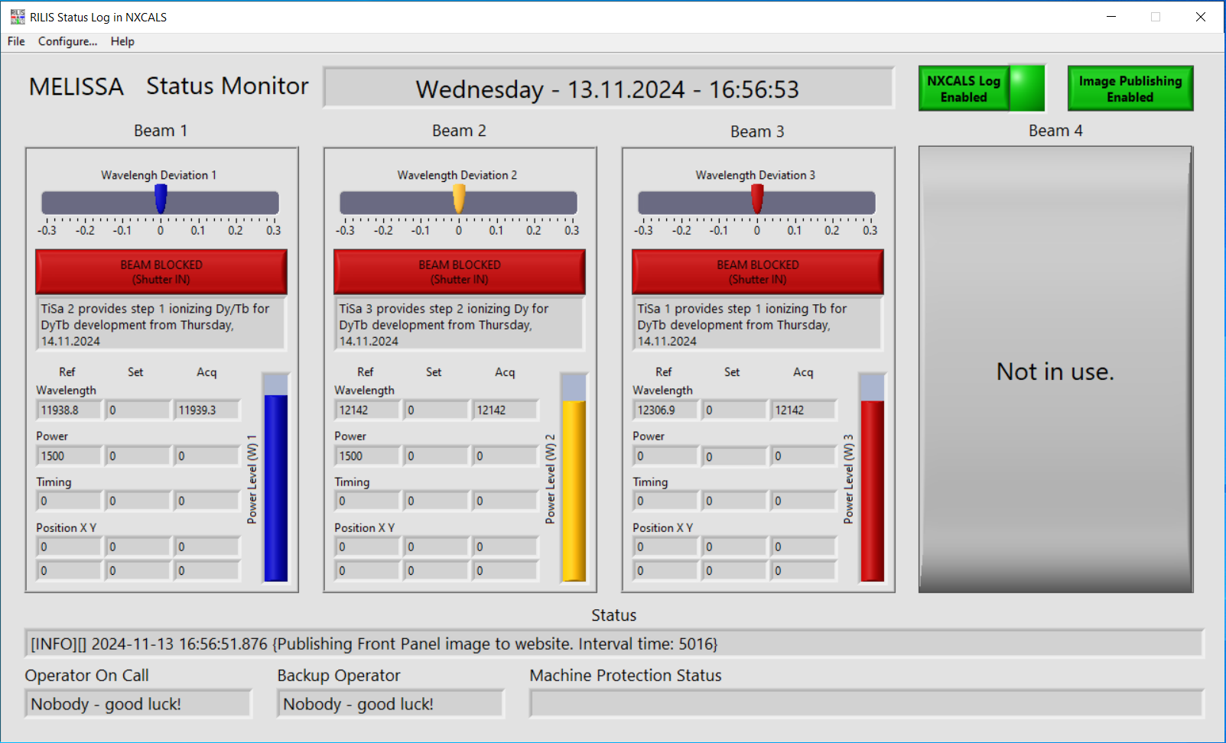
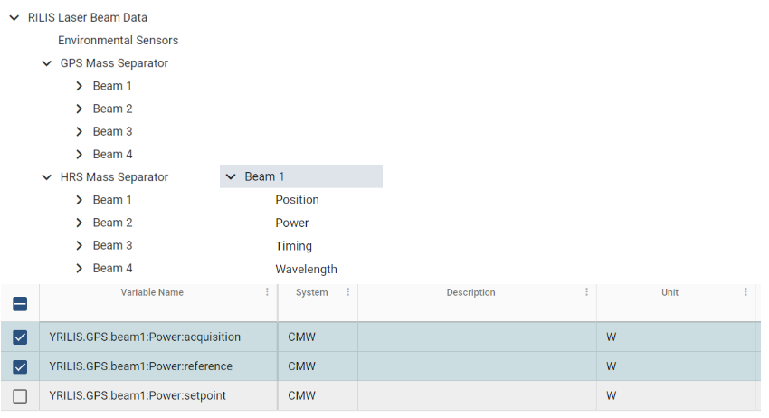
RILIS DAQ: Operation
Slide provided by Cyril!
New monitoring capabilities for RILIS
Monitoring of (when possible):
◦ Position XY ◦ Intensity (ref) ◦ Wavelength ◦ Timing
Values pushed through CERN middleware and accessible in Timber
timber.cern.ch

Slide 13
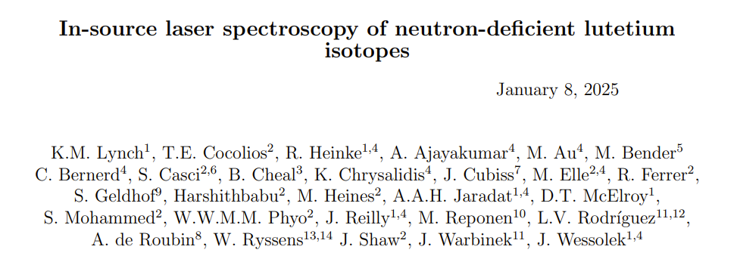
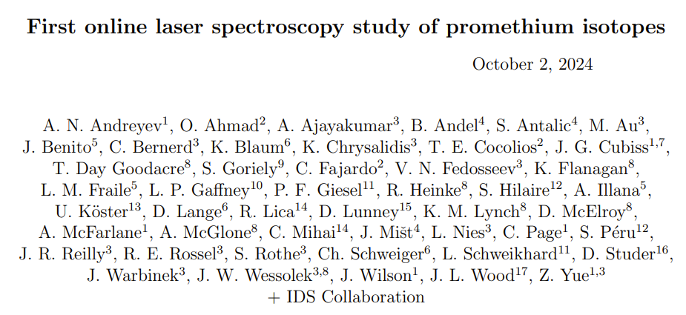
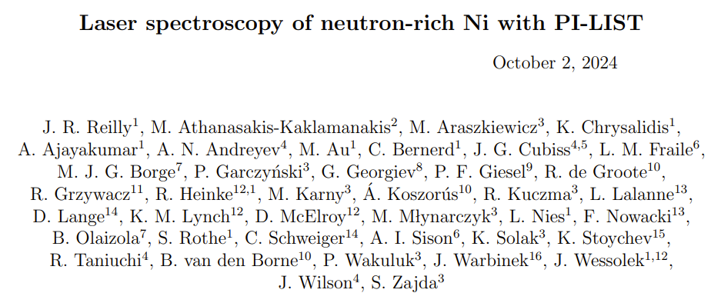
What’s coming up?
Ever-growing demand for (PI)-LIST!
2 Confirmed PI-LIST campaigns: Ni + Pm
1 tbc PI-LIST campaign: Lu
1 In-source LIST campaign: Bi/Cu
1 LIST target Campaign: Tm (COLLAPS)
4 x LIST for Online + 1 Development
Not just the typical LIST targets:
1 W-lined for Ni
1 Neutron-converter for Bi/Cu

Slide 14
What’s coming up?
2025
Ar: 763.5 nm
In: 738 nm
Pm: 905 nm
Ni: 704 nm
Lu: 897 nm
Missing any??
A busy year for PI-LIST, with challenging laser Schemes!
Our plans to provide the high-res light:
Currently high-res seed light is provided by the CRIS Matisse
This year, we have purchase Toptica diode laser (DLPRO) + trying to revive TUI Optics diode laser
Diode lasers moved between RILIS/YOL2/LARIS – wear and tear on equipment
Purchasing + swapping diodes for 2025
Growing demand for high-res PI-LIST and busy schedule for CRIS puts a strain on Matisse + Locals
New Matisse to be housed in CRIS laser lab?

Slide 15
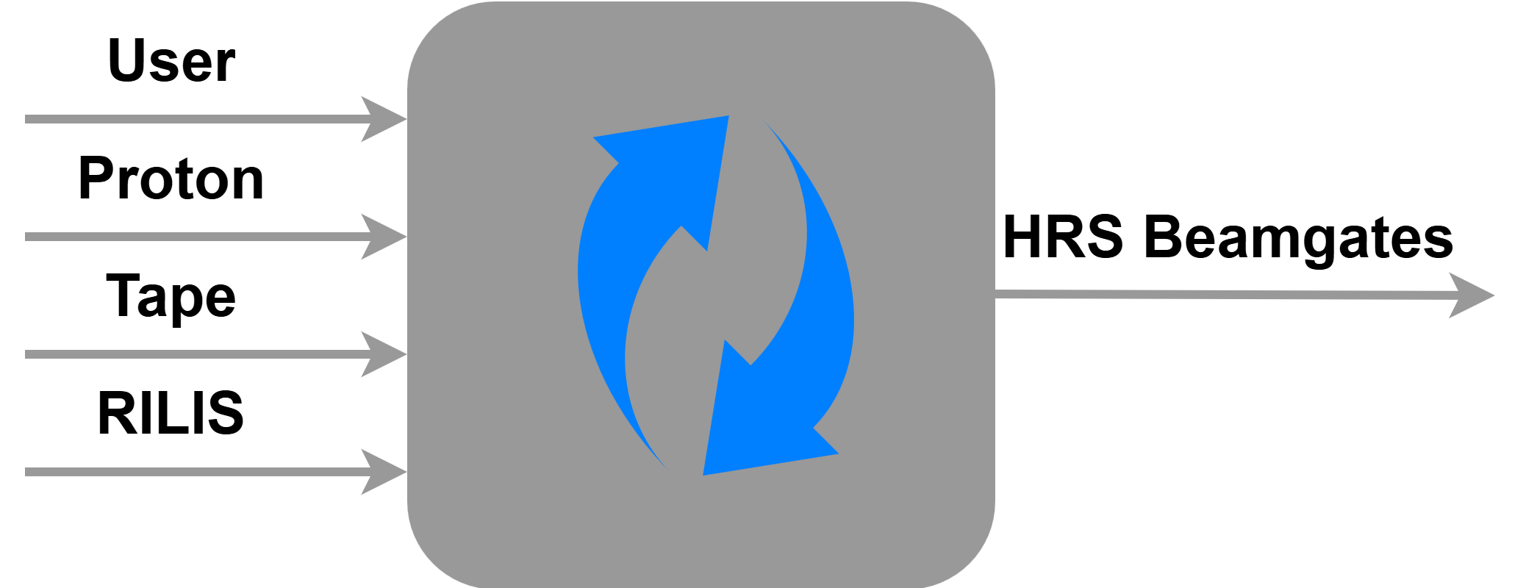
10 kHz Fast Beamgates
Recent implementation of the cRIO
Mixing input TTL signals
RILIS T0, USER or Tape triggered beamgate
All inputs mixed for a single output
Recent upgrades allow proton triggered + proton counting triggered beamgate
Implementation on GPS this year!

Slide 16

New online Database for Laser Ionisation schemes
Found here: https://rims-code.github.io
Or use the QR code!

Slide 17
Conclusion
Future Outlooks
Busy year with 60% of ion beams at ISOLDE requiring RILIS
Exchange of lasers and many late nights
Ongoing developments for PI-LIST
10 kHz beamgates for ion beam improvements
New TiSa only Ni scheme
Experimental runs on Lu, Tm and Hg in 2024
New accepted proposals on Ni and Pm
4 LIST Campaigns
Implementing high-res in YOL2
Construction of new ABU in LARIS
New High-res laser in CRIS laser lab
New RILIS DAQ
Thank you!

Slide 18
Back up Slides

Slide 19
Ni Scheme Development
Measured in Oct!
3 New autoionizing states in Ni observed
This scheme utilizes the laser spectroscopy transition used in literature
Motivated the submission of INTC proposal to study Ni using PI-LIST!
Scheme at least as efficient as production
New autoionizing states found in Ni!

Slide 20
Thank you!
Questions?
Conclusion
Future Outlooks
Busy year with 60% of ions beam at ISOLDE requiring RILIS
Exchange of lasers and many late nights
Ongoing developments for PI-LIST
In-trap decay & 10 kHz beamgates for ion beam improvements
First online deployment of intracavity triple TiSa
New TiSa only Ni scheme
Experimental runs on Lu, Tm and Hg
Submitted proposals on Ni & Pm
Further upgrades to offline2 laser laboratory for high-resolution
Construction of new ABU in LARIS
Raman laser development

Slide 21
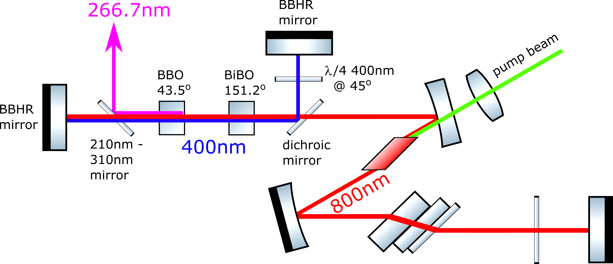
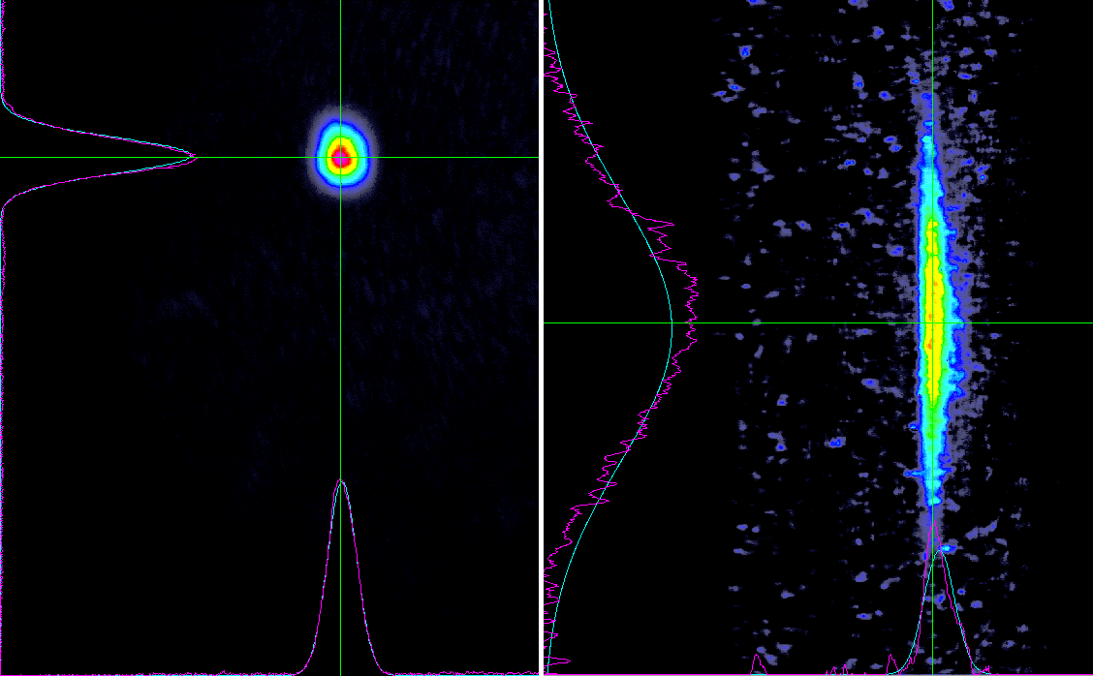
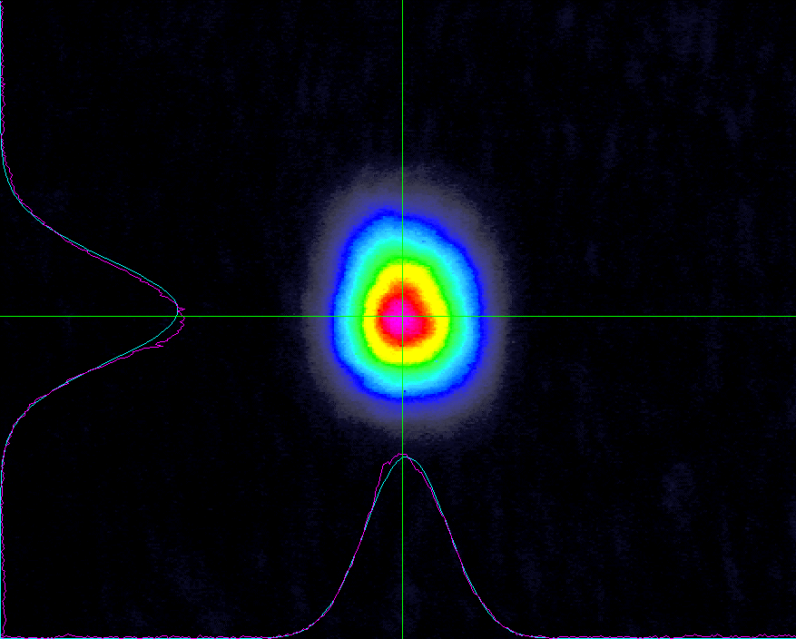
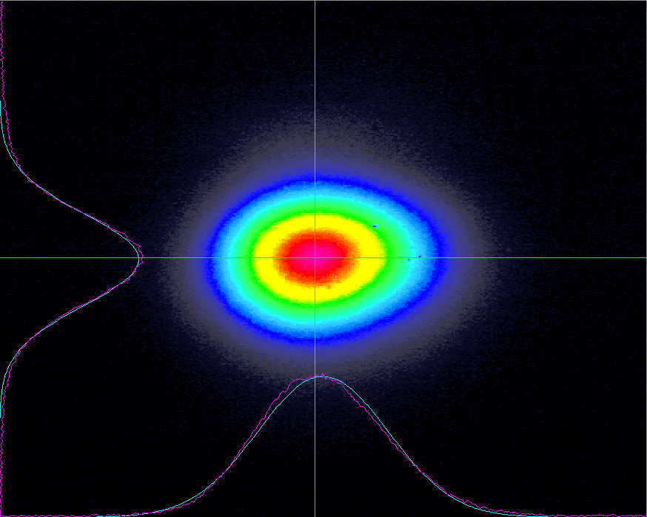
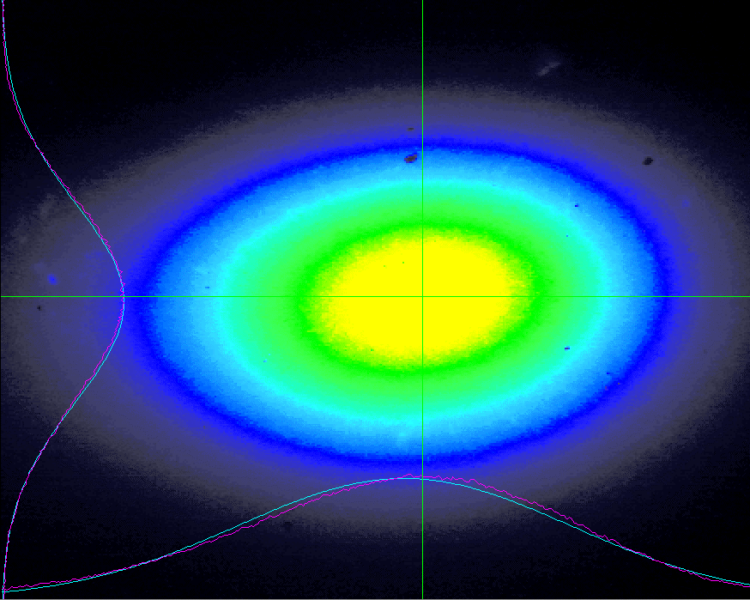
First online deployment of intra-cavity tripling
Courtesy of Julius
65 mW of 304 nm laser light for the production of indium beams
  Stable operation for 7 days without intervention
  Compared to Dye lasers which need constant monitoring
 | Beam Profile | Output Power | Stability | Ease of set up | Space | Cost
Intra
External
25 cm
Intracavity THG Single-Pass THG
100 cm
Long-term stability test for Au 2nd step @ 306nm and 10kHz has shown a slow decrease of power but easily recovered:
250 cm

Slide 22
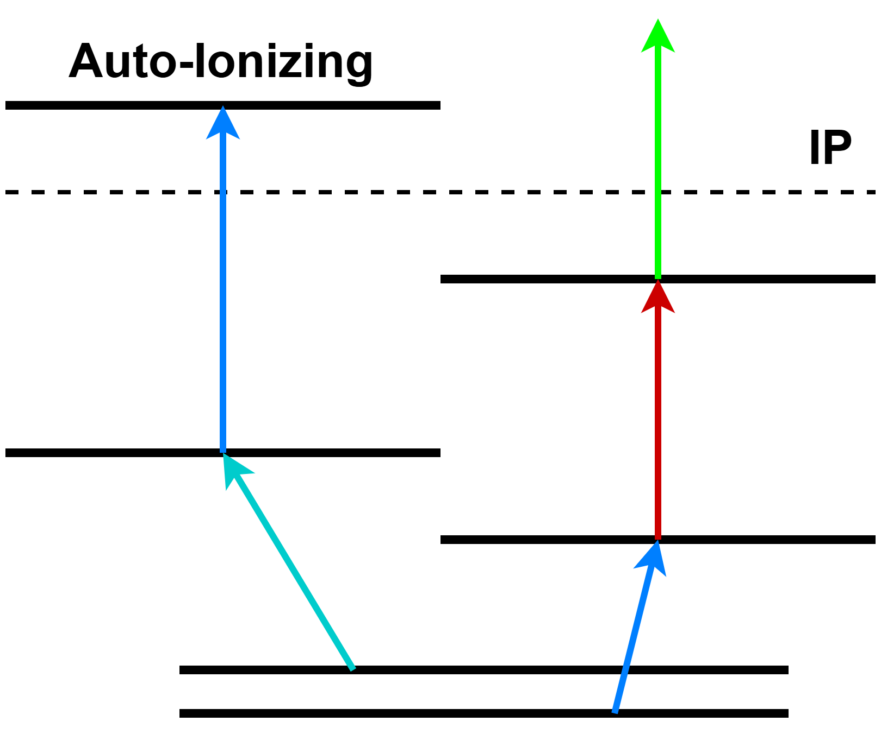
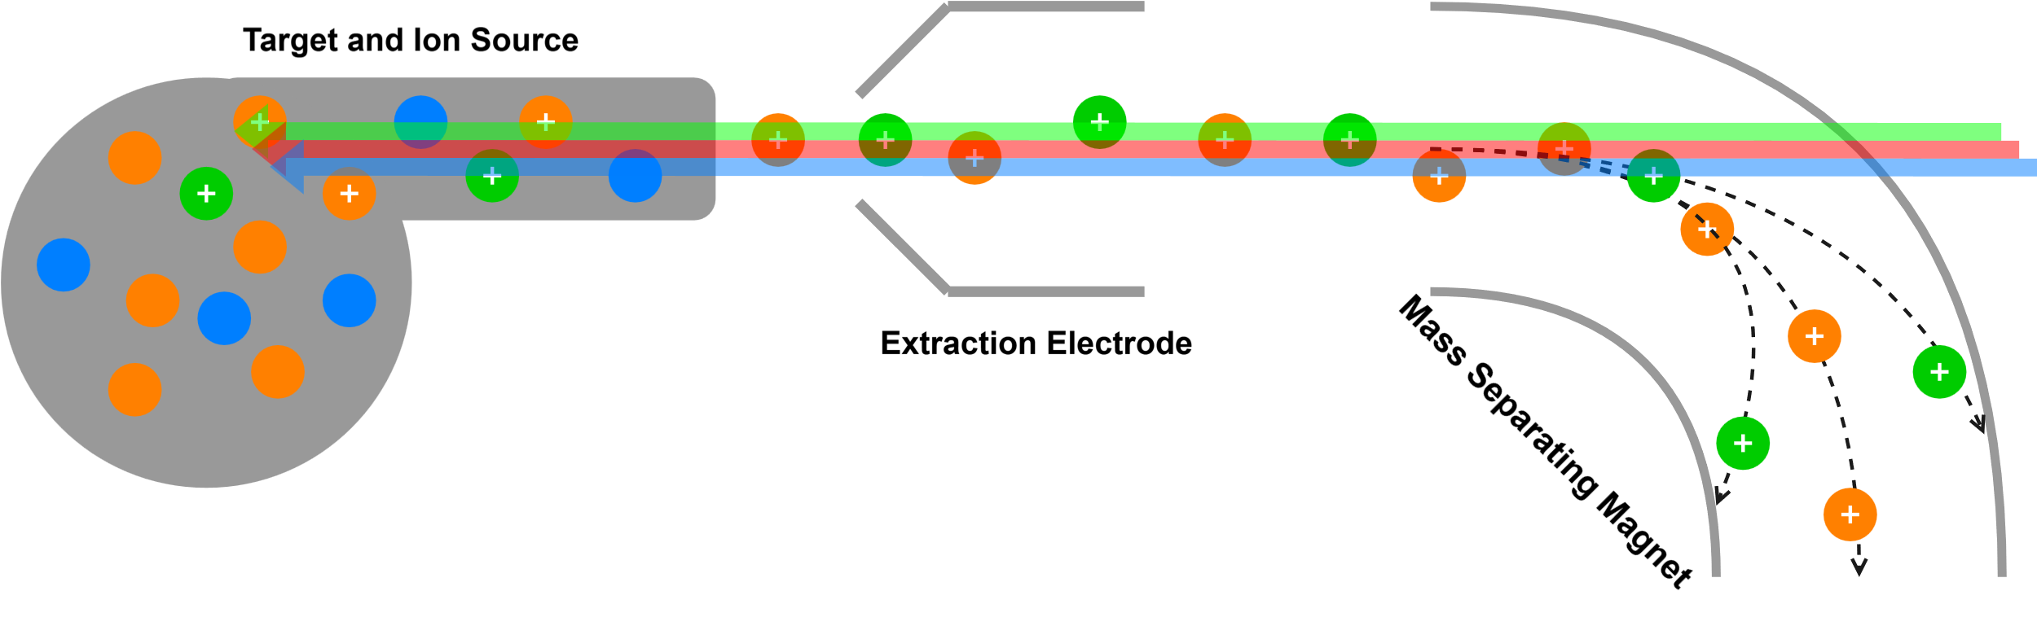
Resonance Ionization Laser Ion Source
RILIS uses a variety of 10 kHz lasers
Unique atomic transitions to step-wise excite and ionize the element of interest
Coupled with mass selectivity for high resolving power

Slide 23
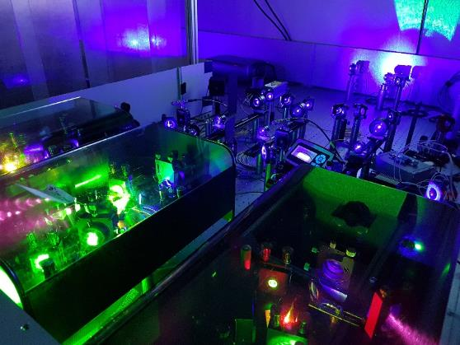
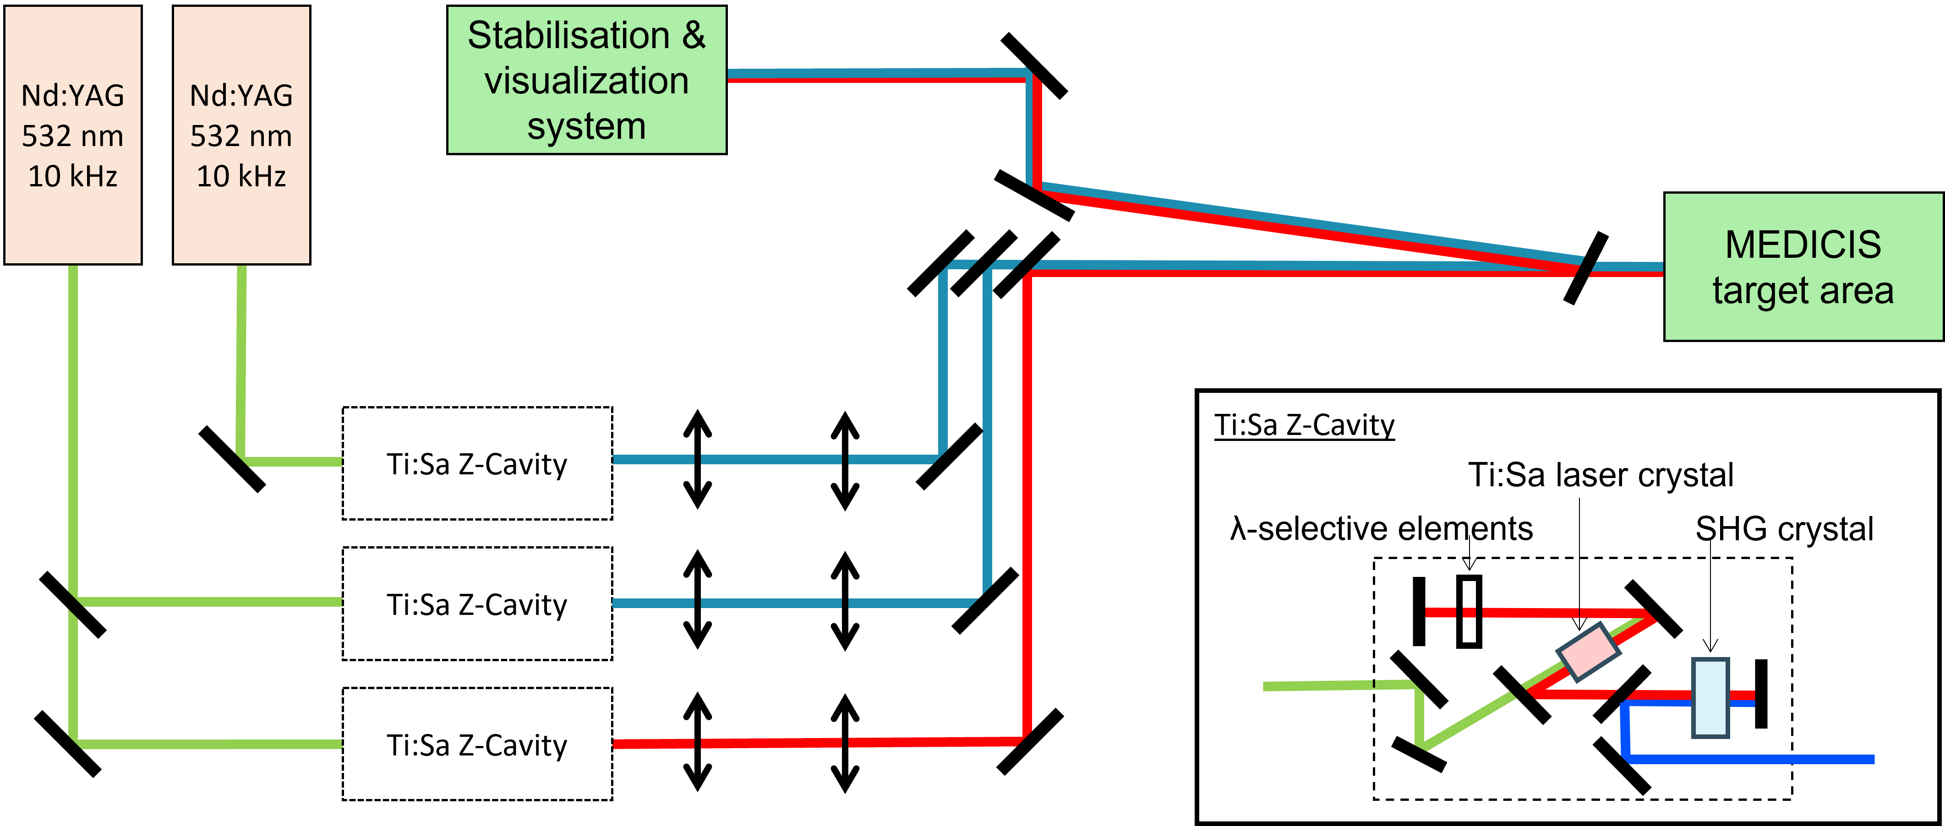

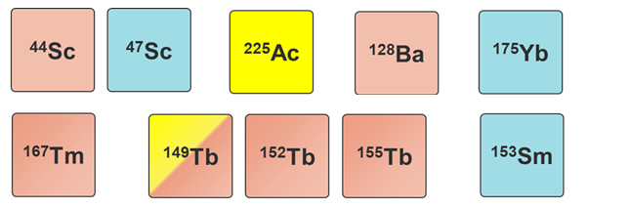
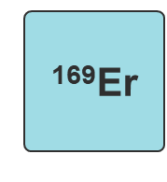
MELISSA in 2024
Courtesy of Cyril
Operators 2024
New 2024
Laser laboratory
Portfolio
Development 2024
2 new collections at MEDICIS in 2024: ¹⁴⁵Eu and ¹⁴⁹Gd
Validation of Eu laser scheme developed in RILIS (B. van Dingenen KU Leuven)
Raman laser : Final z-fold design
¹⁴⁵Eu
¹⁴⁹Gd
New 2024
Operation 2024
Month | May |  |  |  | June |  |  |  | July |  |  |  |  | August |  |  |  | September |  |  |  | October | October |  |  |  | November |  |  |  | D
Week nº | 19 | 20 | 21 | 22 | 23 | 24 | 25 | 26 | 27 | 28 | 29 | 30 | 31 | 32 | 33 | 34 | 35 | 36 | 37 | 38 | 39 | 40 | 41 | 42 | 43 | 44 | 45 | 46 | 47 | 48 | 49
Element |  | Tb Dy | Tb Dy | Tb Dy |  | Tb Dy | Sm |  | Cu | Tb Dy |  |  |  | Tm | Tm | Tb |  |  | Tm | Tb Dy |  |  | Gd Eu | Tb Dy | Tb Dy | Tb Dy |  | Tb Dy | Tb Dy | Sc | Sc

Slide 24
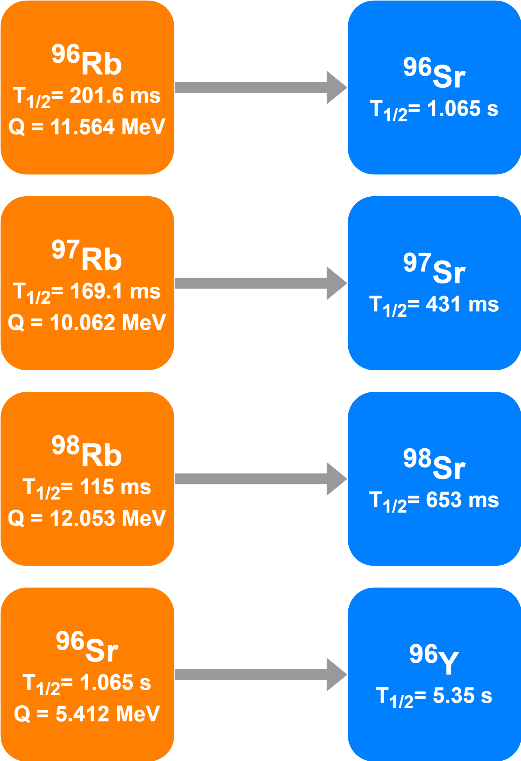
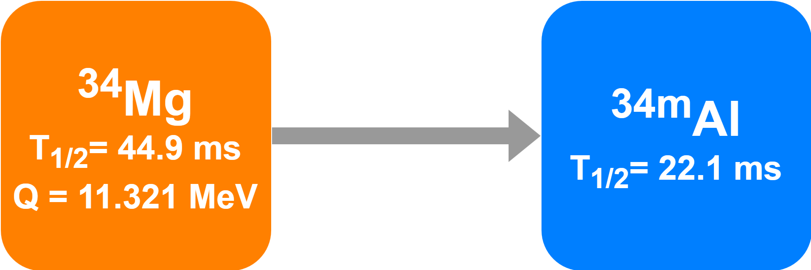



In-trap Decay
Revised Plan
LOI to investigate in-trap decay using ISCOOL RFQ
Provide non-produced and challenging to extract elements
Improve ion confinement by optimizing He gas pressure and potential well depth
Thanks to efforts of TISD/RILIS/ISOLTRAP!
Laser ionized Sr tested!
Original Plan
Analysis ongoing!

Slide 25
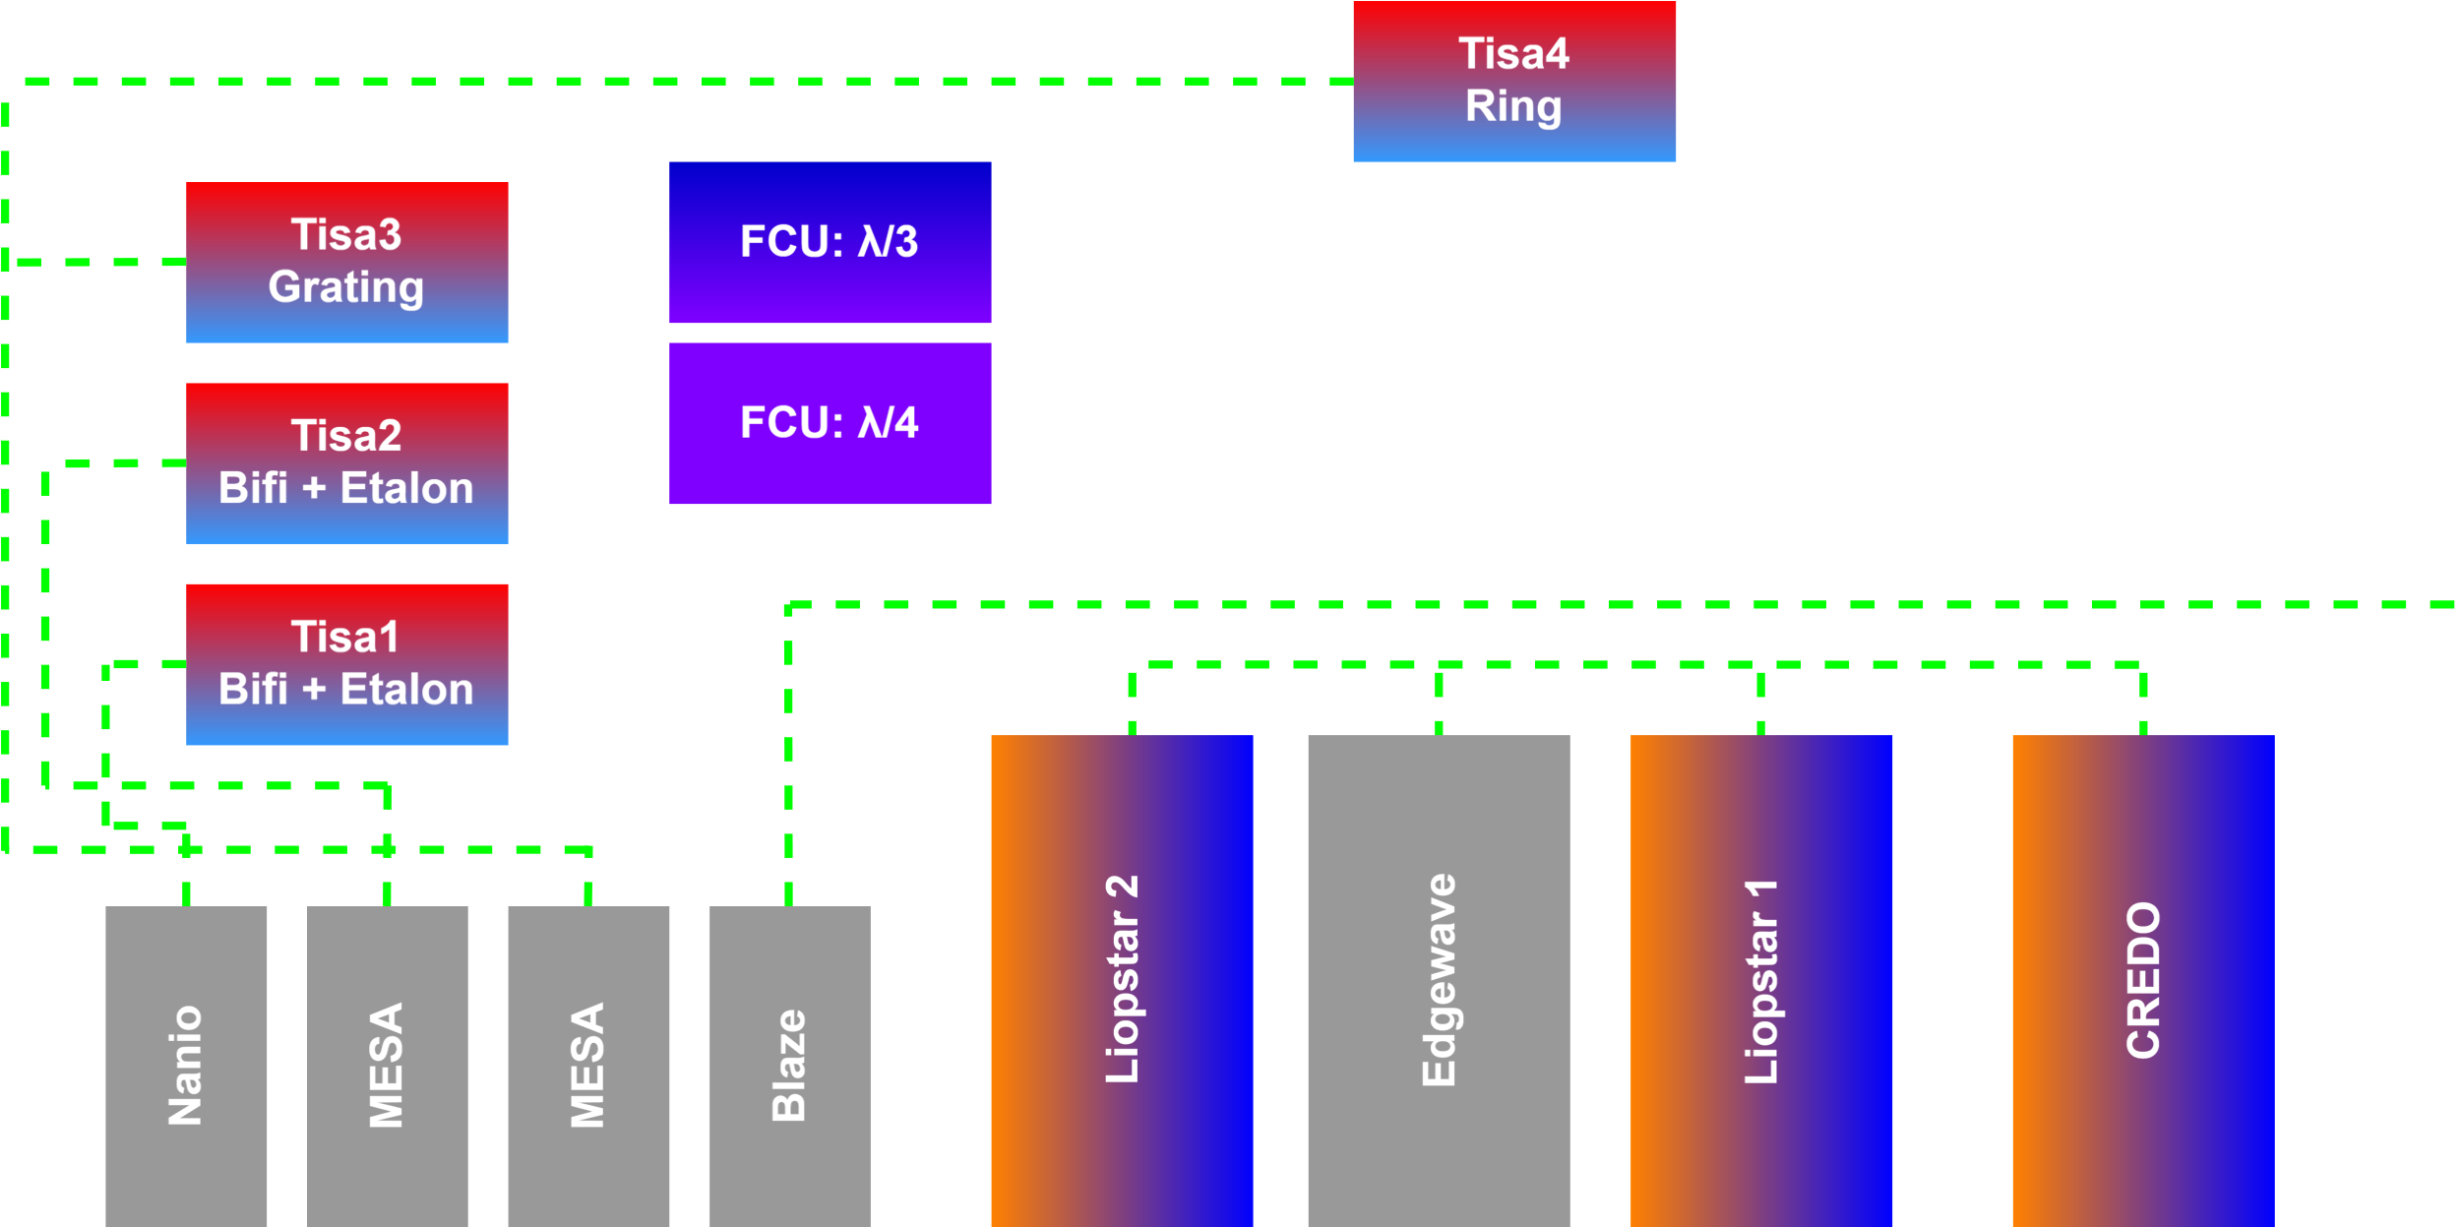



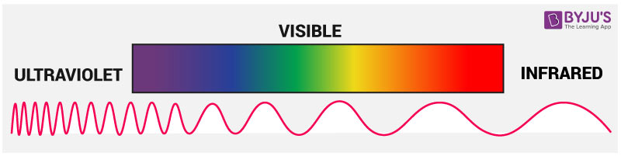

RILIS uses a variety of 10 kHz lasers
Unique atomic transitions to step-wise excite and ionize the element of interest
Coupled with mass selectivity for high resolving power
Properties of MESAs and Photonics are comparable
Future plan is to investigate TiSa performance using MESA vs Photonics vs Nanio in offline labs
Photonics
200
300
400
500
600
700
800
900

