Slide 1


Field Ionization Unit (FIU)
Upgrades for 2025
9 months evaluation
CRIS Collaboration meeting 2025
Osama Ahmad Supervisor: Prof. dr. Gerda Neyens
Co-supervisor: Dr. Jessica Warbinek

Slide 2
Contents
Field Ionization (The idea)
FIU 2024 (Results)
FIU@CRIS (Current design)
Technical upgrades
Outlook
Department of Physics and Astronomy (IKS)

Slide 3
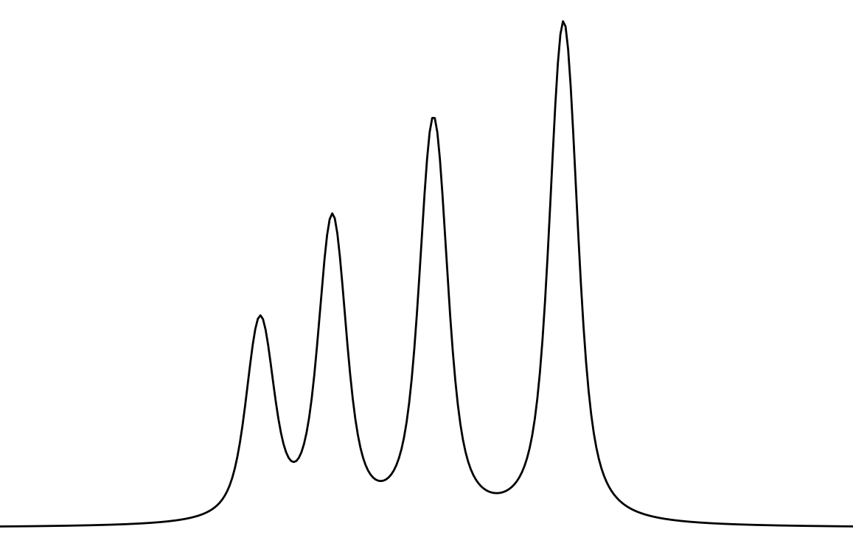
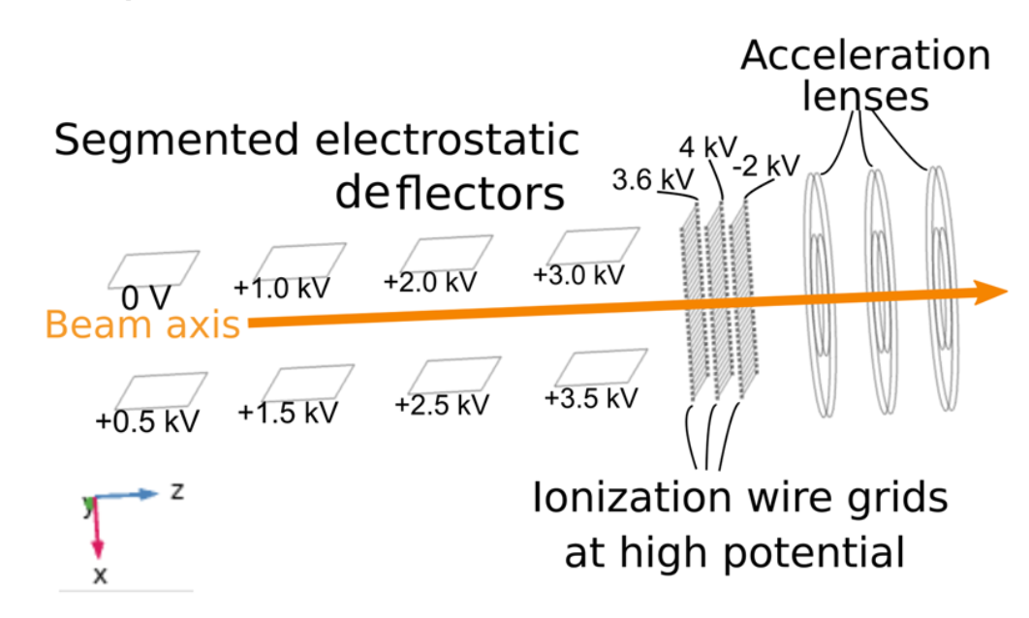
Field Ionization
Reducing the background contributions from:
Collisional ionization
Laser related background, especially from high power non-resonant step
FIU via Rydberg state makes high power laser obsolete
AI
Non-res
IP
Rydberg
Hyperfine Structure (HFS) :
Electric field ionization of Rydberg states in a collinear geometry
F₁
F₂
F₃
F₄
Department of Physics and Astronomy (IKS)
01/09
A. Vernon et al., Sci. Rep. 10, 12306 (2020).

Slide 4
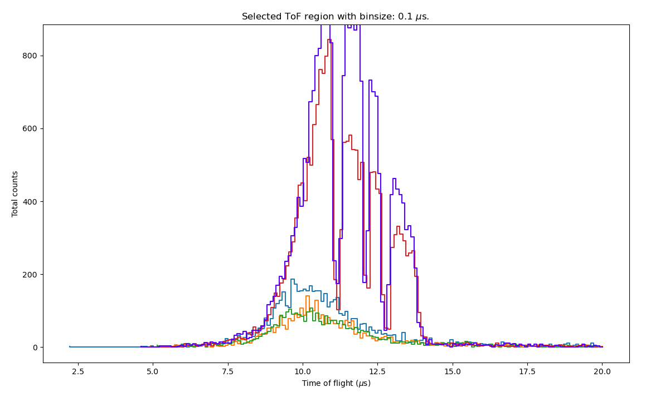
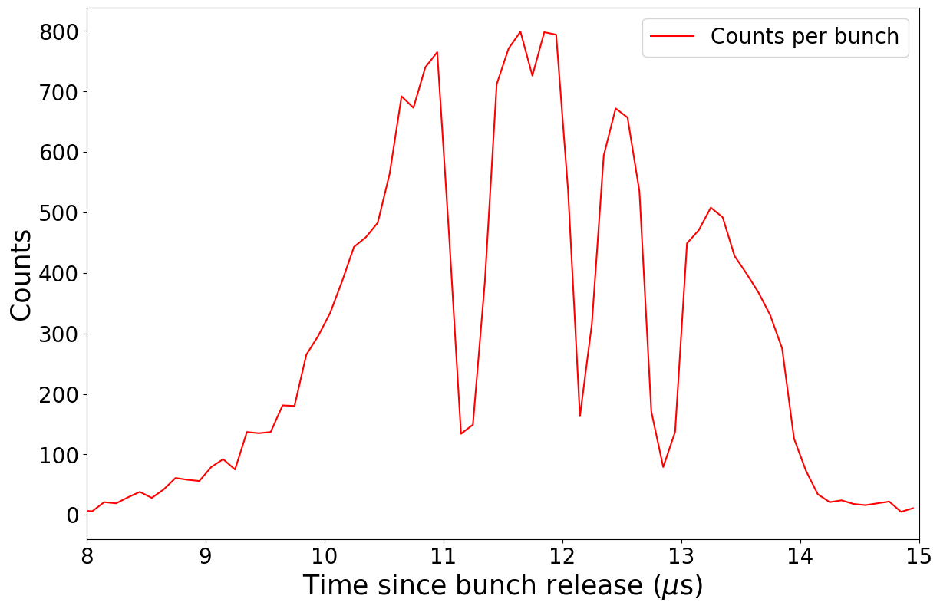
Online commissioning
Field ionized K observed with beam from ISOLDE
See dips in ion bunch, not understood first
Grids on
→Fi at grids
Grids off
→ Fi in bender
courtesy Pierre
High-lying Rydbergs (n=24) affected strongly by Stark shift
Atoms at locations with strong field along beamline not Rydberg excited
→ field ionization not effectful
Resolved with lower CEC deflector potentials and lower Rydbergs (n=18, K)
courtesy Osama
Department of Physics and Astronomy (IKS)
02/09
Slide courtesy: Jessica Warbinek - CRIS collaboration meeting, January 30,2025

Slide 5
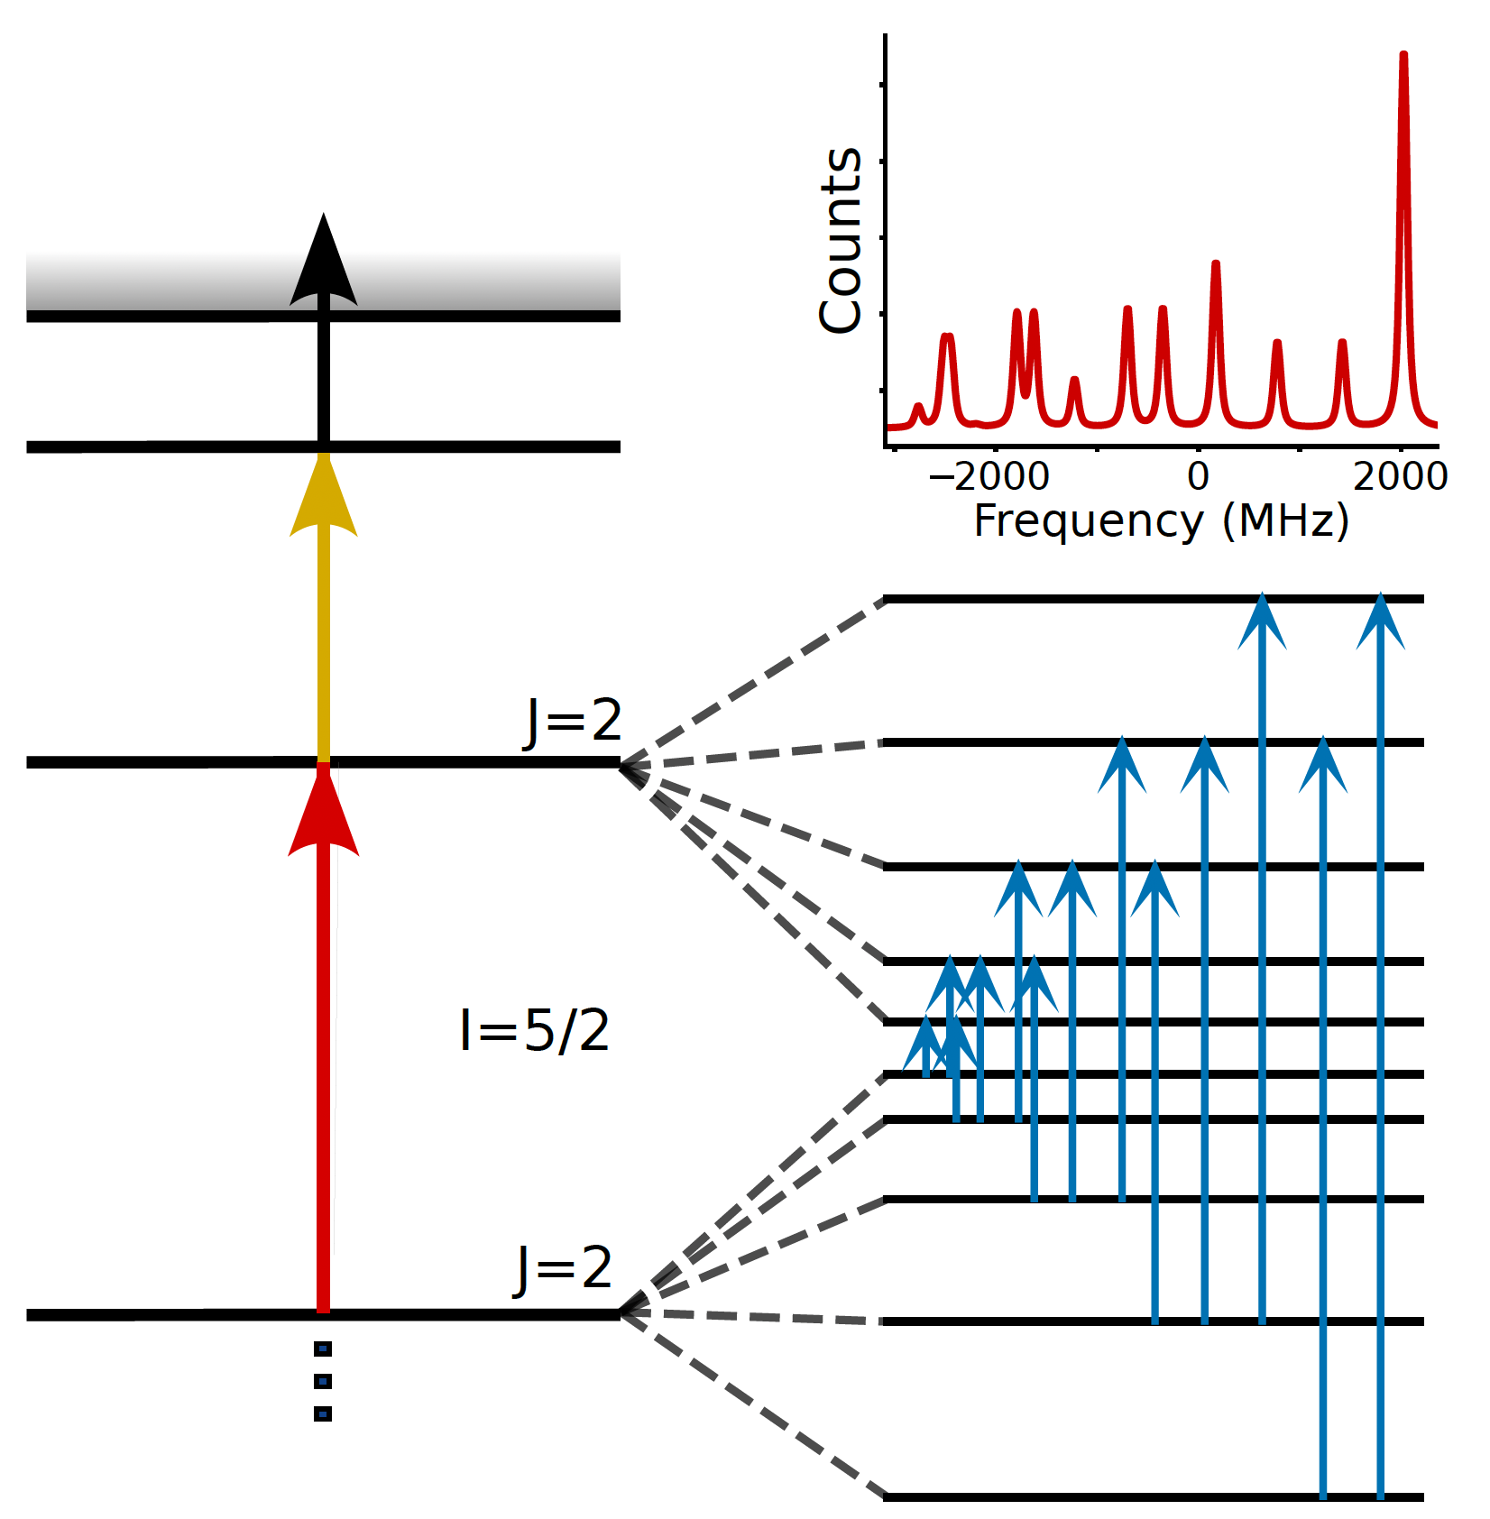
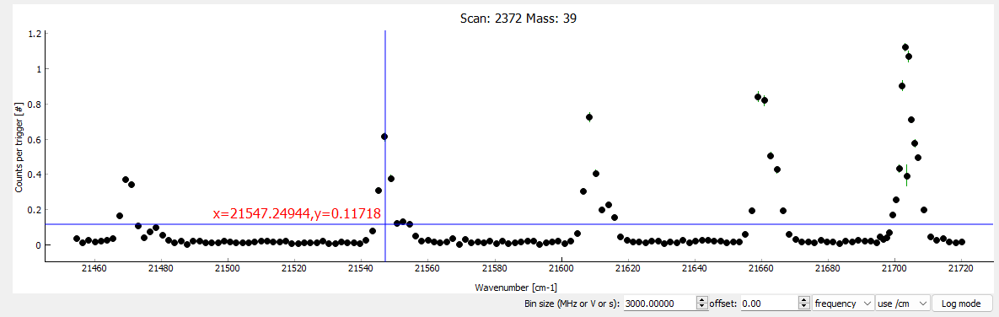
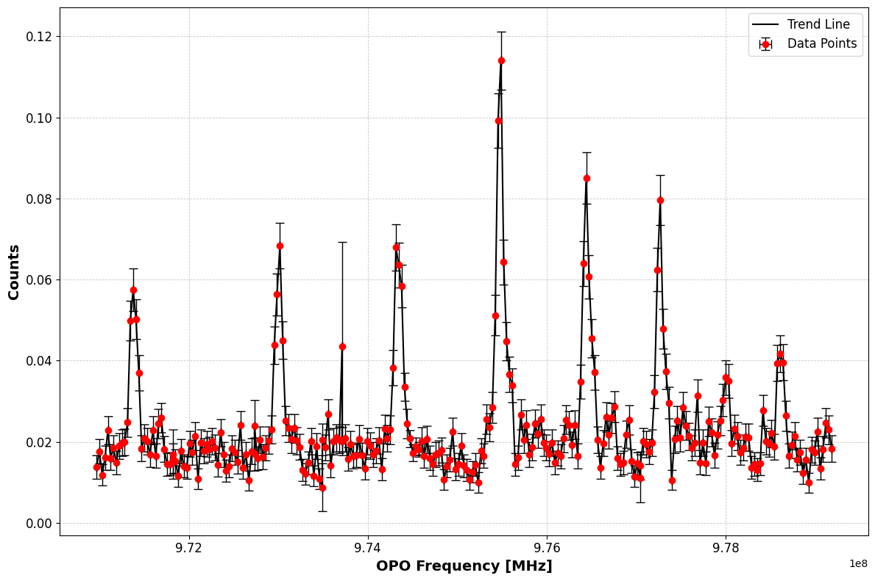
First results
First scan of Rydberg series in K with FIU
1064 nm
First FIU online implementation
New Rydberg series observed
FIU via Rydberg state makes high power laser obsolete
Field ionization unit successfully implemented
Principle shown with stable K beam
Successful for Fr during winter physics 2024.
Department of Physics and Astronomy (IKS)
03/09
Slide courtesy: Jessica Warbinek - Manaslu Workshop, December 16, 2024

Slide 6
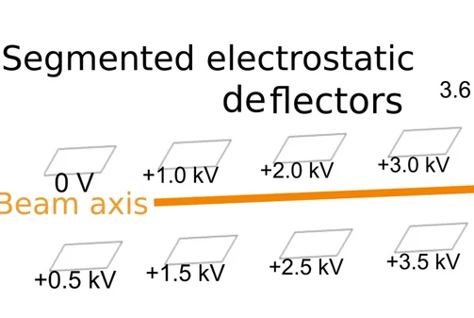
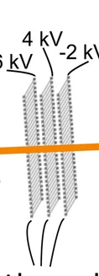
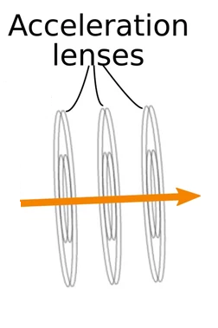
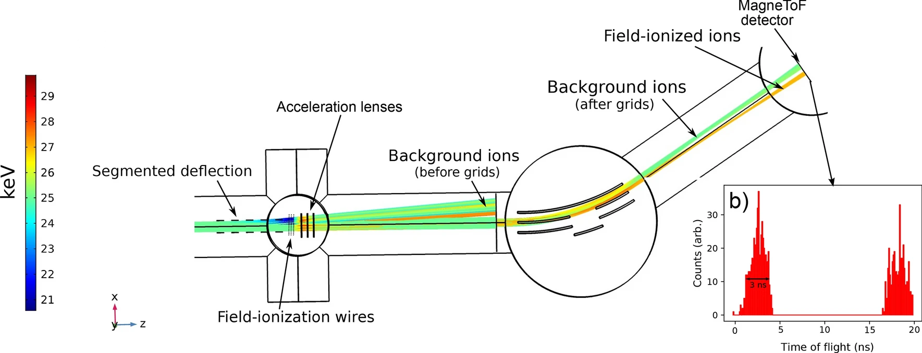
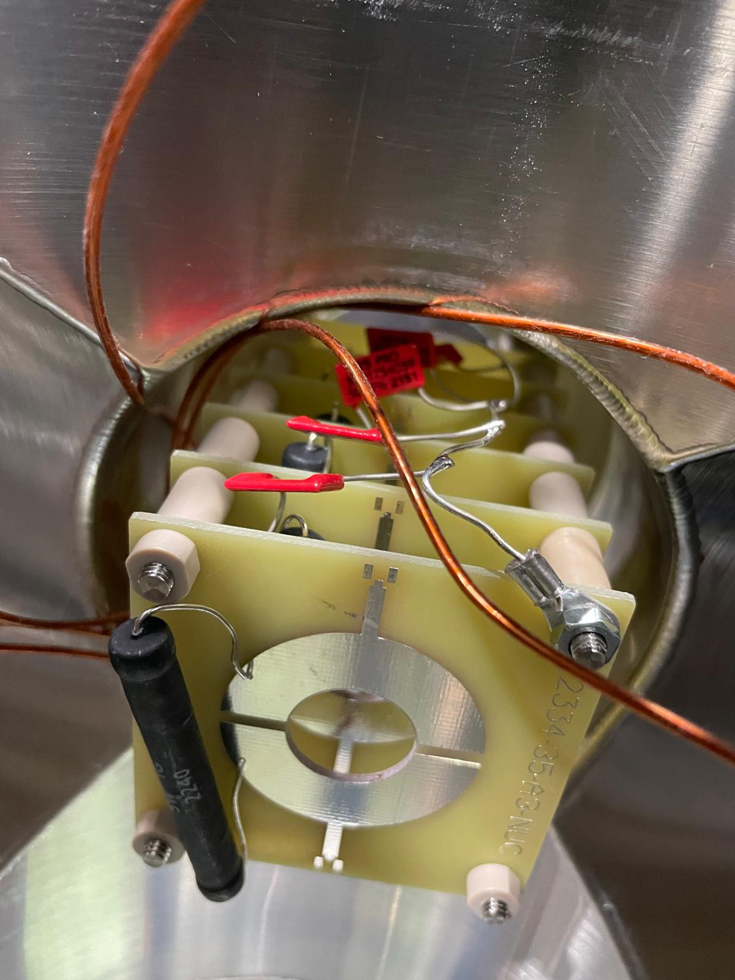
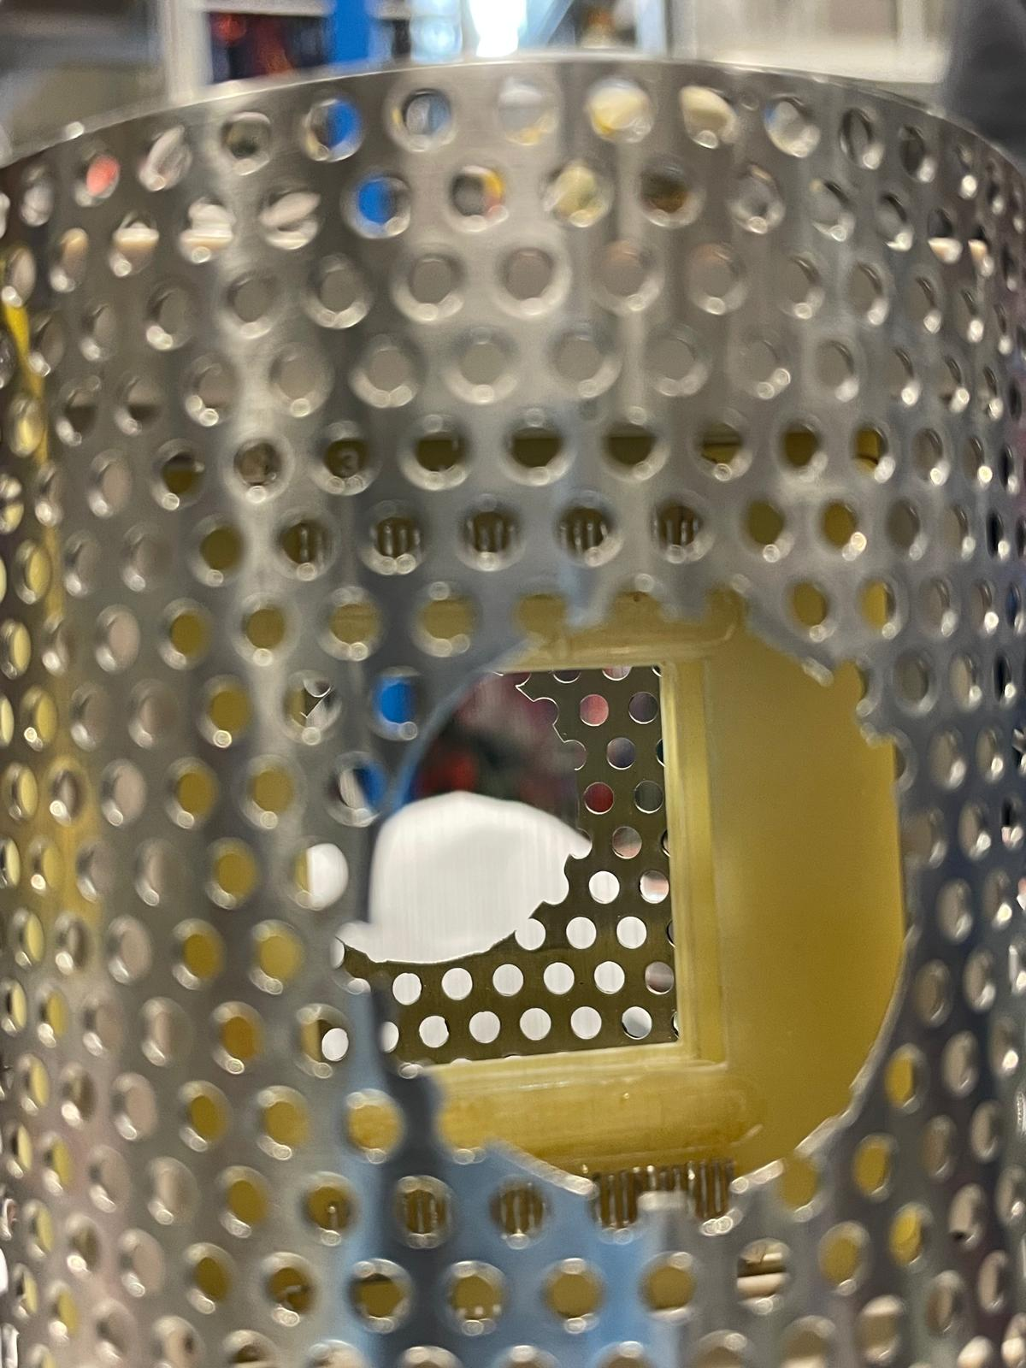
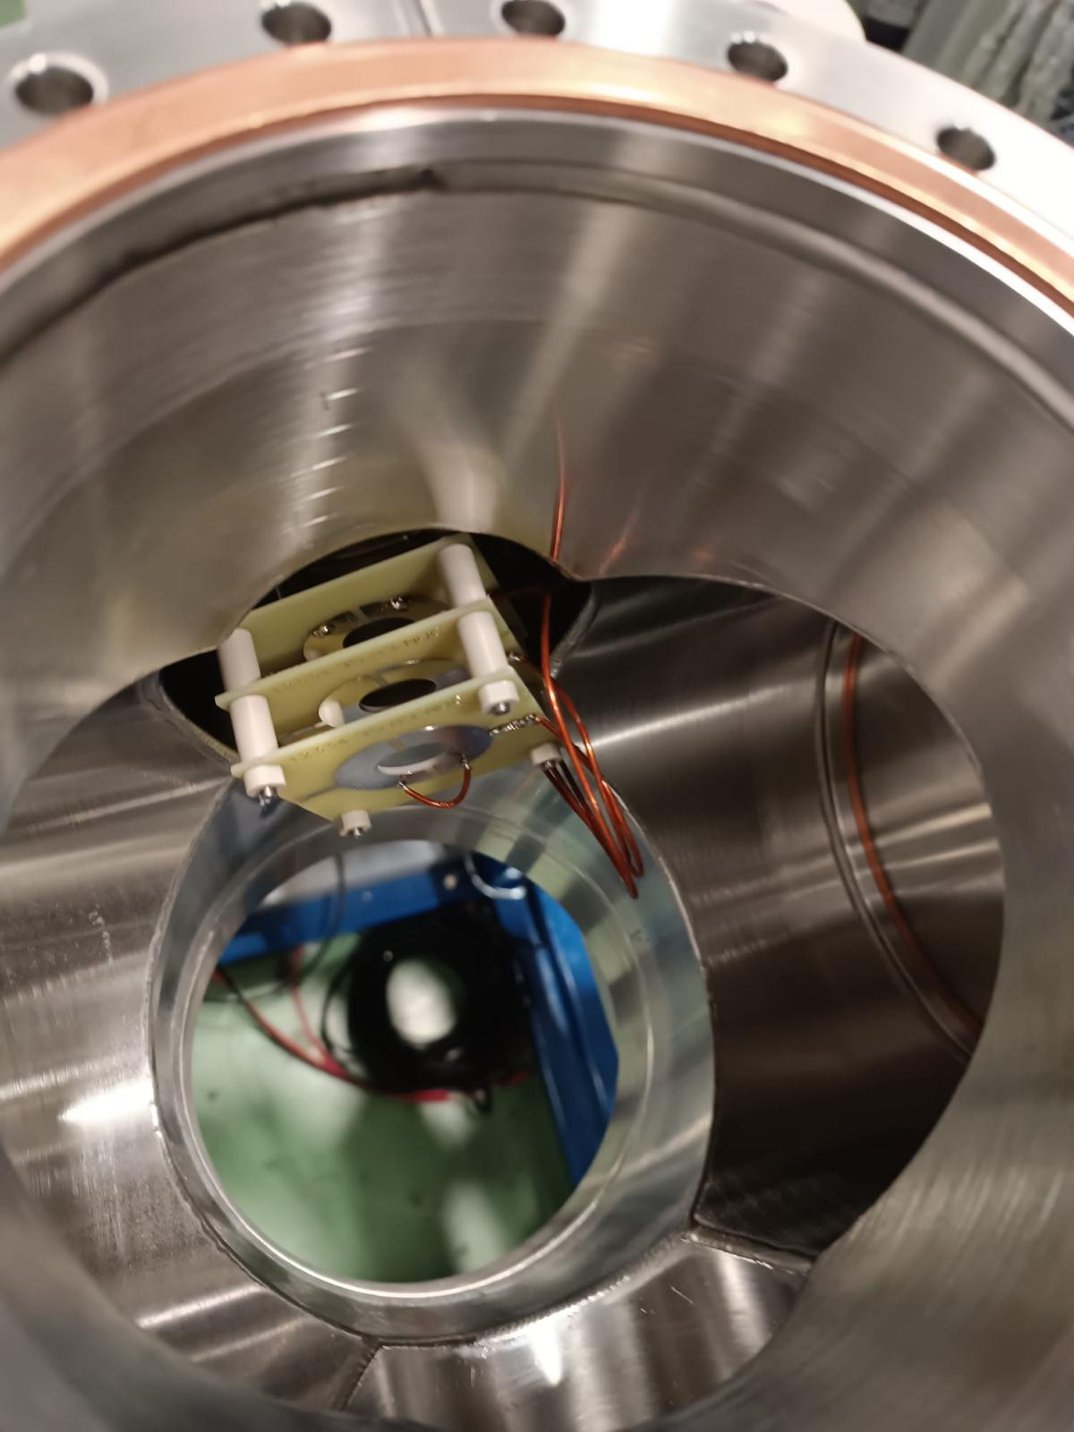
Current design
Acceleration lenses are redundant with our bunch width.
Limitation in vacuum in IR
Grids shortening issues.
Deflectors
Grids
Acceleration lenses
Department of Physics and Astronomy (IKS)
04/09
A. Vernon et al., Sci. Rep. 10, 12306 (2020).

Slide 7

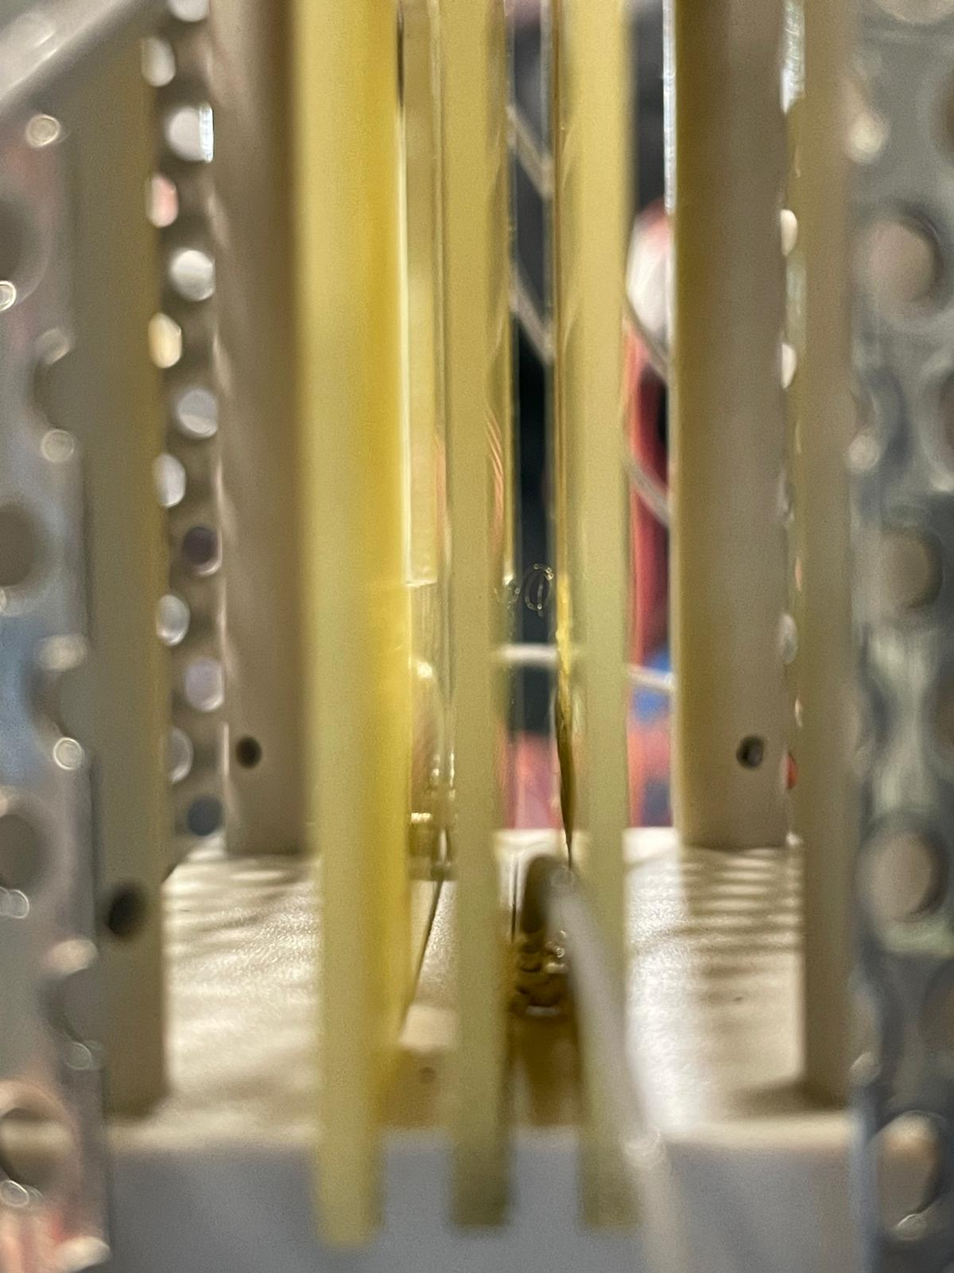
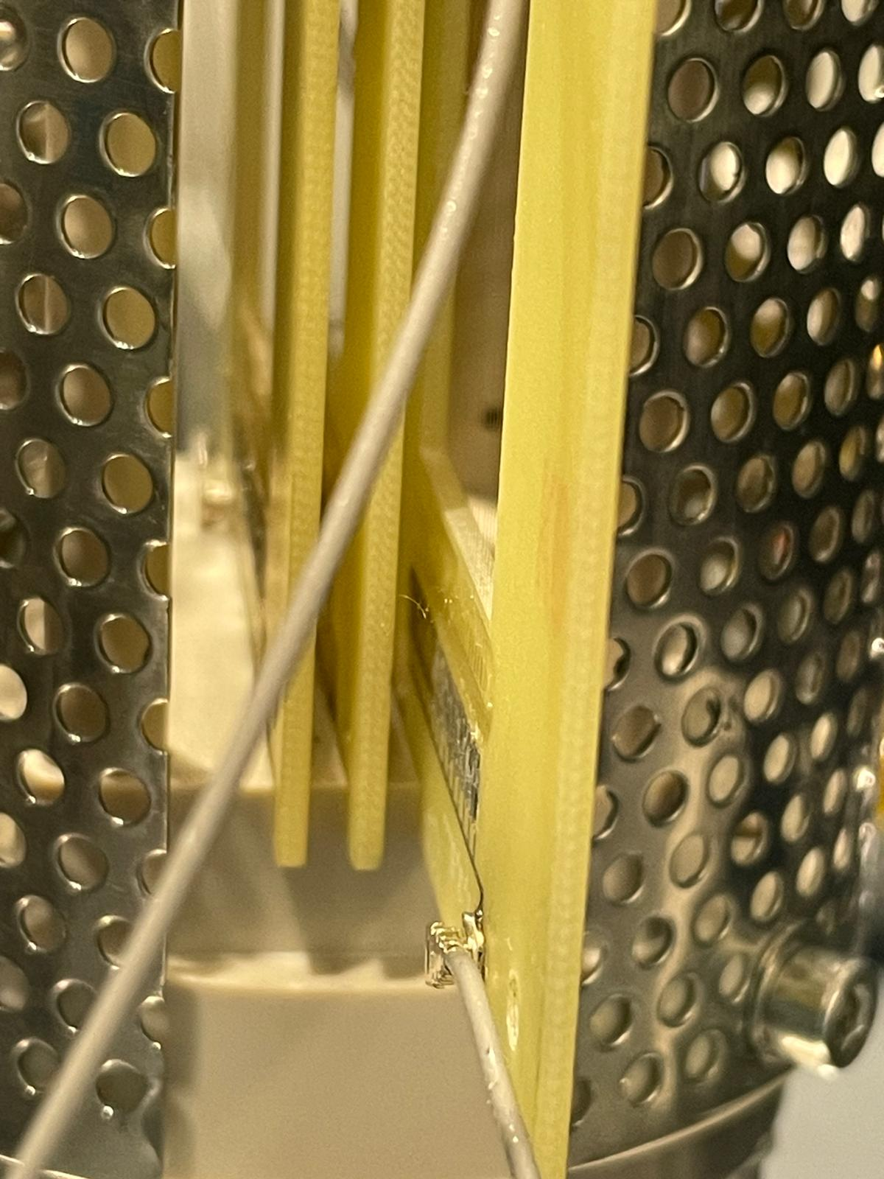
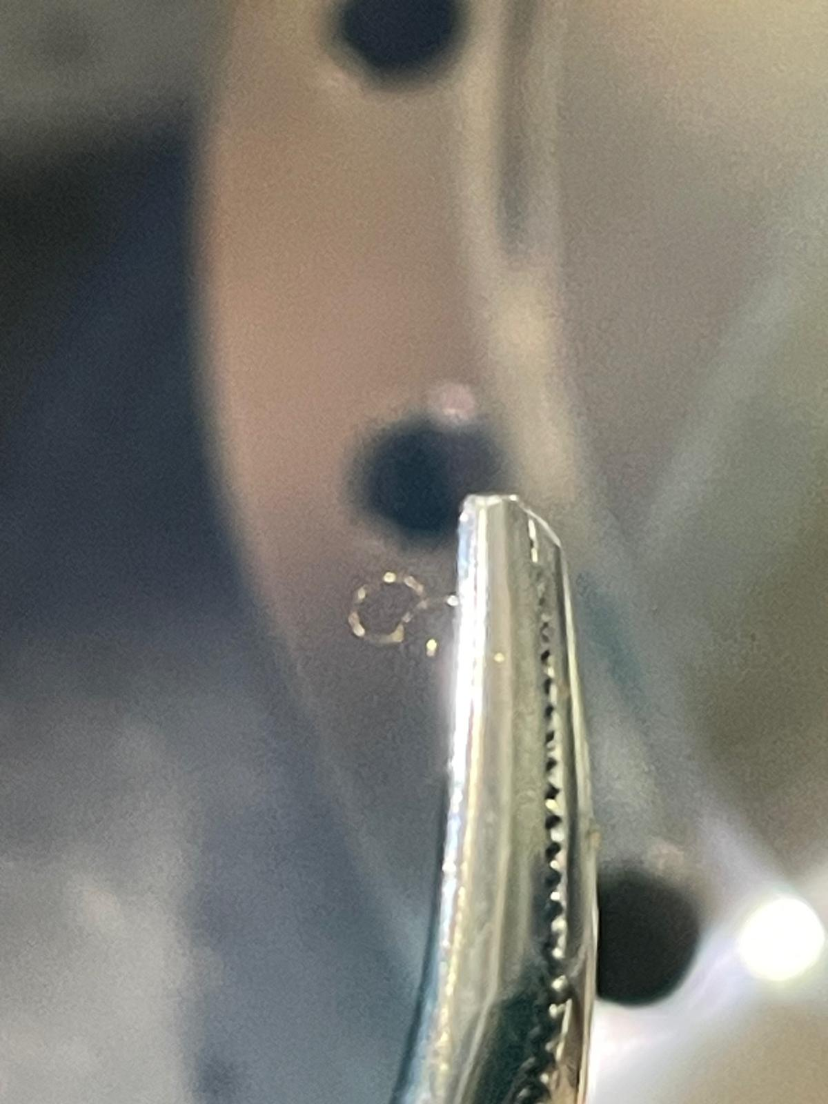
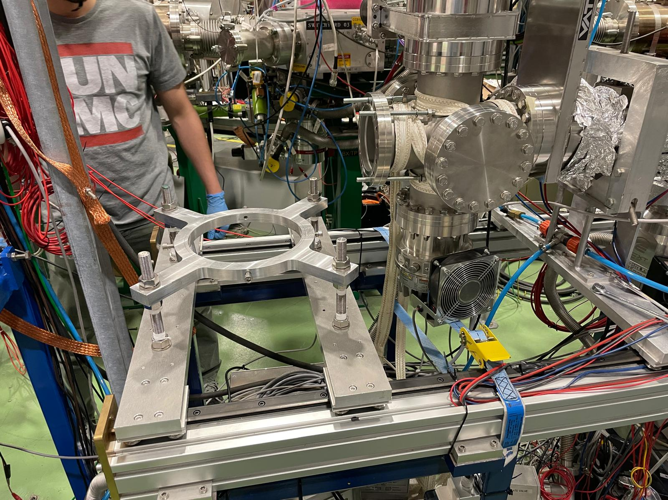
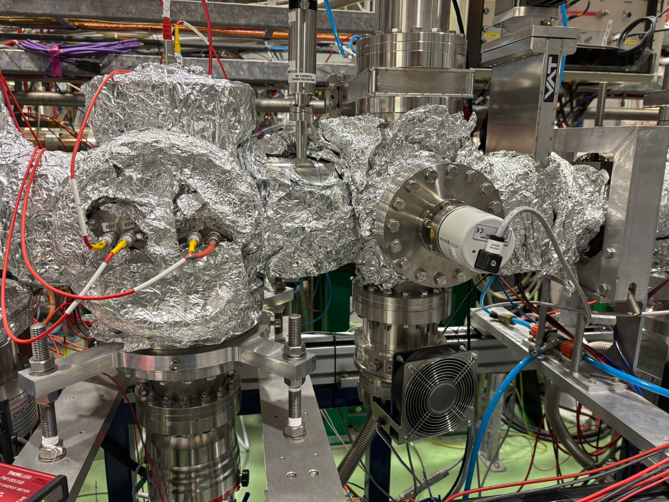
Problems
GRIDS SHORTENING
ASSEMBLY
Department of Physics and Astronomy (IKS)
05/09

Slide 8
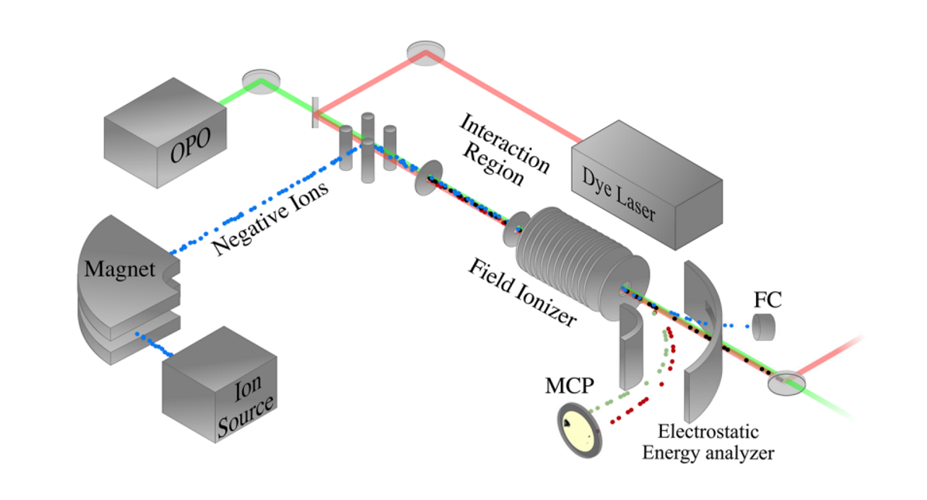
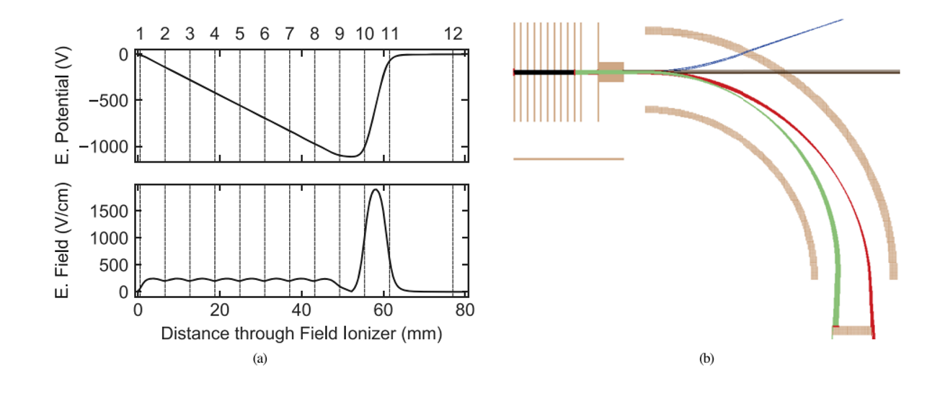
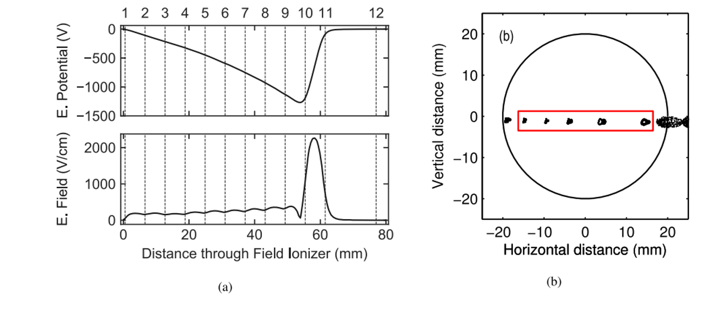
New design
Based on GUNILLA setup @ Gothenberg.
Instead of GRIDS, using a set of parallel coaxial circular plates.
First plate is at ground potential, ensuring a field free interaction region.
All the other plates can be individually biased.
Different Rydberg states being ionized at different location in the Field Ionizer which can be identified with MCP.
Field Ionizer Schematics.Rev. Sci. Instrum. 93, 065004 (2022); doi: 10.1063/5.0061736 Department of Physics and Astronomy (IKS)
06/09

Slide 9
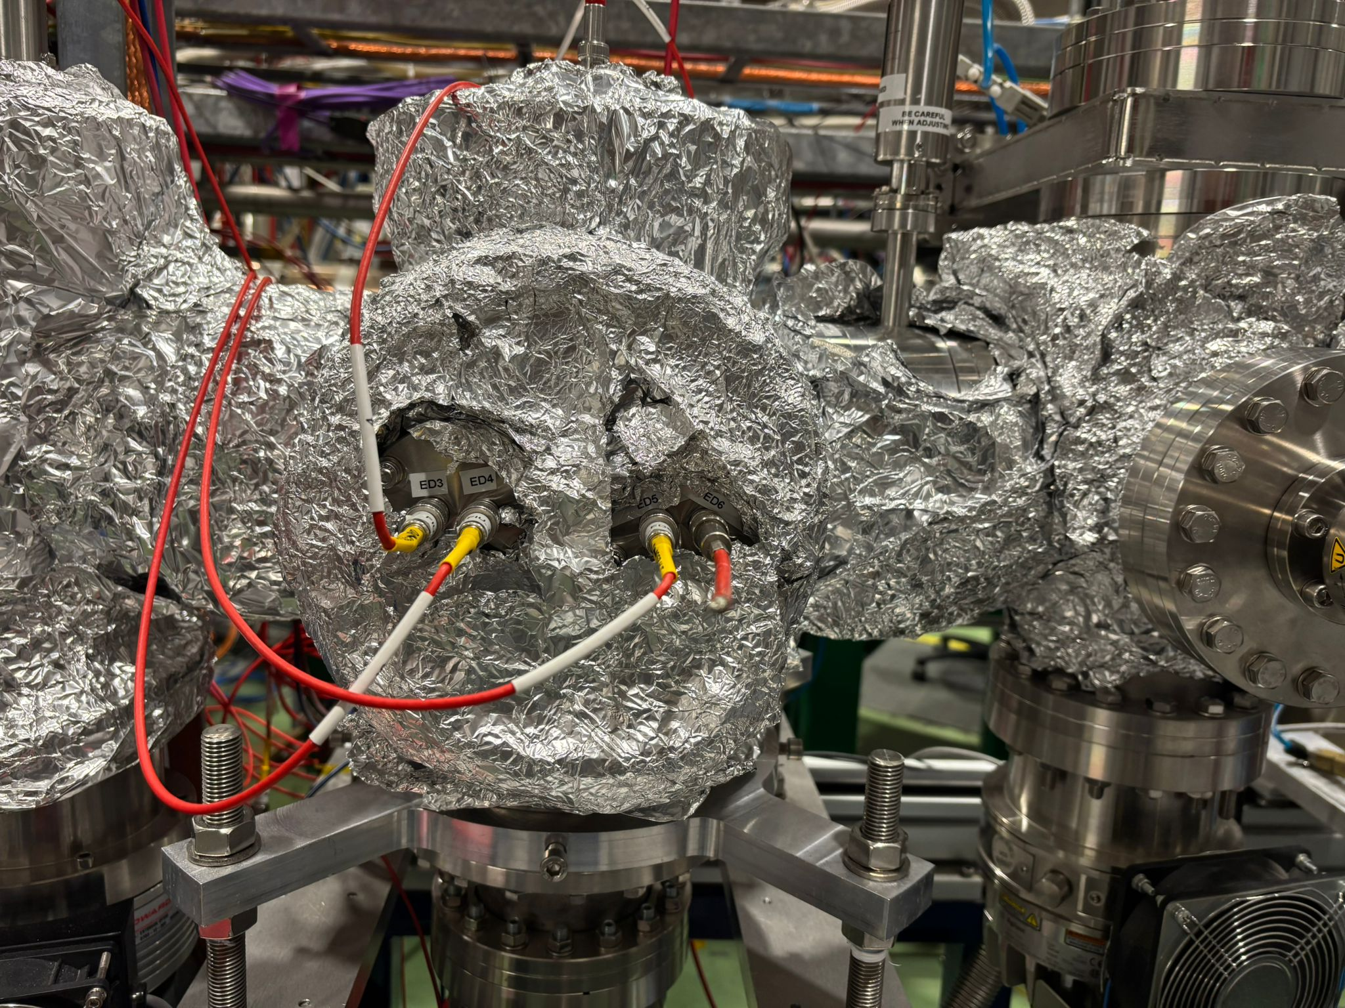
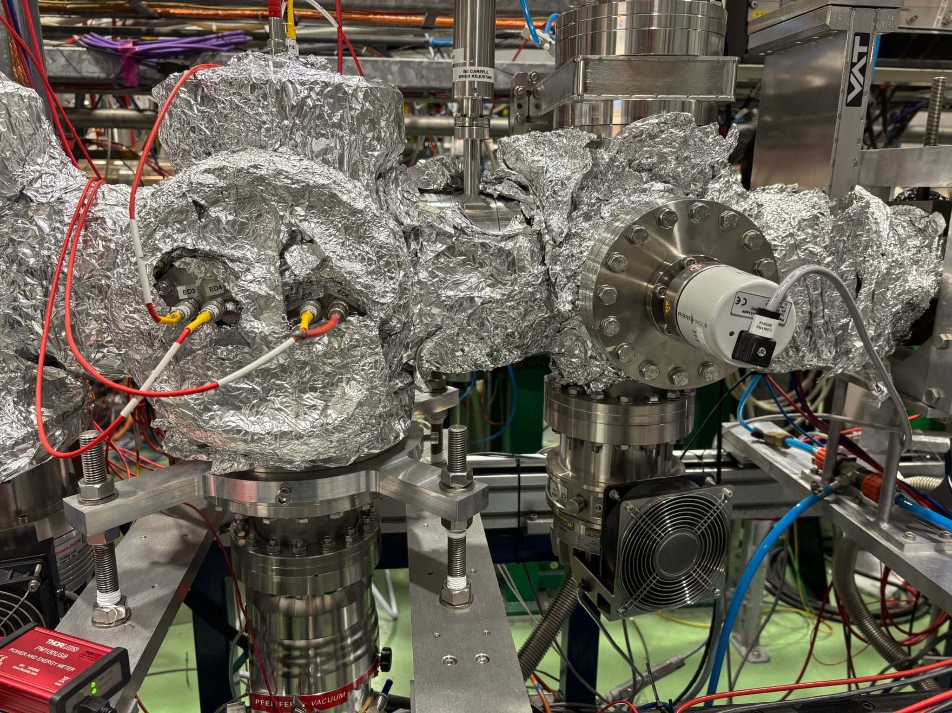
New design
Getting rid of the acceleration lenses.
Change in the design of the deflectors design and assembly.
Designing the deflectors like plates, similar to the ion source bender (instead of rings with PCB)
Position for new deflectors
Field Ionizer Schematics.Rev. Sci. Instrum. 93, 065004 (2022); doi: 10.1063/5.0061736 Department of Physics and Astronomy (IKS)
07/09

Slide 10
New working design
Collisionals
FIU Deflectors
Field Ionizing plates
Rydbergs
High n-rydbergs
Medium n-rydbergs
Low n-rydbergs
MToF
Separate assembly of Field Ionization plates and the deflectors
Field Ionizer Schematics.Rev. Sci. Instrum. 93, 065004 (2022); doi: 10.1063/5.0061736 Department of Physics and Astronomy (IKS)
08/09

Slide 11
Outlook
Work already started on the new design of the FIU
Need the CAD drawings of the CEC deflectors
SIMION simulations to be performed for the number of ionization plates
Advantages
Better vacuum in the Interaction Region (IR).
Baking the beamline at higher temperature > 85 ºC.
Reduction in collisional ionization
Risk of GRIDs shortening reduced
More accessible FIU.
Next step
Laser spectroscopy of K isotopes with 3 step scheme and FIU during ISCOOL commissioning (Technical paper) and In (Jessica’s proposal).
Department of Physics and Astronomy (IKS)
09/09

Slide 12
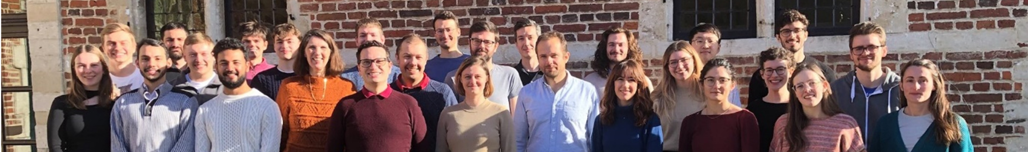








THANK YOU
CRIS collaboration

