Slide 1


Silver at CRIS: Update
Bram van den Borne
Prof. Gerda Neyens
Prof. Ruben de Groote
CRIS collaboration meeting 2025

Slide 2
Two laser spectroscopy runs
2021 low resolution run
2022 high resolution run
S_{1/2} to P_{1/2} transition
99m-110,112-115,118-120,122-123Ag measured
Odd-even
  I = 7/2 fully resolved
  I = 1/2 unresolved
Odd-odd mostly unresolved
Heavily constrained fits
Analysis
  Sonja (odd-even?)
  Bram (finished)
S_{1/2} to P_{3/2} transition
¹⁰⁶⁻¹²³Ag measured
  ^{106m}Ag not measured
Odd-even
  I = 7/2 fully resolved
  I = 1/2 mostly resolved
Odd-odd resolved
Analysis
  Sonja (almost finished?)
  Bram (finished)

Slide 3
Story for papers
Review of g-factors for Z = 43 to 49 for odd-even isotopes
  Currently running HFODD calculations
Charge radii both low res and high res from CRIS
  Reevaluation with F and M factors (written, not submitted) from Leonid
Odd-odd isotopes similarity between silver and indium
  Possibly with HFODD calculations
    If not feasible/possible, empirical single-particle calculations

Slide 4
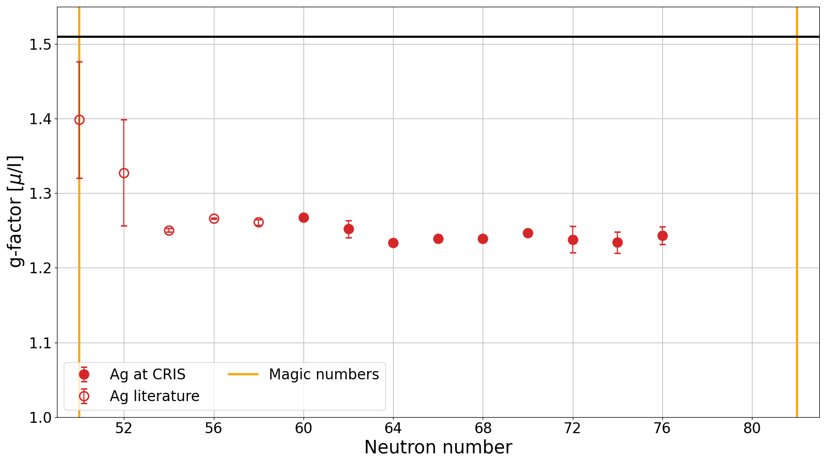
1. g-factor review
Silver isotopes:
  Constant trend slight increase close to N=50
I = 9/2+
I = 7/2+

Slide 5
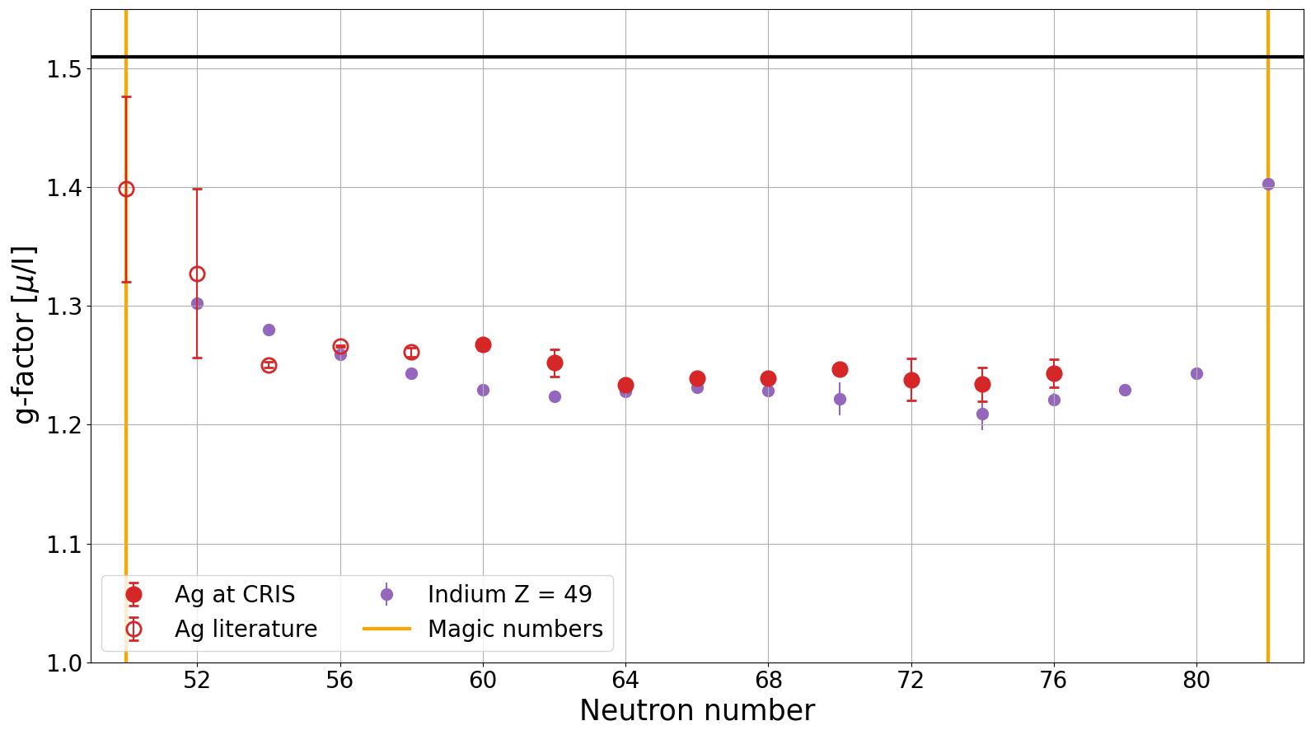
1. g-factor review
Silver isotopes:
  Constant trend slight increase close to N=50
Indium isotopes:
  Similar trend over full chain
I = 9/2+
I = 7/2+
I = 9/2+

Slide 6
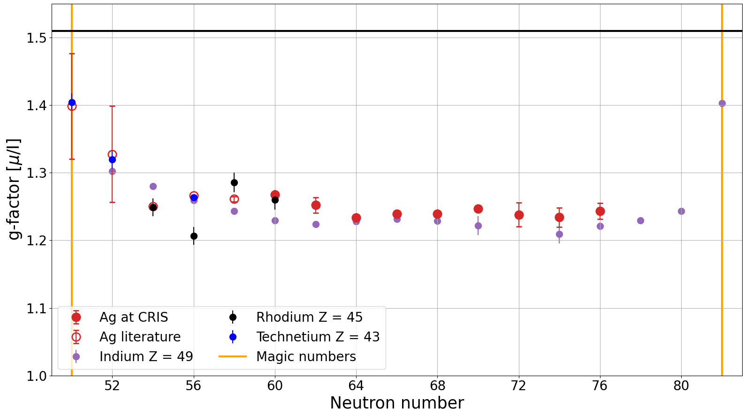
1. g-factor review
Similar trend for high spin states
Idea:
Theoretically predict trend with similar configuration without tuning Skyrme interaction?
I = 9/2+
I = 7/2+
I = 9/2+
I = 7/2+
I = 9/2+

Slide 7
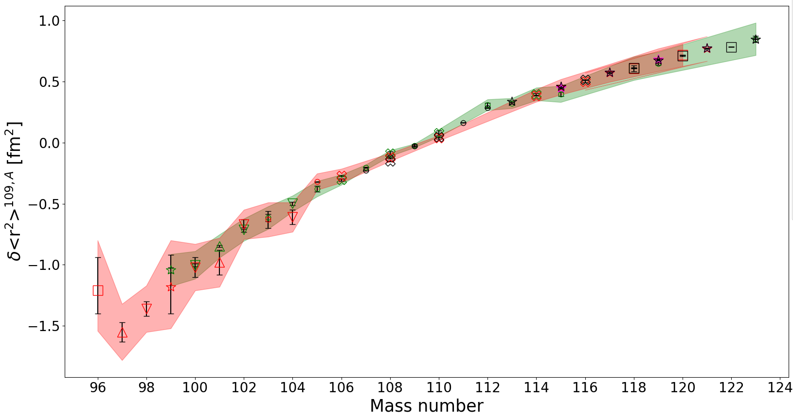
2. Charge radii
Published F and M based on systematics
New values from Leonid
  Remove weird “staggering” in literature at n-def
¹¹²Ag deviates slightly from trend
  Q = 0.73(2)[8] eb
  Only 2⁻ state in chain
Band is stat. + sys. error
Literature
Low resolution CRIS
High resolution CRIS
Notes:
Low res CRIS: 99 is 1/2-, 118 is 0-, rest is high spin states
Literature is all high spin except 115-121 which is the 1/2-, 0- and 1- states
IGISOL is 1/2-
CRIS is high spin except 113-121 which is the 1/2-, 1+, 0- and 1- states

Slide 8
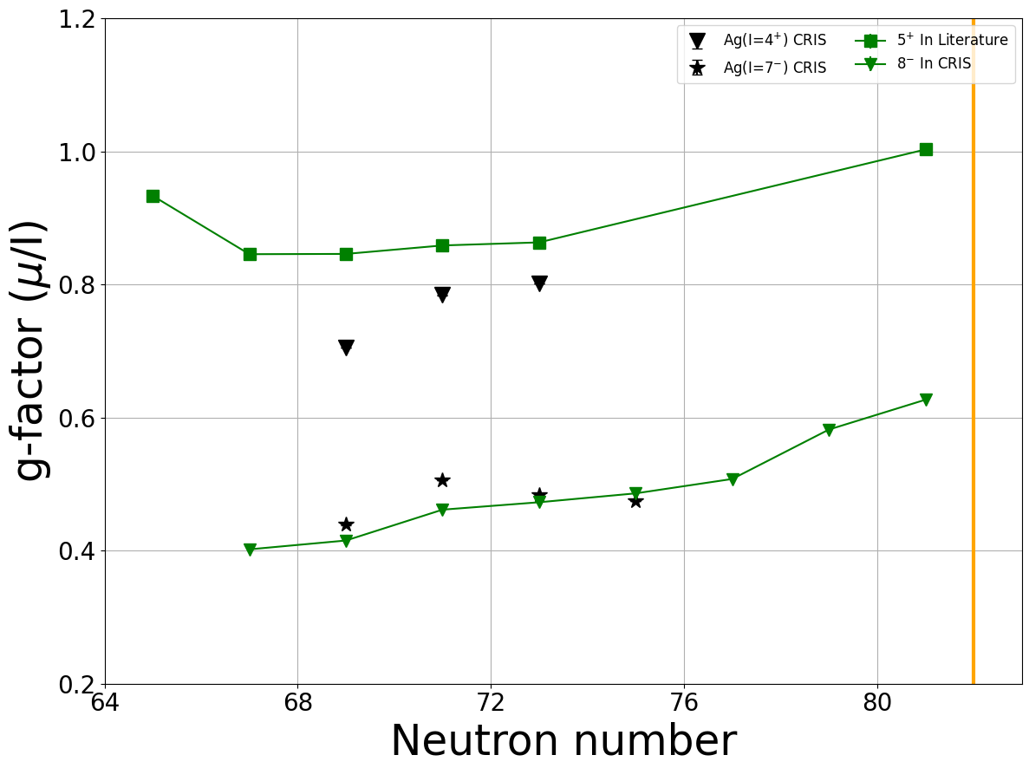
3. Similarity odd-odd silver and indium
Ag and In have 2 similar states
  Ag(4⁺) and In(5⁺)
  Ag(7⁻) and In(8⁻)
Idea
  HFODD calculations if possible
    Theoretically show similarity in configuration
  Empirical s.p. moments

Slide 9
Summary & future
Idea 1: g-factor review
  Currently running HFODD calculations
  Writing paper in progress
Idea 2: charge radii paper
Idea 3: odd-odd silver and indium similarity
  Both fully analysed
  Empirical s.p. moments partially done

Slide 10
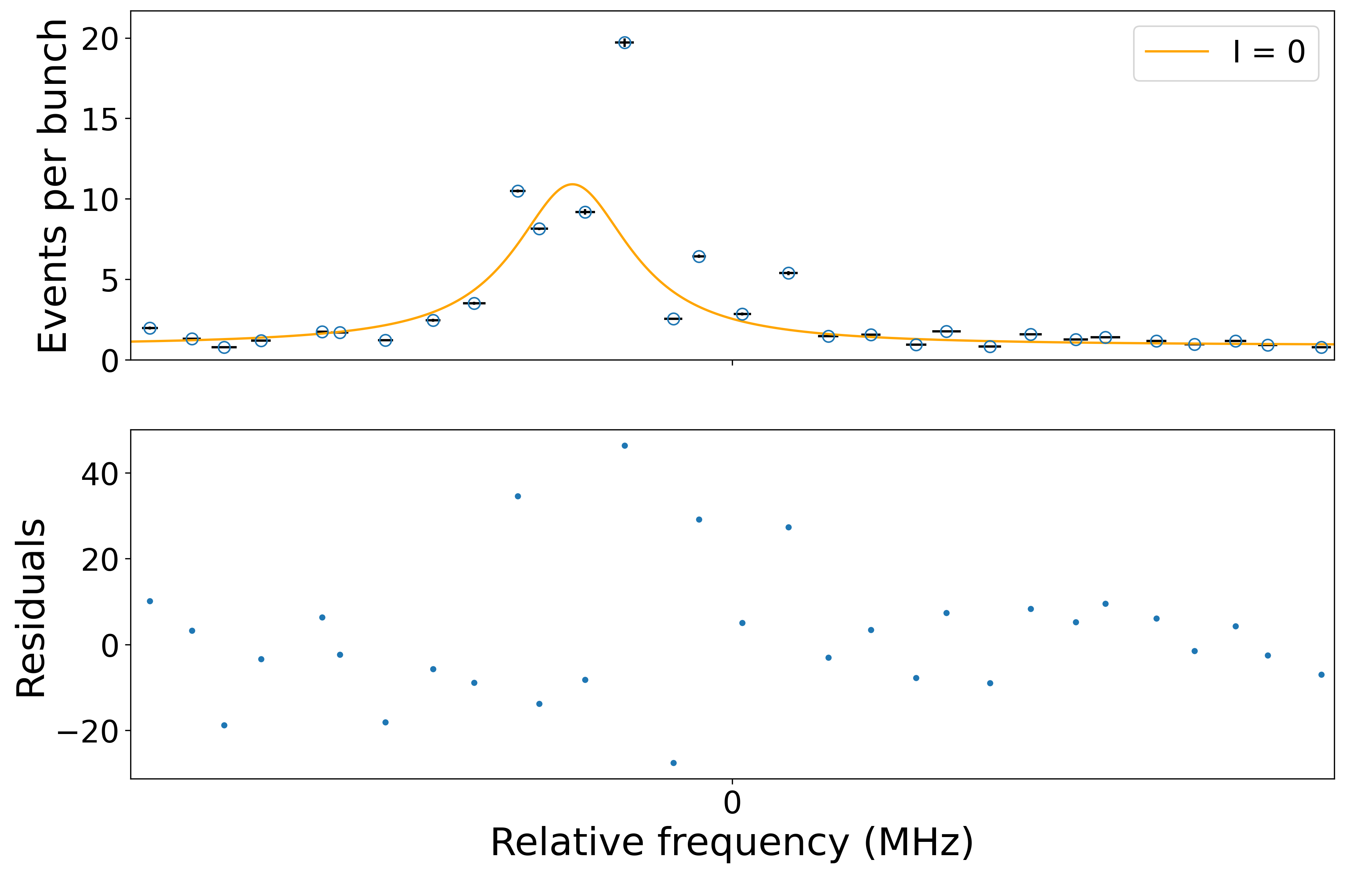
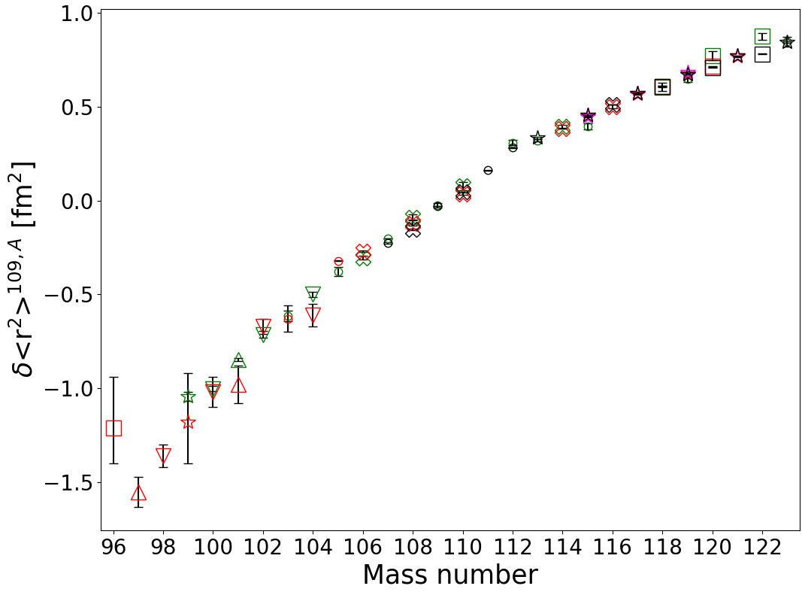
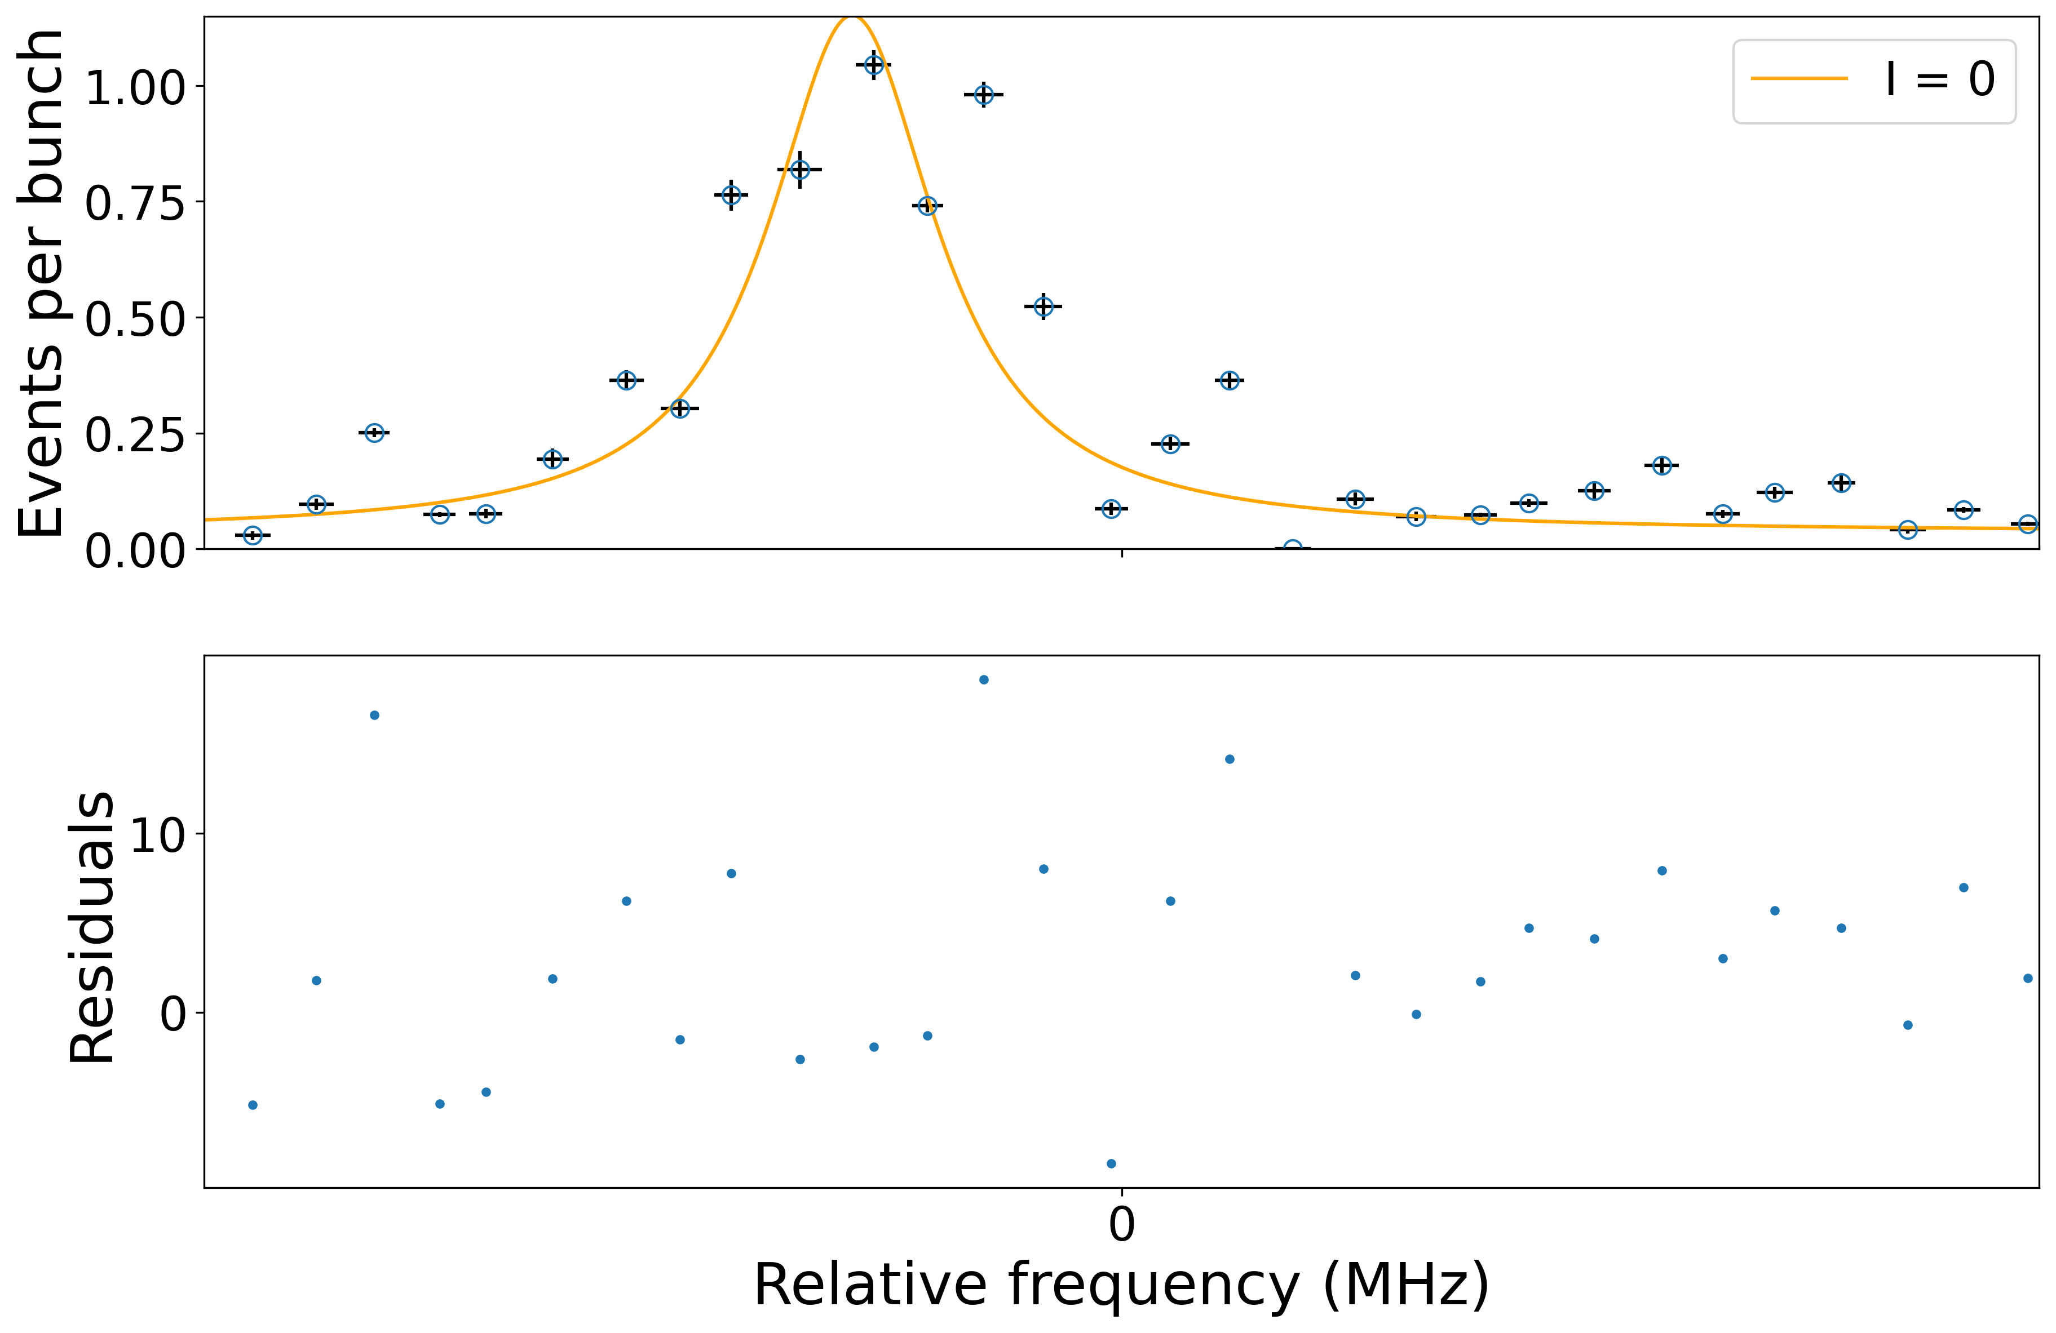
Results: Charge radii
Literature
Low resolution CRIS
High resolution CRIS
IGISOL
Difference from literature in ^{101,104,105,118,120}Ag
  ^{101,104,105}Ag fully resolved
  ^{118,120}Ag not resolved and noisy
¹²⁰Ag

Slide 11
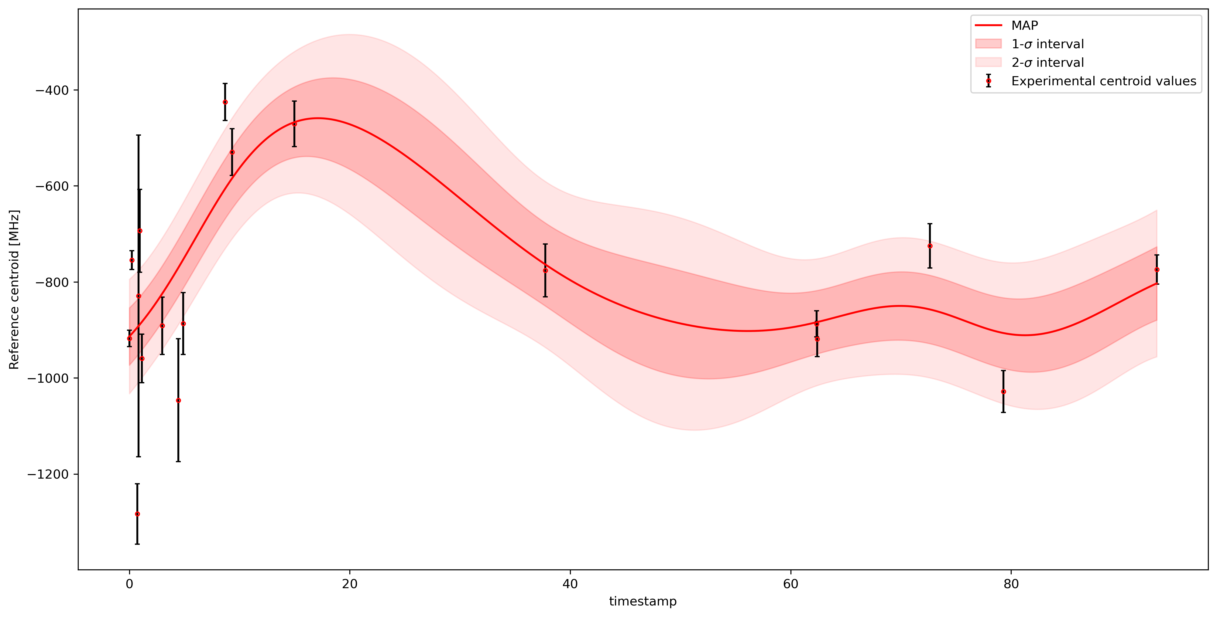
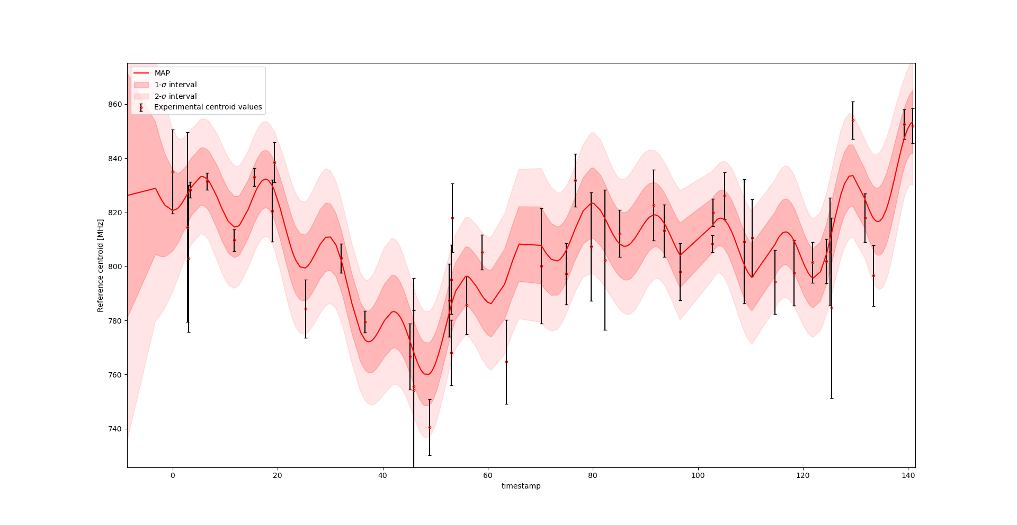
GP regression
2021
2022
More consistency between scans of same isotope

Slide 12
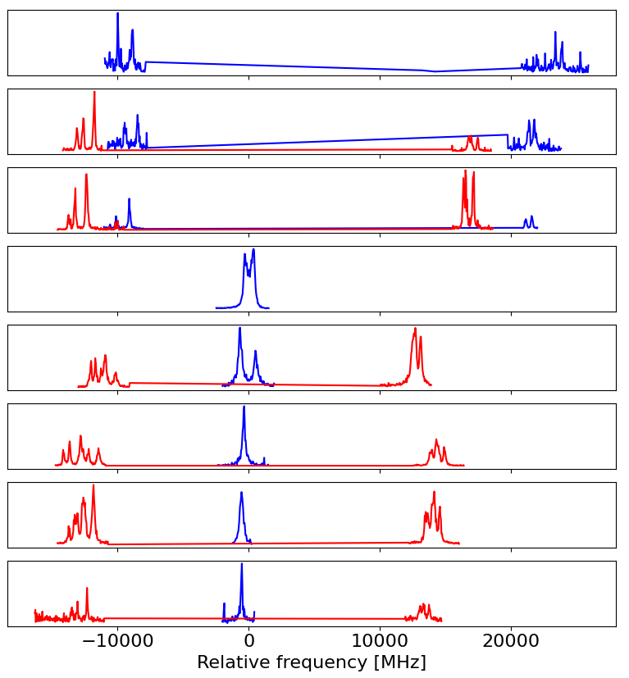
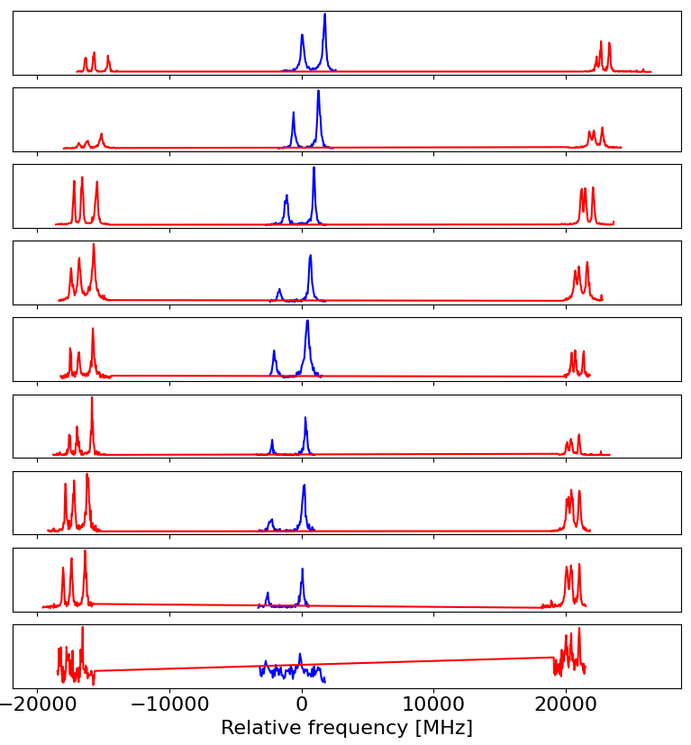
106
107
108
109
110
111
113
112
115
116
117
118
119
120
121
122
123

