Slide 1
Al CRIS COLLAB 2025
Jordan Reilly & Agi Koszorus

Slide 2
Overview
Physics Case
Experiment
Results
Next steps and discussion

Slide 3
Island of Inversion

Slide 4
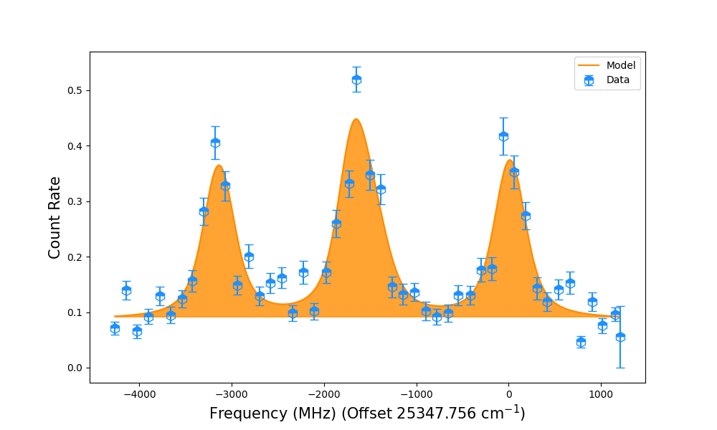
Experiment:
Experimental campaign was split across 2 runs
Both runs very challenging!
Isotope | Scans total
²⁶Al | 3
²⁷Al | 34
²⁸Al | 1
²⁹Al | 15
³⁰Al | 4
³¹Al | 7
³²Al | 3
³³Al | 4
³⁴Al | 2
³³Al

Slide 5
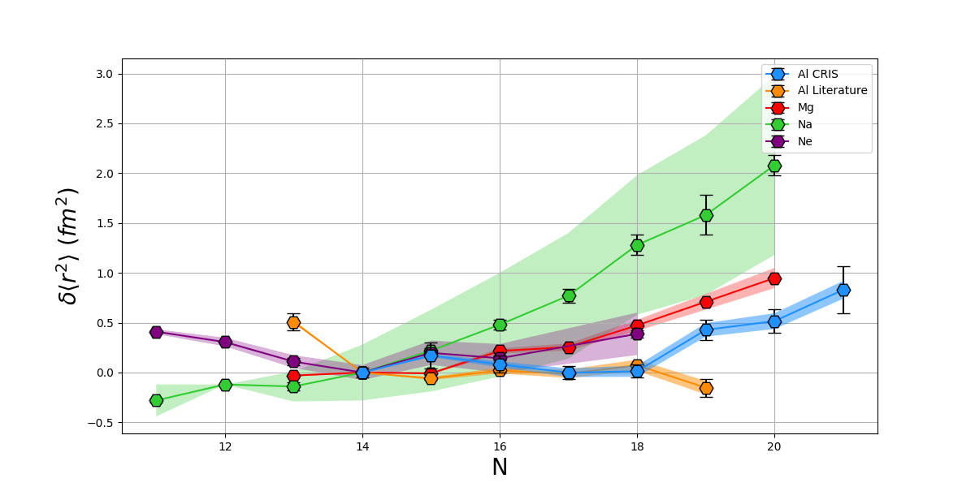
Charge Radii in the Region
Plotted using CCSDT(Q) F and M calculations from Leonid [1]
Lit values replotted using CCSDT(Q)
N = 14-18 displays excellent agreement with Lit.
Increasing trend from N = 19-21
Magnitude of the increase comparable with the region
^{33, 34}Al support conclusion from moments which suggest significant mixing [2, 3]
Why does ³²Al display increase when other measurements place it outside IoI?
[1] L. V. Skripnikov et al., Physical Review A 110 (2024)
[2] P. Himpe et al., Physics Letters B 658 (2008)
[3] H. Heylen Physical Review C 94, 034312 (2016)

Slide 6
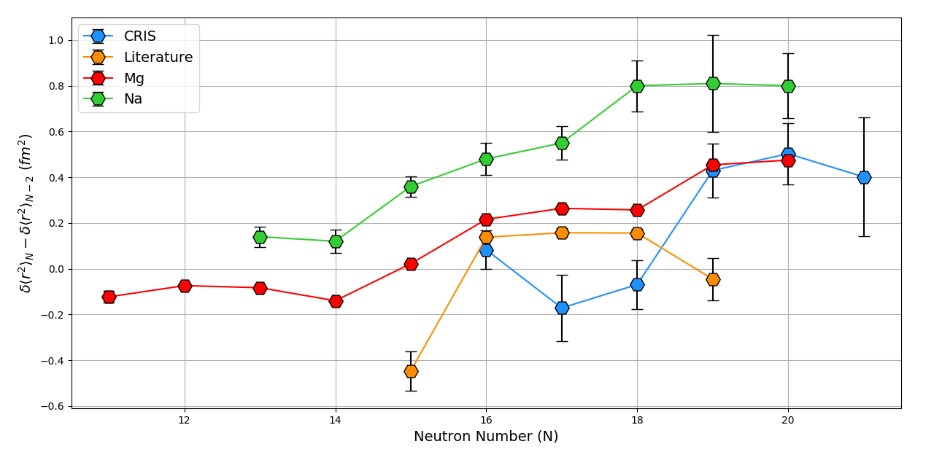
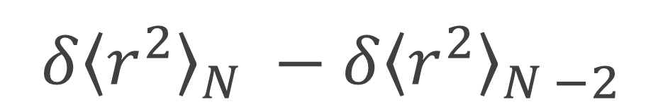
$${δ\left\langle r^{2}\right\rangle }_{N} −{δ\left\langle r^{2}\right\rangle }_{N −2}$$
To decouple from the influence of F and M
Show the relative change between N and N-2
Al displays a similar trend to Mg and Na

Slide 7
Current Status
Analysis finished!
This year was dedicated to finishing my thesis and defending
Paper being prepared and written
Calculations from G. Hagen & T. Miyagi of the charge radii up to N = 21
Where to submit to?
Calculations required for better understanding of ³²Al
Shed light on level of intruder mixing in ^{33, 34}Al

Slide 8
Thank you!
Conclusion:
Analysis complete and defended
Where to submit to?
Calculations being prepared

Slide 9
Back Up

Slide 11
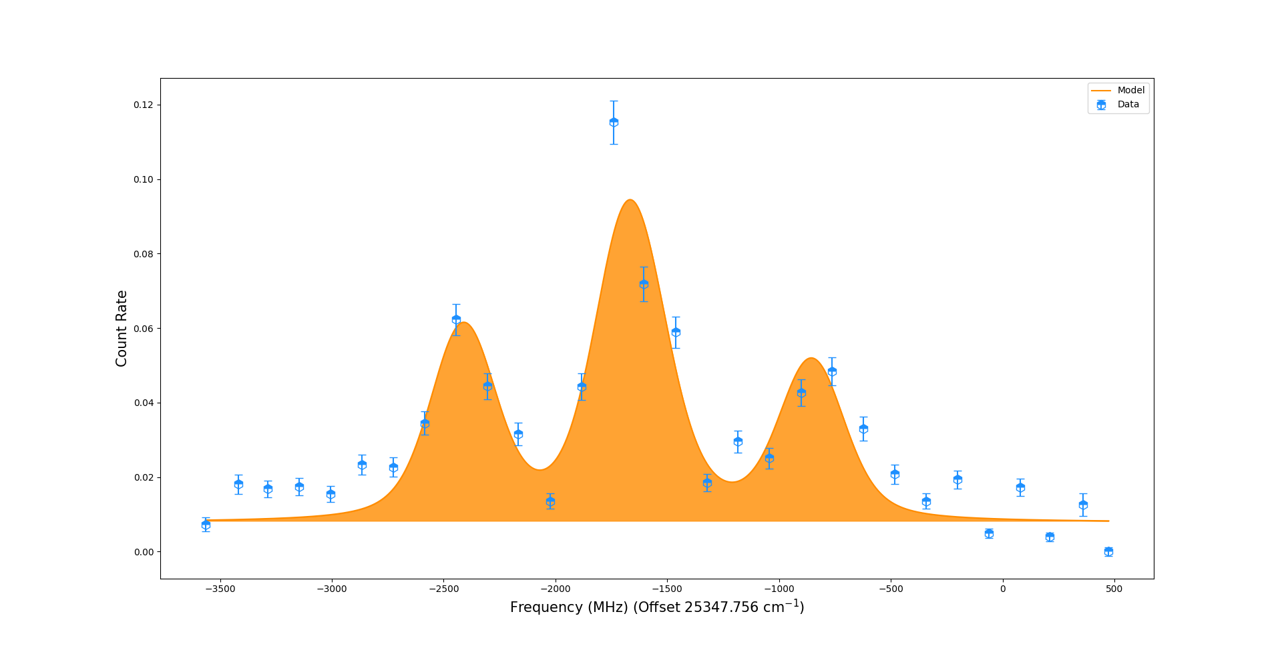
^{33, 34}Al Spectra

Slide 12
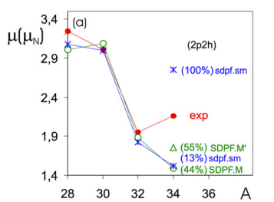
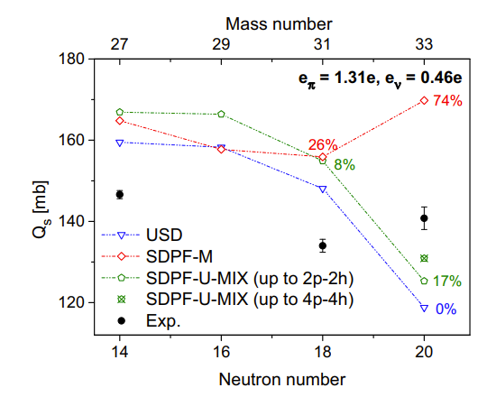
Moments

