Slide 1
ISOLDE TISD 2024 year in review
Running period: 2 April – 8 December
MD activities: HRS fast beamgate system, RP monitor proton scans, 2D proton scans
11 Target and Ion Source Development (TISD) beamtimes:
  Beam development: Pa, TbF_{x}, in-trap decay,
  New target materials: nano ZrO_{x}, TaC,
Beams for operation:
  First negative ions since LS2: Br⁻, Cl⁻
  Molecular beams: SnS, CeF_{x}, YF_{x}, RaF,
  Special target materials: Nb foils, Ti foils, nano CaO
  Special target units: #856 ∆T<20˚C, #861 LIST, #813 LIST, #810 hq, #879 cq, #820 liquid La
TISD team on shift
Nonstandard target/ development for operation

Slide 2
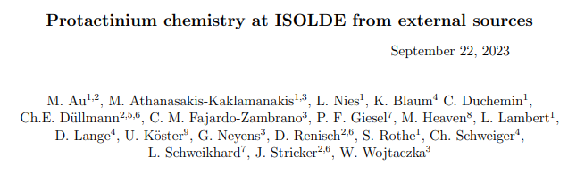
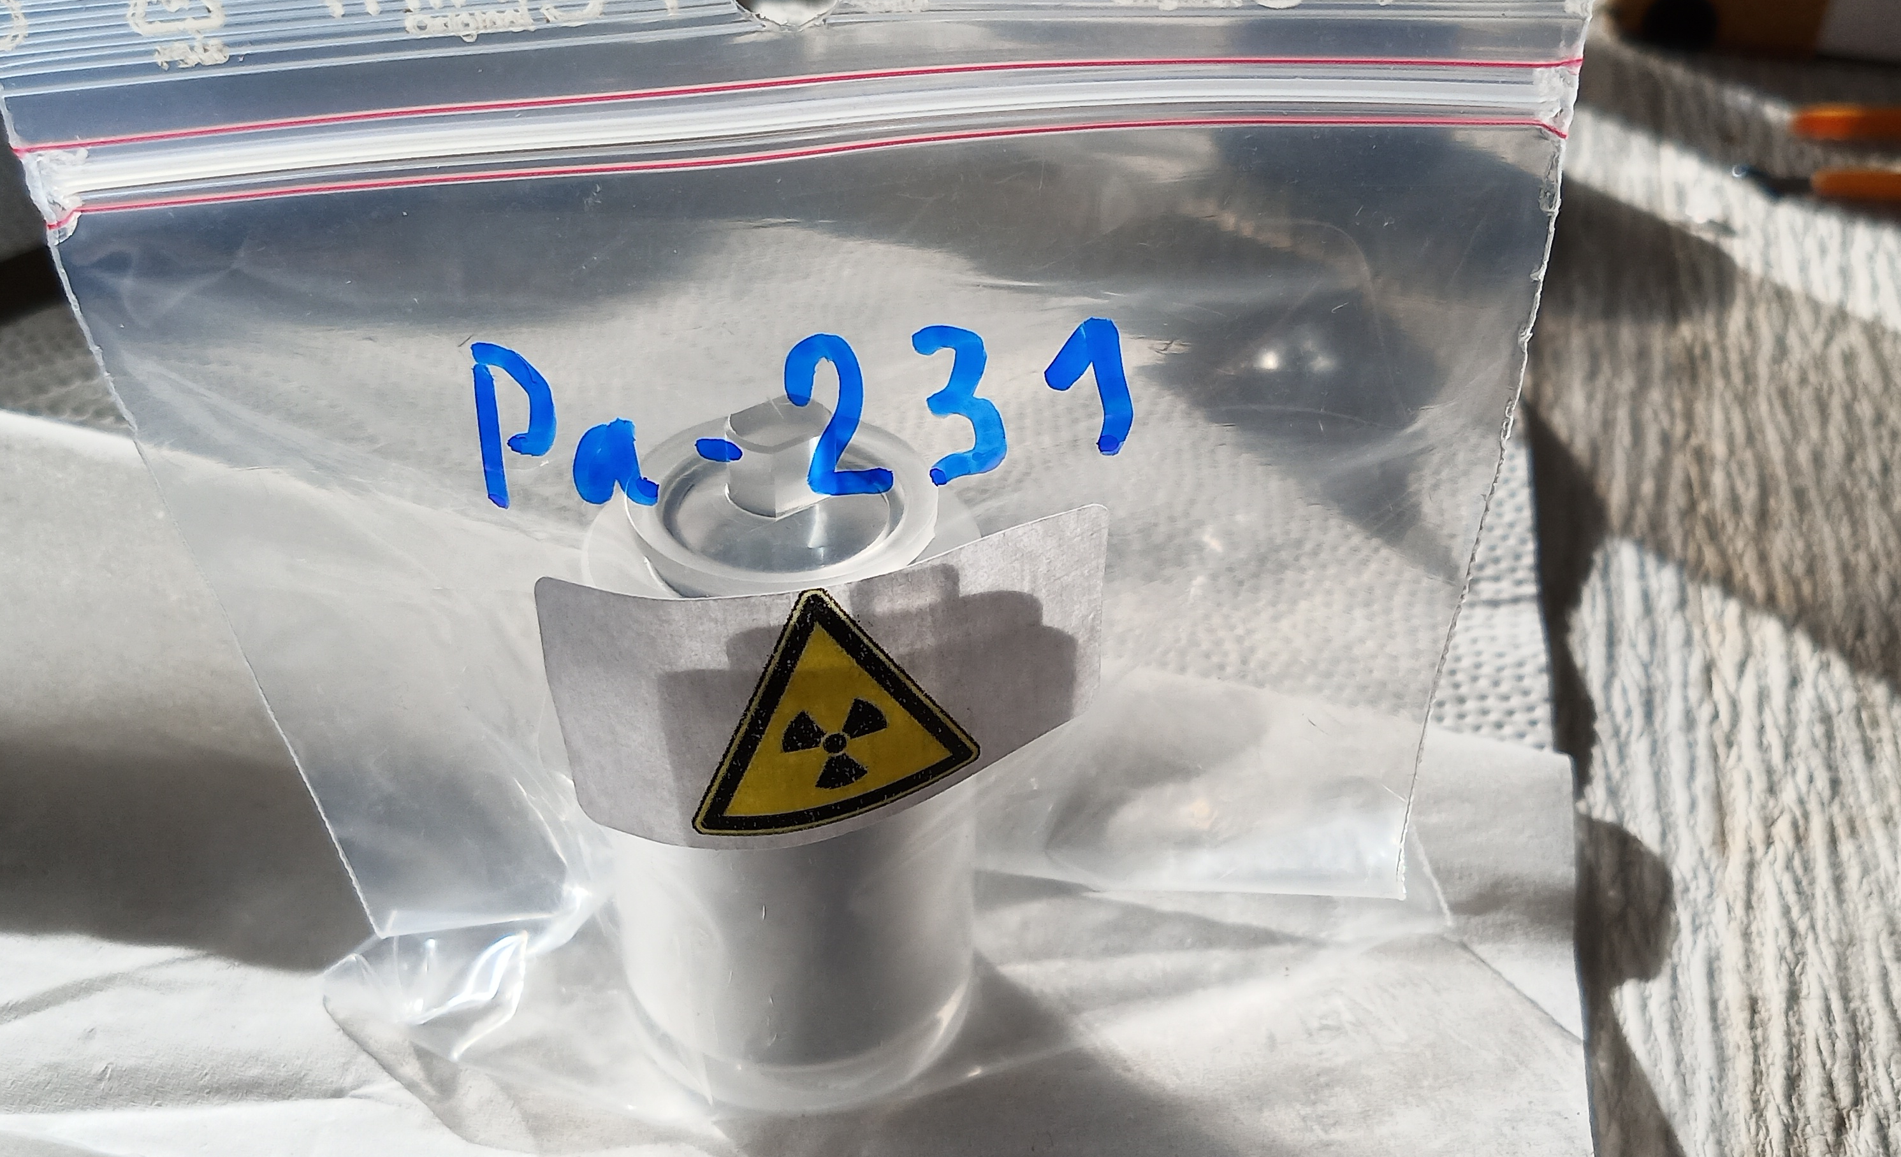

ISOLDE TISD 2024: April-June
LOI258: External sample collaboration, first Pa beam at ISOLDE
Liquid Pb
CaOx nano: One-day turnaround for backup target
HRS fast beamgates: Installation and commissioning
TISD TbF_{x}: Molecular Tb beams for medical applications
In-trap decay: MD and preliminary tests
GANDALPH: First (only) negative ion run since LS2
TISD ZrOx nano: Target material development
Liquid La: #820
TISD team on shift
Nonstandard target/beam development for operation
M. Au

Slide 3
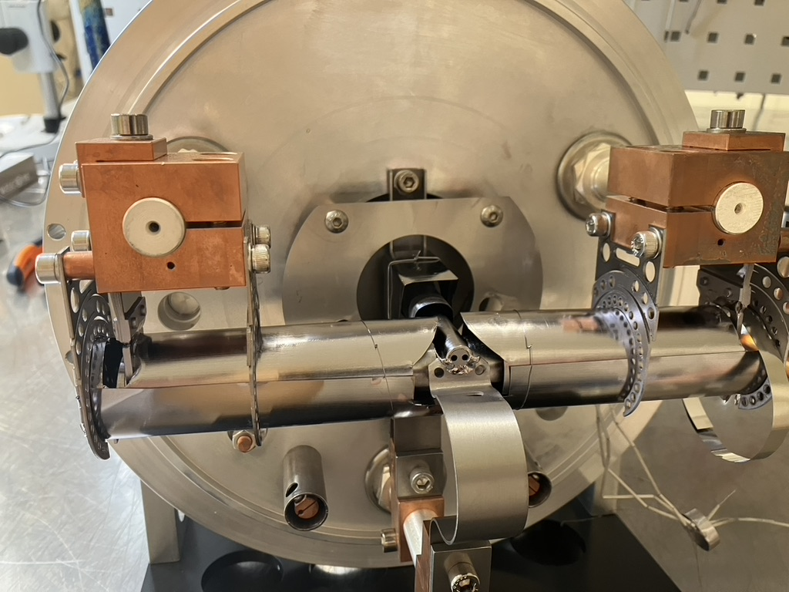
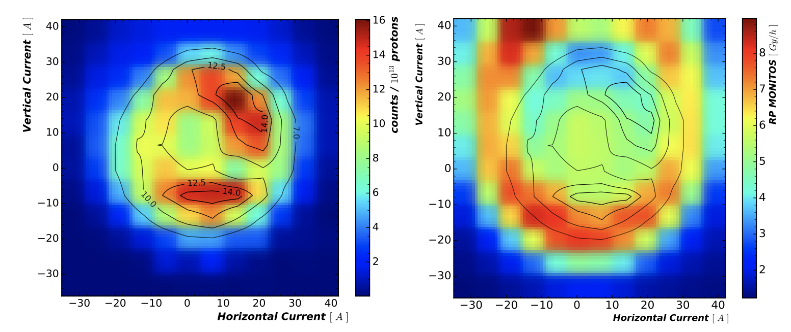
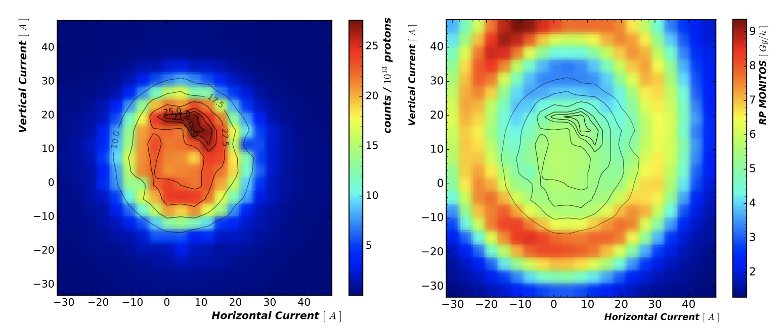
ISOLDE TISD 2024: July-August
LIST Ta: offline development target as backup ~1 day turnaround
TISD TaCx: Target material development
SnS: sulphur oven development
TISD TaCx: Target material development
#856 for IS745: ∆T < 17˚C
TISD ZrOx: Target material development
SnS: sulphur oven development
LIST Ta
Hot quartz
RP monitor data and 2D proton scans
J.B. Frederiksen, M. Au, L. Le
https://cds.cern.ch/record/2908317
TISD team on shift
Nonstandard target/beam development for operation
M. Au

Slide 4
ISOLDE TISD 2024: October-December
RaF⁻: negative molecules through double charge-exchange
CeF_{x}: molecular beam development
TISD: TbF_{x} from tantalum foils
LOI270 in-trap decay: beam development
Nb foil target: target material development, yields for users
Cold quartz
Winter physics: Fr from Ac decay
TISD team on shift
Nonstandard target/beam development for operation
M. Au

Slide 5
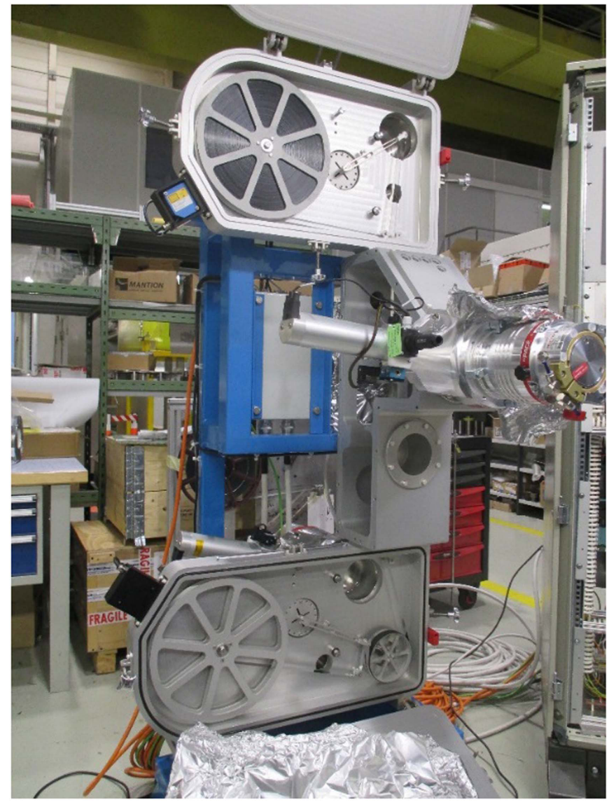
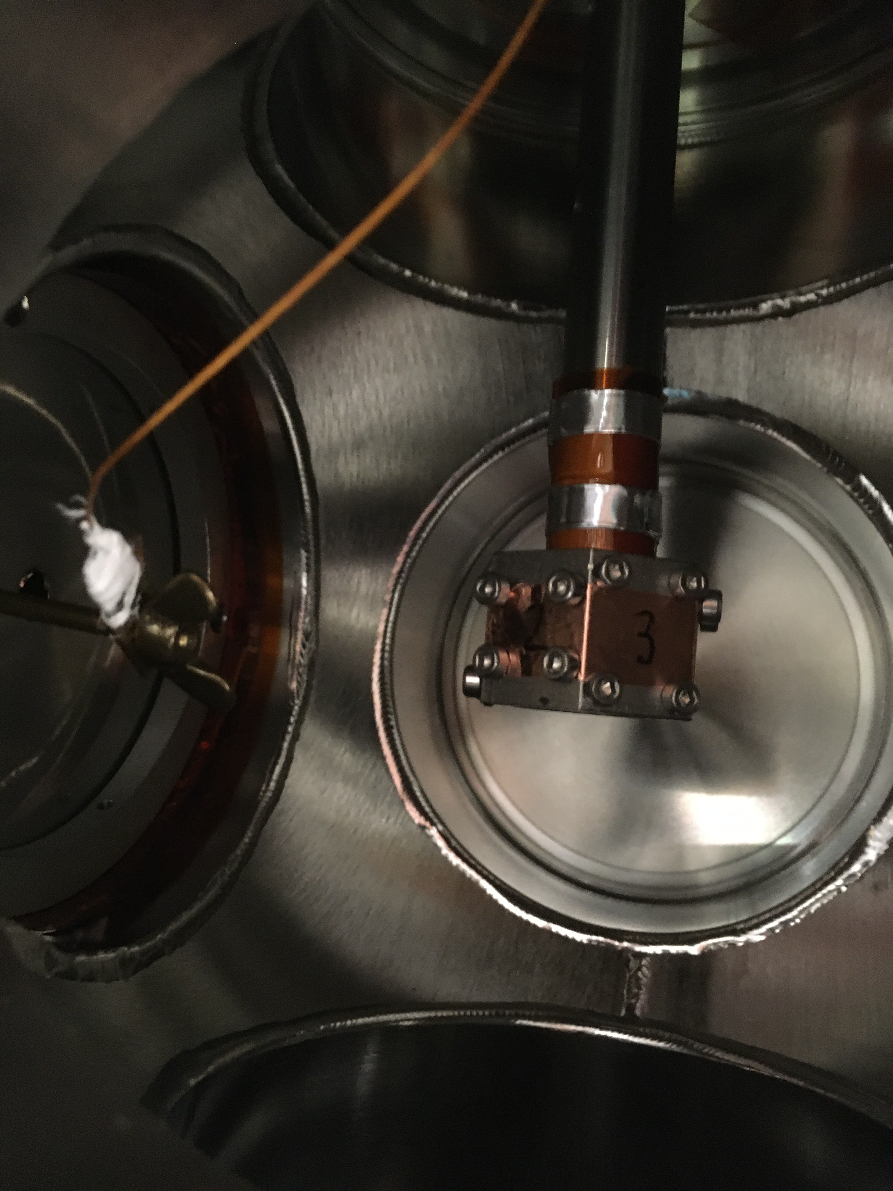
TISD online experiments
target
Contaminant ions
Catherall, R. et al. (2017) J. Phys. G. 44, 9
ISOLDE FTS
Ion source
p+
Contaminant neutrals
Extraction electrode
Ion beam
Isotope of interest
In-beam detector
β
Neutral molecule of interest
β
β
Molecular ion of interest
4-π
Reactive gas
ϒ
Ge
Buffer gas
ISOLDE HRS
Mass separator
ISOLTRAP
MR-ToF MS
ISOLTRAP
RFQ-cb
ISOLDE LA1
collections chamber
M. Au

Slide 6

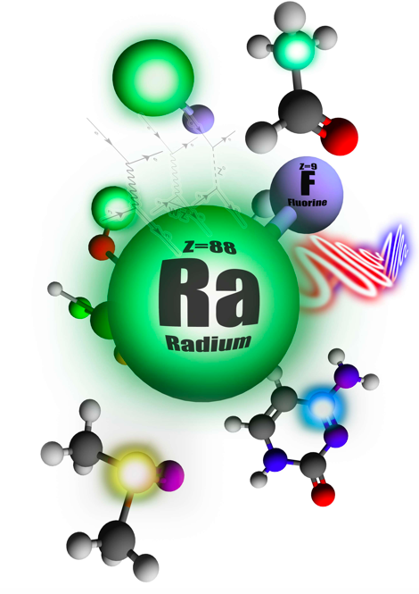


Fluoride beams current status
Z=9
F
Z=9
F
  RaF_{x}: developed, available*
  AcF_{x}: developed, available*
  NpF_{x}, PuF_{x}: observed
  PaF_{x}, PaO_{x}: external sources, development
  ThF_{x}, UF_{x}: long-lived only
  ScF_{x}, TbF_{x}: ongoing development
  VF_{x}: requested
Z=89
Ac
Actinium
Z=9
F
Z=89
Ac
Actinium
Image published in EP Newsletter, CERN (2020)
?
Z=9
F
Z=8
O
?
Z=92
U
Uranium
Z=89
Pa
Protactinium
M. Au
Notes:
Not to scale ☺

Slide 7
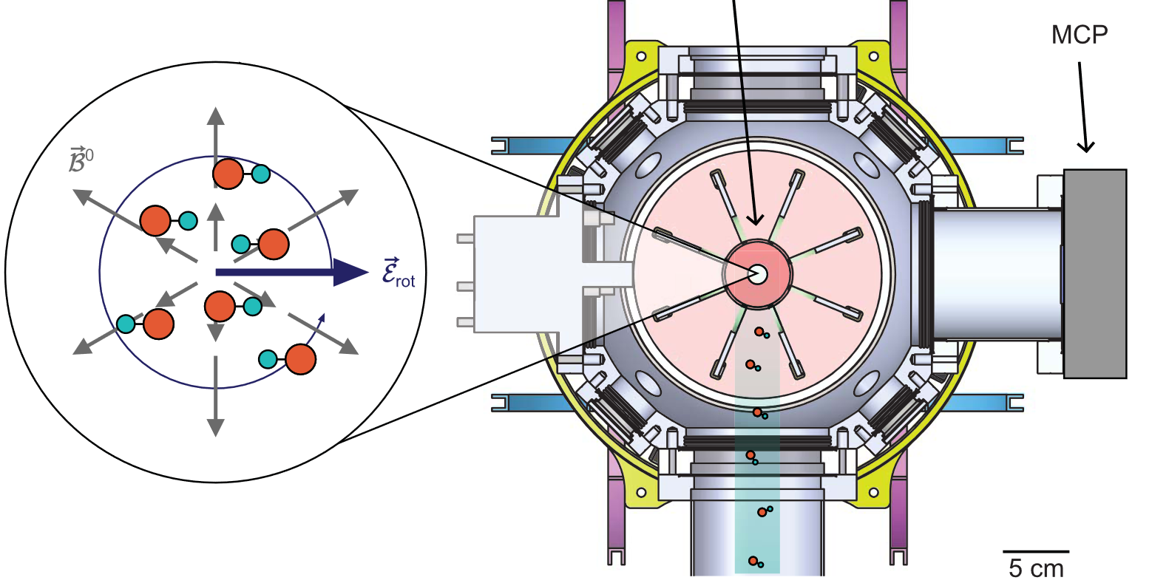
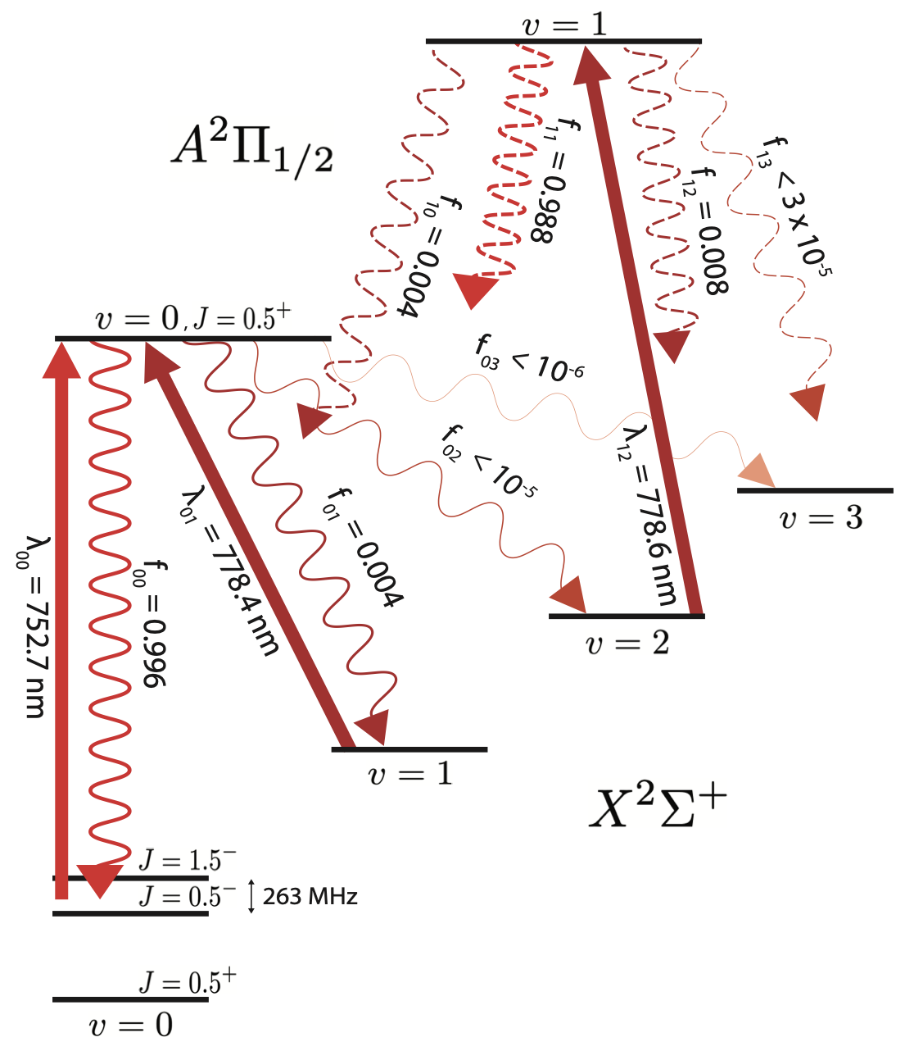

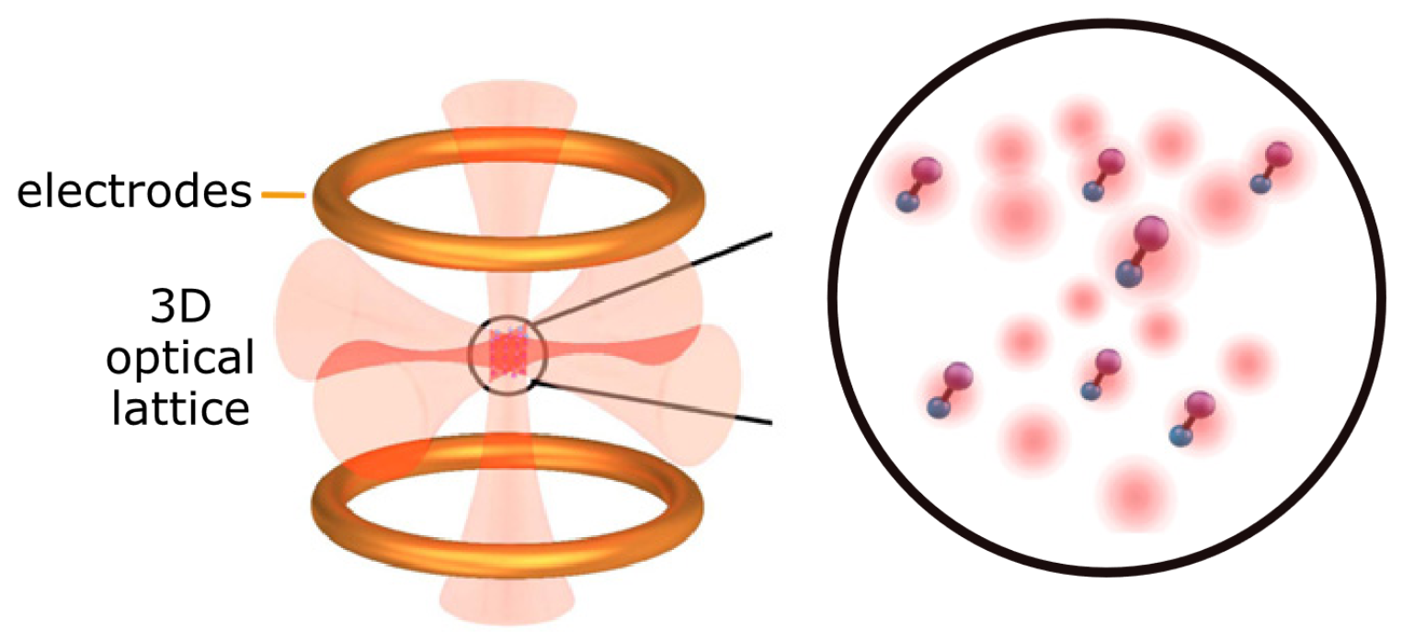
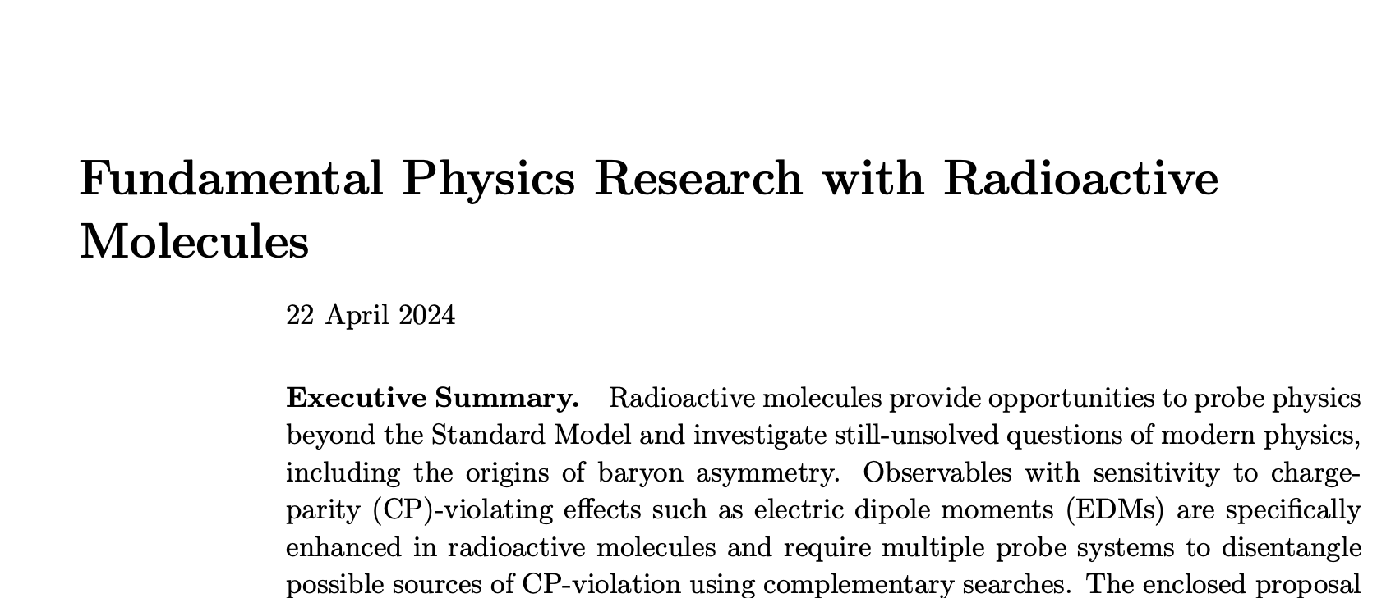
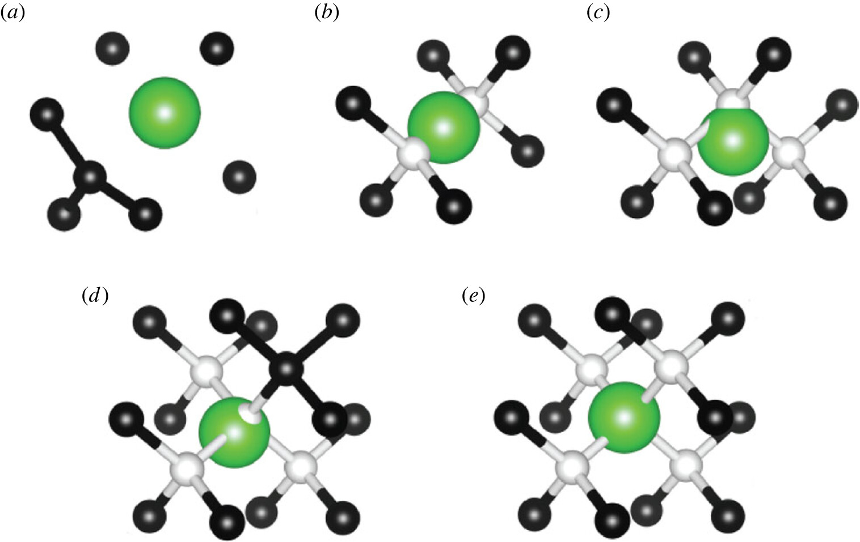
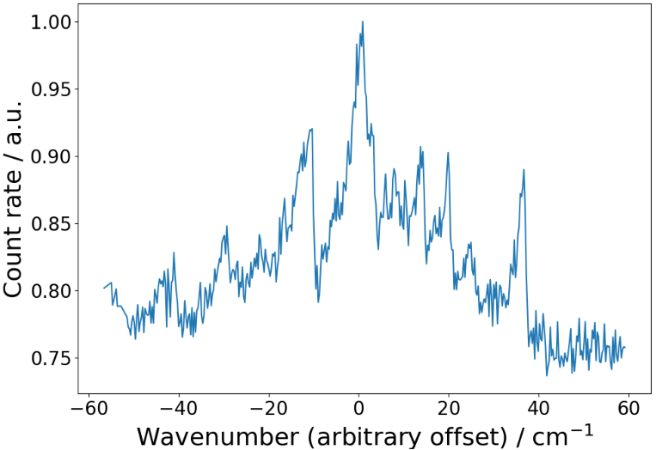
Fundamental
Symmetries collaboration
Roussy et al., Science 381, 46 (2023)
Udrescu et al.,(2024) Nat. Phys. 20, 202
Fitch et al., Q.Sci.T. 6, 014006 (2021)
Athanasakis-Kaklamanakis et al.,(2024) in preparation
Morris et al., Phil. Trans. R. Soc. A. 3822 (2023)
RIB
Precision measurement
Work in progress
  Fellow position closed
  collaboration
Making radioactive molecules
  Beams, traps, targets
Characterizing radioactive molecules
  Spectroscopy, chemistry
  Properties and states
Techniques for bulk systems
M. Au

Slide 8
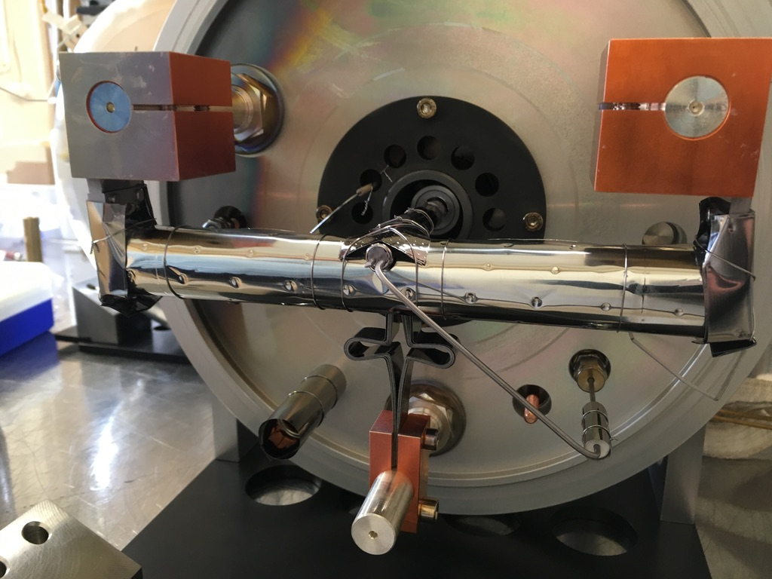
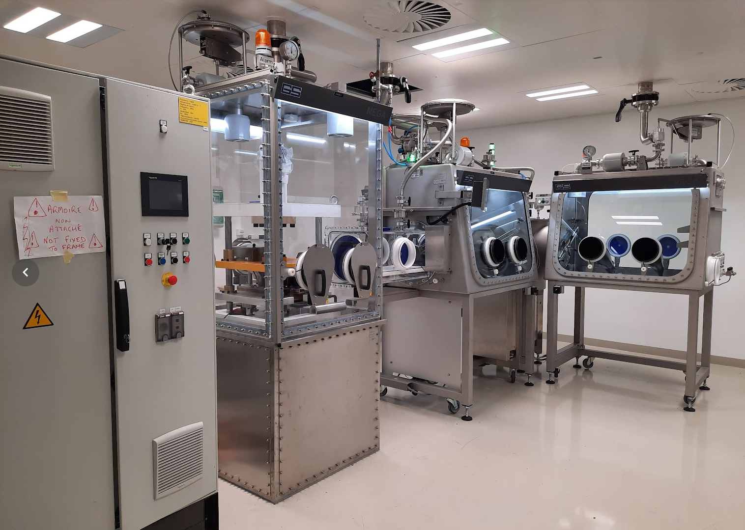

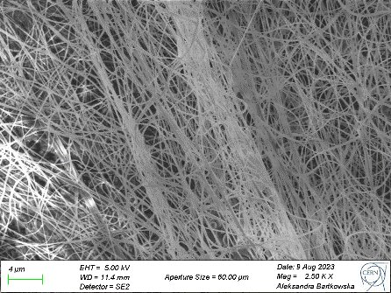
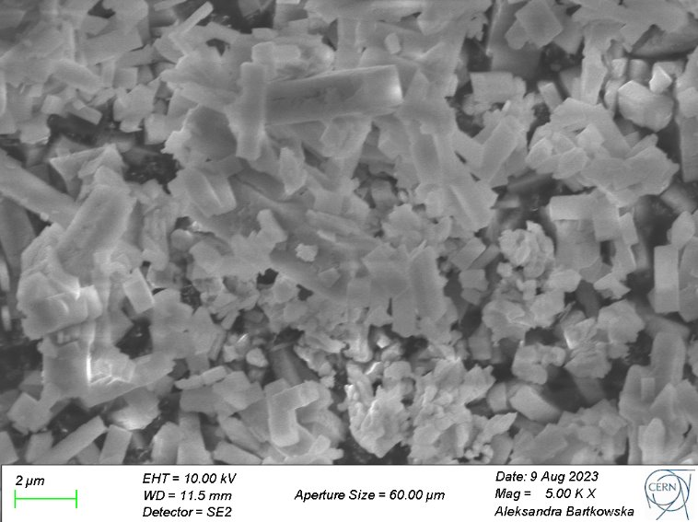
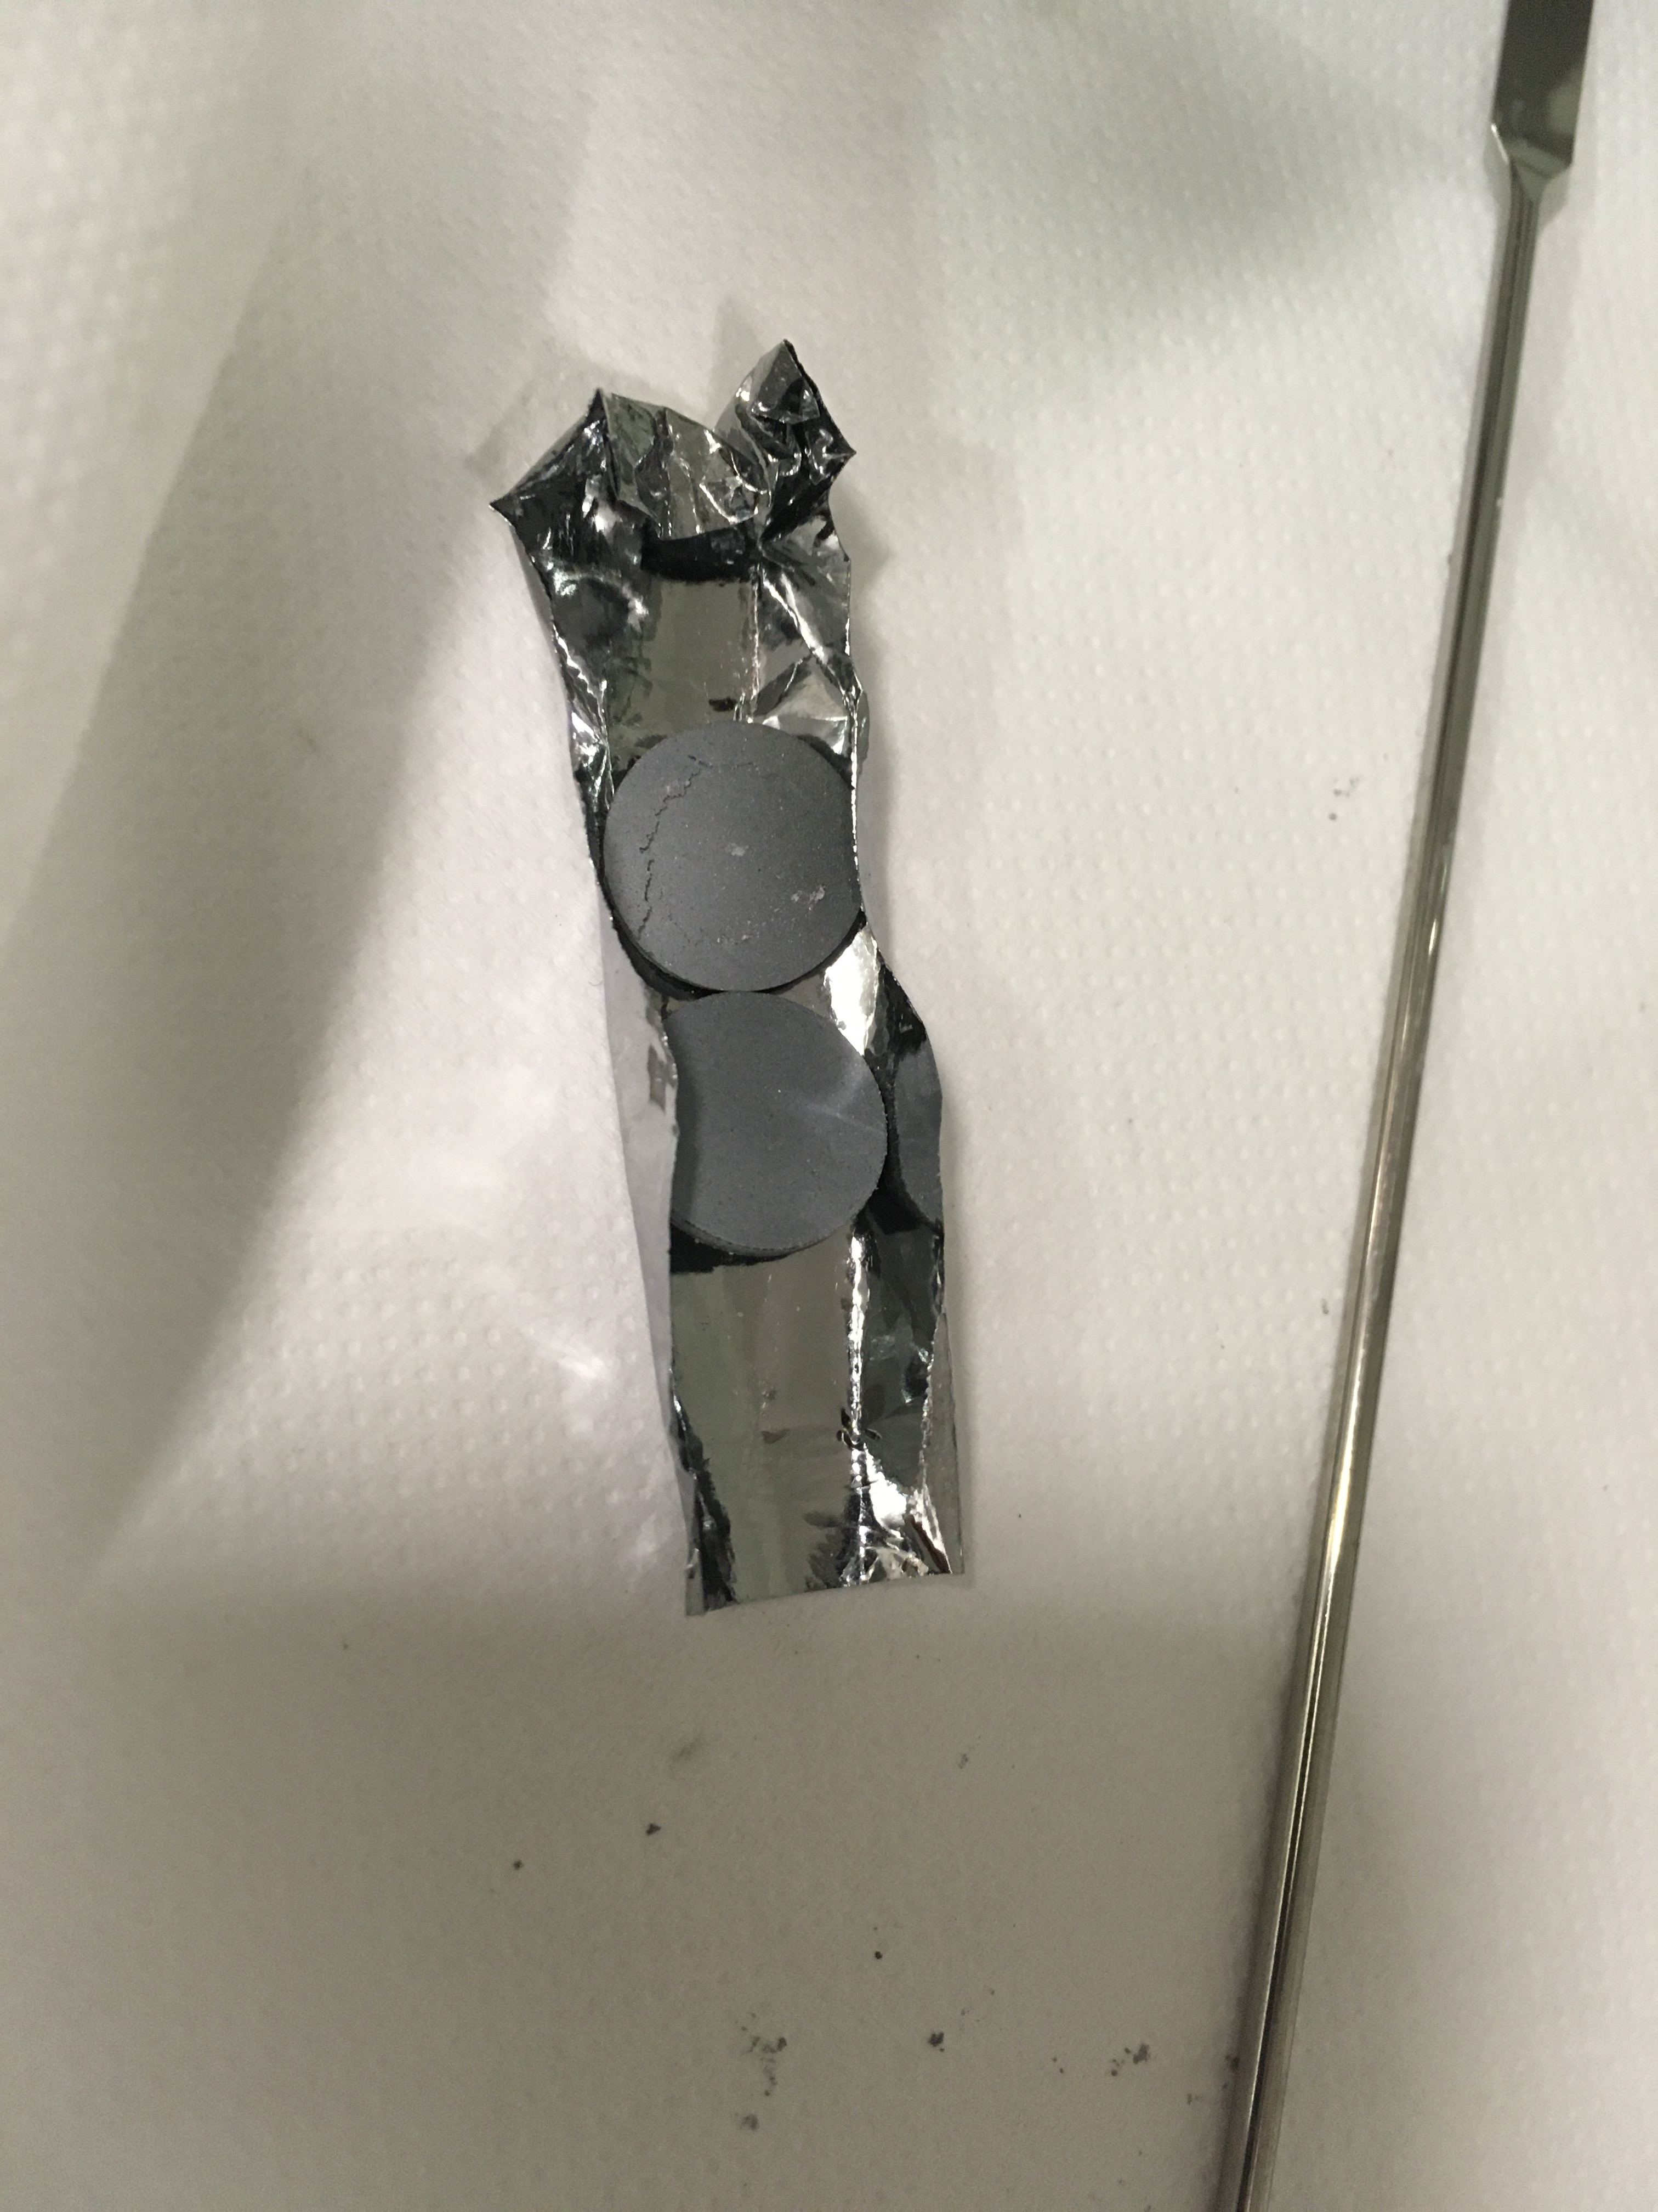
Developments in target materials
Sub-micron and nano materials development:
Valentina Berlin and Edgar Reis
CaO, ZrO₂, La₂O₃,UC_{X},TaC,HfB,Ta foils…
Gas injection
  Reactive/corrosive gases
Reactants
Mass markers
Target materials
Particle size
Open porosity
Nano lab
ZrO₂
La₂O₃
Slides and pictures provided by V. Berlin, M. Au

Slide 9
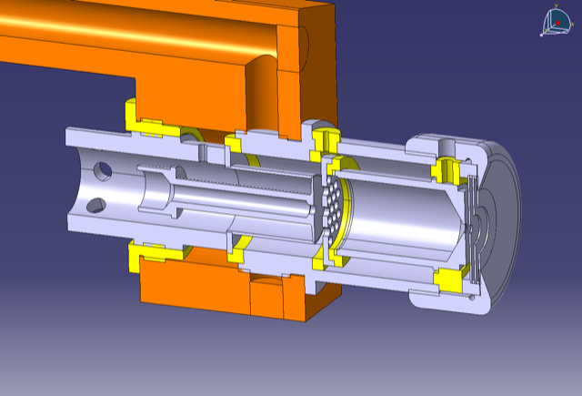
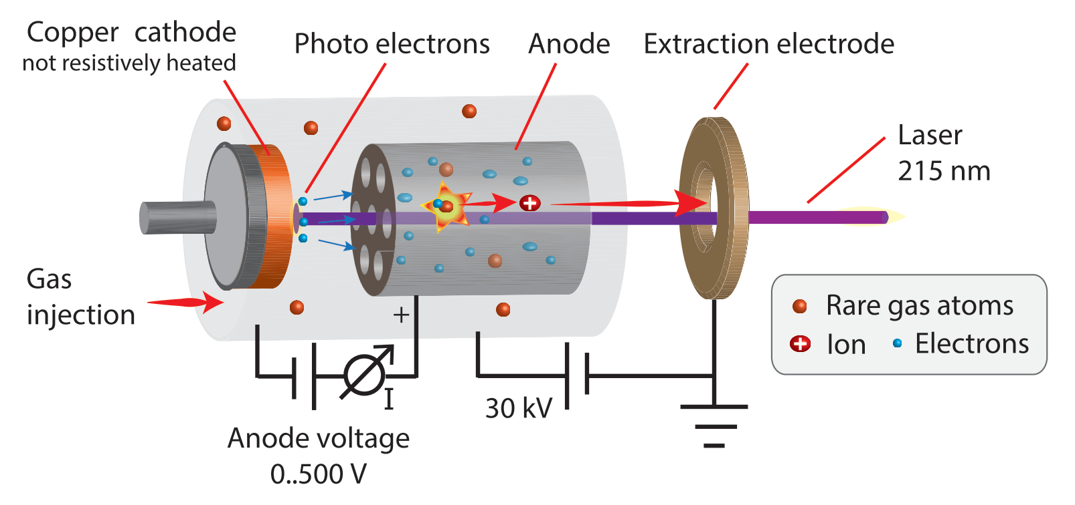
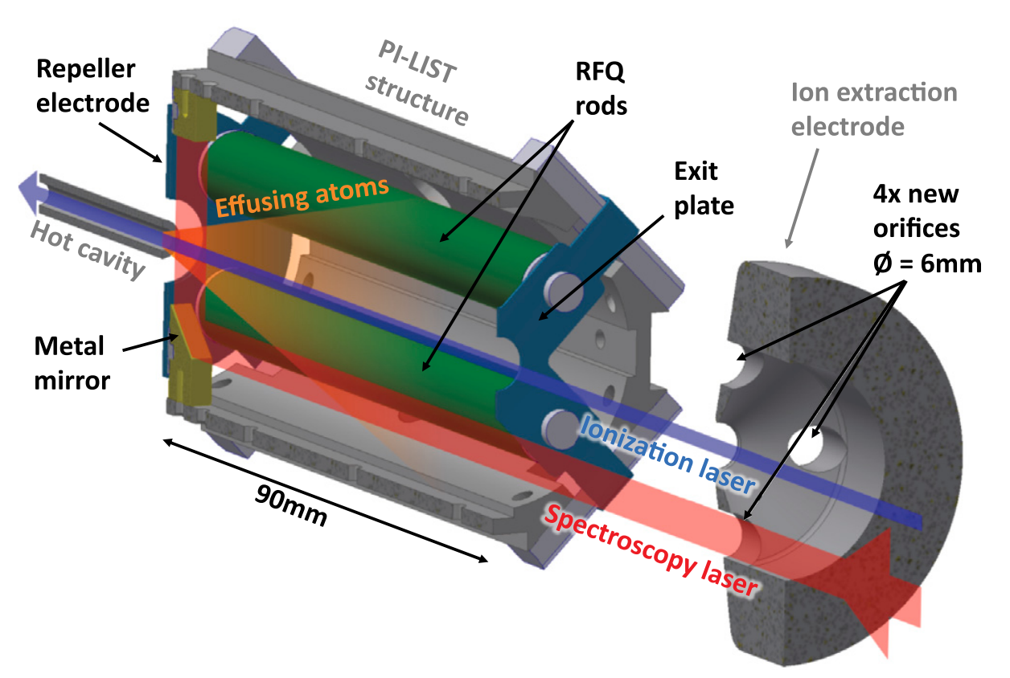
Ion source developments
Molecular breakup and characterization studies
  FEBIAD-type ion sources [1,2]
  Electron energy and source optimization
  Ion source systematics
Photocathode ion sources [3]
  Cold (room-temperature) environments
In-source spectroscopy [4]
  PI-LIST: sub-Doppler hot-cavity in-source spectroscopy
  CERN-ISOLDE implementation
[1] Maldonado (2023) PhD thesis
[2] Martinez Palenzuela (2020) PhD thesis
[3] Ballof . ﻿et al., 2022) J. Phys.: Conf. Ser. 2244 012072
[4] Heinke et al. (2023) NIM B. 541 (8-12)
Slides and pictures provided by M. Au

Slide 10
Molecular ion beam production
Update on ISOLDE Offline 2
Justus Berbalk
CRIS Collaboration meeting 30-31 January 2025

Slide 11
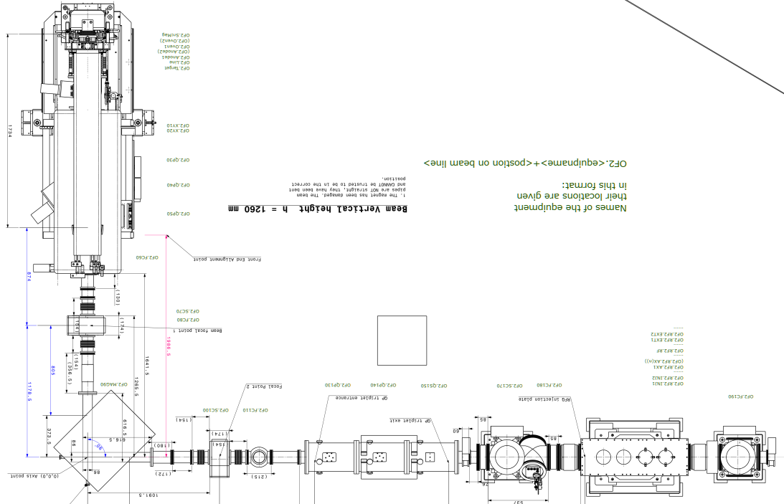
Layout of OFFLINE 2
Ion source
High Voltage racks
High Voltage racks
Beamgate
RFQcb
Radio-frequency quadrupole cooler and buncher
90° Magnet
~ 2 m
Magnetof
RILIS Lab

Slide 12
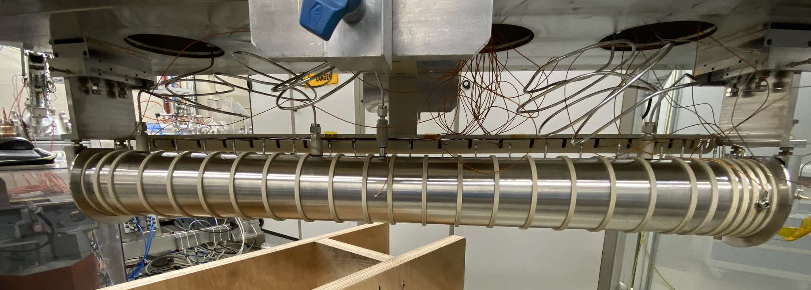
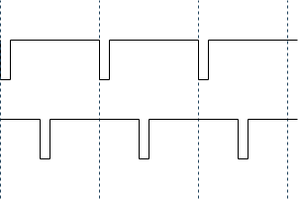

The radiofrequency quadrupole cooler-buncher (RFQcb)
Example: 10 ms trapping
extr. plate
23
24
Beamgate
25
2
2
4
1
3
5
6
7
8
9
10
11
14
15
16
17
13
18
19
12
100 us
Inj. plate
20
RFQ
22
21
12
V
0
50 ms
100 ms
150 ms
Before: 0.5% transmission, no bunching, no cooling
He
He
TTL signal of Quantum Composer switches endcap electrode potential via high-voltage, high-current Behlke switch
Now: 50-60% transmission, bunching and cooling !
He
He

Slide 13
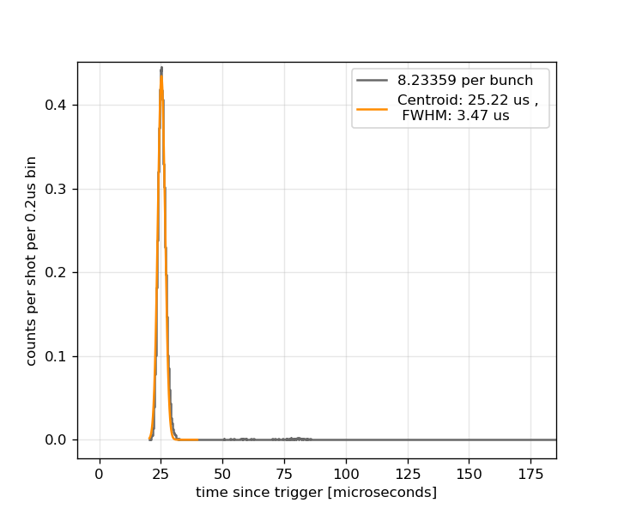
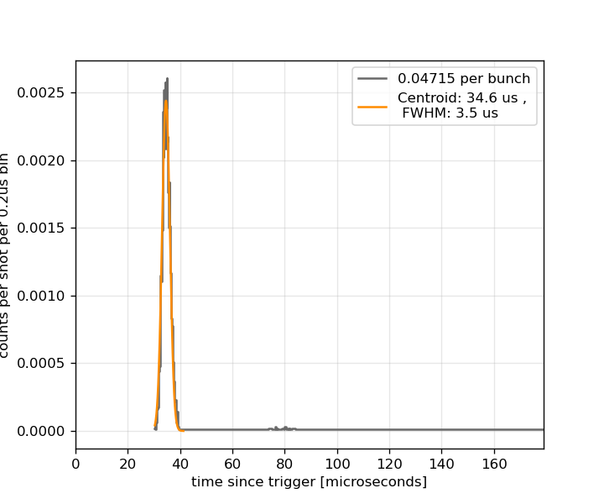
Different Time-of-Fight for different species
³⁹K
10 ms trapping time
⁸⁵Rb
10 ms trapping time

Slide 14
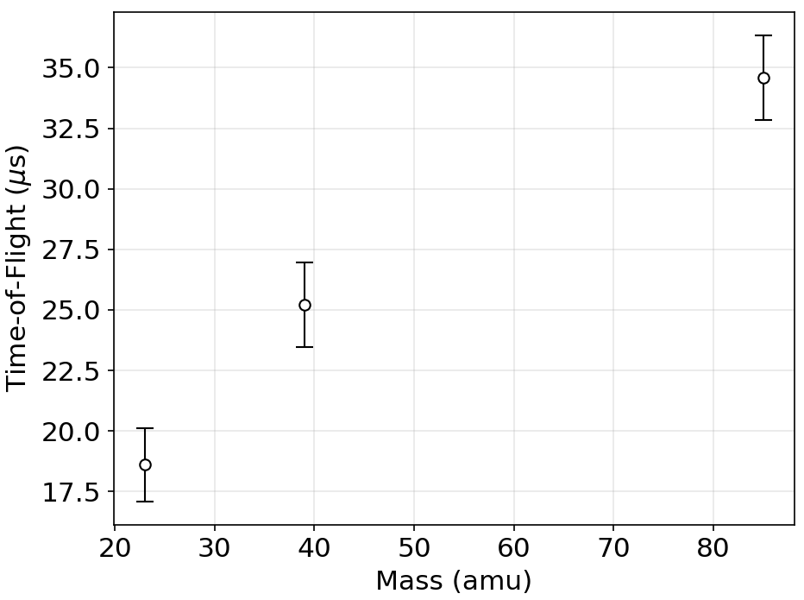
Time-of-Flight vs Mass
Time-of-flight calibration with hot plasma ion source ongoing at the moment
⁸⁵Rb
³⁹K
²³Na
10 ms trapping
Beam @ 30 keV

Slide 15
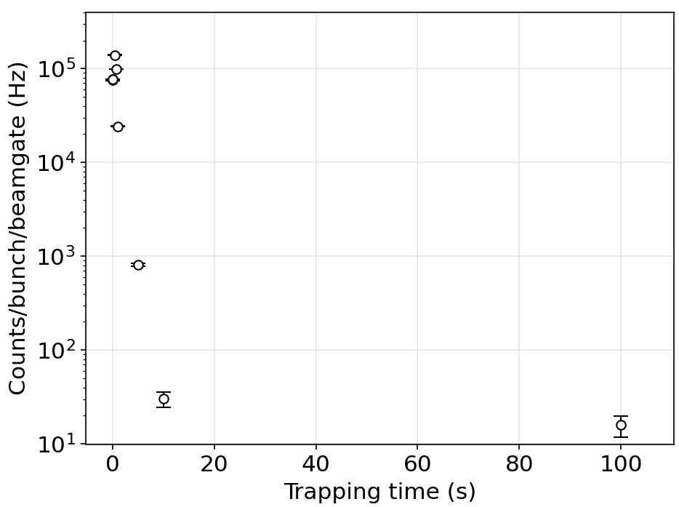
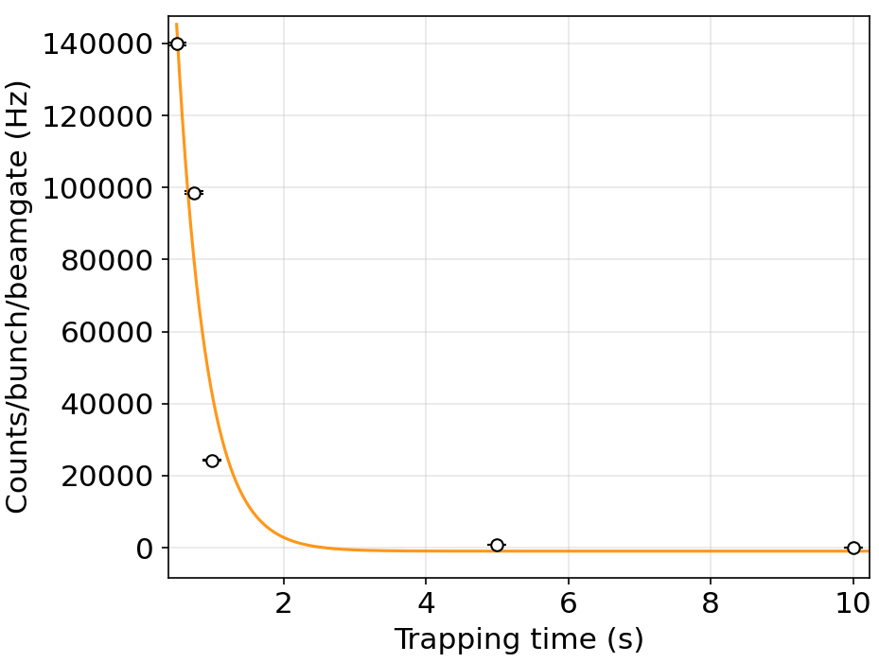
Trapping lifetime
Counts per bunch per beamgate vs trap time
²³Na
PRELIMINARY
After optimising for ~2h

Slide 16
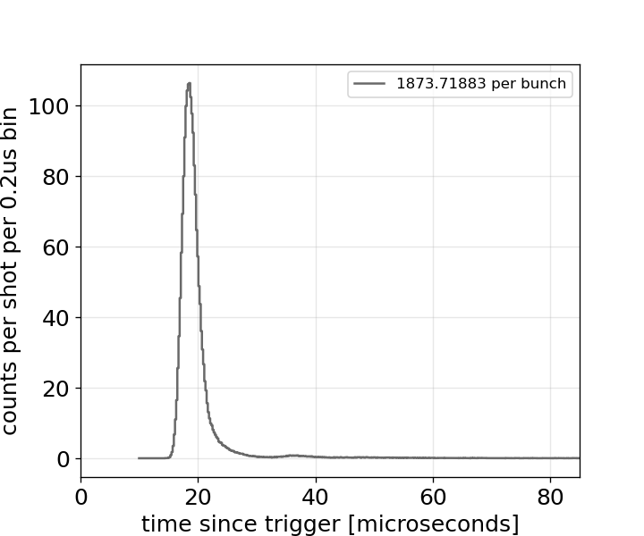
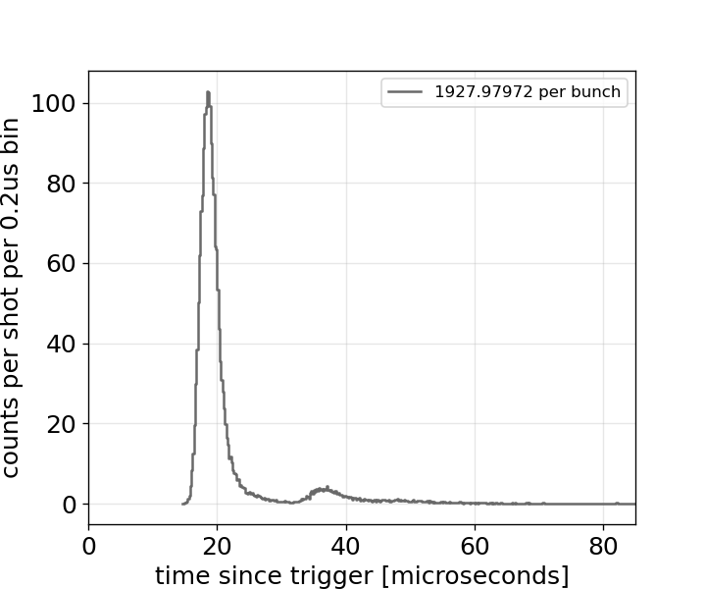
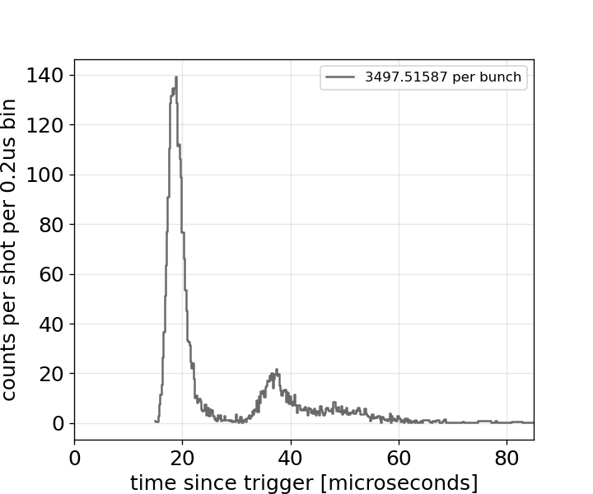
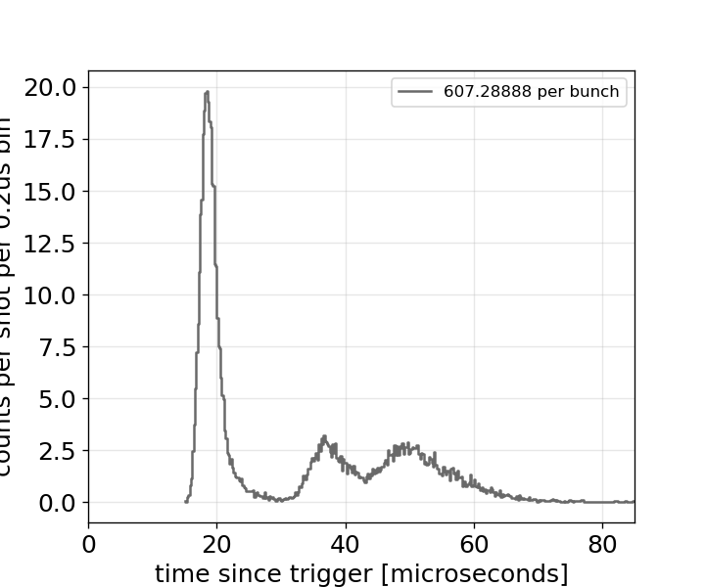
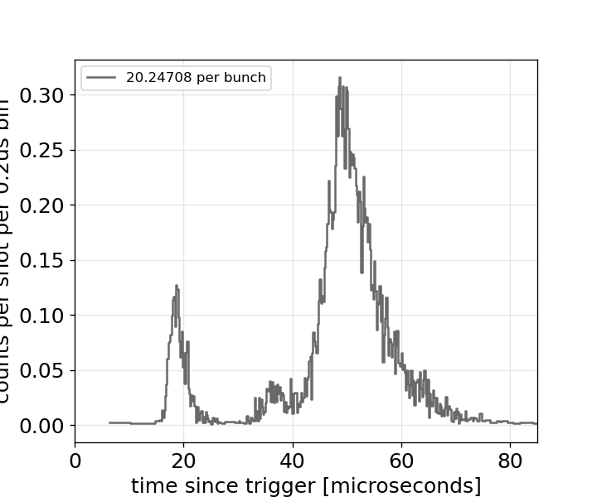
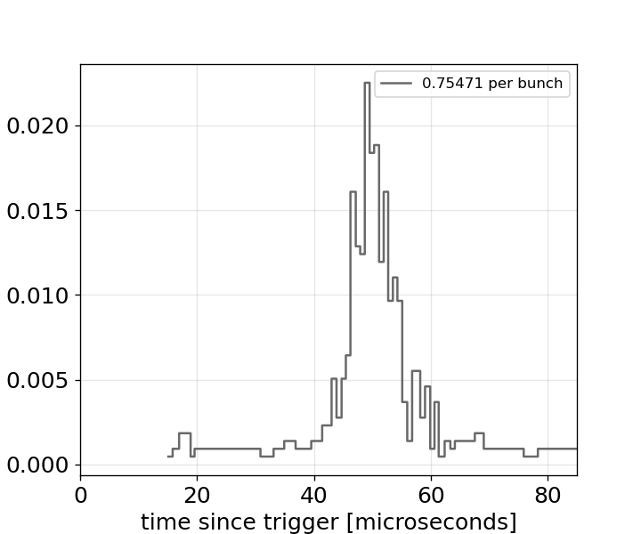
Long trapping times: molecule formation ?
1 ms trap
100 ms trap
500 ms trap
²³Na
1000 ms trap
5000 ms trap
10 000 ms trap
0.8

Slide 17
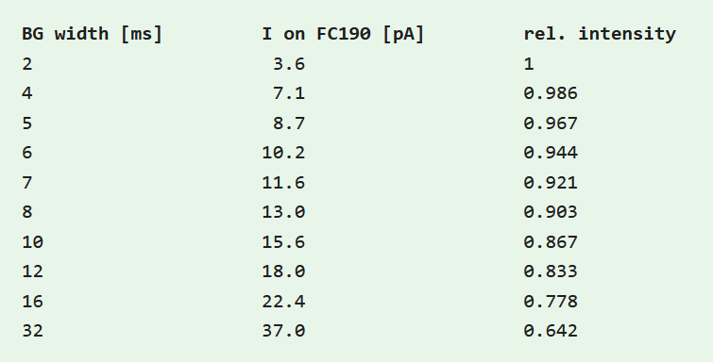
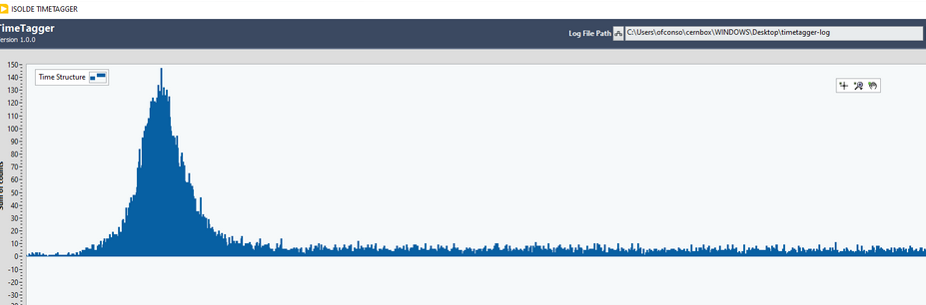
Under investigation
Influence of the potential well shape on cooling-bunching
Helium pressure
Incoming beam and beam gate duty cycle: linearity tests for overflowing the trap
BG: 2us, trap: 20us

Slide 18
Towards high-precision molecular experiment at RIB facilities
Fundamental symmetries, Physics beyond colliders framework

Slide 19
Fundamental
Symmetries
Collaboration
Roussy et al., Science 381, 46 (2023)
Udrescu et al.,(2024) Nat. Phys. 20, 202
Fitch et al., Q.Sci.T. 6, 014006 (2021)
Athanasakis-Kaklamanakis et al.,(2024) in preparation
Morris et al., Phil. Trans. R. Soc. A. 3822 (2023)
RIB
Precision measurement
Work in progress
  Fellow position closed
  collaboration
Making radioactive molecules
  Beams, traps, targets
Characterizing radioactive molecules
  Spectroscopy, chemistry
  Properties and states
Techniques for bulk systems
March 24-25
https://indico.cern.ch/e/FunSy
M. Au

Slide 20


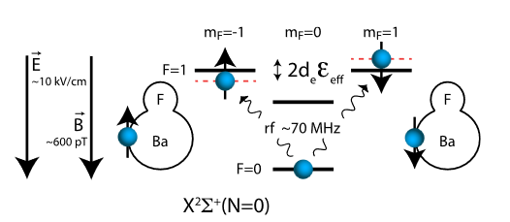






An idealised EDM experiment
Example: Implementation with BaF (NL-eEDM collaboration)
Taken from Nick Hutzler’s talk at TRISEP (2022)
https://www.hutzlerlab.com/teaching/trisep-2022
Taken from: Aggarwal, P., Bethlem, H. L., Borschevsky, A., Denis, M., Esajas, K., Haase, P. A. B., Hao, Y., Hoekstra, S., Jungmann, K., Meijknecht, T. B., Mooij, M. C., Timmermans, R. G. E., Ubachs, W., Willmann, L., Zapara, A., & The NL-eEDM collaboration. (2018). Measuring the electric dipole moment of the electron in BaF. The European Physical Journal D, 72(11), 197. https://doi.org/10.1140/epjd/e2018-90192-9

Slide 21
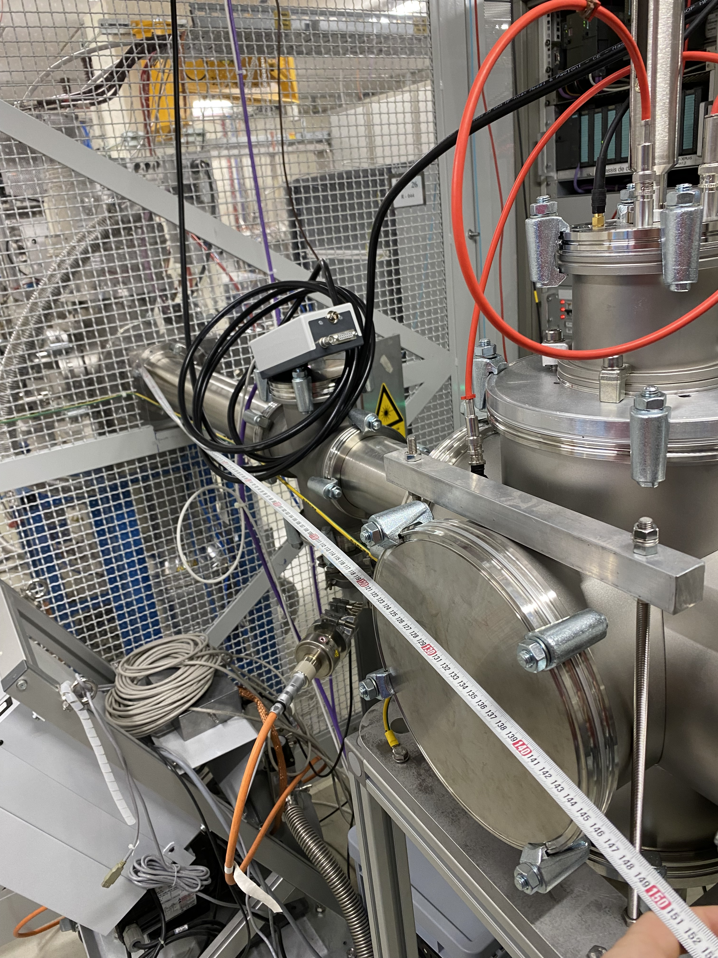
Current layout
Ion source
High Voltage racks
Beamgate
High Voltage racks
Gas injection system
90° Magnet
~ 2 m
RFQcb
Magnetof
RILIS Lab

Slide 22
In trap formation of molecules via atomic RIB
Bridging the gap between high precision and RIB facilities
Reactive gases: CH₃OH, H₂O₂,H₂O,NH₃
Ion source
extr. plate
Beamgate
23
24
25
~ 2 m
Gas injection system
2
4
1
3
5
6
Magnetof
7
8
9
10
11
14
15
16
17
13
18
19
12
Inj. plate
20
22
90° Magnet
21
RFQcb
V
RILIS Lab
He
He
He
He

Slide 23
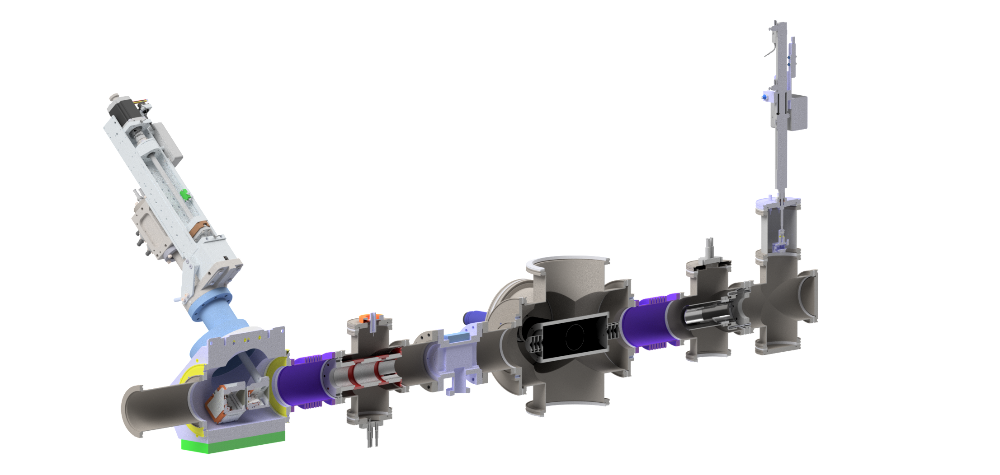
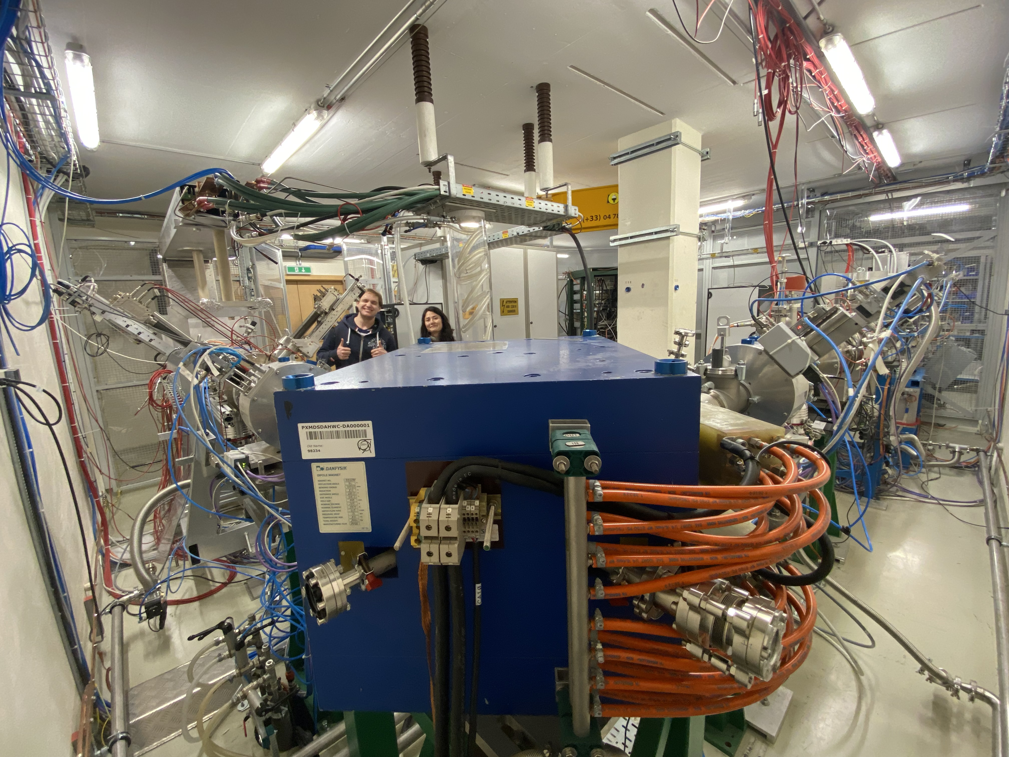
Projected new end of beamline
Model by A.Schmidt
Hole in wall and second window through the magnet already exists !
RILIS Lab

Slide 24
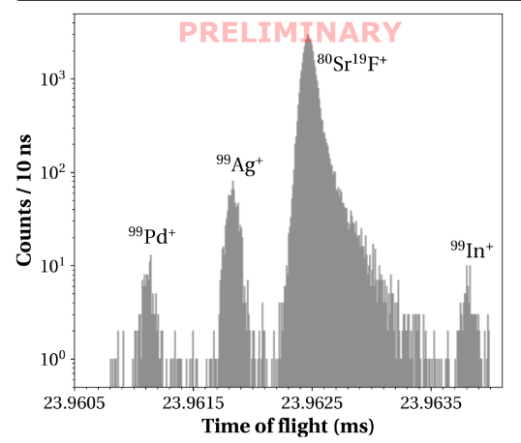
New end of beamline: Phase one
Possible experiments:
Photodissociation of small molecules
Molecular breakup of SrF+ for n-deficient Sn and In
Dissociation thresholds
Ionisation of neutrals ?
Limited by ToF resolution (mass resolving power)
Image: Lukas Nies
Magnetof
installed ✅
ToF region ✅
Deflector to be designed 🛠️
RILIS Lab

Slide 25
New end of beamline: Phase two
Magnetof
installed ✅
Emittance meter
available ✅
Deflectors
Available/to buy ✅
Probing thermodynamics ensemble towards coherent state population for fundamental symmetry project
Wien filter
available ✅
Einzel lens
to buy
Funding refused by SY department
Laser interaction region
Design phase🛠️
PMT + collection optics
Design phase 🛠️
Discussions with REBEL Lab
PI: Agi Koszorus
RILIS Lab
Model by A.Schmidt

Slide 26
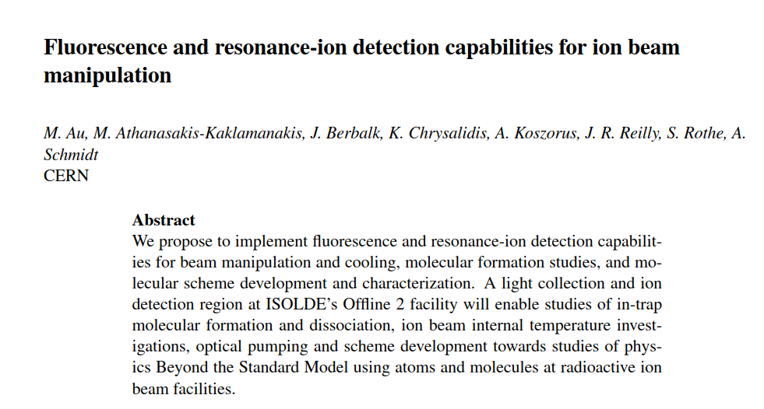
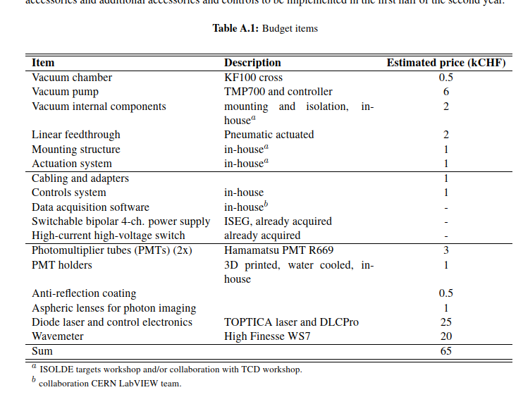
Funding refused by SY department (65k CHF)

Slide 27
New end of beamline: Phase three
Long term :
Pulsing/ramping RFQ to ground
Pulsed drift tube
MR-ToF
Cryogenic trap, MOT
Your ideas
?
RILIS Lab
Model by A.Schmidt

Slide 28
Acknowledgments
CERN:
Sebastian Rothe
Mia Au
Alex Schmidt
Line Le
Jordan Reilly
Reinhard Heinke
Katherina Chrysalidis
Sebastian Rothe
Simon Stegeman
Edgar Reis
Matthias Grasser
Valentina Berlin
Serdar Usta
Patricija Kalnina
Isabel Frank
SY-STI-LP
SY-STI-RBS groups
KU Leuven:
Gerda Neyens
Agi Koszorus
Ruben De Groote
& the entire
IKS Nuclear Moments group

Slide 30
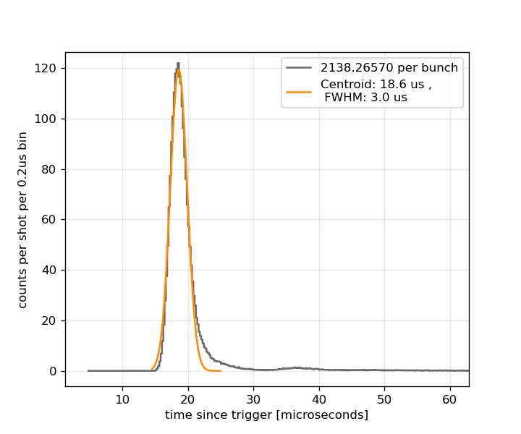
Supplemental
²³Na
10ms trapping time

Slide 31
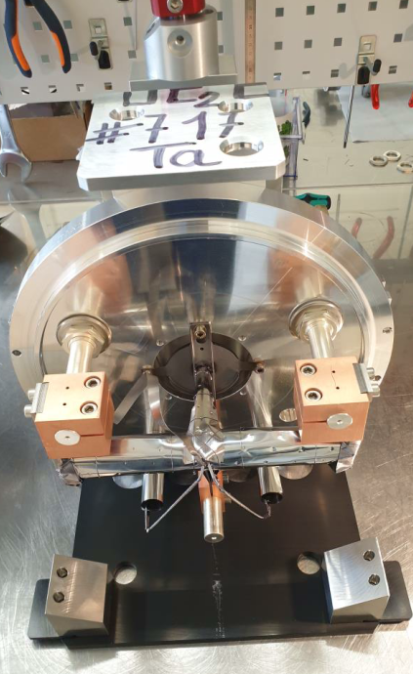
Target unit
Ion source: surface, laser, plasma, …
Each target is custom-tailored to the physics experiment
Transfer line controls transport to ion source, Ta, Cu or quartz
30+ targets per year!
Target container
typically heated to ~2000º C
Slides and pictures from V. Berlin
[ER24]-mod

Slide 32
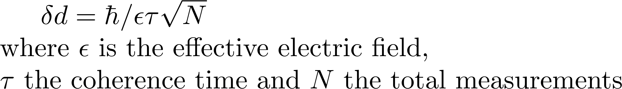
eEDM is symmetry violating
Spatial coordinates mirror
Time reversal
s
s
s
d
d
d
Inspired from Nick Hutzler’s talk at TRISEP (2022)
https://www.hutzlerlab.com/teaching/trisep-2022

