Slide 1

Muon Cooling and Demonstrator
Workshop on FCC-ee and Lepton Collider
INFN-LNF, Frascati, 22 January 2025
https://agenda.infn.it/event
R. Losito, CERN

Slide 2
Summary
Muon Cooling and its challenges
R&D program phases
The demonstrator concept
Implementation at CERN

Slide 3
Muon Cooling and its challenges
Cooling is necessary after production to reduce the 6D emittance of the captured beam

Slide 4
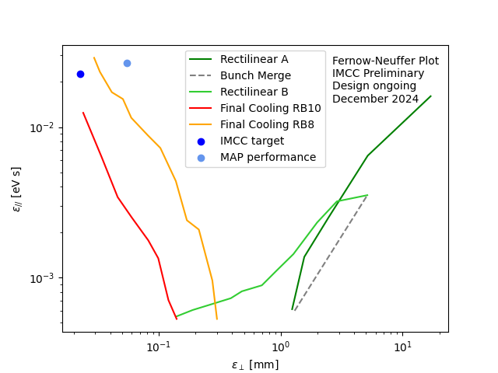
Muon Cooling and its challenges
A reduction of several orders of magnitude is necessary to achieve, in the collider, the required luminosity
The target performance has been achieved (in simulations) by the IMCC starting from the previous work from the Muon Accelerator Program in the US

Slide 5
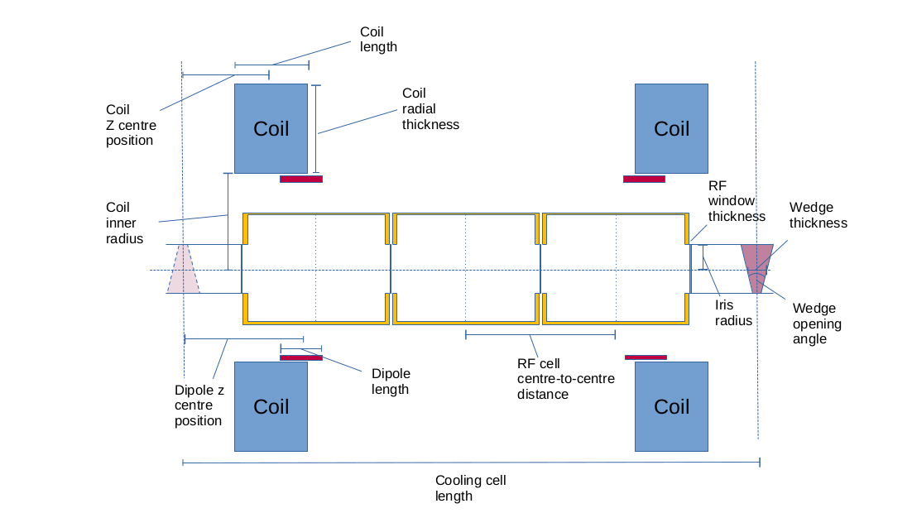
Why a demonstrator
Cooling is achieved through a complex integration of components providing different effects:
  Absorbers: reduction of transverse emittance, increase of longitudinal
  RF Cavities: restoring only longitudinal emittance
  Solenoids: providing focusing
  Dipoles: providing the proper profile of the Dispersion function.

Slide 6
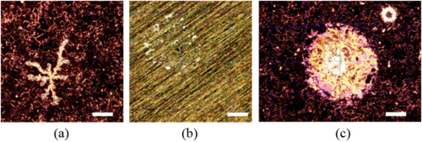
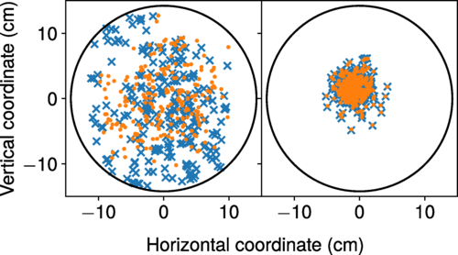
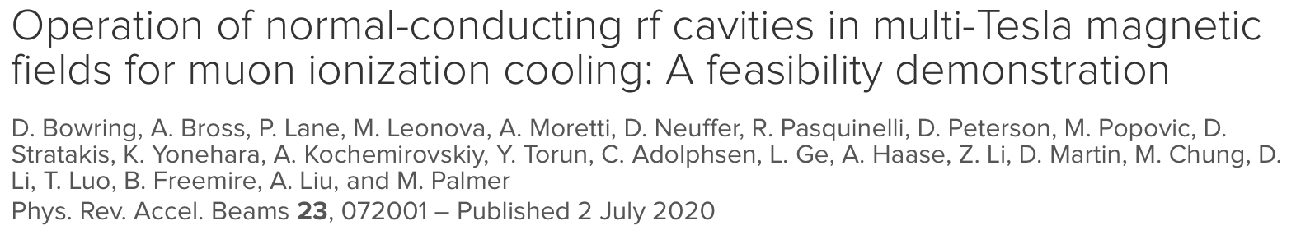
Why a demonstrator
The main issues lie with:
  Keeping the length of the drift spaces as small as possible, to reduce the risk of decay of muons. The limited space available in the system assembly can be a source of errors in the desired field distribution
  RF cavities operating in magnetic fields, that is known to increase the breakdown rate
  Achieving challenging (in operation) values for RF and magnetic fields
https://doi.org/10.1103/PhysRevAccelBeams.23.072001

Slide 7
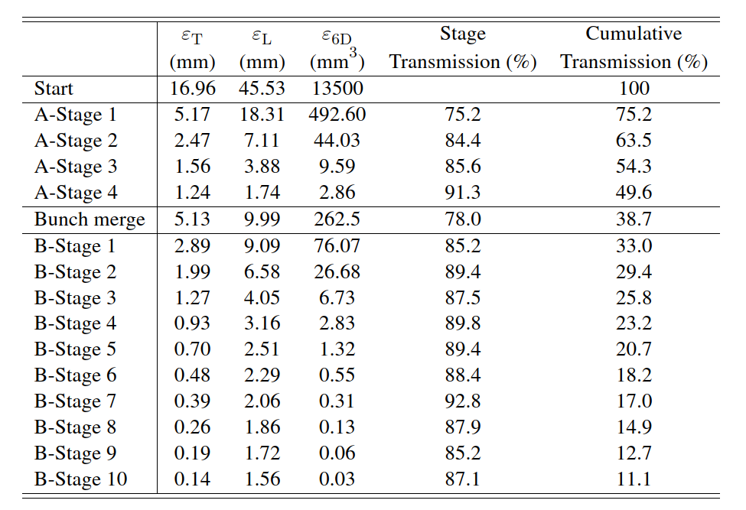
Why a demonstrator
The motivation for a Cooling demonstrator is therefore twofold:
  Benchmarking the beam simulations in presence of a real world field distribution (E and B)
  Testing the assembly of components in an operational scenario, in particular related to the breakdown rate of the RF cavities in presence of a beam.

Slide 8
A Cooling Demonstrator programme
The Demonstrator facility is only the last step of a R&D programme, that involves
  Single cooling cell: Design (being done through the EU project MuCol), construction and test
  5-cooling cell assembly: Design, construction and test
  RF in Magnetic field test stand: to study in detail breakdown phenomena
  Demonstrator Facility: to prove that cooling cells work in an operational scenario
In parallel, R&D on magnet technology, absorber technology etc.. Are also needed.
Budget for R&D (including the demonstrator programme) in the order of ~50 MCHF in the next 5 years will be requested.
Level of contribution of collaborating institutes expected to be significant, and matching some of the investment from CERN, especially in providing experts in RF, Magnet , accelerator physicists etc….
About half of this budget is for the demonstrator programme, the rest for students, magnet, target and absorbers R&D, etc…

Slide 9
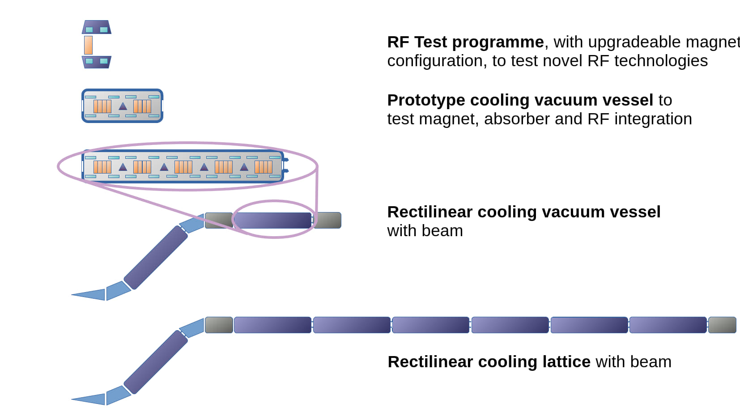
A Cooling Demonstrator programme

Slide 10
Facilities
The first two phases can be hosted in the CTF3 building:
  Most of the technical infrastructure is available,
  Negligible modifications are needed in the civil engineering structure.
  Cryogenics can initially be provided at reduced cost with cryocoolers (at least for the single cell).
For the demonstrator with beam we are studying two possibilities
  TT7 (old PS neutrino beam tunnel)
  CTF3

Slide 11
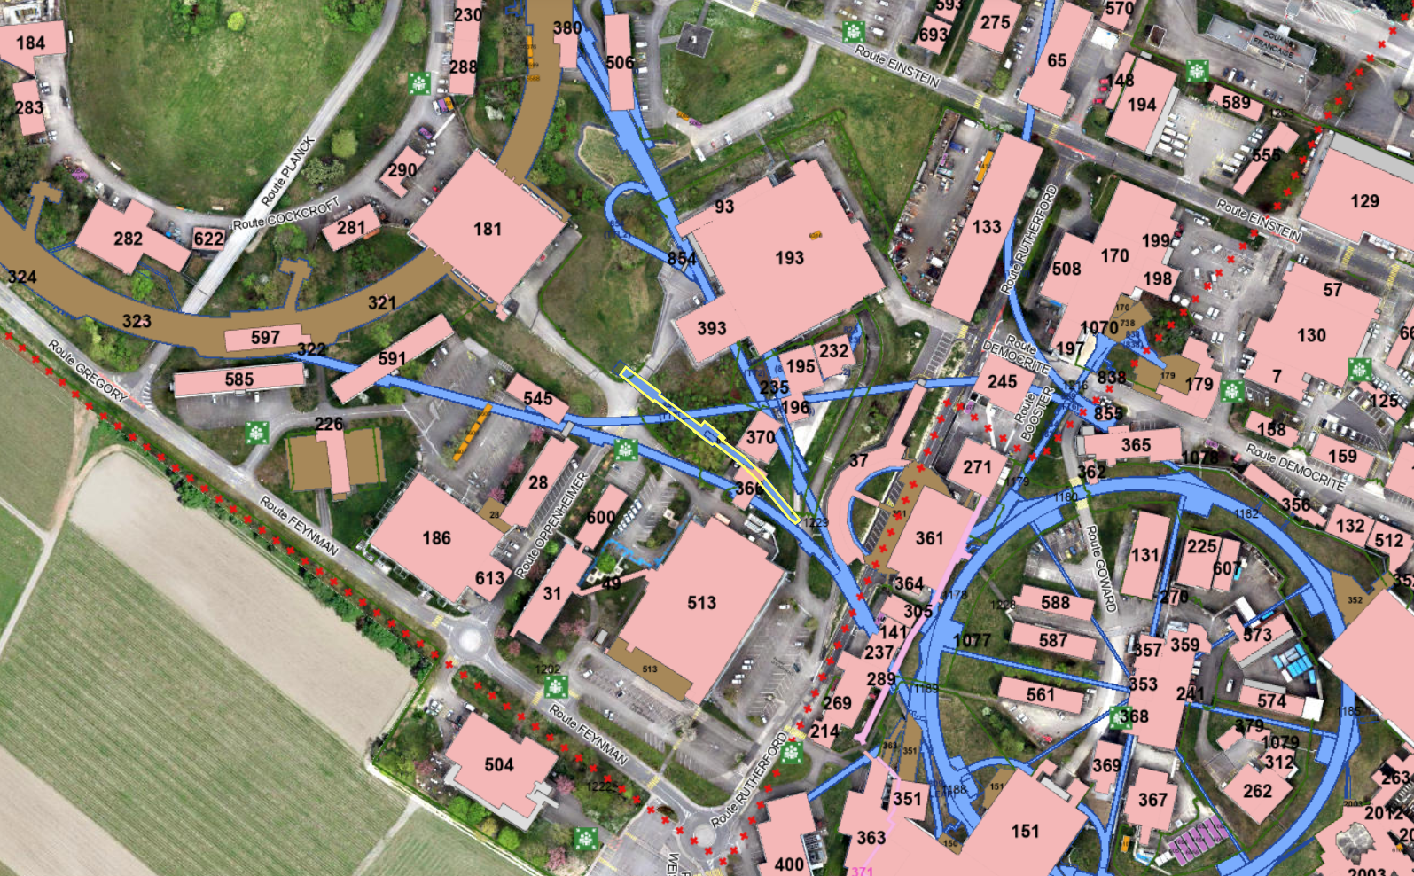
TT7 Facility
The main advantage of installing a muon beam in TT7 lies with the fact that it does not require a new beam extraction in the PS
A pre-study has found no showstoppers, although a few critical points need to be addressed by a proper CDR work.

Slide 12
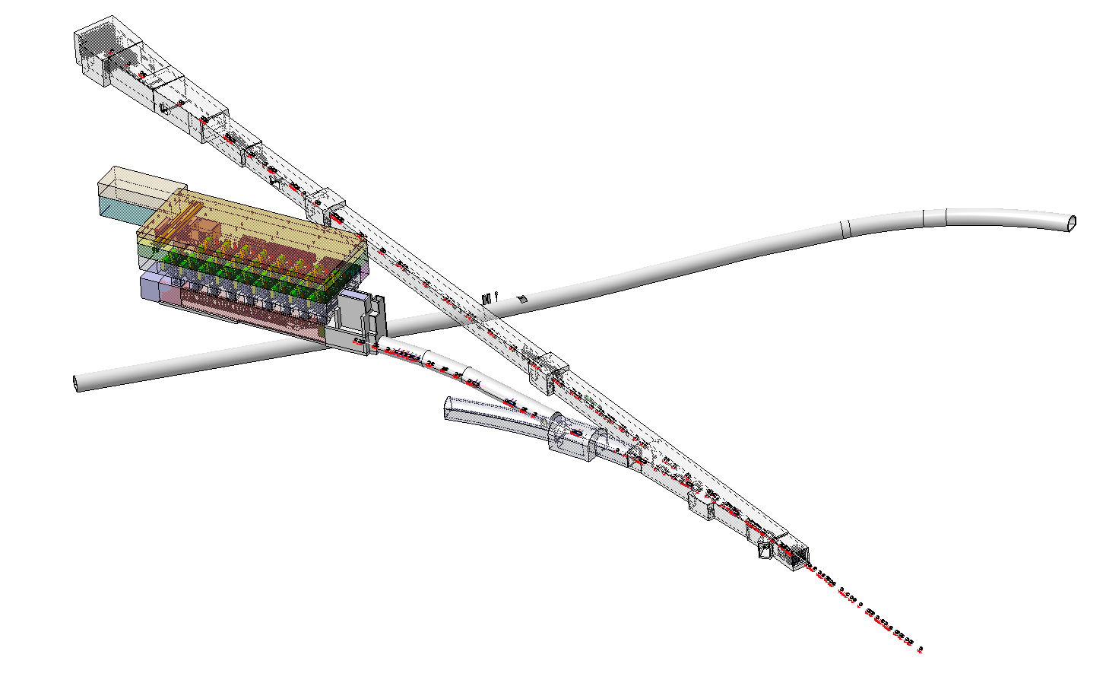
TT7 Facility
SPS
(downstream TT2)
Transfer line in TT7
Demonstrator in TT7
Service building
TT7
TT6
(for information)
Junction TT1/TT7
Transfer line in TT2
TT1
TT2
(upstream TT2)
PS

Slide 13
TT7 Facility
There are a few issues to solve with the passage of personnel and materials, but no major issue.

Slide 14
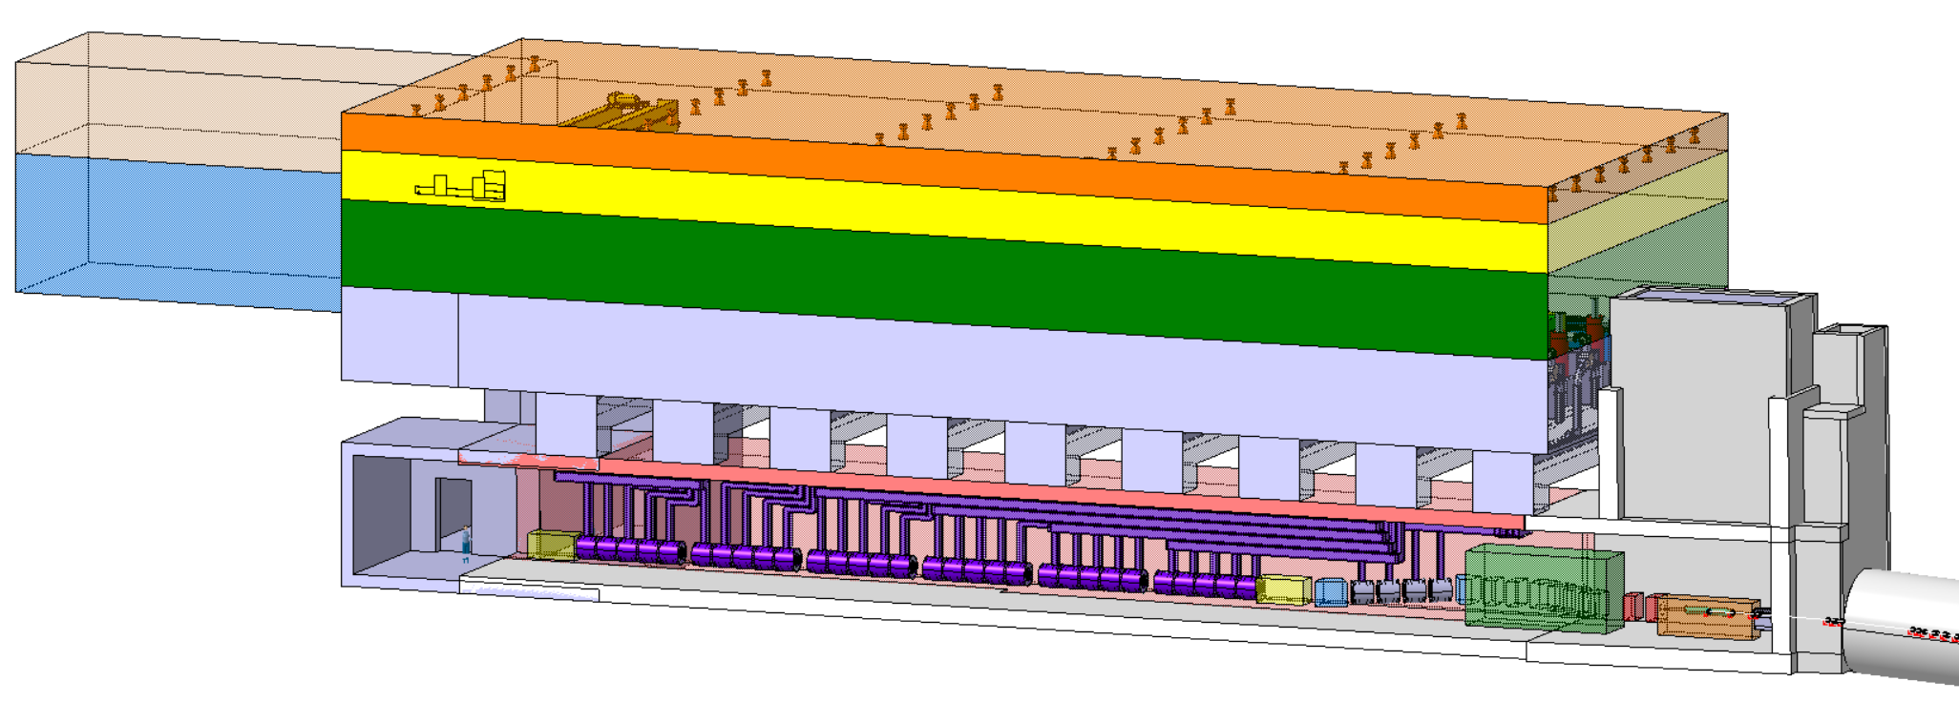
TT7 Facility
Space envelope for cooling and ventilation
Space envelope for lightening
Space envelope for crane
Space envelope for transport
Ground level
Space envelope for klystrons
2m
29m
6x 5x cooling cells
2m
Beam dump
Downstream beam instrumentation
Upstream beam instrumentation
51.8m

Slide 15
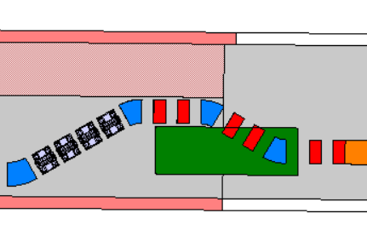
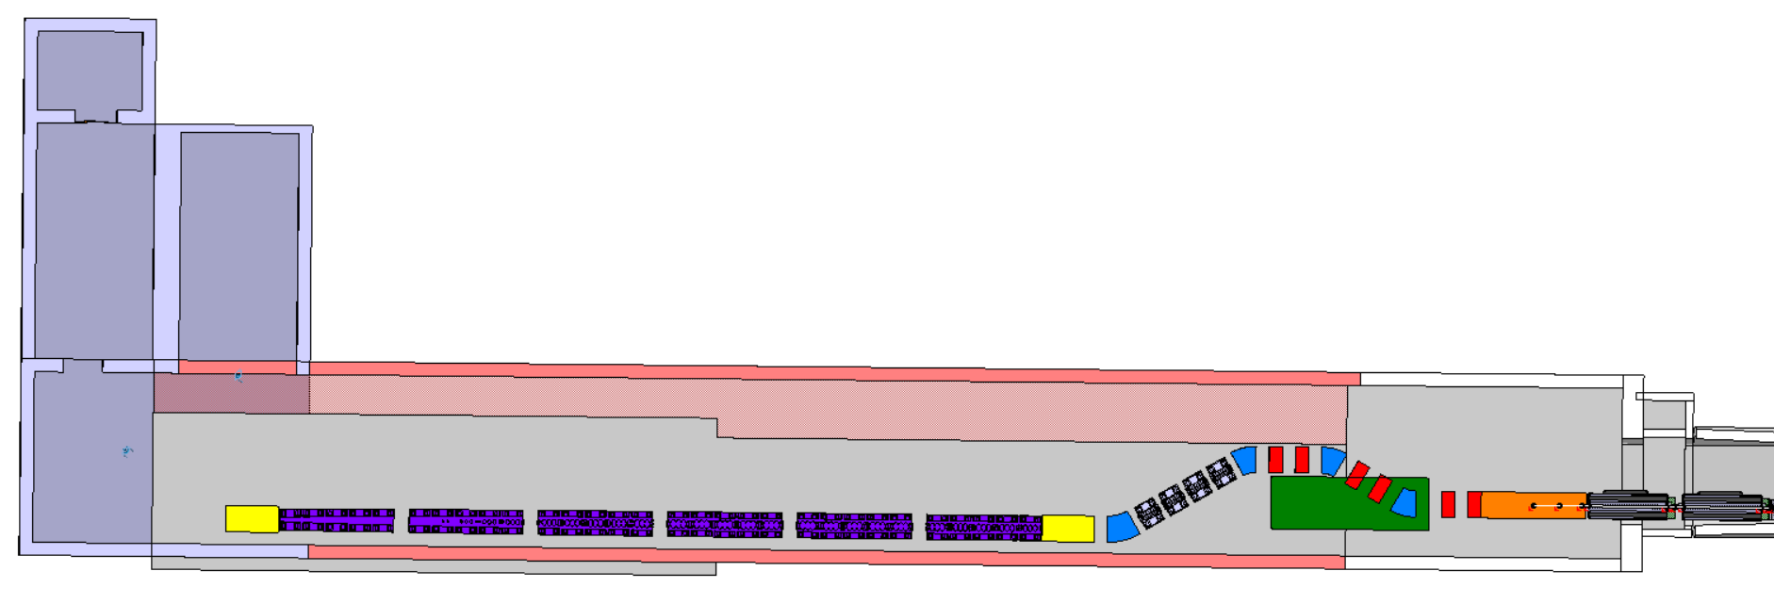
Optimization of transfer line components’ position is required or beam dump’s volume to solve interference
14.3m
Beam dump
Part of new service building
(in grey)
Enlargement of TT7 (in red)
Imprint of current TT7 (in white)

Slide 16
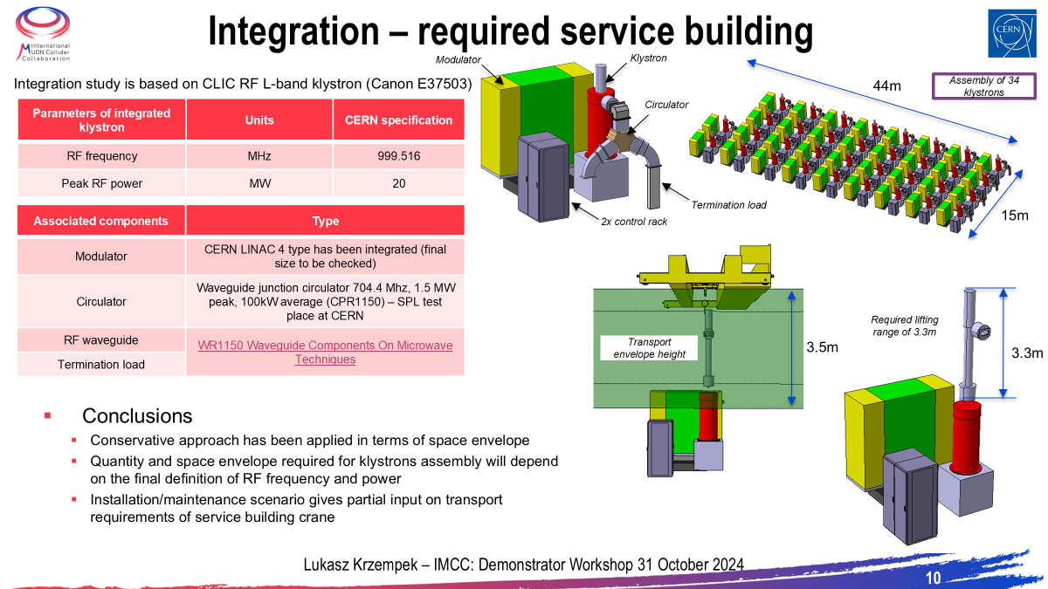

Slide 17
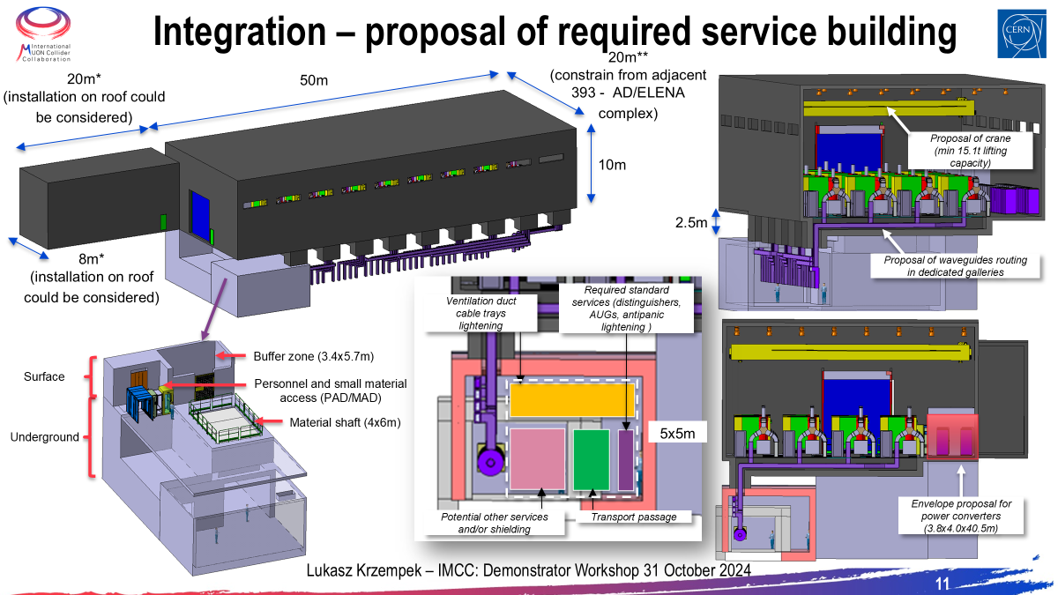

Slide 18
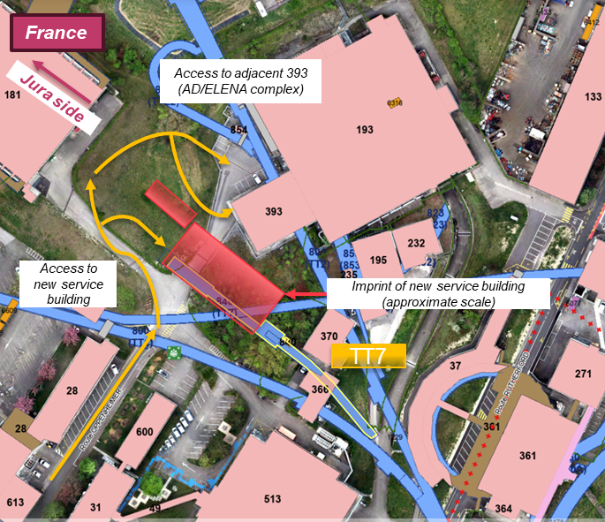
TT7 Facility

Slide 19
Sinergies
TT7 is too short to host a physics facility downstream.
However if necessary (and useful) there is space to add 50m of additional tunnel (to be excavated).
Max Intensity 10⁶ muons at around 200 MeV per pulse can be provided

Slide 20
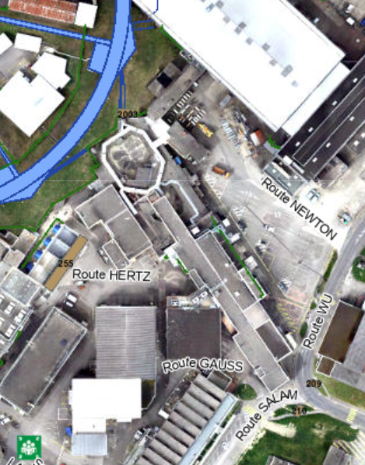
CTF3 Facility
Advantages
  ~100 m of tunnel
  Klystron gallery already available
  All technical infrastructure already available
  Space available to build a proper target area and decay tube
Disadvantages
  No extraction in the PS, will need to rearrange the lattice to make room for an extraction. No beam before the end of LS4…

Slide 21
Tentative technically limited schedule

