Slide 1

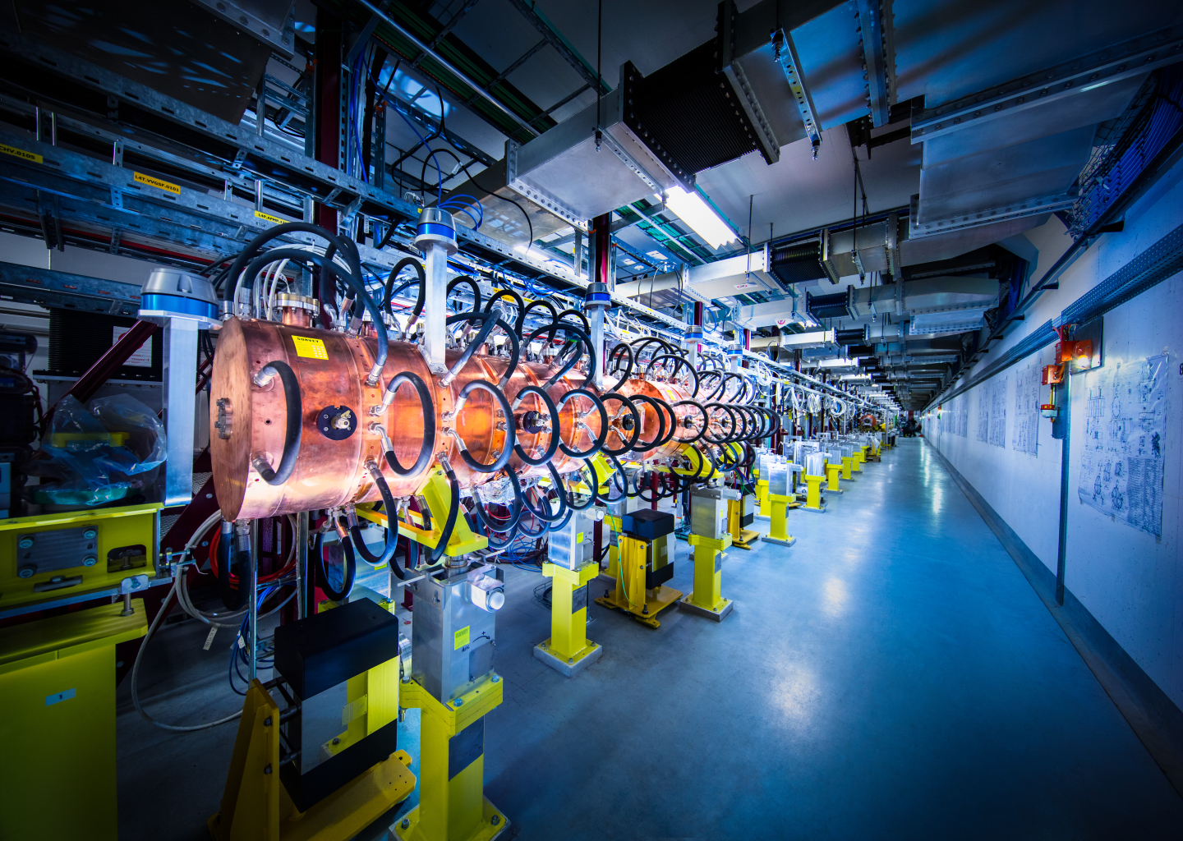
CERN stage presentation

Slide 2
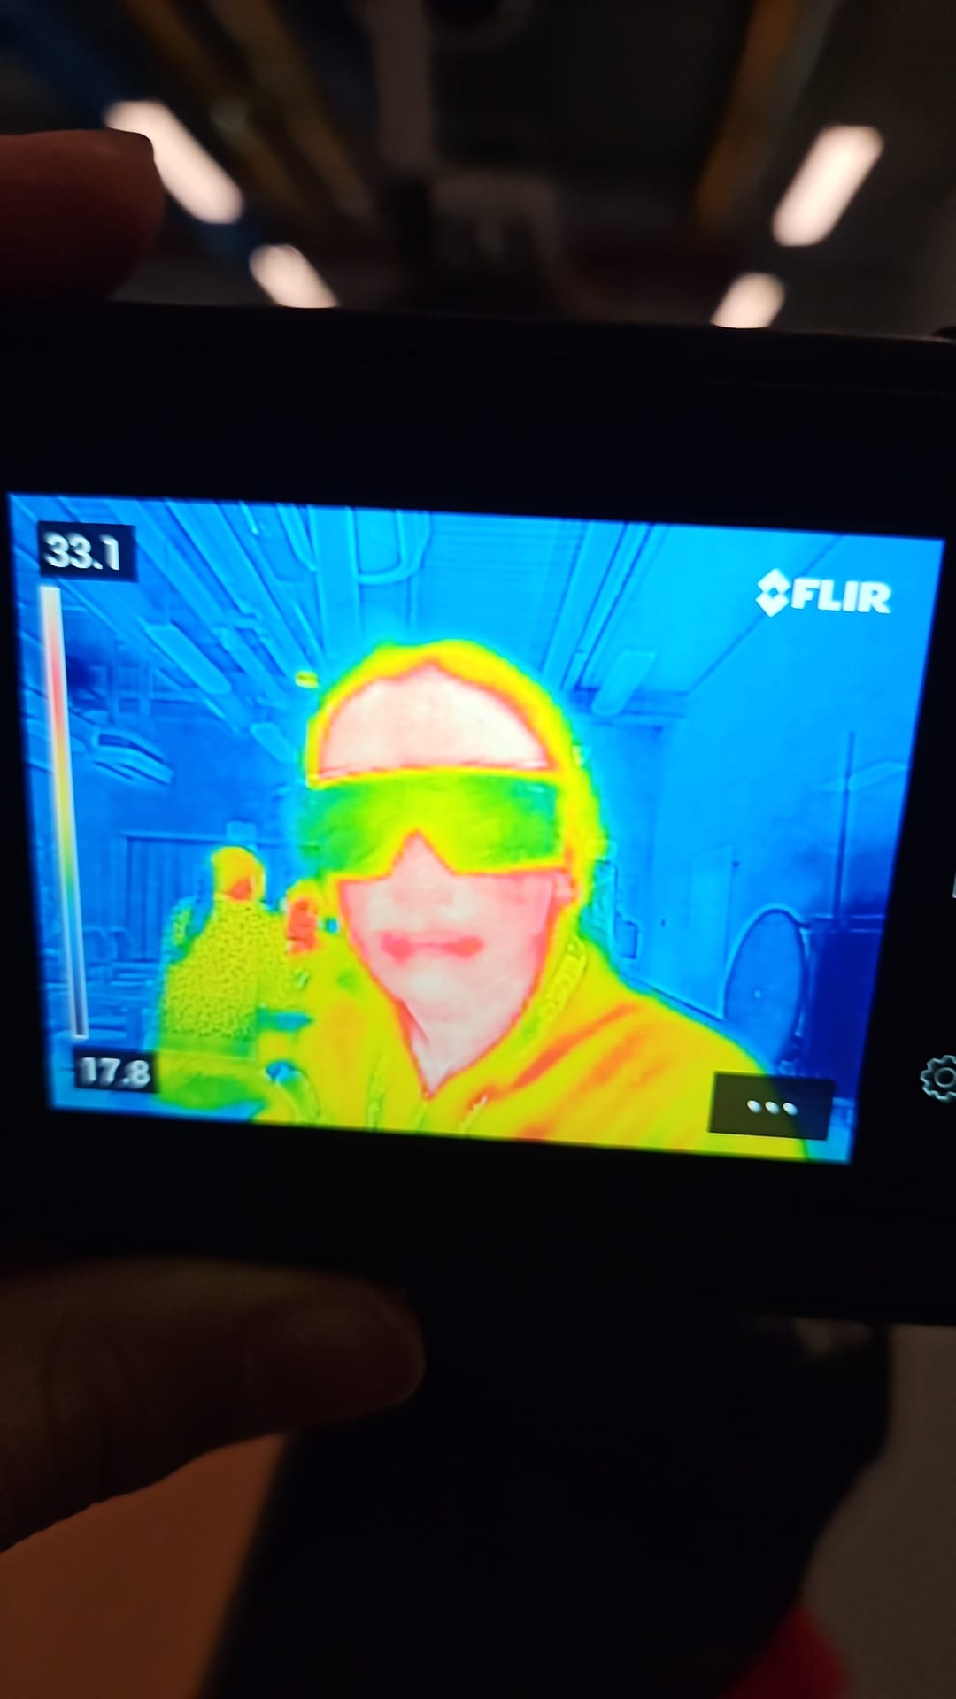
Who am I ?
Bruno DELUCA AGUILO
14 years old
Ferney Voltaire’s International school

Slide 3
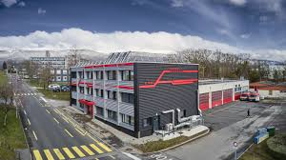
What did I like the most ?
Firestation
Lovely place
Funny activities
Very interesting

Slide 4

What didn’t I like ?
Loved all of it
Some details :
The escape game was a bit easy
The food is too expensive

Slide 5
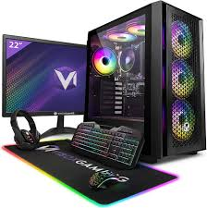
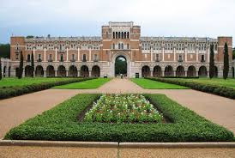
Where do I see myself in 5 years ?
University (probably science)

