Slide 1

My stage at CERN
Taïna Meier Piantanida

Slide 2


WHO AM I ?
Taïna Meier Piantanida
13 years old
I am Swiss and French
Currently in "classe de seconde" in a private school in Nyon
I like skiing, travelling and discovering new cultures
I love theater

Slide 3
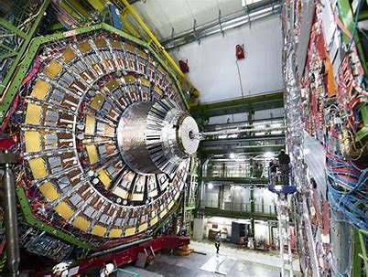
What did I like most during the stage ?
CMS experiment
IdeaSquare
Safety training center, and the fire extinguisher
The cloud chamber experience

Slide 4
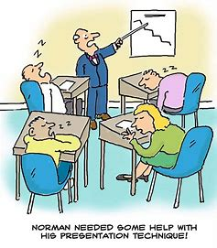
What i didn't like at all?
The stage is too short !!!
Very interesting presentations but sometimes a bit too long and repetitive
The crowded cafeteria

Slide 5


Myself in 5 years
My dream university is the EPFL (Swiss Federal Technology Institute) in Lausanne
To become an engineer at IdeaSquare

Slide 6

Thank you Francesca, Bart, Chiara and everyone for this incredible stage !!!

