Slide 1

Cern’s stage
Ada and federico

Slide 2
ada

Slide 3
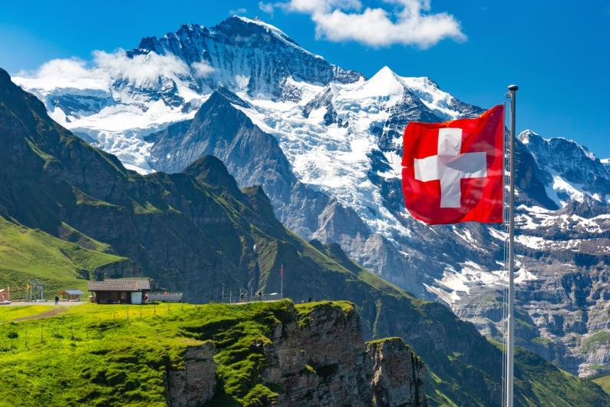

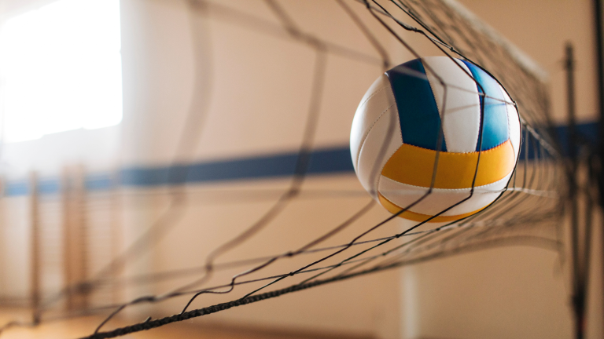
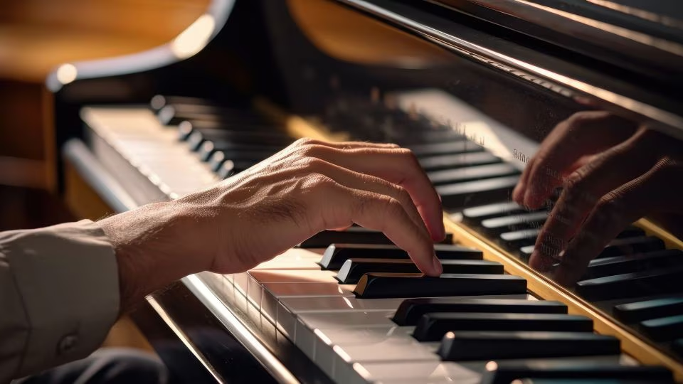
Who am I ?
13/14 years old
Italian but I live in Switzerland
I play volleyball
I play piano
Margot -> my friend
Fede -> my cousin

Slide 4
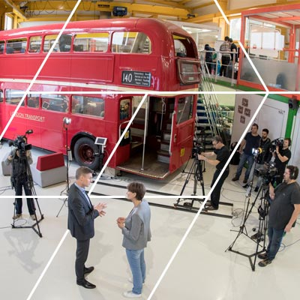
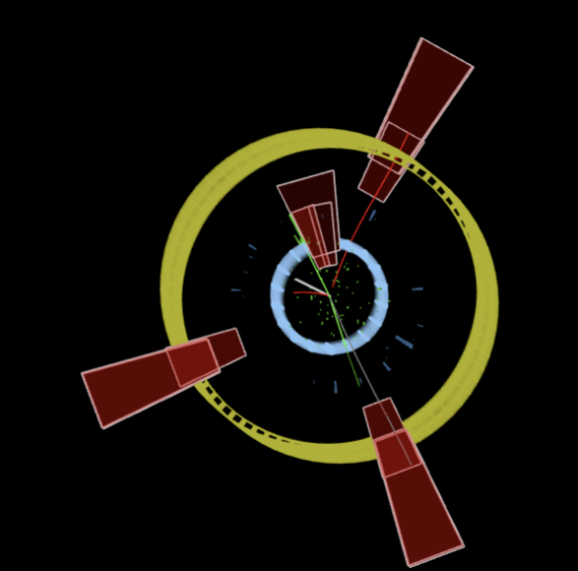
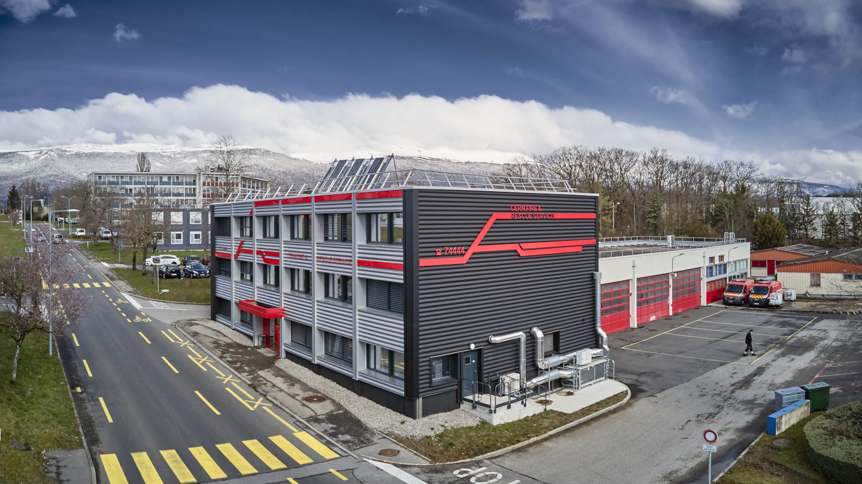
like
Look at the pictures
The visit of the fire station
Idea Square

Slide 5
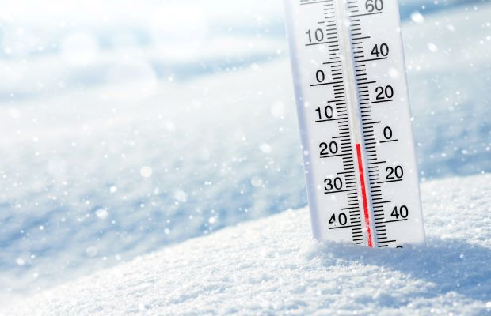

dislike
Cold
Presentations

Slide 6
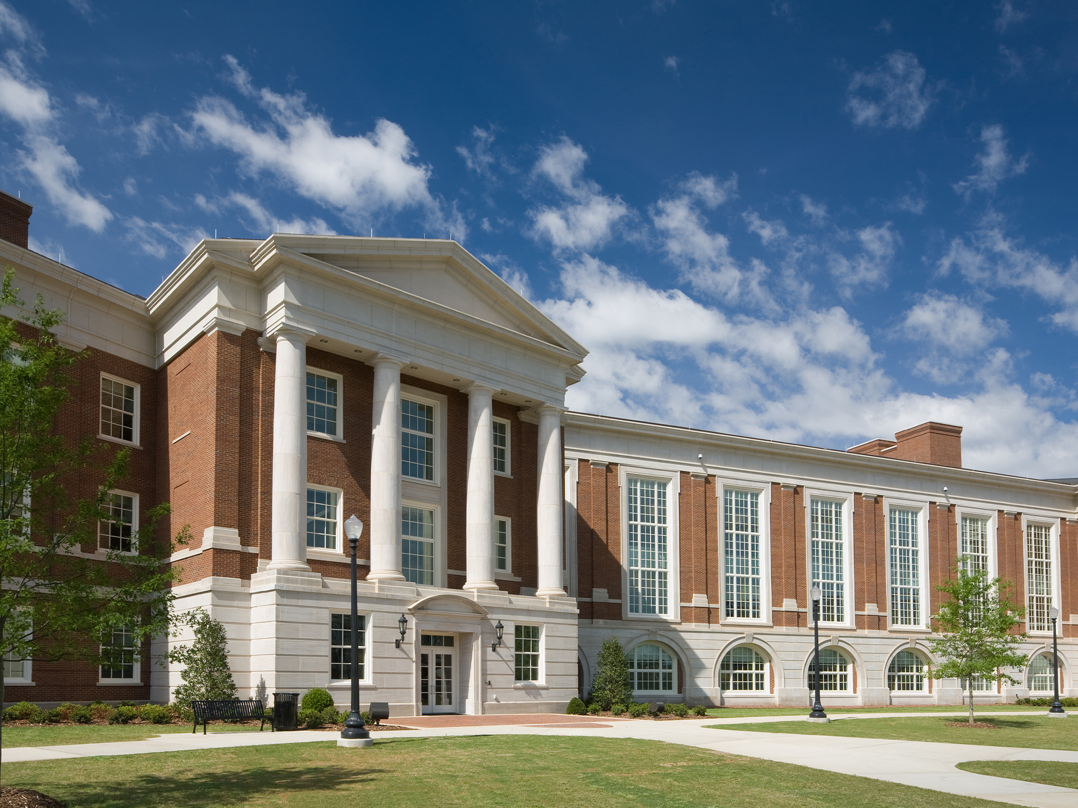
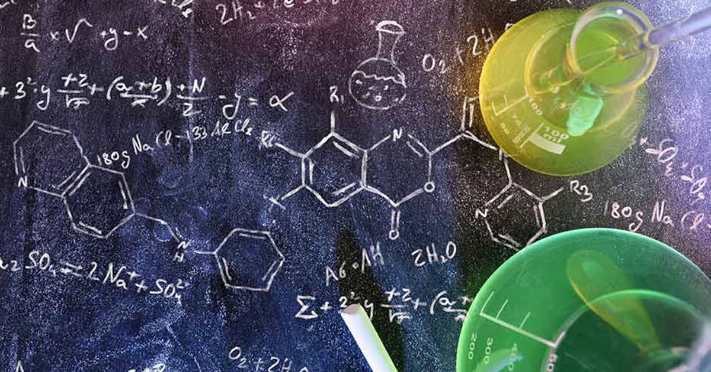
In 5 years
University
Subject: around science
Thanks to the stage I understood that I am sure that I want to study science

Slide 7
federico

Slide 8
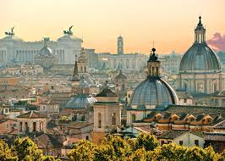
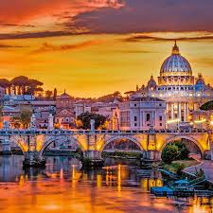
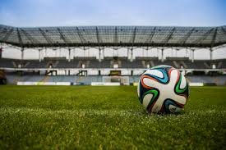
Who am I
I am 15 years old
I play football at a high leval
I like the world of business and finance
I lived 11 years in London and now in Rome

Slide 9

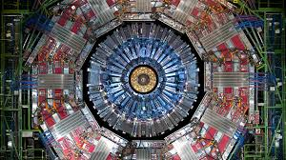
like
I liked the idea square because its a place where you can make and whatever your mind can creates. And I also really liked the cns because it was one of the main ressons why you come to CERN.

Slide 10
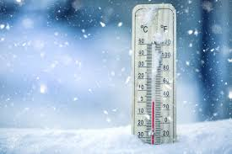
What i did not like
The only thing i did not like was the cold because im not used to it

Slide 11

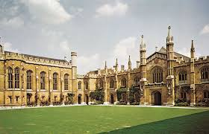
In 5 years
In 5 years I hopefully see my self doing a masters in finance and finished uni for business managment.

