Slide 1

Probing the flavour structure of SMEFT in multi-𝓁 final states [CMS-PAS-TOP-23-009]
R. Schöfbeck (HEPHY Wien) for the CMS Experiment

Slide 2
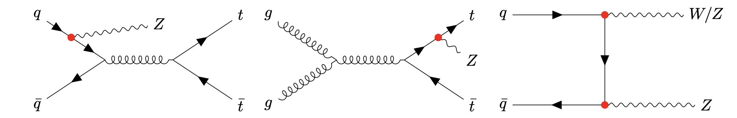
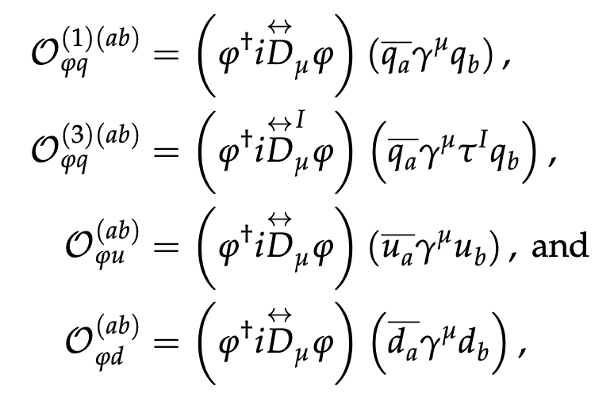

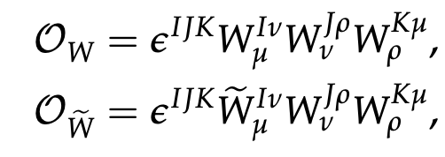
Disentangling flavor structure
“ISR”
“FSR”
Aim: Constrain flavor diagonal 1st + 2nd vs. 3rd gen. coupling @ mass-dimension 6
Select: 3𝓁 & 4𝓁 final states, various jet & b-tag mult.
Ops: Vector coupling operators (L/R) and C_{W}, C_{W~}
C_{𝝋q}⁽⁻⁾⁽¹¹⁺²²⁾, C_{𝝋q}⁽⁻⁾⁽³³⁾, C_{𝝋q}⁽³⁾⁽¹¹⁺²²⁾, C_{𝝋q}⁽³⁾⁽³³⁾,
C_{𝝋u}⁽¹¹⁺²²⁾ C_{𝝋u}⁽³³⁾, C_{𝝋d}⁽¹¹⁺²²⁾, C_{𝝋d}⁽³³⁾, C_{W}, C_{W~}
Not included: FCNC (flavor off-diagonal)

Slide 3
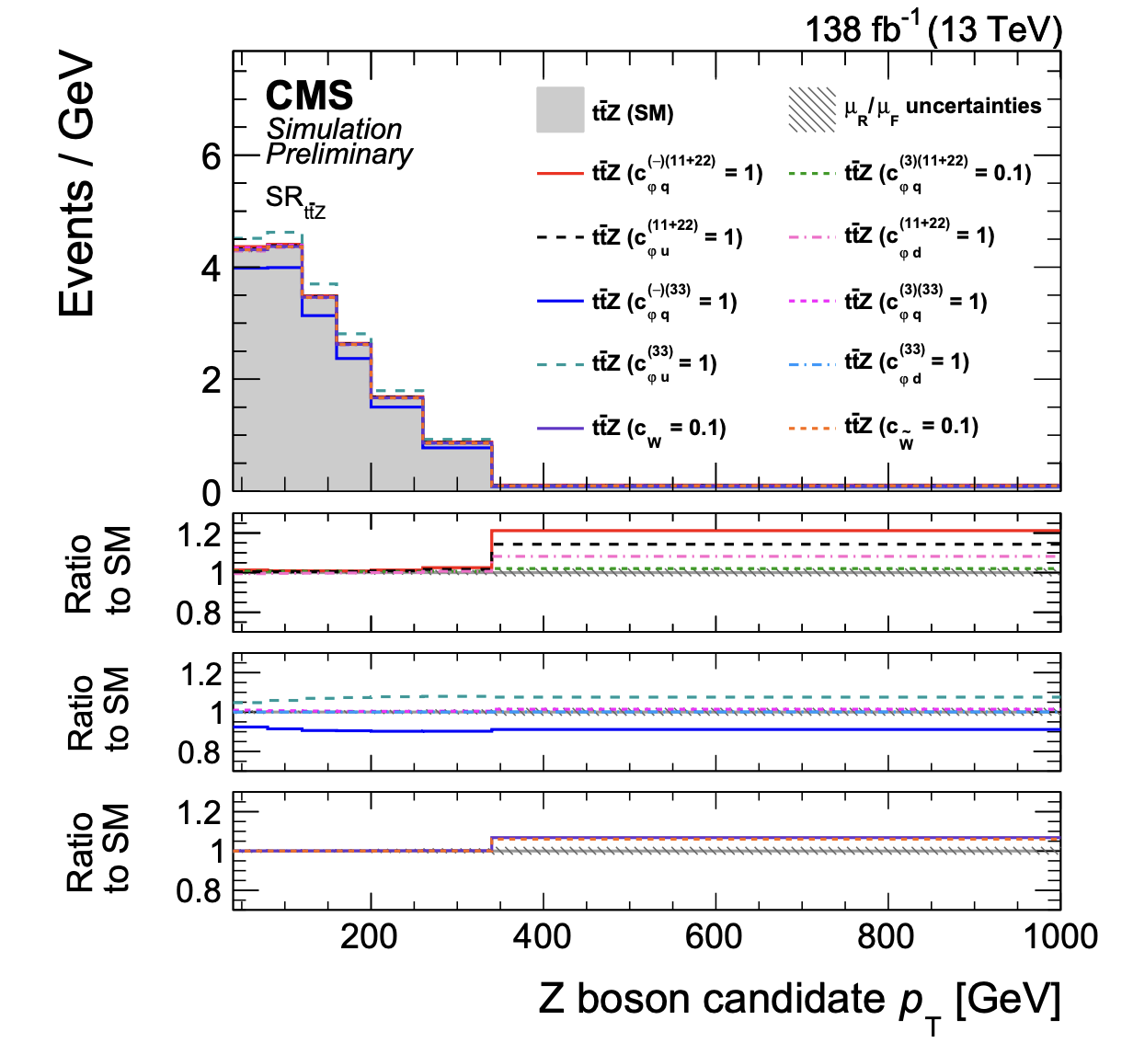
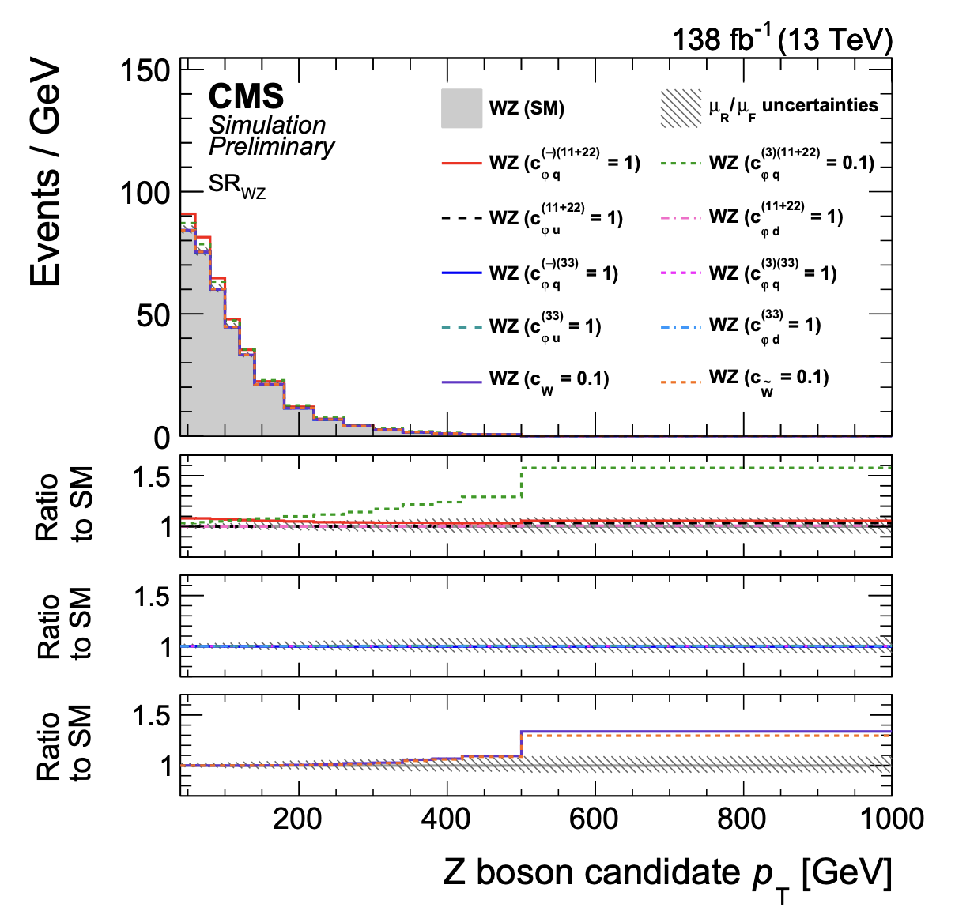
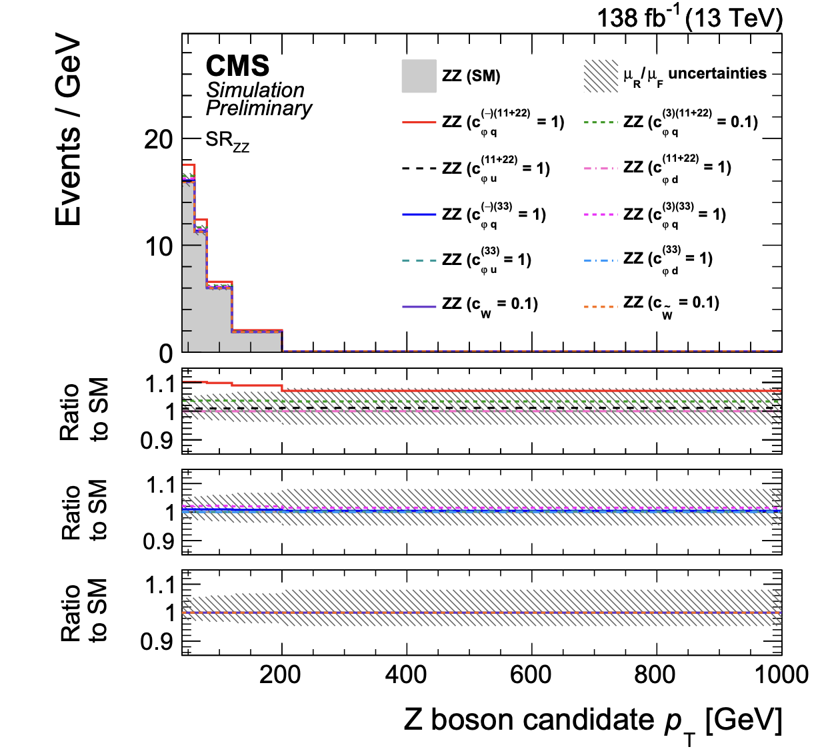
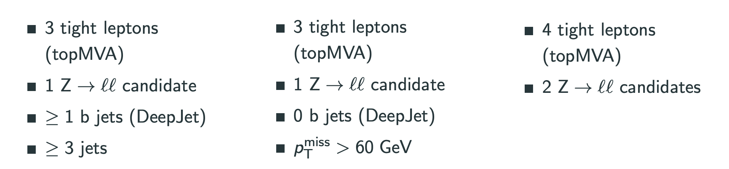

p_{T}(Z) in three signal regions
ttZ region
WZ region
ZZ region
targets ZZ

Slide 4
Signal predictions
sensitive
“ISR”~higher p_{T}
“FSR”~lower p_{T}
pure
Quadratic parametrization of signal yields with [SMEFTsim] (NLO k-factor & EWK corr. for VV)
Based on helicity-aware reweighting method [LHC EFT prediction note]
Various shape differences: ttZ: C_{𝝋q}⁽⁻⁾⁽¹¹⁺²²⁾, C_{𝝋q}⁽⁻⁾⁽³³⁾, WZ: C_{𝝋q}⁽³⁾⁽¹¹⁺²²⁾, C_{W}, C_{W~,} ZZ: C_{𝝋q}⁽⁻⁾⁽¹¹⁺²²⁾

Slide 5
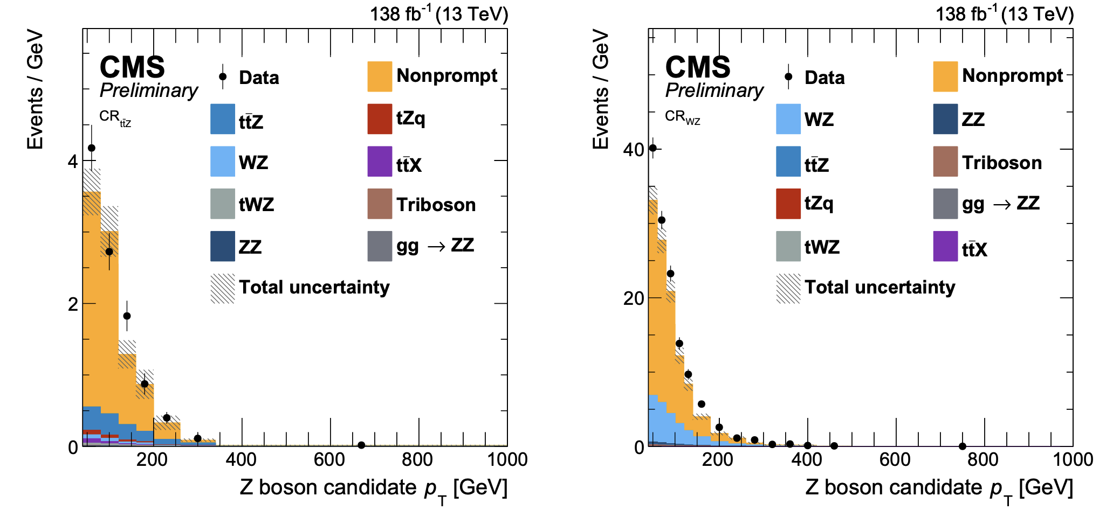
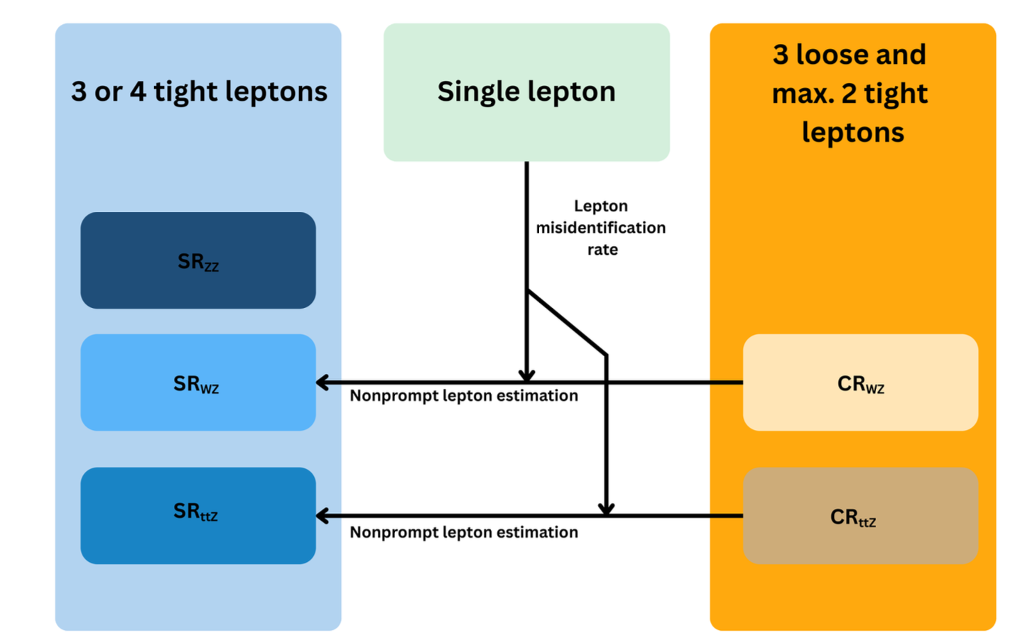
Background estimation
MVA lepton ID from 4t observation
[Phys. Lett. B 847 (2023) 138290]
Nonprompt & fakes well simulated,
but with substantial uncertainties
  From DY or ttbar with extra 𝓁
Tight-to-loose method with detailed
15-param uncertainty model
  CRs with one loose 𝓁 failing tight ID
  constrained SF; applied in SRs
Notes:
What happens with the data error bar in the right plot?

Slide 6
Uncertainties
For most operators, limits are dominantly affected by rate effects
  Normalization uncertainties: ttZ 11%, WZ 5%, ZZ 5%, tWZ 20%, tZq 10%, all pre-fit
  EWK correction as uncertainty [JHEP 02 (2020) 087]
  E.g. E_{T}^{miss} unclustered energy induces a rate effect in WZ
  Ren./fact. scale uncertainties
  JEC relevant operators affecting ttZ because of the many jets
Small impact from N_{Jets} modeling in WZ and extra HF in WZ

Slide 7
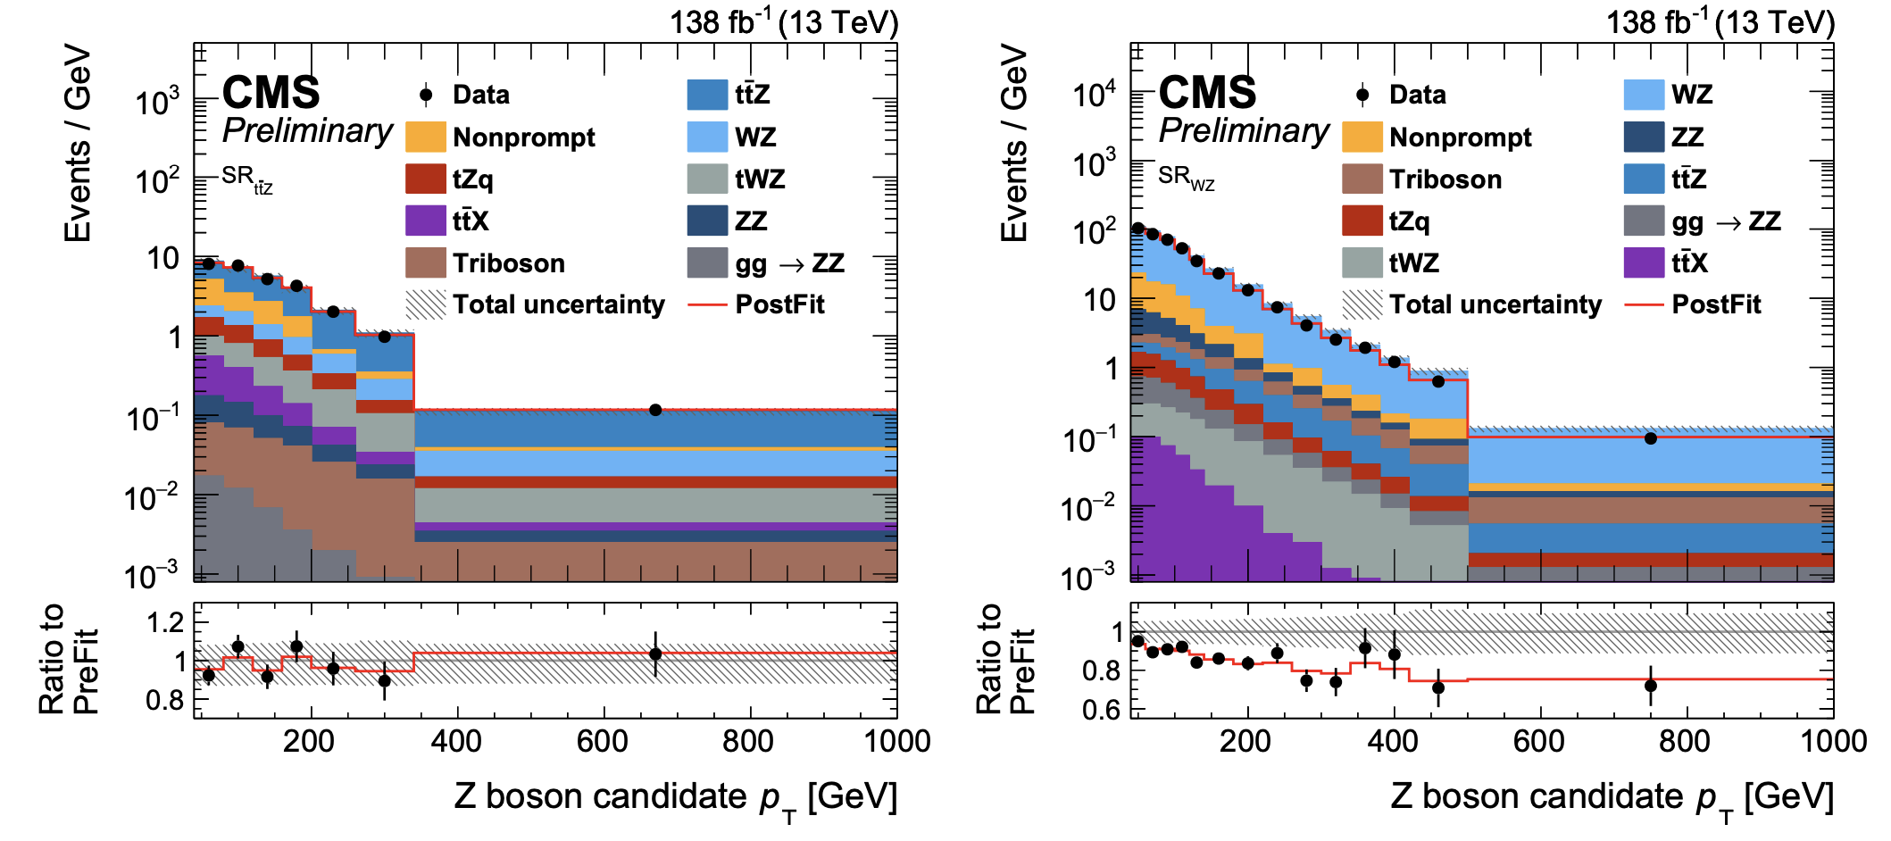
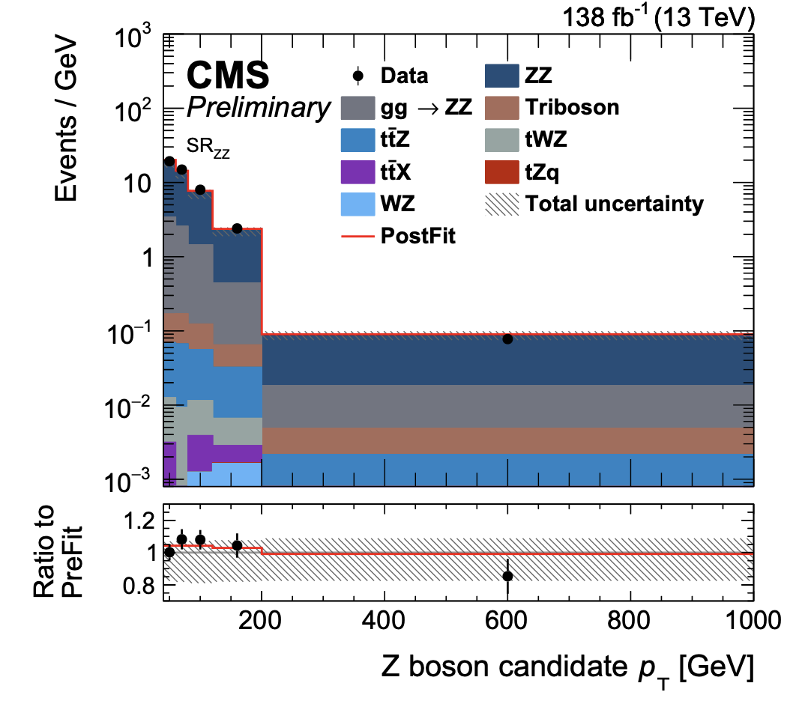
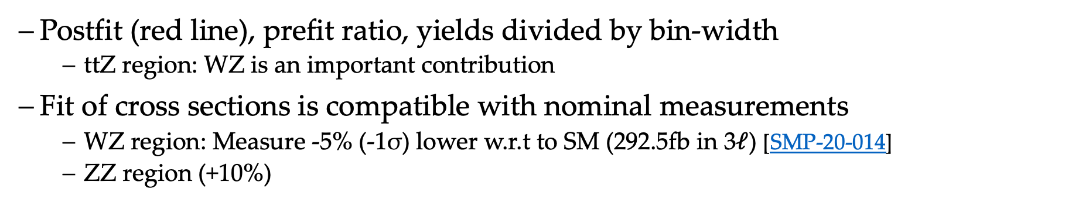
Results
Postfit (red line), prefit ratio, yields divided by bin-width
  ttZ region: WZ is an important contribution
Fit of cross sections is compatible with nominal measurements
  WZ region: Measure -5% (-1σ) lower w.r.t to SM (292.5fb in 3$𝓁$) [SMP-20-014]
  ZZ region (+10%)

Slide 8
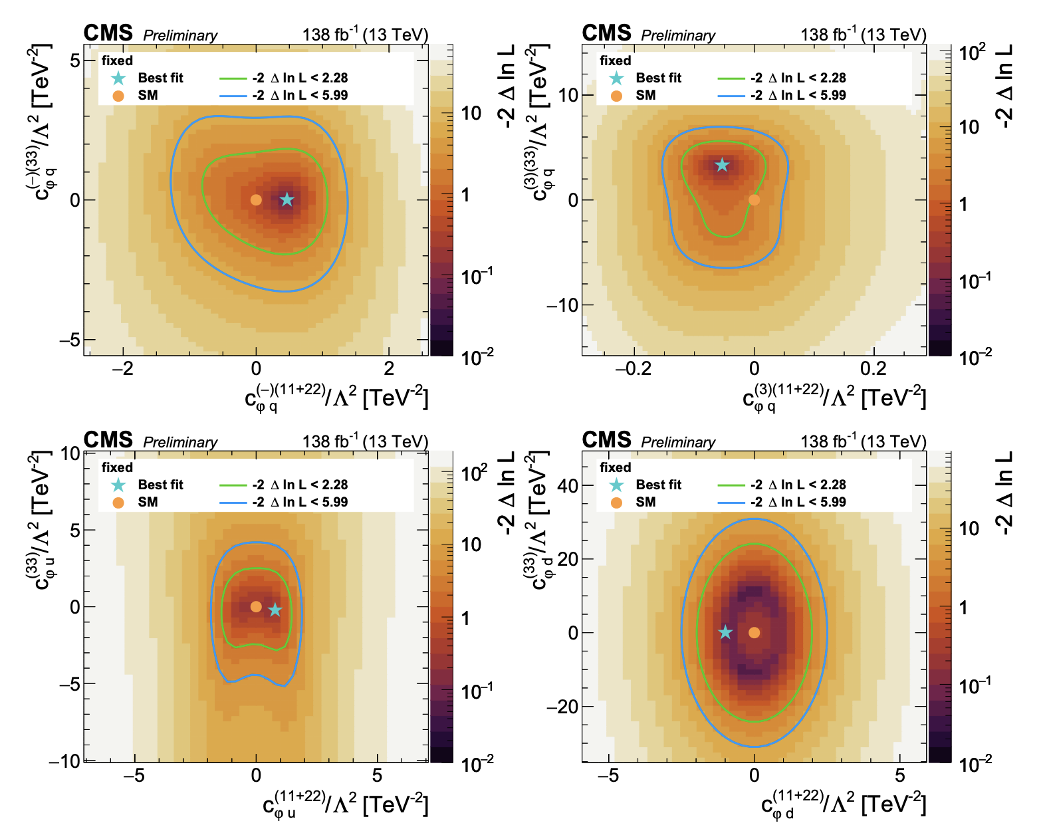
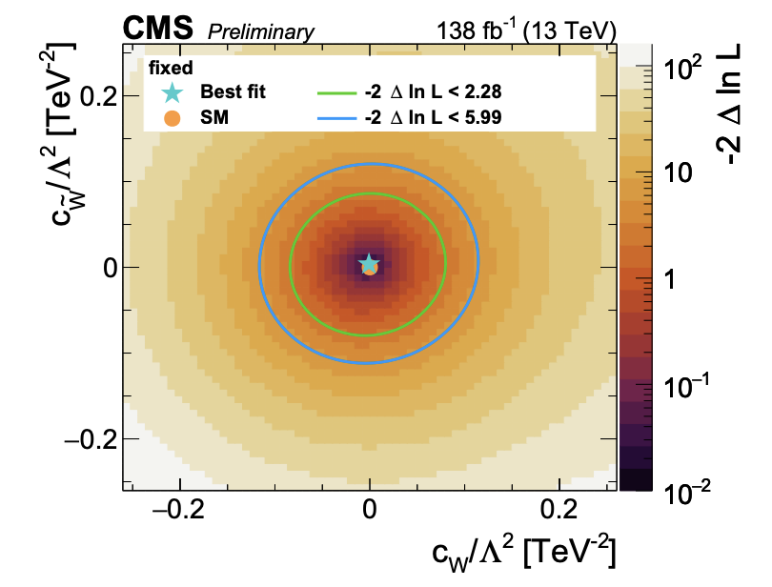
2D limits (others fixed)
Show 11+22 vs. 33 Wilson coefficients
  C_{𝝋q}⁽⁻⁾⁽¹¹⁺²²⁾, C_{𝝋q}⁽⁻⁾⁽³³⁾, C_{𝝋u}⁽¹¹⁺²²⁾, C_{𝝋u}⁽³³⁾,
  C_{𝝋d}⁽¹¹⁺²²⁾, C_{𝝋d}⁽³³⁾ constrained by combination
  C_{𝝋u}⁽³³⁾ and C_{𝝋q}⁽⁻⁾⁽³³⁾ can not be disentangled;
  large differences when profiling
Normalization uncertainties:
  mildly affect C_{𝝋q}⁽³⁾⁽¹¹⁺²²⁾ and C_{𝝋q}⁽³⁾⁽³³⁾
  (non-profiled)
  Slightly distort 2D exclusion contours

Slide 9
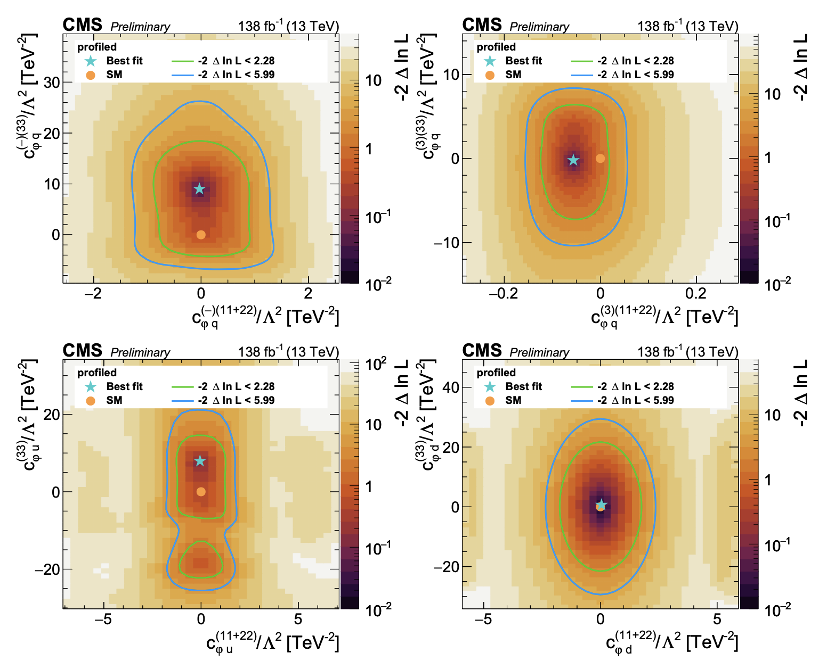
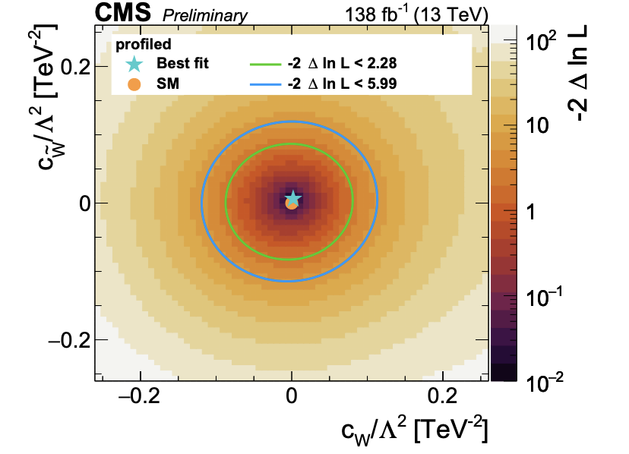
2D limits (profiled)
Show 11+22 vs. 33 Wilson coefficients
  C_{𝝋q}⁽⁻⁾⁽¹¹⁺²²⁾, C_{𝝋q}⁽⁻⁾⁽³³⁾, C_{𝝋u}⁽¹¹⁺²²⁾, C_{𝝋u}⁽³³⁾,
  C_{𝝋d}⁽¹¹⁺²²⁾, C_{𝝋d}⁽³³⁾ constrained by combination
  C_{𝝋u}⁽³³⁾ and C_{𝝋q}⁽⁻⁾⁽³³⁾ can not be disentangled;
  large differences when profiling
Normalization uncertainties:
  mildly affect C_{𝝋q}⁽³⁾⁽¹¹⁺²²⁾ and C_{𝝋q}⁽³⁾⁽³³⁾
  (non-profiled)
  Slightly distort 2D exclusion contours

Slide 10
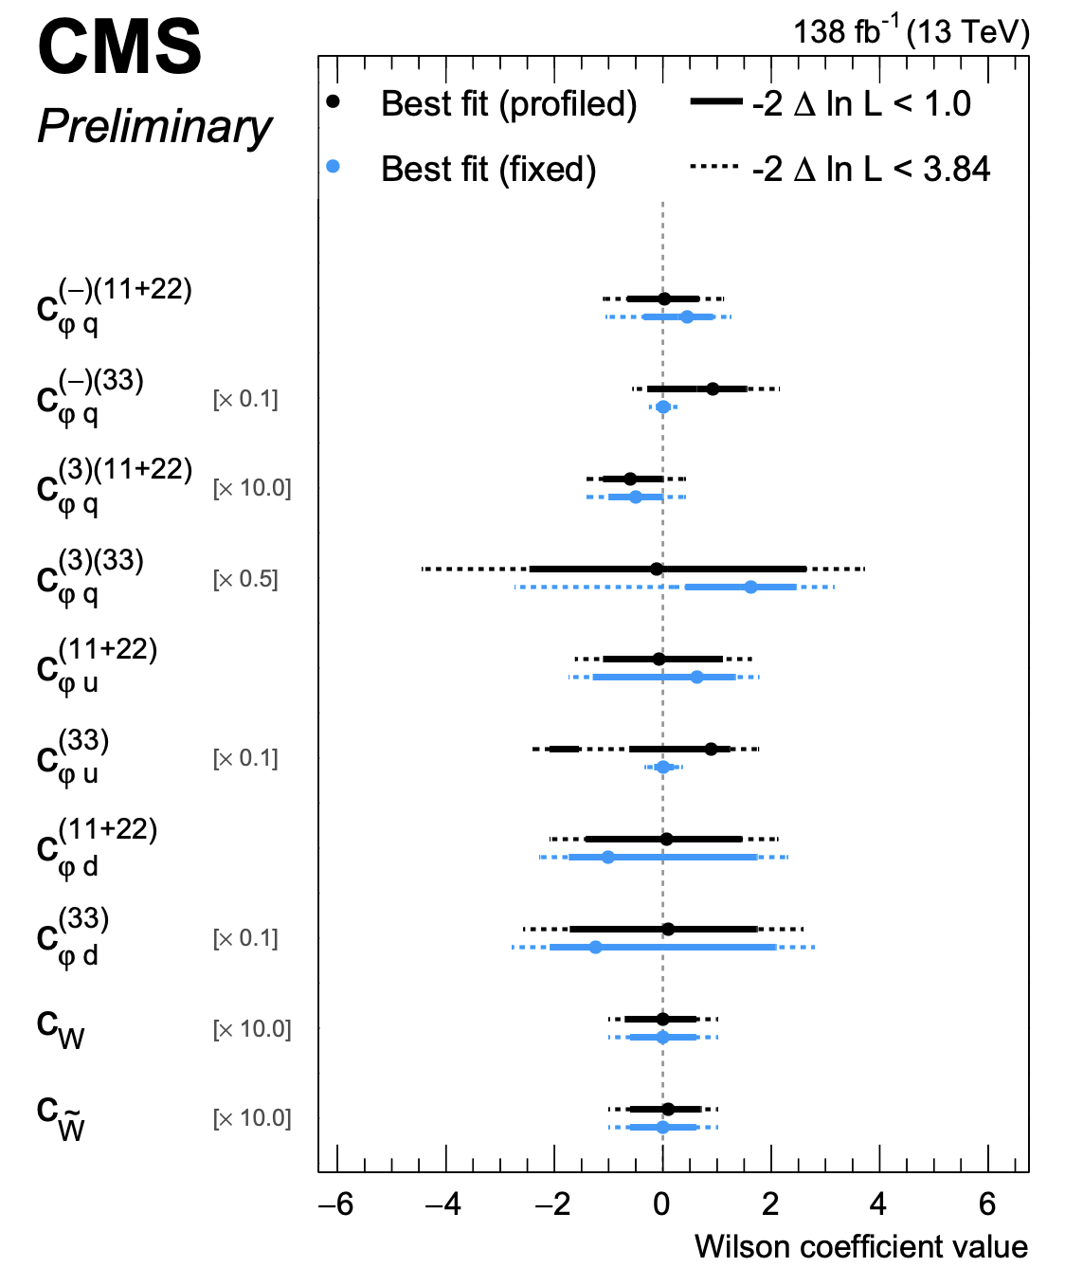
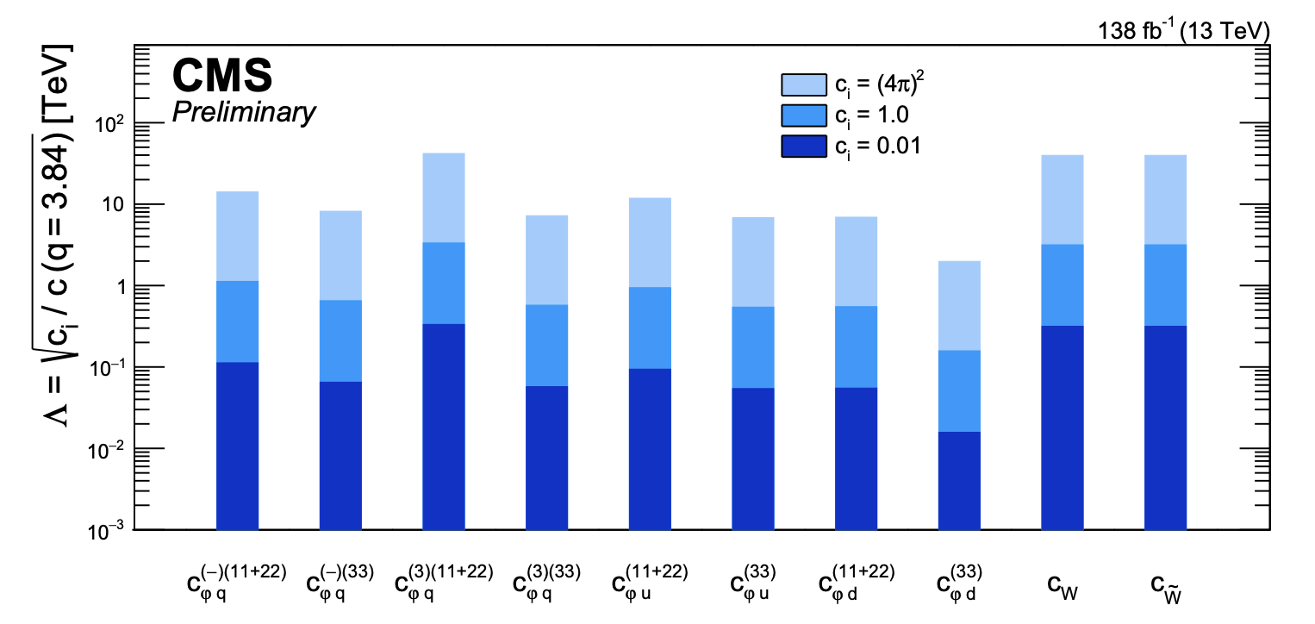
Results
Single-operator limits comparable in top sector
Only c_{W}/c_{W~} dominantly quadratic
VH better constrains C_{𝝋q}⁽⁻⁾⁽¹¹⁺²²⁾ [JHEP 03 (2025) 114]
This analysis is more inclusive
  The best EFT analysis has the worst limits

Slide 11
Summary
Combining ttZ, WZ, and ZZ regions we took one more step towards more global EFT interpretations

