Slide 1

Wbwb differential cross-section
M. Romano
on behalf of the ATLAS Collaboration

Slide 2
“measure the wBWb differential cross section in THE DILEPTON channel, using the full run2 data”
Introduction: the analysis 101
Analysis strategy
Cut-count-unfold:
  selection aiming the WbWb final state: 2 leptons and (at least or exactly) 2 b-jets
  unfold to a fiducial phase space at particle level
  Compare to MC predictions using the full experimental covariance
Several physical and technical improvements:
Measure differential cross sections as a function of additional kinematic variables
Improved modelling uncertainties prescriptions
Latest object calibrations
Analysis scope:
Tackle the tt/tWb interference: differential cross section for one variable and in a region with enhanced sensitivity
Help WbWb modelling: differential cross sections for several kinematic variables in a more inclusive phase space
Previous publication (only interference):
Probing the quantum interference between singly and doubly resonant top-quark (36fb⁻¹)

Slide 3




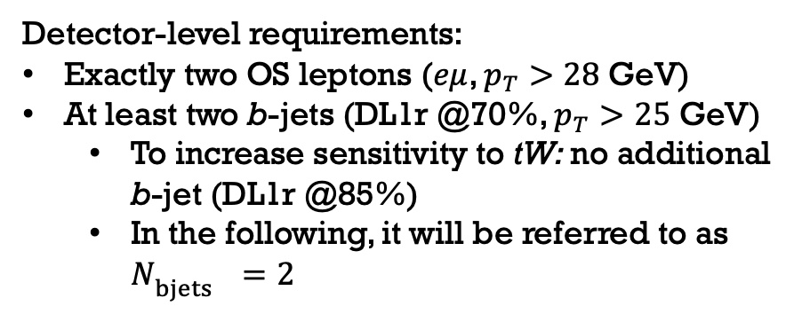




Final states
Detector-level requirements:
Exactly two OS leptons ($eμ$, $p_{T}>28$ GeV)
At least two b-jets (DL1r @70%, $p_{T}>25$ GeV)
  To increase sensitivity to tW: no additional b-jet (DL1r @85%)
  In the following, it will be referred to as $N_{bjets^{}}=2$
$$e/μ$$
$$ν$$
$$W$$
… + extra radiation
$$b$$
$$e/μ$$
$$ν$$
$$W$$
Particle level requirements follow closely the detector-level cuts
$$b$$
Notes:
Chiarire da dove a dove si fa l;'unfolding o qui o sulla slide dell'unfolding
Particle: da pseudo-top a pseudo-top
Parton: da KLFitter a parton

Slide 4
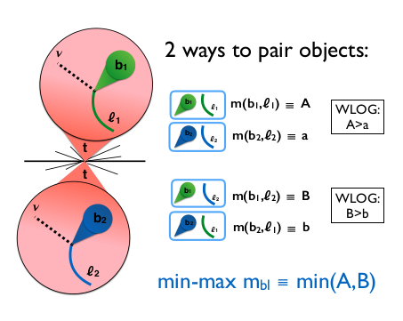
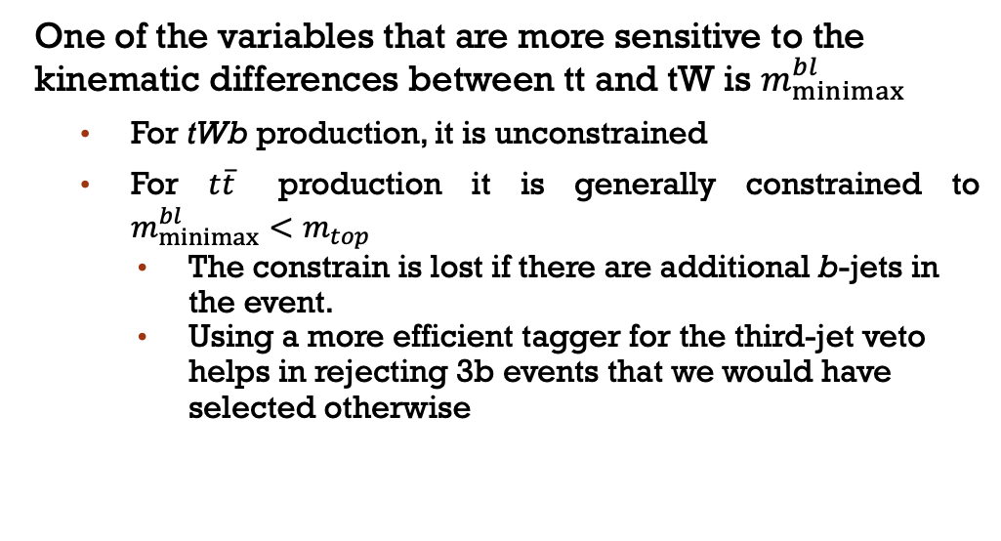
Why the need of 2b exclusive?
One of the variables that are more sensitive to the kinematic differences between tt and tW is $m_{minimax}^{bl}$
  For tWb production, it is unconstrained
  For $t\overline{t}$ production it is generally constrained to $m_{minimax}^{bl}<m_{top}^{}$
    The constrain is lost if there are additional b-jets in the event.
    Using a more efficient tagger for the third-jet veto helps in rejecting 3b events that we would have selected otherwise

Slide 5
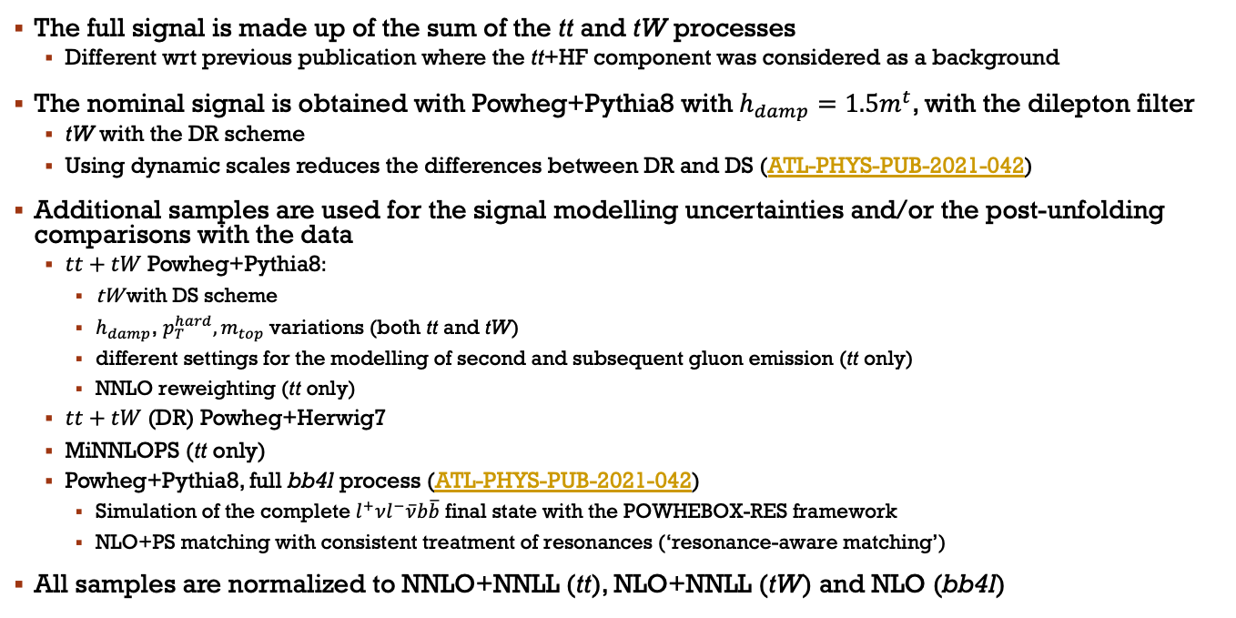
Signal samples
The full signal is made up of the sum of the tt and tW processes
  Different wrt previous publication where the tt+HF component was considered as a background
The nominal signal is obtained with Powheg+Pythia8 with $h_{damp}=1.5m^{t}$, with the dilepton filter
  tW with the DR scheme
  Using dynamic scales reduces the differences between DR and DS (ATL-PHYS-PUB-2021-042)
Additional samples are used for the signal modelling uncertainties and/or the post-unfolding comparisons with the data
  $tt+tW$Powheg+Pythia8:
    tW with DS scheme
    $h_{damp}$, $p_{T}^{hard}, m_{top}^{}$ variations (both tt and tW)
    different settings for the modelling of second and subsequent gluon emission (tt only)
    NNLO reweighting (tt only)
  $tt+tW$(DR) Powheg+Herwig7
  MiNNLOPS (tt only)
  Powheg+Pythia8, full bb4l process (ATL-PHYS-PUB-2021-042)
    Simulation of the complete $l^{+}νl^{−}\overline{ν}b\overline{b}$ final state with the POWHEBOX-RES framework
    NLO+PS matching with consistent treatment of resonances (‘resonance-aware matching’)
All samples are normalized to NNLO+NNLL (tt), NLO+NNLL (tW) and NLO (bb4l)

Slide 6
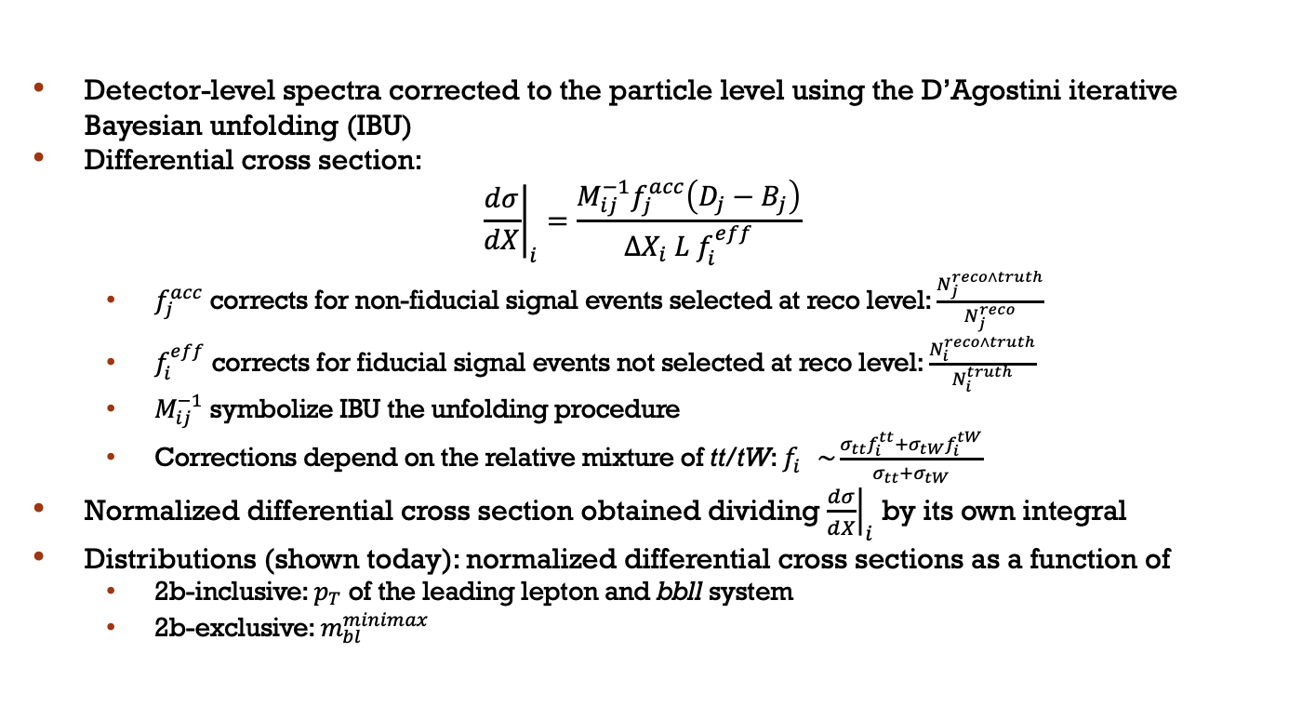
Unfolding procedure
Detector-level spectra corrected to the particle level using the D’Agostini iterative Bayesian unfolding (IBU)
Differential cross section:
$${\left.\frac{dσ}{dX}\right|}_{i}=\frac{M_{ij}^{−1}f_{j}^{acc}\left(D_{j}−B_{j}\right)}{ΔX_{i} L{ f}_{i}^{eff}}$$
  $f_{j}^{acc}$ corrects for non-fiducial signal events selected at reco level: $\frac{N_{j}^{reco∧truth}}{N_{j}^{reco}}$
  $f_{i}^{eff}$ corrects for fiducial signal events not selected at reco level: $\frac{N_{i}^{reco∧truth}}{N_{i}^{truth}}$
  $M_{ij}^{−1}$ symbolize IBU the unfolding procedure
  Corrections depend on the relative mixture of tt/tW: $f_{i}^{}\sim \frac{σ_{tt}f_{i}^{tt}+σ_{tW}f_{i}^{tW}}{σ_{tt}+σ_{tW}}$
Normalized differential cross section obtained dividing ${\left.\frac{dσ}{dX}\right|}_{i}$ by its own integral
Distributions (shown today): normalized differential cross sections as a function of
  2b-inclusive: $p_{T}$ of the leading lepton and bbll system
  2b-exclusive: $m_{bl}^{minimax}$

Slide 7
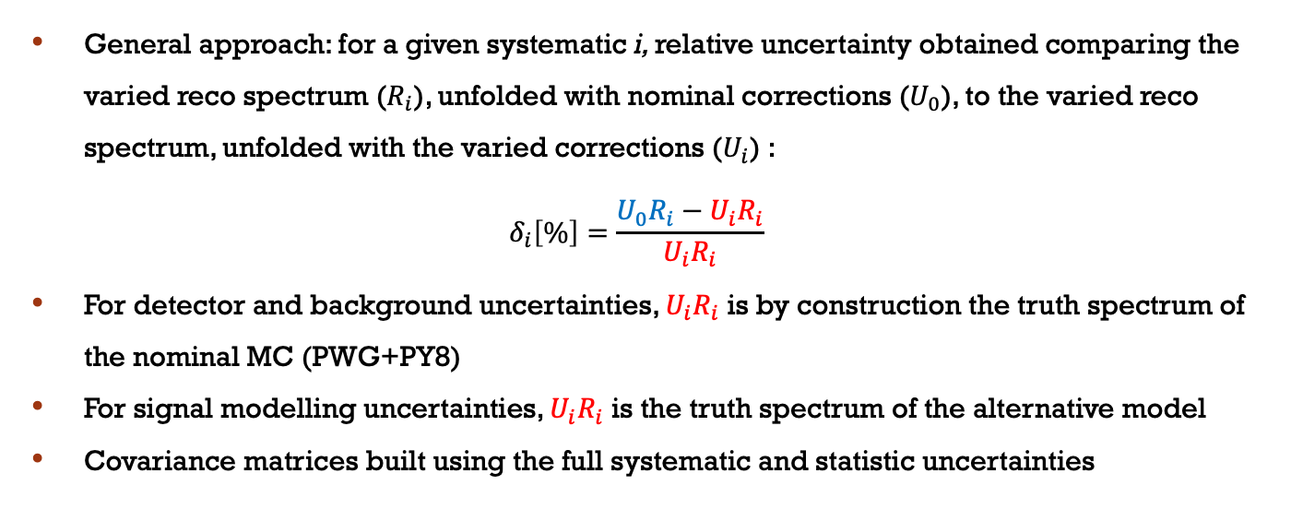
Propagation of uncertainties
General approach: for a given systematic i, relative uncertainty obtained comparing the varied reco spectrum ($R_{i}$), unfolded with nominal corrections ($U_{0}$), to the varied reco spectrum, unfolded with the varied corrections ($U_{i}$) :
$$δ_{i}\left[\%\right]=\frac{U_{0}R_{i}−U_{i}R_{i}}{U_{i}R_{i}}$$
For detector and background uncertainties, $U_{i}R_{i}$ is by construction the truth spectrum of the nominal MC (PWG+PY8)
For signal modelling uncertainties, $U_{i}R_{i}$ is the truth spectrum of the alternative model
Covariance matrices built using the full systematic and statistic uncertainties

Slide 8
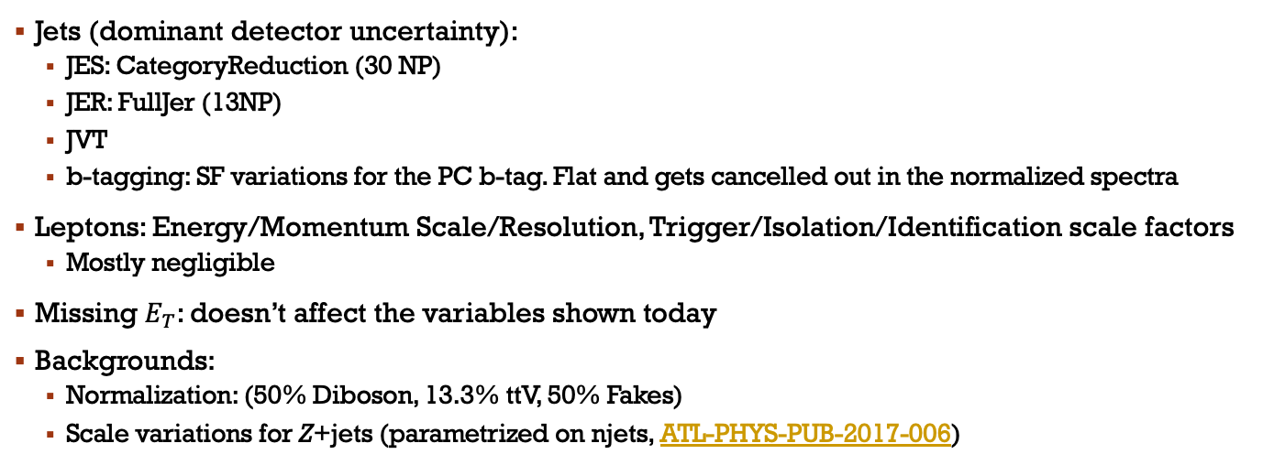
Systematic uncertainties: Detector and background
Jets (dominant detector uncertainty):
  JES: CategoryReduction (30 NP)
  JER: FullJer (13NP)
  JVT
  b-tagging: SF variations for the PC b-tag. Flat and gets cancelled out in the normalized spectra
Leptons: Energy/Momentum Scale/Resolution, Trigger/Isolation/Identification scale factors
  Mostly negligible
Missing $E_{T}$: doesn’t affect the variables shown today
Backgrounds:
  Normalization: (50% Diboson, 13.3% ttV, 50% Fakes)
  Scale variations for Z+jets (parametrized on njets, ATL-PHYS-PUB-2017-006)

Slide 9
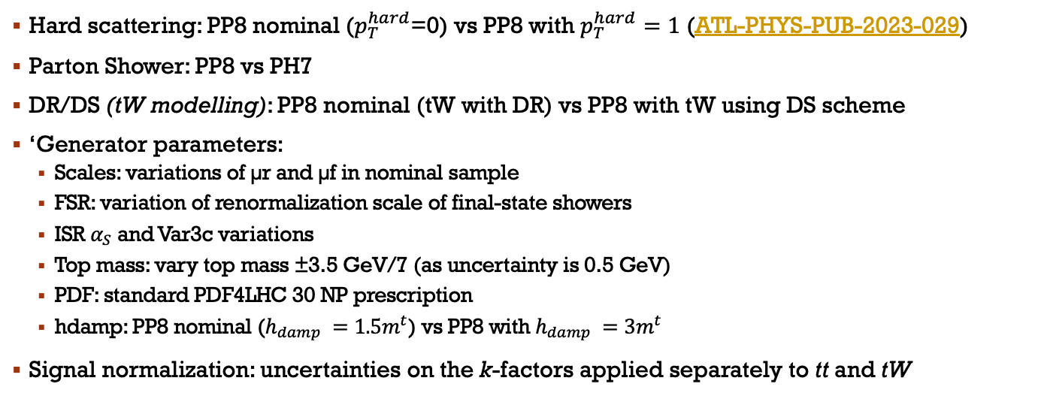
Systematic uncertainties: Signal modelling
Hard scattering: PP8 nominal ($p_{T}^{hard}$=0) vs PP8 with $p_{T}^{hard}=1$ (ATL-PHYS-PUB-2023-029)
Parton Shower: PP8 vs PH7
DR/DS (tW modelling): PP8 nominal (tW with DR) vs PP8 with tW using DS scheme
‘Generator parameters:
  Scales: variations of µr and µf in nominal sample
  FSR: variation of renormalization scale of final-state showers
  ISR $α_{S}$ and Var3c variations
  Top mass: vary top mass ±3.5 GeV/7 (as uncertainty is 0.5 GeV)
  PDF: standard PDF4LHC 30 NP prescription
  hdamp: PP8 nominal ($h_{damp} =1.5m^{t}$) vs PP8 with $h_{damp} =3m^{t}$
Signal normalization: uncertainties on the k-factors applied separately to tt and tW

Slide 10
Systematic uncertainties: summary (1)

Slide 11

Systematic uncertainties: summary (2)

Slide 12
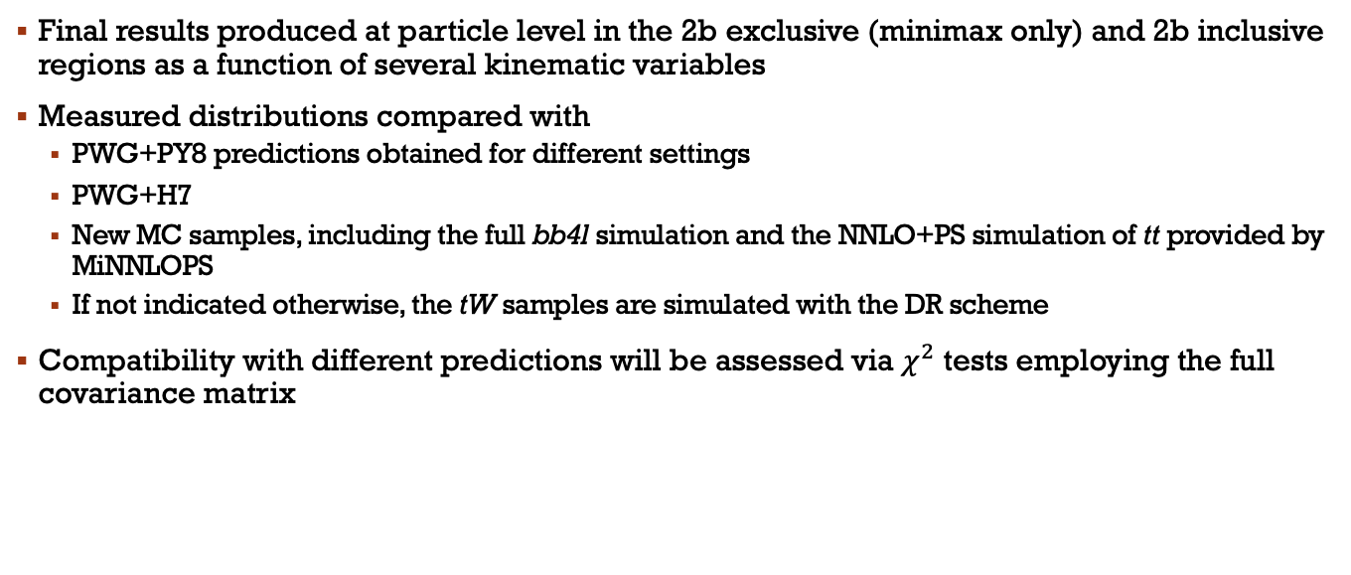
RESULTS
Final results produced at particle level in the 2b exclusive (minimax only) and 2b inclusive regions as a function of several kinematic variables
Measured distributions compared with
  PWG+PY8 predictions obtained for different settings
  PWG+H7
  New MC samples, including the full bb4l simulation and the NNLO+PS simulation of tt provided by MiNNLOPS
  If not indicated otherwise, the tW samples are simulated with the DR scheme
Compatibility with different predictions will be assessed via $χ^{2}$ tests employing the full covariance matrix

Slide 13
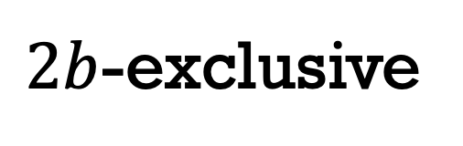
$2b$-exclusive

Slide 14
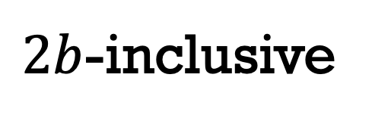
$2b$-inclusive

Slide 15
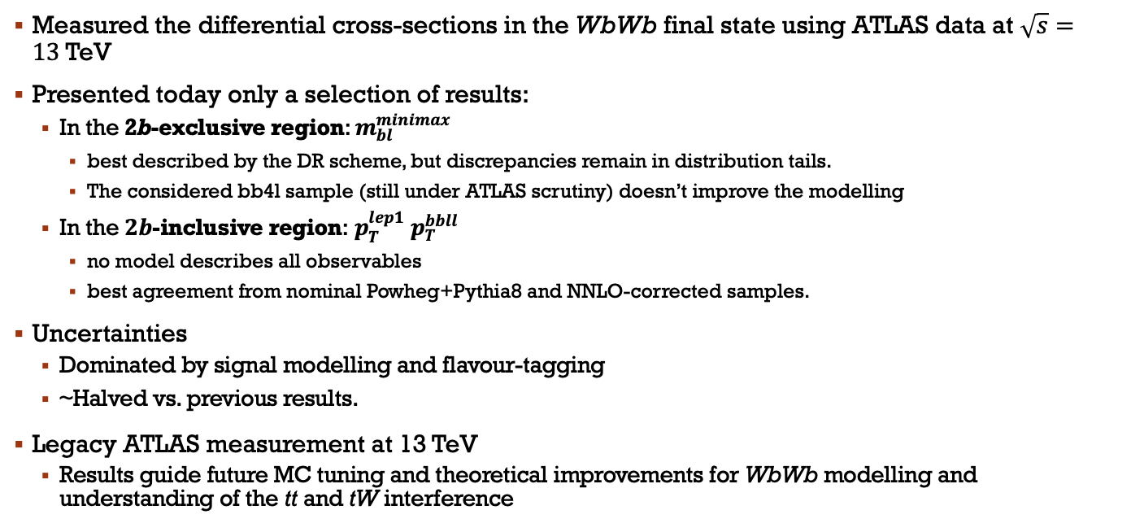
Conclusions
Measured the differential cross-sections in the WbWb final state using ATLAS data at $\sqrt{s}=13$TeV
Presented today only a selection of results:
  In the 2b-exclusive region: $m_{bl}^{minimax}$
    best described by the DR scheme, but discrepancies remain in distribution tails.
    The considered bb4l sample (still under ATLAS scrutiny) doesn’t improve the modelling
  In the $2b$-inclusive region: $p_{T}^{lep1}$ $p_{T}^{bbll}$
    no model describes all observables
    best agreement from nominal Powheg+Pythia8 and NNLO-corrected samples.
Uncertainties
  Dominated by signal modelling and flavour-tagging
  ~Halved vs. previous results.
Legacy ATLAS measurement at 13 TeV
  Results guide future MC tuning and theoretical improvements for WbWb modelling and understanding of the tt and tW interference

Slide 16
Backup

Slide 17
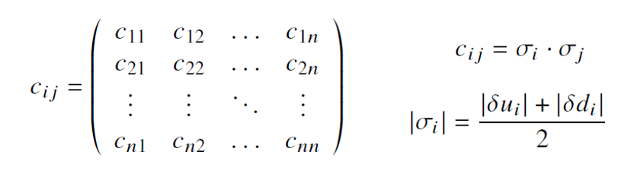
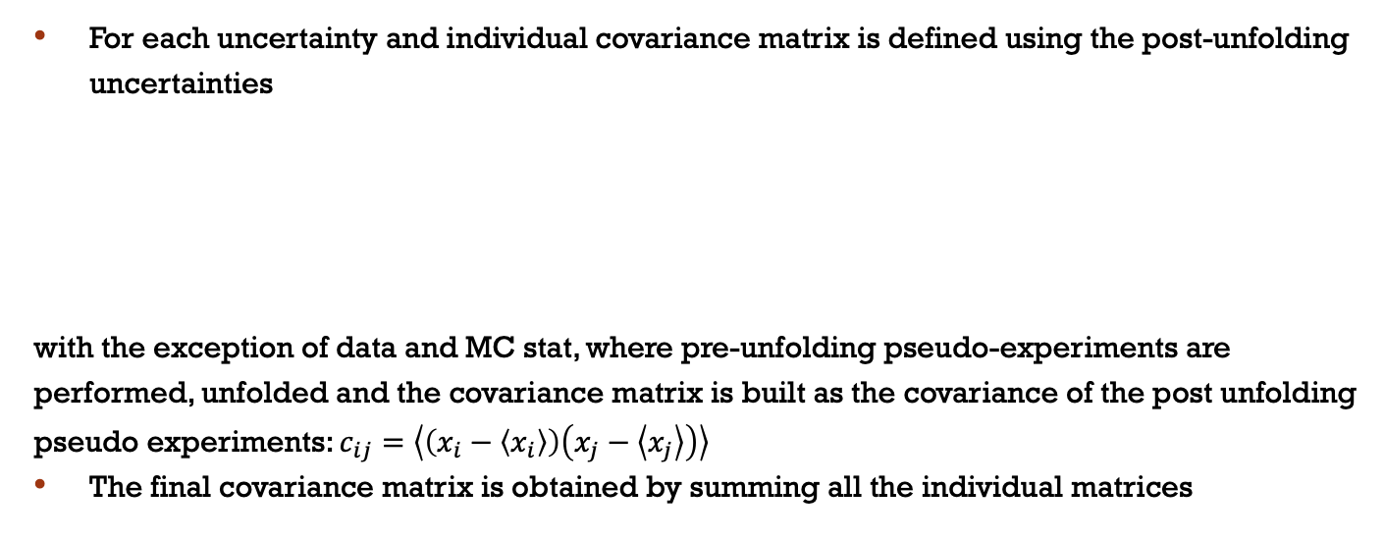
Covariance matrix
For each uncertainty and individual covariance matrix is defined using the post-unfolding uncertainties
with the exception of data and MC stat, where pre-unfolding pseudo-experiments are performed, unfolded and the covariance matrix is built as the covariance of the post unfolding pseudo experiments: $c_{ij}=\left\langle \left(x_{i}−\left\langle x_{i}\right\rangle \right)\left(x_{j}−\left\langle x_{j}\right\rangle \right)\right\rangle$
The final covariance matrix is obtained by summing all the individual matrices

