Slide 1
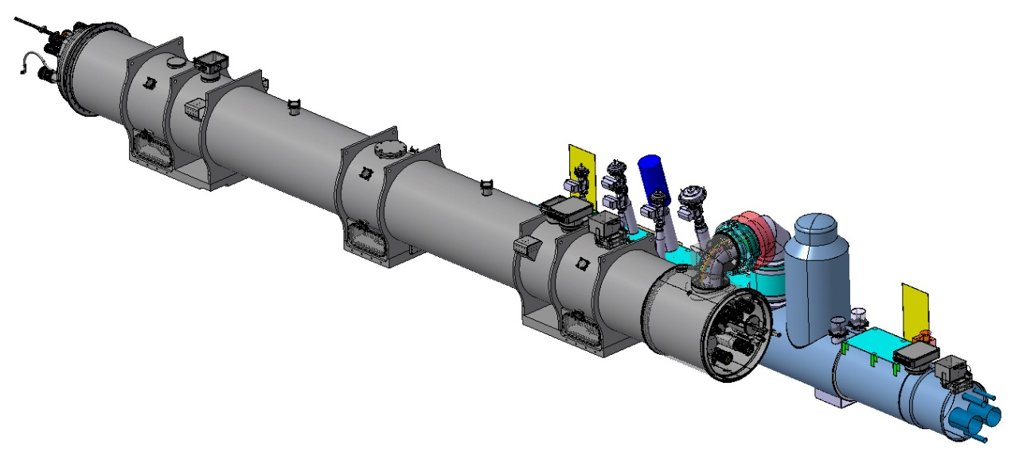

HL magnets and cryogenic jumper interfaces
IT String return on experience
Nicolas Bourcey
TE-MSC-LMF
24/01/2025

Slide 2
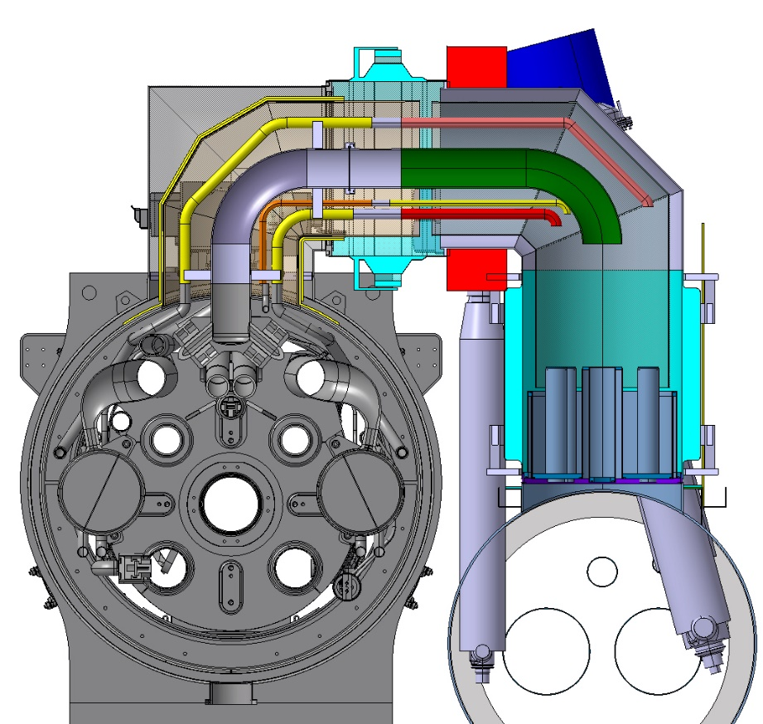
Introduction
The jumper is the link between the cryogenic distribution line and the cryo-magnets.
4 jumpers in the IT String (3 with cryo-magnets)
Design is responsibility of WP9
As agreed with WP16 and WP9 (EDMS 2755342), TE-MSC will proceed with the jumper interconnection between the cryo-magnets and the SQXL and remove the temporary jumper end caps installed for the SQXL commissioning.

Slide 3
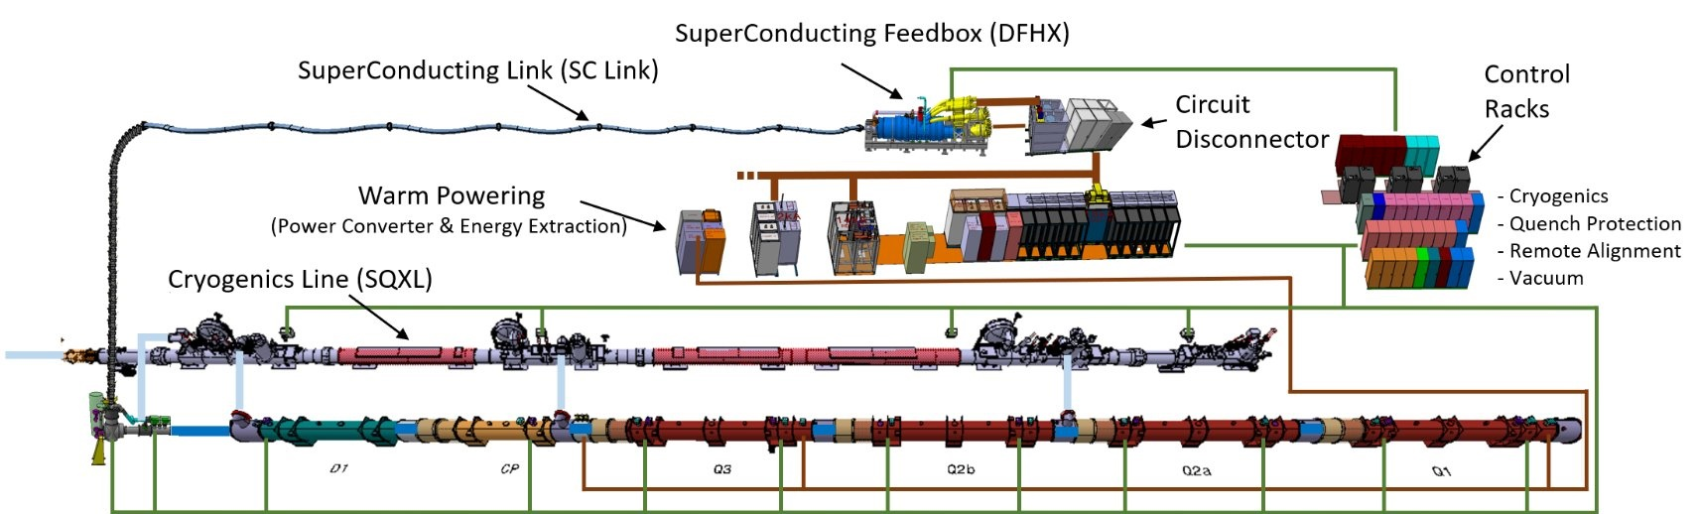
Jumpers in the IT string
1 jumper between SQXL and DFX (WP6a / WP9)
Courtesy of D.Bozzini
3 jumpers between SQXL and cryomagnets (D1, CP, Q2b)
WP9/WP3

Slide 4
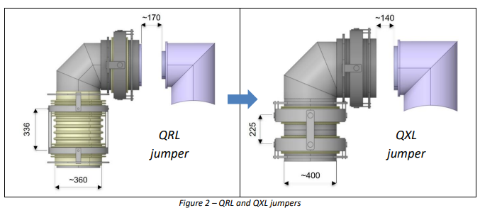
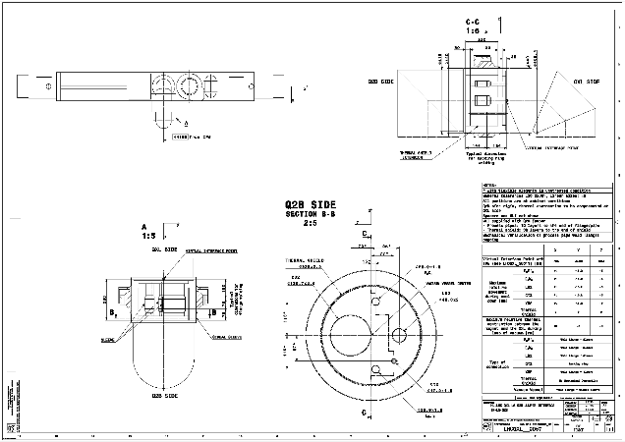
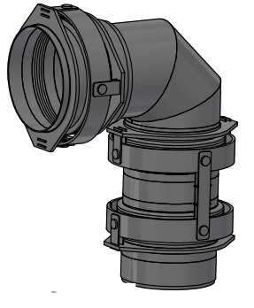
Design
The design was made by TE-CRG and is based on the LHC design with a larger diameter.
SQXL was manufactured according to the initial design before ECR LHC-QXL-EC-0001
Cinematic is based on 3 gimbals to allow the displacement in the 3 directions (X,Y,Z)
Interface and specification drawings available but it was difficult to obtain a 3D model “as built” to produce the interconnection drawings. STEP file received needed some work for the design office to match with the cryo-magnet interfaces. →Mandatory to study the integration of the welding and cutting machines.
Observation: large discrepancies between specification and as built (interconnection gimbal…)
Gimbals

Slide 5
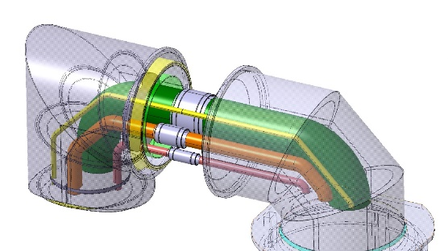
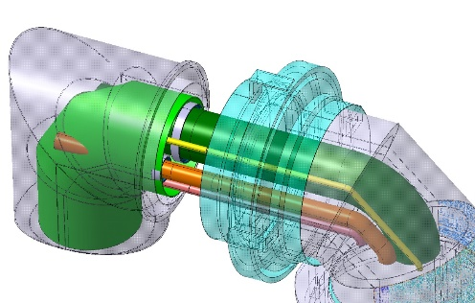
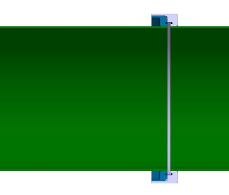
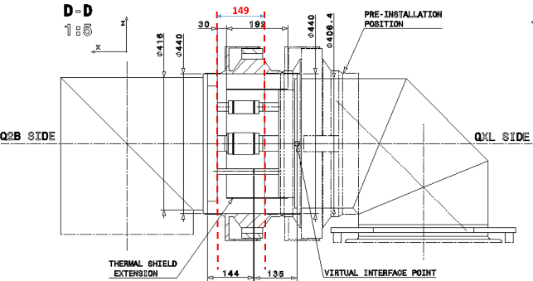
Interconnection
Critical space constraint for interconnection pointed out by TE-CRG, showing that the welding and cutting machine are not compatible.
New interconnection solution was proposed to ease the assembly.
Assembly sequence:
  Cutting of the SQXL jumper vacuum vessel end cap
  Cutting of the process pipes end caps
  Welding of the flanges on the process pipes
  QC of the welds and LT
  Installation of the interconnection gimbal sleeve
  MAGNET INSTALLATION AND ALIGNMENT
  Alignment of the SQXL jumper wrt cryo-magnet
  Welding of the process pipes
  QC of welds and LT
  Closure of the thermal shield
  Welding of the interconnection gimbal sleeve
  QC of the welds and LT
Note: no standard cutting machine is available to cut the gimbal sleeve.

Slide 6
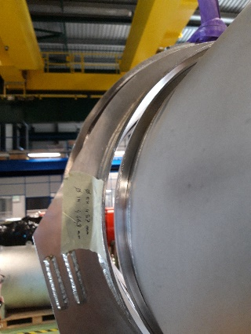
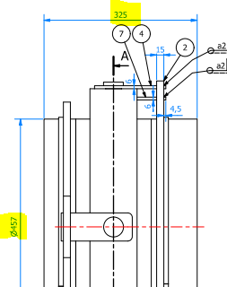
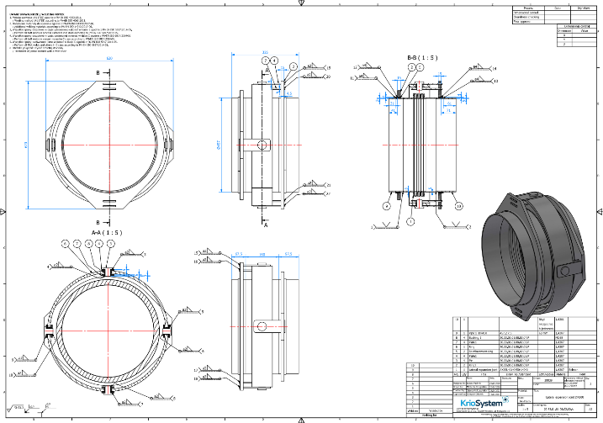
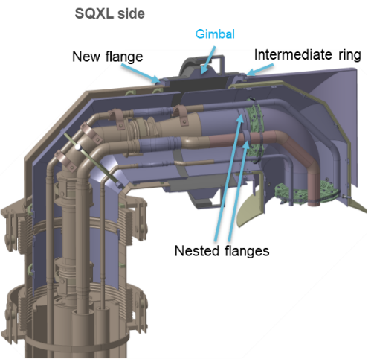
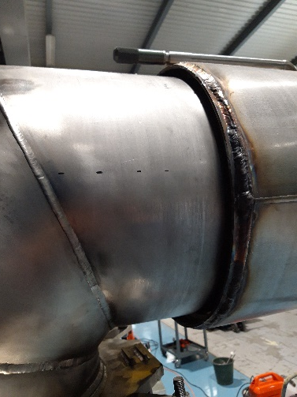
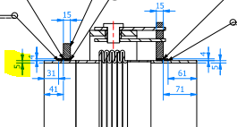
Interconnection gimbal sleeves
Before installation of D1, a test of the gimbal was done on the cryo-magnet and it appears that they were delivered not conforming to the specification.
  Inner diameter of 447 mm instead of 440 mm
  Length of 325 mm instead of 295 mm
  Welding lip of 5 mm
No machined flange on the SQXL side interface and very bad weld quality of the temporary end cover.
Solution: rework completely the interface flange and the gimbal.

Slide 7
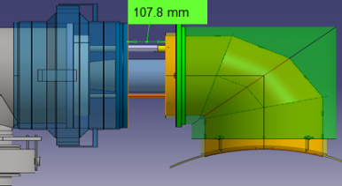
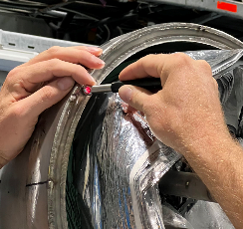
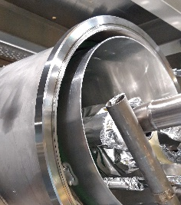
Modification of the gimbal sleeve and SQXL flange
Cutting of the interface on the SQXL side and welding of a new machined flange.
Machining of the gimbal and addition of an intermediate ring to fit the cryo-magnet flange diameter
Drawback: reduction of the available space for interconnection (-40 mm)
Specification
As-built (Cryo-system)
New design
Courtesy of Oussama id Bahmane

Slide 8
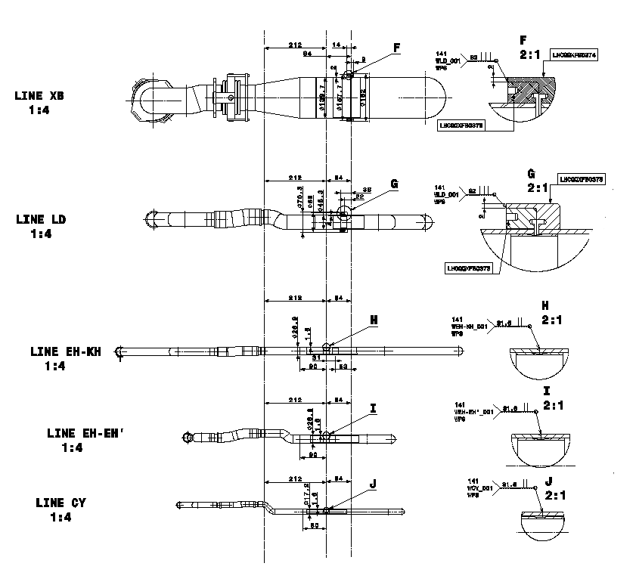
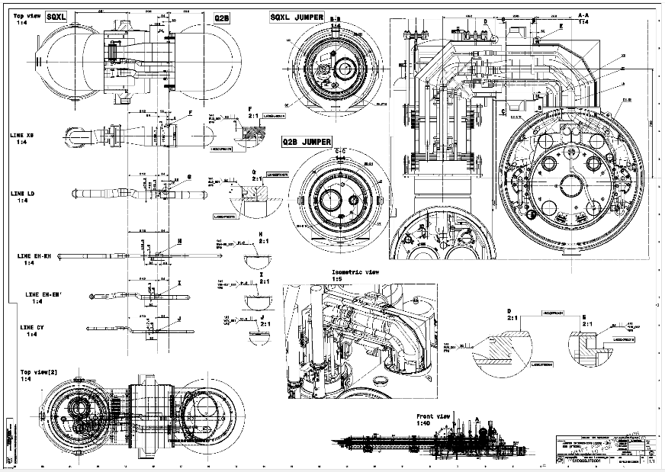
Interconnection drawings
1 drawing / interconnection
  Q2B: LHCQQSJF0001
  CP: LHCQQSJF0002
  D1: LHCQQSJF0003

Slide 9
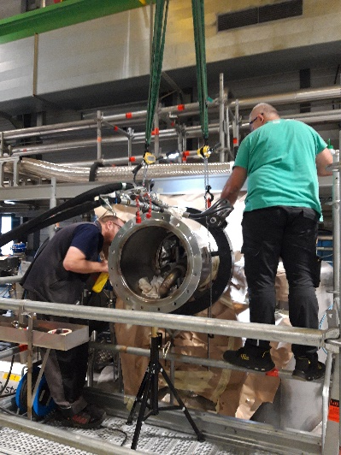
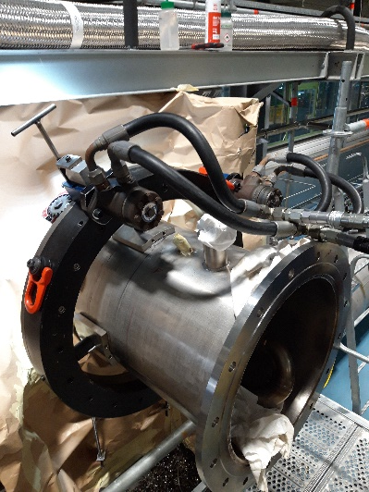
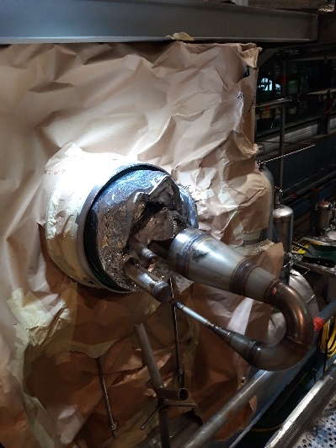
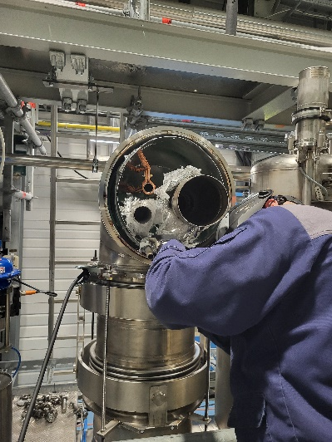
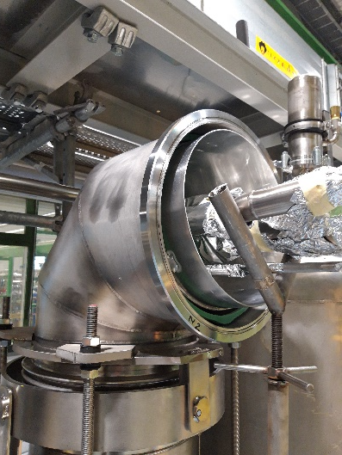
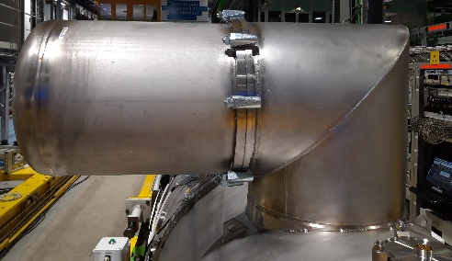
Cutting of the SQXL jumper cap and flange
Heavy operation, time consuming, need of scaffolding, crane to support the end cap
Big deformation and misalignment of the end cap. It was difficult to align the cutting machine perpendicular to the tube.
Why do we weld? This can be closed with an o-ring…
It will save several days of work in the tunnel…

Slide 10
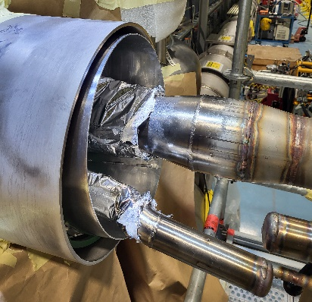
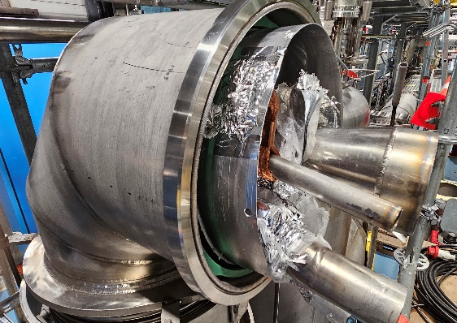
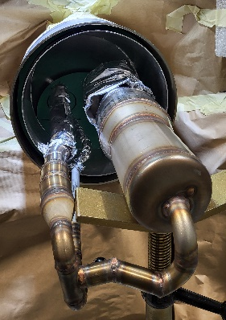
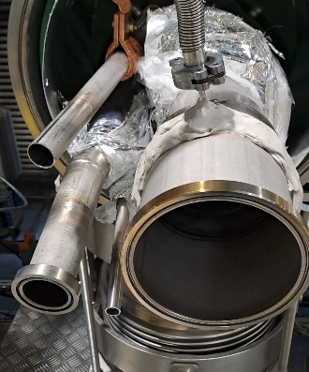
Process pipes
The closure of the process pipes is necessary for the commissioning of the cryo-line but has to be studied and agreed in between TE-MSC and TE-CRG to facilitate the cutting operation.
We observed that the quality of the temporary welds performed by the company is not within the standard…
Tubes were extended and flanges welded, leak test with clamshell delivered to VSC
Problem: all the assembly (tubes + thermal shield) is moving (by few centimeters) in the jumper VV. It was difficult to define the reference for the cutting of the tubes.
Proposal: install the final flanges during construction

Slide 11
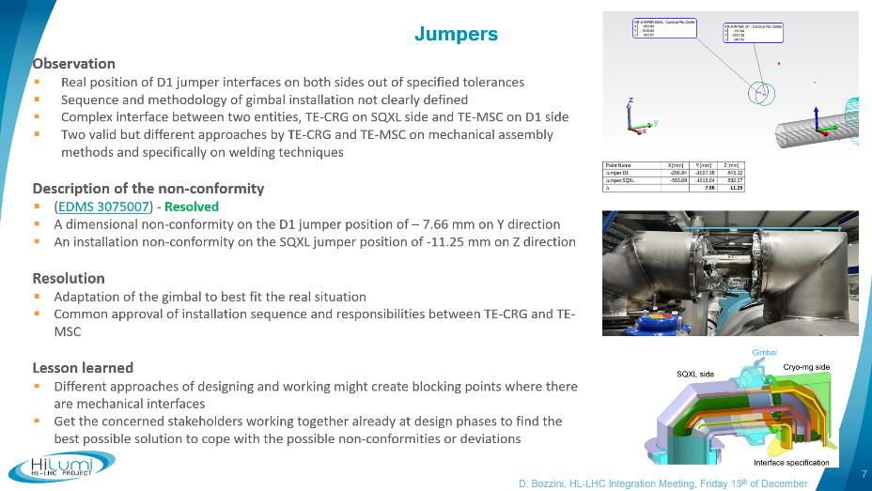
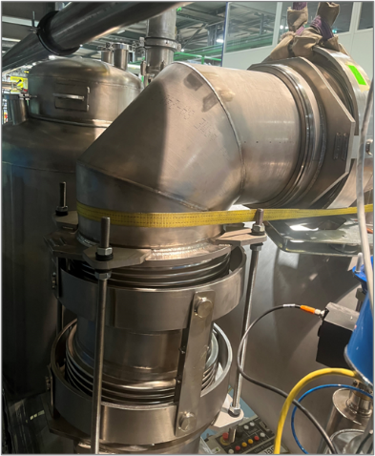
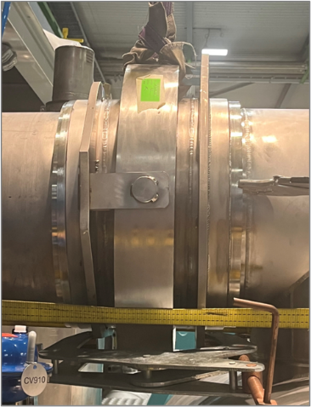
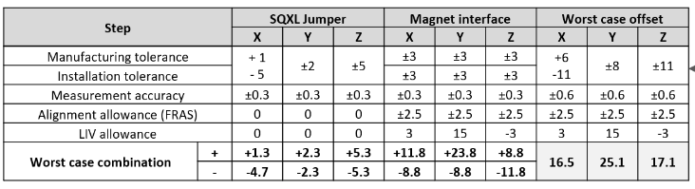
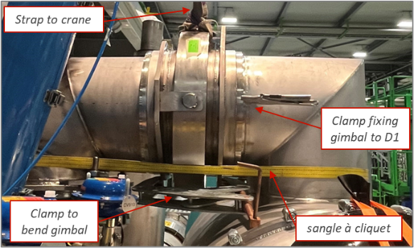
Jumper alignment
Non-conformity on the position of the jumper flanges (see presentation of Davide Bozzini https://indico.cern.ch/event/1487732/)
  D1: -7.66 mm in Y / SQXL: -11.25 mm in Z
TE-CRG verified that it is within the design range of displacement (± 25 mm)
The alignment tie-rods installed on the vertical gimbals were not sufficient to do a correct alignment between the D1 and the SQXL.
TE-CRG managed to align the flanges using straps and pulling the SQXL jumper.
Courtesy of F.Merli / A.J. Lees

Slide 12
Assembly sequence and responsibilities
After discussion between TE-CRG, TE-MSC and WP16, we agreed on the following sequence and responsibilities:
  Alignment of the jumper vacuum vessel flanges (TE-CRG)
  Interconnection of the process pipes (TE-MSC)
  Weld inspection (EN-MME)
  Leak test (TE-VSC)
  Closure of the thermal shield and MLI (TE-MSC)
  Alignment of the gimbal sleeve (TE-CRG)
  Welding of the gimbal sleeve to the cryo-magnet, lip weld (TE-MSC)
  Welding of the gimbal sleeve to the SQXL, fillet weld (TE-CRG)
  Weld inspection (EN-MME)
  Final leak test (TE-VSC)
According to the survey measurements made on the SQXL, the same deviations are expected for the CP and Q2b. No measurements yet on the cryo-magnet side. The same sequence will be applied.
Those operations will be done at a later stage because we know that it cannot be cut easily in case of problem.

Slide 13
Summary
The jumper connection on the IT string was not straight forward and is not yet finished!
Careful check of the “as built” 3d models has to be done to verify the discrepancies with the specification
Verify the conformity of the interfaces and components.
Temporary end caps have to be studied in detail to avoid extra work in the tunnel
Alignment system has to be improved and verified on a training mock-up
A sequence of operation with clear responsibilities has been set-up in between WP9 and WP3 and will be applied in the tunnel
No cutting tool for the gimbal

Slide 14
Aknowledgment
Thanks to all people involved
  TE-MSC (especially Nicolas Eyraud)
  TE-CRG
  WP16 team
  EN-MME
  EN-HE
  TE-VSC and 40/30

Slide 15
Thank you for your attention
Any questions ?

