Slide 1

HL-LHC jumpers interfaces
Interfaces definition in the LHC tunnel
F. Merli (TE-CRG-ME)
on behalf of WP9 cryo-distribution team

Slide 2
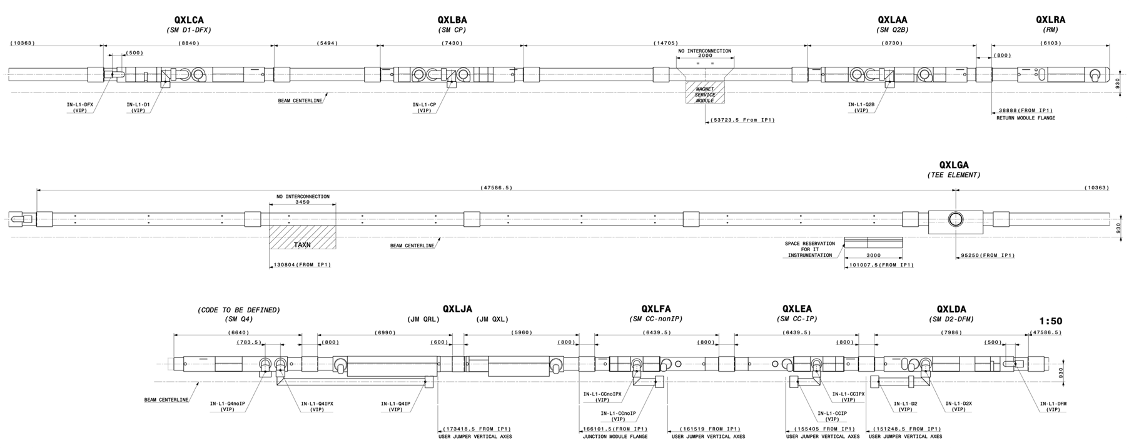
Scope
Inner Triplet region
Junction Module region
(Under revision: LHC-QXLJ-EC-0001)
D2 / Crab Cavities region

Slide 3
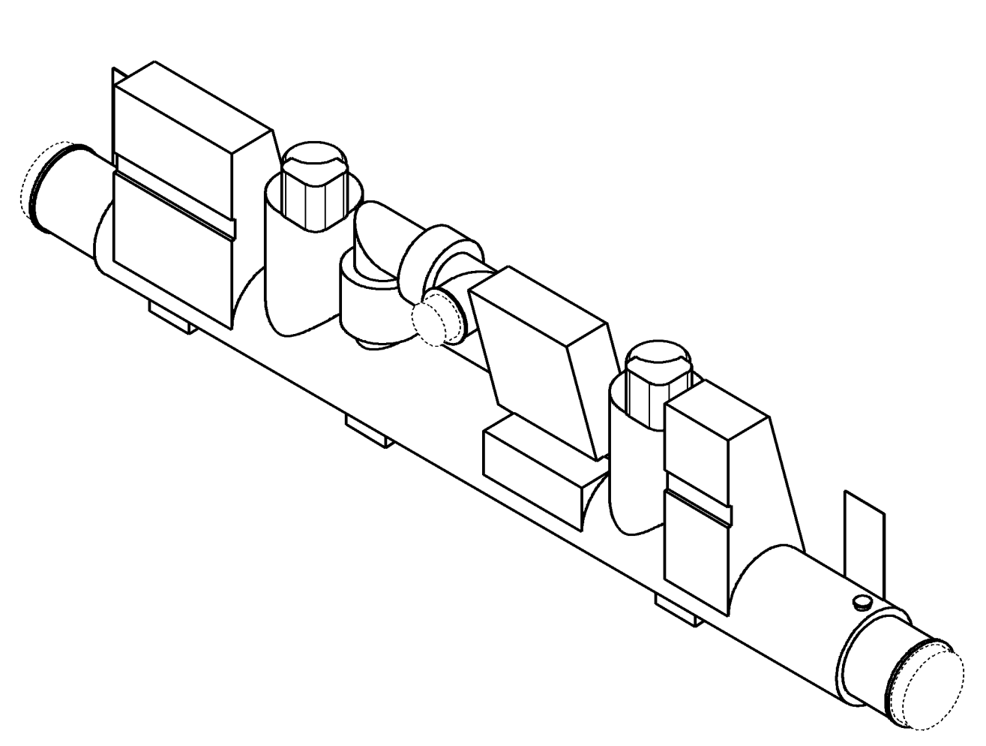
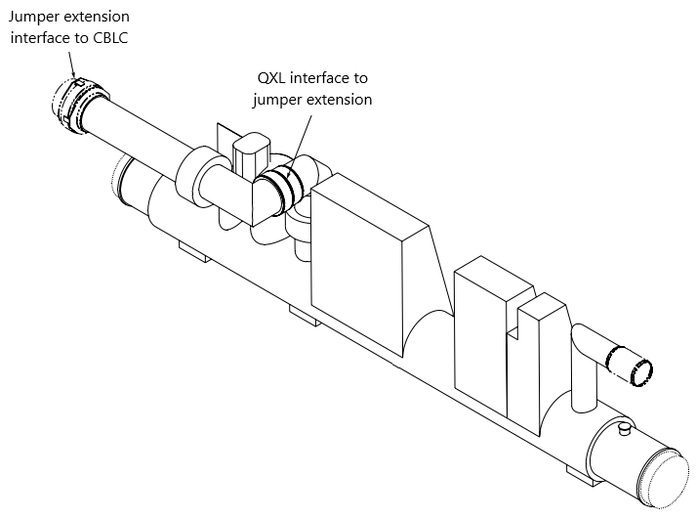
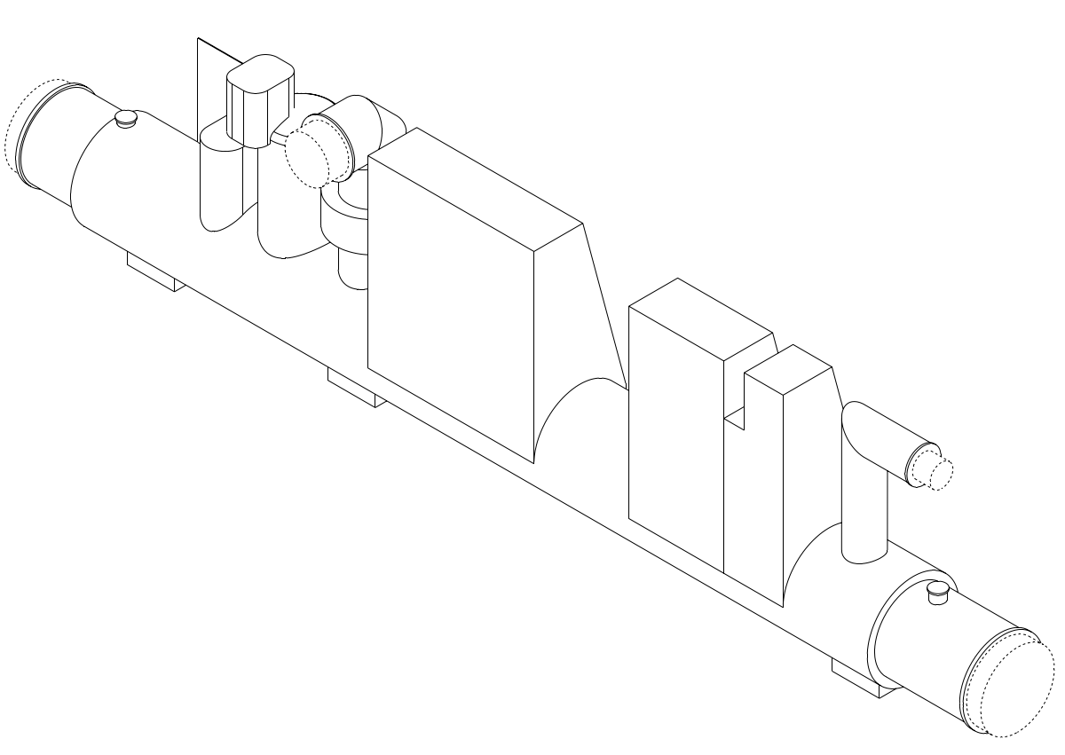
Types of QXL jumper
Inner Triplet jumper
Jumper with Jumper Extension
Rigid jumper
Q2B, CP, D1
D2, CC-IP, CC-nonIP
DFX, DFM

Slide 4
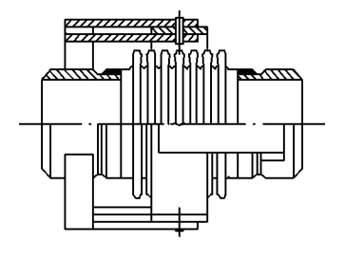
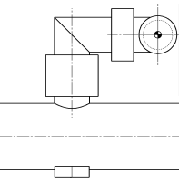
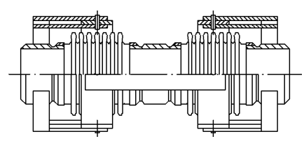
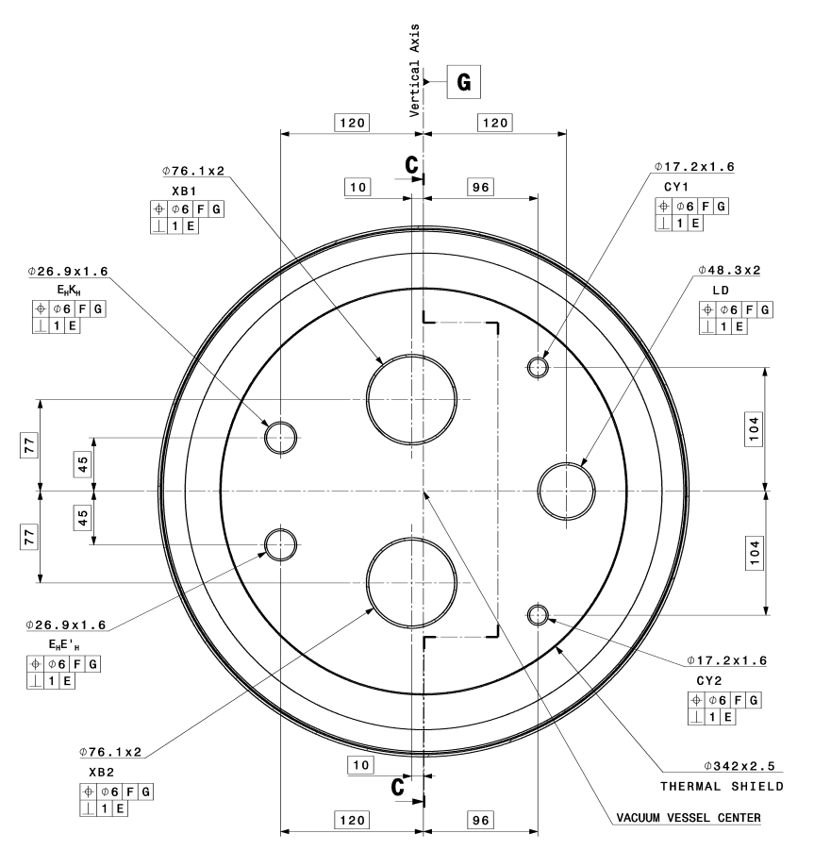
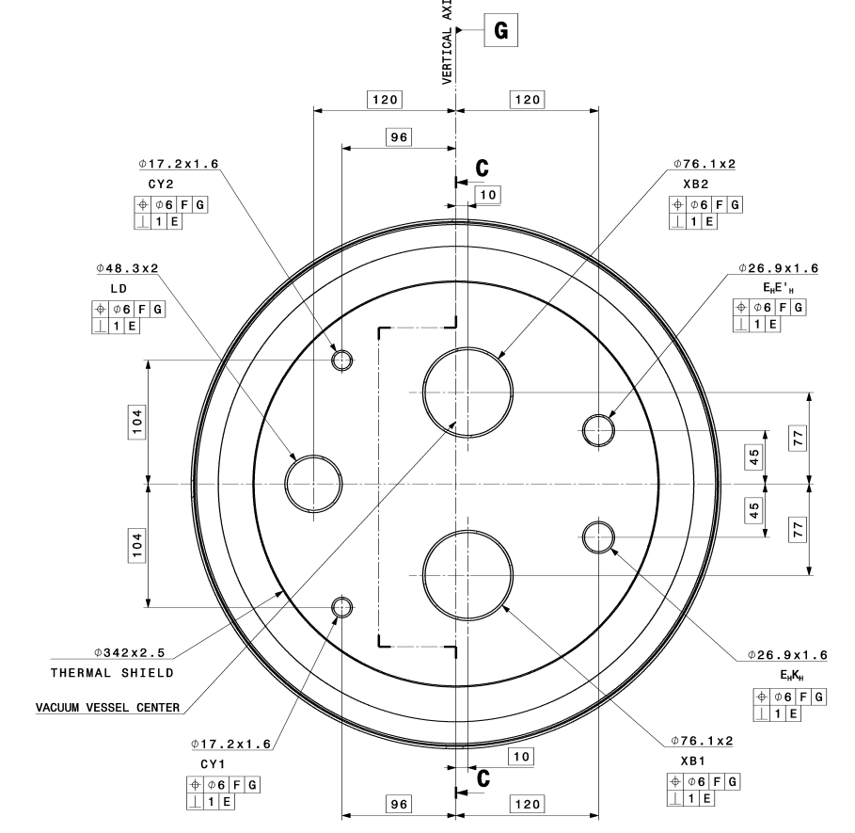
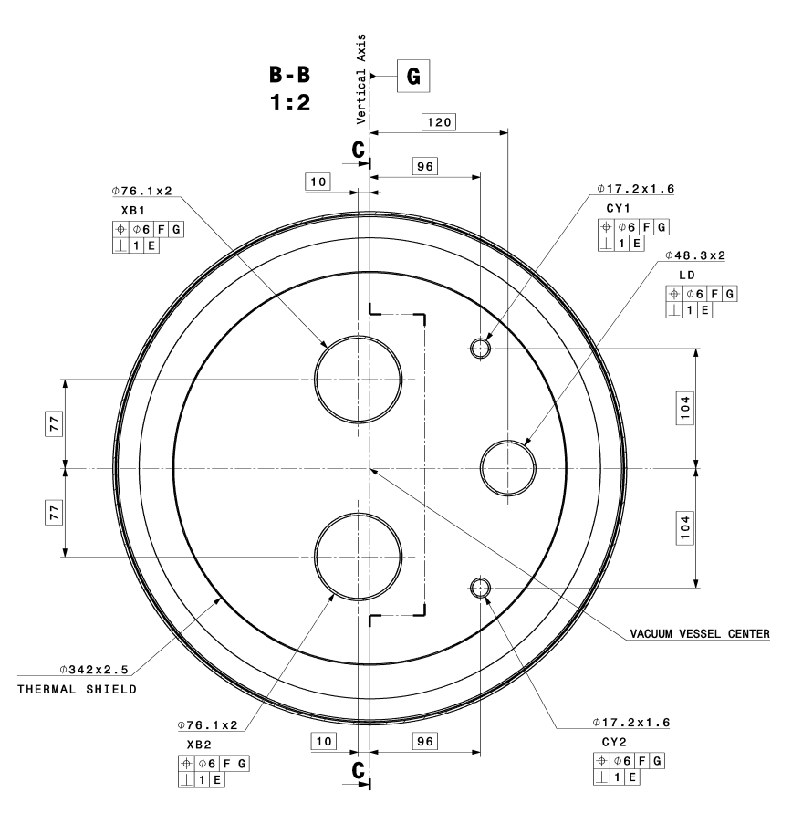
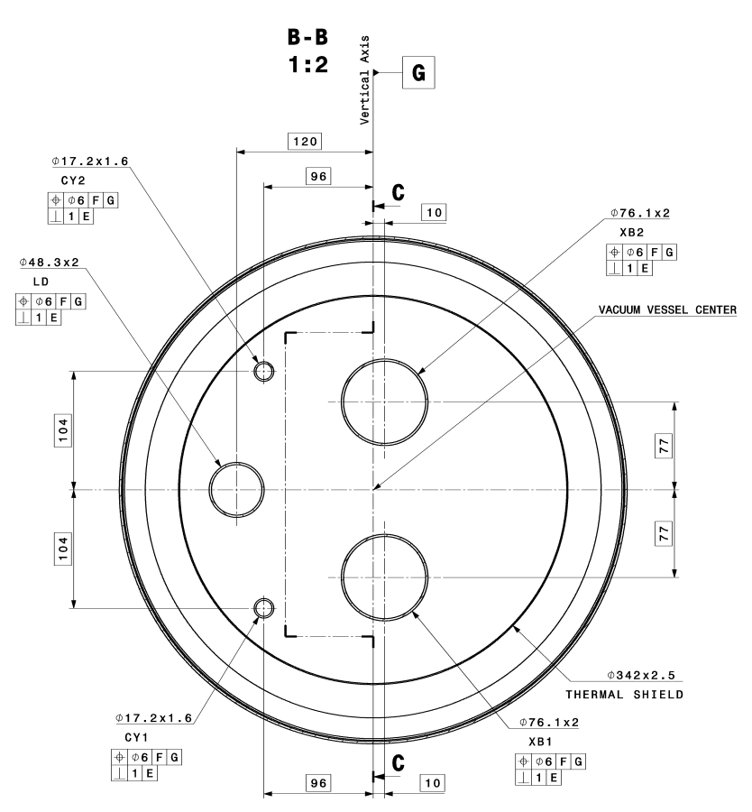
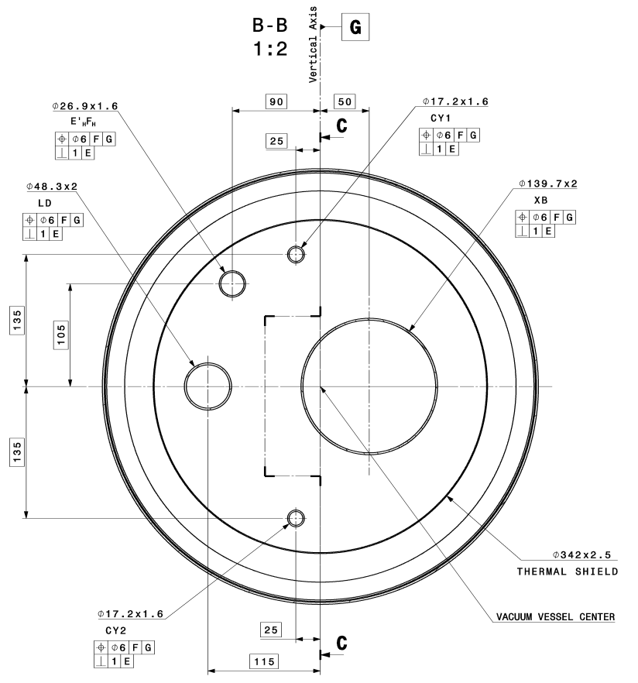
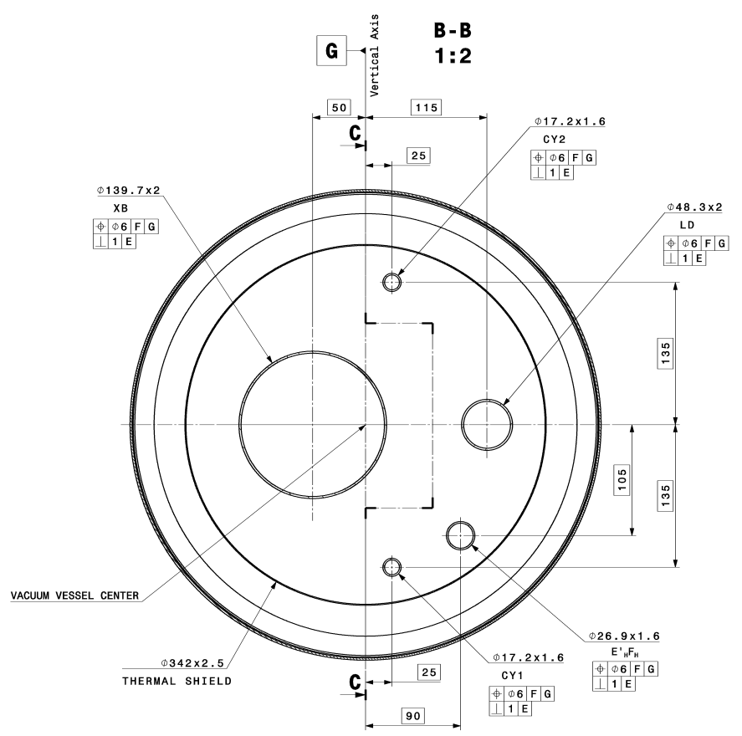
Inner Triplet Jumper
Layout:
  Different height
  Left and right side mirrored
Interfaces:
  different number and size of pipes
    Q2B: 7
    CP: 5
    D1: 7
  Left and right side mirrored
L
D
IP | Side | Jumper | H | L | D
 |  |  | [mm] | [mm] | [mm]
1 | Left | Q2B | 1188 | 1000 | 440
 |  | CP | 1188
 |  | D1 | 1188
 | Right | Q2B | 1188
 |  | CP | 1188
 |  | D1 | 1188
5 | Left | Q2B | 1201
 |  | CP | 1381 | 129 | 405
 |  | D1 | 1381
 | Right | Q2B | 1201
 |  | CP | 1381 | 129 | 405
 |  | D1 | 1381
H
Q2B left
Q2B right
CP left
CP right
D1 left
D1 right

Slide 5
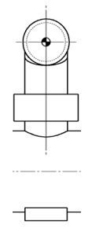

Jumper with Jumper Extension
D2
Crab Cavities
440
380
H_{IP1}=1234
H_{IP5}=1427
H_{IP1}=1234
H_{IP5}=1427
Layout of the pipes at the interface with the jumper extension to be defined based on:
  Layout of pipes at interface with the cryogenic beamline component
  Methods and tooling employed by CERN to make the interconnection on site

Slide 6
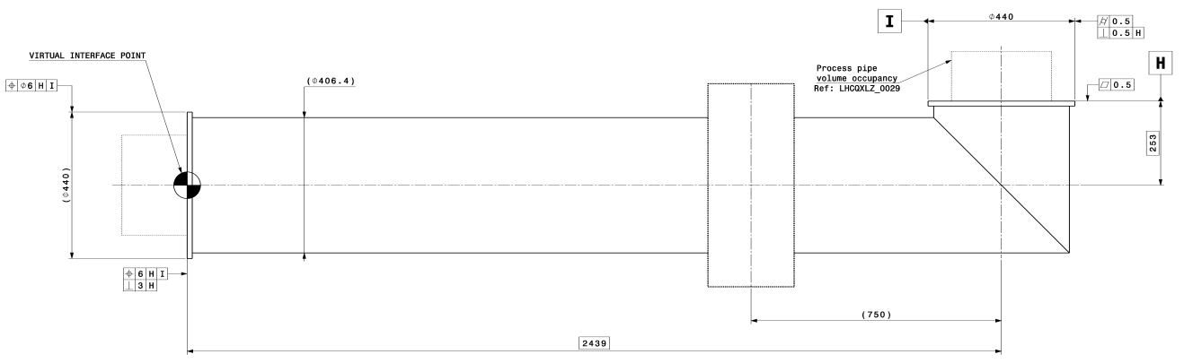
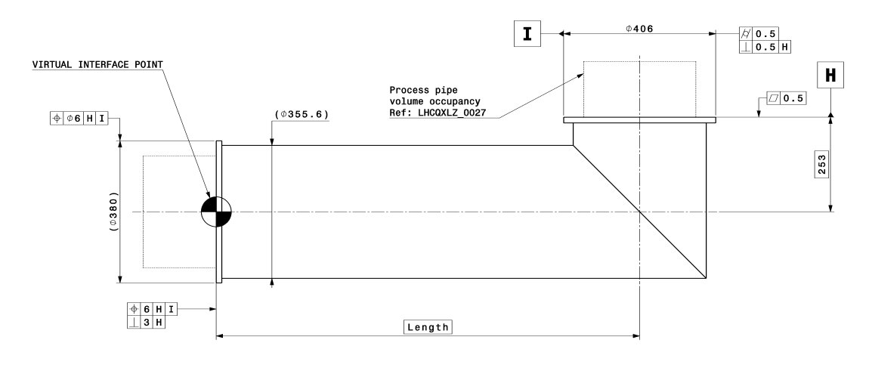
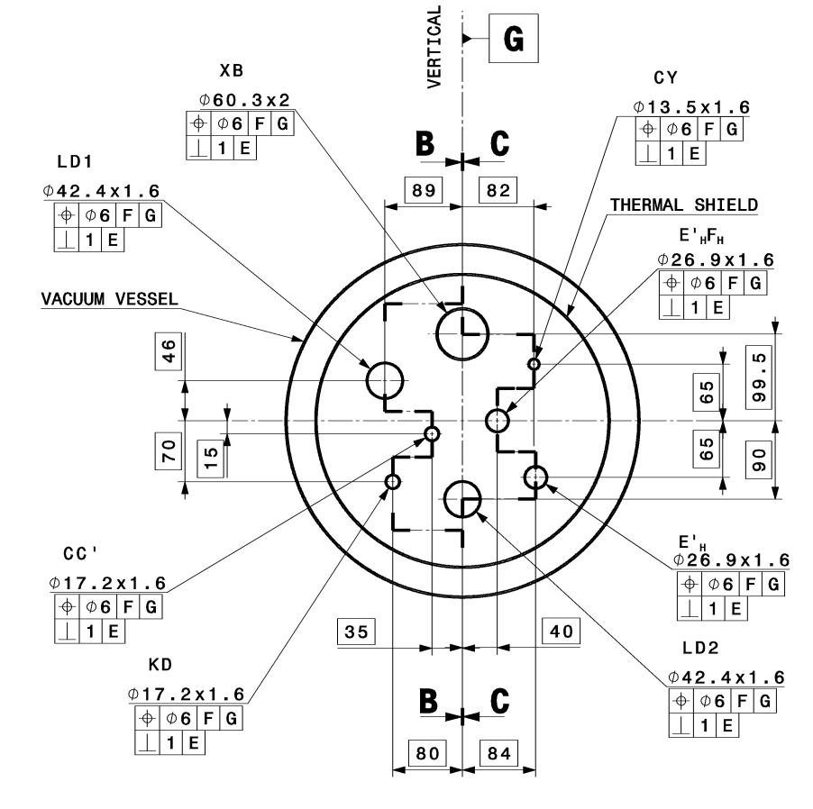
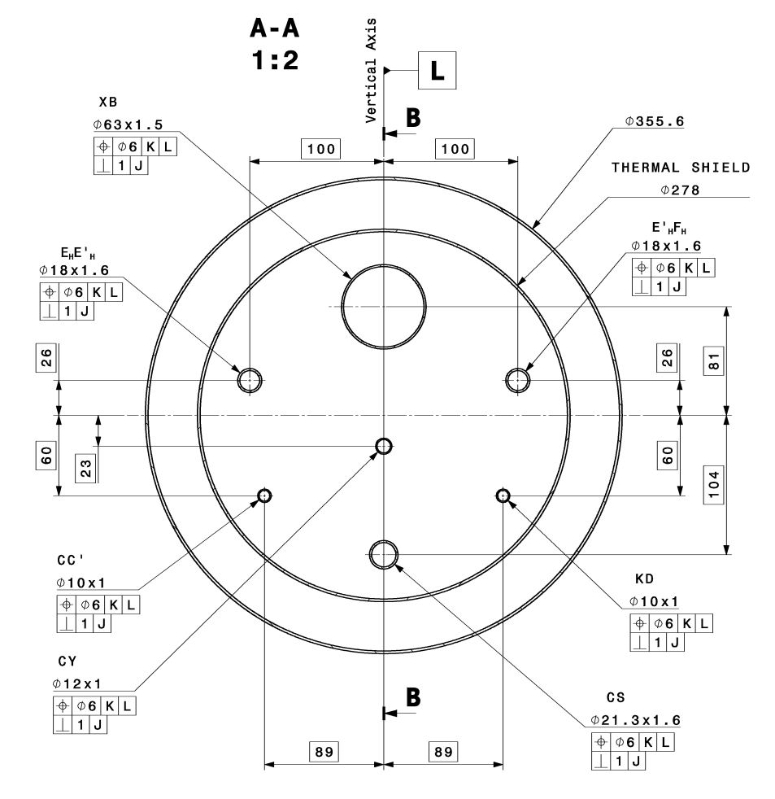
Jumper Extensions
D2
Crab Cavities
In the
interconnection
8 lines
7 lines

Slide 7
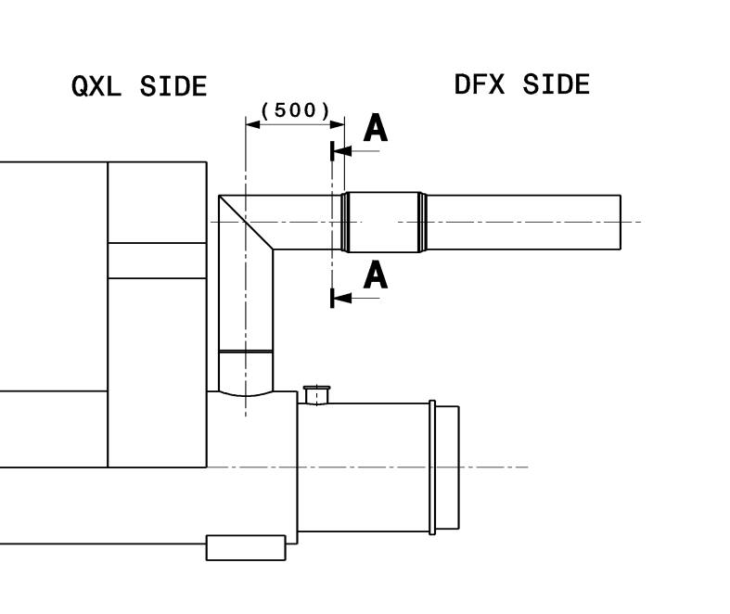
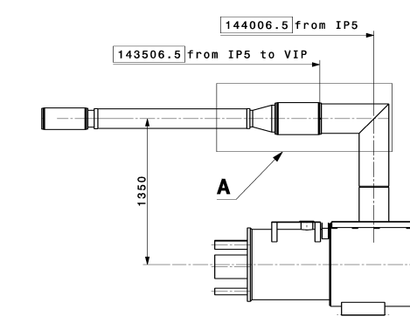
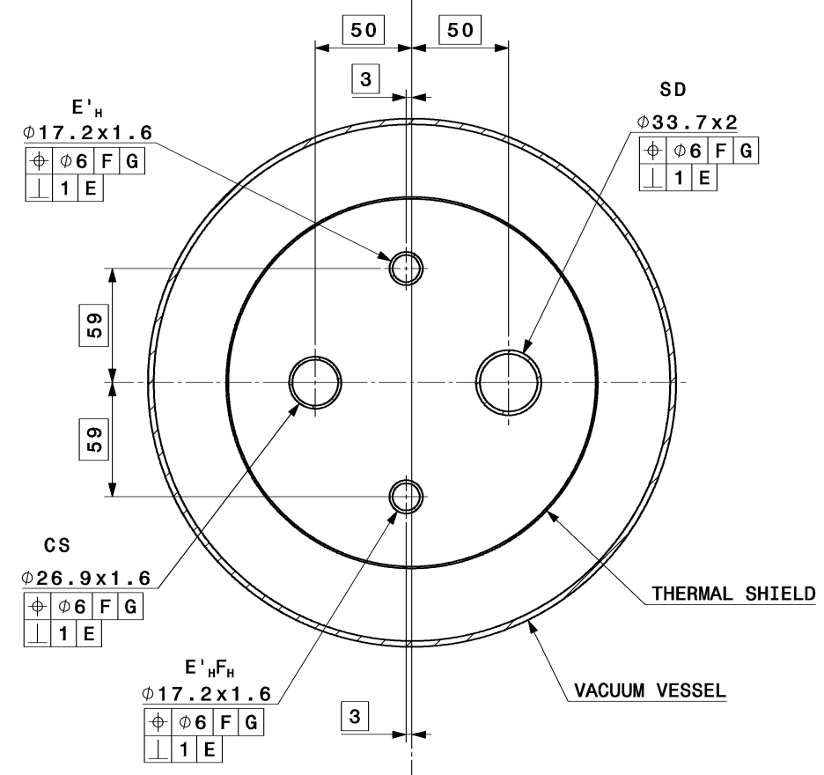
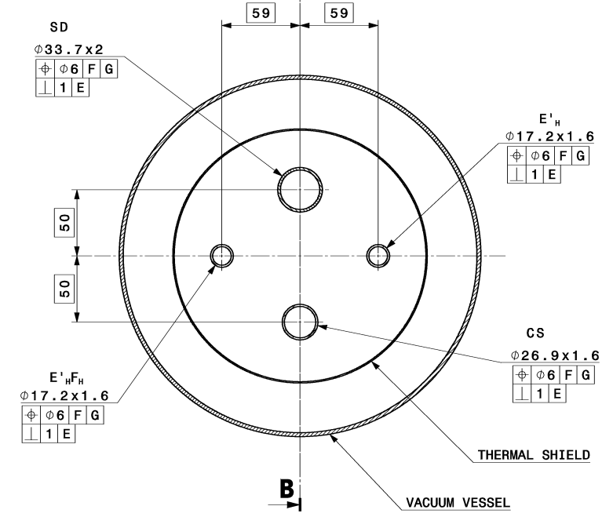
Rigid Jumper
DFX
DFM

Slide 8
Reference documents
QXL Jumper | IP | QXL Layout Drawing | Service Module Assembly Drawing | Service Module Equipment Drawing | Jumper Interface Drawing | Jumper Internal Interface Drawing
Q2B | 1L | LHCQXL_G0009 | - | LHCQXLAA0001 | LHCQXLZ_0001 | -
 | 1R | LHCQXL_G0010 | - | LHCQXLAB0001 | LHCQXLZ_0002 | -
 | 5L | LHCQXL_G0011 | - | LHCQXLAC0001 | LHCQXLZ_0003 | -
 | 5R | LHCQXL_G0012 | - | LHCQXLAD0001 | LHCQXLZ_0004 | -
CP | 1L | LHCQXL_G0009 | - | LHCQXLBA0001 | LHCQXLZ_0005 | -
 | 1R | LHCQXL_G0010 | - | LHCQXLBB0001 | LHCQXLZ_0006 | -
 | 5L | LHCQXL_G0011 | - | LHCQXLBC0001 | LHCQXLZ_0007 | -
 | 5R | LHCQXL_G0012 | - | LHCQXLBD0001 | LHCQXLZ_0008 | -
D1 | 1L | LHCQXL_G0009 | - | LHCQXLCA0001 | LHCQXLZ_0009 | -
 | 1R | LHCQXL_G0010 | - | LHCQXLCB0001 | LHCQXLZ_0010 | -
 | 5L | LHCQXL_G0011 | - | LHCQXLCC0001 | LHCQXLZ_0011 | -
 | 5R | LHCQXL_G0012 | - | LHCQXLCD0001 | LHCQXLZ_0012 | -
D2 | 1L | LHCQXL_G0009 | LHCQXLDA0002 | LHCQXLDA0001 | LHCQXLZ_0017 | LHCQXLZ_0019
 | 1R | LHCQXL_G0010 | LHCQXLDB0002 | LHCQXLDB0001 | LHCQXLZ_0018 | LHCQXLZ_0020
 | 5L | LHCQXL_G0011 | LHCQXLDC0002 | LHCQXLDC0001 | LHCQXLZ_0019 | LHCQXLZ_0019
 | 5R | LHCQXL_G0012 | LHCQXLDD0002 | LHCQXLDD0001 | LHCQXLZ_0020 | LHCQXLZ_0020
CC-IP | 1L | LHCQXL_G0009 | LHCQXLEA0002 | LHCQXLEA0001 | LHCQXLZ_0025 | LHCQXLZ_0027
 | 1R | LHCQXL_G0010 | LHCQXLEB0002 | LHCQXLEB0001 | LHCQXLZ_0026 | LHCQXLZ_0028
 | 5L | LHCQXL_G0011 | LHCQXLEC0002 | LHCQXLEC0001 | LHCQXLZ_0025 | LHCQXLZ_0027
 | 5R | LHCQXL_G0012 | LHCQXLED0002 | LHCQXLED0001 | LHCQXLZ_0026 | LHCQXLZ_0028
CC-noIP | 1L | LHCQXL_G0009 | LHCQXLFA0002 | LHCQXLFA0001 | LHCQXLZ_0026 | LHCQXLZ_0028
 | 1R | LHCQXL_G0010 | LHCQXLFB0002 | LHCQXLFB0001 | LHCQXLZ_0025 | LHCQXLZ_0027
 | 5L | LHCQXL_G0011 | LHCQXLFC0002 | LHCQXLFC0001 | LHCQXLZ_0026 | LHCQXLZ_0028
 | 5R | LHCQXL_G0012 | LHCQXLFD0002 | LHCQXLFD0001 | LHCQXLZ_0025 | LHCQXLZ_0027

Slide 9
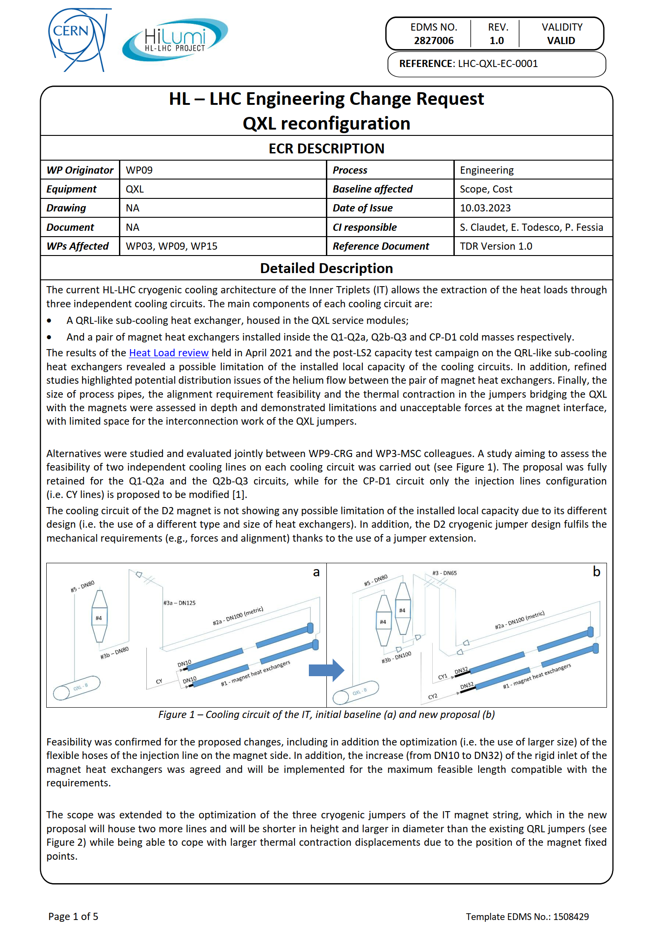

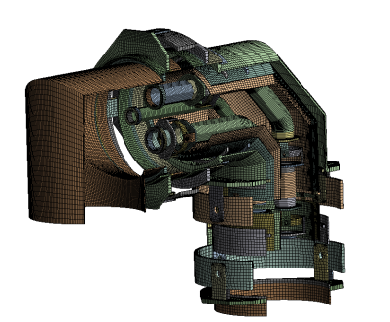
QXL Vs SQXL
Jumper design studies
Inner Triplet region reconfiguration
(EDMS 2827006)
SQXL installation lessons learnt
(EDMS 2768428)

Slide 10
Jumper design studies
Engineering methods for installation
  QXL/QRL Jumper interfaces preparation for interconnection
  QXL/QRL Jumper interfaces alignment
  HL-LHC Jumpers interconnection
  QXL/QRL Installation requirements
  Jumper extension installation requirements
Technical notes
  Jumpers interconnection layout review
  Jumpers required flexibility evaluation
  Jumpers interconnection weld flanges structural verification
  Jumpers stiffness analysis
HL-LHC Jumpers interface specification
(EDMS 2419072)
Validation activities
  Jumpers mock-up
  Flexible hoses characterization tests (EDMS xxx)

Slide 11
Installation methods
magnets
interconnection
QXL/QRL
installation
QXL
commissioning
QXL/QRL
interface preparation
User
Installation
(1st positioning)
Jumper extension installation
User final
positioning
(smoothing)
Jumper
interface
alignment
Interface to magnet
interconnection
Interface to
QXL/QRL
interconnection
QXL/QRL Installation requirements
QXL/QRL Jumper interfaces preparation for interconnection
Jumper extension installation
QXL/QRL Jumper interfaces alignment
HL-LHC Jumpers interconnection

Slide 12
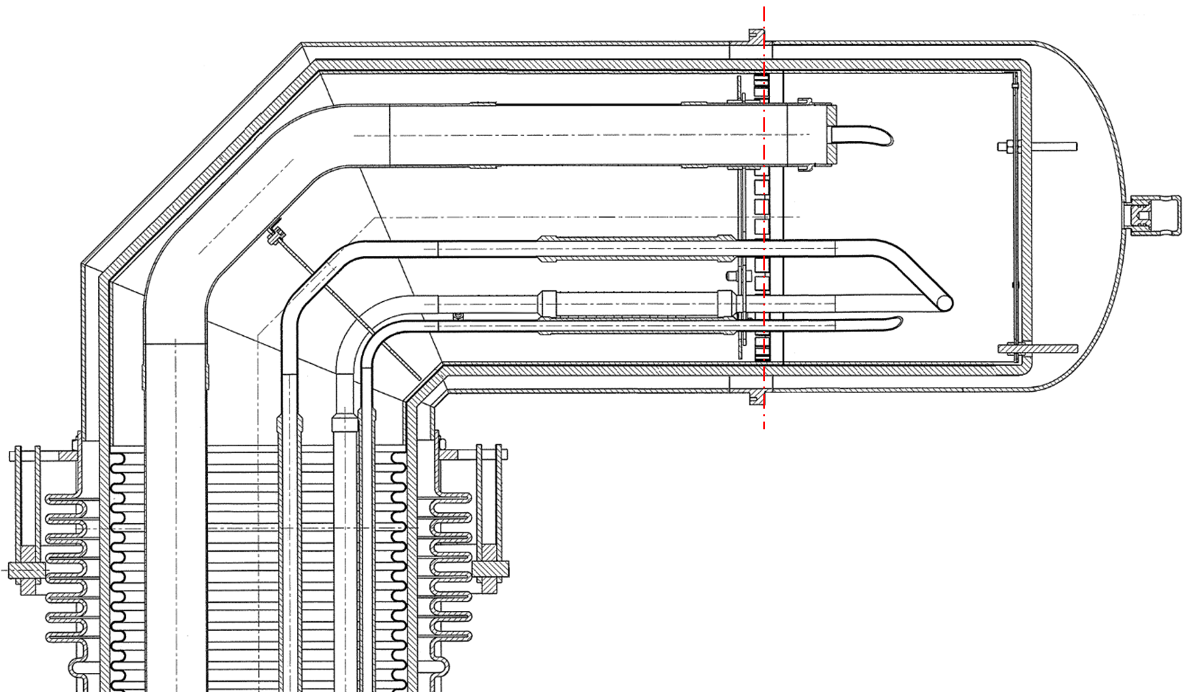
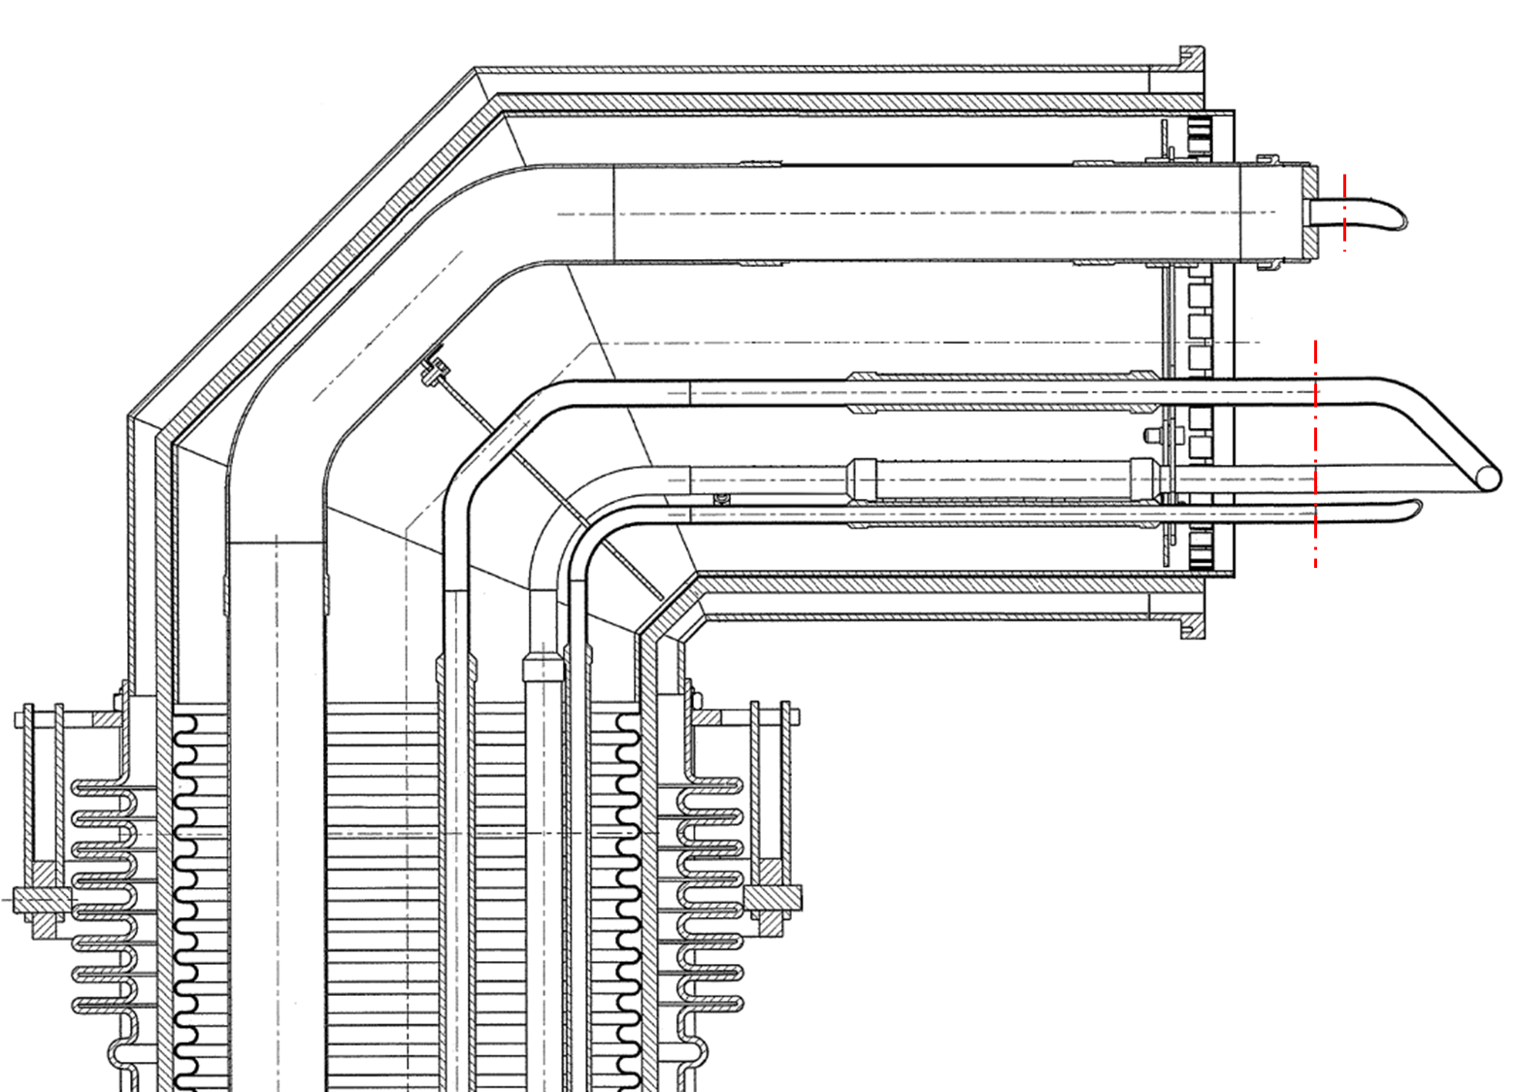
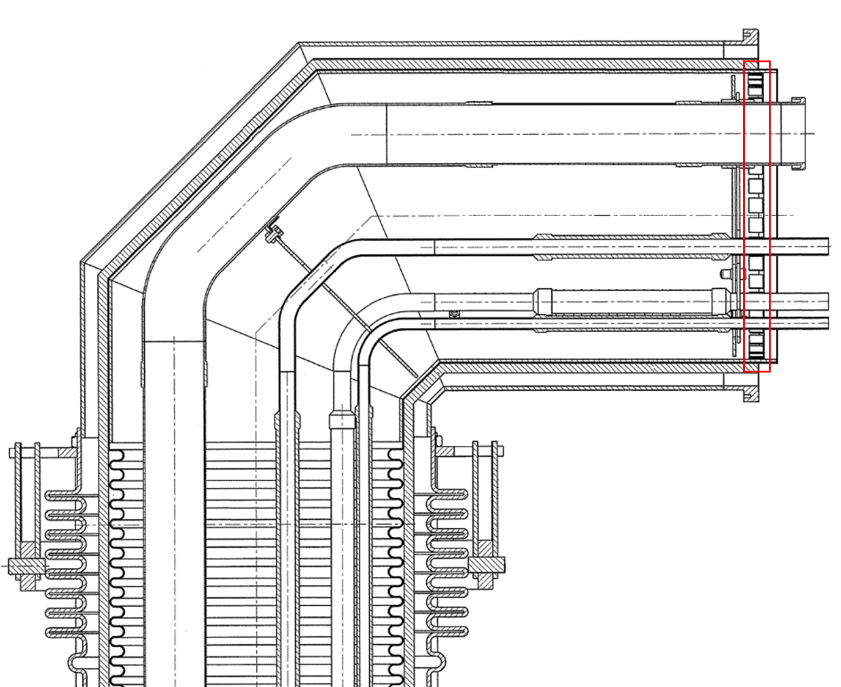
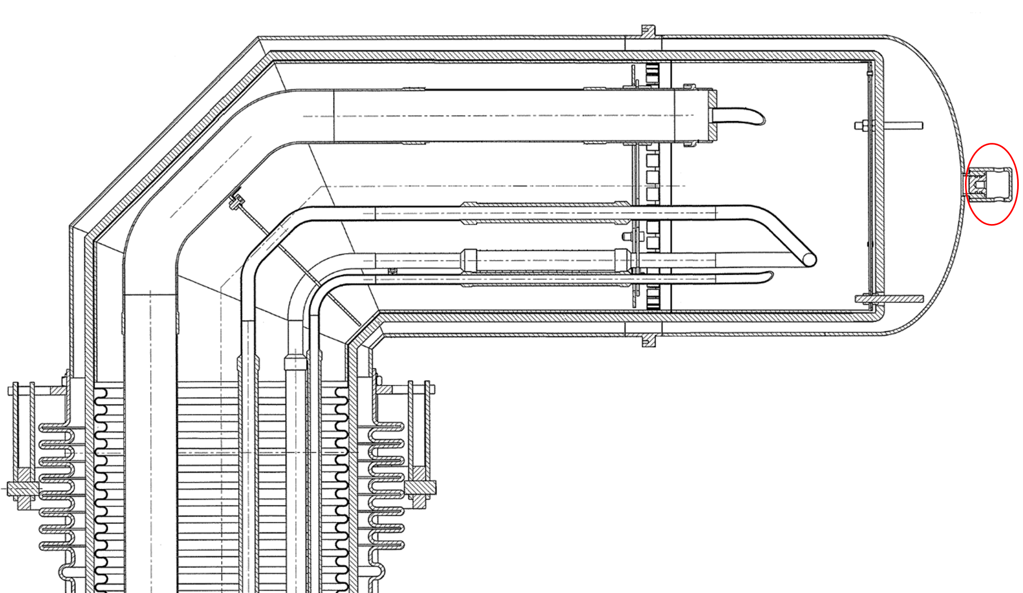
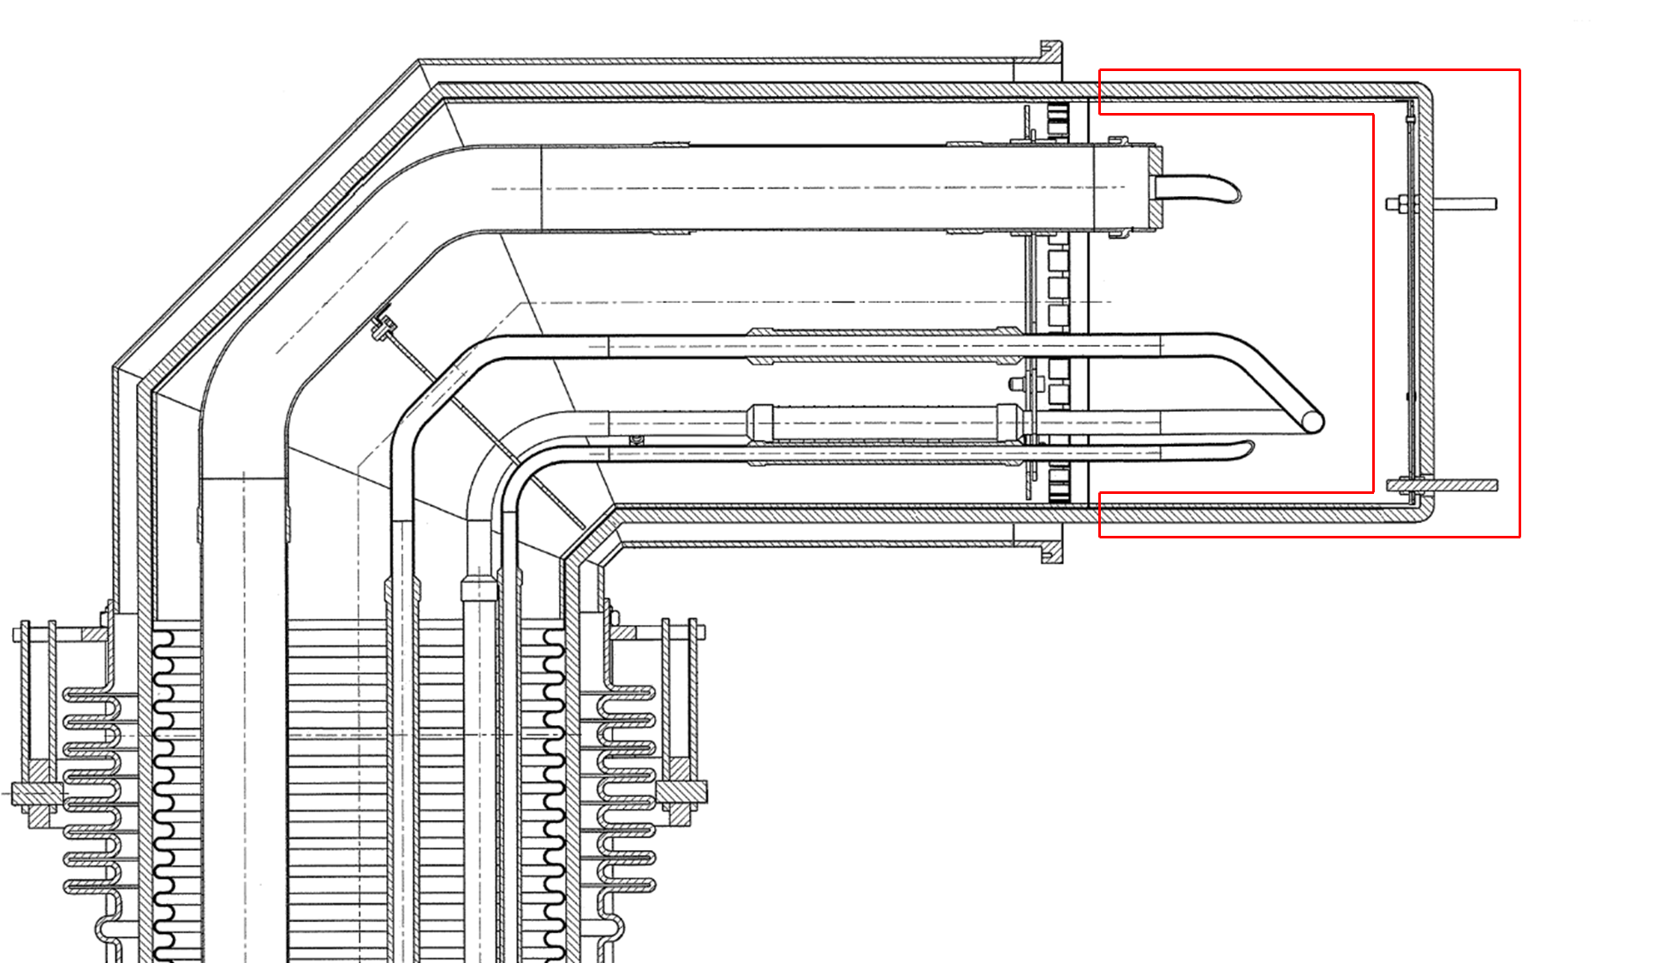
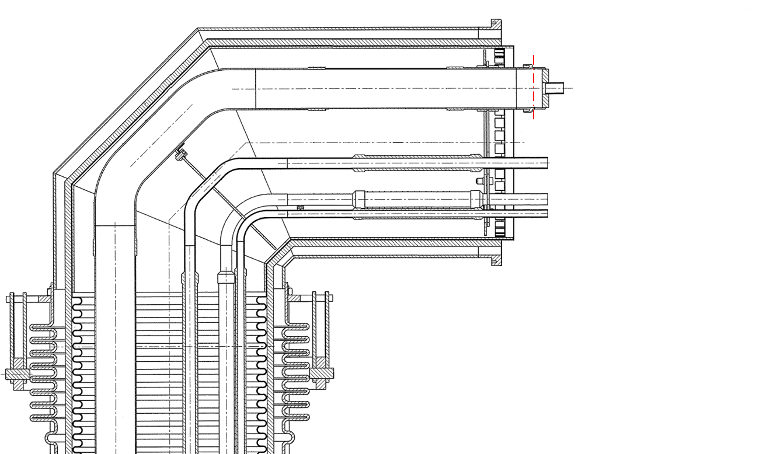
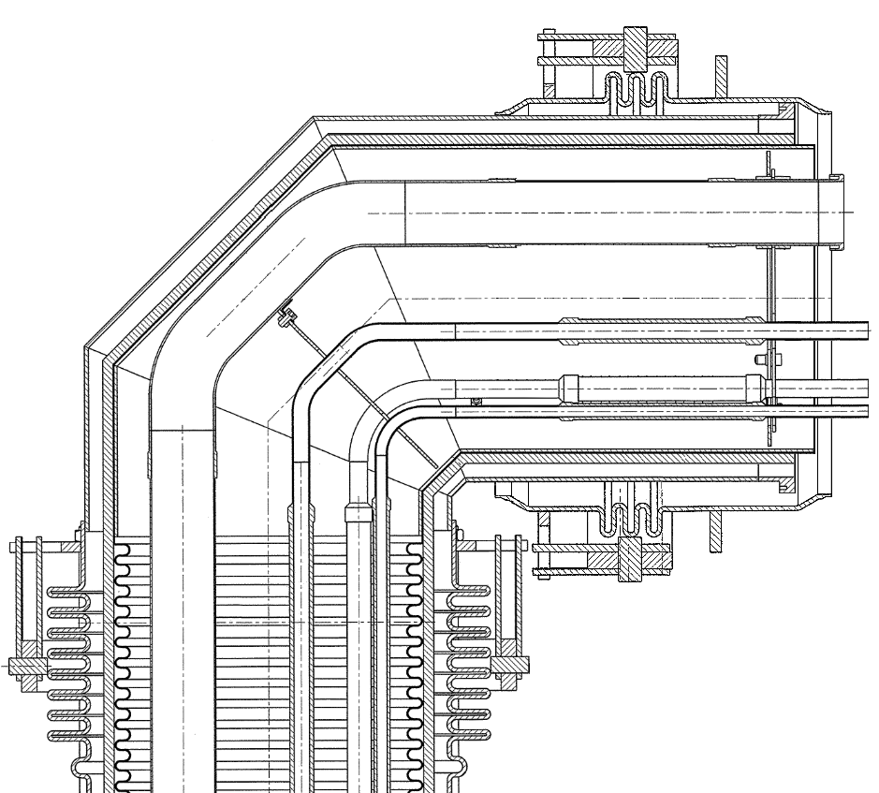
Jumper interfaces preparation for interconnection
Opening of vacuum jacket valves
Cutting of vacuum jacket endcap
Removal of thermal shield endcap and MLI
Cutting of pipes overlength
Removal of pipe endcaps
Removal of piping internal support (optional)
Positioning of vacuum jacket sleeve
Cleaning and preservation

Slide 13
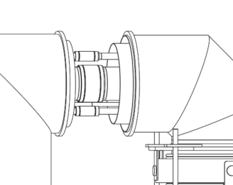
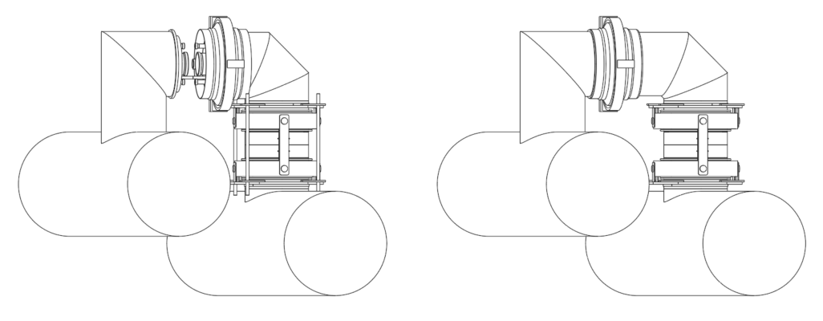
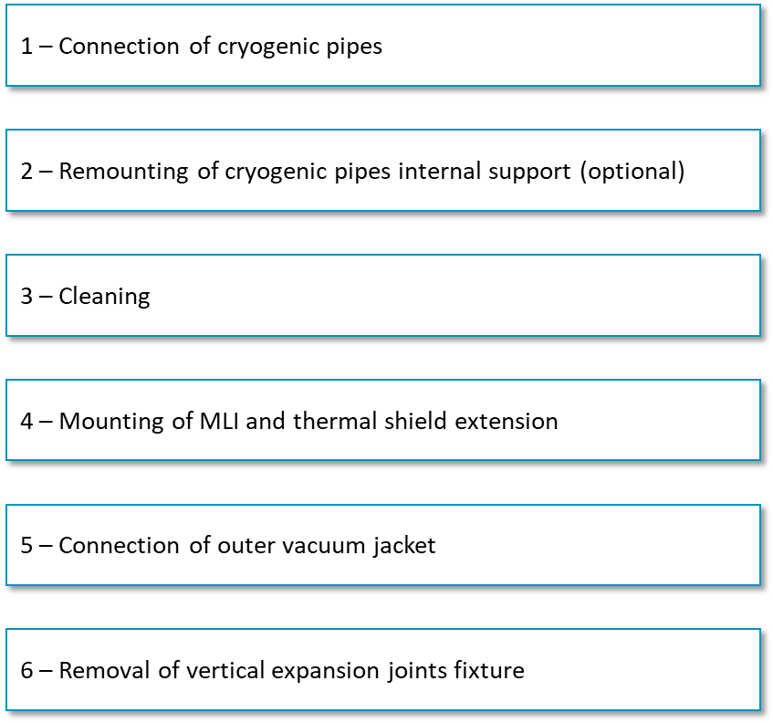
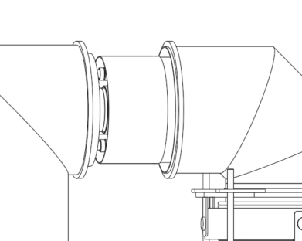
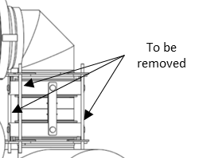
Jumpers interconnection
Interconnection sequence
Initial configuration
Final configuration

Slide 14
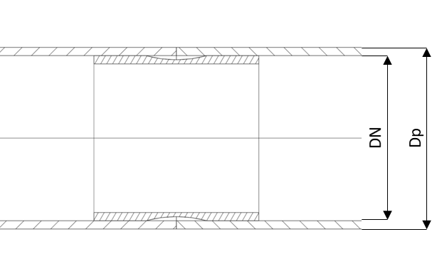
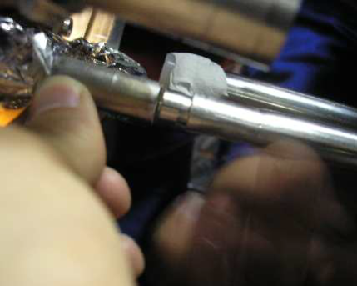
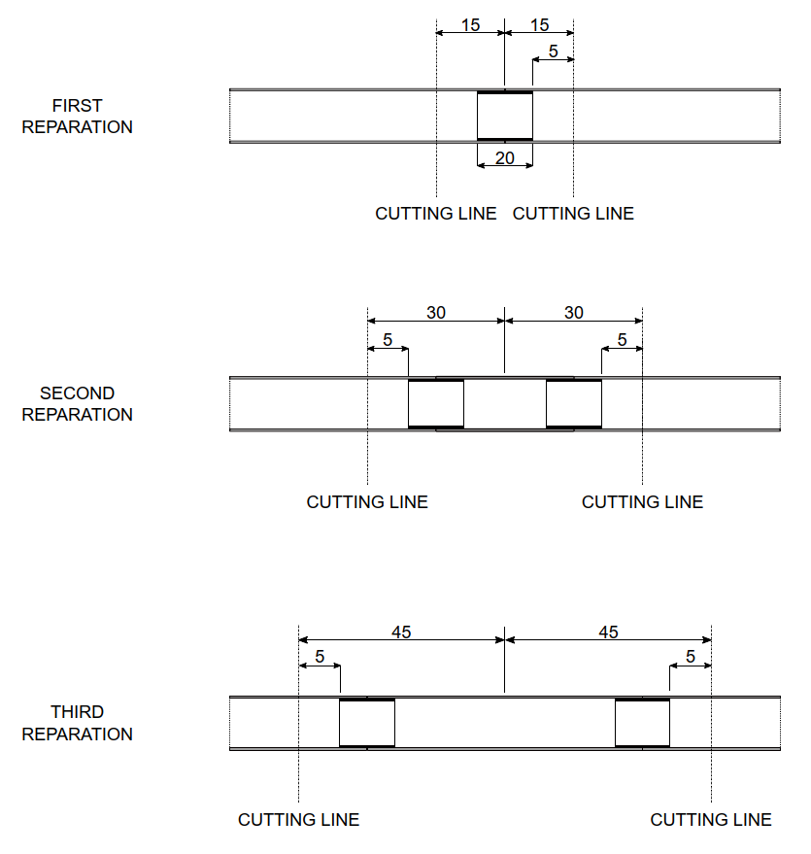
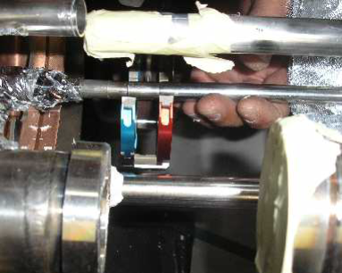
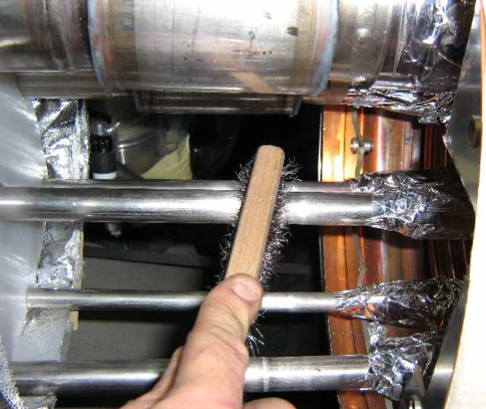
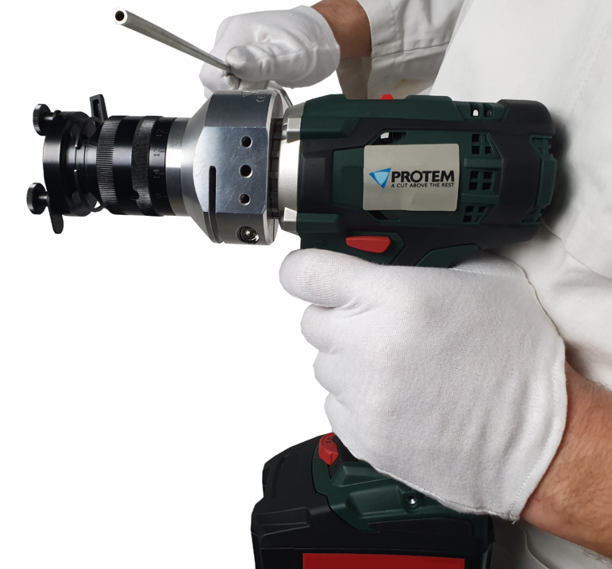
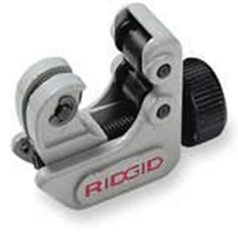
Jumpers interconnection
Pipes with backing rings
Configurations
Installation sequence
Repair
Line | DN | Dp | Tube t | N. of Tubes | Welding technique
[-] | [-] | [mm] | [mm] | [-] | [-]
CC', KD | Φ10 | 10 | 1 | 32 | Orbital TIG
CY | DN6 | 12 | 1 | 16 | Orbital TIG
CY | DN8 | 13.5 | 1.6 | 8 | Manual TIG
CC', CY, EE, E'_{H}, E'_{H}F_{H}, FF, KD | DN10 | 17.2 | 1.6 | 68 | Orbital TIG
E_{H}E'_{H}, E'_{H}F_{H} | Φ18 | 18 | 1.6 | 32 | Orbital TIG
EE, RD | Φ22 | 22 | 1 | 8 | Manual TIG

Slide 15
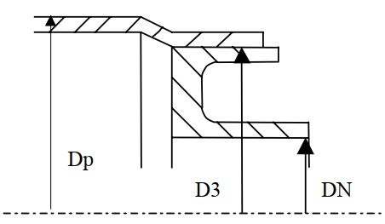
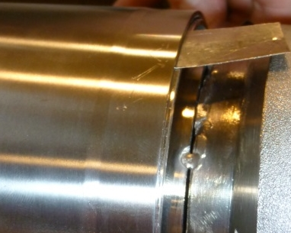
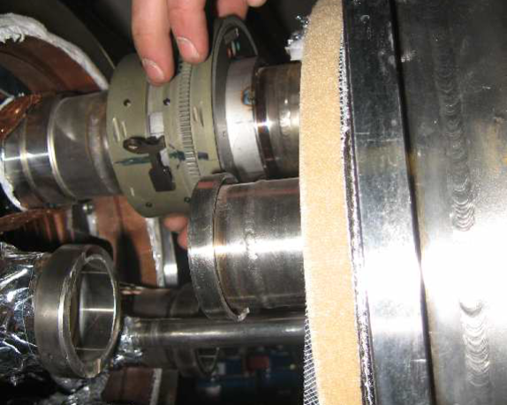
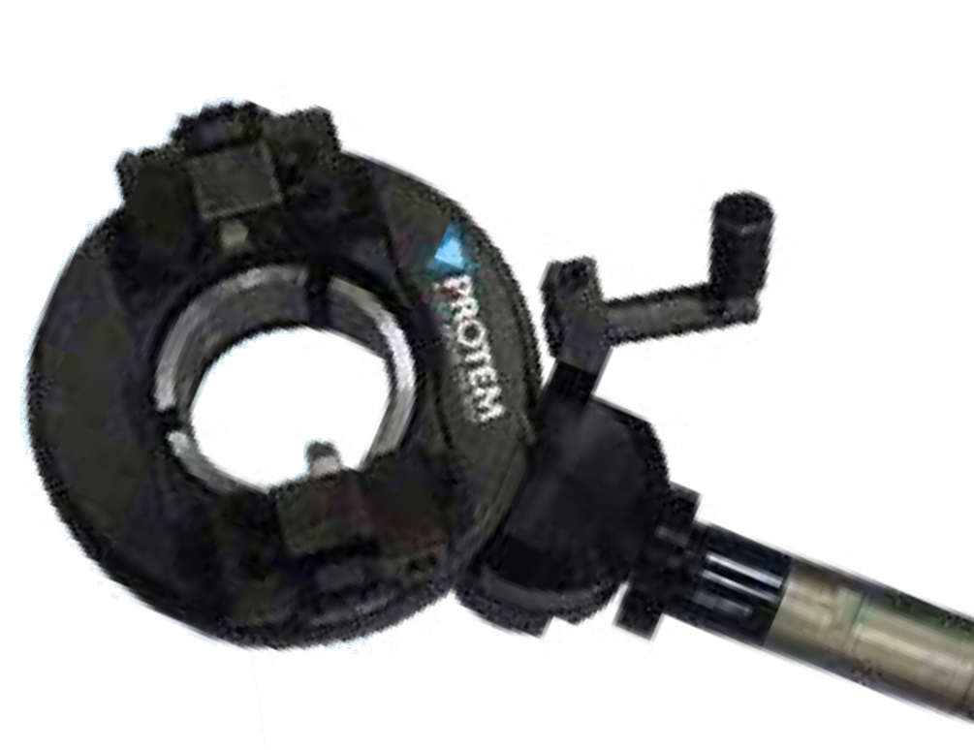
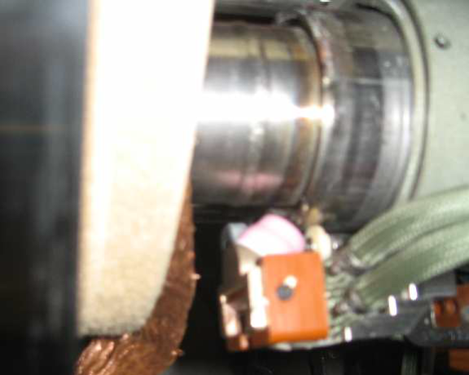
Jumpers interconnection
Pipes with sliding sleeve
Configurations
Installation sequence
Repair
Line | DN | Cutting machine
[-] | [-] | [-]
CS | DN15 | PROTEM TTSRD_41
CS, E_{H}E'_{H}, E_{H}K_{H}, E'_{H}, E'_{H}F_{H} | DN20 | PROTEM TTSRD_41
SD | DN25 | PROTEM TTSRD_71
LD | DN32 | PROTEM TTSRD_71
CL | Φ43 | PROTEM TTSRD_71
LD | DN40 | PROTEM TTSRD_71
LD | Φ52 | TBD
XB | DN50 | PROTEM TTSRD_78
XB | Φ63 | PROTEM TTSRD_78
XB | DN125 | TBD
Line | DN | D3 | Dp | N. of Tubes | Welding technique
[-] | [-] | [mm] | [mm] | [-] | [-]
CS | DN15 | 37 | 41 | 16 | Orbital TIG
CS, E_{H}E'_{H}, E_{H}K_{H}, E'_{H}, E'_{H}F_{H} | DN20 | 37 | 41 | 36 | Orbital TIG
SD | DN25 | 46 | 50 | 8 | Manual TIG
LD | DN32 | 54 | 58 | 16 | Manual TIG
CL | Φ43 | 54 | 58 | 12 | Manual TIG
LD | DN40 | 64 | 68 | 12 | Manual TIG
LD | Φ52 | TBD | TBD | 6 | Manual TIG
XB | DN50 | 73.5 | 77 | 8 | Manual TIG
XB | Φ63 | 73.5 | 77 | 16 | Manual TIG
XB | DN125 | 151 | 155 | 12 | Manual TIG

Slide 16
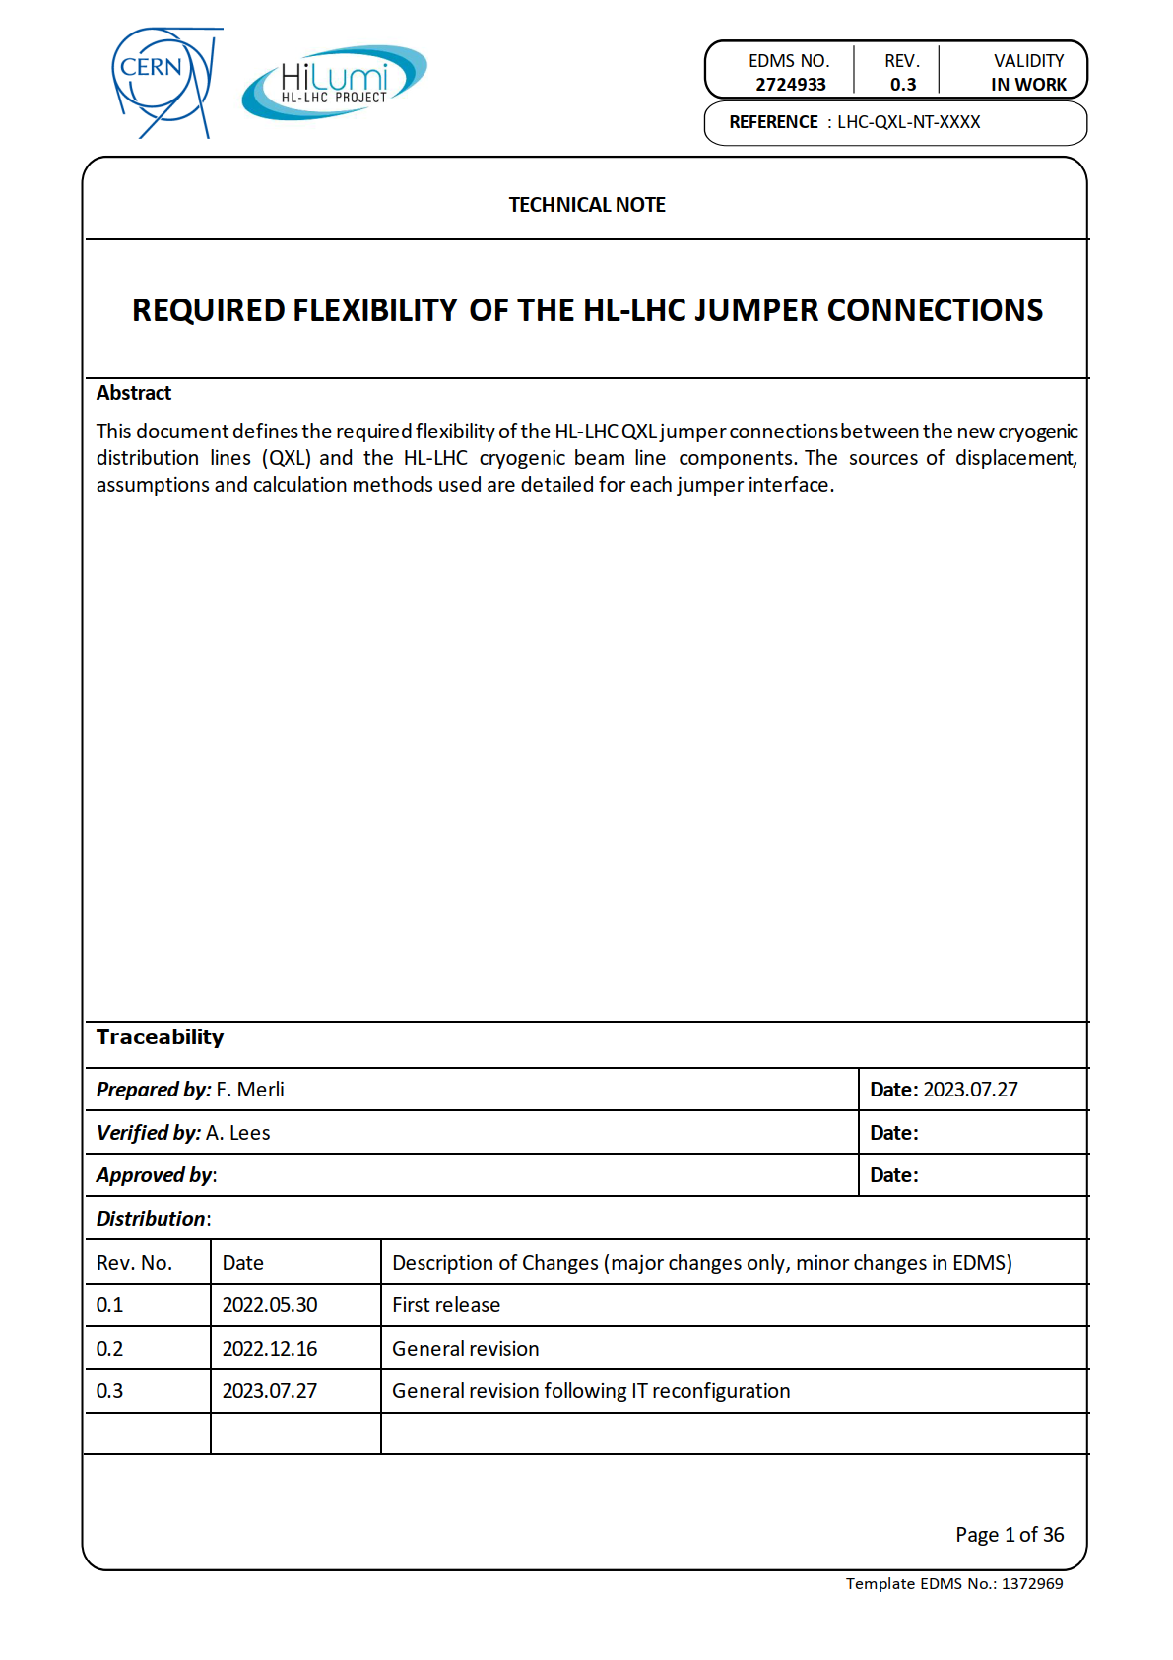
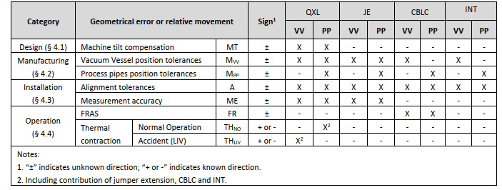
Jumpers flexibility requirements
Jumper required flexibility definition
(EDMS 2724933)
Sources of required flexibility
QXL Jumper (QXL)
Jumper Extension (JE)
Cryogenic Beam Line Component (CBLC)
Interconnection (INT)
Vacuum Vessel (VV)
Process Pipes (PP)
Applicable: “X”
Not applicable: “-”

Slide 17



Machine tilt
The design of the jumpers is adapted to the machine tilt in P1 and P5 to limit the impact on the jumper flexibility requirement

Slide 18



QXL manufacturing tolerances
Vacuum Vessel
Process Pipes
Jumper Extensions

Slide 19


Magnets manufacturing tolerances

Slide 20

Inner triplet region reconfiguration
Relocated gimbal sleeve
Additional length for flexible hoses
→ Increased pipes flexibility
Telescopic sleeve
→ Increased interconnection accessibility
QXL fixed point moved forward magnet fixed point
→ Reduced differential thermal contraction

Slide 21





Inner triplet region reconfiguration
Outcome of the study
Design displacements
  Vacuum jacket ✓
  Process pipes ✓
Loads on magnet’s cryostat
  Stress field ✓
  Global stability ✓
  Buckling ✓
Interconnection ✓
B. Wong Luis and D. Duarte Ramos, TE-MSC
EDMS 2798916
Vacuum jacket flexibility analysis
~260
Pipes flexibility analysis
Interconnection accessibility study

Slide 22


Inner triplet region reconfiguration
Impact of new process scheme
  + 1 subcooling heat exchanger
+ 2 control valves
+ 3 process lines
    CY2 (DN10)
    CY2’ (DN10)
    XB2 (DN65)
Outcome of the study
Internal pipe routing ✓
Thermal contraction accommodation ✓
Pressure drops ✓
External constraints ✓
HXI dome
Jumper interconnection
QXL Service Module
HXI dome
Q2B magnet Service Module
Magnet interconnection

Slide 23



SQXL installation lessons learnt

Slide 24
Summary
Several activities have been performed to anticipate issues with jumper interconnections for the LHC tunnel, which implements requirements and return of experience from:
  QRL design and installation
  SQXL installation
  IT region reconfiguration
The outcome of these activities result in the current specification and the design has undergone different level of validation.
The current design of the QXL is significantly different from the one of the SQXL also thanks to experience gathered during the manufacturing and installation of the SQXL.
The current design requirements will avoid issues experienced in the interconnection operations in SM18, provided that they will be fulfilled.
Quality control to ensure that the new requirements are met will be fundamental to avoid issues in LS3.

Slide 25
End of presentation

