Slide 1
Acoustic related activities in NCSR-D
Christos Markou
27/1/2025

Slide 2
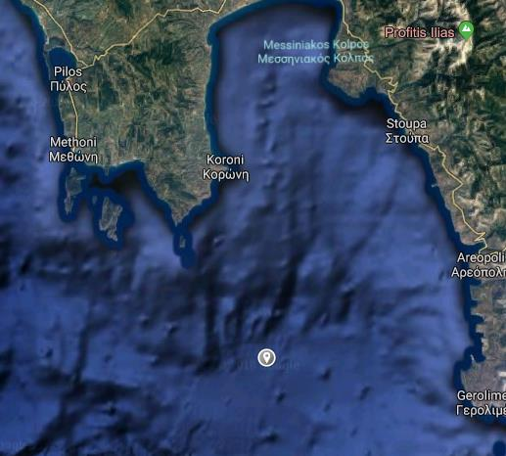
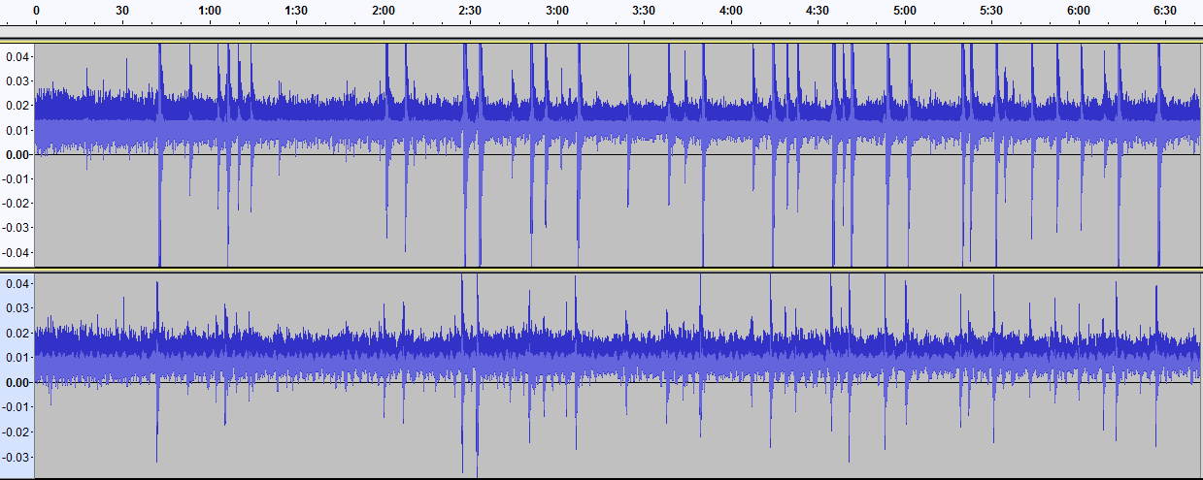
Acoustic detection of neutrinos
Ambient noise in SW Peloponnese
Deployed 2 hydrophones in 2/2018 at 1600 m depth to evaluate the acoustic load of the area.
1 month continuous recording
Data from Martine traffic
Data are used to tune algorithms and MC
Recorded sounds include ship traffic, environmental noises like rain, waves, wind, thunder, and marine life

Slide 3
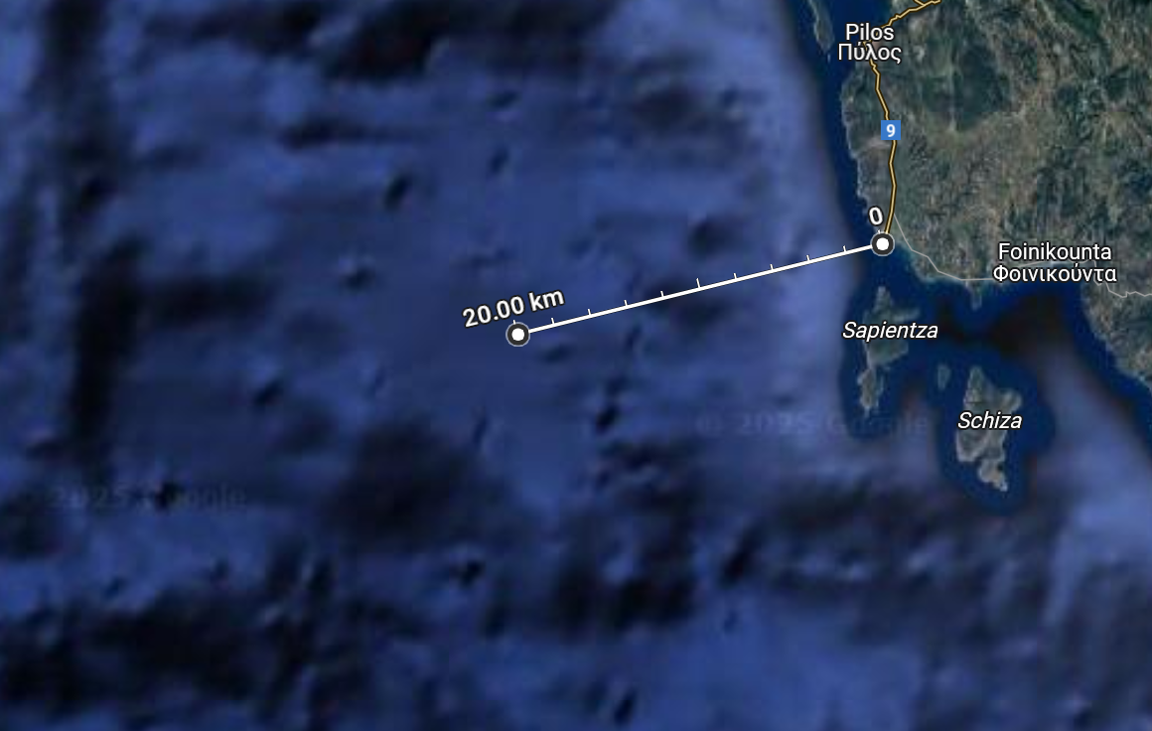
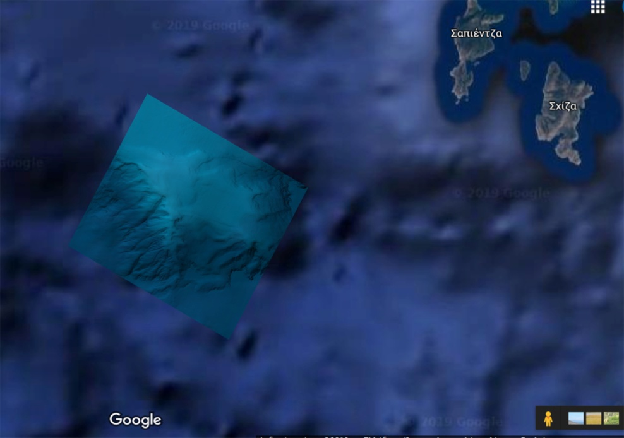
Mapping of the sea bottom (sub-m resolution)

Slide 4
Latest addition:
A system of 4 reference hydrophones sharing the same clock able to work autonomously down to depths of 1200 m. Power autonomy ~ 1 month.

Slide 5
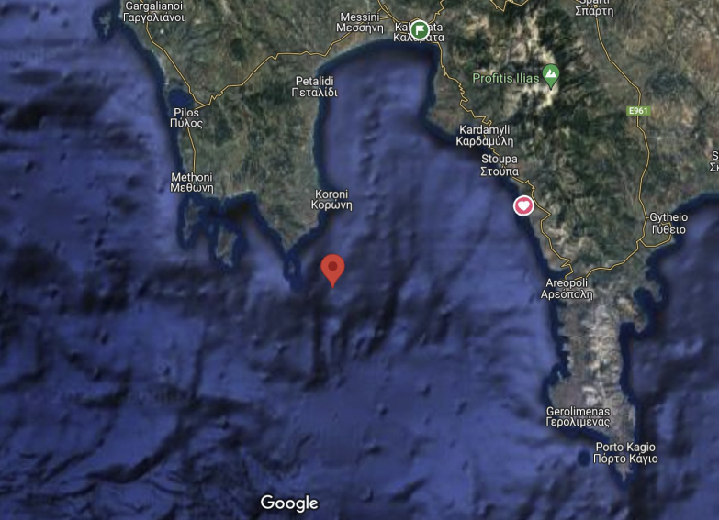
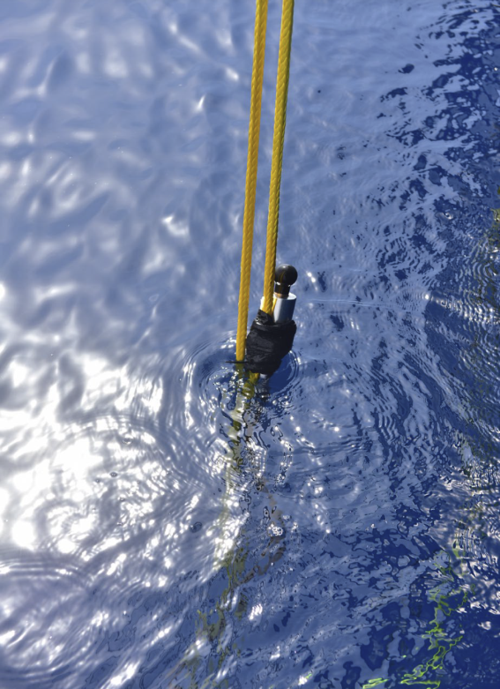
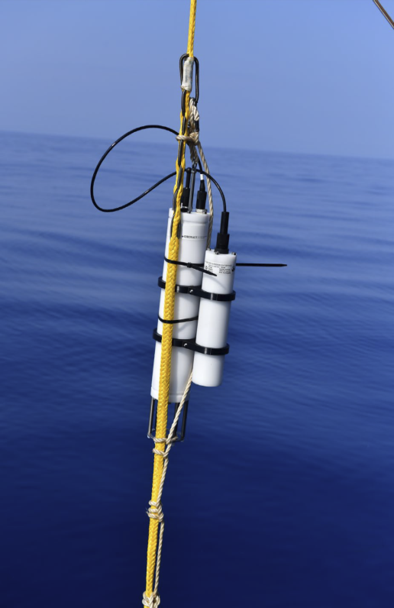
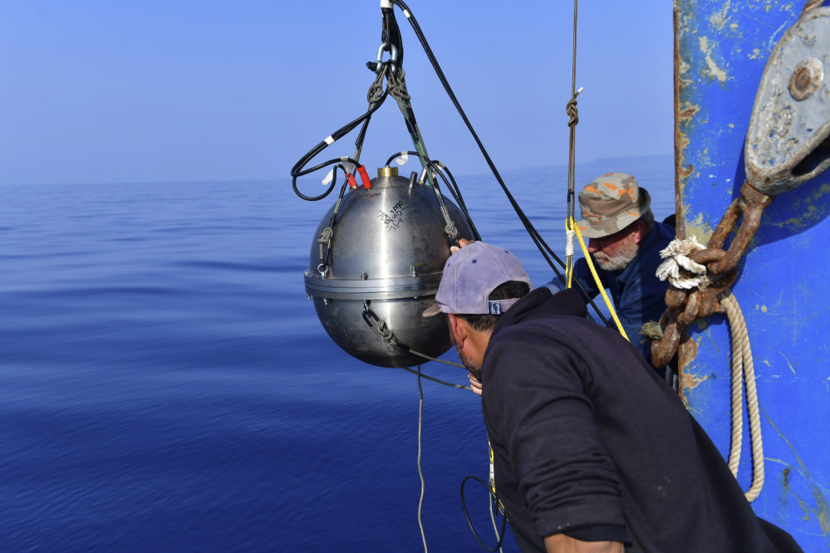

Slide 6
Simulation and reconstruction activities
Noise / background reduction
Full scale geometry

