Slide 1
A data filter for acoustic neutrino telescopes
Maarten de Jong

Slide 2
Introduction
interaction of [very] high-energy neutrino heats up water
sudden increase of temperature leads to acoustic pulse
acoustic pulse can be detected at large distances
because absorption length is long (typically km)
How can signal be filtered from background?

Slide 3

Telescope design
array of 21 x 21 strings with 10 hydrophones (4410 total)
  horizontal spacing $300 m$
  vertical spacing $150 m$
  volume $\sim 100 {km}^{3}$

Slide 4
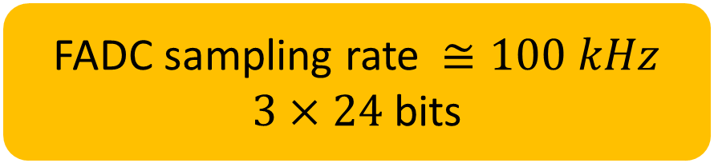
DAQ design¶
{ ADC }
time slice
hydrophone
FADC
FPGA
switch
{ time-of-arrival }
data filter
CPU
FADC sampling rate $≅100 kHz$
$3×24$ bits
events
{ ADC }
¶ Based on “all-data-to-shore” concept.

Slide 5



Simulation
signal (very simplistic)
  length $h = 300 m$
  width $S ∝ {E_{ν} e^{−R/λ}}/R$
noise (probably realistic)
  rate per hydrophone $1÷10 Hz$ (master student C. v.d. Stappen)
“pancake”
(master student K. Oers)
$$h$$
$$R$$

Slide 6
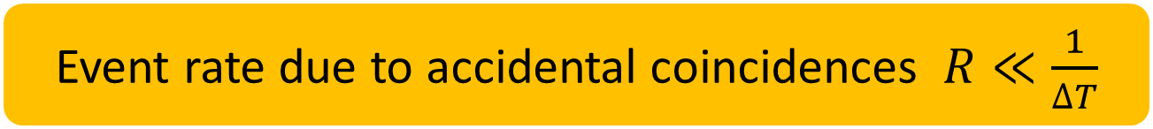

Challenge
detector size $D$ $≅ 10 km$
number of hydrophones $N$ $≥ 4,000$
noise rate / hydrophone $r$ $≅ 1÷10 Hz$
data rate $ℬ$ $≅ 30 {Gb}/s$
sound velocity $v$ $≅ 1500 m/s$
time window $∆T$ $≡ \frac{D}{v} ≅ 5 s$
Event rate due to accidental coincidences $R≪\frac{1}{∆T}$

Slide 7



number of hydrophones
noise rate
time window
$$R\left(m\right)≃\left(\begin{matrix}N \\ m\end{matrix}\right)×r×{\left(r∆T\right)}^{m−1} \\ ≃\frac{N^{m}}{m!}×r×{\left(r∆T\right)}^{m−1} \\ =\frac{1}{m!}×\left(Nr\right)×{\left(Nr∆T\right)}^{m−1}$$
number of coincidences
$$\left(\text{total} \text{rate}\right)$$
$$Nr≅40 kHz$$
$${\left(\text{probability} \text{of} \text{coincidence}\right)}^{m−1}$$
$$Nr∆T ≅ 100,000 ≫ 1$$

Slide 8
Data filter concept
find hits within time window { // majority
if (number of hits >= minimum) { // always
loop over directions { // old idea
if (number of hits >= minimum) { // too often
loop over vertex positions { // new idea
if (number of hits >= minimum) { // ?
}
}
}
}
}
}

Slide 9



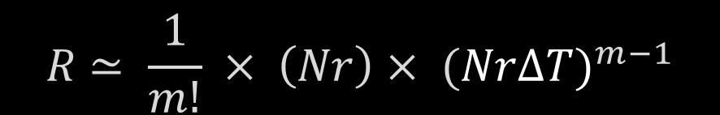




$$R ≃ \frac{1}{m!} × \left(Nr\right)× (NrΔT)^{m−1}$$
$$h$$
$$×{10}^{−3}$$
$N$ $×$ $\frac{h πR^{2}}{V}$
$ΔT=$ $\frac{D}{v}$ $→$ $\frac{R}{v}$ $→$ $\frac{∆x}{v}$
$$×{10}^{−2}$$
$$R$$
$$P=Nr∆T<1$$
$$R∝{\left(N\right)}^{1}$$

Slide 10
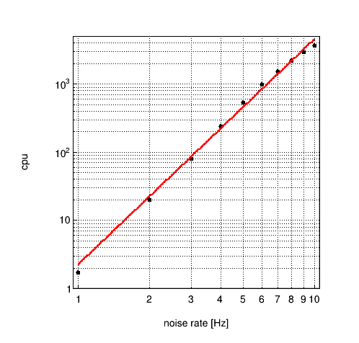
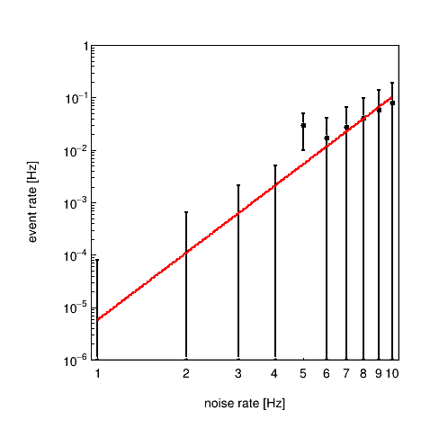
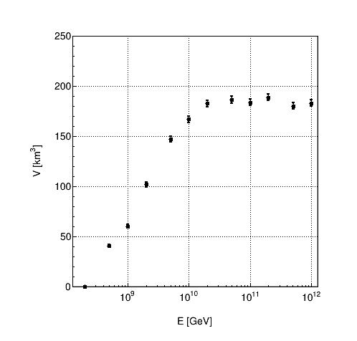

Preliminary results¶
“very high-energy event”
¶ Minimum number of hits $m=13$.

Slide 11

Summary & Outlook
It is possible to process data from an acoustic neutrino telescope
with a volume of $≥100 {km}^{3}$ in real time with $≤3000$ CPU cores
  more accurate profile of signal as function of $\left(E,R,z\right)$ is welcome
  what about GPUs/APUs?
There may be a case for an acoustic neutrino telescope in Pylos,
to be realised under umbrella of KM3NeT
  revival of event simulations
  development of event reconstructions

