Slide 1


Noise/Background reduction
Acoustic Neutrino Detection – 27/01/2025
Louvain CM
D. Stavropoulos, V. Tsourapis, CM
NCSR Demokritos

Slide 2
Introduction
Motivation, information on data and simulation
Applying filters and the wavelet transform
ML classification for identifying neutrino induced acoustic pulses
Outlook

Slide 3
Motivation – Data & MC used in the analysis
Motivation: Investigate the ability to identify UHE neutrino acoustic pulses in underwater recorded data
Methodology:
Simulate UHE neutrino acoustic pulses (see Vasilis' presentation)
Add pulses to underwater recorded data
Identification using frequency domain analysis and Machine Learning
Data:
02/2018: To evaluate acoustic background, 2 hydrophones deployed at 1600 m depth continuously recorded the ambient sea noise for 1 month
Simulation:
10k hadronic showers were generated between 10 and 100 EeV according to an E⁻² energy spectrum
15 pulses were simulated for each shower at a range between 50 m and 250 m from the shower
See Vasilis' presentation

Slide 4
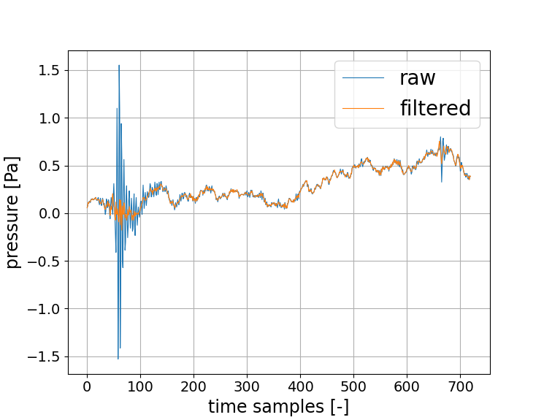
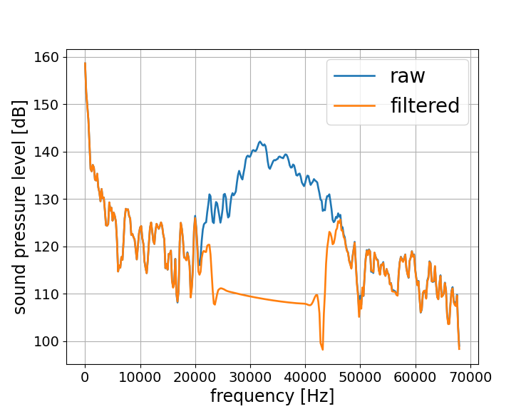
Dolphin click filtering
Recordings have been divided into chunks of 5 ms duration to achieve a convenient data handling
Strong presence of cetacean-related sounds in the Mediterranean, efficiently identified by filtering the frequencies 22-45 kHz and comparing the waveforms in time domain
Pressure time-series for a chunk with a dolphin click before (blue) and after (orange) the filtering
Sound pressure level for the same recording
This was developed to reject this background contribution in a single-hydrophone analysis; Cetacean related sounds will be easily suppressed by a higher level trigger of an acoustic neutrino detector

Slide 5
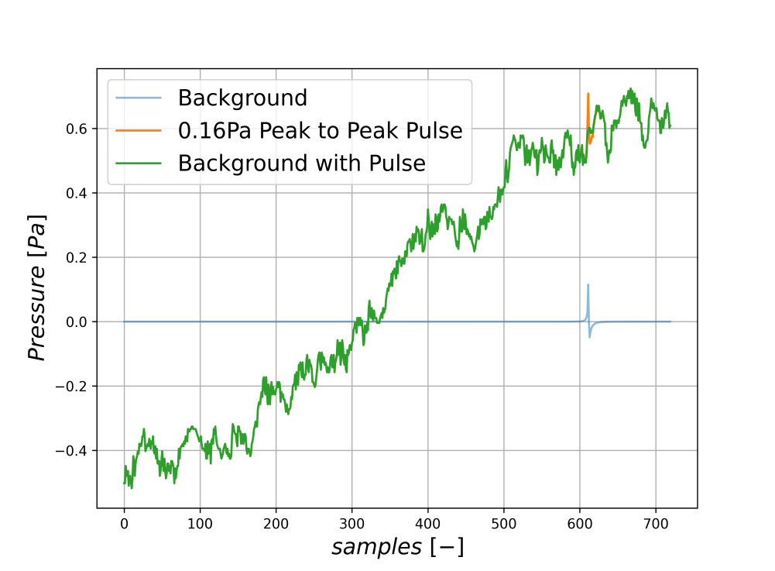

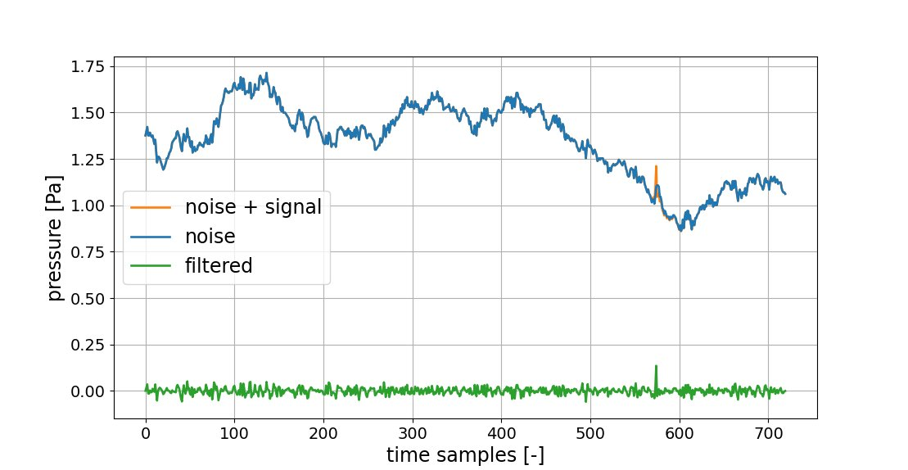
Adding simulated pulses to recorded data – spectrum flattening
Deployed hydrophones have a 144 kHz sampling rate (~7μs resolution). That means:
Simulated neutrino pulses should be resampled to match the data resolution
Each data chunk (5 ms) consists of 720 samples
Large pressure variations in the chunk due to the contribution of low frequency underwater sounds
Can be discarded easily with a high-pass filter without affecting the neutrino pulse

Slide 6
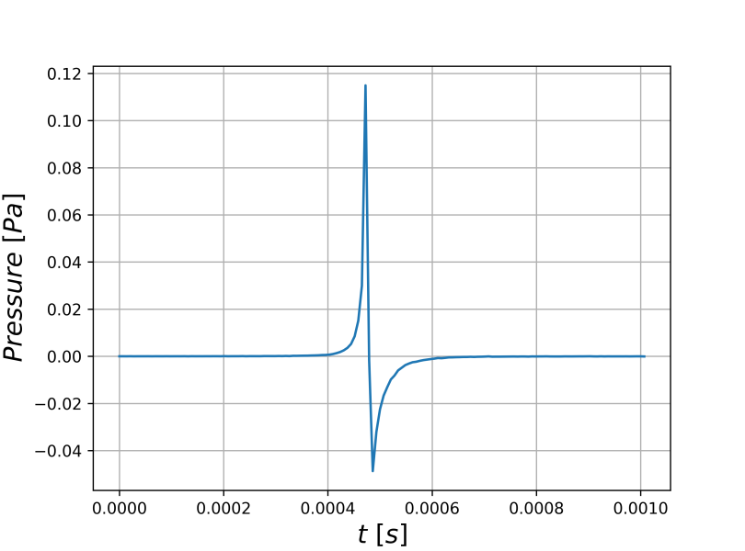
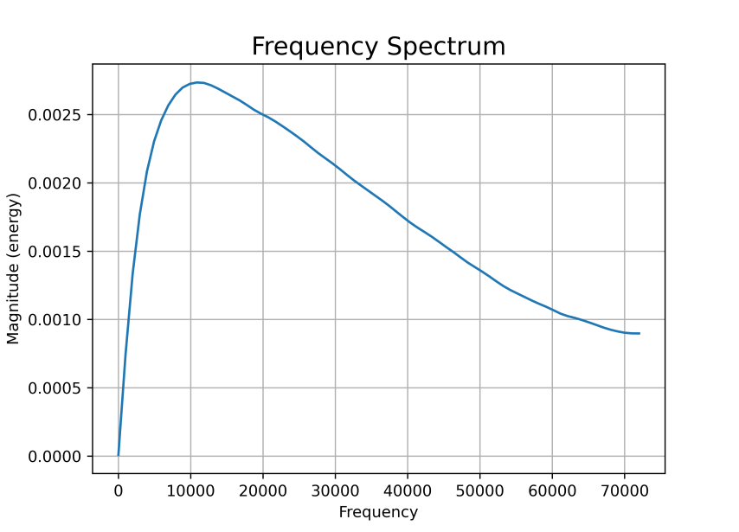
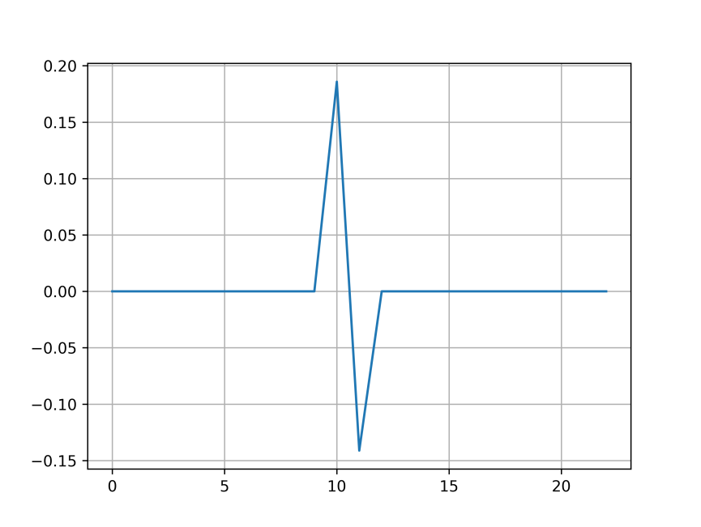
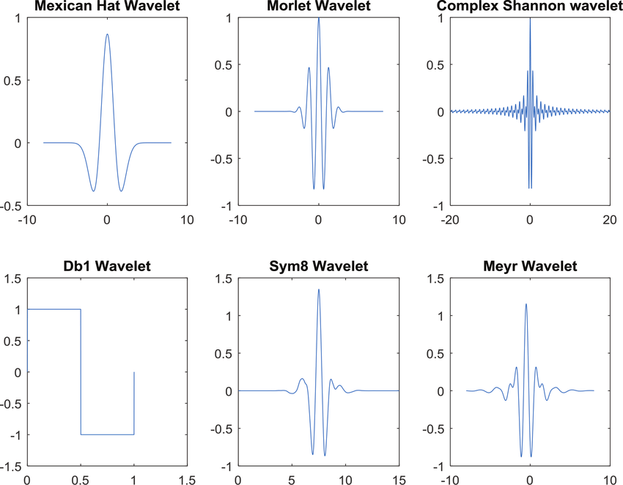
Wavelet transform
Pulse shape very narrow (short in time), leads to a broad frequency spectrum
Signal pulse is not a superimpose of few characteristic frequencies
Is there an alternative for the traditional Fourier spectrum analysis?
Common mother wavelets:
Chosen mother wavelet: Ramp
Wavelet transform: decompose a signal into multiple lower resolution levels by controlling the scaling factors of a single wavelet function (mother wavelet)
Strong shape sensitivity; Find an optimal mother wavelet for the neutrino acoustic pulse

Slide 7
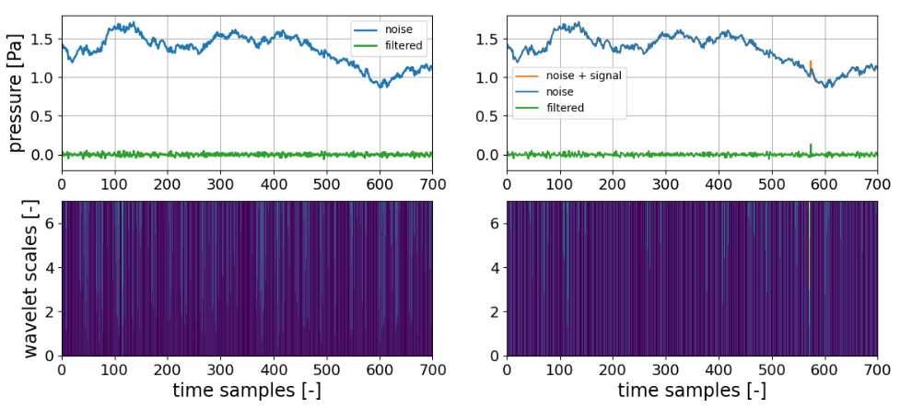
Applying the wavelet tramsform
Same chunk (5ms) with/without signal pulse added:
Acoustic neutrino pulse added on top of the recorded pressure-time series
High-pass pre-filtering to remove low frequency variations enhancing the neutrino pulse width over the baseline
Matrix with the wavelet transform correlation coefficients
Strong correlation at the position of the neutrino acoustic pulse!

Slide 8
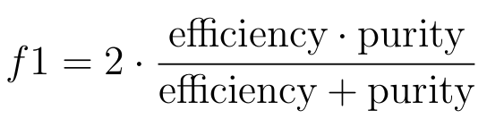
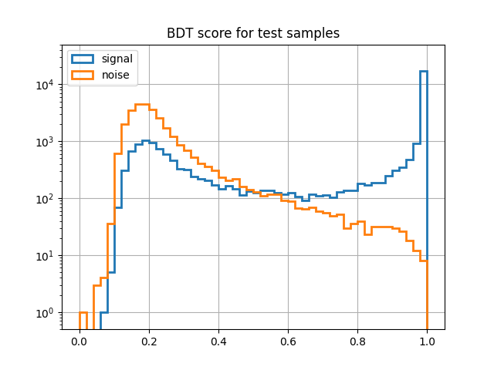
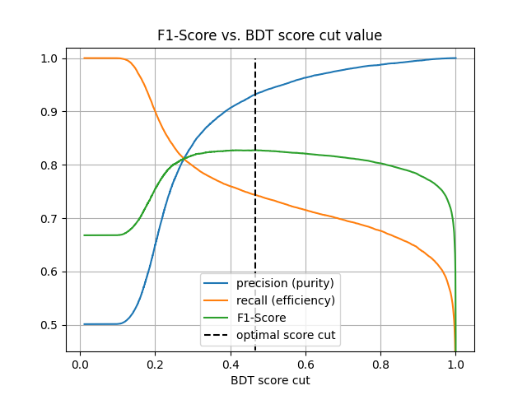
Pulse identification – ML classification
Decide on the BDT score cut using the f1 score metric:
A Boosted Decision Tree algorithm used for classifying chunks containing acoustic neutrino pulses over background, with features extracted from the wavelet correlation matrix
80% of chunks for training, 20% for testing
Evaluation on the test sample:
Cut @ 0.47: Signal efficiency of ~74% achieved with a ~93% selection purity!
chunks/bin
BDT score
BDT score cut

Slide 9
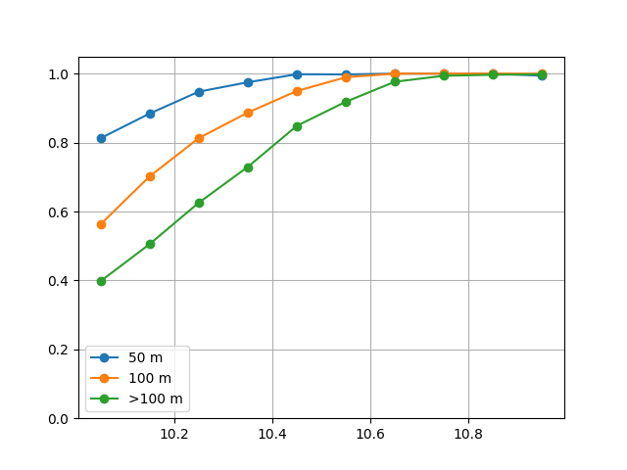
Pulse identification - Efficiency
Efficiency as a function of energy for different distances; test samples:
General remarks:
Efficiency
More than 85% of the signal chunks are identified for E>25 EeV, even at a 250 m distance
At 50 m, more than 80% of the pulses are identified even at the lower investigated energies
Such a study can define the density of hydrophones at an acoustic neutrino detector, playing the role of an L1 trigger at a sensitivity study
Log₁₀(E_{ν}/GeV)

Slide 10
Outlook
Development of an analysis scheme to identify neutrino induced acoustic pulses:
Dolphin click identification
Removing lower frequencies – spectrum flattening
Employing the wavelet transform
ML classification
This analysis can be used as an L1 trigger at a hydrophone array operating as an acoustic neutrino detector
Data have been collected with a much higher resolution (200 kHz), expected to improve these results...

Slide 11
Thank you!

