Slide 1


SND plans for LS3 and Run4
1
SND@LHC plans to present a Technical proposal at the next LHCC (March) to continue running during Run4
As the ADVsnd proposal have been rejected at the last Research board because the proposed excavation of the floor in TI18 was deemed incompatible with the LS3 schedule our TP will be based on simply adapting our experiment to the conditions of High Lumi ( which implies having to replace the Emulsions as active elements of the Neutrino target): this will give us > factor 15 statistics compared to Run3
The emulsions ( used now as the target active elements) are not viable for running at HIGH Lumi LHC ( would need ~weekly replacements!)
CMS has kindly agreed to give us the tracker they will replace during LS3 and our plan is to recover the Tracker Outer barrel silicon strip modules and equip with them the SND@LHC detector ( both target and calorimeter) for Run4
The usage of this detector and the necessity to introduce a corresponding trigger requires some modification/addition of services in the TI18 environment

Slide 2

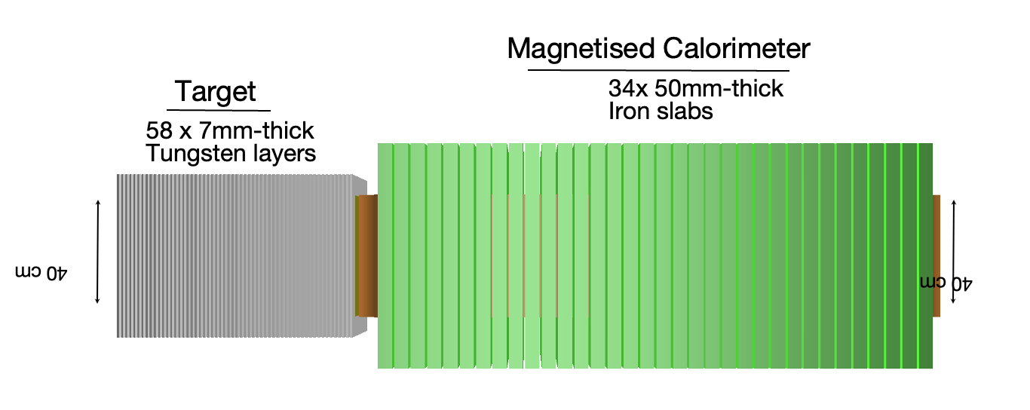
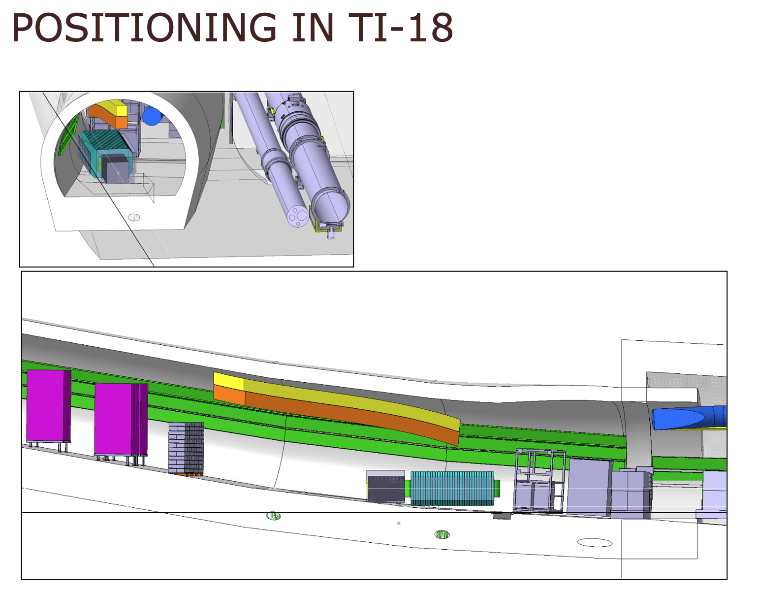
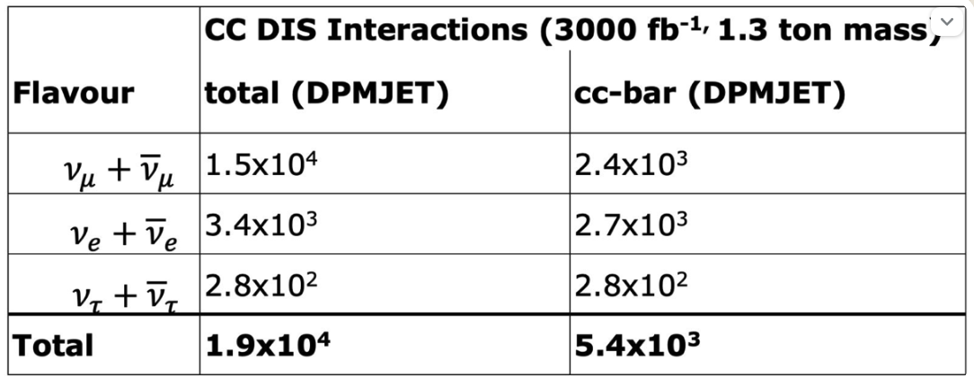
SND@LHC in Run4
2

Slide 3
Activities during LS3
Dismount SND@LHC elements as soon as access is available in 2026
Store Hadron calorimeter Fe plates in UJ18
Will receive the CMS Tracker in September-October 2026
Will take ~2 years to reassemble Outer Barrel Silicon strip Modules onto the mechanics of the W and Fe plates of the SND new target and Hadron calorimeter.
Foresee installation during 2029: need of transport services to
  carry the new detector elements ( W and Fe Plates ) and take back the old Fe plates which had been stored in UJ18
  Carry the magnet coil
  Carry the Electronics crates/racks
  Deliver the Magnet power supplies

Slide 4
Services needed
What is described (regarding modification of the hoist to handle load transfer over the LHC elements, power converters and the cooling infrastructure) in https://edms.cern.ch/comment/3153508/0.1 distributed last summer – and with only positive comments- is still valid ( with the exception that we do not require any Civil engineering )
Since then we have understood more about some of the needs:
Additional crates for Silicon readout and trigger to be locate in TI18 (to be placed in water cooled rack)
Power supply for silicon and trigger planes
Magnet supply: 4 transformer LHC600A-10V for 600A each + control racks (~24KW in total) . Water cooled
Present electrical power available is 11 KW. We estimate that we will need ~40 so, to be conservative, we want to upgrade to 50 KW:Will need additional cable to upgrade electrical power cabinet.
Most cabling will be local :need cable tray between detector and electronic racks in TI 18 to host 20x20 cm²cross section of cables/fibers
Assume that available dry air ( -40 degrees) is ok for thermal enclosure setup
Will need 3 extra fibers to go to SR1

Slide 5
Backup

Slide 6
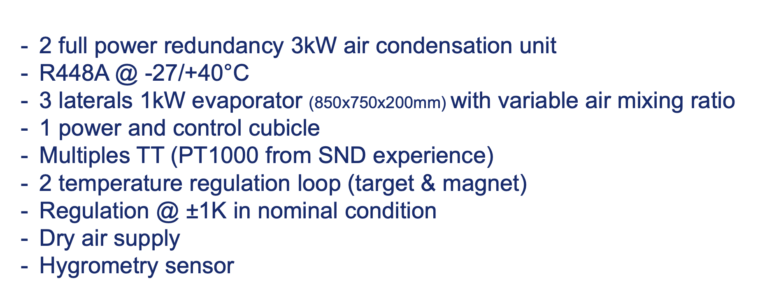
Cooling for thermal enclosure

Slide 7
