Slide 1
Dressed Lepton
Goal: Add general particles such as e+e- to dressed lepton.
Method: add a new option of dress mode Dressingtype::FLAVCLUSTER to Leptonfinder projection using fastjet contrib QCDAwarePlugin (only QED Aware now to get started…).
Rivet’s FastJets projection doesn’t work -> using fastjet directly.

Slide 2
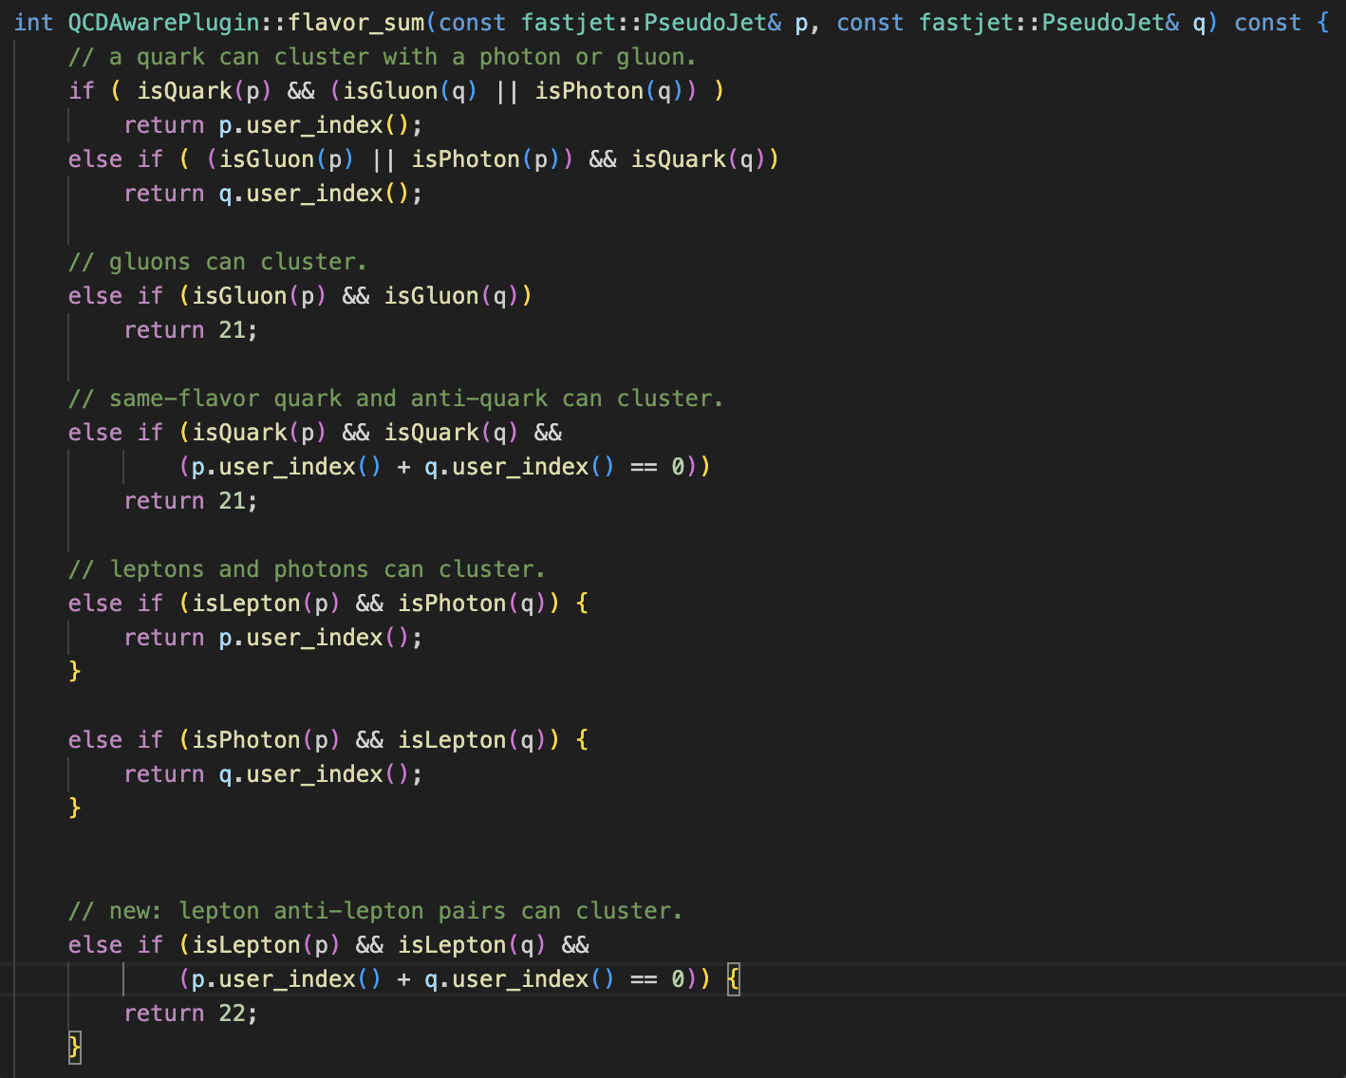
QCDAwarePlugin
Flavour sensitive clustering.
The distance can then be
measured with choice of
kT, anti-kT, or CA.
Added lepton and anti-lepton
-> photon clustering.

Slide 3
Status
QCDAwarePugin is plugged in successfully (an hour ago)
The code is not efficient enough for now. I am making fastjet::pseudojet from Rivet::Particles and then create new Rivet::Particles object.
Solution: to use complex user_index, e.g. user_index = 10000 * rivet_particle_index + particle_id and retrieve them by using user_index/10000 or user_index%10000.

Slide 4
Next steps
Use multiplexing user_index to make the code more efficient.
Add QCD particles.
Add coupling constant to the distance measure method in QCDAware and be careful with the cut off rule.

