Slide 1


FCC-hh cryogenics
R&D and cooling schemes for sc magnets at 4.5 K
– Cross section 2D modelling –
This project has received funding from the European Union's Horizon 2020 research and innovation programme under grant agreement No 951754.
Patricia Borges de Sousa
Ximo Gallud Cidoncha
on behalf of CERN TE/CRG

Slide 2
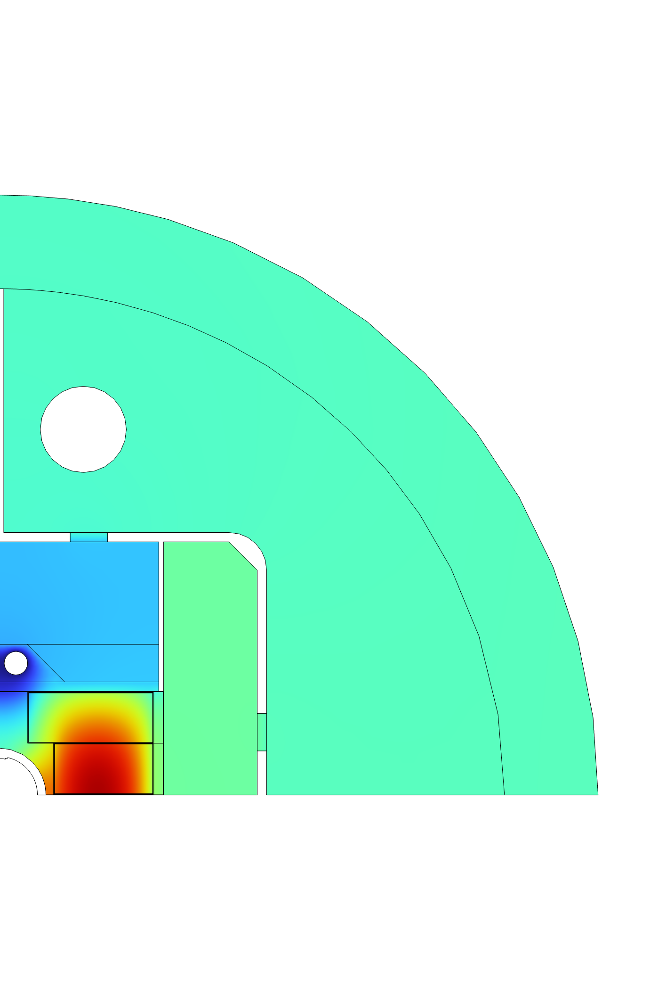

Heat load distributions
Surface load distributed homogeneously along outer shell
FCC-hh heat loads |  | 60 - 80 K (W/m) | 4 K (W/m)
Static | Supports | 2.4 | 0.13
 | Radiative Insulation |  | 0.13
 | Thermal Shield | 3.1
 | Feedthrough and vacum barrier | 0.2 | 0.10
 | Beamscreens |  | 0.30
 | Distribution | 3.6 | 0.10
 | Total Static | 9.3 | 0.76
Dynamic | Synchrotron Radiations | 37 | 0.05
 | Image Currents | 3.4
 | Resistive Heating |  | 0.30
 | Beam Gas Scattering |  | 0.45
 | Total Dynamic (no losses) | 40.4 | 0.80
 | Magnetization losses (eddy current) |  | 3.13
TOTAL (with mag. losses) |  | 49.7 | 4.69
Volumetrically distributed load in coils
Distributed homogeneously along inner core shell

Slide 3
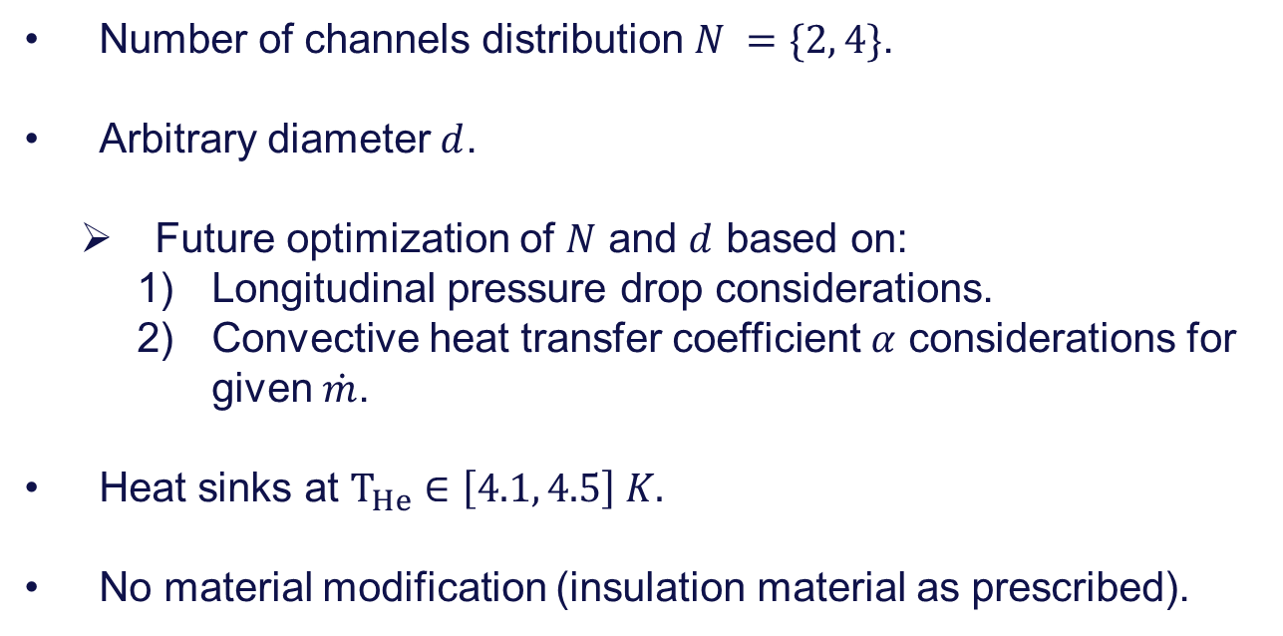
Preliminary geometrical placement of cooling channels:
Number of channels distribution $N =\{2, 4\}$.
Arbitrary diameter $d$.
  Future optimization of $N$ and $d$ based on:
    Longitudinal pressure drop considerations.
    Convective heat transfer coefficient $α$ considerations for given $\dot{m}$.
Heat sinks at $T_{He}∈\left[4.1, 4.5\right] K.$
No material modification (insulation material as prescribed).

Slide 4
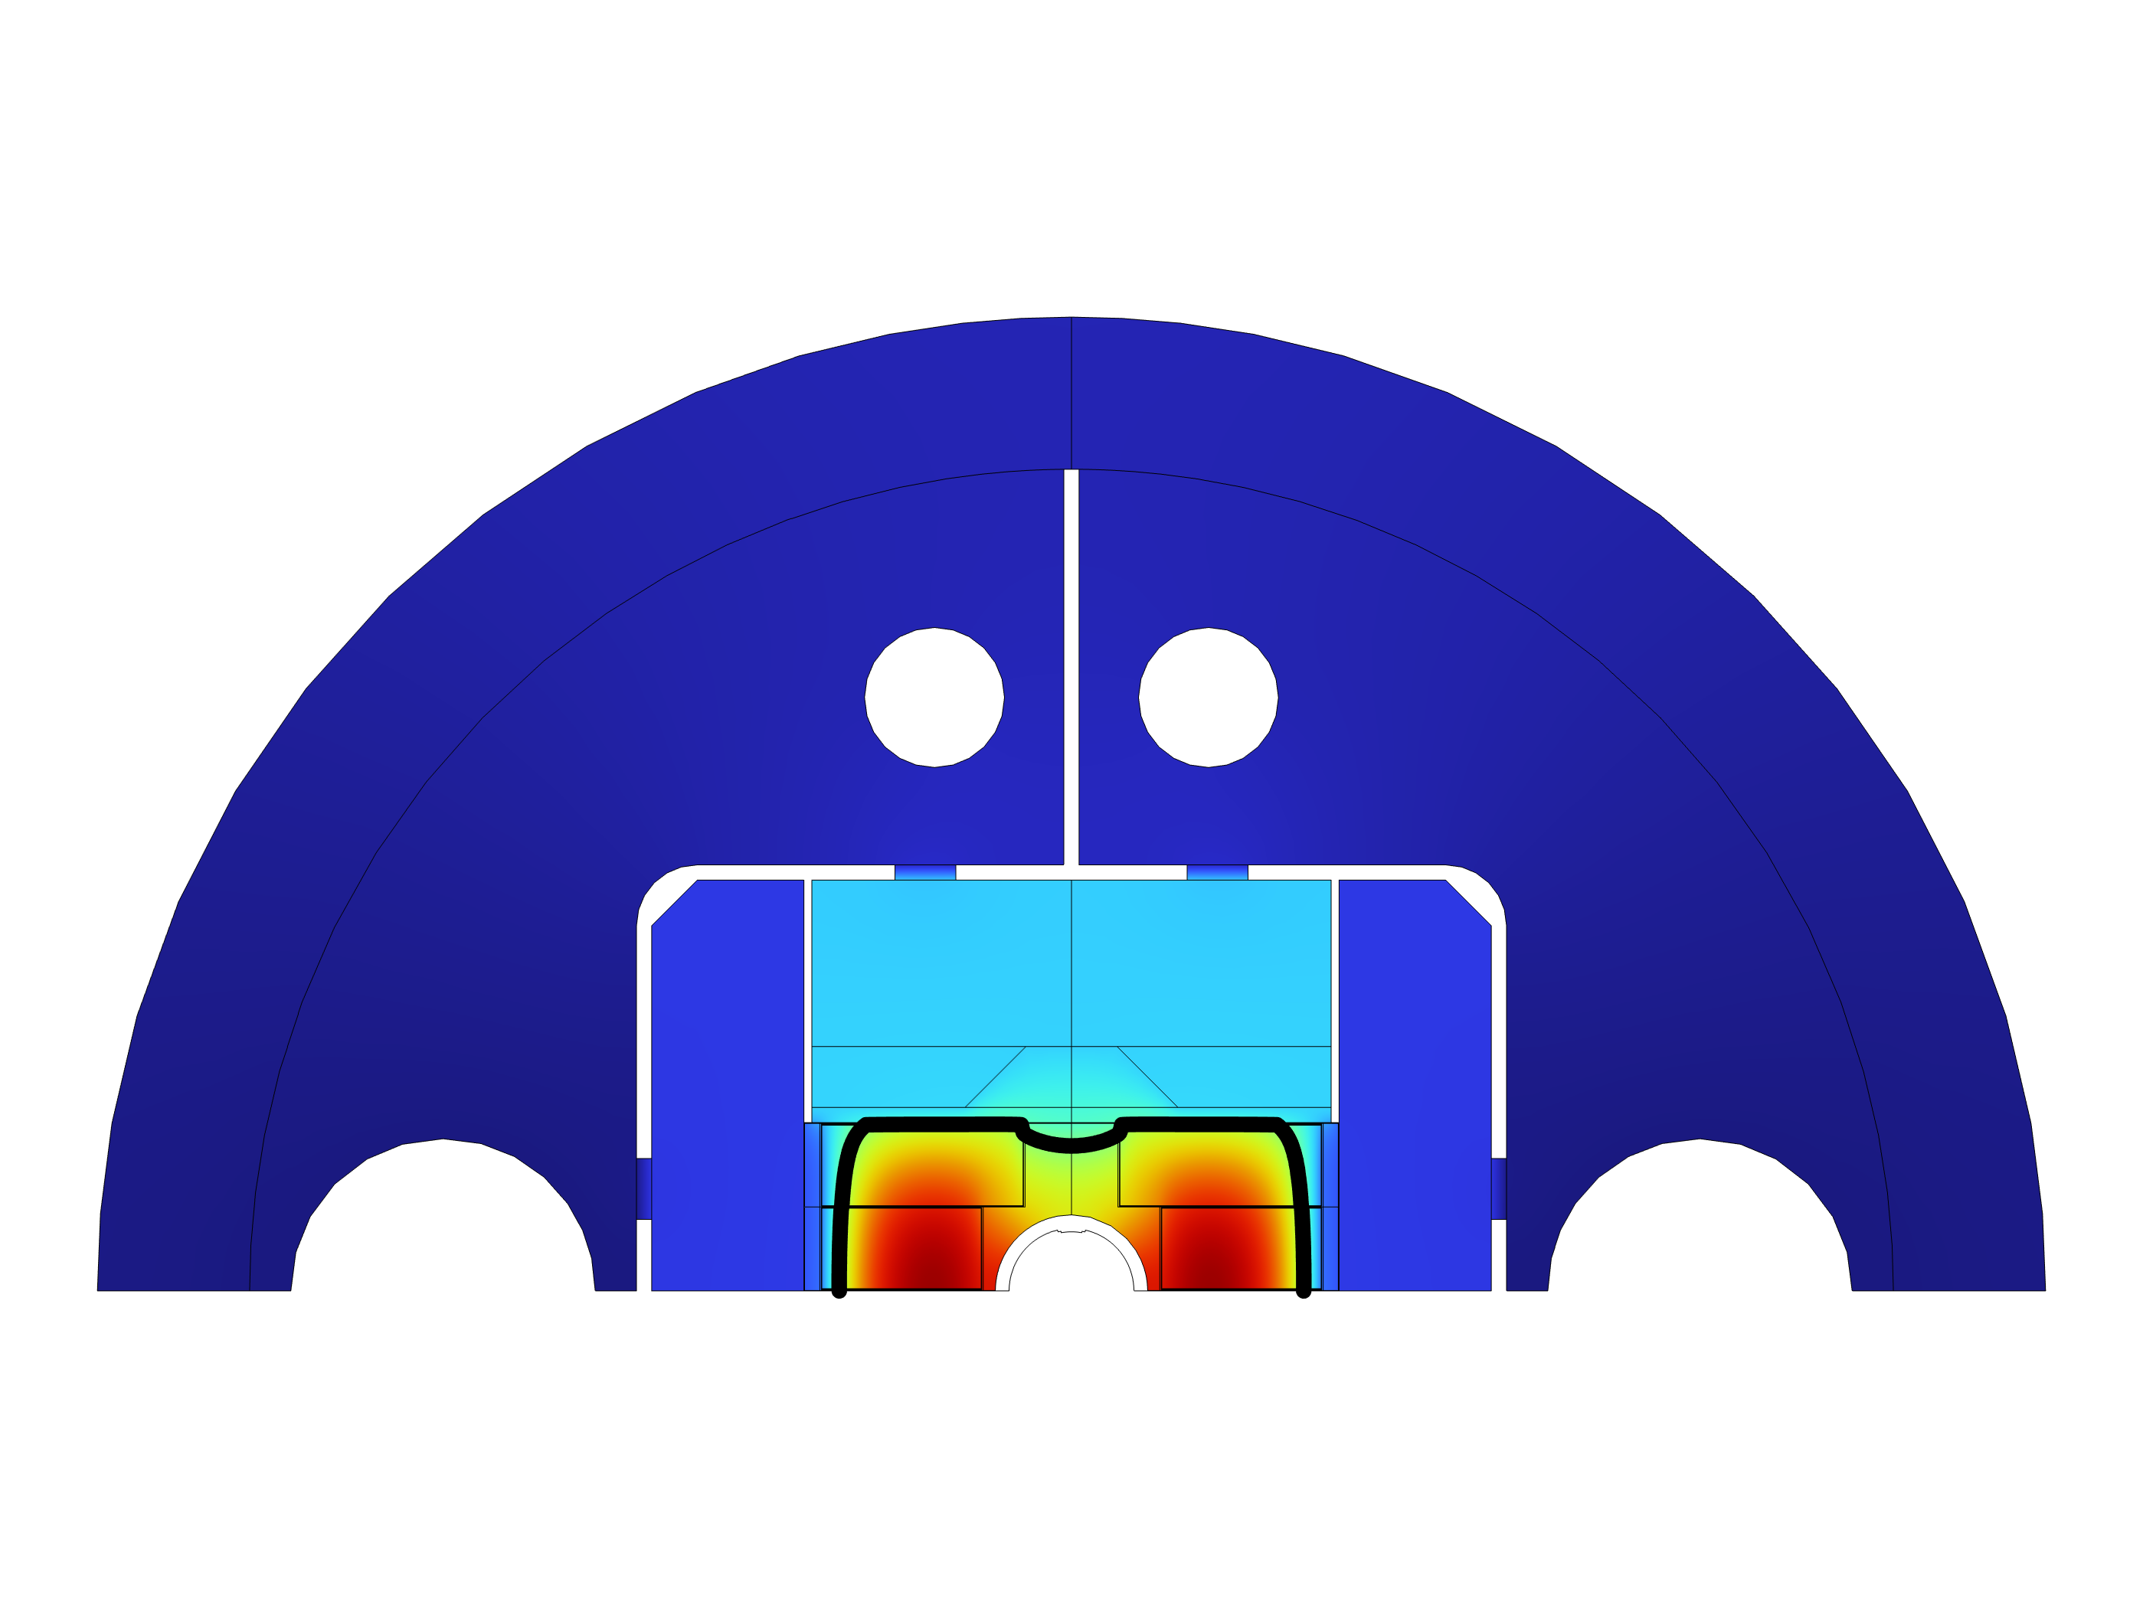
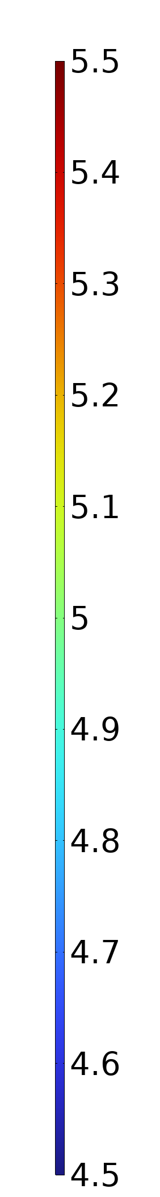
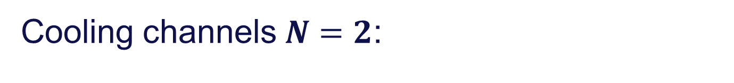
Cooling channels $N=2$:
T (K)

Slide 5
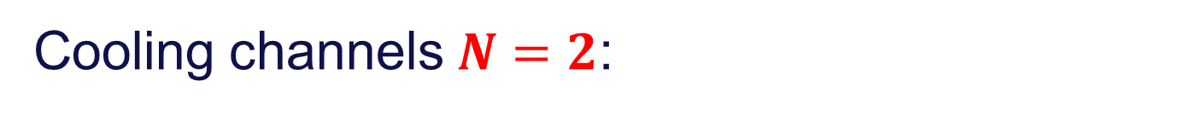
Cooling channels $N=2$:
T (K)

Slide 6
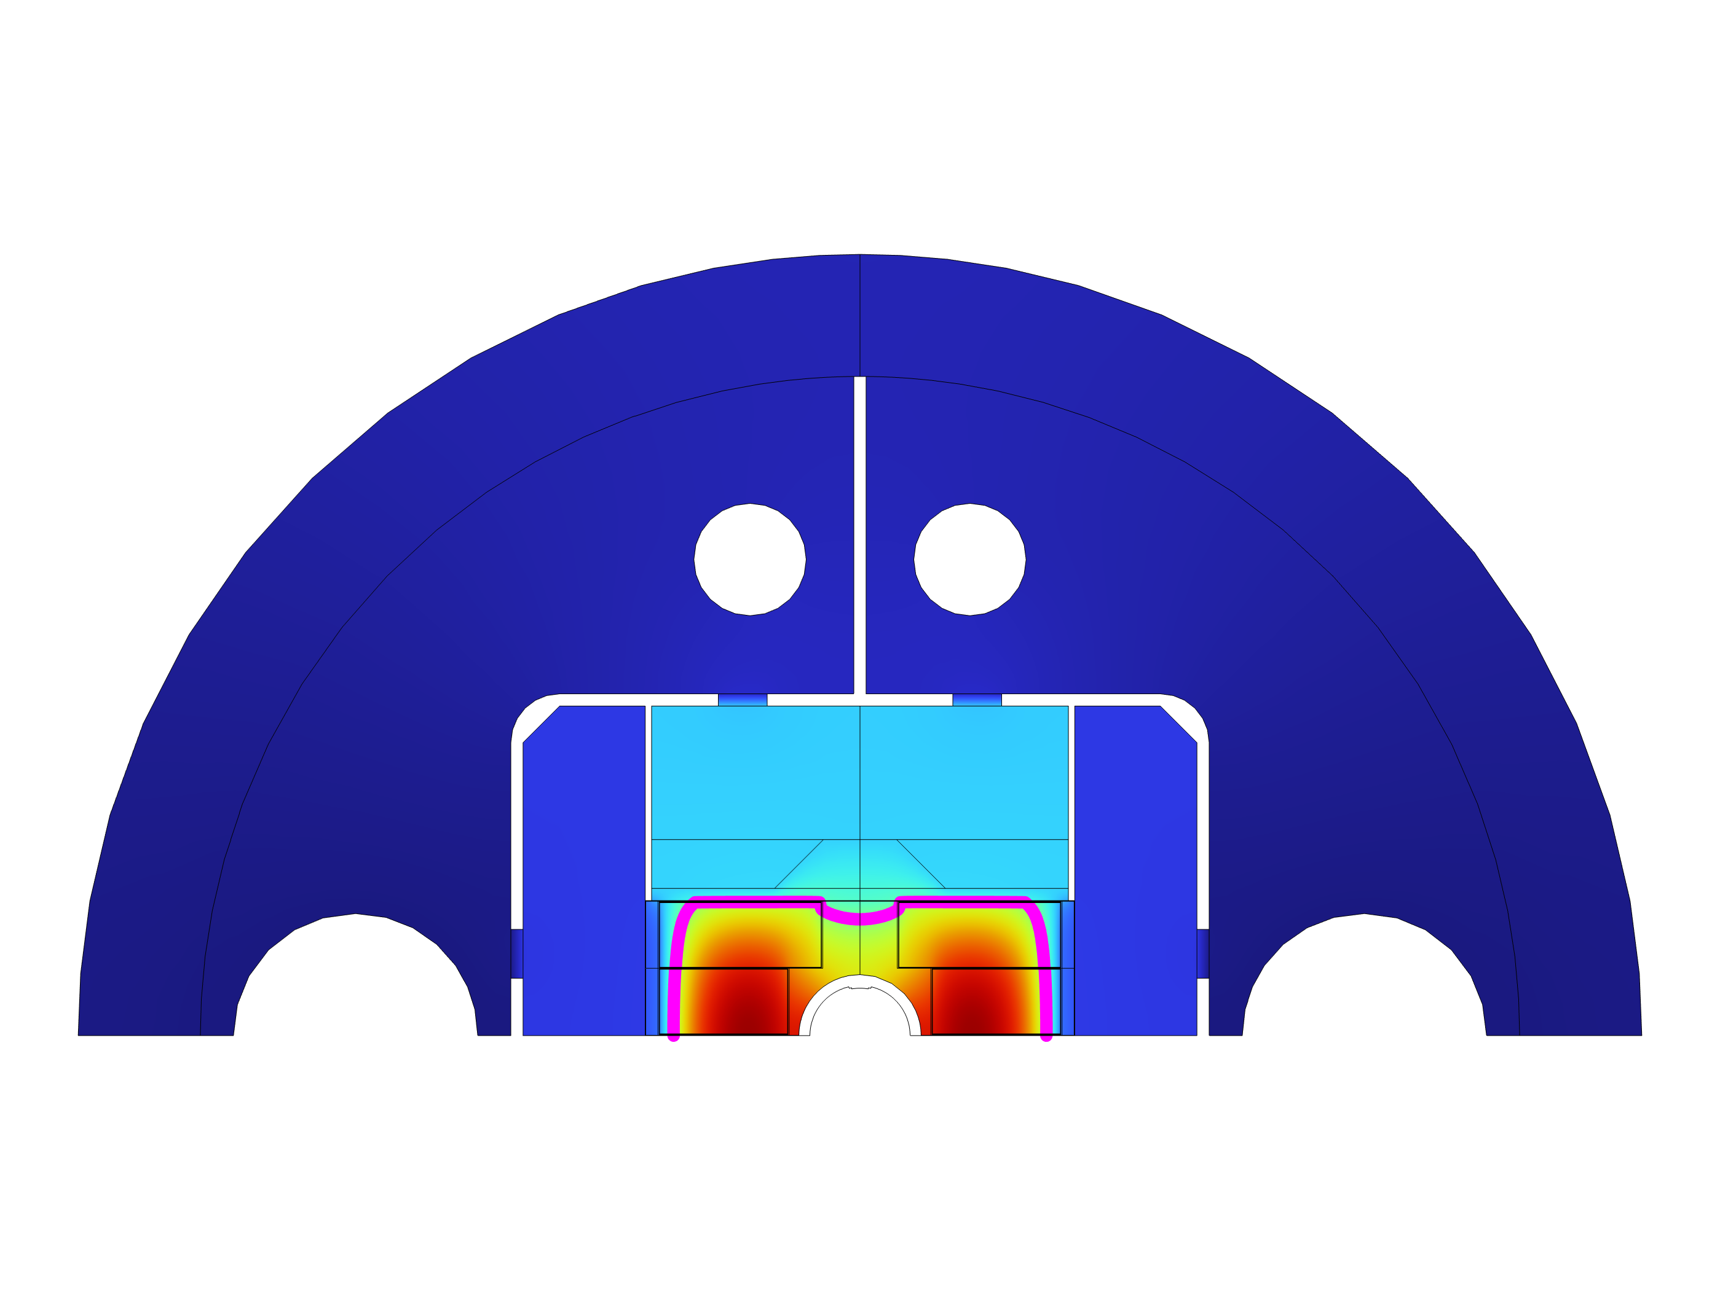


Cooling channels $N=2$:
T (K)
$$T<5 K$$
$$T>5 K$$

Slide 7
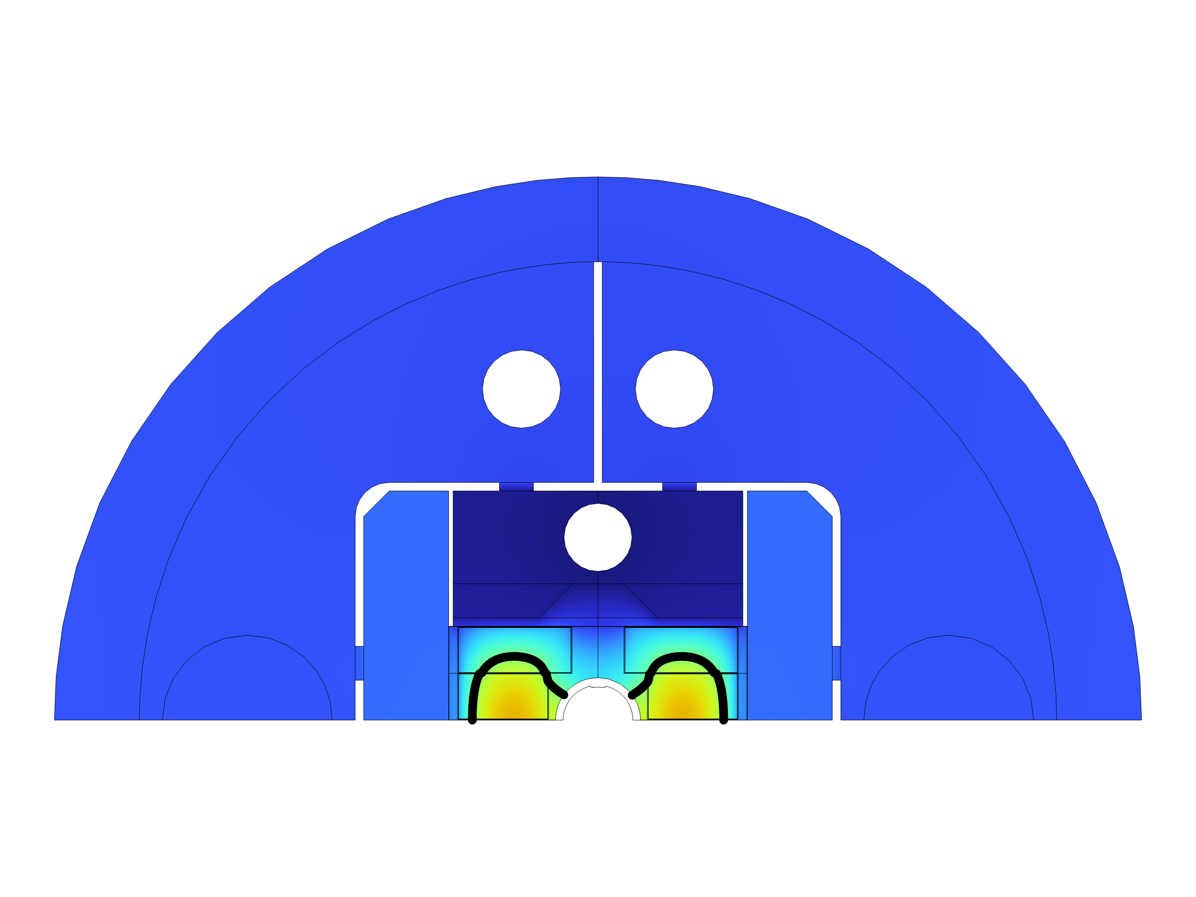
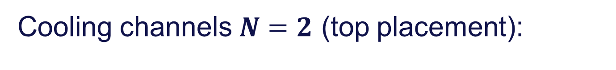
Cooling channels $N=2$ (top placement):
T (K)
(Second channel in
symmetry plane)

Slide 8
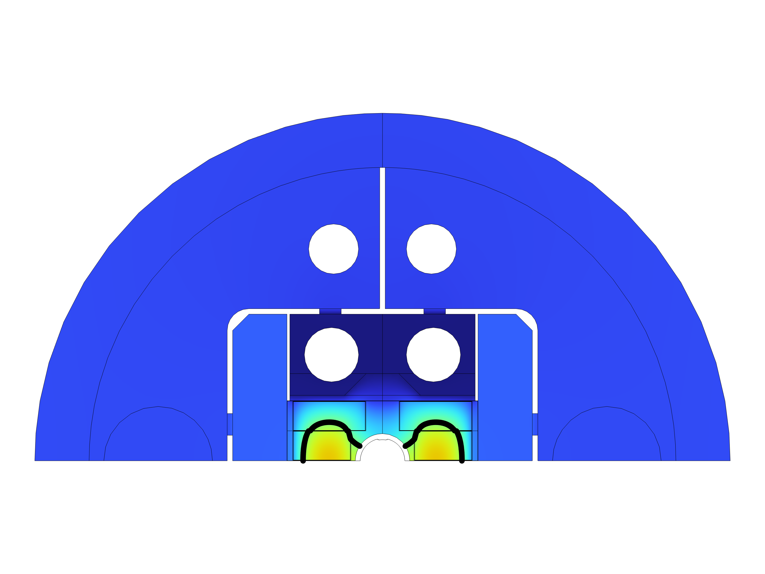
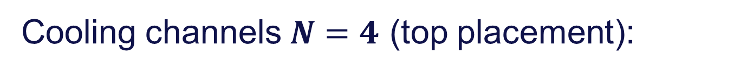
Cooling channels $N=4$ (top placement):
T (K)

Slide 9
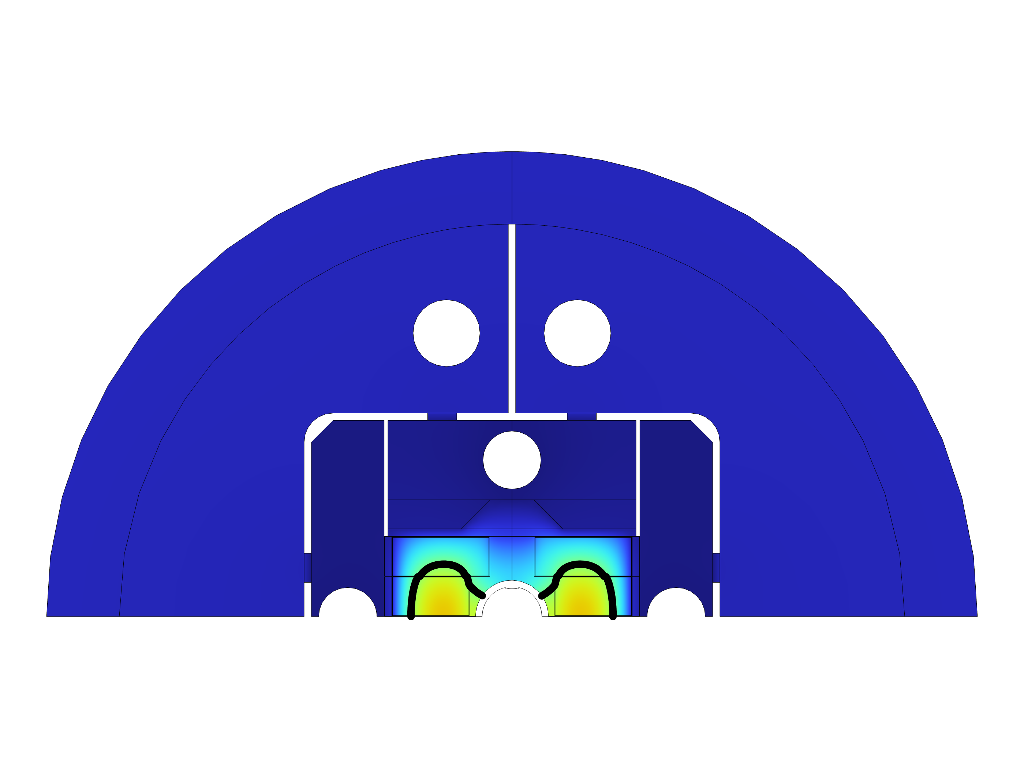
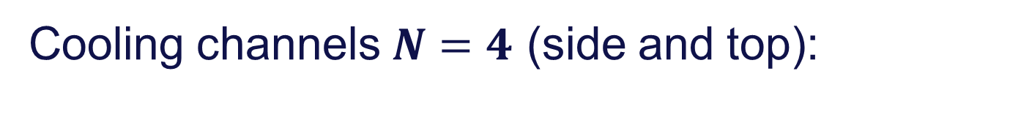
Cooling channels $N=4$ (side and top):
T (K)

Slide 10
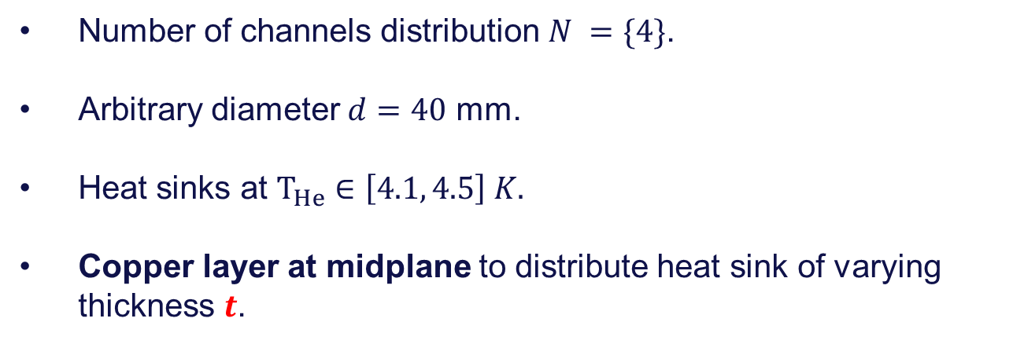
Adding of Copper conducting layer of cooling channel size:
Number of channels distribution $N =\{4\}$.
Arbitrary diameter $d=40$ mm.
Heat sinks at $T_{He}∈\left[4.1, 4.5\right] K.$
Copper layer at midplane to distribute heat sink of varying thickness $t$.

Slide 11
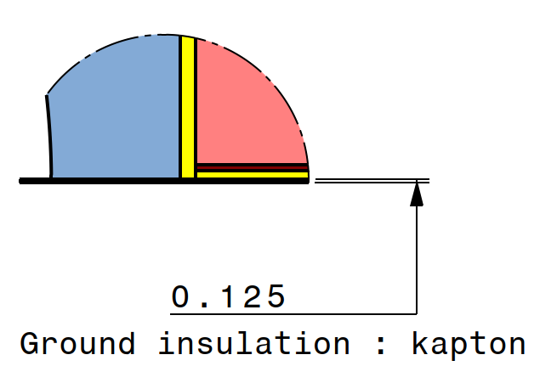


Cooling channels $N=4$ (side and top):
Copper layer thickness $t$
T (K)
$$− t$$

Slide 12
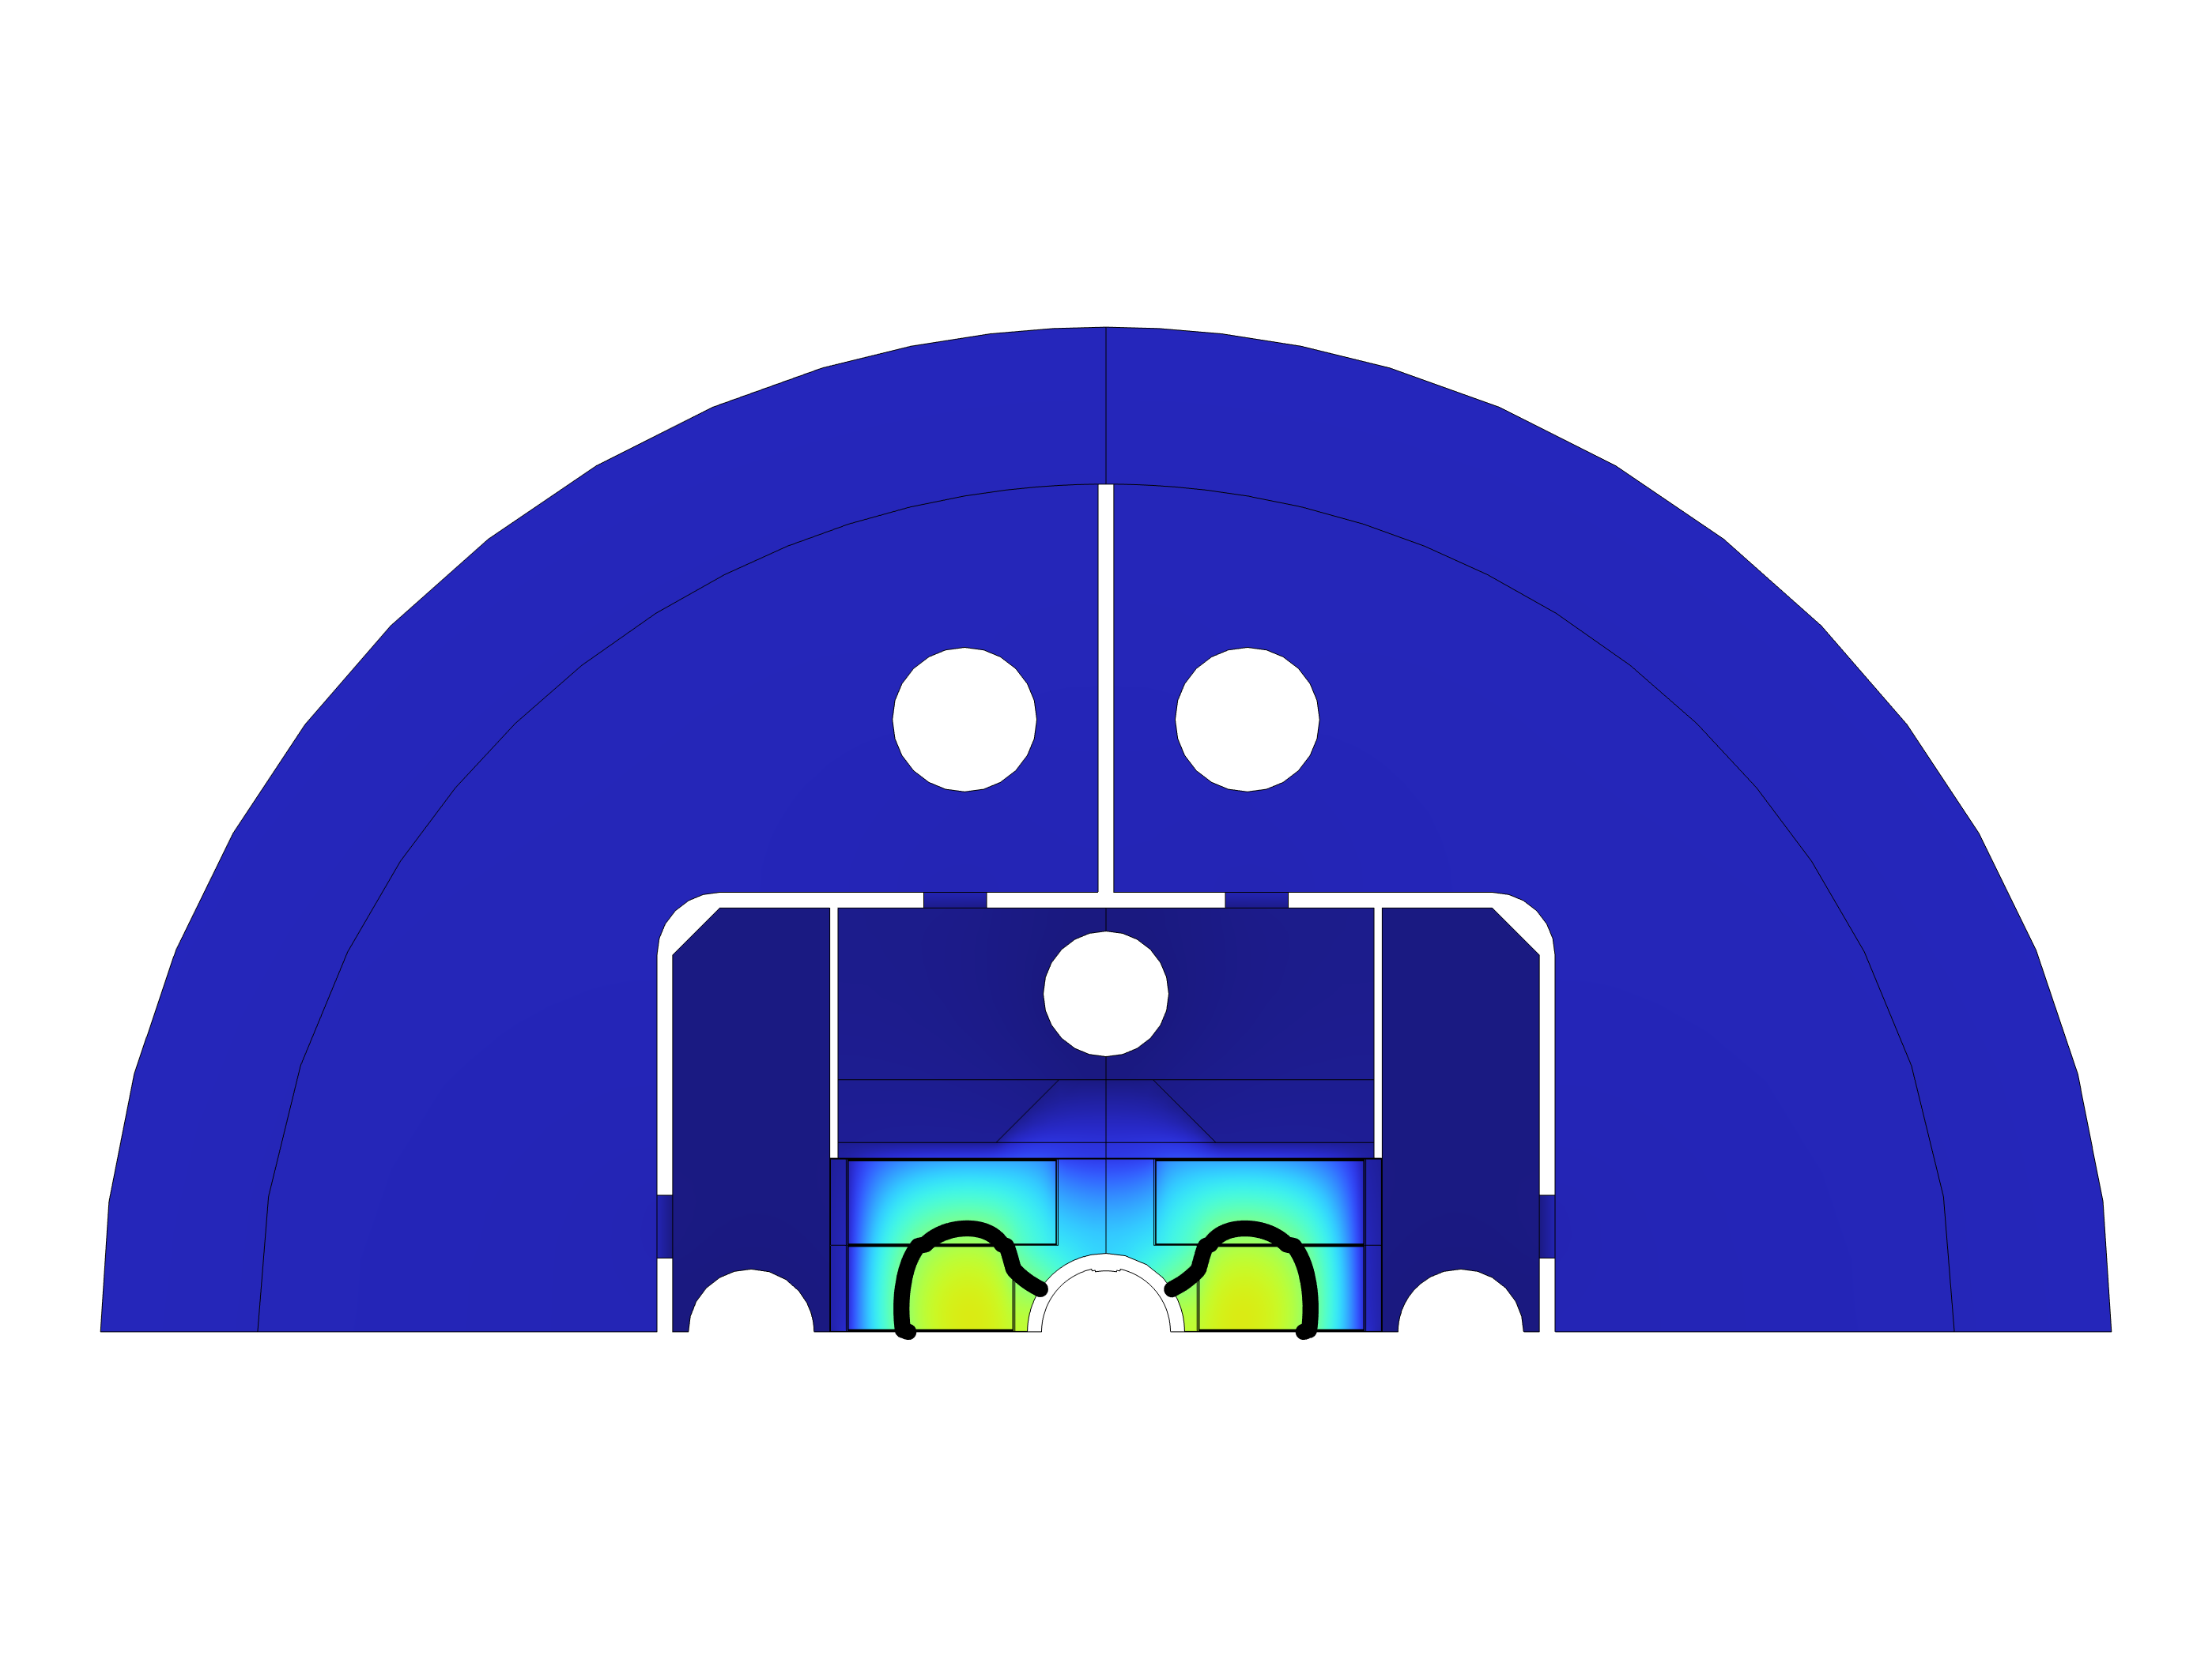
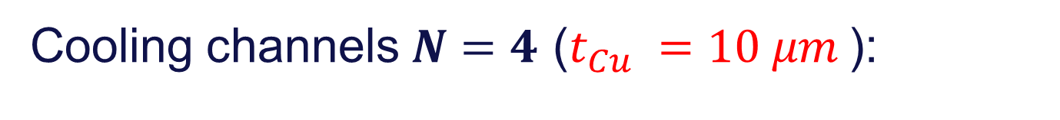
Cooling channels $N=4$ ($t_{Cu} =10 μm$):
T (K)

Slide 13
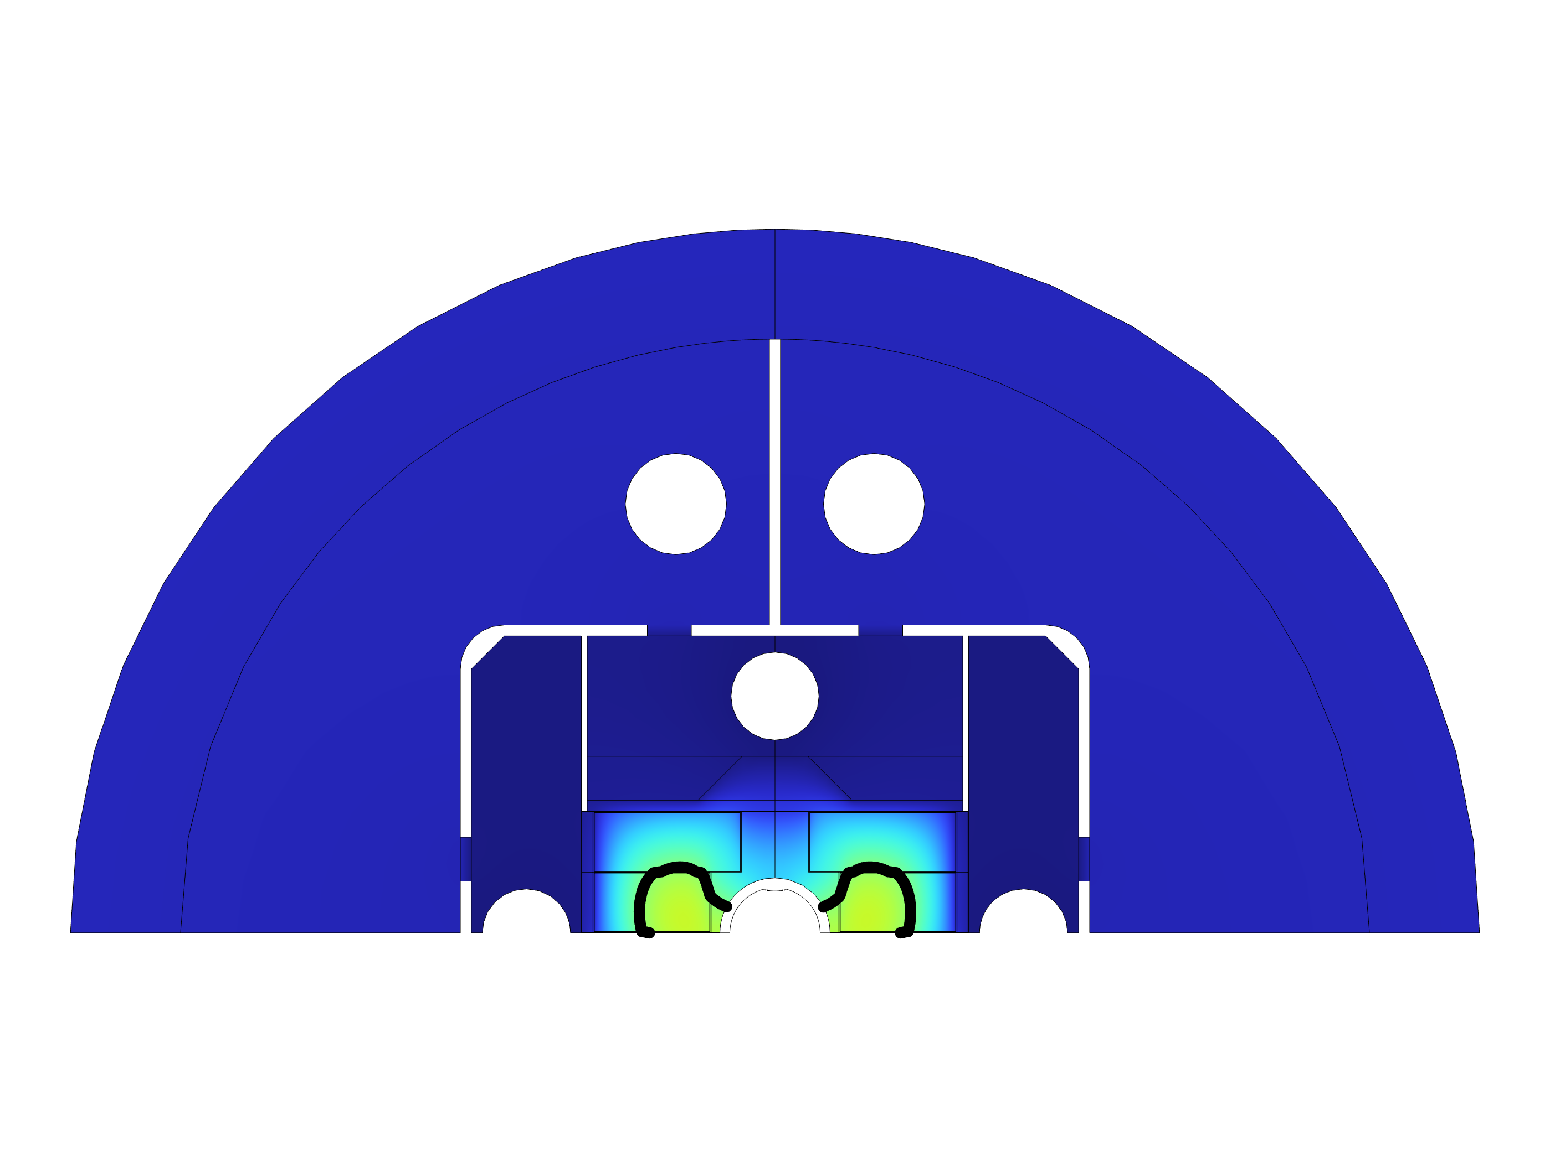
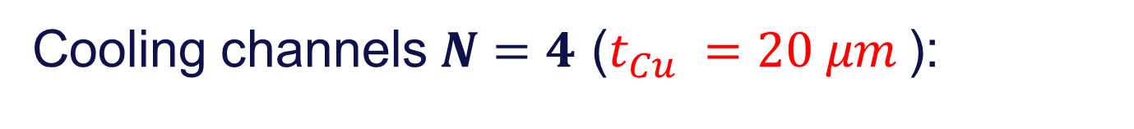
Cooling channels $N=4$ ($t_{Cu} =20 μm$):
T (K)

Slide 14
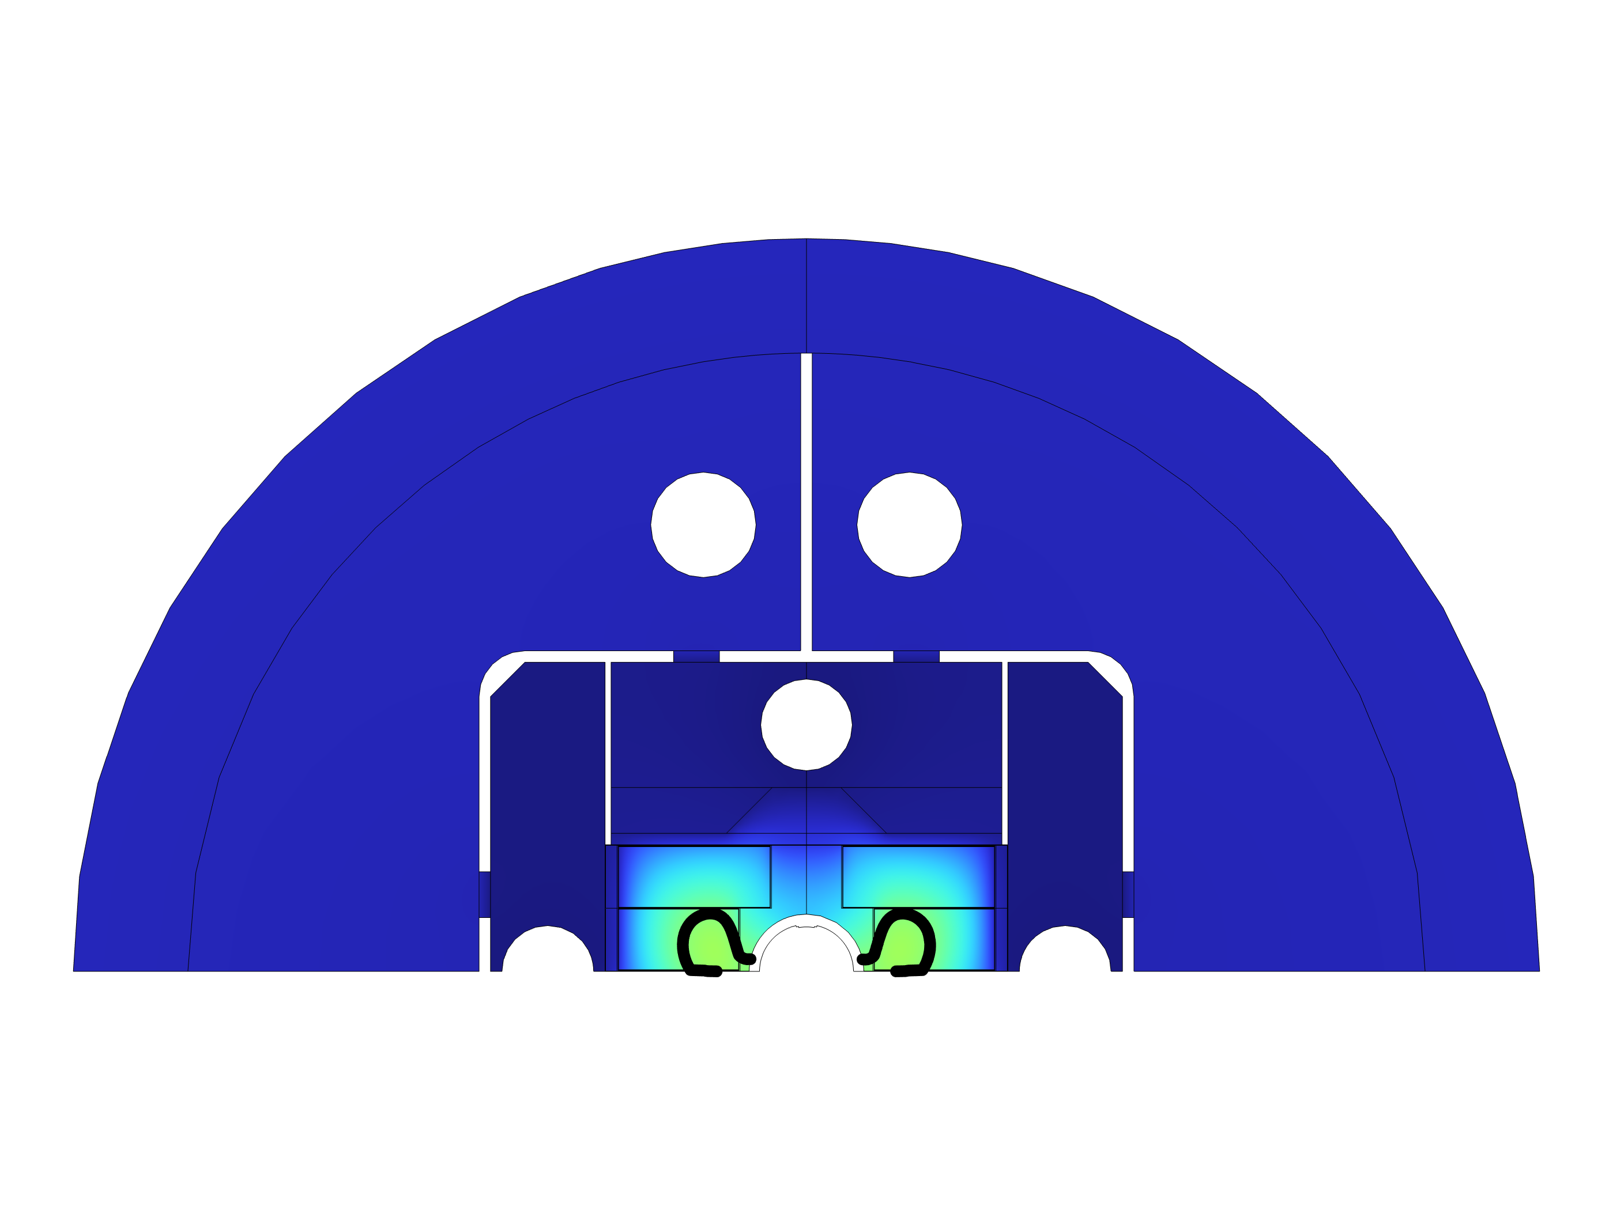
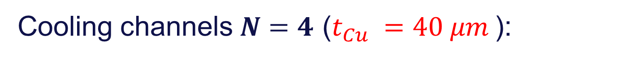
Cooling channels $N=4$ ($t_{Cu} =40 μm$):
T (K)

Slide 15
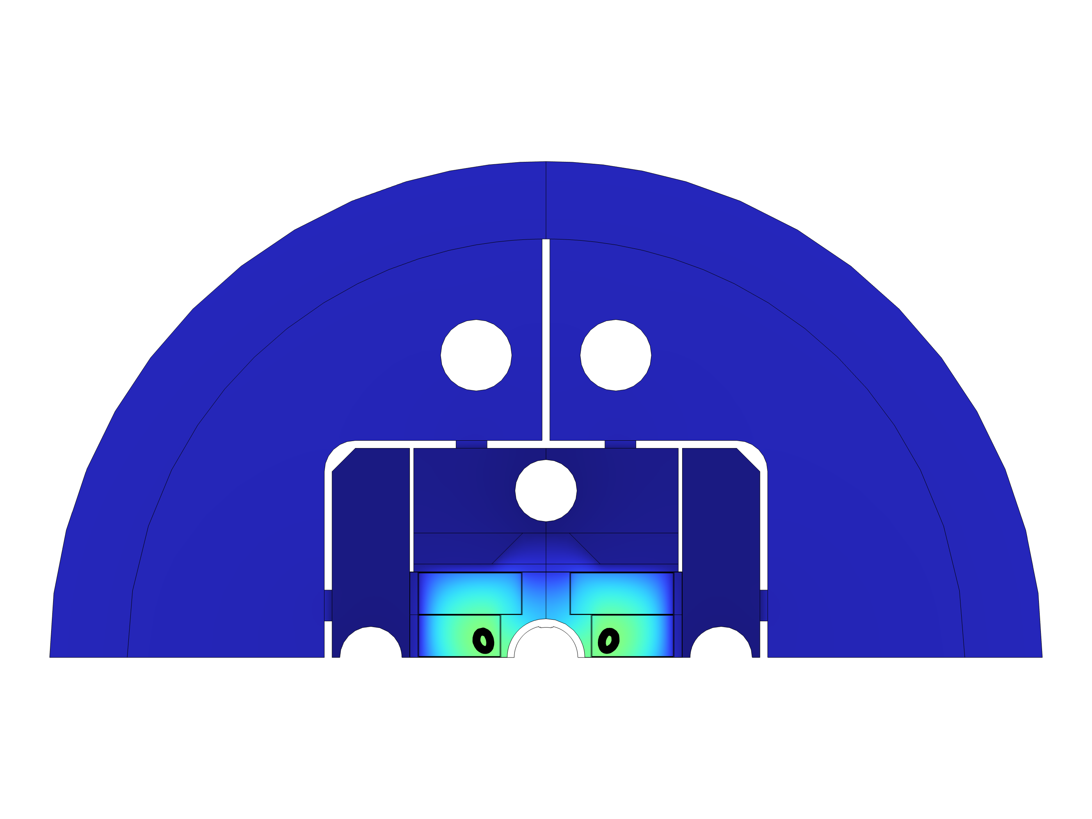
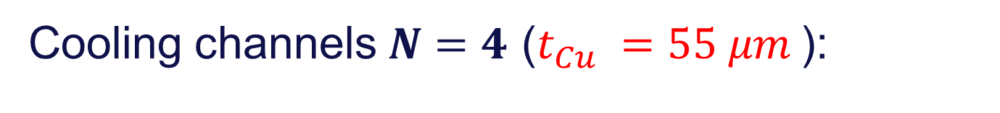
Cooling channels $N=4$ ($t_{Cu} =55 μm$):
T (K)

Slide 16
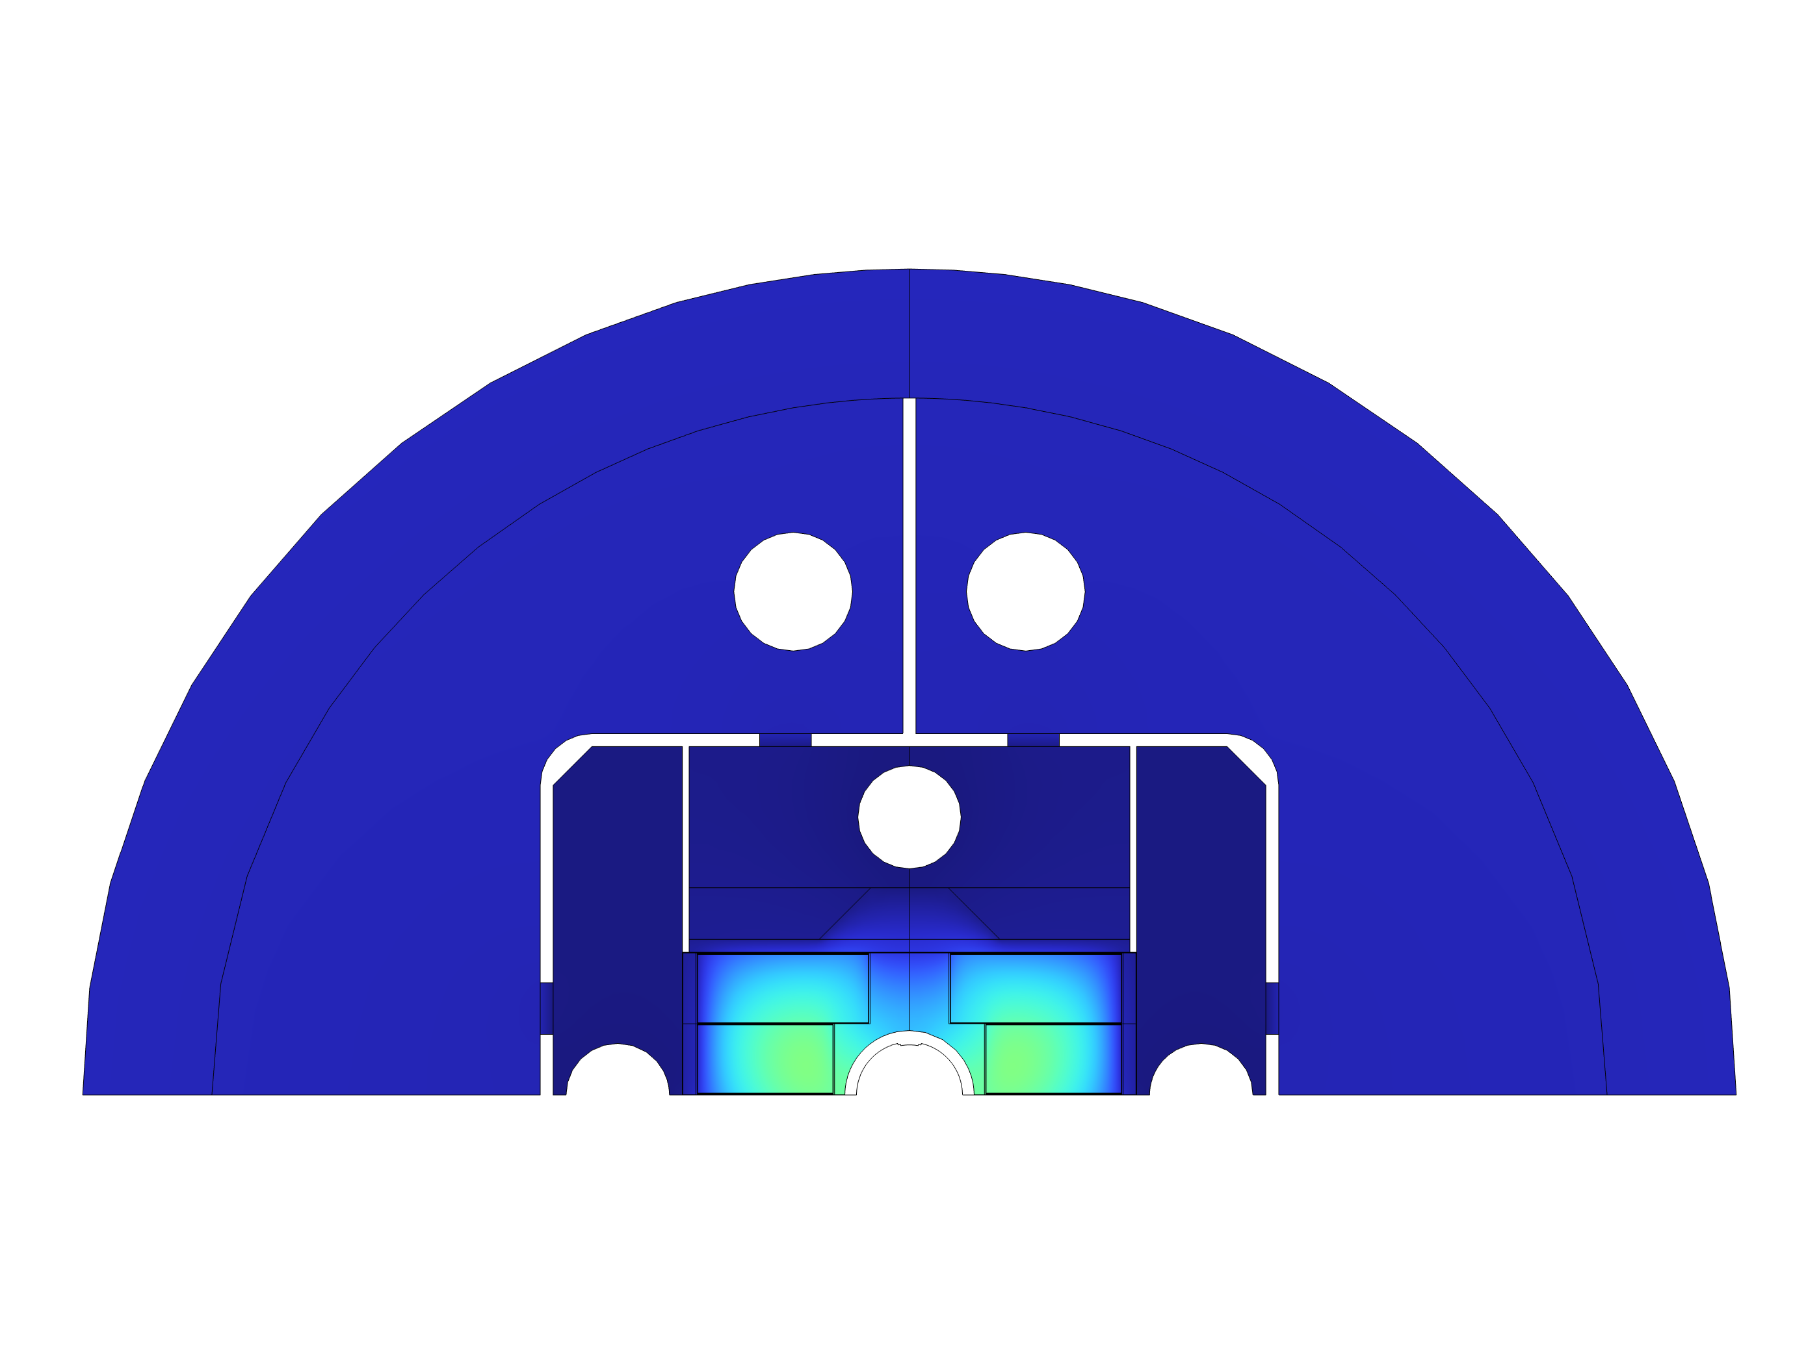

Cooling channels $N=4$ ($t_{Cu} =60 μm$):
T (K)

Slide 17
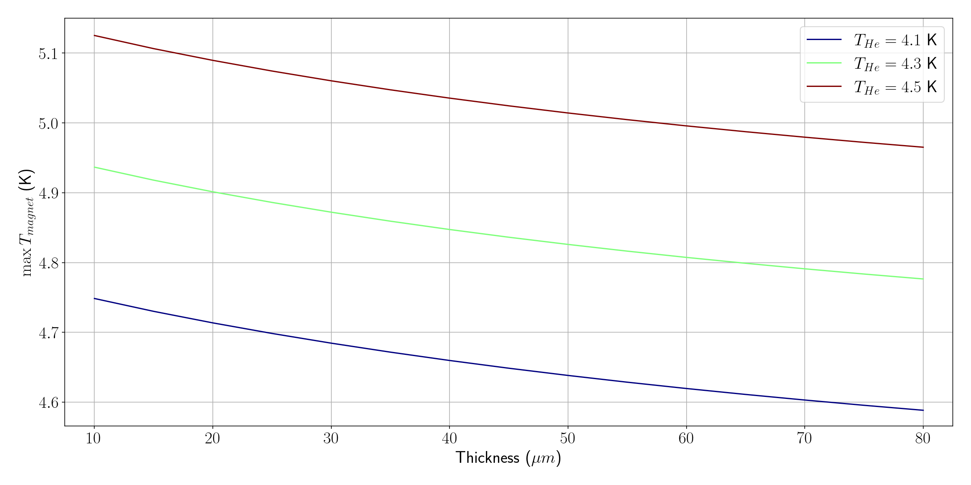
Maximum magnet temperature vs. Cu thickness:

Slide 18
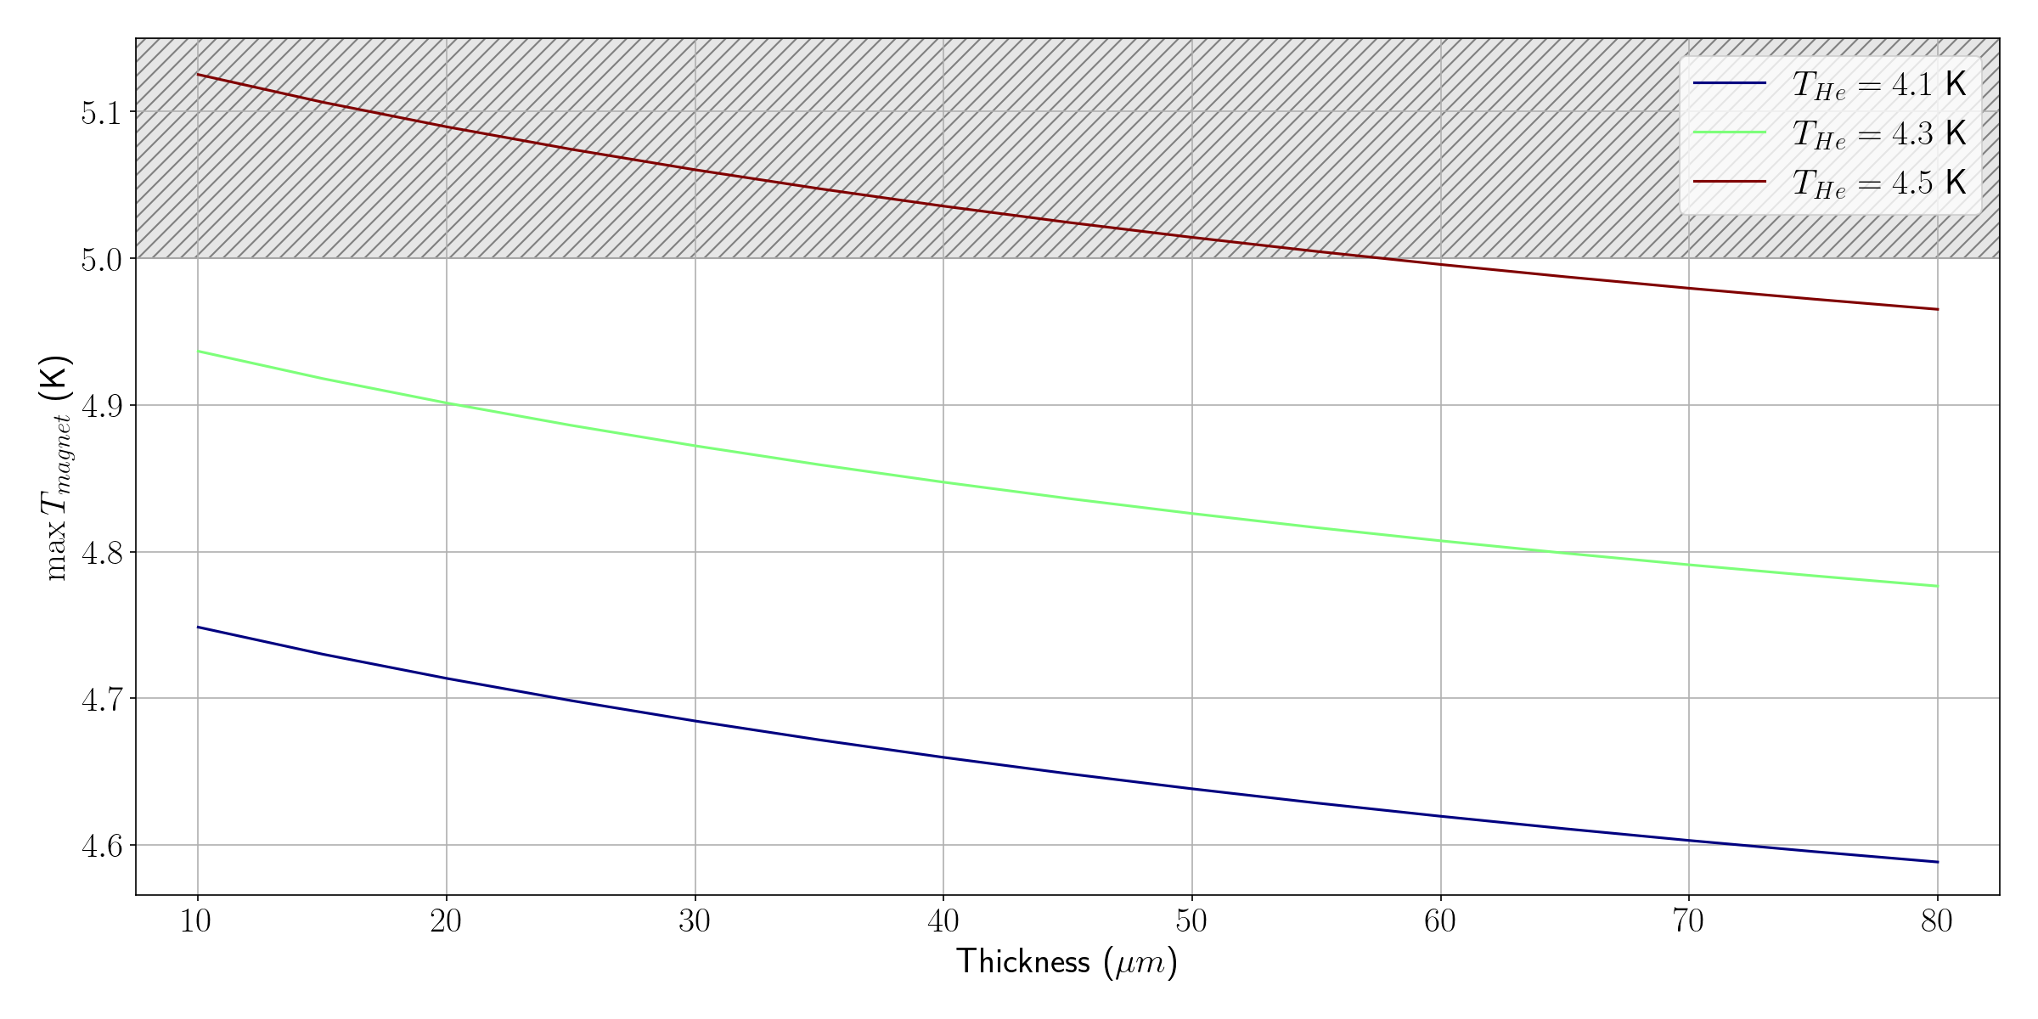
Maximum magnet temperature vs. Cu thickness:

Slide 19

Maximum magnet temperature vs. Cu thickness:
Minimum copper thickness $t_{Cu}≈57 μm$ for $T_{He} = 4.5 K$

Slide 20
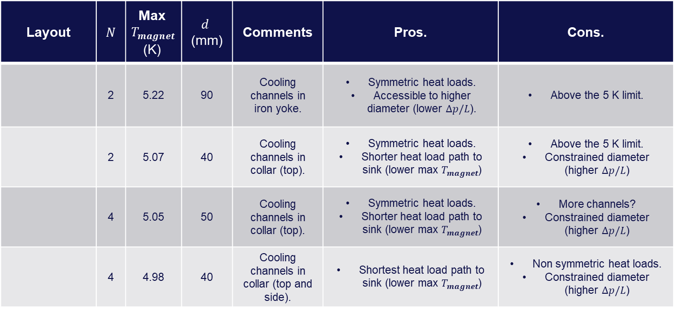
Summary of preliminary design exploration ($t_{Cu}≈60 μm$, $T_{He}= 4.5 K$)
Layout | $N$ | Max $T_{magnet}$ (K) | $$d$$ (mm) | Comments | Pros. | Cons.
 | 2 | 5.22 | 90 | Cooling channels in iron yoke. | Symmetric heat loads. Accessible to higher diameter (lower $Δp/L$). | Above the 5 K limit.
 | 2 | 5.07 | 40 | Cooling channels in collar (top). | Symmetric heat loads. Shorter heat load path to sink (lower max $T_{magnet}$) | Above the 5 K limit. Constrained diameter (higher $Δp/L$)
 | 4 | 5.05 | 50 | Cooling channels in collar (top). | Symmetric heat loads. Shorter heat load path to sink (lower max $T_{magnet}$) | More channels? Constrained diameter (higher $Δp/L$)
 | 4 | 4.98 | 40 | Cooling channels in collar (top and side). | Shortest heat load path to sink (lower max $T_{magnet}$) | Non symmetric heat loads. Constrained diameter (higher $Δp/L$)

Slide 21
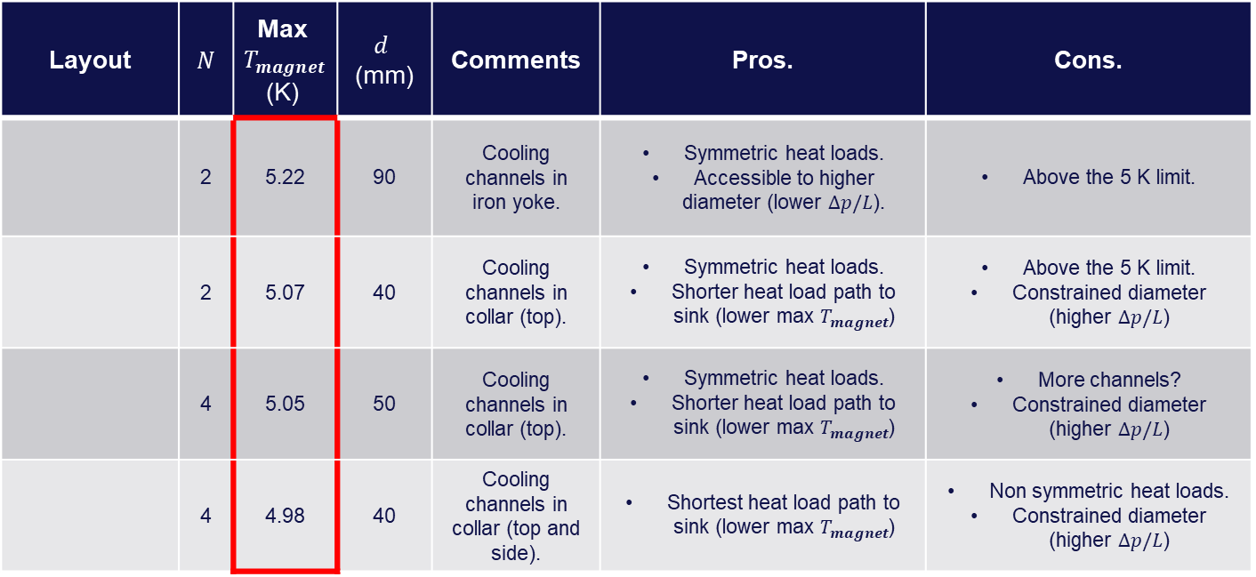

Summary of preliminary design exploration ($t_{Cu}≈60 μm$, $T_{He}= 4.5 K$)
Layout | $N$ | Max $T_{magnet}$ (K) | $$d$$ (mm) | Comments | Pros. | Cons.
 | 2 | 5.22 | 90 | Cooling channels in iron yoke. | Symmetric heat loads. Accessible to higher diameter (lower $Δp/L$). | Above the 5 K limit.
 | 2 | 5.07 | 40 | Cooling channels in collar (top). | Symmetric heat loads. Shorter heat load path to sink (lower max $T_{magnet}$) | Above the 5 K limit. Constrained diameter (higher $Δp/L$)
 | 4 | 5.05 | 50 | Cooling channels in collar (top). | Symmetric heat loads. Shorter heat load path to sink (lower max $T_{magnet}$) | More channels? Constrained diameter (higher $Δp/L$)
 | 4 | 4.98 | 40 | Cooling channels in collar (top and side). | Shortest heat load path to sink (lower max $T_{magnet}$) | Non symmetric heat loads. Constrained diameter (higher $Δp/L$)
max $T_{magnet}$ decreases

Slide 22
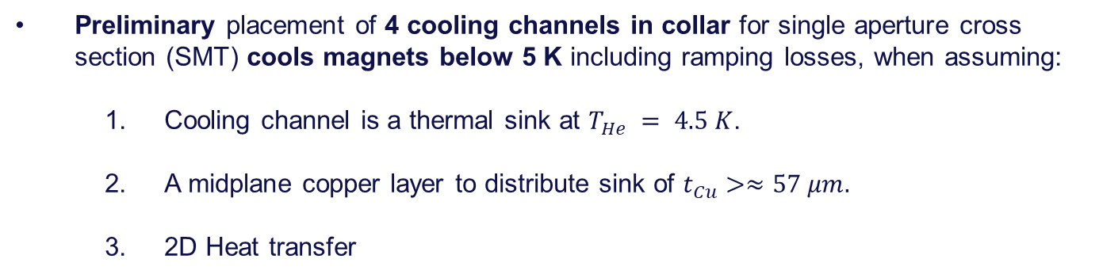
Conclusions:
Preliminary placement of 4 cooling channels in collar for single aperture cross section (SMT) cools magnets below 5 K including ramping losses, when assuming:
    Cooling channel is a thermal sink at $T_{He} = 4.5 K$.
    A midplane copper layer to distribute sink of $t_{Cu}>≈57 μm.$
    2D Heat transfer
Limited availability of cross section area limits hydraulic diameter to $d_{ML}≈40$ mm smashing pressure drop in magnet supply line up to 1 bar.

Slide 23
Discussion items

Slide 24
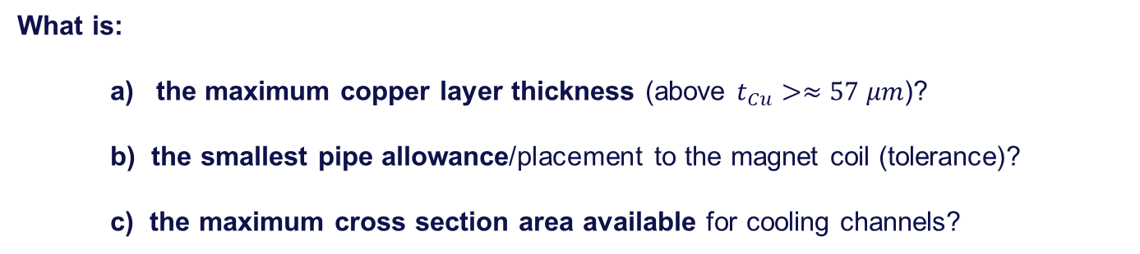
Discussion items:
What is:
    the maximum copper layer thickness (above $t_{Cu}>≈57 μm$)?
b) the smallest pipe allowance/placement to the magnet coil (tolerance)?
c) the maximum cross section area available for cooling channels?
That does not compromise any structural and magnetic field requirements.
(On the side):
    d) In which ways would any 3D model (conjugate heat transfer/turbulent single phase He flow) be helpful to devise possible hot spots/dangerous thermal gradients in magnet coils?

Slide 25
Longitudinal $Δp$ considerations

Slide 26
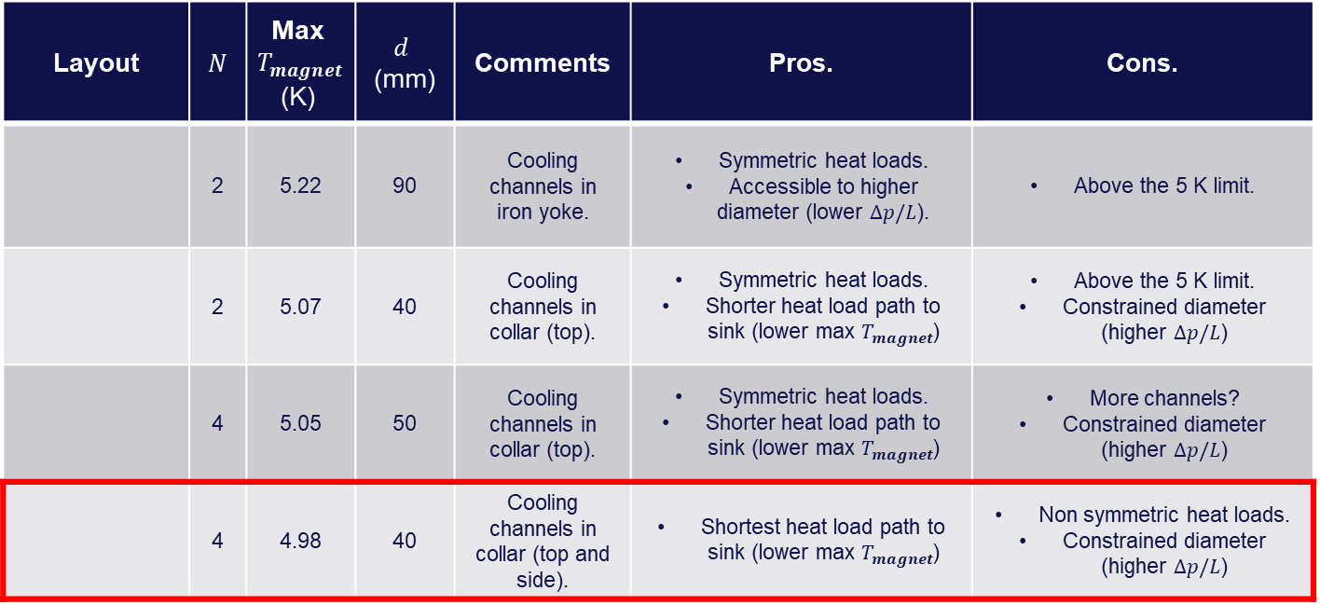
Summary of preliminary design exploration ($t_{Cu}≈60 μm$, $T_{He}= 4.5 K$)
Layout | $N$ | Max $T_{magnet}$ (K) | $$d$$ (mm) | Comments | Pros. | Cons.
 | 2 | 5.22 | 90 | Cooling channels in iron yoke. | Symmetric heat loads. Accessible to higher diameter (lower $Δp/L$). | Above the 5 K limit.
 | 2 | 5.07 | 40 | Cooling channels in collar (top). | Symmetric heat loads. Shorter heat load path to sink (lower max $T_{magnet}$) | Above the 5 K limit. Constrained diameter (higher $Δp/L$)
 | 4 | 5.05 | 50 | Cooling channels in collar (top). | Symmetric heat loads. Shorter heat load path to sink (lower max $T_{magnet}$) | More channels? Constrained diameter (higher $Δp/L$)
 | 4 | 4.98 | 40 | Cooling channels in collar (top and side). | Shortest heat load path to sink (lower max $T_{magnet}$) | Non symmetric heat loads. Constrained diameter (higher $Δp/L$)
Chosen as benchmark for recooling scheme update

Slide 27
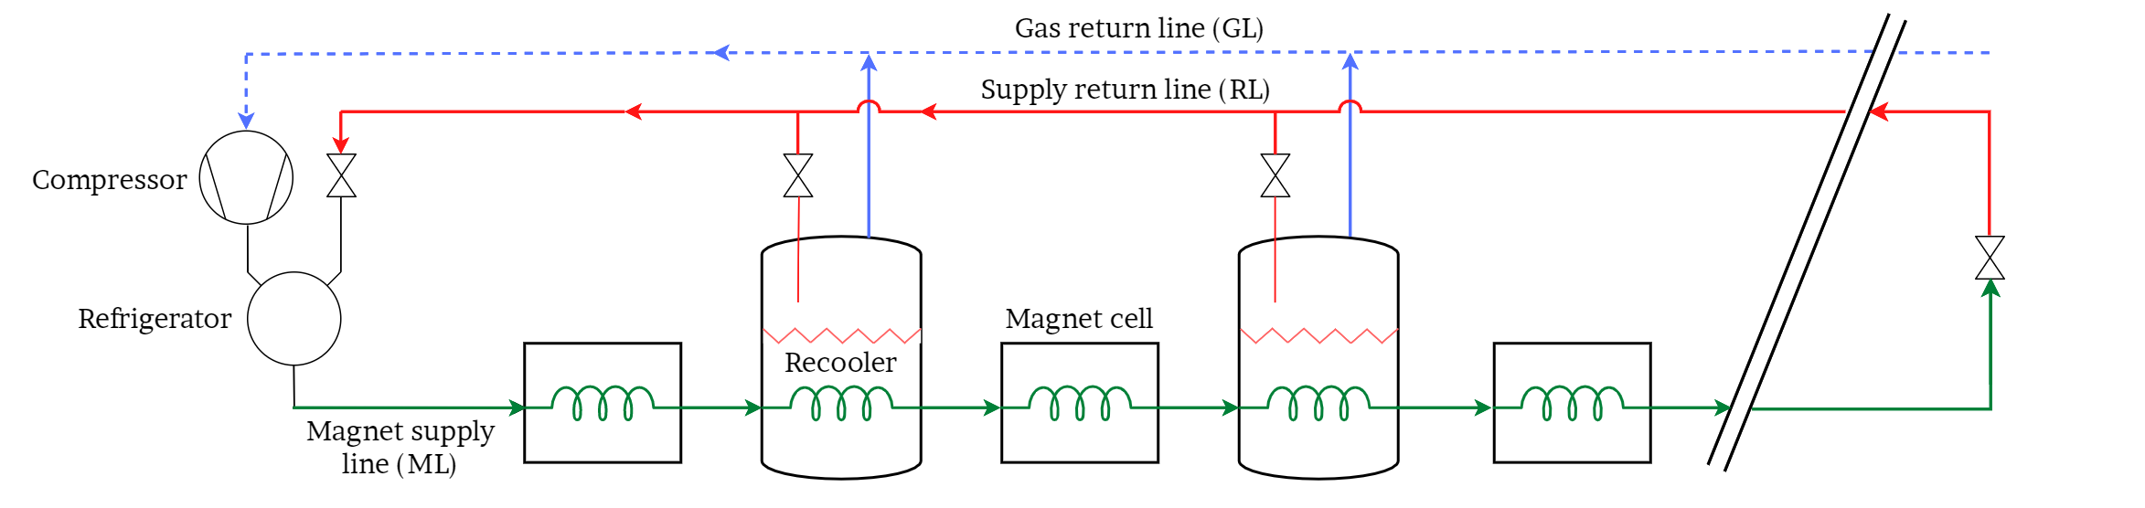



Cold mass cooling scheme PID (nomenclature):
$$p_{GL}^{out}$$
$$p_{GL}=p_{sat}$$
$$L_{cell}$$
$$p_{sat}$$
$$\dot{m}$$
$$p_{ML}^{in}$$
$$T_{ML}^{in}$$
$$T_{ML}^{out}$$
$${\dot{Q}}_{ML}$$
$${\dot{Q}}_{ML}$$
$${\dot{Q}}_{ML}$$
$$L_{sector}$$

Slide 28
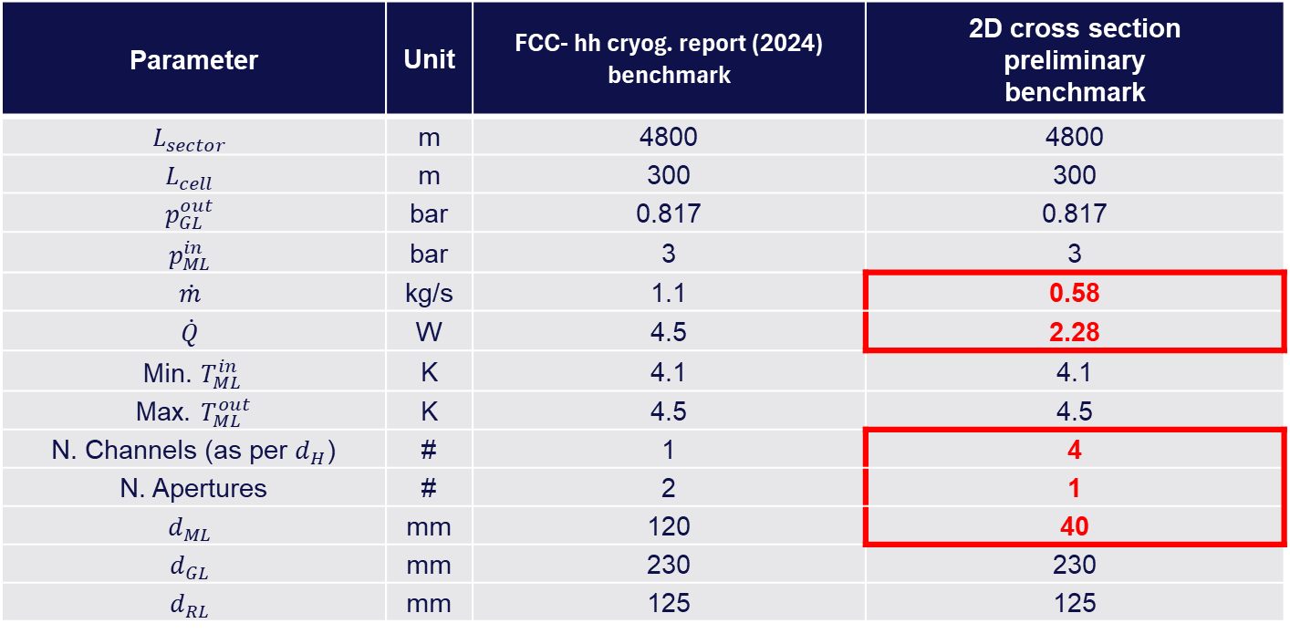
Reminder of last update from cold mass cooling scheme input parameters:
Parameter | Unit | FCC- hh cryog. report (2024) benchmark | 2D cross section preliminary benchmark
$$L_{sector}$$ | m | 4800 | 4800
$$L_{cell}$$ | m | 300 | 300
$$p_{GL}^{out}$$ | bar | 0.817 | 0.817
$$p_{ML}^{in}$$ | bar | 3 | 3
$$\dot{m}$$ | kg/s | 1.1 | 0.58
$$\dot{Q}$$ | W | 4.5 | 2.28
Min. $T_{ML}^{in}$ | K | 4.1 | 4.1
Max. $T_{ML}^{out}$ | K | 4.5 | 4.5
N. Channels (as per $d_{H}$) | # | 1 | 4
N. Apertures | # | 2 | 1
$$d_{ML}$$ | mm | 120 | 40
$$d_{GL}$$ | mm | 230 | 230
$$d_{RL}$$ | mm | 125 | 125
(Due to single aperture heat load adjustment)

Slide 29
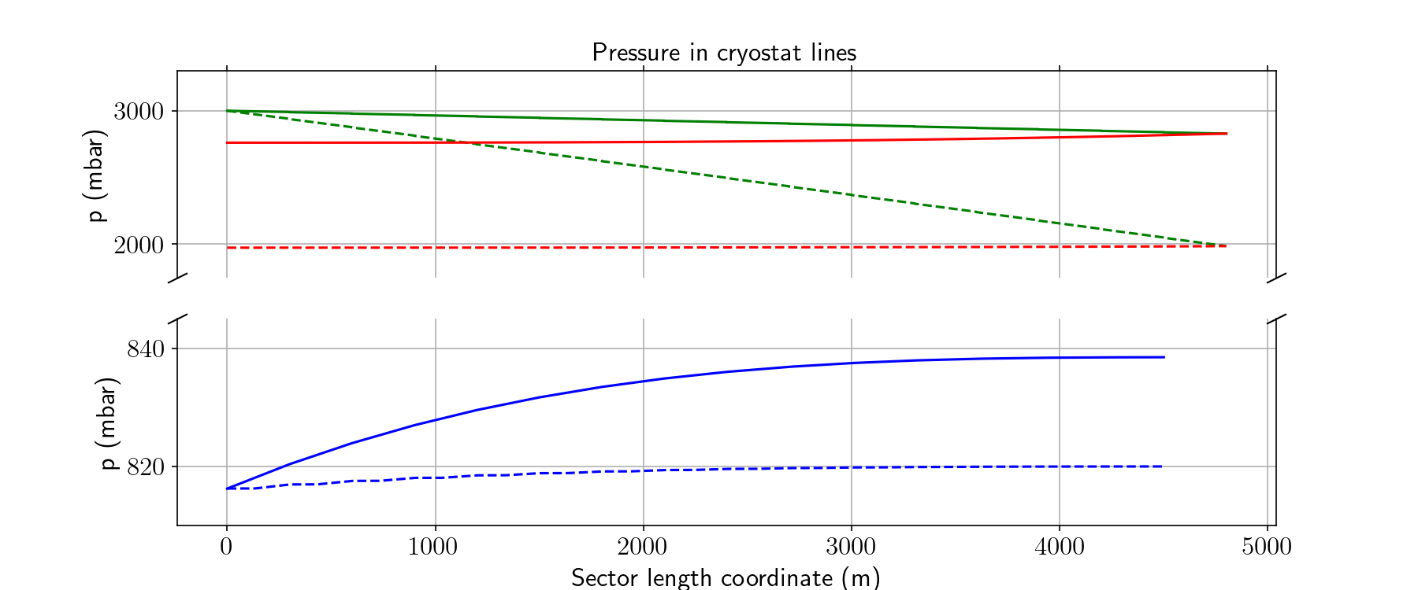


Longitudinal grad. scheme results, from self code:
FCC-hh report
benchmark
$$N=1,$$
$$\dot{m}=1.1 \frac{kg}{s},$$
$${ d}_{ML}=120 mm,$$
$$\dot{Q}=4.5 \frac{W}{m}$$
2D cross sec.
preliminary
benchmark
$$N=4,$$
$$\dot{m}=0.58 \frac{kg}{s},$$
$${ d}_{ML}=40 mm,$$
$$\dot{Q}=2.28 \frac{W}{m}$$
Magnet supply
Recooler supply
Gas return

