Slide 1

RF Measurement Techniques
Manfred Wendt – BNL / CERN
based on the training classes given at the Joint University Accelerator School (JUAS),
the CERN Accelerator School (CAS) on Advanced Accelerator Physics,
and the U.S. Particle Accelerator School (USPAS) on Modern Beam Diagnostics
CERN Accelerator School CAS 2025
Beam Instrumentation
Split, Croatia, November 16 – 29, 2025

Slide 2
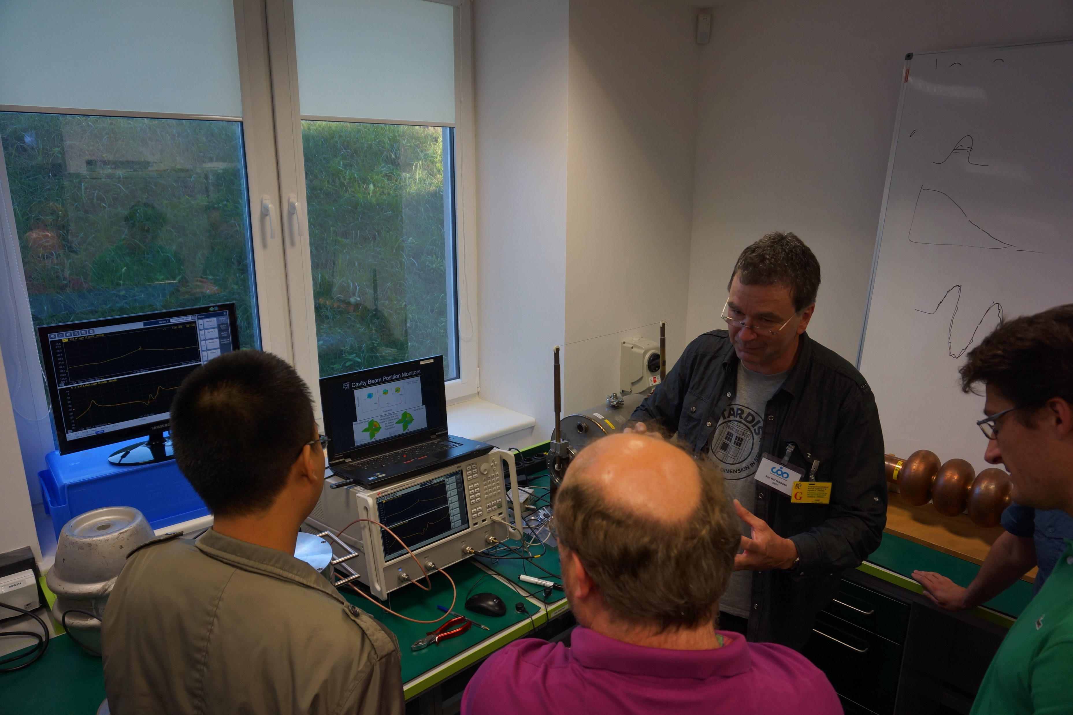
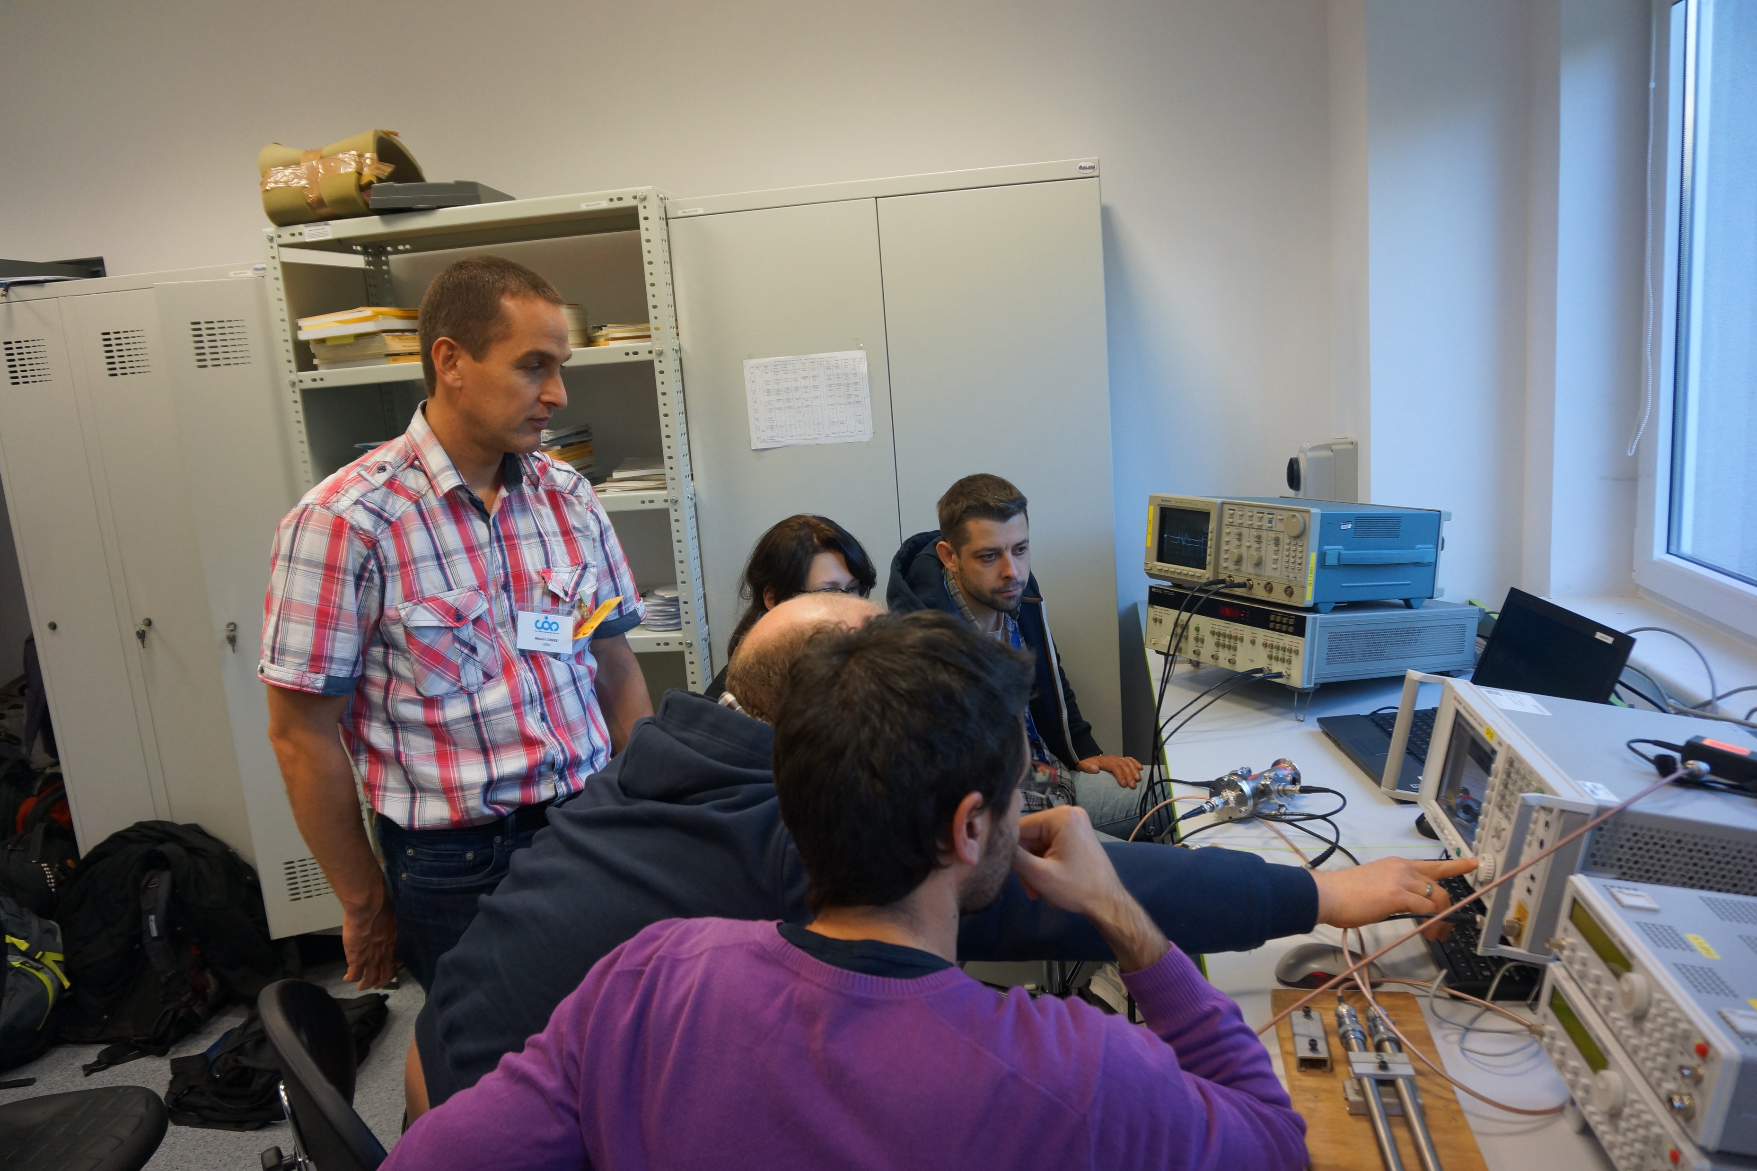
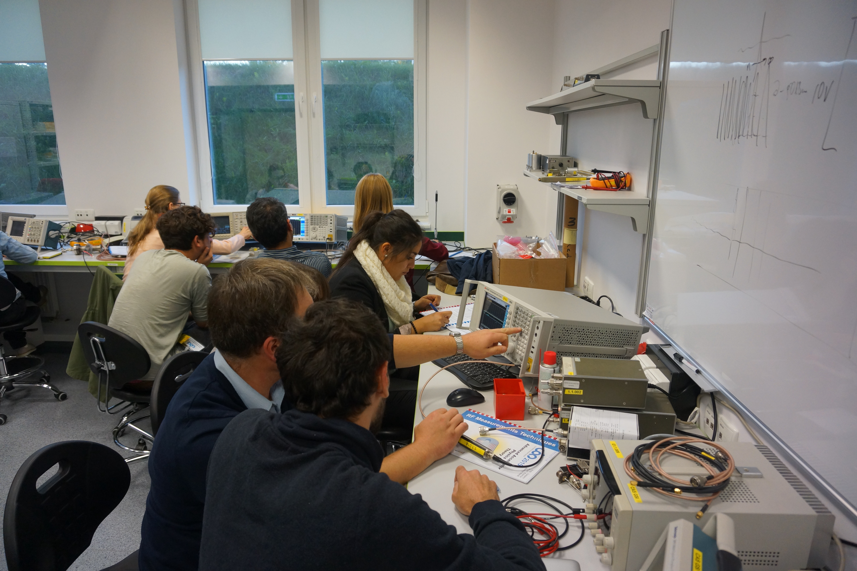
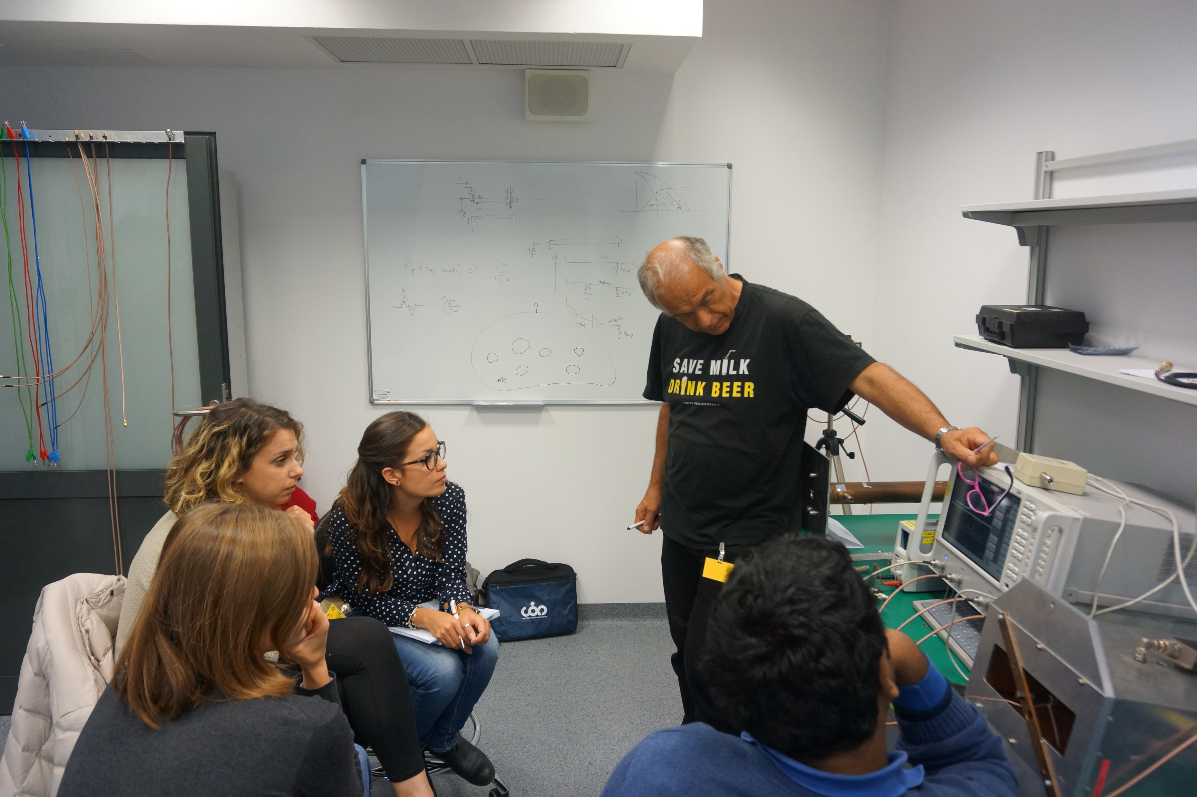
Contents
Introduction
Transmission-lines
The Smith chart
Scattering (S) parameters
RF measurement methods
& instruments
Backup slides:
If you want to know more…

Slide 3



Introduction – An Electro-Magnetic Beam Monitor
control
system
(LAN)
coaxial signal cable
RF & Analog Signal Conditioning
ADC
Digital Signal Processing
& DAQ
EM beam
pickup
$Z(ω$)
$$v\left(t\right), V(ω)$$
bunched beam
(with EM-field)
RF measurement
instrument, e.g.:
spectrum analyzer,
oscilloscope,
diode detector, etc.
v
$i\left(t\right), I(ω$)
RF Measurement
Techniques apply
metallic beam pipe (vacuum)
EM beam pickup, e.g. for
  Beam intensity monitoring
    Beam pickup based on toroidal transformer, wall-current monitor
  Beam position / orbit and/or tune monitoring
    Beam pickup based on button-style or other electrostatic, stripline, resonant cavity, periodic RF coupler, etc. electrodes
Transmission-lines
  Usually, coaxial cables to transmit the signals from the beam pickup to the read-out electronics
    Also used for calibration, trigger and clock signals
RF signal processing
  Analog components for signal shaping and conditioning
    Amplifier, attenuator, filter, hybrid coupler, RF diode & limiter, signal splitter & combiner, transformers & balun, etc.

Slide 4
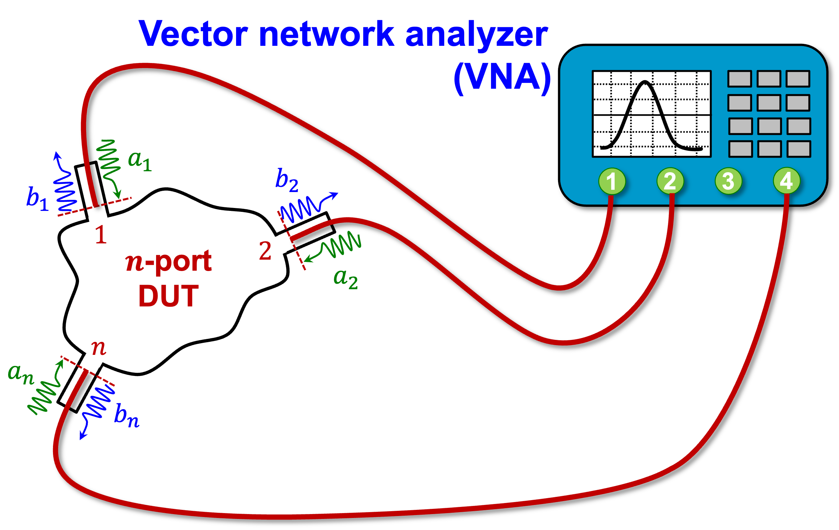
Introduction – RF component characterization
signal
generator
measurement
instrument
Characterization of RF components and subsystems on the test bench
  Not limited to beam instrumentation and accelerator RF systems
    fast kickers and
    other beam manipulation devices,
    beam-coupling impedance measurements
    of accelerator vacuum components
Signal generator
  RF sine-wave (with modulation, sweep), pulse, arbitrary waveform
Measurement instrument
  Oscilloscope, spectrum analyzer,
  vector voltmeter, diode detector
Most popular:
All-in-one DUT characterization by the
Vector Network Analyzer (VNA)
DUT
DUT stimulus
signal
DUT response
signal
DUT: Device Under Test

Slide 5
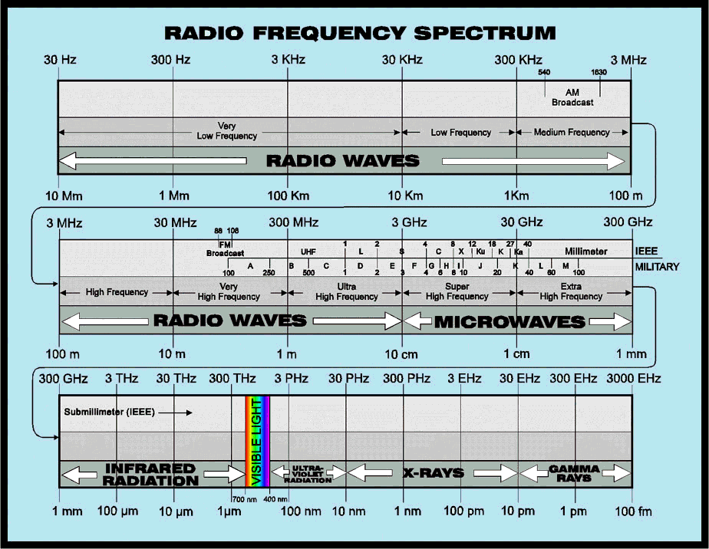
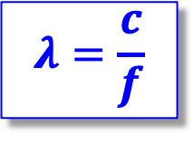

Introduction – What are Radio-Frequencies?
Free space
wavelength:
$$λ=\frac{c}{f}$$
We care about
RF concepts
if the physical
dimensions of
an apparatus
is $>λ/10$
RF frequencies typically utilized
in accelerator applications

Slide 6
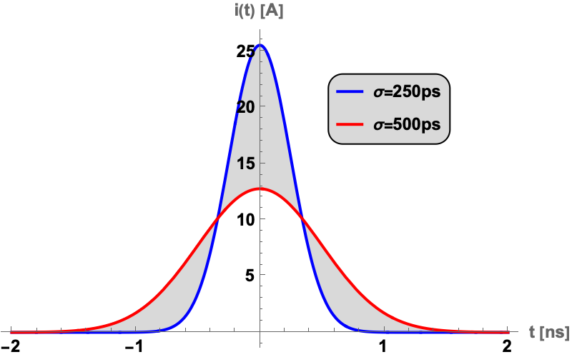
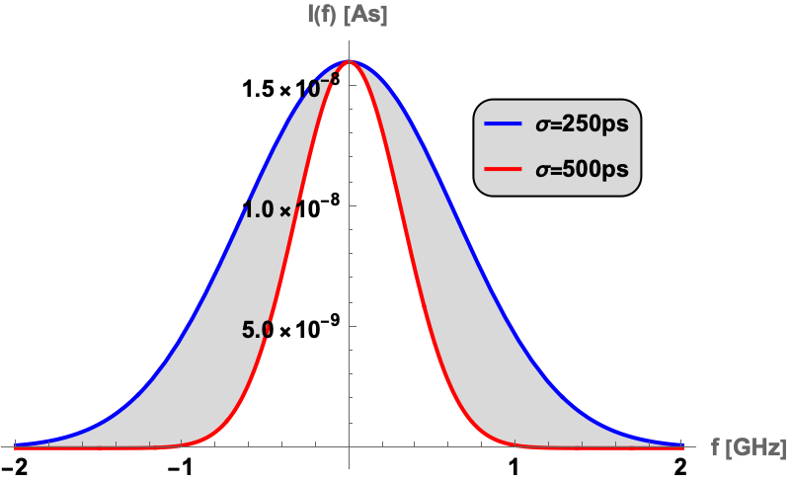

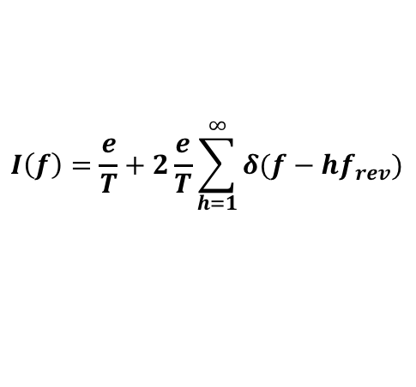



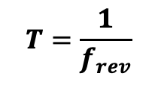
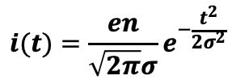
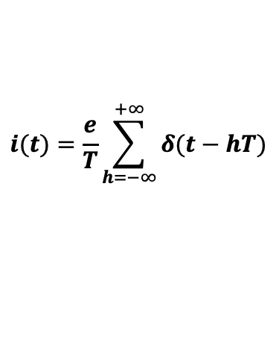
Introduction – Beam Signals
Single point charge $q=e$ in time and frequency domain
  Circulating in a ring accelerator at constant, relativistic velocity with
Many particles, single bunch, e.g. protons, $n={10}^{11}$, Gaussian distribution
$$T=\frac{1}{f_{rev}}$$
$$i(t)=\frac{e}{T}\sum_{h=−∞}^{+∞}{δ(t−hT)}$$
I(f)
$$I\left(f\right)=\frac{e}{T}+2\frac{e}{T}\sum_{h=1}^{∞}{δ(f−hf_{rev})}$$
i(t)
Fourier trans. or
spectrum analyzer
0
1
2
3
4
0
1
2
3
4
time $t/T$
harmonic number $h=f/f_{rev}$
$$i(t)=\frac{en}{\sqrt{2π}σ}e^{−\frac{t^{2}}{2σ^{2}}}$$
$$I(f)=\frac{en}{2\sqrt{2π}σ^{2}}e^{−2{\left(πfσ\right)}^{2}}$$

Slide 7
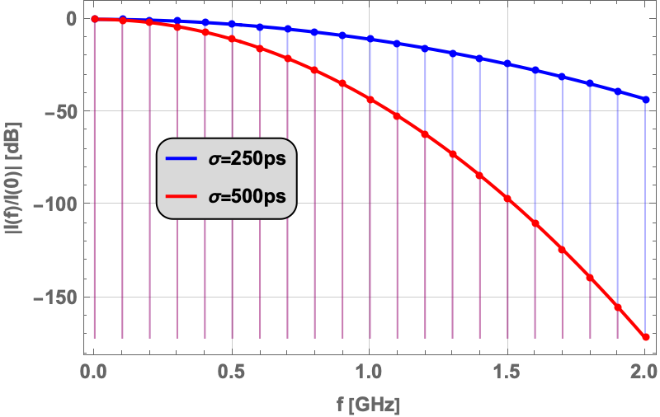

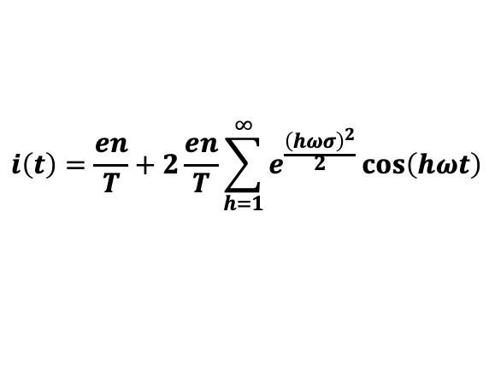

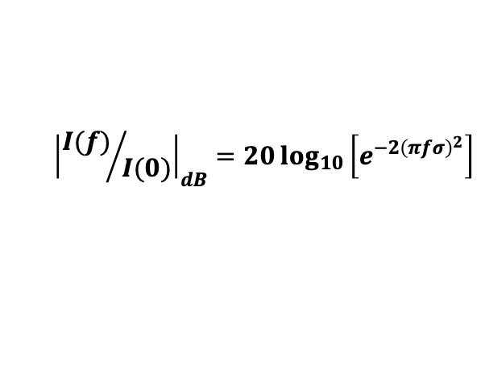
Introduction – Beam Signals (cont.)
Normalized representation on a logarithmic amplitude (magnitude, modulus) scale
  Typical magnitude spectrum
    As it would be observed with a spectrum analyzer
  Spectrum of repetitive bunches of same shape and intensity
    Fourier series expansion
Beam bunches have different distribution functions and length
  Electron bunches are typically 100…1000x shorter compared to proton bunches
  Ion bunches can be 10…1000x longer than relativistic proton bunches
  Longitudinal particle distribution vary depending on particle type and “RF gymnastics”:
    Gaussian (electrons), parabolic, Tsallis q-Gaussian, cos², etc. (hadrons)
$${\left|{I(f)}/{I(0)}\right|}_{dB}=20\log_{10}\left[e^{−2{\left(πfσ\right)}^{2}}\right]$$
$$I(0)=\frac{en}{2\sqrt{2π}σ^{2}}$$
revolution harmonics, here $\text{i}\text{ndicated} \text{at}\text{: }\frac{1}{T}=f_{rev}=100 MHz$
$$i\left(t\right)=\frac{en}{T}+2\frac{en}{T}\sum_{h=1}^{∞}{e^{\frac{{\left(hωσ\right)}^{2}}{2}}}\cos\left(hωt\right)$$
$$ω=2πf$$

Slide 8

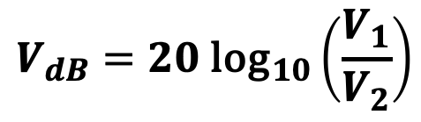
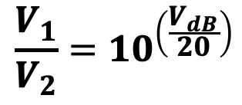
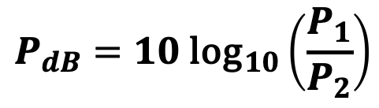
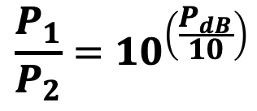
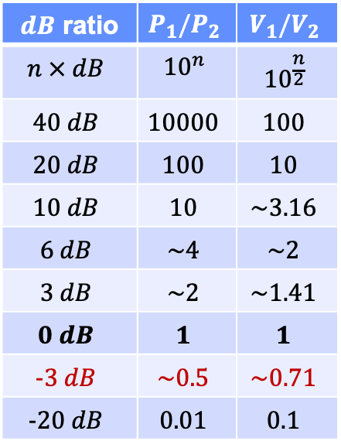
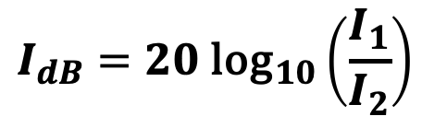
Introduction – “dB” [dee-bee], or not to be…
dezi-Bel: 1 dB = 0.1 B (Bel)
  Logarithmic scaling to compare large, e.g., power ratios:
  or large ratios of other quantities, e.g.:
$$P_{dB}=10{ \text{log}}_{10}\left(\frac{P_{1}}{P_{2}}\right)$$
$$V_{dB}=20{ \text{log}}_{10}\left(\frac{V_{1}}{V_{2}}\right)$$
voltage ratio:
$dB$ ratio | $$P_{1}/P_{2}$$ | $$V_{1}/V_{2}$$
$$n × dB$$ | $${10}^{n}$$ | $${10}^{\frac{n}{2}}$$
$$40 dB$$ | $$10000$$ | $$100$$
$$20 dB$$ | $$100$$ | $$10$$
$$10 dB$$ | $$10$$ | $$\sim 3.16$$
$$6 dB$$ | $$\sim 4$$ | $$\sim 2$$
$$3 dB$$ | $$\sim 2$$ | $$\sim 1.41$$
$$0 dB$$ | $$1$$ | $$1$$
$$−3 dB$$ | $$\sim 0.5$$ | $$\sim 0.71$$
$$−20 dB$$ | $$0.01$$ | $$0.1$$
$$I_{dB}=20{ \text{log}}_{10}\left(\frac{I_{1}}{I_{2}}\right)$$
current ratio:
$$\frac{P_{1}}{P_{2}}={10}^{\left(\frac{P_{dB}}{10}\right)}$$
$$\frac{V_{1}}{V_{2}}={10}^{\left(\frac{V_{dB}}{20}\right)}$$
The $3 dB$ ratio (half power) is a
common specification for the bandwidth

Slide 9
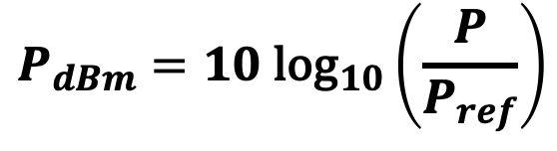
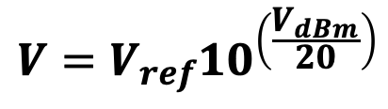
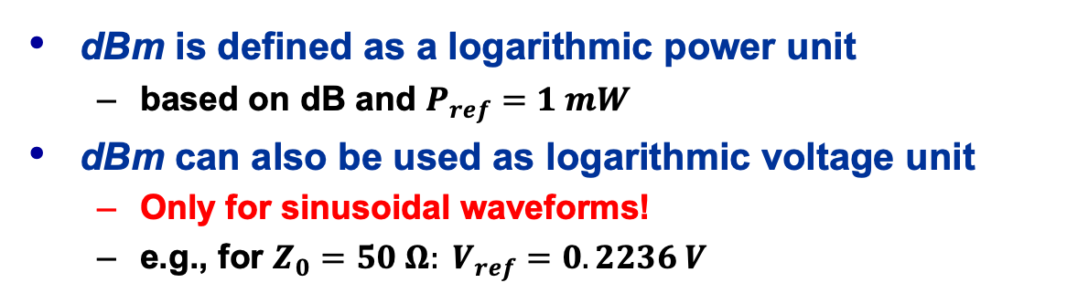
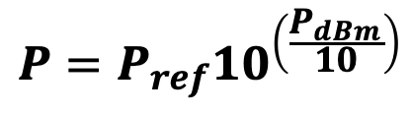
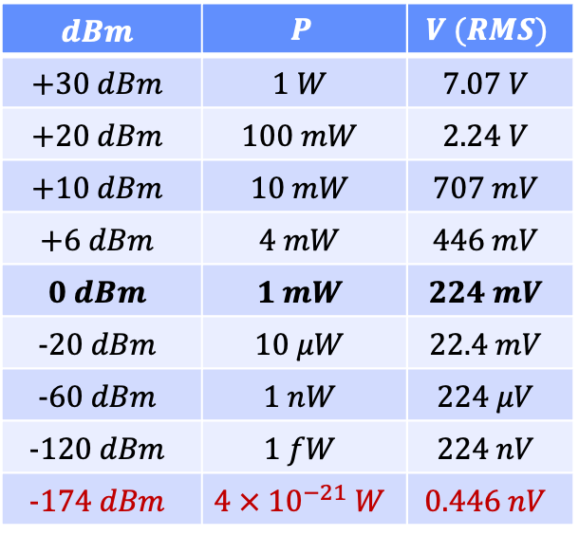
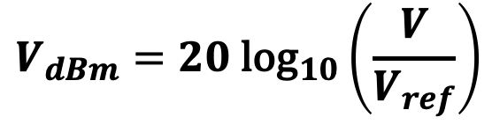
Introduction – “dB” is not “dBm”
dBm is defined as a logarithmic power unit
  based on dB and $P_{ref}=1 mW$
dBm can also be used as logarithmic voltage unit
  Only for sinusoidal waveforms!
  e.g., for $Z_{0}=50 Ω: V_{ref}=0.2236 V$
$$P_{dBm}=10{ \text{log}}_{10}\left(\frac{P}{P_{ref}}\right)$$
$$V_{dBm}=20{ \text{log}}_{10}\left(\frac{V}{V_{ref}}\right)$$
$$dBm$$ | $$P$$ | $$V (RMS)$$
$$+30 dBm$$ | $$1 W$$ | $$7.07 V$$
$$+20 dBm$$ | $$100 mW$$ | $$2.24 V$$
$$+10 dBm$$ | $$10 mW$$ | $$707 mV$$
$$+6 dBm$$ | $$4 mW$$ | $$446 mV$$
$$0 dBm$$ | $$1 mW$$ | $$224 mV$$
$$−20 dBm$$ | $$10 μW$$ | $$22.4 mV$$
$$−60 dBm$$ | $$1 nW$$ | $$224 μV$$
$$−120 dBm$$ | $$1 fW$$ | $$224 nV$$
$$−174 dBm$$ | $$4 × {10}^{−21} W$$ | $$0.446 nV$$
$$P={P_{ref}10}^{\left(\frac{P_{dBm}}{10}\right)}$$
$$V={V_{ref}10}^{\left(\frac{V_{dBm}}{20}\right)}$$
noise power in a bandwidth $BW=1 Hz$ at room temperature

Slide 10
Part I: Transmission-lines
Outline and Learning objectives
  Introduction and some minimum theoretical background
  Reflections effects of pulse signals on transmission-lines
  due to characteristic-termination impedance mismatch
  Standing waves on transmission-lines for continuous wave (CW) sinusoidal signals, definition of the reflection coefficient
  Relation between reflection coefficient, standing wave ration and return loss

Slide 11
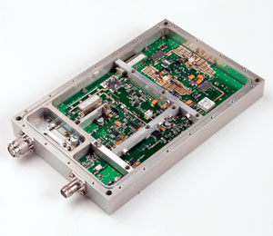
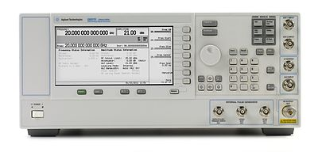
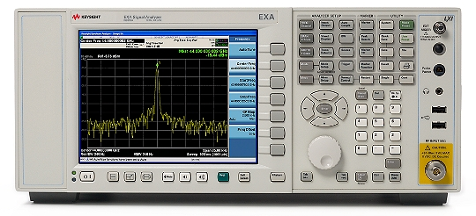
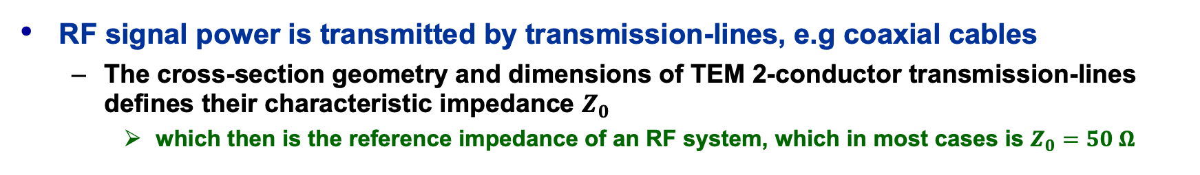
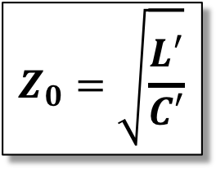
Transmission-lines
coaxial
cable
outer
conductor
dl
equivalent
circuit of a
lossless
TEM transmission-line
$$Z_{0}=\sqrt{\frac{L′}{C′}}$$
L’
C’
inner
conductor
dl
RF signal power is transmitted by transmission-lines, e.g coaxial cables
  The cross-section geometry and dimensions of TEM 2-conductor transmission-lines defines their characteristic impedance $Z_{0}$
    which then is the reference impedance of an RF system, which in most cases is $Z_{0}=50 Ω$

Slide 12
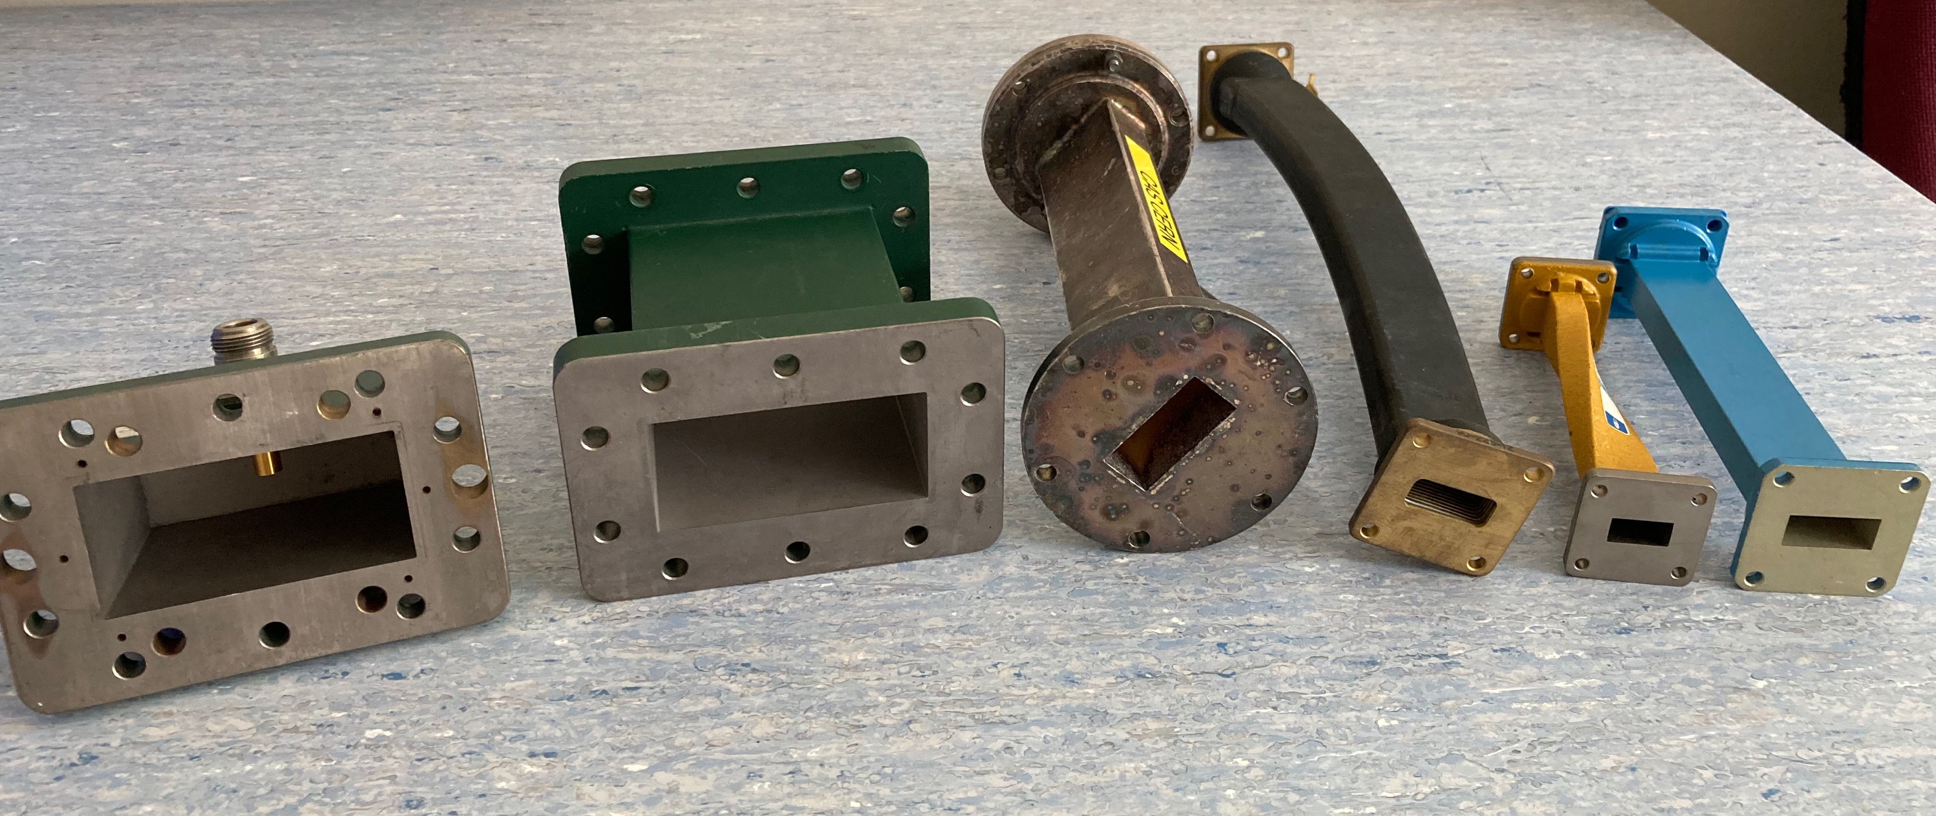
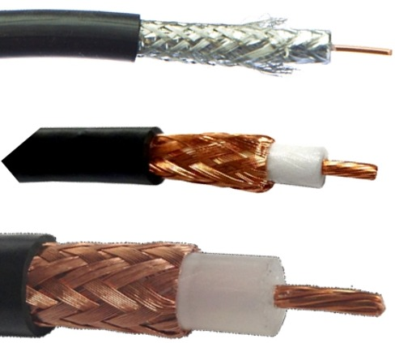
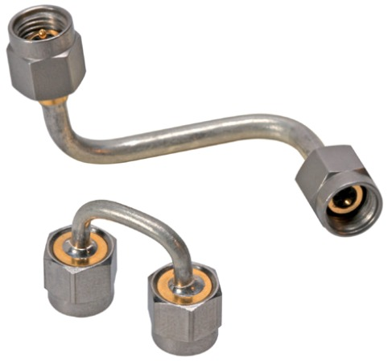
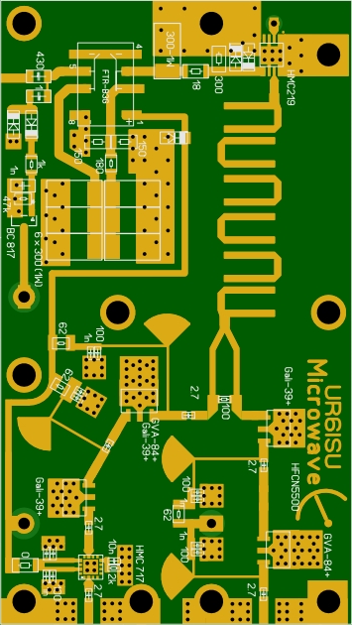
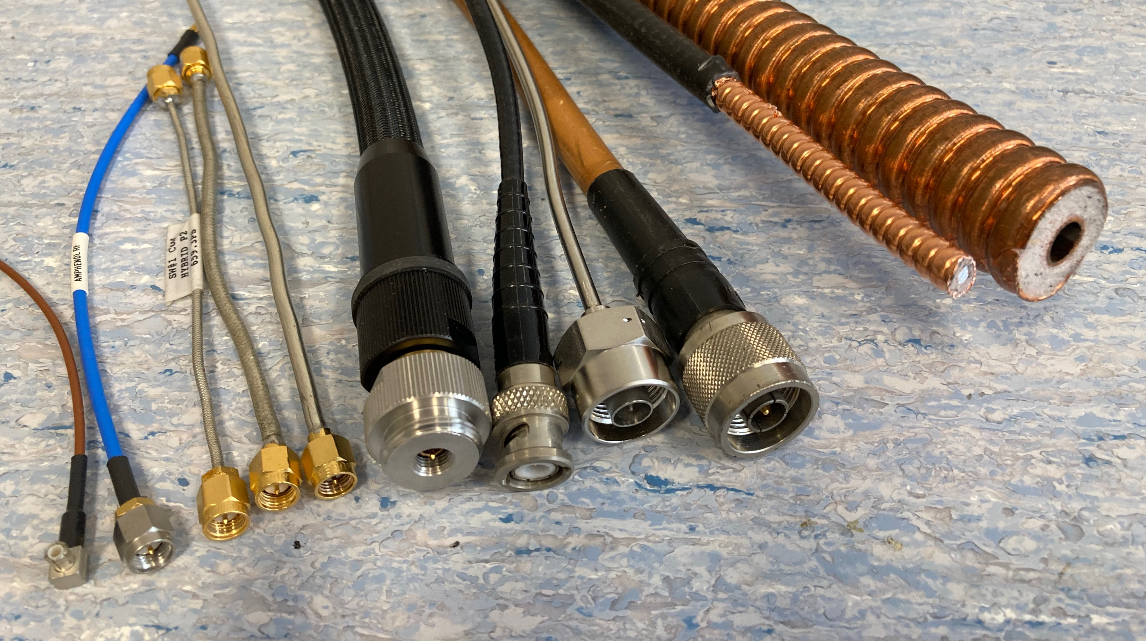
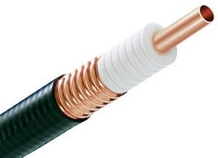
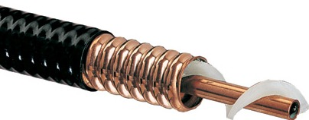
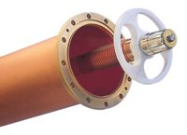
Transmission-lines (1)
Waveguides (TE10)
Semi-rigid
coaxial cables
0.141”, SMA,
$$DC⋯18 GHz$$
PCB microstrip-line (TEM)
WR-137:
5.85$⋯8.20 GHz$
WR-284:
$$2.60⋯3.95 GHz$$
WR-90:
8.2$⋯12.4 GHz$
RG-type
coaxial cables
RG58
7/8”
1/2”
1/4”
Low-loss, high-power
air coaxial
transmission-line
VNA
SiO2
semi-rigid
& flex
N-type
corrugated
coaxial cables,
foamed PE & air
BNC
Coaxial cables (TEM)
with and w/o connectors
SMA
MCX

Slide 13
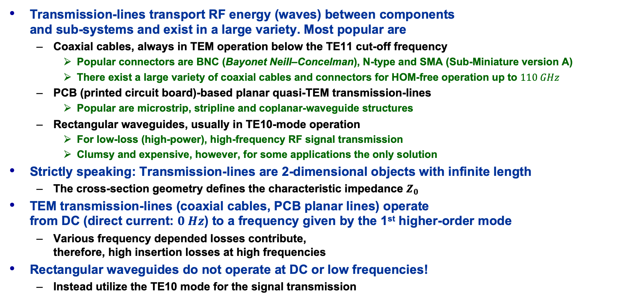
Transmission-lines (2)
Transmission-lines transport RF energy (waves) between components
and sub-systems and exist in a large variety. Most popular are
  Coaxial cables, always in TEM operation below the TE11 cut-off frequency
    Popular connectors are BNC (Bayonet Neill–Concelman), N-type and SMA (Sub-Miniature version A)
    There exist a large variety of coaxial cables and connectors for HOM-free operation up to $110 GHz$
  PCB (printed circuit board)-based planar quasi-TEM transmission-lines
    Popular are microstrip, stripline and coplanar-waveguide structures
  Rectangular waveguides, usually in TE10-mode operation
    For low-loss (high-power), high-frequency RF signal transmission
    Clumsy and expensive, however, for some applications the only solution
Strictly speaking: Transmission-lines are 2-dimensional objects with infinite length
  The cross-section geometry defines the characteristic impedance $Z_{0}$
TEM transmission-lines (coaxial cables, PCB planar lines) operate
from DC (direct current: $0 Hz$) to a frequency given by the 1st higher-order mode
  Various frequency depended losses contribute,
  therefore, high insertion losses at high frequencies
Rectangular waveguides do not operate at DC or low frequencies!
  Instead utilize the TE10 mode for the signal transmission

Slide 14
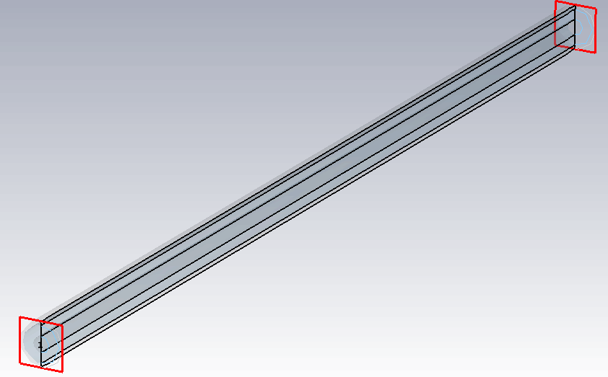



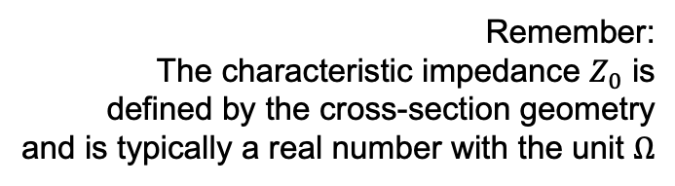


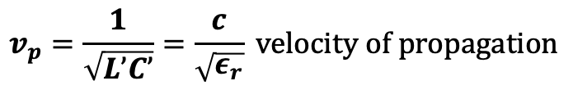
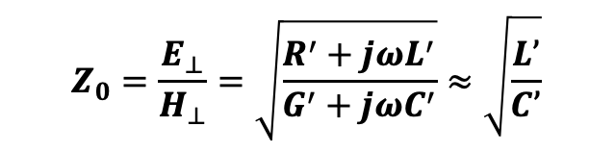




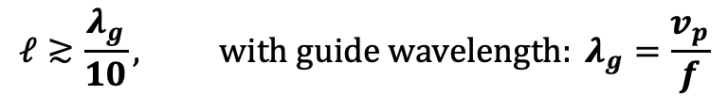


Transmission-lines (3)
TEM: coaxial cable, PCB stripline, micro-stripline, co-planar waveguide, etc.
  but also, TE / TM: waveguides (rectangular, circular, elliptical)
Transport RF energy (EM waves) from a RF source to a load.
Physical length $ℓ$ becomes relevant for
Reflections occur if the load impedance $Z_{L}$
is not matched to the characteristic
impedance $Z_{0}$ of the TL
load
$$Z_{L}$$
transmission-line,
here: TEM coaxial
$$ℓ≳\frac{λ_{g}}{10}, with guide wavelength: λ_{g}=\frac{v_{p}}{f}$$
$$Z_{0}, γ$$
$$f:operating frequency (max.)$$
$$v_{p}=\frac{1}{\sqrt{L’C’}}=\frac{c}{\sqrt{ε_{r}}} velocity of propagation$$
$$ℓ$$
Remember:
The characteristic impedance $Z_{0}$ is
defined by the cross-section geometry
and is typically a real number with the unit $Ω$
$$Z_{S}$$
$$Z_{L}=Z_{0} ⇒Γ=0:no reflections$$
$$Z_{0}=\frac{E_{⊥}}{H_{⊥}}=\sqrt{\frac{R^{′}+{jωL}^{′}}{G^{′}+{jωC}^{′}}}≈\sqrt{\frac{L’}{C’}}$$
$$v_{S}$$
$Z_{L}≠Z_{0} ⇒Γ≠0:reflections$!
RF source
with losses no losses

Slide 15
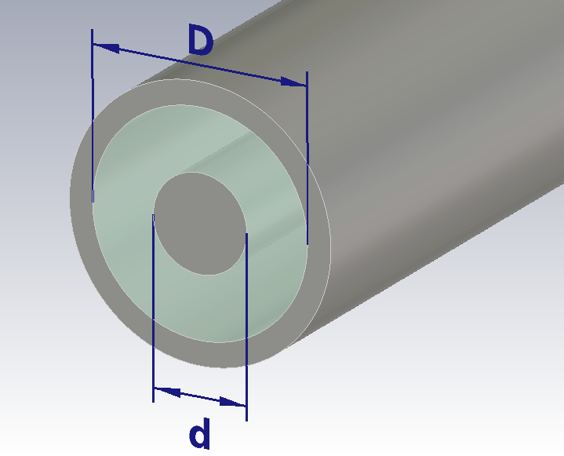







Transmission-lines – Coaxial Cables
The characteristic impedance is defined by the cross-section geometry:
The attenuation losses in the propagation constant $γ$
are dominated by the material properties:
  Propagation constant:
  Attenuation constant:
    The attenuation losses are dominated by conductor and dielectric losses
  Conductor losses:
  Dielectric losses:
    with:
$$Z_{0}=\frac{η_{0}}{2π\sqrt{ε_{r}}}\ln\left(\frac{D}{d}\right)≈\frac{60 Ω}{\sqrt{ε_{r}}}\ln\left(\frac{D}{d}\right) [Ω]$$
$$ε_{r}$$
$$γ=α+jβ$$
$$α=α_{c}+α_{d}+α_{r}+α_{l}$$
For inner and outer conductor in copper:
$$α_{c}=\sqrt{\frac{μ_{0}μ_{r}πf}{σ}}\frac{\sqrt{ε_{r}}}{η_{0}\ln\left(\frac{D}{d}\right)}\left(\frac{1}{D}+\frac{1}{d}\right) [Np/m]$$
$${μ_{rD}=μ_{rd}=μ}_{rCu}=1; ρ_{D}=ρ_{d}=ρ_{Cu}=1.72∙{10}^{−8} Ωm$$
$$α_{c}=6∙{10}^{−9}\sqrt{fε_{r}}\frac{D+d}{dD\ln\left(D/d\right)} [dB/m]$$
(surface resistance) $=R_{S}$
$$α_{d}=πf\sqrt{μ_{0}ε_{0}ε_{r}}\tan{δ_{ε}} [Np/m]$$
$$α_{d}=91∙{10}^{−9}f\sqrt{ε_{r}}\tan{δ} [dB/m]$$
$$resistivity: ρ=\frac{1}{σ} \left[Ωm\right]; loss tangent: \tan{δ_{ε}=\frac{ε”}{ε’}}; permittivity: ε=ε’−jε” \left[F/m\right]; permeability: μ=μ’−jμ” [H/m]$$

Slide 16

TL: Signal visualization in time-domain
Circuit simulator applet:
https://www.falstad.com/circuit/
  Load file: IdealTL_DCswitched_Z050-RL.txt
    Change the load resistor value:
    RL = 50, 100, 25 Ω
    Operate the switch and observe the signals at the beginning, and at the end of the transmission-line.
  Load file:
  IdealTL_pulsed_Z050-RL.txt
    Change the load resistor value:
    RL = 50, 100, 25 Ω
    Observe the signal waveforms!
    Can you predict the values?!
      (Press Run/STOP and hover with the mouse over the waveform)

Slide 17




















TL: Operating with sinusoidal signals (FD)
incident wave: $V^{+}e^{−γz} ⟹$
For a single frequency,
continues wave (CW) signal
on a transmission-line
  Superposition of forward $a, E^{inc},V^{+}$ and backward b$, E^{refl}, V^{−}$
  traveling waves
  $⇒$ standing waves
Reflection coefficient $Γ$
  $Γ$ is related to the
  impedance ratio: $Z_{L}/Z_{0}$
    The load impedance $Z_{L}$ can be complex
  $Γ$ is a complex number
Reflections also originate due to discontinuities of the TL along $z$
  Same $Z_{0}$ does not prevent reflections! EM-field effect!
$$f=1 GHz$$
$$λ=30 cm$$
$$Z_{S}=Z_{0}$$
reflected wave: $V^{−}e^{γz} ⟸$
load
transmission-line
p1
$$Z_{0}, γ=jβ$$
p2
matched:
pure travelling waves
$$Γ=0$$
$$Z_{L}$$
source
(sine-wave
generator)
$$0$$
$$ℓ$$
$$z$$
$$Γ=\frac{b}{a}=\frac{E^{refl}}{E^{inc}}=\frac{V^{−}}{V^{+}}=\frac{Z_{L}−Z_{0}}{Z_{L}+Z_{0}}$$
open:
standing waves
$$Γ=+1$$
here:
$V(z)$ for a
lossless TL
($γ=jβ$)
waves
E-fields
voltages
impedances
short:
standing waves
$$Γ=−1$$

Slide 18

Part III: Scattering Parameters
A few notes on electrical networks
  Electrical network composed out of lumped and distributed elements
  Two-port RC-filter example using admittance (Y) parameters
Introduction to scattering (S) parameters
  General concept of incident / reflected waves scattered at the ports of an RF network
  Reference impedance $Z_{0}$
  $1$-port and $2$-port S-parameters
  Properties of the S-matrix: reciprocity, symmetry, losses
    with more examples in the backup slides
  A few S-matrix examples for RF networks with $1$-, $2$-, $3$-, and $4$-ports
  S-parameters in practice: the SnP Touchstone file format
  General $n$-ports

Slide 19













Electrical Networks (1)
The electromagnetic behavior or RF circuits and systems, like any other
electrical / electronics circuit or system can be described by Maxwell’s equations
  These equations need to be solved, taking all the boundaries and materials into account
However, this is far too complicated and inconvenient for most practical situations!
  simplified electrical network description based on approximative lumped or distributed elements
    With given characteristics and values of each circuit element represented by a symbol in an electrical network, following the laws of Ohm and Kirchhoff. Here some examples:
$$∇∙E=\frac{ρ}{ε}, ∇×B−\frac{∂E}{c^{2}∂t}=μJ, ∇×E+\frac{∂B}{∂t}=0, ∇∙B=0$$
lumped, passive, linear
lumped, passive,
non-linear
lumped, active,
non-linear
distributed, passive,
linear
resistor $R$
inductor $L$
capacitor $C$
diode $D$
transistor $T$
transmission-line $TL$
$$v=L\frac{di}{dt}$$
$$i=C\frac{dv}{dt}$$
$$R=\frac{v}{i}$$
$$Z_{0}, γ$$
$$jωL=\frac{\hat{V}}{\hat{I}}$$
$$\frac{1}{jωC}=\frac{\hat{V}}{\hat{I}}$$
$$i=I_{S}(e^{v/V_{T}}−1)$$
npn transistor

Slide 20



















Electrical Networks (2)
Complex electrical, electronics and RF systems are divided into functional blocks, i.e., networks, with $n$-ports, each port has two terminals
  The two-port network is most popular, typical examples for two-port networks are filters, attenuators, amplifiers, etc.
The characteristic behavior of the $n$-port network is defined by a set of $2n$ parameters, linked to their ports.
  A two-port network has four parameters as port voltages ($V_{1}$, $V_{2}$) and port currents ($I_{1}$, $I_{2}$),
  two are independent, the other two are dependent parameters.
  Various combinations of dependent and independent port voltages and currents exist, accordingly various $n×n$ matrix definitions for linear $n$-port networks exist, known as $Y$-, $Z$-, $h$- and $g$- parameters.
$Y$- parameters
$$I_{1}$$
$$I_{2}$$
2
$$Y_{11}={\left.\frac{I_{1}}{V_{1}} \right|}_{V_{2}=0}$$
$$Y_{12}={\left.\frac{I_{1}}{V_{2}} \right|}_{V_{1}=0}$$
1
$$I_{1}=Y_{11}V_{1}+Y_{12}V_{2}$$
$$+$$
$$+$$
$$V_{1}$$
2-port network
$$V_{2}$$
$$I_{2}=Y_{21}V_{1}+Y_{22}V_{2}$$
$$−$$
$$−$$
$$Y_{21}={\left.\frac{I_{2}}{V_{1}} \right|}_{V_{2}=0}$$
$$Y_{22}={\left.\frac{I_{2}}{V_{2}} \right|}_{V_{1}=0}$$
1’
2’
$I_{1}$, $I_{2}$: dependent
$V_{1}$, $V_{2}$: independent
$$I_{1}$$
$$I_{2}$$

Slide 21























Electrical Networks (3)
It is more convenient to express the parameters for linear networks in the frequency domain
  Avoids solving differential equations! Example: Simple RC two-port network
    Only for time-invariant and linear networks!
Voltage/current-based network parameters fail at high frequencies!
  Now voltages and currents are a function of frequency (or time) AND space: $V(ω, z)$, $I(ω,z)$
    Originating from time/space varying EM-fields
  Example: RC two-port network embedded between transmission-lines
    While it is still possible to solve the network problem, it becomes complicated and cumbersome based on $V$ and $I$
  The circuit may become unstable or might be damaged, when operating on a short or open end for characterizing the network parameters
  Due to parasitic effects, a reliable measurement of $V$ and $I$ becomes almost impossible.
Resolution: RF scattering parameters based on power-waves
for linear networks which include distributed elements
  The magnitude of a traveling wave is independent of the location $z$ in a lossless transmission-line
linear two-port
$$\acute{I_{1}}$$
$$I_{2}$$
$Y$- parameters:
$Z$- parameters:
$$I_{1}$$
$$I_{2}$$
$$\acute{I_{2}}$$
$$I_{1}$$
$$R$$
$$Y=\frac{1}{R}\left[\begin{matrix}1 & −1 \\ −1 & 1+jωRC\end{matrix}\right]$$
$$Z=\frac{1}{jωC}\left[\begin{matrix}1+jωRC & 1 \\ 1 & 1\end{matrix}\right]$$
$$\acute{V_{1}}$$
$$TL$$
$$V_{1}$$
$$V_{1}$$
$$R$$
$$V_{2}$$
$$V_{2}$$
$$TL$$
$$\acute{V_{2}}$$
$$C$$
$$C$$

Slide 22


Principle of Scattering (S)-Parameters
Analogy to optical waves
  Light falls on a car window
    Some parts of the incident light is reflected
    (you see the mirror image of my house)
    Other parts of the light is transmitted
    through the window
    (you can still see objects inside the car)
  Optical reflection and transmission coefficients of the window glass define the ratio between reflected and transmitted light.
Similar in RF networks:
The scattering (S)-parameters of an
$n$-port RF network (DUT) is characterized by incident and reflected / transmitted (power) waves.

Slide 23
















Generalized S-Parameters
for an arbitrary $n$-port microwave or RF network are defined by a set of
normalized complex voltage waves:
  as incident $a_{i}$ and reflected / transmitted $b_{i}$ power waves
  at the $i^{th}$ port of the network, defined by the terminal
  voltage $V_{i}$ and current $I_{i}$, and an arbitrary reference impedance $Z_{i}$
    Please note the complex notation implies linear, time-invariant networks
    describe in the frequency-domain
Today, for most practical cases the RF network, also called “device under test” (DUT) is characterized by a vector network analyzer (VNA), connected with coaxial cables (transmission-lines) with a characteristic impedance of $Z_{0}=50 Ω$ to the ports.
  Usually the S-parameters are defined for a port reference impedance: $Z_{i}=Z_{0}=50 Ω$
  Some VNAs with a physical reference impedance of $Z_{0}=50 Ω$ allow a mathematical port impedance conversion to adapt to a port reference impedance $Z_{i}≠50 Ω$
$$a_{1}$$
incident wave at port $i$:
reflected wave at port $i$:
$$b_{2}$$
$$a_{i}=\frac{V_{i}+Z_{i}I_{i}}{2\sqrt{ℜ\{Z_{i}\}}}=\frac{V_{i}^{inc}}{\sqrt{ℜ\{Z_{i}\}}}$$
$$b_{1}$$
$$b_{i}=\frac{V_{i}−Z_{i}^{∗}I_{i}}{2\sqrt{ℜ\{Z_{i}\}}}=\frac{V_{i}^{refl}}{\sqrt{ℜ\{Z_{i}\}}}$$
$Z_{i}^{∗}$:
conjugate
complex
$$1$$
$$2$$
$n$-port
$$a_{2}$$
$$n$$
$$a_{n}$$
$$b_{n}$$

Slide 24










S-Parameters – $1$-port
Electrical / electronics networks
  $1⋯n$-port electronics circuits
  Defined by voltages $V_{i}(ω)$ or $v_{i}(t)$
  and currents $I_{i}(ω)$ or $i_{i}(t)$ at the port terminals
  Characterized by circuit matrices, e.g., $Z$, $Y$, $h$, etc.
RF / microwave networks
  $1⋯n$-port RF DUT circuit or subsystem, e.g., filter, amplifier, transmission-line, hybrid, circulator, resonator, etc.,
  which may include distributed elements
  Defined by incident $a_{i}(ω)$ and reflected / transmitted waves $b_{i}(ω)$ at a reference plane $s$ (physical position) at the ports.
  Characterized by a scattering parameter (S-parameter) matrix of the reflected and transmitted power waves, typically as a function of the frequency $f=2π/ω$
  Normalized to a reference impedance
  of typically $Z_{0}=50 Ω$
DUT
(device under test)
$$a_{1}$$
$$I_{1}$$
e.g., any
complex
load $Z$
1
$$Z_{0}$$
$$S_{11}$$
$$V_{1}$$
$$b_{1}$$
C
R
L
1’
$$S_{11}=\frac{b_{1}}{a_{1}}=Γ$$
1-1’ reference plane
(port 1)
1-port RF network (DUT) example
S-Parameters allow to characterize the DUT with the measurement equipment located at some physical distance
All high frequency effects of distributed elements are included with respect to the reference plane

Slide 25























S-Parameters – $2$-port (1)
$$Z_{s}=Z_{0}$$
$$I_{1}$$
DUT
$$I_{2}$$
$$a_{1}$$
$$b_{2}$$
1
$$Z$$
2
$$V_{0}$$
$$Z_{0}$$
$$S_{11}$$
$$V_{1}$$
$$V_{2}$$
$$Z_{0}$$
$$Z_{L}=Z_{0}$$
$$S_{21}$$
$$b_{1}$$
1’
2’
port 1
port 2
Analysis of the forward S-parameters:
  $3+$-port networks still can be fully characterized with a $2$-port VNA, but always remember:
  Terminated unused ports
  in their characteristic impedance!
$$a_{1}=\frac{V_{1}^{inc}}{\sqrt{Z_{0}}}=\frac{V_{1}+I_{1}Z_{0}}{2\sqrt{Z_{0}}}$$
  Independent
  parameters:
  Dependent
  parameters:
$$S_{11}={\left.\frac{b_{1}}{a_{1}} \right|}_{a_{2}=0}≡input reflection coefficient$$
$$(Z_{L}=Z_{0}⇒a_{2}=0)$$
$$S_{21}={\left.\frac{b_{2}}{a_{1}} \right|}_{a_{2}=0}≡forward transmission gain$$
$$b_{1}=\frac{V_{1}^{refl}}{\sqrt{Z_{0}}}=\frac{V_{1}−I_{1}Z_{0}}{2\sqrt{Z_{0}}}$$
$$b_{2}=\frac{V_{2}^{refl}}{\sqrt{Z_{0}}}=\frac{V_{2}−I_{2}Z_{0}}{2\sqrt{Z_{0}}}$$

Slide 26




















S-Parameters – $2$-port (2)
$$I_{1}$$
DUT
$$I_{2}$$
$$a_{2}$$
$$Z_{S}=Z_{0}$$
$$b_{1}$$
1
$$Z$$
2
$$b_{2}$$
$$V_{0}$$
$$Z_{L}=Z_{0}$$
$$Z_{0}$$
$$V_{1}$$
$$V_{2}$$
$$Z_{0}$$
$$S_{12}$$
$$S_{22}$$
1’
2’
port 1
port 2
Analysis of the reverse S-parameters:
  Examples of 2-ports DUT: filters, amplifiers, attenuators, transmission-lines (cables), etc.
  ALL ports ALWAYS need to be terminated
  in their characteristic impedance!
  Independent
  parameters:
  Dependent
  parameters:
$$S_{22}={\left.\frac{b_{2}}{a_{2}} \right|}_{a_{1}=0}≡output reflection coefficient$$
$$(Z_{L}=Z_{0}⇒a_{1}=0)$$
$$a_{2}=\frac{V_{2}^{inc}}{\sqrt{Z_{0}}}=\frac{V_{2}+I_{2}Z_{0}}{2\sqrt{Z_{0}}}$$
$$S_{12}={\left.\frac{b_{1}}{a_{2}} \right|}_{a_{1}=0}≡reverse transmission gain$$
$$b_{1}=\frac{V_{1}^{refl}}{\sqrt{Z_{0}}}=\frac{V_{1}−I_{1}Z_{0}}{2\sqrt{Z_{0}}}$$
$$b_{2}=\frac{V_{2}^{refl}}{\sqrt{Z_{0}}}=\frac{V_{2}−I_{2}Z_{0}}{2\sqrt{Z_{0}}}$$

Slide 27


















S-Parameters – $2$-port (3)
$$b_{S}=\frac{V_{S}\sqrt{Z_{0}}}{Z_{S}{+Z}_{0}}$$
port 1
port 2
Linear equations for a
$2$-port network (DUT):
  with:
$$b_{1}=S_{11}a_{1}+S_{12}a_{2} \\ b_{2}=S_{21}a_{1}+S_{22}a_{2}$$
$$a_{1}$$
$$S_{21}$$
$$b_{2}$$
$$1$$
$$Γ_{L}=\frac{Z_{L}{−Z}_{0}}{Z_{L}{+Z}_{0}}$$
$$Γ_{S}=\frac{Z_{S}{−Z}_{0}}{Z_{S}{+Z}_{0}}$$
$$S_{11}$$
$$S_{21}$$
$$\left.\begin{matrix}S_{11}={\left.\frac{b_{1}}{a_{1}} \right|}_{a_{2}=0}≡input reflection coefficient \\ { S}_{22}={\left.\frac{b_{2}}{a_{2}} \right|}_{a_{1}=0}≡output reflection coefficient\end{matrix}\right\}\begin{matrix}impedance \\ measurements\end{matrix}$$
$$b_{1}$$
$$S_{12}$$
$$a_{2}$$
signal flow graph (SFG)
of a $2$-port network
port1: $V_{S}$ with $Z_{s}≠Z_{0}$
port 2: $Z_{L}≠Z_{0}$
$$\left.\begin{matrix}{ S}_{21}={\left.\frac{b_{2}}{a_{1}} \right|}_{a_{2}=0}≡forward transmission \left(insertion\right)gain \\ S_{12}={\left.\frac{b_{1}}{a_{2}} \right|}_{a_{1}=0}≡reverse transmission (insertion) gain\end{matrix}\right\}\begin{matrix}transmission \\ (insertion) \\ measurements\end{matrix}$$

Slide 28





S-Parameters – $n$-port
Reflection coefficient and impedance at the $i^{th}$-port of a RF network (DUT):
Power reflection and transmission for a $n$-port network (DUT):
$$S_{ii}=\frac{b_{i}}{a_{i}}=\frac{\frac{V_{i}}{I_{i}}−Z_{0}}{\frac{V_{i}}{I_{i}}+Z_{0}}=\frac{Z_{i}−Z_{0}}{Z_{i}+Z_{0}}=Γ_{i}$$
$$Z_{i}=Z_{0}\frac{1+S_{ii}}{{1−S}_{ii}} with Z_{i}=\frac{V_{i}}{I_{i}}being the input impedance at the i^{th}port$$
$${\left|S_{ii}\right|}^{2}=\frac{power reflected from port i}{power incident on port i} \\ {\left|S_{ij}\right|}^{2}=transmitted power between ports i and j$$
Here the US notion is used, where power $={\left|a_{i}\right|}^{2}$.
European notation (often): power $={{\left|a_{1}\right|}^{2}}/2$
These conventions have no impact on the S-parameters,
they are only relevant for absolute power calculations
with all ports terminated in their characteristic impedance $Z_{0}$
and $Z_{s}=Z_{0}$

Slide 29




The Scattering Matrix
Waves traveling towards the n-port:
Waves traveling away from the n-port:
The relation between $a_{i}$ and $b_{i}$ ($i=1...n$) can be written as a
system of $n$ linear equations
($a_{i}=$ the independent variable, $b_{i}=$ the dependent variable)
  in compact matrix form follows
$$\left(a\right)=\left(a_{1},a_{2},a_{2},…a_{n}\right) \\ \left(b\right)=\left(b_{1},b_{2},b_{2},…b_{n}\right)$$
one-port | $$b_{1}=S_{11}a_{1}+S_{12}a_{2}+S_{13}a_{3}+S_{14}a_{4}+⋯$$
two-port | $$b_{2}=S_{21}a_{1}+S_{22}a_{2}+S_{23}a_{3}+S_{24}a_{4}+⋯$$
three-port | $$b_{3}=S_{31}a_{1}+S_{32}a_{2}+S_{33}a_{3}+S_{34}a_{4}+⋯$$
four-port | $$b_{4}=S_{41}a_{1}+S_{42}a_{2}+S_{43}a_{3}+S_{44}a_{4}+⋯$$
$$\left(b\right)=\left(S\right)\left(a\right)$$

Slide 30



S-Matrix Examples – $1$-port
Examples for $1$-port S-matrices are any simple, passive (complex) impedances $Z$
  Any R, L, C, RL, RC, LC and RLC circuit or any combinations of those elements leading to a single port network, which of course also my include distributed (transmission-line) elements
  “Special” cases are:
    $Z=Z_{0} ⇒ S_{11}=0$ (matched, ideal termination)
    $Z=0 ⇒ S_{11}=−1$ (ideal short)
    $Z=∞ ⇒ S_{11}=+1$ (ideal open)
  If $\left|S_{11}\right|>1$ an active element is involved, e.g., a reflection amplifier
Strictly speaking, a simple RF resonator, e.g., a “pill-box” cavity, is a $3$-port
  One coaxial or waveguide port as RF power coupler, plus two beam (waveguide) ports.
However, for many practical cases it can be treated as $1$-port
  The mode of interest,
  e.g., TM010, is trapped with no or negligible fields contribution near the beam-ports
  We consider only a single coupler to characterize,
  e.g., the TM010 mode in terms of a $1$-port S-parameter measurement
    Typically applying an RLC-parallel equivalent circuit
$$\left(S\right)=S_{11}=Z$$

Slide 31






































S-Matrix Examples – $2$-port
Ideal (matched: $Z=Z_{0}$) transmission-line of length $ℓ$
  For a lossless transmission-line:
  For a lossless line of length $ℓ=λ/4$:
Ideal attenuator
signal flow graph (SFG):
$$\left(S\right)=\left(\begin{matrix}0 & e^{−γℓ} \\ e^{−γℓ} & 0\end{matrix}\right)$$
$γ=α+jβ$: propagation constant
$α$: attenuation constant in [Np/m]
$β=2π/λ$: phase constant [rad/m]
port 1
port 2
$$a_{1}$$
$$e^{−γℓ}$$
$$b_{2}$$
$$α=0 ⇒ \left|S_{21}\right|=\left|S_{12}\right|=1$$
$$\left(S\right)=\left(\begin{matrix}0 & −j \\ −j & 0\end{matrix}\right)$$
$$b_{1}$$
$$e^{−γℓ}$$
$$a_{2}$$
SFG example: 3 dB attenuator
$$\left(S\right)=\left(\begin{matrix}0 & k \\ k & 0\end{matrix}\right)$$
$k=V_{2}/V_{1}={10}^{−(ΔdB/20)}$: attenuation $k<1, k∈ℝ$
$ΔdB=20\log_{10}{V_{1}/V_{2}}$: attenuation in dB
$α=−\ln{k}$: attenuation in neper
port 1
port 2
$$S_{21}=\frac{b_{2}}{a_{1}}=\frac{1}{\sqrt{2}}$$
$$a_{1}$$
$$k=1/\sqrt{2}$$
$$b_{2}$$
$T$-attenuator:
$$R_{A}=\frac{1−k}{1+k}Z_{0} \\ R_{B}=\frac{2k}{1−k^{2}}Z_{0}$$
$π$-attenuator:
$$R_{1}=\frac{1−k}{1+k}Z_{0} \\ R_{2}=\frac{1−k^{2}}{2k}Z_{0}$$
$$1$$
$$R_{A}$$
$$R_{A}$$
$$2$$
$$1$$
$$R_{2}$$
$$2$$
$$R_{1}$$
$$R_{1}$$
$$S_{12}=\frac{a_{2}}{b_{1}}=\frac{1}{\sqrt{2}}$$
$$R_{B}$$
$$b_{1}$$
$$k=1/\sqrt{2}$$
$$a_{2}$$
$$1’$$
$$2’$$
$$1’$$
$$2’$$

Slide 32















S-Matrix Examples – $2$-port
Ideal amplifier (gain stage)
Low-noise RF transistor
  Avago VMMK-1218
  E-pHEMT GaAs FET
    The S-parameters are different at other frequencies
    and operational conditions
    The transistor requires impedance matching networks at in- and output
port 2
port 1
$$a_{1}$$
$$G$$
$$b_{2}$$
$$\left(S\right)=\left(\begin{matrix}0 & 0 \\ G & 0\end{matrix}\right)$$
$G=V_{out}/V_{in}={10}^{g/20}$: voltage gain $G>1$
$g=20\log_{10}{V_{0ut}/V_{in}}$: voltage gain in dB
$$\left(S\right)=\left(\begin{matrix}0.78e^{j158°} & 0.08e^{−j24°} \\ 3.43e^{j42°} & 0.3e^{−j159°}\end{matrix}\right)$$
Datasheet Avago VMMK-1218:
$$f=10 GHz, Z_{0}=50Ω, T_{A}=25°C,$$
$$V_{ds}=2V, I_{ds}=20mA$$
port 1
port 2
$$a_{1}$$
$$3.43e^{j42°}$$
$$b_{2}$$
$$.78e^{j158°}$$
$$.3e^{−j159°}$$
$$b_{1}$$
$$.08e^{−j24°}$$
$$a_{2}$$

Slide 33







S-Matrix Example – $4$-port
Ideal directional coupler
  Operating at the center frequency
  Figures of merit (ideal, lossless):
    Coupling factor
    Insertion loss
    Coupling loss
  Coupler with losses, imperfections, etc.
    Isolation
    Directivity
coupling coefficient: $k=\left|\frac{b_{2}}{a_{1}}\right|; κdB=20\log_{10}{k}$
$$\left(S\right)=\left(\begin{matrix}0 & −j\sqrt{1−k^{2}} & k & 0 \\ −j\sqrt{1−k^{2}} & 0 & 0 & k \\ k & 0 & 0 & −j\sqrt{1−k^{2}} \\ 0 & k & −j\sqrt{1−k^{2}} & 0\end{matrix}\right)$$
port 1
port 2
transmitted
input
isolated
port 4
port 3
coupled
$$C_{3,1}=κdB=10\log_{10}\left(P_{3}/P_{1}\right) [dB]$$
$$L_{i2,1}=−10\log_{10}\left(P_{2}/P_{1}\right) [dB]$$
no losses:
$$L_{i2,1}=L_{c2,1}$$
$$L_{c2,1}=−10\log_{10}{[1−\left(P_{3}/P_{1}\right)] [dB]}$$
double-symmetry
$$I_{4,1}=−10\log_{10}\left(P_{4}/P_{1}\right) \left[dB\right];I_{3,2}=−10\log_{10}\left(P_{3}/P_{2}\right) \left[dB\right]$$
https://en.wikipedia.org/wiki/Power_dividers_and_directional_couplers
$$D_{3,4}=−10\log_{10}\left(P_{3}/P_{4}\right)=−10\log_{10}\left(P_{4}/P_{1}\right)+10\log_{10}\left(P_{3}/P_{1}\right) [dB]$$

Slide 34


















The ideal Directional-Coupler
$${{(1−k}^{2}) V}_{in}∠−90°$$
$$V_{in}$$
port 1
$$λ_{g}/4$$
port 1
$$λ_{g}/4$$
$$λ_{g}/4$$
$$λ_{g}/4$$
port 2
port 2
main line
$$k_{2}$$
$$k_{1}$$
$$k_{2}$$
$$k$$
coupled line
port 3
port 4
port 3
3-section
planar TEM directional coupler
port 4
single section
planar TEM directional coupler
$${k V}_{in}∠0°$$
The ideal coupler is matched:
The transfer functions are:
$$S_{ii}=0$$
electrical length:
$$θ=βl=2π\frac{ℓ}{λ_{g}}$$
with: $λ_{g}=\frac{v}{f}$
$$S_{31}\left(θ\right)=S_{13}\left(θ\right)=S_{42}\left(θ\right)=S_{24}\left(θ\right)=\frac{jk\sin{θ}}{\sqrt{1−k^{2}}\cos{θ+j\sin{θ}}}$$
$$S_{21}\left(θ\right)=S_{12}\left(θ\right)=S_{43}\left(θ\right)=S_{34}\left(θ\right)=\frac{\sqrt{1−k^{2}}}{\sqrt{1−k^{2}}\cos{θ+j\sin{θ}}}$$
$$S_{41}=S_{14}=S_{32}=S_{23}=0$$

Slide 35

S-Parameters in Practice
In practice, S-parameters are a function of the frequency: $S(f)$
  Some instruments or applications can also provide time-domain S-parameters
In most real-world practical situations, S-parameters are acquired by a measurement, e.g., characterization of a RF component or sub-system by a VNA.
  By characterizing the DUT over a range of frequencies, $f_{min}<f<f_{max}$ in steps of $Δf$
Also, numerical RF analysis tools (Qucs, ADS, Microwave Office, etc.)
generate S-parameters through linear RF circuit / systems simulations.
  Numerical EM software tools (CST, HFSS, etc.) and PCB tools (Cadence Allegro)
  can also generate S-parameters
Both application types, VNA measurements and RF/EM simulation software exchange S-parameters on a file basis
  The SnP Touchstone ASCII file format is de-facto the industry standard for S-parameters
  Example Touchstone s2p file:

Slide 36






SnP Touchstone S-Parameter Files
$2$-port VNA file
! header
Touchstone v1.1 example file
v2.0 is different, file ext. *.ts
# format
frequency $f$
${|S}_{11}|$[dB]
${∠S}_{11}$[deg]
The file name extension specifies the number $n$ of ports
  Attention: NOT equal to the number of columns! The carriage return (CR) is different between s1p, s2p and s3p, s4p files!
The comment header (!) includes general information, e.g., type of instrument, measurement time, etc.
The format line (#) defines the format (mag[dB],angle[deg], mag/angle, real/imag), stimulus units and the reference impedance
The column delimiter varies, e.g., space, comma, semicolon, etc.
  Column order in the example file: f S11dB S11a S21dB S21a S12dB S12a S22dB S22a

Slide 37










General $n$-Ports
A general $n$-port may include ports of different technologies, i.e., waveguides, as well as TEM transmission-lines, such as coaxial lines, microstrip lines etc.
  In the frequency range of interest different modes may propagate at each physical port, e.g., several waveguide modes in a rectangular waveguide and/or higher order modes in a coaxial line..
  Each EM-mode must then be represented
  by a distinct modal port.
    This is very important in EM-simulation
    to ensure the absorption of the energy for all modes!
  The number of modal ports needed
  generally, increases with frequency,
  as more waveguide modes can propagate.
$$H_{10}$$
$$H_{11}^{x}$$
modal
$5$-port
physical
$3$-port
$$H_{20}$$
$$H_{11}^{y}$$
$$TEM$$
$H_{11}^{x}, H_{11}^{y}$: $x, y$-polarization of the $E_{11}$ circular mode

Slide 38
Part IV: RF Measurement Methods
Overview of RF measurement instruments
  Oscilloscope, spectrum analyzer (SA), signal (FFT) analyzer,
  slotted measurement line, vector network analyzer (VNA)
The super-heterodyne receiver principle
  Modulation, down-conversion, mixer, spectrum analyzer block schematics
S-parameter measurements with the VNA
  Simple measurement setup, VNA block schematics
  VNA calibration
  Features of modern RF measurement equipment
  Synthetic pulse measurements with the VNA

Slide 39
RF Measurement Methods (1)
There are different options to observe RF signals
Here some typical measurement tools:
Oscilloscope: to observe signals in time-domain
  periodic signals
  burst and transient signals with arbitrary waveforms
  application: direct observation of signals from a beam pick-up,
  from a test generator, or from other sources
  visualizes the shape of a waveform, etc.
  limited performance for the evaluation of non-linear effects.

Slide 40


Cathode Ray Tube (CRT) Oscilloscope
fortunately, or unfortunately,
this good ol times are gone…

Slide 41


Today: Digital Storage Oscilloscope (DSO)
100 GHz bandwidth
240 GS/s oscilloscope
(LeCroy)
…and digital signal generator
(AWG: arbitrary waveform generator)
Device Under Test (DUT)
50 GS/s, 10-bit AWG (Tektronix)
Signal processing based on fast ADCs and DACs
  Similar “look and feel” as analog oscilloscopes, but better performance
    8…12-bit multi-GS/s ADCs, still, be aware of aliasing effects!
    Fast sampling oscilloscope require sufficient memory resources.
AWG or pulse generator & digital oscilloscope:
Time-domain (TD) test setup
  Device under test (DUT) characterization and trouble shooting
    Impulse, step, or arbitrary waveform (e.g., beam signal) as stimulus signal
    High impedance probe for measurements on the printed circuit board (PCB)

Slide 42

RF Measurements Methods (2)
RF detection (Schottky) diode (RF power meter)
  Supplies a rectified (video) output signal proportional
  to the RF signal level
  Delivers no frequency or phase information but operates over
  a very broad frequency range few MHz to many GHz,
  and up to ~60 dB dynamic range.
Spectrum analyzer: to observe signals in a “frequency-domain like” fashion
  sweeps in equidistant steps through a given frequency range
  application: observation of spectrum from the beam, or from a signal generator or RF source, or the spectrum emitted from an antenna to locate EMI issues in the accelerator tunnel, etc.
    Also, DUT characterization in the laboratory, e.g., noise figure measurement on amplifiers (requires a noise source), intermodulation measurements on amplifiers (requires two RF generators).
  Requires periodic signals
  Assumes time-invariance of the measurement object (DUT) throughout the frequency sweep
  Large dynamic range!

Slide 43

RF Measurements Methods (2)
Spectrum analyzer: to observe signals in a “frequency-domain like” fashion
  sweeps in equidistant steps through a given frequency range
  application: observation of spectrum from the beam, or from a signal generator or RF source, or the spectrum emitted from an antenna to locate EMI issues in the accelerator tunnel, etc.
    Also, DUT characterization in the laboratory, e.g., noise figure measurement on amplifiers (requires a noise source), intermodulation measurements on amplifiers (requires two RF generators).
  Requires periodic signals
  Assumes time-invariance of the measurement object (DUT) throughout the frequency sweep
  Large dynamic range!

Slide 44
RF Measurements Methods (3)
Vector signal analyzer (VSA), sometimes called FFT analyzer
  Acquires the RF signal, after down-conversion to an intermediate (IF) signal,
  in time-domain by fast sampling
  Further numerical treatment in digital signal processors (DSPs)
  Spectrum calculated using Fast Fourier Transform (FFT)
  Combines features of an oscilloscope and a spectrum analyzer:
  Signals can be observed directly in time-domain, or in a frequency-domain like fashion
  Contrary to the SA, also the spectrum of non-periodic signals
  and transients can be measured
  Application: Observation of tune sidebands, transient behavior of a phase locked loop, single pass beam signal spectrum, etc.
  Digital oscilloscopes and FFT analyzers share similar technologies, i.e., fast sampling and digital signal processing, and therefore can provide similar measurement options
    The digital oscilloscope directly digitizes the RF signal
    → limited dynamic range, large instantaneous bandwidth
    The FFT analyzer digitizes the down-converted IF signal
    → large dynamic range, but (still) limited instantaneous bandwidth

Slide 45

RF Measurements Methods (4)
Tools to characterize RF components and sub-systems:
Slotted coaxial (or waveguide) measurement transmission-line
  For study and illustration purposes only –
  not anymore used in today’s RF laboratory environment.
Vector Network Analyzer (VNA)
  Combines the functions of a vector spectrum analyzer (FFT analyzer),
  a RF sweep generator, and a S-parameter test set (directional coupler)
  Excites a Device Under Test (DUT, e.g., circuit, antenna, amplifier, etc.) network at a given sinusoidal continuous wave (CW) frequency, and measures the response in magnitude and phase => determines the S-parameters
  Covers a selectable frequency range by measuring step-by-step at subsequent frequency points (like a spectrum analyzer, again requires the DUT to be time-invariant!)
  Applications: characterization of passive and active RF components, also in time-domain and
  Time Domain Reflectometry (TDR) by iFFT of the Sij or Sii measeurement, etc.
    Also, power sweep measurements ($1 dB$ compression point),
    4-port VNAs enable virtual ports: e.g., single-ended / differential port DUT characterization.
  The VNA is the most versatile and comprehensive tool in the RF laboratory!

Slide 46





RF Signals & Modulation, without Math!
RF signals are continuous wave (CW),sinusoidal signals
  Often, a high frequency carrier is modulated with low frequency information
  Modulation appears “naturally” in ring accelerators as:
    Modulation is also provided through the LLRF system to the accelerating structures
AM: Betatron oscillations
FM: Synchrotron oscillations

Slide 47
A (too) simple Radio Receiver
broadband
low-noise RF amp
e.g., 87-108 MHz
tunable
narrowband
band-pass filter
RF amp
demodulator
audio amp
…or: How does a ”traditional” analog radio works?
  It was, and still is, difficult to make precisely tunable narrowband, band-pass filters
  for high frequencies (~100 MHz)!!
  high frequency low-noise amplifiers are expensive!
  high frequency demodulators are not trivial.
  direct detection of radio and RF signals is challenging!

Slide 48





The Super-Heterodyne Receiver
frequency mixer
$$f_{IF}=f_{RF}±f_{LO}$$
ACG
audio amp
$$f_{RF}$$
$$f_{IF}$$
broadband
low-noise RF amp
e.g., 87-108 MHz
IF narrowband
band-pass filter
e.g., 10.7 MHz ± 90 kHz
$$f_{LO}$$
IF amp
demodulator,
e.g., FM PLL or
AM diode detector
Introduce a non-linear element: the (frequency) mixer!
  ”down-convert” the RF band
  to a fixed ”intermediate” frequency (IF): $f_{IF}=f_{RF}±f_{LO}$
  requires a tunable local oscillator (LO)
  well manageable IF section:
    narrowband band-pass filter(s) (BPF) and amplifier(s)
  RF telecommunication standard
  Often multiple mixing stages are used in modern
  RF instruments, e.g., spectrum and network analyzers
tunable
local oscillator (LO)
e.g., 97.7-118.7 MHz

Slide 49




















The RF Mixer as Down-Converter
$$y_{RF}\left(t\right)=A_{RF}\sin\left(ω_{RF}t+φ_{RF}\right)$$
$$RF$$
$$IF$$
$$y_{IF}\left(t\right)=y_{RF}\left(t\right)y_{LO}\left(t\right)$$
$$f_{IF}=f_{RF}±f_{LO}$$
Ideal mixer:
Frequency conversion
  $f_{RF}≠f_{LO}$: heterodyne receiver
  $f_{RF}=f_{LO}$: homodyne, demodulator
Real-world mixer:
  Image frequency:
$$LO$$
$$y_{LO}\left(t\right)=A_{LO}\sin\left(ω_{LO}t+φ_{LO}\right)$$
$$y_{IF}\left(t\right)={\frac{1}{2}A}_{LO}A_{RF}\left\{\sin\left[\left(ω_{RF}−ω_{LO}\right)t+\left(φ_{RF}−φ_{LO}\right)\right]\right. \\ +\left.\sin\left[\left(ω_{RF}+ω_{LO}\right)t+\left(φ_{RF}+φ_{LO}\right)\right]\right\}$$
upper sideband
$$f_{LO}$$
lower sideband (also called “base-band”)
$$A$$
The mixer is based on non-linear circuit elements
  e.g., the diode
    popular is the
    double-balanced
    mixer
$$f$$
$$f_{RF}−f_{LO}$$
$$f_{IM}$$
$$f_{RF}$$
$$f_{RF}+f_{LO}$$
$$I_{D}=I_{S}(e^{\frac{V_{D}−I_{D}R_{S}}{nV_{T}}}−1)$$
$$f_{IF}={mf}_{RF}±{nf}_{LO}$$
$$f_{IM}=f_{LO}−f_{IF}$$

Slide 50
Simplified Spectrum Analyzer
based on the super-heterodyne principle
RF input
attenuator
pre-selector, or
low-pass filter
log
amp
envelope
detector
mixer
IF gain
IF bandwidth
RF
input
local
oscillator
video
bandwidth
Switchable BW of the
IF filter and video BPF
(analog or digital)
allows to improve the
signal-to noise (S/N)-ratio
sweep
generator
reference
oscillator
display

Slide 51











Vector Signal Analyzer (VSA) or FFT Analyzer
digital data stream
$$t$$
$$t$$
frequency-domain
analog IF waveform
Time
FFT
mixer
$$I$$
ADC
$$f$$
RF
input
NCO
modulation-domain
$$90°$$
$$Q$$
anti-aliasing
filter
Demod
$$I$$
local
oscillator
$$Q$$
digital down-converter:
quadrature demodulator
& digital CIC/FIR filters
$$I$$
RF & analog
signal processing
digital
signal processing
$$t$$
$$Q$$
time-domain
code-domain

Slide 52

Modern Spectrum (RF Signal) Analyzer

Slide 53
Example: E-cloud investigation in the SPS
Electron cloud beam studies in the SPS (CERN) – courtesy F. Caspers
high-resolution measurement
of the detected beam signal
color-coded spectogram display
of 200 measurement traces
time

Slide 54








How to measure S-Parameters?
DUT = Device Under Test
$$R_{s}=50Ω$$
DUT
2-port
4-port
RF source
detector
$$∝b_{2}$$
directional coupler
detector
$$∝a_{1}$$
detector
$$∝b_{1}$$
swap DUT
for $S_{22}$ and $S_{12}$
Performed in the “frequency domain”
  Single or swept frequency generator, stand-alone or as part of a VNA or SA
  Requires a directional coupler and RF detector(s) or receiver(s)
Evaluate $S_{11}$ and $S_{21}$ of a 2-port DUT
  Ensure $a_{2}=0$, i.e., the detector at port 2 offers a well-matched impedance
  Measure incident wave $a_{1}$ and reflected wave $b_{1}$
  at the directional coupler ports and compute for each frequency
  Measure transmitted wave $b_{2}$ at DUT port 2 and compute
Evaluate $S_{22}$ and $S_{12}$ of the 2-port DUT
  Perform the same methodology as above
  by exchanging the measurement equipment on the DUT ports
$$S_{11}={\left.\frac{b_{1}}{a_{1}}\right|}_{a_{2}=0}$$
$$S_{21}={\left.\frac{b_{2}}{a_{1}}\right|}_{a_{2}=0}$$

Slide 55








The Vector Network Analyzer (VNA)
RF
source
IF
X-switch
ADC
term
IF $a_{1}$
IF $a_{2}$
directional
couplers
directional
couplers
LO
source
DAQ CTRL
Sig Proc
Display
IF $b_{1}$
IF $b_{2}$
port 1
port 2
2-port VNA
  Simplified block schematic
$$a_{1}$$
$$a_{2}$$
DUT
coaxial
cable
coaxial
cable
$$b_{1}$$
$$b_{2}$$

Slide 56

Fun with the VNA!
The “look and feel” between VNAs vary between manufacturers and models
  Concepts and operation is still very similar

Slide 57







VNA Calibration (1)
Calibration is not necessary for pure frequency or phase measurements
Before calibrating the VNA measurement setup,
perform a brief measurement and chose appropriate VNA settings:
  Frequency range (center, span or start, stop)
  Number of frequency points
    Can be sometimes increased by rearranging the VNA memory (# of channels)
  IF filter bandwidth
  Output power level
Calibrate the setup, preferable with an electronic calibration system
if more than 2 ports are used!
  Each port and combination needs to be
  calibrated, with the cables attached
  Choose the appropriate connector type and sex
  The instrument establishes a correction matrix
  and displays the ”CAL” status.
DUT, corr.
error adapter
DUT
$$1$$
$${RF}_{in}$$
$$e_{D}$$
$$e_{S}$$
$$S_{iiDUT}$$
$$S_{iiM}$$
$$e_{RT}$$

Slide 58



VNA Calibration (2)
Calibration improves the measurement performance
  Return loss improvement by typically 20 dB. Enables mdB accuracy measurements!
  Full 2-port or 4-port calibration with manual calibration kits is prone to errors,
  better use electronic calibration systems.
  Changing VNA settings after calibration will cause the instrument to inter- and extrapolate,
  and the calibration status becomes uncertain!
Cables need to be included in the calibration!
  However, changing coaxial connector types usually not!
  Special VNA cables allows the adaption of different connector types and sex,
  without requiring a re-calibration of the setup!

Slide 59

RF Measurement Instrument Features
Modern VNAs (SAs, oscilloscopes, etc. as well) have many “features”
Hardware features, e.g.
  Automatic calibration system, down to DC
  4 and more ports
  Additional 2nd source, for downconverter / mixer measurements
  Integrated spectrum analyzer function
Software, control and data post processing options, e.g.
  Far too many to list all
  Sweep options, e.g., lin., log., segmented, in frequency or power
  iDFT (or iFFT), gating
  TDR, TDT for BP or LP step or impulse, segmented (advanced) TDR
    Only for linear, time-invariant systems!
  Port extension, virtual ports (4-port VNA), $Z_{0e}, Z_{0o}$ characterization, virtual baluns, etc.
  Data transformations, e.g., $Γ⇒Z$
  Noise figure measurements
  Measurements following telecommunication standards

Slide 60






Learning by Doing
Thank you!

Slide 61
Backup Slides

Slide 62




















Telegrapher’s Equation for TEM transmission-lines
A more general approach:
$$i+\frac{∂i}{∂z}dz$$
$$i$$
$$R^{′}dz$$
$$L^{′}dz$$
$$\frac{∂v(z,t)}{∂z}=−\left(R^{′}+L^{′}\frac{∂}{∂t}\right)i(z,t)$$
phase
velocity
$$v$$
$$G^{′}dz$$
$$v+\frac{∂v}{∂z}dz$$
$$C^{′}dz$$
$$v_{p}=\frac{λ}{T}=\frac{ω}{β}$$
$$\frac{∂i(z,t)}{∂z}=−\left(G^{′}+C^{′}\frac{∂}{∂t}\right)v(z,t)$$
$$dz$$
voltage and current along a transmission-line:
wave
number
in steady state:
$$V\left(z\right)=V_{0}\cosh{γz−Z_{0} I_{0} \sinh{γz}}$$
$$\frac{dV}{dz}=−\left(R^{′}+{jωL}^{′}\right)I$$
$$I\left(z\right)=I_{0}\cosh{γz−{V_{0}}/{Z_{0}} \sinh{γz}}$$
$$k=\frac{2π}{λ}=β$$
$V_{0}, I_{0}:$ voltage and current at the beginning of the line ($z=0$)
$$\frac{dI}{dz}=−\left(G^{′}+{jωC}^{′}\right)V$$
propagation constant
attenuation
constant
phase
constant
characteristic impedance
$$Z_{0}≅\sqrt{\frac{L’}{C’}}$$
$$\frac{d^{2}V}{dz^{2}}=γ^{2}V$$
$$Z_{0}=\sqrt{\frac{R^{′}+{jωL}^{′}}{G^{′}+{jωC}^{′}}}$$
$$γ=\sqrt{\left(R^{′}+{jωL}^{′}\right)\left(G^{′}+{jωC}^{′}\right)}=α+jβ$$

Slide 63





TL: Voltage Standing Wave Ratio (VSWR)
The voltage standing wave ratio (VSWR) expresses the ratio between the maximum and minimum voltage of a standing wave along a transmission-line
  The VSWR is a function of the frequency.
The return loss (RL) is another way
to express reflection effects
Old, but excellent information on
transmission-lines and standing waves:
  https://www.youtube.com/watch?v=I9m2w4DgeVk
  https://www.youtube.com/watch?v=DovunOxlY1k&t=38s
$$VSWR=\frac{\left|V_{max}\right|}{\left|V_{min}\right|}=\frac{\left|a\right|+\left|b\right|}{\left|a\right|−\left|b\right|}=\frac{1+\left|Γ\right|}{1−\left|Γ\right|}=\left|\frac{Z_{L}}{Z_{0}}\right|$$
with: $\left\{\begin{aligned}\left|V_{max}\right|=\left|V^{+}\right|+\left|V^{−}\right| \\ \left|V_{min}\right|=\left|V^{+}\right|−\left|V^{−}\right|\end{aligned}\right.$
symbols: incident (forward) wave: $a, X^{+}$
reflected (backward) wave: $b, X^{−}$
$$Γ$$ | $$VSWR=Z_{L}/Z_{0}$$ | Return Loss [dB] | Refl. Power ${\left|Γ\right|}^{2}$ | Inc. Power ${1−\left|Γ\right|}^{2}$
0.0 | 1.00 | ∞ | 0.00 | 1.00
0.1 | 1.22 | 20.0 | 0.01 | 0.99
0.2 | 1.50 | 14.0 | 0.04 | 0.96
0.3 | 1.87 | 10.5 | 0.09 | 0.91
0.4 | 2.33 | 8.0 | 0.16 | 0.84
0.5 | 3.00 | 6.0 | 0.25 | 0.75
0.6 | 4.00 | 4.4 | 0.36 | 0.64
0.7 | 5.67 | 3.1 | 0.49 | 0.51
0.8 | 9.00 | 1.9 | 0.64 | 0.36
0.9 | 19.00 | 0.9 | 0.81 | 0.19
1.0 | ∞ | 0 | 1.00 | 0.00
$$RL \left[dB\right]=10 \log_{10}\frac{P^{+}}{P^{−}}=−20 \log_{10}\left|Γ\right|$$

Slide 64

Part II: Smith-Chart
Outline and Learning objectives
  Refresher: Visualization of a complex impedance in the frequency domain
  Definition of the Smith chart, mapping the complex impedance / admittance plane
  with the complex reflection coefficient
  Basic facts and important points on the Smith chart
  Simple example
    More examples and information in the backup section:
    Examples for a RL and RC series circuit,
    and for a transmission-line terminated with a RL series circuit.
    Operation of a $λ/4$-transformer based on a transmission-line
    as a (normalized) impedance inverter

Slide 65








Reminder: The complex $Z$-Plane
Different ways to visualize $Z(f)$
  magnitude / phase
  real / imaginary
  complex $Z$-plane
    parametric graph
    in the complex plane
    with $f$ as parameter
$$R=25 Ω$$
$$Z(f)$$
$$L=10 nH$$
complex impedance plane

Slide 66

















Reminder: Circuit Vocabulary
conductor, with:
conductance $G [S]$
resistor, with:
resistance $R [Ω]$
$$R$$
complex impedance
example:
$Z=R+jωL [Ω]$
$$L$$
inductor, with:
inductance $L [H]$
reactance $X_{L}=ωL [Ω]$
susceptance $B_{L}=1/ωL [S]$
complex admittance
example:
$Y=G+jωC [S]$
capacitor, with:
capacitance $C \left[F\right]$
susceptance $B_{C}=ωC [S]$
$$C$$
$$G$$
reactance $X_{C}=−1/ωC [Ω]$
complex impedance $Z$
or
complex admittance $Y$
Resistance, impedance, reactance are inverse proportional to conductance, susceptance, admittance
$Z$ or $Y$
$$R=\frac{1}{G}$$
$$Z=\frac{1}{Y}$$
$$X=\frac{−1}{B}$$

Slide 67


The Smith Chart (1)
The Smith chart is a calculation tool, divided in 2 parts:
  A transformation of the
  complex, normalized impedance $z$
  and admittance $y$-planes on a circle.
  A set of “rulers” below, for additional computations
    VSWR, return and reflection loss, etc.
At a 1st look the Smith chart is quite overwhelming
  In this introduction the focus is on the complex z-plane

Slide 68











The Smith Chart (2)
The Smith chart (in impedance / admittance coordinates)
represents the complex $Γ$-plane (in polar coordinates) within the unit circle.
It is a conformal mapping of the complex $Z$-plane
on the $Γ$-plane by applying the transformation:
⇒ the real positive half plane of $Z$ is thus
transformed (Möbius) into the interior of the unit circle!
$$ℑ\{Z\}$$
$$\left|Γ\right|$$
complex
$Γ$-plane
$$ℑ\{Z\}$$
$$Γ=\frac{Z−Z_{0}}{Z+Z_{0}}$$
complex
$Z$-plane
$$∠Γ$$
$$Z_{0}$$
$$ℜ\{Z\}$$
$$Z_{0}$$
$$ℜ\{Z\}$$

Slide 69



The Smith Chart (3)
$$z=\frac{Z}{Z_{0}}$$
In the classical paper Smith chart the impedance $Z$ is normalized:
to a reference impedance $Z_{0}$,
typically, to the characteristic impedance of the coaxial cable transmission-lines used in RF / microwave engineering: $Z_{0}=50 Ω$.
The normalized form of the transformation follows then as:
The Smith chart is a parametric graph
  with the frequency $f$ as parameter
  and the normalized, complex impedance $z$ and complex reflection coefficient $Γ$ as variables
    also, the normalized, complex admittance $y=1/z$ is mapped and can be used as variable.
In the past
  The Smith chart was used as a calculation tool for impedance matching, e.g., antennas to transmitters or receivers, amplifier input / output stages, couplers of accelerating cavities, etc.
At presence, the Smith chart is still popular
  for visualization purposes, e.g., vector network analyzer (VNA) measurement of input / output impedances (display of the Snn scattering parameters)
  for the optimization of the coupling between RF source and a cavity resonator.
  …
$$Γ=\frac{z−1}{z+1} ⇒ \frac{Z}{Z_{0}}=z=\frac{1+Γ}{1−Γ}$$

Slide 70










The Smith Chart (4)
$$ℑ\{Γ\}$$
In the Smith chart,
the complex reflection factor
is expressed in linear polar coordinates, representing the ratio of backward $b$ vs. forward $a$ traveling waves.
$$\left|Γ\right|$$
$$Γ=\left|Γ\right|e^{jφ}=\frac{b}{a}$$
$$arg\left(Γ\right)$$
$$ℜ\{Γ\}$$
$$φ$$
$$0$$
This is the ratio between backward and forward wave
(implied forward wave $a=1$)

Slide 71










The Smith Chart (5)
$$ℑ\{Γ\}$$
The distance from the center of the directly proportional to the
magnitude of the reflection factor $\left|Γ\right|$ and
permits an easy visualization
of the matching performance.
  In particular, the perimeter
  of the diagram represents
  total reflection: $\left|Γ\right|=1$.
  (power dissipated in the load) =
  (forward power) – (reflected power)
$$\left|Γ\right|=1$$
$$\left|Γ\right|=0.75$$
$$\left|Γ\right|=0.5$$
$$\left|Γ\right|=0.25$$
$$\left|Γ\right|=0$$
$$ℜ\{Γ\}$$
$$P={\left|a\right|}^{2}−{\left|b\right|}^{2}$$
$$={\left|a\right|}^{2}\left(1−{\left|Γ\right|}^{2}\right)$$
available source power
mismatch losses

Slide 72














The Smith Chart – “Important Points”
$$ℑ\left(z\right)=1$$
$$ℑ\left(z\right)=1$$
Important Points:
Short Circuit
$Γ=−1, z=0$
Open Circuit
$Γ=+1, z→∞$
Matched Load
$Γ=0, z=1$
On the circle $\left|Γ\right|=1$:
lossless element
Upper half:
”inductive” =
positive imaginary part of $Z$
Lower half:
”capacitive” =
negative imaginary part of $Z$
  Outside the circle, $Γ>1$:
  active element, e.g., tunnel diode reflection amplifier
$$ℑ\{Γ\}$$
$$Γ=j$$
Short Circuit
$$ℜ(z)=0$$
$$z=0 \\ Γ=−1$$
$$\left|Γ\right|=1$$
Open Circuit
$$z=∞ \\ Γ=+1$$
$$ℜ(z)=1$$
inductive
$$ℑ\left(z\right)=−1$$
$$ℜ\{Γ\}$$
capacitive
$$z=1 \\ Γ=0$$
$$Γ=−j$$
Matched Load

Slide 73














The Smith Chart – Basic Example
incident wave $⇒$
reflected wave $⇐$
$$R=25 Ω$$
resistive
reactive
$$Z_{0}=50 Ω$$
$$Z=R+X_{L}$$
with: $X_{L}=jωL$
$ω=2πf$
$$L=10 nH$$
Complex impedance based on
lumped element components
Calculate $Z$ for a given frequency, e.g., $f=50 MHz$: $Z=\left(25+j6.28\right) Ω$
Calculate the normalized impedance $z=Z{/Z}_{0}=0.5+j0.126$
  Locate $z$ in the Smith chart
  Retrieve $Γ=0.34∠161°=0.34e^{j2.81}$
Repeat for other frequencies…

Slide 74

Remarks on transmission-lines and the Smith chart
The Smith chart is a special type of a parametric plot for the complex impedance or admittance, mapped to the plane of the complex reflection coefficient.
The use of the Smith chart can be viewed in two ways:
  As a calculation and impedance matching tool as originally envisioned.
    However, today this will happen rather rarely!
    Please notice: All the examples presented (in the backup slides) are based on the paper-style Smith chart,
    which is always based on an unitless, normalized impedance $z=Z/Z_{0}$
  As a visualization tool for the complex impedance, along with the reflection coefficient
    Still very popular and useful for displaying and analyzing $S_{ii}$ on a vector network analyzer, also used in data-sheets, and RF simulation and education software.
    Here the Smith chart utilizes the actual complex impedance $Z$ in units of $Ω$! Markers on the parametric trace give all relevant information, including the element values of a selected equivalent circuit.
More information and basics examples are found in the backup slides
Old, but excellent information on transmission-lines and standing waves:
  https://www.youtube.com/watch?v=I9m2w4DgeVk
  https://www.youtube.com/watch?v=DovunOxlY1k&t=38s
Smith chart education software (only for MS-Windows):
  https://www.fritz.dellsperger.net/smith.html

Slide 75














Reflection (VSWR) Measurement
matching
network
V
RF detector
DVM
E-field
probe
$$λ/4$$
$$VSWR=\frac{|V_{max}|}{|V_{min}|}$$
$$Z_{0}$$
$${R_{S}=Z}_{0}$$
DUT
$$Z_{X}$$
$$λ/2$$
$$z_{min}$$
$$|Γ|=\frac{VSWR−1}{VSWR+1}$$
$$ℓ$$
$$∠Γ=\frac{4π}{λ}z_{min}−π$$
Slotted coaxial air-line is used as standing wave detector
  Probes the radial electric field along the slotted line.
  Measurement of E-field minima's $E_{min}$ and maxima's $E_{max}$
  with a diode detector, thus detect $\left|V_{min}\right|$ and $\left|V_{max}\right|$ along the line.
  Evaluate the reflection coefficient $Γ$ of a DUT of unknown $Z_{X}$ at the end of the line
$$Z_{x}=Z_{0}\frac{1−Γ}{1+Γ}$$

Slide 76


























S-Matrix Examples – $3$-port
$3$-port resistive power divider
  The transfer-loss between $ij$-ports is 6 dB.
Ideal circulator
  Matched, but not reciprocal
port 1
port 2
$$a_{1}$$
$$b_{2}$$
$$\begin{matrix}b_{1}=\frac{1}{2}\left(a_{2}+a_{3}\right) \\ b_{2}=\frac{1}{2}\left(a_{1}+a_{3}\right) \\ b_{3}=\frac{1}{2}\left(a_{1}+a_{2}\right)\end{matrix}$$
$$Z_{0}/3$$
$$Z_{0}/3$$
$$\left(S\right)=\frac{1}{2}\left(\begin{matrix}0 & 1 & 1 \\ 1 & 0 & 1 \\ 1 & 1 & 0\end{matrix}\right)$$
$$b_{1}$$
$$a_{2}$$
$$Z_{0}/3$$
port 3
$$a_{3}$$
$$b_{3}$$
$$a_{2}$$
Isolator, based on the circulator
  Terminating, e.g., port 3 internally results in a $2$-port, called isolator
$$b_{2}$$
port 2
$$\left(S\right)=\left(\begin{matrix}0 & 0 & 1 \\ 1 & 0 & 0 \\ 0 & 1 & 0\end{matrix}\right)$$
$$\begin{matrix}b_{1}=a_{3} \\ b_{2}=a_{1} \\ b_{3}=a_{2}\end{matrix}$$
$$\left(S\right)=\left(\begin{matrix}0 & 0 \\ 1 & 0\end{matrix}\right)$$
$$b_{2}=a_{1}$$
port 1
port 3
port 1
port 2
$$a_{1}$$
$$b_{3}$$
$$a_{1}$$
$$b_{2}$$
$$b_{1}$$
$$a_{3}$$

Slide 77

















Beam Coupling Impedance
The wake potential
  Lorenz force on $q_{2}$ by the wake field of $q_{1}$:
  Wake potential of a structure, e.g.,
  a discontinuity driven by $q_{1}$
$$\vec{F}=\frac{d\vec{p}}{dt}=q_{2}\left(\vec{E}+c_{0}{\vec{e}}_{z}×\vec{B}\right)$$
$$\vec{w}\left(x_{1},y_{1},x_{2},y_{2},s\right)=\frac{1}{q_{1}}\int_{−∞ (or 0)}^{+∞ (orL)}{dz{\left[\vec{E}(x_{2},y_{2},z,t)+c_{0}{\vec{e}}_{z}×\vec{B}(x_{2},y_{2},z,t)\right]}_{t=\left(s+z\right)/c}}$$
Beam coupling impedance
  Frequency domain representation of the wake potential
  Can be decomposed in longitudinal $Z_{∥}$ and transverse $Z_{⊥}$ components (Panofsky-Wenzel theorem)
  Resonant structures, $i^{th}$ mode:
$$q_{1}$$
$$q_{2}$$
$$y$$
$$Z\left(x_{1},y_{1},x_{2},y_{2},ω\right)=−\frac{1}{c_{0}}\int_{−∞}^{+∞}{ds\vec{ w}\left(x_{1},y_{1},x_{2},y_{2},s\right)e^{−jωs/c_{0}}}$$
$$x_{1},y_{1}$$
$$x_{2},y_{2}$$
$$z$$
$$s$$
$$−x$$
$$0$$
$$L$$
$$R_{sh,i}=Z_{∥,i}=\frac{2k_{loss,i}Q_{i}}{ω_{i}}$$

Slide 78














Stretched-Wire $Z_{∥}$ Measurement
Formulas:
  Normalized electrical length:
  Lumped impedance formula
  Log formula
  Improved log formula
  Transmission coefficient
  Circular beam pipe impedance
VNA
S21 meas.
$$Θ=2π\frac{L}{λ}$$
$$Z_{0}$$
$$Z_{0}$$
P1 P2
$$Z_{∥}=2Z_{pipe}\frac{1−S_{21}}{S_{21}}$$
$Θ≤1$
$$L<D_{pipe}$$
DUT
$$Z_{pipe}$$
$$Z_{∥}=−2Z_{pipe}\ln{S_{21}}$$
-10dB
-10dB
$$Z_{∥}=−2Z_{pipe}\ln{S_{21}\left(1+j\frac{\ln{S_{21}}}{2Θ}\right)}$$
$$R_{match}$$
$$R_{match}=Z_{pipe}−Z_{0}$$
stretched wire
REF
$$S_{21}=\frac{S_{21,DUT}}{S_{21,REF}}$$
-10dB
-10dB
$$Z_{pipe}=\frac{η_{0}}{2π\sqrt{ε_{r}}}\ln{\frac{D}{d}≅60 Ω}\ln{\frac{D_{pipe}}{d_{wire}}}$$
absorbing foam

Slide 79
Refresher: Some TL Equations (1)
Characteristic impedance
  for a TEM transmission-line
    with losses
    lossless, non-magnetic media ($μ_{r}=1$)
Propagation constant
  for a TEM transmission-line
    attenuation constant
    phase constant
Equivalent circuit
TEM TL segment
$$L’$$
$$R’$$
$$γ=\sqrt{(R’+jωL’)(G’+jωC’)}$$
$$Z_{0}=\sqrt{\frac{R’+jωL’}{G’+jωC’}} [Ω]$$
$$γ=α+jβ=\sqrt{jωμ(σ+jωε)}$$
$$C’$$
$$G’$$
$$Δℓ$$
$$α=ω\sqrt{\frac{με}{2}\left(\sqrt{1+\frac{σ^{2}}{ω^{2}ε^{2}}}−1\right)} [\frac{Np}{m}]$$
$$Z_{0}≅\frac{\sqrt{μ_{0}ε_{0}ε_{r}}}{C’}=\frac{\sqrt{ε_{r}}}{cC’}=\frac{1}{v_{p}C’} [Ω]$$
$$Z_{0}≅\sqrt{\frac{L’}{C’}} [Ω]$$
$$β=ω\sqrt{\frac{με}{2}\left(\sqrt{1+\frac{σ^{2}}{ω^{2}ε^{2}}}+1\right)} [\frac{rad}{m}]$$
The characteristic impedance can be
calculated from 2D electrostatic equations
$$Z_{0}≅\frac{L’}{\sqrt{μ_{0}ε_{0}ε_{r}}}=\frac{cL’}{\sqrt{ε_{r}}}=v_{p}L’ [Ω]$$
$$β=\frac{2π}{λ_{g}} [\frac{rad}{m}]$$
$$β=ω\sqrt{L’C’}$$

Slide 80
Refresher: Some TL Equations (2)
Wave impedance
Speed of light
Phase velocity
  non-magnetic media ($μ_{r}=1$)
Wavelength
  non-magnetic media:
  ($μ_{r}=1$)
Electrical length
  for a TEM line of physical length $ℓ$
Permeability:
Permittivity:
in media
Characteristic impedance of free space
in free space
guide wavelength (in media)
$$η=\sqrt{\frac{μ}{ε}} [Ω]$$
$$η_{0}=\sqrt{\frac{μ_{0}}{ε_{0}}}≅120π \left[Ω\right]≅377 [Ω]$$
$$λ_{0}=λ=\frac{c}{f} [m]$$
$$λ_{g}=\frac{c}{f\sqrt{μ_{r}ε_{r}}}=\frac{λ_{0}}{\sqrt{μ_{r}ε_{r}}} [m]$$
$$λ_{g}≅\frac{c}{f\sqrt{ε_{r}}} [m]$$
$$c=\frac{1}{\sqrt{μ_{0}ε_{0}}}≅2.997925∙{10}^{8} [\frac{m}{s}]$$
$$θ=βℓ=2π\frac{ℓ}{λ_{g}} \left[rad\right]$$
$$θ=βℓ=360\frac{ℓ}{λ_{g}} \left[deg\right]$$
$$v_{p}=\frac{1}{\sqrt{L’C’}}=\frac{1}{\sqrt{με}}=\frac{1}{\sqrt{μ_{0}μ_{r}ε_{0}ε_{r}}}=\frac{c}{\sqrt{μ_{r}ε_{r}}} [\frac{m}{s}]$$
$$μ=μ_{0}μ_{r}$$
$$μ_{0}≅4π∙{10}^{−7} [H/m]$$
$$v_{p}≅\frac{c}{\sqrt{ε_{r}}} [\frac{m}{s}]$$
$$ε=ε_{0}ε_{r}$$
$$ε_{0}≅8.854∙{10}^{−12} [F/m]$$

Slide 81
Lossless Transmission-lines
Transmission-line terminated with an arbitrary impedance $Z$:
Lossless transmission-line:
$$Z_{in}=Z_{0}\frac{1+Γ_{in}}{1−Γ_{in}} with: Γ_{in}=Γe^{−2γℓ} and: Γ=\frac{Z−Z_{0}}{Z+Z_{0}}$$
$$Γ_{in}⇒$$
$$Γ⇒$$
$$Z_{in}=Z_{0}\left(\frac{Z\cosh{γℓ+Z_{0}\sinh{γℓ}}}{Z_{0}\cosh{γℓ+Z\sinh{γℓ}}}\right)=Z_{0}\frac{Z+Z_{0}\tanh{γℓ}}{Z_{0}+Z\tanh{γℓ}} \left[Ω\right]$$
$$Z_{in}⇒$$
$$Z_{0}, γ$$
$$Z$$
$$ℓ$$
  Popular applications
    Quarter-wave line:
    Terminated (matched) line:
    Open line:
    Shorted line:
$$α=0 ⇒$$
$$ℓ=\frac{λ}{4} ⇒ θ=\frac{π}{2} ⇒$$
$$Z_{in}=\frac{Z_{0}^{2}}{Z}$$
$$Z_{in}=Z_{0}\left(\frac{Z\cos{βℓ+jZ_{0}\sin{βℓ}}}{Z_{0}\cos{βℓ+jZ\sin{βℓ}}}\right) \left[Ω\right]$$
$$Z=Z_{0} ⇒$$
$$Z_{in}=Z_{0}$$
$$Z→∞ ⇒$$
$$Z_{in}=−jZ_{0}cot{βℓ}$$
$$Z=0 ⇒$$
$$Z_{in}=jZ_{0}tan{βℓ}$$

Slide 82

Lossless Transmission-lines
physical length $ℓ$ electrical length $θ=βℓ$ | $$0<ℓ<λ_{g}/4 \\ 0<θ<π/2$$ | $$λ_{g}/4<ℓ<λ_{g}/2 \\ π/2<θ<π$$ | $$λ_{g}/2<ℓ<3λ_{g}/4 \\ π<θ<3π/2$$ | $$3λ_{g}/4<ℓ<λ_{g} \\ 3π/2<θ<2π$$
lossless TL open | “capacitive” | “inductive” | “capacitive” | “inductive”
lossless TL shorted | “inductive” | “capacitive” | “inductive” | “capacitive”
$$Z_{in,open}=−jZ_{0}cot{βℓ}$$
$$Z_{in,short}=jZ_{0}tan{βℓ}$$
A lossless TL with open ($Z=0$) or shorted ($Z→∞$) termination can approximate a lumped reactive element (capacitor or inductor)
  A “capacitive” element has the form:
  An “inductive” element has the form:
    A more precise method follows a “T” or “$π$” $LCL$ or $CLC$ equivalent circuit of the lossless TL.
    In case of $θ≪1$, we can simplify $\tan{θ≅θ}$, etc.
    In practice it is useful to select a low $Z_{0}$ for a capacitive, or a high $Z_{0}$ for an inductive semi-lumped element approximation
inductive
$$Z_{C}=\frac{1}{jωC}=−j\frac{1}{ωC}$$
$$Z_{L}=jωL$$
capacitive

Slide 83

Navigation in the Smith Chart (1)
This is a “bilinear” transformation with the following properties:
Generalized circles are transformed into generalized circles
  circle $→$ circle
  straight line $→$ circle
  circle $→$ straight line
  straight line $→$ straight line
Angles are preserved locally
    a straight line is equivalent to a circle with infinite radius
    a circle is defined by 3 points
    a straight line is defined by 2 points

Slide 84

Navigation in the Smith Chart (2)
in red: impedance plane ($=z$)
in blue: admittance plane ($=y$)
Series L
Shunt L
Shunt C
 | Up | Down
Red circles | Series L | Series C
Blue circles | Shunt L | Shunt C
Series C

Slide 85



Navigation in the Smith Chart (3)
$$G$$
$$R$$
Toward load
Toward generator
Red arcs | Resistance $R$
Blue arcs | Conductance $G$
Con-centric circle | Transmission line going Toward load Toward generator

Slide 86
The Smith Chart – Basic Example (1)
incident wave $⇒$
reflected wave $⇐$
$$R=25 Ω$$
resistive
reactive
$$Z_{0}=50 Ω$$
$$Z=R+X_{L}$$
with: $X_{L}=jωL$
$ω=2πf$
$$L=10 nH$$
Complex impedance based on
lumped element components
Calculate $Z$ for a given frequency, e.g., $f=50 MHz$: $Z=\left(25+j6.28\right) Ω$
Calculate the normalized impedance $z=Z{/Z}_{0}=0.5+j0.126$
  Locate $z$ in the Smith chart
  Retrieve $Γ=0.34∠161°=0.34e^{j2.81}$
Repeat for other frequencies…

Slide 87








The Smith Chart – Basic Example (2)
incident wave $⇒$
reflected wave $⇐$
$$R=25 Ω$$
$$Z_{0}=50 Ω$$
$$Z=R+{jX}_{L}$$
with: $X_{L}=ωL$
$$L=10 nH$$
…and for different component values and circuit combinations
incident wave $⇒$
reflected wave $⇐$
$$R=50 Ω$$
$$Z_{0}=50 Ω$$
$$Z=R+{jX}_{C}$$
with: $X_{C}=\frac{−1}{ωC}$
$$C=20 nH$$

Slide 88













The Smith Chart – TL Transformer (1)
$$Γ_{in}=Γe^{−j2βℓ}⇒$$
$$Γ⇒$$
incident wave $⇒$
The lossless transmission-line adds a phase delay of $2βℓ$, seen at its input, to the reflection coefficient at its output:
This results in a transformation of the impedance $Z$ at the end of the line to a different impedance $Z_{in}$ at the input of the line
  The Smith chart offers an effective, simple graphical way to calculate this transmission-line based impedance transformation
reflected wave $⇐$
$$Z_{in}⇒$$
$$Z_{0}, β$$
$$Z$$
$$ℓ$$
$$Γ_{in}=Γe^{−j2βℓ}$$
S-parameter of a lossless transmission-line:
  Phase delay (electrical length) of
  with: $β=\frac{2π}{λ_{g}}$
backward
transmission
coefficient S12
$$S=\left[\begin{matrix}0 & e^{−jβℓ} \\ e^{−jβℓ} & 0\end{matrix}\right]$$
forward
transmission
coefficient S21
$$θ=βℓ$$

Slide 89













The Smith Chart – TL Transformer (2)
$$Γ_{in}=0.58∠−54°⇒$$
$$Γ=0.58∠90°⇒$$
$$Z=\left(25+j43.4\right) Ω$$
@ $f=345 MHz$
$$z_{in}=1.02−j1.43⇒$$
$$z=0.5+j0.87⇒$$
$$R=25 Ω$$
$$Z_{in}=\left(50.8−j71.3\right) Ω⇒$$
$$Z_{0}=50 Ω$$
$$ℓ=\frac{λ}{5}$$
$$L=10 nH$$
Based on the previous example
Calculate the normalized impedance $z$ for
$f=345 MHz and$ locate the point in the Smith chart.
  Notice the corresponding value of $Γ$,
  and read the $λ$-length value on the rim
Add $ℓ=λ/5$ by rotating $Γ$ by $2βℓ=4π/5≡144°$
  From $0.125 λ$ to $0.325 λ$
    The phase is subtracted, therefore clockwise rotation!
Notice the value of $Γ_{in}$ and read the corresponding
value of the normalized impedance $z_{in}$
  Calculate the transformed impedance $Z_{in}@f=345 MHz$
  What is the equivalent circuit, and what are the component values?
    …and what is the physical length $ℓ$ of the transmission-line?
      assuming a coaxial cable as transmission-line with a dielectric constant of $ε_{r}=2.1$

Slide 90












The Smith Chart – TL Transformer (3)
impedance $z$
A transmission-line
of length
transforms a reflection $Γ$ at the end of the line to its input as
This results the unitless, normalized impedance $z$ at the end of the line to be transformed into:
at the beginning of the line
A short circuit at the end of the
$λ/4$-transformer is transformed
to an open, and vice versa
  This is the principle
  of the $λ/4$-resonator.
$$ℓ=λ/4≡βℓ=\frac{π}{2}$$
$$Γ$$
$$Γ_{in}=Γ e^{−j2βℓ}=Γ e^{−jπ}=−Γ$$
$$2βℓ \\ =π$$
$$z=0$$
$$2βℓ \\ =π$$
$$z→∞$$
$$z_{in}=1/z$$
$$Γ_{in}$$
impedance $1/z$
when adding a transmission-line
to some terminating impedance we rotate
clockwise through the Smith-Chart

Slide 91








Examples for Symmetry and Reciprocity
$π$-network
divider-network
1
2
1
2
$$Z_{a}$$
$$Z_{a}$$
$$Z_{b}$$
$$Z_{b}$$
$$Z_{b}$$
1’
2’
1’
2’
symmetry
$$(S_{π})=\frac{1}{Δ}\left(\begin{matrix}Z_{a}Z_{b}^{2}−Z_{0}^{2}(Z_{a}+2Z_{b}) & 2Z_{0}Z_{b}^{2} \\ 2Z_{0}Z_{b}^{2} & {Z_{a}Z_{b}^{2}−Z_{0}^{2}(Z_{a}+2Z}_{b})\end{matrix}\right)$$
with: $Δ=\left(Z_{a}+Z_{b}\right)[Z_{a}Z_{b}+Z_{0}(Z_{a}+2Z_{b})]$
$${(S}_{div})=\frac{1}{Δ}\left(\begin{matrix}Z_{a}Z_{b}−Z_{0}{(Z}_{0}−Z_{a}) & 2Z_{0}Z_{b} \\ 2Z_{0}Z_{b} & Z_{a}Z_{b}−Z_{0}(Z_{0}+Z_{a})\end{matrix}\right)$$
with: $Δ=Z_{0}\left(Z_{0}+Z_{a}\right)+Z_{b}(2Z_{0}+Z_{a})$
$S_{12}=S_{21}∧ S_{11}=S_{22} ⇒ reciprocal and symmetric$
$S_{12}=S_{21}∧ S_{11}≠S_{22} ⇒ reciprocal,but not symmetric$
Without prof: The S-matrix is always symmetric for reciprocal networks.

Slide 92










Numerical lossless / lossy Examples
$2$-port series-network
$4$-port ideal directional coupler
1
$$\left(S_{dc}\right)=\frac{1}{2}\left(\begin{matrix}0 & \sqrt{3} & j & 0 \\ \sqrt{3} & 0 & 0 & j \\ j & 0 & 0 & \sqrt{3} \\ 0 & j & \sqrt{3} & 0\end{matrix}\right)$$
2
$${(S}_{ser})=\frac{1}{2Z_{0}+Z}\left(\begin{matrix}Z & 2Z_{0} \\ 2Z_{0} & Z\end{matrix}\right)$$
$$Z$$
$$S_{11}=S_{22} ∧ S_{12}=S_{21}$$
1’
2’
$$Z=jωL=j10$$ | $$Z=R=10$$
$$\left|S_{11}\right|=\sqrt{1−{\left|S_{12}\right|}^{2}}$$
$$\frac{1}{\sqrt{101}}=\sqrt{1−{\left(\frac{10}{\sqrt{101}}\right)}^{2}}$$ | $$\frac{1}{11}≠\sqrt{1−{\left(\frac{10}{11}\right)}^{2}}$$
$$∠S_{11}−∠S_{12}=∠S_{21}−∠S_{22}−π$$
$$\tan^{−1}\left(10\right)+\tan^{−1}{\frac{1}{10}=}−\tan{\frac{1}{10}}−\tan\left(10\right)−π$$ | $$0−0≠0−0−π$$
$⇒$ lossless | $⇒$ lossy
It is evident, this ideal $4$-port coupler is symmetric and reciprocal
It also is matched:
But is it lossless or lossy?
$S_{ij}=S_{ji}∧ S_{ii}=S_{jj}$
$S_{ii}=0$

Slide 93








Numerical lossless / lossy Examples
$2$-port series-network
$4$-port ideal directional coupler
$$\left(S_{dc}\right)=\frac{1}{2}\left(\begin{matrix}0 & \sqrt{3} & j & 0 \\ \sqrt{3} & 0 & 0 & j \\ j & 0 & 0 & \sqrt{3} \\ 0 & j & \sqrt{3} & 0\end{matrix}\right)$$
$$\left(S_{dc}\right)=\frac{1}{2}\left(\begin{matrix}0 & \sqrt{3} & j & 0 \\ \sqrt{3} & 0 & 0 & j \\ j & 0 & 0 & \sqrt{3} \\ 0 & j & \sqrt{3} & 0\end{matrix}\right)$$
$$\left(S_{dc}\right)=\frac{1}{2}\left(\begin{matrix}0 & \sqrt{3} & j & 0 \\ \sqrt{3} & 0 & 0 & j \\ j & 0 & 0 & \sqrt{3} \\ 0 & j & \sqrt{3} & 0\end{matrix}\right)$$
$$\left(S_{dc}\right)=\frac{1}{2}\left(\begin{matrix}0 & \sqrt{3} & j & 0 \\ \sqrt{3} & 0 & 0 & j \\ j & 0 & 0 & \sqrt{3} \\ 0 & j & \sqrt{3} & 0\end{matrix}\right)$$
1
$$\left(S_{dc}\right)=\frac{1}{2}\left(\begin{matrix}0 & \sqrt{3} & j & 0 \\ \sqrt{3} & 0 & 0 & j \\ j & 0 & 0 & \sqrt{3} \\ 0 & j & \sqrt{3} & 0\end{matrix}\right)$$
2
$${(S}_{ser})=\frac{1}{2Z_{0}+Z}\left(\begin{matrix}Z & 2Z_{0} \\ 2Z_{0} & Z\end{matrix}\right)$$
$$Z$$
$$S_{11}=S_{22} ∧ S_{12}=S_{21}$$
1’
2’
$${\left(S\right)}^{†}\left(S\right)=\left(I\right) ⇒\sum_{k=1}^{N}{S_{ki}S_{ki}^{∗}=1} ∧ \sum_{k=1}^{N}{S_{ki}S_{kj}^{∗}=0 ∀ i≠j}$$
$${\left(S\right)}^{†}\left(S\right)=\left(I\right) ⇒\sum_{k=1}^{N}{S_{ki}S_{ki}^{∗}=1} ∧ \sum_{k=1}^{N}{S_{ki}S_{kj}^{∗}=0 ∀ i≠j}$$
$$Z=jωL=j10$$ | $$Z=R=10$$
$$\left|S_{11}\right|=\sqrt{1−{\left|S_{12}\right|}^{2}}$$
$$\frac{1}{\sqrt{101}}=\sqrt{1−{\left(\frac{10}{\sqrt{101}}\right)}^{2}}$$ | $$\frac{1}{11}≠\sqrt{1−{\left(\frac{10}{11}\right)}^{2}}$$
$$∠S_{11}−∠S_{12}=∠S_{21}−∠S_{22}−π$$
$$\tan^{−1}\left(10\right)+\tan^{−1}{\frac{1}{10}=}−\tan{\frac{1}{10}}−\tan\left(10\right)−π$$ | $$0−0≠0−0−π$$
$⇒$ lossless | $⇒$ lossy
Multiply matrix columns by itself with the conjugate complex
  and test for $=1$
$$S_{11}S_{11}^{∗}+S_{21}S_{21}^{∗}+S_{31}S_{31}^{∗}+S_{41}S_{41}^{∗}=(0∙0+\sqrt{3}∙\sqrt{3}+j∙\left(−j\right)+0∙0)/2^{2}=1$$
$$S_{12}S_{12}^{∗}+S_{22}S_{22}^{∗}+S_{32}S_{32}^{∗}+S_{42}S_{42}^{∗}=(\sqrt{3}∙\sqrt{3}+0∙0+0∙0+j∙\left(−j\right))/2^{2}=1$$
$$S_{13}S_{13}^{∗}+S_{23}S_{23}^{∗}+S_{33}S_{33}^{∗}+S_{43}S_{43}^{∗}=(j∙\left(−j\right)+0∙0+0∙0+\sqrt{3}∙\sqrt{3})/2^{2}=1$$
$$S_{14}S_{14}^{∗}+S_{24}S_{24}^{∗}+S_{34}S_{34}^{∗}+S_{44}S_{44}^{∗}=(0∙0+j∙\left(−j\right)+\sqrt{3}∙\sqrt{3}+0∙0)/2^{2}=1$$

Slide 94





Numerical lossless / lossy Examples
$2$-port series-network
$4$-port ideal directional coupler
$$\left(S_{dc}\right)=\frac{1}{2}\left(\begin{matrix}0 & \sqrt{3} & j & 0 \\ \sqrt{3} & 0 & 0 & j \\ j & 0 & 0 & \sqrt{3} \\ 0 & j & \sqrt{3} & 0\end{matrix}\right)$$
1
$$\left(S_{dc}\right)=\frac{1}{2}\left(\begin{matrix}0 & \sqrt{3} & j & 0 \\ \sqrt{3} & 0 & 0 & j \\ j & 0 & 0 & \sqrt{3} \\ 0 & j & \sqrt{3} & 0\end{matrix}\right)$$
2
$${(S}_{ser})=\frac{1}{2Z_{0}+Z}\left(\begin{matrix}Z & 2Z_{0} \\ 2Z_{0} & Z\end{matrix}\right)$$
$$Z$$
$$S_{11}=S_{22} ∧ S_{12}=S_{21}$$
1’
2’
$${\left(S\right)}^{†}\left(S\right)=\left(I\right) ⇒\sum_{k=1}^{N}{S_{ki}S_{ki}^{∗}=1} ∧ \sum_{k=1}^{N}{S_{ki}S_{kj}^{∗}=0 ∀ i≠j}$$
$${\left(S\right)}^{†}\left(S\right)=\left(I\right) ⇒\sum_{k=1}^{N}{S_{ki}S_{ki}^{∗}=1} ∧ \sum_{k=1}^{N}{S_{ki}S_{kj}^{∗}=0 ∀ i≠j}$$
$$Z=jωL=j10$$ | $$Z=R=10$$
$$\left|S_{11}\right|=\sqrt{1−{\left|S_{12}\right|}^{2}}$$
$$\frac{1}{\sqrt{101}}=\sqrt{1−{\left(\frac{10}{\sqrt{101}}\right)}^{2}}$$ | $$\frac{1}{11}≠\sqrt{1−{\left(\frac{10}{11}\right)}^{2}}$$
$$∠S_{11}−∠S_{12}=∠S_{21}−∠S_{22}−π$$
$$\tan^{−1}\left(10\right)+\tan^{−1}{\frac{1}{10}=}−\tan{\frac{1}{10}}−\tan\left(10\right)−π$$ | $$0−0≠0−0−π$$
$⇒$ lossless | $⇒$ lossy
Multiply all different matrix columns with the conjugate complex
  and test for $=0$
$$S_{11}S_{12}^{∗}+S_{21}S_{22}^{∗}+S_{31}S_{32}^{∗}+S_{41}S_{42}^{∗}=(0∙\sqrt{3}+\sqrt{3}∙0+j∙0+0∙(−j))/2^{2}=0$$
$$S_{11}S_{13}^{∗}+S_{21}S_{23}^{∗}+S_{31}S_{33}^{∗}+S_{41}S_{43}^{∗}=(0∙(−j)+\sqrt{3}∙0+j∙0+0∙\sqrt{3})/2^{2}=0$$
$$S_{11}S_{14}^{∗}+S_{21}S_{24}^{∗}+S_{31}S_{34}^{∗}+S_{41}S_{44}^{∗}=(0∙0+\sqrt{3}∙(−j)+j∙\sqrt{3}+0∙0)/2^{2}=0$$
$$S_{12}S_{13}^{∗}+S_{22}S_{23}^{∗}+S_{32}S_{33}^{∗}+S_{42}S_{43}^{∗}=(\sqrt{3}∙(−j)+0∙0+0∙0+j∙\sqrt{3})/2^{2}=0$$
$$S_{12}S_{14}^{∗}+S_{22}S_{24}^{∗}+S_{32}S_{34}^{∗}+S_{42}S_{44}^{∗}=(\sqrt{3}∙0+0∙(−j)+0∙\sqrt{3}+j∙0)/2^{2}=0$$
$$S_{13}S_{14}^{∗}+S_{23}S_{24}^{∗}+S_{33}S_{34}^{∗}+S_{43}S_{44}^{∗}=(j∙0+0∙(−j)+0∙\sqrt{3}+\sqrt{3}∙0)/2^{2}=0$$

Slide 95

















T-Parameters
Cascading e.g., $2$-port S-parameter files is important to characterize a larger RF system.
  Solution: Transfer (T) parameters, which directly relates the waves at input and output
  T-parameters enable cascaded $2$-port networks by simply multiplying their matrices:
  Relation between $2$-port T-parameters and S-parameters:
$$a_{1}^{(1)}$$
$$a_{2}^{(1)}$$
$$a_{1}^{(2)}$$
$$a_{2}^{(2)}$$
$$\left(T\right)=\left(\begin{matrix}T_{11} & T_{12} \\ T_{12} & T_{22}\end{matrix}\right) ⇒ \begin{matrix}b_{1}=T_{11}a_{2}+T_{12}b_{2} \\ a_{1}=T_{21}a_{2}+T_{22}b_{2}\end{matrix}$$
$$T^{(1)}$$
$$T^{(2)}$$
$$b_{1}^{(1)}$$
$$b_{2}^{(1)}$$
$$b_{1}^{(2)}$$
$$b_{2}^{(2)}$$
$$\left(T\right)=\left(T^{(1)}\right)\left(T^{(2)}\right)⋯\left(T^{\left(N\right)}\right)=\prod_{i=1}^{N}{\left(T^{\left(i\right)}\right)}$$
$$\left(T\right)=\frac{1}{S_{21}}\left(\begin{matrix}−det⁡(S) & S_{11} \\ −S_{22} & 1\end{matrix}\right)$$
$$\left(S\right)=\frac{1}{T_{22}}\left(\begin{matrix}T_{12} & det⁡(T) \\ 1 & −T_{21}\end{matrix}\right)$$
with: $\det\left(S\right)=S_{11}S_{22}−S_{12}S_{21}$
with: $\det\left(T\right)=T_{11}T_{22}−T_{12}T_{21}$

Slide 96

















ABCD-Parameters
Also called “chain” parameters, used for cascading networks based on V and I
  Useful for chaining a mix of lumped elements and transmission-lines
  Chaining 2-port ABCD-parameter networks:
  Relation between $2$-port ABCD-parameters and S-parameters:
$$I_{1}^{(1)}$$
$${−I}_{2}^{(1)}$$
$$I_{1}^{(2)}$$
$${−I}_{2}^{(2)}$$
$$\left(ABCD\right)=\left(\begin{matrix}A & B \\ C & D\end{matrix}\right) ⇒ \begin{matrix}V_{1}=AV_{2}−BI_{2} \\ I_{1}=CV_{2}−DI_{2}\end{matrix}$$
$${ABCD}^{(1)}$$
$${ABCD}^{(2)}$$
$$V_{1}^{(1)}$$
$$V_{2}^{(1)}$$
$$V_{1}^{(2)}$$
$$V_{2}^{(2)}$$
$$\left(ABCD\right)=\left({ABCD}^{(1)}\right)\left({ABCD}^{(2)}\right)⋯\left({ABCD}^{\left(N\right)}\right)=\prod_{i=1}^{N}{\left({ABCD}^{\left(i\right)}\right)}$$
$$S_{11}=\frac{A+B/Z_{0}−CZ_{0}−D}{A+B/Z_{0}+CZ_{0}+D}$$
$$S_{12}=\frac{2(AD−BC)}{A+B/Z_{0}+CZ_{0}+D}$$
$$S_{21}=\frac{2}{A+B/Z_{0}+CZ_{0}+D}$$
$$S_{11}=\frac{−A+B/Z_{0}−CZ_{0}+D}{A+B/Z_{0}+CZ_{0}+D}$$

