Slide 1


Intensity measurement
Marek Gąsior, Michał Krupa
CERN Beam Instrumentation Group
BI CAS 2025, Split, Croatia

Slide 2
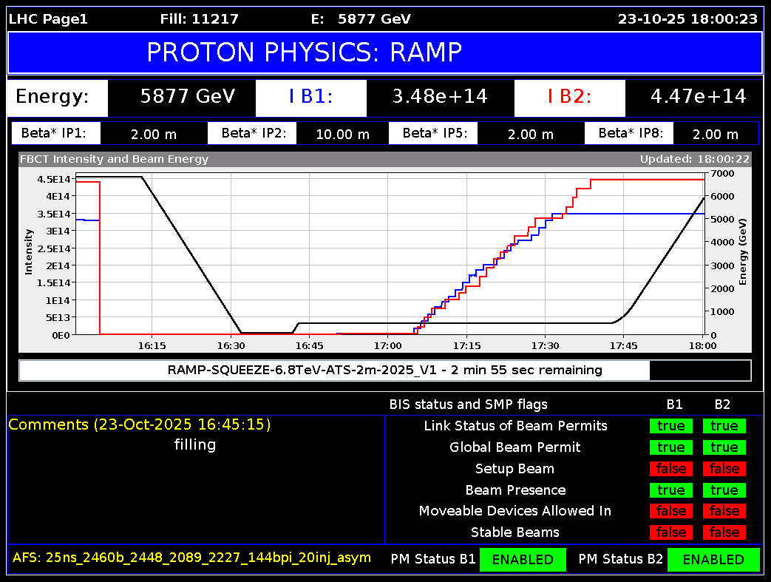



Introduction
Intensity is one of the most important beam parameters
Intensity measurement is essential for:
operating an accelerator
quantifying an optimizing accelerator performance
scaling physics data (accuracy)
(performance most important)
Intensity measurement can be critical for:
accelerator protection
equipment protection
human health (e.g. medical applications)
(reliability most important)

Slide 3
Outline
A selection of topics related to operation and designing beam intensity measurement systems based on electromagnetic sensors working on the time scales ~ ∞ .. ~ 0.1 ns (frequency range ~ 0 .. ~ 10 GHz)
Faster techniques in two lectures ”Short Bunch Measurements I + II” by Thibaut
Fundamentals
Wall charge and wall current
Beam current, charge and intensity
Low pass filtering and signal integrals
Intensity measurement time resolution
Numerical integration
Baseline restoration and correction
Sensors
Wall Current Monitor
Fast Beam Current Transformer
Integrating Current Transformer
Wall Current Transformer
Faraday Cup
DC Beam Current Transformer
Cryogenic Current Comparator
Electronics
Low frequency compensation
Calibration
Beam signal filtering
Cohabitation with power systems
In spare slides and the proceedings
as well as Jeroen’s lecture

Slide 4
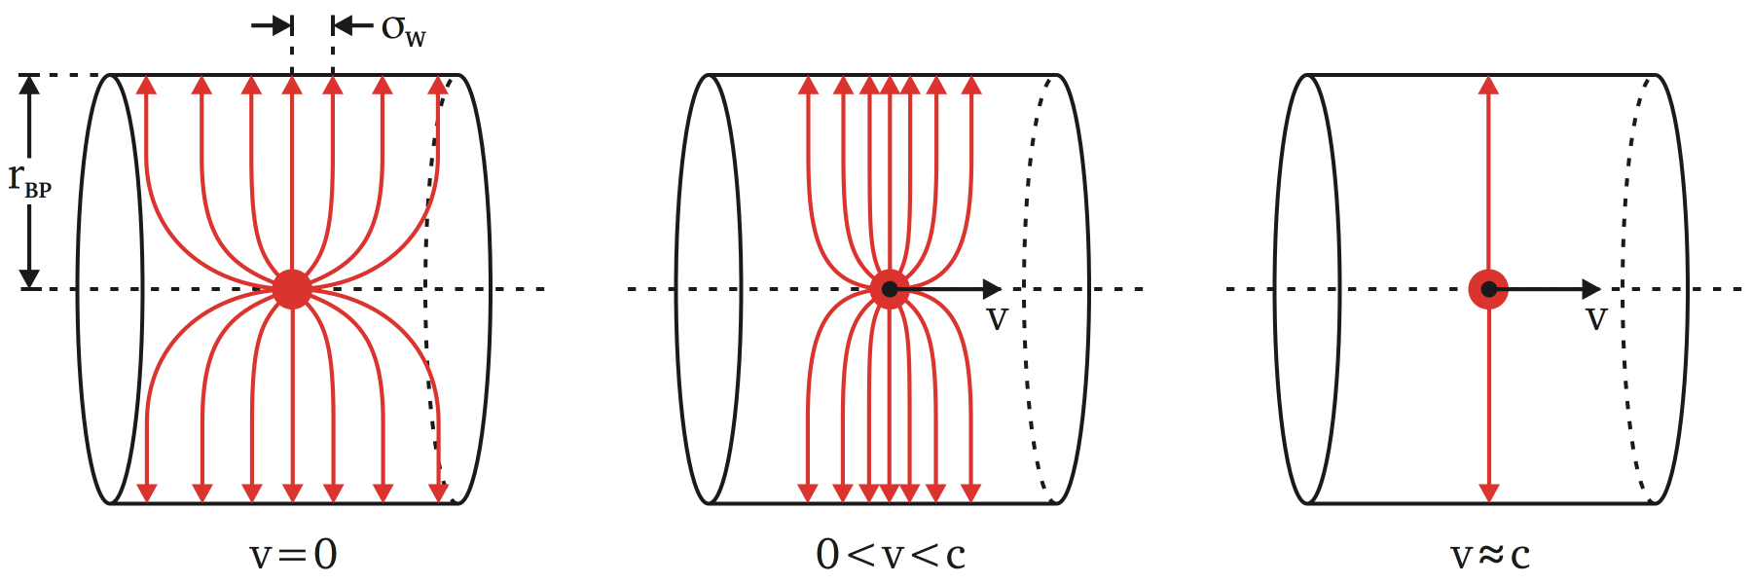
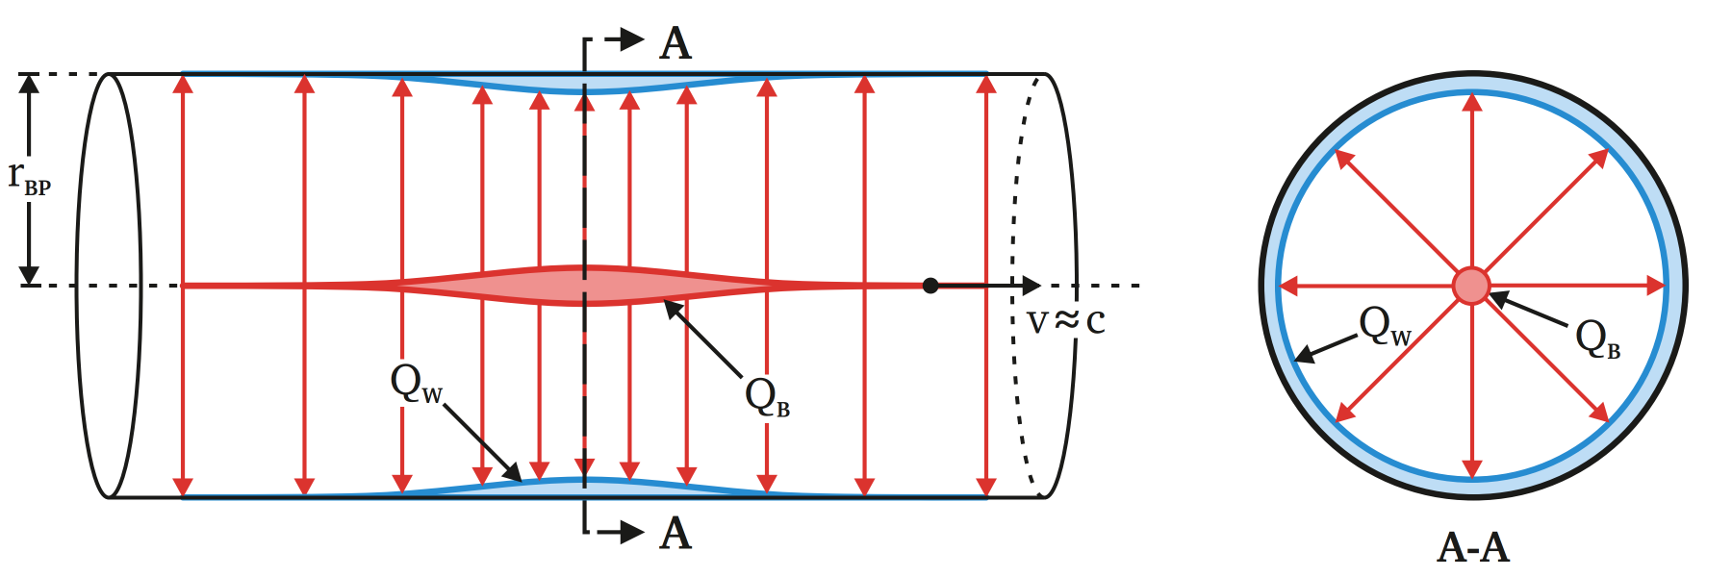
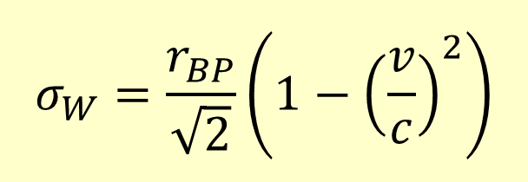


Wall charge and wall current
(a recap of Gero’s lecture)
$$σ_{W}=\frac{r_{BP}}{\sqrt{2}}\left(1−{\left(\frac{v}{c}\right)}^{2}\right)$$
RMS of the wall charge distribution
r_{BP} – radius of the beam pipe
v, c – speed of the particles and of the light
$$Q_{W}(z)={−Q}_{B}(z)$$
wall charge density
beam charge density
$$i_{W}(t)={−i}_{B}(t)$$
wall current
beam current

Slide 5
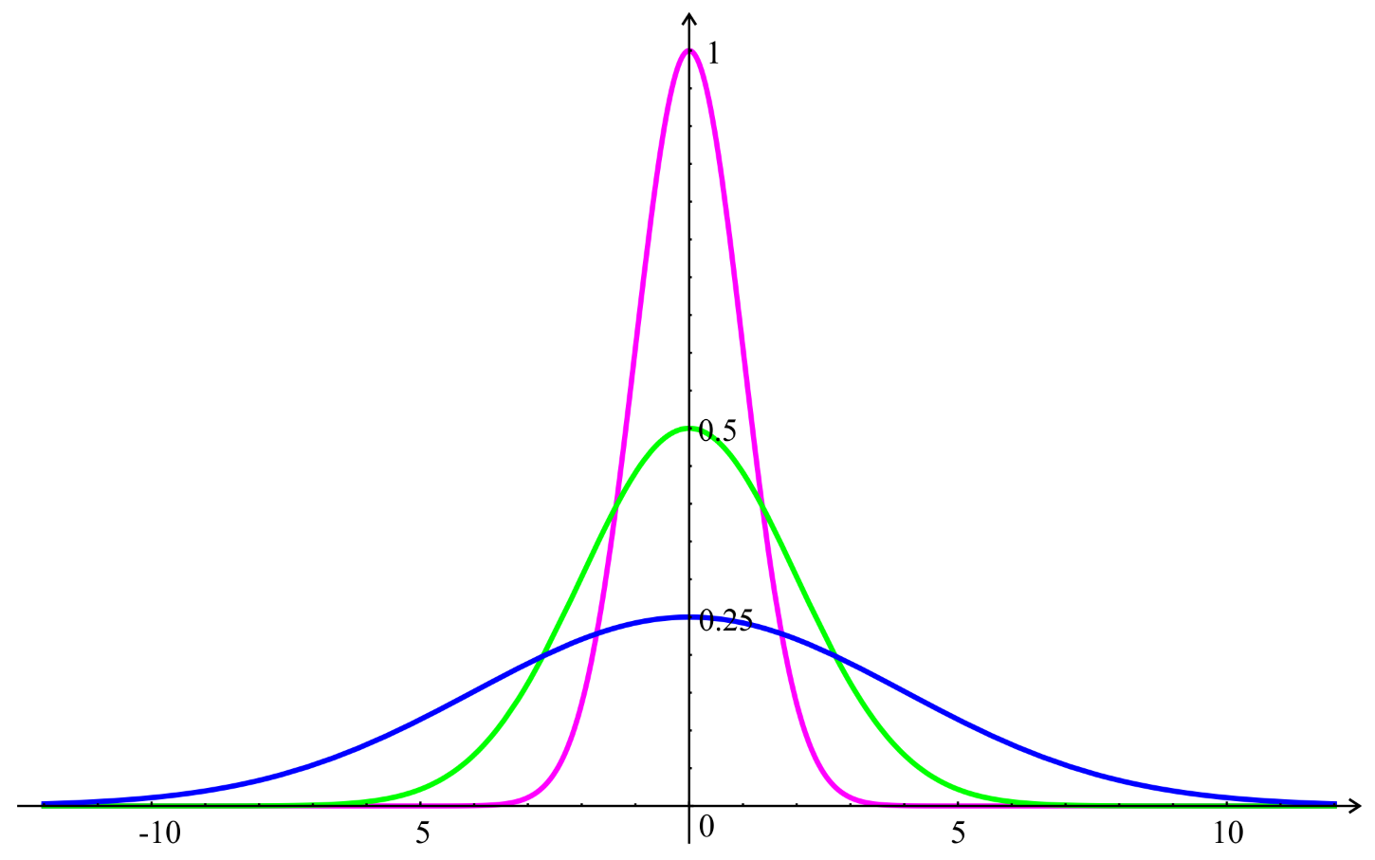
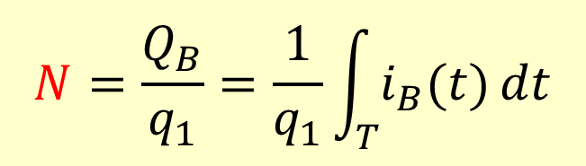

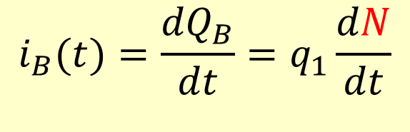
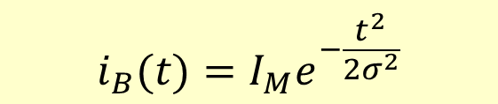
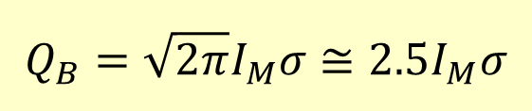
Beam current, charge and intensity
N
T
I_{M}
σ
= beam intensity = number of particles
= integration interval
= maximal (peak) current
= RMS bunch length
current
charge
intensity
$$i_{B}(t)=\frac{{dQ}_{B}}{dt}=q_{1}\frac{dN}{dt}$$
$$N=\frac{Q_{B}}{q_{1}}=\frac{1}{q_{1}}\int_{T}{i_{B}(t)}dt$$
charge of one particle
number of charges q₁ during time interval T
beam beam intensity charge
I_{M}
in BI world often
:
i₁ (t)
i₂ (t)
i₃ (t)
σ₁ = 1
σ₂ = 2
σ₃ = 4
I_{M1} = 1
I_{M2} = 0.5
I_{M3} = 0.25
$$i_{B}(t)=I_{M}e^{−\frac{t^{2}}{2σ^{2}}}$$
Q₁ = Q₂= Q₃
current distribution in a Gaussian bunch
$$\frac{t}{σ}$$
$$Q_{B}={\sqrt{2π}I}_{M}σ≅2.5I_{M}σ$$
charge of a Gaussian bunch

Slide 6
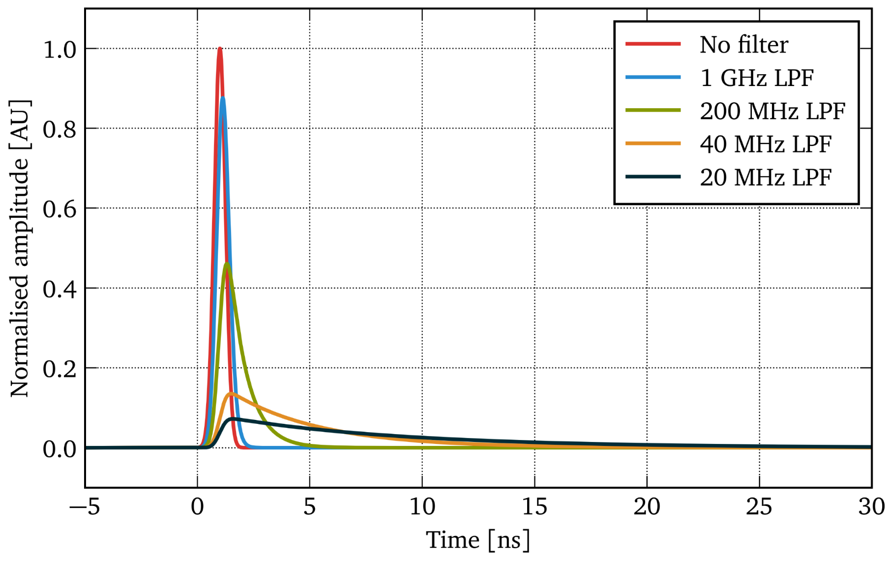
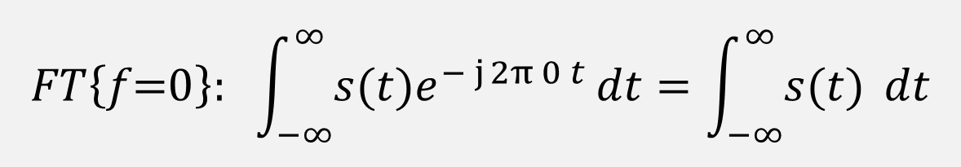
Low pass filtering and integrals
A low pass filter should be used before any active electronics:
To pass only desired beam spectrum, from a “good part” of the sensor bandwidth
To limit the signal slew rate and exclude potential amplitude nonlinear response of the following active electronics
To adapt pulse lengths to the acquisition sampling rate and optimise the accuracy of the integration
Low pass filtering conserves the signal integral
low pass filtering does not affect beam charge calculated as the beam current integral
$$FT\left\{f\text{=}0\right\}: \int_{−∞}^{∞}{s(t)e^{− j 2π 0 t}}dt=\int_{−∞}^{∞}{s(t) }dt$$

Slide 7
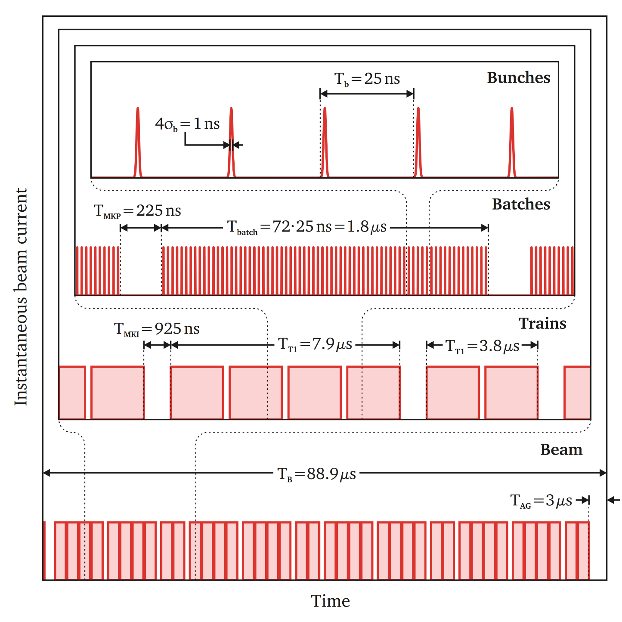
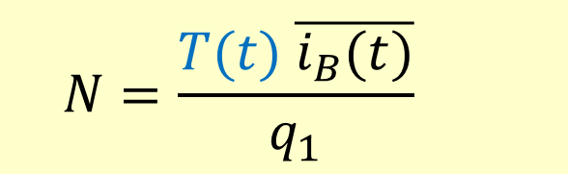
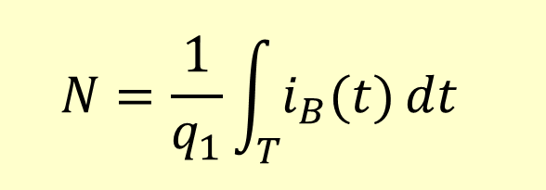
Intensity measurement time resolution
T(t)
= revolution period
bunches
$$N=\frac{1}{q_{1}}\int_{T}{i_{B}(t)}dt$$
batches
integration
$$N=\frac{T(t) \overline{i_{B}(t)}}{q_{1}}$$
trains
rectangular surface calculation
one revolution period
DC beam current (!)

Slide 8
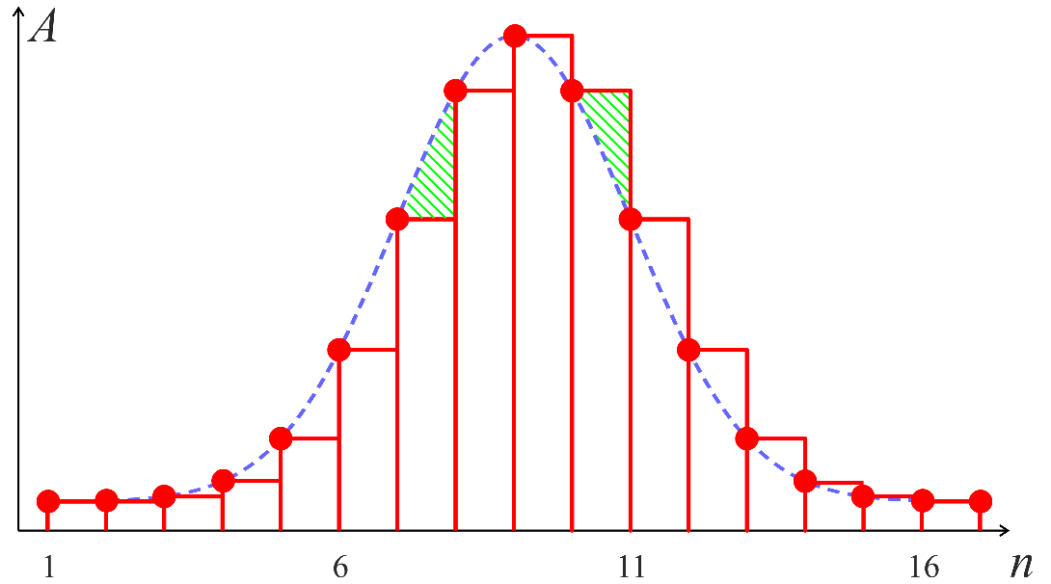
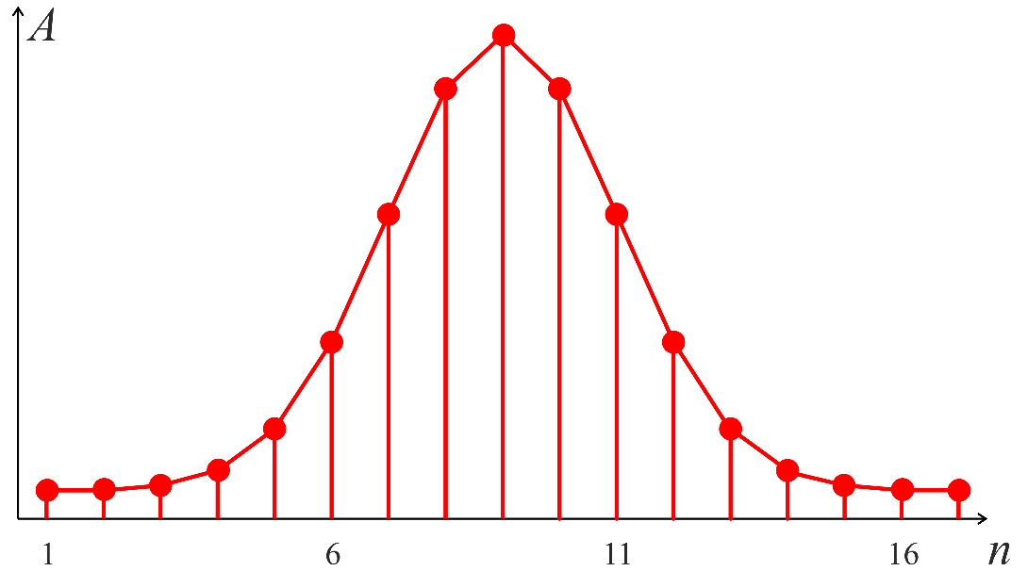
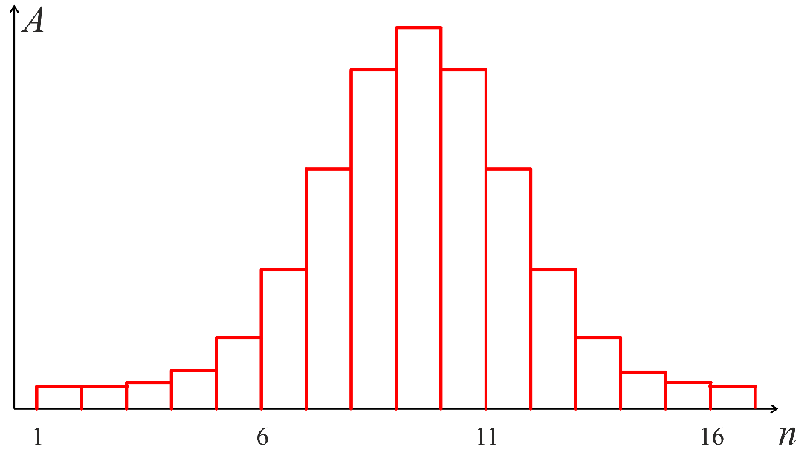
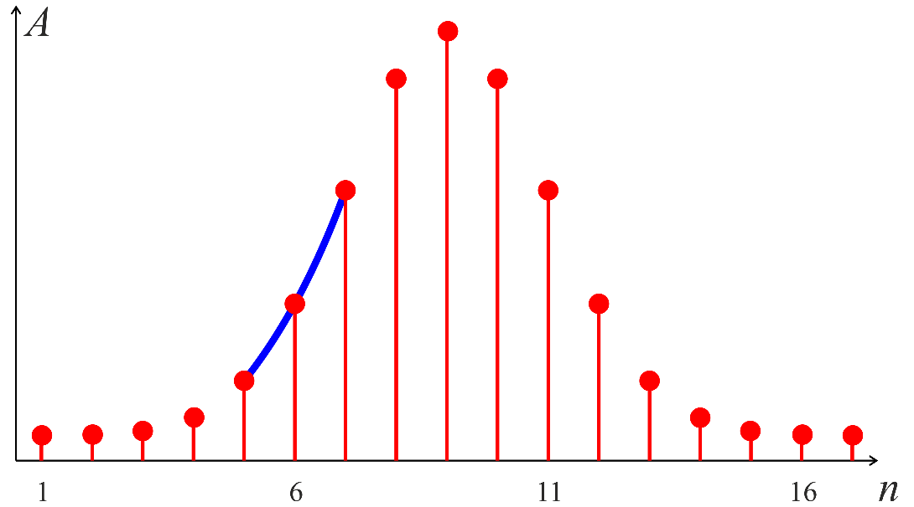

Beam current numerical integration
integration
error
zero order hold
rectangular integration
first order hold
trapezoidal integration
zero order hold
rectangular integration
second order hold
parabolic integration
symmetry
≈ conserved
parabola
section

Slide 9
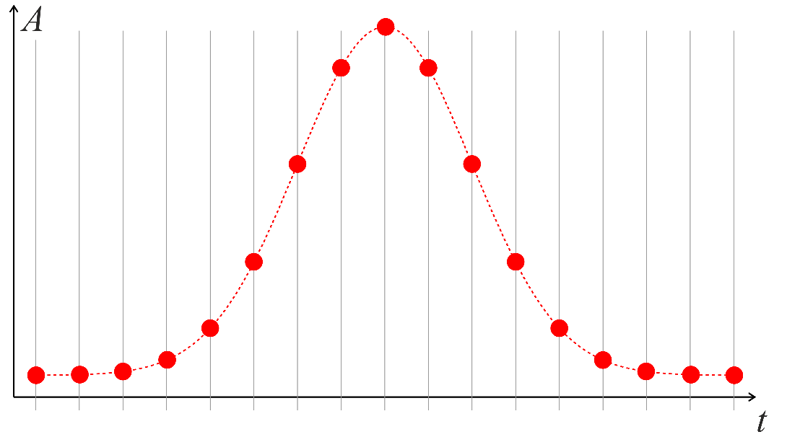
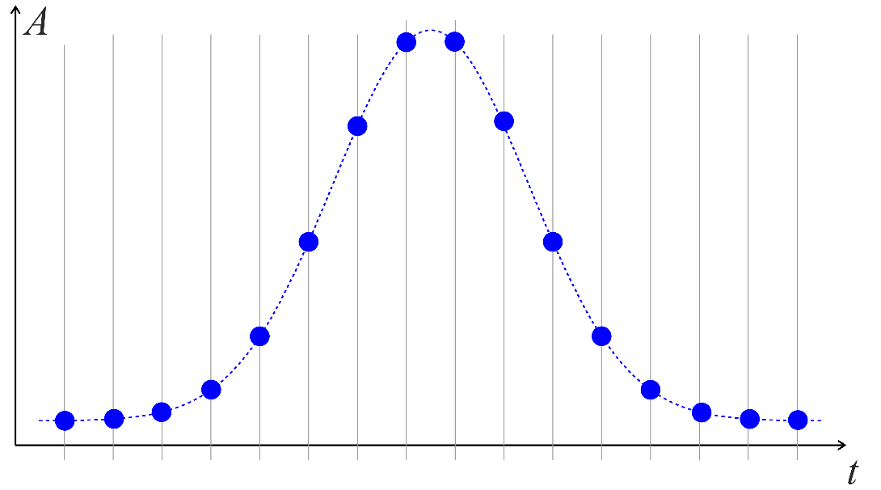
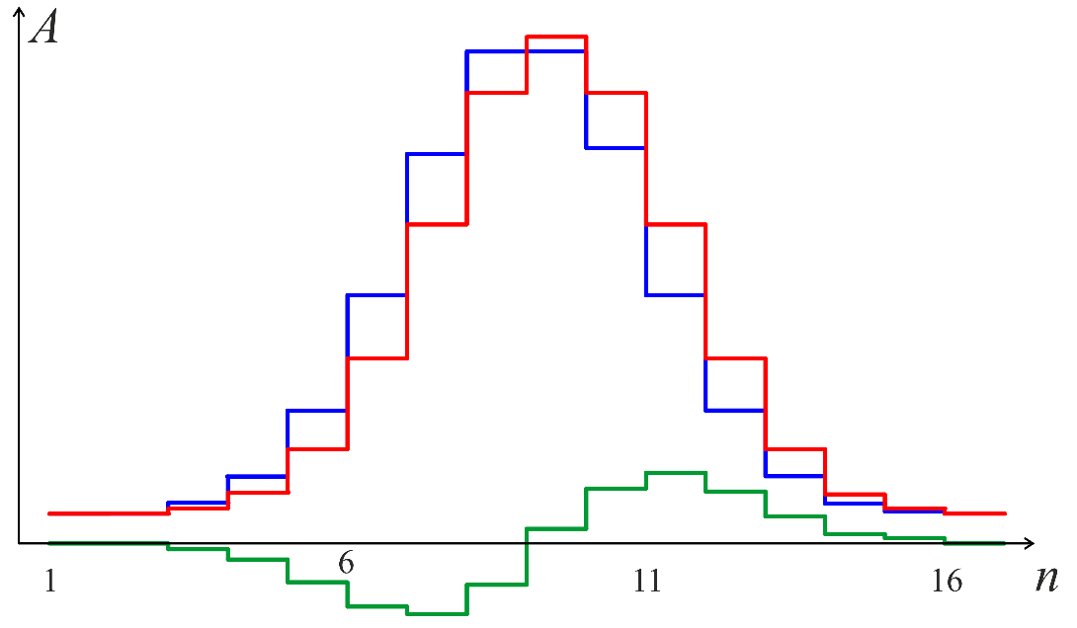
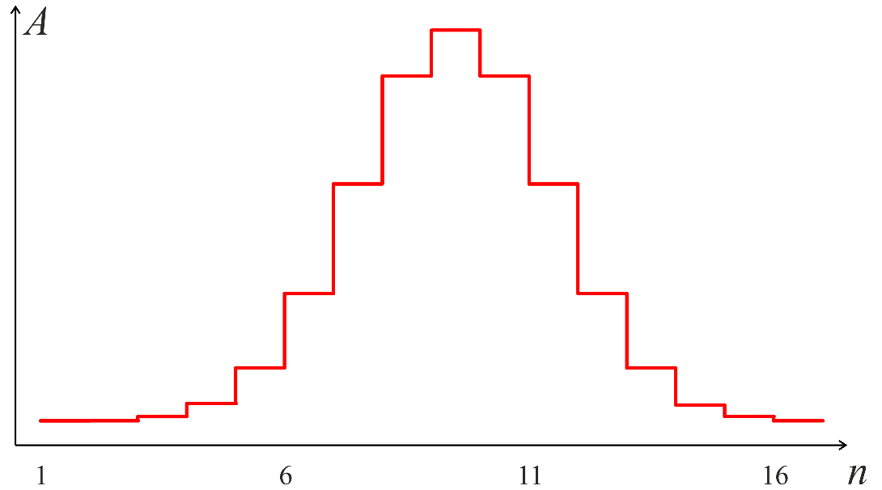
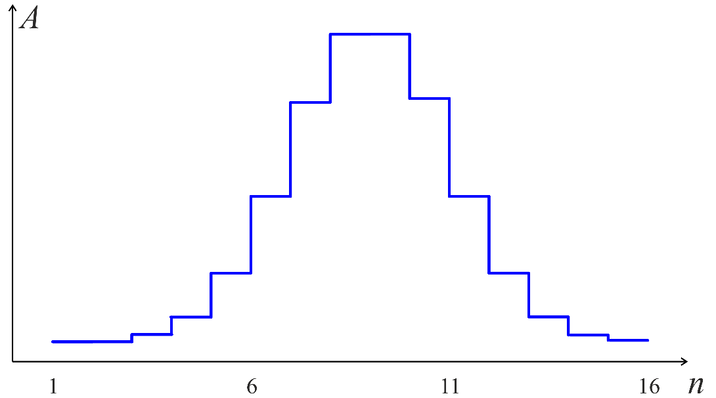
Beam current numerical integration
9
Integration noise due to changing sampling phase
sampling phase 1
sampling phase 2
signal difference P1 – P2
Convenient symmetrical changes ONLY for symmetrical pulses

Slide 10
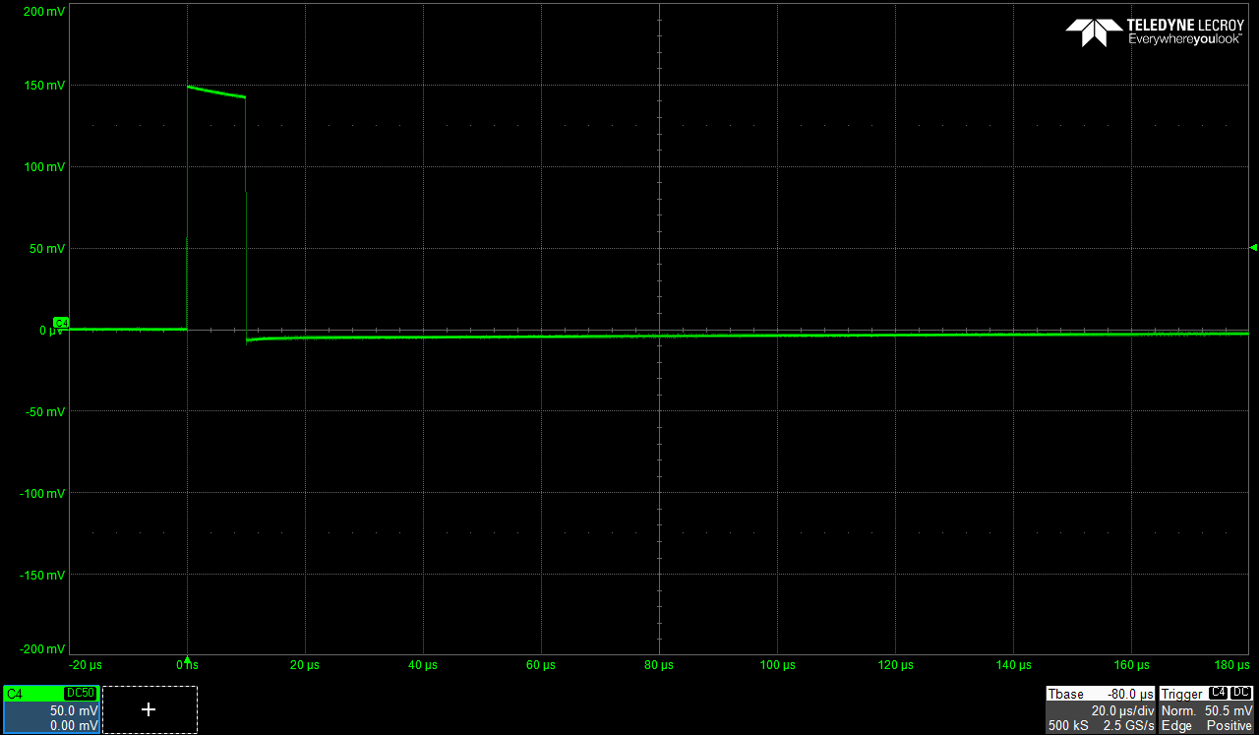

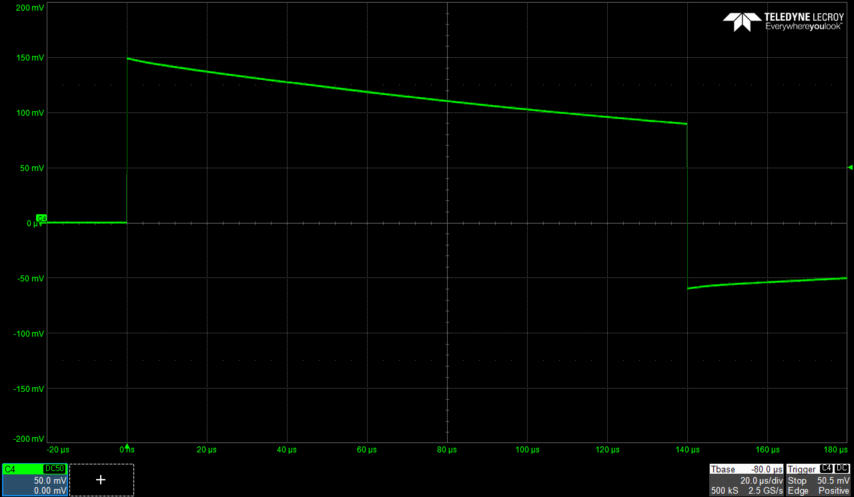
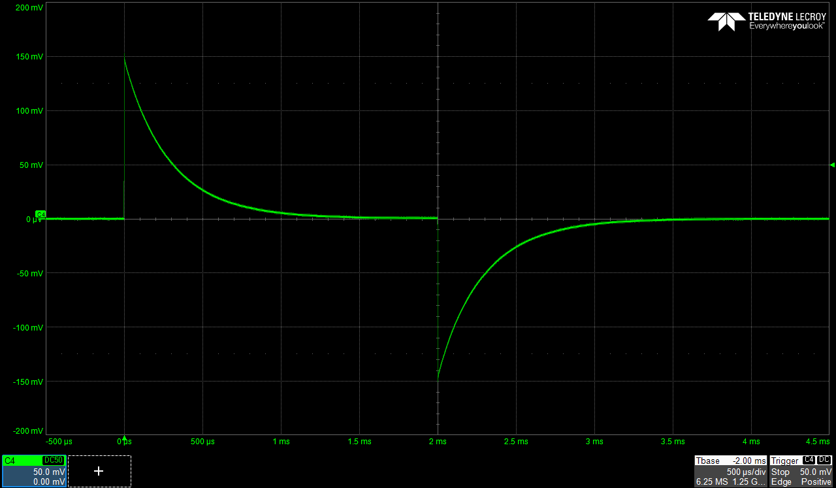


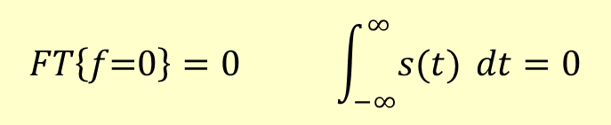

Typical signals – pulses
Typical signals from intensity sensors with no DC response induced by rectangular beam pulses
| positive charge | = | negative charge |
positive charge + negative charge= 0
Many intensity sensors are blind for DC signals
no DC net charge = 0
“0 line”
$$FT\left\{f\text{=}0\right\}=0 \int_{−∞}^{∞}{s(t) }dt=0$$
10

Slide 11
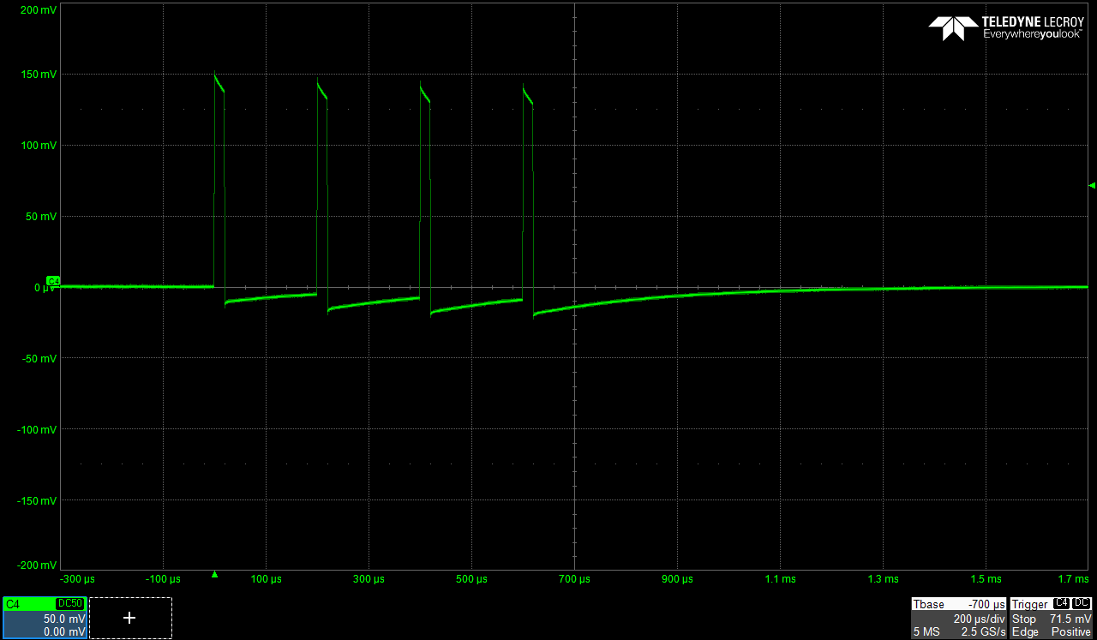
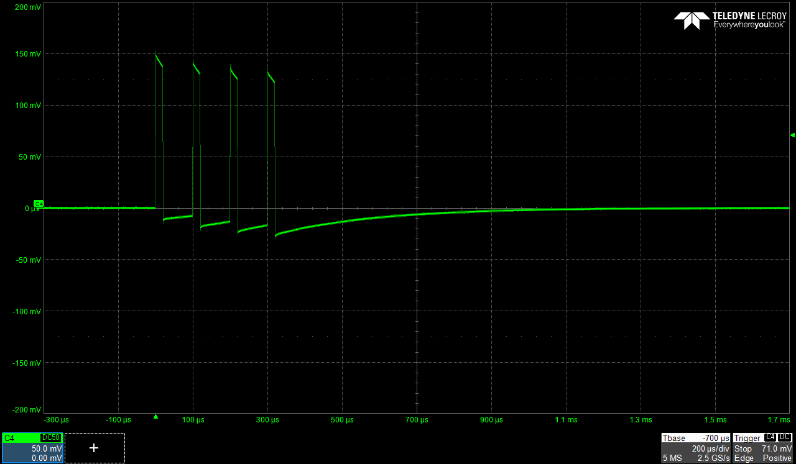
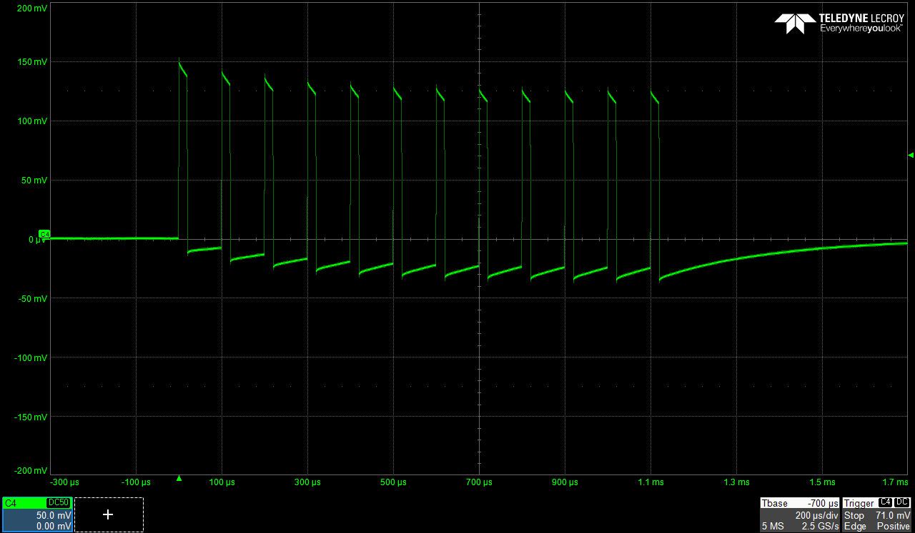
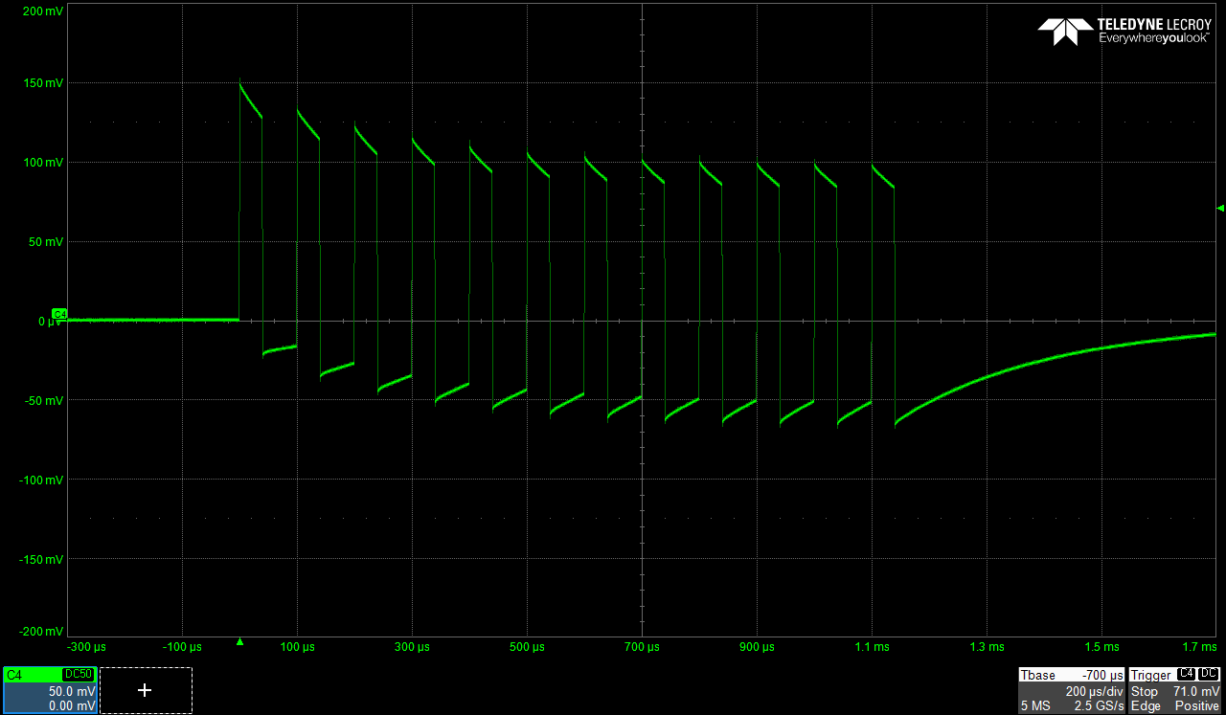
Typical signals – trains
11

Slide 12
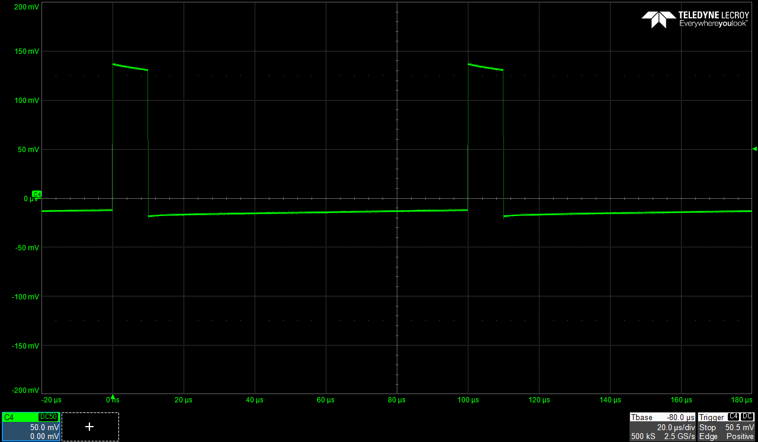
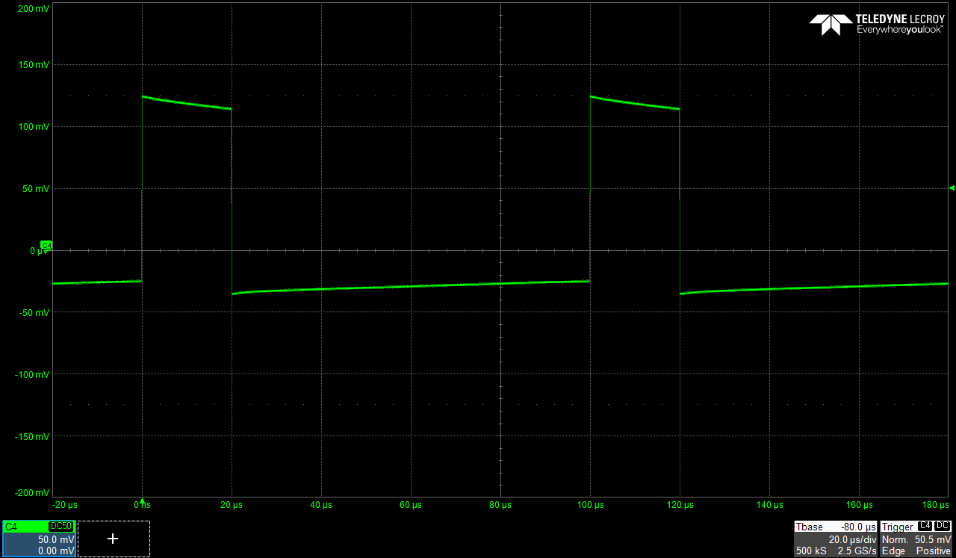

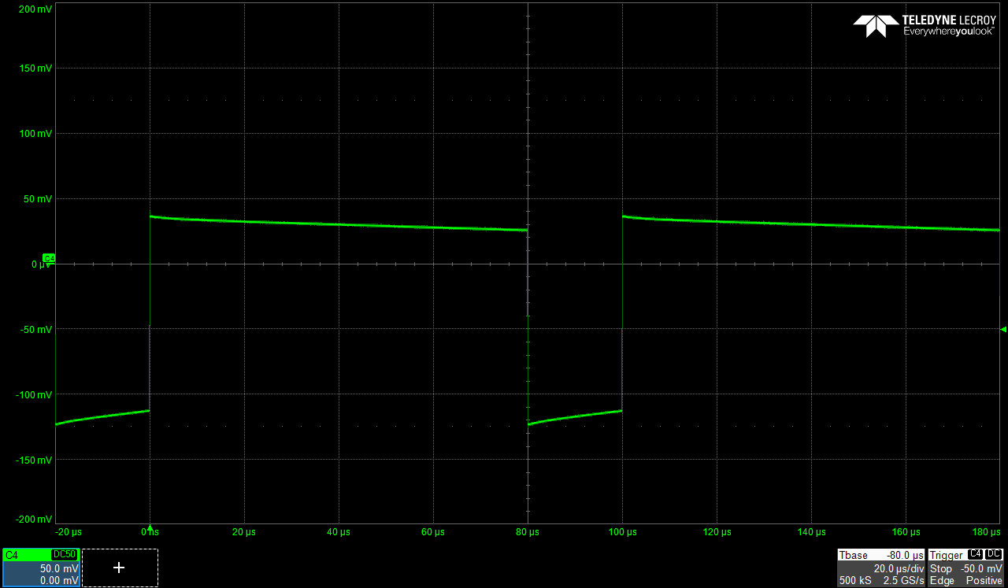
Typical signals – circulating beam
12

Slide 13
Baseline restoration
integration windows
restored baseline
corrected baseline

Slide 14
(restored) Baseline correction
integration windows
restored baseline
corrected baseline

Slide 15
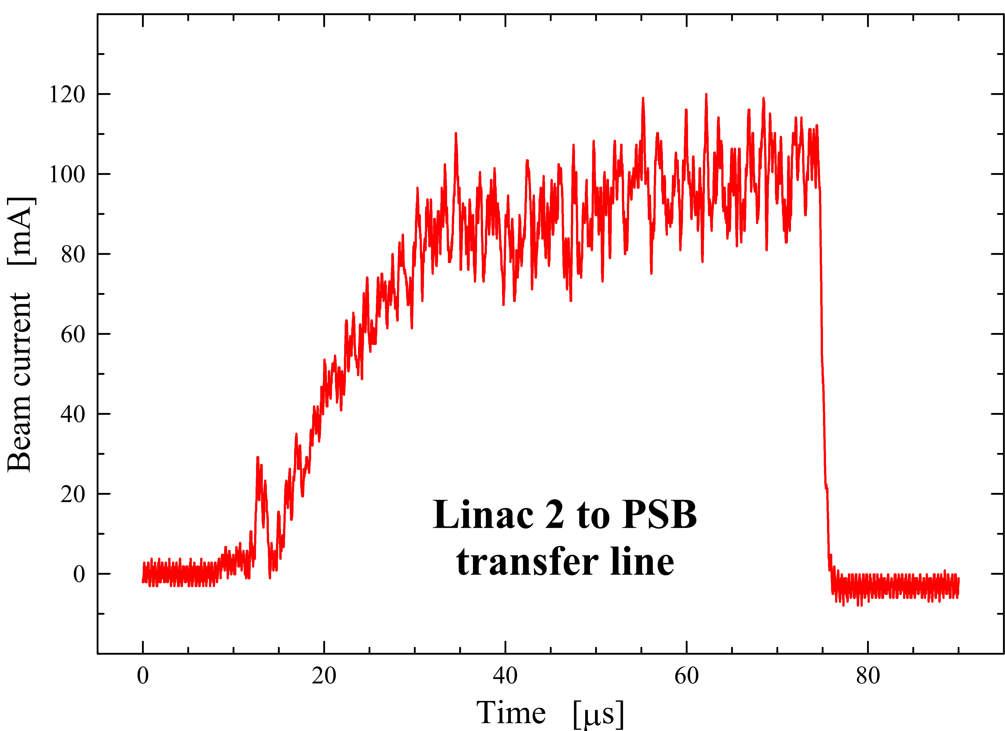
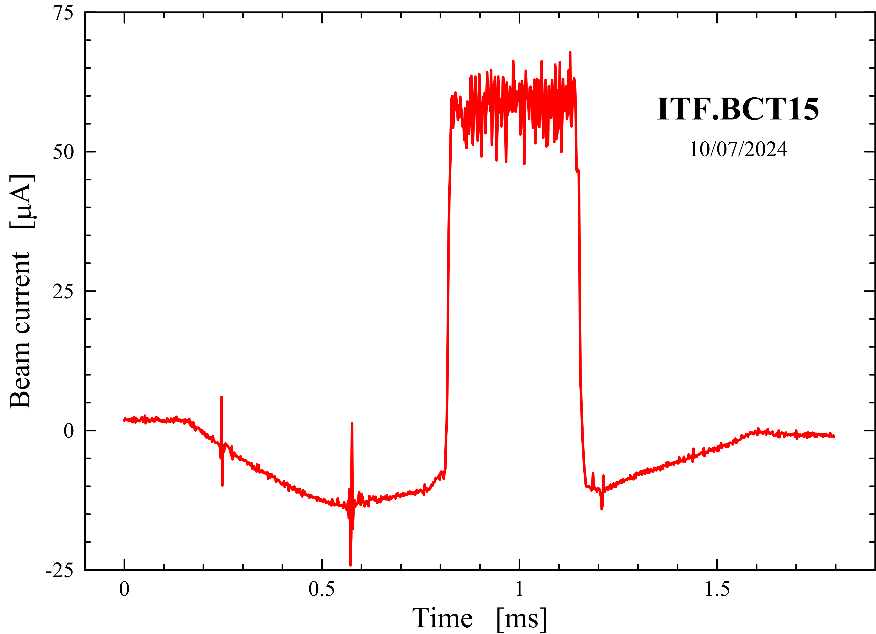
Baseline restoration and correction – examples
J
LLL

Slide 16
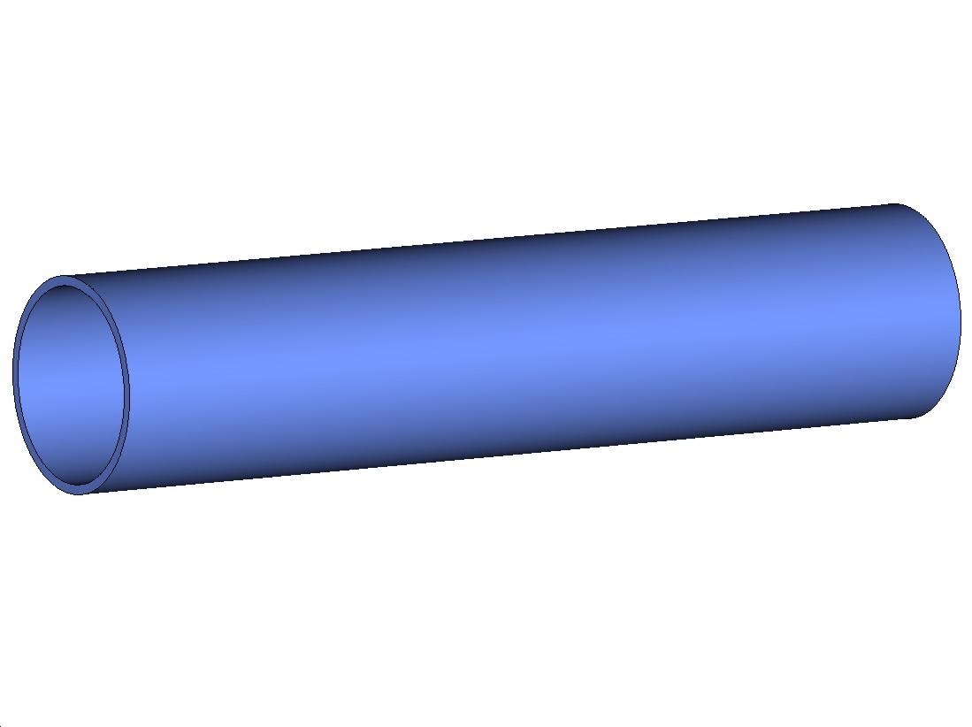
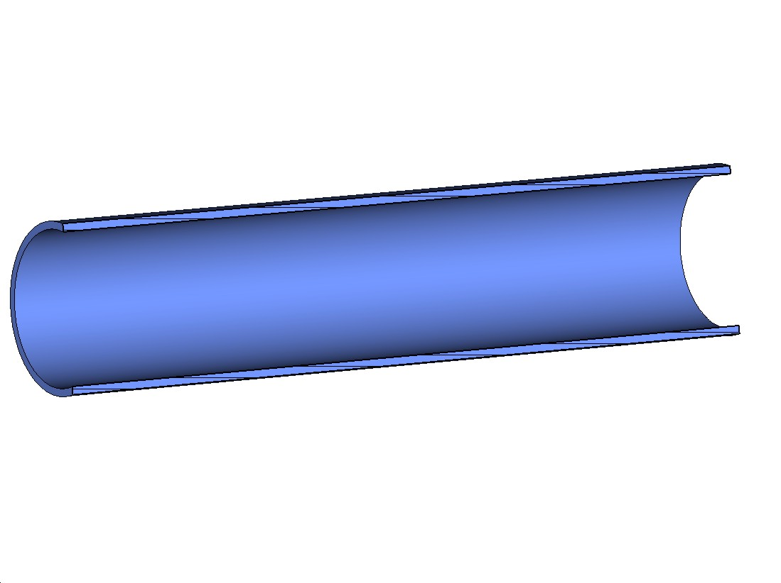
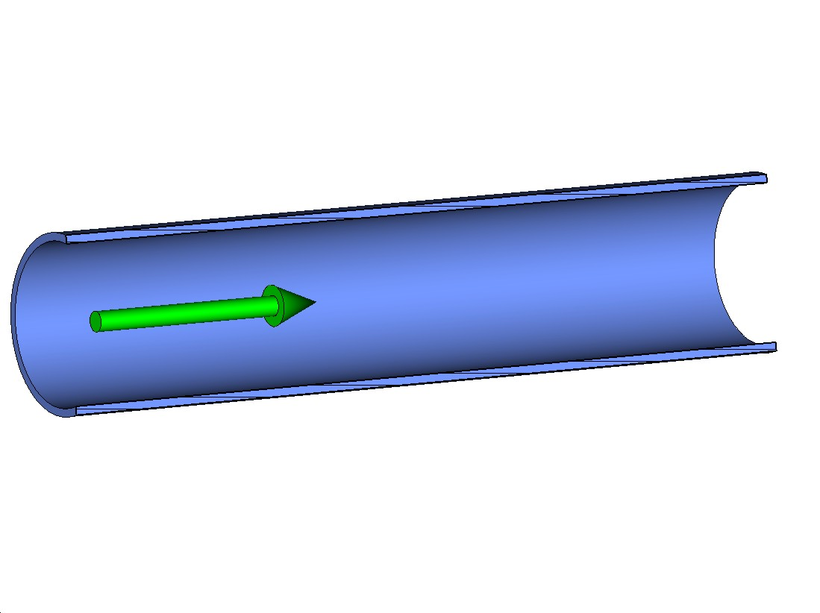
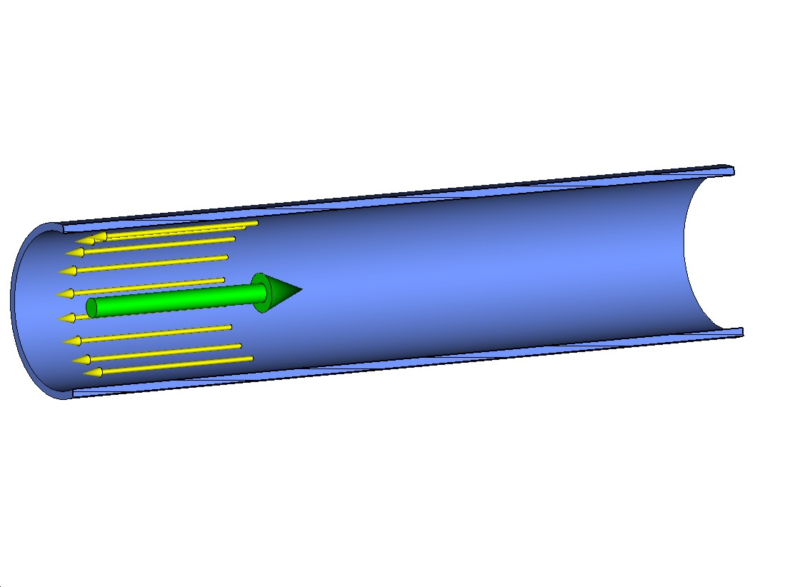
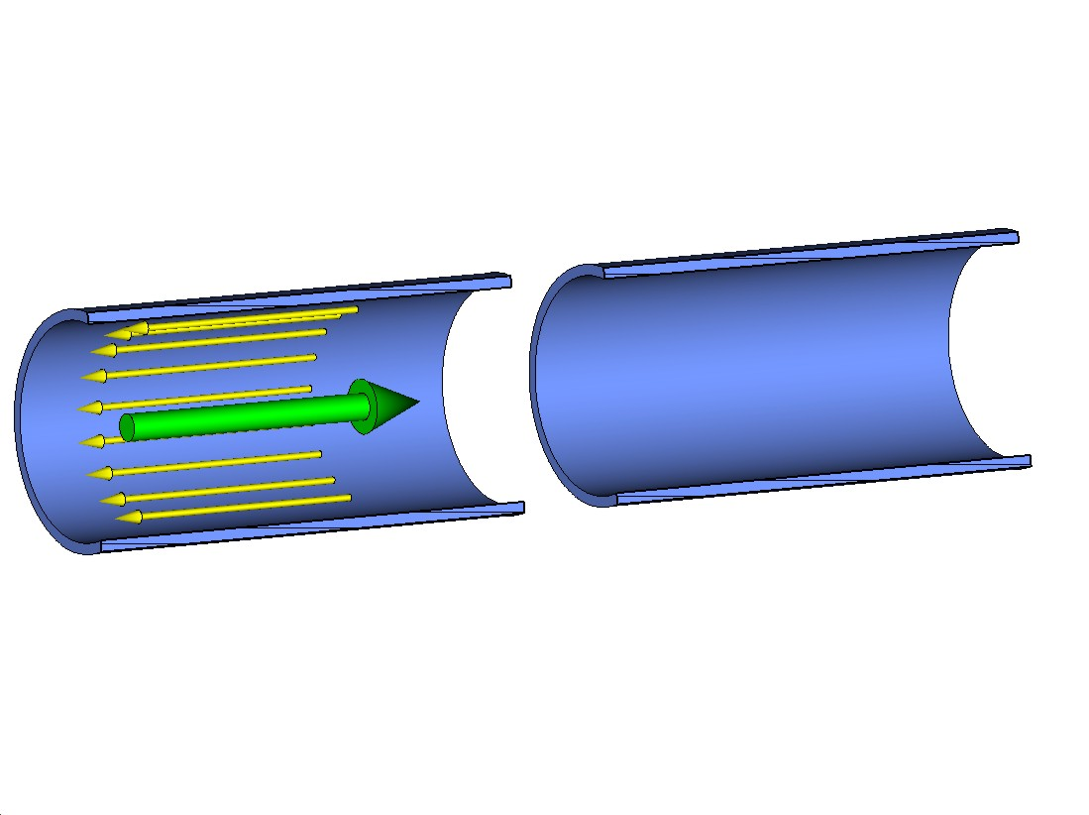
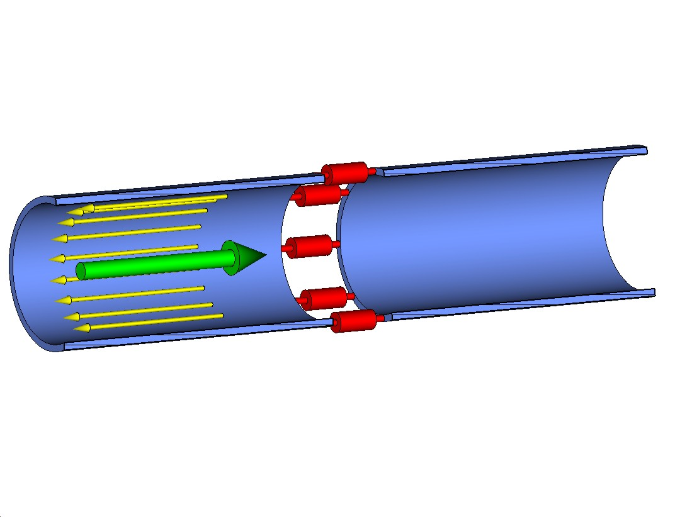
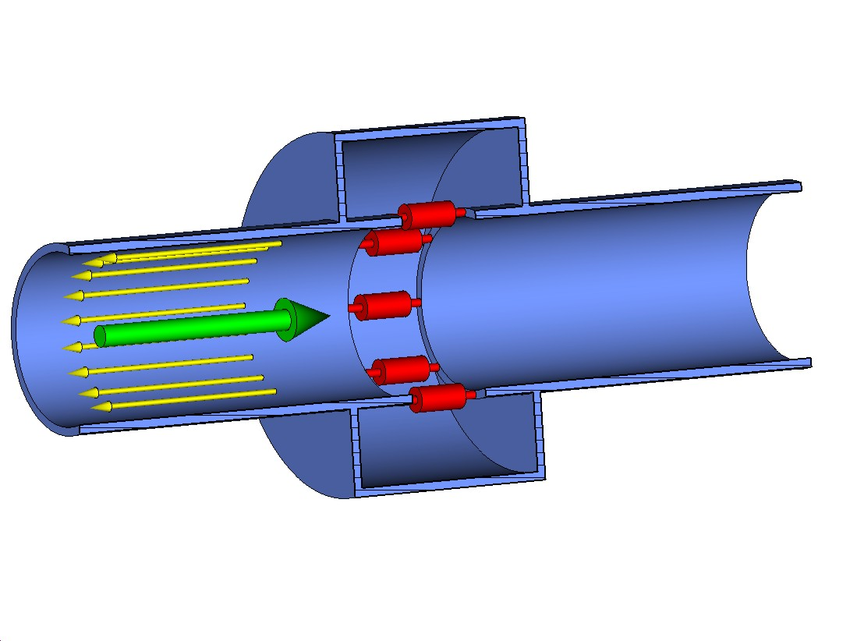
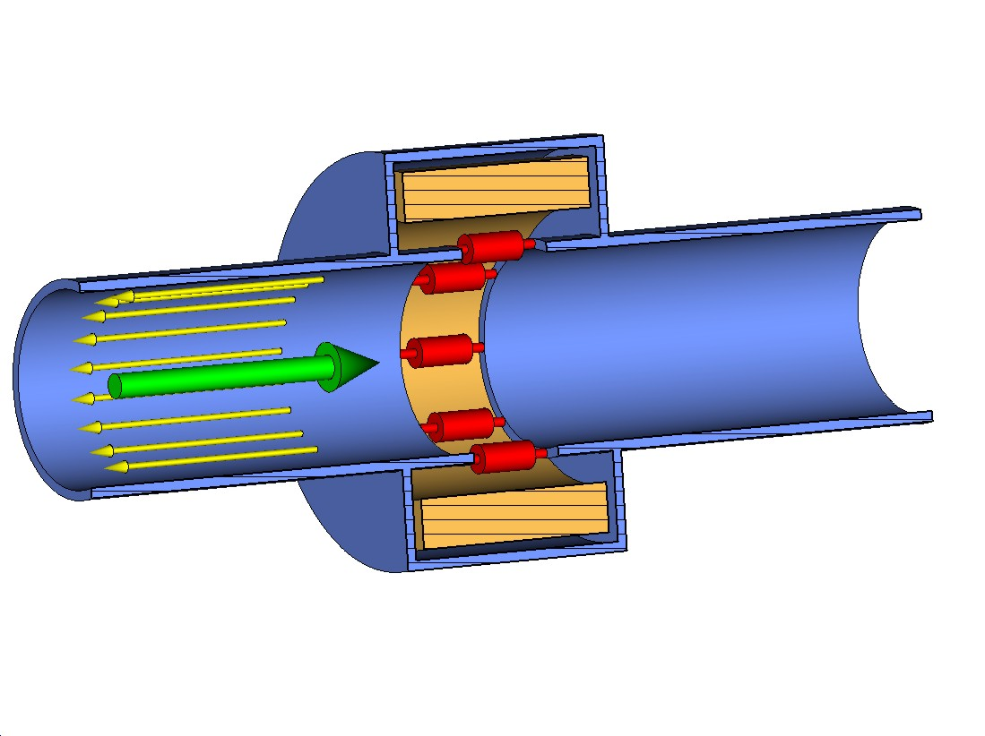
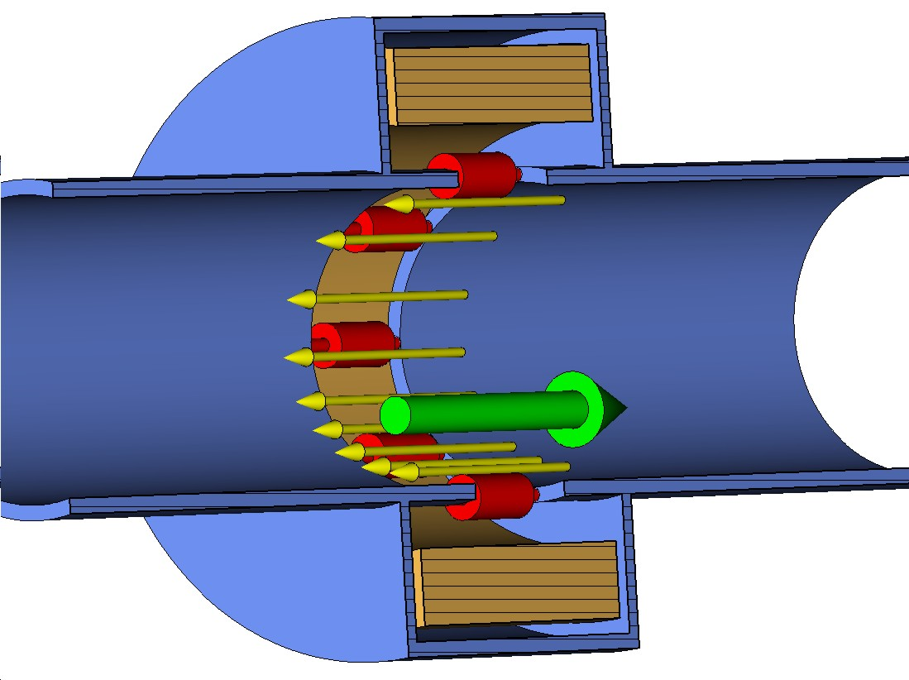
Wall Current Monitor (WCM)

Slide 17
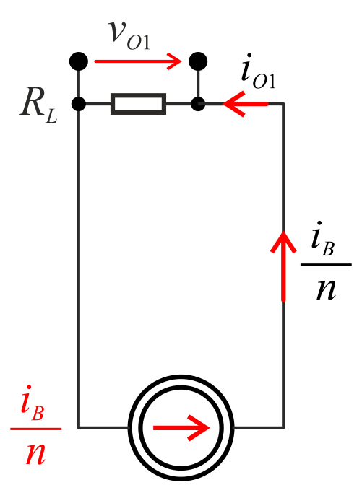
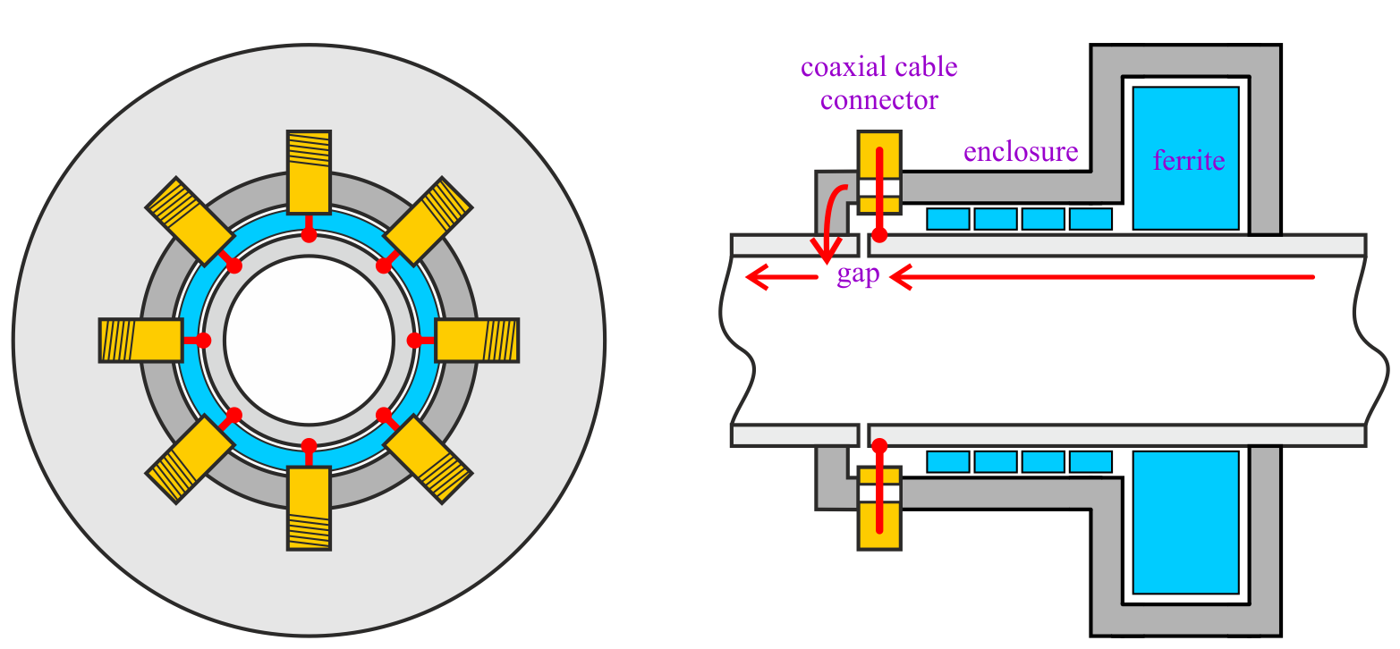
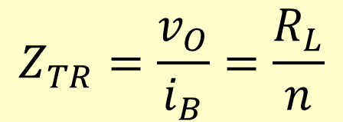
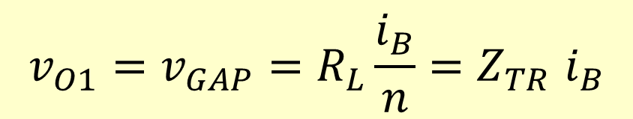
Wall Current Monitor (WCM)
wall current
$$v_{O1}=v_{GAP}=R_{L}\frac{i_{B}}{n}{=Z}_{TR}i_{B}$$
$$Z_{TR}=\frac{v_{O}}{i_{B}}=\frac{R_{L}}{n}$$
v_{O1}
i_{B}
R_{L}
n
Z_{TR}
i_{O1}
= one port output voltage
= beam current
= load resistor
= number of ports
= transfer impedance
= one port output current
The beam pipe gap is loaded with typically 8 transmission lines, most often 50 Ω (R_{L} = 50 Ω)
The gap connection (in red) is very critical for the WCM performance (must be kept very short)
For the vacuum gap the ferrite is in the beam vacuum (a serious issue for good vacuum, often a dedicated pump)

Slide 18
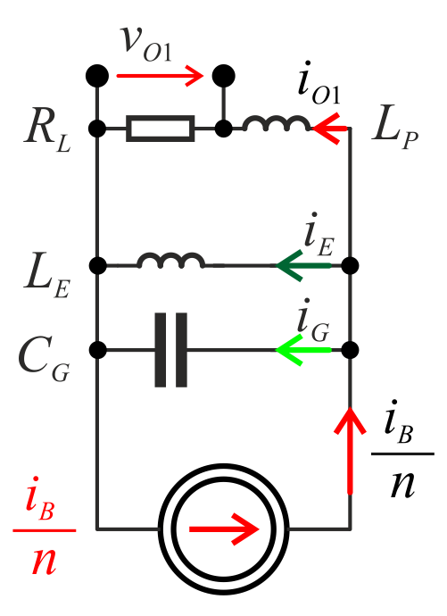












Wall Current Monitor (WCM)
$$vO1$$
$$iE$$
$$iG$$
wall current
$$f_{CL}=\frac{R_{L}}{{2π L}_{E}}$$
$$f_{CH}=\frac{1}{{2π R}_{L}C_{G}}$$
$${f\text{‘}}_{CH}=\frac{R_{L}}{{2π L}_{P}}$$
f_{CL} f_{CH}
f'_{CH}
i_{E}
L_{E}
i_{G}
C_{G}
L_{P}
= cut-off low frequency
= “gap” cut-off high frequency
= “series L” cut-off high frequency
= enclosure current
= enclosure inductance
= gap current
= gap capacitance
= parasitic series inductance
$$\text{≈}\text{400 }\text{kHz}$$
@$\text{R}\text{L}\text{=50 }\text{Ω}$, $\text{L}\text{E} \text{=}\text{10} \text{μ}\text{H}$
$$≈3 \text{GHz}$$
$$@ \text{R}\text{L}\text{=50 }\text{Ω}\text{,}\text{C}\text{G} \text{=}\text{1} \text{pF}$$
$≈8 \text{GHz}$
$$\text{@} \text{R}\text{L}\text{=50 }\text{Ω}\text{, }\text{L}\text{P} \text{=}\text{1} \text{nH}$$
$$1 pF≈3×3 mm electrodes$$ $with 1 mm distance$
$$\text{1 }\text{nH} \text{≈}\text{ 1 }\text{mm} \text{piece} \text{of} \text{an}$$ $\text{unmenaged} \text{wire}$

Slide 19





WCM – position signal dephasing
$${+Δt}_{p}$$
$${−Δt}_{p}$$
$$\text{A} \text{nice}\text{ 10 }\text{GHz} \text{WCM}$$ fastest risetime $≈35 \text{ps}$
(shortly an example)
$${2 Δt}_{p}≈3\text{5 }\text{ps} \text{for}\text{ 5 }\text{mm} \text{beam} \text{offset}$$

Slide 20

Wall Current Monitor (WCM)
To combine …
Good signal position independency (only position dephasing)
Signal deterioration by the combiner
… or not to combine
Largest position dependency
Best signal quality
Some decoupling between respective outputs
Saved money and thinking on the combiner

Slide 21


WCM example 1 (CTF)
Curtesy of P. Odier
High frequency direct output bandwidth: 250 kHz – 10 GHz
Low frequency output with an active compensation: 10 kHz – 300 MHz
Courtesy of Patrick Odier

Slide 22







WCM example 2 (LHC)
ferrite distributed along the length
Gap 1.2 mm
High frequency cut-off ≈ 3 GHz
$\text{LHC} \text{Case}\text{:}{ I}_{M}\text{=}\frac{ \text{∗ }}{\text{2.5}\text{ ∗ }\text{0.25}\text{e}\text{−9 }\text{s}}$ $\text{≈}\text{ 46} \text{A}$
${ V}_{M1}≈\frac{\text{4}\text{6 }\text{A}}{ \text{8} }$ $\text{∗} \text{50} \text{Ω} ≈\text{290} \text{V}$
$$I_{M}=\frac{Nq_{1}}{\sqrt{2π} σ}$$
$$V_{M1}=\frac{I_{M}}{8}R_{L}$$
Courtesy of Tom Levens

Slide 23


Fast Beam Current Transformer (FBCT)
23
ferromagnetic toroid
Courtesy of Romain Ruffieux
ceramic insert
Workhorse of intensity measurements in many accelerators
In a circular machine one FBCT is enough, while linacs and transfer lines often require many of them
It is a current transformer, with the beam forming the primary single turn winding
Particular FBCT construction often determined (and sometimes limited) by the choice of commercially available ferromagnetic toroids
FBCTs are available commercially, along with their dedicated electronics

Slide 24


Fast Beam Current Transformer
i_{B} ~ 100 mA (CERN L4 proton linac)
i_{B} ~ 100 μA (CERN L3 ion linac)
24

Slide 25






Fast Beam Current Transformer (FBCT)
$$L_{n}=A_{L}n^{2}$$
$$i_{O}=\frac{i_{B}}{n}$$
$$v_{O}=i_{B}\frac{R_{L}}{n}$$
$$τ =\frac{L_{n}}{R_{L}}$$
$$A_{L} ∝ \frac{S}{l}$$

Slide 26














FBCT signal droop
26
$v_{O}(t)=\frac{i_{B}}{n}$ $R_{L}$exp$\left(−\frac{t}{τ}\right)$
$d(t)=$ exp$\left(−\frac{1}{n^{2}}\frac{t}{τ_{1}}\right)$
$v_{O}(t)=\frac{V_{1}}{n}$ exp$\left(−\frac{1}{n^{2}}\frac{t}{τ_{1}}\right)$
$τ_{1} =\frac{A_{L}}{R_{L}}$
v₁ – output voltage for n=1
τ₁ – time constant for n=1
$$\frac{v_{o}}{v_{1}}$$
$$\frac{v_{o}}{v_{1}}$$
$$d(t)$$
n = 5, 10, 20, 50
n = 5, 10, 20, 50
$$\frac{t}{τ_{1}}$$
$$\frac{t}{τ_{1}}$$
$$\frac{T}{τ_{1}}=10$$
$$\frac{T}{τ_{1}}=50$$

Slide 27







FBCT signal droop
27
$v_{O}(t)=\frac{i_{B}}{n}$ $R_{L}$exp$\left(−\frac{t}{τ}\right)$
$d(t)=$ exp$\left(−\frac{1}{n^{2}}\frac{t}{τ_{1}}\right)$
$v_{O}(t)=\frac{V_{1}}{n}$ exp$\left(−\frac{1}{n^{2}}\frac{t}{τ_{1}}\right)$
$τ_{1} =\frac{A_{L}}{R_{L}}$
v₁ – output voltage for n=1
τ₁ – time constant for n=1
$$d$$
$$d$$
n = 5, 10, 20, 50
$$T/{τ_{1}}$$
= 3, 10, 30, 100
$$T/{τ_{1}}$$
$$n$$

Slide 28




FBCT high frequency response
200 ns
“in flange” FBCT

Slide 29



FBCT high frequency response

Slide 30

Integrating Current Transformer (ICT)
ICT ≈ FBCT + good BUILT-IN low pass filter

Slide 31


Integrating Current Transformer (ICT)
CERN AWAKE
ps electron bunches
For bunches much shorter than the ICT pulse response, the ICT output pulse shape is independent of the bunch shape (so ICT integrates short beam current pulses)
For clean response ICT output may need to be further filtered by an external low-pass filter (e.g. on the input of its amplifier)

Slide 32


FBCT and ICT position dependency
≈ 1 % of the intensity
≈ 2 % of the pipe diameter

Slide 33

Wall Current Transformer (WCT)

Slide 34



Wall Current Transformer (WCT)
WCT ≈
WCM + FBCT
Invented for the LHC to assure bunch-by-bunch intensity measurement independent of the beam position and bunch length
The WCM gap load is replaced by small transformers allowing very small gap loads (R_{G} = R_{L}/ n²) (C of the ceramic insert not important)
Small ferromagnetic toroids assure very good high frequency operation
Position dependent signals on respective outputs are combined by high frequency combiners, internal on PCB and external
The RF bypass provides the control of the high frequency response and the impedance presented to the beam
Particular mechanical construction for the LHC to be mounted without opening the vacuum

Slide 35








Wall Current Transformer (WCT)
35

Slide 36

Frequency response comparison: WCT, ICT, FBCT
WCT
full BW
WCT
400 MHz

Slide 37

Faraday cup
Measurements from DC to GHz with special designs
The only destructive sensor in the lecture
“Natural” operation if combined with a beam dump (dissipated power may be a challenge)
In any other location it requires some mechanics operating in the beam vacuum to put the sensor to/from the beam
Can be designed to measure very small and very large currents
The energy of the measured beam is very important for the design (low energy more difficult)
Available commercially, along with dedicated acquisition
Well described in the literature

Slide 38




Faraday cup
https://doi.org/10.1063/5.0131890
www.dreebit.com

Slide 39


DC Beam Current Transformer
I_{B}
I_{DC}
V_{m}
i₁, i₂
= beam current
= compensating DC current
= (triangular) modulation voltage
= T₁, T₂ currents
T₁, T₂
CCS
ASP
= ferromagnetic toroids
= controllable current source
= analog signal processing
Very small dynamic range of the sensitive detection circuitry addressed by using a compensation method
“Zero flux” operation
Excellent precision and dynamic range typical for DC measurements
In many accelerators a golden standard used to calibrate other intensity measurement systems
39

Slide 40

DC Beam Current Transformer
I_{B}
I_{DC}
V_{m}
i₁, i₂
= beam current
= compensating DC current
= (triangular) modulation voltage
= T₁, T₂ currents
T₁, T₂
CCS
ASP
= ferromagnetic toroids
= controllable current source
= analog signal processing
Very small dynamic range of the sensitive detection circuitry addressed by using a compensation method
“Zero flux” operation
Excellent precision and dynamic range typical for DC measurements
In many accelerators a golden standard used to calibrate other intensity measurement systems
40

Slide 41


DC Beam Current Transformer (DC BCT)

Slide 42




Cryogenic Current Comparator (CCC)
CCC ≈ DC BCT with a quantum supersensitive “zero” flux detector
CCC of the CERN Antiproton Decelerator
Photos from the left:
commercial SQUID system
Magnetic circuit assembly
CCC tank, Ø ≈80 cm, with ≈50 litres of liquid helium
Photos: curtesy of Miguel Fernandes

Slide 43


FBCT, ICT, WCT calibration
JJJ
The great one-turn calibration winding allows:
quickly testing the sensor anytime, anywhere, and if connected there, its whole acquisition chain
calibrating the amplitude scale of the whole acquisition chain in real-time, by applying precise reference signals
L
43

Slide 44

No precise calibration with only an oscilloscope
12-bit, 1 GHz, 2.5 GS/s
A signal generator connected successively to each of the four inputs of an oscilloscope
Acquired waveforms stored in the oscilloscope memory
Identical channel settings, Identical generator settings, the same coax cable
Special techniques necessary:
DC precision measurement AND “zero detection” with an oscilloscope
See proceedings for details

Slide 45






FBCT, ICT, WCT calibration errors
from the beam “point of view”
$$\frac{i_{C}}{i_{O}}=\frac{R_{L}}{R_{C}n^{2}}$$
$$i_{C} R_{C} =i_{O}\frac{R_{L}}{n^{2}}$$
$$Z_{BEAM}=R_{C}||\frac{R_{L}}{n^{2}}=\frac{ R_{L}}{n^{2}+\frac{R_{L}}{R_{C}}}$$

Slide 46



Low freqnecy compensation: integrating amplifier
FBCT, ICT WCT, WCM, …
The first order high-pass response of the sensor is compensated by the “integrating” first order slope of the amplifier
Extending the sensor cut-off by a factor requires a proportional increase of the DC gain
The amplifier frequency characteristic must be well matched to the characteristic of the sensor. Spread in inductances of FBCTs in practice means that each FBCT must have a dedicated amplifier.
An input low-pass is easy to implement and, if required (e.g. radiation), the amplifier can be connected to the sensor through a long coaxial cable
In practice only the first amplifier stage has the DC response and the following stages are coupled capacitively with the cut-off frequencies much lower than the low-cut of frequency of the FBCT
$${ g}_{W}≅\left(α+1\right)R_{G}$$
$${ g}_{DC}≅\left(αβ+1\right)R_{G}$$
$${{ g}_{DC}}/{g_{W}}≅β \text{for} α, β≫1$$

Slide 47



LF compensation: transimpedance amplifier
theory
practice
$$v_{A}=−\frac{i_{b}}{n}R_{F}$$
$$g_{DC}={{− R}_{F}}/{R_{L}}$$
“virtual ground”
Very low input impedance of a transimpedance (TI) amplifier loading a FBCT output assures its good low frequency response. This is achieved at the expense of large amplifier DC gains. The very low input impedance is only within the amplifier bandwidth.
Spread in inductances of FBCTs connected to TI amplifiers results in a corresponding spread in the low frequency cut-offs
In general, a TI amplifier input must be directly connected to its corresponding FBCT (radiation issues)
Because of its very low input impedance, low pass filters are difficult to implement before the TI amplifiers. An adequate filtering can be achieved in the following classical stages, while limiting the gain of the input TI amplifier to an adequate value
In practice only the first amplifier stage has a DC response and the following stages are coupled capacitively with the cut-off much lower than the FBCT (for millisecond beam pulses even below 1 Hz)
Very low input impedance of TI amplifiers keep the calibration turn error very low

Slide 48







(Sensor bandwidth) Summary
WCM FBCT ICT WCT FC DCBCT CCC
bunches
batches
trains
one revolution period
DC
invasive

Slide 49



A few more important points to take away
Intensity is one of the most important beam parameters
Beam intensity measurements are crucial for machine operation, optimisation, scaling physics data, sometimes also for protecting accelerator, equipment or even human health
A good intensity sensor is a requirement, but not a guarantee of a good beam intensity measurement system, as the sensor must be followed by adequate cabling, filtering, amplification, acquisition and software
To cover all operational needs often beam intensity is measured by a few complementary systems (unbunched beams, turn by turn, bunch by bunch, bunch temporal profile, …)
In general, any active electronics should be preceded by an adequate low pass filter
Low pass filtering does not affect beam charge calculated as the beam current integral
Intensity measurement accuracies better than a couple of percent require good calibration strategies
A beam current transformer “calibration winding” introduce an intensity measurement error
In general, oscilloscopes do not provide amplitude measurements with accuracy better than a couple of percents. For better accuracies special techniques should be used. Such techniques will be explained in the proceedings.
An adequate amplifier can dramatically improve the sensor low frequency response
BPMs can be used for intensity measurements and in special cases they can even overtake “true” intensity sensors. Examples will be provided in the proceedings.
For more on intensity measurements please read the proceedings (+ literature, electronics, calibration, cohabitation with power systems, intensity with BPMs, …)
49

Slide 50
Spare slides

Slide 51
A mathematical proof that beam intensity is more important than beam position
position = 0 ➔ J
intensity = 0 ➔ L L L

Slide 52

(FBCT, ICT, WCT, …) Signal filtering
to use
passband
to throw
stopband
filter
classic reactive lossless LP filter

Slide 53

(FBCT, ICT, WCT, …) Signal filtering
to use
passband LP
to throw
passband HP
filter
nonreflective absorptive constant impedance
filter

Slide 54

(FBCT, ICT, WCT, …) signal filtering
Z = 50 Ω
Z = 50 Ω
Z = 50 Ω
(100 || 100)
Z = 100 Ω
Z = 50 Ω
(60 || 300)
Z = 300 Ω

