Slide 1
Tentative selection of IT cryomagnets to keep as spare magnets
Selection done considering
  Known non-conformities on main magnets and corrector magnets
  LS2 powering performance test
  Maximum local dose taken during Run 1, Run 2 and objective of Run 3
    On main magnets
    On corrector magnets

Slide 2
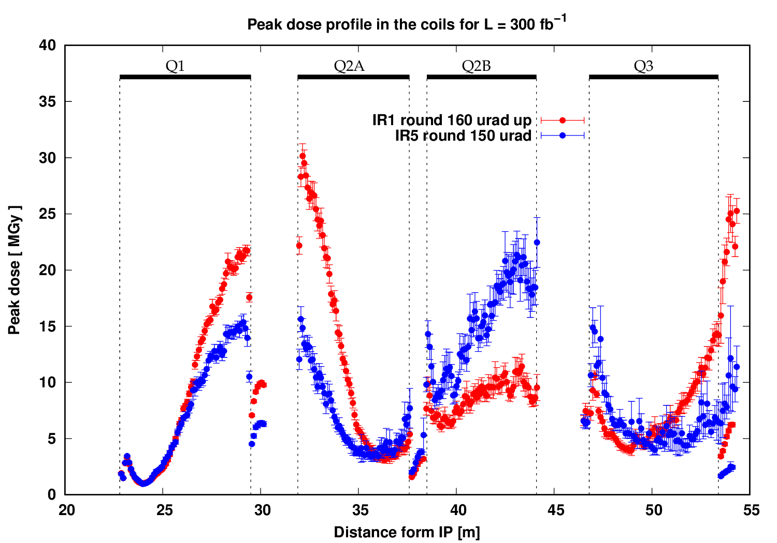
Polarity : FDF = configuration Run1, Run2 and beginning of Run 3
correctors:
MCBX: larger aperture
MQSX: coils off mid planes
MC S/T X & MC O/OS/SS X
Without considering the change of Atlas magnet polarity
Insulation degradation may appear (to be confirmed)
Above 30 MGy for main magnets
Above 7 MGy for corrector magnets

Slide 3
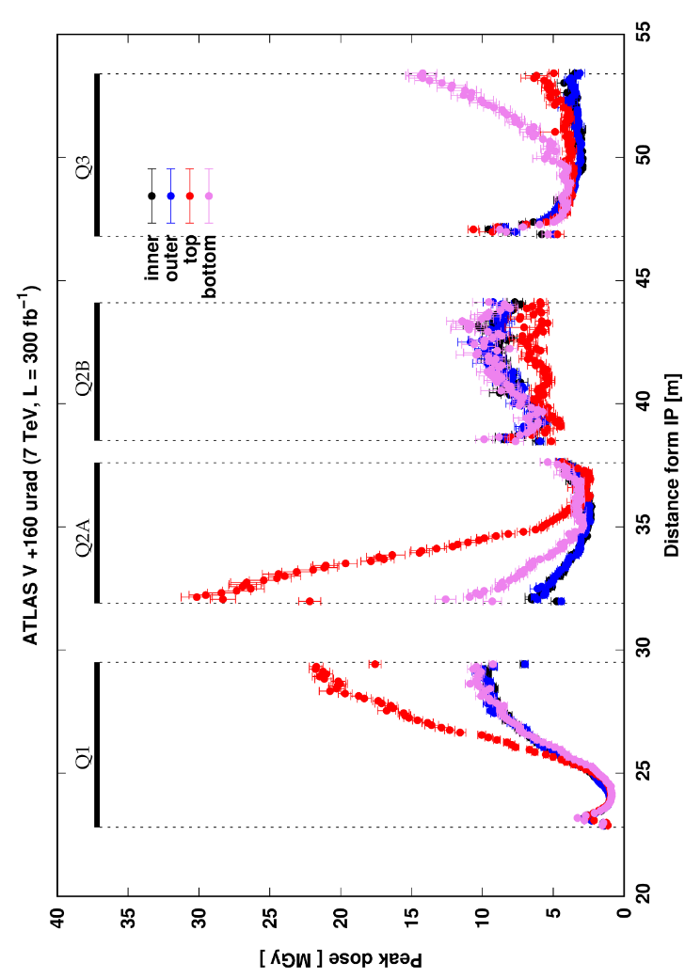
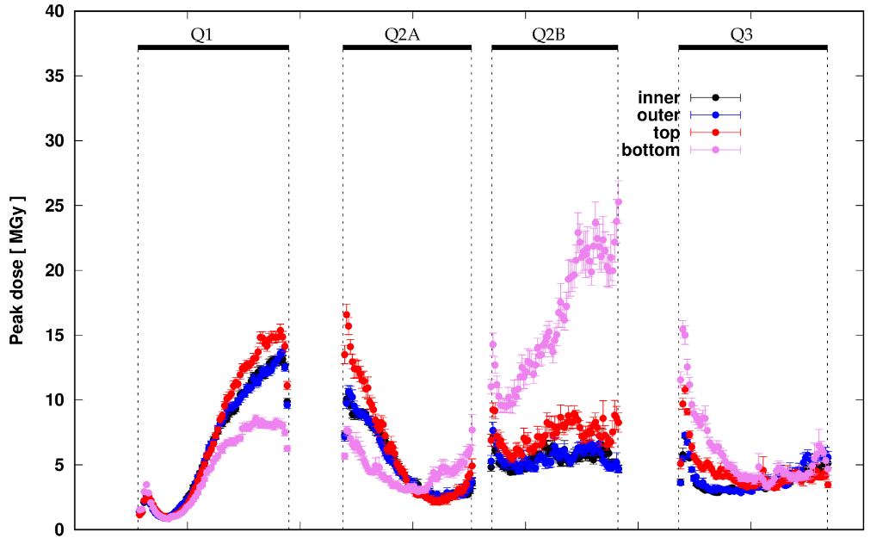
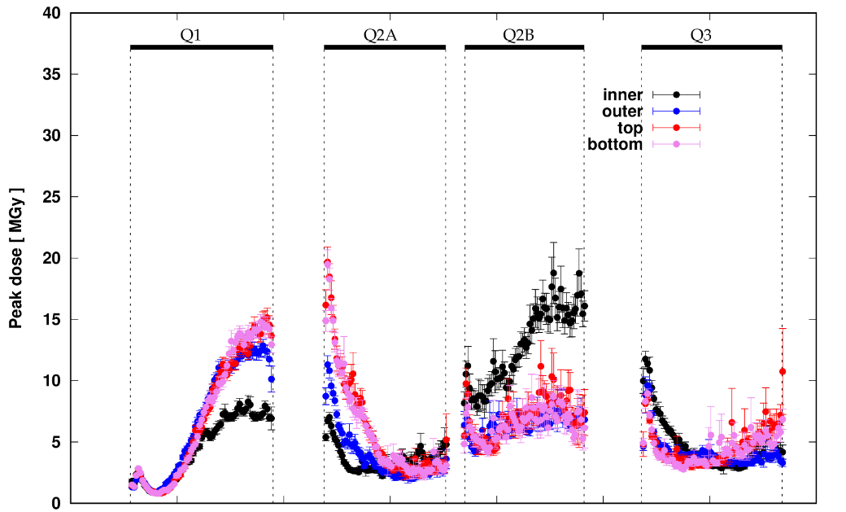
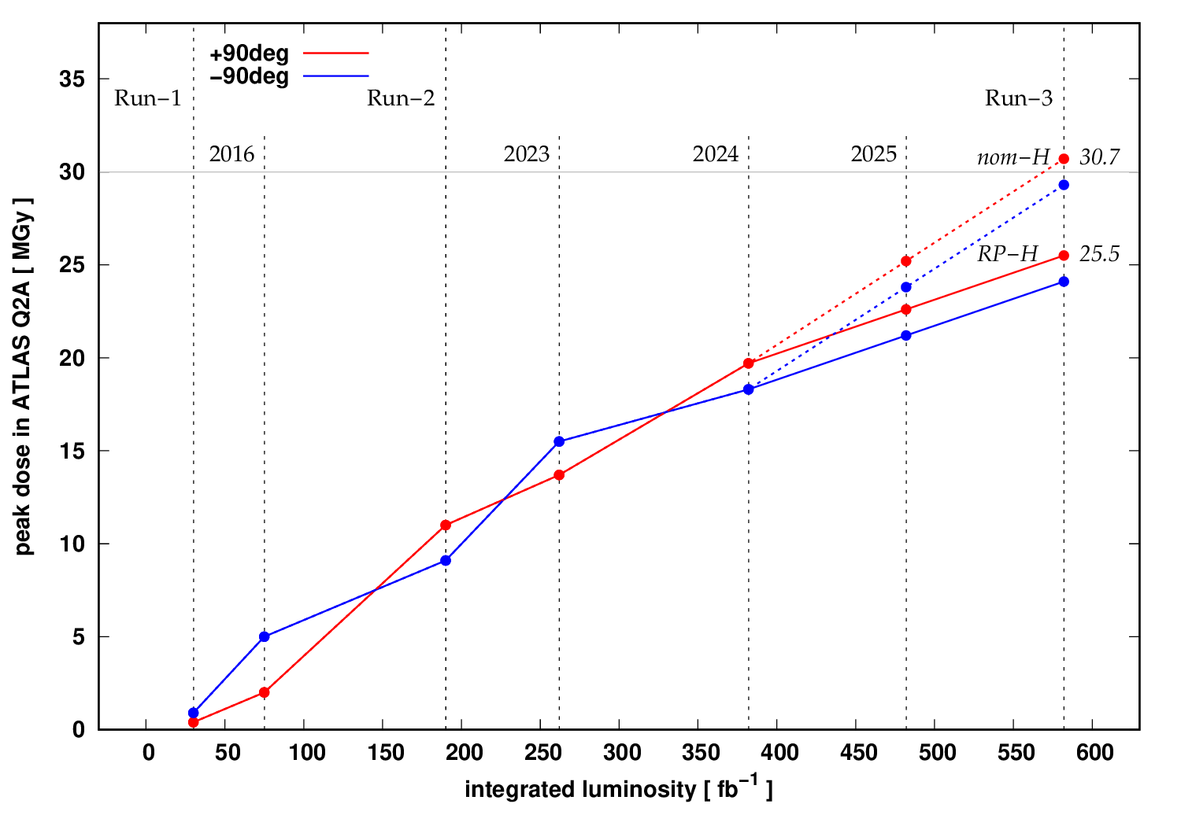
Q2 IR1 : Nom – V up to 2023; RP- V up to 2024 ; → Nom – H
0 < L < 260 fb-1
87%
260 fb-1 < L < 380
40%
380 fb-1 < L < 530?
50%
IR1: Nom-V
IR1: RP-V
IR1: Nom-H
V
V
V
H
Cham2024
= top
= bottom
Q2a (update 12.2024)
5MGy/100fb⁻¹
IR1: Nom-V
IR1: RP-V
100 fb⁻¹
100 fb⁻¹
IR1: Nom-H

Slide 4
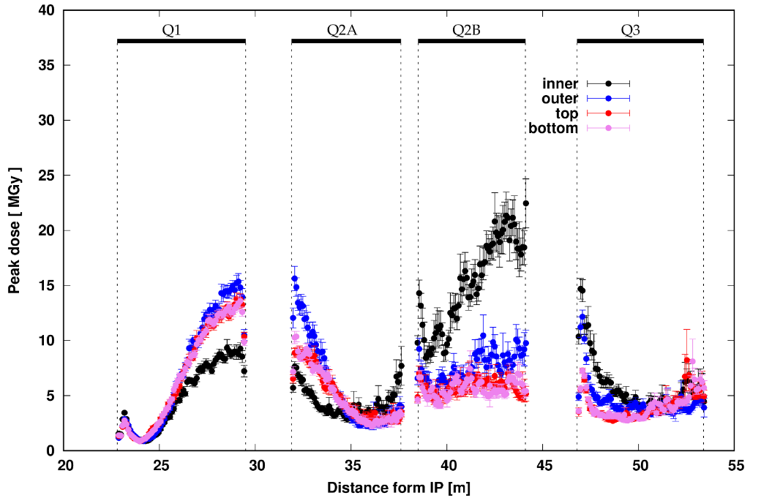
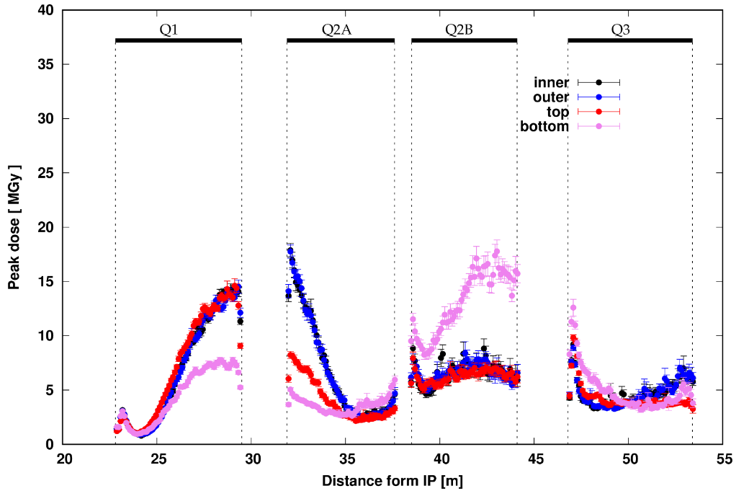
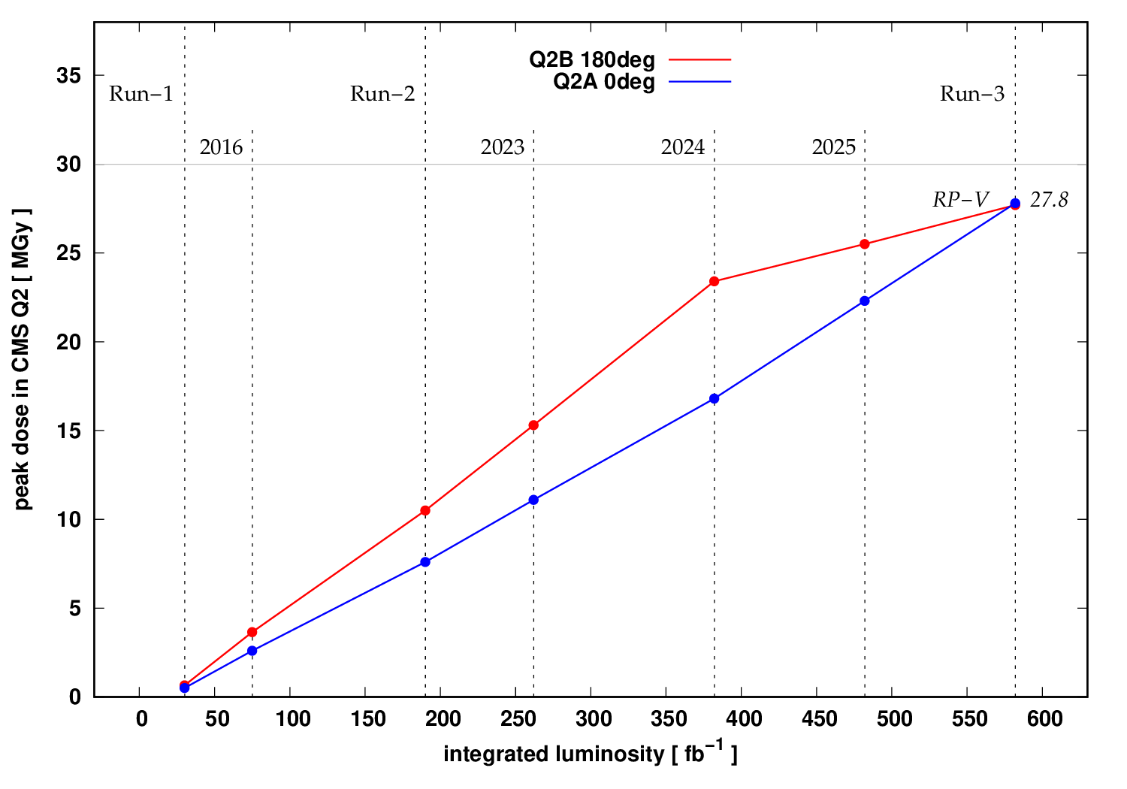
Q2 IR5 : Nom – H up to 2024 ; → RP - V
0 < L < 380 fb-1
127%
380 fb-1 < L < 530?
50%
IR5: Nom-H
IR5: RP-V
H
H
V
IR5: Nom-H
2MGy/100fb⁻¹
IR5: RP-V

Slide 5
For Q1 in IR1 and IR5
0 < L < 260 fb-1
87%
260 fb-1 < L < 380
40%
380 fb-1 < L < 530?
50%
IR1: Nom-V
IR1: RP-V
IR1: Nom-H
V
V
V
H
300 fb-1
Q1~ 15*530/300=26.5MGy
Idem pour IR5
0 < L < 380 fb-1
127%
380 fb-1 < L < 530?
50%
IR5: Nom-H
IR5: RP-V
H
H
V
Mail de F. Cerutti:
Pour les quatre Q1 (P1 et P5), dans l'hypothèse 580 fb-1 (c'est-à-dire200 fb-1 sur 2025+2026) on va arriver sur les 25 MGy.

Slide 6
For Q3 in IR1 and IR5
0 < L < 260 fb-1
87%
260 fb-1 < L < 380
40%
380 fb-1 < L < 530?
50%
IR1: Nom-V
IR1: RP-V
IR1: Nom-H
V
V
V
H
9
+4
+4
0 < L < 380 fb-1
127%
380 fb-1 < L < 530?
50%
IR5: Nom-H
IR5: RP-V
Mail de F. Cerutti:
Niveau main quadrupoles, les aimants moins impactés sont les deux Q3 d'ATLAS (Point 1) qui selon les calculs toucheront 15 MGy après 580 fb-1
Puis il y a les deux Q3 de CMS (P5), qui passeront à peine les 20 MGy après les mêmes 580 fb-1.
H
H
V
18
+3

Slide 7
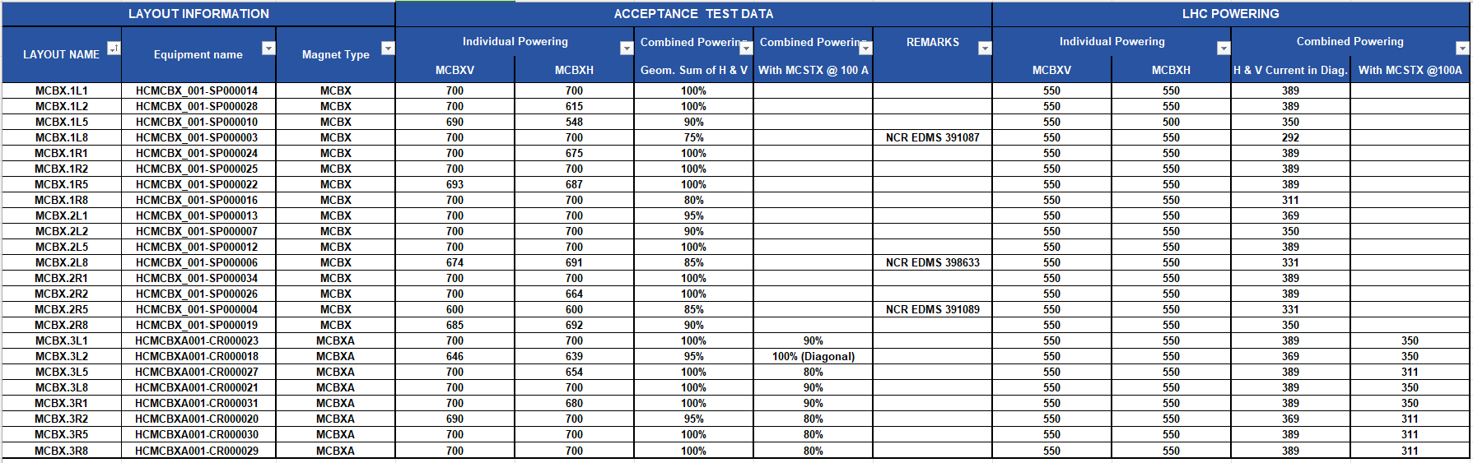
Weakness on MCBX combined magnets : https://edms.cern.ch/document/1395638 (see LMC#183)
Known non-conformity on IT magnets
QH issue on Q1.R1 : 1017174 One of the two quench heater circuits (YT1121) breaks down above 1000V →Power supply of the QHC reduced to 800V

Slide 8
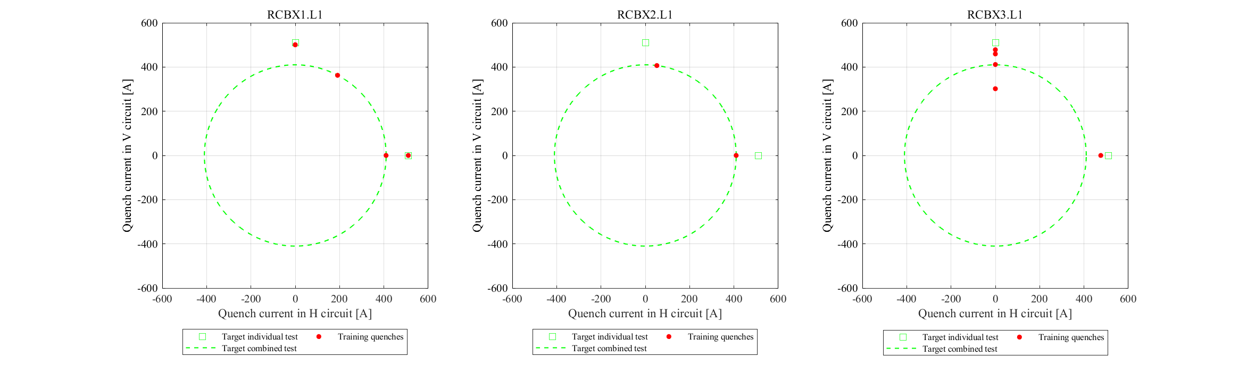
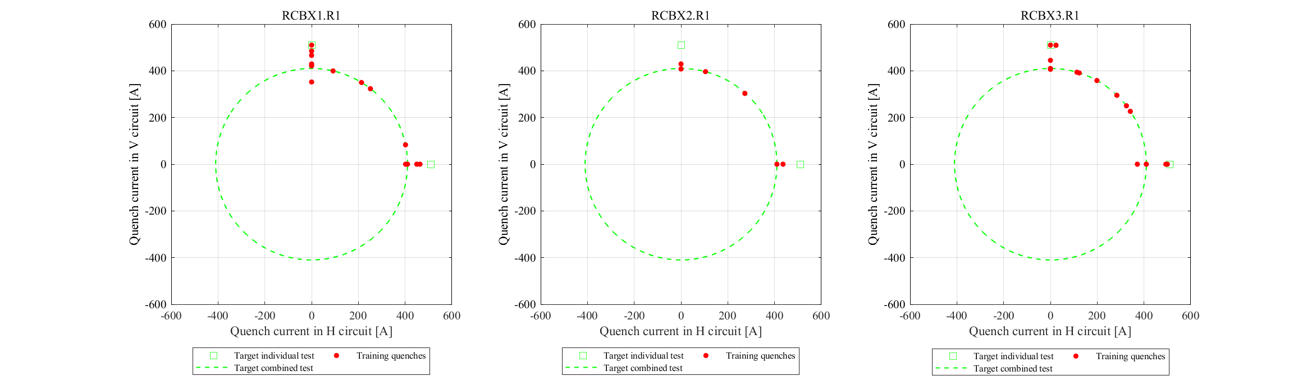
Training quenches in RCBXx.x1 in Post LS2 (combined+individual)
Ranking 1,2,3
***, ***, ***
*, **, *

Slide 9
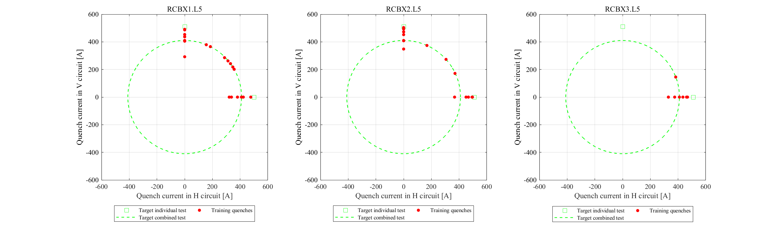
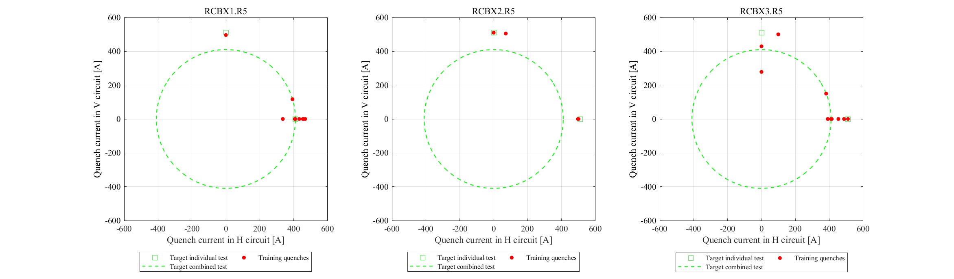
Training quenches in RCBXx.x5 in Post LS2 (combined+individual)
Ranking 1,2,3
*, *, **
**, ***, **

Slide 10
Wrap up
 | Q1 | Q2 | Q3 | MCBX | MCBX1,2,3 Powering test
IR1 | 25MGy @580 fb⁻¹ | 27MGy @530 fb⁻¹ 30MGy @580 fb⁻¹ | 15MGy @580 fb⁻¹ | 100% powering test (95% for 2L1) | ***, ***, *** for L1 * , ** , * for R1 | HQ issue on Q1.R1
IR5 | 25MGy @580 fb⁻¹ | 27MGy @530 fb⁻¹ 28MGy @580 fb⁻¹ Both on Q2a and Q2b | 20MGy @580 fb⁻¹ | 100% powering test (85% for 2R5, 90% for 1L5) | * , * , ** for L5 ** , ***, ** for R5
 | First : Q1L1 Second: Q1R5 | First : Q2L1 Second: Q2R5 | First : Q3L1 Second: Q3L5 Third : Q3R5
My first choice @ 530 fb⁻¹ : Q1, Q2, Q3L1 → major constraint for dismantling
If L (2025+2026)> 530 fb⁻¹: Q1L1 , Q2R5, Q3L1 (and Q3L5)
Note: during YETS test, RCBX circuits IR1 & IR5 are tested only individually up to 300A
The baseline is also to keep the present spare triplet cryo-magnets (Q1, Q2 and Q3) , plus the above selection.
Q1 magnet was tested at cold in 2018 at SM18, but the tests are still pending for Q2 and Q3!

