Slide 1
Machine Protection Panel Meeting
TT60 vacuum interlock issue
G. Pigny
On behalf of the TE-VSC Group

Slide 2
Outline
  Fast valves in SPS
  The event and consequences
  Fast valve behaviour and control system
  Sequence of events
  Short, medium, long-term solutions

Slide 3
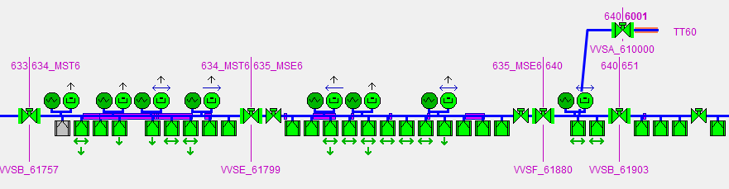
Fast valves in SPS
Originally installed to protect septa against a sudden pressure rise (closing time <50ms).
Two types of actuation: electric (VVFA) and electropneumatic (VVFB).
Located at the extraction zones of LSS2 (1x VVFA, 2x VVFB), LSS4 (1x VVFA), LSS6 (3x VVFA, 2x VVFB) and TT60 (1x VVFA).
VVFA locally powered from the tunnel (230VAC) and controlled from the racks (BA).
Obsolete equipment without a replacement candidate (keeping old spares).
SPS Vacuum SCADA application: fast valves in LSS6

Slide 4
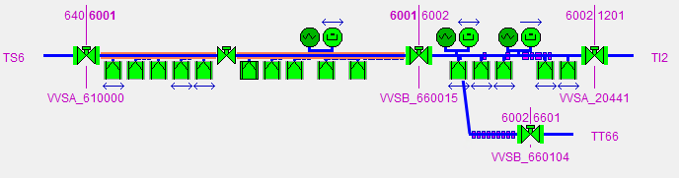
The event and consequences
07-04-2023 21:00 => The fast valve located in TT60 (VVFA_610213) goes into error (switches Open & Closed both activated).
  08-04-2023 ~14:00 => Vacuum piquet realizes the problem and intervenes to check it.
  08-04-2023 ~16:19 => Vacuum piquet solves the problem (missing 230 VAC supply).
  From 07-04-2023 21:00 to 08-04-2023 14:00
    Several beam injections (440 GeV, 1e11 p) to LHC/HiRadMat with the valve in error (physically closed).
to LHC
to HiRadMat
SPS Vacuum SCADA application: fast valve in error in TT60

Slide 5
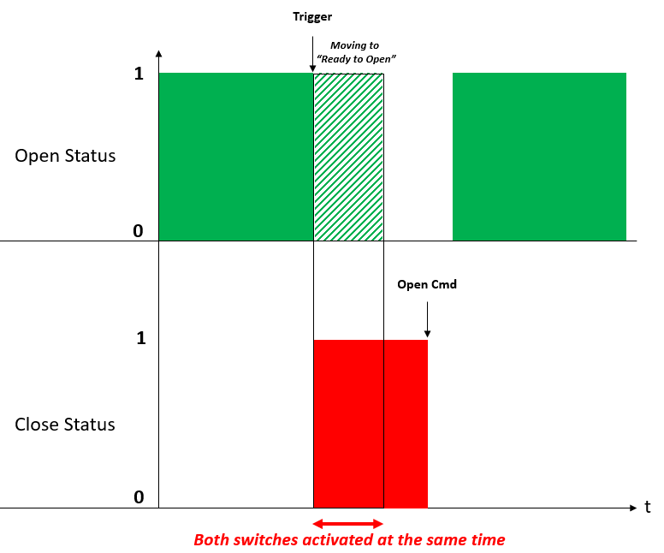
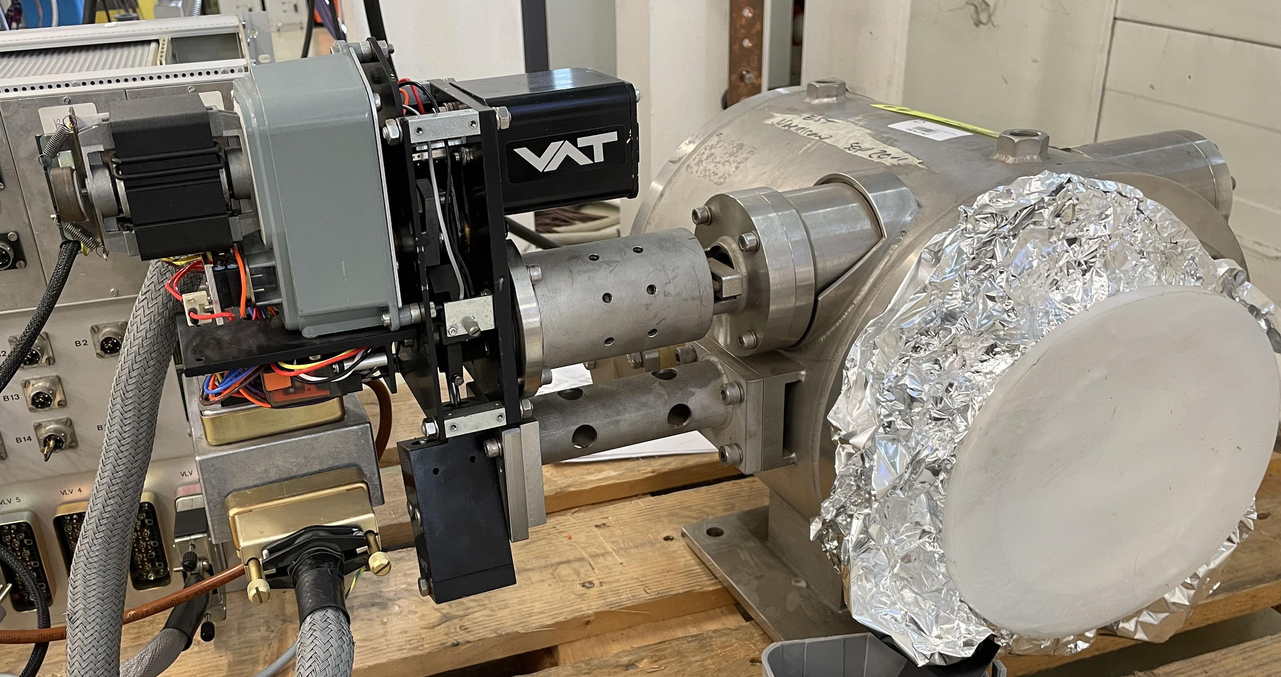
Fast Valve Behaviour
Close Position switch immediately active after triggering the valve (activated by spring closing mechanism).
Open Position switch still active until valve moves to the “Ready to Open” position (activated by motor shaft).
Open Position Switch
Close Position Switch

Slide 6

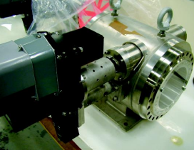
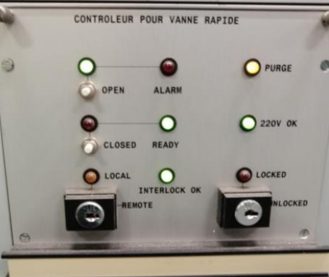
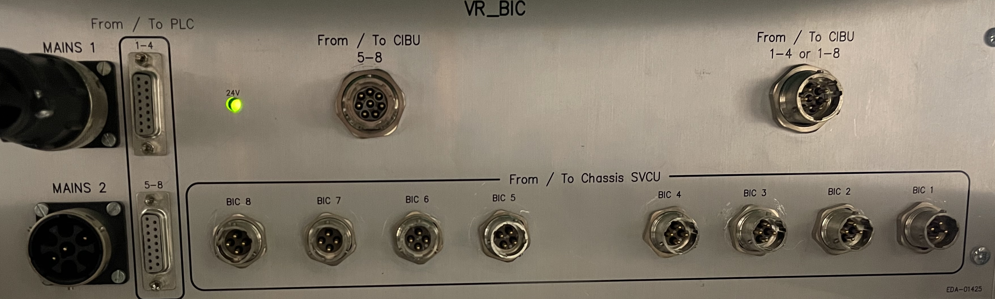
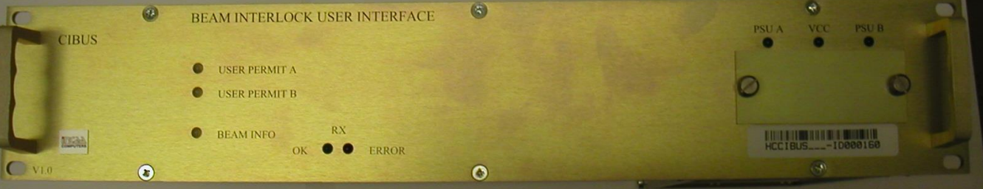
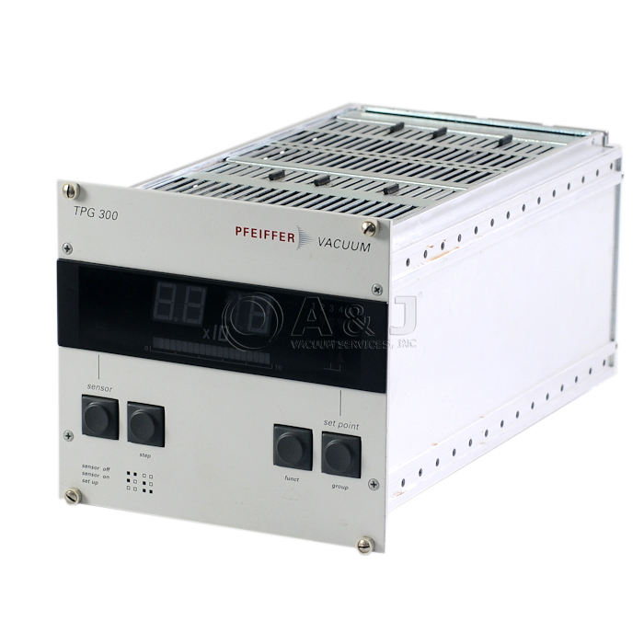
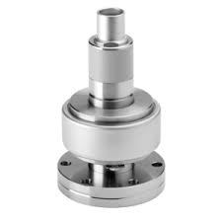
Fast valve control system (before the event)
Sector valve card
“Fast” valve
“Fast” valve controller
Vacuum Beam Interlock Crate
Beam Interlock User Interface
Vacuum user permit
Interlock
Profibus
Ethernet to SCADA
PLC
Penning gauge controller
Penning gauge

Slide 7
Sequence of events
We lose the 230 VAC to locally supply the valve in the tunnel while the valve is open
  230 VAC are used to move the valve to “Ready to Open” and Open positions.
  230 VAC feedback only available locally at the controller level.
On April 7 at 21h01, there is a pressure rise generating a vacuum interlock, and the interlock input is not disabled as it should, which triggers the fast valve closing
  Pressure rise in gauge VGHB_610405 shorter than SCADA acquisition time (1Hz), therefore not visible.
The valve closes but does not move to “Ready to Open position” because there is not 230 VAC local power
  Therefore, both switches remain activated.
Sector valve card only evaluates the “Open” status for the Beam Interlock Control
  Therefore, it does not generate an interlock to dump the beam or disable the injection.

Slide 8
Implemented solutions
Short term solutions
  Check the 230VAC presence during commissioning (rack side)
    Enforced from April 2023 onward
  Disconnect the interlock cables to not trigger fast valve closure (rack side)
    Done after April 2023 event
  Tighten the 230VAC extension cables in the tunnel to avoid any accidental disconnection
    Done during TS June 2023

Slide 9
Fast valve control system (after the event)
Sector valve card
“Fast” valve
“Fast” valve controller
Vacuum Beam Interlock Crate
Beam Interlock User Interface
Vacuum user permit
Interlock
Profibus
Ethernet to SCADA
PLC
Penning gauge controller
Penning gauge

Slide 10
Implemented solutions
Short term solutions
  Check the 230VAC presence during commissioning (rack side)
    Enforced from April 2023 onward
  Disconnect the interlock cables to not trigger fast valve closure (rack side)
    Done after April 2023 event
  Tighten the 230VAC extension cables in the tunnel to avoid any accidental disconnection
    Done during TS June 2023
Medium term solution
  Implementation of PLC-based interlock to the BIC evaluating both statuses
  Vacuum user permit TRUE only if the Fast valve is Open and not Closed
    Implemented during YETS23-24

Slide 11
Fast valve control system (after YETS23-24)
Sector valve card
“Fast” valve
“Fast” valve controller
Vacuum Beam Interlock Crate
Beam Interlock User Interface
Vacuum user permit
Interlock
Profibus
Ethernet to SCADA
PLC
Penning gauge controller
Penning gauge

Slide 12
Implemented solutions
Short term solutions
  Check the 230VAC presence during commissioning (rack side)
    Enforced from April 2023 onward
  Disconnect the interlock cables to not trigger fast valve closure (rack side)
    Done after April 2023 event
  Tighten the 230VAC extension cables in the tunnel to avoid any accidental disconnection
    Done during TS June 2023
Medium term solution
  Implementation of PLC-based interlock to the BIC evaluating both statuses
  Vacuum user permit TRUE only if the Fast valve is Open and not Closed
    Implemented during YETS23-24
Long term solution
  Removal of all fast valves in SPS during LS3. ECR preparation on going, will be sent in 2025 for approval.

Slide 13
THANK YOU

