Slide 1
Review of the Linac4 BCT Watchdog Interlocking Policy for High Loss Events
Piotr Skowronski

Slide 2
EXISTING SITUATION AND INTRODUCTION

Slide 3
Introduction
One of the machine protection systems in LINAC4 is the BCT Watchdog.
BCT stands for Beam Current Transformer.
  It is a device that measures beam intensity.
BCT Watchdog is implemented as a FESA class called BCTWD
  For each beam pulse it computes
    Beam losses between a pair of BCTs.
    Beam transmission in percent.
  If any of those two values is out of a permitted range, then it enables an interlock via Beam Interlock System (BIS).
    It tolerates that transmission is occasionally out of range
      Referred to as low losses watchdog interlock
    Any occurrence of high loss stops all the beams.

Slide 4
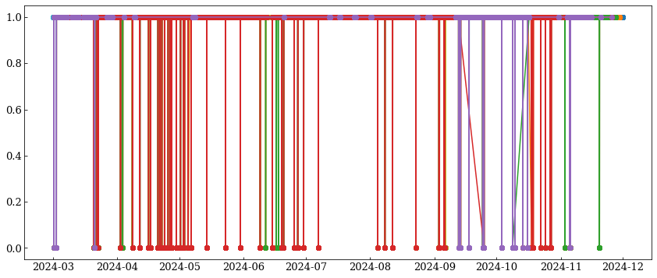
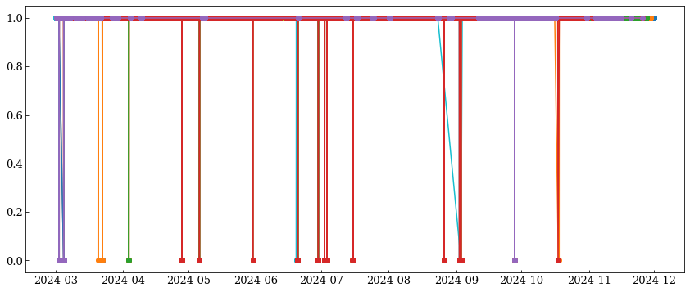
2024 statistics of high loss events
The experience gained in operation shows that many of the high loss events is because of breakdowns in RF cavities.
Only some of them were related to hardware failures or wrong settings,
another few with communication issue between BCTWD and BCTs.
L4L.BCTWD.L4T: 222 events
L4T.BCTWD.BI: 31 events

Slide 5


The watchdogs in question
Source
L4Z dump
Linac
rfq
LEBT
MEBT
L4L.BCTWD.L4T
L4T Line
LBE dump
LBE line
BI Line
L4T.BCTWD.BI
Booster

Slide 6
REASON FOR THE CHANGE

Slide 7
Reason for the change
Currently every detected event of high loss results in interlocking of all users.
  i.e., when measured intensity difference is above allowed threshold
Very often the high losses are a result of electromagnetic field breakdowns
in the high gradient RF cavities of LINAC4
  It is a normal phenomenon which happens once per couple of days.
  Usually, they are one of events, however, sometimes the coming series.
We propose to change of the specification of the BCT WATCHDOG class
  Such that it can allow for occasional high loss events
  if they happen less often than the defined threshold.
  This shall reduce the machine downtime with
  a negligible increase of risk for the machine safety.

Slide 8
The proposal
We propose to permit 1 event per 12 hours in 2 BCTWD devices
  L4L.BCTWD.L4T surveys the linac from DTL1 to PIMS12
  L4T.BCTWD.BI surveys the transfer lines from the end of linac to PSB injection
Source
L4Z Dump
Linac
rfq
MEBT
L4L.BCTWD.L4T
L4T Line
LBE line
LBE dump
BI Line
L4T.BCTWD.BI
Booster

Slide 9
Risk assessment
High-loss interlock protects against prolongated beam losses.
By definition, high losses are detected only when an equipment failure or misconfiguration occurs.
It can happen in the following scenarios:

Slide 10
Risk assessment:
Quadrupole power converter stops
Focusing is altered and beam being too large is scraped.
The losses are distributed over sizeable area and therefore there is a low risk of damage.
These power converters are monitored by SIS, which interlocks the beam when a power converter stops
From 2025 external condition is configured such that the beam with affected destination cannot be played.
Therefore, the related risk is very low.

Slide 11
Risk assessment:
Dipole power converter stops
Beam has wrong trajectory.
The losses are punctual, and in case impacting a sensitive location,
for example, a joint in a flange, they can lead to a vacuum leak.
Considering beam parameters, this requires several consecutive pulses impacting the same location.
  SY-STI will perform simulations, the results are expected within February.
  No change will be implemented in operation until this statement is confirmed.
However, these power converters are under surveillance of the FGC Interlock, that will not give the permit to BIS system until correct amperage is measured.
Therefore, the related risk is very low.

Slide 12
Risk assessment:
Trajectory correctors power converter stops
Because they create relatively small angles to the beam trajectory,
the induced losses are distributed over a certain area.
In case impacting a sensitive location, for example a joint in a flange,
it can lead to a vacuum leak.
Considering beam parameters, this requires multiple consecutive pulses impacting the same location.
These devices are not directly monitored by any interlock system.
The associated risk to damage any equipment with 3 bad pulses is low.

Slide 13
Risk assessment
Incidental change of settings
The effect is very similar to the described above scenario when a power convert trips.
The impact depends on how much the new setting deviates from the optimum value:
  The smaller the change, the lower is the risk of a small area beam impact.
  In case of the dipoles, the FGC interlock has a relatively narrow window
    Therefore, it will interlock when settings are outside of this window.
    Thus, this reduces the risk.
  There is no such protection for quadrupoles or trajectory correctors,
    Because the risk that their failure provokes machine any damage is extremely low and the beam can be re-steered with given corrector off.
The probability of incidental change is low a risk to damage any equipment with 3 bad pulses is low.

Slide 14
Risk assessment:
Field breakdown in the accelerating structures
Such an event alters the amplitude and phase of the accelerating field.
The beam is accelerated to a different energy, which changes the subsequent focusing and bending angles.
Unless the breakdown occurs in the very last cavity of the linac, the effect of wrong focusing is such that the losses are distributed over a very large area of the beam chamber.
In case it is the last cavity then the wrong angle received from the bends is the dominant effect and the losses can be concentrated in a narrow area.
However, based on operational experience there is a relatively low probability that the following pulse will also suffer an RF breakdown, although this cannot be excluded.

Slide 15
Functional specification

Slide 16
Specification
The most intuitive approach would be to define a value with
maximum number of events allowed within given period.
  For example, 1 event per hour or 3 events per day.
However, its implementation is quite complex,
  It requires to store in memory the list of the timestamps for each event and to compare them at every pulse with the current time.
The already existing transmission efficiency counter of BCT Watchdog
is implemented with counting down bad pulses
from the threshold value down to zero.
Therefore, high loss counters should be implemented also using similar way.

Slide 17
Solution based on counters
highLossCounter:
  It tracks the number of high loss events.
  It is initialized to with value defined by the highLossCounterThreshold setting.
  It is reduced by one ay each high loss event.
  The watchdog removes the permit when this counter becomes zero.
highLossGoodEventCounter
  It monitors the number of consecutive pulses without high loss events.
  It is initialized with the value specified by the highLossInterval setting.
  It decreases by one with each good pulse.
  When it becomes zero, then
    highLossCounter increases by one, if not bigger than highLossCounterThreshold
    highLossGoodEventCounter is set back highLossInterval.
  It is reset to value of highLossInterval whenever a high loss event occurs.
Neither counter can become negative.

Slide 18
Specification: Reset action
To avoid that resetting the watchdog allows multiple high loss events
on the next occasion, reset action
will not set highLossCounter to highLossCounterThreshold.
Instead, it should leave highLossCounter unchanged if it is bigger than zero.
If it is equal to zero, then reset action should set highLossCounter to 1.

Slide 19
Detailed description
Two new setting variables need to be defined BCTWD class
  highLossCounterThreshold
  highLossInterval
Both need to be protected with Machine Critical Setting
RBAC role.

Slide 20
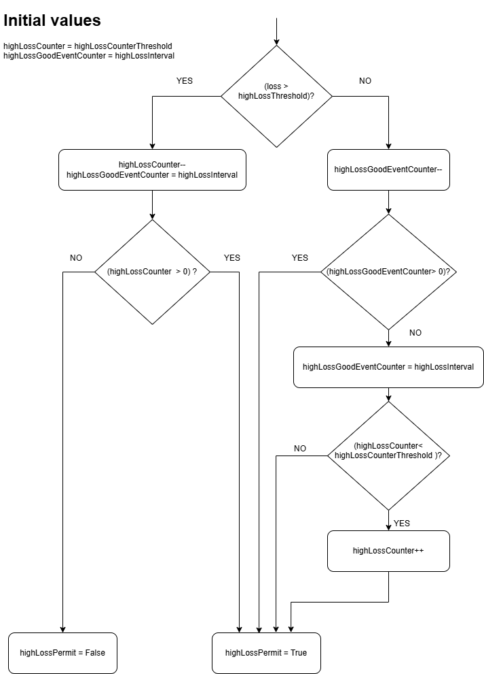
UML diagram of the proposed algorithm
As an example, we take settings
  highLossCounterThreshold = 2 and highLossInterval = 30000
    meaning that 1 high loss event per 10 hours is accepted.
  Initially both counters are zero, highLossCounter highLossGoodEventCounter.
Then let’s consider the possible scenarios

Slide 21
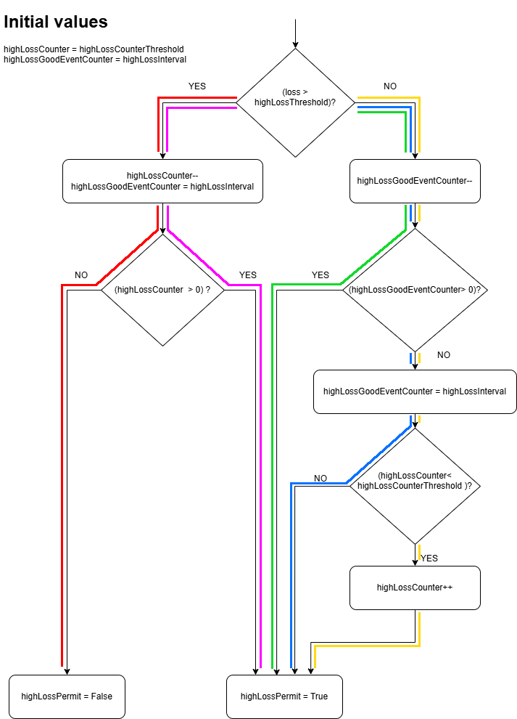
No high loss event for an extended period
Initially,
  highLossGoodEventCounter = 30000
    defined by highLossInterval.
  highLossCounter = 2
    defined by highLossCounterThreshold.
highLossGoodEventCounter is decreased
at each pulse until it reaches value of 0.
  This corresponds to the green path.
When it reaches 0, then
  It is set back to 30000.
  highLossCounter is not smaller than highLossCounterThreshold, therefore,
  it cannot be further increased.
  This corresponds to the blue path.

Slide 22
1 high loss event followed by extended period with no high losses
When high loss event is detected then
  highLossCounter is decreased by 1,
    meaning that it is set to 1.
  highLossGoodEventCounter is reset to 30000.
  highLossCounter is still bigger than 0, therefore highLossPermit is set to true and the operation continues.
  This corresponds to the magenta path
From now on only good pulses are encountered
  at each pulse highLossGoodEventCounter is decreased until it reaches 0 (the green path).

Slide 23
1 high loss event followed by extended period with no high losses
From now on only good pulses are encountered
  at each pulse highLossGoodEventCounter is decreased until it reaches 0 (the green path).
When highLossGoodEventCounter reaches 0
  highLossCounter is increased by 1
    meaning that it is set to 2.
  highLossGoodEventCounter is also set to 30000.
  This corresponds to the yellow path.
Further the algorithm continues
as described in the 1st point.

Slide 24
2 high loss events within less than 10 hours
When 1st high loss event is detected then
  highLossCounter is decreased by 1,
    meaning that it is set to 1.
  highLossGoodEventCounter is reset to 30000.
  highLossCounter is still bigger than 0, therefore highLossPermit is set to true and the operation continues.
  This corresponds to the magenta path
Until next high loss event is encountered highLossGoodEventCounter is decreased at each pulse (the green path).
Then, highLossCounter is decreased by 1
  meaning that it is set to 0
  highLossPermit is set to false and
  all beams are interlocked (the red path)

Slide 25
Conclusions
We propose to relax high loss policy for BCT Watchdog in Linac4 and
to permit occasional high loss events
  Only 2 watchdog instances would have the relaxed setting
    In particular, the RFQ policy WILL NOT be changed
  Start with 1 event allowed per 10 hours
  If ever needed, this could be relaxed in the future under approval of MPP
Increase of the risk for the machine safety is very small
  Waiting for FLUKA simulations to confirm that even in the worst-case scenario of direct beam impact on metallic structures
  they should not melt with less then 10 pulses

