Slide 1
BGC regular meeting geometric considerations for BGC v4
26/01/2025
D. Butti

Slide 2

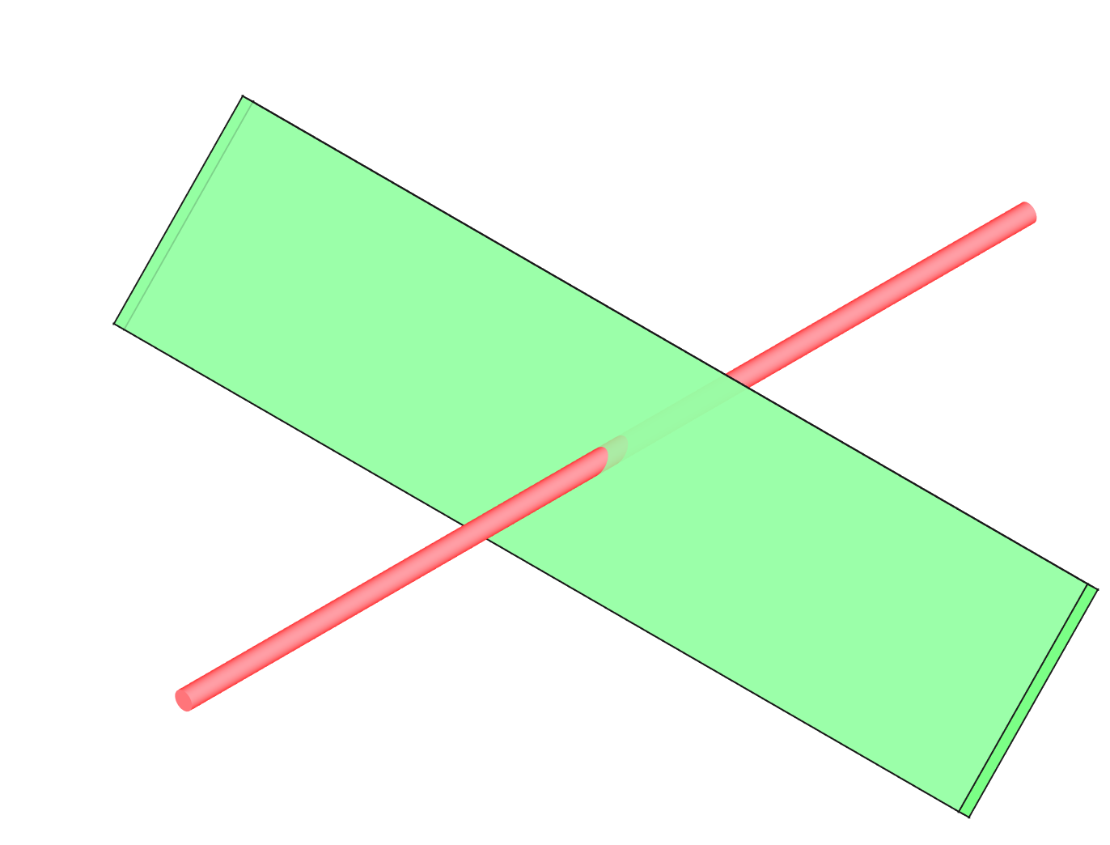
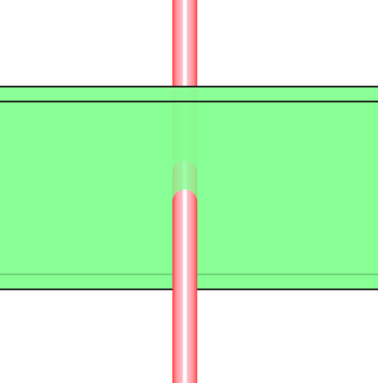
V3 configuration
Pro
both planes with one optical line
configuration OK for overlap monitor
relaxed margin for jet-beam alignment
Contra
one direction strongly affected by jet profile
thin jet limits size of emission volume (hence signal)
cannot be easily integrated in B2 due to QRL
cam view
H plane
beam_{V} ∗ jet
beam_{H}
QRL
B2
B1
beam
jet
V plane
Cross-section of V3 installed in B1

Slide 3
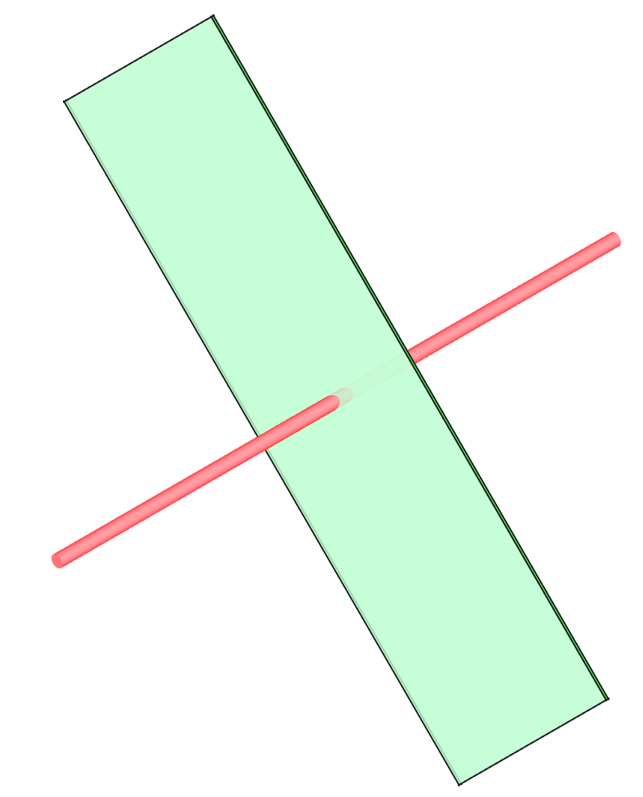
V3 skew configuration
Pro
same as V3 non-skew
simpler integration in B2
Contra
one direction strongly affected by jet profile
thin jet limits size of emission volume (hence signal)
cannot be easily integrated in B2 due to QRL
V plane
cam view
45
H plane
beam_{H,V} ∗ jet
beam_{H,V}
QRL
B2
B1
beam
jet
Cross-section of V3 skew concept for B2

Slide 4
Towards optimized instrument…
Wishlist:
try to eliminate impact of jet thickness in both planes
avoid mixing H and V beam size in one image
prefer configuration with skew jet for QRL integration
cam H view
Let’s forget about the jet orientation and imagine the jet as something that creates a visible footprint of the beam…
cam H
beam_{H}
→ true beam size on both planes can be detected by looking along the two beam directions
H plane
cam V view
The longer the footprint, the more signal at the camera
cam V
beam_{V}
V plane

Slide 5
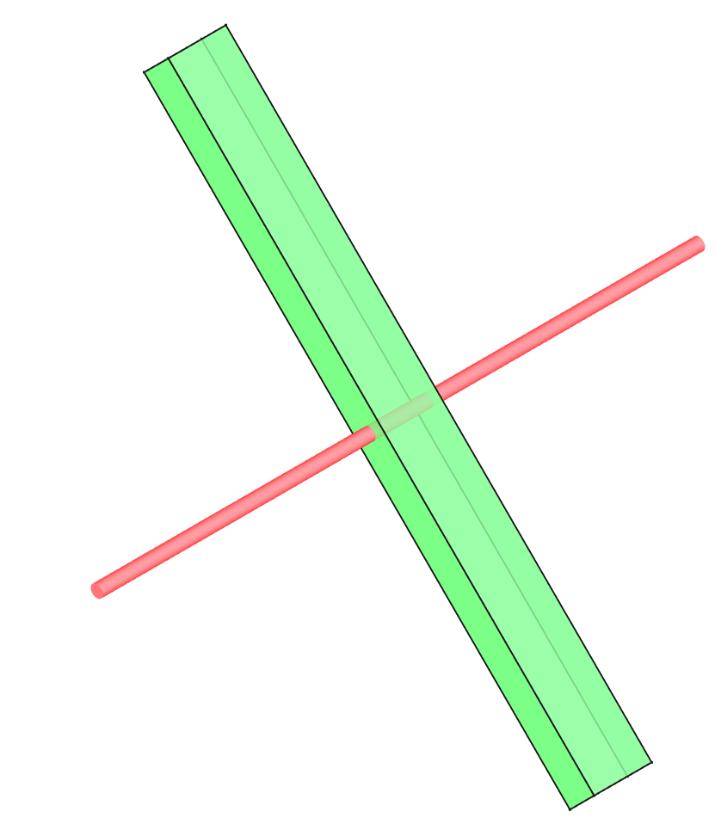
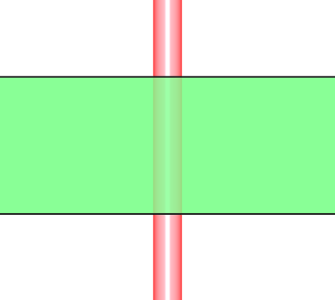
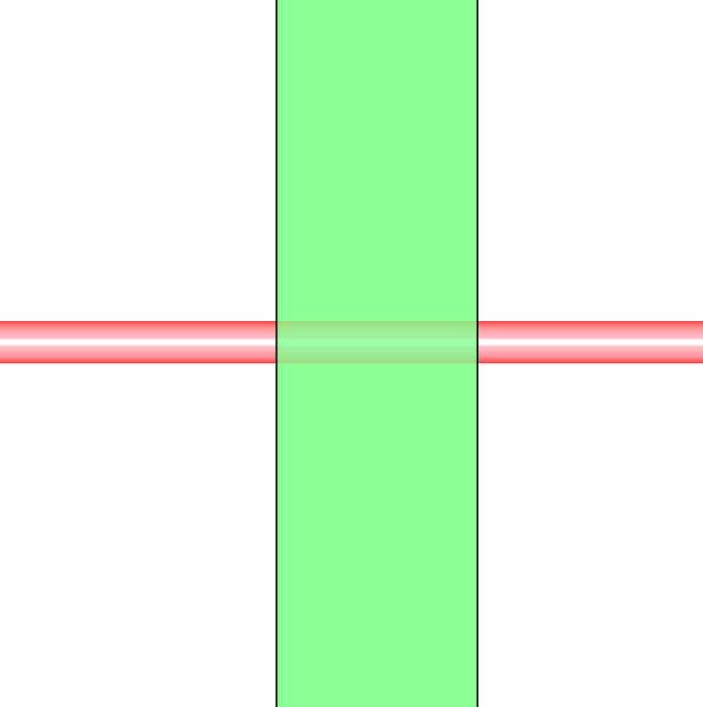
V4 concept with skew jet and two optical lines
Pro
no jet thickness effect
longer emissive region provides more signal
simpler integration in B2
Contra
extra optical line
tighter margin for beam-jet alignment
(jet cannot be too big for gas load)
more packed jet and optical lines
(45 deg instead of present 90)
cam H
cam H view
45
beam_{H}
H plane
cam V view
QRL
B2
B1
cam V
V plane
beam_{V}
Concept of skew jet and two optical line, one folded with flat mirror

Slide 6
V4 concept with skew jet and one optical lines
Pro
same as option with two lines
only one camera to maintain
Contra
optics becomes more challenging
optical branch more packed
H line
cam view
Configuration achievable by modifying only the optical branch of the version with two lines
→ could be considered as an optimization option in a second stage
V line
beam
beam_{V}
beam_{H}
jet
Cross-cut view

Slide 7
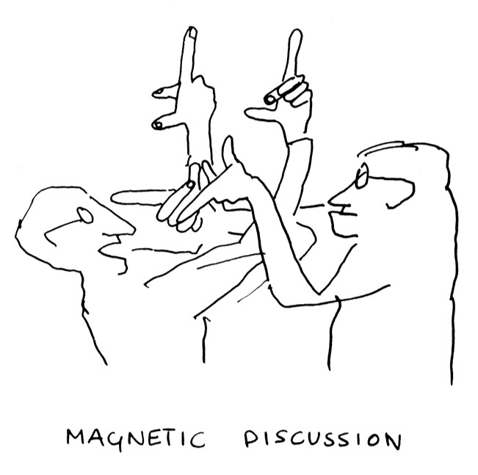
Conclusion
Decoupling H and V measurements highly beneficial for BGC performance
accurate emittance measurements in both planes
allow tail measurements in both direction (impossible in jet-affected plane in V3 configuration)
Configuration with two optical lines and skew jet allows this option and ease integration of BGC B2
Design effort required to manage reduced angular distance between optical lines and jet
Configuration could be further improved, with modifications of the optical branch only, to send the two beam projections on one camera
BGC V4
B. Touschek

