Slide 1
CI update
BGC CI team

Slide 2
Cockcroft experimental update
Oliver continue his experiments with JEREMY setup (Thesis work)
  Gas curtain density distribution scan
  Background pressure tests
  Validating the MOGA code
Shakti works on the pulse jet setup
  Assemble the pulse nozzle by Parker inc.
  Prepare the chamber and detail experimental plan.
Cross-section analysis
  Initial analysis was communicated through collaboration meeting in Liverpool.

Slide 3
JEREMY & TPMC BG Validation
$${\dot{∆m}}_{Jet}+{\dot{∆m}}_{Effusion}={\dot{m}}_{Pumping}$$
Primarily thesis content, but increases confidence on MOGA work for future BGC’s.
1st Skim | 2nd Skim | 3rd Skim | 4th Skim
400 um | 2 mm | 0.4x30 mm | 4x60 mm

Slide 4
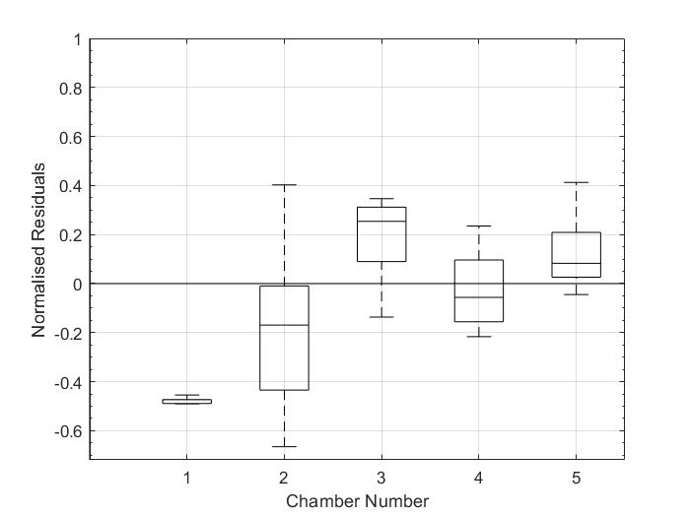
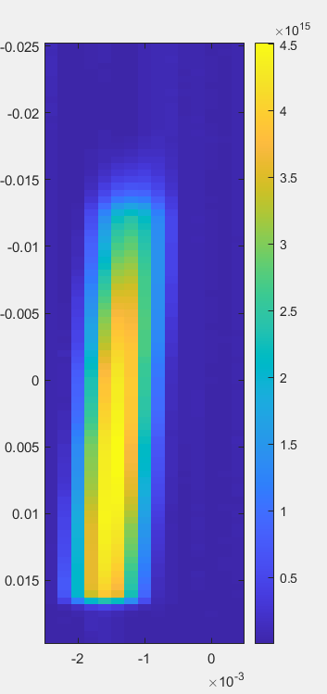
N2
N2 at 6 bar abs.
(rotated by ~0.8º)

Slide 5
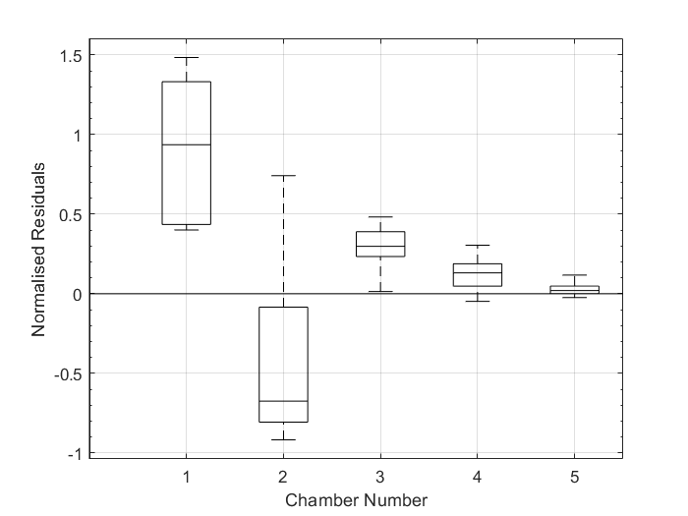
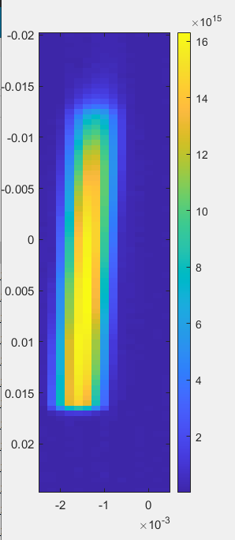
Ne
Ne at 6 bar abs.
(rotated by ~0.8º)

Slide 6
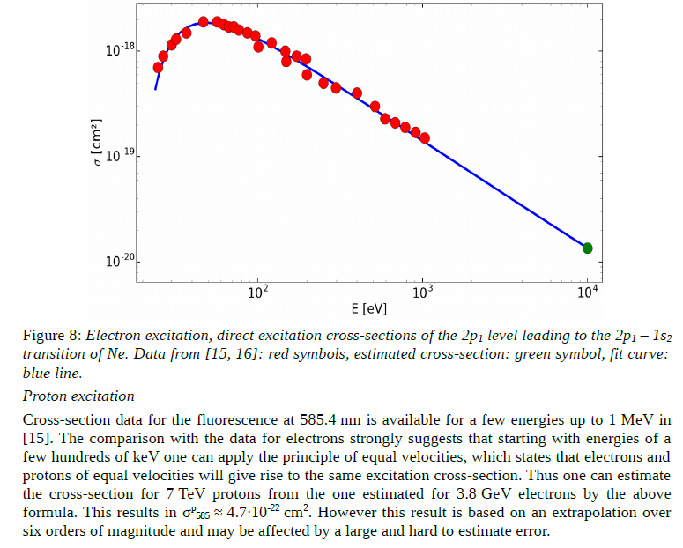
Cross-section study with Ion
Beam size (mm)

Slide 7
BGC 4.1 for EBTS
Chambers
  In end of February due to the shortage of ss316LN materials.
  Weekly meeting setup with Manufacturer
Other mechanical parts
  Mid of February.
Pumps are ready
  Using pumps from JEREMY for Tests at CI.

Slide 8
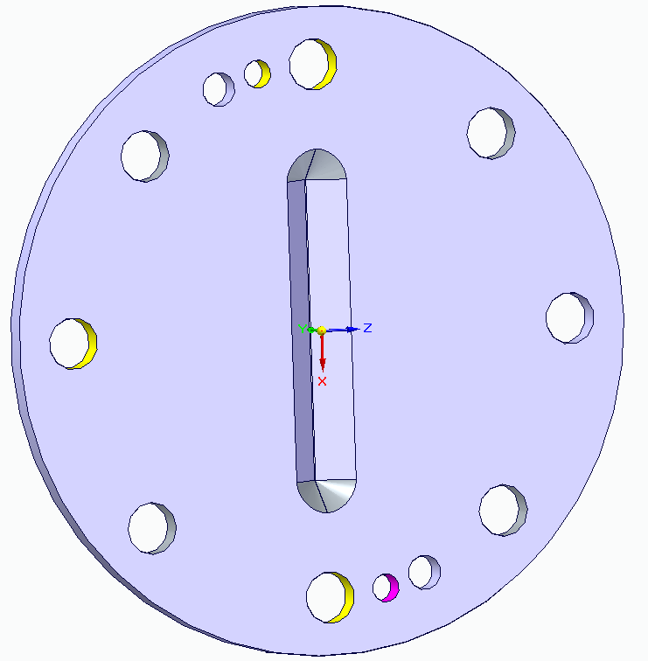
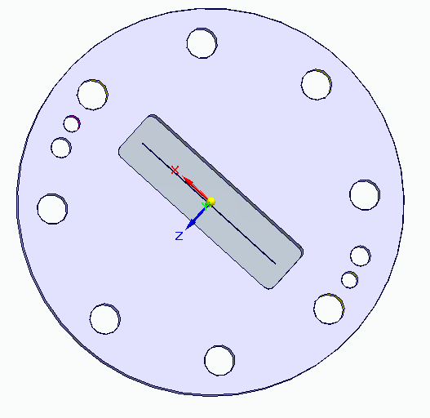
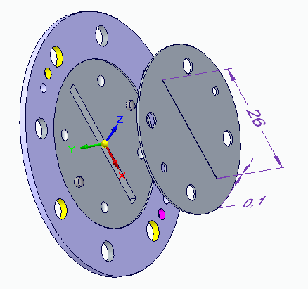
Difficulty with 3rd skimmer
Original design from v3
  Hard to do with CNC machine
Modified design from v3
  Try to combine CNC and advanced machining such as Laser and chemical etching
  Still challenge
Two parts design
  CNC machine the holder
  Slits on sheet metal done by Laser or chemical etching (achieved before)
  Any potential cons?

Slide 9
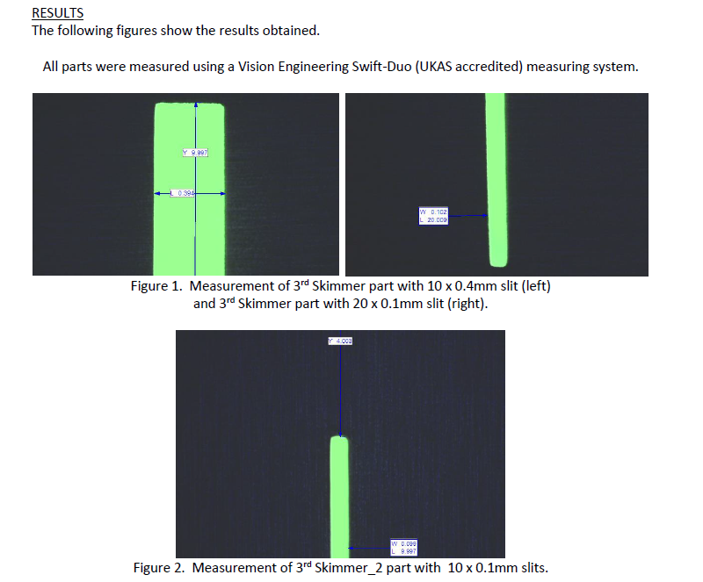

Slide 10
Planned journal articles
2024:
  “Beam gas curtain monitor: Vacuum studies for LHC integration and operation”
    lead by Christiana lead, published in PRAB
  “Simulation and experimental studies into a supersonic gas jet curtain for beam profile monitoring”,
    mainly about the simulation method,
    analytical calculation for continuum flow + quitting surface for transition + Monte Carlo simulation for molecular beam tracking.
    Lead by Hao, in preparation for Vacuum or Nucl Instr Meth A, delayed.
  “Measurements at 7 TeV with protons and lead ions”, Delayed
    lead by Ondrej and Hao, in preparation for PRL.
  BGC@EBTS results from 2023, Delayed
    lead?
    Potentially Nucl Instr Meth A or Rev Sci Instr.
2025:
  “MOGA simulation”
    lead by Oliver, potentially Vacuum.
  “V3 with full technical details”
    Mechanical design and gas flow test
    Optical system and resolution test
    LHC measurements in details (Visible and UV)
    Phys Rev AB, Lead? Danielle and Hao? ( Initially Ondrej, but full- time job now)
  “Cross section study”
    lead by Hao/Shakti/Oliver, Phys Rev C?

Slide 11
Plan
Starting the pulse jet work
BGC 4.1 test
Continue cross-section analysis
  Cross check the CI code with Timber data
  Proton data

