Slide 1
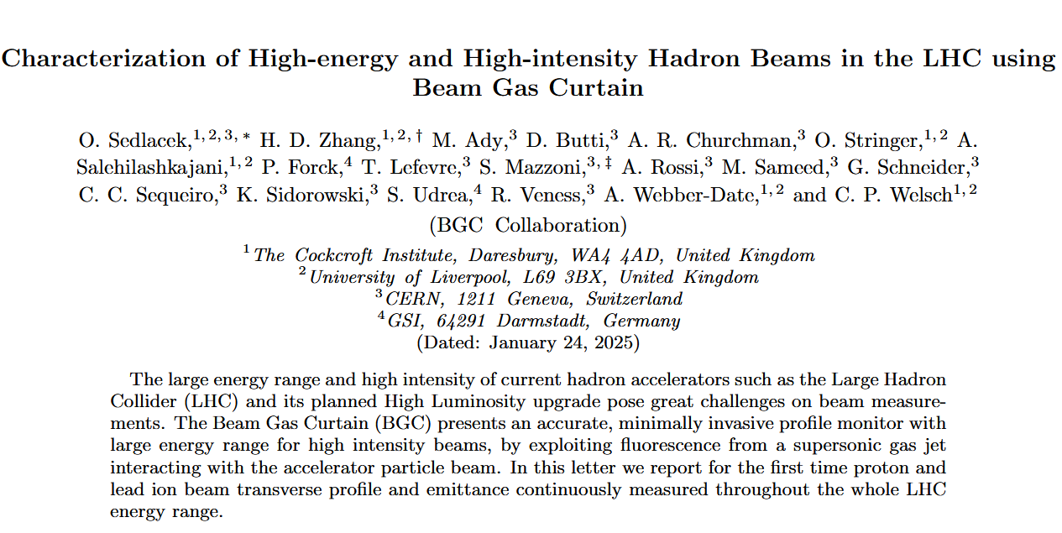
Thank you for comments & suggestions

Slide 2
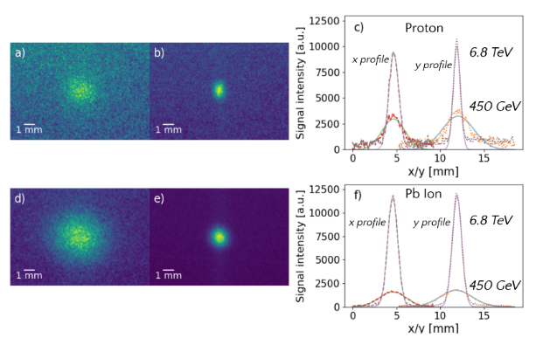
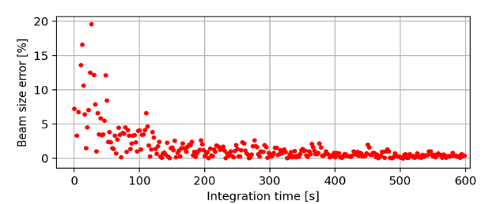
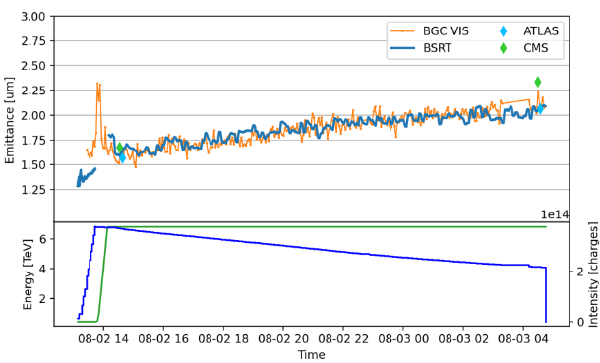
Contents
Introduction
  Different methods of profile & emittance
Experimental setup
  Working principle
Results
  Sample signals at 450 GeV & 6.8 TeV
  Systematic beam errors studies
  Emittance measurements
    Comparison to BSRT, Experiments & etc
Summary
  Where BGC fits (limitations of other installed monitors)

Slide 3
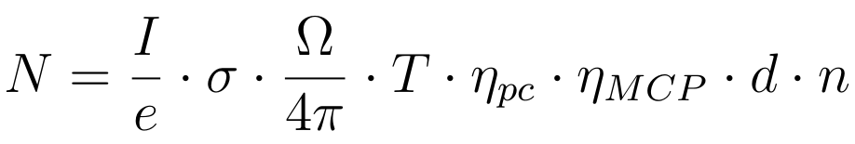
Remaining comments
Introduction
  Citations (also in other sections)
Experimental setup
  Figure 1) clarity
Results
  Binning
  Text alterations
Parameter | Value
σ | Fluorescence cross-section
Ω | Solid angle
T | Transmittance
I | Beam current
𝜂_{pc} ᐧ 𝜂_{mcp} | QE of Intensifier
d | Gas curtain thickness
n | Gas curtain density

Slide 4
Citations
BSRT
  Some main paper about the monitor at LHC
  Paper or proceeding with its PSF mentioned or calculated
LHC Wire scanner
  Some main paper about the monitor at LHC
BGI at LHC - Beam heating?
  Is there paper or proceeding about BGI at LHC with the beam heating?
Emittance scans at ATLAS and CMS
Parameter | Value
σ | Fluorescence cross-section
Ω | Solid angle
T | Transmittance
I | Beam current
𝜂_{pc} ᐧ 𝜂_{mcp} | QE of Intensifier
d | Gas curtain thickness
n | Gas curtain density

Slide 5
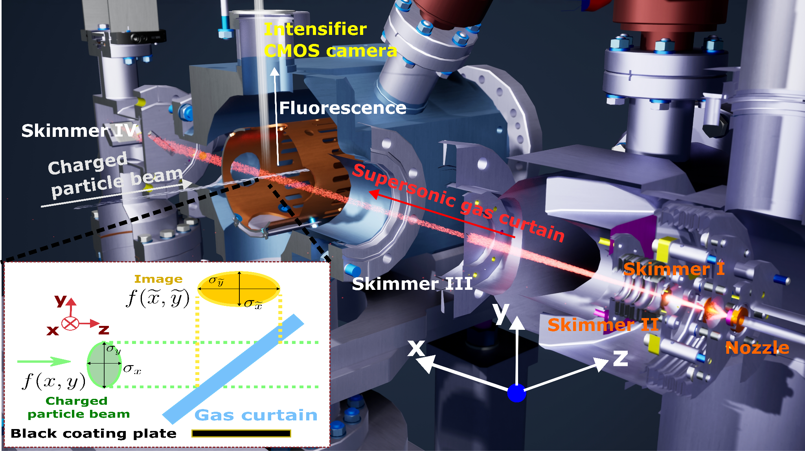
Figure 1 clarity
Parameter | Value
σ | Fluorescence cross-section
Ω | Solid angle
T | Transmittance
I | Beam current
𝜂_{pc} ᐧ 𝜂_{mcp} | QE of Intensifier
d | Gas curtain thickness
n | Gas curtain density

Slide 6
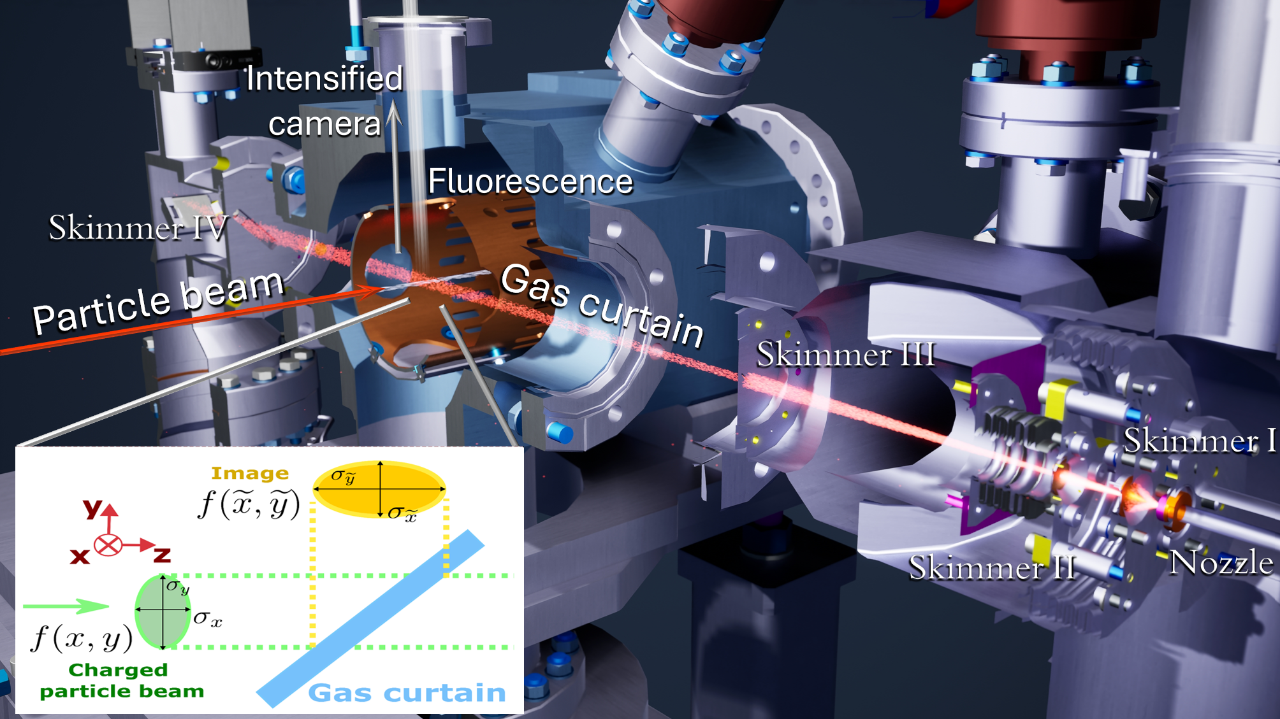
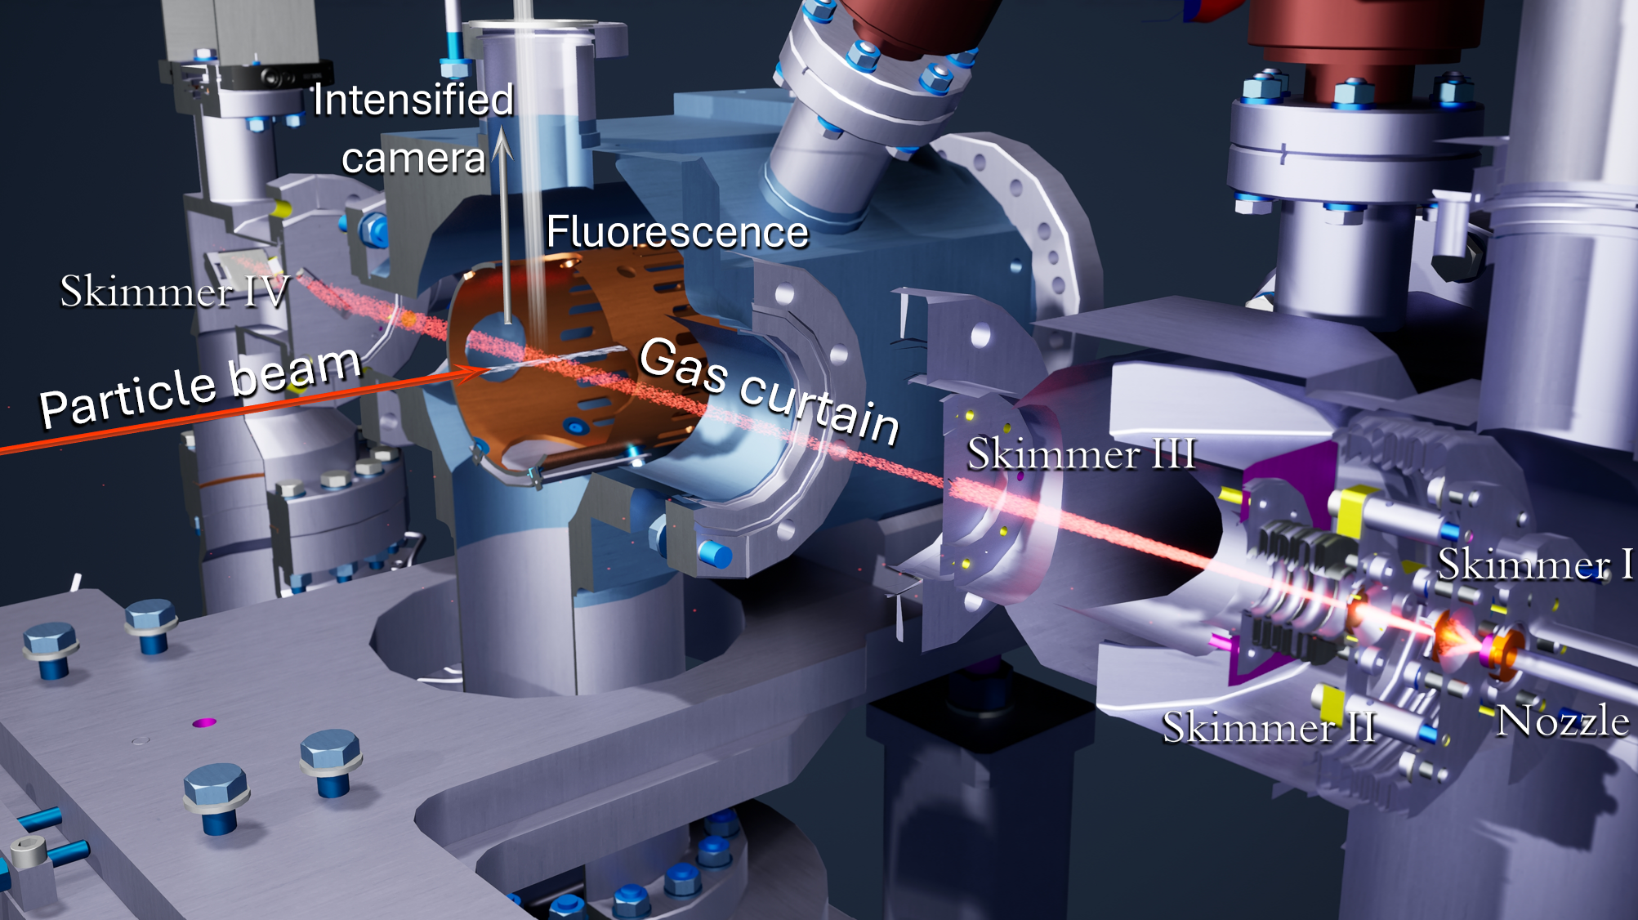
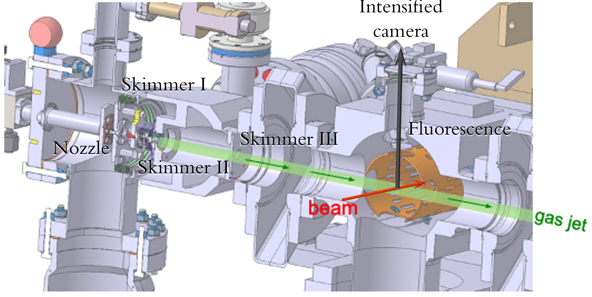
Figure 1 clarity
(1)
(2)
(3)

Slide 7
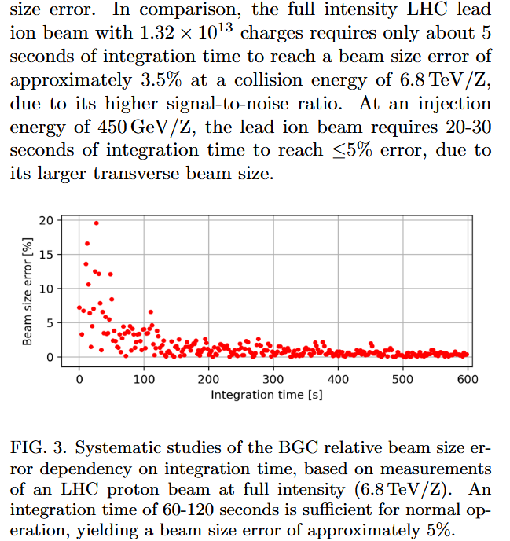
Binning
No binning used in the studies
  Might simply remove last sentence
  Or mention expected lower light-yield
Bethe-Bloch expects lower light-yield
  ~2.7x lower at 450 GeV than 6.8 TeV
Might benefit in future by binning
Parameter | Value
σ | Fluorescence cross-section
Ω | Solid angle
T | Transmittance
I | Beam current
𝜂_{pc} ᐧ 𝜂_{mcp} | QE of Intensifier
d | Gas curtain thickness
n | Gas curtain density

Slide 8
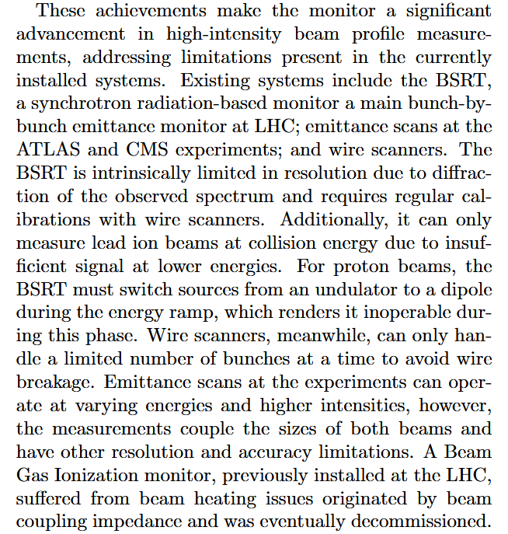
Limitations of other instruments
No citations
  Probably hard to find papers mentioning limitations?
No quantification
  Would require probably more extensive comparison (e.g. BSRT limited resolution)

Slide 9
Thank you for your attention!
Questions?

Slide 10
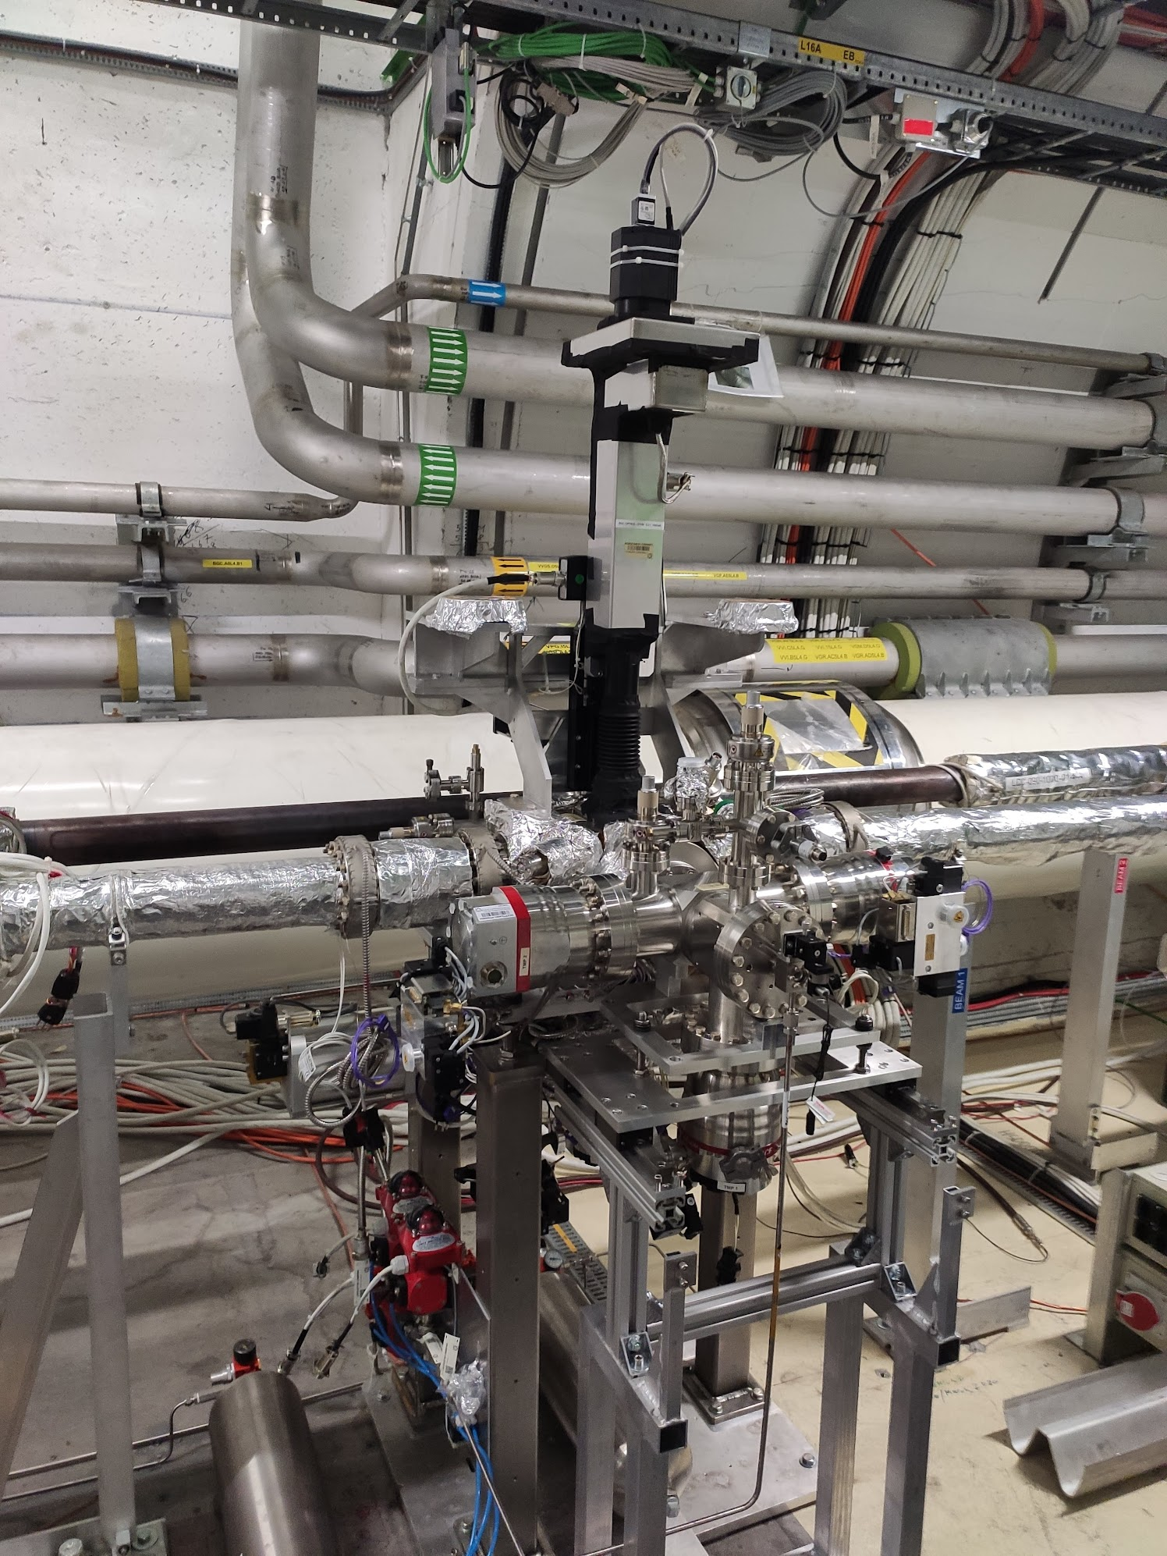
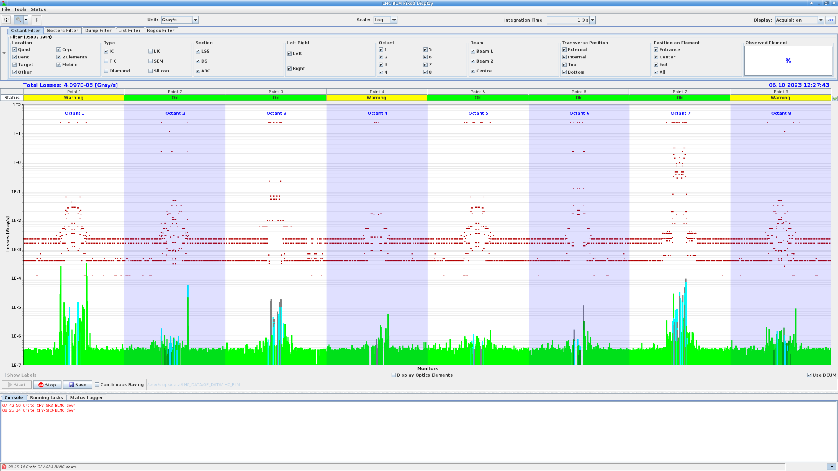
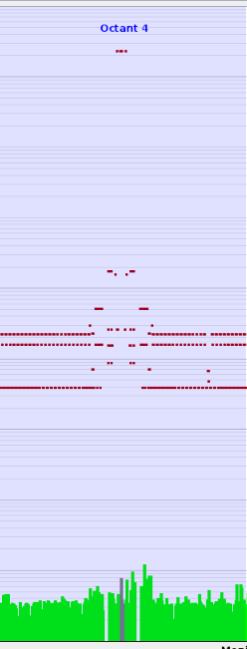
Working conditions
P4: 5L4
Beam 1
BGC operated and validated on standard full intensity (Injection->Ramp->Stable Beams) for proton and ion beam
Beam losses
  Beam Injection - no losses above noise in Fixed display
  Stable beams - local increase in P4 ~2-3x above noise
  No observed effect on emittance
BGC in 2023 on LHC p-beam ~10h
  Validation - ok
  Systematic studies needed
BGC in 2023 on LHC Pb-beam >70h
  Validation - ok
  Systematic studies done
    Being analysed
Interaction chamber (VGP.4a.5L4.BGC) | Pressure [mbar]
Gas Jet OFF | 2.0e-10
Gas Jet On | 4.00e-8
Optical system
Gas curtain dump
BGC ON
BGC OFF
Gas curtain injection
TBCited
Radiation levels during 2022 Distributed gas experiments - D. Prelipcean, G. Lerner; BGC collaboration meeting

Slide 11
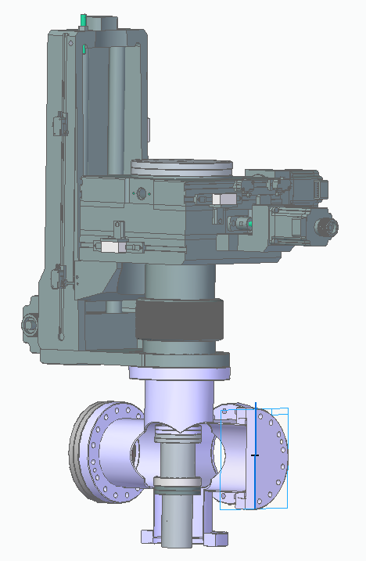
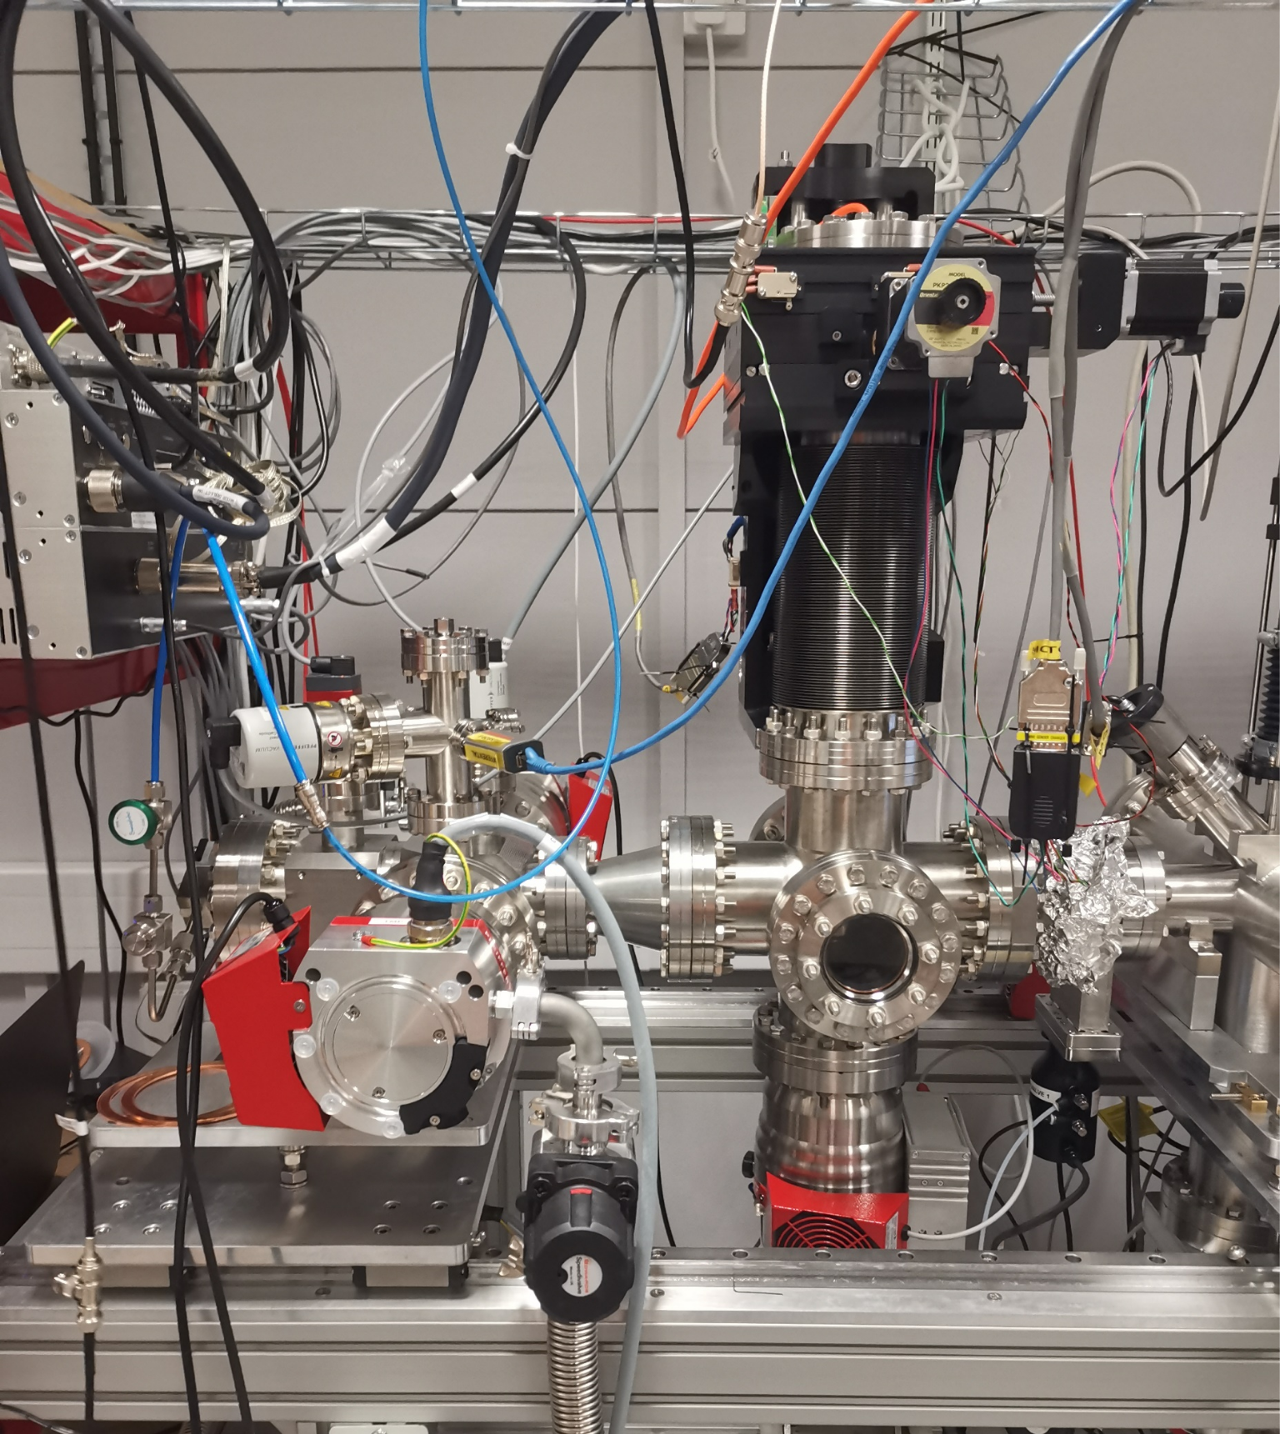
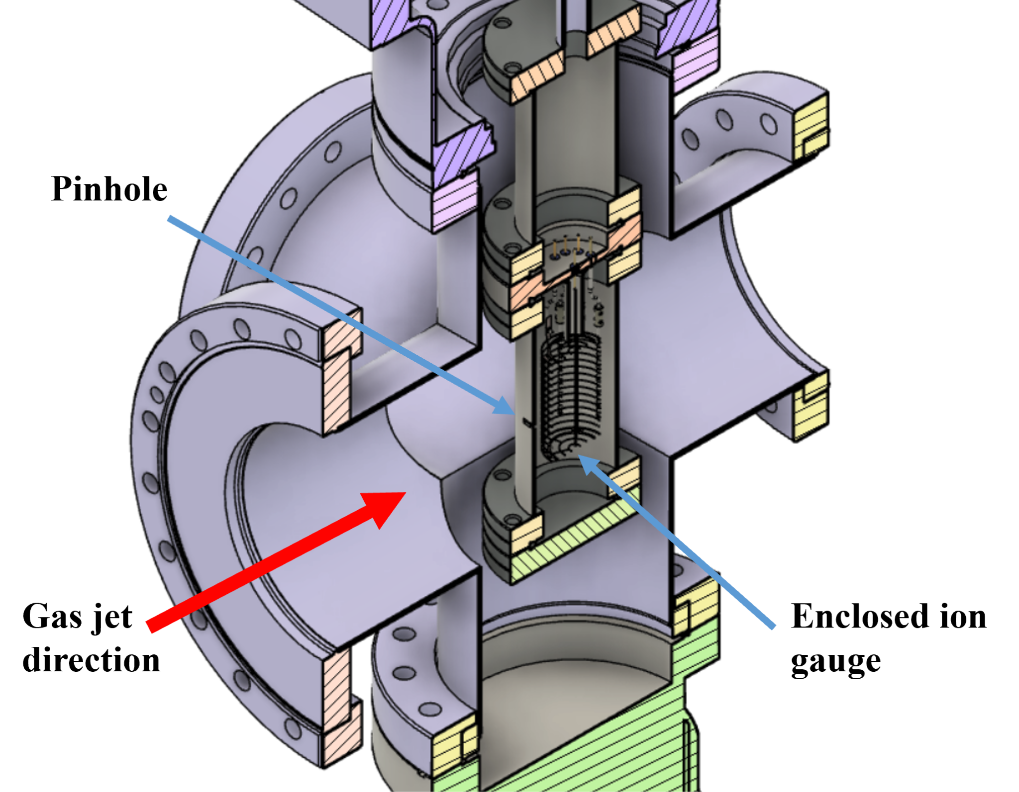
Direct gas curtain profile measurements
Moveable pinhole pressure gauge
Stepmotors in all 3 dimensions
1mm
x
z (beam)
y
Local gas pressure measurement
Replaces interaction chamber -> Measuring Gas curtain profile at interaction point

Slide 12
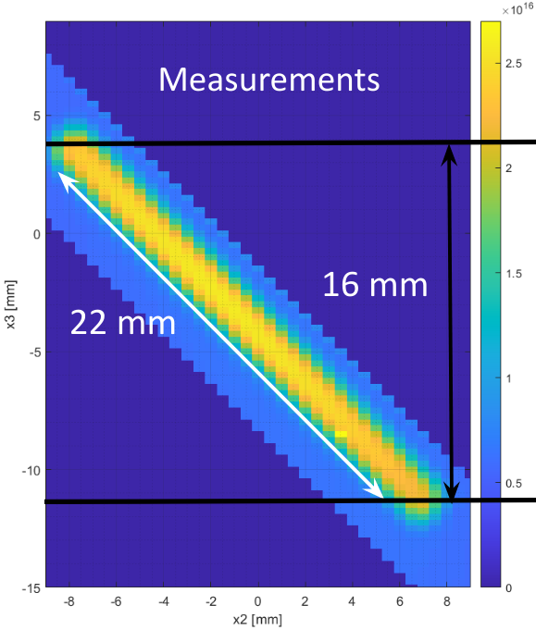
BGC Version 3 to CERN - Commissioning
mol. m⁻³
Full assembly in one week
  Including vacuum pump down tests - Successful
Alignment of nozzle-skimmer assembly - Successful
  Including building alignment setup at CERN
Moveable pressure gauge installed & Gas curtain profile measured - Successful
  Great agreement with simulations
x [mm]
z [mm]

Slide 13
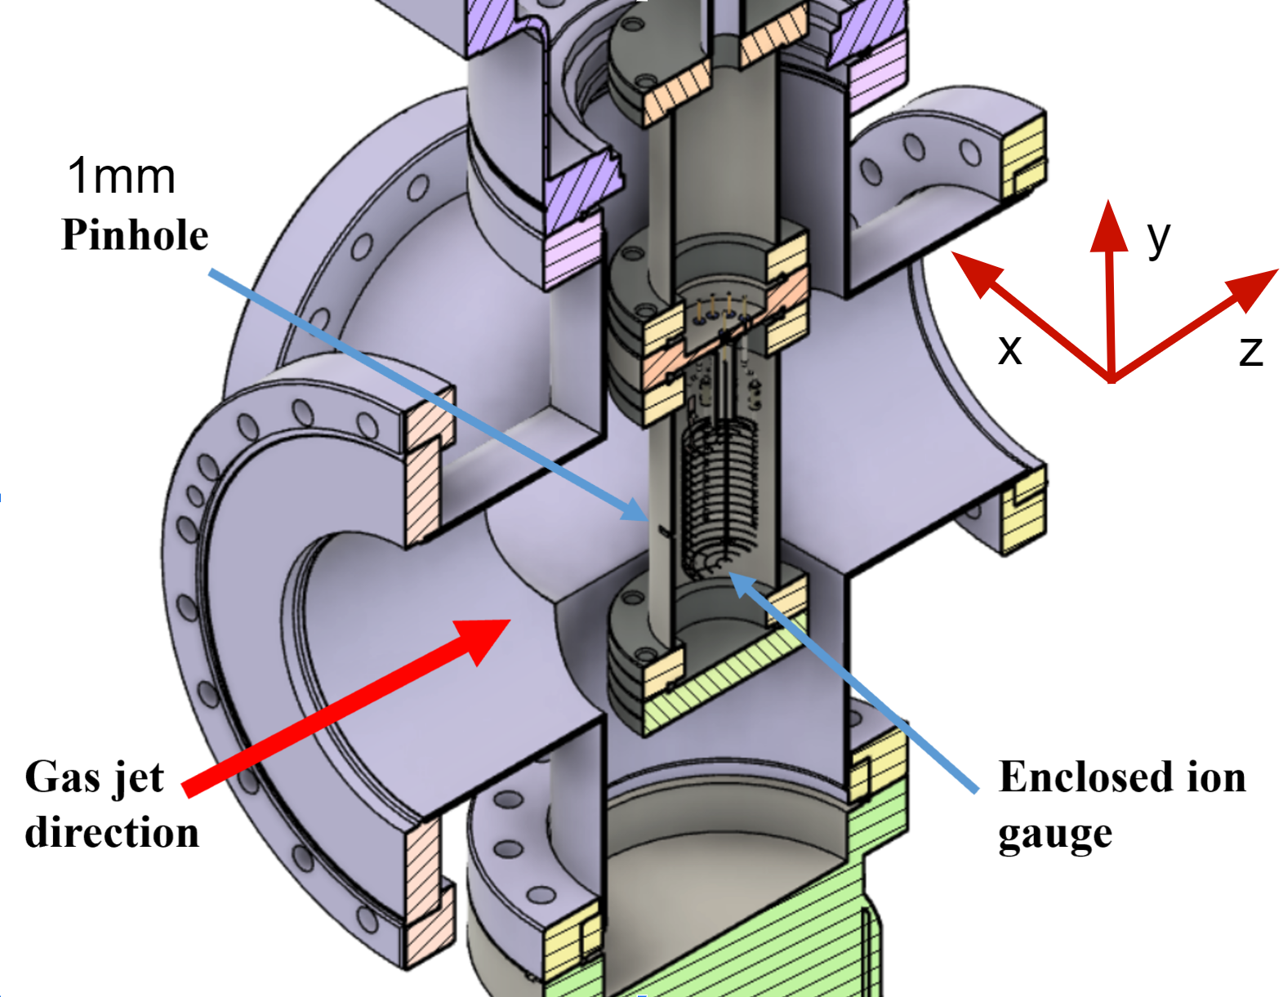
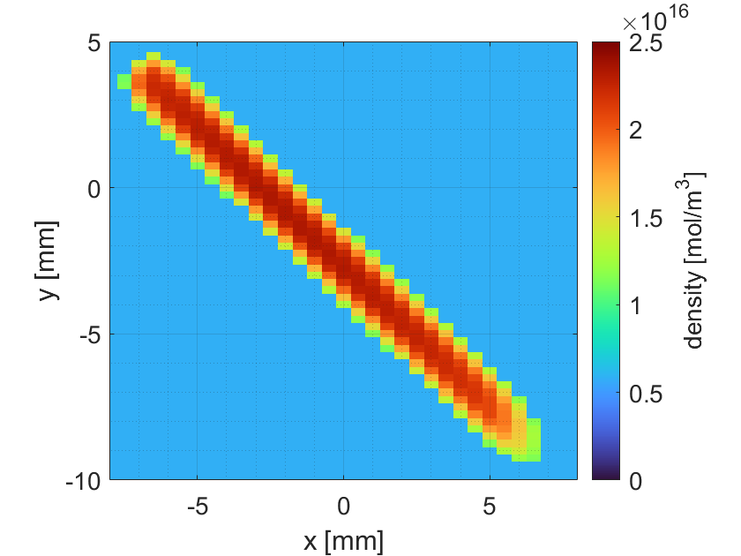
Gas jet profile
Appl. Phys. Lett.. 2022;120(17).
doi:10.1063/5.0085491
Moveable pinhole
Moveable pinhole
  Jet pressure sampling
N2
Notes:
Is the figure from the collaboration?
Do I put the light yield? Maybe only if I would need the equation later, otherwise it is quite obvious…
Mention: It is transparent for the LHC beam as I will show towards the end of the presentation. And present the effect on the beam somehow, the minimal losses or something, or at least some statement.
I’m not happy with Slide 8) - Thickness broadening, I need to change the structure of the slide somehow -
Logical follow up of slides 8 and 9 - Thickness broadening and gas jet measurements; Space-charge effect -> Thickness broadening makes sense; Gas jet measurements -> Thickness broadening makes sense

Slide 14
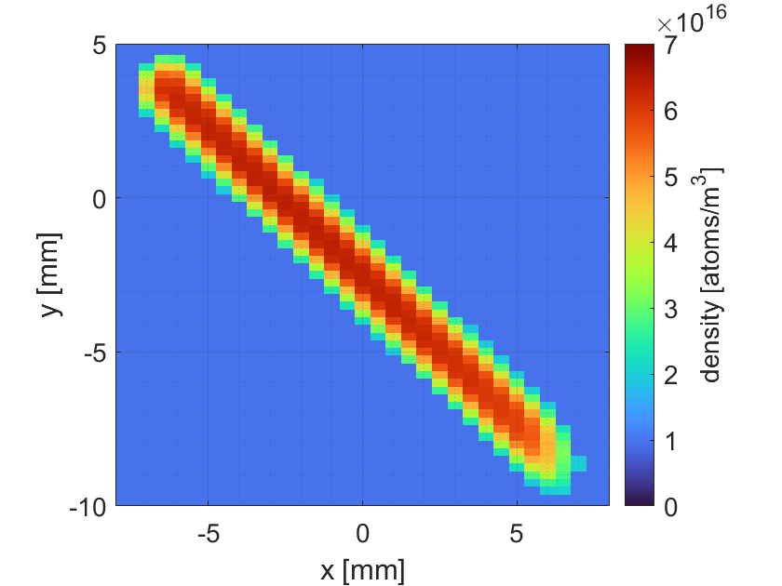
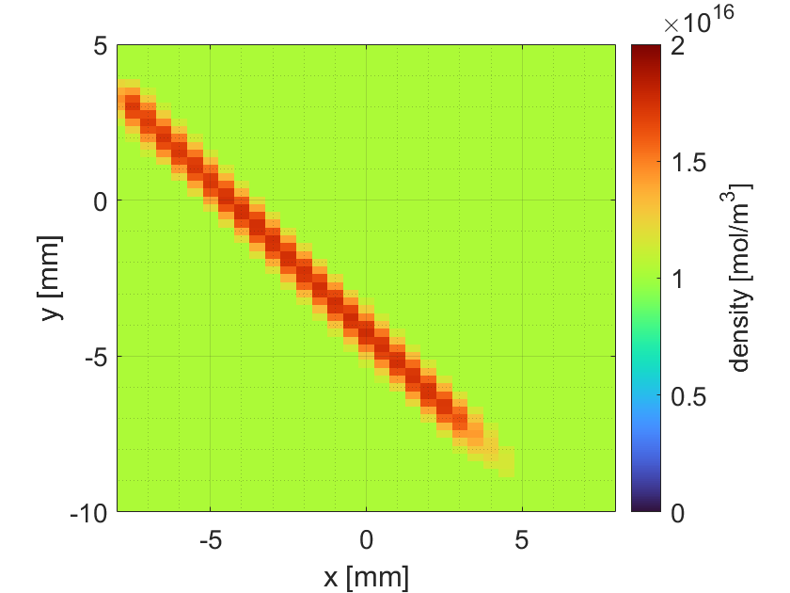
Gas jet profile
Ne
Moveable pinhole
  Jet pressure sampling
Gass shape - constant
  Ne/N₂ ≈ 2.9
N2
Notes:
Is the figure from the collaboration?
Do I put the light yield? Maybe only if I would need the equation later, otherwise it is quite obvious…
Mention: It is transparent for the LHC beam as I will show towards the end of the presentation. And present the effect on the beam somehow, the minimal losses or something, or at least some statement.
I’m not happy with Slide 8) - Thickness broadening, I need to change the structure of the slide somehow -
Logical follow up of slides 8 and 9 - Thickness broadening and gas jet measurements; Space-charge effect -> Thickness broadening makes sense; Gas jet measurements -> Thickness broadening makes sense

Slide 15
Gas jet profile
N2, 0.3 x 9 mm
Moveable pinhole
  Jet pressure sampling
Gass shape - constant
  Ne/N₂ ≈ 2.9
3rd skimmer - thickness, density
  Signal vs vacuum
N2, 0.7 x 9 mm
N2
Notes:
Is the figure from the collaboration?
Do I put the light yield? Maybe only if I would need the equation later, otherwise it is quite obvious…
Mention: It is transparent for the LHC beam as I will show towards the end of the presentation. And present the effect on the beam somehow, the minimal losses or something, or at least some statement.
I’m not happy with Slide 8) - Thickness broadening, I need to change the structure of the slide somehow -
Logical follow up of slides 8 and 9 - Thickness broadening and gas jet measurements; Space-charge effect -> Thickness broadening makes sense; Gas jet measurements -> Thickness broadening makes sense

Slide 16
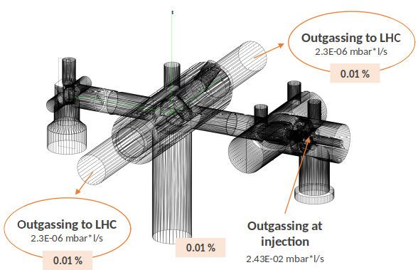
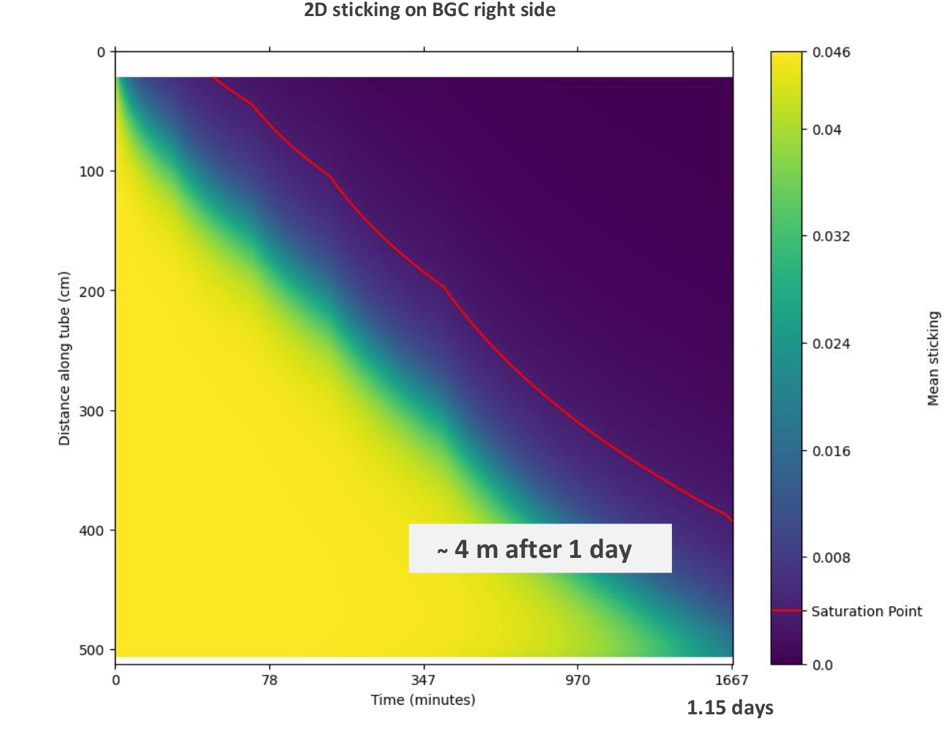
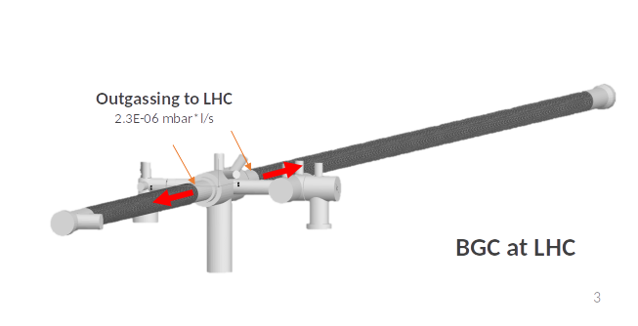
LHC Vacuum and LHC NEG coating saturation
BGC Version 3 - Pump down curves being characterized to simulate effect on LHC vacuum
  Bakeout needed ?
  If N₂ jet - saturation of NEG coating?
Courtesy of Cristina Castro Sequeiro TE-VSC

