Slide 1

Updating Everest
A new approach to multiple Coulomb scattering: need for new geometry
Simone Otelie Solstrand, F. Van der Veken
14.02.2025

Slide 2
Outline
What is multiple Coulomb scattering (MCS)?
Limitations of multiple Coulomb scattering
A simplified introduction to Everest/K2
Edge effects
What is the impact, and can we improve it?
How are we changing it?

Slide 3

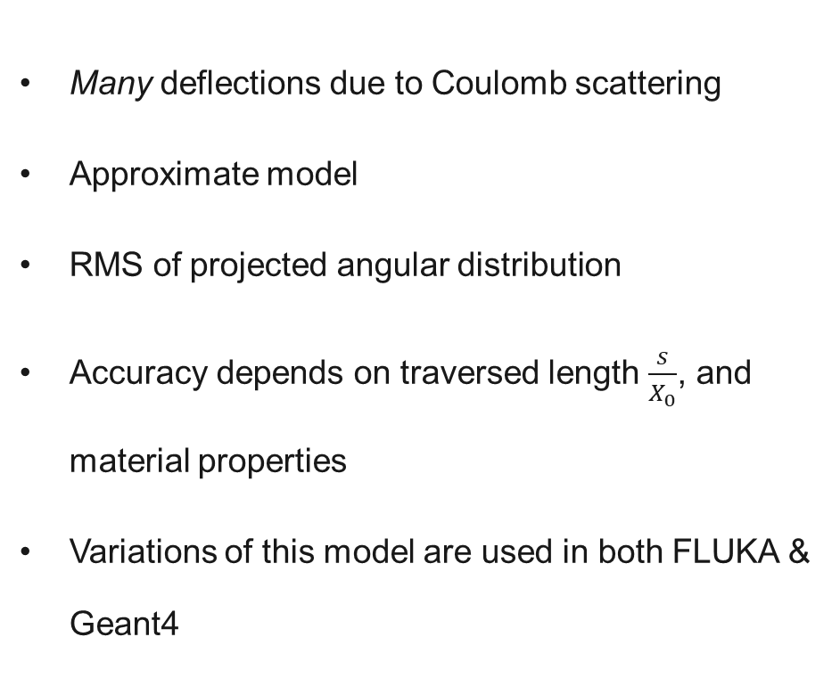


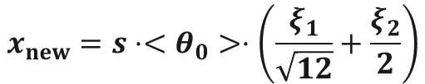
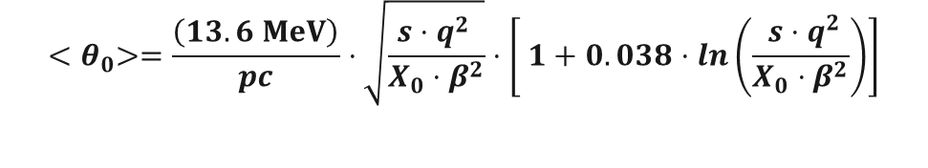
What is multiple Coulomb scattering?
$$F_{1}=\frac{q_{1}q_{2}}{4⋅π⋅ε_{0}}⋅\frac{{\hat{r}}_{12}}{{\left|r_{12}\right|}^{2}}$$
Many deflections due to Coulomb scattering
Approximate model
RMS of projected angular distribution
Accuracy depends on traversed length $\frac{s}{X_{0}}$, and material properties
Variations of this model are used in both FLUKA & Geant4
Proton
Nuclei
$${<θ}_{0}>=\frac{\left(13.6 MeV\right)}{pc}⋅\sqrt{\frac{s⋅q^{2} }{X_{0}⋅β^{2}}}⋅\left[ 1+0.038⋅ln\left(\frac{ s⋅q^{2}}{X_{0}⋅β^{2}}\right)\right]$$
$$x_{new}=s⋅<θ_{0}>⋅\left(\frac{ξ_{1}}{\sqrt{12}}+\frac{ξ_{2}}{2}\right)$$
$$x_{new}^{′}={ <θ}_{0}>⋅ξ_{2}$$
$ξ_{1},ξ_{2}$ random normal variables

Slide 4
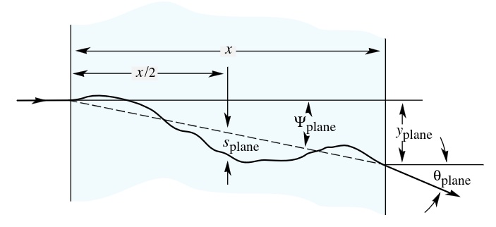
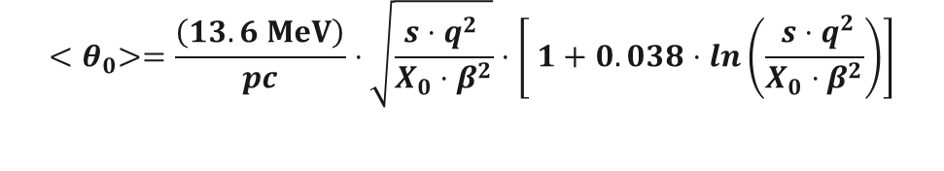






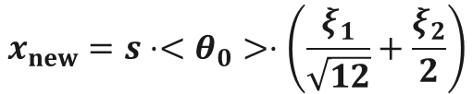
So, essentially...
$${<θ}_{0}>=\frac{\left(13.6 MeV\right)}{pc}⋅\sqrt{\frac{s⋅q^{2} }{X_{0}⋅β^{2}}}⋅\left[ 1+0.038⋅ln\left(\frac{ s⋅q^{2}}{X_{0}⋅β^{2}}\right)\right]$$
$$x_{new}=s⋅<θ_{0}>⋅\left(\frac{ξ_{1}}{\sqrt{12}}+\frac{ξ_{2}}{2}\right)$$
$$s$$
$$\frac{s}{2}$$
$$x_{new}^{′}={<θ}_{0}>⋅ξ_{2}$$
$ξ_{1},ξ_{2}$ random normal variables
$$x_{plane}$$
$$θ_{plane}$$
Notes:
Particle goes in → deflections
Black box tho, the model only gives us the info of the result, NOT the steps.
Highlight THE MODEL
Hit straight on and inf in transversal direction

Slide 5
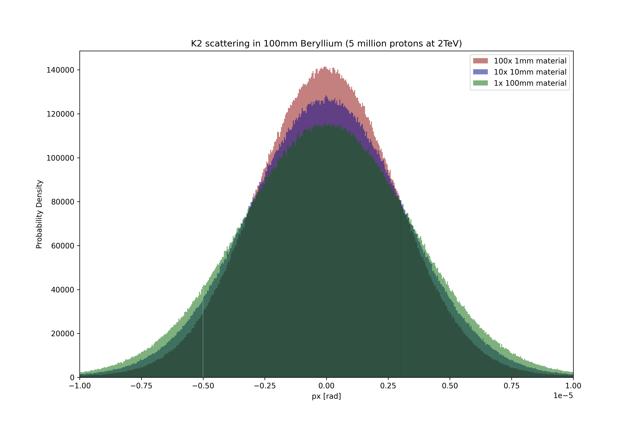
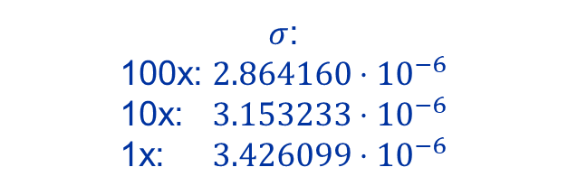



Limitations of multiple Coulomb scattering
It does not account for geometry
Expects beam to hit perpendicular to material
This model is not transitive/additive
More steps → overpopulated core → $σ$ decreasing
$$f\left(a\right)+f(b)≠f(a+b)$$
$\sqrt{s_{1}+s_{2}}≠\sqrt{s_{1}}+\sqrt{s_{2}}$
$σ$:
100x: $2.864160⋅{10}^{−6}$
10x: $3.153233⋅{10}^{−6}$
1x: $3.426099⋅{10}^{−6}$
Example from original K2 implementation deep in the jaw
Notes:
K2

Slide 6
A simplified introduction to Everest/K2
Start of collimator
Multiple Coulomb scattering
Nuclear interaction
End of collimator

Slide 7
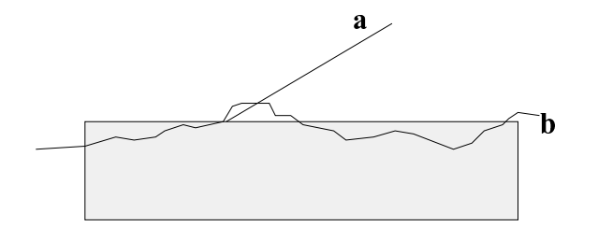
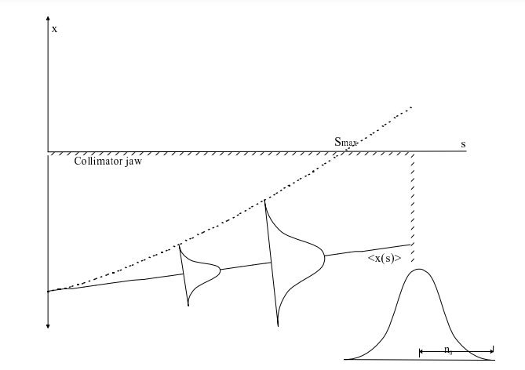
Edge effects
Recall: Multiple Coulomb scattering does not take geometry into consideration
Edge effect implementation
Adaptive step length
Close to jaw → small and many steps
Far away from jaw → long and few steps
Interactions we care about are close to the corner
Notes:
3 sigma

Slide 8
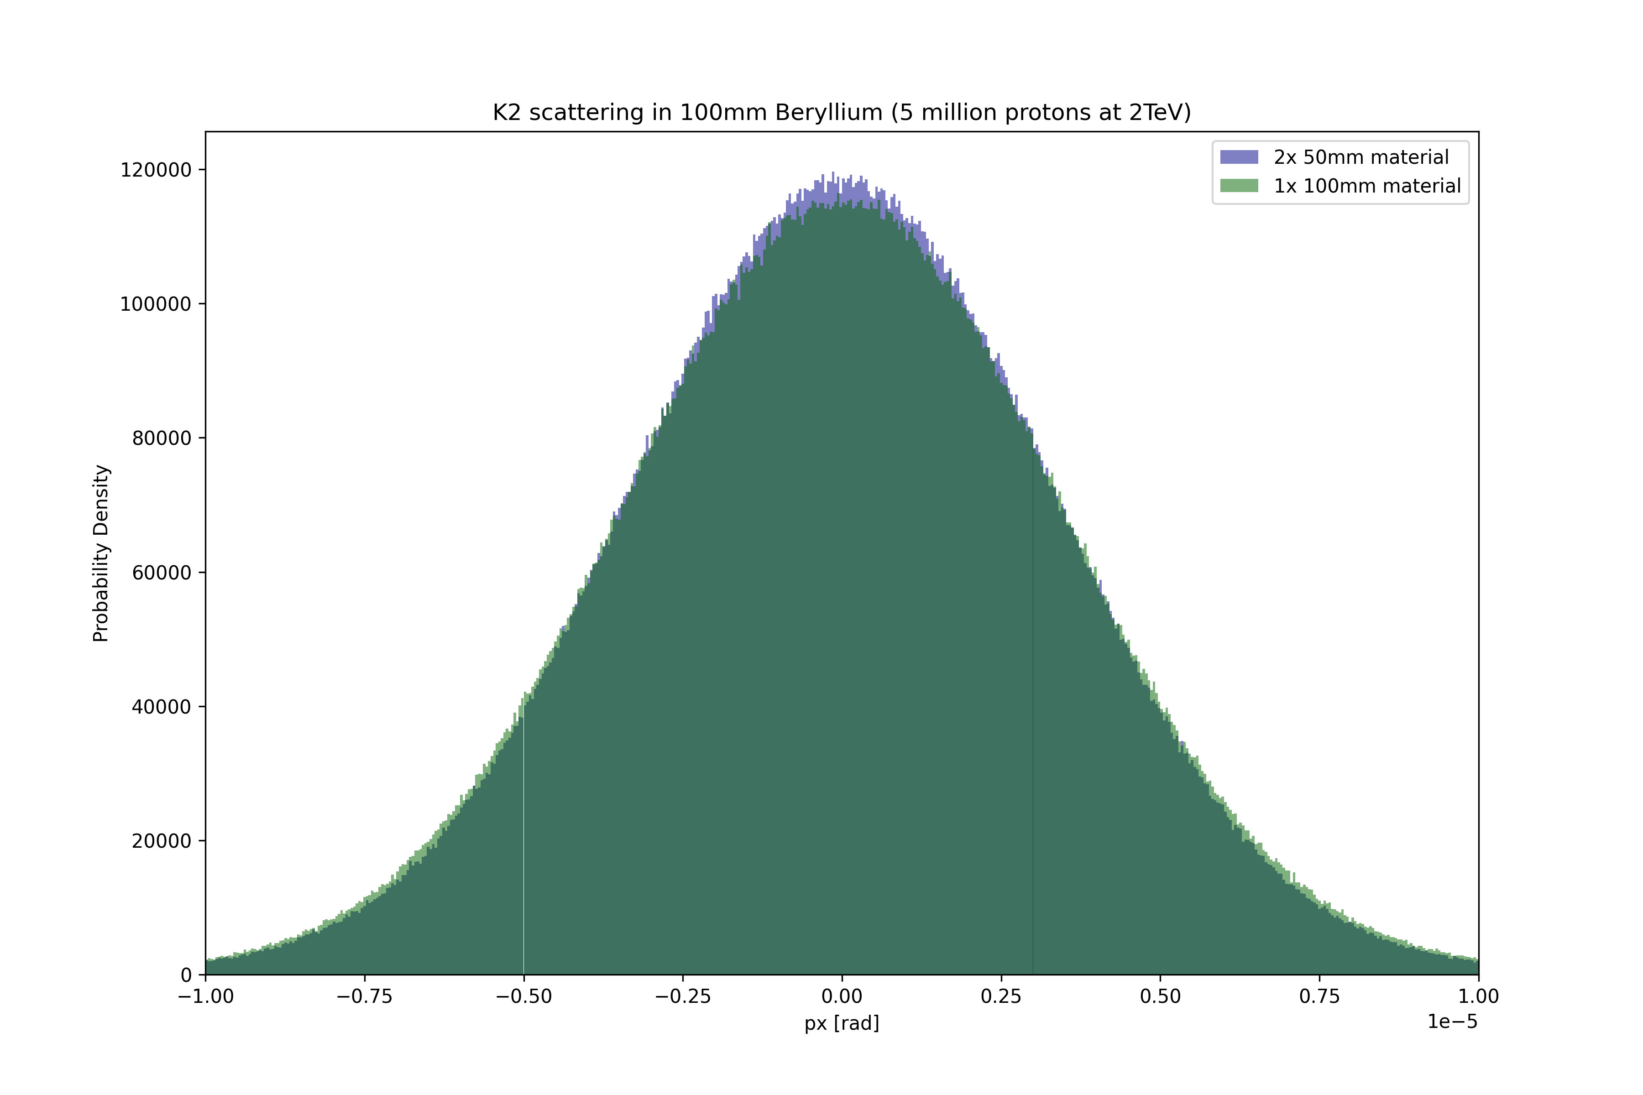
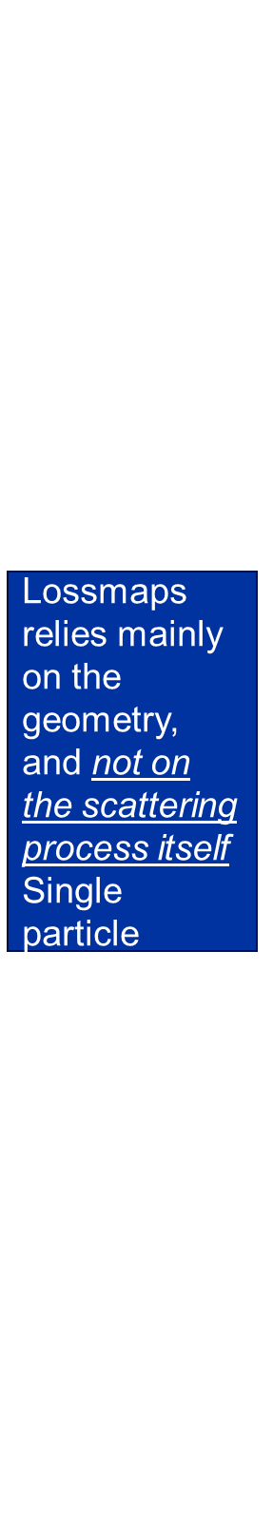
What is the impact, and can we improve it?
Lossmaps
    Relies mainly of the geometry
    Irrelevant for LHC
    SPS – lower energy
  MCS would prefer to simulate all of the collimators as one huge collimator
    Not possible due to tracking
  What about the slicing within the collimator?
    Nuclear interactions
No reason to panic
Ideally, we would simulate all of the collimators as one huge collimator.
Acceptable difference in distribution
Lossmaps relies mainly on the geometry, and not on the scattering process itself
Single particle scattering
The energy is inversely proportional to $<θ_{0}>$
Lower energies → larger “kicks”
What about steps within the collimators?
vs.
Notes:
Beholder pga nucl int. Det skjer ikke ofte, de er viktige for aperture etc. Big kick.
Endrer ikke mcs distribution. 1000 ganger strengere.
Med nucl så bryr vi oss ikke lengre om mccs, fordi da vil den dominre HELT klart .
When we have to slice its for the cases where it doesn’t matter.

Slide 9
How are we changing it?
Segments
Trajectories
Shape
Notes:
Shape consists of segments. The shape “knows” the trajectories, and can find when they cross.
We reconstruct the geometry in order to reconstruct the mcs in a way that both limits the number of steps?

Slide 10










How are we changing it?
Segments
Trajectories
Shape
….
Line
Half Open Line
Circular
Bèzier
$$s\left(t\right)=\left(1−t\right)⋅s_{1}+t⋅s_{2}$$
$$s\left(t\right)=s_{1}+t⋅cos⁡(θ)$$
$$s\left(t\right)=s_{1}+R⋅cos⁡(t)$$
$${s\left(t\right)=\left(1−t\right)}^{3}⋅s_{1}+3⋅{\left(1−t\right)}^{2}⋅t⋅c_{s_{1}}+3⋅\left(1−t\right)⋅t^{2}⋅c_{s_{2}}+t^{3}⋅s_{2}$$
$$x\left(t\right)=\left(1−t\right)⋅x_{1}+t⋅x_{2}$$
$$x\left(t\right)=x_{1}+t⋅sin⁡(θ)$$
$$x\left(t\right)=x_{1}+R⋅sin(t)$$
$${x\left(t\right)=\left(1−t\right)}^{3}⋅x_{1}+3⋅{\left(1−t\right)}^{2}⋅t⋅c_{x_{1}}+3⋅\left(1−t\right)⋅t^{2}⋅c_{x_{2}}+t^{3}⋅x_{2}$$
$$t ε [0,1]$$
$$t ε [0,∞]$$
$$t ε [θ_{1},θ_{2}]$$
$$t ε [0,1]$$
Notes:
Fifth order polynomial fit in the works for jaw flatness.
More to come. Easier to implement.

Slide 11








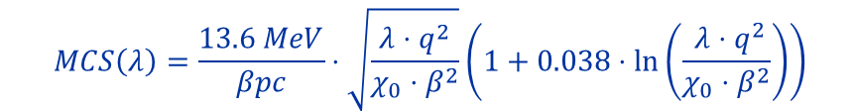
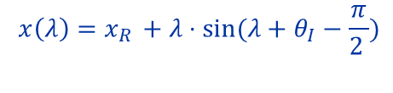

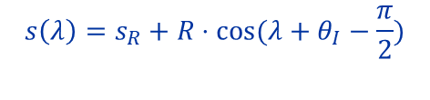

How are we changing it?
Segments
Trajectories
$$(s_{0},x_{0})$$
$$Δθ$$
$$(s_{R},x_{R})$$
$$θ_{I}$$
$$θ_{chan}$$
Shape
Multiple Coulomb
$$θ_{0}$$
$$s\left(λ\right)=s_{0}+λ⋅\cos\left(θ_{0}\right)−\left(\frac{ξ_{1}}{\sqrt{12 }}+\frac{ξ_{2}}{2}\right)λ⋅MCS\left(λ\right)⋅\sin\left(θ_{in}\right)$$
$$(s_{0}.x_{0})$$
$$x\left(λ\right)=x_{0}+λ⋅\sin\left(θ_{0}\right)+\left(\frac{ξ_{1}}{\sqrt{12 }}+\frac{ξ_{2}}{2}\right)λ⋅MCS\left(λ\right)⋅\cos\left(θ_{in}\right)$$
Line
Circular
$$s\left(λ\right)=s_{0}+λ⋅cos⁡(θ_{0})$$
$$s\left(λ\right)=s_{R}+R⋅cos⁡(λ+θ_{I}−\frac{π}{2})$$
$$θ\left(λ\right)=θ_{0}+ξ_{2}⋅MCS(λ)$$
$$x\left(λ\right)=x_{R }+λ⋅sin⁡(λ+θ_{I}−\frac{π}{2 })$$
$$MCS\left(λ\right)=\frac{13.6 MeV}{βpc}⋅\sqrt{\frac{λ⋅q^{2}}{χ_{0}⋅β^{2}}}\left(1+0.038⋅\ln\left(\frac{ λ⋅q^{2}}{χ_{0}⋅β^{2}}\right)\right)$$
$$x\left(λ\right)=x_{0 }+λ⋅sin⁡(θ_{0})$$

Slide 12
How does it work?
Find crossing with Drift and segment
1
Drift to start of collimator
Find crossing with MCS and segment
3. Circular
Check probability for interaction
2
MCS to volume capture
2. MCS
Find crossing with Channeling and segment
1. Drift
3
Channel to end of collimator
Notes:
Fyi probs for interaction in channel etc as well type of dechann

Slide 13
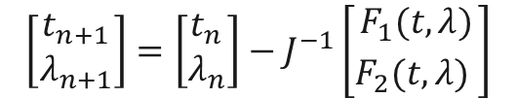

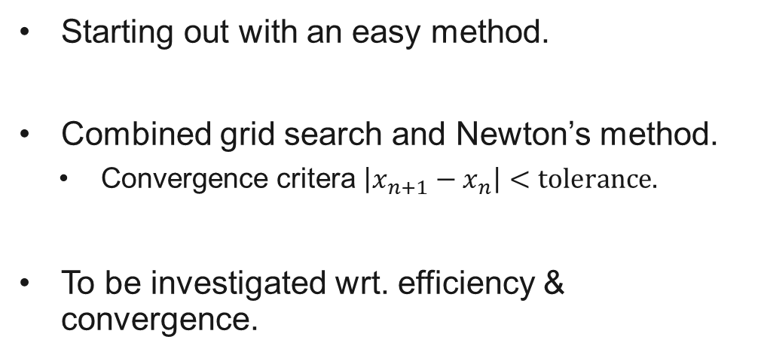



Finding the crossing
$$F_{1}\left(t,λ\right)=s_{s}\left(t\right)−s_{T}\left(λ\right)$$
$$F_{2}\left(t,λ\right)=x_{s}\left(t\right)−x_{T}\left(λ\right)$$
$$F_{1}\left(t_{n},λ_{n}\right)⋅F_{1}\left(t_{n+1},λ_{n+1}\right)<0$$
Starting out with an easy method.
Combined grid search and Newton’s method.
  Convergence critera $\left|x_{n+1}−x_{n}\right|<tolerance$.
To be investigated wrt. efficiency & convergence.
$$F_{2}\left(t_{n},λ_{n}\right)⋅F_{2}\left(t_{n+1},λ_{n+1}\right)<0$$
$$\left[\begin{matrix}t_{n+1} \\ λ_{n+1}\end{matrix}\right]=\left[\begin{matrix}t_{n} \\ λ_{n}\end{matrix}\right]−J^{−1}\left[\begin{aligned}F_{1}(t,λ) \\ F_{2}(t,λ)\begin{matrix} \\ \end{matrix}\end{aligned}\right]$$

Slide 14
Work done during internship and outlook
Previous work:
  General Xcoll API
    Literal FORTRAN K2 implementation in Xcoll
    First steps of crystal rewrite
    Impact table
    Removal of Collimation Manager
    Changes to Colldb and initial conditions etc.
  Contribution to tests for Xcoll.
  Documentation.
Finish implementation
Testing (lossmaps etc.)
Benchmarch cross section of nuclear interactions by comparing to FLUKA & Geant4
Outlook
Notes:
Collimation Manager, Initial conditions, Impact table, Colldb, first steps of crystal rewrite, literal FORTRAN K2 implementation in Xcoll.

Slide 15
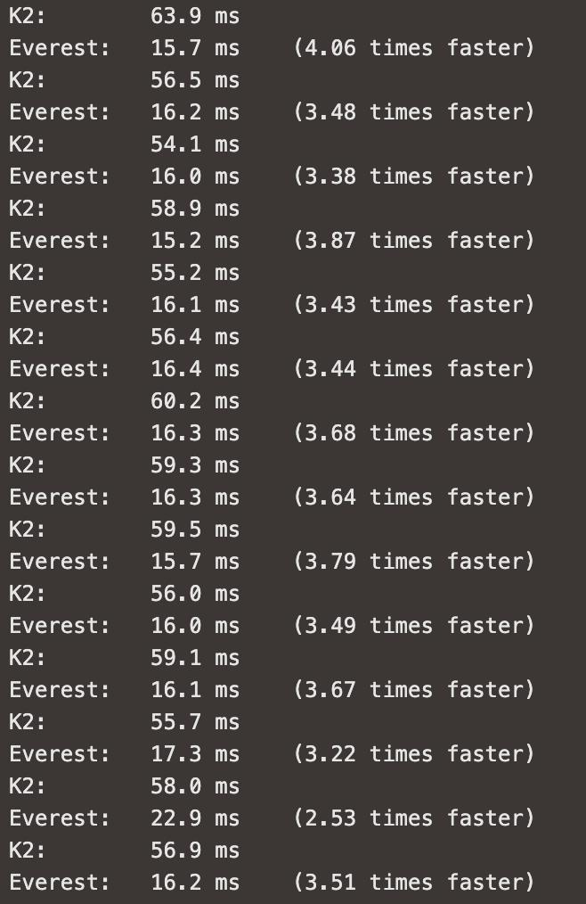
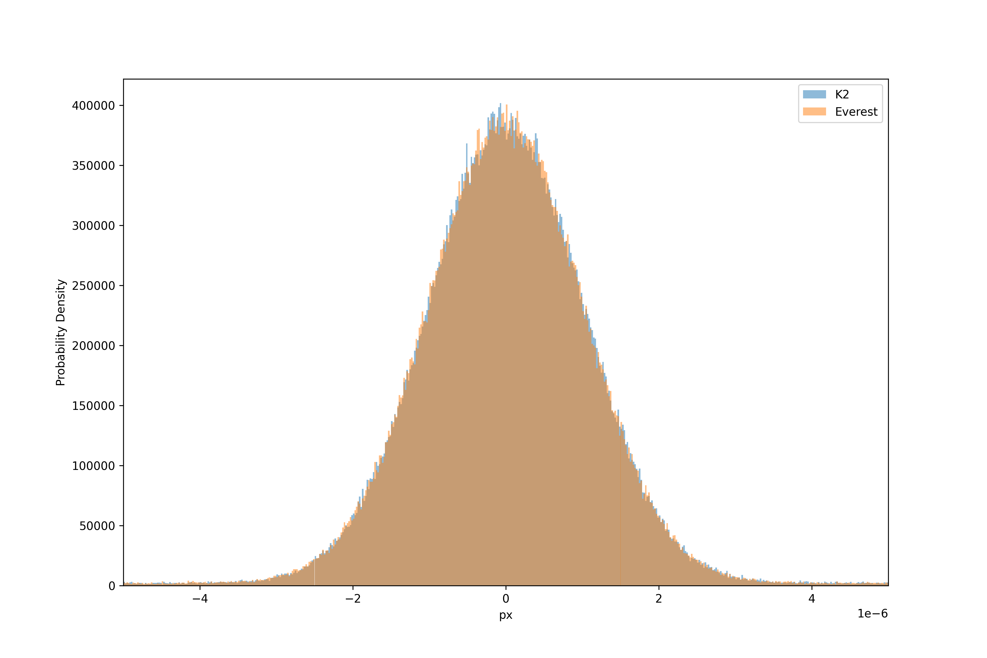
K2 coupling for benchmarking

Slide 16
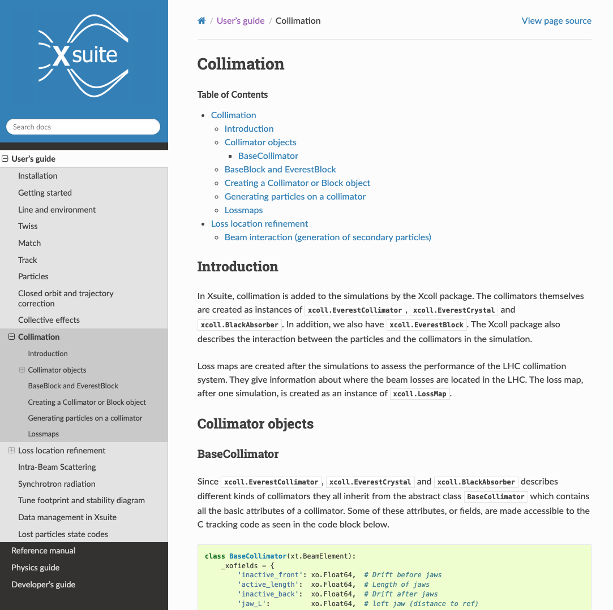
Documentation
https://xsuite.readthedocs.io/en/latest/collimation.html
Physics manual on Overleaf

