Slide 1
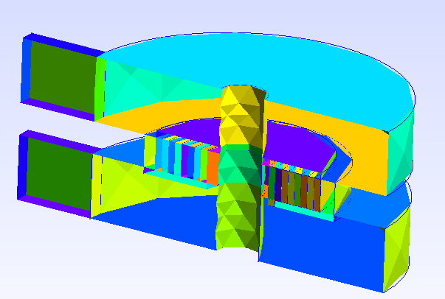
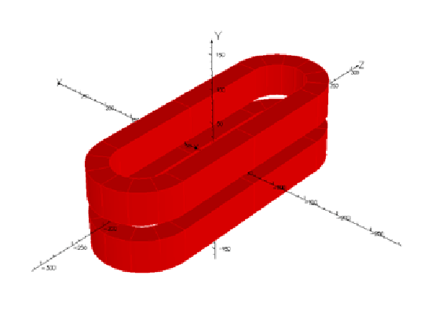
HTS simulations
3D HTS Magnets, FE
HTS Conductors
3D HTS Magnets, Non-FE
(Daniel Mayr, PhD work)
1st year
Full 3D EM calculation accounting for:
Source currents (BS most likely)
Non-linear B-H relation and eddy currents in metal structures (some hybrid method that combines BS with a method that can deal with iron, eddy currents, like BEM-FEM, VIM. It is too early to say exactly but it will be not just standard 3D FE with meshed air)
Types:
Single pancake
Stack of pancakes
Racetrack coils
Types:
Twisted Stack
CORC
Robel
Simulation types:
Stand-alone quench simulations
Ramp up and down simulations
Thermal transient and steady-state sim.
Simulation types:
AC loss and magnetization
(differential) inductance
current sharing
2nd year
Include analytical ROHM/F to deal with single tape and cable-based magnets.
Keep ability to have iron and eddies.
Rely on CATI to precompute ROHM/F homogenization parameters for a given HTS conductor.
Existing or planned abilities:
Eddy currents/iron yoke can be included
No/Patrial/Smart/Full Insulation
EE, QH, self-protected, capacitive discharge
Circuit coupling and co-simulation
Simple windings and parts generated parametrically
Complex(-ish) shapes imported from CAD
Very long term – include cables via ROHM/F
Domain Decomposition method to speed up!
Existing or planned abilities:
H-phi for tape level solution, potentially thin-shell
CATI method for the cable level solution
ROHM/F for homogenisation at the cable level
ROHM/F for homogenisation at winding cell
Parallel solution (HTCondor) to identify parameters
M. Wozniak, 23.01.2025
3rd year
Study new protection methods, like CD, ESC, etc. applied to HTS magnets
Verify against other codes
Validate against measurements!

