Slide 1
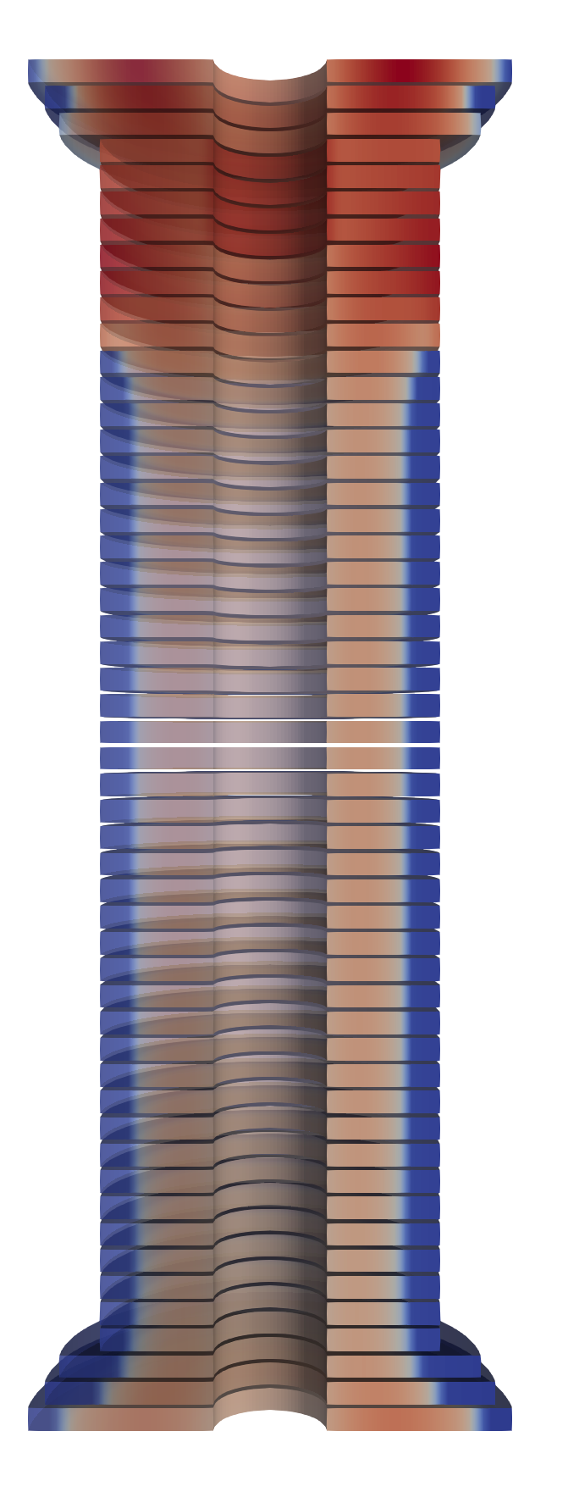
NICQS – No Insulation Coils Quench Simulator
Current capabilities:
2D axisymmetric.
Stacks of NI HTS pancake coils, concentric coils, quench-back cylinders.
Ramp loss and cooling requirement estimations.
Optimization of the ramp scheme.
Screening currents.
Quench propagation in stacks of pancake coils.
Quench protection: heaters, self-discharge, capacitor discharge.
Lorentz force estimations, and the export of force data for COMSOL.
Foreseen additions (2025):
Radial inductance (for the voltage spike upon breaker opening)
Local defects and some random noise on the I_{c} of the tape.
Small rework of dataflow within the model, and the data storage.
Faster and more feature-rich post-processing (using the techniques from HETS & torch impl.).
User specified voltage taps + hall probes.
Tests for the solver.
Other addition (2025-2026):
Allowing its use for external users for testing.
Changes based on user feedback.
Validation:
Ramp behavior and loss partially validated with COMSOL and FiQuS data
Ramp behavior validated with Demo3 coil from Tokamak Energy and PSI coil.
Results validation between NICQS and HETS ongoing.
Quench not validated.

Slide 2
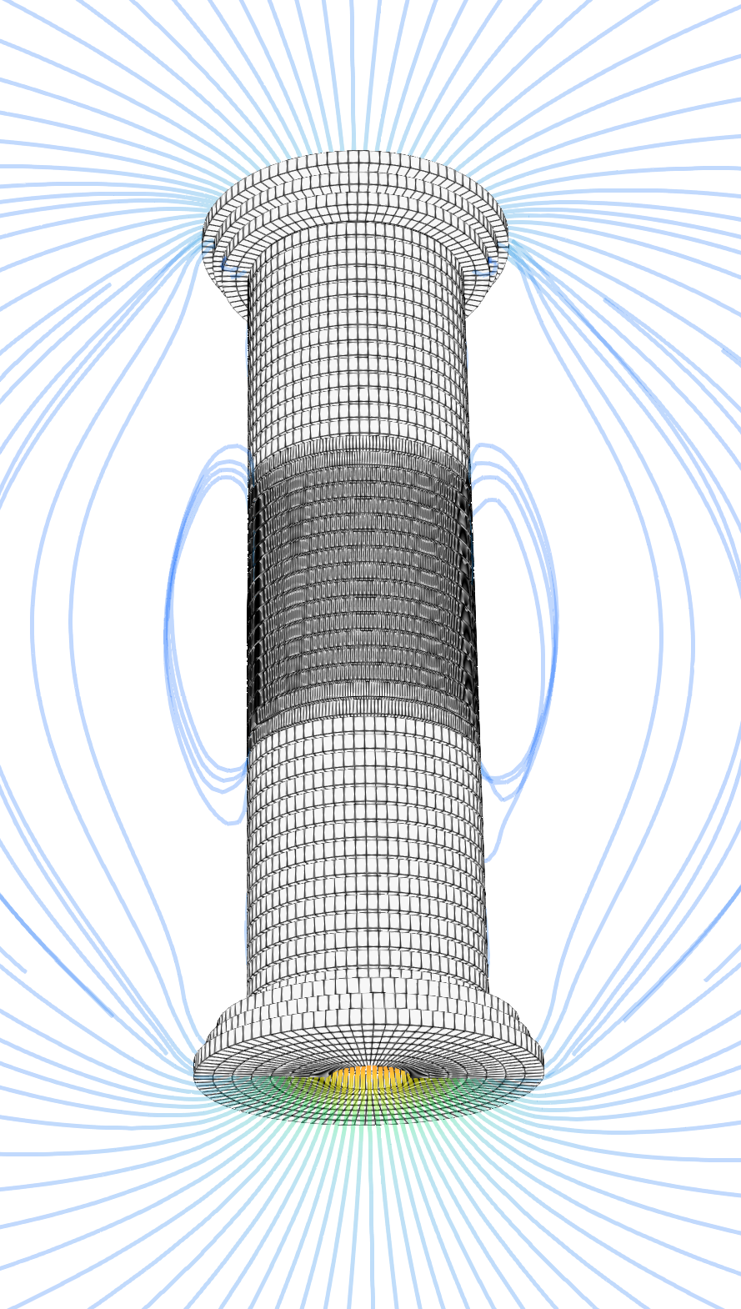
HETS – Homogenized, Electrothermal Transients of Superconductors
Current capabilities:
3D thermo-electromagnetic.
HTS insulated and non-insulated pancake/racetrack coils.
Ramp and associated loss.
Screening currents.
Inductive quench propagation.
Quench protection: self-discharge, energy extraction.
Foreseen additions (2025-2026):
- Optimization of the ramp scheme.
- Quench protection: heaters, capacitor discharge (both already partially supported).
Radial inductance (for the voltage spike upon breaker opening)
Thermal conduction between adjacent elements, not fully supported yet.
Lorentz force estimations, and its export to either COMSOL or ANSYS.
User specified voltage taps + hall probes + temperature sensor.
Better material support, user definitions in yaml.
Internal testing (2025):
Test with data from small coils for the muon collider.
3D quench calculations for the final cooling magnets of the muon collider.
3D quench calculations for the 6D cooling magnets of the muon collider.
3D ramp and quench calculations on insulated and non-insulated racetrack coils of various sized.
Test of new quench protection ideas from me.
External testing (2026+):
Opening of the code to external users and allow them to test and provide feedback.
Validation:
Results validation between NICQS and HETS ongoing.
Quench partially validated with the quench data of the PSI coil.

