Slide 1



Light Emission of Plasma with a Self-Modulating
Proton Bunch
Presented by Jan Mezger

Slide 2
Contents
Introduction
  Concept
  Setups – DPS / VPS
Light and Wakefields
  Light signals → Causality between light and wakefields
  Growth rates → Scaling with bunch and plasma parameters
  Seed wakefields → Proportionality between light and wakefields
Studies on Self-Modulation
  SSM / SMI threshold
  Gradient suppression

Slide 3
Introduction

Slide 4
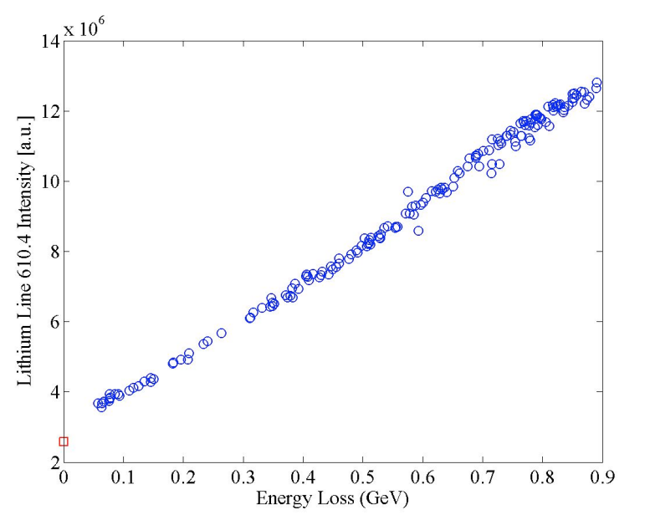
Concept
Bunch deposits energy by driving wakefields
Wakefields dissipate energy in plasma
Energy in plasma is partially converted to light
→ Amount of light measured proportional to wakefield amplitude?
Idea: Measuring light along plasma as diagnostic for wakefields!
E. Oz et al.“Optical Diagnostics for Plasma Wakefield Accelerators”
Notes:
Fluorescent tube 22%

Slide 5
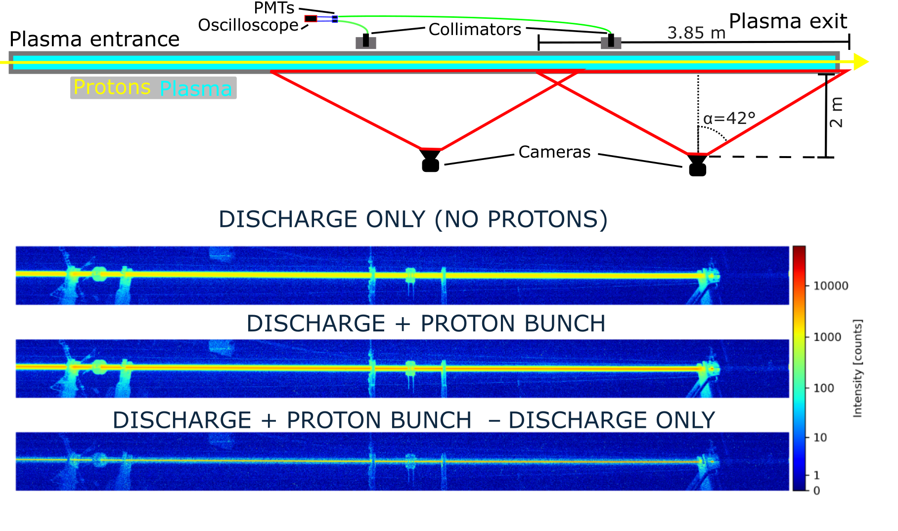
Setup – Discharge Plasma Source (DPS)
Discharge light uniformly distributed in discharge tube
Light from wakefields mainly emitted in center of the discharge tube
Notes:
Fluorescent tube 22%

Slide 6
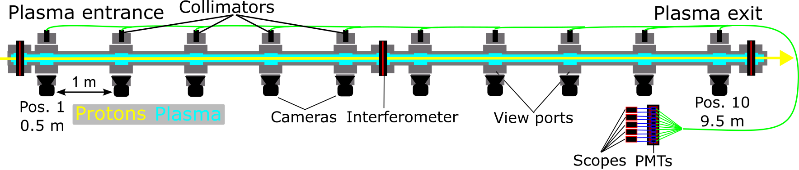
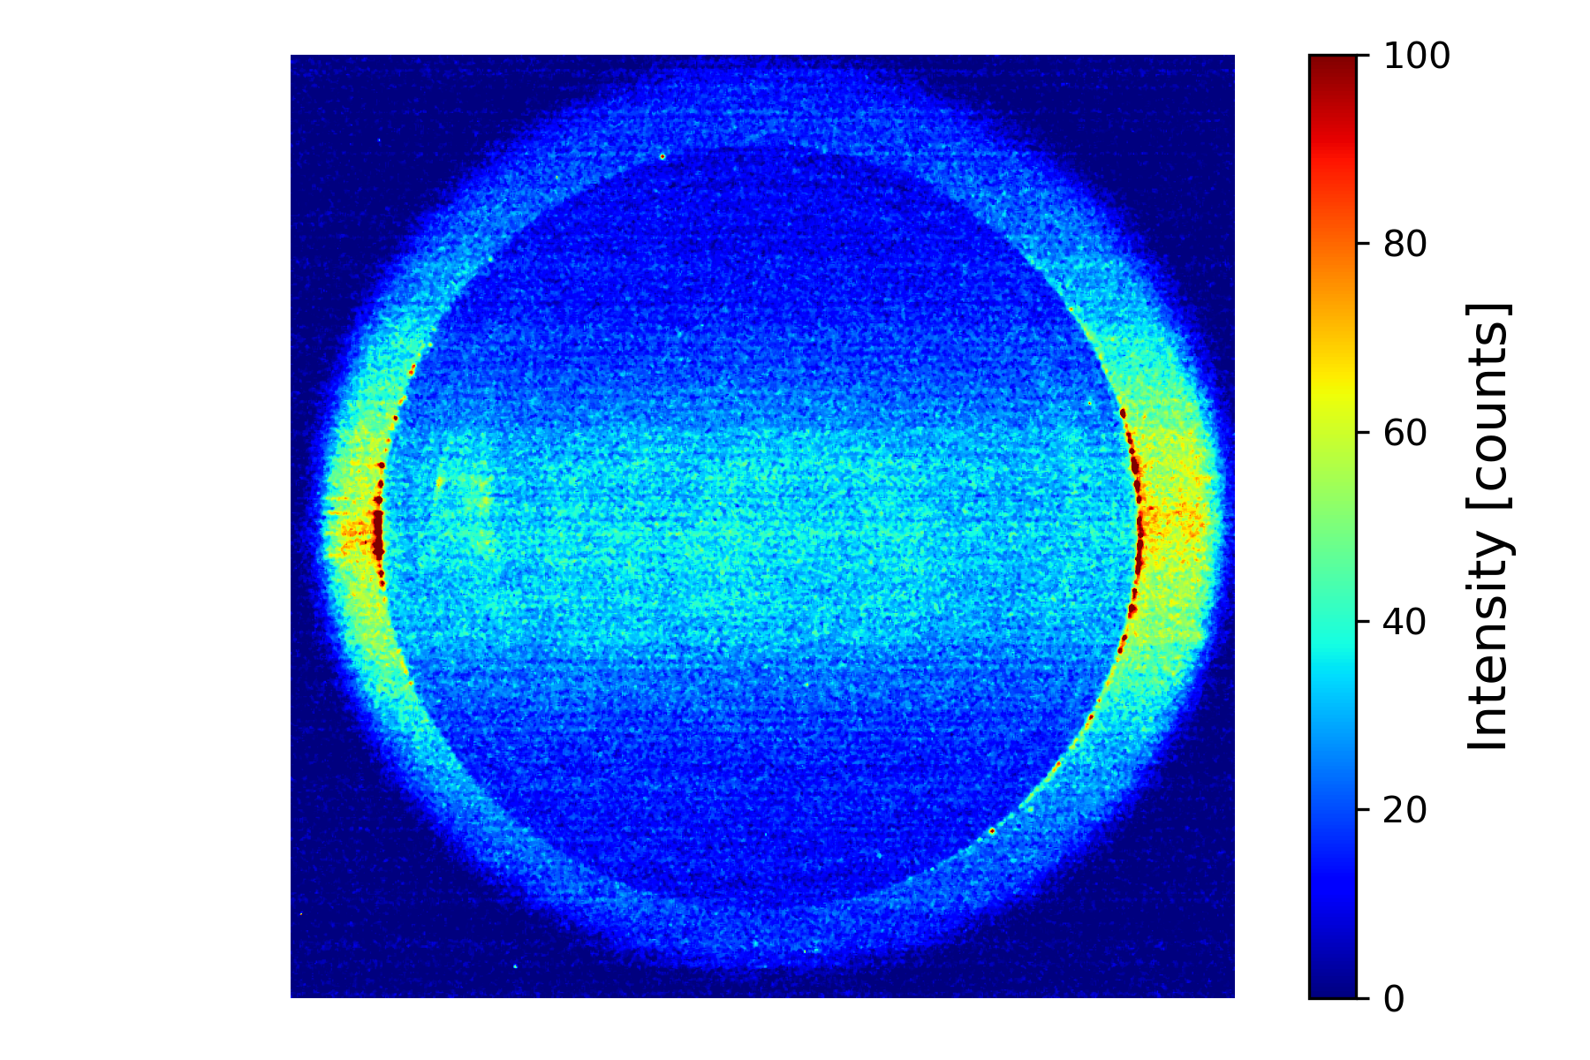
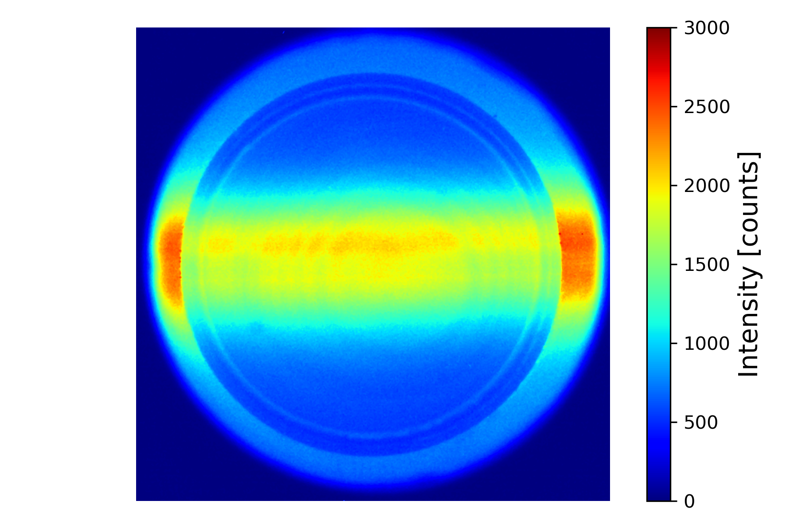
Setup – Vapor Plasma Source (VPS)
Laser pulse only
Laser pulse + protons
15 mm
Notes:
Fluorescent tube 22%

Slide 7
Light and wakefields

Slide 8
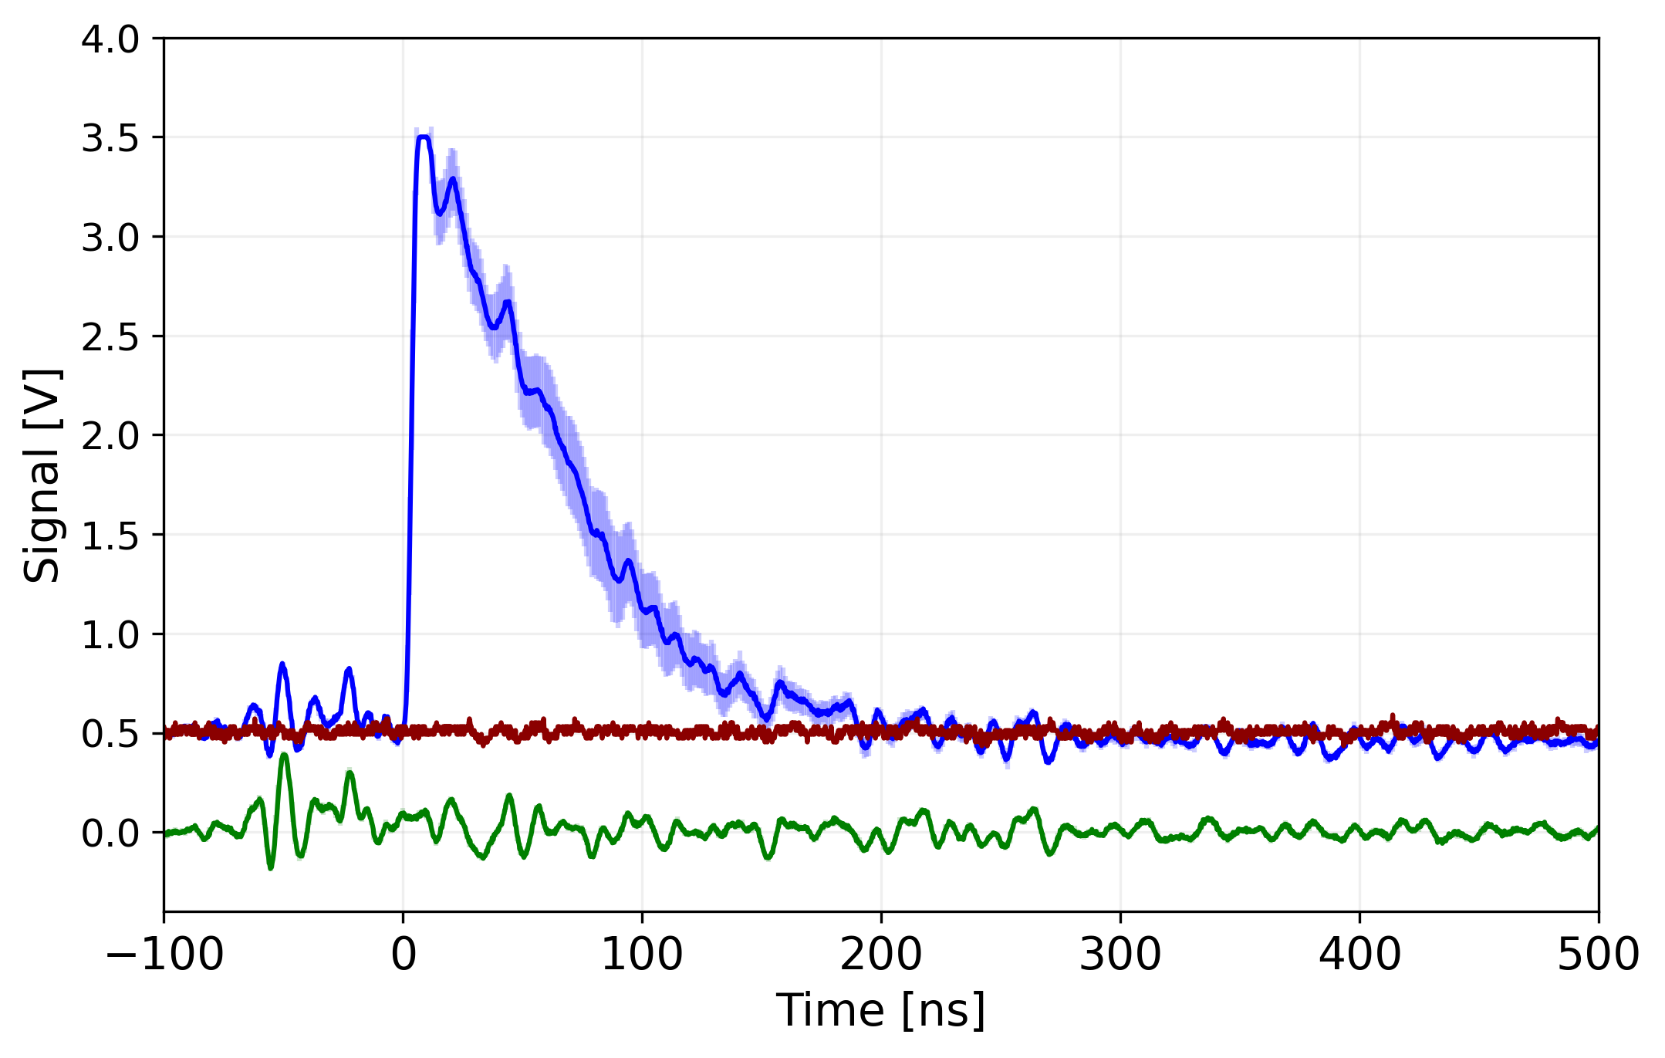
Light signals (DPS)
Discharge + Protons
Discharge only
Protons only
Time resolved:
Peak caused by wakefields:
  ~200-400 ns
+
Discharge light
+
PMT response to proton extraction
d = 6.9 m
No signal from proton bunch in neutral gas (Xe)
Discharge plasma produces constant light signal (on this timescale)
Peak in light signal with modulated proton bunches in plasma (not observed with wide bunches)
→ Light peak is caused by large amplitude wakefields
Notes:
Fluorescent tube 22%
Radiation appears earlier than light, because light travels longer distance through fibers

Slide 9
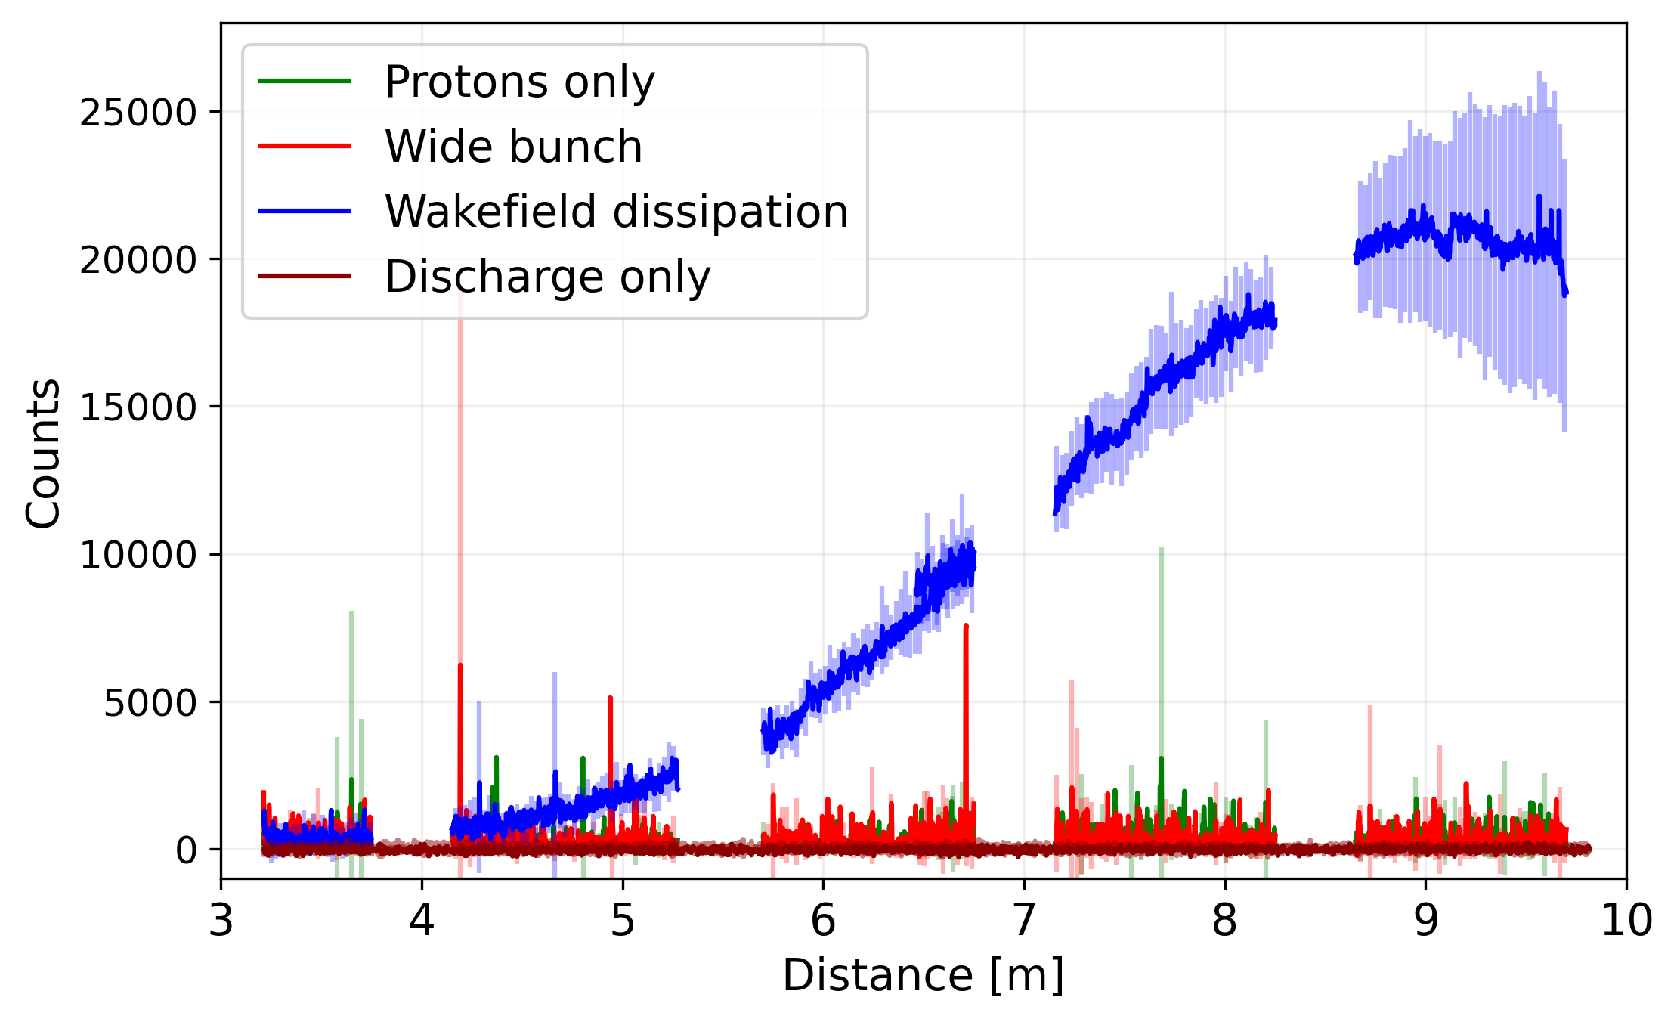


Light signals (DPS)
Spatially resolved:
Protons + Discharge
Discharge only
Protons only
Wide bunch
$${ n}_{pe}=2.5 ×{10}^{14}cm^{−3}$$
Integrated over entire emission peak (1 us)
Summed counts along plasma
Avg. discharge only subtracted from signals
Light emitted from wakefields increases along length of plasma
$$N_{p}=1.5 ×{10}^{11}$$
Notes:
Fluorescent tube 22%

Slide 10
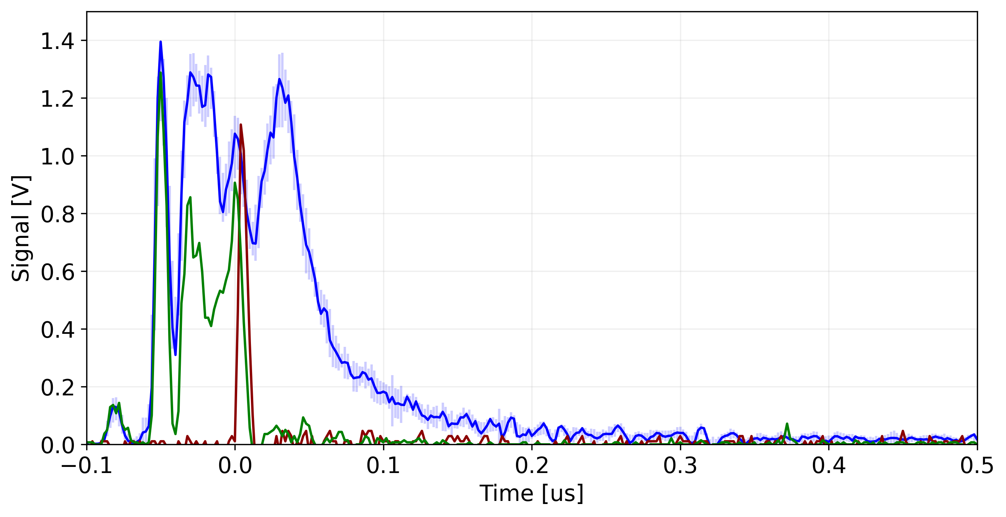
Light signals(VPS)
Laser + Protons
Laser only
Protons only
Time resolved:
Wakefield peak:
  < 2 us
+
Light from ionizing laser pulse
+
PMT response to proton extraction
No signal from proton bunch in neutral rb vapor
Short peak from laser pulse
Peak in light signal with modulated bunch after laser pulse
Notes:
Fluorescent tube 22%

Slide 11
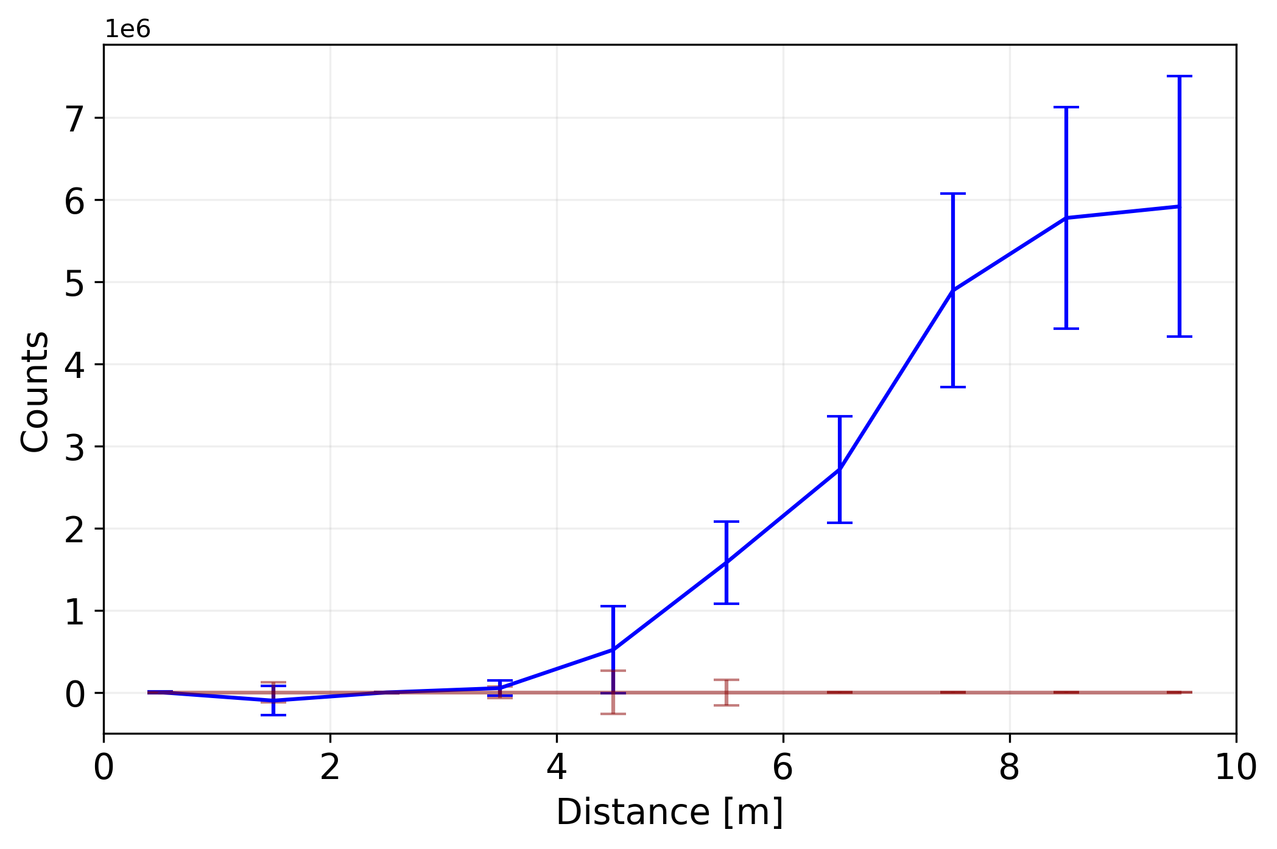


Light signals(VPS)
Spatially resolved (Cameras):
Laser pulse + Protons
Protons ahead of laser pulse
10 discrete points along the plasma
Avg. background subtracted
Light emitted from wakefields increases along length of plasma
$${ n}_{pe}=7.8 ×{10}^{14}cm^{−3}$$
$$N_{p}=1 ×{10}^{11}$$
Notes:
Fluorescent tube 22%

Slide 12
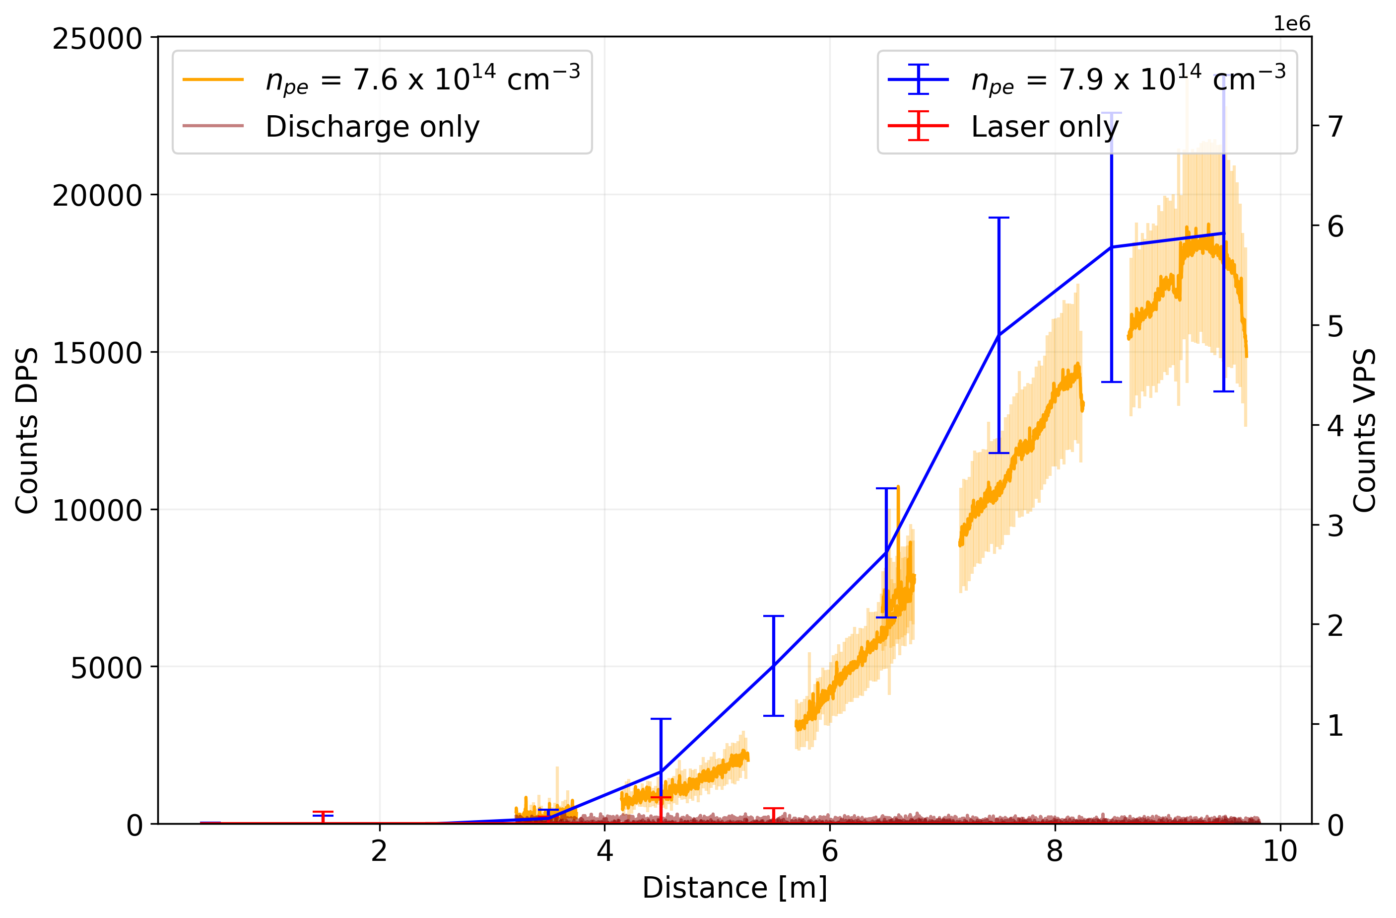


Light signals
Comparison:
$$N_{p}=1.5 ×{10}^{11}$$
$$N_{p}=1 ×{10}^{11}$$
Both signals for SMI (unseeded)
Qualitatively the signals looks similar
Light signal independent of plasma source and setup
Notes:
Fluorescent tube 22%

Slide 13
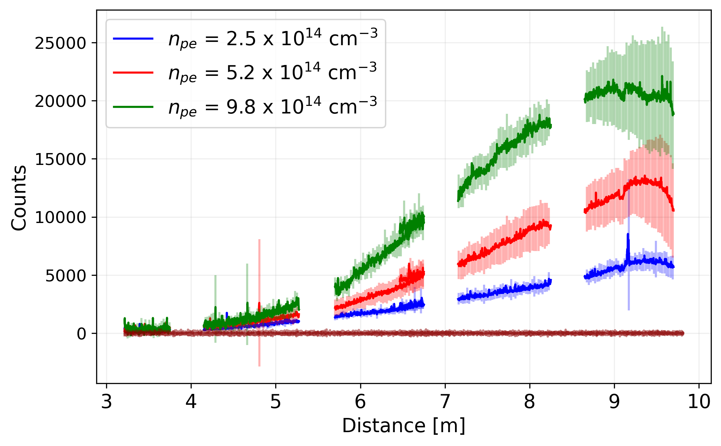
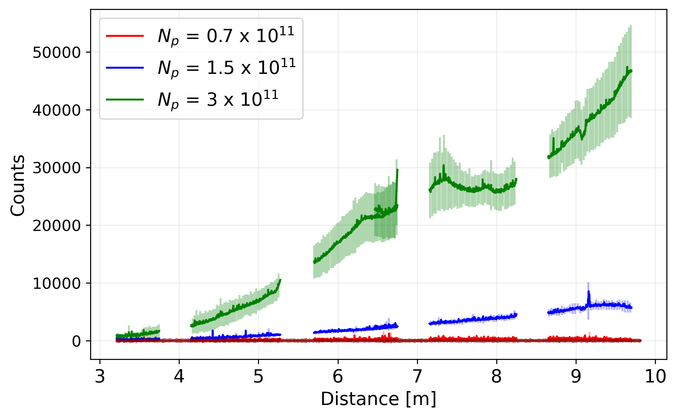


Growth rates
Light signals scale with bunch population / plasma density
Growth rates can be determined and compared to theory
$$N_{p}=1.5 ×{10}^{11}$$
$${ n}_{pe}=2.5 ×{10}^{14}cm^{−3}$$
Notes:
Fluorescent tube 22%

Slide 14
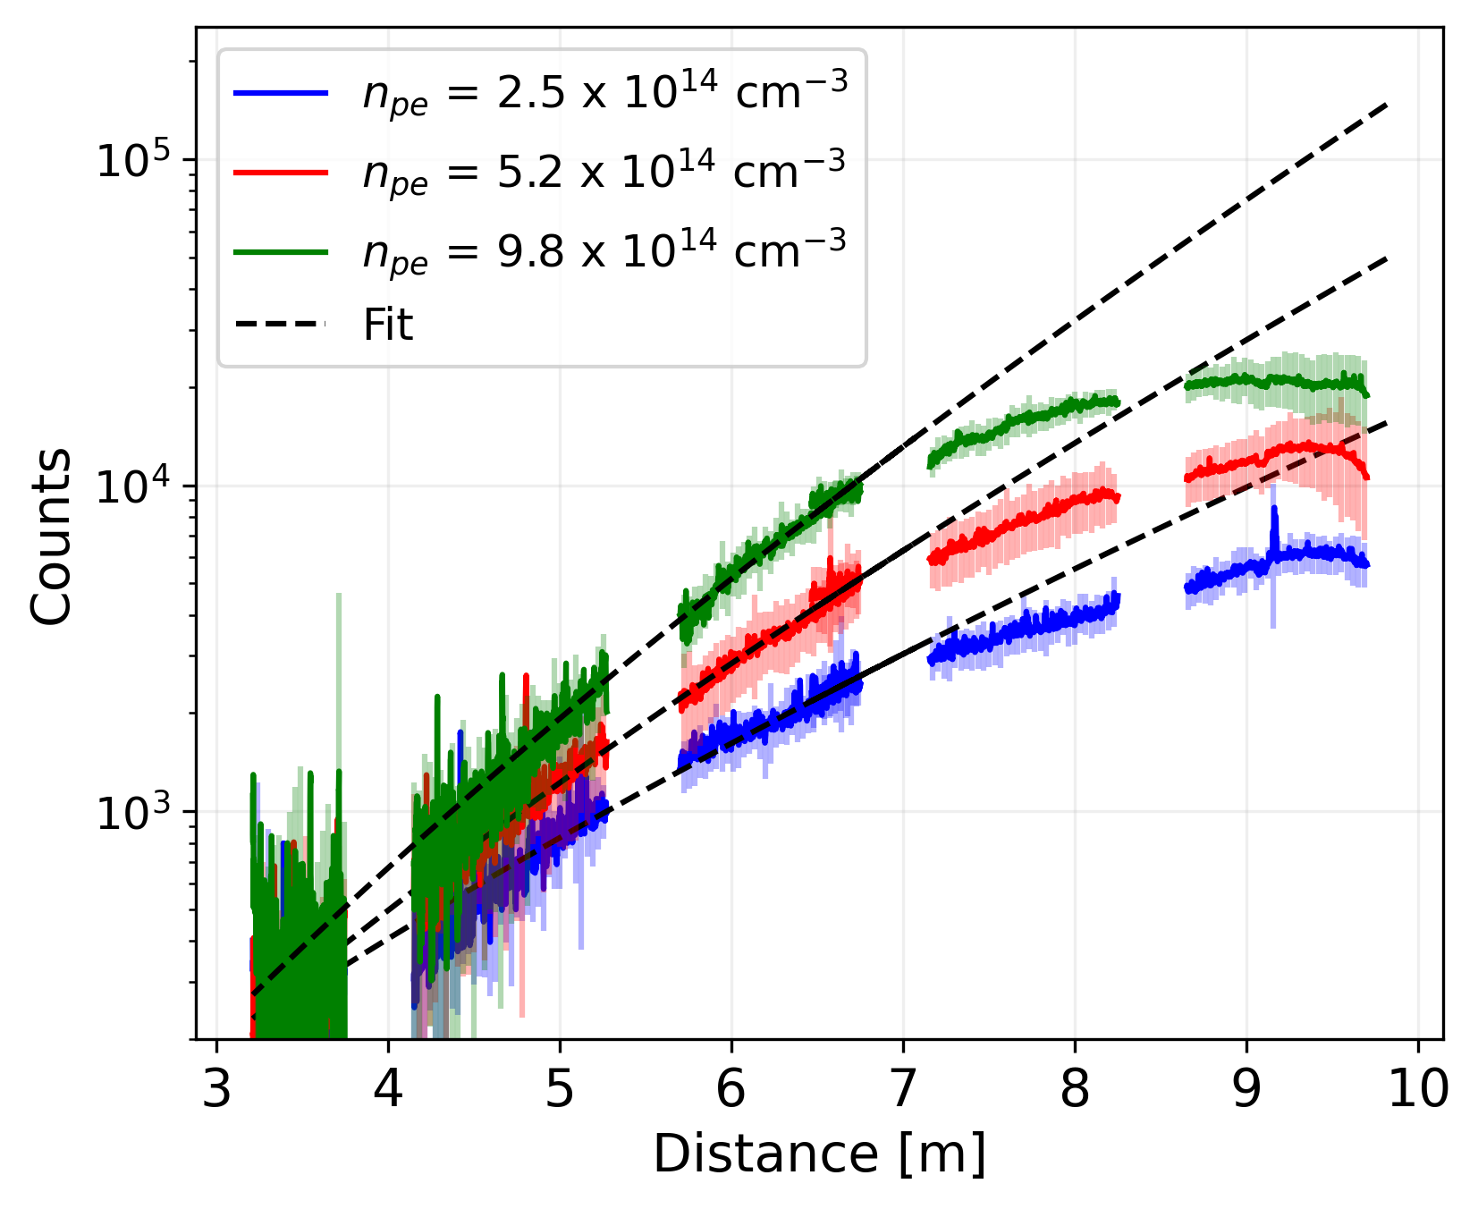
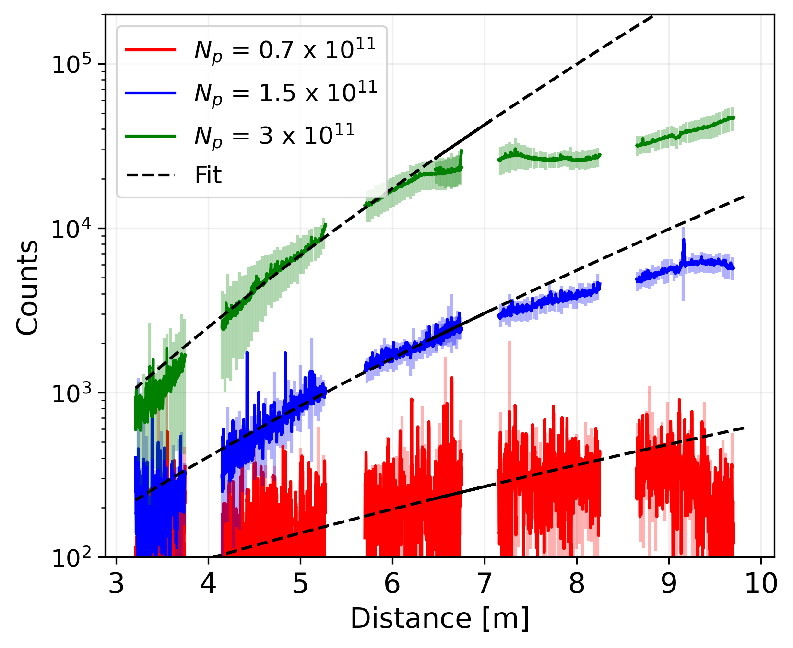
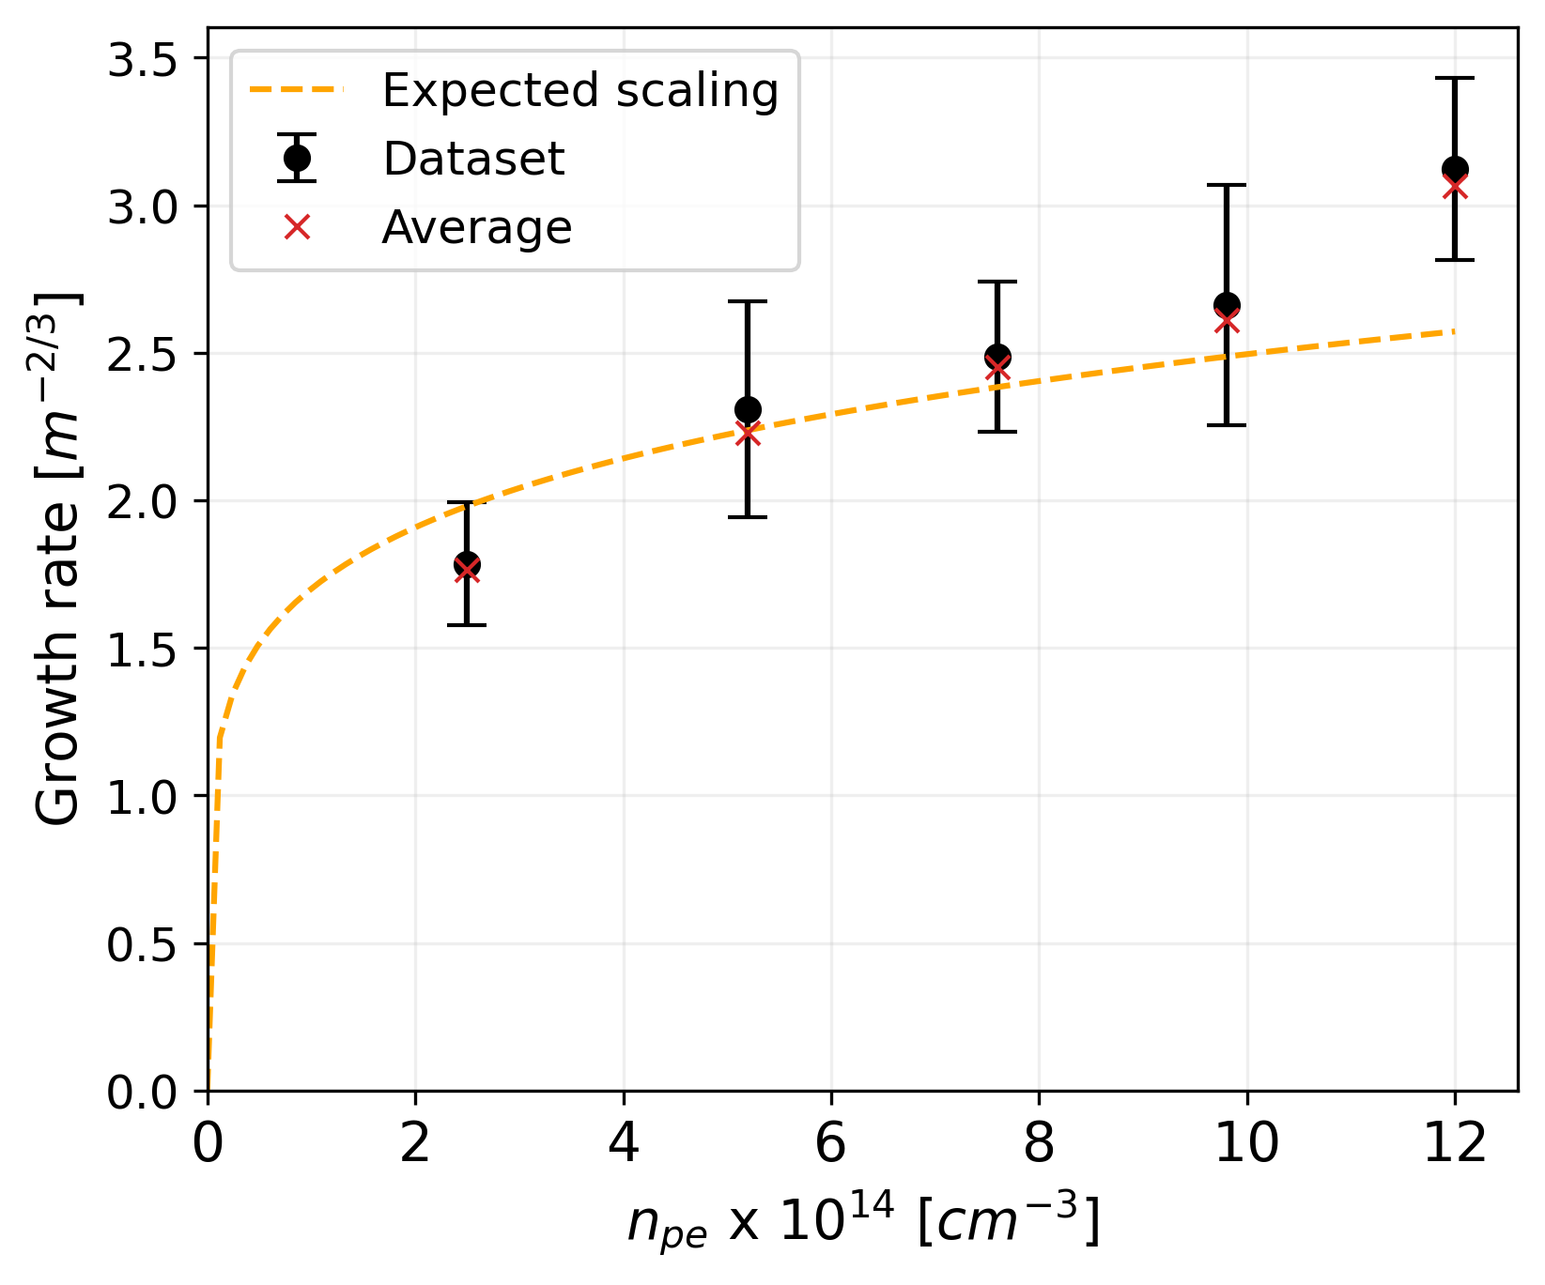
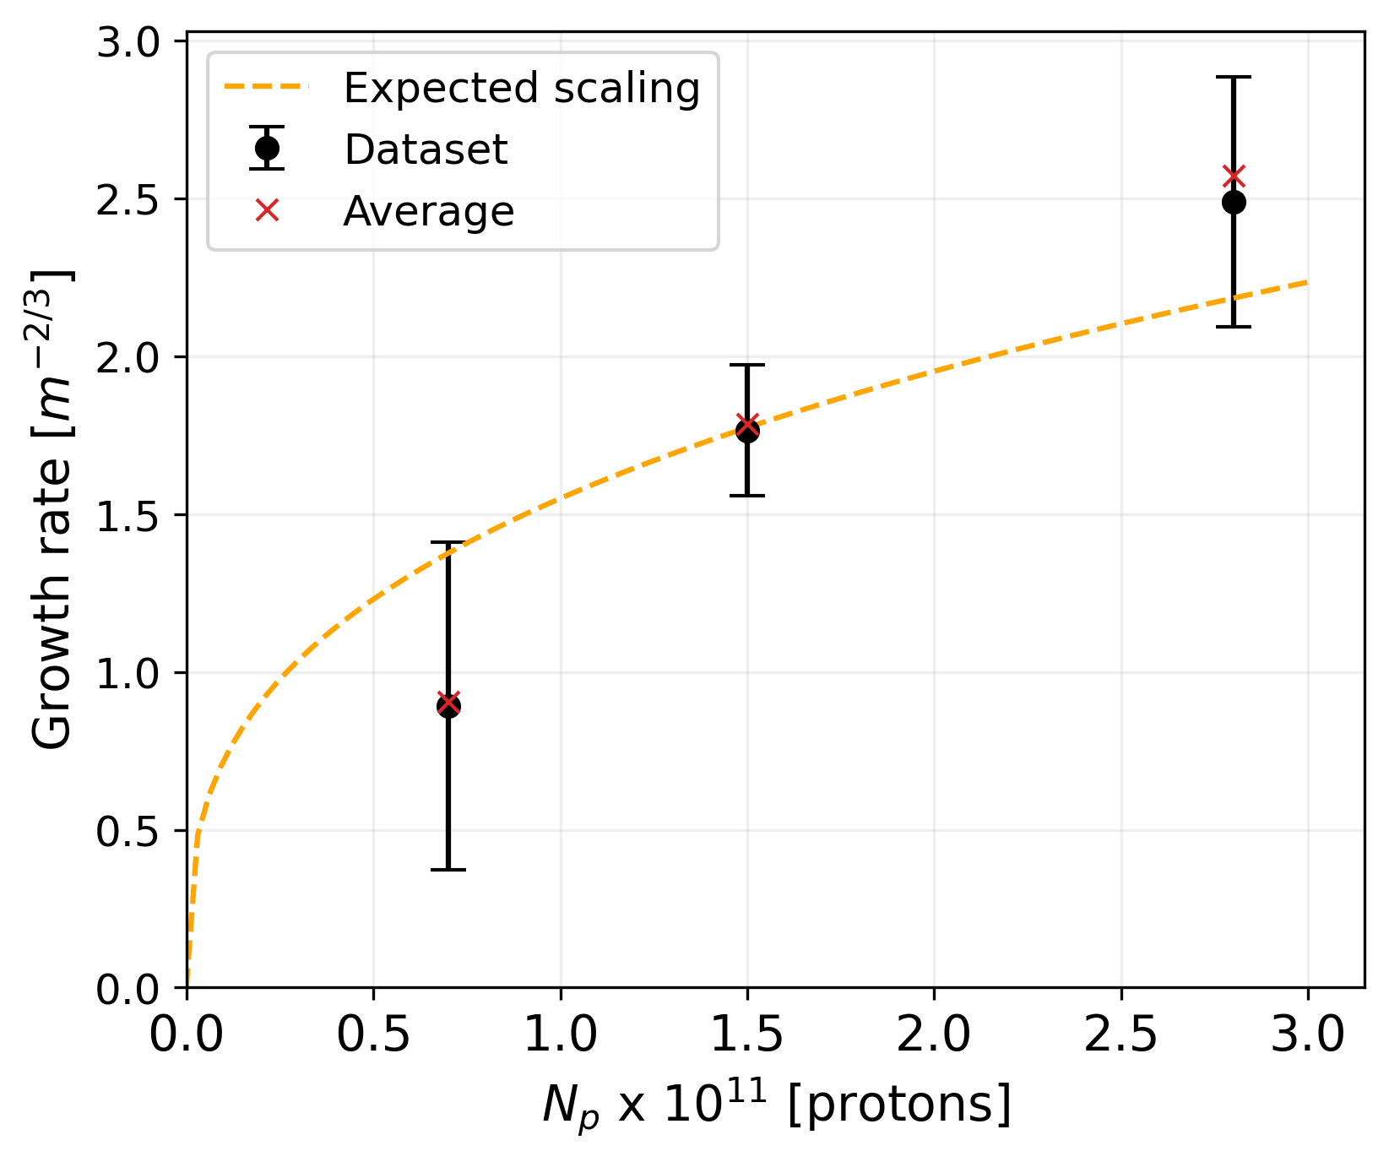

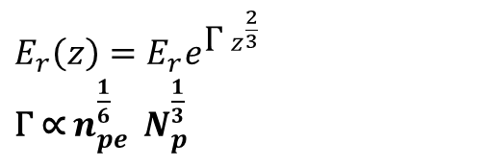

Growth rates
$$N_{p}=1.5 ×{10}^{11}$$
$${ n}_{pe}=2.5 ×{10}^{14}cm^{−3}$$
Wakefields in linear theory:
Growth rate of plasma light signals scales as expected
Proportionality between plasma light and wakefield amplitude
Not able to determine what power (square?, linear?, square root?)
$E_{r}\left(z\right)=E_{r}e^{{\text{Γ} z}^{\frac{2}{3}}}$
$\text{Γ}$ ∝ $n_{pe}^{\frac{1}{6}}$ $N_{p}^{\frac{1}{3}}$
Notes:
Fluorescent tube 22%

Slide 15
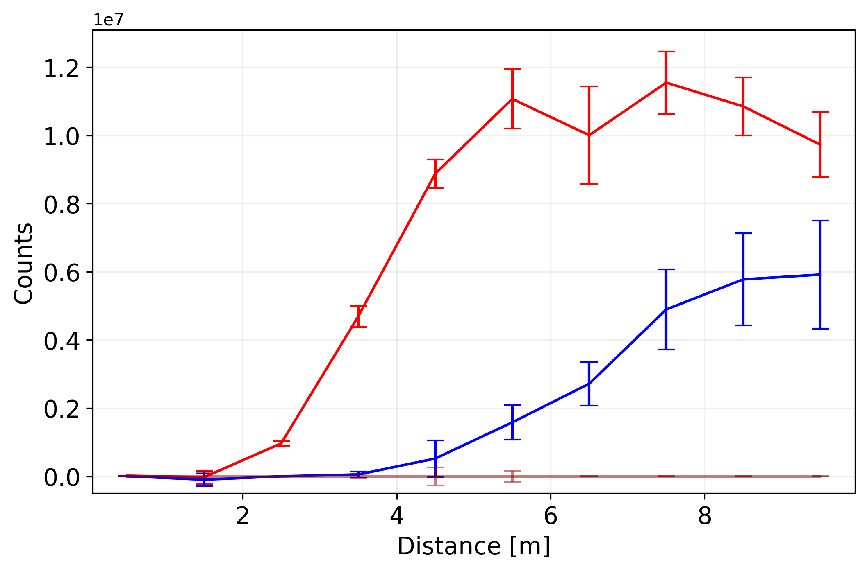


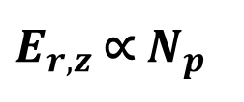
Seeding
$${ n}_{pe}=7.8 ×{10}^{14}cm^{−3}$$
Amplitude of seed wakefields scales with plasma density and bunch population
Measuring light from seed wakefield amplitude could yield absolute calibration
Difficult measurement to take
→ Measurements for seed wakefields will be taken next run
$$N_{p}=1 ×{10}^{11}$$
RIF = 0.2 ns
$E_{r,z}$ ∝ $N_{p}^{}$
RIF = 0.5 ns
Effect of seeding on SM development was observed
→ SSM/SMI studies
Notes:
Fluorescent tube 22%

Slide 16
Studies on
Self-Modulation

Slide 17
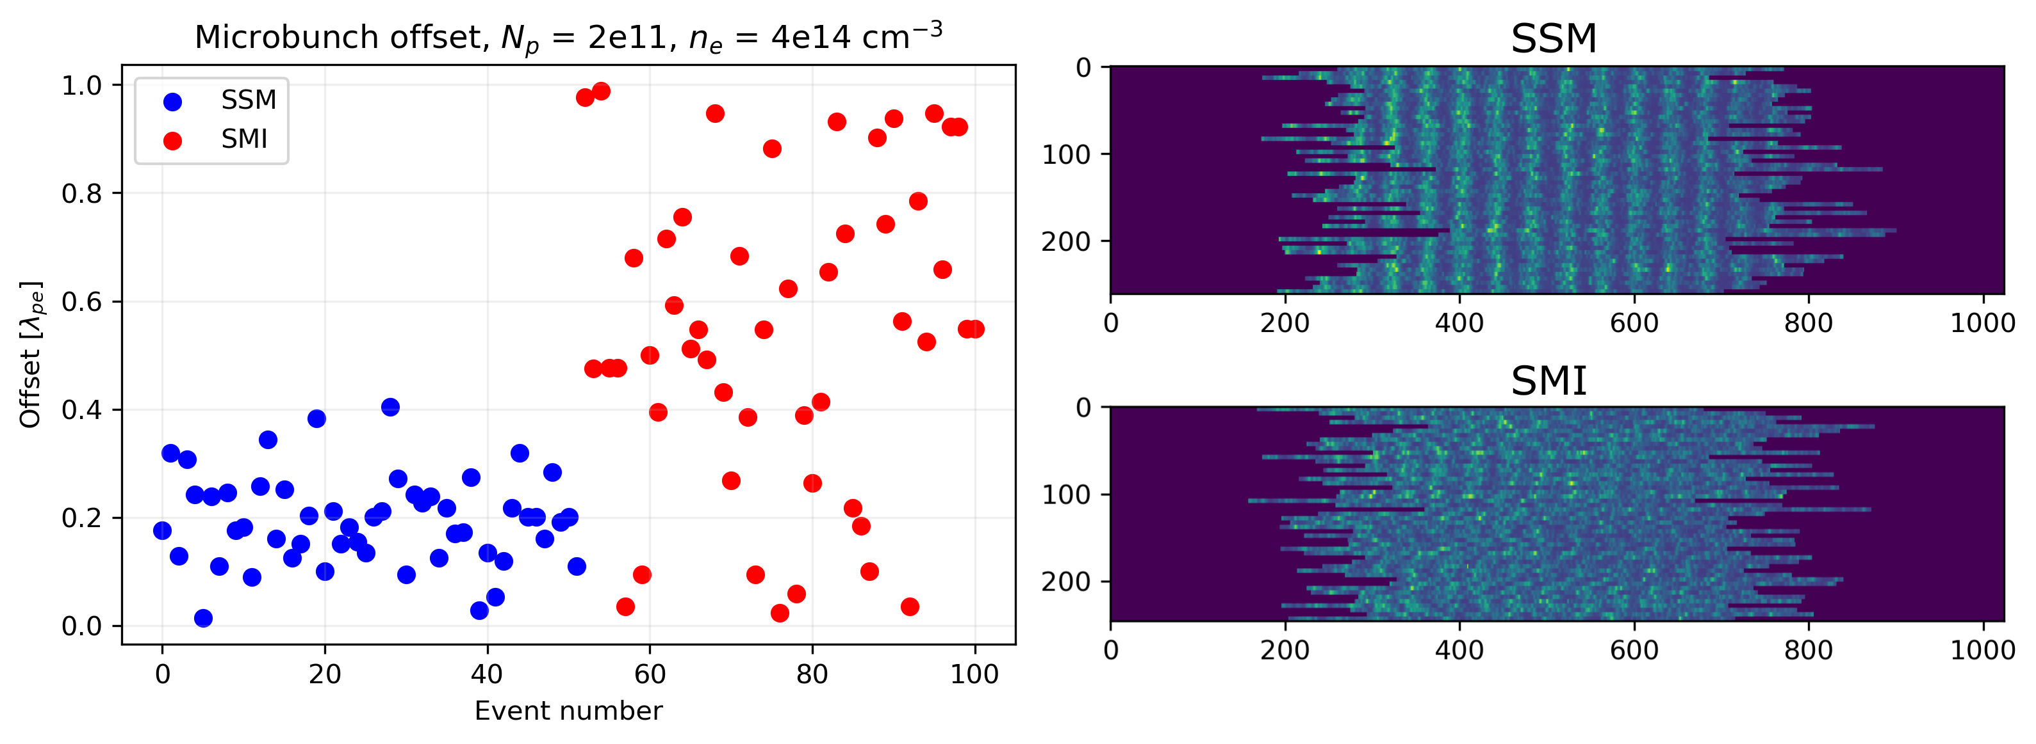
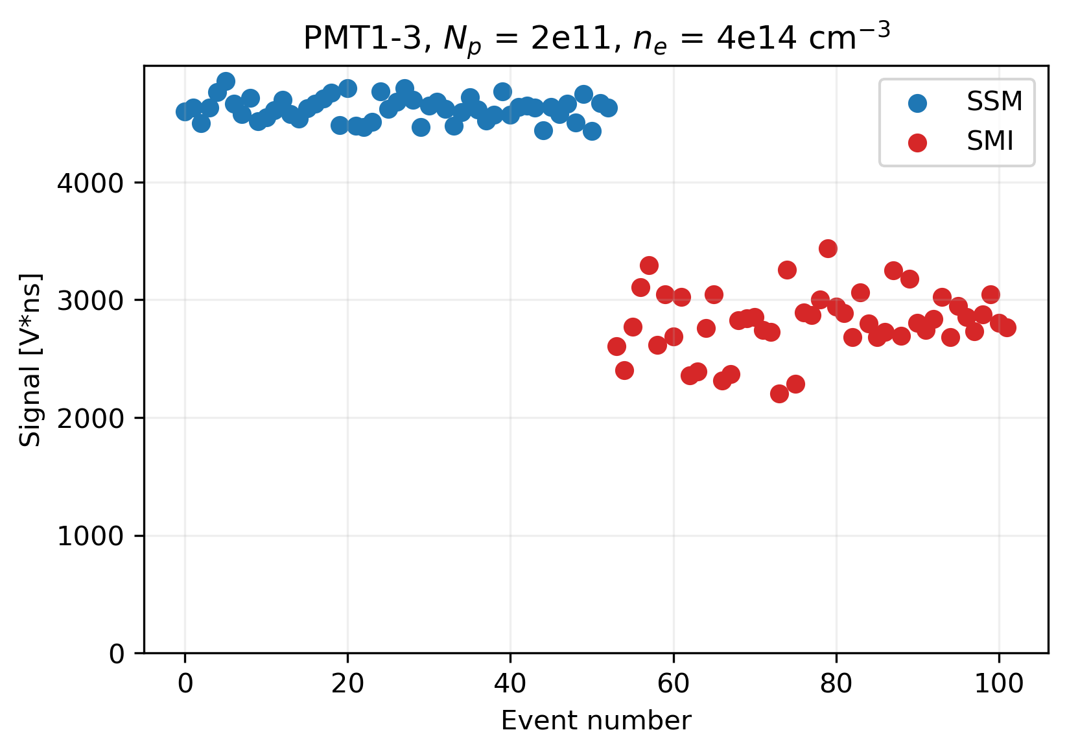
SSM / SMI
Prediction
Seeding the SM leads to reproducible phase (already shown)
Seeding leads to more reproducible field amplitude
Experiment
Threshold between SMI and SSM
  Plasma light more reproducible
  Profiles reach higher amplitude
  Bigger Halos
Amplitude is higher and more reproducible with SSM
Notes:
Fluorescent tube 22%

Slide 18
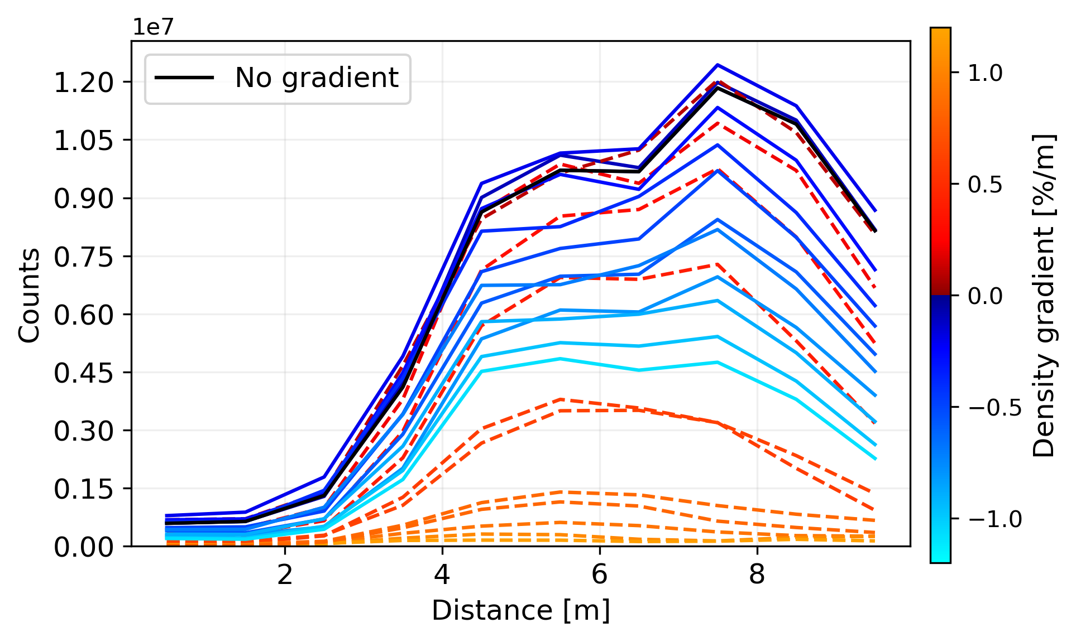
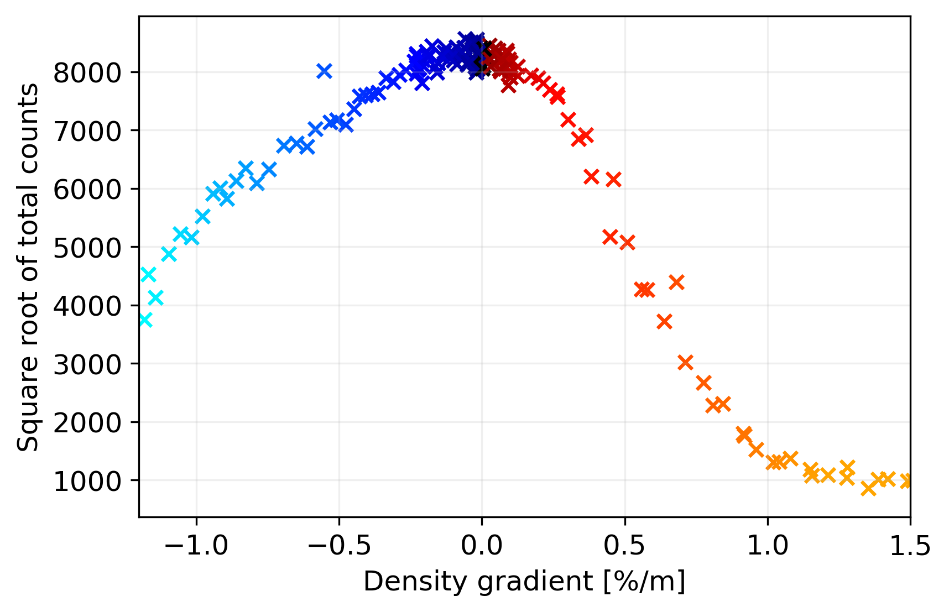
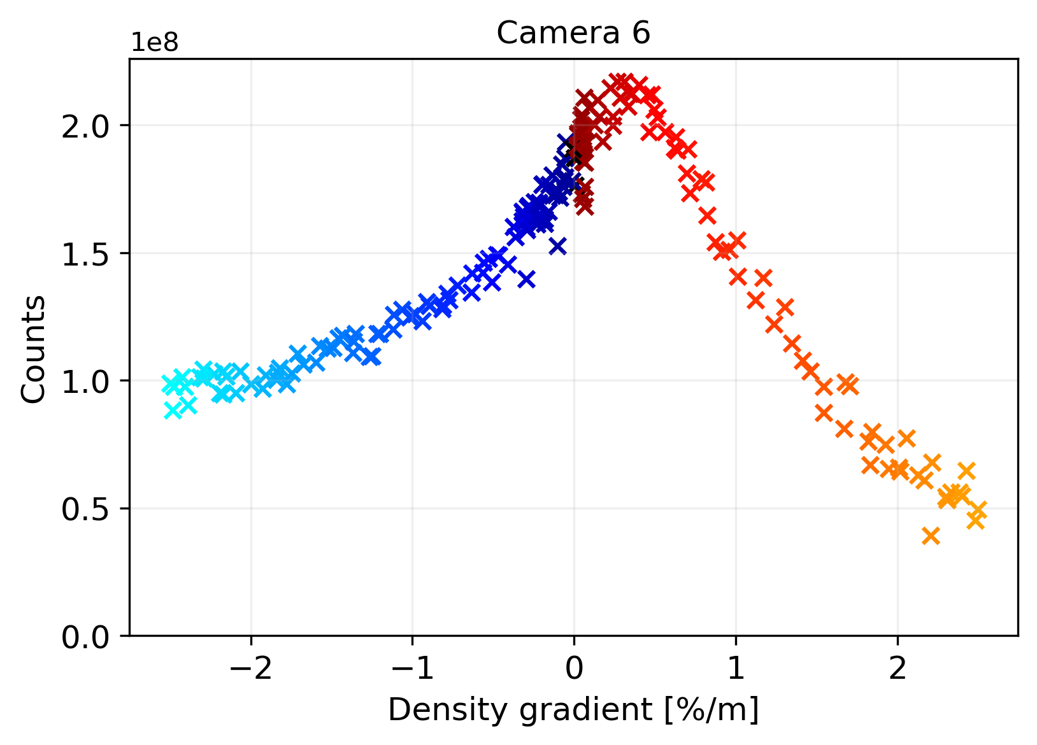



Density Gradient
Prediction
Small (positive) gradient counteracts dephasing
Large gradient suppresses the instability
Experiment
Slowly increasing gradient to +- 20%
  Low charge: less light the higher the gradient
  High charge: more light with small positive gradient
Gradient suppression observed
Positive effect observed only with high bunch charge
Asymmetry between positive and negative gradient
$${ n}_{pe}=2 ×{10}^{14}cm^{−3}$$
$$N_{p}=0.5 ×{10}^{11}$$
$${ n}_{pe}=2 ×{10}^{14}cm^{−3}$$
$$N_{p}=3 ×{10}^{11}$$
Notes:
Fluorescent tube 22%

Slide 19
Conclusion
Discharge + Protons
Discharge only
Protons only
Light emitted by the plasma can be used to observe the evolution of wakefields with a modulating proton bunch
Time resolved signals: peak of light after modulating proton bunch passes through plasma
Spatially resolved signals: quasi exponential growth
Growth rates scale as expected
Some proportionality between wakefields and light signal
Using light signals to study effects of SM developememt:
  Observed Amplitude reproducibility with SSM
  Observed growth suppression with gradient

