Slide 1
Preparations for Run 2b dismantling and update on Run 2c
AWAKE Collaboration meeting – Eloïse Guran
24-26 March 2025
AWAKE Collaboration Meeting - 24-26 March 2025

Slide 2
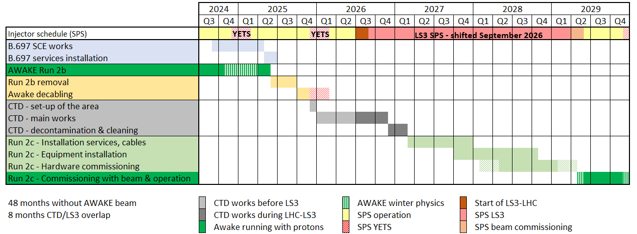
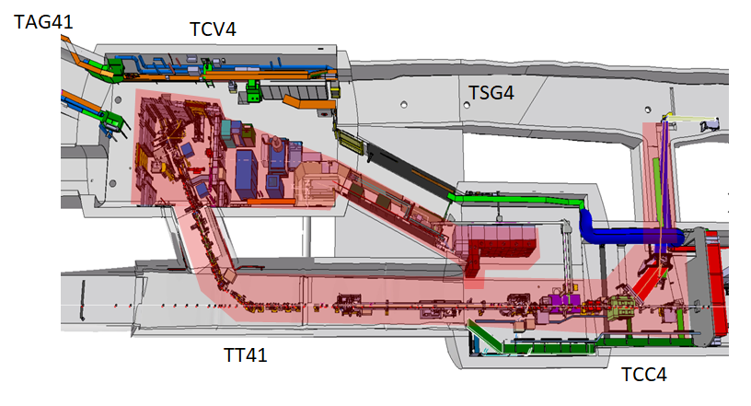
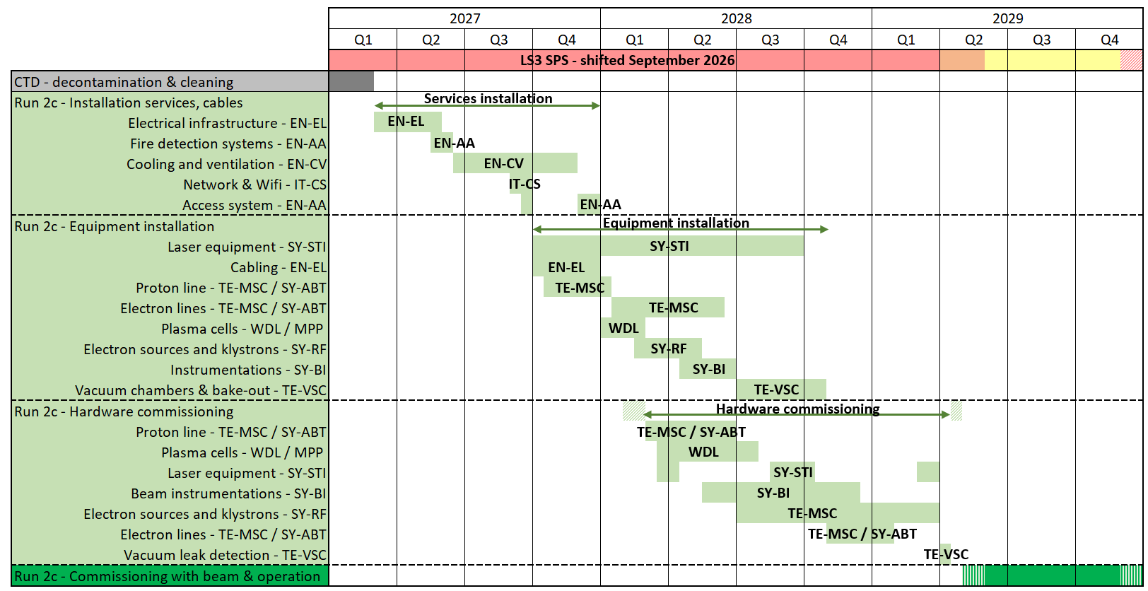
Outline
Global planning
Run 2b dismantling & decabling preparations
Update on Run 2c schedule and milestones

Slide 3
Global planning
Run 2b removal: 10th of June to mid-September 2025
Decabling: Mid-September to mid-November 2025
CTD: December 2025
AWAKE Run 2c installation: March 2026

Slide 4
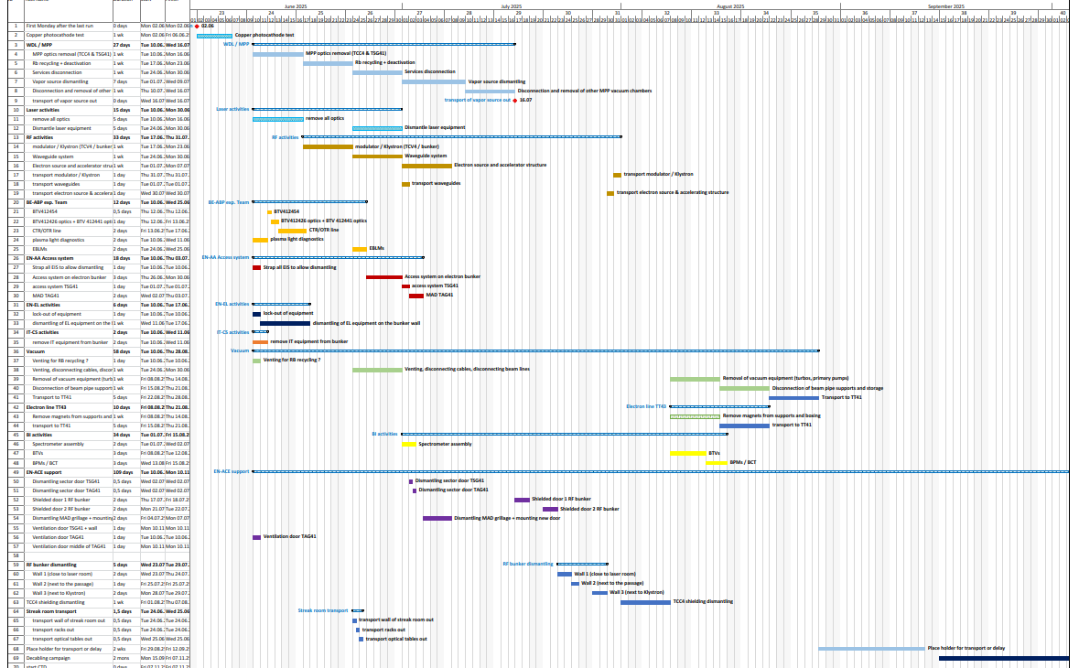
Run 2b dismantling - planning
Photocathode test: 02/06
Dismantling start = Tuesday 10th of June
End = 19th of September
Duration ~3.5months
Several co-activities to coordinate

Slide 5
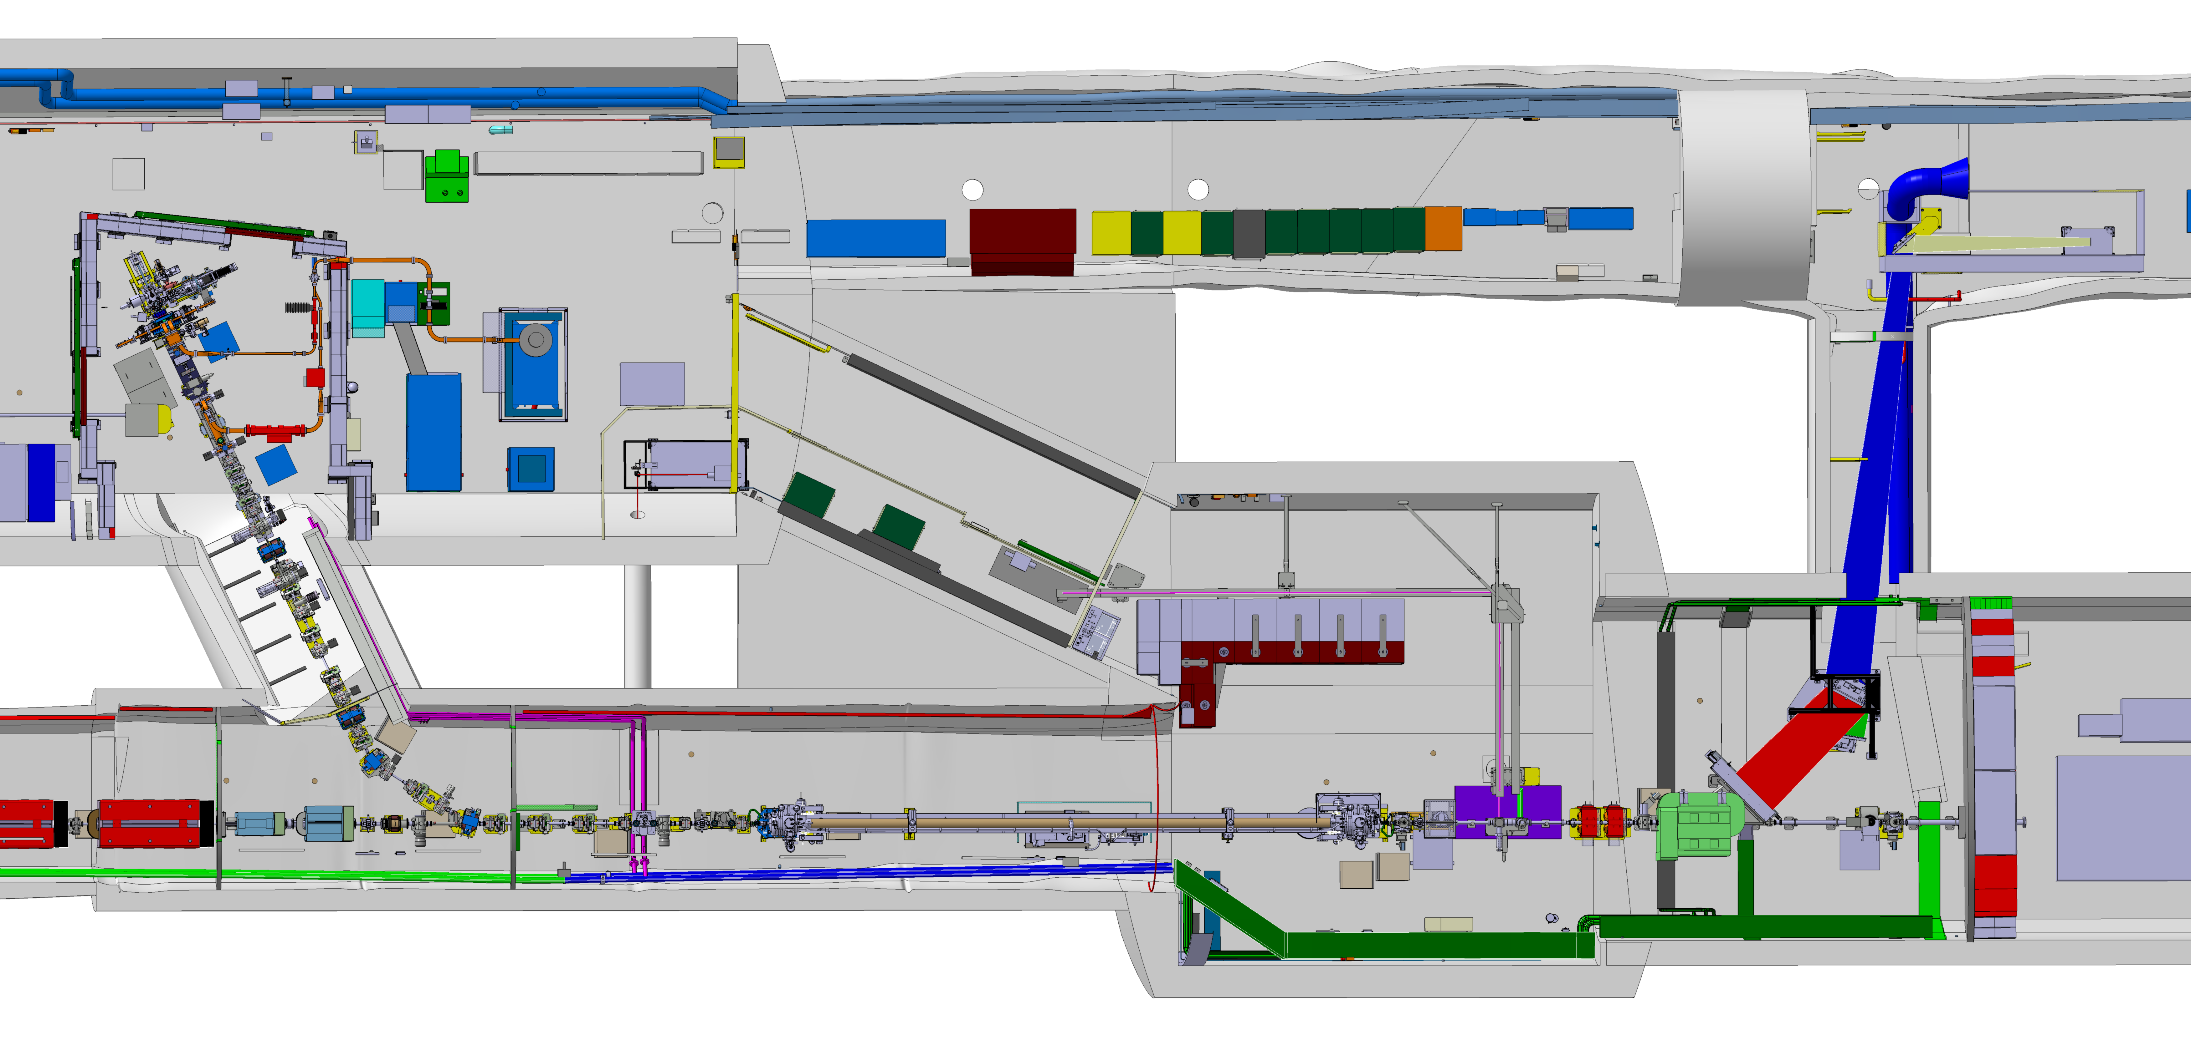
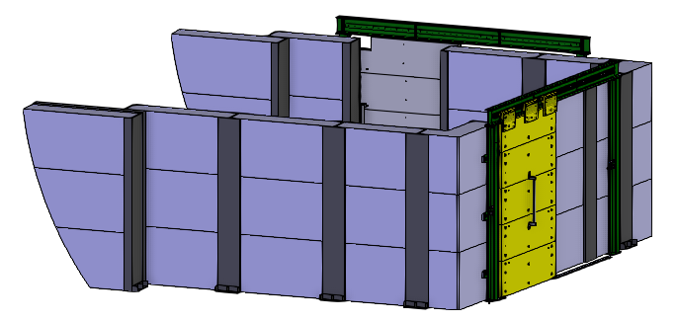
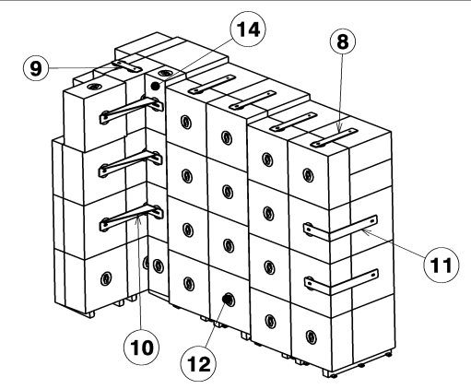
Run 2b dismantling - sequence
Main steps of the dismantling:
Optics removal - 1 week
Plasma cell + RF - 4 weeks
Removal of electron bunker and TCC4 shielding - 3 weeks
TT43 electron line removal (magnets, BI, girders) - 2 weeks
TT41/TCC4 proton line removal (magnets, BI, girders) - 2 weeks
Support from vacuum team during all steps (except step 3)

Slide 6
Run 2b dismantling – what’s next
Dedicated meetings (detailed planning, transport, safety, etc)
Collect your needs in terms of pallets
Check all storage locations are defined
START
Tuesday 10th of June
DAYS LEFT
77

Slide 7
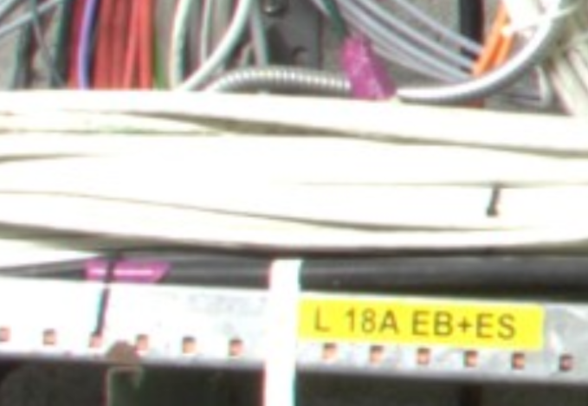
Run 2b decabling
Cable lists for decabling defined
Pre-identification on-site
Next → Final identification with purple tape on both end + disconnection of cable on both end
START
Monday 22nd of Sept.

Slide 8
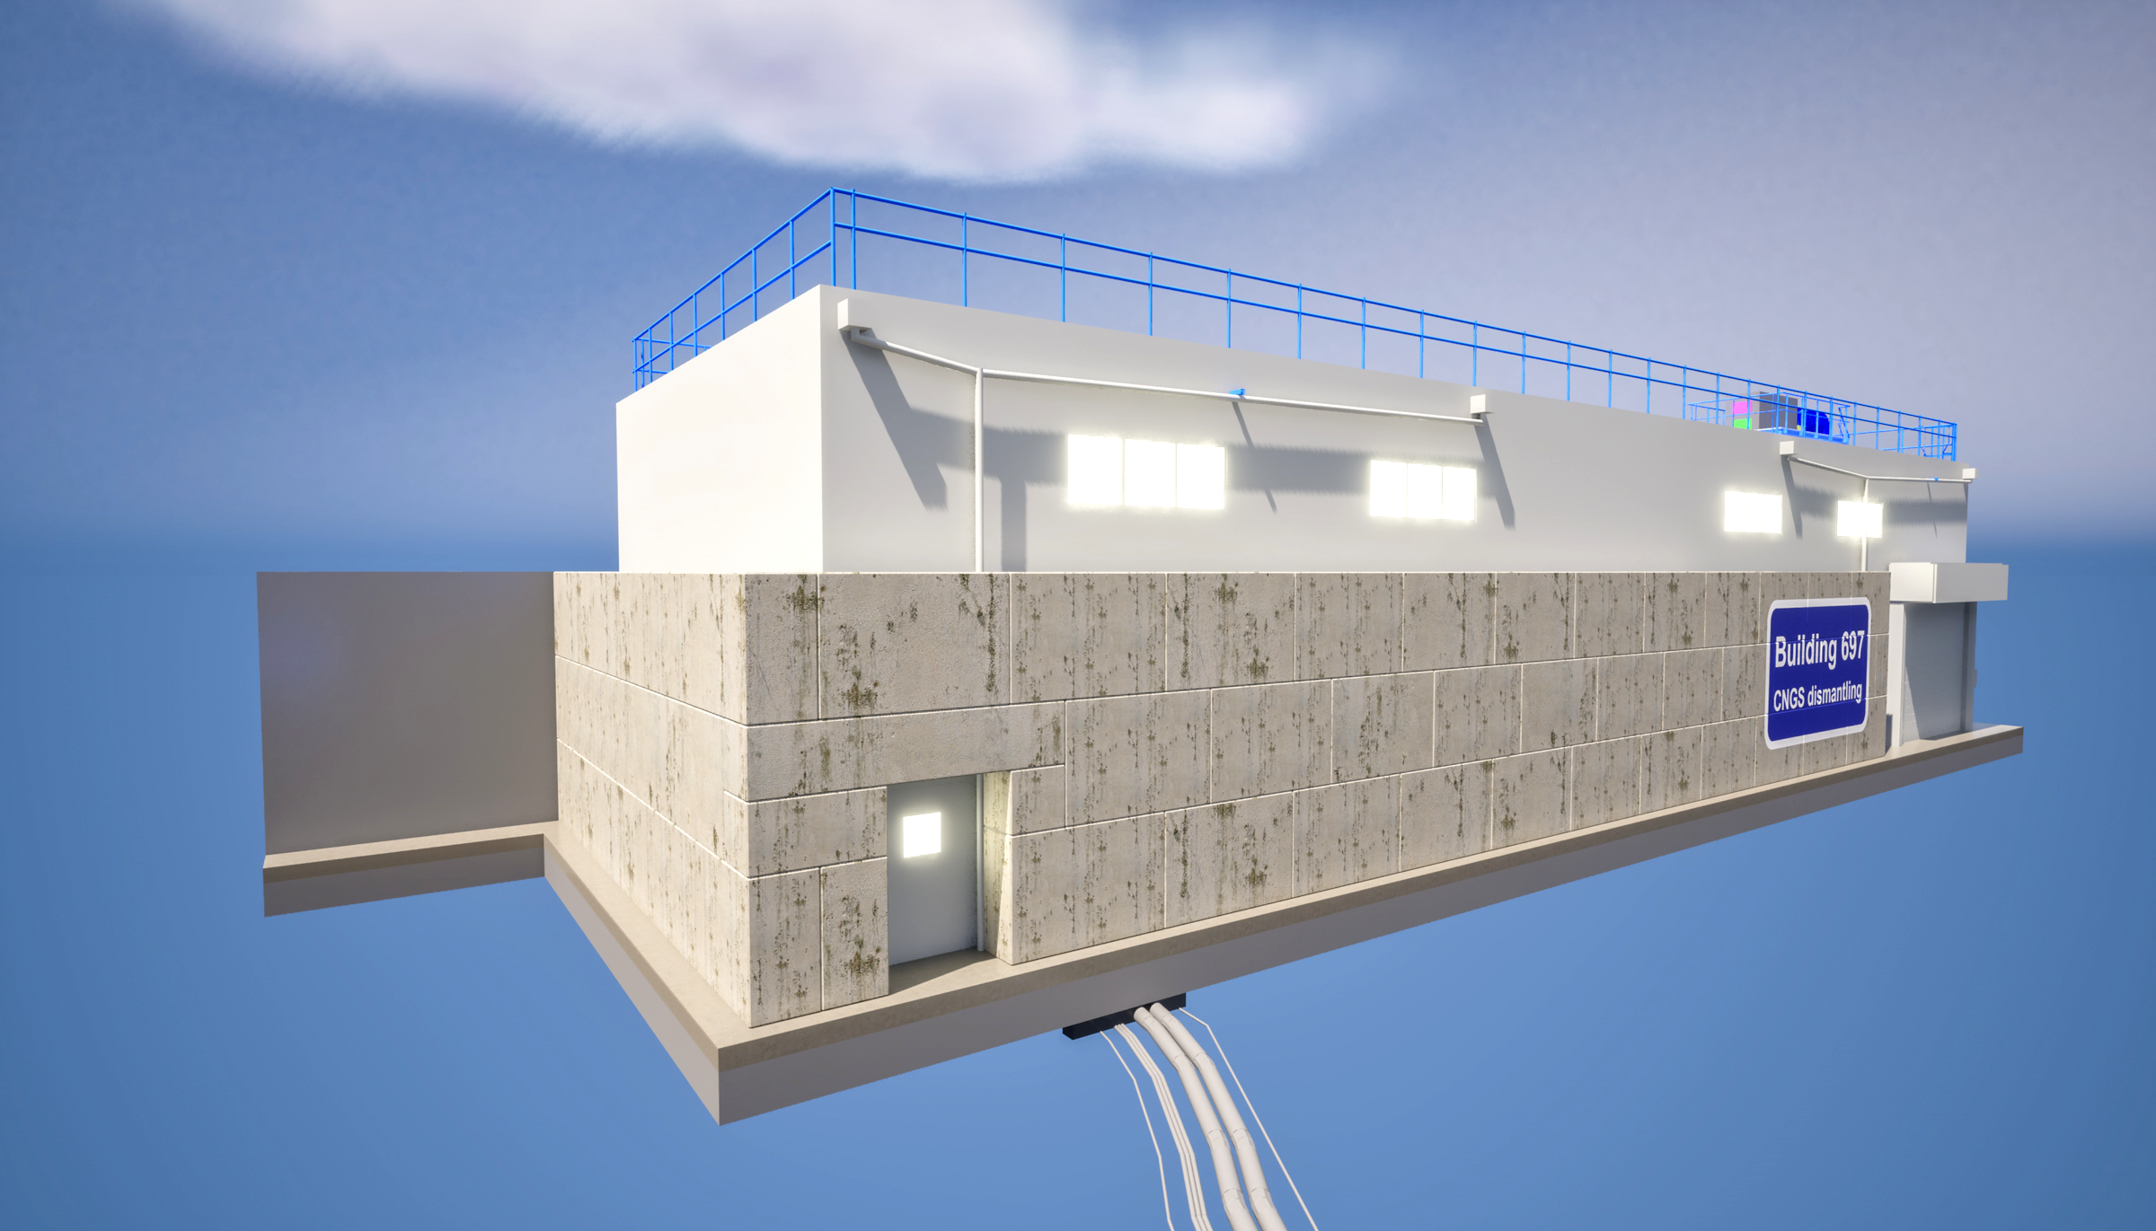
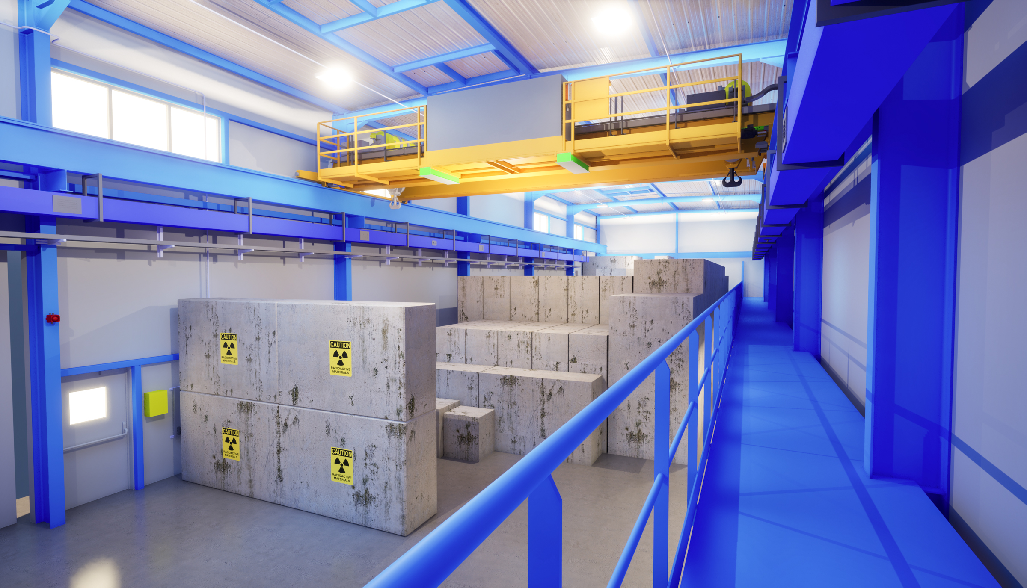
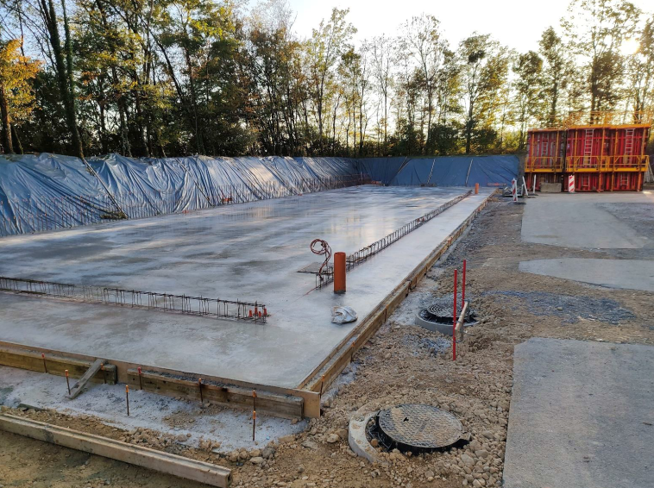
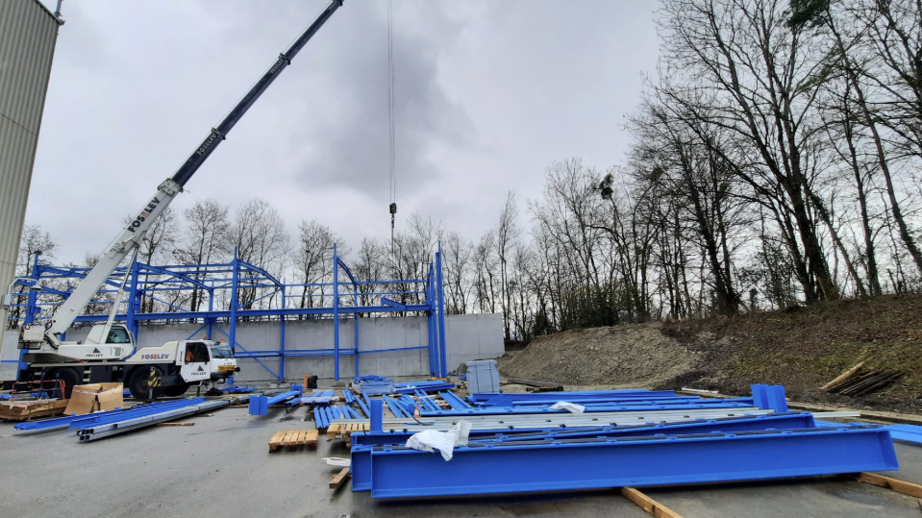
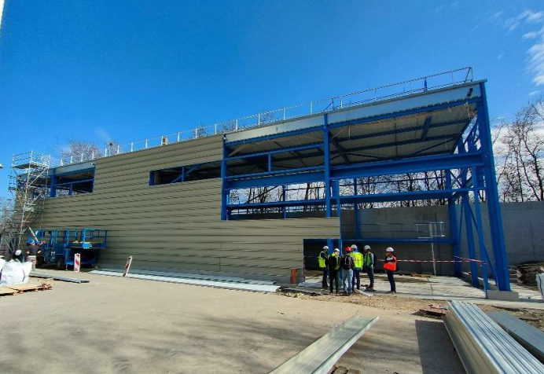
Surface building for CTD
Civil engineering completed
  end of April
Building ready to use
  mid-July
3D rendering of building 697 (courtesy of Antoine Kosmicki)
November 2024
26th February 2025
19th March 2025

Slide 9
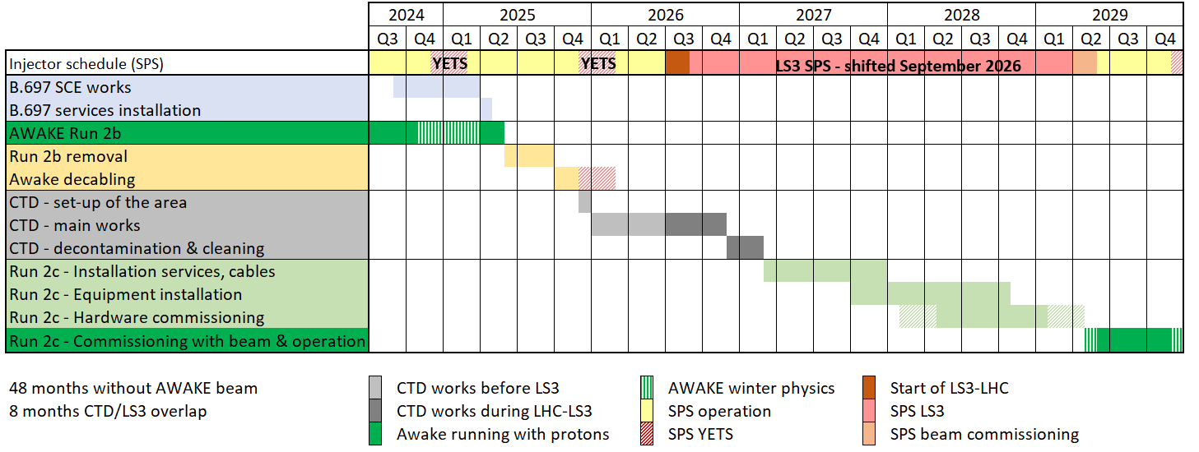
Global planning

Slide 10
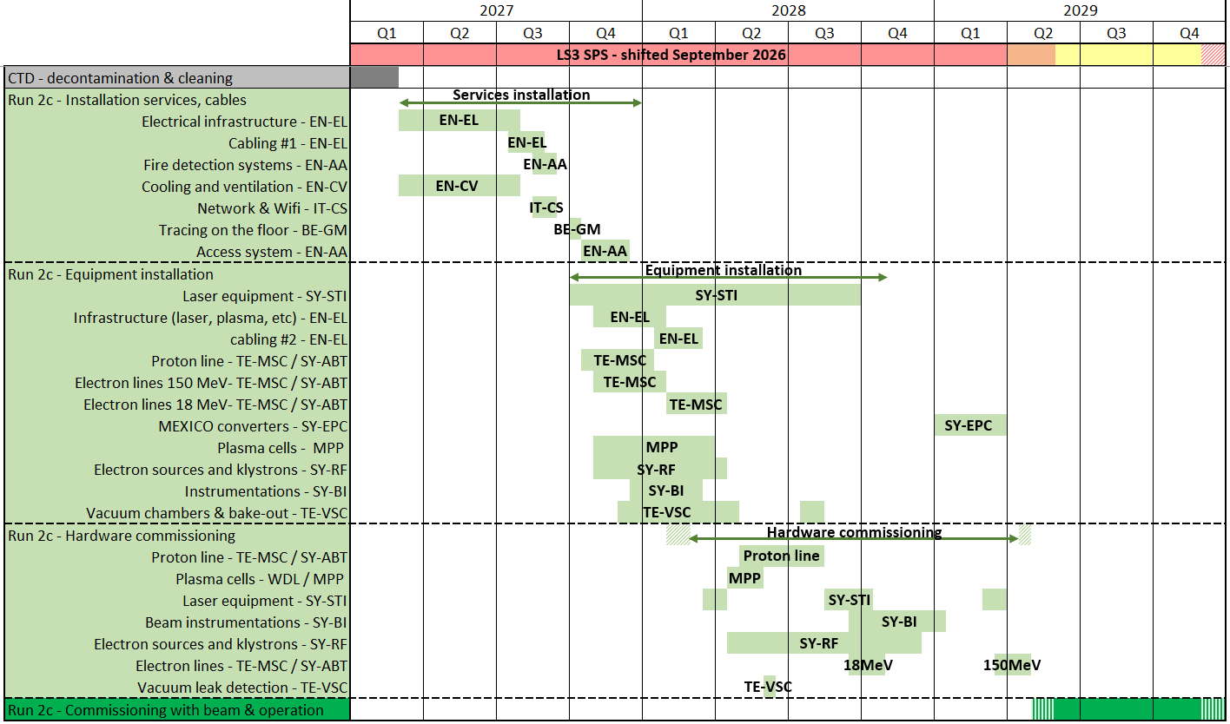
Run 2c schedule
Wishful planning:
~10months for services
~13months for equipment
~13.4months for HWC
→Planning currently being updated
Proton line
Plasma cells
Electron sources
Klystron area
Rack area

Slide 11
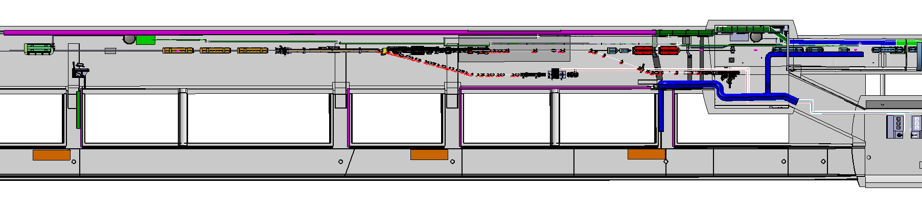
Run 2c – Constraints for installation / planning
Availability of resources during LS3
Cabling
Vacuum (especially for bake-out)
Transport
Sequence of install
Crane limitations (7.5T)
Restart for beam commissioning
Need DSO tests for electron beam
Need services (cooling, access system, etc) fully functionnal
EPC (MEXICO converters)

Slide 12
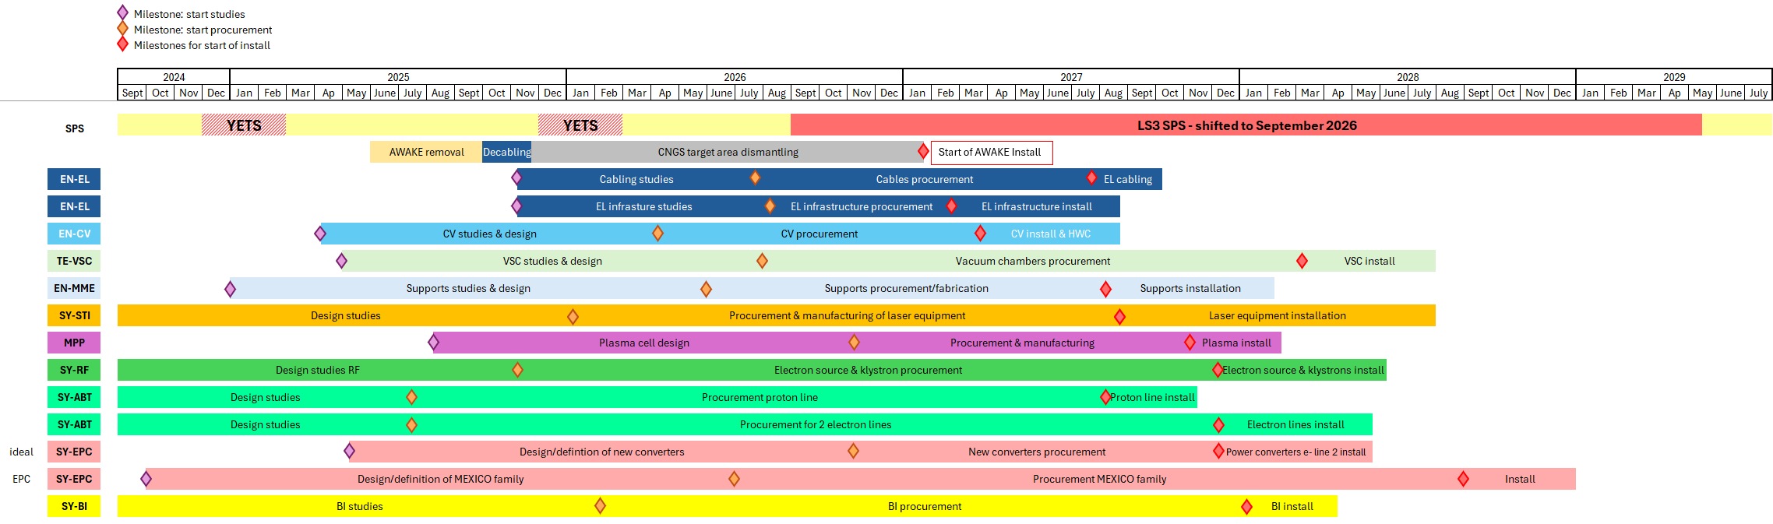
Milestones – studies & procurement
Services status:
EN-CV: On-track. User requirement documents to be sent for approval on edms this summer
TE-VSC: On-track. /!\might have lack of resources for the bake-out of photo-injectors needed in 2027/2028, especially if it falls at the same time as LHC bake-out /!\
EN-MME: on-track
EN-EL / infrastructure: on track → needs update on electric requirements for equipment to be able to perform detailed studies /!\ might have space issue for new transformer /!\
EN-EL / cabling: on track for start of studies /!\ need cable lists to start studies /!\
Equipment status:
Laser: on-track
Plasma cell (MPP): On-track
RF: on-track
Proton & electron line: on track, Beamline design almost finalised
BI: On-track
EPC: /!\ MEXICO converters ready for install Q1 2029 → very tight for Awake schedule
Globally on-track → need to maintain momentum to stay that way

Slide 13
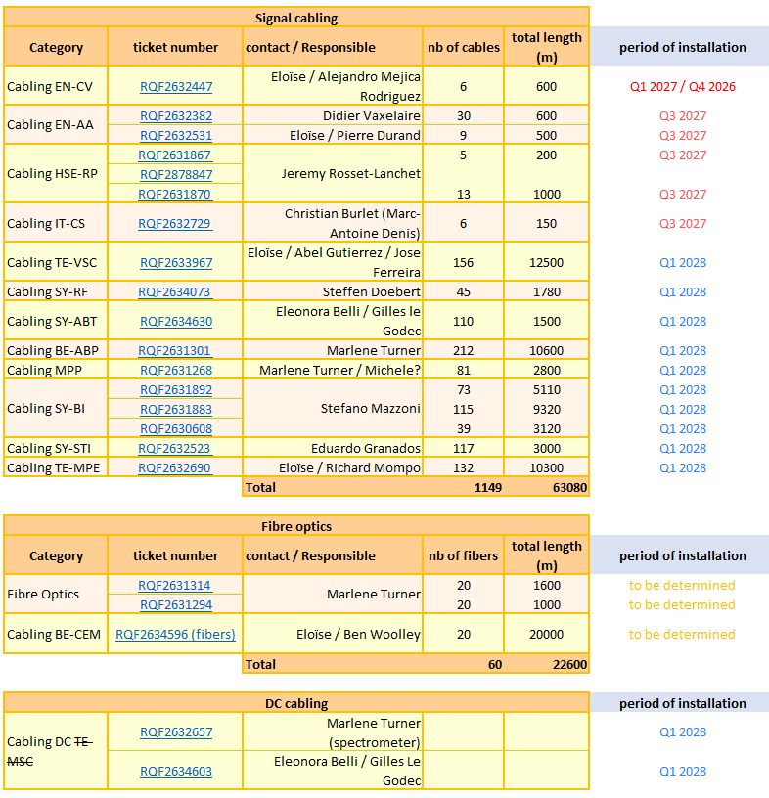
Run 2c – cabling requests
Cabling requests (DICs) well defined
EN-EL studies
Cable rooting
Cost & feasibility
Cabling campaigns
2027 & 2028
Input needed as soon as possible
Else, cabling campaigns will be delayed

Slide 14
Summary
START
Run 2b dismantling/decabling preparations are progressing smoothly → on-time for a start on 10th of July
Run 2c planning currently being updated → ramping up meetings and discussion to progress
Milestones for Run 2c still on time, but need to maintain the momentum
- Some critical issues, such as the injection region design, still need to be resolved
→ Essential to maintain momentum
- Need to continue progress in the integration studies
Tuesday 10th of June
DAYS LEFT
77

