Slide 1

Status of Run 2c integration
Ans Pardons
with input from Frederic Galleazzi, Vincent Clerc,
Eloïse Guran and Alena Puckova

Slide 2
Outline
Beamlines in the AWAKE 2c area – first view
Situation at the end of CTD → permanent shielding
Beamlines in the AWAKE 2c area – challenges
An example: Racks and rooms in TSG4
Integration and equipment design

Slide 3
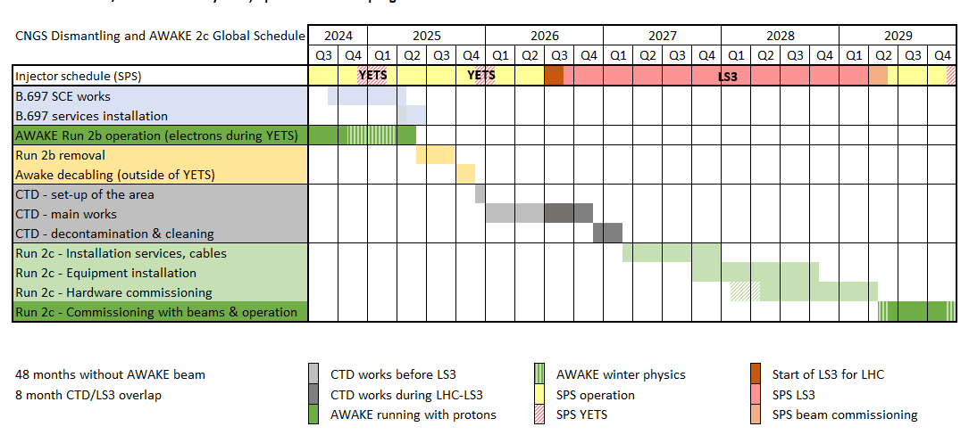
From “Ground zero”: the situation after CNGS target area dismantling
to “Ready to go”: the situation before the first beam for AWAKE 2c

Slide 4
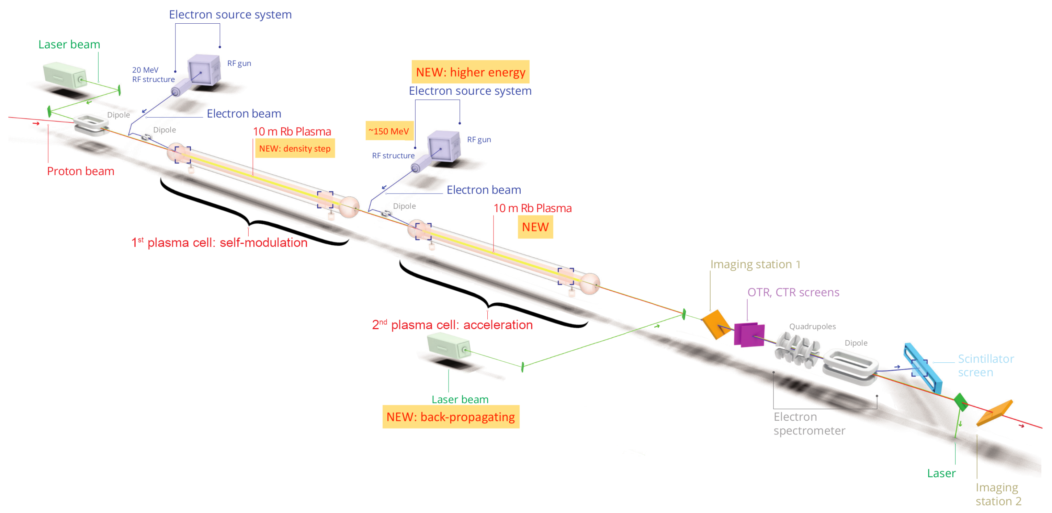
Update of the electron source(s)
by Steffen at 9h35
The injection region of Run 2c
by Michele at 10h50
Run 2c beamlines update
from Eleonora at 10h15
Laser system update
from Edu at 9h55
Status of BI for run 2c
by Collette at 11h10
Several presentations on the spectrometer
system and experimental diagnostics

Slide 5
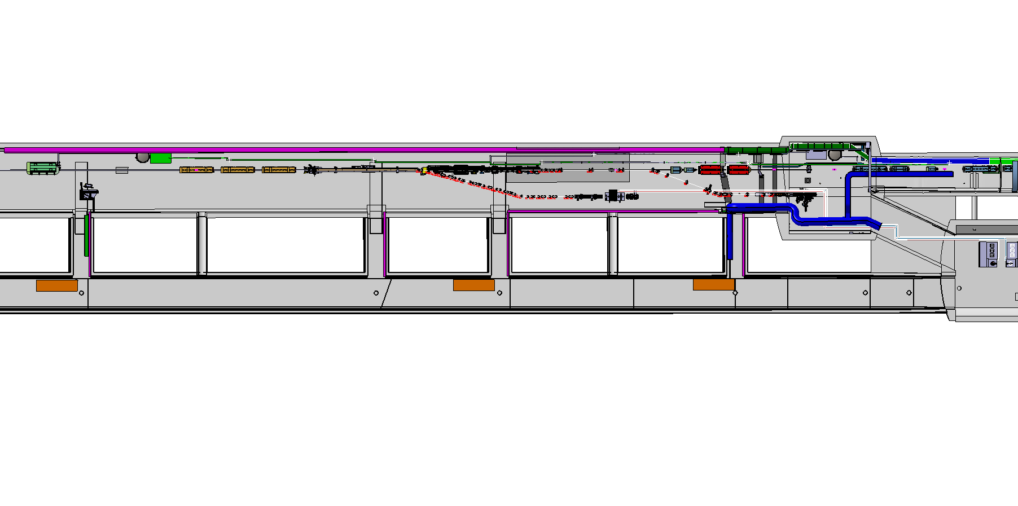
Integration of main elements
TT41: proton beam and IR laser beam, as now
TSG4: racks, UV laser room, streak rooms
TCV4: klystrons
TCC4: … everything else (shifted downstream ~40-50m compared to AWAKE 2b)
TT41
TCC4
TSG4
TCV4
Top view of AWAKE 2c area, proton beam from right to left

Slide 6
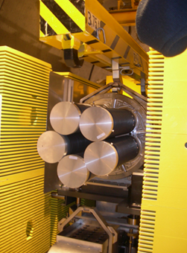
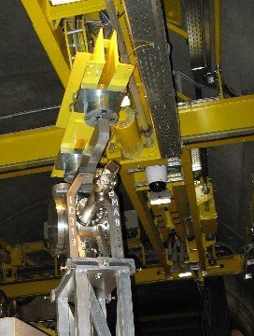
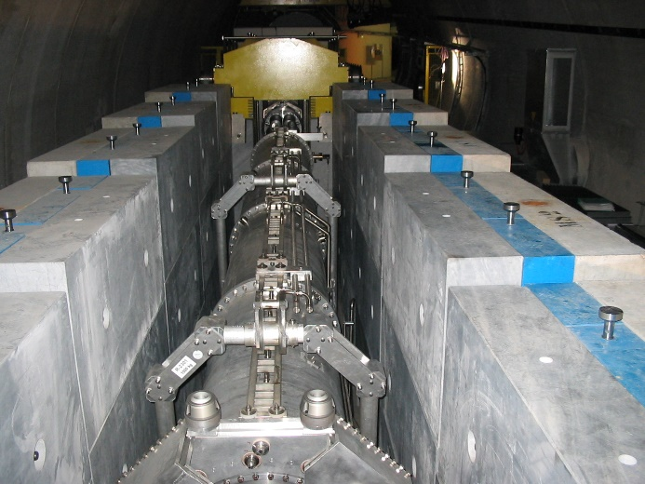
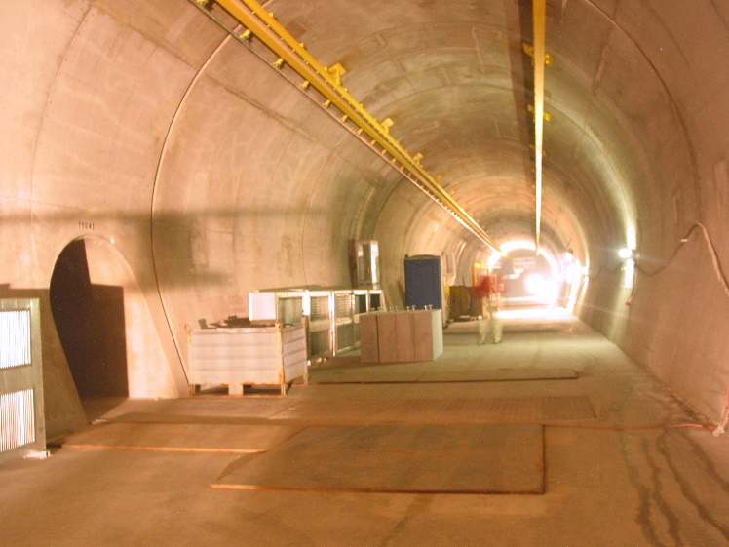
Situation at the end of CTD (early 2027)
The main deliverable of the CTD project
is a CNGS target cavern…
completely emptied of all material present during CNGS operation
(except: overhead crane rails)
completely decontaminated (CS < 1)
classified as a simple controlled radiation area (dose rate ≤ 50µSv/h)

Slide 7
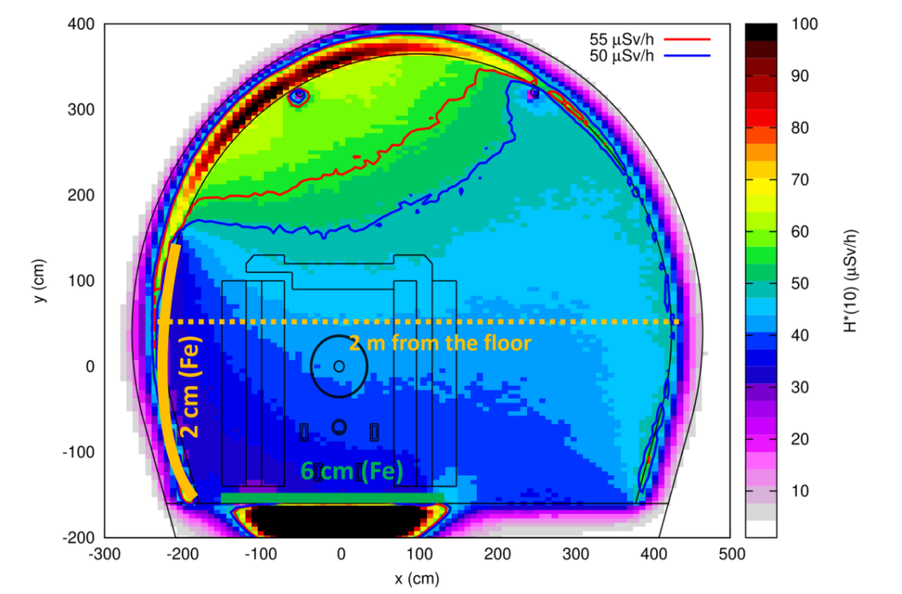
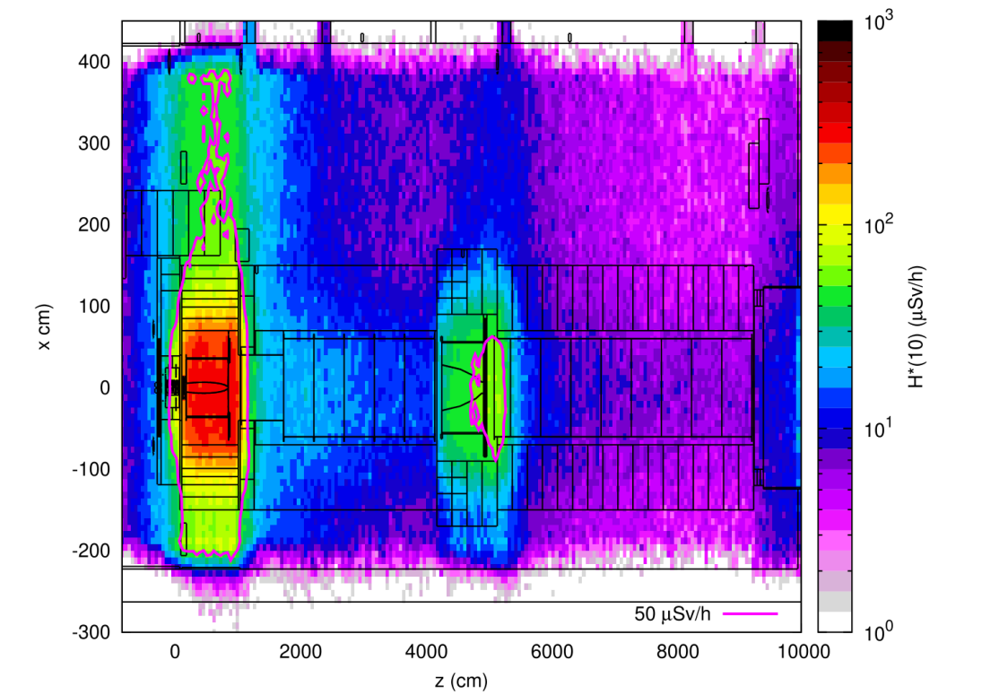
Shielding AWAKE from CNGS remnant radiation
Keep dose rate ≤ 50µSv/h, simple controlled radiation area (classroom course, dosimeter)
Now: AWAKE is a supervised radiation area, dose rate ≤ 15µSv/h (online course, dosimeter)
Even after full CNGS TCC4 dismantling, several areas are > 50µSv/h (simulations)
Install shielding on floor and wall:
Floor under horn (13mx3m width) and reflector (1mx1m width): 20cm concrete
Wall next to horn (10mx3m height): 2cm iron
Top view and transversal view, remnant dose rate superposed on CNGS equipment [C. Ahdida, EDMS 2665333]

Slide 8
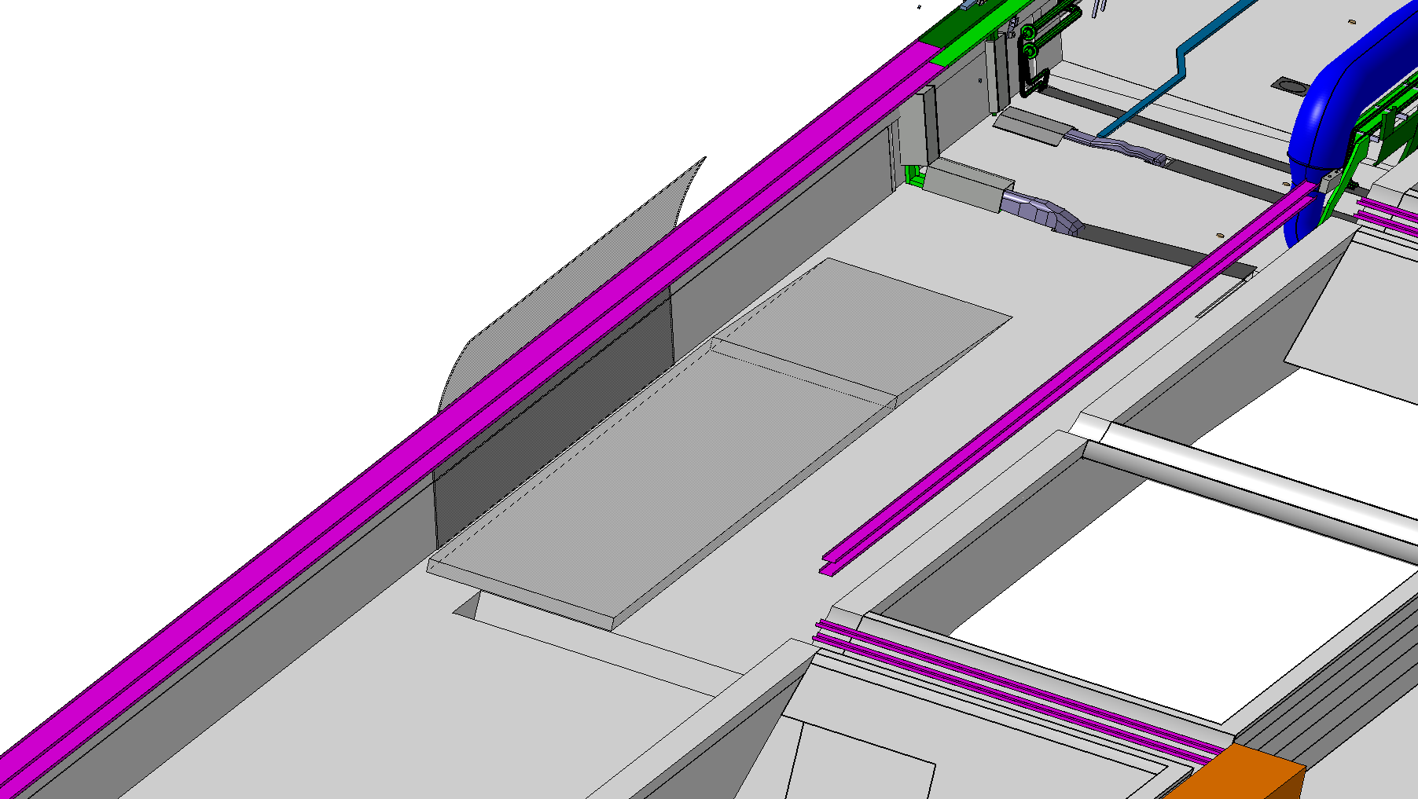



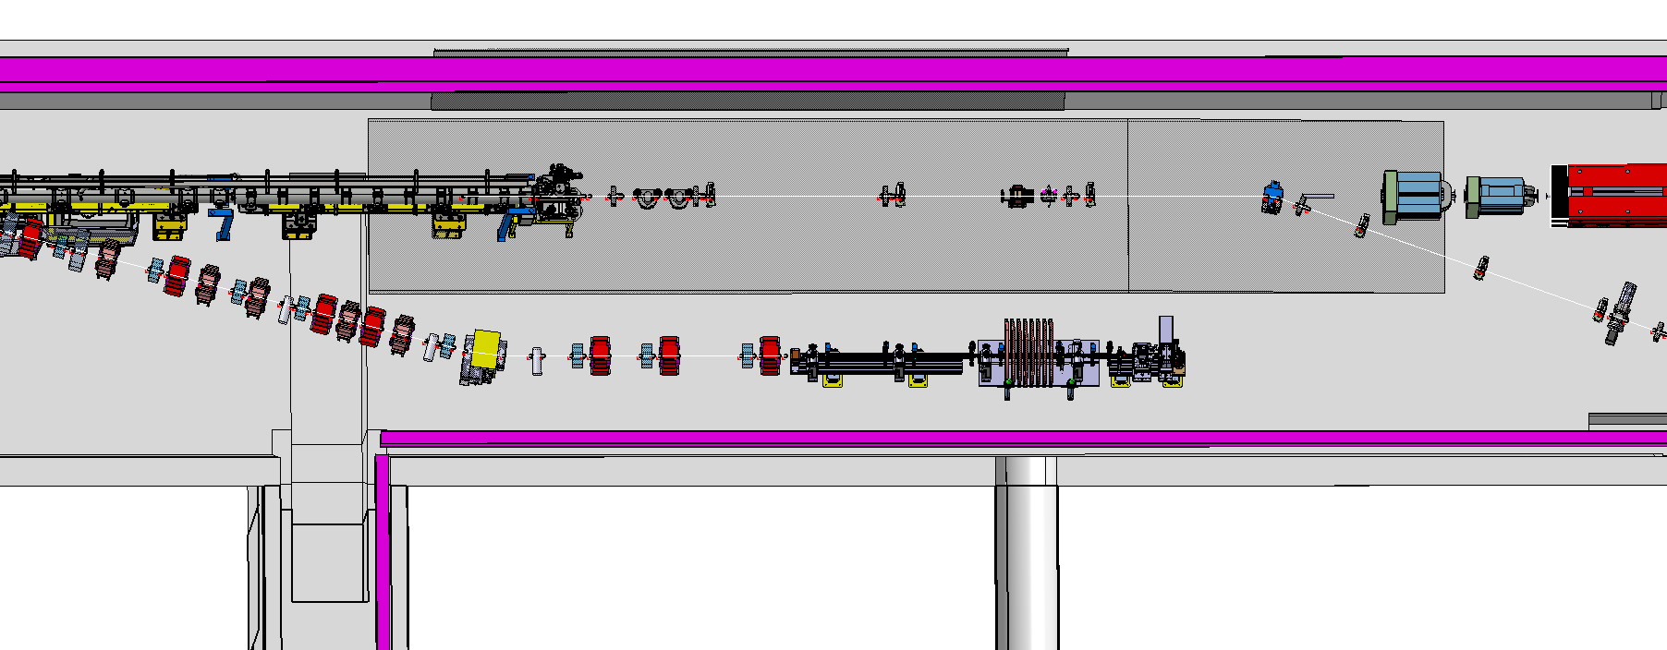
Shielding near CNGS horn
Interference cable trays, services with iron sheet? → study
Concrete shielding blocks must be stable (long-term) to ensure correct position of supports/elements
→ investigate different solutions
Ensure safe work conditions → access ramp and/or steps
Sheet of 2cm iron on wall
Platform of 20cm concrete
blocks on floor
Access ramp to reach
concrete platform

Slide 9
TT41
TCC4
TSG4
TCV4
Very dense upstream TCC4 area: access is not straightforward, and the installation procedure is complex and rigid
(e.g. spectrometer magnets need vehicle as they are too heavy for crane)
Keep crane & transport paths free
Klystron waveguides from TCV4 to TCC4
Many racks in TSG4 (see next slide)
Many more challenges….
TCC4
TSG4
Top views of AWAKE 2c area, proton beam from right to left

Slide 10
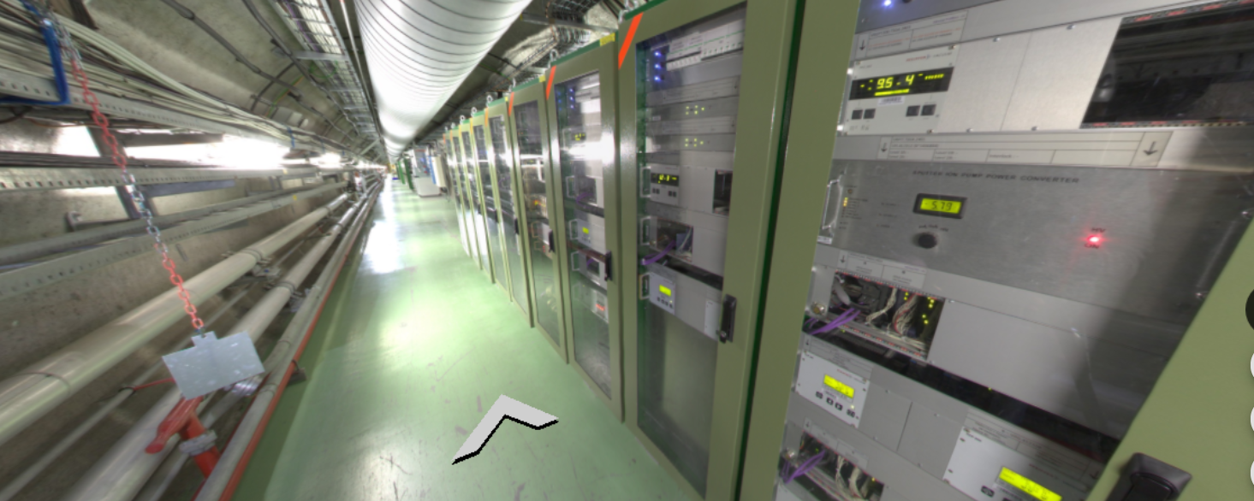
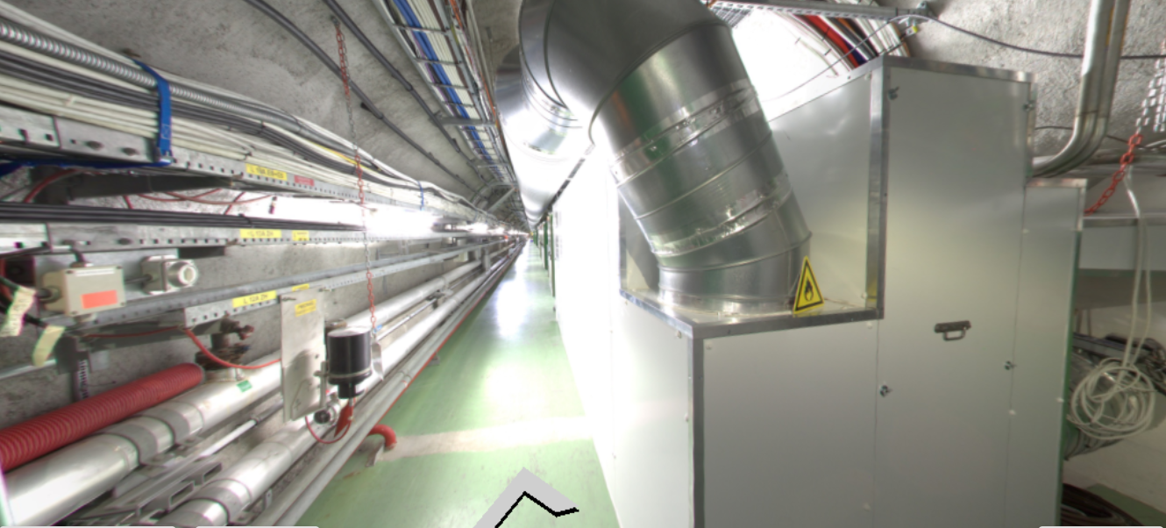
Racks and rooms in TSG4
For AWAKE 2b,
  58 racks in the 100m-long TSG4
  1 room: spectrometer camera
For AWAKE 2c
  estimated to need 90 racks
  3 rooms: 1 UV room, and 2 streak/diagnostics rooms
TSG4 also needs to house the new TCC4 HVAC system
Sump at end of TSG4 needs vehicle access and entire TSG4 needs personnel access

Slide 11
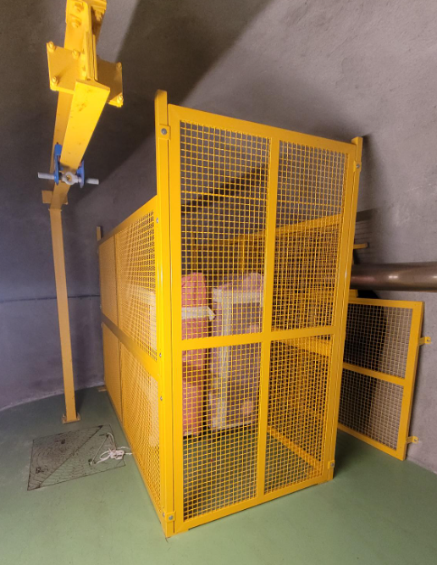
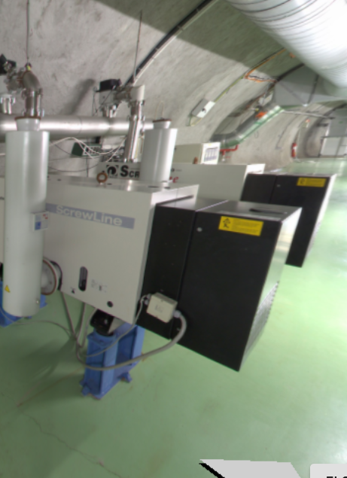
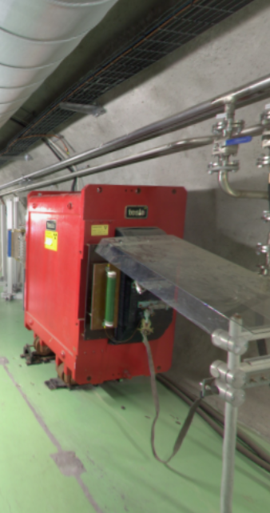
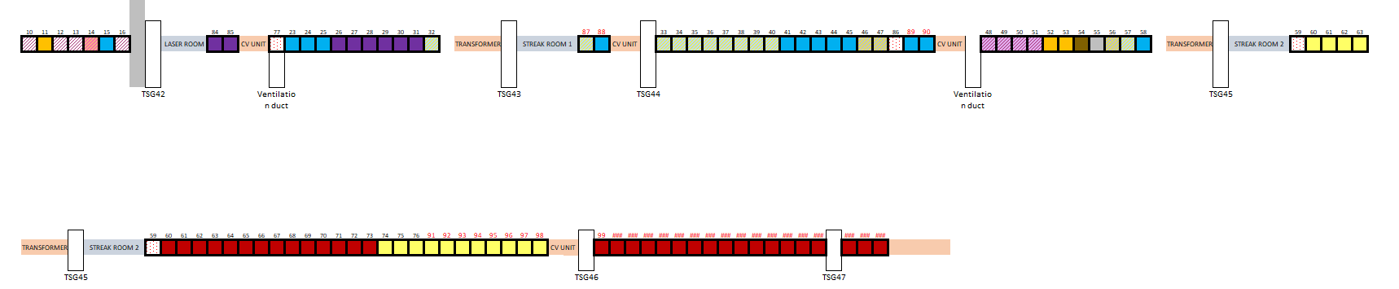
Racks and rooms in TSG4
Make more space:
  Remove CNGS-related waste at end of TSG4
  Remove pumping system CNGS decay tube
  Study whether CNGS-era transformers can be removed
Get more info:
  Scan of TSG4 → update model
  Collect estimated racks needed from each user, max distance to equipment, etc.
Propose a first layout:
Upstream
TSG4
Downstream TSG4

Slide 12
Integration of AWAKE 2c
The integration of elements in AWAKE must move together with (or even ahead of) the design of those elements, because
  Many service groups need first information early on, to deal with enormous LS3 workload, e.g. cabling requests → needs rack position and beamline layouts
  Checking integration topics (access, transport, etc.) during design allows discovering issues early → is more time-efficient (but iterative).
  Installation planning needs installation order, and therefore integration info.
The integration team holds “CSCP” meetings to guide other coordination packages discussing with the CERN groups (vacuum, survey, mechanical design, magnets, etc.) linked to their CP.
→ The CSCP meetings combine pre-integration with design and interface discussions, allowing integration to be considered early on.

