Slide 1
Update on the Electron Sources
RF system layout
Integration status
Status of key components; Prototyping and Procurement
News from ARTI in CTF2
Conclusions and Issues
AWAKE Collaboration Meeting : Munich, 24-26.3.2025
Anton Eager, Steffen Doebert

Slide 2
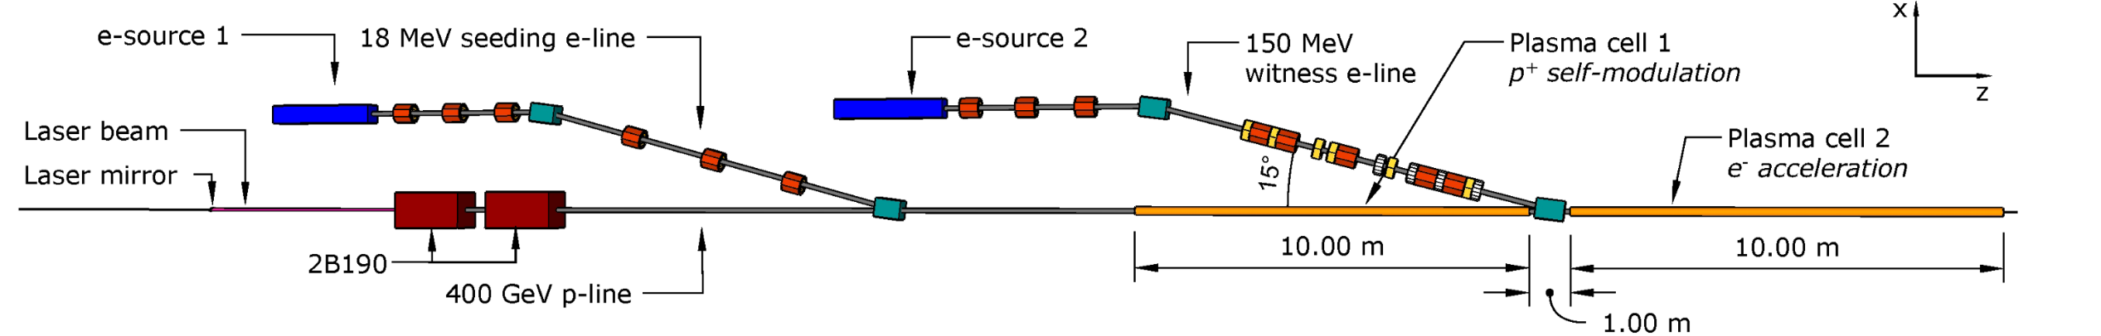
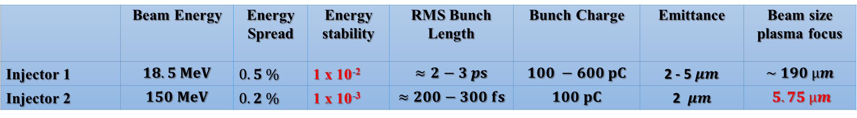
Parameters for both injectors
Working documents held by Rebecca (Injector 2, EDMS 2378918) and John (Injector 1, EDMS 2417022,2588263)
 | Beam Energy | Energy Spread | Energy stability | RMS Bunch Length | Bunch Charge | Emittance | Beam size plasma focus
Injector 1 | $$18.5 MeV$$ | $0.5 \%$ | 1 x 10⁻² | $$≈2−3 ps$$ | $$100 −600 pC$$ | 2 - 5$μm$ | $$\sim 190 µm$$
Injector 2 | $$150 MeV$$ | $0.2 \%$ | 1 x 10⁻³ | $$≈200−300 fs$$ | $$100 pC$$ | 2 $μm$ | $$5.75 µm$$
Flexibility in the beam parameters which can be delivered keeping good energy spread and emittance
Energy: +- 10%, Charge: up to 400 pC, Bunch length: 0.2-1 ps, beam size : see transport
Constraint space for hardware
Excellent timing stability and synchronisation with laser and self-modulation device; ~ 30 fs stability

Slide 3
S-Band RF System Layout
S-band, 45 MW
We propose now to use a single high-power klystron to power all 3 GHz cavities
less waveguides
same rf source and timing jitter
easier to maintain
Coupling of the operation of the two injectors
circulator
A
ϕ
ϕ
15 MW, SW
10 MW, SW
10 MW, TW
~ 20 m difference for injection points = 67 ns
Could be powered by the same rf pulse

Slide 4
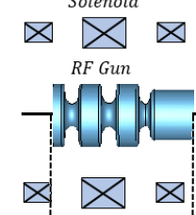

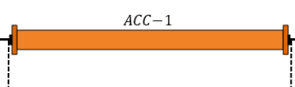
150 MeV injector – RF layout
25 MW, x-band
50 MW, x-band
ϕ
15 MW, S-band
A, ϕ
PC, 120-130 MW
PC, 90 MW
Long waveguides 40-50 m
Round or double height WG needed
Solenoid
Solenoid
X
X
X
X
X
X
X
X
X
X
X
X
X
X
3 structures at 55 MV/m
This solution gives a bit more margin in 12 GHz power and makes optimal use of contributed equipment from CLIC (cost savings)

Slide 5
Integration constraints and status
Study K400 + K400 + K300
Transport passage
We try to find positions for the equipment which allows to change the klystrons with a reasonable effort

Slide 6
Integration constraints
Fire hose
Height
beams
240mm
1860mm
1890mm
2750mm
900mm
Height under
beams

Slide 7
Space for dismantling
with new crane
( level 1 or between the beams)
540mm
500mm
900mm
space for dismantling
with existing crane (level 1)

Slide 8
Existing crane
New crane
The position of the K400 can be optimized
if it is possible to shift the existing crane.

Slide 9
Electron Source Integration status

Slide 10
Injector 1, seeding injector
Injector 1:
All elements are basically known.
Detailed mechanical design of supports and vacuum chambers can/has started
As in Run1 with
CsTe cathode

Slide 11
Injector 2, Probe beam injector
Injector 2:
Integration has started, still many elements not known in detail.
But a lot of progress !

Slide 12
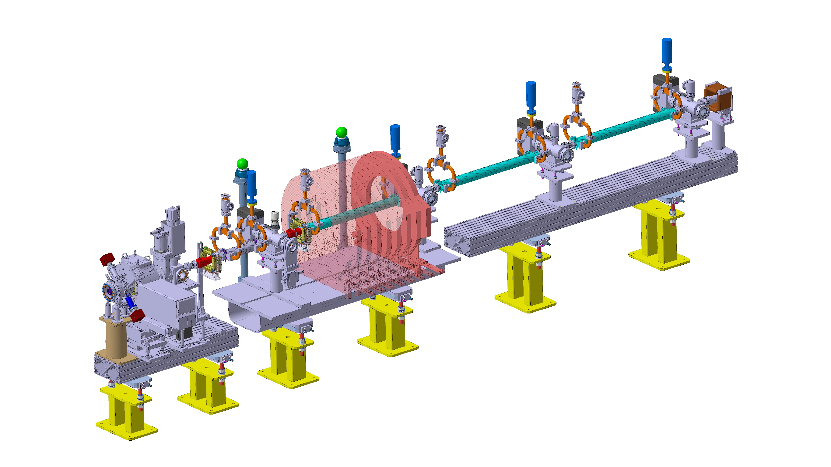
Current 3D model of Injector 2
Used to study integration and sort out interface with other groups
Currently assuming a copper cathode

Slide 13
Electron Source Integration status
Waveguide routing study
PROPOSAL C
Length: 46 and 49m
This version is currently our preferred one → base line
we will study this one in more detail
90°
90°
90°
Length: 34m

Slide 14
Waveguide routing study
PROPOSAL B
New crossing
2 WAVE GUIDE K400/K300 => Ø70 mm
1 WAVE GUIDE K300 => REC 80*42 mm
ANGLE DIFFERENCE TO RECOVER
SLOPE TCV4 0°
SLOPE TCC4 3.24 °
2m
K300
K300
K400
2.2m

Slide 15


Key component procurements

Slide 16
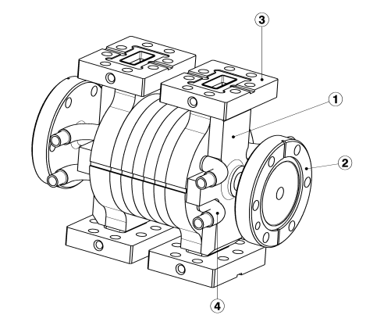
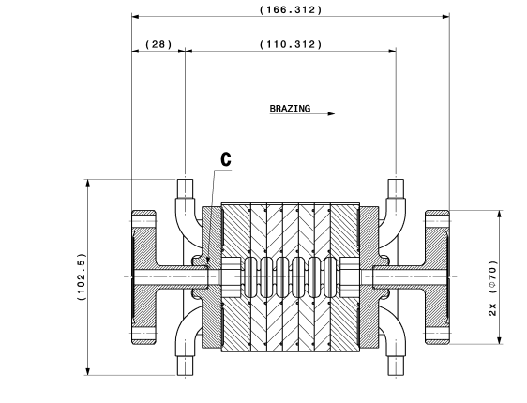
First short prototype under construction
C. Capelli, N. Chritin
Verify mechanical design, brazing assembly and tolerances needed
Maybe low power RF measurements but no high-power test planned

Slide 17
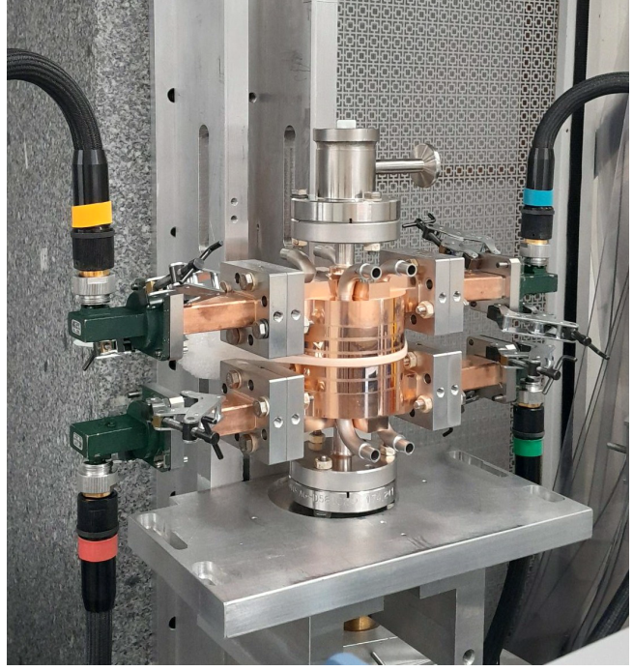
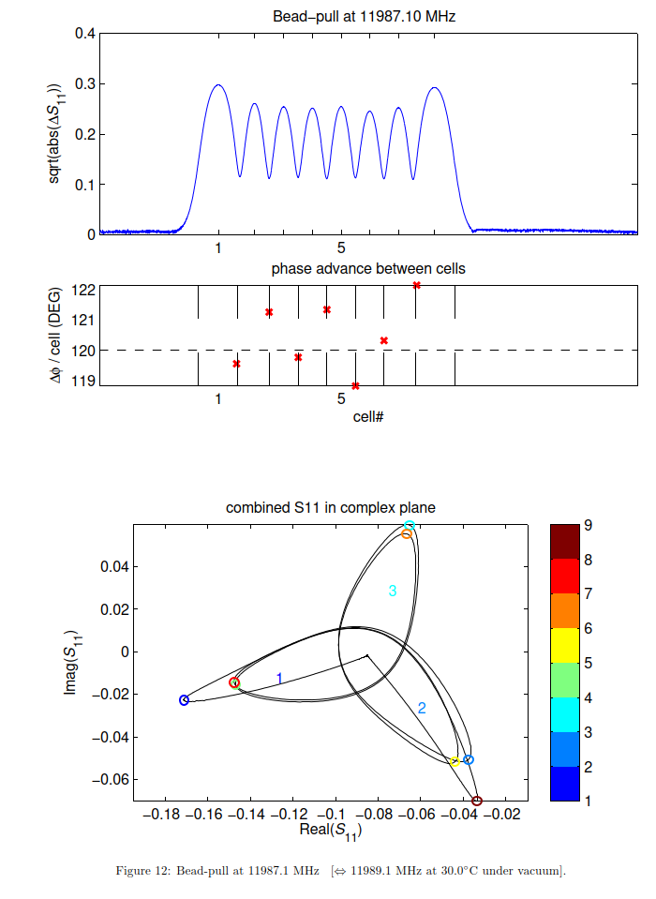
AWAKE 12 GHz accelerating structure prototype
Mechanical, vacuum and RF measurements done to evaluate prototype, now being cut for further analysis

Slide 18
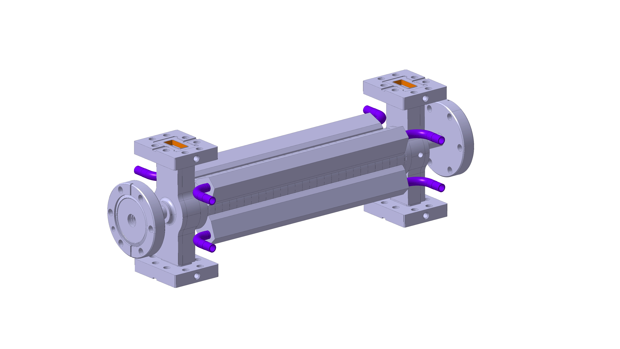
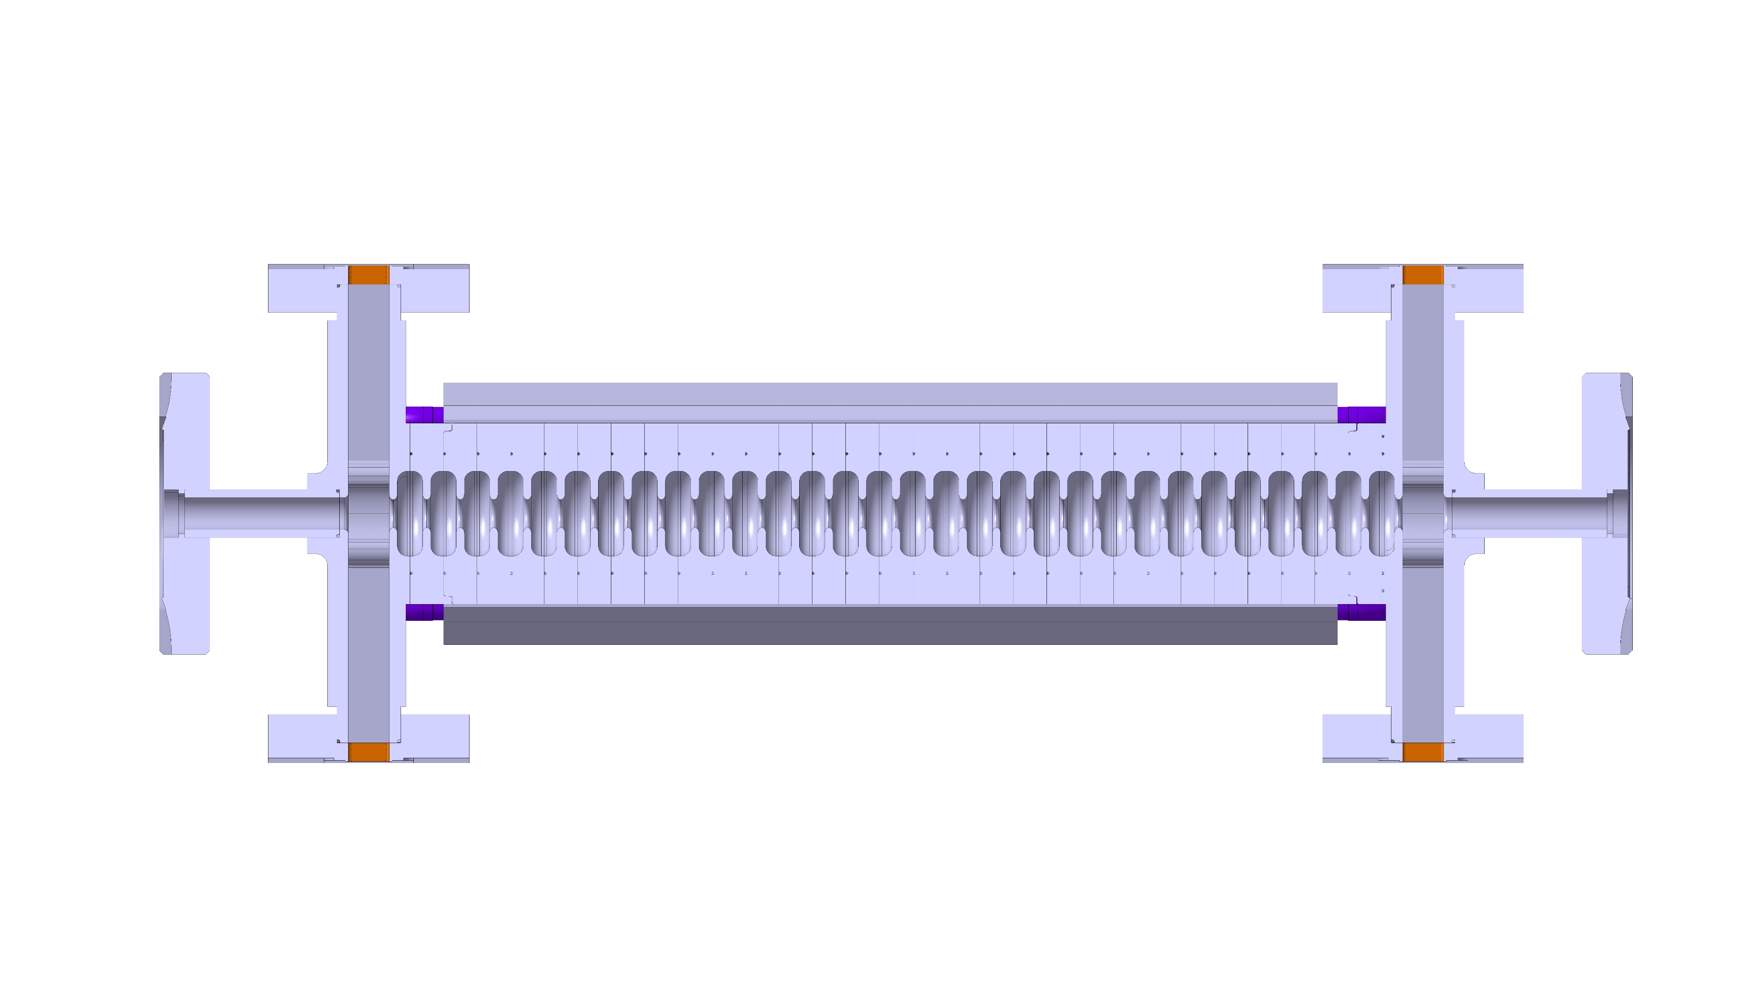
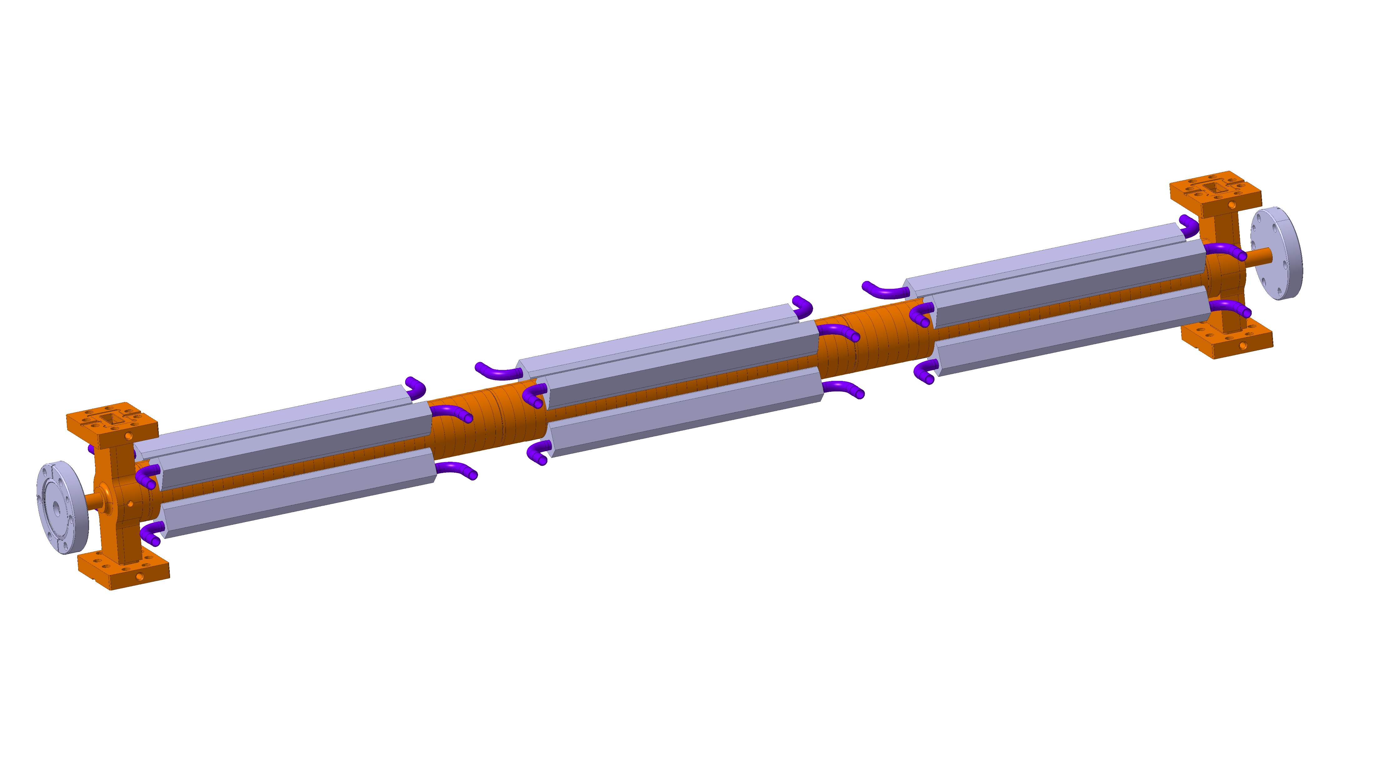
Next prototype and final structure
30 cm
90 cm
C. Capelli, N. Chritin
C. Capelli, N. Chritin

Slide 19
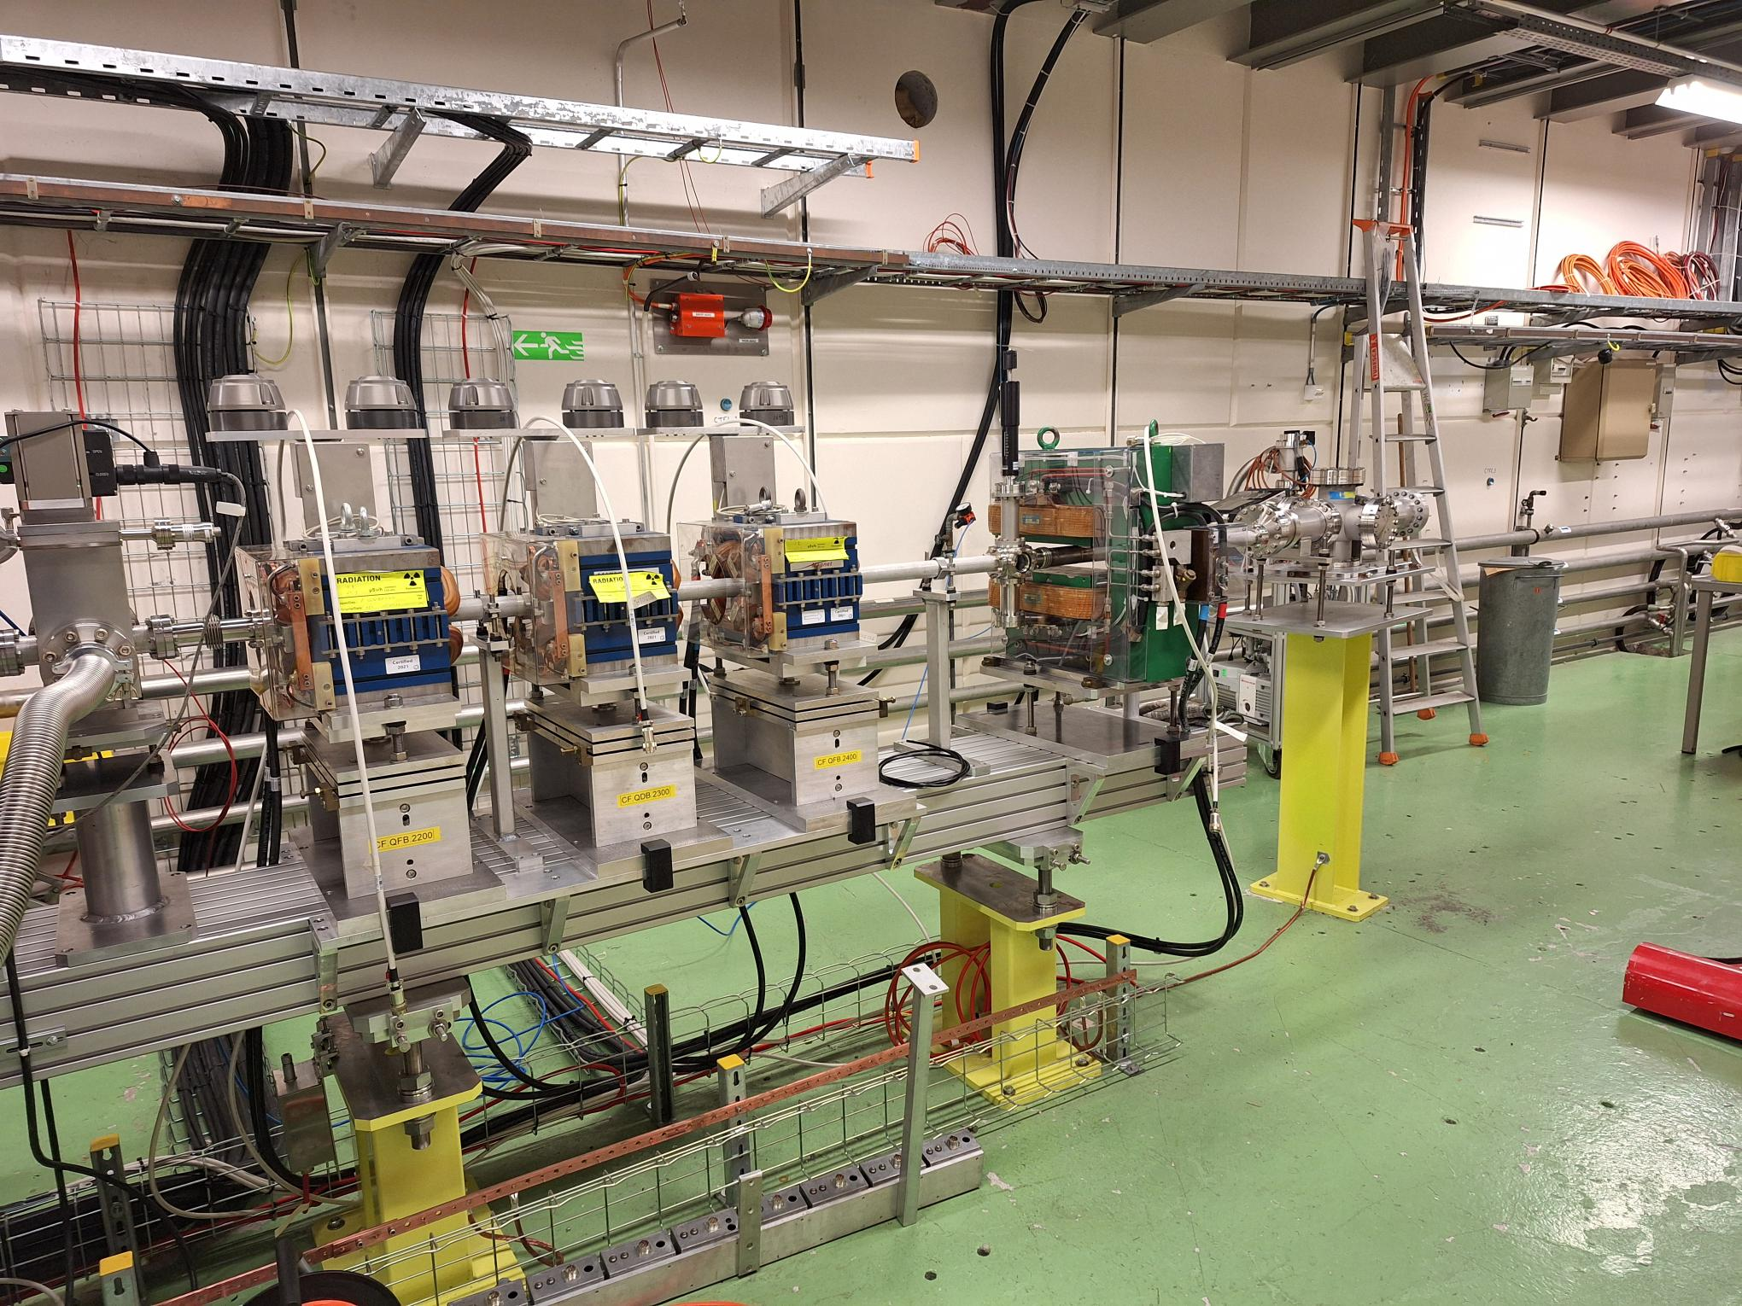
ARTI status
RF-gun and diagnostics operational
Magnets for second phase installed
Vacuum system installed
Missing the x-band waveguide system
and the klystron (still at CPI for repair)
First ‘user’ experiment sucessful:
Vlad’s CBS experiment

Slide 20
User Experiment Compton Back Scattering
First user experiment with quite demanding stability requirements:
Vlad Musat, time delay scan to detect photons in an MCP
preliminary

Slide 21
Conclusion and Issues
Purchasing of key components has started
Integration studies and detailed mechanical designs are progressing
Keeping the schedule will remain a challenge
Due to x-band klystron delay need to rethink CTF2 prototype strategy
Need to develop detailed construction and commissioning schedule

Slide 22
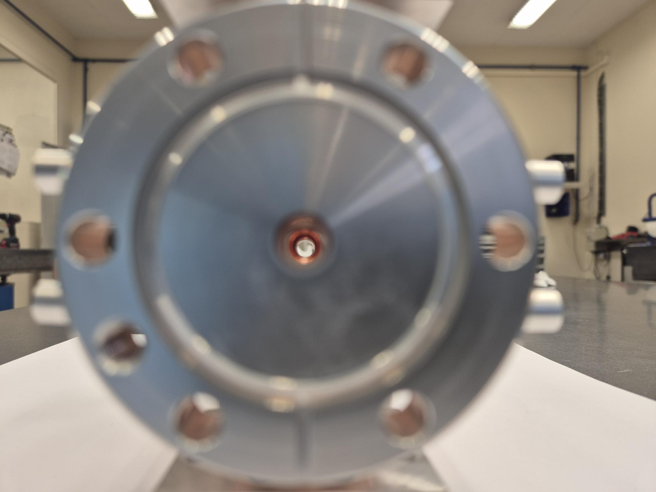
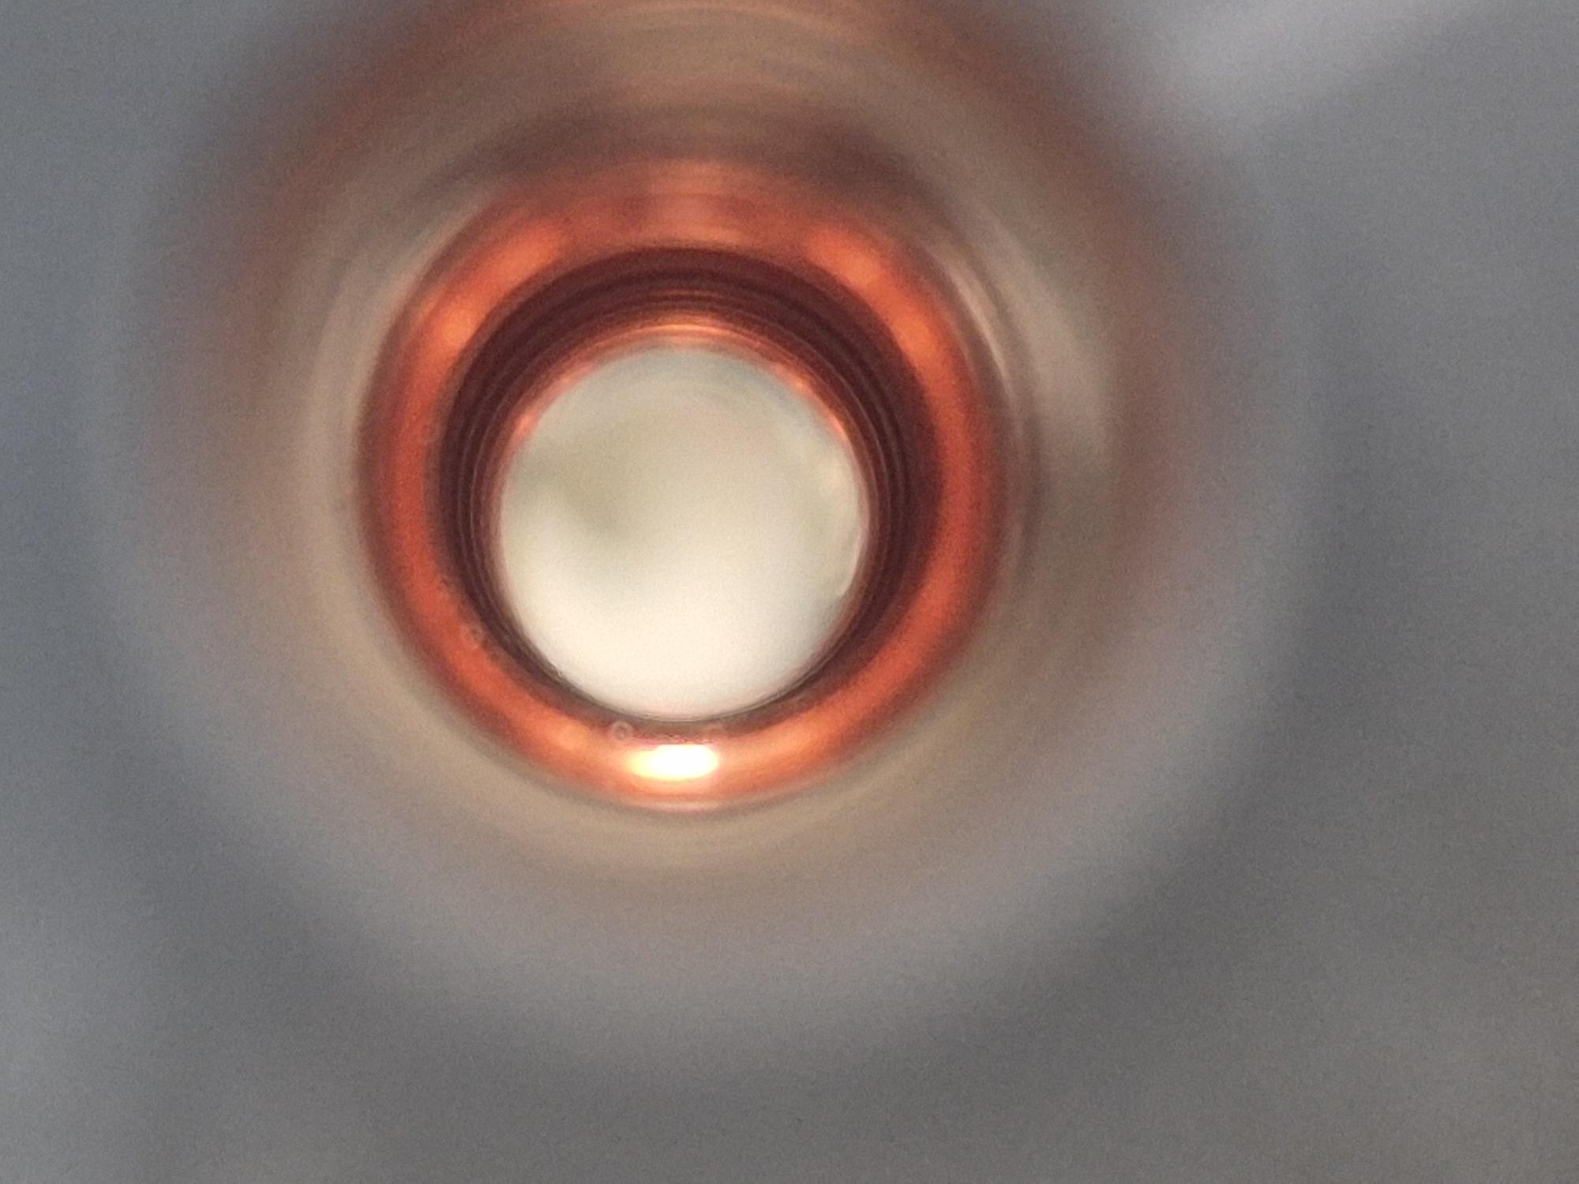
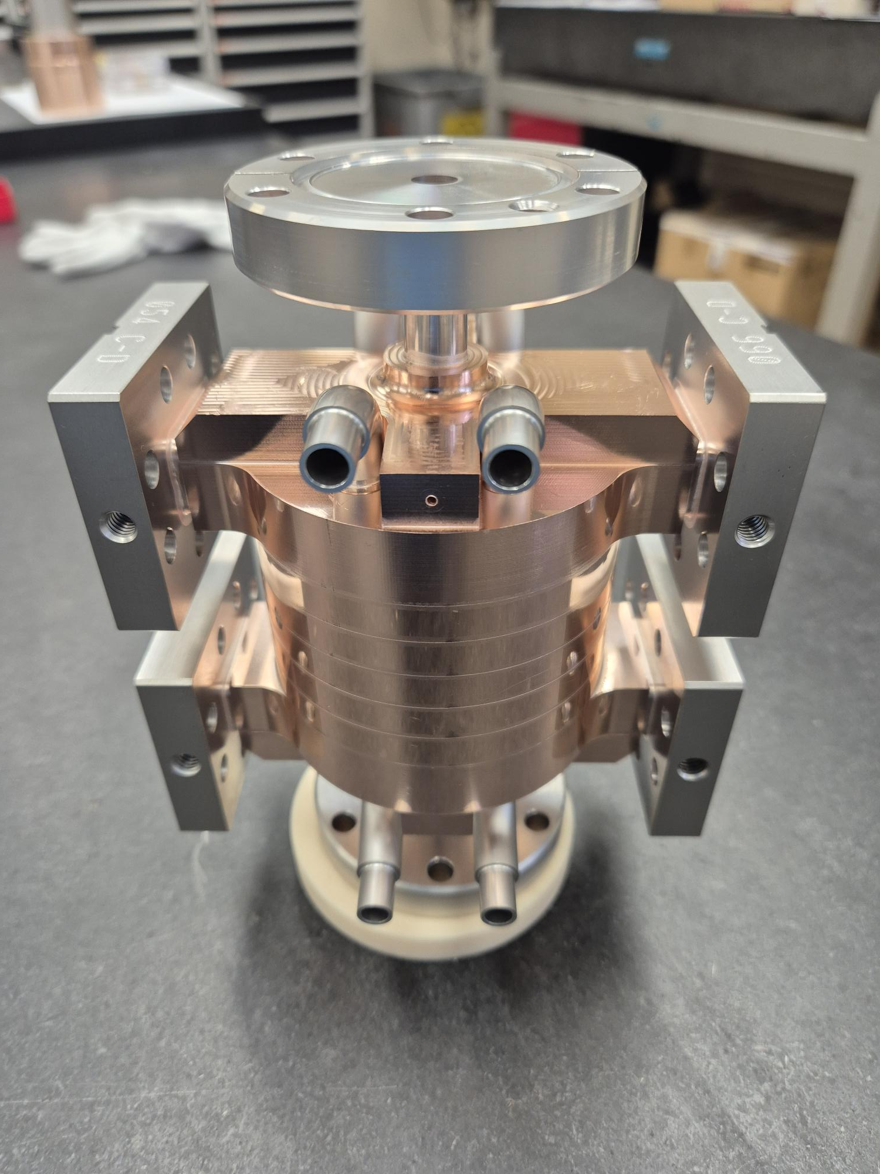
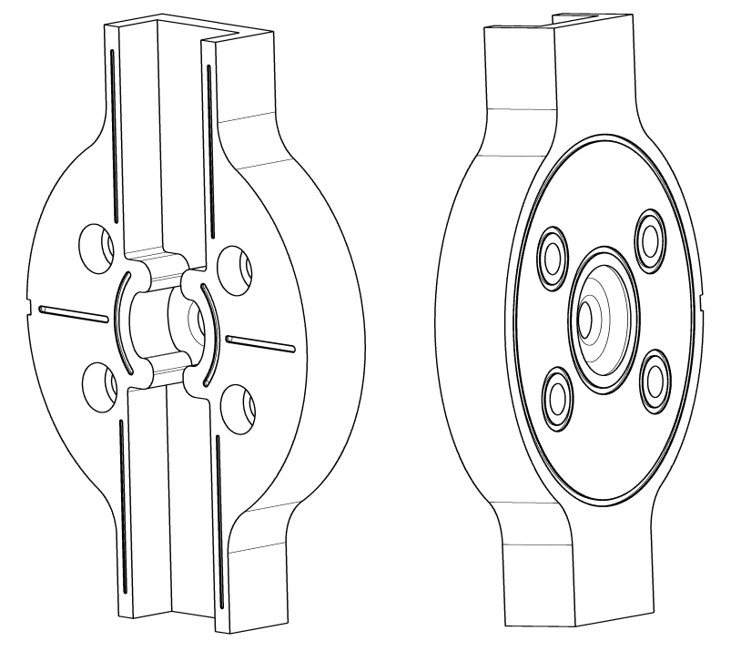
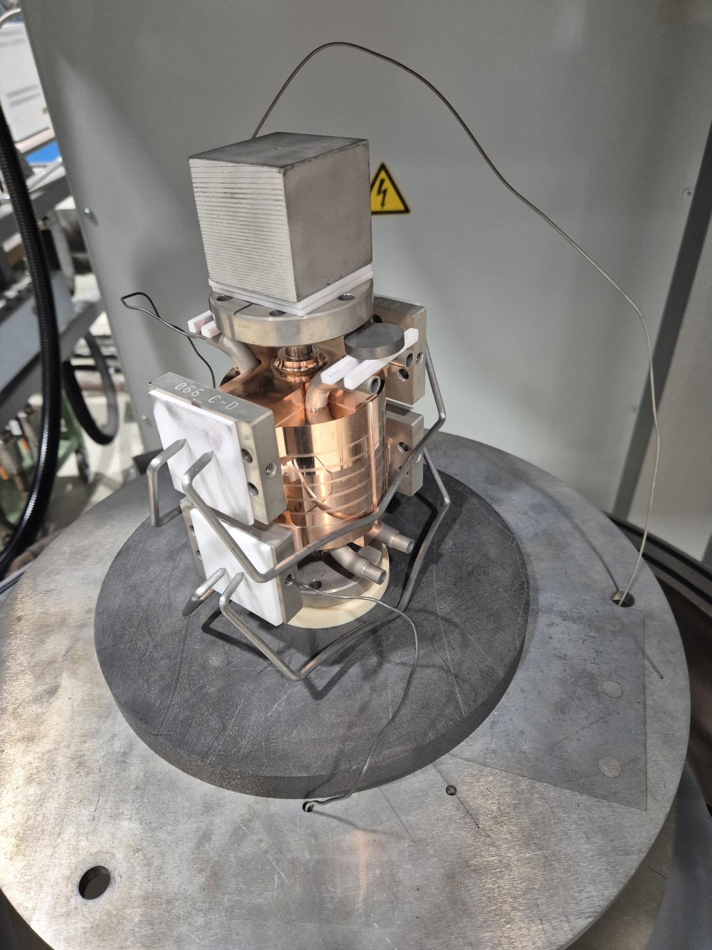
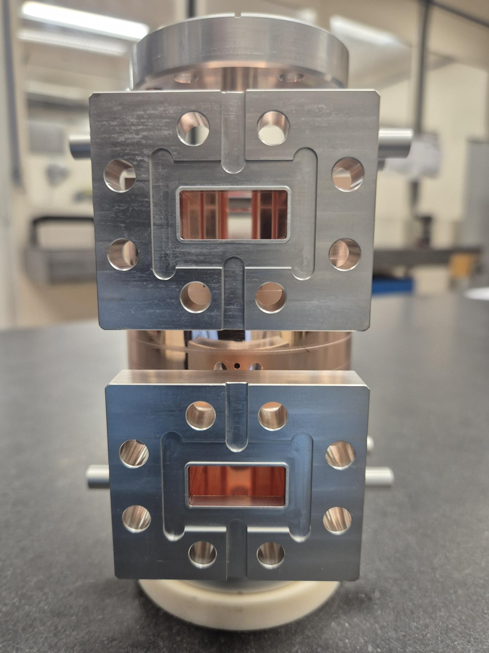
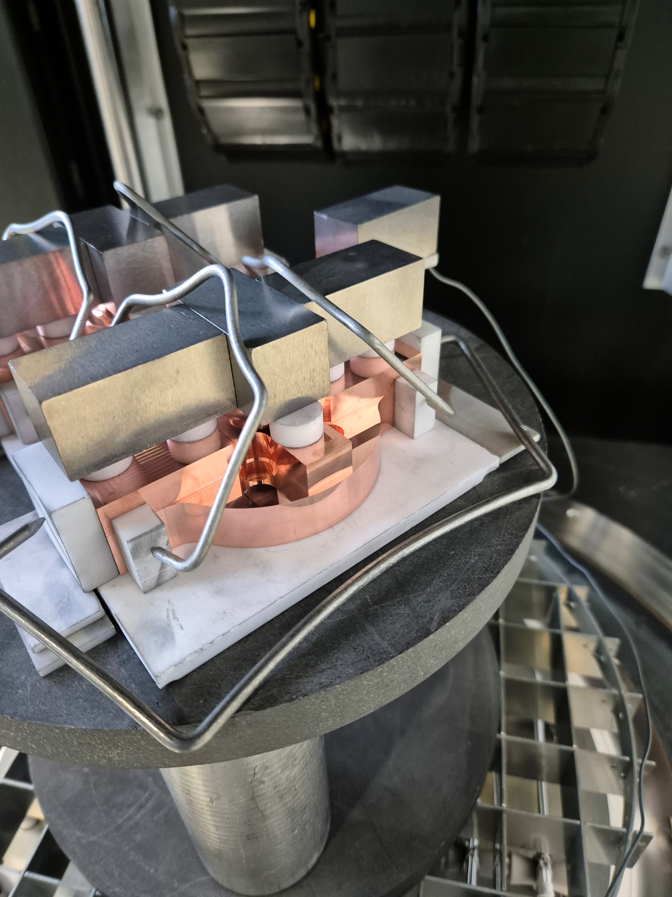
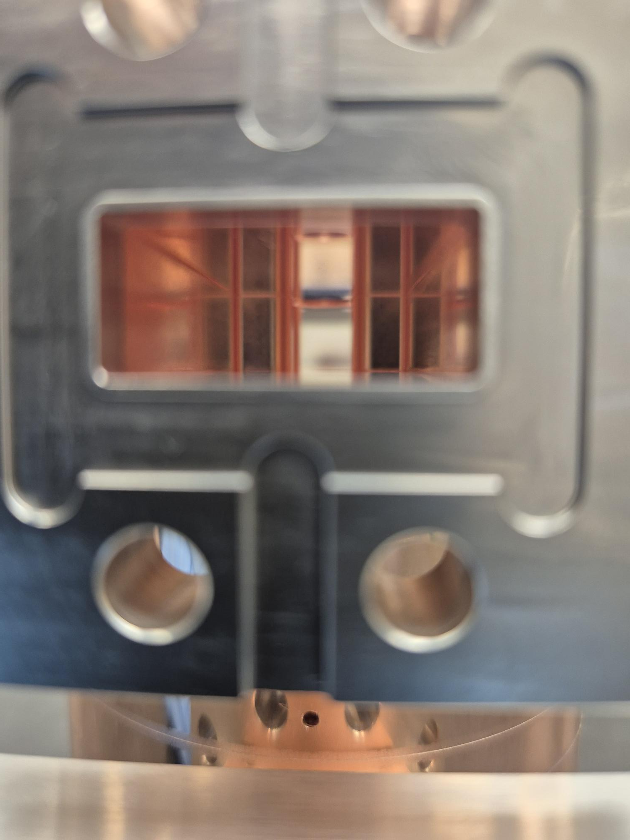
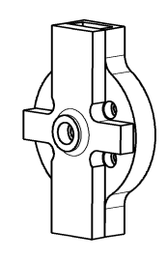
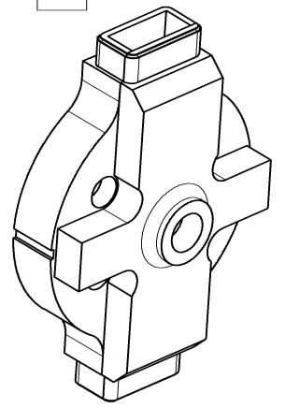
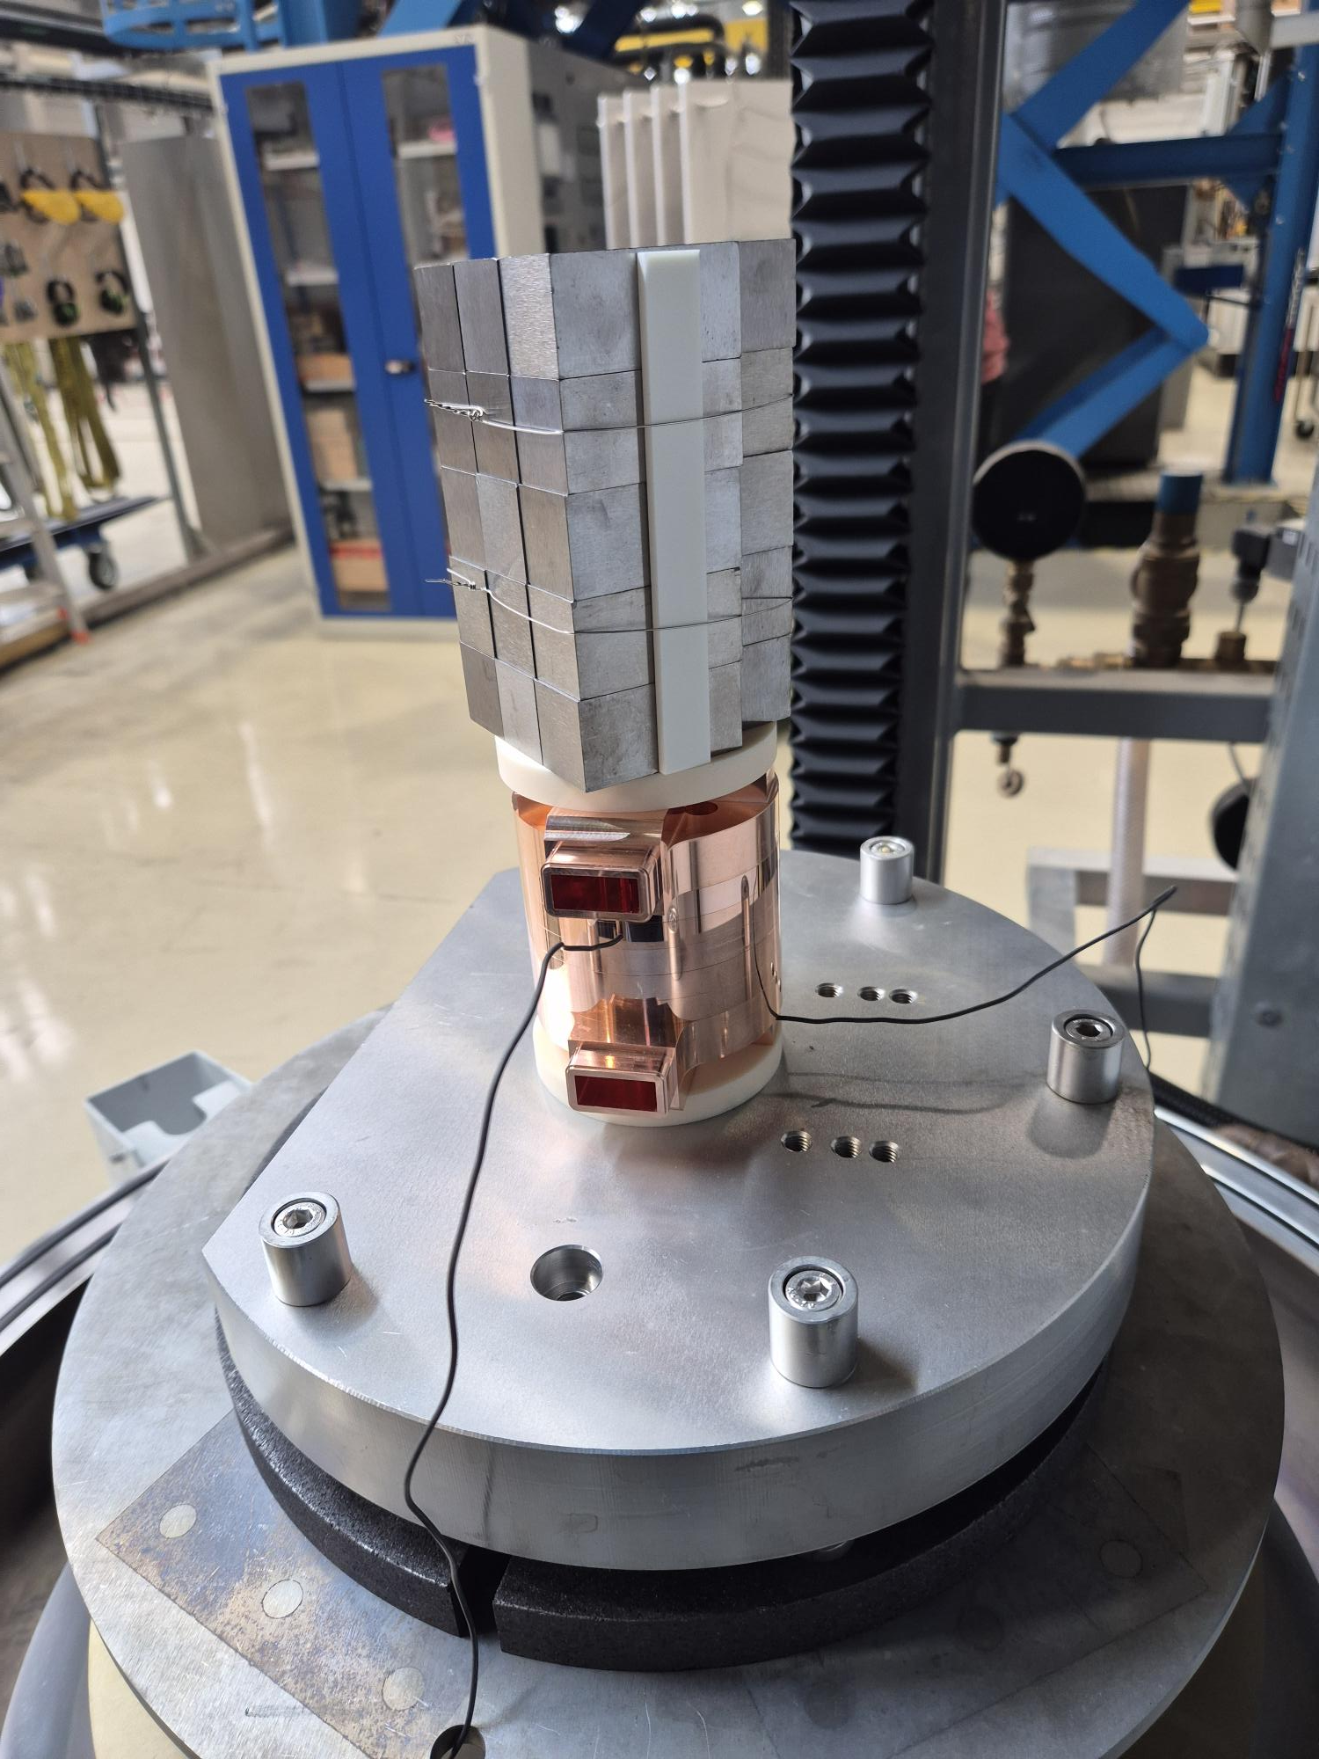
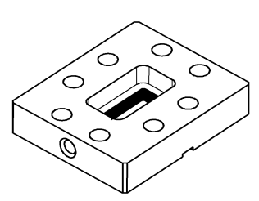
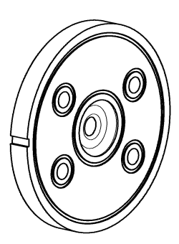
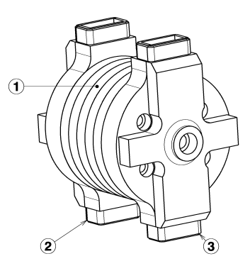
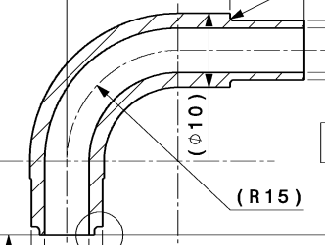
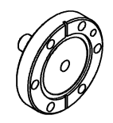
Structure Awake - 3 brazing steps
AgCu : 780°C
AgCuPb10 : 850°C
Brazing
AgCuPb5 : 810°C
Machining
+
x4
x2
+
x5
x8
x2

Slide 23
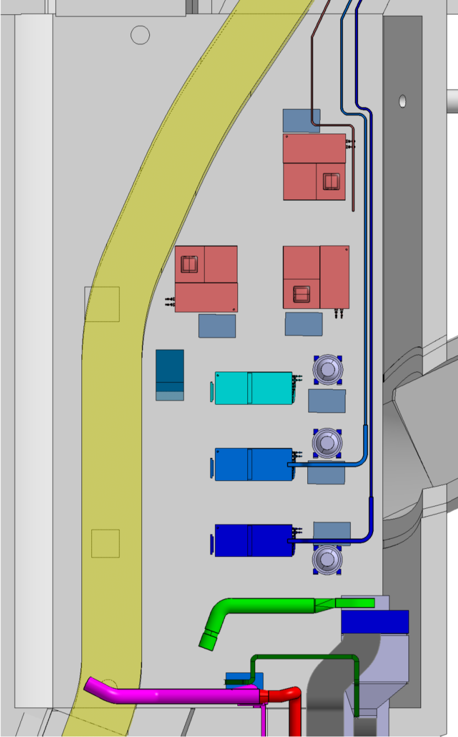
150 MeV injector – RF layout
7-10 MW, S-band
5-10 MW, x-band
25 / 50 MW, x-band
Klystron layout on the tunnel
PC, 15 -20 MW
PC, 160 -200 MW
A, ϕ
Possibly long waveguides 30 m
Round or double height WG needed
Solenoid
Solenoid
X
X
X
X
X
X
X
X
X
X
X
X
X
X
3 structures at 55 MV/m
Total Energy 100- 160 MeV, 10 Hz rep. rate, single bunch
Will use CLIC developed x-band components as much as possible
Multiple RF-power configurations studied

