Slide 1
Laser system update
Eduardo Granados (SY-STI)
On behalf of the SY-STI-LP section

Slide 2
Agenda
Photoinjector status – February 2025
Run 2c laser beamline design status:
  IR beamlines:
    Transport (cubes)
    Compressor #2
    Integration
    Merging chamber #2 position and new focusing arrangement
  UV beamlines:
    Stretcher design

Slide 3
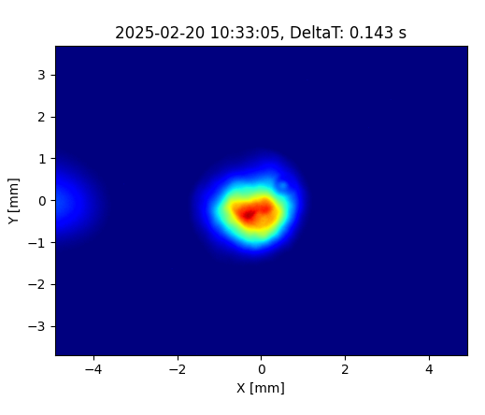
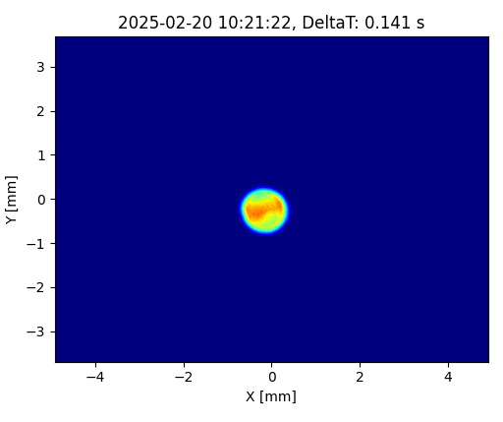
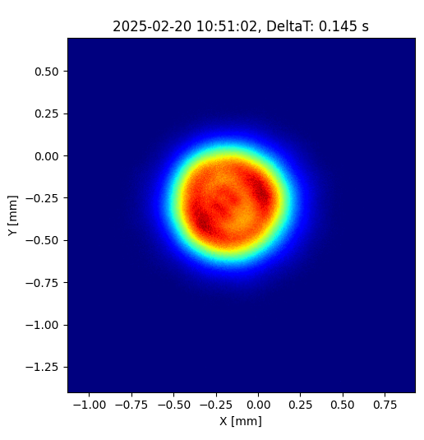
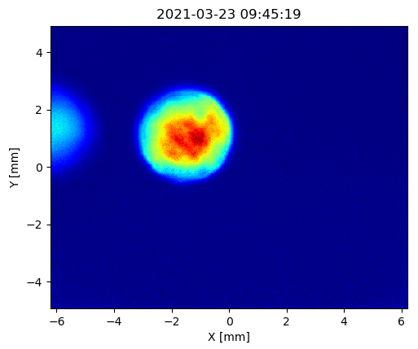
Status in February 2025
During summer 2024, the UV telescope was readjusted to increase the available laser fluence on cathode (in order to mitigate the photocathode aging).
The maximum attainable fluence on cathode was increased by a factor of >2x by reducing the spot size (iris open).
Setting since summer 2024
Iris open
1 mm diameter
~0.5 mm diameter
Old telescope setting

Slide 4
Status in February 2025
Compare the laser energy needed to produce a 300 pC electron bunch:
  Raised from 50 – 100 nJ to 500 – 1500 nJ (a factor of 10x – 15x higher laser pulse energies are required to produce the same electron bunch charge).
QE has decreased from ~8% to around ~0.4% (factor of 20x, both measured in the PHIN RF gun)
Saturation fluence increased from 4 µJ/cm² to ~30 µJ/cm², possibly due to aging / exposure to contaminants.

Slide 5
Comparison table and conclusions
Parameter | 2025 | 2024 | 2023 | 2022 | 2021
QE | 0.4% | 8% | 15% | 25% | 5.5% (used)
Saturated QE | 0.15% | 2% | 4% | 5% | 1.8%
Saturation fluence | 30 uJ/cm² | 4 uJ/cm² | <5 uJ/cm² | 2.5 uJ/cm² | 4 uJ/cm²
In the current condition, the maximum bunch charge attainable is 600 pC.
No signs of exposure to air (vacuum level through the entire period indicate no leaks).
The safest option would be to use this cathode until an intervention is scheduled in May (between runs).
Intervention in May (if required):
  Bringing the photocathode transport carrier to AWAKE (with rejuvenated photocathode #217 with QE ~10%, alongside new copper photocathode for June tests).
  Requires baking of the SAS (24 hours) after connecting transport carrier to manipulator chamber.
  Replace photocathode # with photocathode #217.
  Conditioning work (1-2 days).

Slide 6

Laser beams concept for Run 2c
IR beamlines
UV beamlines
3 GHz
RF ref
3 GHz
Existing Ti:Sapphire laser
New laser for
photo-injectors
TSG40
TSG4
SYNC 10 Hz
SYNC 3 kHz
f*300
TT41
TSG42
Split / Delay
TCC4
TCC4
Split / Delay
Compressor 1
Compressor 2
e- gun 1
e- gun 2
Rb cell 1
Rb cell 2

Slide 7
IR beamlines for plasma cells
Laser (at ~15 m)
63 m
~46 m
Variable splitter
CCD
Relay system
Relay system
CCD
~46 m
Delay stage
CCD
Merging chamber
Relay system
Plasma cell 1
Plasma cell 2
Beam
expander
Beam
expander
CCD
Diagnostics PC1
Diagnostics spatiotemporal
overlap
Diagnostics PC2
CCD
Virtual
Virtual
Compressor 1
Compressor 2
CCD
~30 m
~30 m
CCD
Increase spot size on gratings within the pulse compressor, allows use full potential of the laser system
Spot size with longer focal length in each arm, to be checked: beam propagation in Rb (Gabor)
Study of tolerances, transmission, beam pointing stability for optomechanical design + controls
Stretched pulse
Compressed pulse
Mirror leak

Slide 8
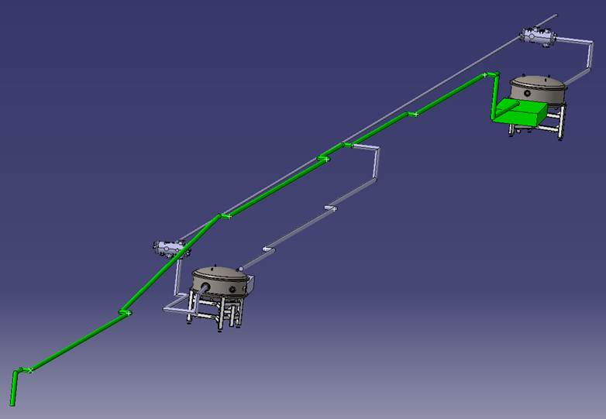
IR beamlines
Stretched IR lines
TT41
46 m
Split point
IR line 2
Compressor 2
63 m
IR line 1
46 m
Main beam
Compressor 1
Laser room
Nicolas Critin

Slide 9
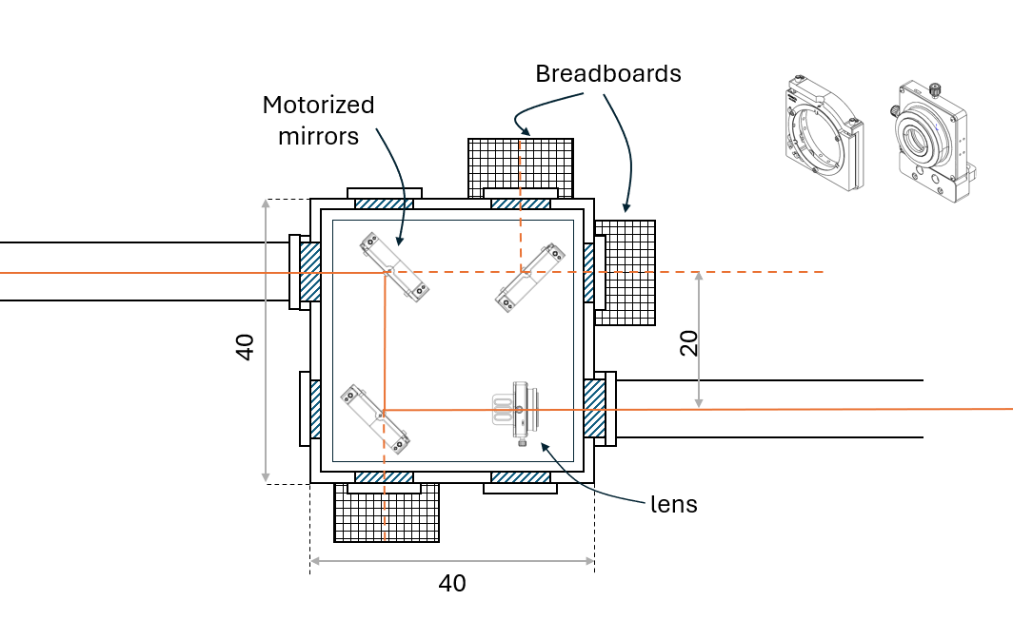
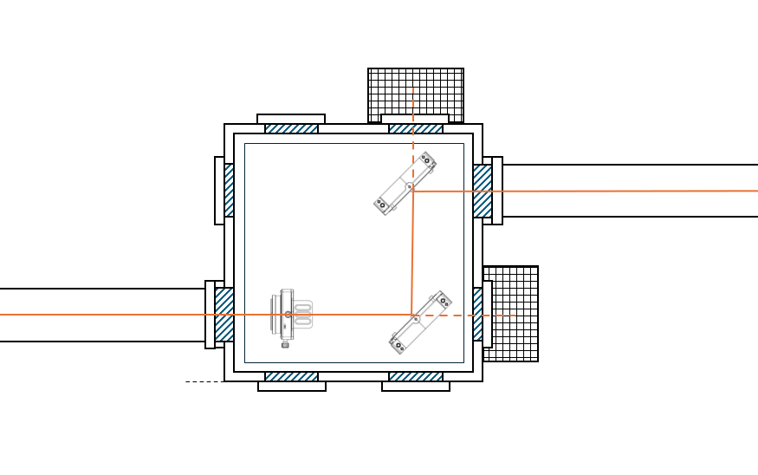
Interconnecting boxes concept
Input of telescope
Relay system
Output of telescope
Profile / energy
Feedthroughs
Beam position
Feedthroughs
…
lens
Beam position

Slide 10
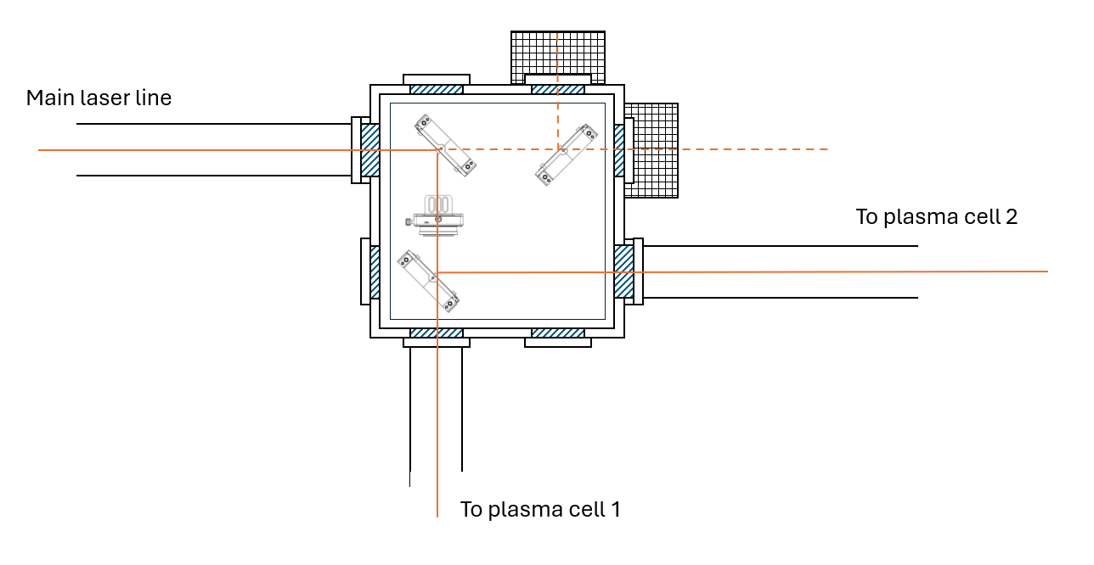
Split point plasma cell 1 & 2
HR mirror
Beam position
Motorized waveplate
50:50
Polarizer
Feedthroughs

Slide 11
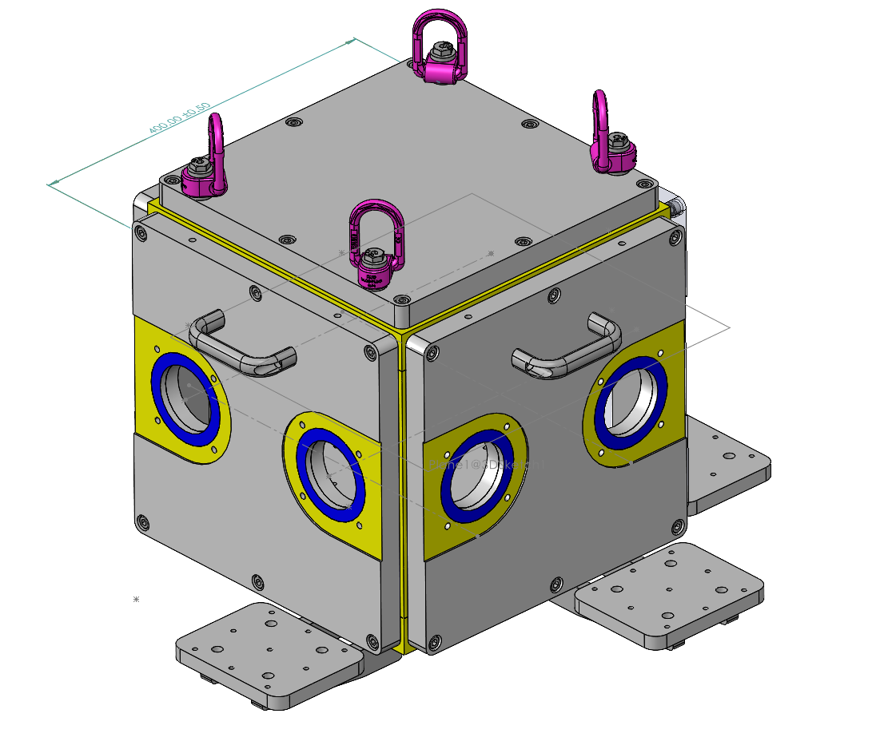
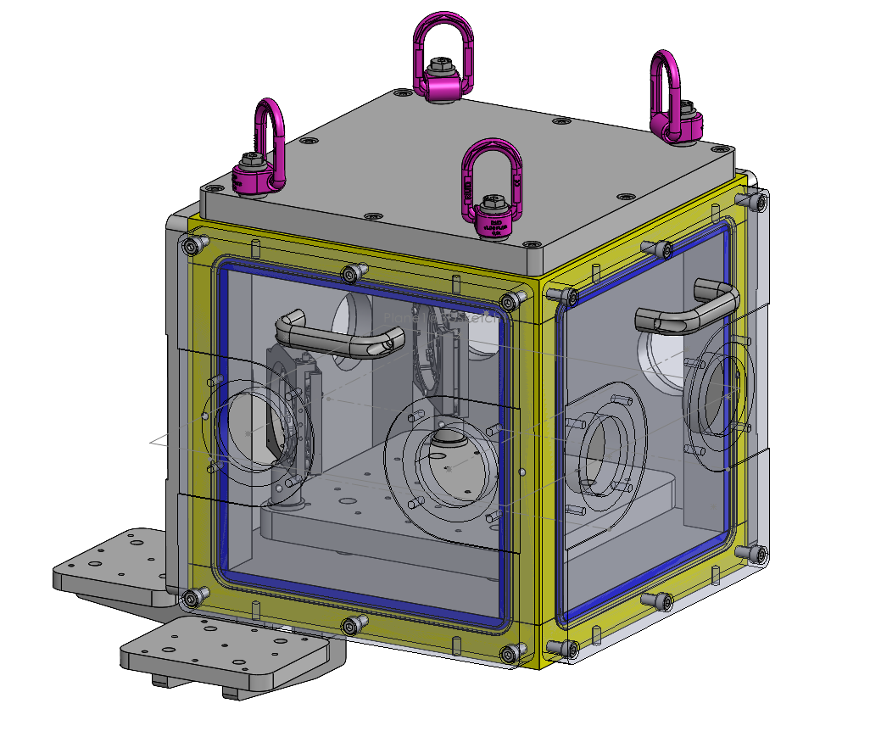
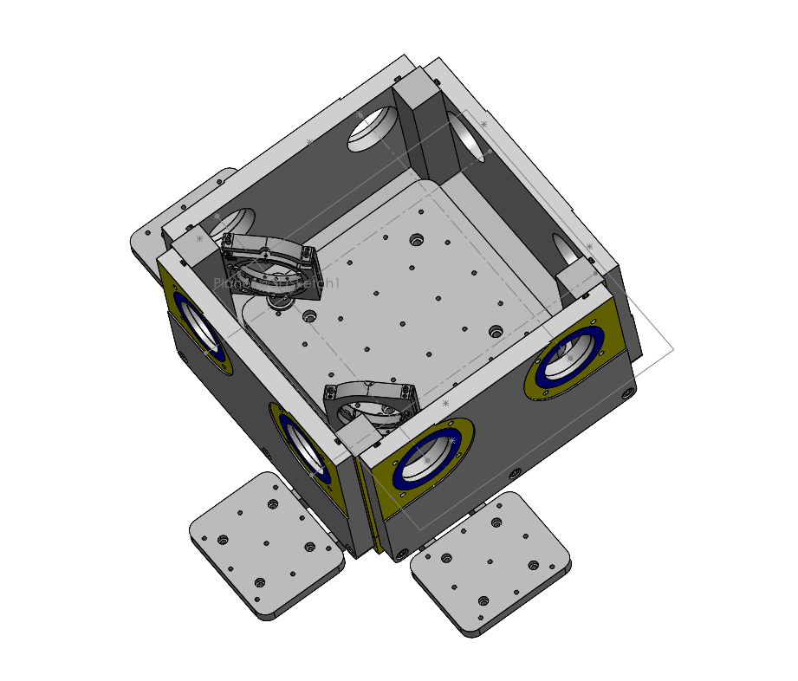
Interconnecting boxes
Meeting with Stretcher, design proposal discussed -> requested quote for 15 of these boxes
Design is too tight, needs to be enlarged by 10 cm in each direction
On-going discussion with vacuum team (Maria Carmen) to sectorize beamlines and pumping requirements. Simulations indicate 10⁻⁵ mBar achievable.

Slide 12
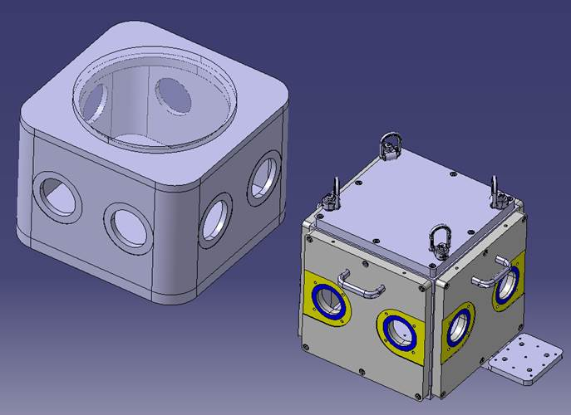
Interconnecting boxes
Simpler design being proposed by N. Chritin.
Requires welding 2 halves of the chamber.
Advantages include larger inner space for optical mounts, potentially lower cost (estimate underway).
Construction in 2026?
Integration of controls and diagnostics to be discussed with BE-CEM and SY-BI (+cabling).

Slide 13
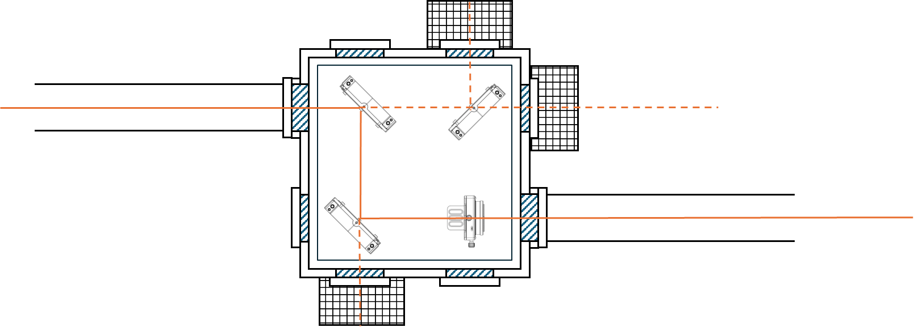
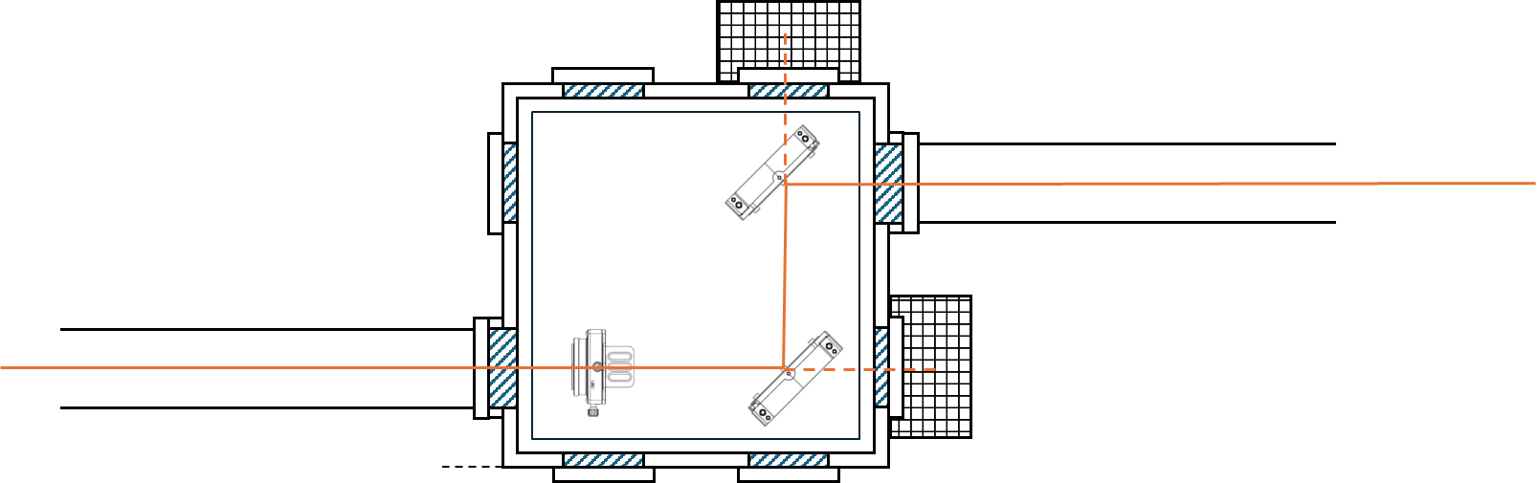
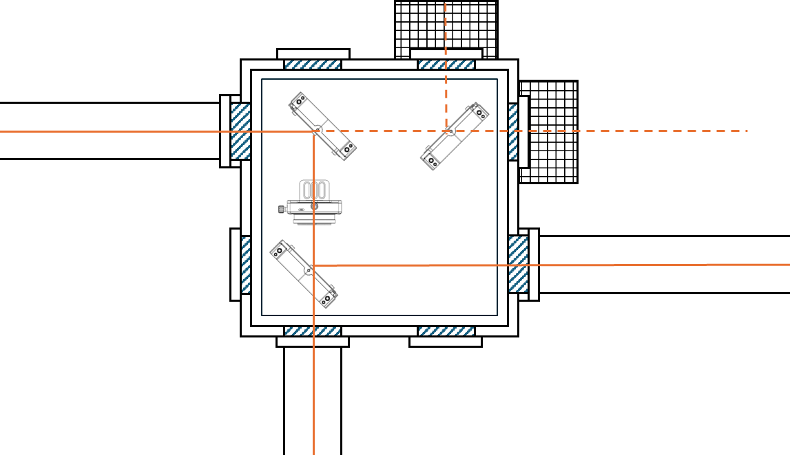
Distances and locations for compressor to be adjusted
Periscope
16.4 m
14 m
7 m
f = 10 m
f = 10 m
f = 10 m
f = 10 m
…
…
f = 7 m
…
…
…
f = 7 m
20 m
~5 m
…
20 m
19.6 m
20 m
…
Periscope to optical table
Compressor 2
f = 7 m
f = 7 m
Periscope to optical table
…
0.6 m
7.6 m
1.55 m
Compressor 1
Optical table
…
17 m
7 m
14 m
1.6 m
0.4 m
Merging chamber 1
0.3 m
27 m
1 m
Plasma 1
Plasma 2
25 m
0.7 m
4.7 m
0.3 m
36 m
35 m
Design is not fixed yet due to spectrometer magnet position

Slide 14
Compressors optical tables
2 m
Motorized delay 1
Motorized beam positioning
Motorized delay 2
Power meter
0.6 m
1 m
0.6 m
Motorized telescope
Motorized attenuator
Splitter
CCD
To compressor
Motorized beam positioning
Pick-off
Input
point
output
point
Nominal optical beam path from input to output point = 0.33+ 0.68 + 1.3 + 0.08 + 0.9 + 0.08 + 0.5 + 0.5 + 0.8 = 5.17 m
Minimum path length = 5.17 – 4*0.3 = 3.97 m
Maximum path length = 5.17 + 4*0.3 = 6.37 m
Delay range (total) = 2.4 m (+/- 3.6 ns)

Slide 15
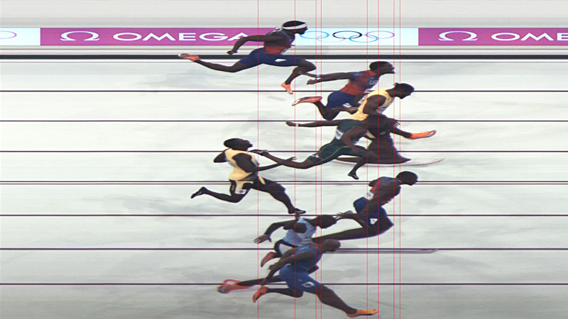
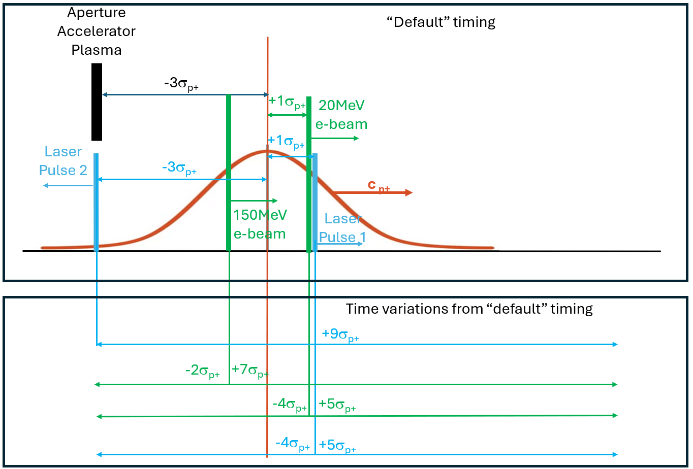
‘Time 0’
Current ‘picture’
Defining delays:
Rather than ‘time of arrival’, we take spatial distance between beams at a particular time wrt to a known position.
Final specification of delay stage ranges
Patric Muggli

Slide 16
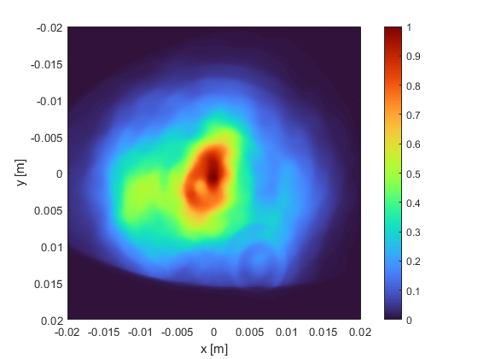
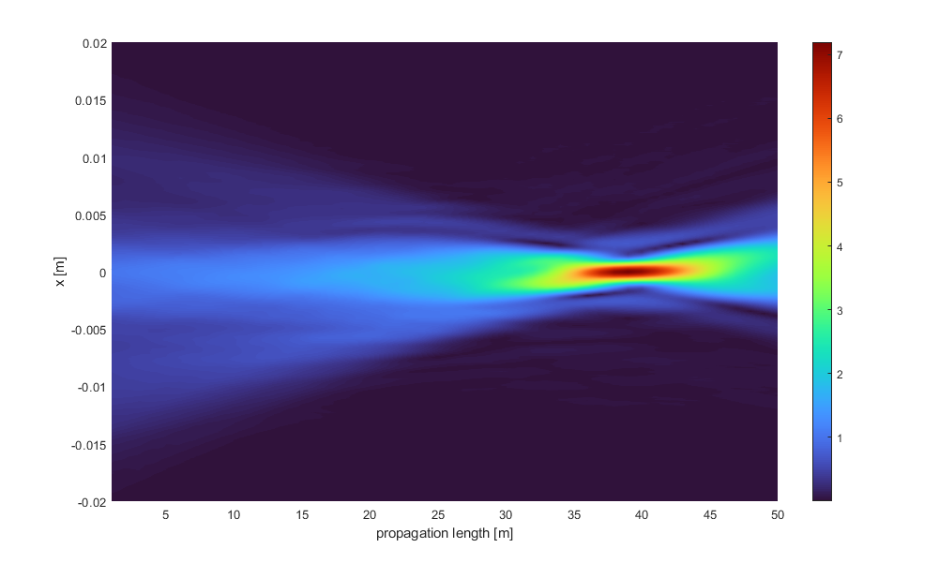
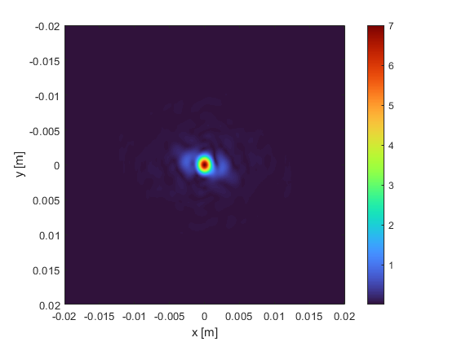
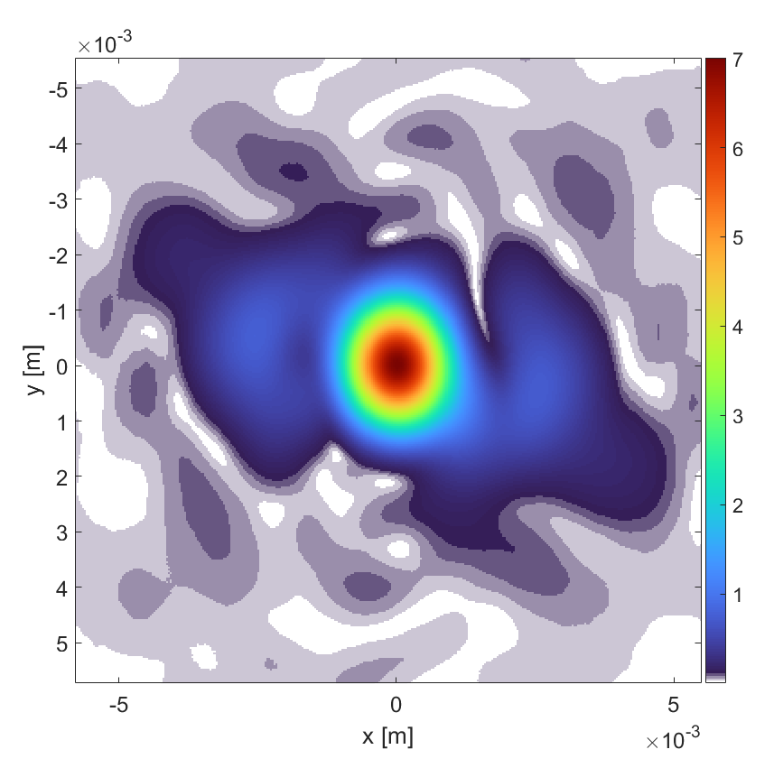
Current focusing geometry into vapour source
Compressor output
Input vapor source
Current focusing geometry
Input vapor source

Slide 17
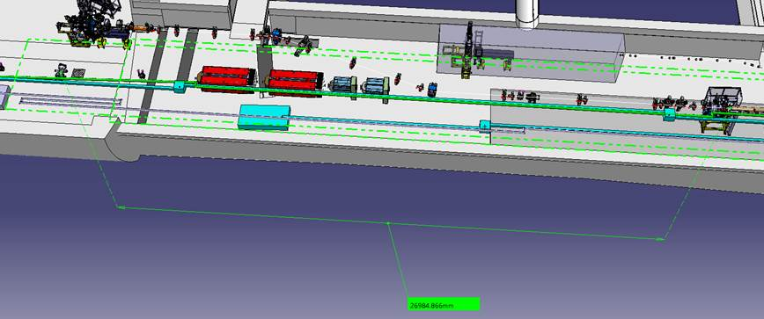
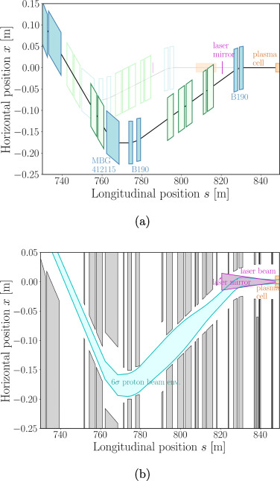
Position of the merging chamber #1 in run 2c
20 m
Merging chamber #1
Vapour source 1
Nicolas Chritin
distance = ~ 27 m
(+5 meters compared to run2b)
Confirmation of the position of the merging chamber #1 necessary
https://www.sciencedirect.com/science/article/pii/S0168900223000840

Slide 18
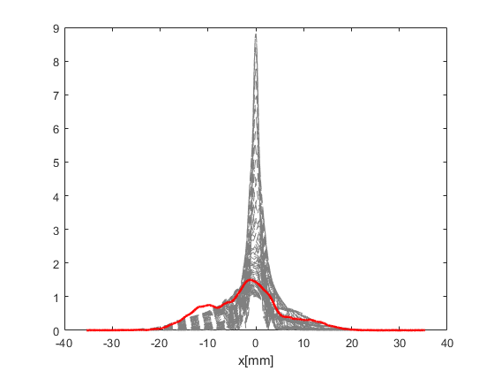
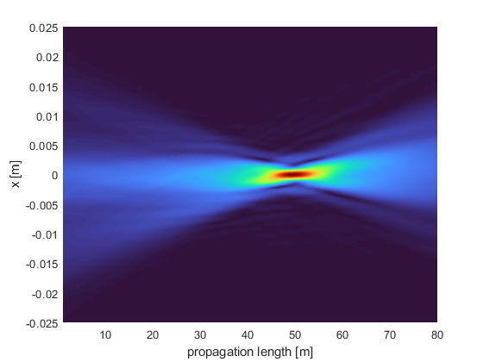
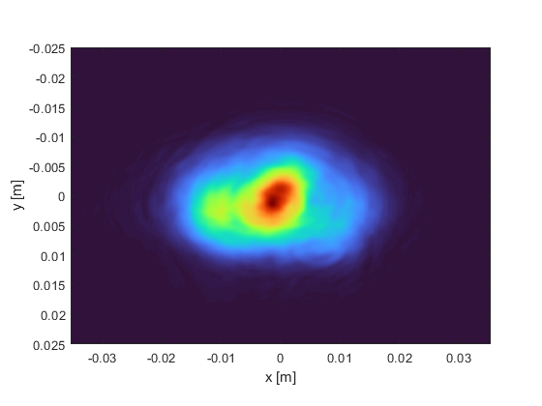
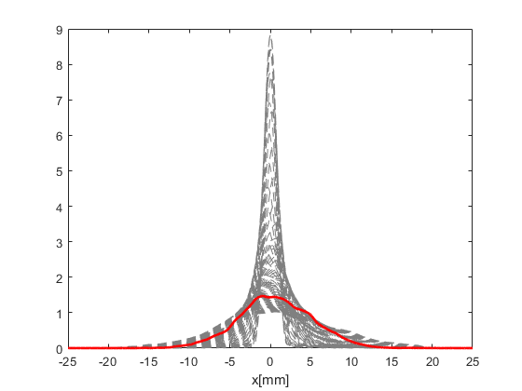
Merging chamber #2 mirror footprint and focusing
Horizontal
Mirror position
Vapor source
Laser footprint on merging chamber mirror
30 m
Vertical
Input beam needs to be magnified by 5/4x → 60% increase in pulse energy at the compressor

Slide 19
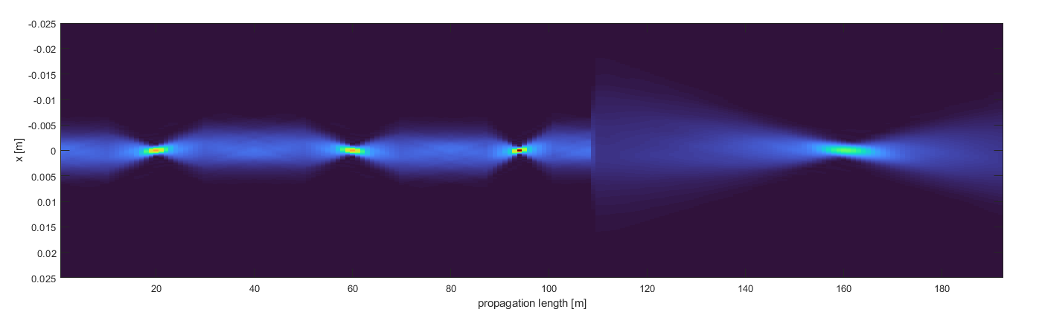
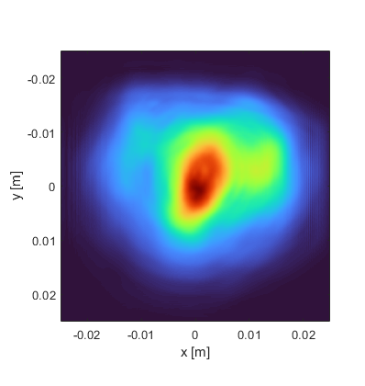
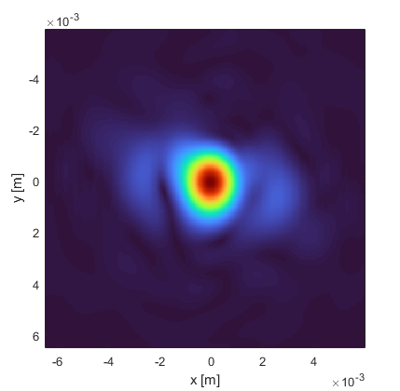
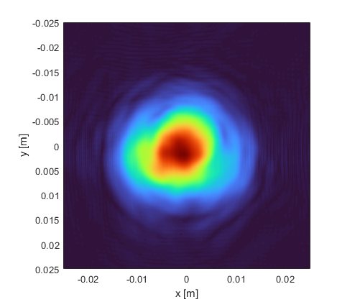
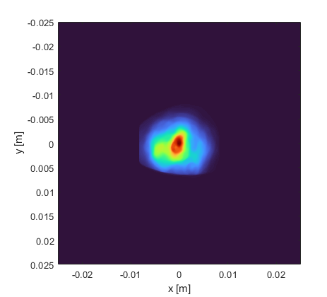
Full IR beam transport and focusing simulations
expander
f = 50 m
1st telescope
2nd telescope
3rd telescope
f = 10 m
f = 10 m
f = 7 m
Vapour source
Laser room
Split point
Compressor

Slide 20
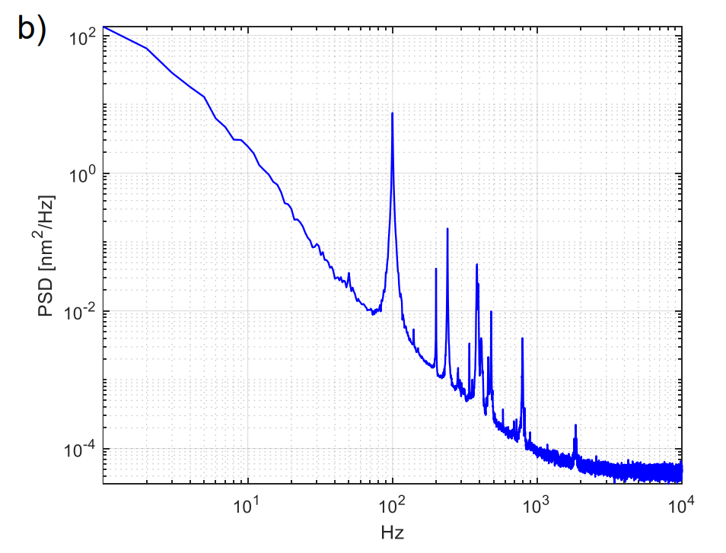
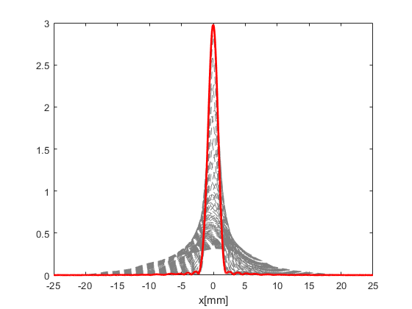
Full IR beam transport and focusing simulations
Current Run 2b (39.5 m focal)
SPS vibration analysis
Design Run 2c (50 m focal)
https://cds.cern.ch/record/2868829
Next steps:
Fluence calculation on optics.
Tolerances and apertures.
Pointing stability simulation.

Slide 21
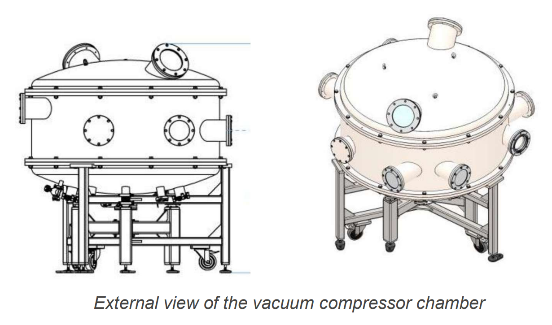
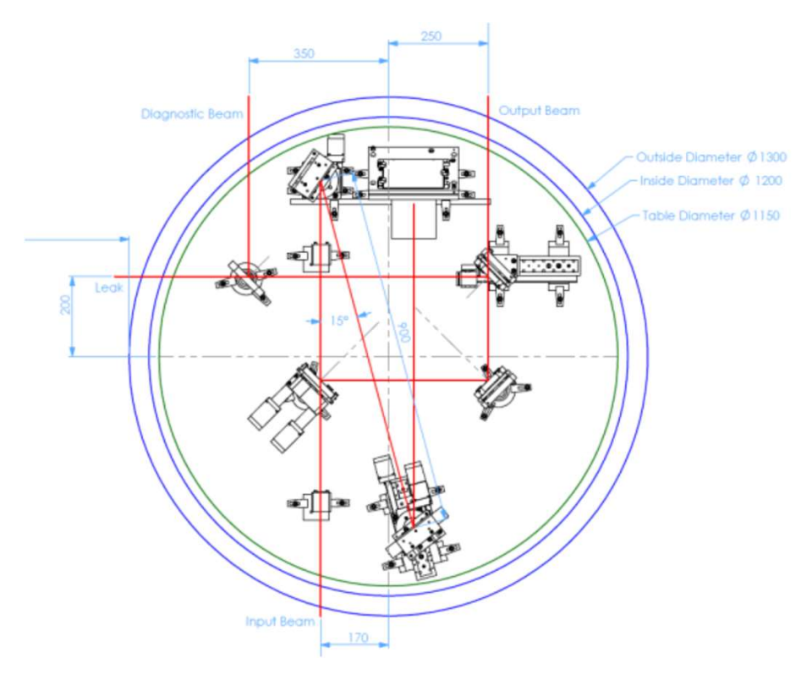
Compressor #2 – nearly identical to existing compresor
Cost ~ 330 kCHF
Vacuum chamber diameter: 1200 mm
Open aperture > 50 mm.
Pulse duration < 120fs (for an amplified spectrum > 12nm FWHM)
Efficiency > 66%
Delivery ~ 6-8 months (by the end of 2025)

Slide 22
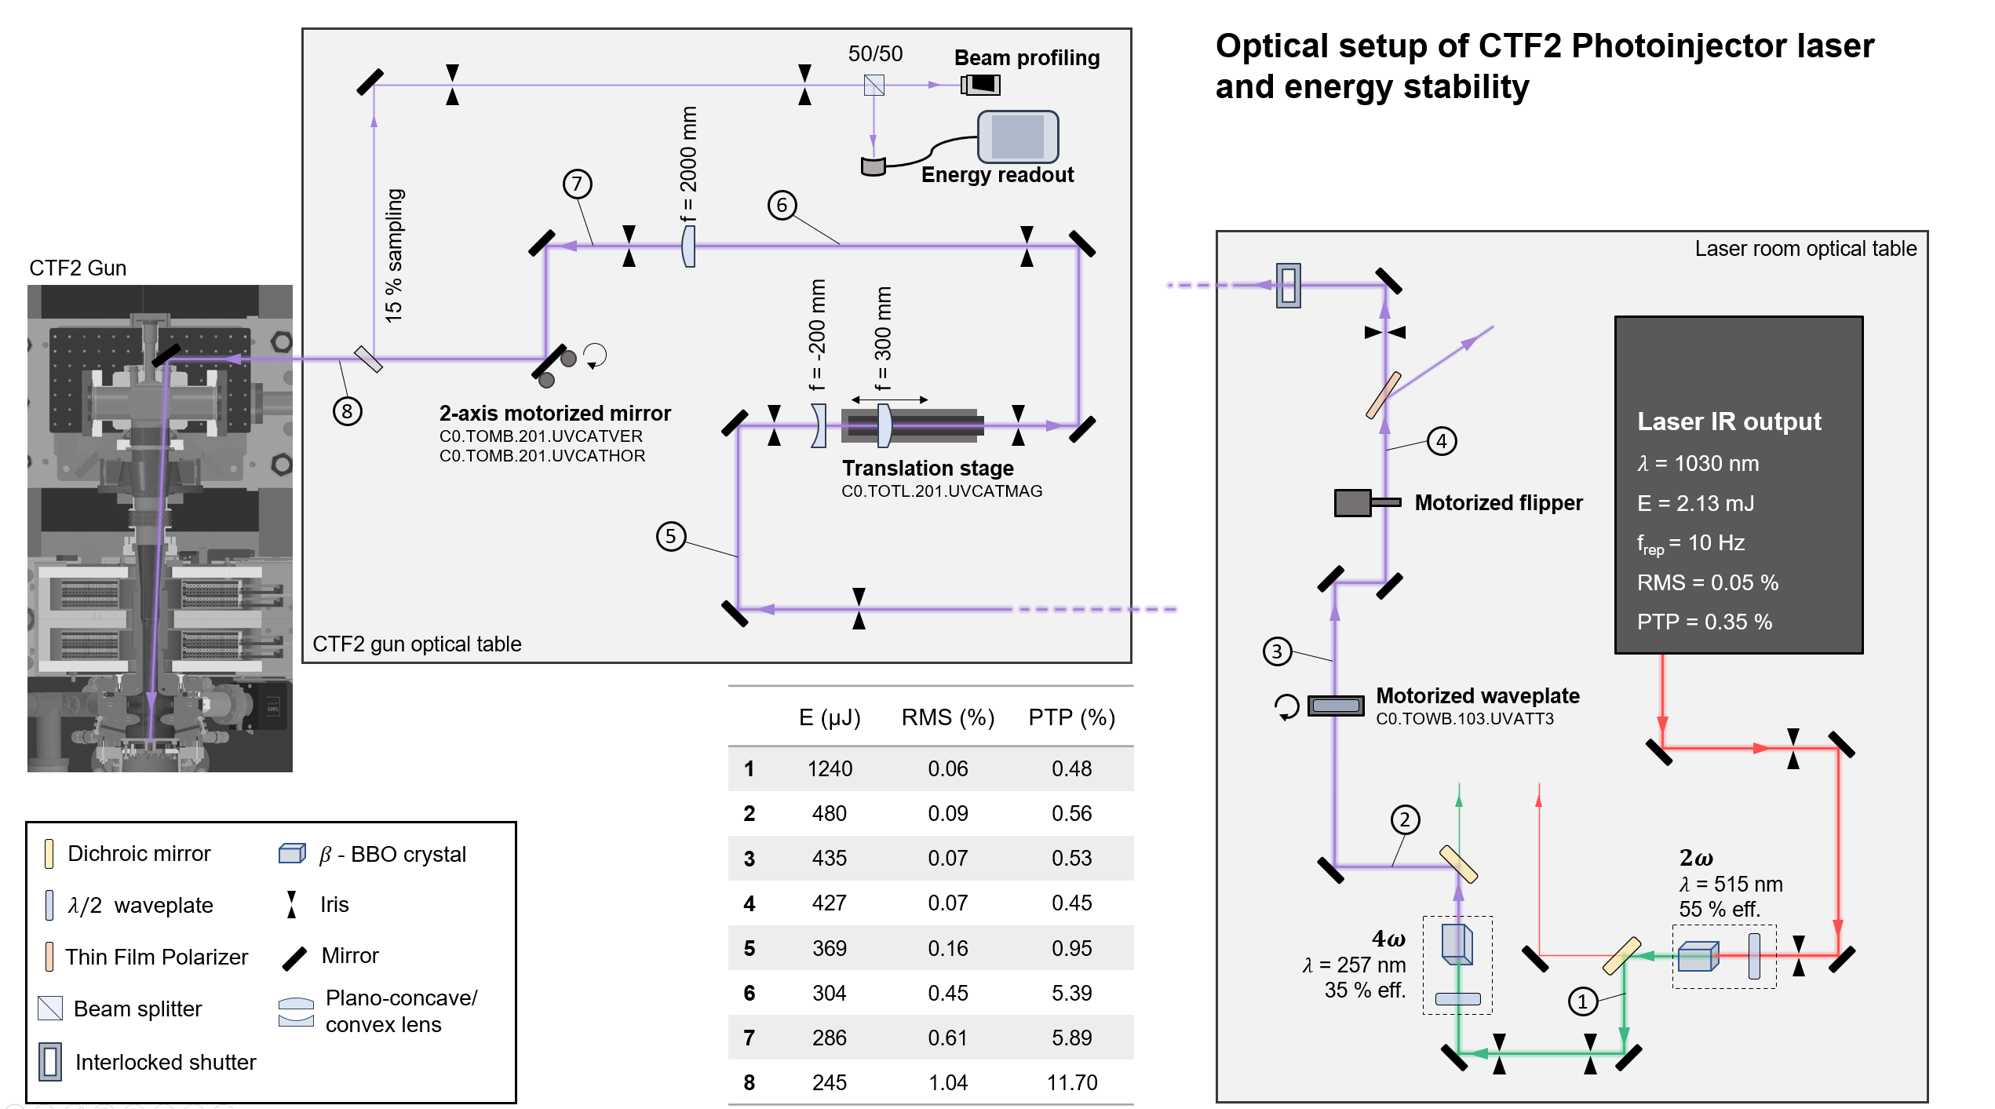
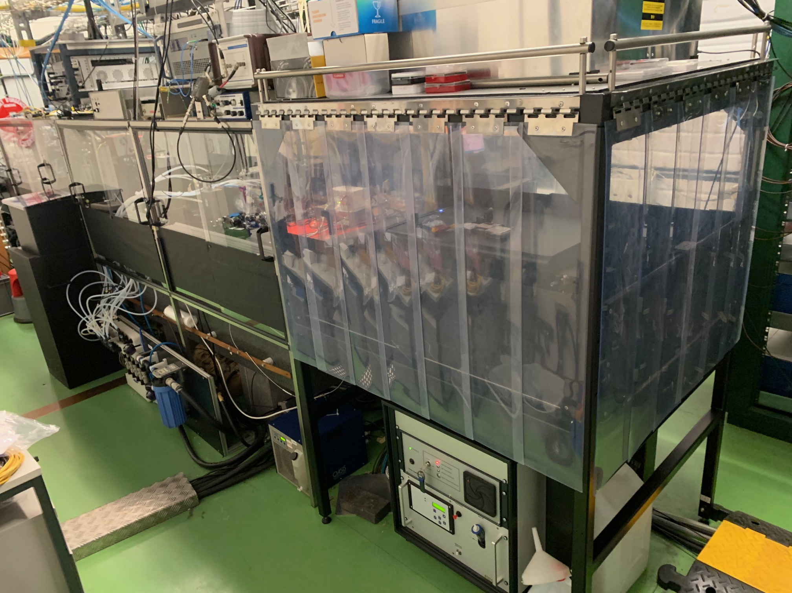
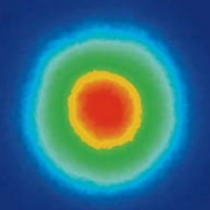
AWAKE run 2c photoinjector laser
Dedicated laminar flow tent
Photocathode
515 nm
Conversion efficiency:
IR to green ~60%
Green to UV ~30%
Overall ~ 18%
257 nm

Slide 23
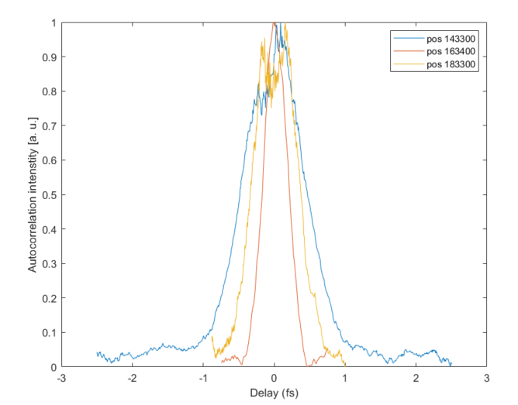
UV beamlines for run 2c: New photoinjector laser
Motor position | IR pulse duration* | UV pulse duration*
163400 | 151 fs | 265.5 fs
143300 | 2100 fs (negative chirp) | 540 fs
183300 | 2310 fs (positive chirp) | 775.7 fs
775.7 fs
265.5 fs
540 fs
* Deconvolved values are given at FWHM for Gaussian fits
The UV pulse energy was reduced to 65 uJ (by a factor of 6.2) when the longer IR pulse was used.
For the 775 fs pulse, the energy delivered on the cathode was around 35 uJ. The energy stability was better, going to below 1% RMS on cathode

Slide 24
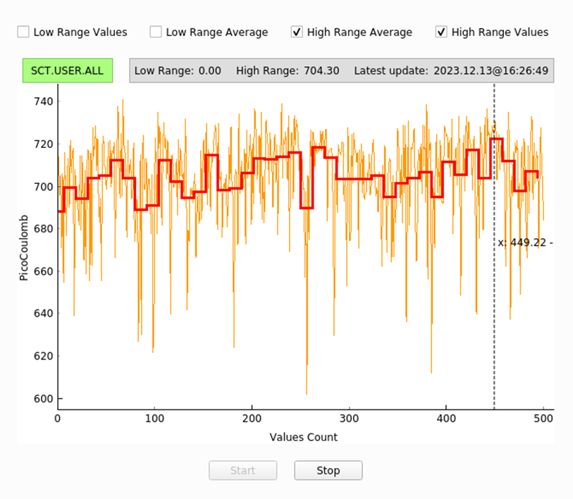
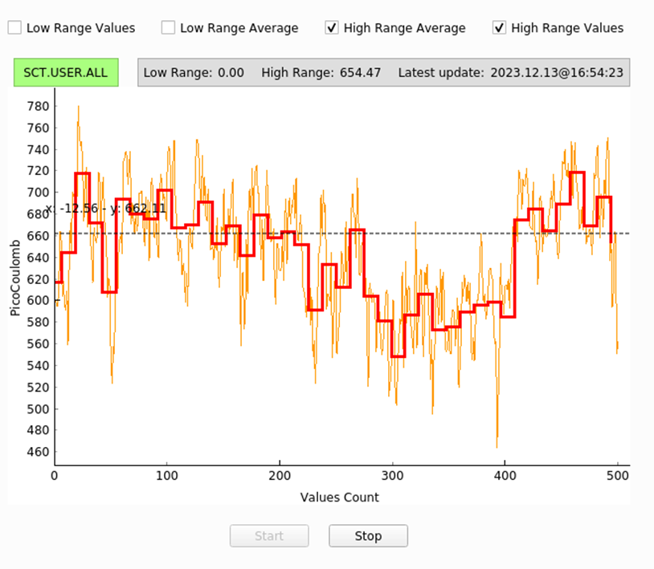
UV beamlines for run 2c: New photoinjector laser
700 pC bunch charge!!! 775.7 fs (FWHM) UV pulse length
Again 700 pC bunch charge 265.5 fs (FWHM) UV pulse length
Better stability with longer UV pulse, stability improves from 5% to 1% RMS
Likely due to lower B-integral with longer pulse

Slide 25
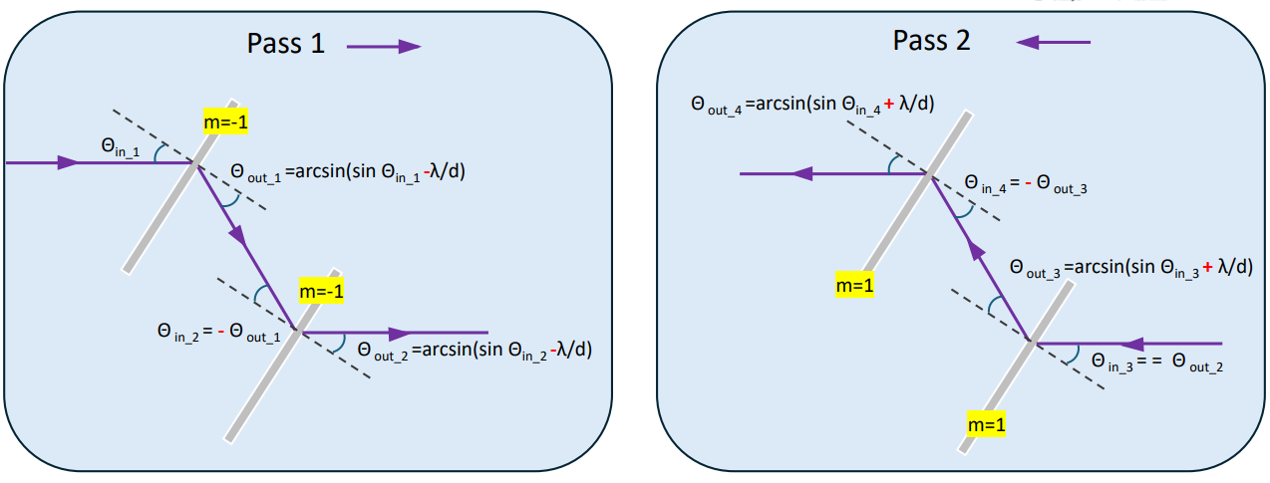
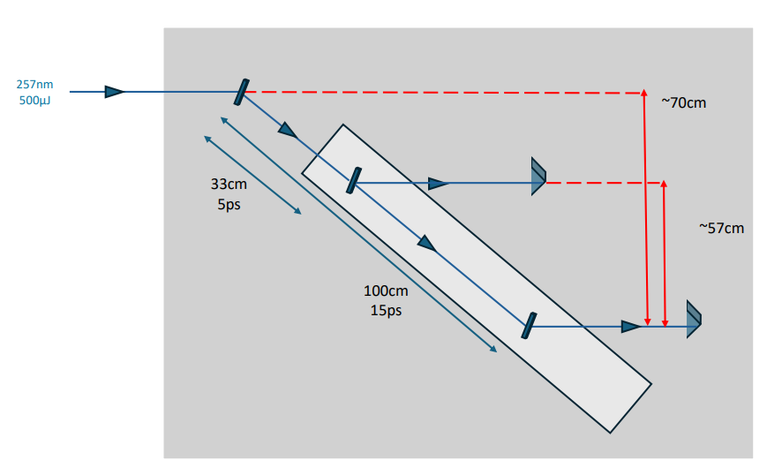
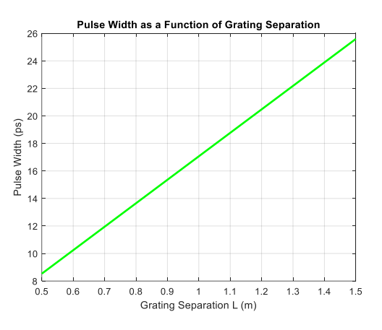
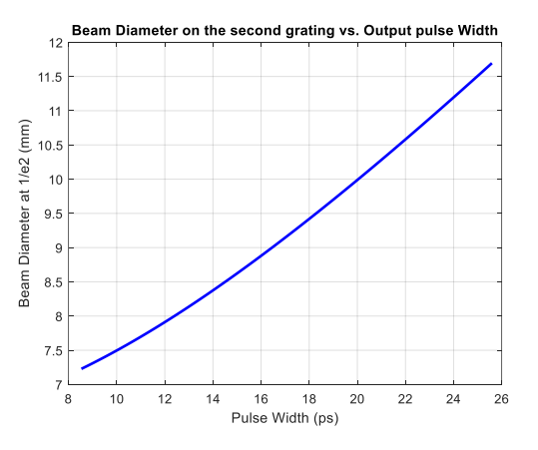
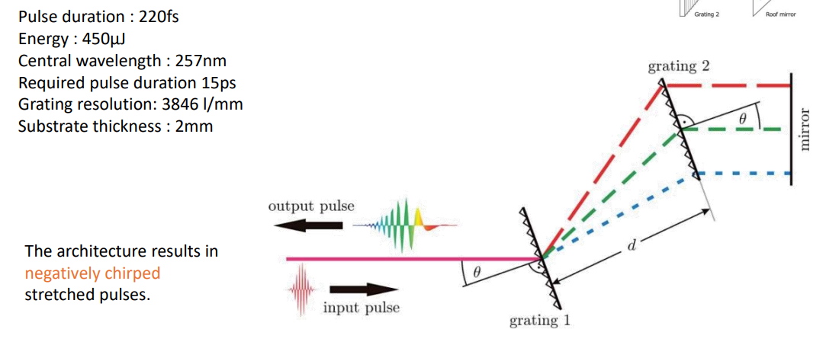
UV pulse duration tunability at constant energy: UV stretcher
Grating 1
Translation stage
Grating 2
Hollow prism
Anahita Omoumi

Slide 26
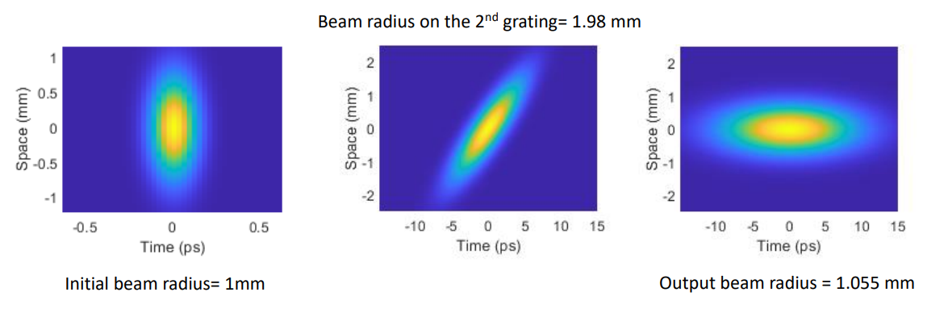
UV stretcher – pulse duration at stretched point
At L = 89 cm
Input ~ 200 fs
Output ~ 10 ps
Anahita Omoumi

Slide 27
Topics update
Photoinjector:
  Current cathode to remain in place at least until May, then option to replace with rejuvenated Cs2Te.
  Copper cathode to be installed in June after last run.
IR beams
  Timing resolution required for synchronization -> Development of specific optical/electronic diagnostics -> received quote from Light conversion to provide 75 MHz reference signal from laser.
  2nd Compressor vessel design -> check integration of provided design
  Pulse energy required in each cell? -> increase in spot size by 5/4 means that energy can be increased by 56% in each arm keeping fluence constant. -> Estimation of beam pointing stability needed
  Where is time 0? i.e. where is the crossing of the 2 IR beams exactly? What is the angle? Discussions ongoing
UV beams
  Pulse duration tunability capabilities, ranges? Variable compressor/stretcher? Different pulse durations for each e- gun?
  Pulse shaping in transverse/longitudinal capabilities? -> Replicate capabilities existing in run 2a,b but keep the design open for future upgrades.
  Procurement of control components started
Diagnostic lines
  Specification required

Slide 28
Thank you for
your attention!

