Slide 1
Run 2b Rb vapor dismantling and the injection area of Run 2c
AWAKE collaboration meeting
25/03/2025
Michele Bergamaschi, P. Muggli, GWA ltd.

Slide 2
Contents
Vapor source decommissioning
Run 2c injection area
Conclusions

Slide 3
Vapor source Decommissioning
MPP with GWA have a valuable and successful experience in decommissioning Vapor source gen I (Run 1 and Run 2a) down to storage
Contract signed with GWA in 2024 to cover:
  Decontamination of Vapor source gen I
  Decommissioning and decontamination of “Dirty system” in EHN1
  Clean-up and reorganization of EHN1 awake area
  Decommissioning and decontamination of Vapor source gen II
Decommissioning of “dirty system” started in February 2025
Procedure for decontamination all Rubidium (Rb) contaminated sources

Slide 4
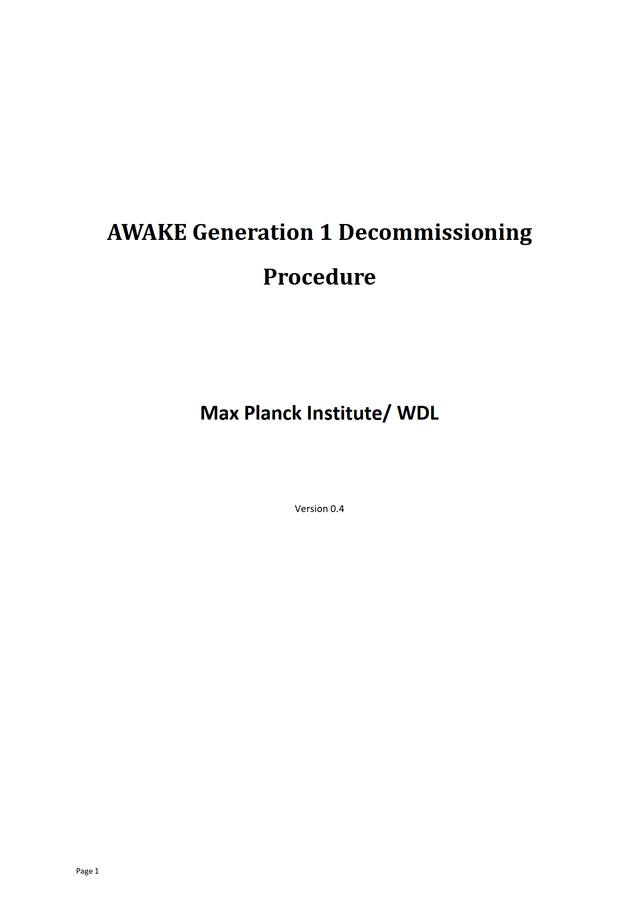
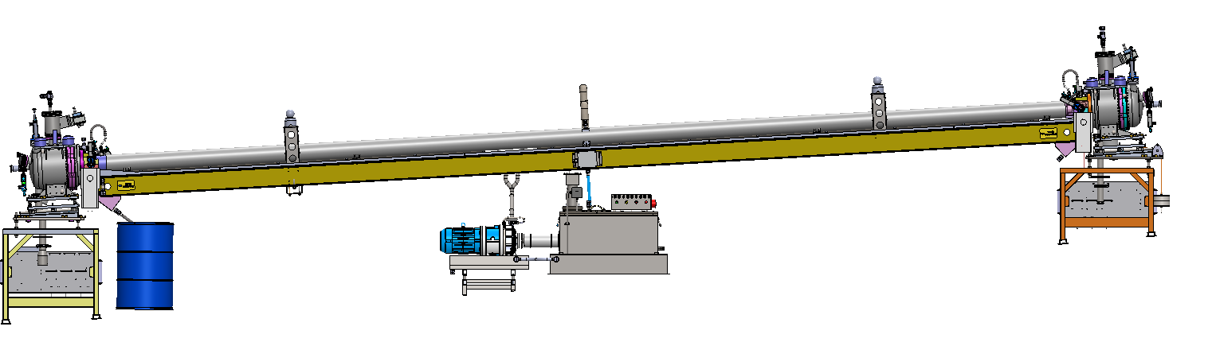
Decommissioning of vapor source gen I
Plasma cell heat exchanger on I Beam
Galden Fluid Heating & Pumping System
Upstream Vapour Source
Downstream Vapour Source
Defined (by MPP/WDL) in 2022 a procedure covering all the decommissioning phases (to storage).
Wrote a safety documents and SOP approved by safety and RP at CERN in Jan 2023
Implemented (to last point) in Jan/Feb 2023

Slide 5
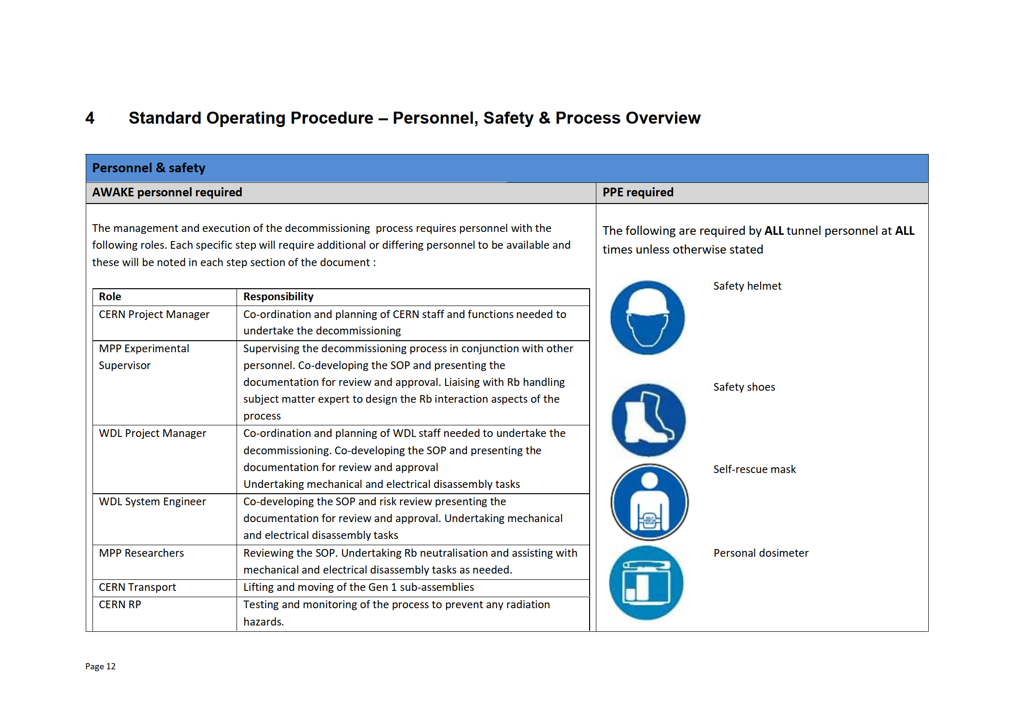
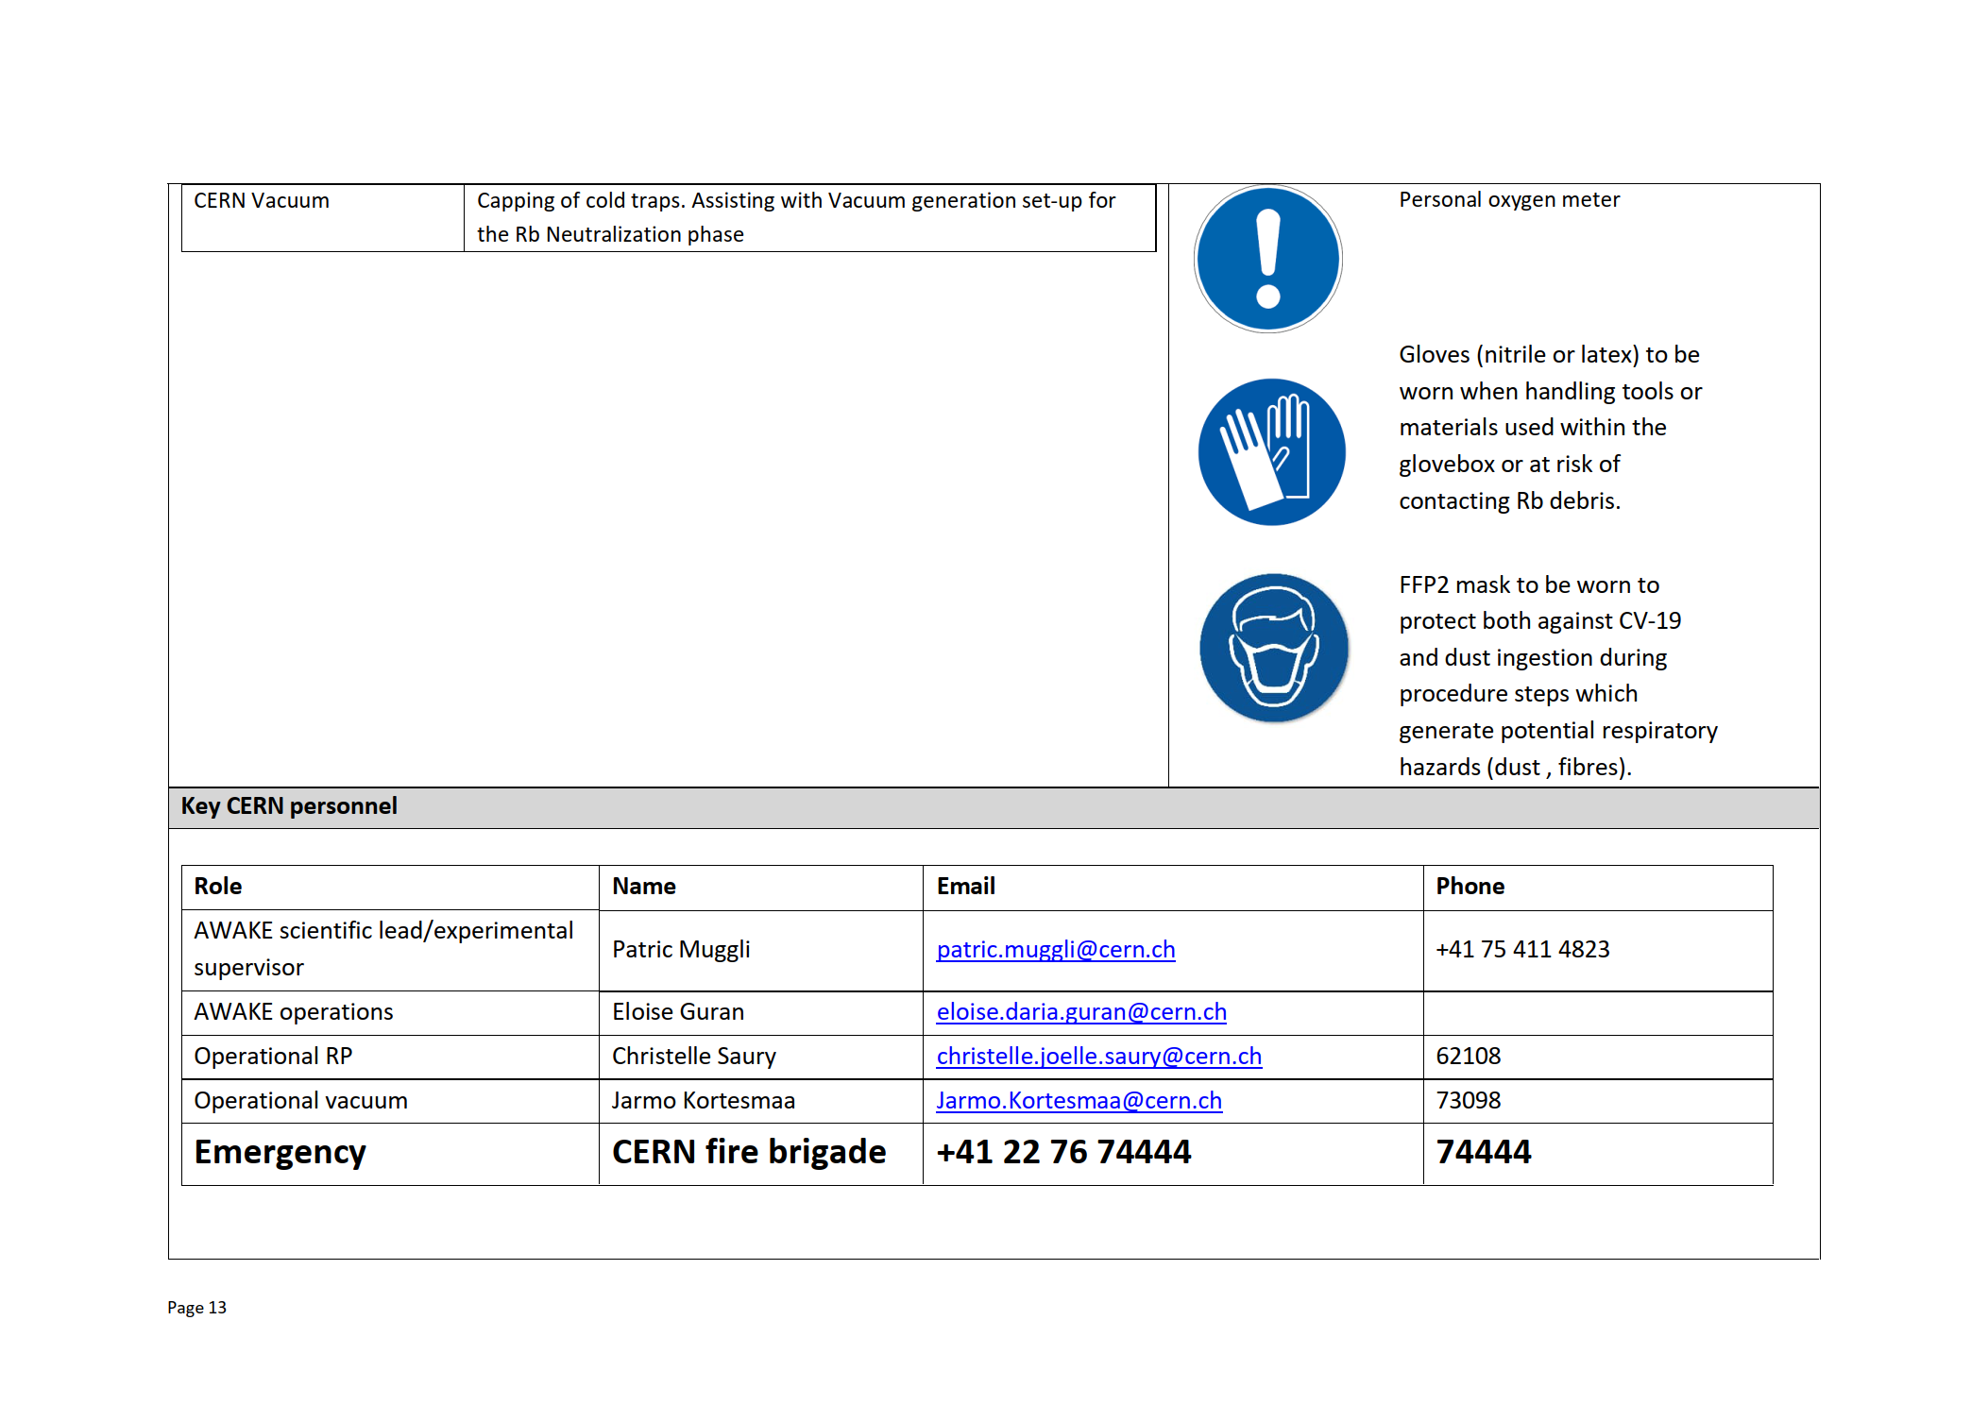
Decommissioning of vapor source gen I

Slide 6
Decommissioning of vapor source gen I
Step 1: Procedure & Risk Review
Happened in 2022
Step 2: Recycling & Rb reservoir removal
Step 3: Rb neutralization
Step 4: Service disconnection
Took place in Jan 2023
Step 5: Disassembly
(6 sub steps)
Step 6: Tunnel extraction
Happened in Feb 2023
Step 7: Rb cleaning and disposal
During 2025

Slide 7
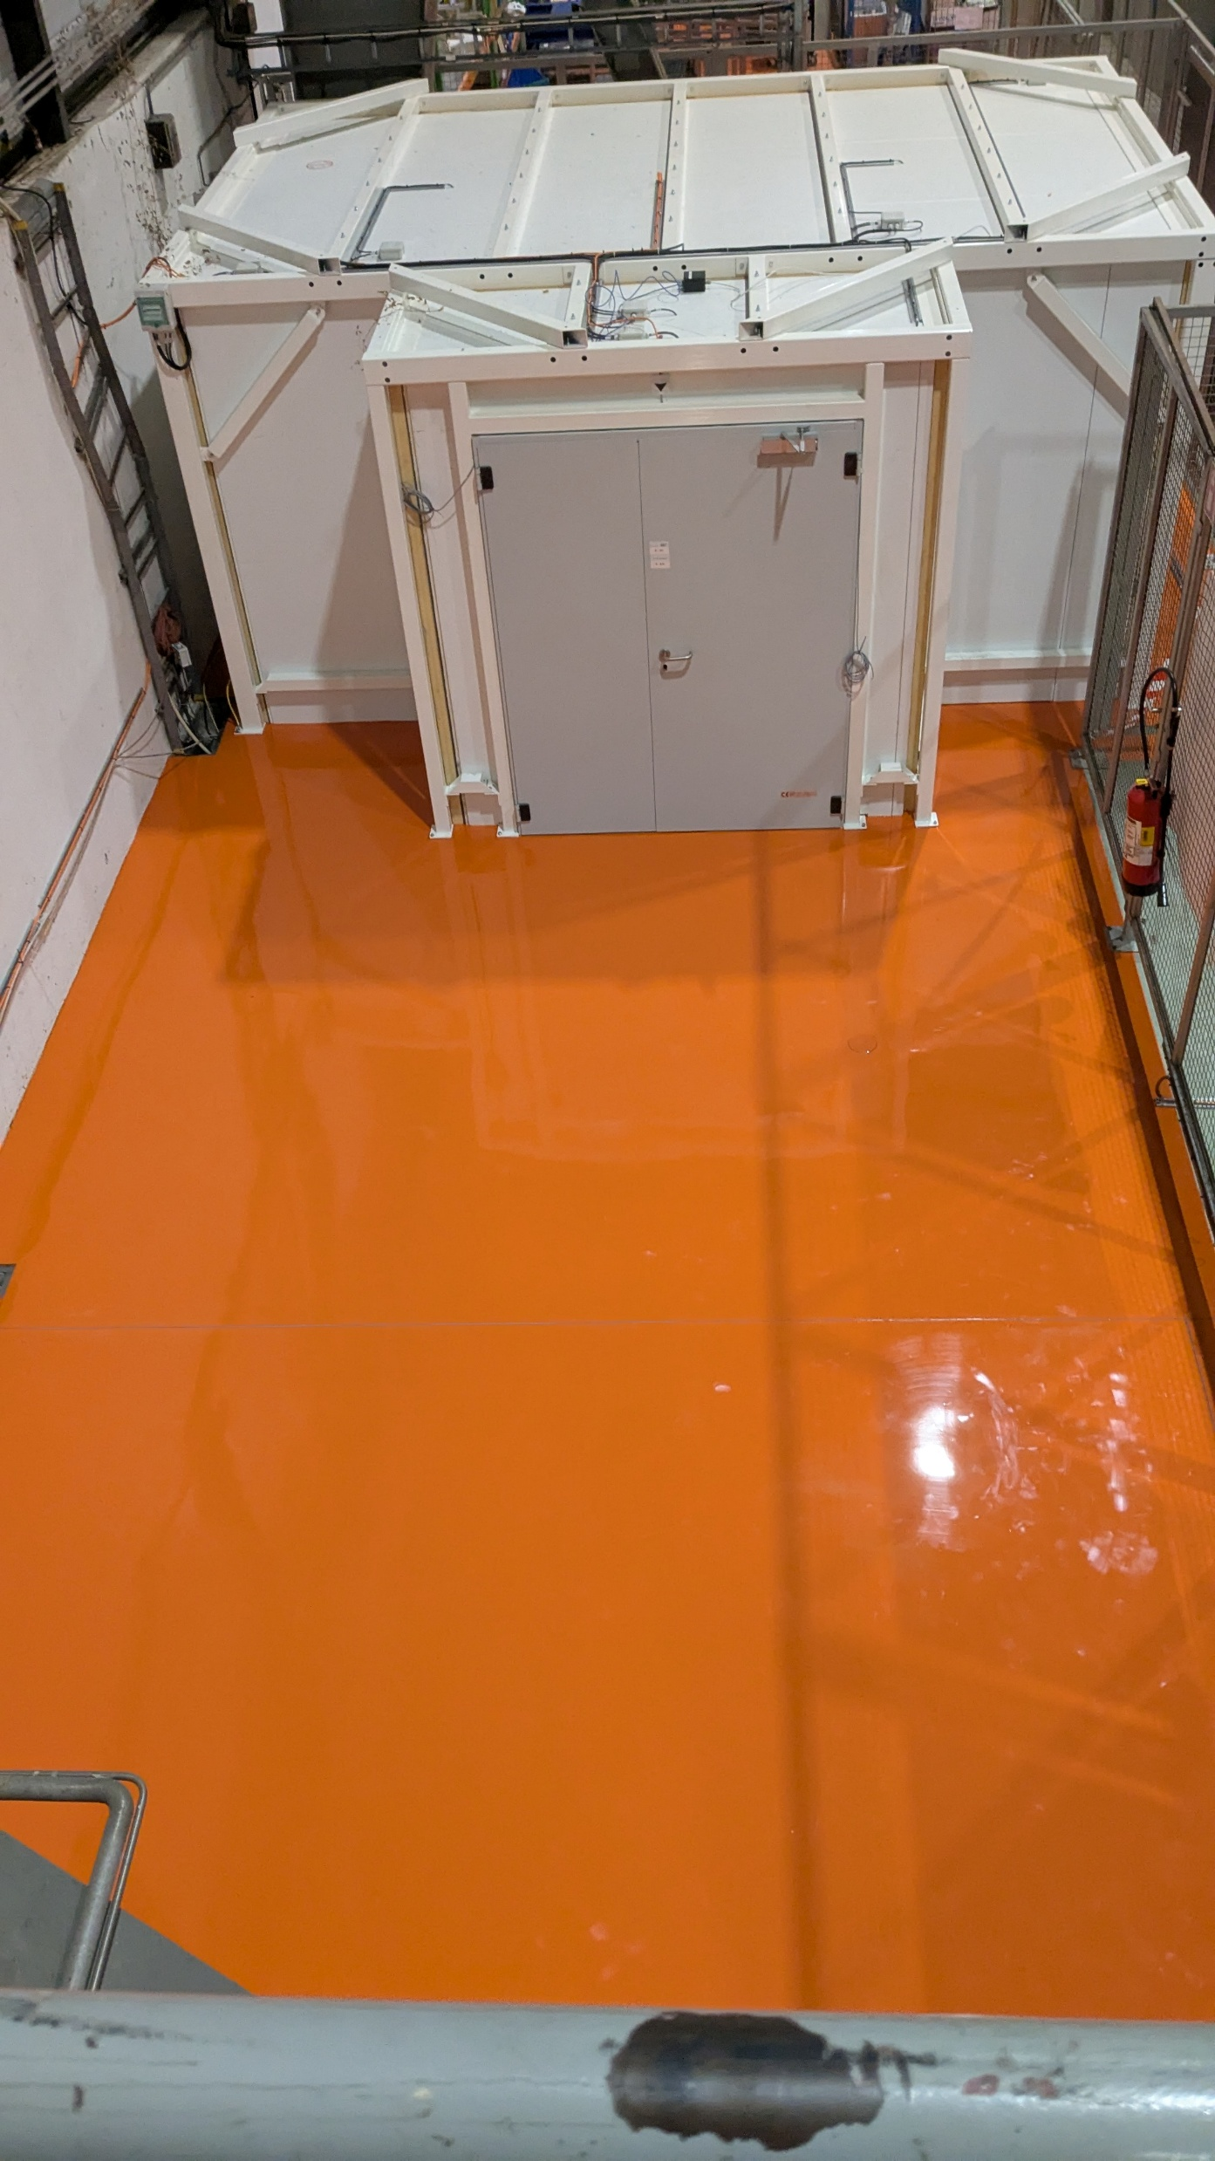
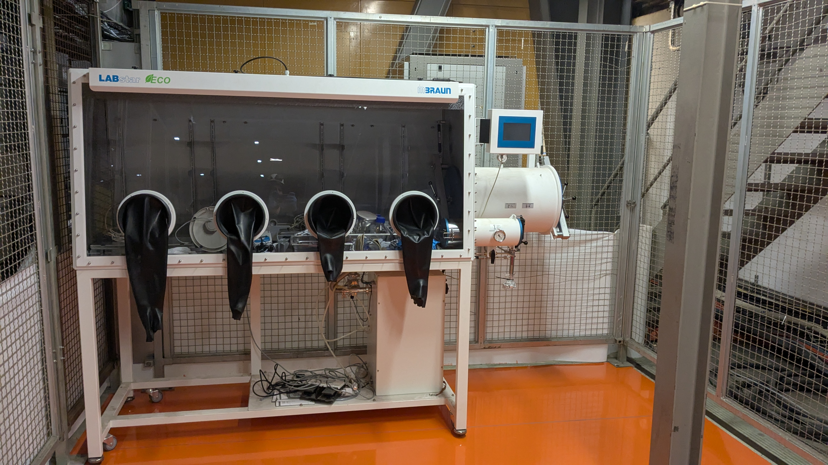
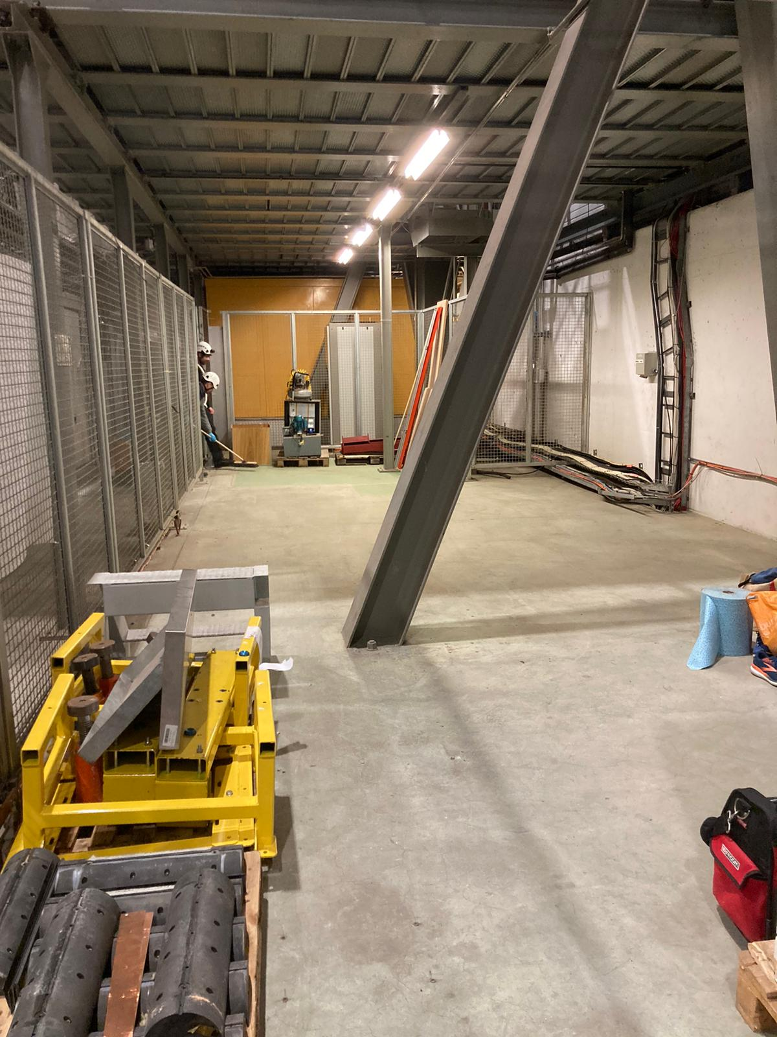
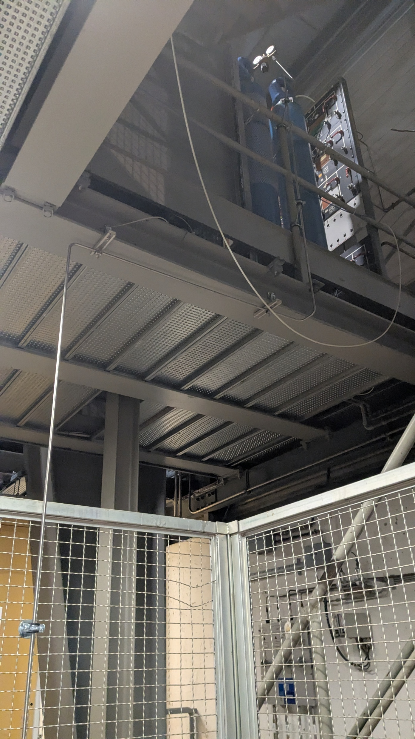
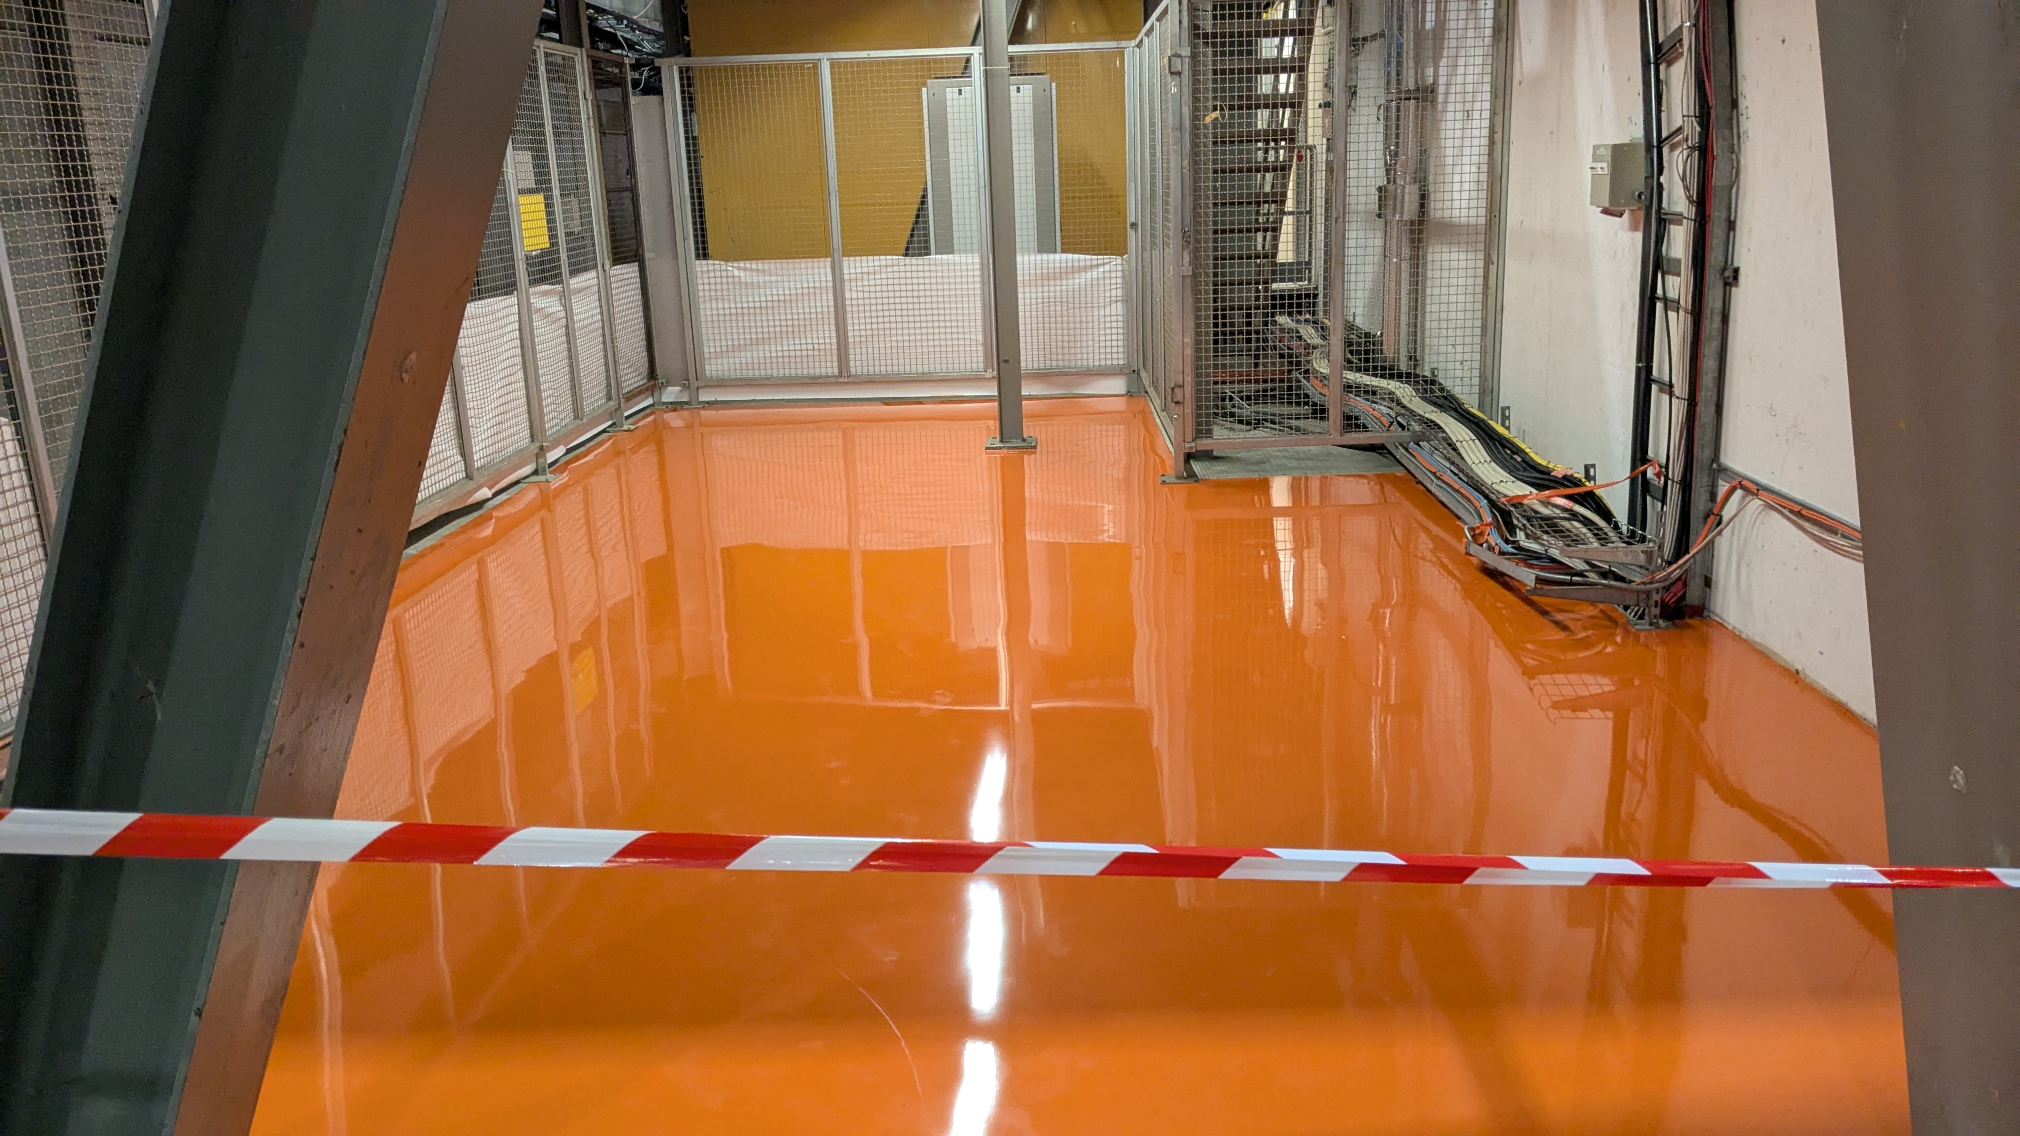
EHN1 decom of “Dirty system” and clean-up
Dirty system disassembled and neutralized as per SOP
Area emptied
Re-furbishing of floor
MPP glove box and argon piping displacement

Slide 8
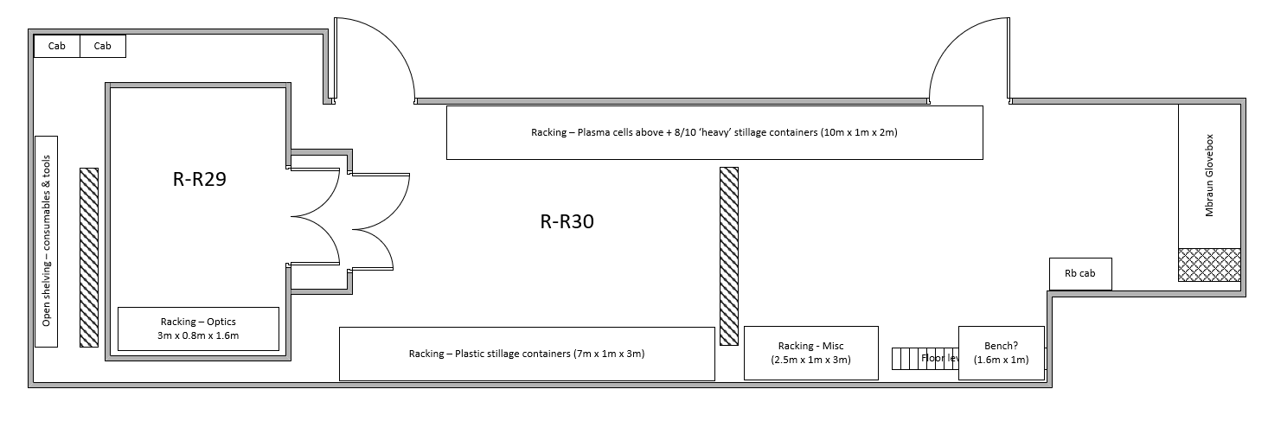
EHN1 decom of “Dirty system” and clean-up
Door already moved here

Slide 9
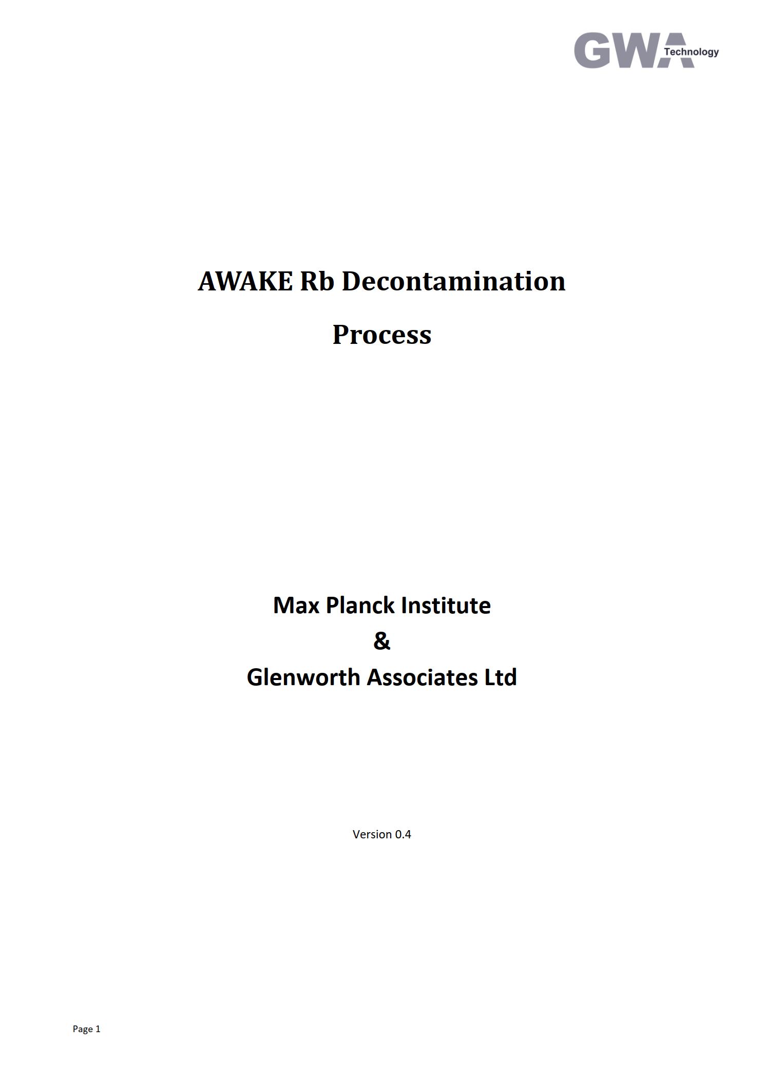
Procedure for decontamination all Rubidium (Rb) contaminated sources
Prepared by GWA and MPP
Reviewed by Prof. Florian Kraus Chemist by Uni. Marburg
Shared with Rp, HSE-OHS-PE, AWAKE PSO
Feedback from Rp already received
Discussion ongoing with Vacuum for possible use of 867 cleaning lab, that can treat activated parts, visit tomorrow of the lab by GWA
Meeting next week with HSE-ENV for waste water/chemical treatment/release,

Slide 10
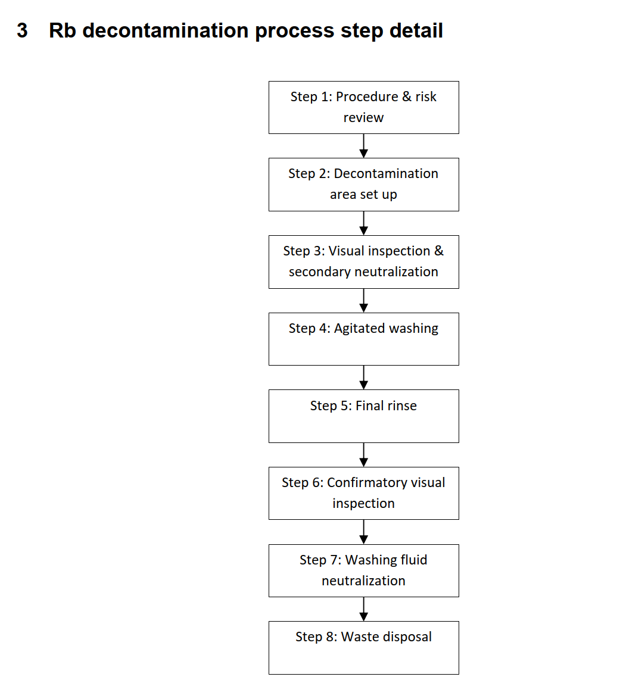
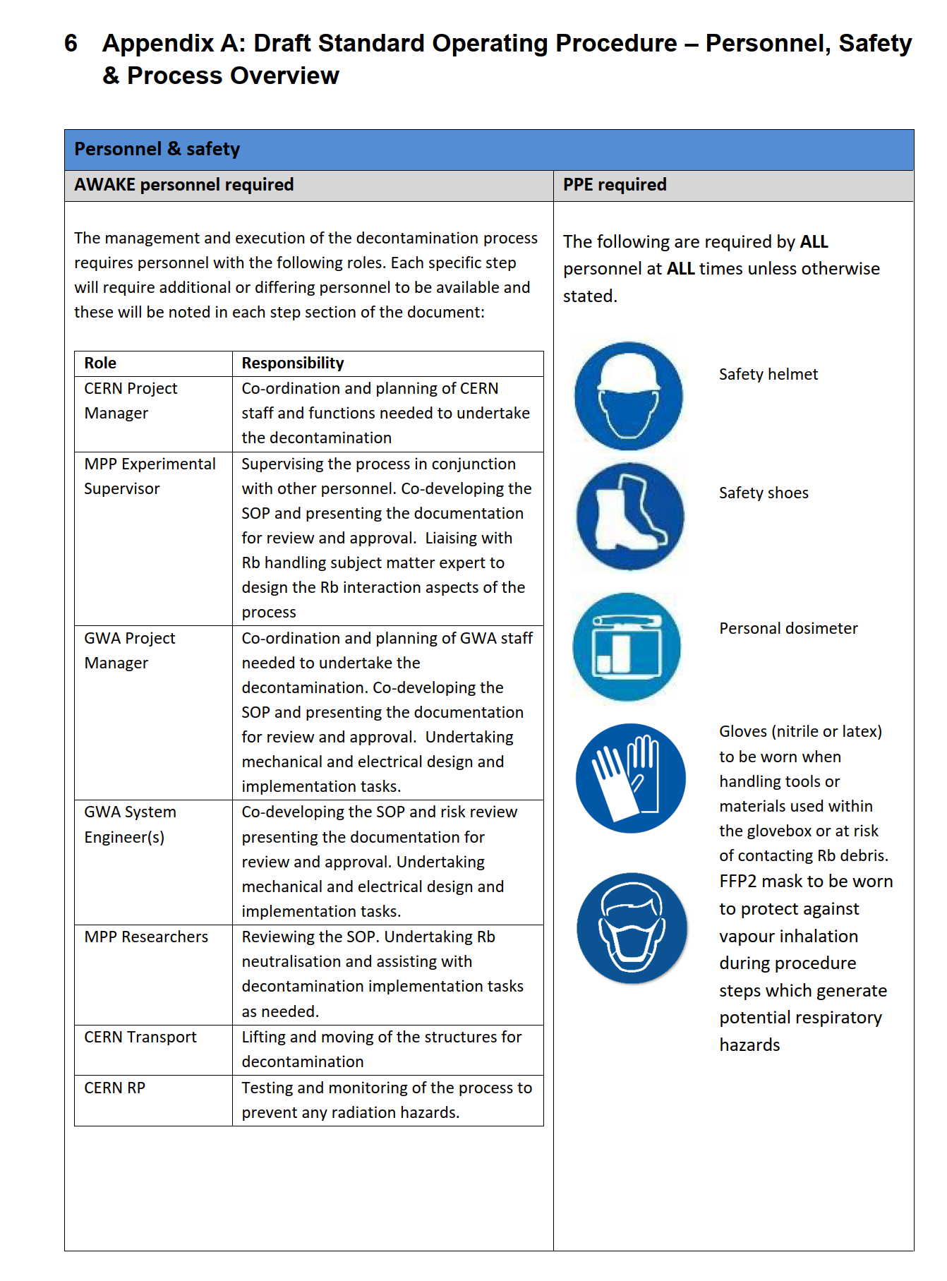
Procedure for decontamination all Rubidium (Rb) contaminated sources
Treat properly parts to re-use as much as possible for Run 2c (e.g. cold traps, 10 m tubes, 5m tubes)
Storage of long pipes (10m/5m) conceived in new EHN1 area till installation
Temporary storage between decom in June and cleaning (few months probably September) to be addressed EHN1 proposed

Slide 11
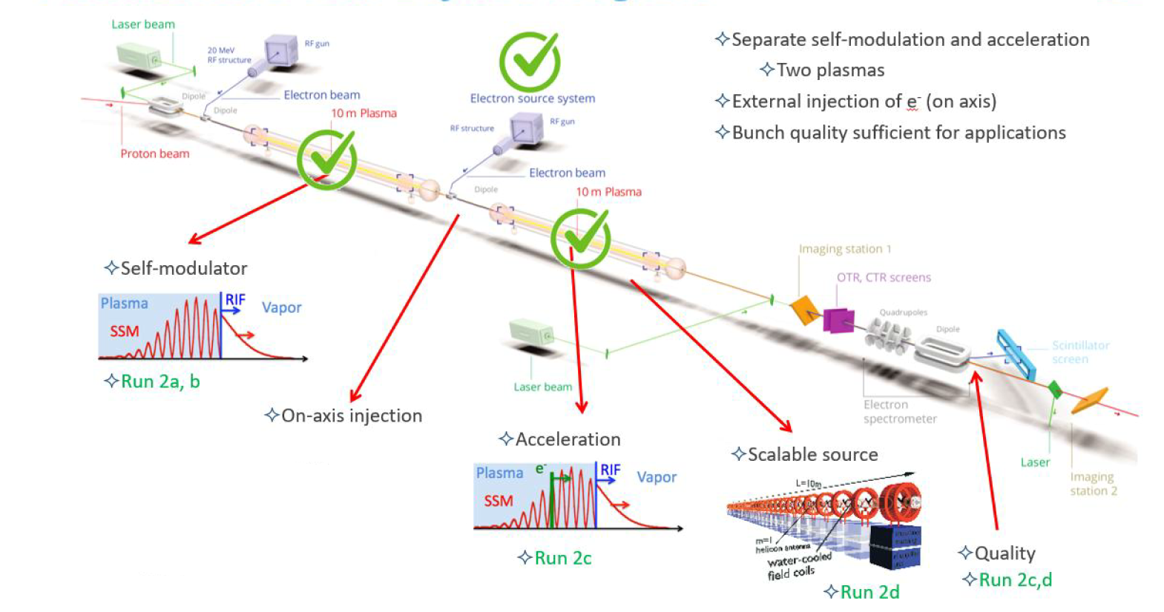
Work ongoing for Injection region for Run 2c
Discussion has started for the design of the injection region for Run 2c:
  Physics motivation is guiding the design, though technical constraints are several because of the complexity of the area
  Conceptual design phase started (Patric and Michele with GWA)
  Discussion to understand limitations has started with CERN: vacuum, e-beamline, magnets, integration, instrumentation
See Patric’s talk: “Run2c has started” at last PEB

Slide 12
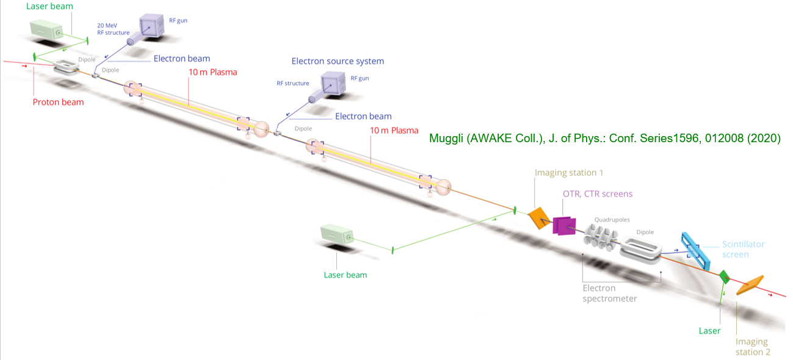
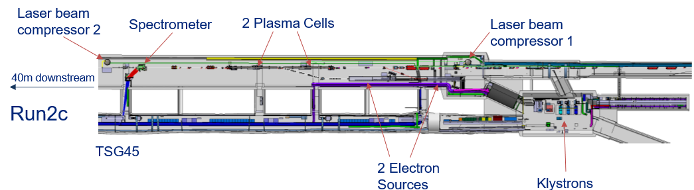
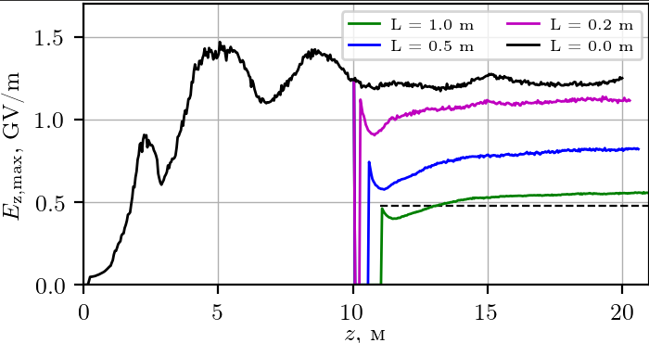
Work ongoing for Injection region for Run 2c
Slide from P. Muggli talk at last PEB
Self-Modulator
Accelerator
Self-Modulator
Accelerator
Vlada Yarigova
Physics motivation:
Accelerating gradient: 1GeV/m
Energy gain 4-10GeV over 10m
Minimize the gap length (between the two plasmas) to maximize the accelerating gradient in the accelerator
  Gap -> defocusing of p⁺
  Lower accelerating gradient in the accelerator
Essential for the success of Run 2c
Gap!

Slide 13
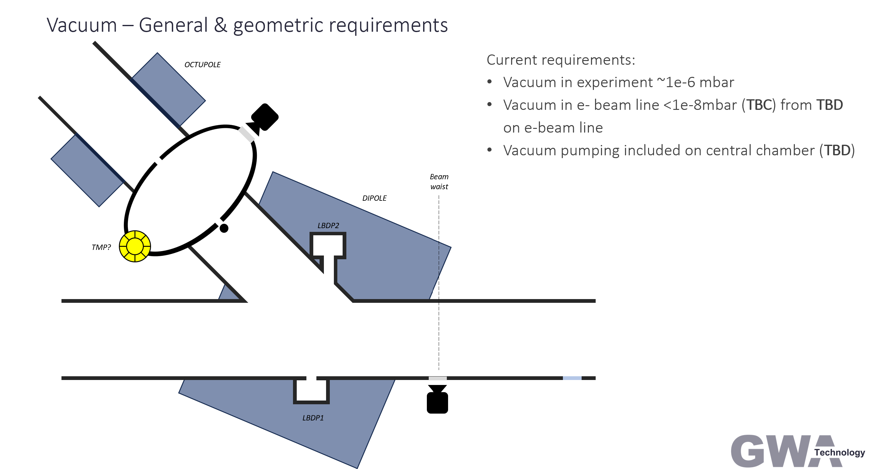
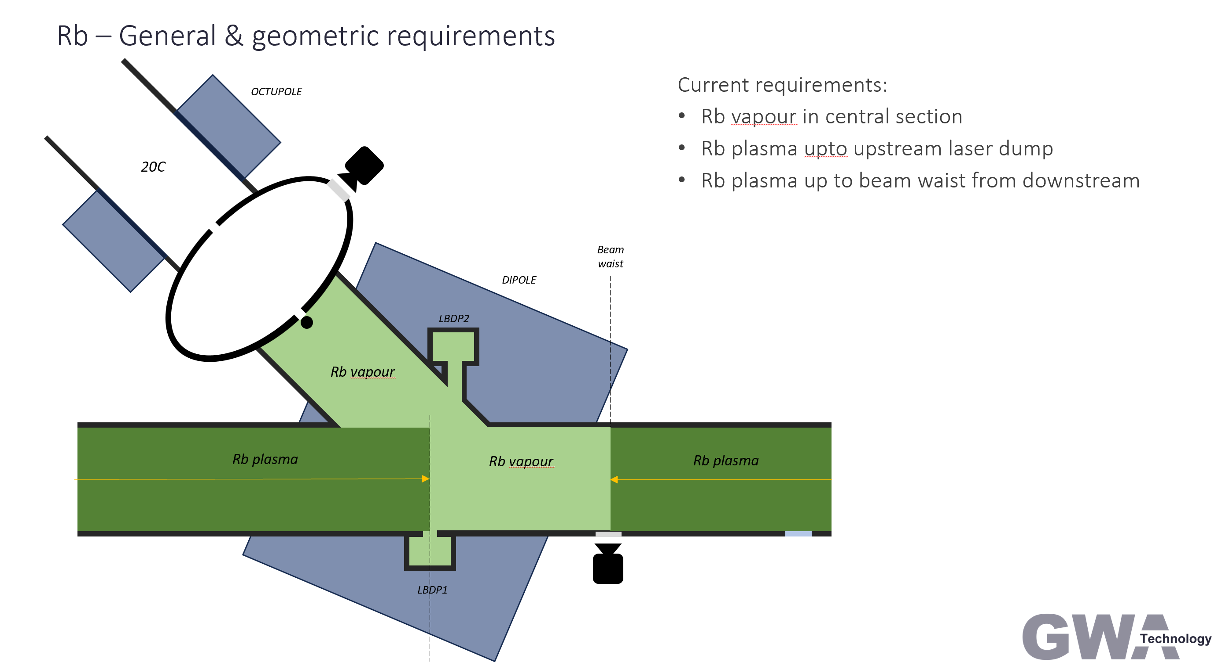
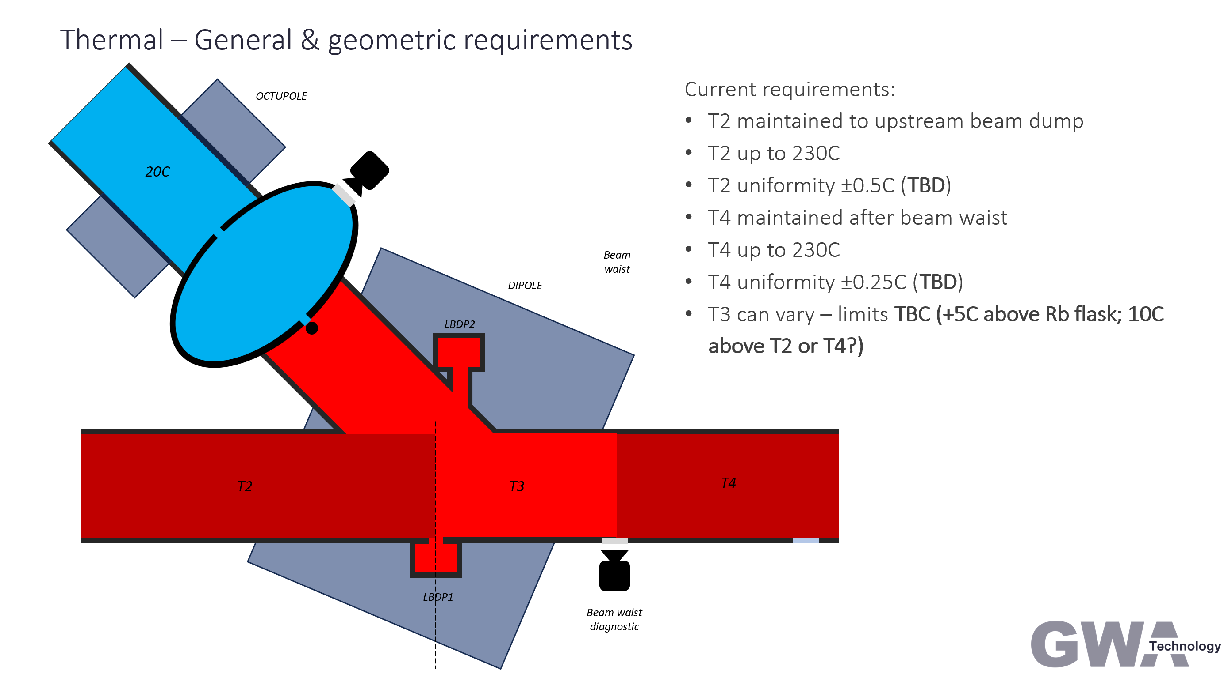
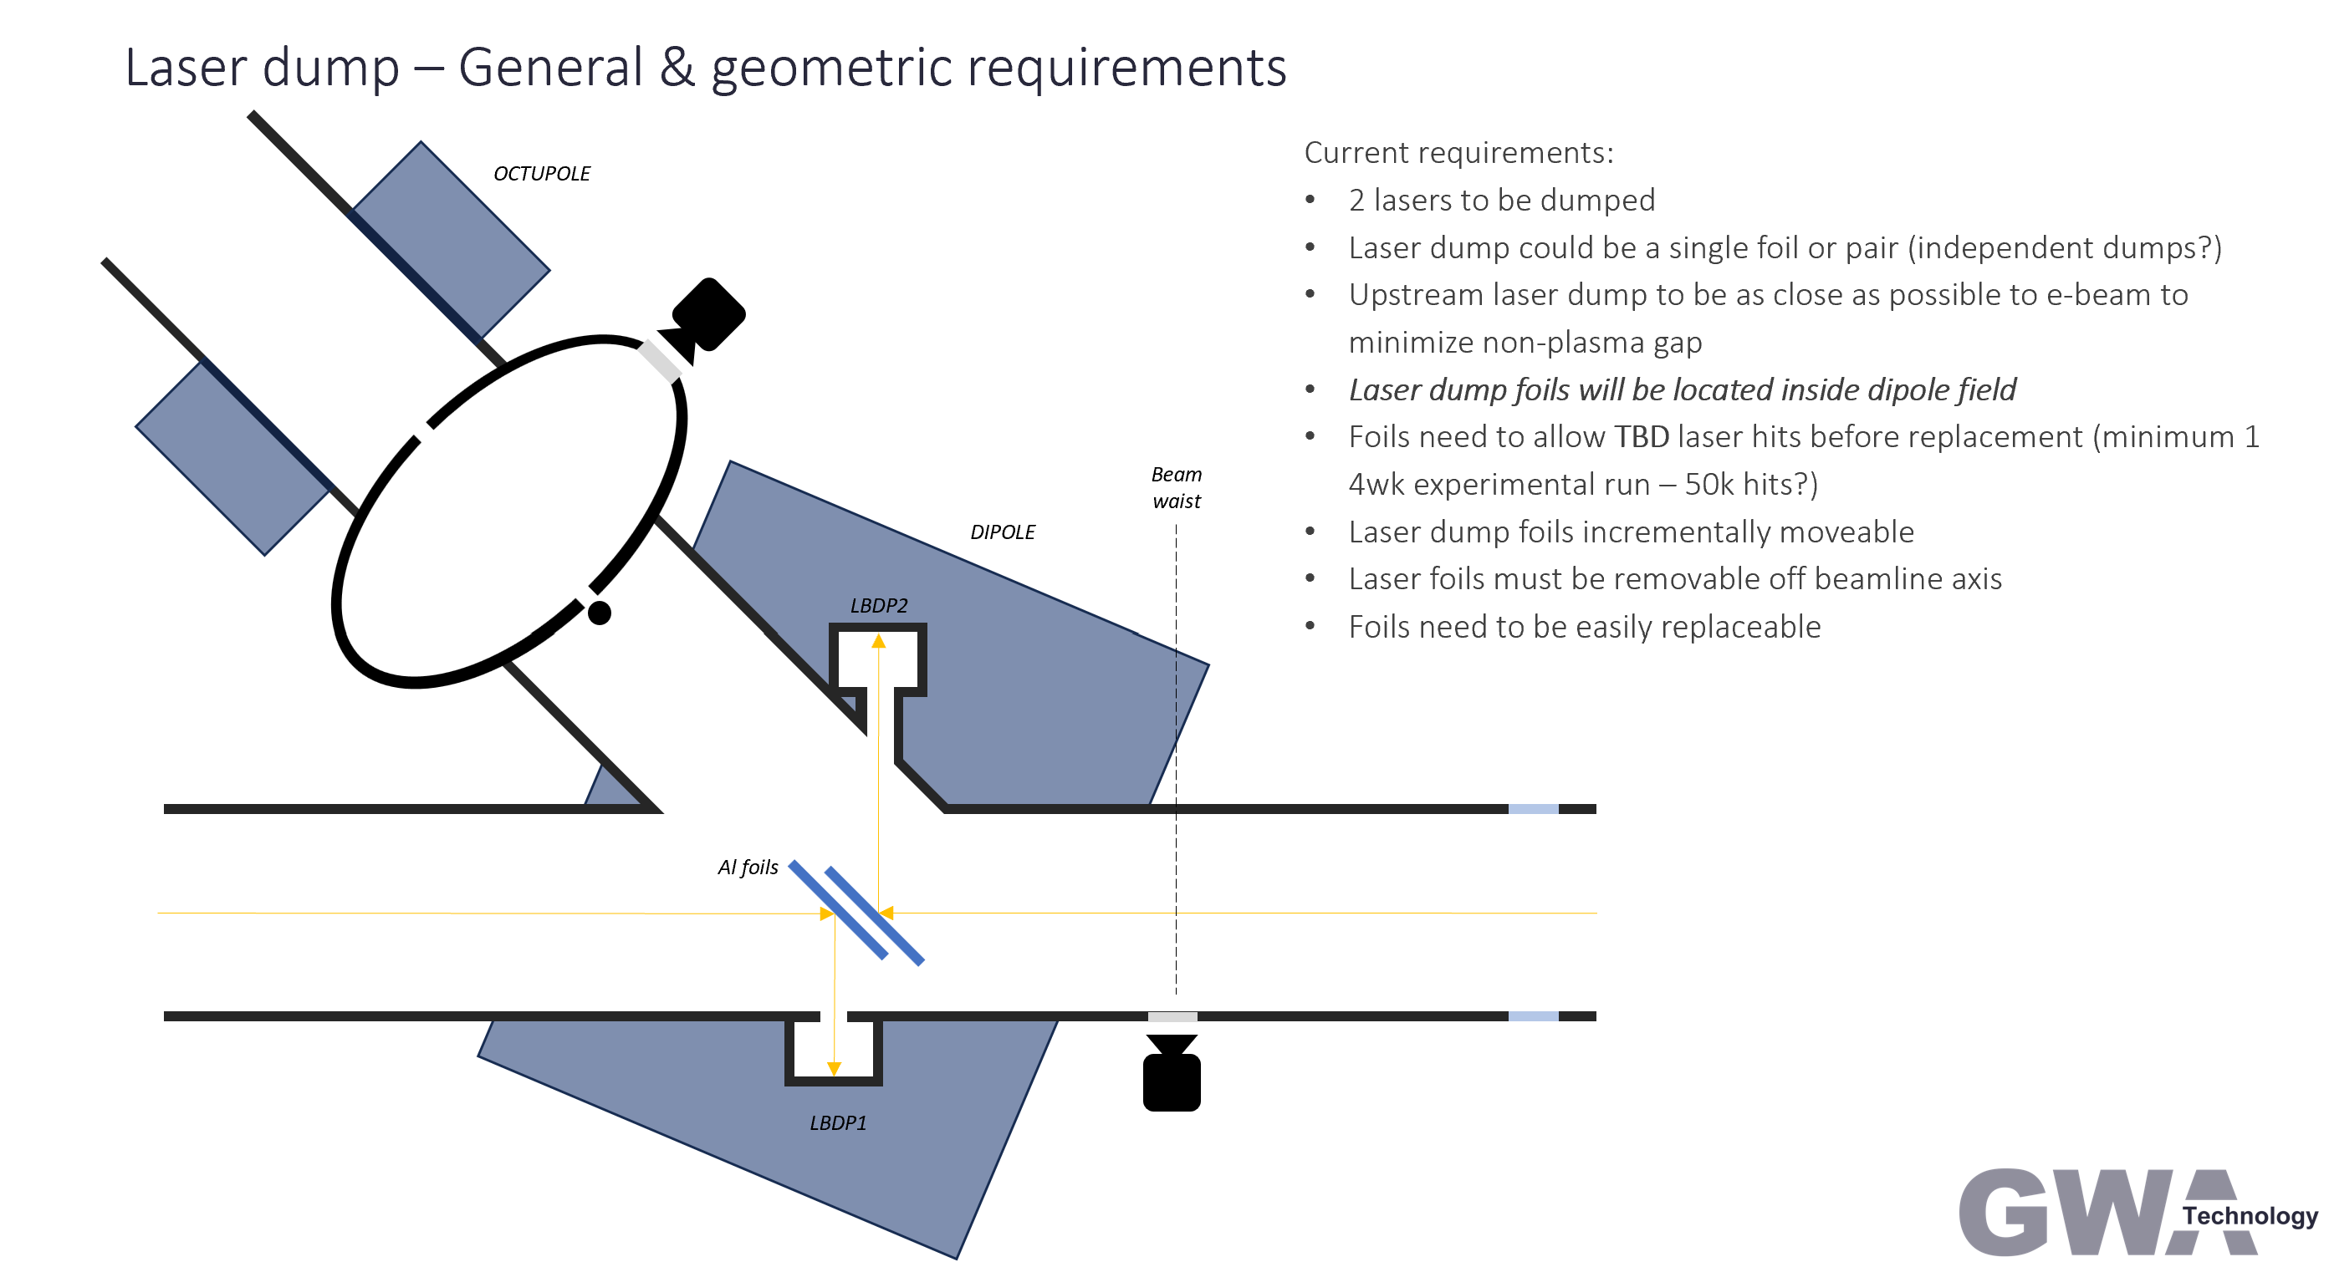
Work ongoing for Injection region for Run 2c

Slide 14
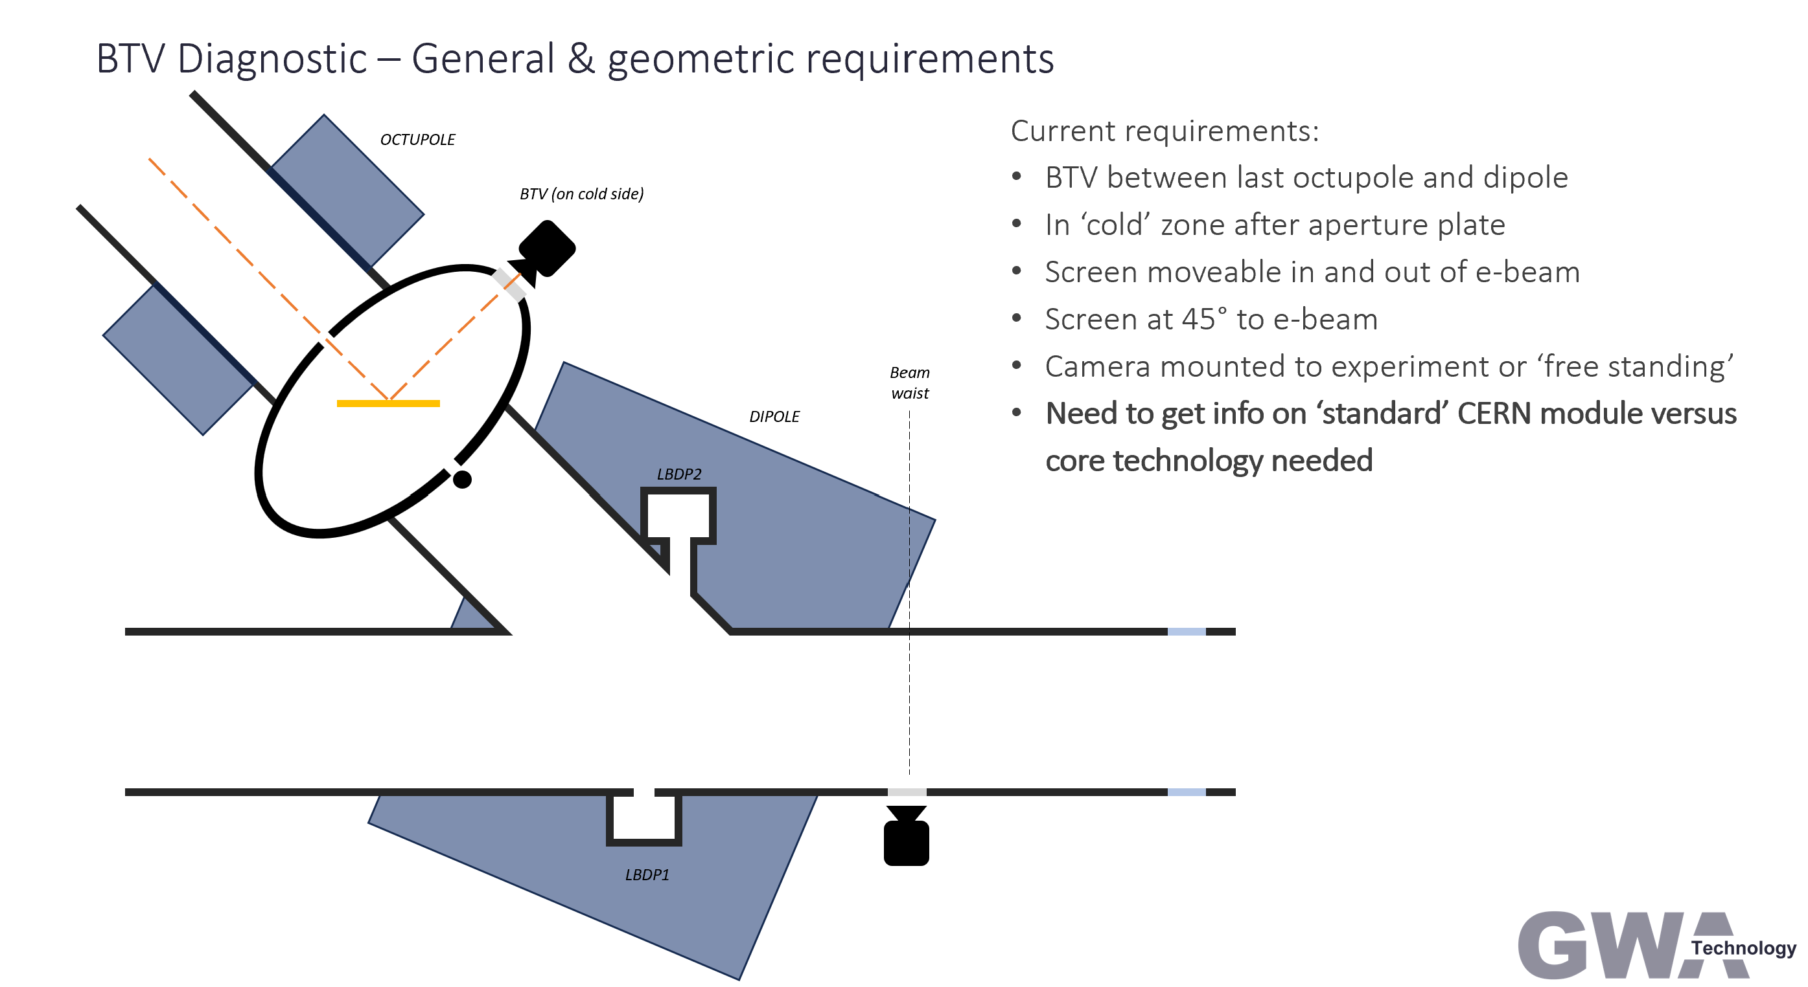
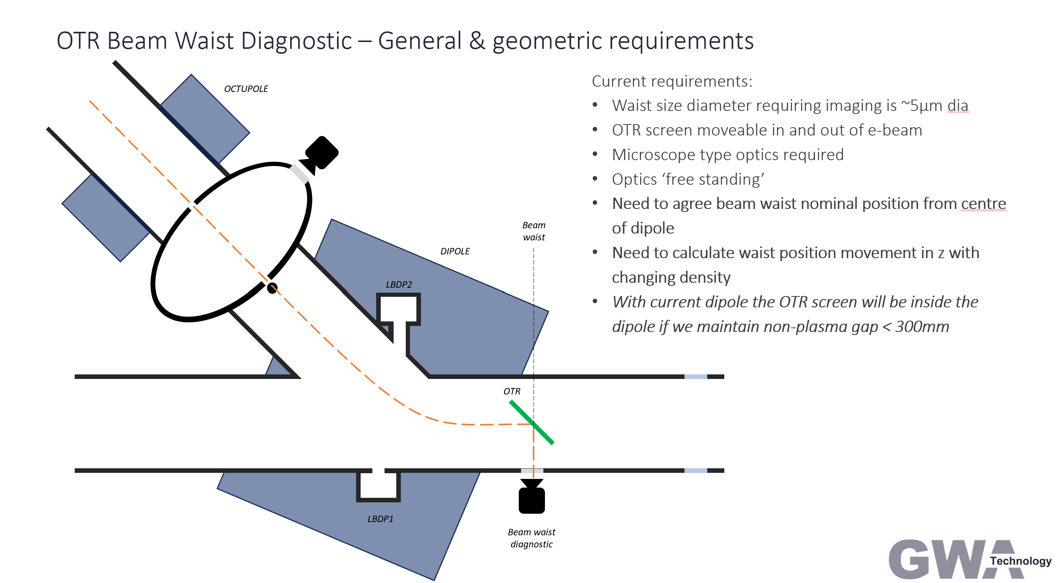
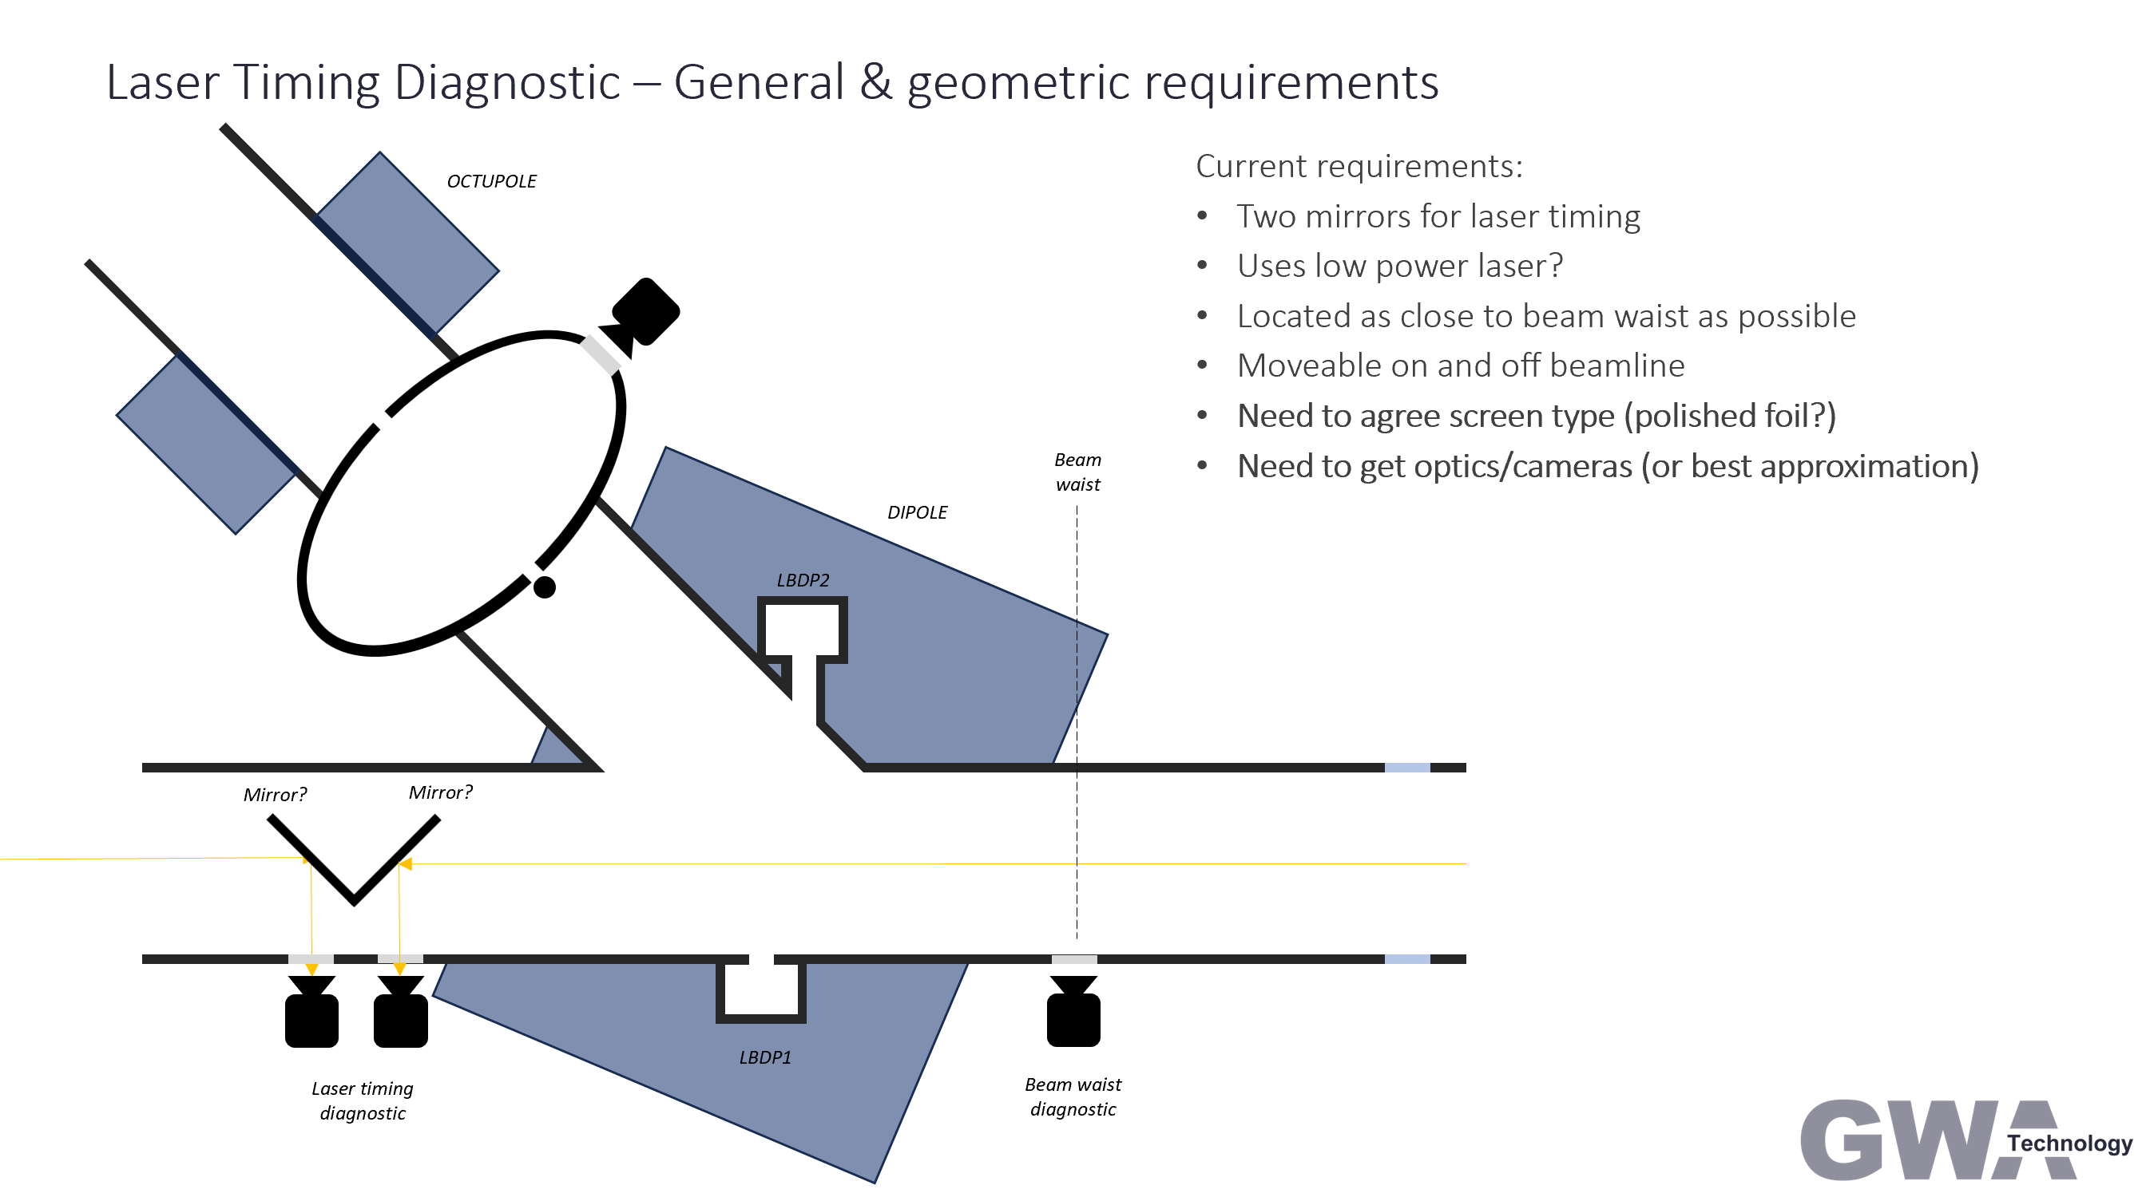
Work ongoing for Injection region for Run 2c

Slide 15
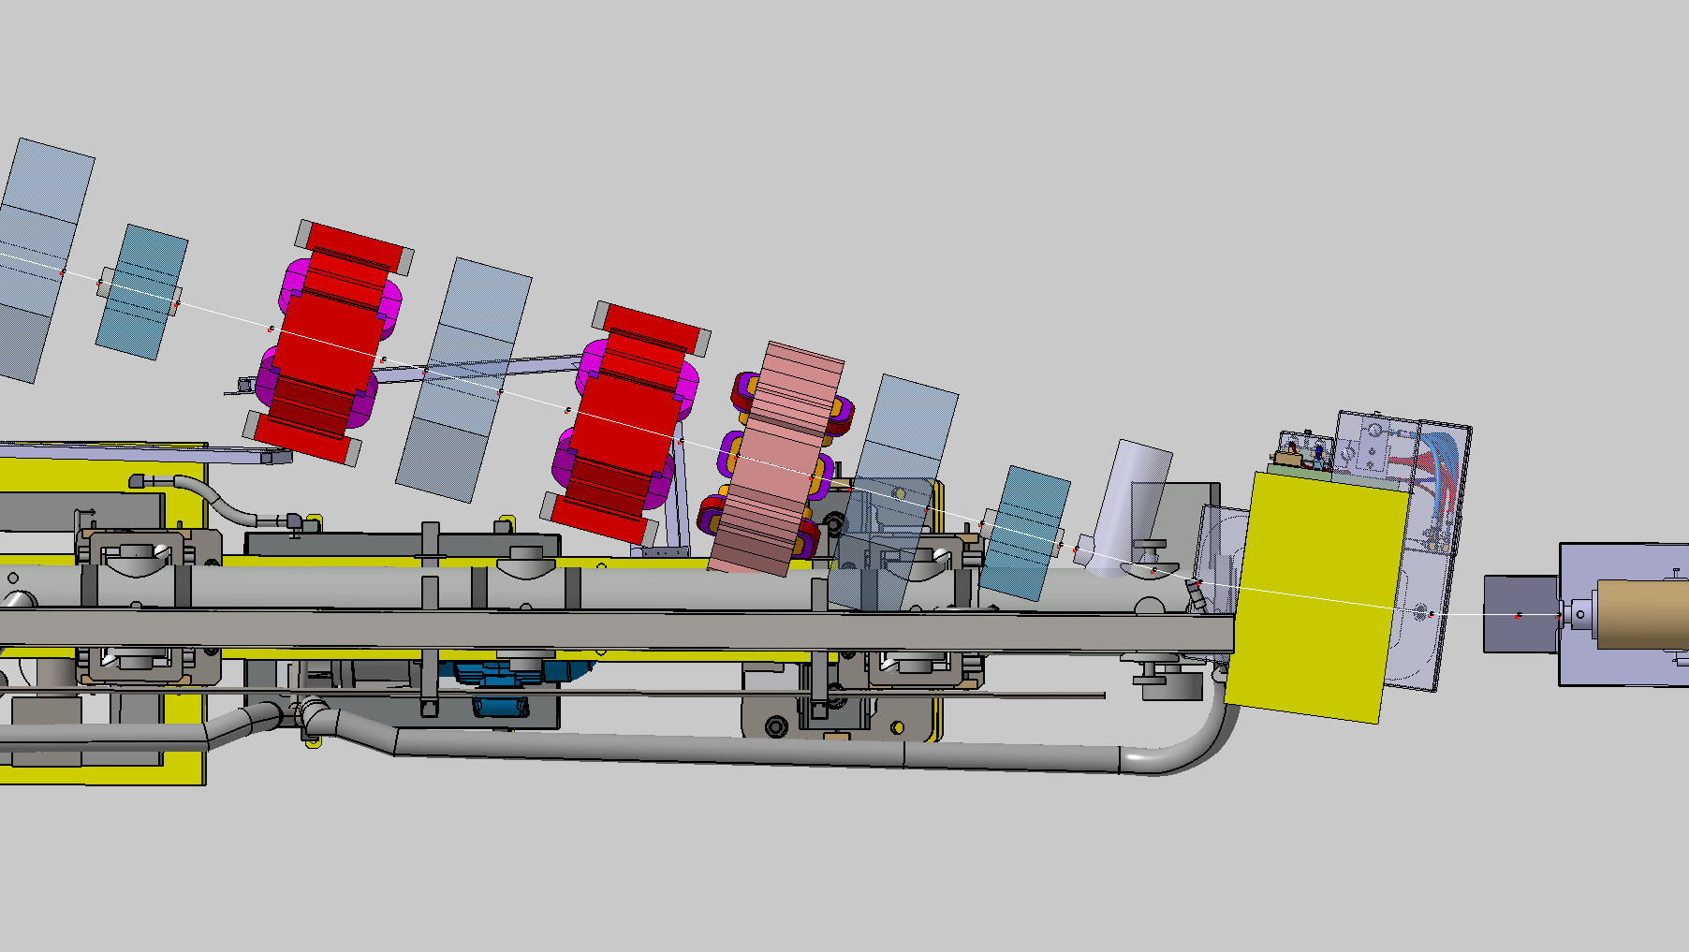
Work ongoing for Injection region for Run 2c
Understanding real size of magnets of 150MeV line is crucial: last dipole, corrector, octupole, sexpole and quadrupole
  Input needed from e-beamline and magnets experts
Thermal estimate studies will be priorities for feasibility of source integration inside` dipole gap (52-80 or 100mm gap ?)
Feasibility of laser beam dumps inside/close to dipole magnet is been investigated and will be crucial to minimize gap in the plasma
Understand use of diagnostic presence in injection area for tuning and accurate delivery of 150MeV at injection point
  Input needed from e-beamline experts to access which diagnostics are essential (screen, OSR, timing etc)
Picture from F. Galeazzi

Slide 16
Conclusions
Decommissioning and decontamination activities proceed in parallel with Run 2b and Run 2c MPP activities
Aim to have comments/suggestions implemented soon into decontamination procedure soon and have it approved by all CERN safety stakeholders
Run 2c injection area is an engineering challenge with all the experiment constraints which require dedicated studies and resources
Injection area, many inputs still needed to able to pass to the engineering phase of a fully integrated system

Slide 17
Thank you for your attention

