Slide 1
Status of Beam Instrumentation for AWAKE Run 2c
Collette Pakuza for AWAKE BI
AWAKE Collaboration Meeting, 24-26 March 2025,
Max-Planck-Institute for Physics, Garching, Germany

Slide 2
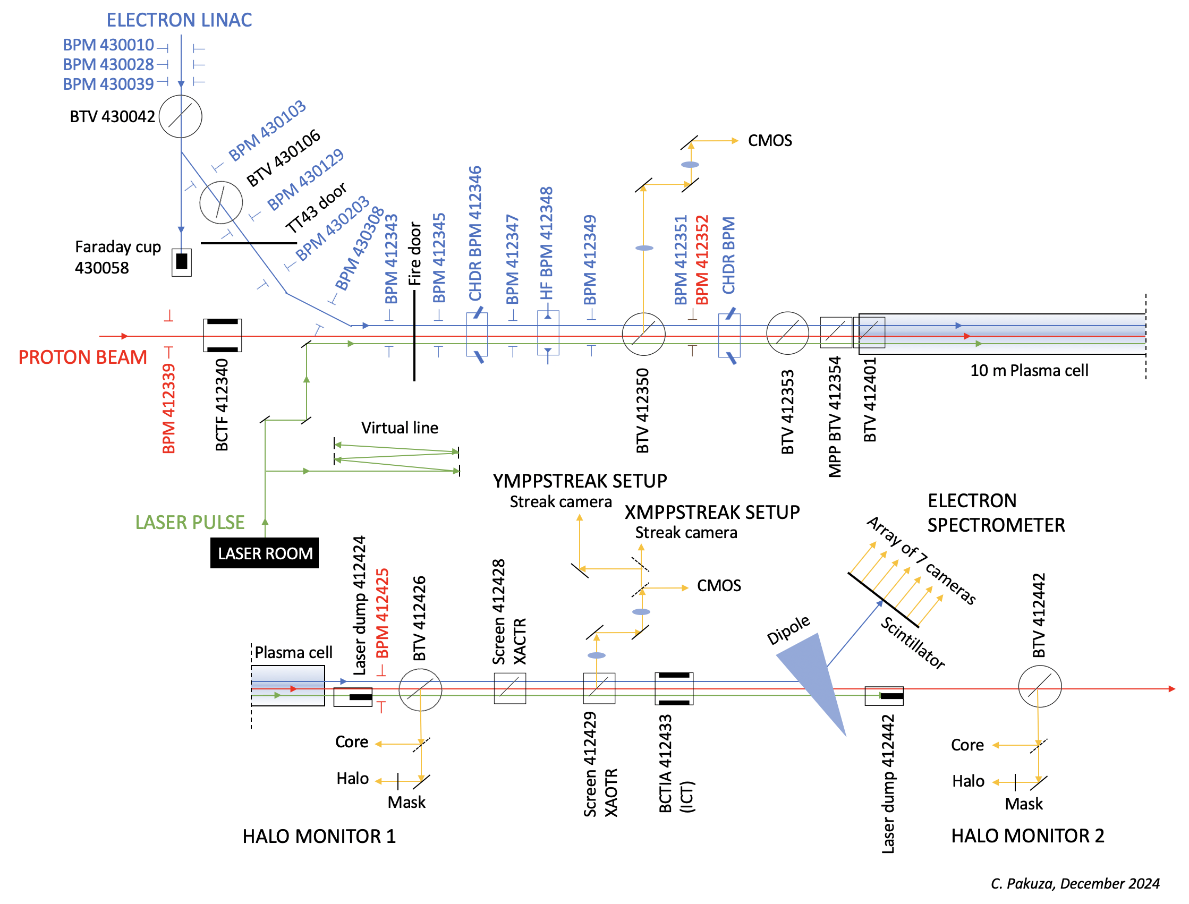
Reminder of existing instruments
Beam position monitors:
Electrons
7x 40 mm ID TRIUMF stripline BPMs in the e-line
5x 60 mm ID TRIUMF stripline BPMs in the common line
2 ChDR and 1 HF BPM in the common line
Protons
21 button BPMs from SPS extraction to AWAKE
Profile measurements:
2+4 standard BTVs (Beam TVs) in the e and common line
Additional BTVs installed by MPP
Intensity:
Faraday cup
2 CTs
Electron energy:
Spectrometer (dipole, screen and imaging system)
Plus a lot of digital cameras, motors, software
10 plasma cameras and plungers
C. Pakuza

Slide 3
For Run 2c
18 MeV line will keep most of the existing instruments but with relocation to new positions (further down the tunnel, in the experimental hall)
New 150 MeV beamline will require new “standard” diagnostics to be manufactured, installed and commissioned (more of what already exists at AWAKE with adjustments - BPMs, BTVs)
New beam parameters of the new 150 MeV beamline and spatial constraints at injection region will require “special” diagnostics

Slide 4
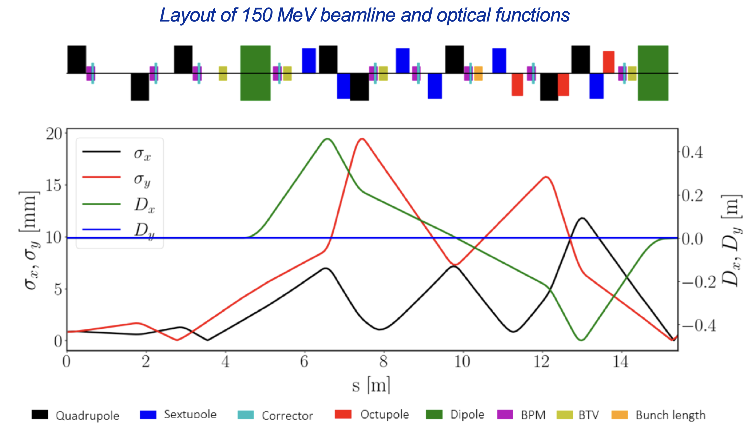
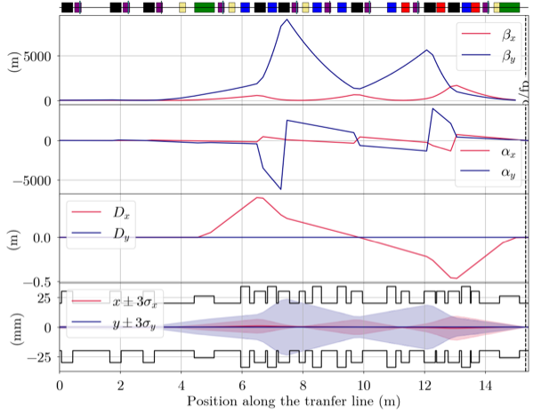
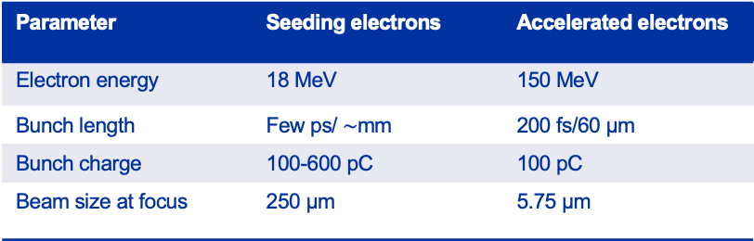
Overview of 150 MeV line and challenges for instrumentation
New 150 MeV beam line:
  Most of the line will have same aperture as 18 MeV line (40 mm ID)
  Large beta function in certain area may require diagnostics to have larger ID – BTV, BPM
  Limited space in region close to injection dipole – has to be considered for diagnostics and how best to integrate them
Injection region (space between plasma cells):
  Integration of diagnostics in this region will need to be carefully considered – BTV, CSR for bunch length (UoL)
  Small beam size at focus, how to measure this? – Stefano’s talk
Short bunch length:
  Requires dedicated diagnostic and R&D
E. Belli
Comparison e-line parameters
Parameter | Seeding electrons | Accelerated electrons
Electron energy | 18 MeV | 150 MeV
Bunch length | Few ps/ $\sim$mm | 200 fs/60 µm
Bunch charge | 100-600 pC | 100 pC
Beam size at focus | 250 µm | 5.75 µm

Slide 5
“Standard” diagnostics
BTVs
  150 MeV line will have a new “standard” design
    Keep as simple as possible
    Discussions have started with some ideas for an initial design
    Will aim to have OTR, YAG screen and calibration target where possible
    Linear screen actuator, commercial magnetically-coupled actuators
    40 mm flange aperture, possible exception in large beta region
    Working together with Eleonora to understand the beta functions as input for necessary screen sizes
  Number of units and production:
    For 150 MeV line, 7 (5+2 spares) will be produced
    For 18 MeV line, 1 will be produced to replace the pepperpot
    Design with MME to start this year, procurement and production in-house to follow

Slide 6
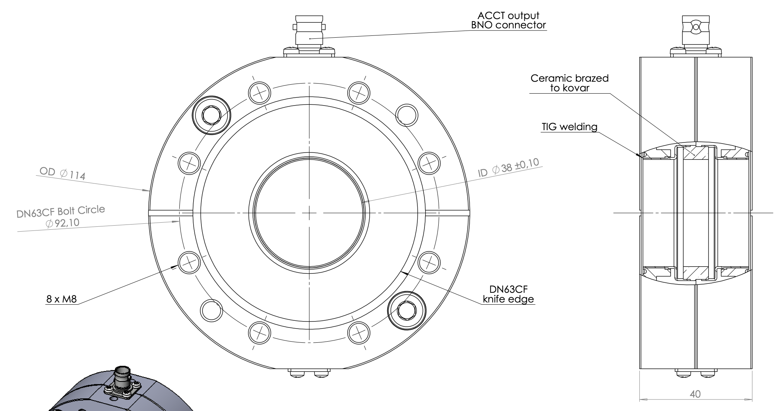
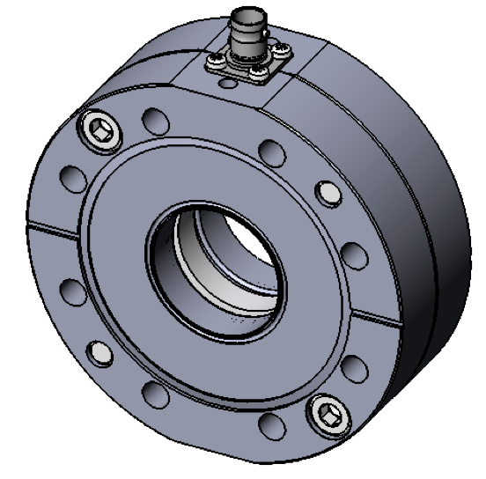
“Standard” diagnostics
ICTs
  Similar to one already installed at the spectrometer dipole (in-flange ICT from Bergoz) – keep for Run 2c
  Two additional requested near the gun of 18 MeV and 150 MeV line
  Possibility to have more in both transfer lines if needed
  Discussions started and order will be made from Bergoz once total number of units collected
  Doesn’t require a lot of space in beamline or in the racks – no new rack requests

Slide 7
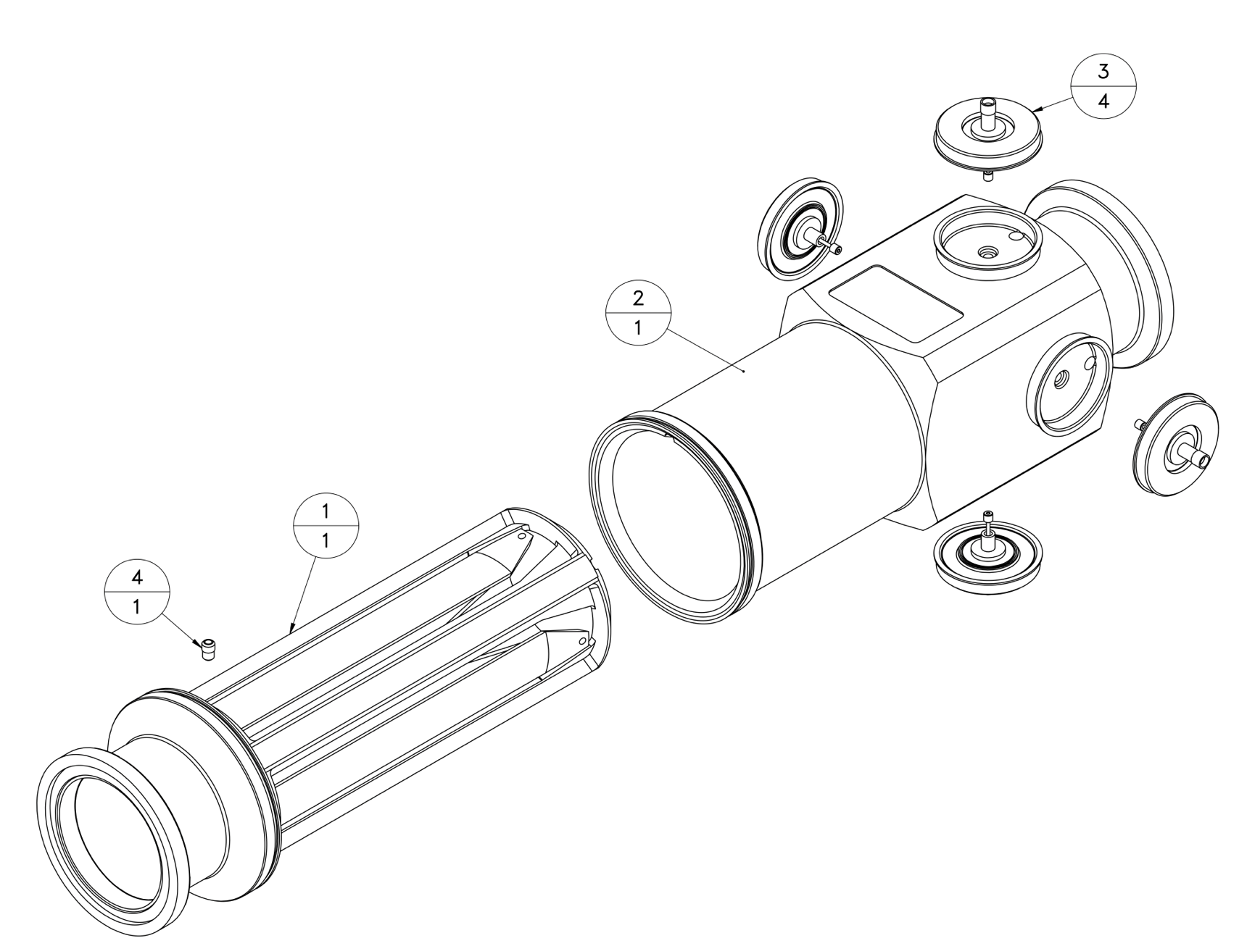
“Standard” diagnostics
BPMs
  For 150 MeV line
    Involves production of new BPMs in-house based on TRIUMF drawings for the existing stripline BPMs
    Working together with MME and VSC
    This will be 10 (8+2 spares) x40mm ID and 2 (1+1 spare) x60 mm ID units
    Change of TRIUMF drawings to ISO-standard already started
    Requires some adjustments such as ensuring electrical contact between the components
    Plan to start prototype production this year
    Electrical tests in the lab before production of rest of the units
  For all transfer lines:
    Refurbishment of electronics of all existing BPMs (proton button and electron stripline) – Laurence’s talk

Slide 8
“Special” diagnostics
Bunch length measurements are being studied
  CSR (UoL) – Joe’s talk
  EO methods (UoM)
  Coherent ChDR (UoM)
To be defined:
  Space reservation and position
  Number of instruments needed
Emittance diagnostics
  Electron spectrometer (UCL) – David’s talk
  OTR/OSR imaging (UoL)

Slide 9
Existing instruments
ChDR and HF BPMs (Oxford, TRIUMF)
  Electron bunch measurements in presence of the more-intense but longer proton bunches in AWAKE common line via frequency discrimination
  Detection at 30 GHz
  Works with pilot p-bunch (1e11 ppb) but not 3e11 ppb
  Proton spectrum extends to higher frequencies than expected and we get contribution from protons in the measured signals
  Will need dedicated R&D to understand if instrument can work at 3e11 ppb
  Decision to keep for Run 2c will be presented and discussed at next PEB
2 spare HF BPM buttons will be used for e-bunch synchronization system testing at CTF2 – Josh’s talk
Possibility to use the existing 4 buttons at AWAKE depending on whether we keep them for Run 2c or not

Slide 10
Conclusions
Run 2c diagnostics will have several challenges, namely injection region integration, small bunch length measurement, small electron beam size measurement at injection
The preparations for design and production of the standard instruments have begun (BPMs, BTVs), some in more advanced stages than others
R&D for “special diagnostics” has started (short electron bunch length and emittance diagnostics)
Some decisions still required to be made regarding existing instruments but these will come very soon

Slide 11
Thank you for your attention!

