Slide 1
Options for injection beam size diagnostics
S. Mazzoni for the AWAKE BI team.
AWAKE Collaboration meeting, 24-26 March 2025

Slide 2
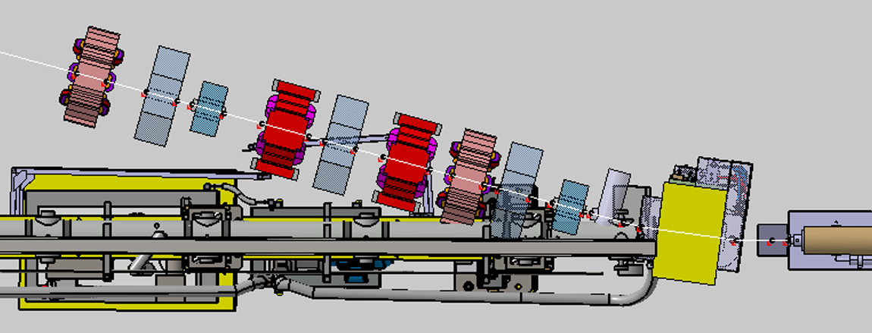
Electron beam size at injection
Expected beam size at merging point approximately 6 um (σ). To be measured inside Rb vapour.
Could be measured by polarised Optical Transition Radiation PSF analysis. Challenging!
Back-up (?): measure beam size from SR produced in last dipole

Slide 3
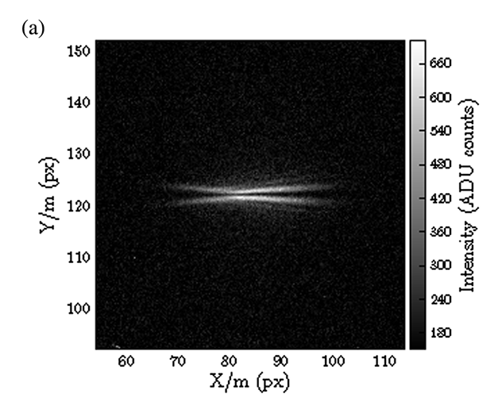
polarized Optical Transition Radiation
Point Spread Function of OTR is a radially polarized ring-like structure. Measured in 2011 by P. Karataev et al (PRL 110)
Systematic study of OTR PSF in “Very high resolution optical transition radiation imaging system: Comparison between simulation and experiment”, B. Bolzon et al. PRAB 18 (2015)
Studied at ATF2 on hundreds of um H, few um V beam with V polarizer

Slide 4
polarized Optical Transition Radiation
Observe beam with high resolution / magnification instrument (eg 10X magnification…a microscope)

Slide 5
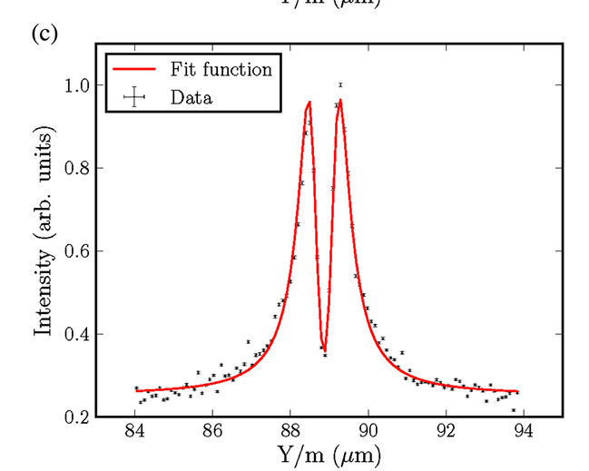
polarized Optical Transition Radiation
Get profile along the polarization axis

Slide 6
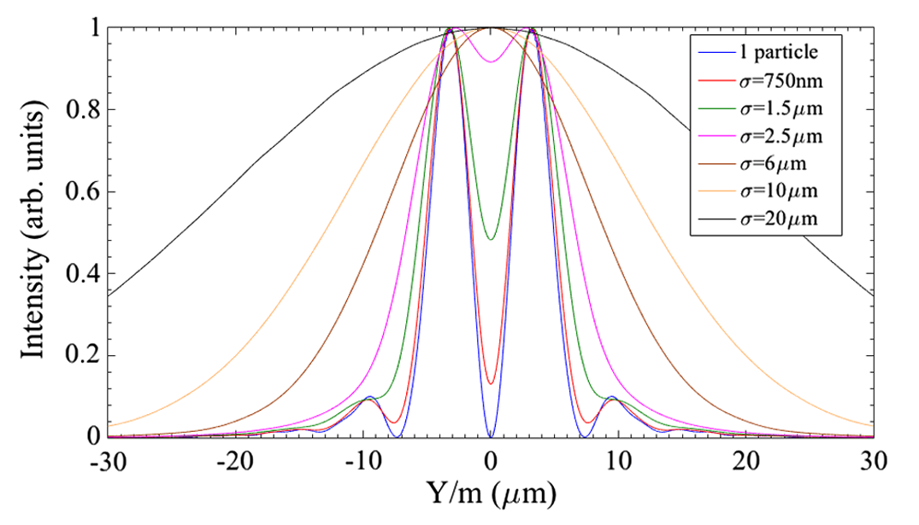
polarized Optical Transition Radiation
Beam size measurement as convolution of distribution and OTR. In practice it depends on size range:
  from loss of visibility for small (<10 um?) sizes
  full convolution for intermediate and large sizes
Micrometre resolution achievable BUT
  need very high resolution instrument
  accuracy will depend on knowledge of PSF and other factors (SNR, instrument PSF,…)
B. Bolzon et al. PRAB 18 (2015)
λ = 550 nm, γ = 2500

Slide 7

What else is there
Exploit SR emission from injection dipole
Expected beam parameter in the middle of dipole:
$$σ_{x}=800 μm,σ_{y}=640 μm, {σ′}_{x}=1.5 mrad,{σ′}_{y}=1.2 mrad$$

Slide 8
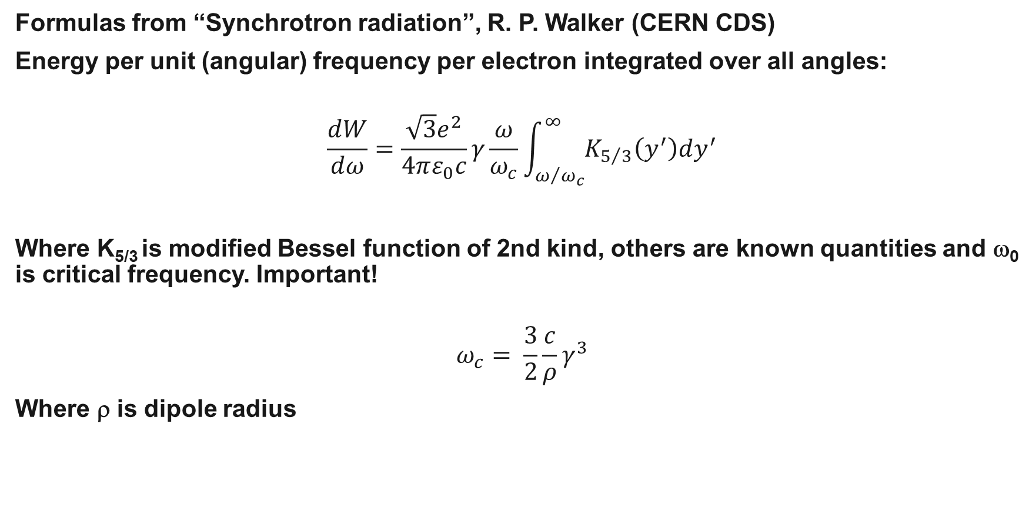
Spectral / angular properties of SR
Formulas from “Synchrotron radiation”, R. P. Walker (CERN CDS)
Energy per unit (angular) frequency per electron integrated over all angles:
$$\frac{dW}{dω}=\frac{\sqrt{3}e^{2}}{4πε_{0}c}γ\frac{ω}{ω_{c}}\int_{ω/{ω_{c}}}^{∞}{K_{5/3}\left(y^{′}\right)dy^{′}}$$
Where K_{5/3} is modified Bessel function of 2nd kind, others are known quantities and ω₀ is critical frequency. Important!
$$ω_{c}= \frac{3}{2}\frac{c}{ρ}γ^{3}$$
Where ρ is dipole radius

Slide 9
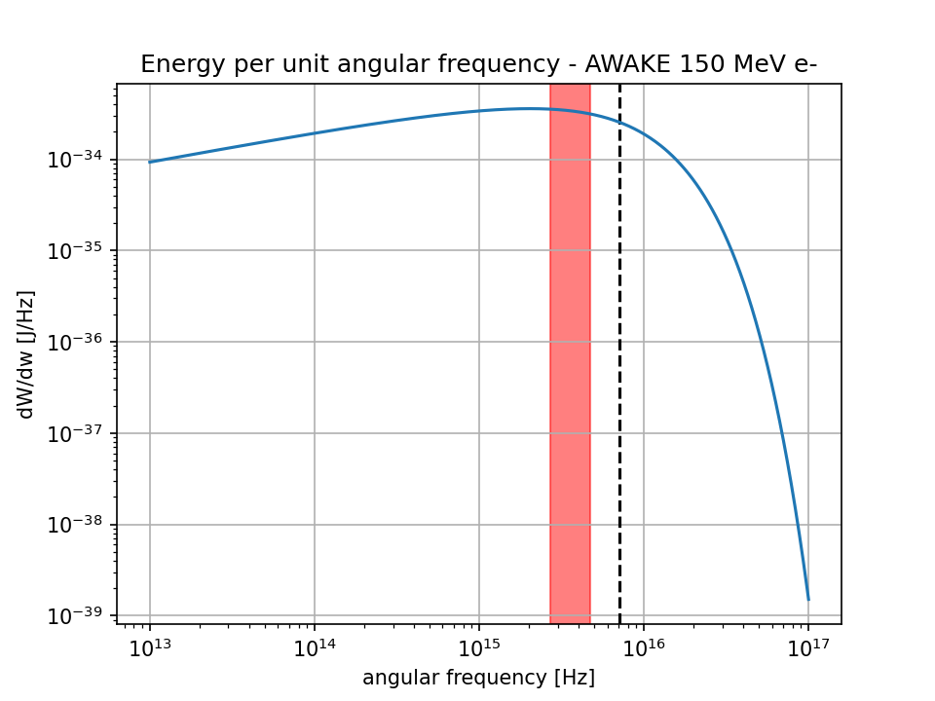
Spectral / angular properties of SR
In our case (rho = 1.6 m, gamma = 293) critical frequency is 7.1E15 Hz, corresponding to 264 nm We can work comfortably at short visible wavelength eg 400 nm
Order of magnitude yield at 400 nm , 10 nm BW:
  7.4E-20 J emitted
  0.023 ph/el emitted
  200 pC bunch => 3E07 ph
OK!

Slide 10
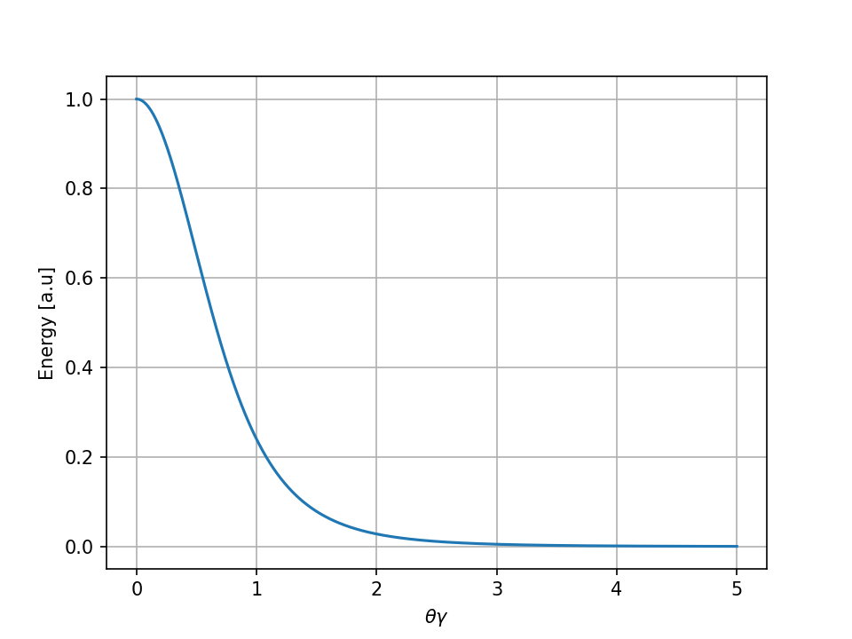

Spectral / angular properties of SR
SR polarized. H polarization predominant a critical frequencies.
Emission per solid angle:
$$\frac{dW}{dΩ}=\frac{7}{64π}\frac{e}{ε_{0}}\frac{γ^{5}}{ρ}\frac{1}{{\left(1+γ^{2}θ^{2}\right)}^{5/2}}\left[1+\frac{5γ^{2}ψ^{2}}{7\left(1+γ^{2}ψ^{2}\right)}\right]$$
Well-known result: most of energy within 1/gamma cone

Slide 11
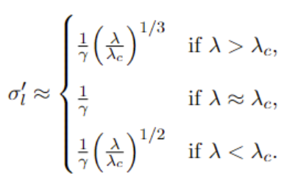

Resolution limit
However resolution depends critically on angular emission which in turn depends on working wavelength. In general opening angle
In general diffraction limit for a light source is $σ_{l}{σ^{′}}_{l}\sim λ/4$, therefore our resolution limit is:
$$σ_{l}\sim \frac{γλ}{4}$$
That is order of 30 um @ 400 nm
K.J. Kim, Characteristics of Synchrotron Radiation (1989)

Slide 12
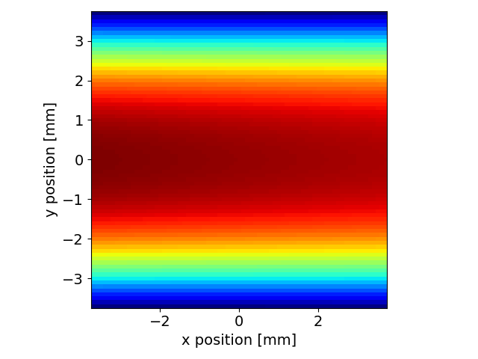
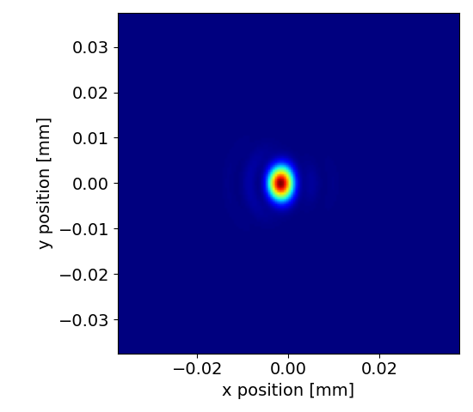
PSF using SRW
pySRW (https://pysrw.docs.cern.ch/) is python wrapper of SR workshop suite. Simulation performed by D. Butti
magnetic length 0.6 m, deflection angle 15 deg, rho = 1.6233 m
SR fan at 400 nm at 1 m distance
Imaging with ideal 100 mm f, 10 mm dia lens
PSF (image plane):
  2.5 um V (“1/γ rule”)
  1.8 um H (“Airy”: limited by lens aperture)
Resolution OK!

Slide 13
Summary
pOTR:
  um-resolution: enough for beam size at injection. Very sensitive to beam changes
  Accuracy difficult to predict, experimentally challenging.
SR from last dipole
  ‘good’ properties. Beam size can be accurately measured.
  Integration of viewport challenging, measurement point far from injection
BI supports studies for pOTR / SR –based beam size at injection

