Slide 1


Particle beam collisions with plasma simulation codes
AWAKE Collaboration Meeting Mar 25
Thomas WIlson

Slide 2
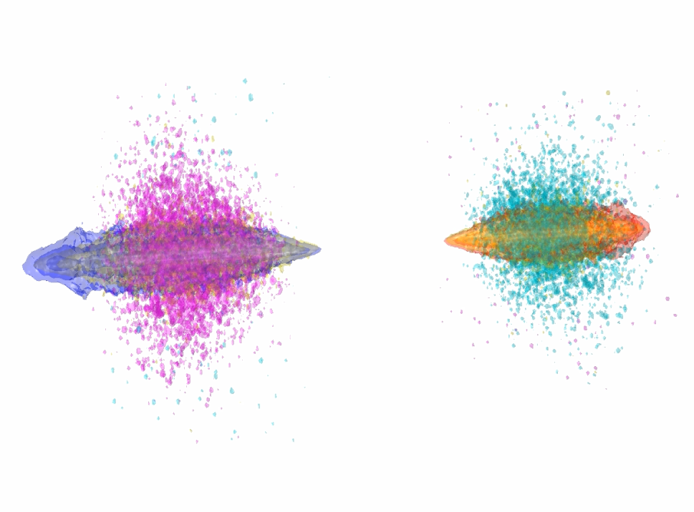
Overview
Particle colliders
  Luminosity
Beam-beam interactions
  Pinch & disruption
Plasma-produced beams for colliders
  Difficult
Outlook & summary
VLPL simulation

Slide 3
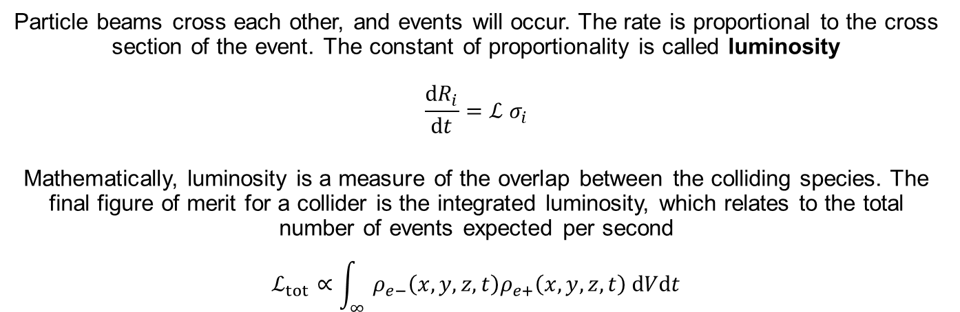
Particle colliders
e⁻
e⁺
Particle beams cross each other, and events will occur. The rate is proportional to the cross section of the event. The constant of proportionality is called luminosity
$$\frac{dR_{i}}{dt}=ℒ σ_{i}$$
Mathematically, luminosity is a measure of the overlap between the colliding species. The final figure of merit for a collider is the integrated luminosity, which relates to the total number of events expected per second
$$ℒ_{tot}∝\int_{∞}{ρ_{e−}\left(x,y,z,t\right)ρ_{e+}\left(x,y,z,t\right) dVdt}$$

Slide 4
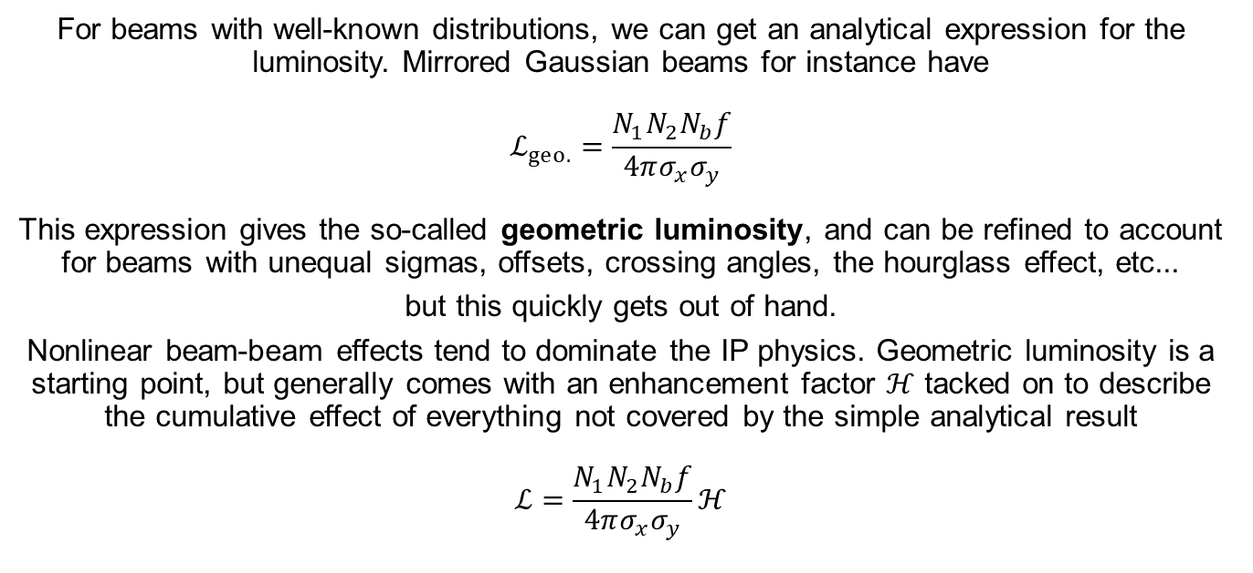
Luminosity
For beams with well-known distributions, we can get an analytical expression for the luminosity. Mirrored Gaussian beams for instance have
$$ℒ_{geo.}=\frac{N_{1}N_{2}N_{b}f}{4πσ_{x}σ_{y}}$$
This expression gives the so-called geometric luminosity, and can be refined to account for beams with unequal sigmas, offsets, crossing angles, the hourglass effect, etc...
but this quickly gets out of hand.
Nonlinear beam-beam effects tend to dominate the IP physics. Geometric luminosity is a starting point, but generally comes with an enhancement factor $ℋ$ tacked on to describe the cumulative effect of everything not covered by the simple analytical result
$$ℒ=\frac{N_{1}N_{2}N_{b}f}{4πσ_{x}σ_{y}}ℋ$$

Slide 5
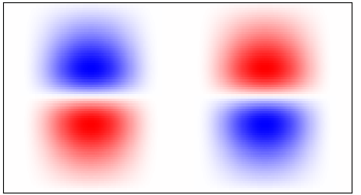
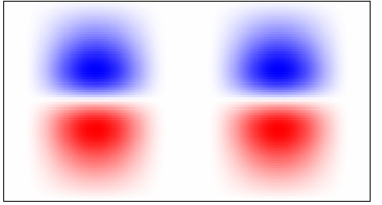
Pinch & disruption
The most relevant IP physics for us at the moment is beam pinch
e⁻e⁺ colliders exhibit pinching at the IP, the reason for this is easy to see
As the bunches collide, the defocussing E-fields are neutralised, and the focussing B-field is enhanced
e⁻e⁻ (or p⁺p⁺, etc.) colliders can also experience a so-called 'anomalous pinch', to do with pair creation. The amount that the beam pinches is summarised as disruption
E_{y}
B_{z}
e⁻
e⁺
e⁻
e⁺

Slide 6
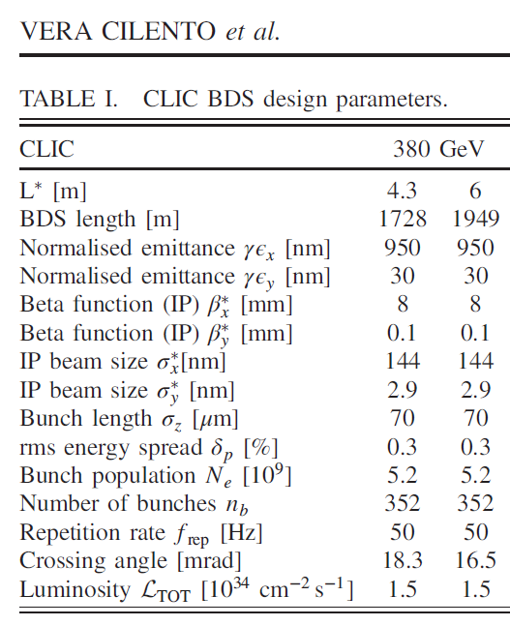
A starting point
Phys. Rev. Accel. Beams 24, 071001
We’re going to start with the parameters for CLIC*, and perform beam-beam simulations in Guinea-Pig and VLPL
We want to know about the dynamics at the interaction point (IP) and how to maximise the performance of a future collider
* beam charge is reduced by ~20%

Slide 7
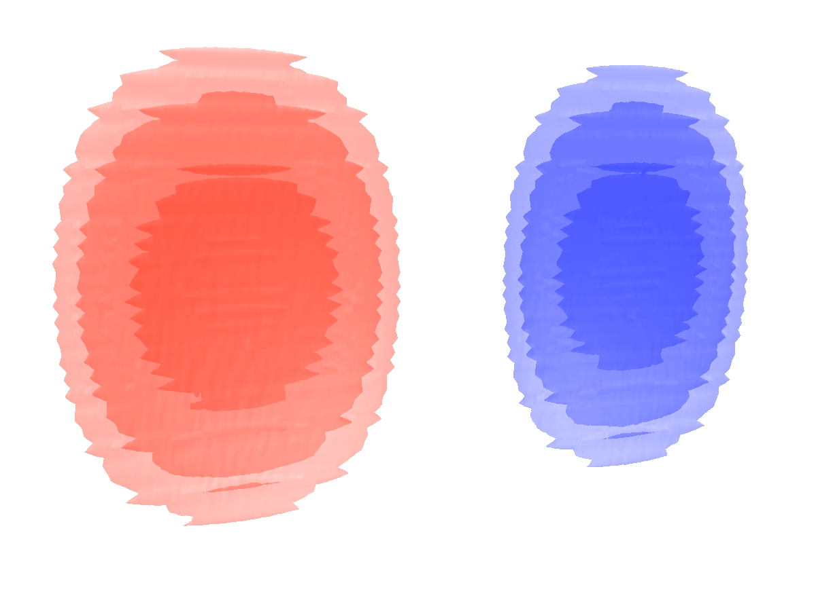
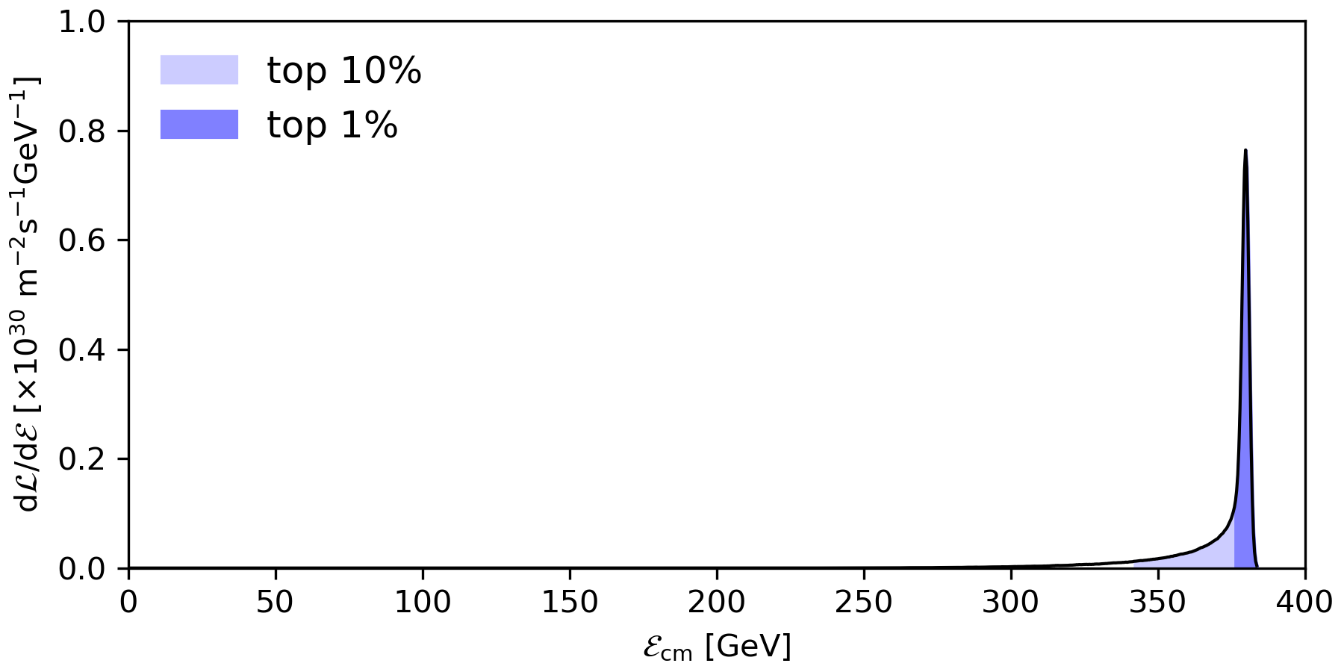

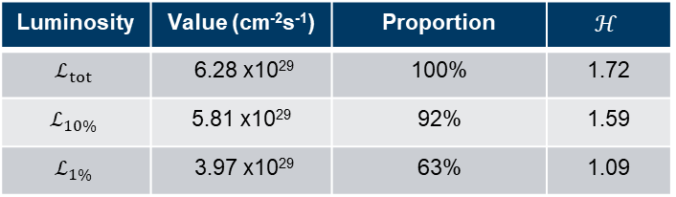
Luminosity at low disruption
Luminosity is not enough – the particles that are colliding need to be of high energy
Luminosity | Value (cm⁻²s⁻¹) | Proportion | $$ℋ$$
$$ℒ_{tot}$$ | 6.28 x10²⁹ | 100% | 1.72
$$ℒ_{10\%}$$ | 5.81 x10²⁹ | 92% | 1.59
$$ℒ_{1\%}$$ | 3.97 x10²⁹ | 63% | 1.09
e⁻
e⁺
Breit-Wheeler e⁻
Briet-Wheeler e⁺
$γ$

Slide 8
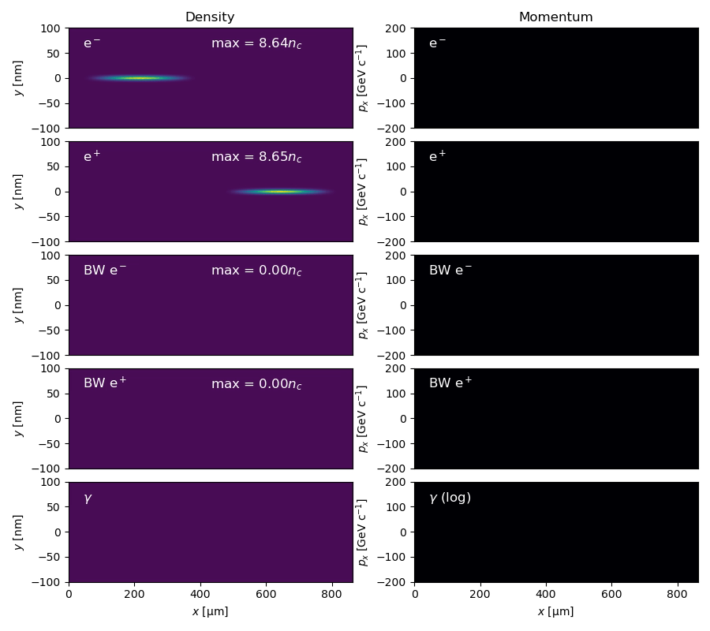
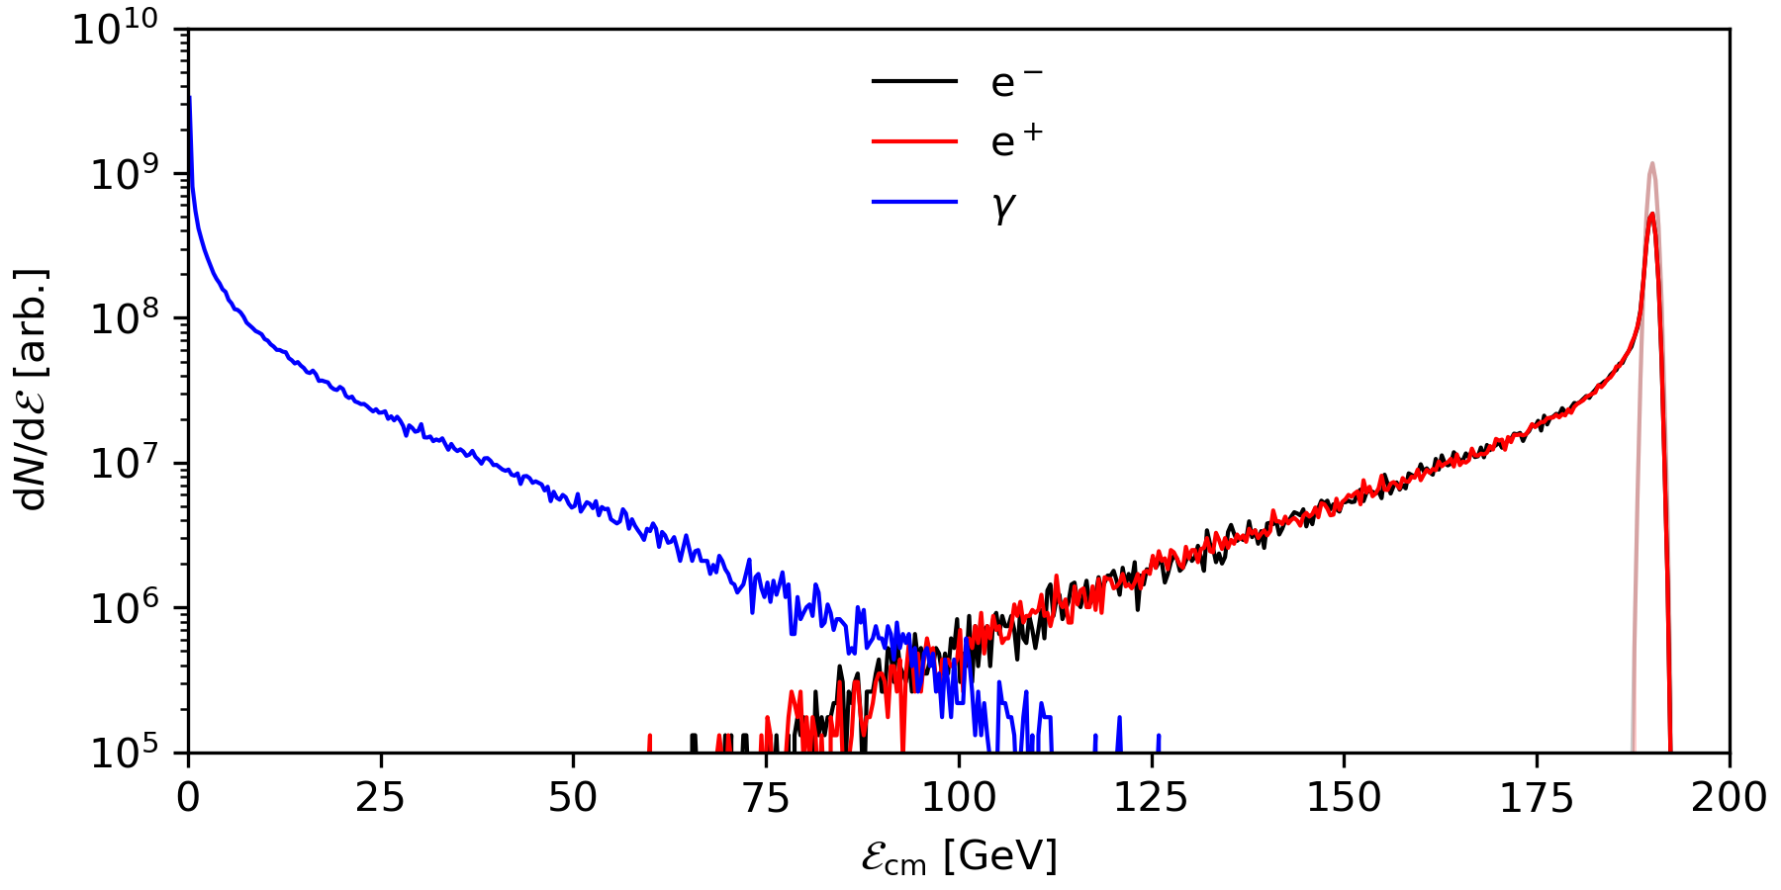
Flat beams
Flat beams are employed because the focusing forces on a noncircular beam are weaker, therefore the pinch effect is weaker, therefore disruption is lower
Initial
No Breit-Wheeler!

Slide 9
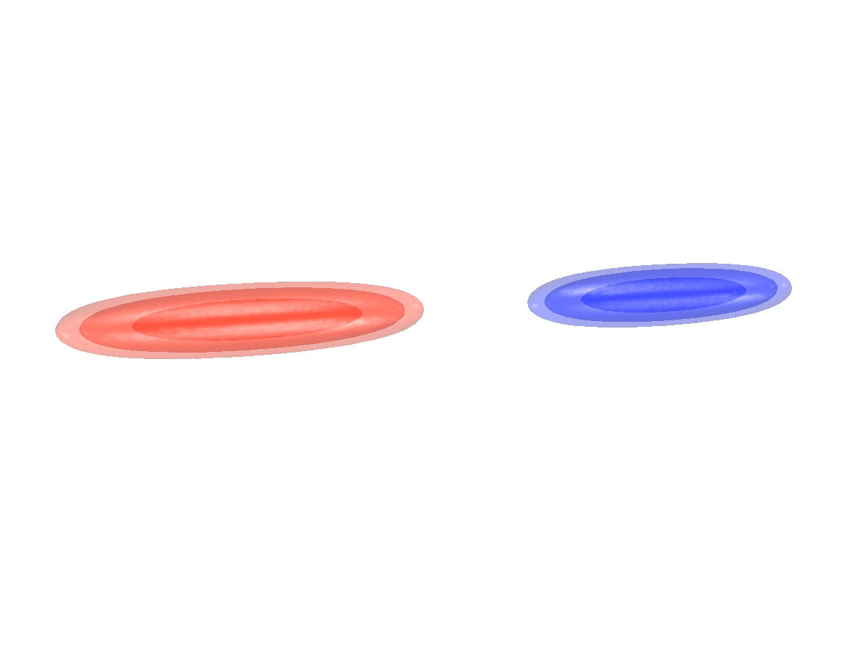

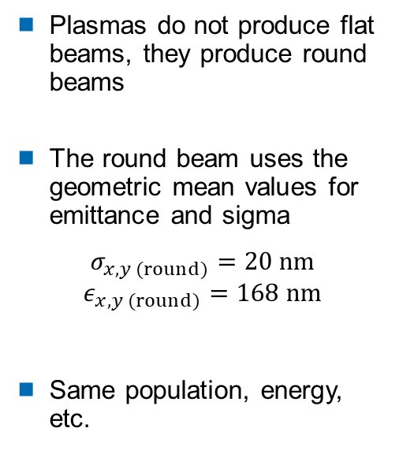
Round beams
Plasmas do not produce flat beams, they produce round beams
The round beam uses the geometric mean values for emittance and sigma
$$σ_{x,y (round)}=20 nm$$
$$ε_{x,y (round)}=168 nm$$
Same population, energy, etc.
e⁻
e⁺
Breit-Wheeler e⁻
Briet-Wheeler e⁺
$γ$

Slide 10
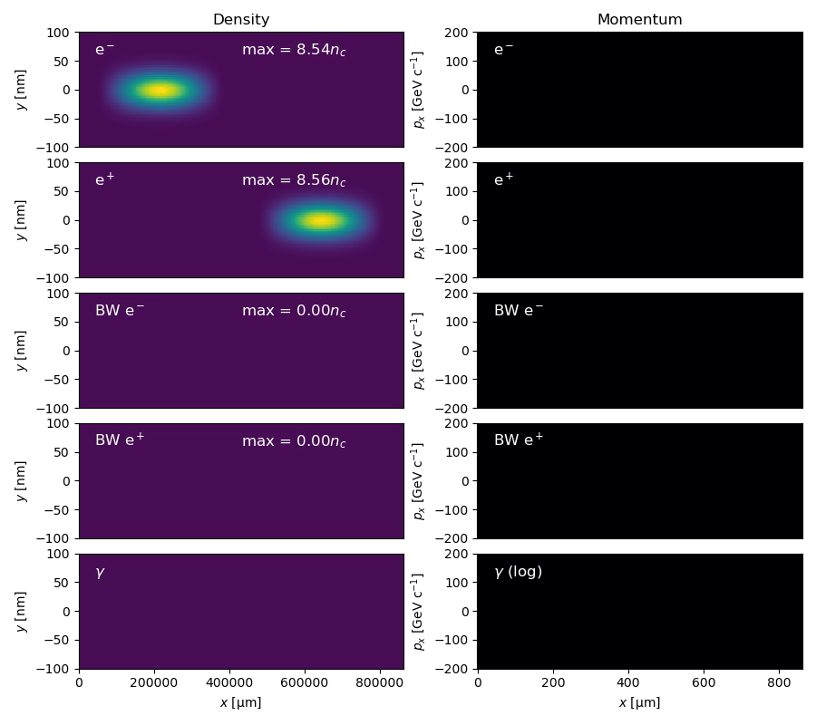
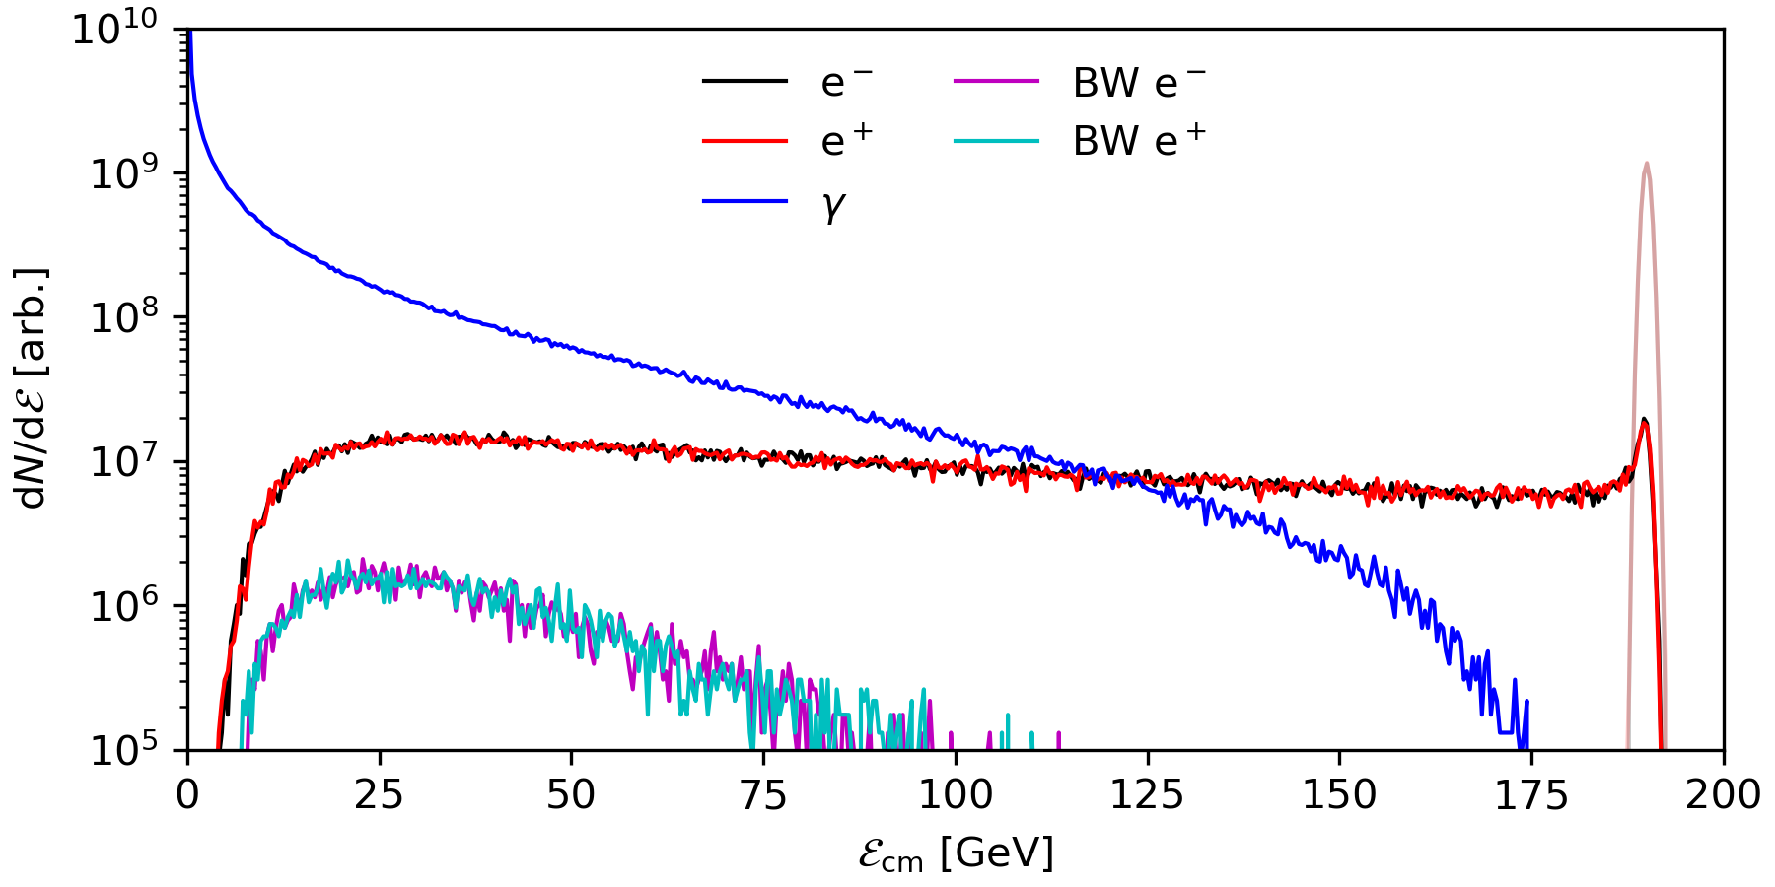
Round beam spectra
High disruption collisions lose energy to beamsstrahlung radiation and parasitic SF-QED effects like the Breit-Wheeler process (pair production)
Initial

Slide 11
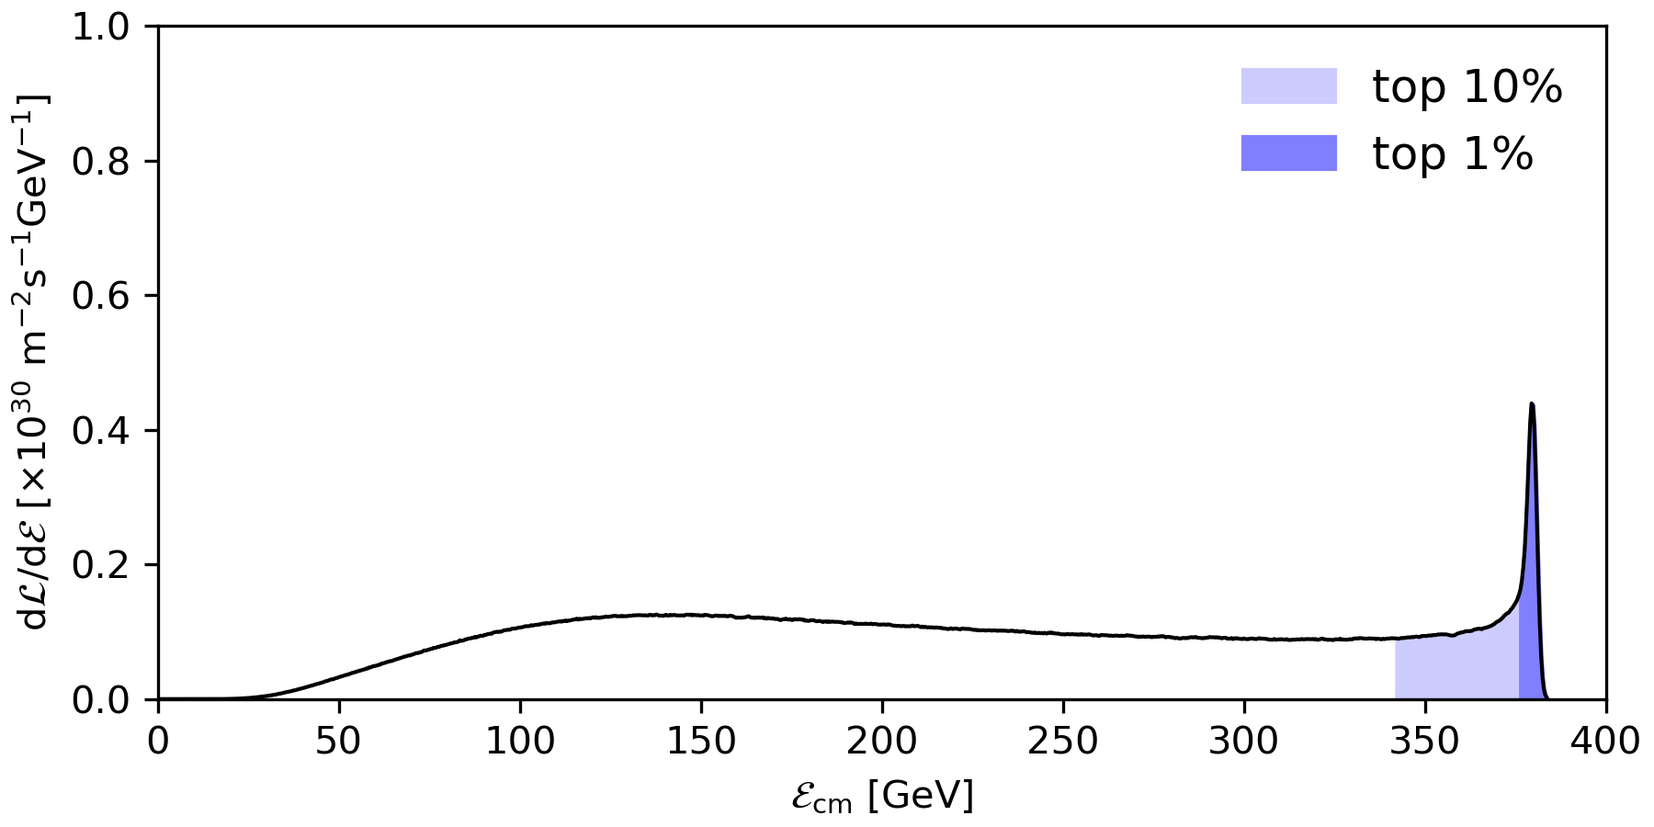
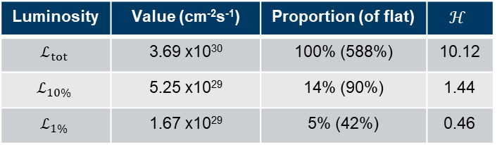
Round beam luminosity
Pinch increases particle flux density, and therefore increases total luminosity
Intense disruption lowers the individual collision energies, reducing luminosity in the top X% of energy
Luminosity in the top 1% is an often-quoted measure, and here it is around 5%
Luminosity | Value (cm⁻²s⁻¹) | Proportion (of flat) | $$ℋ$$
$$ℒ_{tot}$$ | 3.69 x10³⁰ | 100% (588%) | 10.12
$$ℒ_{10\%}$$ | 5.25 x10²⁹ | 14% (90%) | 1.44
$$ℒ_{1\%}$$ | 1.67 x10²⁹ | 5% (42%) | 0.46

Slide 12
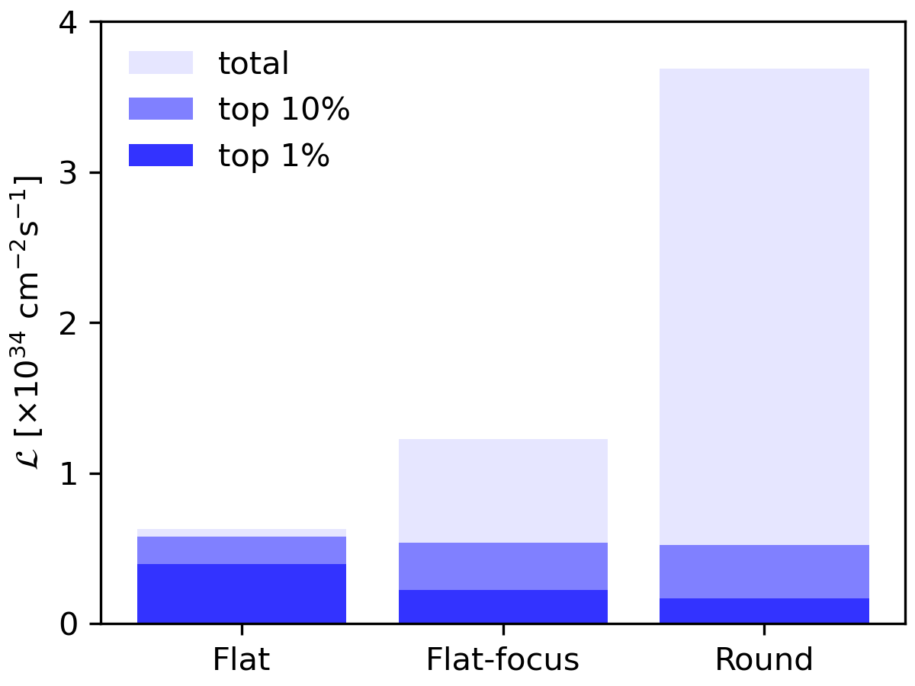
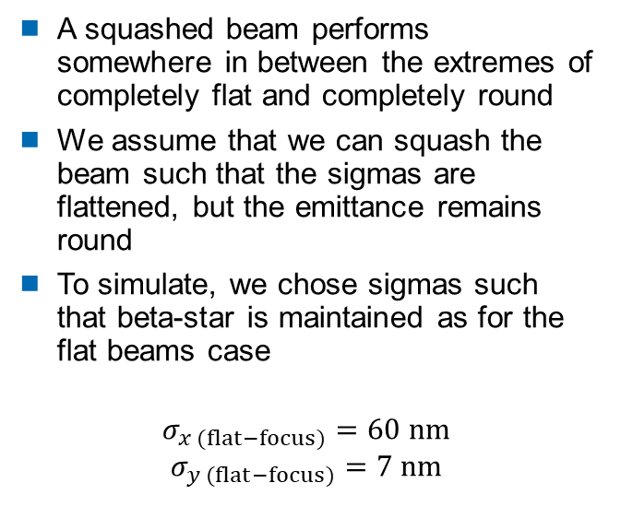
Flat-focus beams
A squashed beam performs somewhere in between the extremes of completely flat and completely round
We assume that we can squash the beam such that the sigmas are flattened, but the emittance remains round
To simulate, we chose sigmas such that beta-star is maintained as for the flat beams case
$$σ_{x (flat−focus)}=60 nm$$
$$σ_{y (flat−focus)}=7 nm$$
0

Slide 13
Future work
Beam crossing angles or offsets give a transverse kick as the beams pass, causing them to deflect and radiate
Guinea-Pig and CAIN are electrostatic, and thus do not model this behaviour
As we move further into the high energy, high luminosity, high disruption regime, it is increasingly difficult to justify discarding radiative effects
Plasma simulation codes with QED modules offer a solution to this, being fully electromagnetic, fully relativistic and making fewer approximations in the physical models
Optimisation, code development and theory development are all simultaneously ongoing

Slide 14
Summary
The unique challenges of a plasma-based accelerator/collider demand both physics and engineering solutions
QED-PIC is here, another tool for future collider design
Fully electromagnetic codes open the way to exploiting the extreme high-disruption regime
Thank you for your attention

