Slide 2
Injection point change
Sen Yue (SY-ABT-BTP)

Slide 3
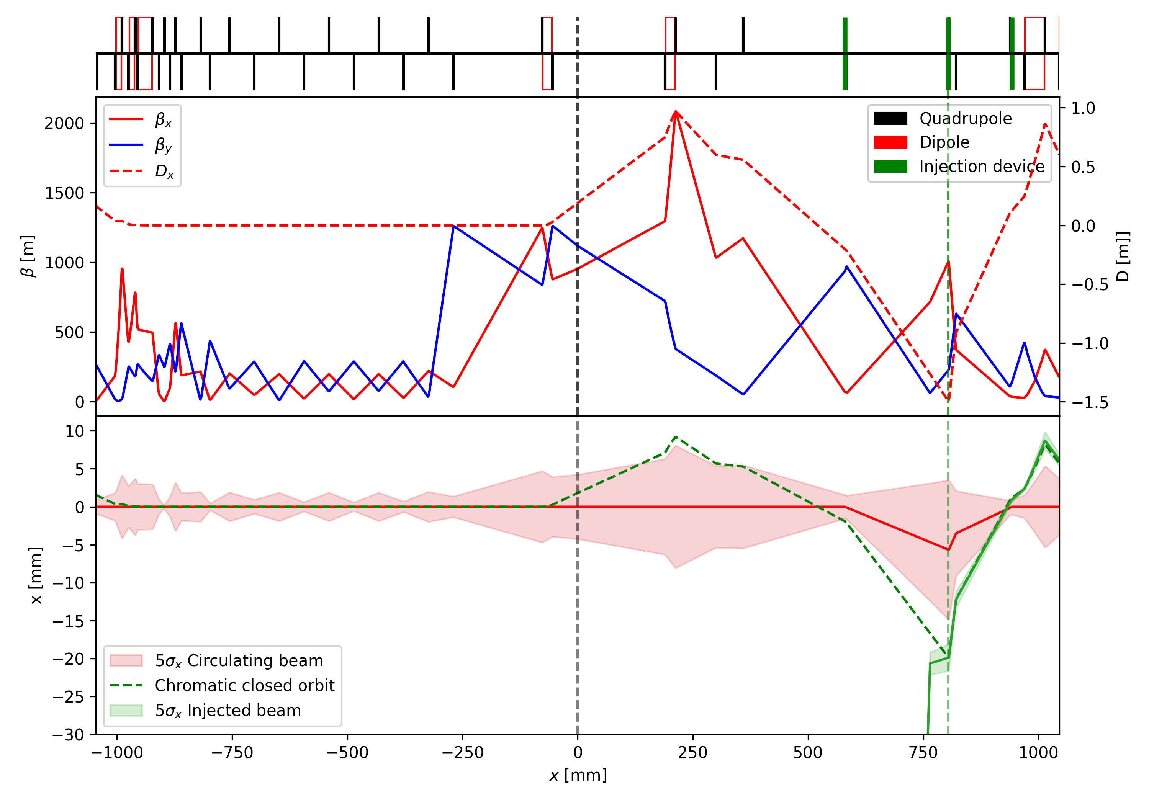
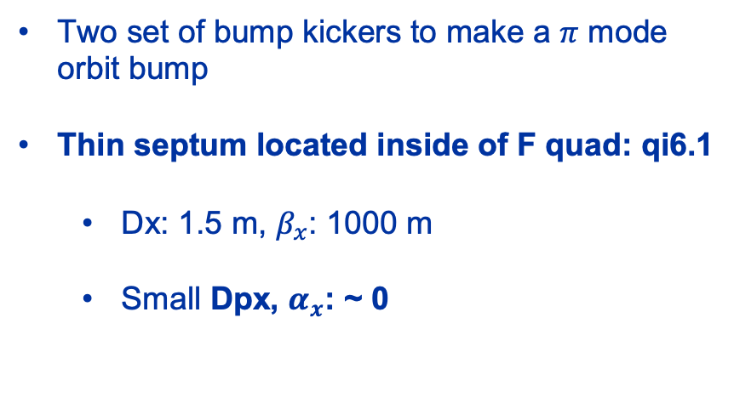
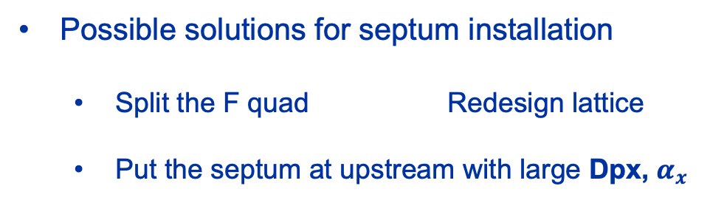
Conventional on-axis injection scheme
Two set of bump kickers to make a $π$ mode orbit bump
Thin septum located inside of F quad: qi6.1
  Dx: 1.5 m, $β_{x}$: 1000 m
  Small Dpx, $α_{x}$: ~ 0
Possible solutions for septum installation
  Split the F quad Redesign lattice
  Put the septum at upstream with large Dpx, $α_{x}$
Bump kicker
Thin septum

Slide 4
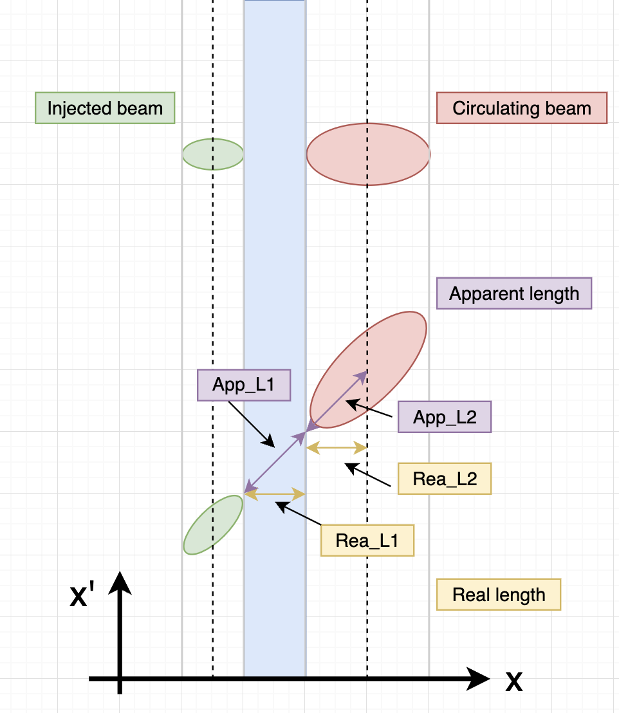
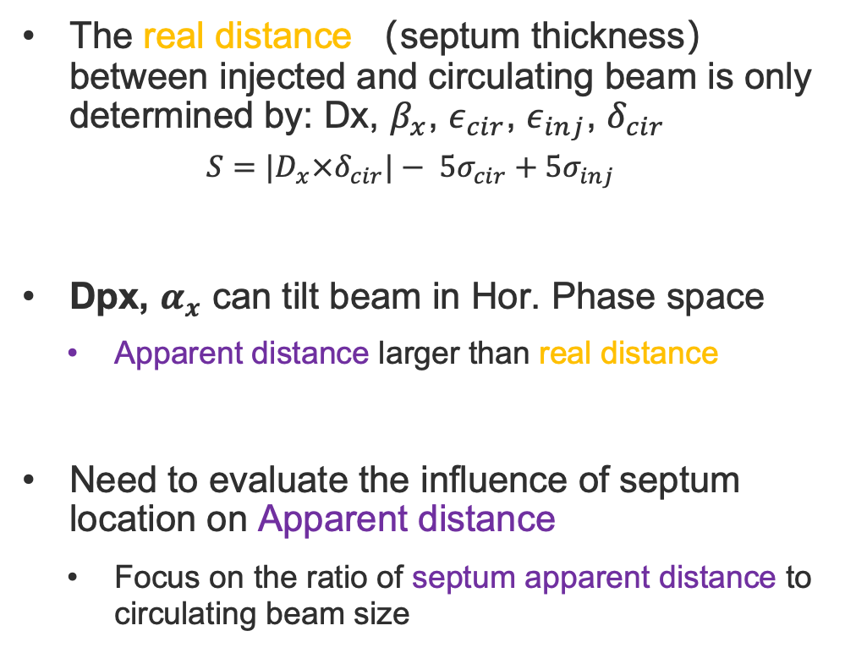



Injection point with large Dpx, $α_{x}$
The real distance （septum thickness） between injected and circulating beam is only determined by: Dx, $β_{x}$, $ε_{cir}$, $ε_{inj}$, $δ_{cir}$
  $$S=|D_{x}×δ_{cir}|− 5σ_{cir}+5σ_{inj}$$
Dpx, $α_{x}$ can tilt beam in Hor. Phase space
  Apparent distance larger than real distance
Need to evaluate the influence of septum location on Apparent distance
  Focus on the ratio of septum apparent distance to circulating beam size
Small Dpx, $α_{x}$
Large Dpx, $α_{x}$

Slide 5
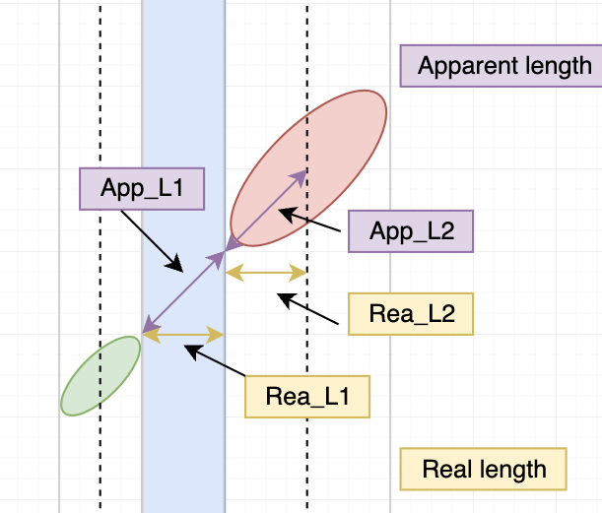
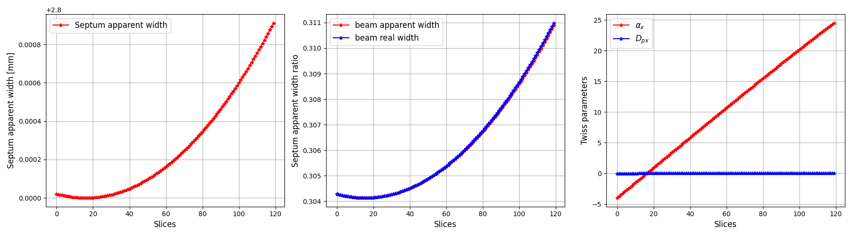
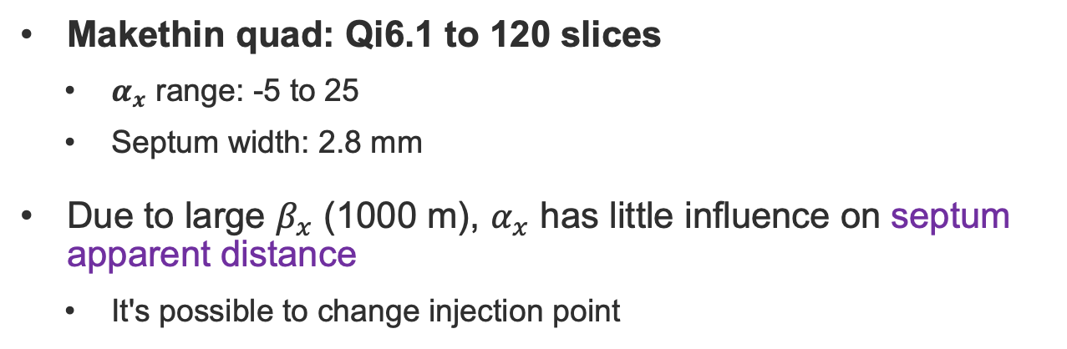
Ratio scan
Makethin quad: Qi6.1 to 120 slices
  $α_{x}$ range: -5 to 25
  Septum width: 2.8 mm
Due to large $β_{x}$ (1000 m), $α_{x}$ has little influence on septum apparent distance
  It's possible to change injection point

Slide 6
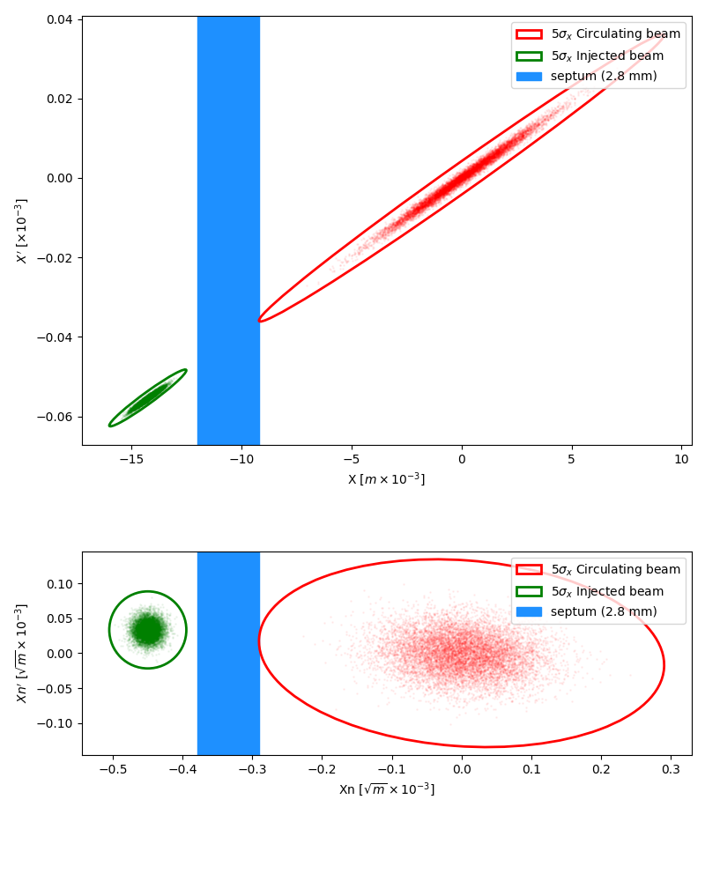
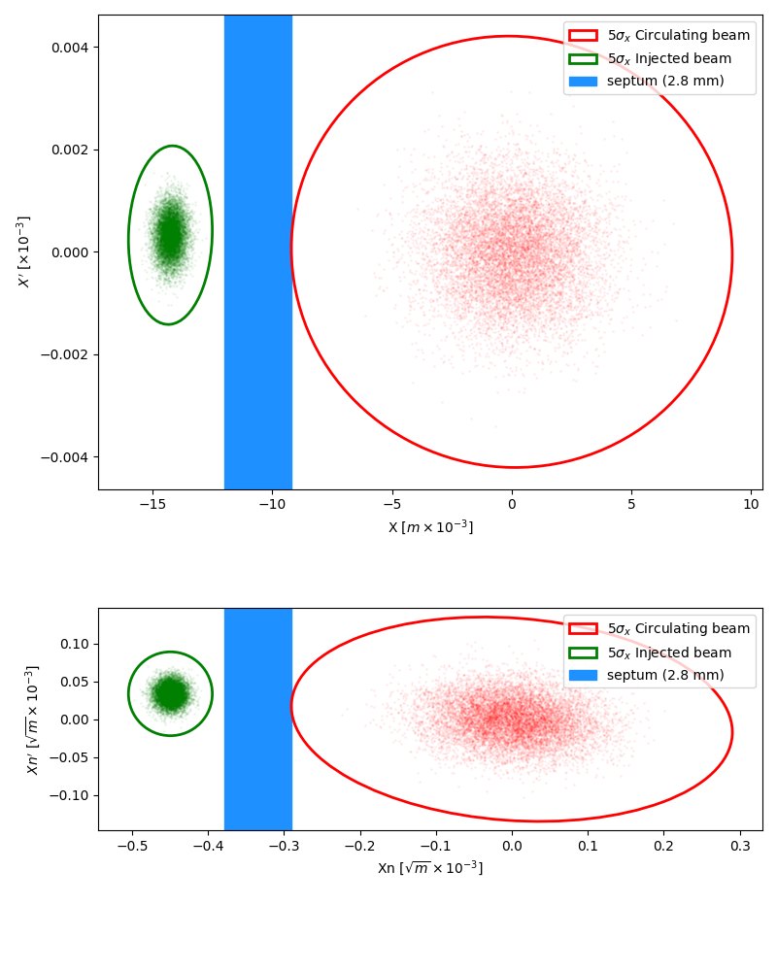
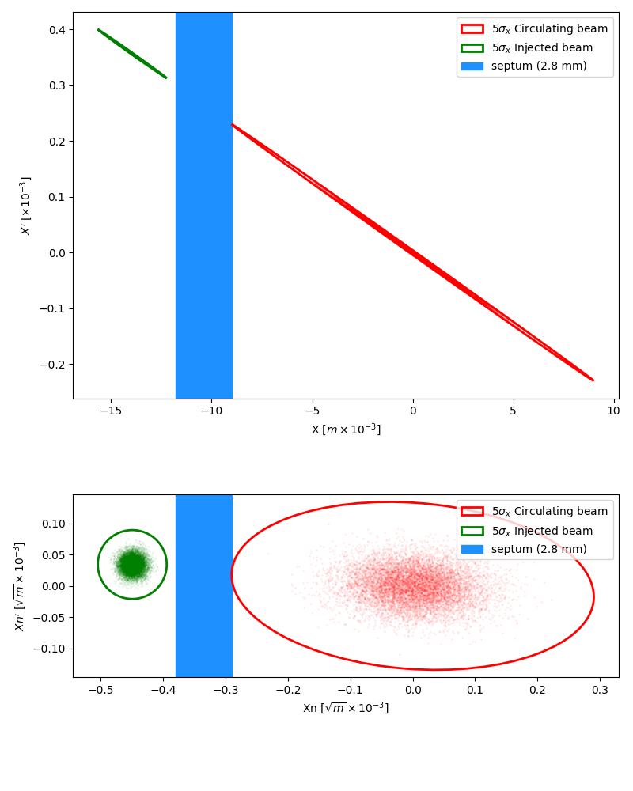
Horizontal phase space at injection point
It is possible to change injection point baseline from 17th slice to the upstream of qi6.1
First slice for qi6.1
17th slice for qi6.1
120th slice for qi6.1
Real space
Normalized phase space

Slide 7
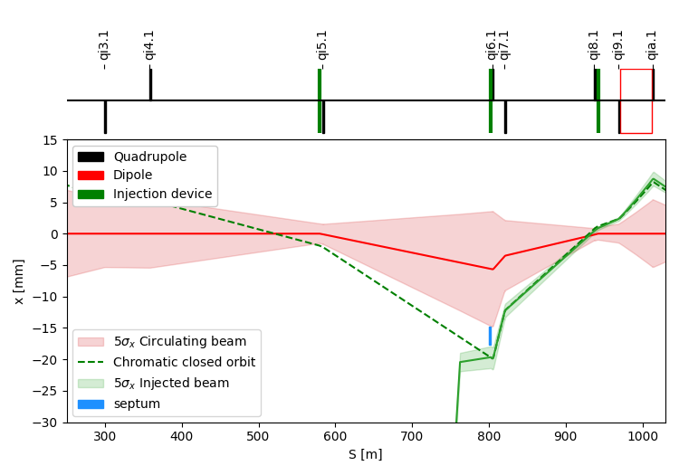
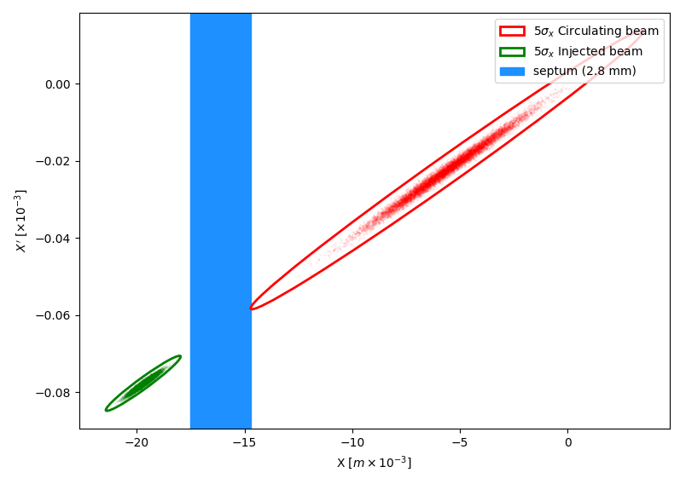
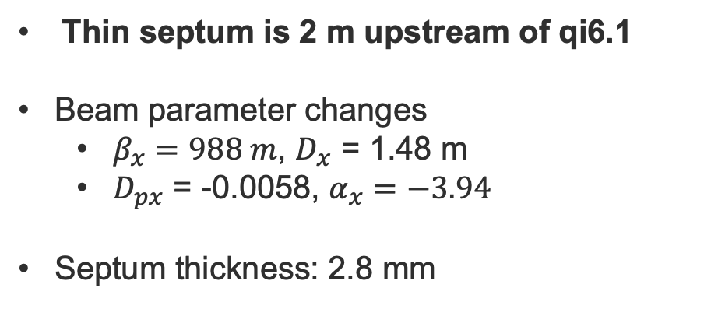
On-axis injection with new injection position baseline
Thin septum is 2 m upstream of qi6.1
Beam parameter changes
  $β_{x}=988 m$, $D_{x}$ = 1.48 m
  $D_{px}$ = -0.0058, $α_{x}=−3.94$
Septum thickness: 2.8 mm
Real phase space at injection point
Energy offset: 0.95 %
Lattice version: V24.4_GHC

Slide 8
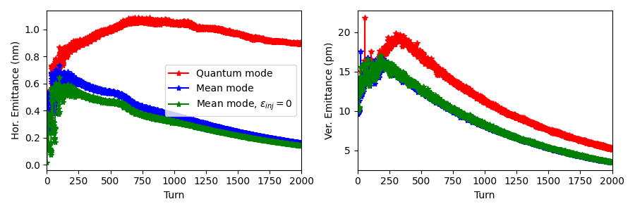
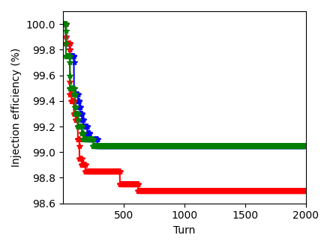
Tracking results
Only consider SR effect, injection position is 2 m upstream of qi6.1
The H&V emittance blow up in mean SR mode is smaller than that in quantum mode
  Reduce the injected beam emittance can’t mitigate the emittance blow up
On-axis injection has good injection efficiency
  Little influence of location change on injection efficiency
Energy offset: 0.95 %

Slide 9
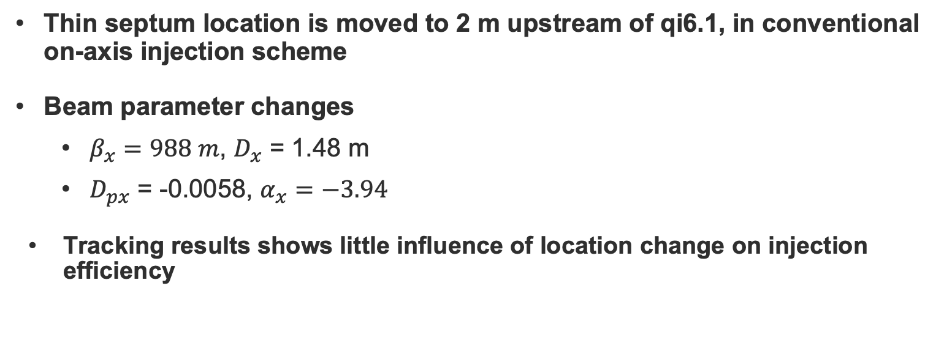
Conclusion
Thin septum location is moved to 2 m upstream of qi6.1, in conventional on-axis injection scheme
Beam parameter changes
  $β_{x}=988 m$, $D_{x}$ = 1.48 m
  $D_{px}$ = -0.0058, $α_{x}=−3.94$
Tracking results shows little influence of location change on injection efficiency

Slide 10
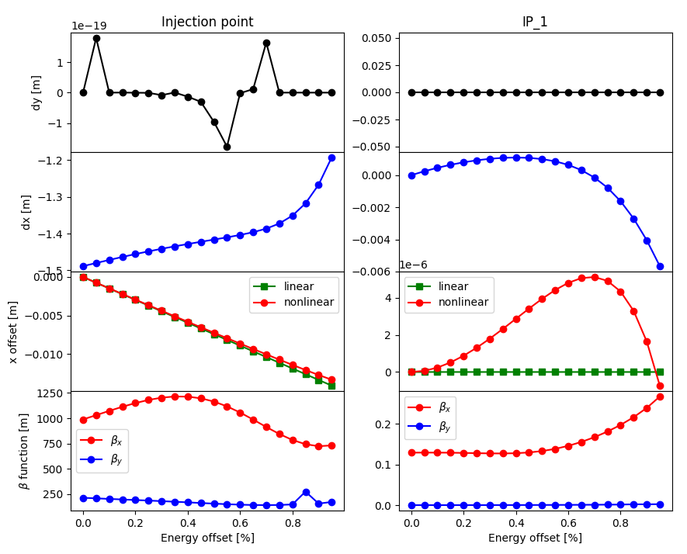
Backup
Nonlinear effect at injection point and interaction point

