Slide 1
Quasi-Strong-Strong Beam-Beam Calculation for Bootstrapping Injection Conditioning (0)
FCC-ee Top-up Injection Monthly Meeting
03/04/2025
Takashi Mori

Slide 2
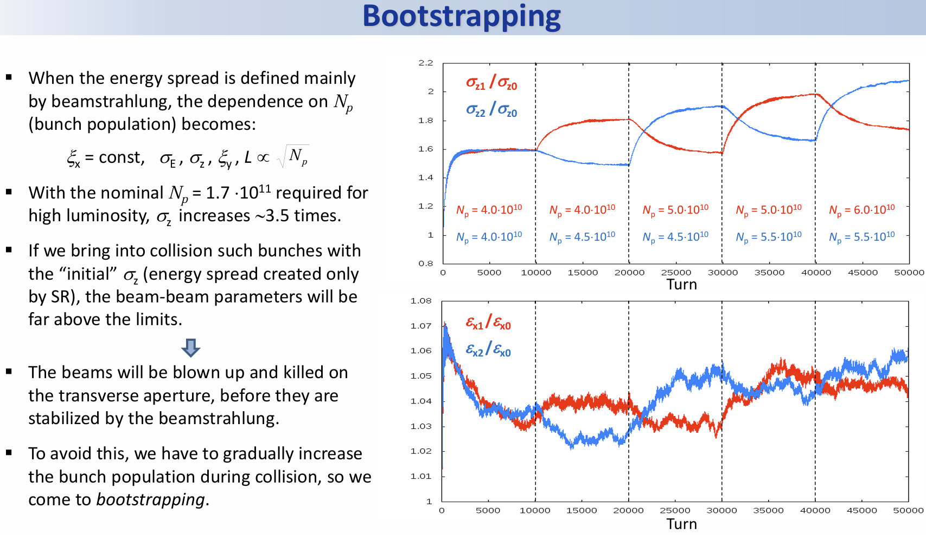
D. Shatilov

Slide 3
Start from simple case
Single bunch per ring: 1 on 1 collision
  Bunches collides only 2 IPs
    IPA,G are selected this time
  Beam-beam force is turned on at turn 1000,
  with 10 % of full current,
  updated collision by collision according to the weak beam parameters just before the collision.
IPA
FINJ.4
IPD
IPJ
IPG

Slide 4
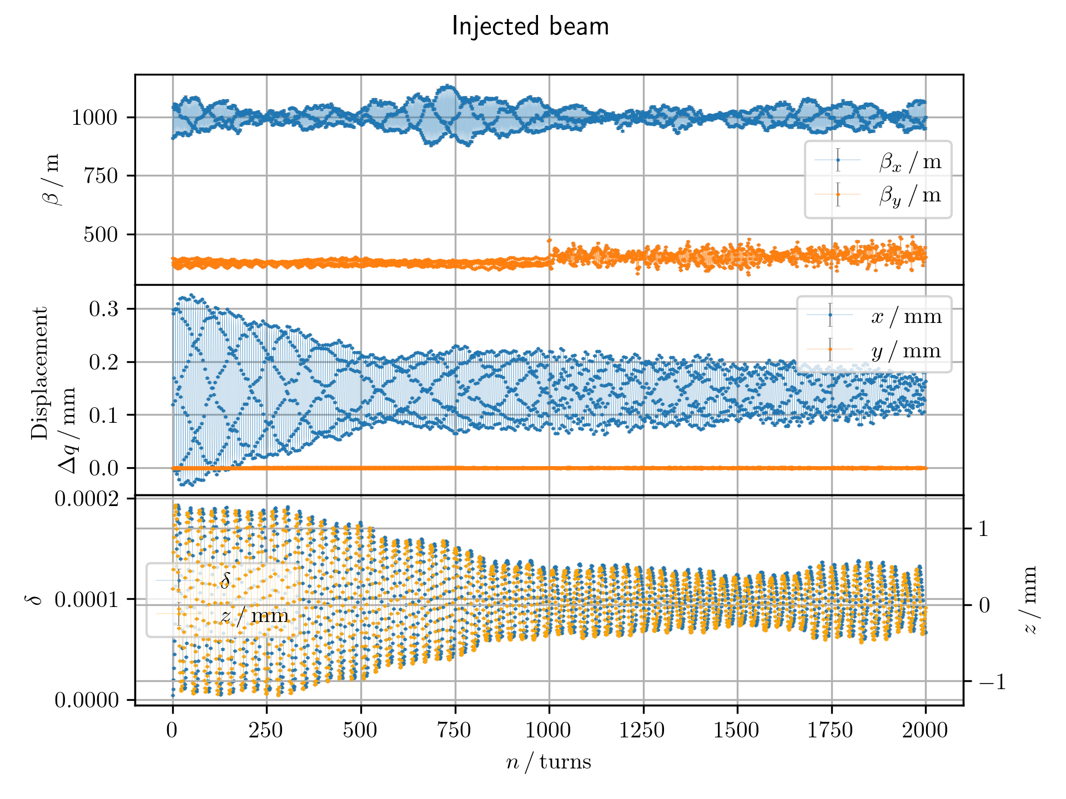
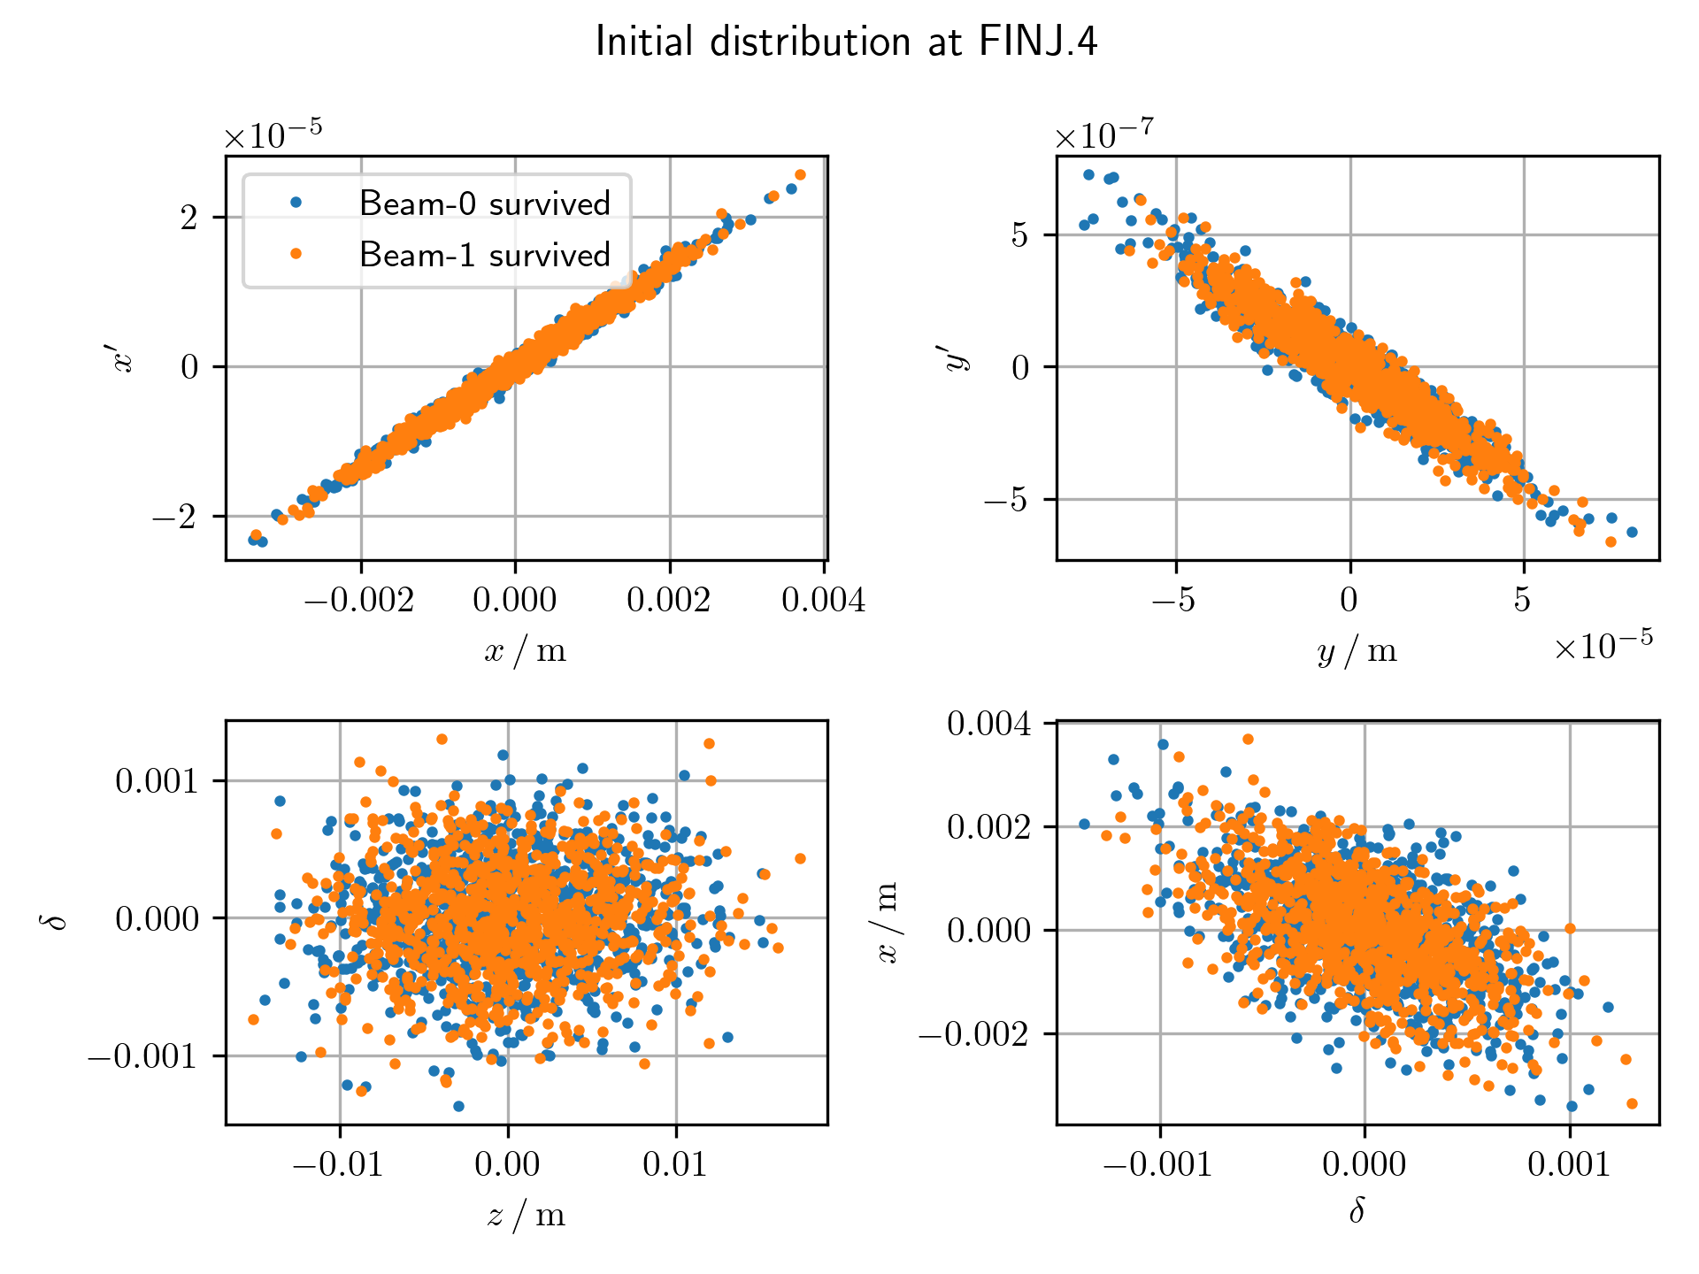
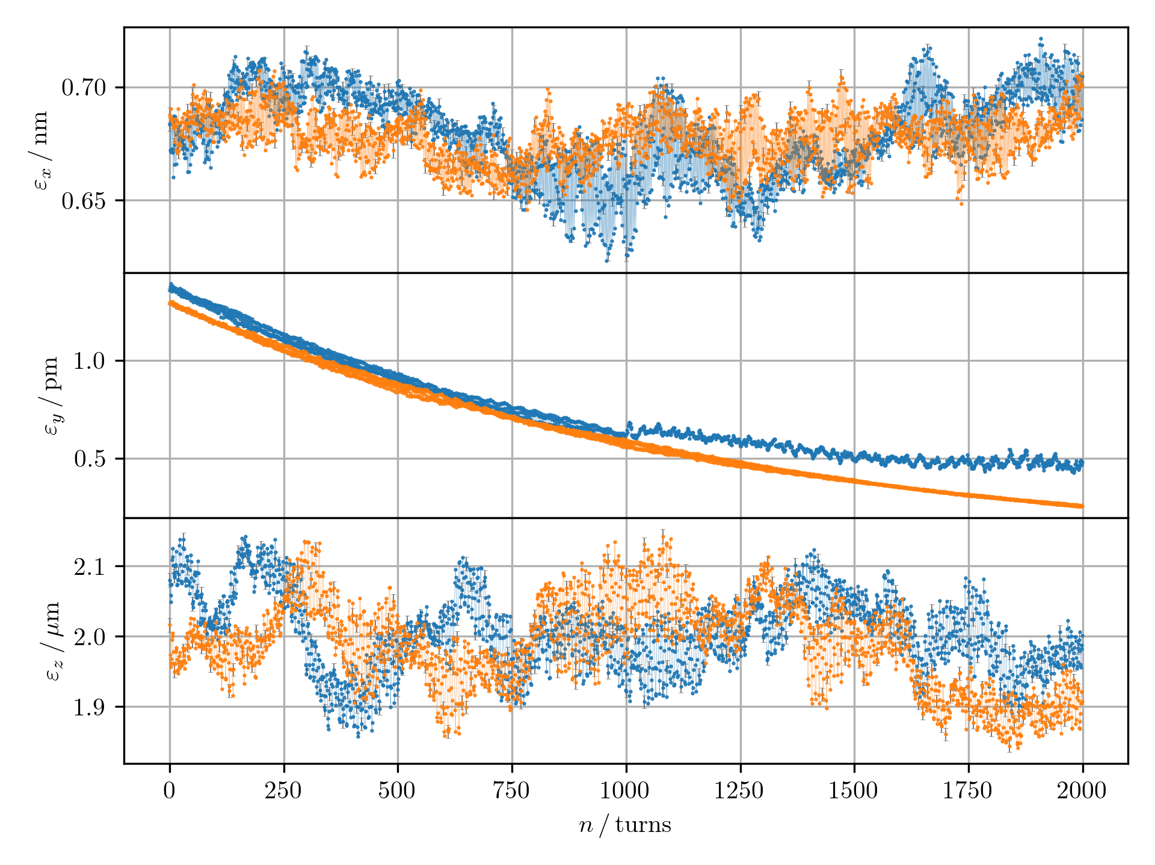
What I obtained preliminary
Beam-beam effects are seen in the vertical emittance
Effects also seen in horizontal orbit
Distributions of two bunches, both beams are stored beams

