Slide 1
FCC-ee injection repo
Sen Yue (SY-ABT-BTP)

Slide 2
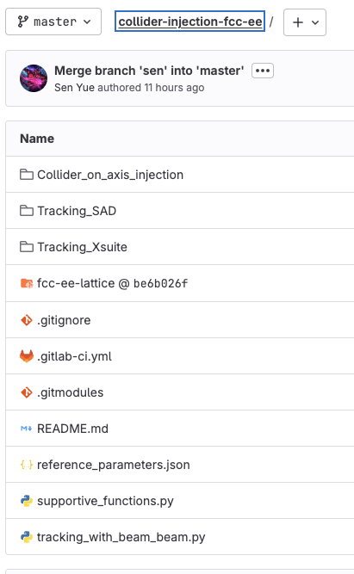
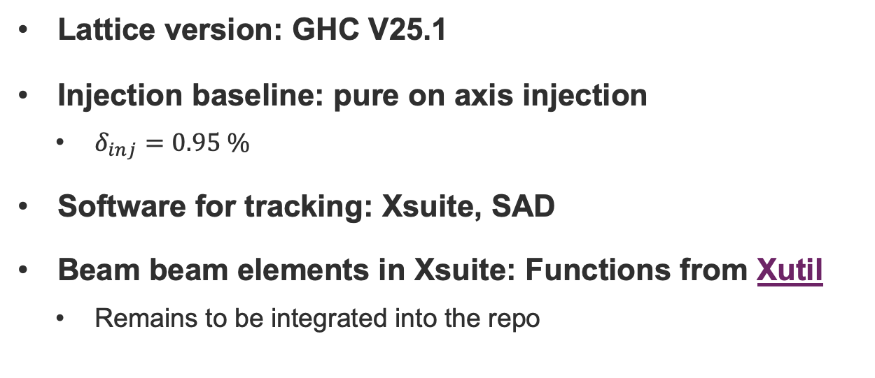
Repo status
Lattice version: GHC V25.1
Injection baseline: pure on axis injection
  $δ_{inj}=0.95 \%$
Software for tracking: Xsuite, SAD
Beam beam elements in Xsuite: Functions from Xutil
  Remains to be integrated into the repo

Slide 3
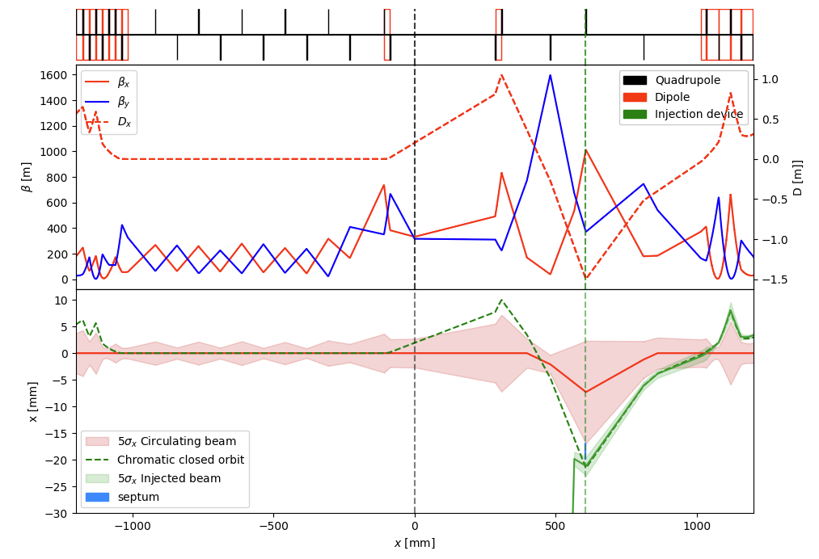
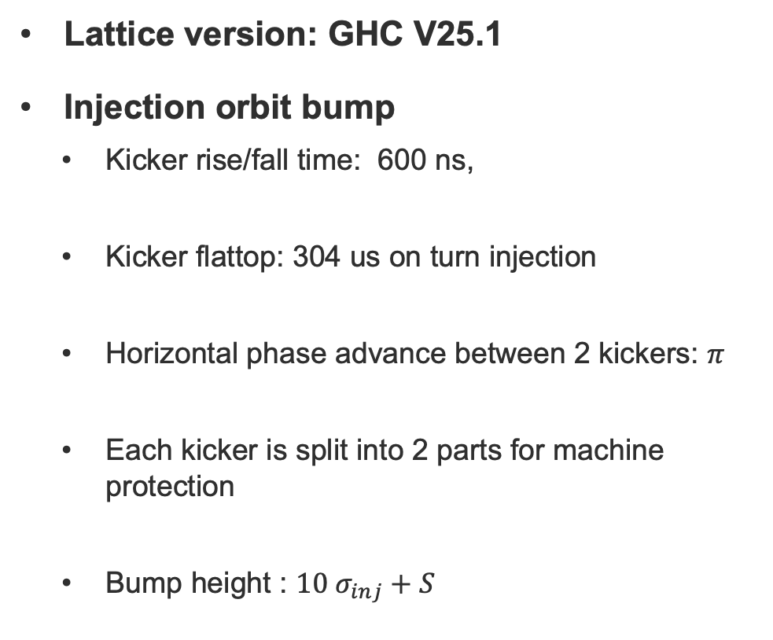
Present injection scheme
Lattice version: GHC V25.1
Injection orbit bump
  Kicker rise/fall time: 600 ns,
  Kicker flattop: 304 us on turn injection
  Horizontal phase advance between 2 kickers: $π$
  Each kicker is split into 2 parts for machine protection
  Bump height : $10 σ_{inj}+S$
@ Here

Slide 4
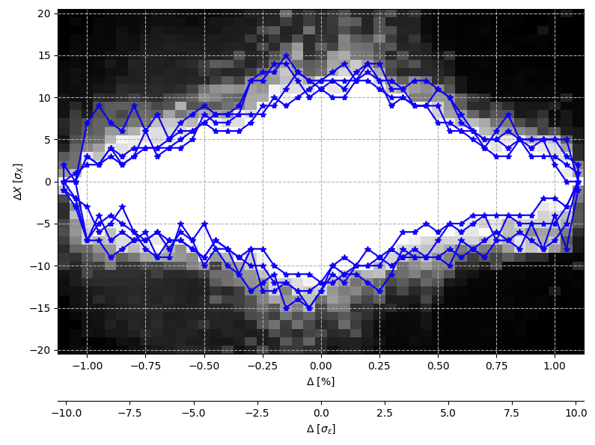
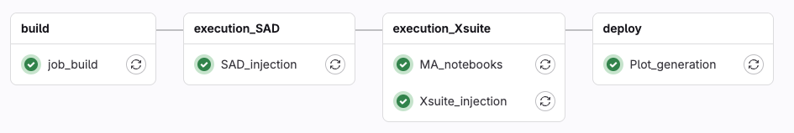
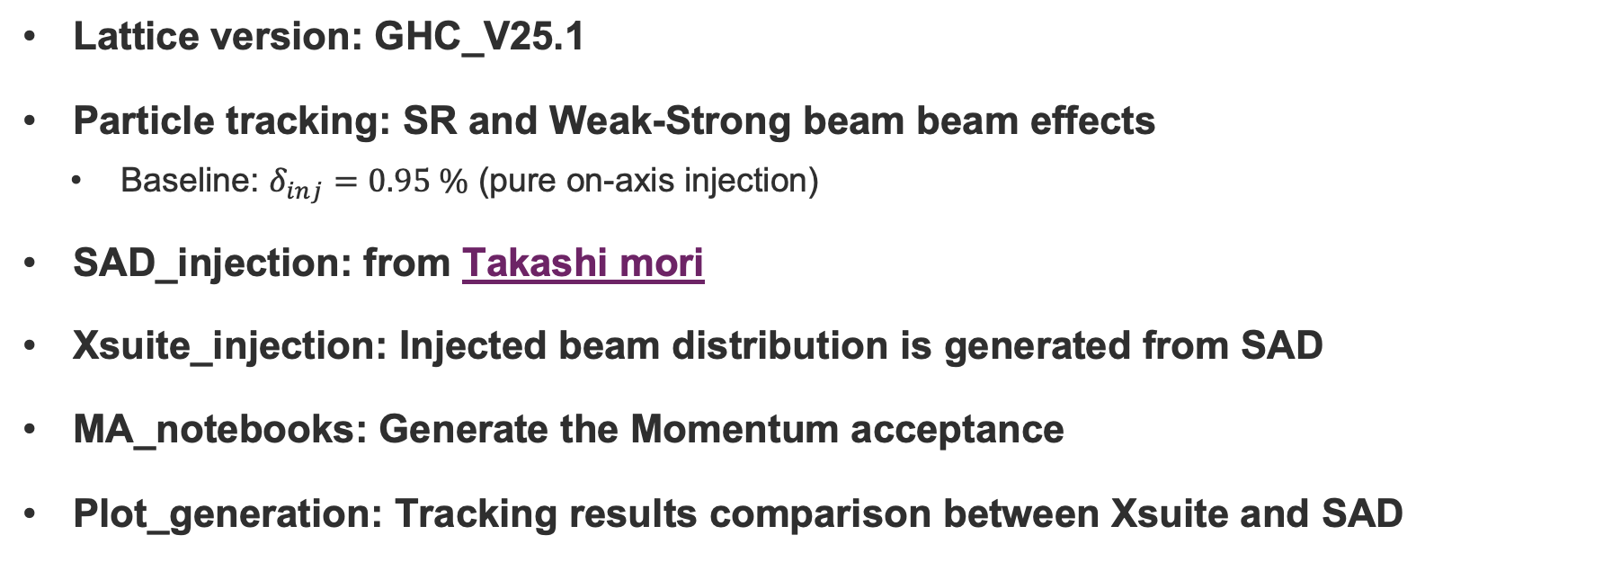
Tracking simulation with CI/CD
Lattice version: GHC_V25.1
Particle tracking: SR and Weak-Strong beam beam effects
  Baseline: $δ_{inj}=0.95 \%$ (pure on-axis injection)
SAD_injection: from Takashi mori
Xsuite_injection: Injected beam distribution is generated from SAD
MA_notebooks: Generate the Momentum acceptance
Plot_generation: Tracking results comparison between Xsuite and SAD
@ Here

Slide 5
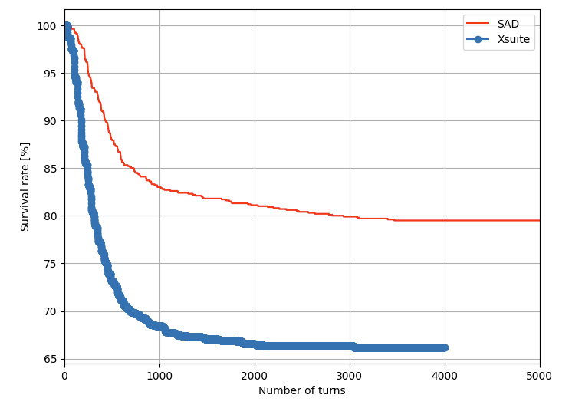
Results comparison
Injection efficiency:
  SAD: ~ 80%
  Xsuite: ~ 66 %

Slide 6
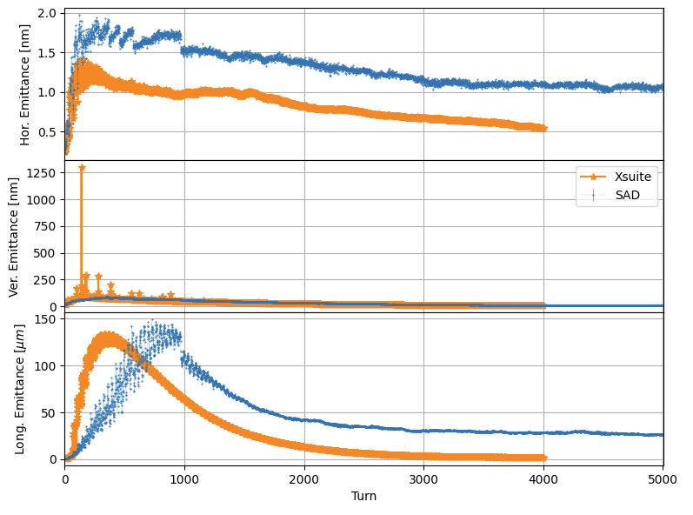
Results comparison
Injection efficiency:
  SAD: ~ 80 %
  Xsuite: ~ 66 %
Emittance evolution
  Horizontal emittance
    SAD: 1 nm
    Xsuite: 0.5 nm
  Vertical emittance: similar trend
  Longitudinal emittance
    Xsuite is much lower than that of SAD

Slide 7
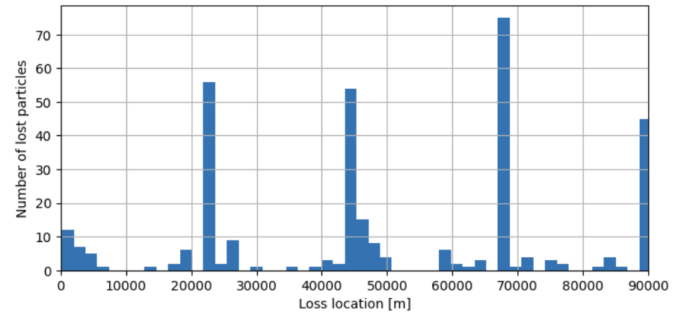
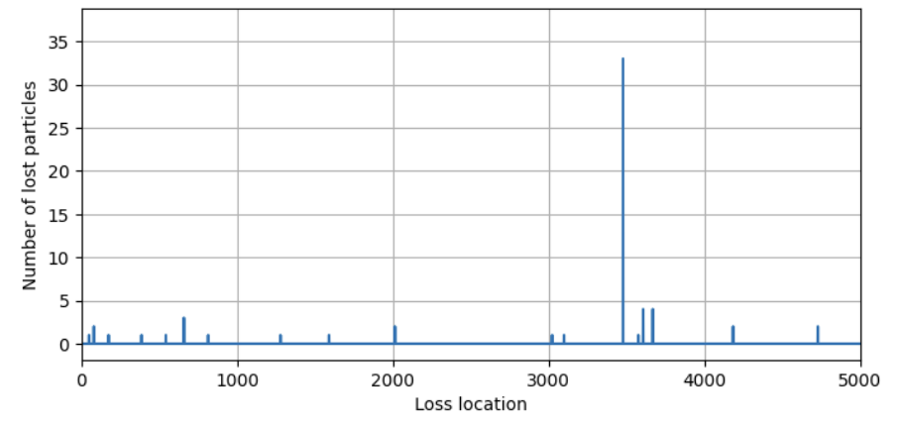
Results comparison
Injection efficiency:
  SAD: ~ 80 %
  Xsuite: ~ 66 %
Emittance evolution
  Horizontal emittance
    SAD: 1 nm
    Xsuite: 0.5 nm
  Longitudinal emittance in Xsuite is much lower than that of SAD
Loss location
  Xsuite: mainly around the 4 IPs
Xsuite
SAD

Slide 8
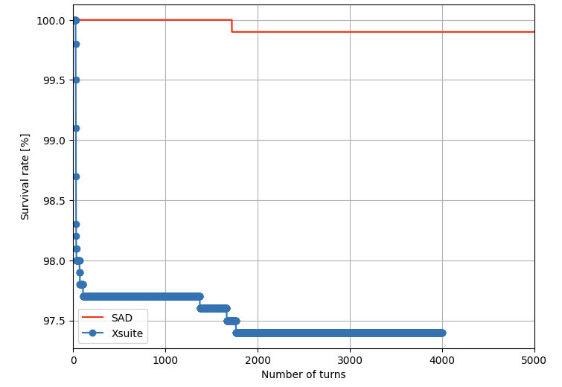
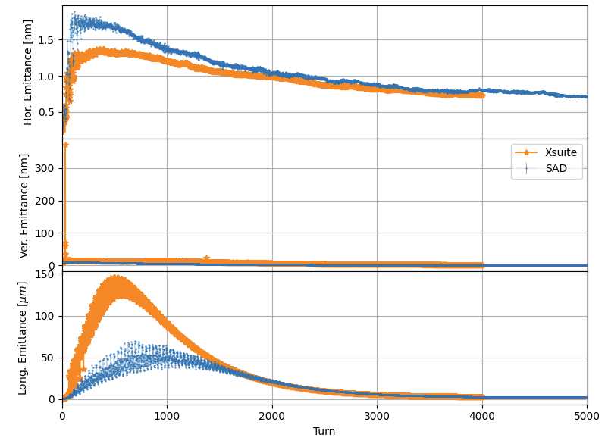
Results comparison
Only consider SR
Injection efficiency
  SAD: ~ 99 %
  Xsuite: ~ 97%
Emittance results have good agreements
Possible issues
  Beam-beam effects in Xsuite and SAD are not consistent
  Injected beam distribution in Xsuite may be mismatched

Slide 9
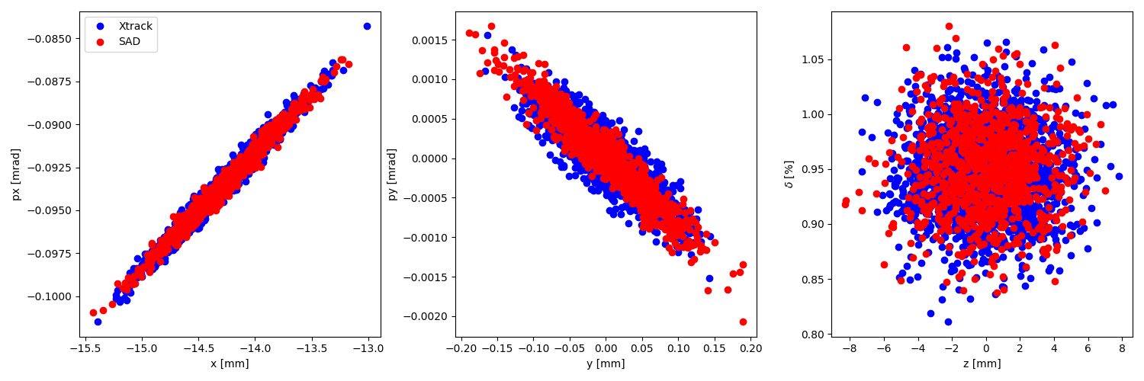
Results comparison
Only consider SR
Injection efficiency
  SAD: ~ 99 %
  Xsuite: ~ 97%
Emittance results have good agreements
Possible issues
  Beam-beam effects in Xsuite and SAD are not consistent
  Injected beam distribution in Xsuite may be mismatched

Slide 10
Conclusion
SAD simulation has been integrated into the Gitlab
A comparison between has been made by Gitlab CI/CD
  SR and weak-strong beam effects are considered
  Still some divergence between SAD and Xsuite simulation
Next step
  Multipole injection study
  Switch study to LCC lattice

