Slide 1
Top-up injection performance between GHC and LCC
Sen Yue (SY-ABT-BTP)

Slide 2
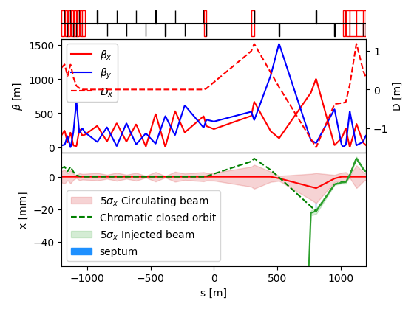
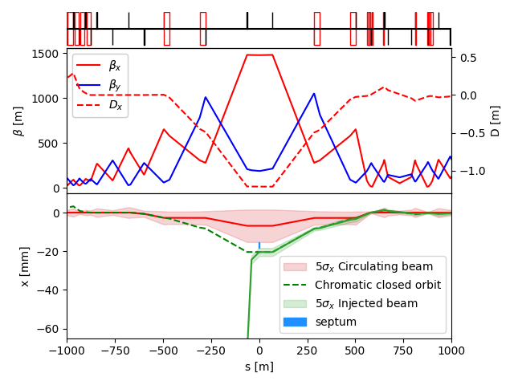
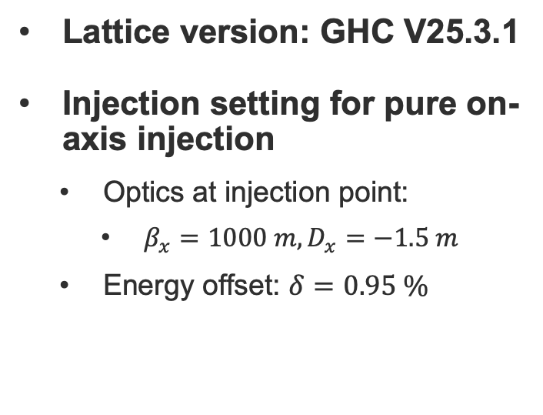
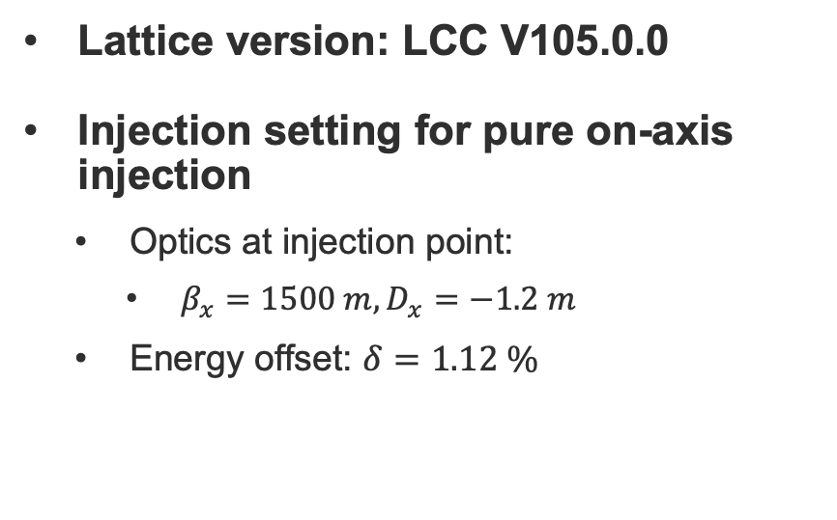
Injection settings for GHC and LCC
Lattice version: GHC V25.3.1
Injection setting for pure on-axis injection
  Optics at injection point:
    $β_{x}=1000 m, D_{x}=−1.5 m$
  Energy offset: $δ=0.95 \%$
Lattice version: LCC V105.0.0
Injection setting for pure on-axis injection
  Optics at injection point:
    $β_{x}=1500 m, D_{x}=−1.2 m$
  Energy offset: $δ=1.12 \%$

Slide 3
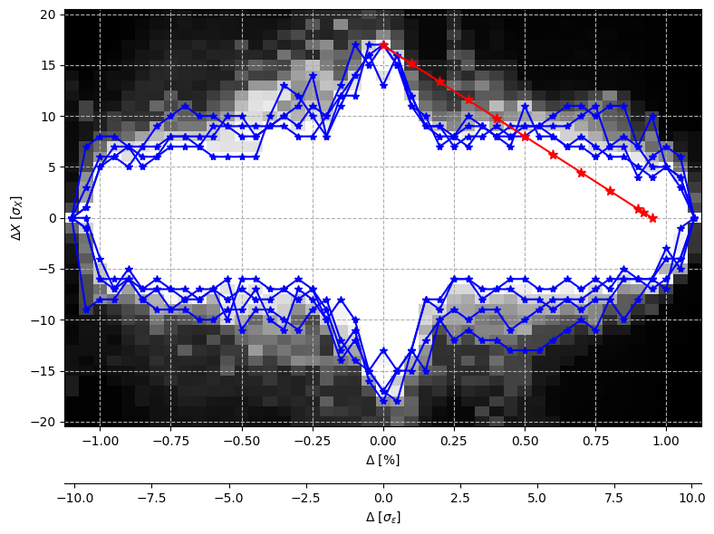
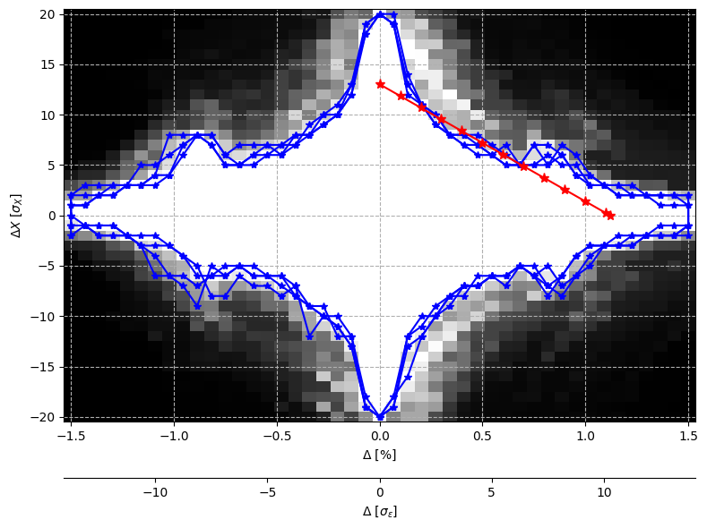
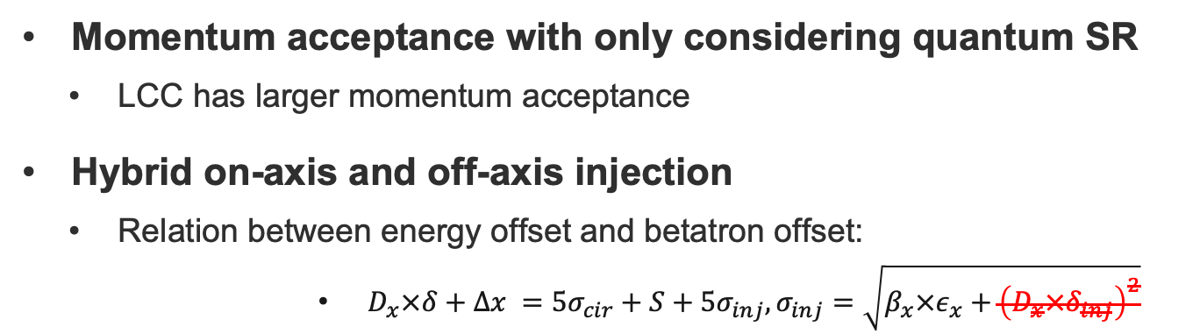
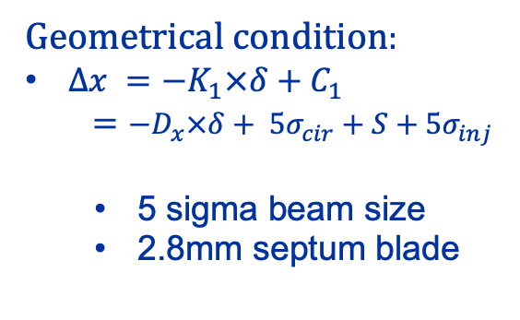
Momentum acceptance
Momentum acceptance with only considering quantum SR
  LCC has larger momentum acceptance
Hybrid on-axis and off-axis injection
  Relation between energy offset and betatron offset:
        $D_{x}×δ+Δx =5σ_{cir}+S+5σ_{inj},σ_{inj}=\sqrt{β_{x}×ε_{x}+{\left(D_{x}×δ_{inj}\right)}^{2}}$
Geometrical condition:
$Δx =−K_{1}×δ+C_{1}$
$=−D_{x}×δ+ 5σ_{cir}+S+5σ_{inj}$
  5 sigma beam size
  2.8mm septum blade
GHC_V253.1
LCC_V105.0

Slide 4
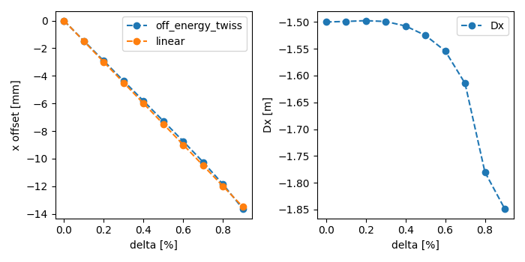
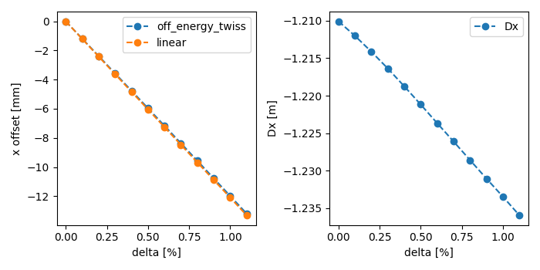
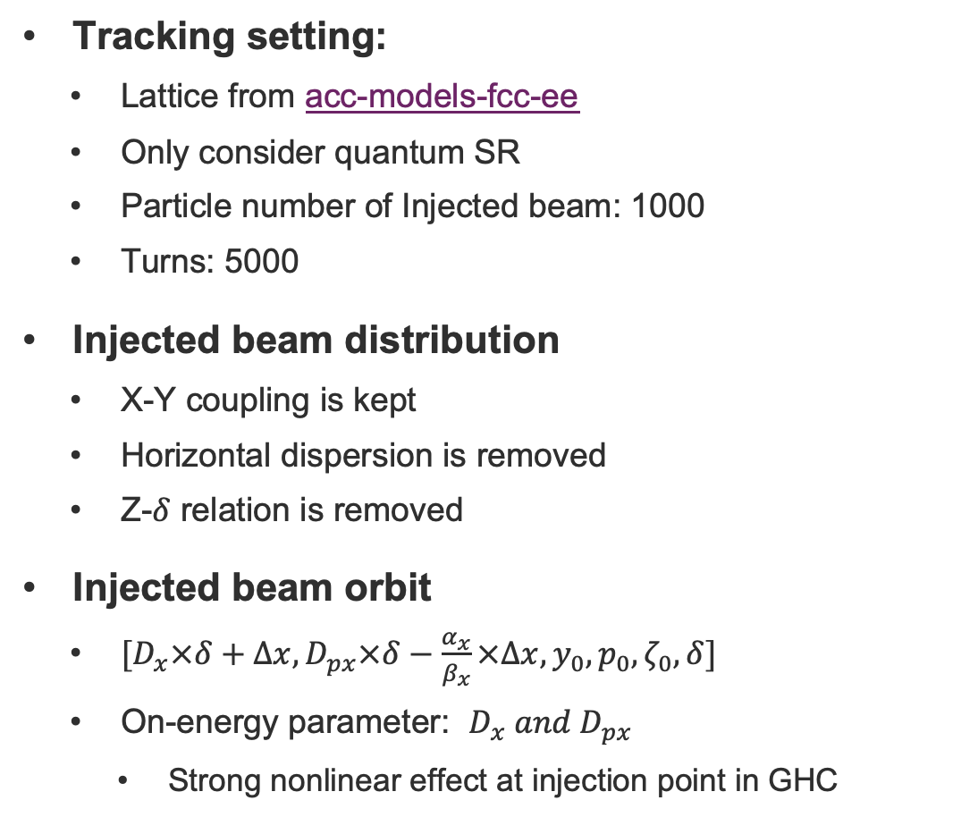
Tracking setting
GHC lattice
Tracking setting:
  Lattice from acc-models-fcc-ee
  Only consider quantum SR
  Particle number of Injected beam: 1000
  Turns: 5000
Injected beam distribution
  X-Y coupling is kept
  Horizontal dispersion is removed
  Z-$δ$ relation is removed
Injected beam orbit
  $[D_{x}×δ+Δx, D_{px}×δ−\frac{α_{x}}{β_{x}}×Δx, y_{0}, p_{0},ζ_{0},δ]$
  On-energy parameter: $D_{x} and D_{px}$
    Strong nonlinear effect at injection point in GHC
LCC lattice

Slide 5
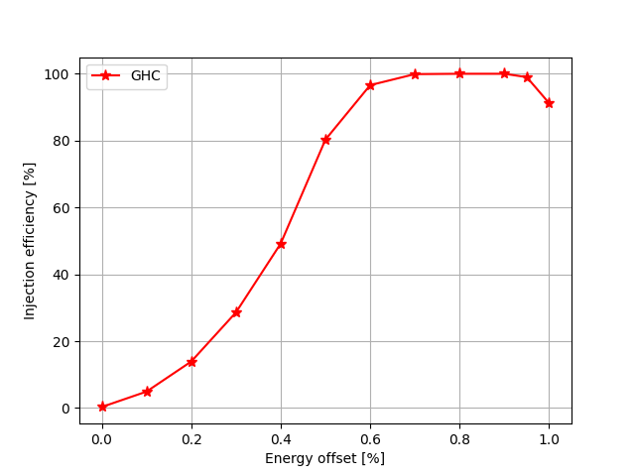
Injection efficiency -- GHC
Good injection efficiency for pure on-axis injection
  energy offset = 0.95%
Also good for some hybrid injection schemes
  energy offset: 0.5 - 1%
Impossible for pure off-axis injection
  According to MA, injection efficiency should not be 0 ?

Slide 6
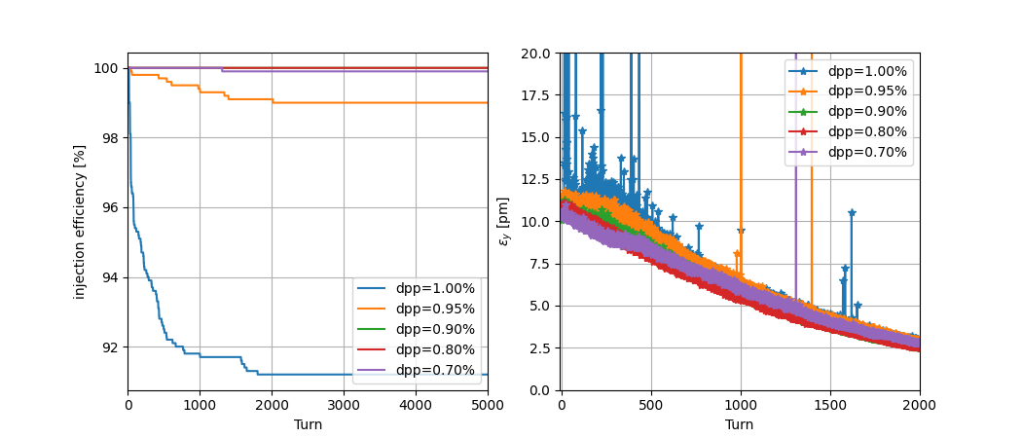
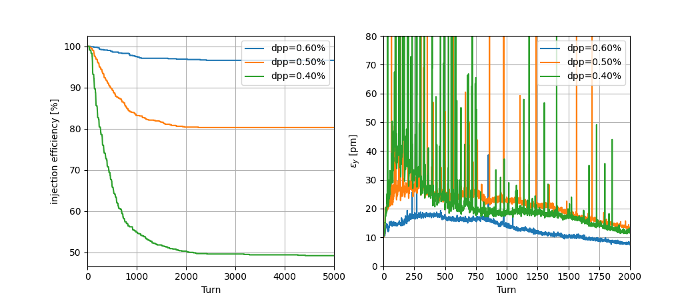
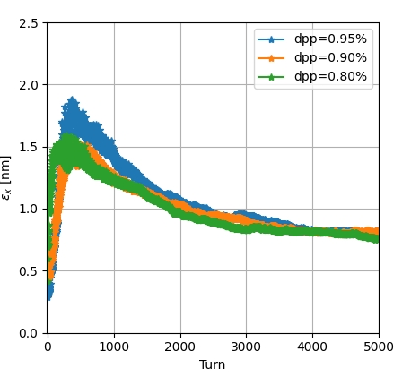
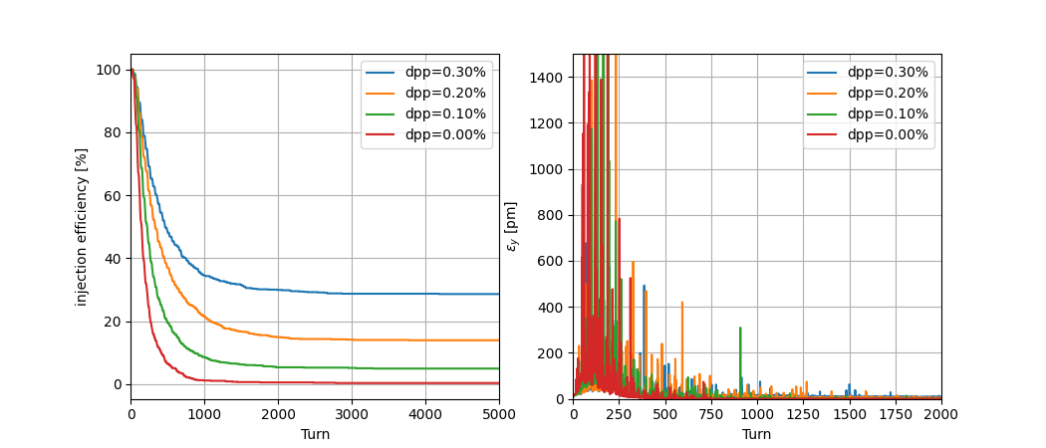
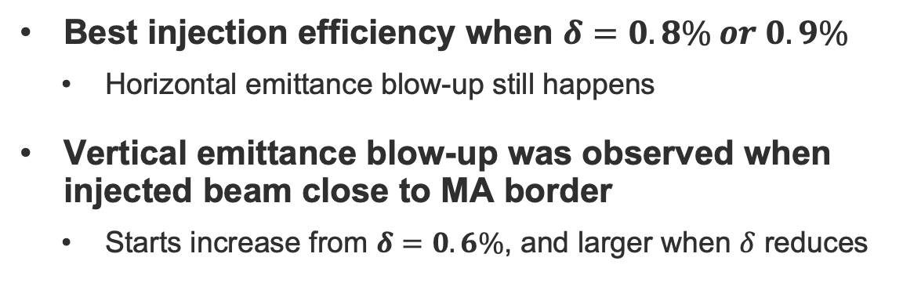
Injected beam evolution-- GHC
Best injection efficiency when $δ=0.8\% or 0.9\%$
  Horizontal emittance blow-up still happens
Vertical emittance blow-up was observed when injected beam close to MA border
  Starts increase from $δ=0.6\%$, and larger when $δ$ reduces

Slide 7
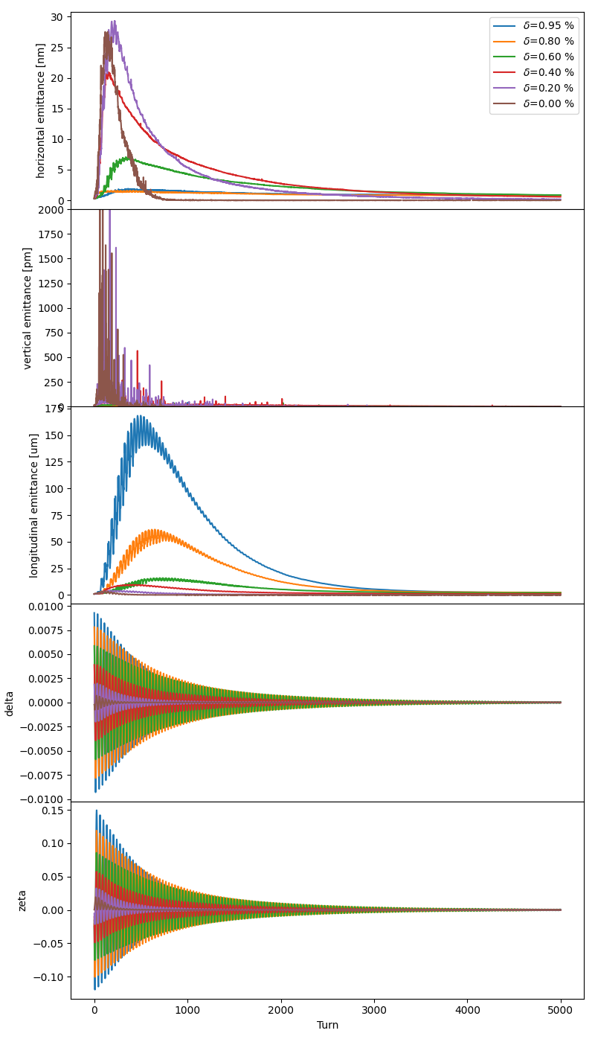
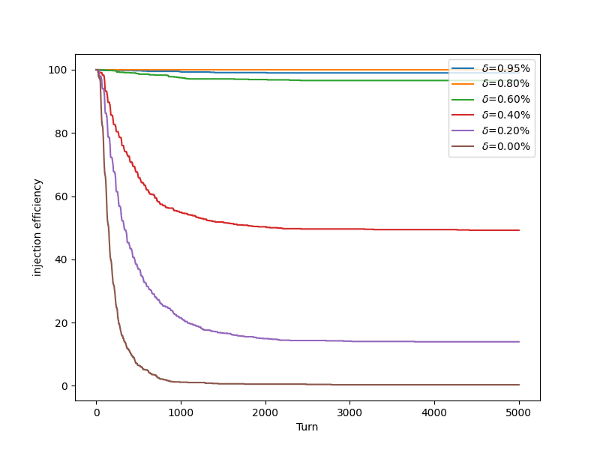
Beam evolution-- GHC

Slide 8
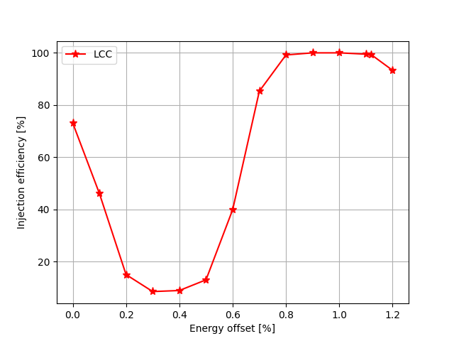
Injection efficiency -- LCC
Good injection efficiency for pure on-axis injection
  energy offset = 1.12%
Also good for some hybrid injection schemes
  energy offset: 0.7-1.2%
Possible for pure off-axis injection
  The injection efficiency looks not high enough: less than 80%

Slide 9
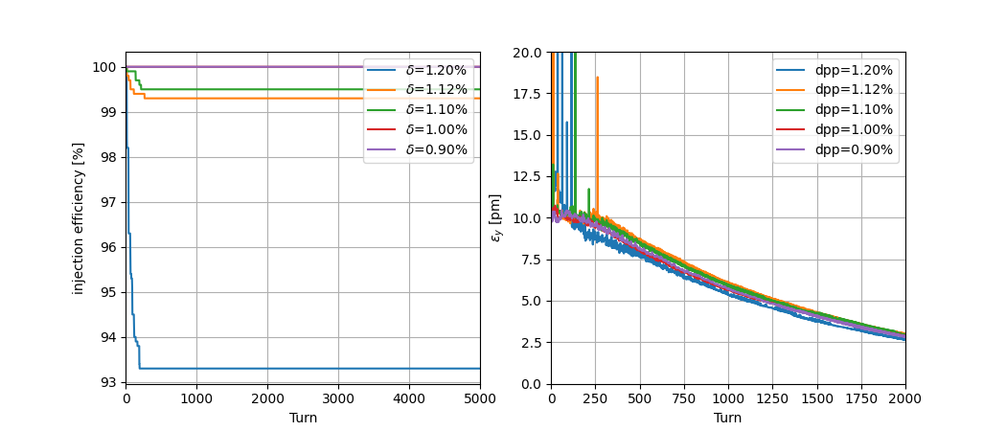
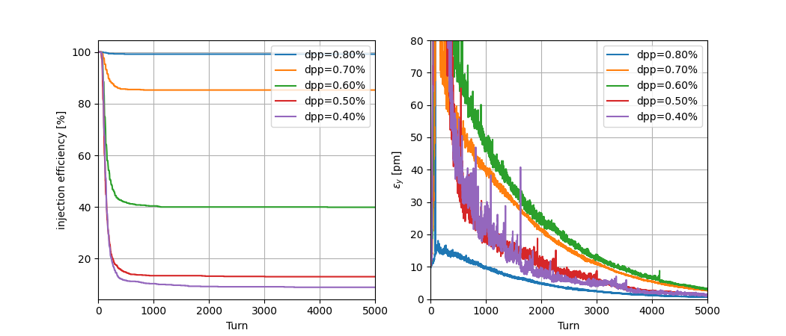
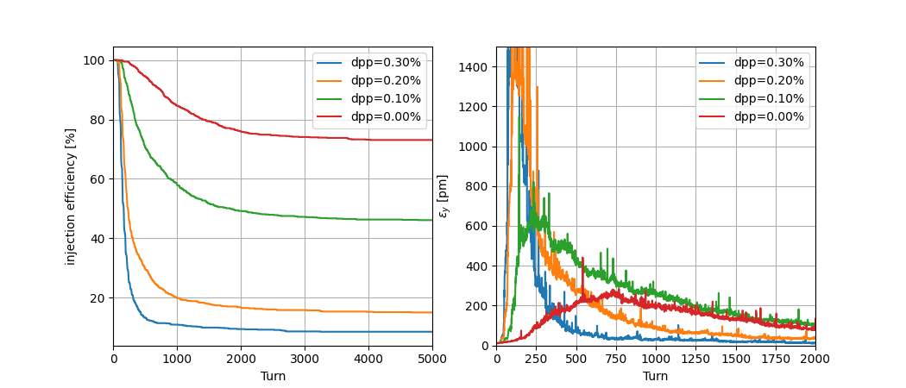
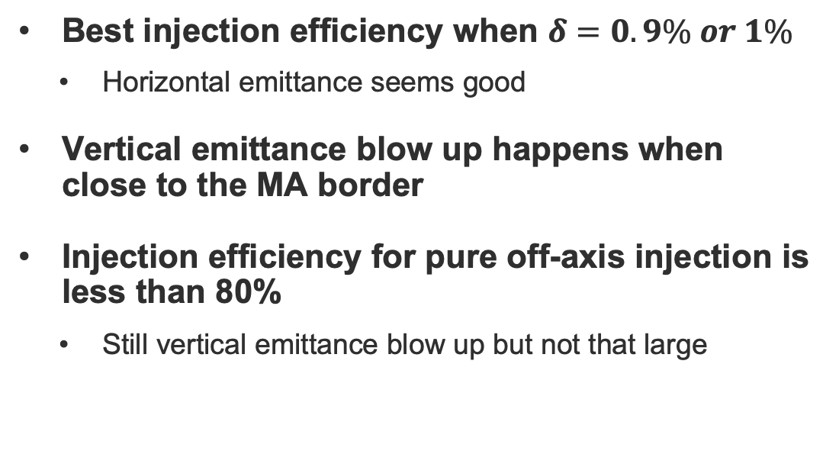
Injected beam evolution-- LCC
Best injection efficiency when $δ=0.9\% or 1\%$
  Horizontal emittance seems good
Vertical emittance blow up happens when close to the MA border
Injection efficiency for pure off-axis injection is less than 80%
  Still vertical emittance blow up but not that large

Slide 10
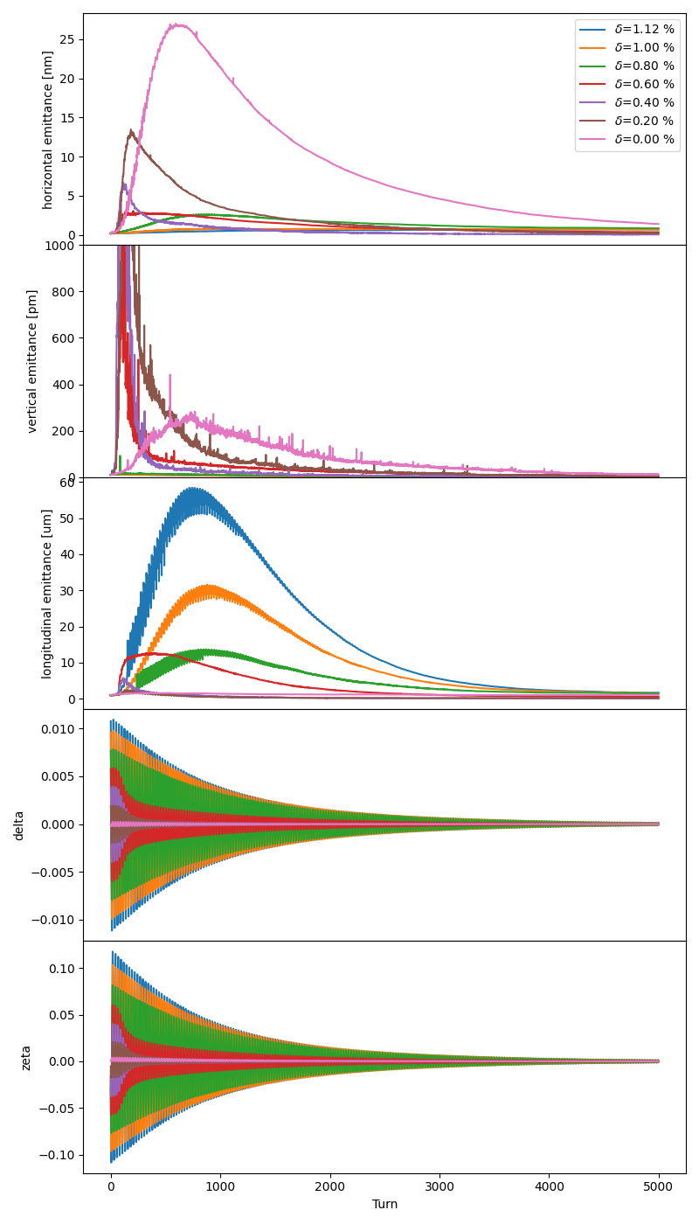
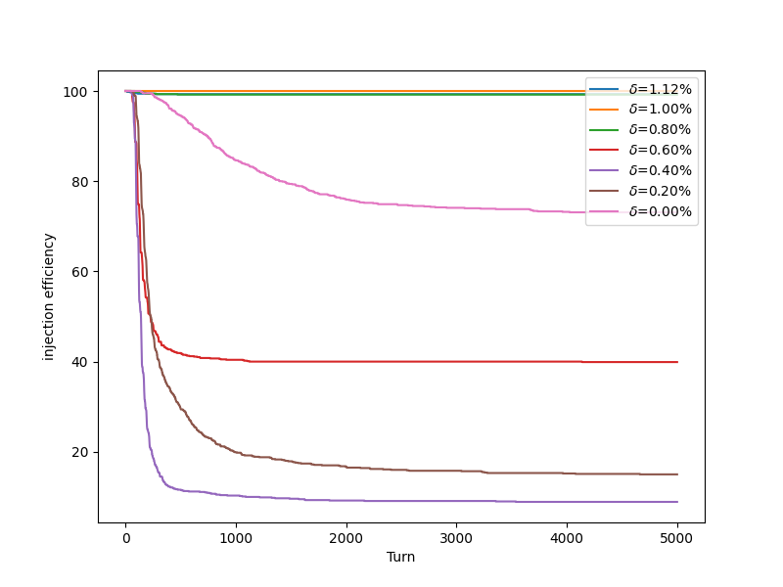
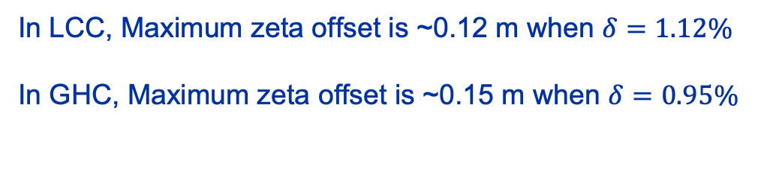
Beam evolution-- LCC
In LCC, Maximum zeta offset is ~0.12 m when $δ=1.12\%$
In GHC, Maximum zeta offset is ~0.15 m when $δ=0.95\%$

Slide 11
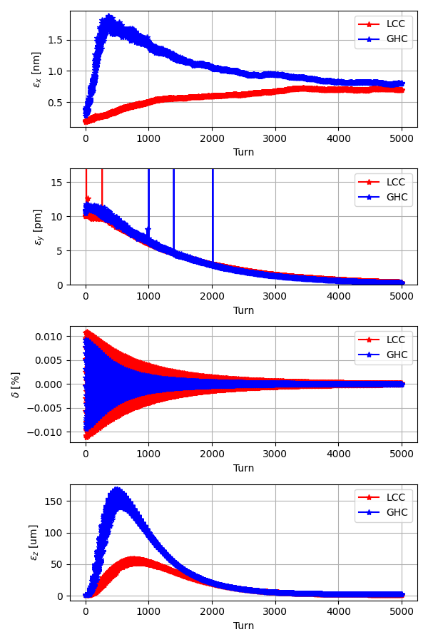
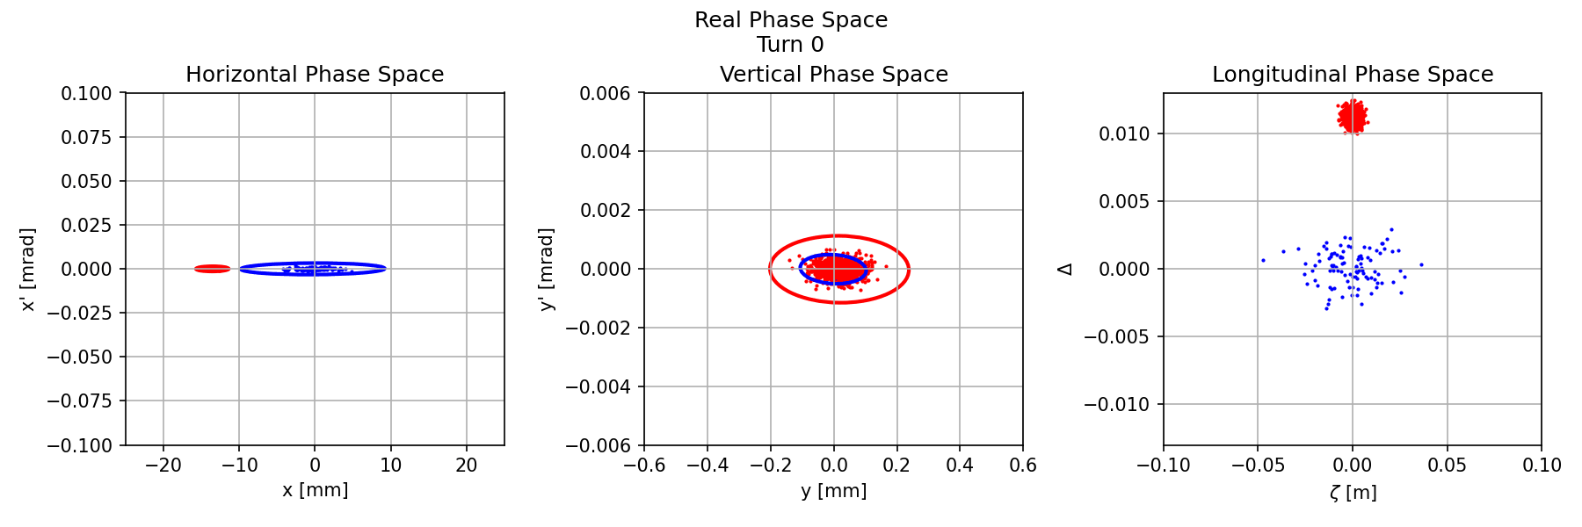
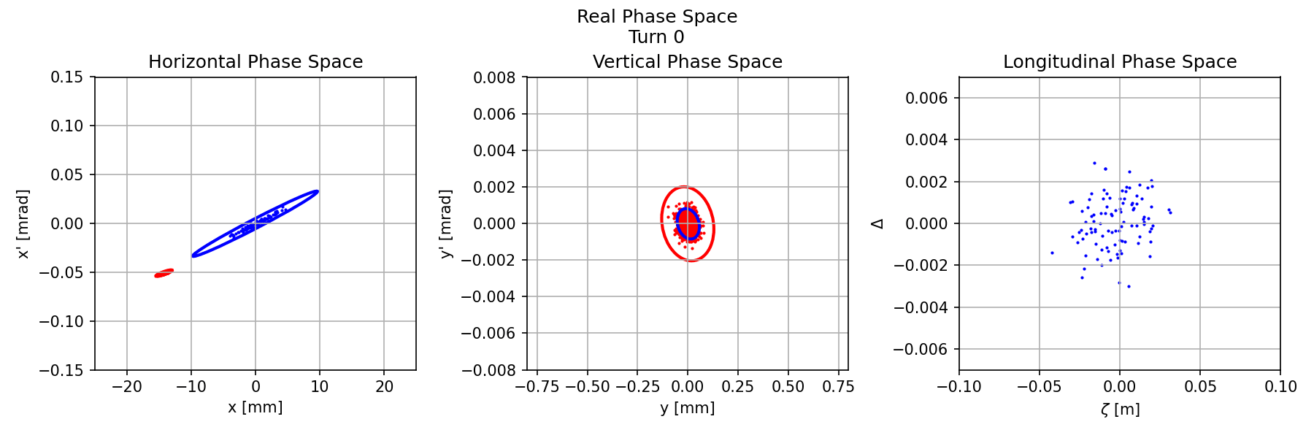
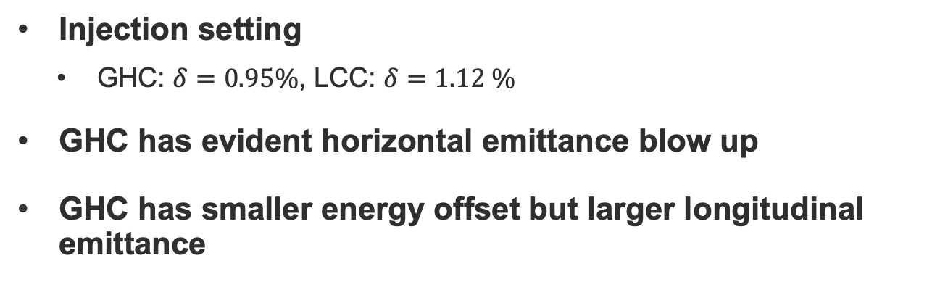
On-axis injection comparison
Injection setting
  GHC: $δ=0.95\%$, LCC: $δ=1.12 \%$
GHC has evident horizontal emittance blow up
GHC has smaller energy offset but larger longitudinal emittance
LCC
GHC

Slide 12
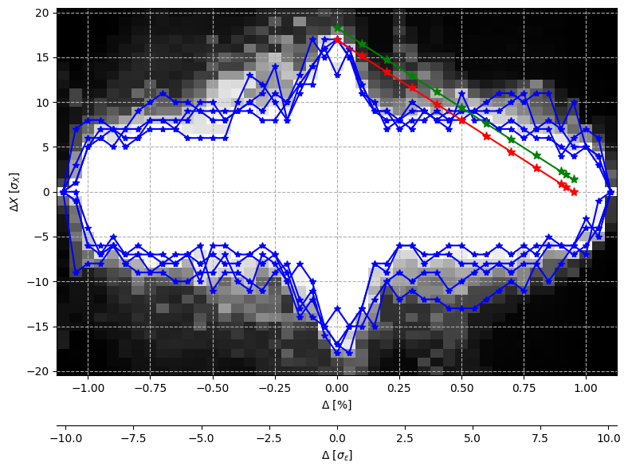
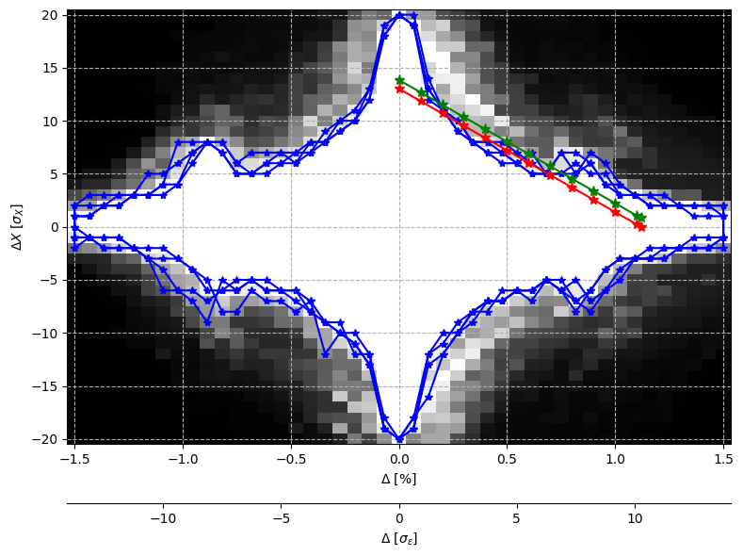
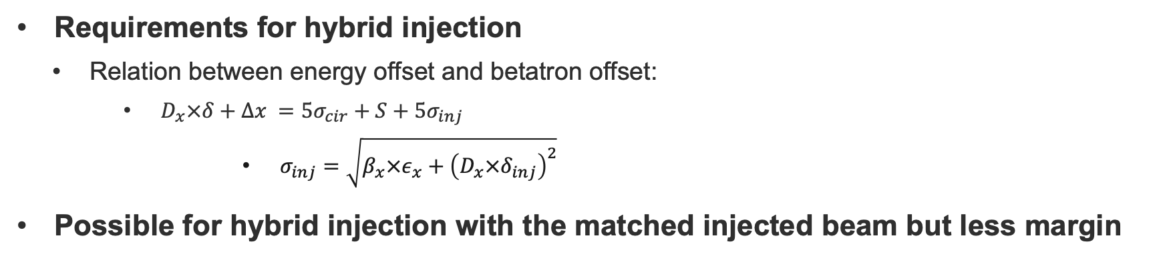
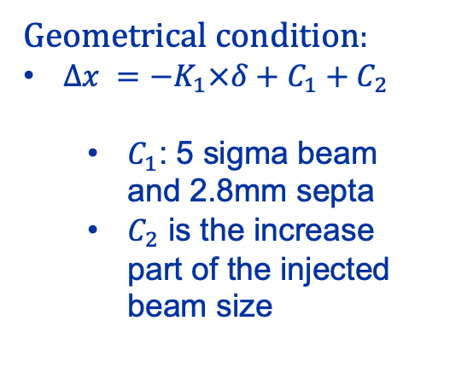
Hybrid injection with matched injected beam
Requirements for hybrid injection
  Relation between energy offset and betatron offset:
      $D_{x}×δ+Δx =5σ_{cir}+S+5σ_{inj}$
        $σ_{inj}=\sqrt{β_{x}×ε_{x}+{\left(D_{x}×δ_{inj}\right)}^{2}}$
Possible for hybrid injection with the matched injected beam but less margin
Geometrical condition:
$Δx =−K_{1}×δ+C_{1}+C_{2}$
  $C_{1}$: 5 sigma beam and 2.8mm septa
  $C_{2}$ is the increase part of the injected beam size
GHC_V253.1
LCC_V105.0

Slide 13
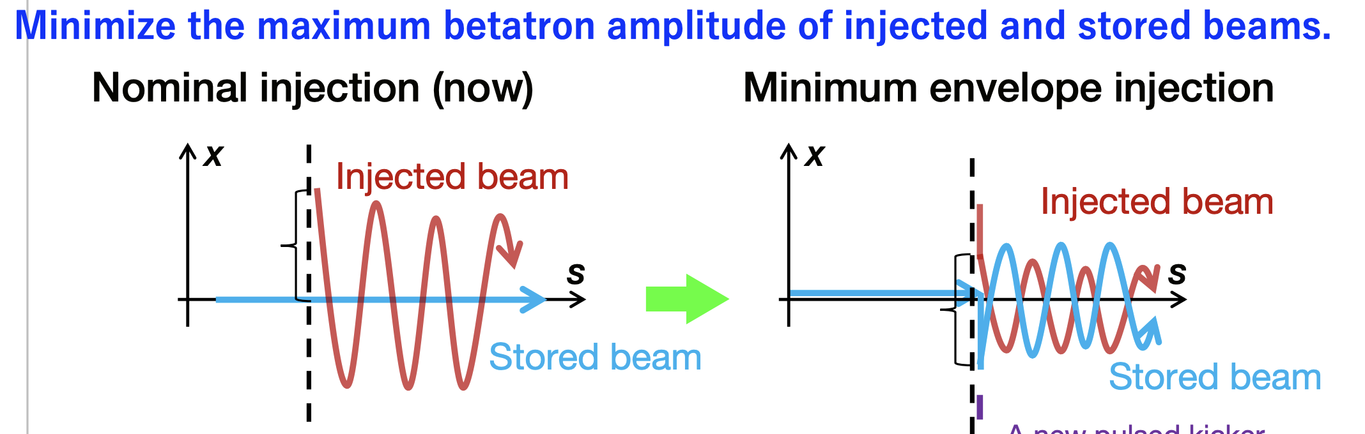
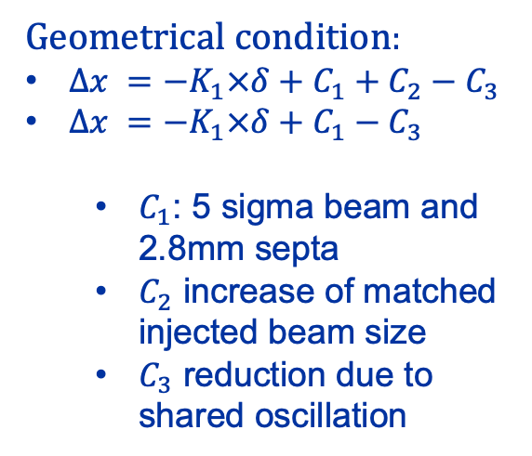
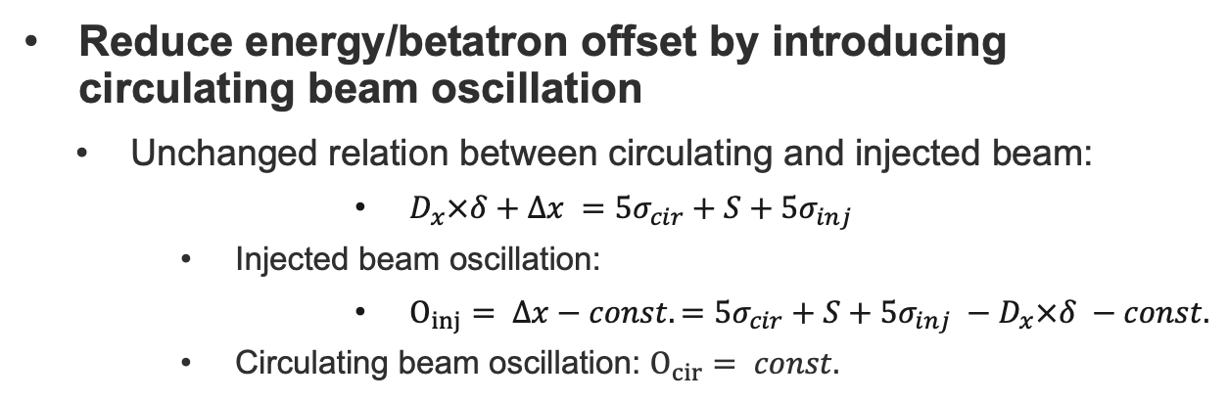
Hybrid injection with shared oscillation
Reduce energy/betatron offset by introducing circulating beam oscillation
  Unchanged relation between circulating and injected beam:
        $D_{x}×δ+Δx =5σ_{cir}+S+5σ_{inj}$
      Injected beam oscillation:
        $O_{inj}= Δx−const. =5σ_{cir}+S+5σ_{inj} −D_{x}×δ −const.$
      Circulating beam oscillation: $O_{cir}= const.$
May need to adjust the filling scheme since only inject 10% bunch
[1]
Geometrical condition:
$Δx =−K_{1}×δ+C_{1}+C_{2}−C_{3}$
$Δx =−K_{1}×δ+C_{1}−C_{3}$
  $C_{1}$: 5 sigma beam and 2.8mm septa
  $C_{2}$ increase of matched injected beam size
  $C_{3}$ reduction due to shared oscillation
GHC_V253.1
LCC_V105.0
[1] Injection Status and Issue of SuperKEKB

Slide 14
Conclusion
Pure on-axis injection
  Good injection efficiency is achieved in both GHC and LCC
Hybrid on-axis and off-axis injection
  GHC: energy offset should be 0.5 - 1 %
  LCC: energy offset should be 0.7 -1.2% % or around 0
  It’s possible for LCC to switch to off-axis injection but not for GHC
It’s possible to use the fully matched injected beam in hybrid injection but less margin in MA
  For both GHC and LCC
Top-up injection with shared oscillation
  Can increase the space for on-axis/off-axis/hybrid injection
  Reduce the oscillation amplitude
  Need to study the influence on the circulating beam

Slide 15
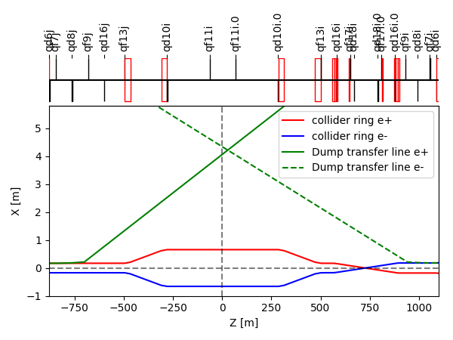
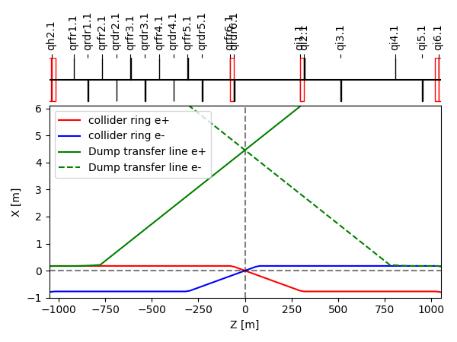
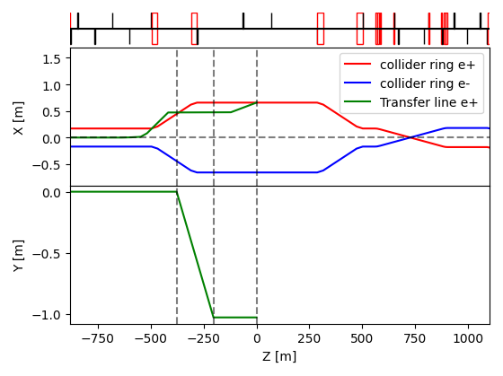
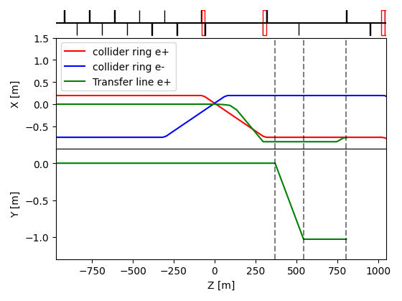
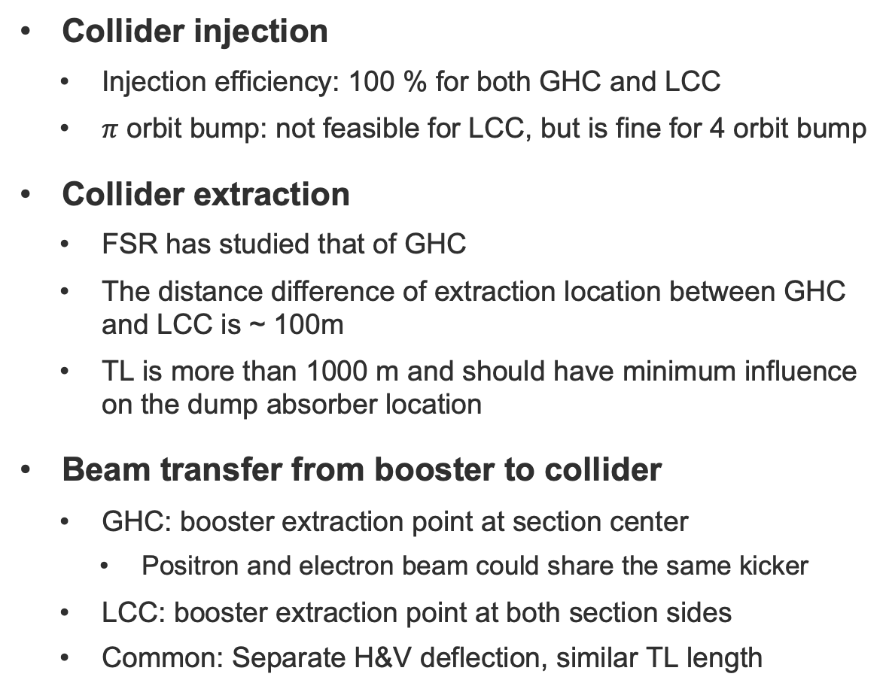
Conclusion of Lattice comparison report
Collider injection
  Injection efficiency: 100 % for both GHC and LCC
  $π$ orbit bump: not feasible for LCC, but is fine for 4 orbit bump
Collider extraction
  FSR has studied that of GHC
  The distance difference of extraction location between GHC and LCC is ~ 100m
  TL is more than 1000 m and should have minimum influence on the dump absorber location
Beam transfer from booster to collider
  GHC: booster extraction point at section center
    Positron and electron beam could share the same kicker
  LCC: booster extraction point at both section sides
  Common: Separate H&V deflection, similar TL length

Slide 16
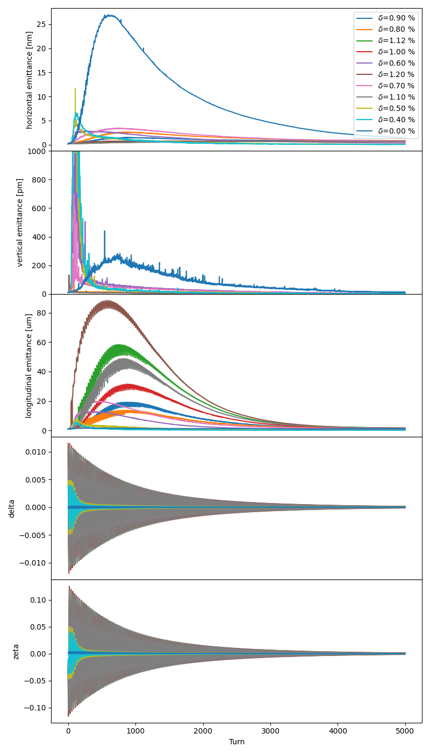
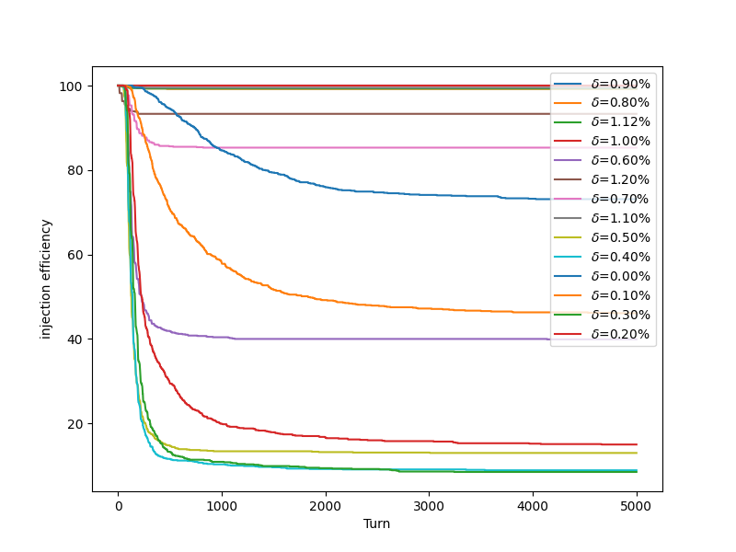
Back-up: Evolution-- LCC

Slide 17
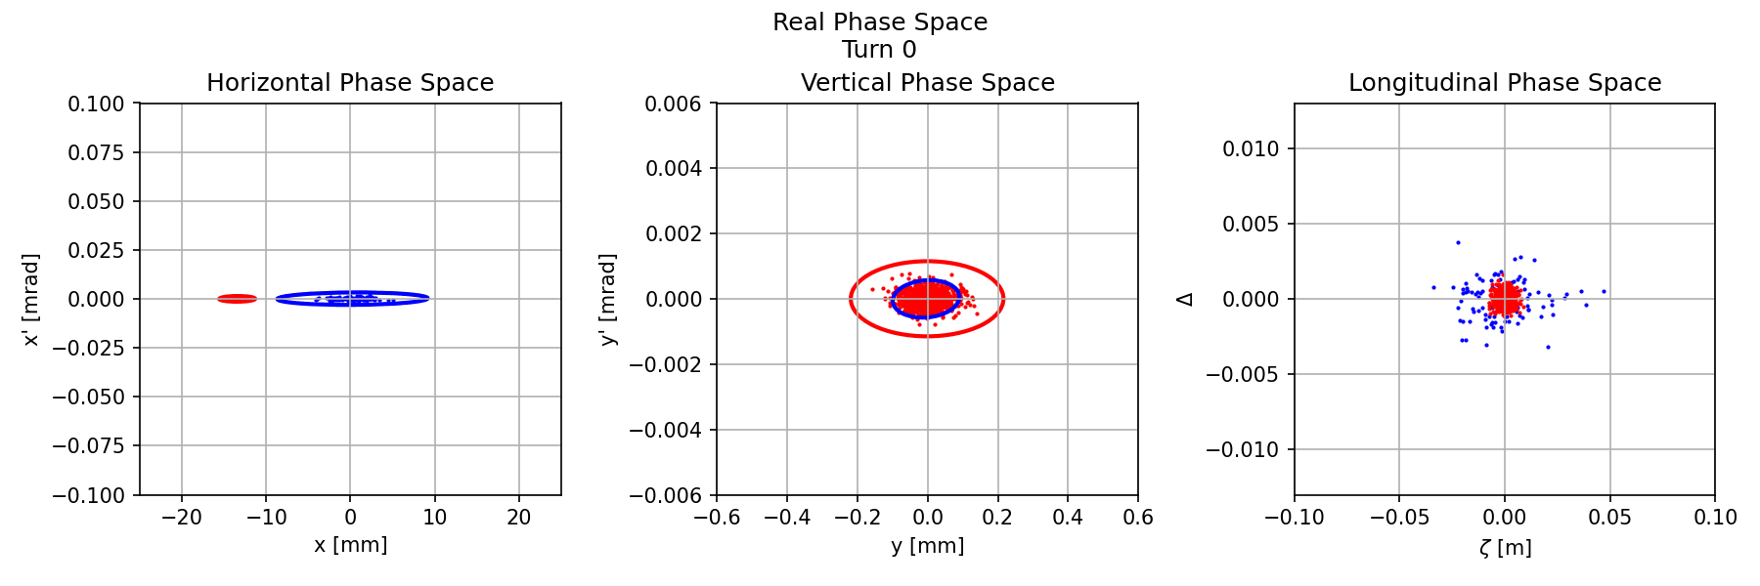
Back-up: Evolution-- LCC
Pure off-axis injection

Slide 18
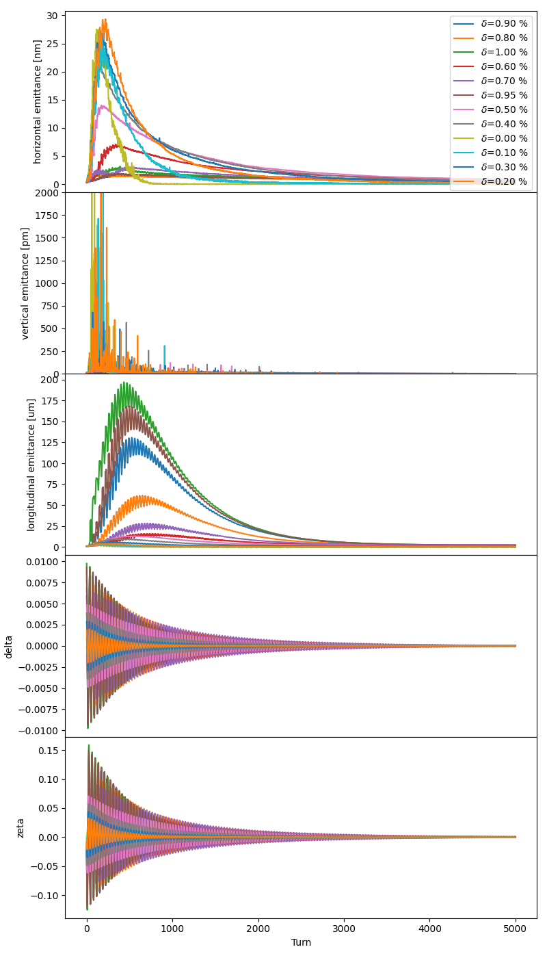
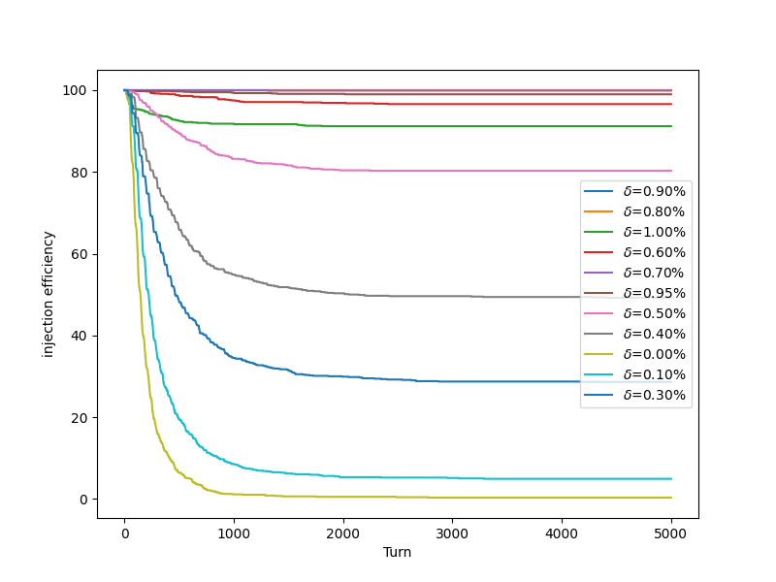
Back-up: Evolution-- GHC

