Slide 1

AvailSim4: Open-Source Framework For Availability and Reliability Simulations
Milosz Blaszkiewicz, Lukas Felsberger
CB Section Meeting, February 4th, 2025

Slide 2
Contents
Introduction
Methodology & Implementation
Resources
Conclusions

Slide 3
Contents
Introduction
Methodology & Implementation
Resources
Conclusions

Slide 4
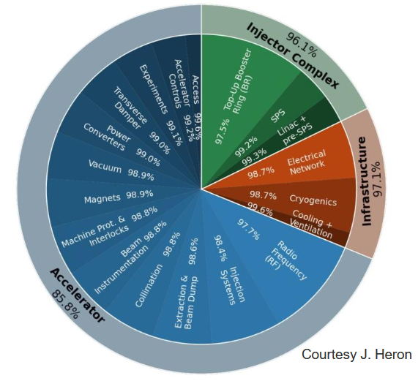
Introduction
RAMS simulations at CERN
Stochastic simulations for RAMS studies
  A broad range of tools is available to estimate or predict those metrics quantitatively.
  Stochastic simulations:
    unparalleled flexibility,
    straightforward translation of a conceptual description into a model,
    highly realistic representation of studied systems.
At CERN
  Availability concerns are relevant as the machine is an expensive project and downtime disrupts its scientific goals.
  Reliability matters due to presence of systems that deal with large energy stored in the beams and magnets.

Slide 5

Overview
What is AvailSim4?
Clone from https://gitlab.cern.ch/availsim4/
or
Monte Carlo simulation framework for availability and reliability studies of complex systems.
Main characteristics of the framework:
  Customizable models for systems composed of many sub-systems.
  Open source; features tabular input & output, for easy integration with other tools.
  Parallelization capacity and distributed computing support for large-scale simulations.
> pip install availsim4
The 4th take on the tool
  Previous versions have been developed at other particle accelerator facilities.
  Current version:
  written in Python,
  designed with long-term maintainability in mind,
  in use at CERN since 2020.
Difficult to find in commercially availabile tools

Slide 6
Contents
Introduction
Methodology & Implementation
Resources
Conclusions

Slide 7
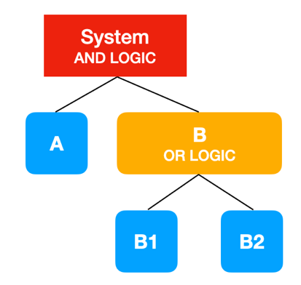

Algorithm & Implementation
Model Description
Models are made of components:
  Basic – elements with a failure mode
  Compound – elements aggregating other basic and compound components into more complex structures
Component dependencies with logic operators:
  X out of Y, AND, OR…
Additional parameters:
  Phase-dependent failure and repair behaviour
  Inspection and repair strategies
time

Slide 8
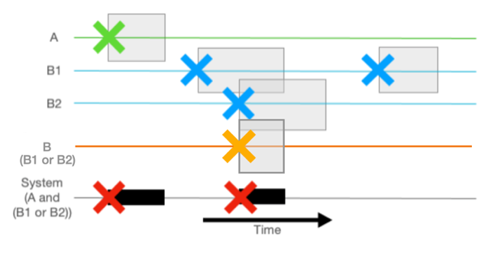
Algorithm & Implementation
Discrete Event Simulation & Monte Carlo
Discrete Event Simulation (DES):
  For driving the individual iterations.
  DES chosen to have maximum flexibility in modelling the system.
Monte Carlo (MC):
DES performed repetitvely, each time sampling the desired probability distributions.
The most flexible approach reflecting real-life events
  Comes at the price of the slow convergence – for rare events, millions of iterations may be needed to obtain accurate results.

Slide 9
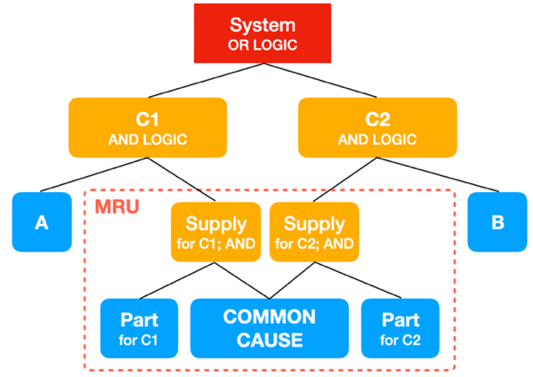
Selected built-in features
Support for complex models
Minimal Replaceable/Swappable Units
  Failures of certain components may trigger repairs/replacement of others.
Shared children
  Parent components can be dependent on the same children.
Custom children logic
  Possibility to define custom advanced children logic through Python classes where other properties than a number of failures play a role.

Slide 10
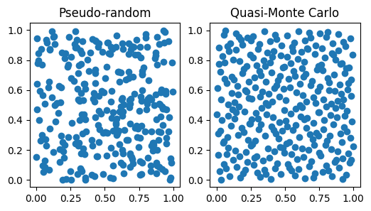
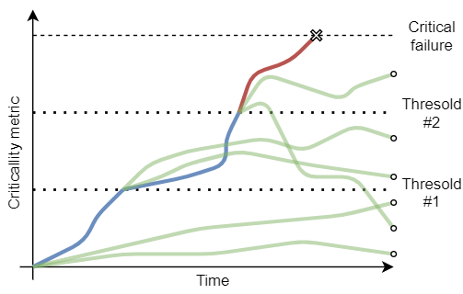
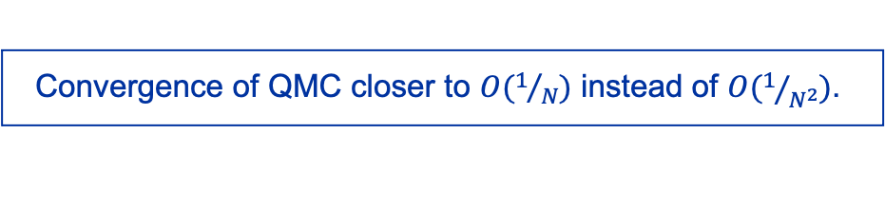
Performance optimizations
Omptimized sampling
Disclaimer: not used
much these days
Quasi-Monte Carlo
Importance Splitting
(RESTART and similar approaches)
  Improves convergence speed using low-discrepancy sequences (as opposed to pseudo-random in standard Monte Carlo).
  Reduces variance, increasing efficiency “out-of-the-box”.
  Focuses on rare, critical events, through splitting simulations at crucial points.
Increased efficiency by orders of magnitude in synthetic test cases but feasibility varies per use-case and depends strongly on additional user input.
Convergence of QMC closer to $O(1/N)$ instead of $O(1/{N^{2}})$.

Slide 11
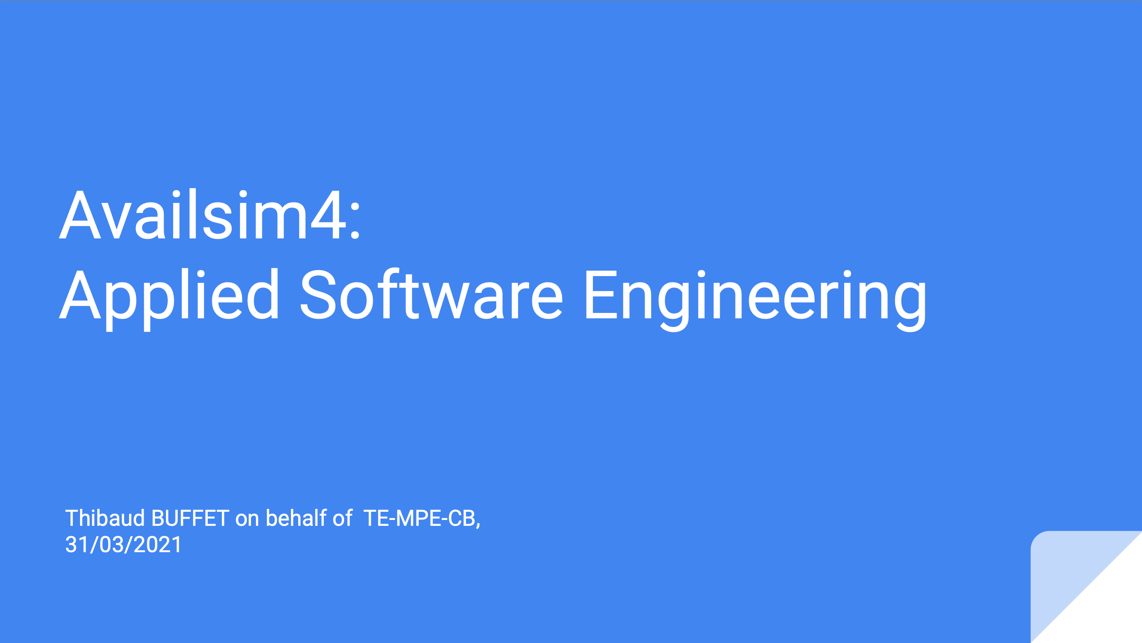
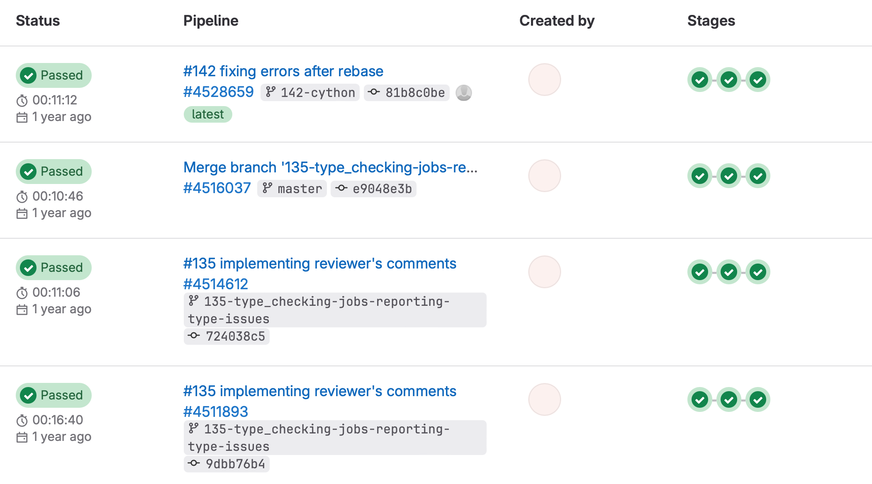
Code quality and long-term maintainability
Project features
High code quality:
  written in Python 3, with dependencies on well known libraries only
  11,000 lines, >200 tests in the Continuous Integration pipeline, 95% lines coverage
Getting started and contributing aided by
  User and developer guides.
  Examples
Releases so far:
  1st release in 2021, 2nd in 2023.
Available through PyPI and CERN Gitlab instance.
  Released under the GPL-3.0 licence.
See: TE-MPE TM Thibaud BUFFET 31/03/2021

Slide 12
Contents
Introduction
Methodology & Implementation
Resources
Conclusions

Slide 13
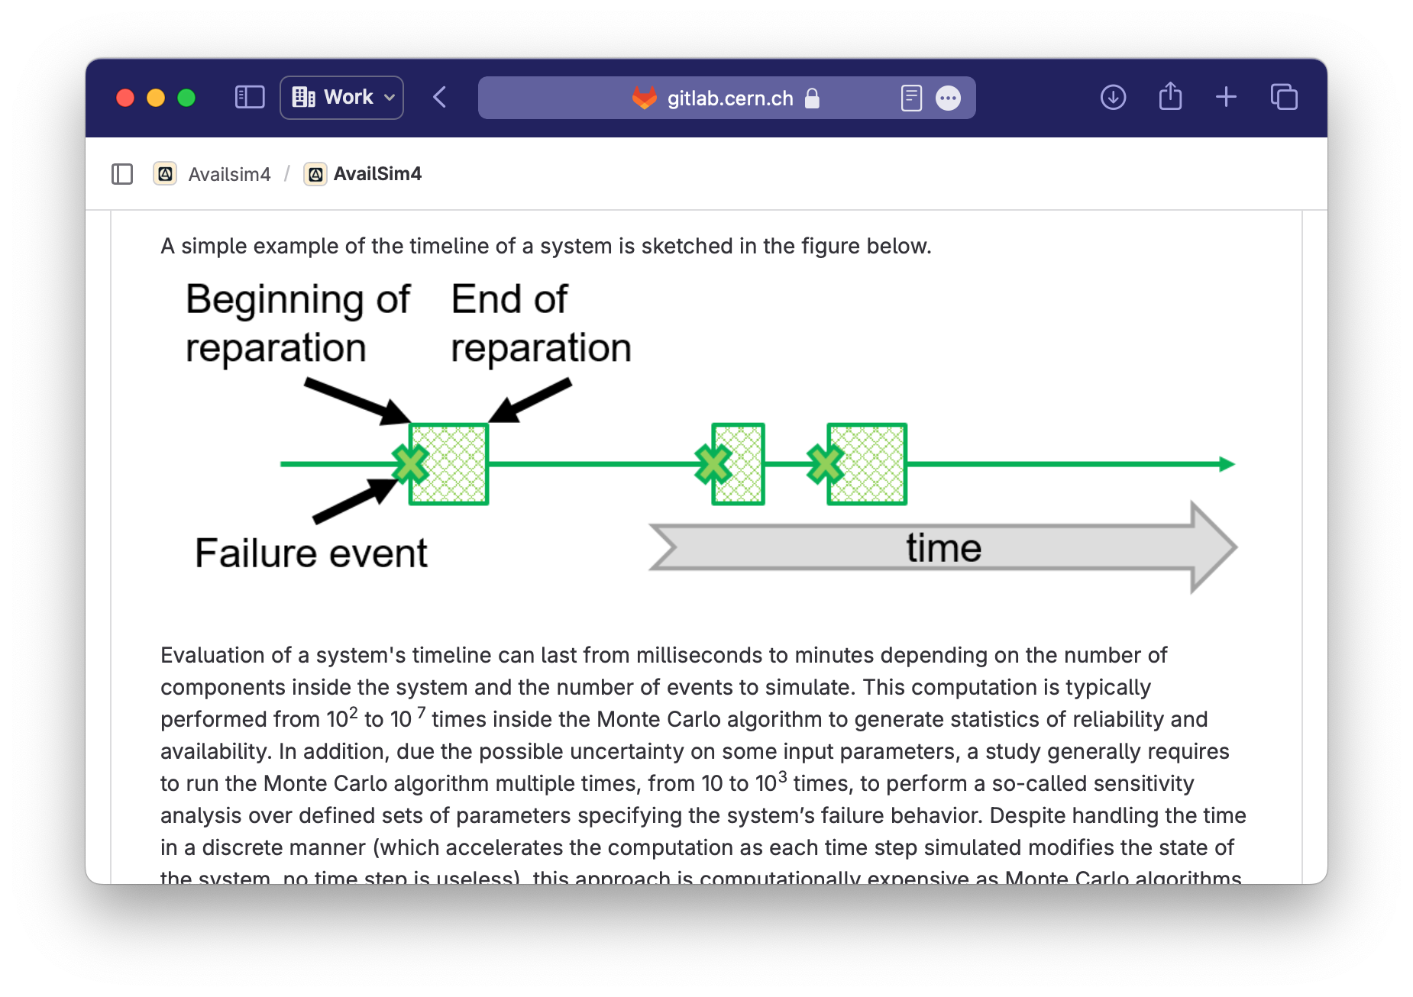
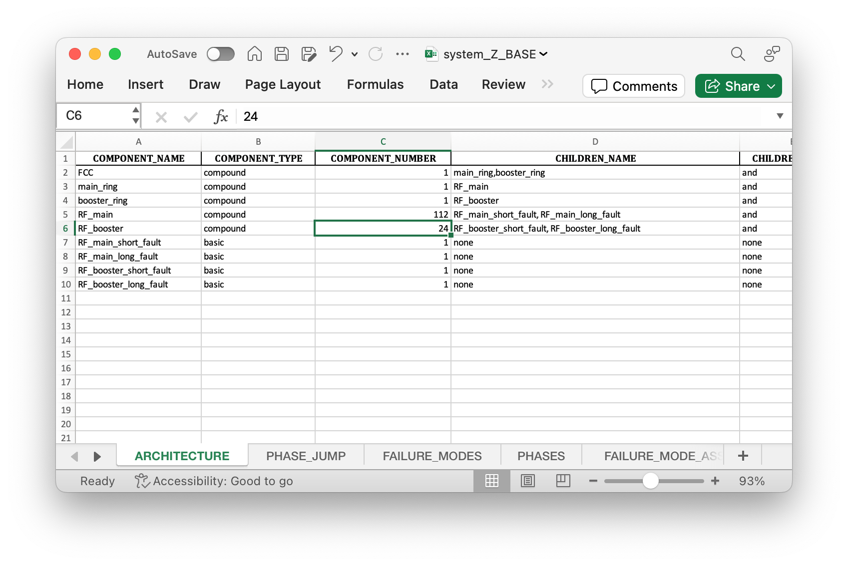
Getting started
Guides, examples, tools, etc.
User guide: CERN Gitlab - AvailSim4 User Guide
Examples: CERN Gitlab - Simple Examples for AvailSim4 beginners
FCC study: CERN Gitlab - FCC-ee Sensitivity Availability Study
Custom children logic showcase: CERN Gitlab - Dynamic Compensation Study
HTCondor Post Processing: CERN Gitlab - Scripts to facilitate running on HTCondor

Slide 14
Release 2.2 (December 2024)
What’s new?
New probability laws: shifted exponential and exponentiated Weibull (Gitlab - Issue 185)
Refactoring of the RCA code: doesn’t create overhead when not used and stored in a memory-efficient way (Gitlab - Issue 184) and better phase treatment (Gitlab - Issue 184, 140)
HTCondor runner improvements (for using AvailSim4 as a module and from other scripts) (Gitlab - Issue 182)
Optional columns: all columns with default values no longer need to present (Gitlab - Issue 178)
Deployment: pyproject.toml instead of setup.py, fixed dependency requirements (Gitlab - Issue 181); AvailSim4 on CVMFS (Gitlab - Issue 166)
Documentation improvements and example notebooks (Gitlab - Issue 160, 181), typo and minor bug fixes (e.g., Gitlab - Issue 175)

Slide 15
Contents
Introduction
Methodology & Implementation
Resources
Conclusions

Slide 16
AvailSim4 in the next years
Ensuring software remains functional and user-friendly
Ensuring performance in CERN environments (SWAN, HTCondor)
Maintaining GitLab CI pipelines
Providing support for availability studies

Slide 17

Conclusions
Advanced simulation tools are indispensable in detailed availability and reliability studies.
AvailSim4 delivers an open-source solution, which:
  works with complex models,
  is easily interfaced with other tools,
  supports large-scale simulations via multi-core and multi-node computing.
Has been used in availability (LHC, FCC-ee, MYRRHA, etc.) as well as
reliability (LHC Energy Extraction, LHC’s Safe Machine Parameter
system, etc.) projects.
Explore at: gitlab.cern.ch/availsim4 (open access)
@ CERN Gitlab

Slide 19
Comparison with other tools
How does AvailSim4 compare to the others?
One of a few open-source projects in this area:
  Released under the GPL-3.0 licence.
Popular programming language (Python 3),
  Enables numerous extensions and adjustments in a straightforward manner,
  Lowering the threshold for potential contributors.
  Access to many other open-source libraries (such as QMCPy).
Ease of integration with other tools and automated pipelines through tabular input/output.
Rare-event simulations: specialized techniques as well as focus on parallel and distributed computing.
List of alternatives provided in the paper.
Lack of GUI: may be intimidating at first.

Slide 20


When to use AvailSim4?
Is modelling of redundancy, demand, repair required?
NO
YES
Analytical methods
Stochastic methods
Limited by complexity of the equations, at a certain point computer aid is necessary
May quickly result in sets of convoluted formulas difficult to comprehend
Fast to compute
Very flexible, potentially antyhing can be included in the simulation
Easy to understand models
Computationally slow
Notes:
Show actual models exemplifying the problems applicable to both groups.

