Slide 1
PhD research plan
Reliability assurance for highly-critical complex systems in particle accelerators
David Westermann
04.02.2025

Slide 2
Agenda
Introduction
Objectives
  Automated Assignment of End-Effects in the Component FMECA
  Integrating field & test data for improved reliability predictions
  Integrating Software assurance processes
Summary

Slide 3
1. Introduction

Slide 4
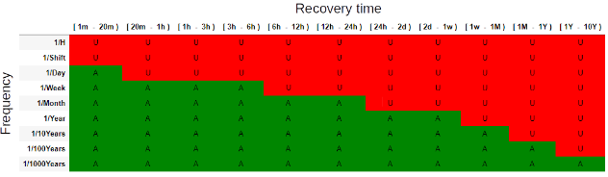
1. Introduction
For safety-critical systems, we ensure at the design stage that the frequency of
undetectable failures that could lead to catastrophic damage in a demand situation, and
failures that affect the availability of the accelerator (e.g. spurious execution of a protection function)
is within an accepted target and make recommendations based on the results.
Top-level FMECA
Identification and quantification of the risk
Identify functions and corresponding failure modes
Identify associated risks and hazards and possible end-effects
Quantify reliability requirements to mitigate risks and hazards

Slide 5
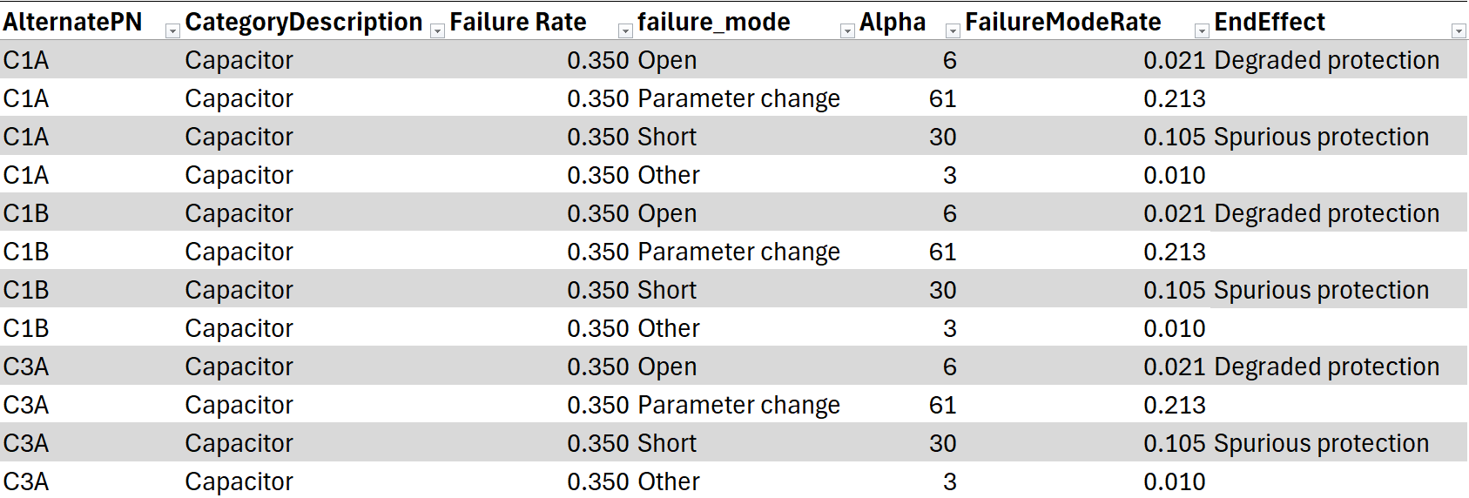
1. Introduction
For safety-critical systems, we ensure at the design stage that the frequency of
undetectable failures that could lead to catastrophic damage in a demand situation, and
failures that affect the availability of the accelerator (e.g. spurious execution of a protection function)
is within an accepted target and make recommendations based on the results.
Component FMECA
Analysis of a sub-system
Determine the failure rate & failure modes for each component
Assign system level end effects to each component failure mode
Derive design improvements

Slide 6
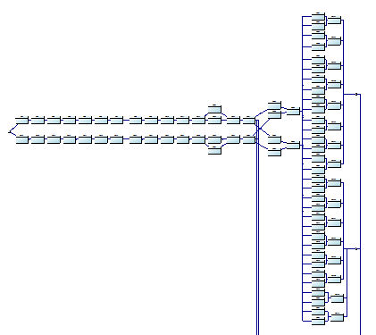
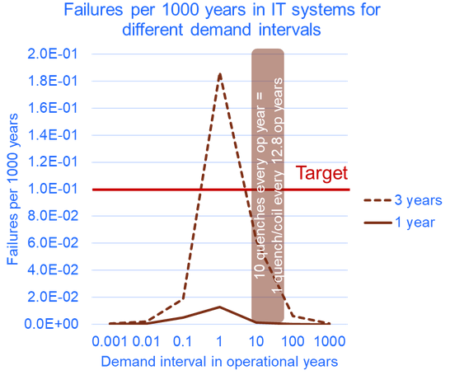
1. Introduction
For safety-critical systems, we ensure at the design stage that the frequency of
undetectable failures that could lead to catastrophic damage in a demand situation, and
failures that affect the availability of the accelerator (e.g. spurious execution of a protection function)
is within an accepted target and make recommendations based on the results.
System-level reliability model
Risk estimation and mitigation
Build a model that captures the system structure, redundancies, critical/non-critical parts, demand and inspection rates
Use simulations or analytic models to determine the expected failure frequency
Give recommendations based on the results

Slide 7
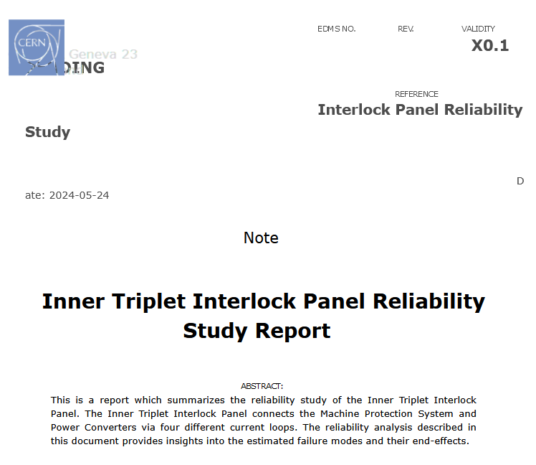
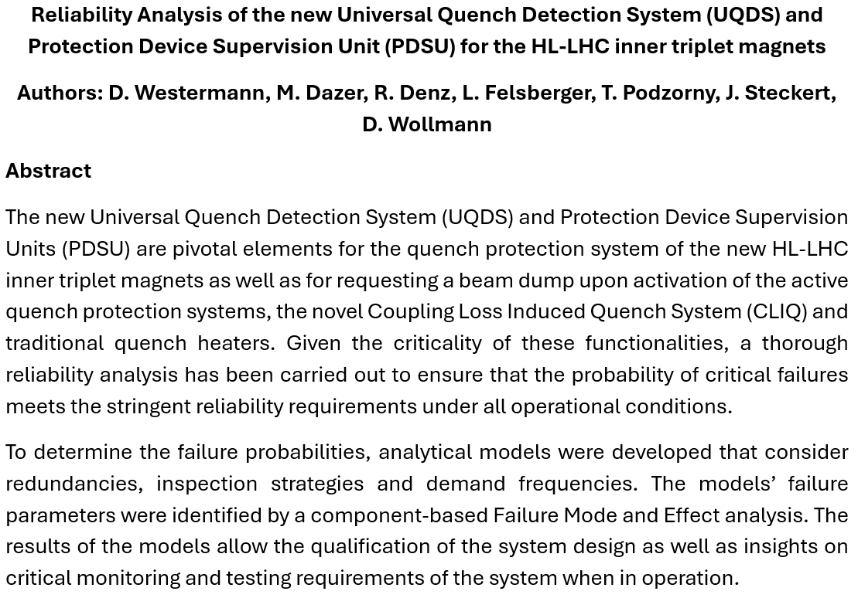
1. Introduction
For safety-critical systems, we ensure at the design stage that the frequency of
undetectable failures that could lead to catastrophic damage in a demand situation, and
failures that affect the availability of the accelerator (e.g. spurious execution of a protection function)
is within an accepted target and make recommendations based on the results.
Universal Quench Detection System (UQDS) & Protection Device Supervision Unit (PDSU) (IPAC paper 2025)
Inner Triplet Interlock Panel

Slide 8
2. Objectives

Slide 9
2. Objectives –
Automated Assignment of End-Effects in the
Component FMECA
In our current process, for each failure mode of each component, the system expert determines the end effect at the system level.

Slide 10
2. Objectives –
Automated Assignment of End-Effects in the
Component FMECA
In our current process, for each failure mode of each component, the system expert determines the end effect at the system level.
Problems
The expert can make mistakes when assigning the end effects.
We do only consider single component failures.

Slide 11
2. Objectives –
Automated Assignment of End-Effects in the
Component FMECA
Project: Contactor Controls Board
Paper for ICSRS 2025
Topic
Simulation of single and multi-component electronic failure scenarios, including random and degradation failures
Aim
Review the results of the manual examination
Determine the failure of not considering multi-component failures in the analysis
Determine the effect of degradation failures
Needed Results
Spice model
End effects with corresponding output signals
Degradation mechanisms
Script to simulate failures and degraded components
End Effects for different failure scenarios
Model to calculate the system failure rate for different scenarios
Recommendations based on the comparison of the results
In our current process, for each failure mode of each component, the system expert determines the end effect at the system level.
Problems
The expert can make mistakes when assigning the end effects.
We do only consider single component failures.
We need to
Simulate single-component failures as well as multi-component failures and degraded components and determine from the results whether they need to be included in the analysis.
No recommendation yet in the literature about the simulation of multi-component failure scenarios.

Slide 12
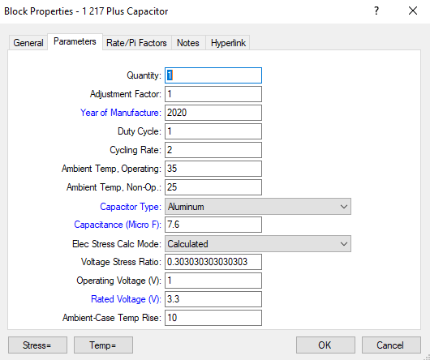
2. Objectives –
Integrating field & test data for improved reliability predictions
In our current process, failure rates are predicted at the design stage based on standard conditions (e.g. year of manufacture) using the Reliability Prediction Standard 217 Plus.

Slide 13
2. Objectives –
Integrating field & test data for improved reliability predictions
In our current process, failure rates are predicted at the design stage based on standard conditions (e.g. year of manufacture) using the Reliability Prediction Standard 217 Plus.
Problems
The actual operating conditions are only partially taken into account (e.g. duty cycle).
The use of prediction standards like 217 Plus can lead to predicted values deviating (significantly) from the actual values for various reasons.
We do not determine the lifetime.
The actual reliability of the systems is not checked during operation, so the predictions are not validated and updated.

Slide 14
2. Objectives –
Integrating field & test data for improved reliability predictions
We need to better predict the reliability, by
Defining and including mission profiles that reflect the actual operational, environmental and other conditions.
No reference mission profiles established for our application environments.
Identifying prediction standards and data sources (monitoring data, data from manufacturers etc.) that reflect the failure rate of our components the best.
No benchmarking of prediction standards with actual field data in our operating environments done yet.
Project: BIS - Analysis of failure data
Machine | CIBM | Date of installation
LHC | 34 | 01/01/2008
LHC INJ | 4 | 01/01/2008
SPS Ring | 6 | 01/01/2006
SPS EXT | 10 | 01/01/2006
SPS INJ | 3 | 01/01/2019
LINAC4 | 3 | 01/01/2012
PSB EXT | 6 | 01/01/2012
TOTAL | 66
Total Runtime in h | 9558024
Failure rate in FITs | 240.9

Slide 15
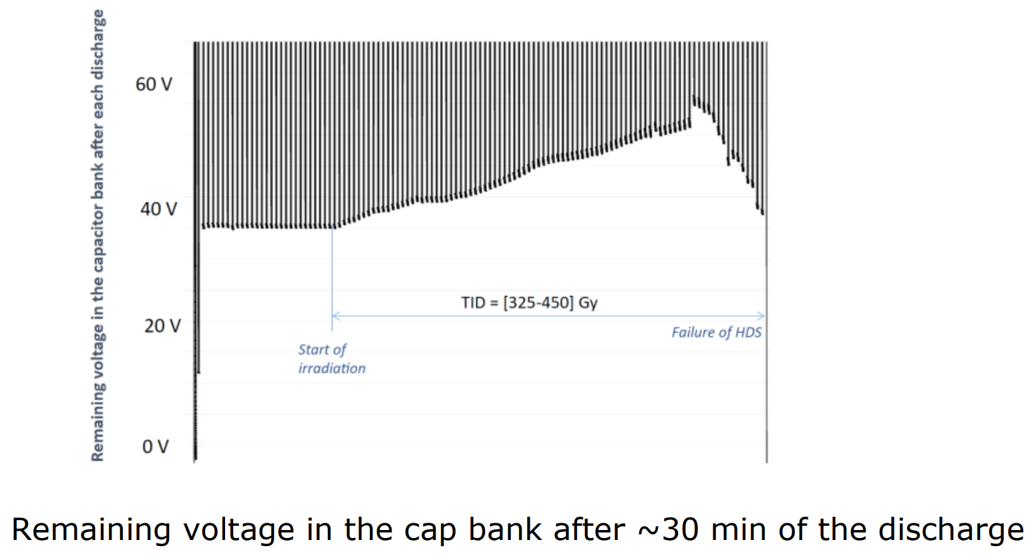
2. Objectives –
Integrating field & test data for improved reliability predictions
Project: BIS - Analysis of failure data
Machine | CIBM | Date of installation
LHC | 34 | 01/01/2008
LHC INJ | 4 | 01/01/2008
SPS Ring | 6 | 01/01/2006
SPS EXT | 10 | 01/01/2006
SPS INJ | 3 | 01/01/2019
LINAC4 | 3 | 01/01/2012
PSB EXT | 6 | 01/01/2012
TOTAL | 66
Runtime in h total | 9558024
Failure rate (FITs) | 240.9
We need to better predict the reliability, by
Defining and including mission profiles that reflect the actual operational, environmental and other conditions.
Identifying prediction standards and data sources (monitoring data, data from manufacturers etc.) that reflect the failure rate of our components the best.
We need to check and update the reliability prediction during operation, by
identifying Key Performance Indicators (KPIs) in the design stage that can be measured and provide information about the reliability/lifetime of the system.
monitoring and analysing the KPIs and updating the prediction for early end-of-life detection/prediction.
Project: DQHDS - Monitoring of KPIs

Slide 16
2. Objectives –
Integrating field & test data for improved reliability predictions
Projects: BIS and DQHDS
Paper for 2026
Topic
Empirical models for predicting the reliability in the design phase und updating the analysis during operation with new data
Aim
Create mission profiles
Creation of empirical models that allow the reliability prediction based on mission profiles
Definition of adequate KPIs and creation of a monitoring framework
Needed Results
Mission profiles
Analysis of failure data (from BIS)
Database with reliability data
Empirical models, based on a comparison of the failure data with different prediction standards
Condition based KPIs (e.g. transistor failure in a radiation environment)
Monitoring framework
We need to better predict the reliability, by
Defining and including mission profiles that reflect the actual operational, environmental and other conditions.
Identifying prediction standards and data sources (monitoring data, data from manufacturers etc.) that reflect the failure rate of our components the best.
We need to check and update the reliability prediction during operation, by
identifying Key Performance Indicators (KPIs) in the design stage that can be measured and provide information about the reliability/lifetime of the system.
monitoring and analysing the KPIs and updating the prediction for early end-of-life detection/prediction.

Slide 17
2. Objectives –
Integrating Software assurance processes
In our current process, we do only study hardware failures.

Slide 18
2. Objectives –
Integrating Software assurance processes
In our current process, we do only study hardware failures.
Problems
Critical functions are increasingly being moved into programmable devices, but we do not consider failures caused by Software.
We do not yet have a process to fully interface and integrate software aspects.

Slide 19
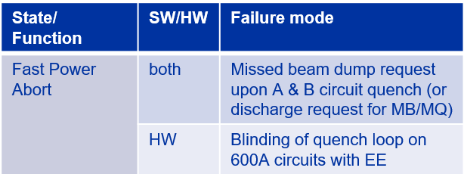
2. Objectives –
Integrating Software assurance processes
Project: Software Assurance of the PIC PLC code
In our current process, we do only study hardware failures.
Problems
Critical functions are increasingly being moved into programmable devices, but we do not consider failures caused by Software.
We do not yet have a process to fully interface and integrate software aspects.
We need
A process to interface and integrate software assurance aspects into a reliability assurance process.
Focus on PLCs (PIC) and Microelectronics (e.g. UQDS, PDSU etc.).

Slide 20
2. Objectives –
Integrating Software assurance processes
Project: Software Assurance of the PIC PLC code
Paper for 2027
Topic
Interface and integration of software aspects into the reliability assurance process
Aim
Framework for interfacing and integrating Software aspects into the reliability assurance process
Guidance in executing formal verification/ reaching a certain SIL level
Needed Results
Defined Hardware Assurance process
Analysis of how to interface and integrate software aspects
Defined Software Assurance Methods
Formal Verification results of the PIC code
Comparison with Standard (which SIL level can be reached)
Adapted assurance process
In our current process, we do only study hardware failures.
Problems
Critical functions are increasingly being moved into programmable devices, but we do not consider failures caused by Software.
We do not yet have a process to fully interface and integrate software aspects.
We need
A process to interface and integrate software assurance aspects into a reliability assurance process.
Focus on PLCs (PIC) and Microelectronics (e.g. UQDS, PDSU etc.).

Slide 21
3. Summary

Slide 22
3. Summary
Assignment of End Effects in the Component FMECA (Paper ICSRS 2025) → Contactor Controls Board
  Evaluating impact of multi-component failure scenarios and component degradation
Reliability Prediction (Paper 2026) → BIS and DQHDS
  Improve the prediction of failure rates by using mission profiles and empirical models (BIS)
  Improve end-of-life assessment through defining & monitoring adequate KPIs (DQHDS)
Software Assurance (Paper 2027) → PIC
  Find ways to interface and integrate software aspects into the reliability analysis
  Focus on PLCs (and Microelectronics)
Improve individual steps and extend the reliability assurance process for safety-critical systems to include hardware and software failures.

