Slide 1



Nb₃Sn/Cu - Status and perspectives
Valentin Giglia
TE-VSC-SCC
TE-VSC Seminar – 18th March 2024

Slide 2
Outline
Introduction: Why Nb₃Sn
Nb₃Sn on small sample for development
QPR for fine tuning
Towards first cavity depositions
Conclusion

Slide 3
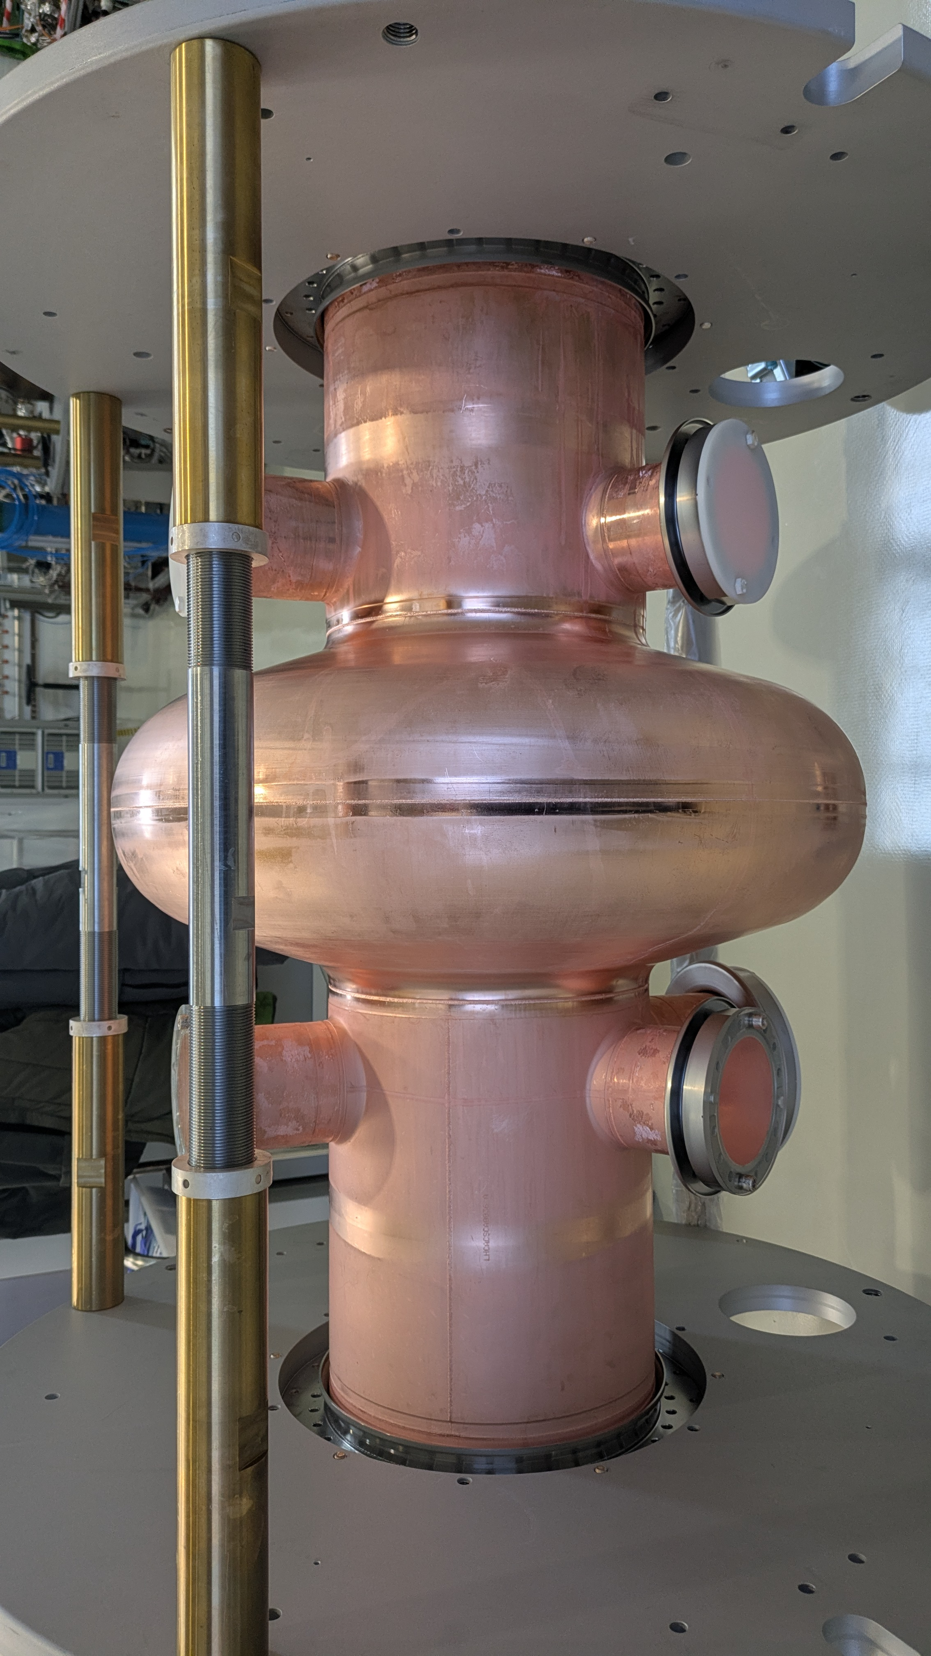
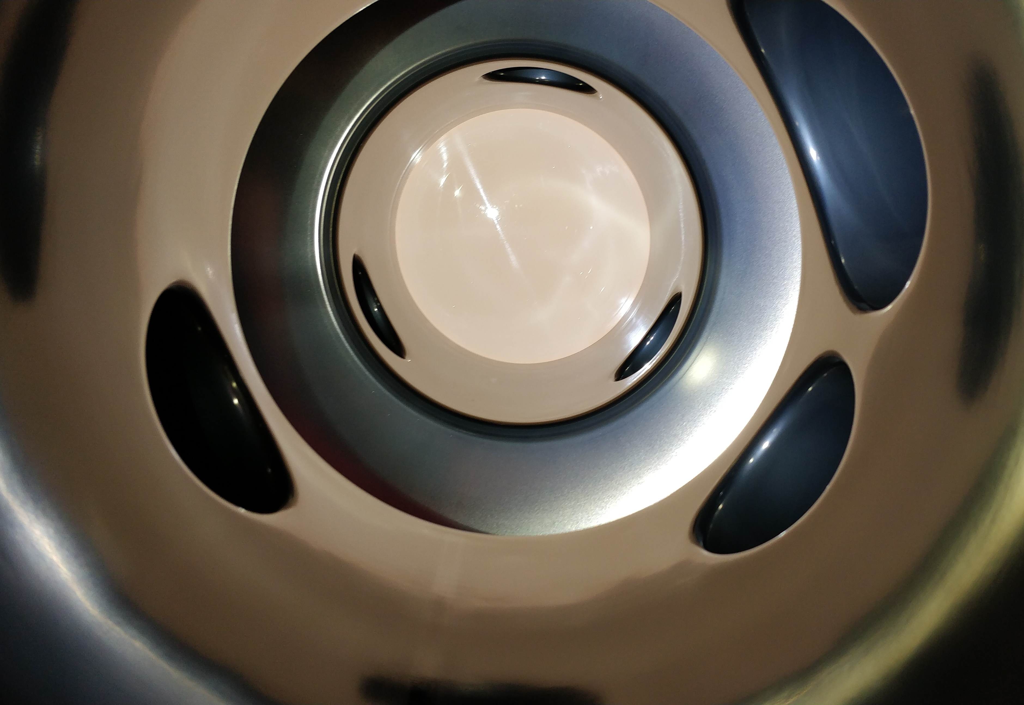
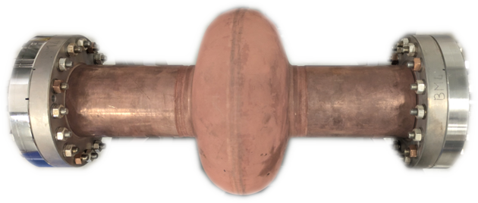
Introduction
Superconducting Radio Frequency (SRF) Cavities
  Accelerate charged particles
    Electromagnetic standing wave
    Force applied to charged particle
  Bulk Nb
  Nb/Cu (LHC, ISOLDE):
    Cu = high thermal conductivity
    Lower load on cooling system

Slide 4
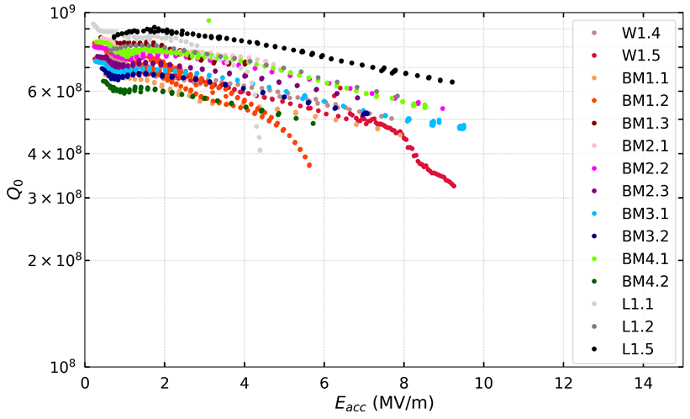
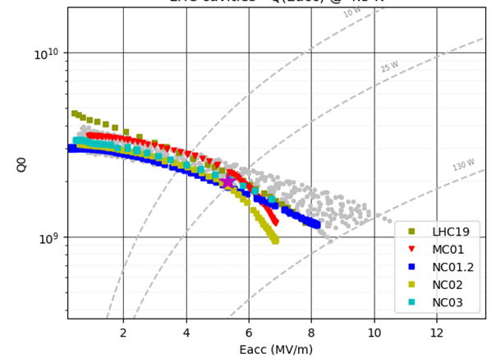
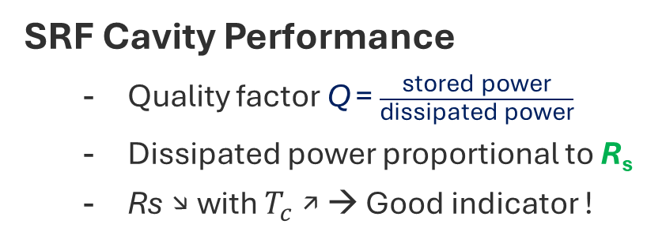
Introduction
SRF Cavity Performance
    Quality factor Q = $\frac{\text{stored} \text{power}}{\text{dissipated} \text{power}}$
    Dissipated power proportional to R_{s}
    Rs ↘ with $T_{c}$ ↗ → Good indicator !
400 MHz, 4.2K
1.3GHz, 4.2K

Slide 5
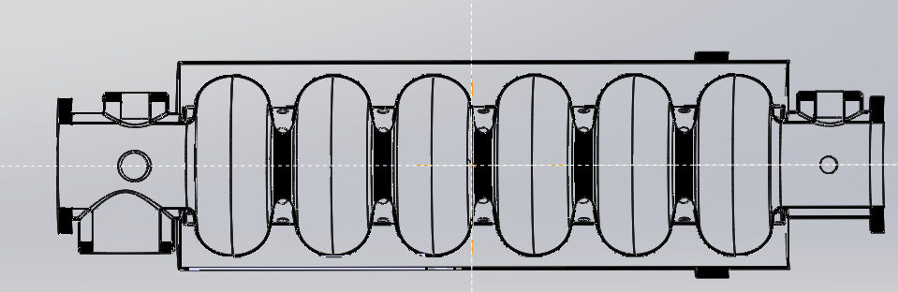
Introduction
How Nb₃Sn compares to Nb ?
Q₀ at 4.5 K ~ bulk Nb at 2 K
Better overall performances
 | Nb | Nb₃Sn
Tc (K) | 9.2 | 18.3
R_{BCS} (nΩ) | 45 | 0.4
H_{sh} (mT) @4.2K and 500MHz | 220 | 425
Max th. Eacc (MV/m) | 50 | 100
How this is interesting for accelerators ?
For FCC: bulk Nb cavities for booster operations
Could operate at 4.5K instead of 2K + Use of Cu substrate
Energy and cost savings for future colliders

Slide 6
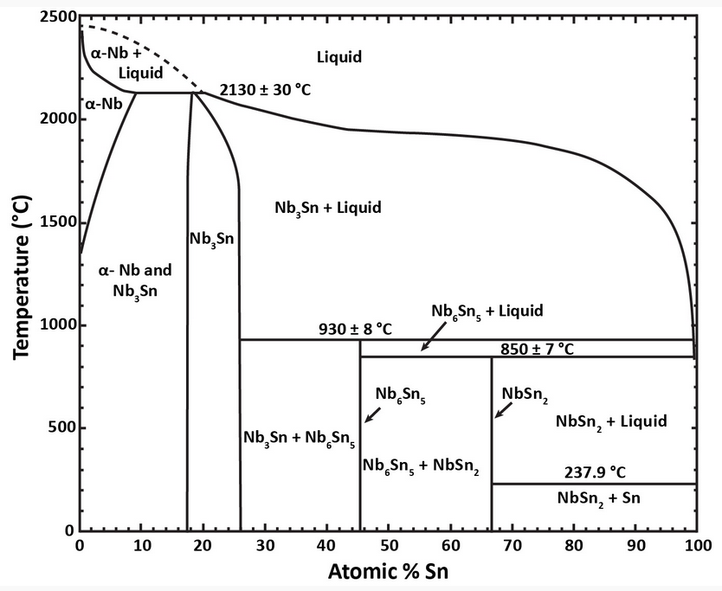
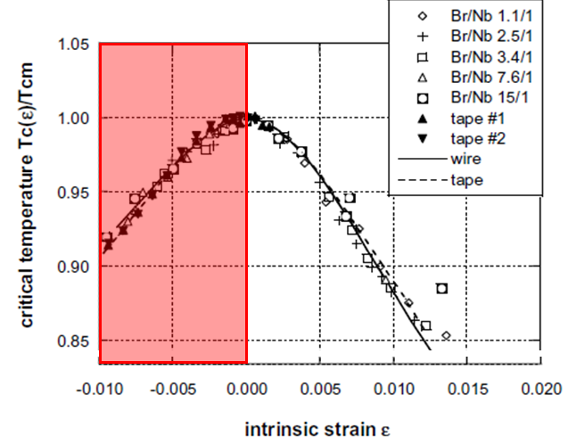
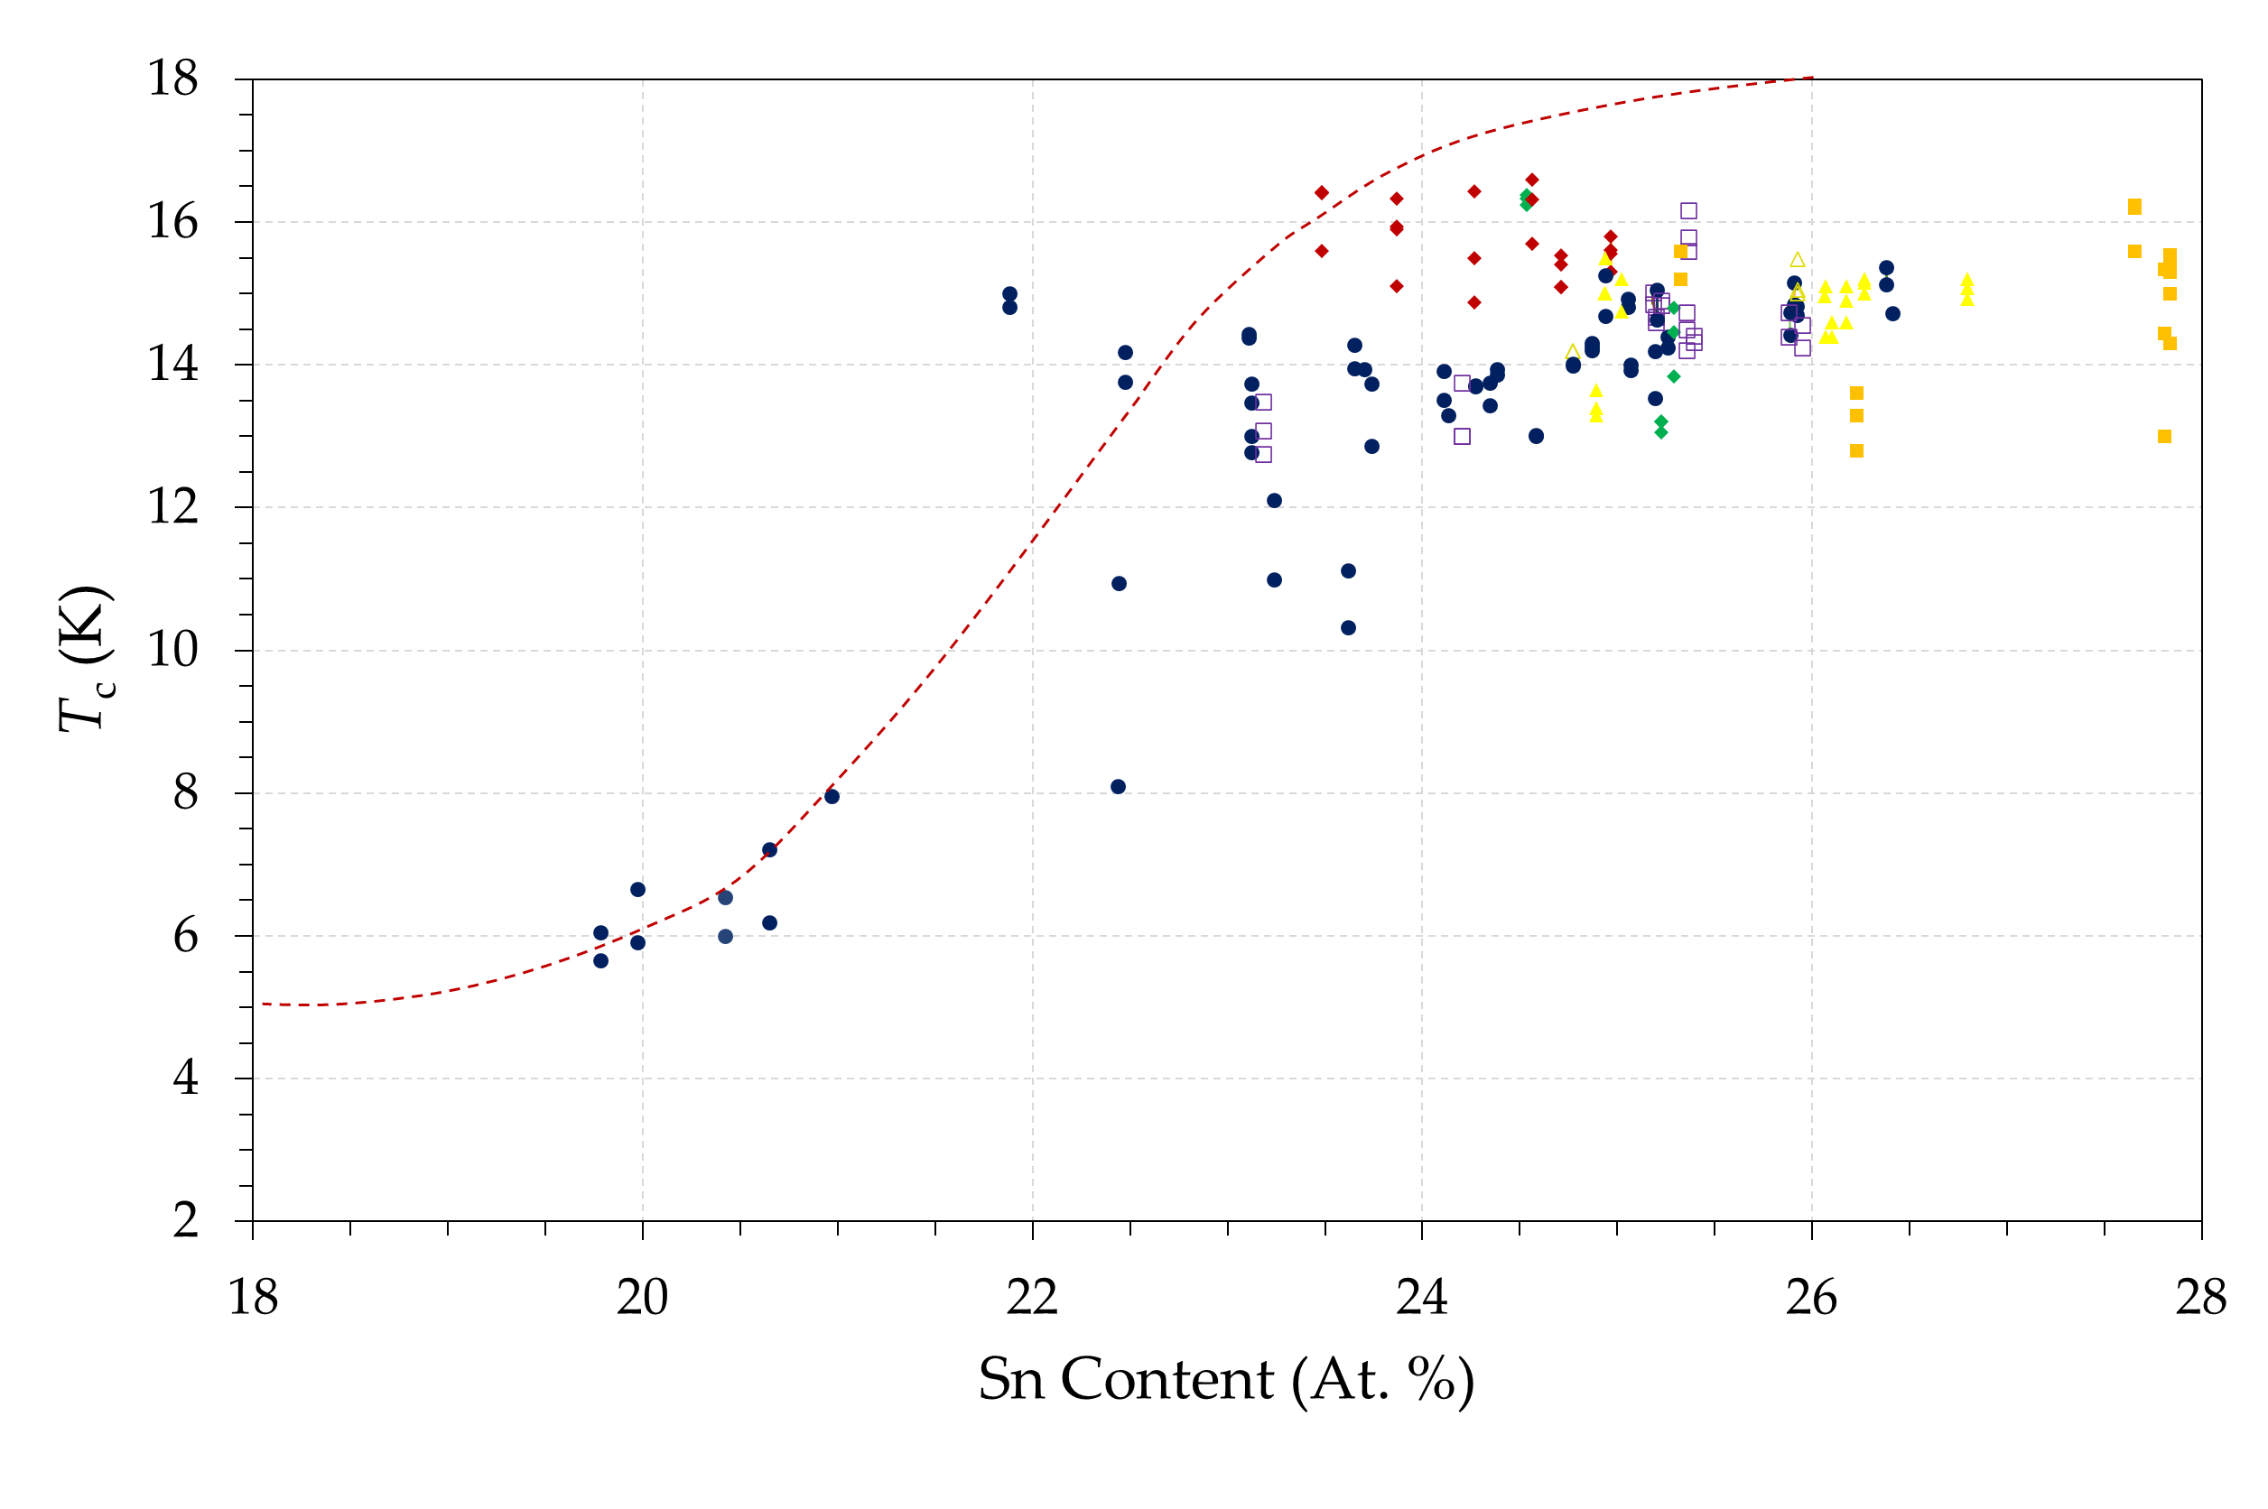
Introduction
Nb₃Sn
Some challenges for Nb₃Sn dev:
  Very narrowed region in phase diagram
  Requires high temperature process
  Composition is crucial to ensure high perf.
    Optimal Sn content 25 At.%
  Perf. are hindered by mechanical stress
[1]
Theoretical Max T_{c} @ -1.5 GPa
[2]
[3]
[1] J. Charlesworth, I. MacPhail, and P. Madsen, J. Mater. Sci. 5, 580 (1970)
[2] G. De Marzi et al. J. Phys.: Condens. Matter 25 (2013)
[3] A. Godeke. Supercond. Sci. Technol. 19 (2006)

Slide 7
Outline
Introduction: Why Nb₃Sn
Nb₃Sn on small sample for development
QPR for fine tuning
Towards first cavity depositions
Conclusion

Slide 8
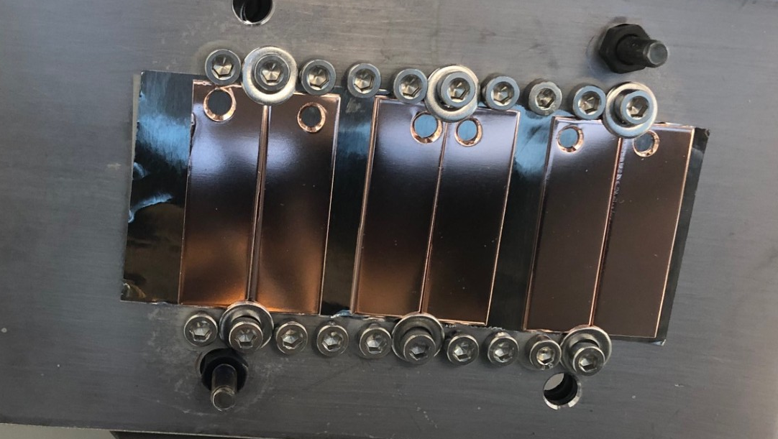
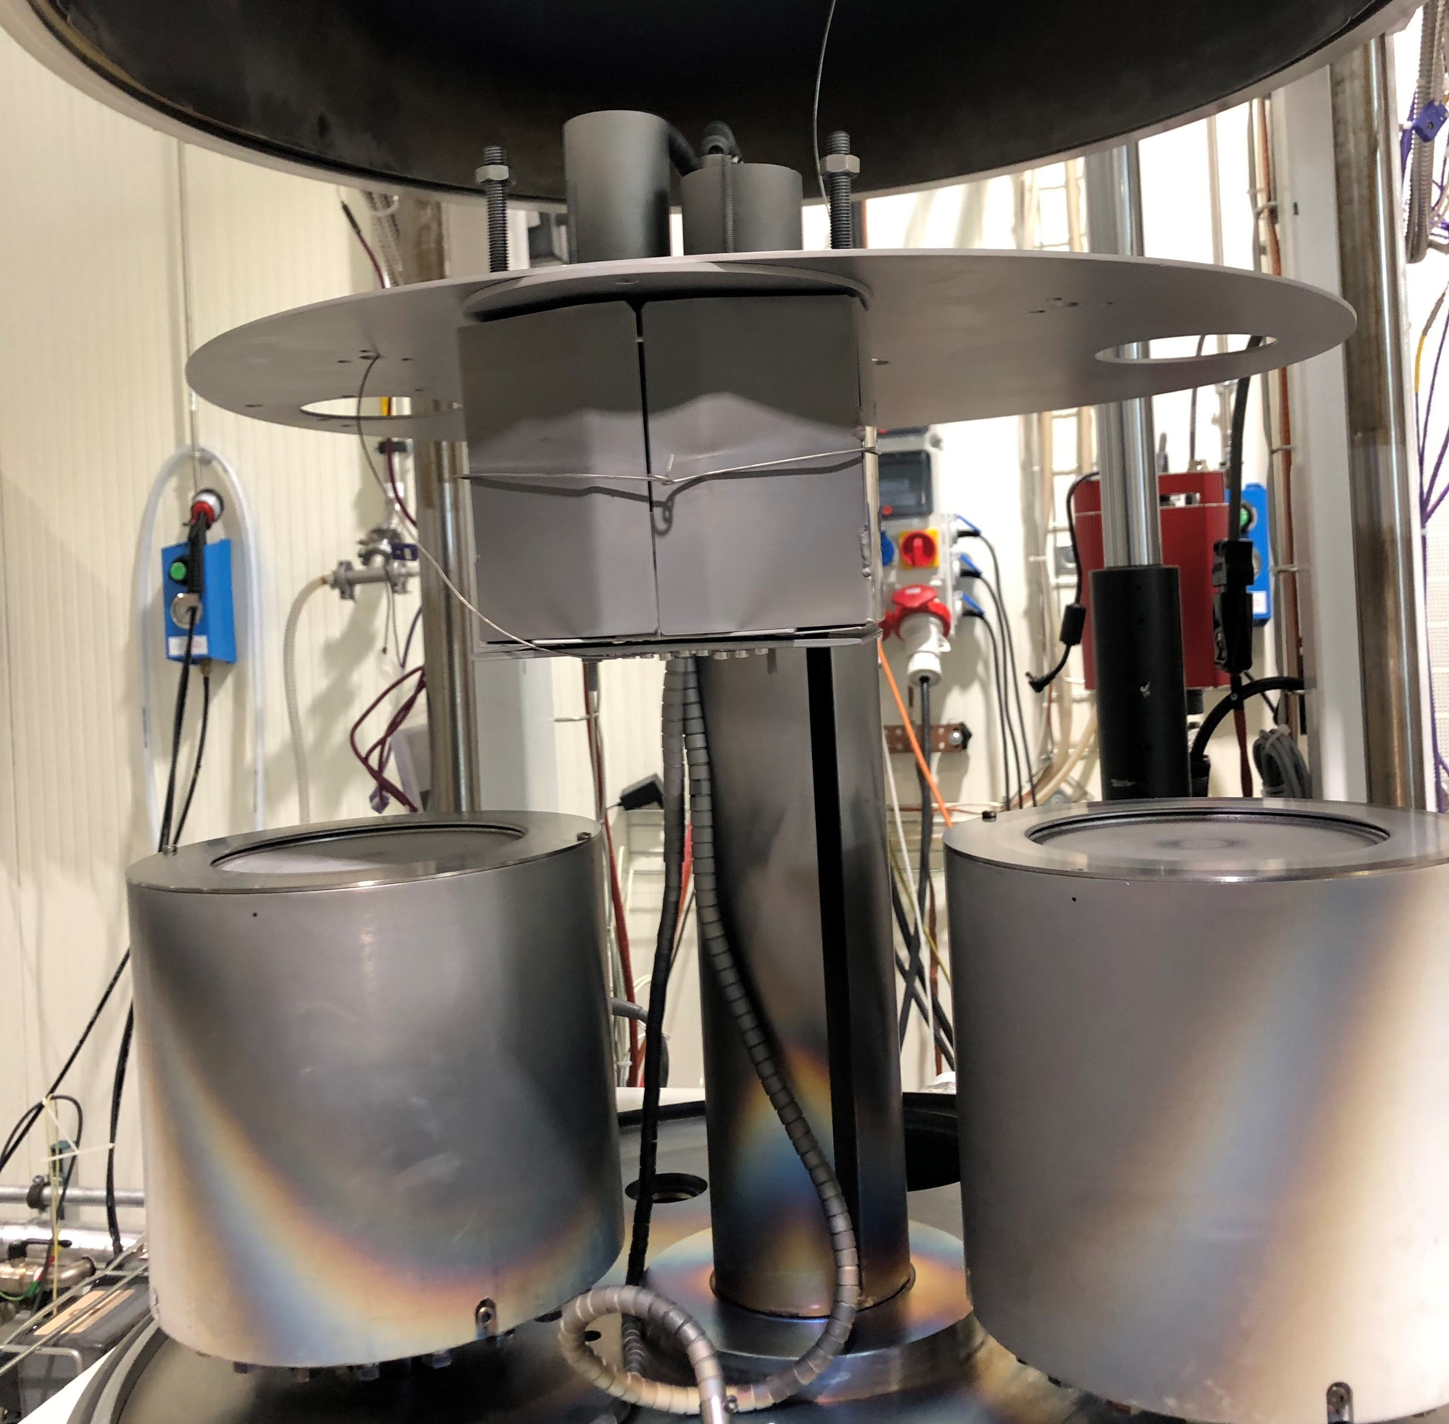
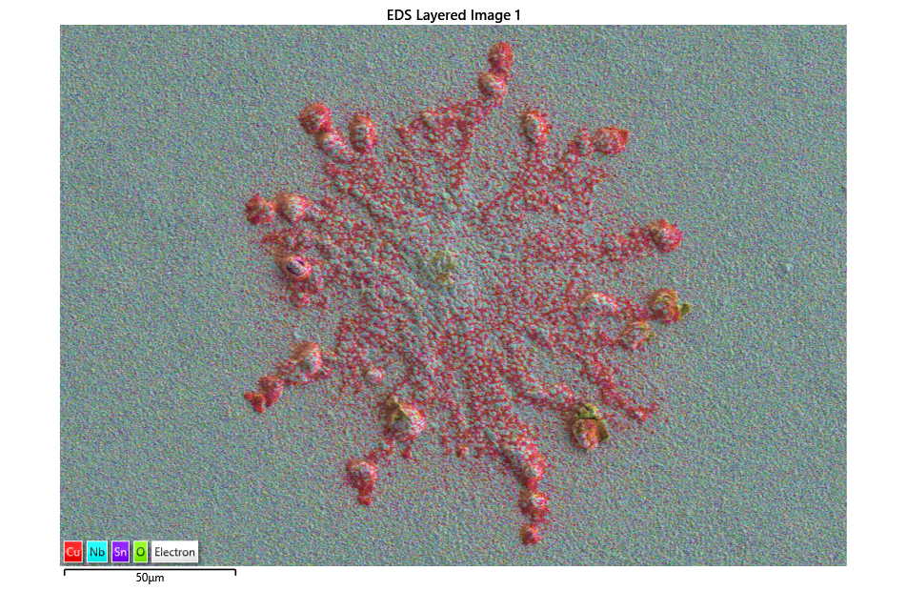
Development on small Cu samples
Surface preparation:
  SUBU (chemical polishing)
  EP (Electro polishing)
  PEP (Plasma electro polishing)
Coating process Bi-Polar HiPIMS:
  Samples mounted on T-regulated, rotative support
  Two steps coating
    1St dep: Ta barrier*
    2nd dep: Nb₃Sn layer
Nb₃Sn
Ta
*Prevents from copper diffusion [1] →
50 μm
[1] E A Ilyina et al. Supercond. Sci. Technol. 32. (2019)

Slide 9
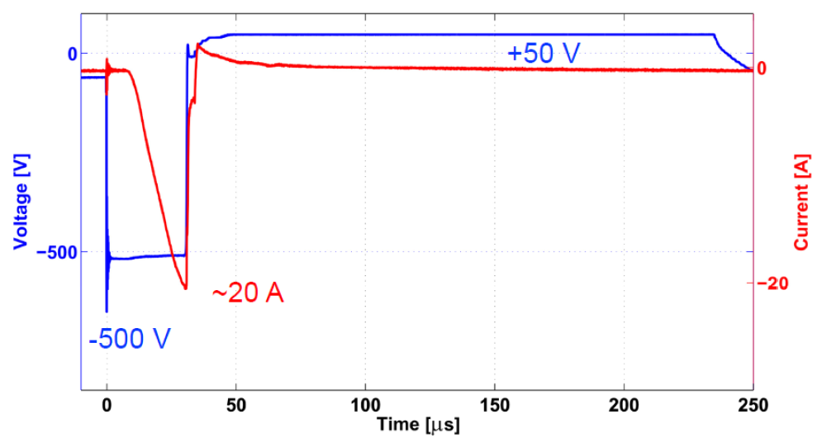
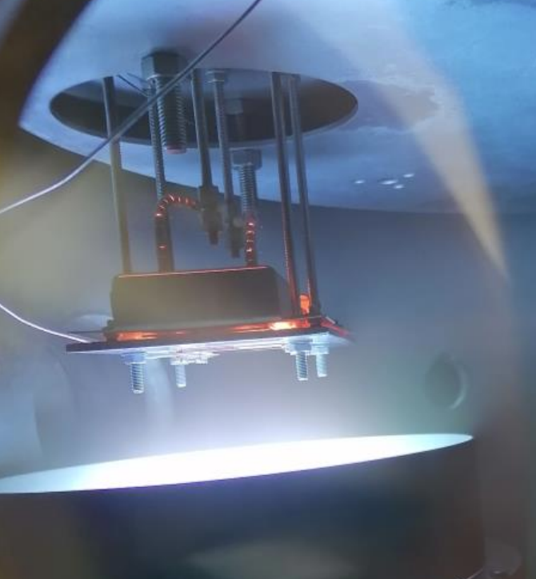
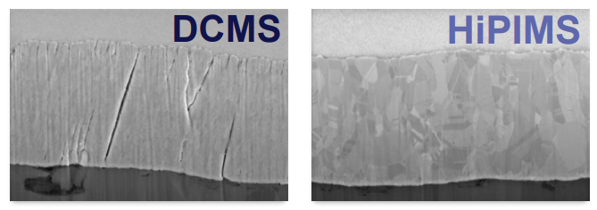
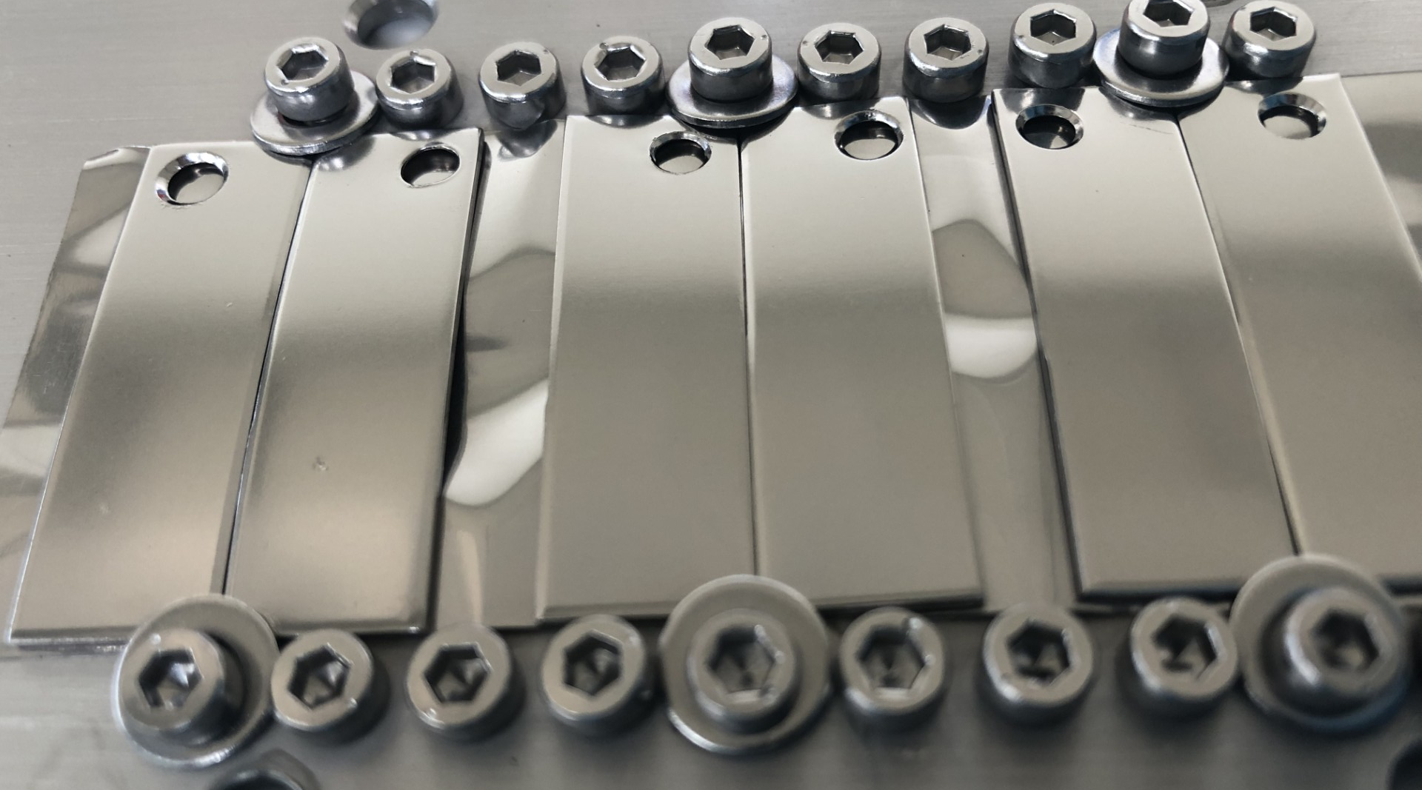
Development on small Cu samples
High Power Impulse Magnetron sputtering:
  High power density during short pulses
  Advantages for thin films:
    Higher plasma ionisation
    Higher film density
  Bi-Polar for Nb₃Sn devs:
    Both negative and positive pulses
    PP pushes charged species towards the sample
    Even higher film density
b)
C.P.A Carlos et al. FCC week 2022

Slide 10
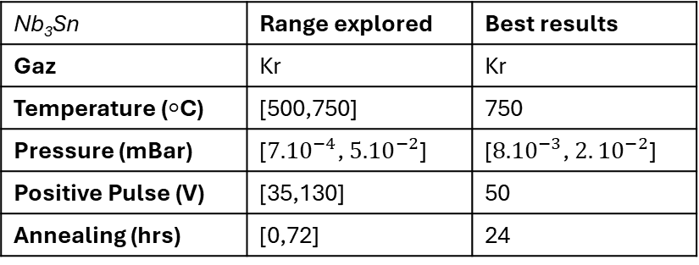
Development on small Cu samples
High Power Impulse Magnetron sputtering:
  High power density during short pulses
  Advantages for thin films:
    Higher plasma ionisation
    Higher film density
  Bi-Polar for Nb₃Sn devs:
    Both negative and positive pulses
    PP pushes charged species towards the sample
    Even higher film density
Extensive ongoing study (started by S. Leith):
Nb₃Sn | Range explored | Best results
Gaz | Kr | Kr
Temperature (◦C) | [500,750] | 750
Pressure (mBar) | [${7.10}^{−4}$, ${5.10}^{−2}$] | [${8.10}^{−3}$, $2.{10}^{−2}$]
Positive Pulse (V) | [35,130] | 50
Annealing (hrs) | [0,72] | 24

Slide 11
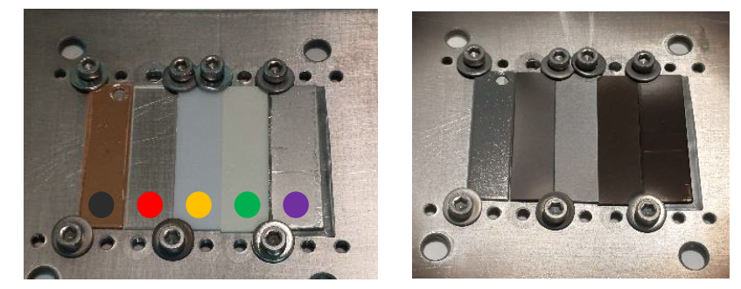
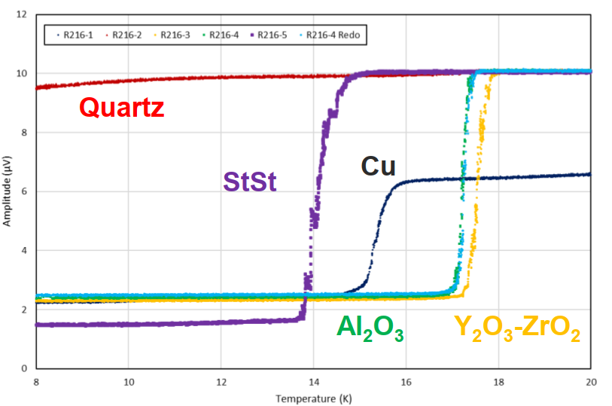
Development on small Cu samples
Best results on small samples:
  Tc is capped at 16K
  First order impact of mechanical stress
  (Different CTE between Cu and Nb₃Sn)
Demonstration:
  Same coating recipe on different substrates
  Tc ↗ when CTE becomes closer to Nb₃Sn
  Total improvement = 2K
A promising solution:
  Changing Cu substrate for CuW
  First coating in characterization now
S. Leith

Slide 12
Outline
Introduction: Why Nb₃Sn
Nb₃Sn on small sample for development
QPR for fine tuning
Towards first cavity depositions
Conclusion

Slide 13
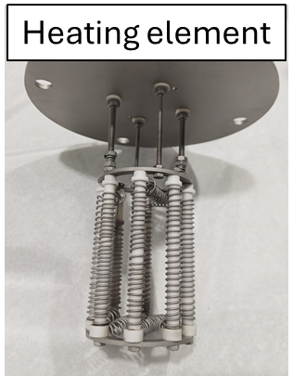
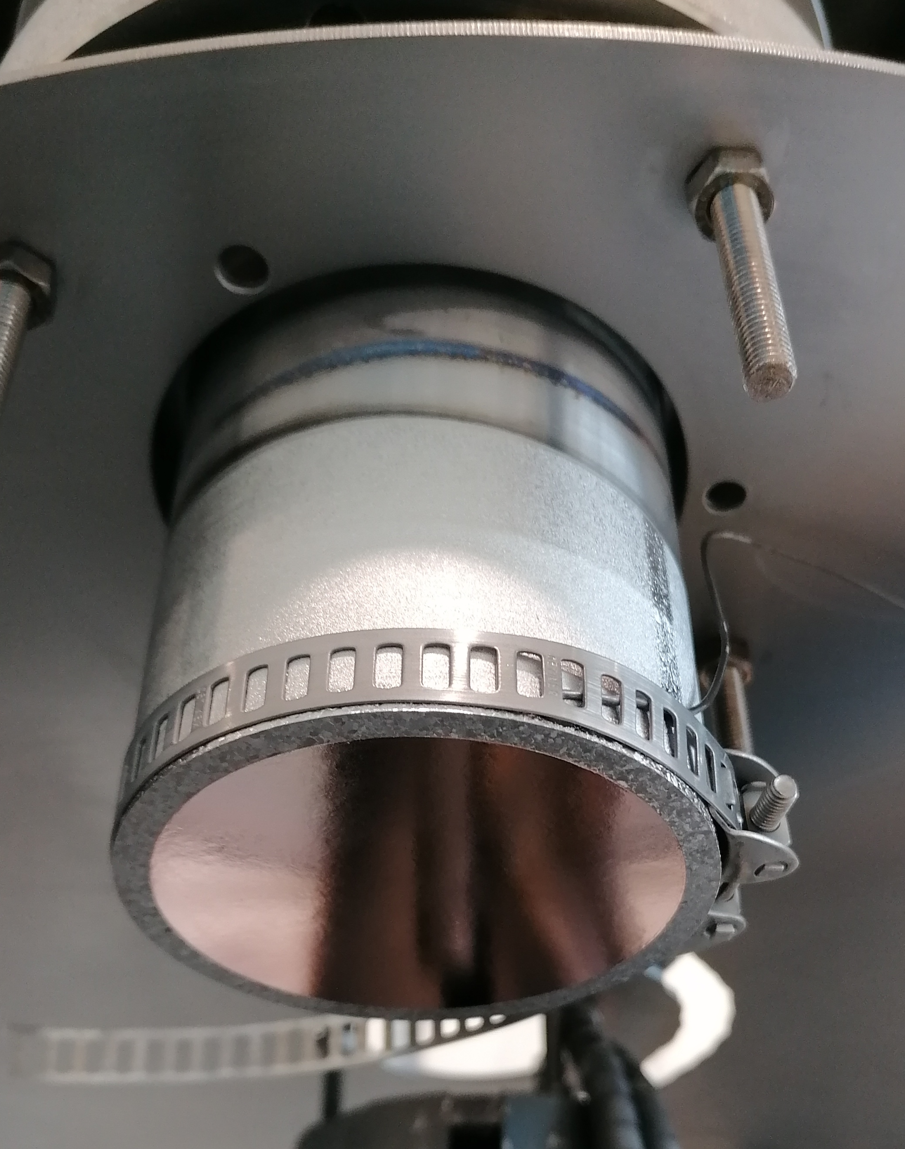
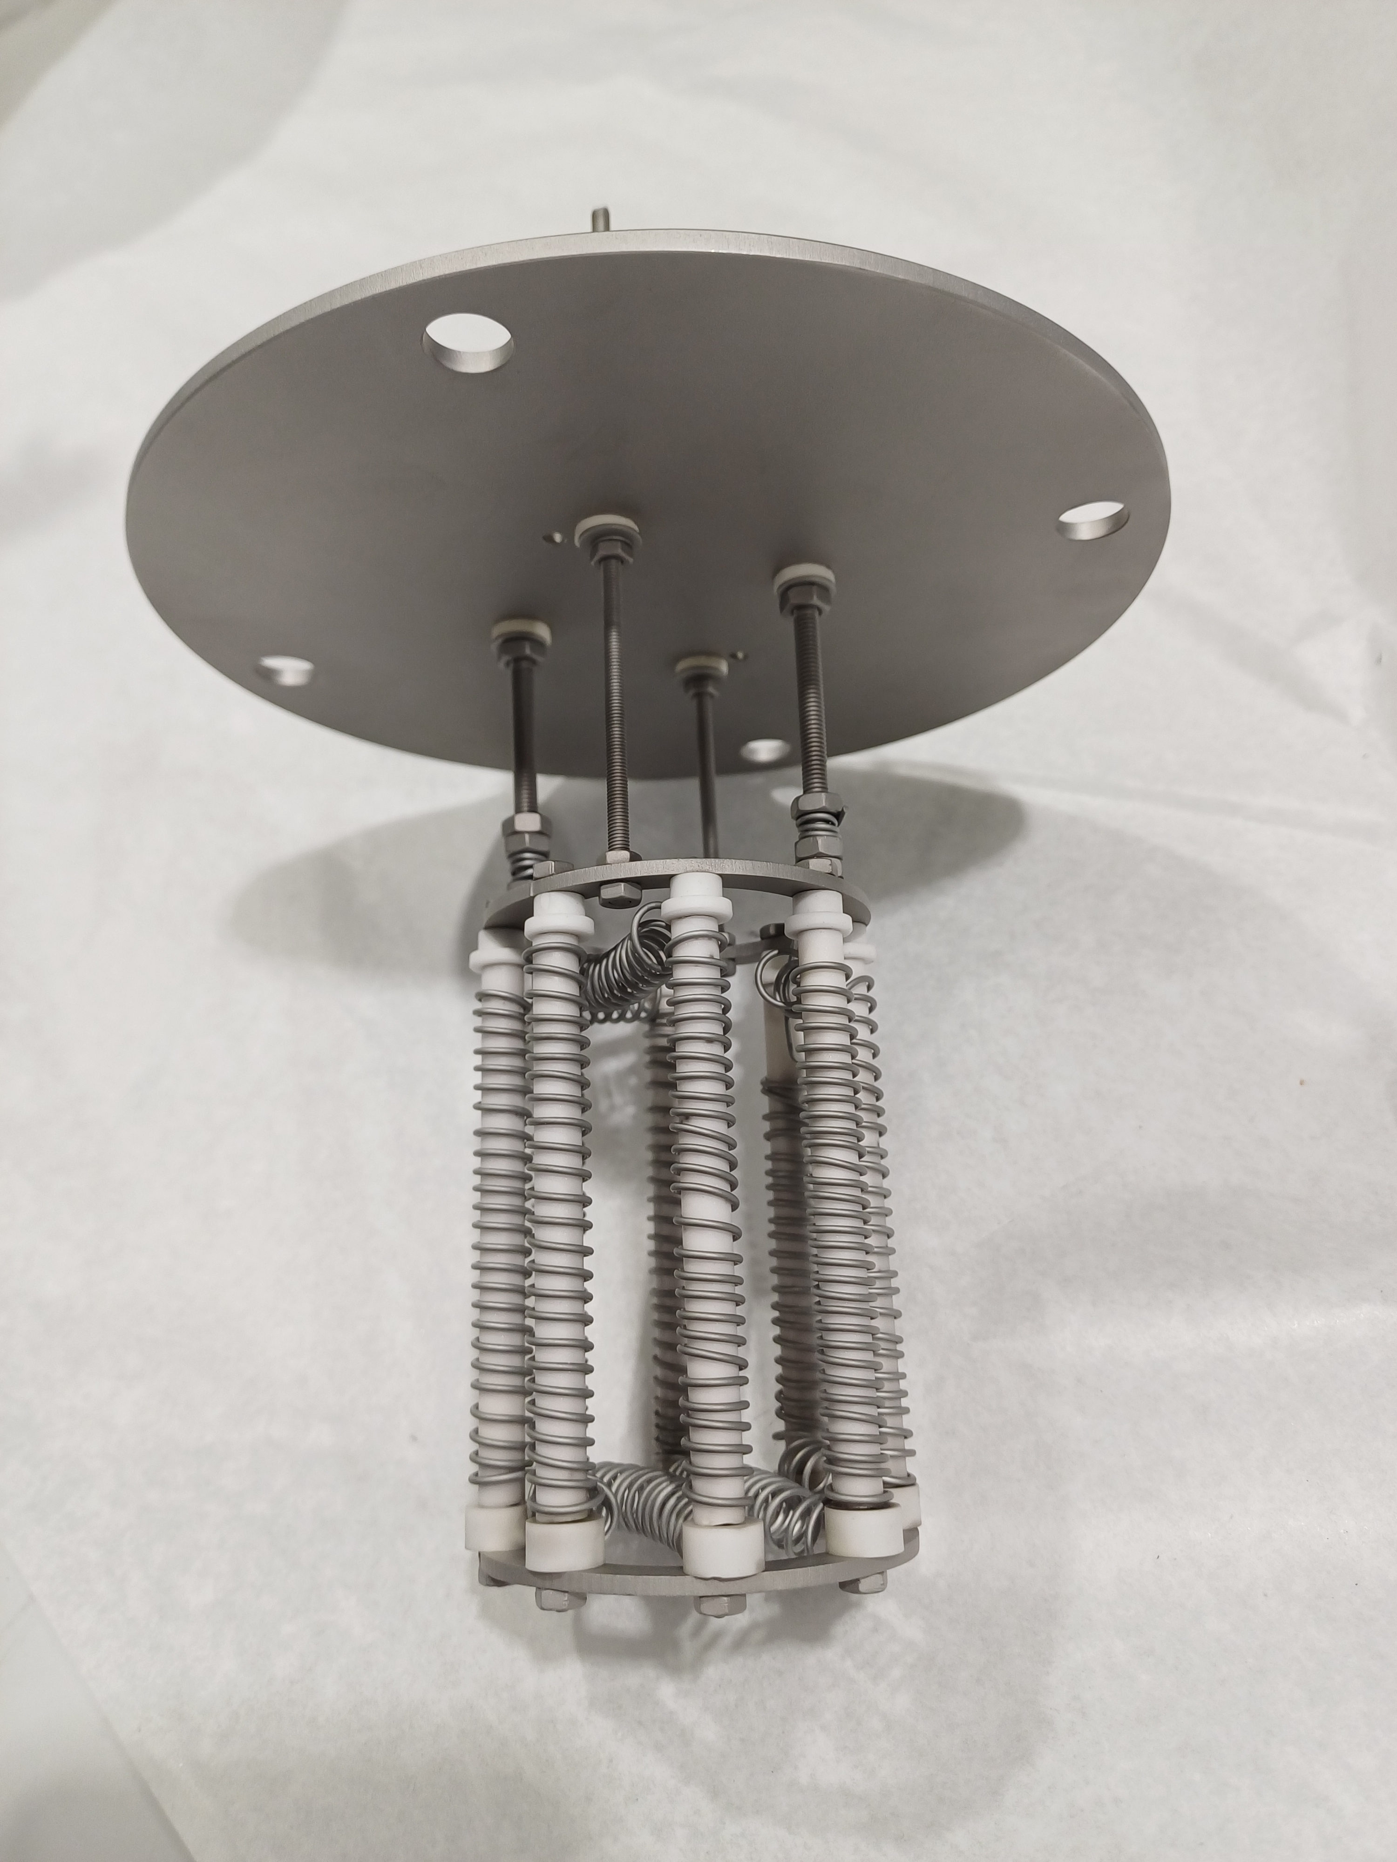
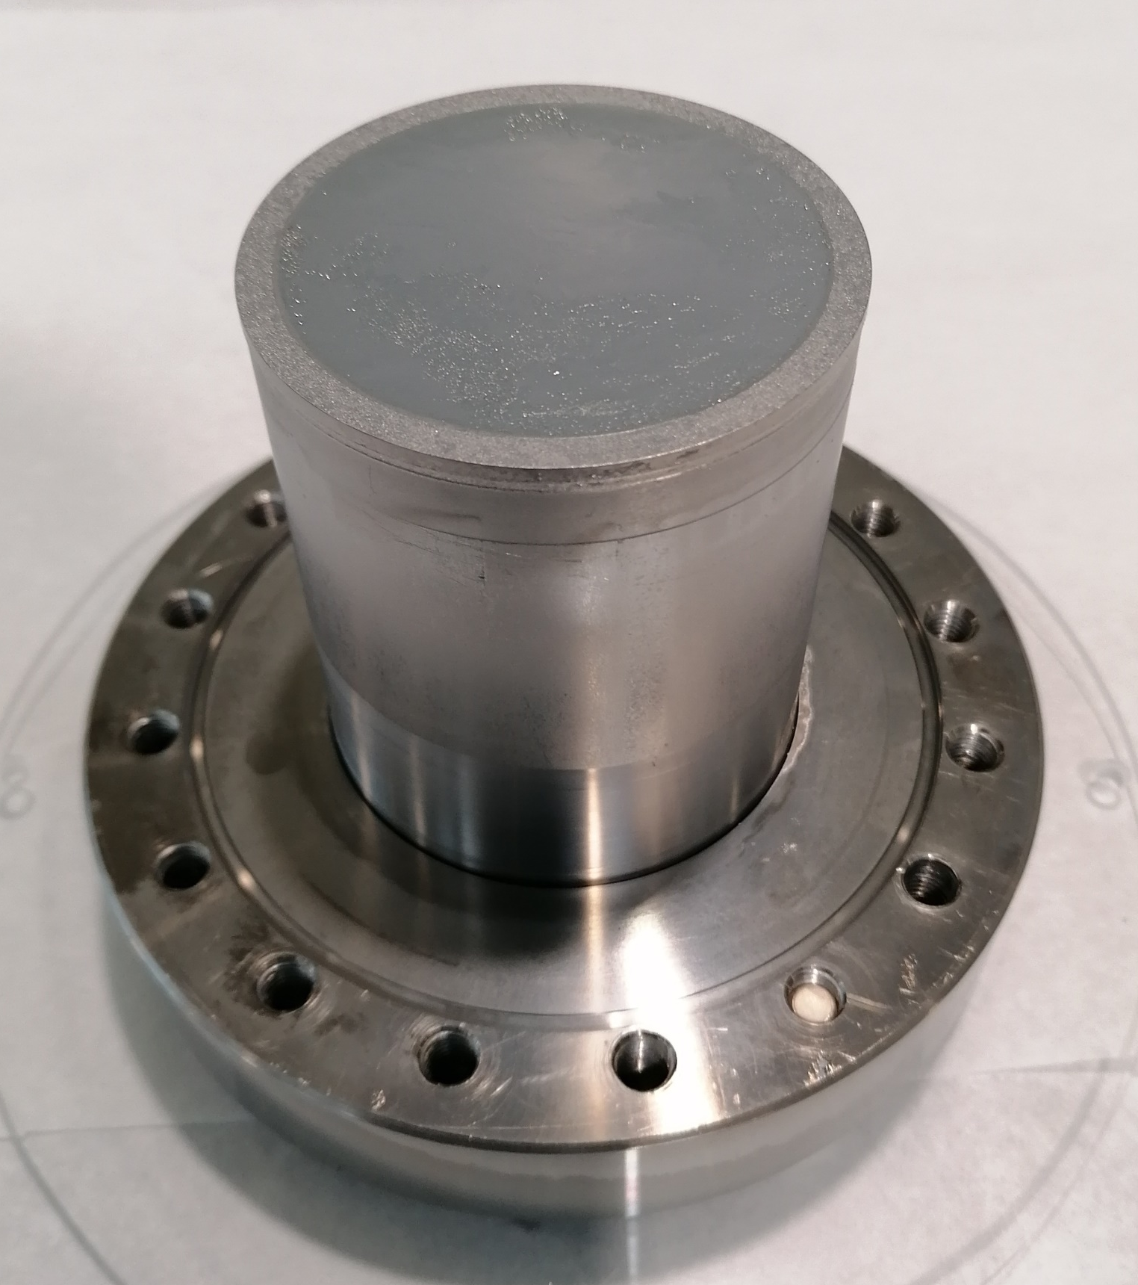
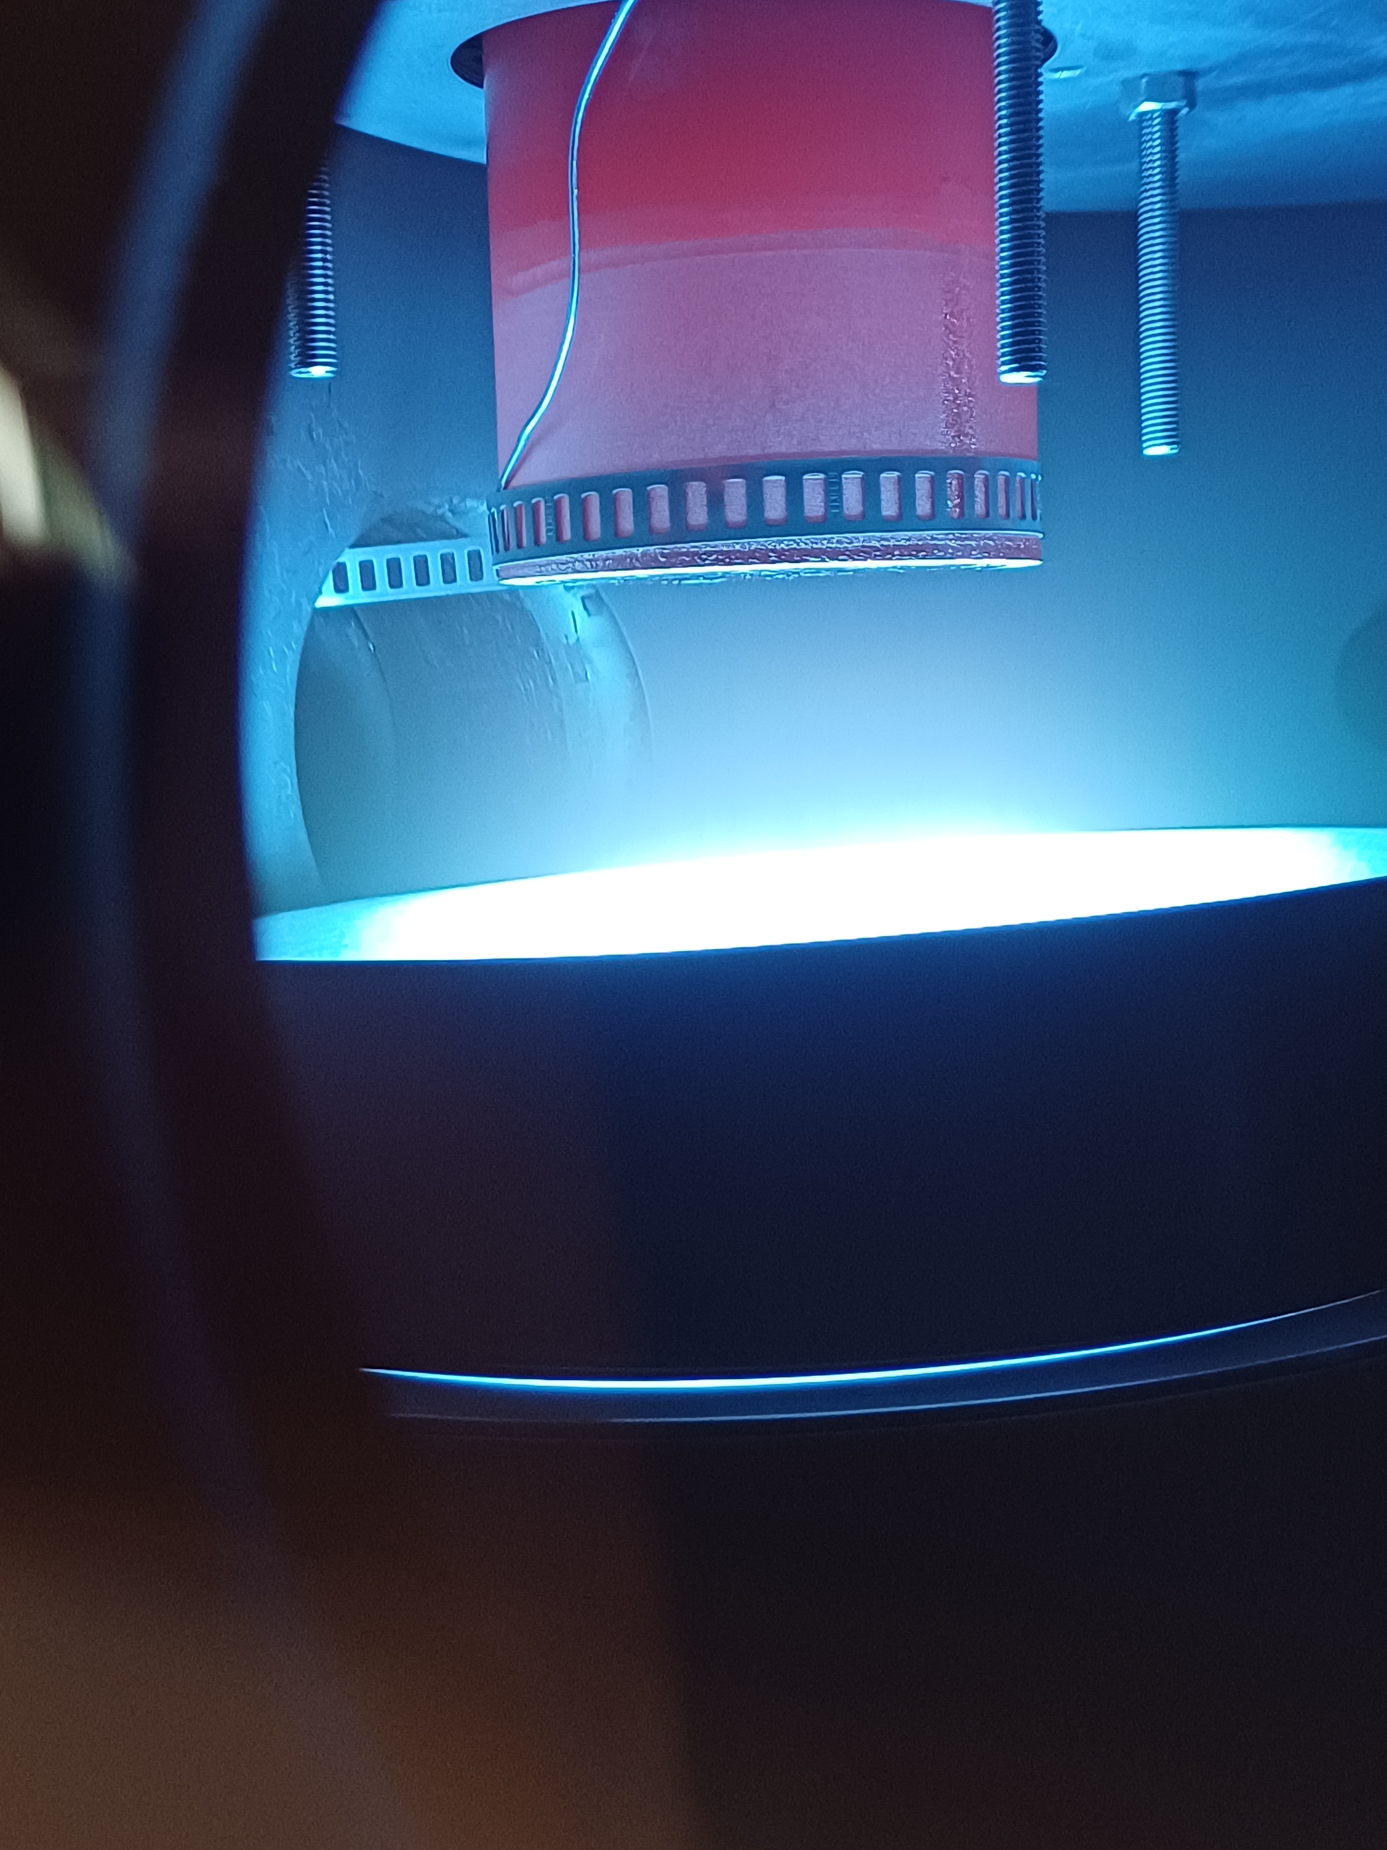
Recipe fine tuning with QPRs
QPR = Quadrupole resonator:
  Flat object as close as possible to a cavity
  For thin films RF characterization
  Allows to quantify Rs
Before Dep
During Dep
After Dep

Slide 14
Recipe fine tuning with QPRs
Comparison with Nb/Cu layers:

Slide 15
Recipe fine tuning with QPRs
Comparison with Nb/Cu layers:

Slide 16
Recipe fine tuning with QPRs
Comparison with Nb/Cu layers:

Slide 17
Recipe fine tuning with QPRs
Comparison with Nb/Cu layers:
  Significant improvements these past 2 years
  Rs 2-3 times lower for Nb₃Sn vs Nb !!!!
41nΩ
14nΩ
Notes:
Cohérence

Slide 18
Recipe fine tuning with QPRs
Comparison with Nb/Cu layers:
  Significant improvements these past 2 years
  Rs 2-3 times lower for Nb₃Sn vs Nb !!!!
Extrapolation to cavity:
  Better performance than Nb/Cu cavities
  On the right way towards FCC requirements
Constant dev to even higher perfs:
  Substrate material and preparation
  Coating adjustments
FCC ee
1cell
First validation for cavity application
Notes:
Estimation FCC ajustée aux facteurs LHC

Slide 19
Outline
Introduction: Why Nb₃Sn
Nb₃Sn on small sample for development
QPR for fine tuning
Towards first cavity depositions
Conclusion

Slide 20
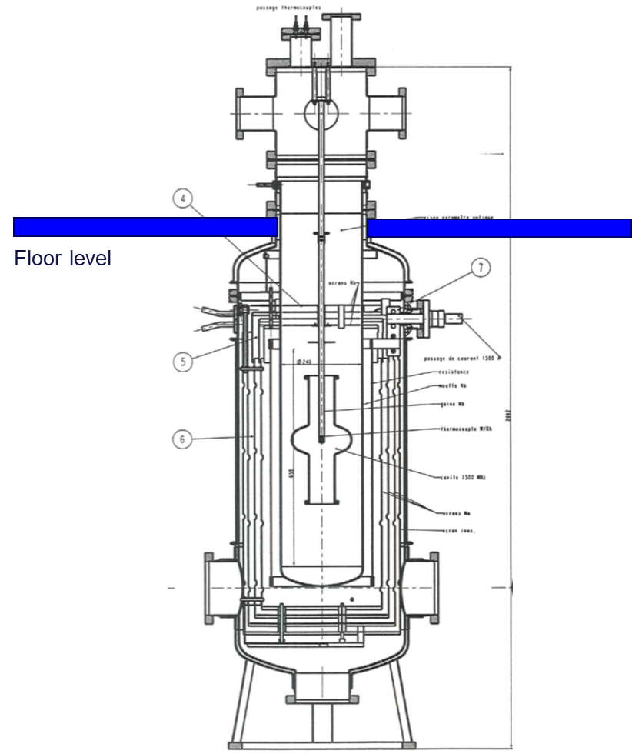
Towards cavity coating: Requirements
High temperature deposition (750C):
  Requires large furnace
  Cu cavities must be upgraded:
    Increased cavity thickness
    Rigid support structure inside the furnace ?
    Alternative materials?
Dia. 500mm

Slide 21
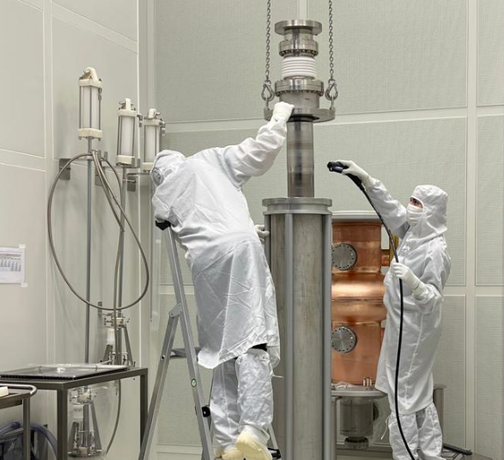
Towards cavity coating: Requirements
High temperature deposition (750C):
  Requires large furnace
  Cu cavities must be upgraded:
    Increased cavity thickness
    Rigid support structure inside the furnace ?
    Alternative materials?
Nb₃Sn target ideal geometry:
  Hollow and cylindrical (like Nb or Ta targets)
  Advantages:
    Use our long-term experience
    Allows for vertical coating
    Avoid cavity rotation required by flat target
Dia. 500mm

Slide 22
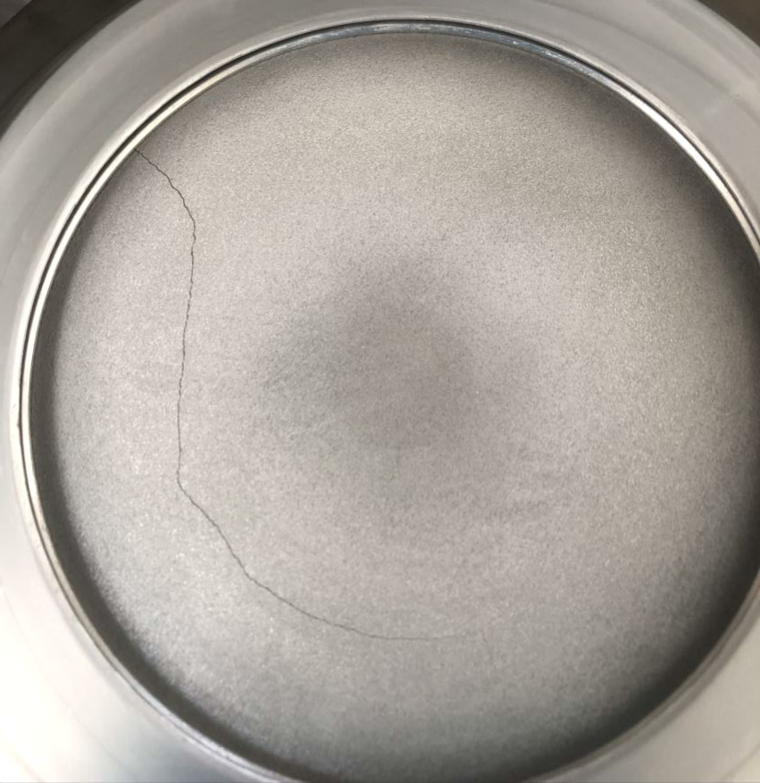
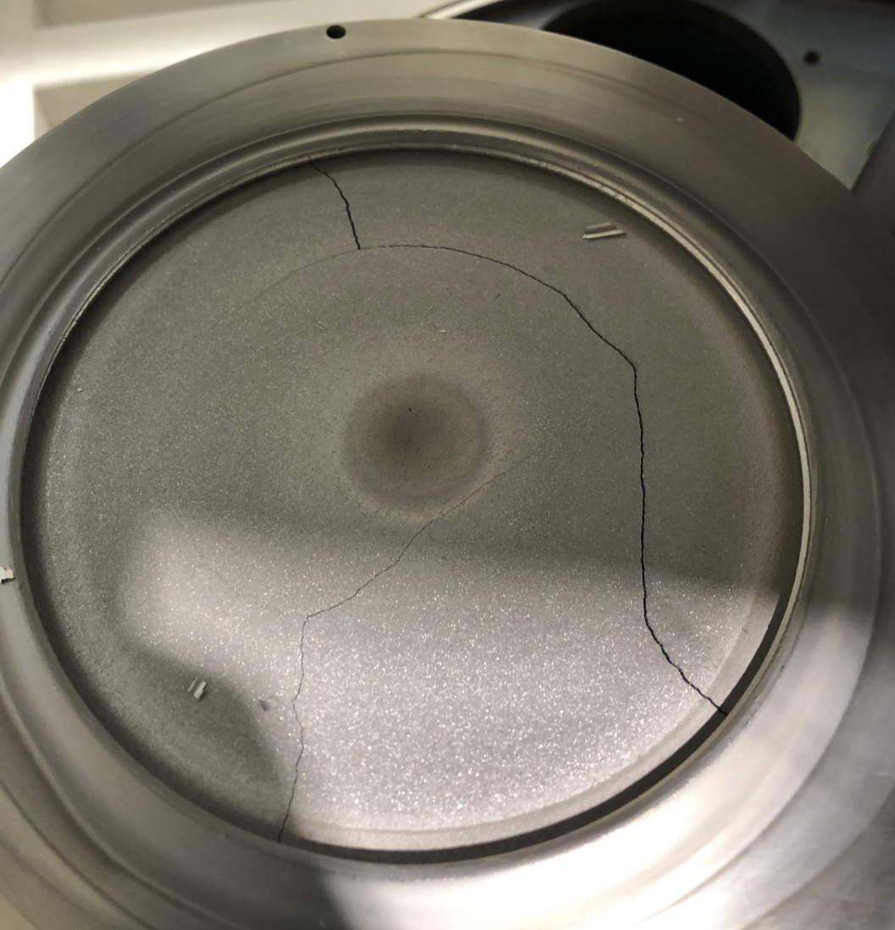
Towards cavity coating: Limitation
Nb3Sn target specifications:
  Alloyed target
  Limitation to 2 targets:
    One for diffusion barrier layer
    One for Nb₃Sn
Nb3Sn target undesired properties:
  Fragile and prompt to cracking
  Dust creation
  Not compatible with cylindrical shapes
Root cause identification:
  Thermal cycles, power ramp rate, max power
  The cracking is unavoidable
1 Coating
10 Coatings
Dia. 500mm

Slide 23
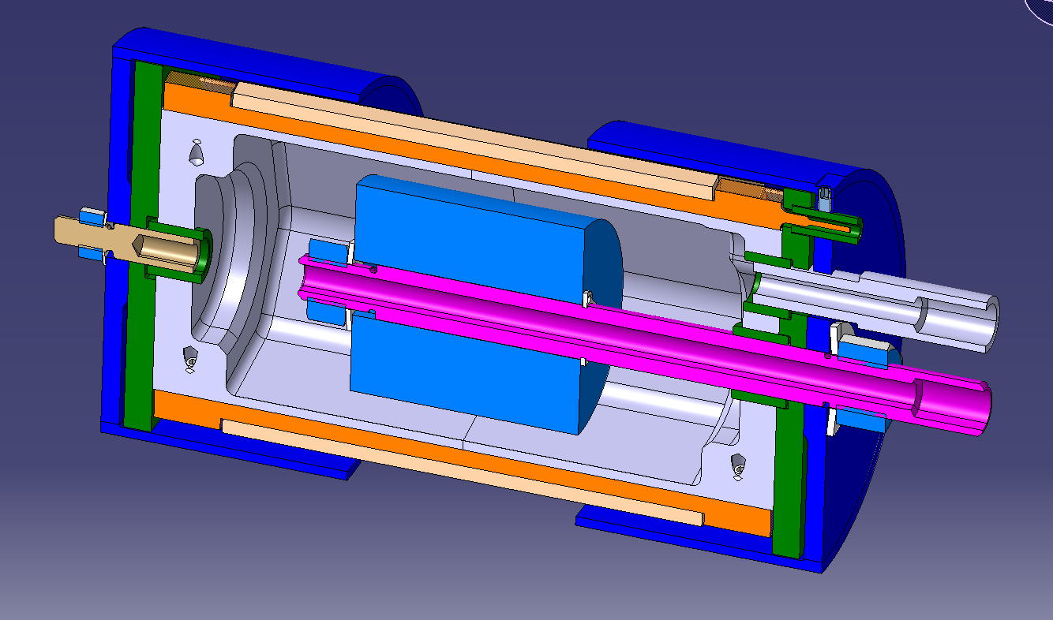
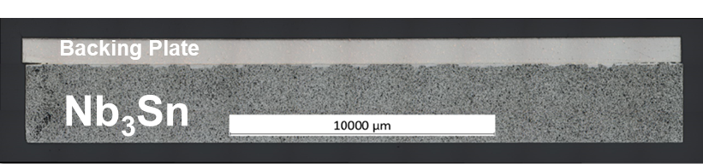
Towards cavity coating: Solution
G. Girod (EN-MME)
Most promising solution:
  Bonding on backing plate
  BP made of CuW (same CTE as Nb₃Sn)
First tests on small target:
  Positive on Ø 20mm target
  Ongoing for Ø 50mm target (then 150mm)
New magnetron design:
  Grounded magnet and dark space shields
  Cooling liquid bath for:
    Magnet
    Target through BP
80mm
Dia. 500mm
V. Sibue and M. Crouvizier (EN-MME)

Slide 24
Conclusions
Big improvements have been made with the Nb₃Sn/Cu technology :
  Confirmation of Nb₃Sn coating repeatability
  RF performances higher than Nb/cu cavities
  Very promising for FCC
First cavity coating system designs:
  Nb₃Sn bonding on CuW is very promising to mitigate target breaking
  Allows for polyedric target → deposition system as close as possible to well known settings
Future developments:
  Complete target survival tests with larger targets
  Studies on QPR :
    Coating improvements
    Flux trap, thermal gradient effect
  Nb₃Sn coating on CuW

Slide 25
Thank you for your attention

