Slide 1

Introduction to the
DRD3 WG2 session
Anna Macchiolo (UZH)
Alessandro Tricoli (BNL)
Martin van Beuzekom (Nikhef)
DRD3 Workshop, Amsterdam, 2025-06-04

Slide 2
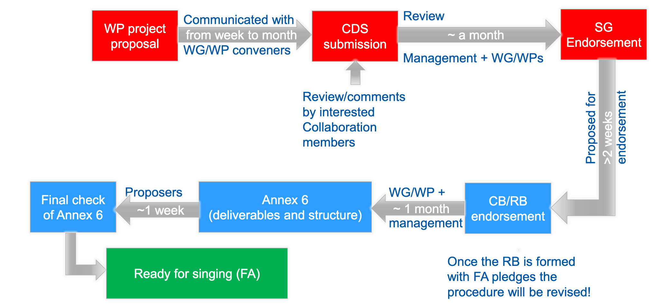
Project proposals and MoU preparation
TCT set-up
DRD3 Week, June 2025, Amsterdam

Slide 3
Project proposals and MoU preparation
5 Projects to be included in this round of MoU Annex 7, all with a CDS entry in the dedicated DRD3 CDS page
    Development of TI-LGADs
    Development of Ultra Fast-Time Low Mass Tracking Detectors
    Novel silicon 3-D trench pixel detectors on 8 inch CMOS process
    LGAD based timing tracker development for future electron collider
    Development of very small pitch, ultra rad-hard 3D sensors for tracking + timing applications at FBK
Short presentations for each project in this session, with a summary of the scientific program
Approval during CB today
  A draft of the WG2 section of Annex7 already exists. After approval, we aim to build common deliverables for Annex7 based on characterization for projects related to the same technological area
Other WG2 project proposals, already presented in DRD3, are warmly invited to upload the drafts of the scientific proposals to the CDS page, to start the approval procedure
TCT set-up
DRD3 Week, June 2025, Amsterdam

Slide 4
List of Proposed Projects
Development of TI-LGADs for 4D Tracking
  Contact: Anna Macchiolo (Anna.Macchiolo@cern.ch)
Novel silicon 3D-trench pixel detectors based on 8-inch CMOS process
  Contact: Manwen Liu (liumanwen@ime.ac.cn)
Development of Ultra Fast-Time Low Mass Tracking Detectors
  Contacts: Artur Apresyan (Artur.Apresyan@cern.ch), Koji Nakamura, (Koji.Nakamura@cern.ch), Alessandro Tricoli (Alessandro.Tricoli@cern.ch)
LGAD based timing tracker development for future collider
  Contact: Mei Zhao (mei.zhao@cern.ch)
Development of very small pitch, ultrarad-hard 3D sensors for tracking + timing applications @ FBK
  Contact: Maurizio Boscardin (boscardi@fbk.eu), Gian Franco Dalla Betta (gianfranco.dallabetta@unitn.it)
4DRSD: 4D-tracking with Resistive Silicon Sensor
  Contact: Roberta Arcidiacono (roberta.arcidiacono@cern.ch)
Advancing the Pixelated Resistive Silicon Readout and Charge Collection Techniques
  Contact: Gaetano Barone (Gaetano.Barone@cern.ch)
Characterizing the Environmental Operational Envelope of Timing and Resistive Silicon Sensors
  Contact: Gaetano Barone (Gaetano.Barone@cern.ch)
ASIC Development for Timing Measurements using LGAD Sensors for CMS Tracker phase III
  Contact: Abderrahmane Ghimouz (abderrahmane.ghimouz@cern.ch)
NEUROPIX: A neuromorphic computing framework for pixelated detector data processing
  Contact: Mathieu Benoit (benoitm@ornl.gov)
OPTIMA, a board dedicated to Optimized Precision Timing for Multichannel Acquisition
  Contact: Federico de Benedetti (federico.de.benedetti@cern.ch)
LGAD and 3D technology at the IMB-CNM
  Contact: Neil Moffat (neil.moffat@cern.ch)
Fast 3D Sensors
  Contact: Ulrich Parzefall (Ulrich.Parzefall@cern.ch)
RD50 Common Fund Project - RD50-2023-03: Deep Junction LGAD
  Contact: Simone Mazza (simazza@ucsc.edu)
RD50 Common Fund Project - RD50-2023-09: State-of-the-art Radiation Resistant AC- coupled Resistive LGAD - RadHard AC-LGAD
  Contact: Roberta Archidiacono (roberta.arcidiacono@cern.ch)
To be included in MoU Annex 7
DRD3 WG2 Meeting, 2025-3-25

Slide 5
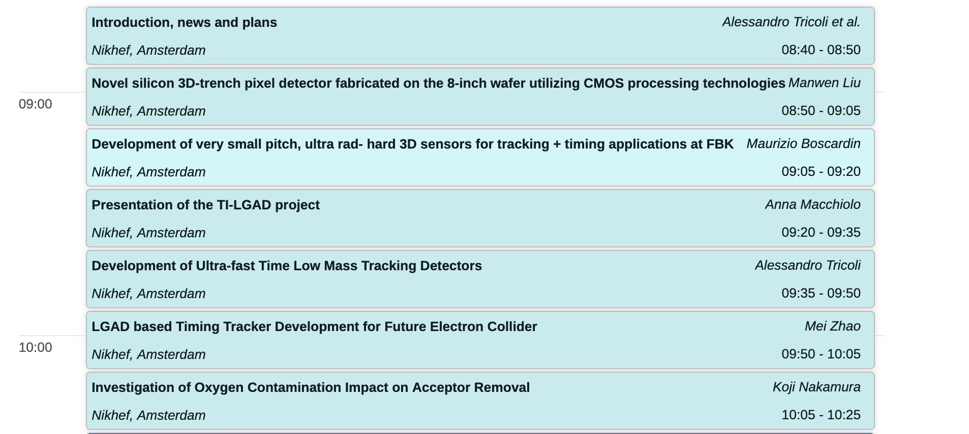
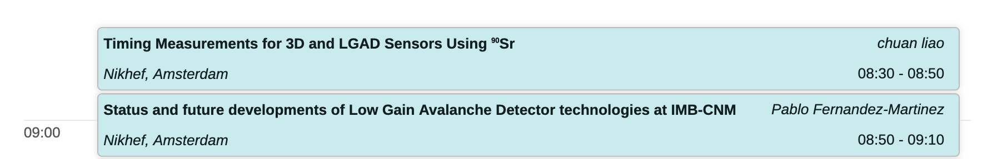
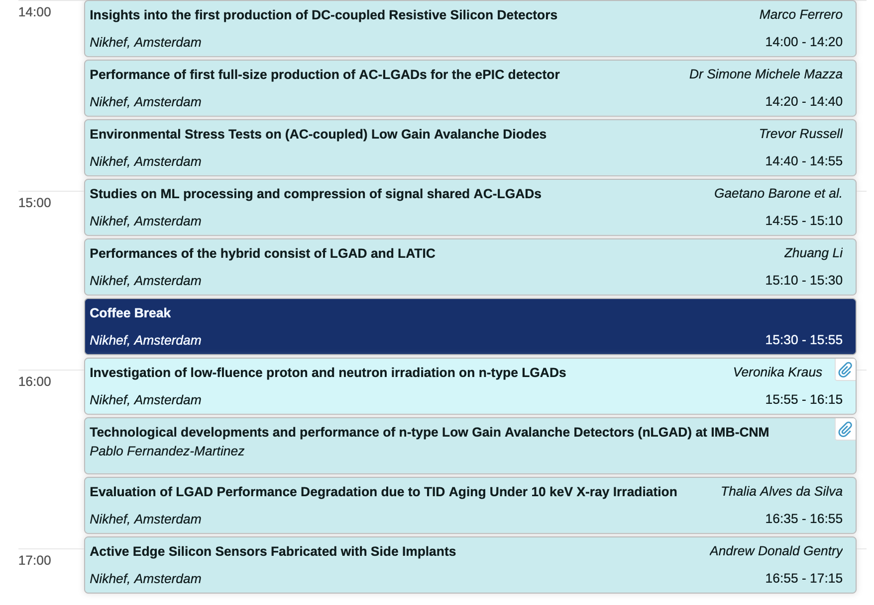
WG2 Agenda
Wednesday
Thursday
Projects in approval
LUNCH

