Slide 1
Simulations studies of 3D detectors with gain
G. Kramberger, B. Hiti, I. Mandić, I. Velkovska
Jožef Stefan Institute
work performed within the Novel silicon 3D-trench pixel detectors based on 8-inch CMOS process (WP2 project)

Slide 2
Motivation
Utilizing the gain in silicon (and possibly SiC) detectors has been the key advancement in tracking detectors opening possibility of real 4D tracking with planar devices.
The gain is achieved with fine tuning of gain layer
Implementation of gain is now ongoing in several CMOS projects (CASSIA, ARCADIA, …)
What about 3D detectors? The doping of columns of 3D detectors is almost impossible to control with the required precision. Marriage of 3D and LGAD of therefore almost impossible
Improvement of aspect ratio to 100:1 allows manufacturing of very narrow columns <1 μm which can be seen as proportional wire counter. The questions are:
  Can electric field high enough be achieved by “field focusing” rather than gradient of doping?
  Is it possible to dope the columns with profile that is narrow enough to assure that field focusing allows gain?
  How can such device be realized and what would be the consequences of the standard single sided “not full through columns processing” on device performance?
doping profile
How to dope as narrowly as possible to minimize the effective width of the column,
The field depends as
E~1/r
Can we progress from “solid state ionization chamber” to semiconductor “wire proportional chamber”?

Slide 3
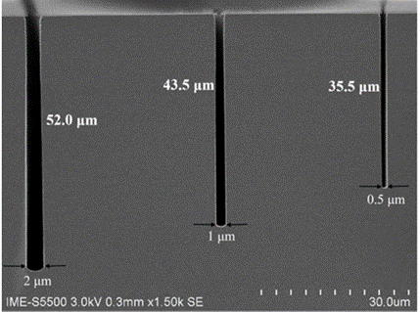
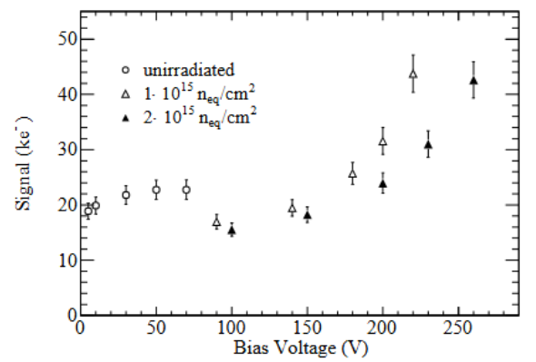
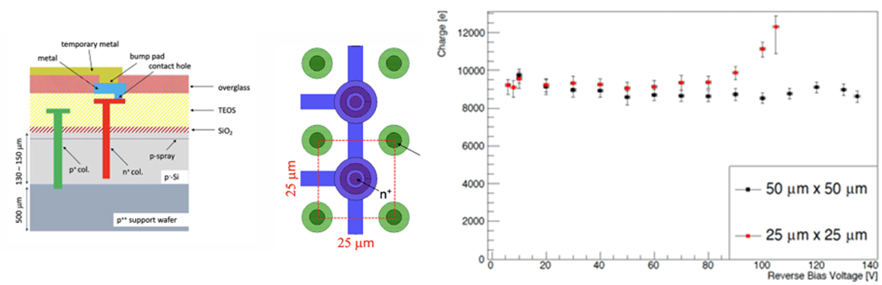
Small pitch narrow – column/trench sensors
Simulation of structures for particle physics experiments with gain (multiplication) due to high fields caused by field focusing
We would like to understand the performance of such devices
Simulations were/will be tailored to 8” process of IME which has demonstrated the aspect ration of ~100:1.
KDetSim software was used to:
  Calculate the electric and weighting field
  Perform the drift of mip particle and calculate the induced charge.
To account for the effects of the weighting field larger cell – including the neighbouring pixels was simulated in addition.
Novel silicon 3D-trench pixel detectors based on 8-inch CMOS process (IME)
WP2 project
IME capability – aspect ratio
Gain region close to electrodes!
GAIN in 3D is not new (very small cell and/or very high N_{eff})
FBK results
M. Koehler PhD. thesis, Uni. Freiburg

Slide 4
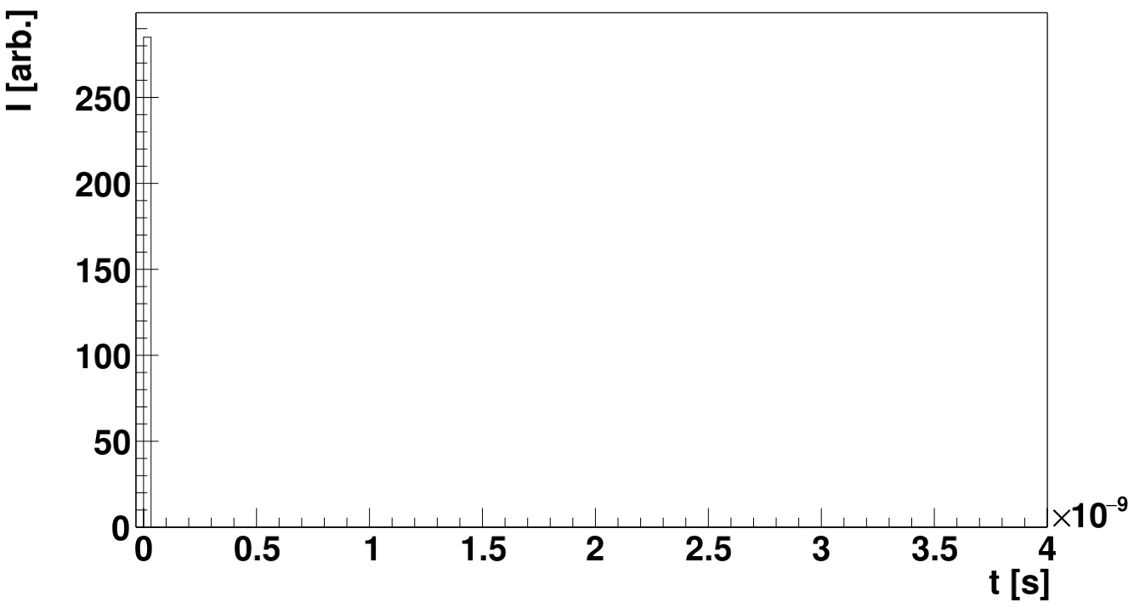
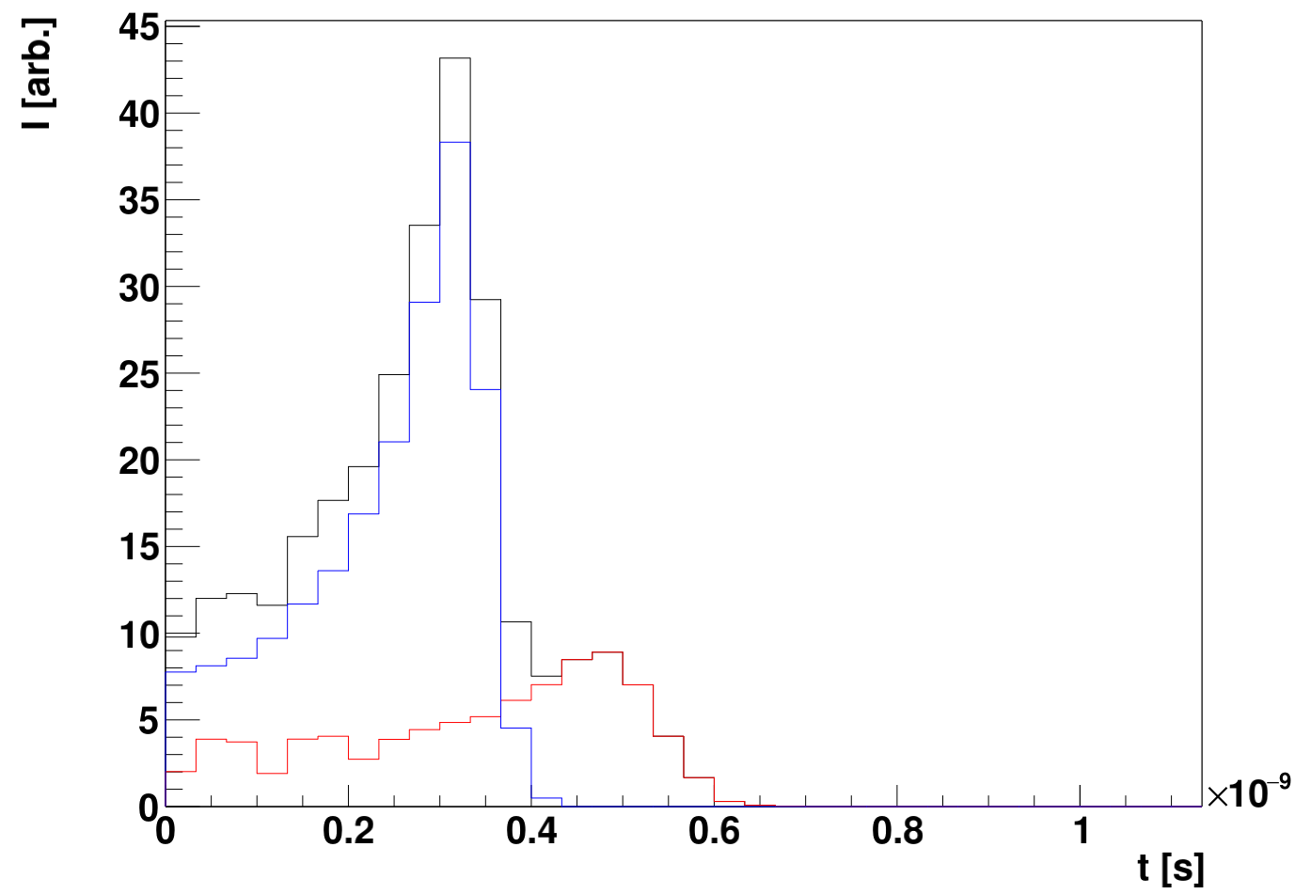
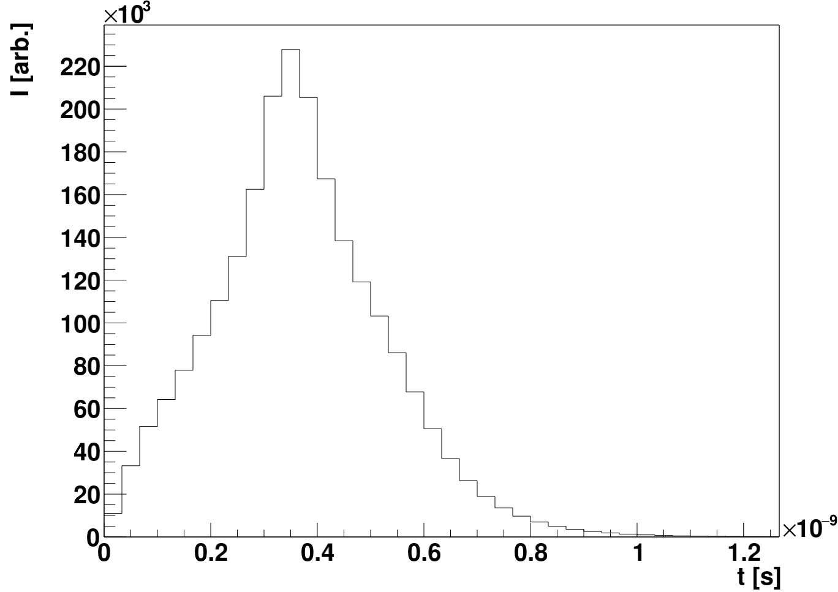
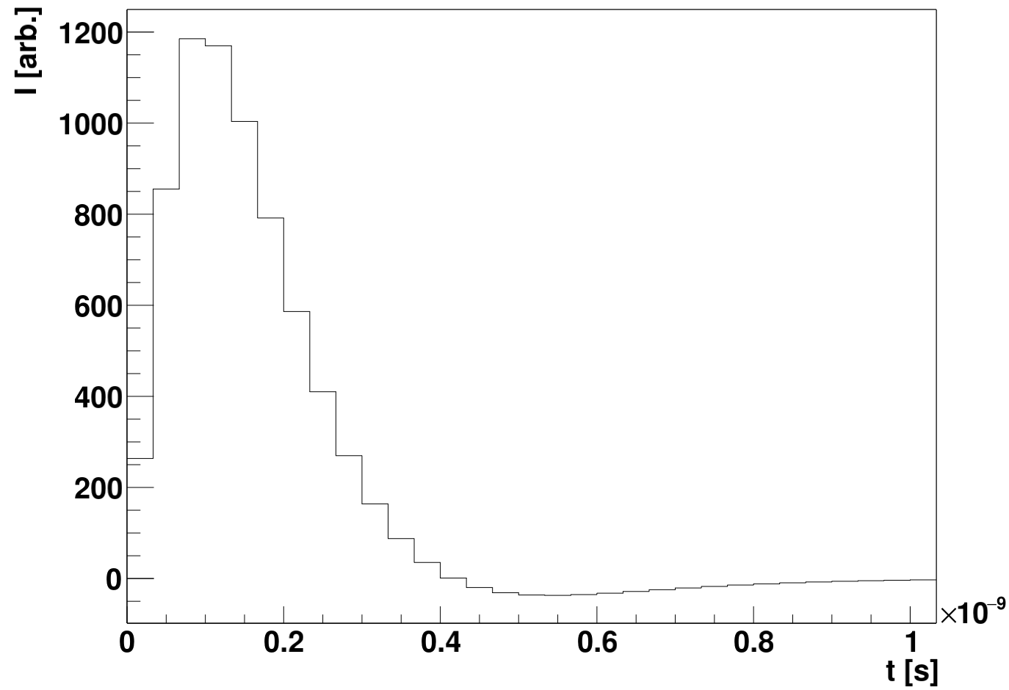
Signal simulation
“Imaginary transfer function” – something that integrates as long as the drift takes – similar rise time as recent ASICs (e. g. ALTIROC)
Simulations show some, but not significant, dependence of ToA spread on the choice of the transfer function with rise time of around 500 ps – 1 ns.
Holes
Electrons
Total
Response to a “dirac” pulse
CFD 25%
ToA

Slide 5
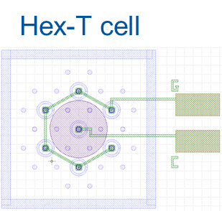
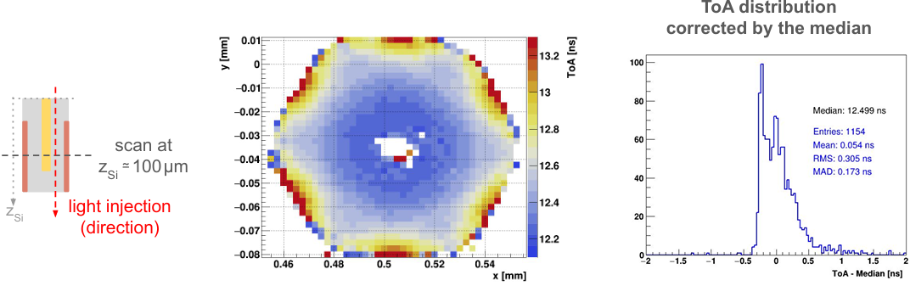
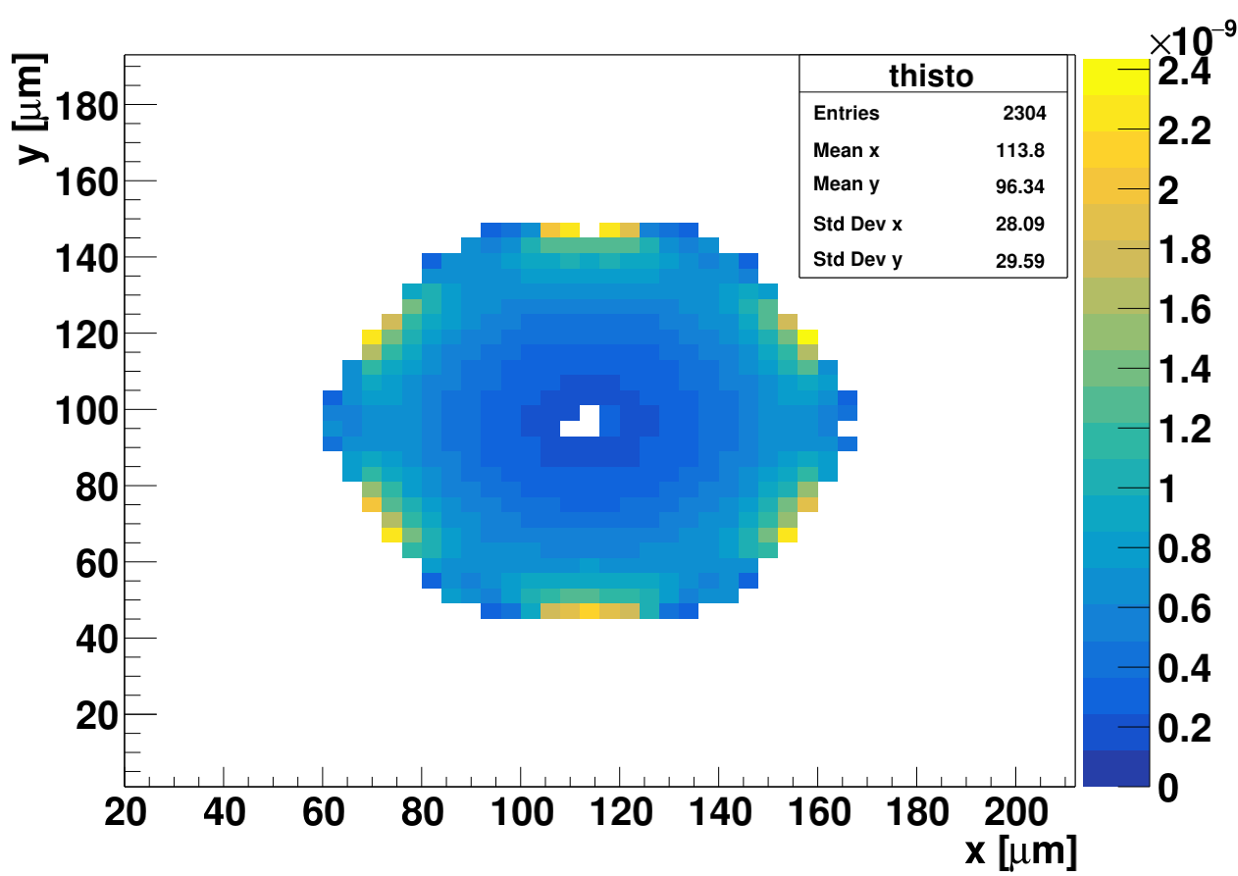
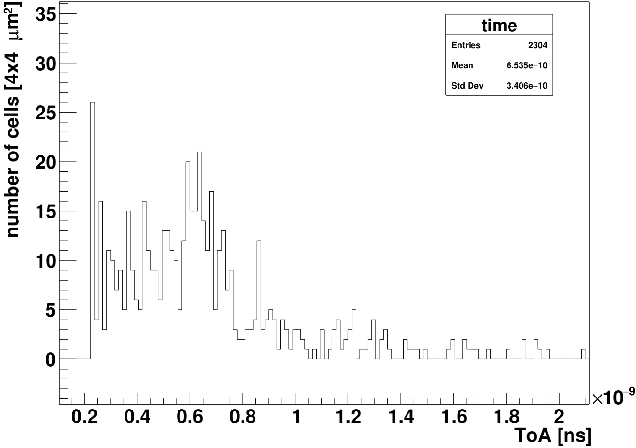
Simulation verification – TPA comparison
RD50-3D timing run
samples
IFCA data, presented at TREDI workshop
20V
Assumptions:
electronics with 500-600 ps peaking time
10 μm “cigar” shape of TPA in z and 1.5 μm in xy
p-type isolation not yet implemented (no oxide charge)
Simulation - bining of the area 4x4 μm²
RMS measured 305 ps
RMS simulated 340 ps
20 V, room T
SIMULATION
SIMULATION

Slide 6
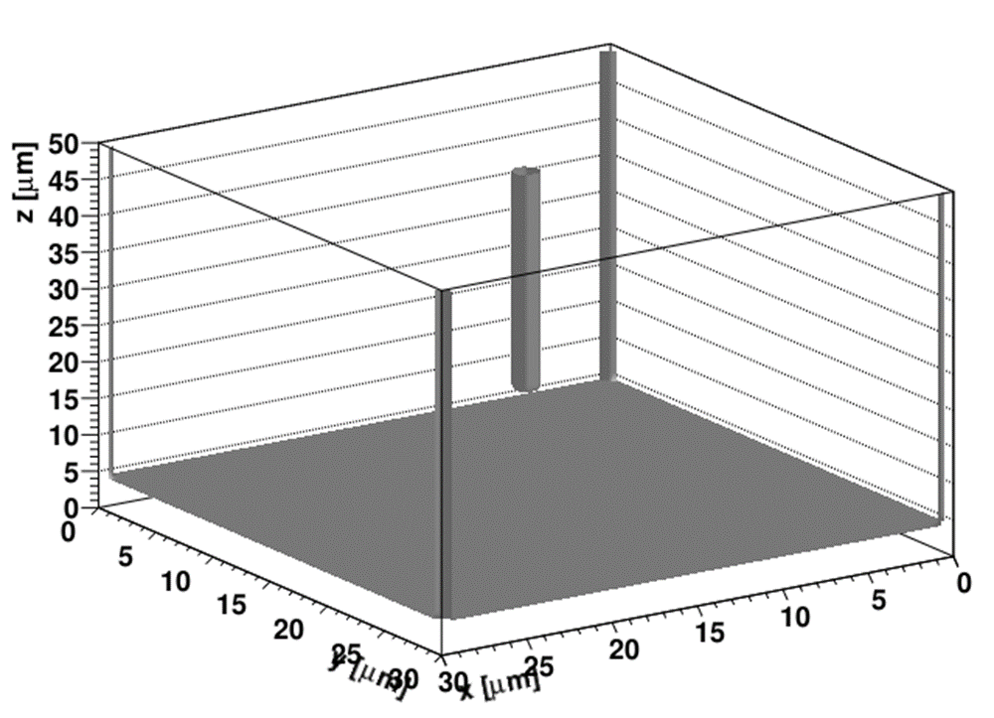
Design of the sensor – full 3D simulation
n+
p+
50 μm
p
25/30 μm
2R~1 μm
20 μm
25/30 μm
¼ of the cell, 1x1 and 2x2 cells
were simulated – depending on the meshing (up to 100 nm)
25/30 μm
Small square cell size detector was investigated
a single sided process assumed:
30x30 μm²
25x25 μm²
20 μm gap
0.5-2 μm column radius
N_{eff}=3e13-1e14 cm⁻³ doping levels
Bias voltages from 50 to 100 V, -20ºC
CFD~25% , shaping electronics with ~0.6 ns peaking time

Slide 7
Simulation of half of the HL-LHC pixel cell - 25x25 μm² cell
We get some gain, but not excessive (few times)
The gain is such that it compensates smaller signal
For thick sensors of small pitch the inclined tracks pose a problem – reducing the efficiency and time resolution
Thin small cell with gain would lead to better performance (low capacitance)
Simulated volume – 50x50 μm²
U_{w}=0
U_{w}=1
2R~1 μm
Thick 3D sensors with small pitch have several issues with angled tracks:
reduction of efficiency
worse time resolution
larger data rate
small diameter = better fill factor

Slide 8
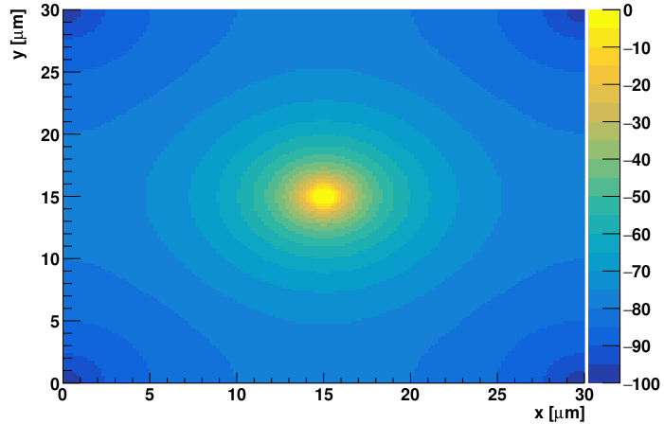
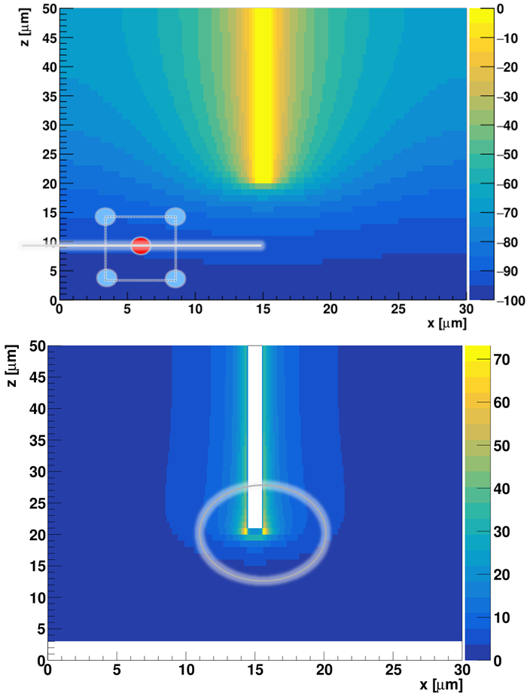
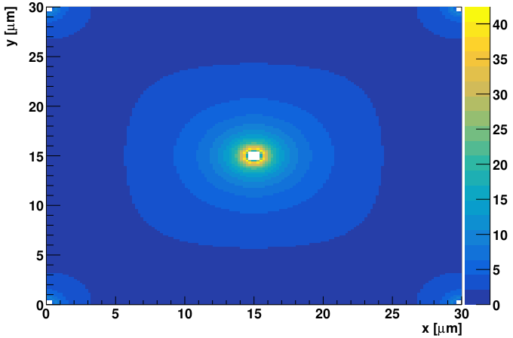
Initial studies of the electric field
U [V]
U [V]
Two problems identified
Non-rounding of the tip leads to unrealistically high electric fields – if there is no charge multiplication this has no impact on CC
We assumed very high (unrealistically narrow doping profile) of the column.
25 μm from the top
25 μm from the top
|E| [V/μm]
|E| [V/μm]
1e14 cm⁻³
1e14 cm⁻³

Slide 9
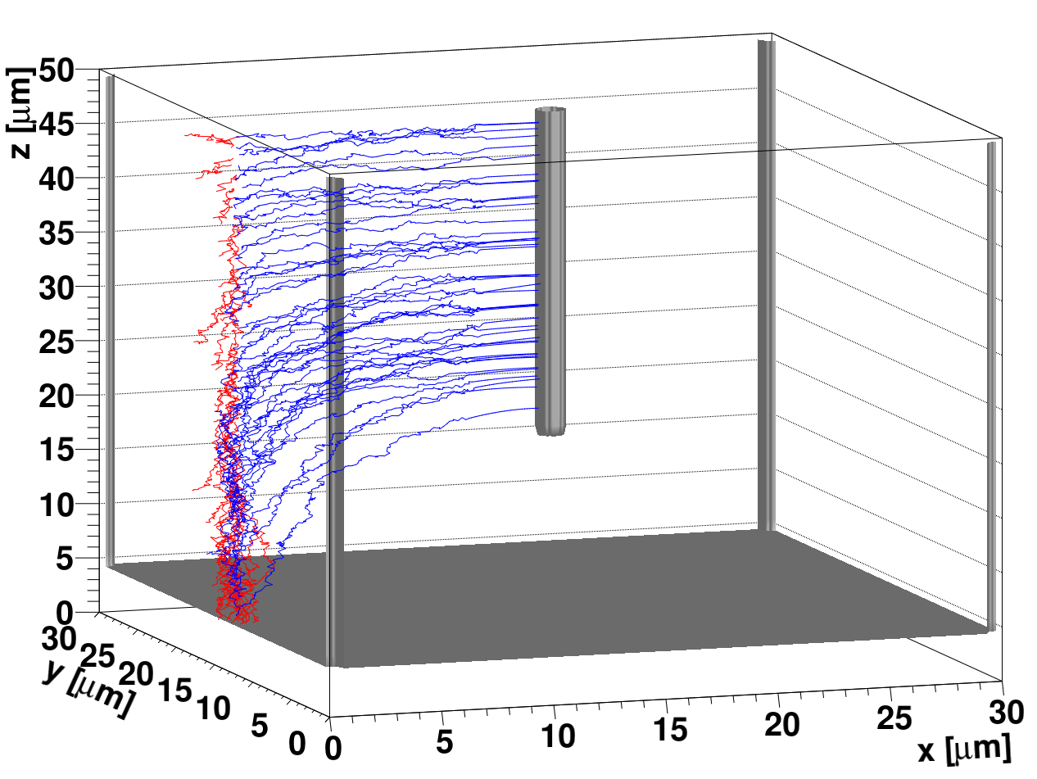
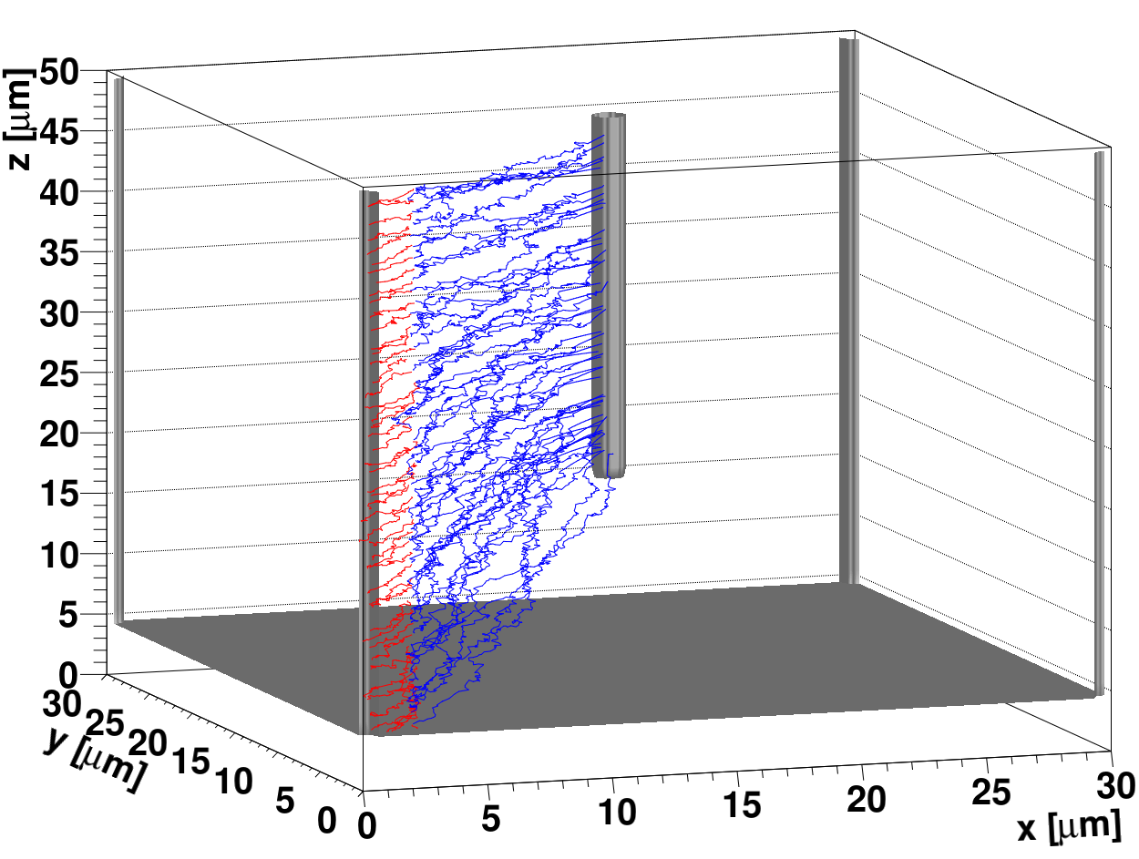
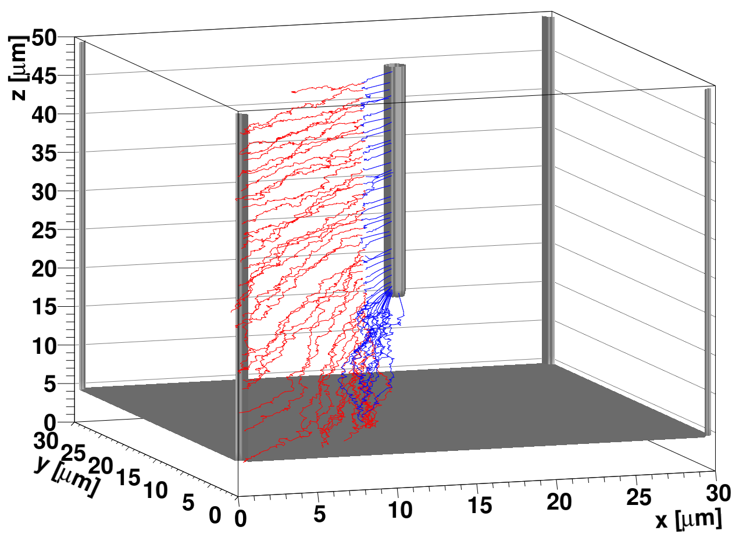
Simulated drift paths
MIP track
There is clear difference between the drift paths of primary generated carriers:
  those ending at the tip of the junction column will have a different gain due to different peak fields
  there will be an intrinsic difference in gain for tracks over the surface of the cell (different gain for different tracks – that can have an adverse effect on the timing )
How much is the distance between the back plane and the tip is a matter of optimization – break down voltage vs. gain difference vs. timing vs. the yield and processing (future work)
Using a single cell in simulations has a “wrong” weighting field – in order to calculate proper charge collection it should be large cell.

Slide 10
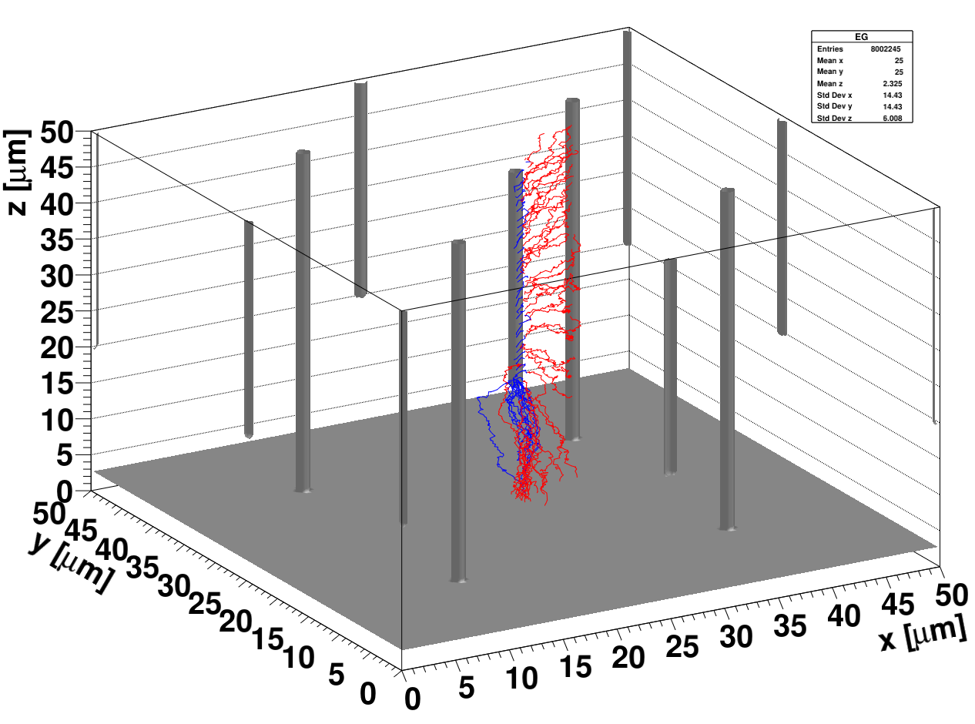
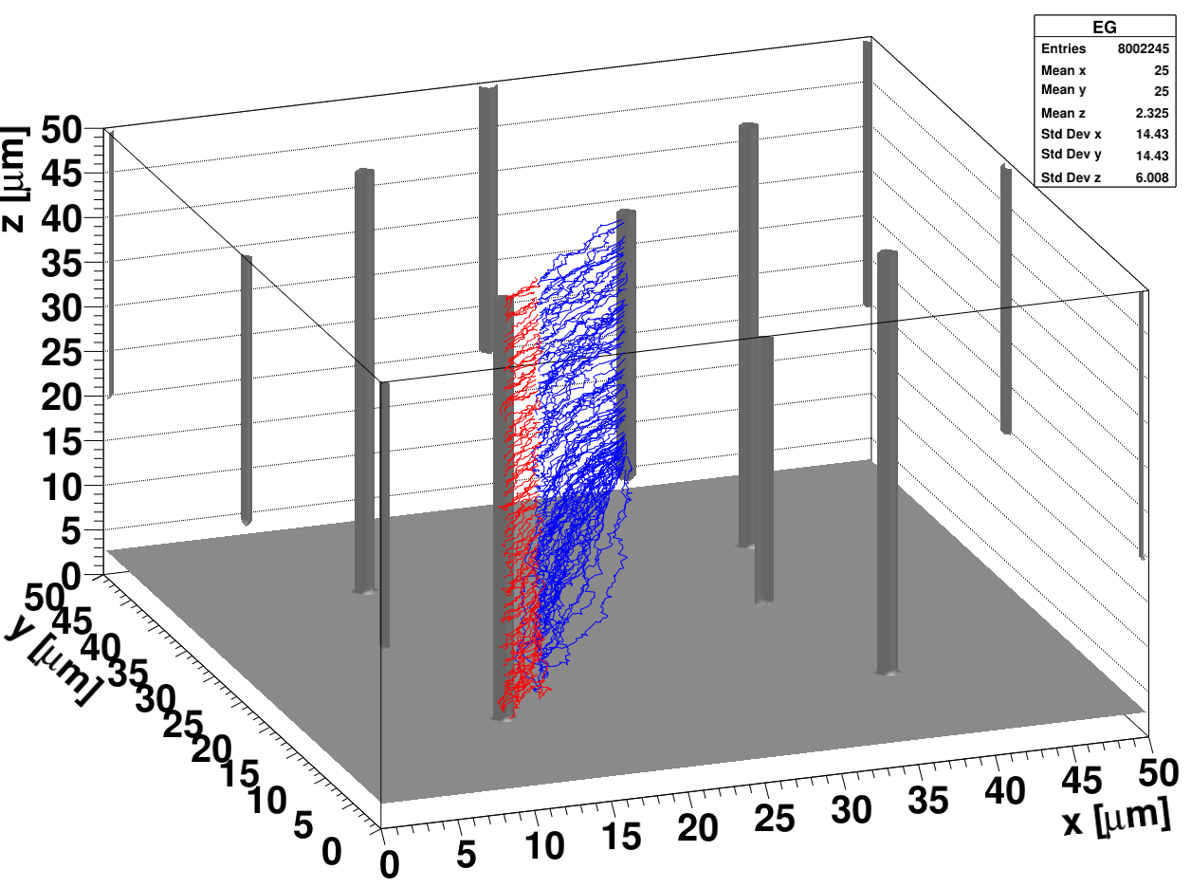
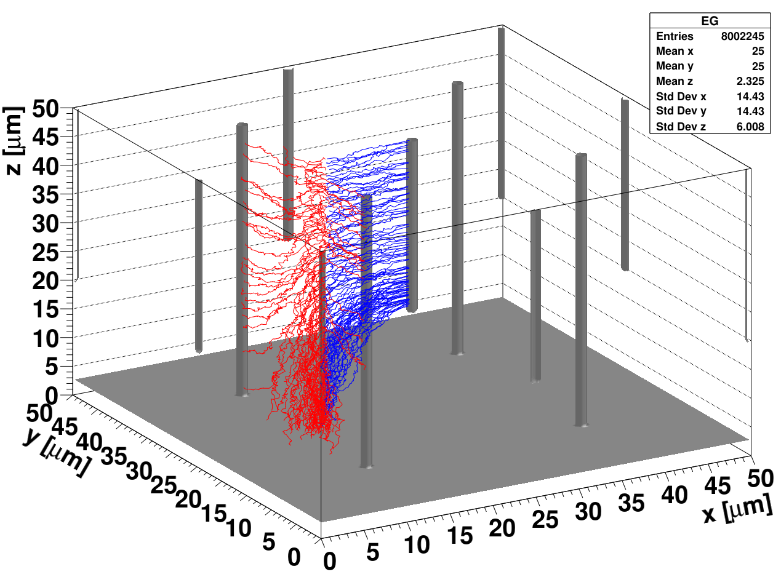
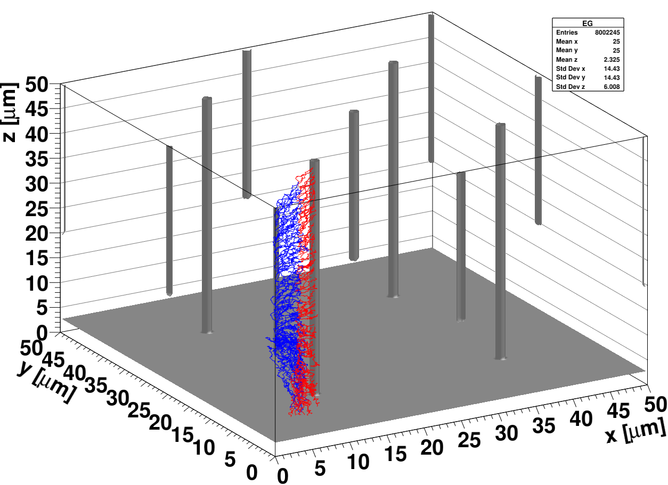
Simulation of the 25x25 μm² cell
parameters that don’t lead to bulk breakdown – gain at column peak
abrupt n+ doping
V_{bias}=70V
T=-20ºC
N_{eff}=3e13 cm⁻³
single cell
primary charges drift paths

Slide 11
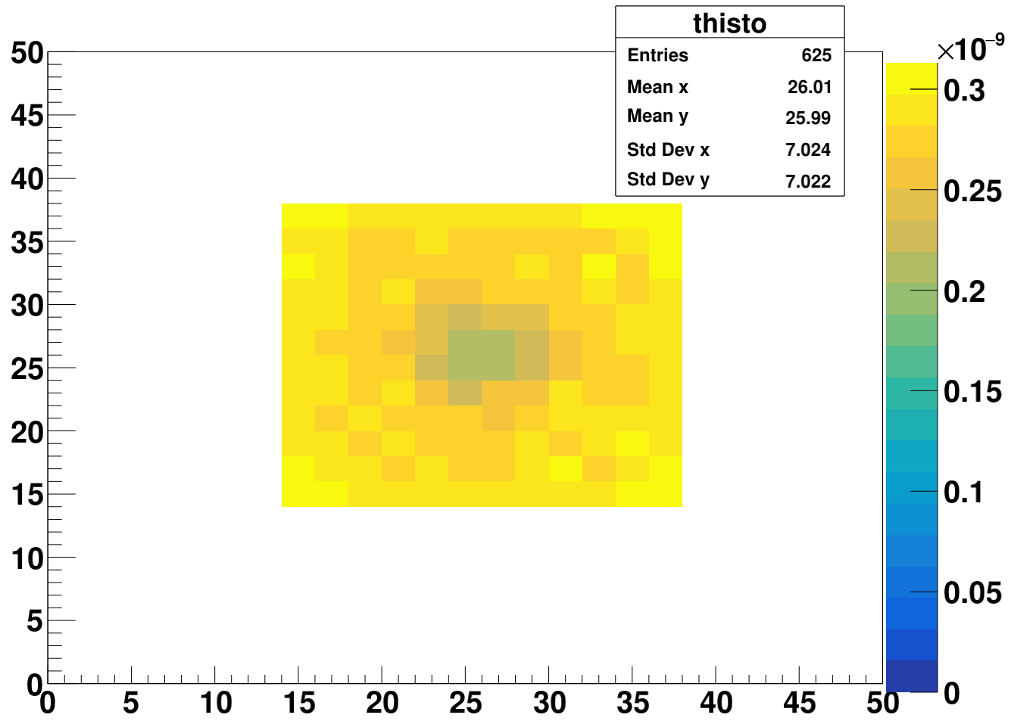
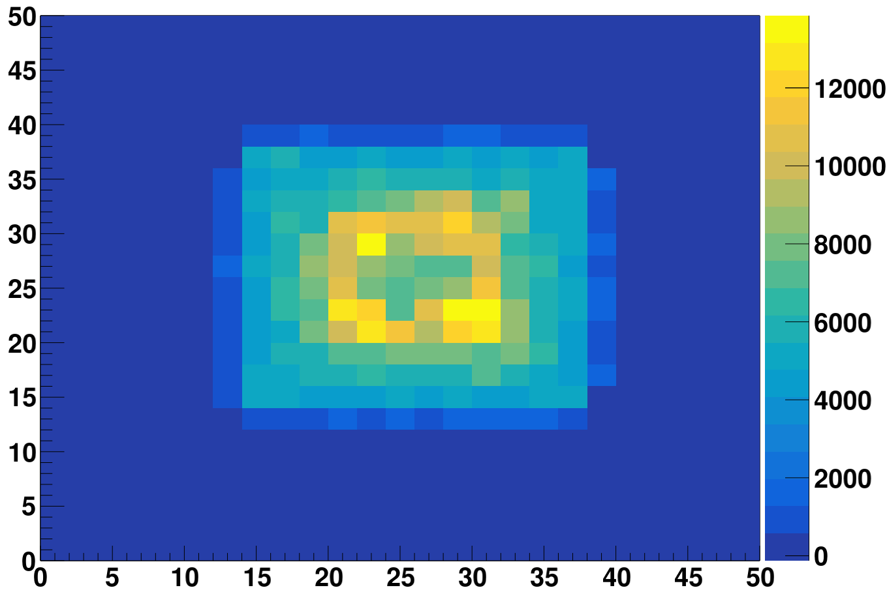
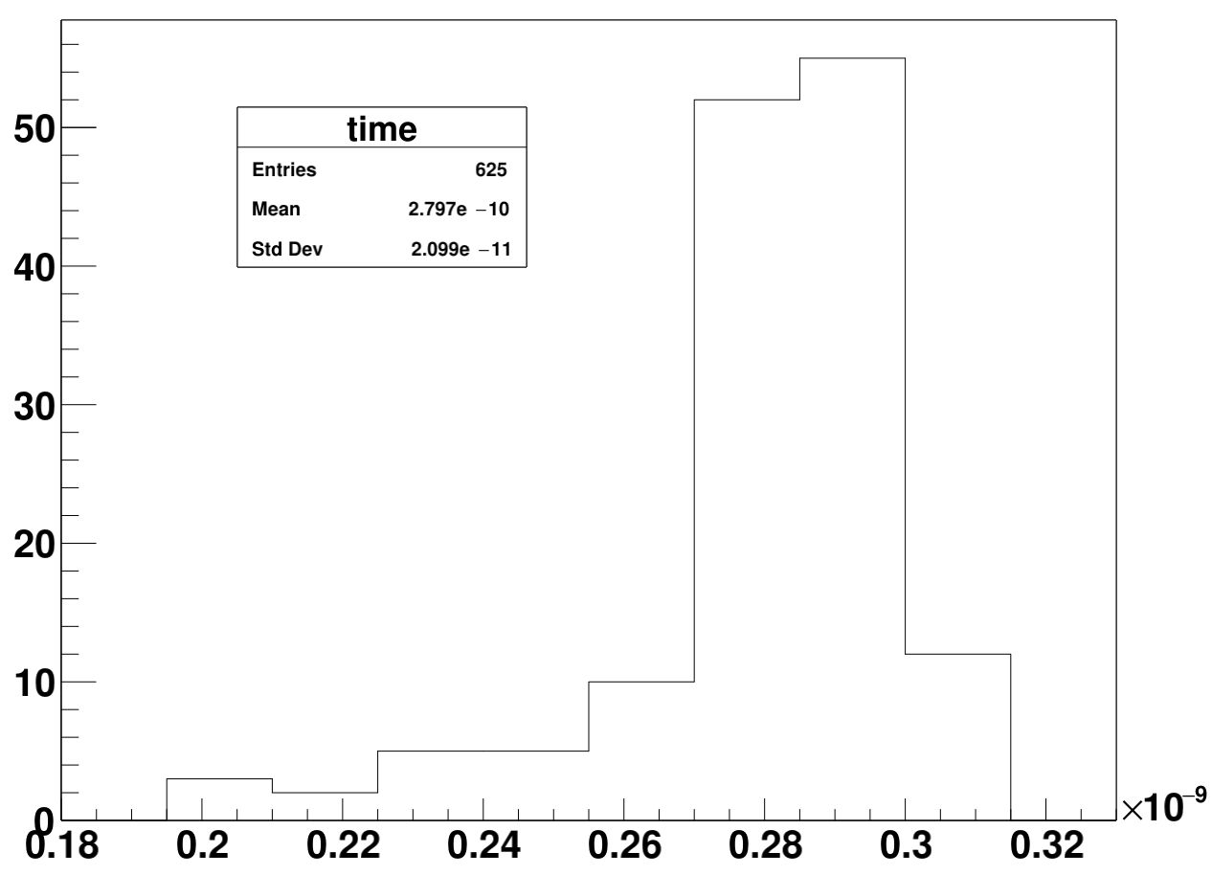
Simulation of CC and ToA
Collected charge distribution
Q [e]
ToA distribution
ToA [s]
V_{bias}=70V
T=-20ºC
N_{eff}=3e13 cm⁻³
mip deposition
~1 MIP is 3400 e, 50 μm thick 3D
Large dispersion of CC across the cell:
variation of the gain from 2 to 4
Variation of the ToA with CFD~25% of ~20 ps is larger than without gain (weighting field/distortion component) which is around 10 ps.

Slide 12
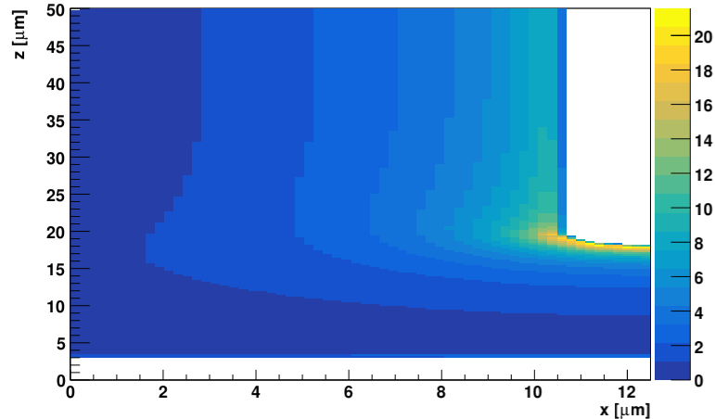
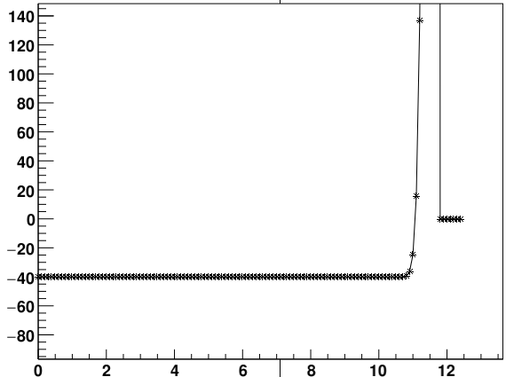
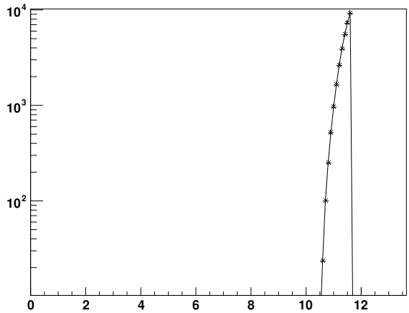
Improvements of simulation
We concentrated on simulation of one quarter of the small cell square pixel (25x25 μm²) – more refined stepping (100 nm) and faster simulation
Modifications made
  a tip of the column was rounded (same diameter as column radia)
  doping profile of the n⁺ junction/column was approximated by error function with different widths (σ_{d})
N_{eff} [1e12 cm⁻³ ]
cross section
|E| [V/μm]

Slide 13
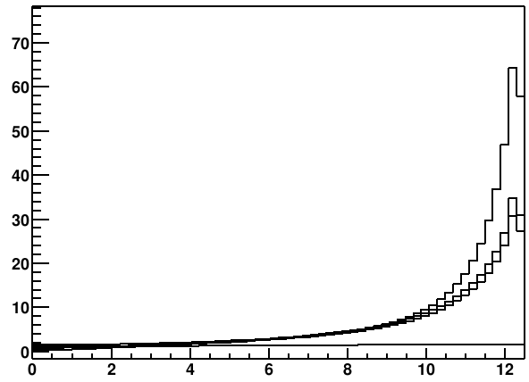
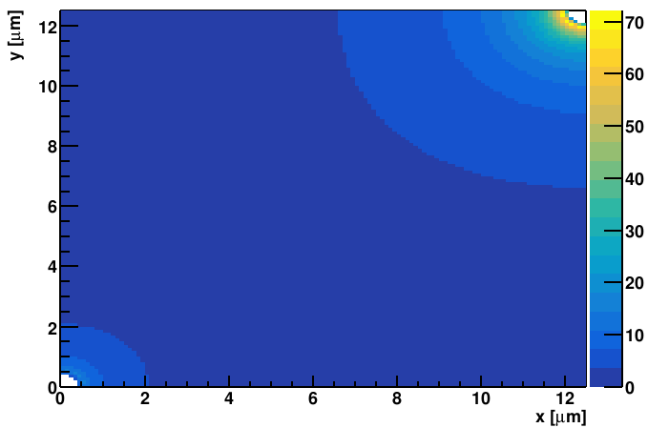
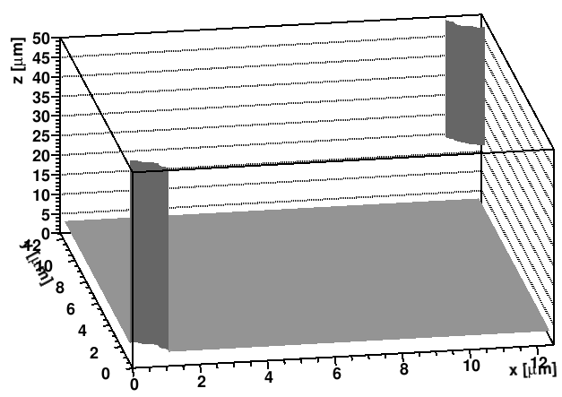
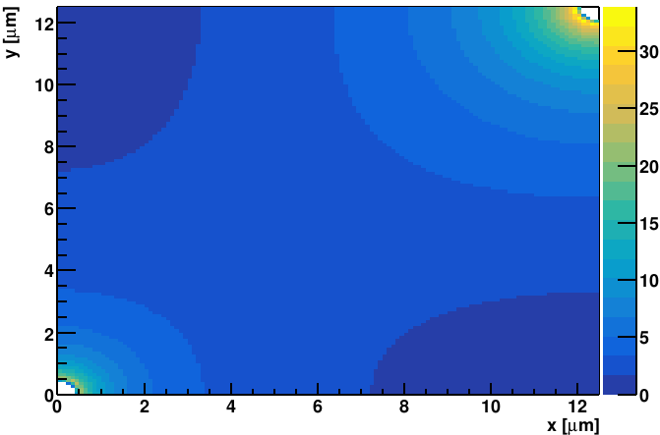
Refined electric field simulation
100 nm mesh – ¼ of the cell
|E| [V/μm]
|E| [V/μm]
r=0.5 μm, σ_{d}=1 μm x, N_{D}=1e16 cm⁻³
N_{A}=4e13 cm⁻³ doping of the bulk, 100 V
z=20 μm
tip of n⁺
|E| [V/μm]
x [μm]
z=40 μm
center of n⁺
The tip of the column will break down before more uniform gain is achieved. The geometry allows for high enough fields, but the challenge is how to smooth it around the tip.

Slide 14
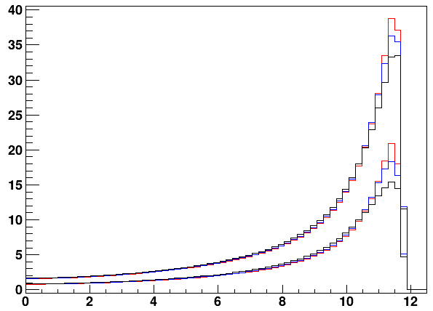
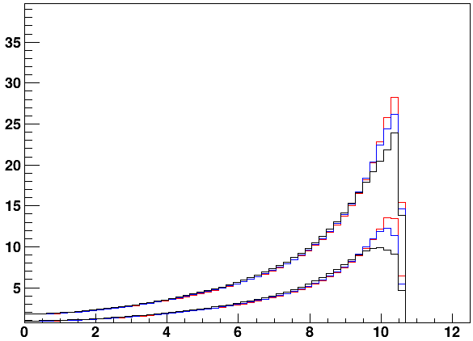
Impact of column width and profile
cross section
r=1 μm,
<N_{D}>=1e16 cm⁻³
N_{A}=4e13 cm⁻³
r=2 μm,
<N_{D}>=1e16 cm⁻³
N_{A}=4e13 cm⁻³
|E| [V/μm]
100 V
|E| [V/μm]
100 V
σ_{d}=1 μm
50 V
z=20 μm
tip of n⁺
σ_{d}=0.5 μm
50 V
σ_{d}=0.25 μm
“doping level” is the same – larger σ_{d} smaller amplitude N_{D}
x [μm]
x [μm]
The condition of ~30V/μm (sizeable gain) is reached at the tip for r=1 μm column, and rapidly decreases with larger diameter
Doping profile plays a role, but is for realistic doping profiles it is not so crucial
The electric field away from the tip in the centre of the n⁺ column is much smaller of 10 V/μm so most of the gain is at the tip
Solutions to the tip problem can be either special doping profile at the tip (not clear how to realize it such a “blob”), moderation of the field by more columns or full through columns (complicated processing and difficult surface treatment)

Slide 15
Conclusions
We have setup a full 3D fast simulation for 3D detector signal simulations in order to simulate devices with very large aspect ratio (WP2 project – IME)
The simulations has shown that for single sided processing (not full through columns) the tip of the column drives the high electric field (breakdown), but that the process is fine enough to reach gain along the columns with given realistic parameters.
The gain in the devices is highly non-homogenous depending on the position of the hit and amount of the generated charge drifting towards the tip.
The ToA is impacted (CFD ~25 %) and distortion component may even become the dominant one.
We plan to optimize the design parameters to get best performance – thin 3D would have many advantages (lower capacitance).

