Slide 1






Novel energy-sensitive x-ray cameras, record fusion-plasmas, real-time monitoring and the need of radiation-hardened detectors
L. F. Delgado-Aparicio¹, T. Barbui¹, R. Barnsley², D. Vezinet³, R. Dumont⁴, N. Fedorczak⁴, J. Morales⁴, T. Fonguetti⁴, P. Manas⁴, S. Mazzi⁴, X. Litaduon⁴, F. Imbeaux⁴, K. Hill¹, M. Bitter¹,
N. Pablant¹, J. Wisniewski¹, B. Luethi⁵, M. Rissi⁵, T. Donath⁵, L. Glatt⁵, P. Hofer⁵, and N. Pilet⁵
¹ Princeton Plasma Physics Laboratory, Princeton, NJ, USA
² ITER Organization, Saint-Paul-les-Durance Cedex, France
³ Commonwealth Fusion Systems, Devens, MA, USA
⁴ CEA, IRFM, Saint-Paul-les-Durance Cedex, France
⁵ DECTRIS Ltd., 5405 Baden-Dattwil, Switzerland
DRD3
Amsterdam, Netherlands
Tuesday, June 3rd, 2025

Slide 2
Agenda
Long Pulse Operation (LPO) and example @ WEST
X-ray spectroscopy and tomography…back to the basics!
WEST and challenges of multi-energy program
Few results and physics
Eight drivers for the future…
Summary
PPPL Advisory Board, November 14-15th, 2023

Slide 3
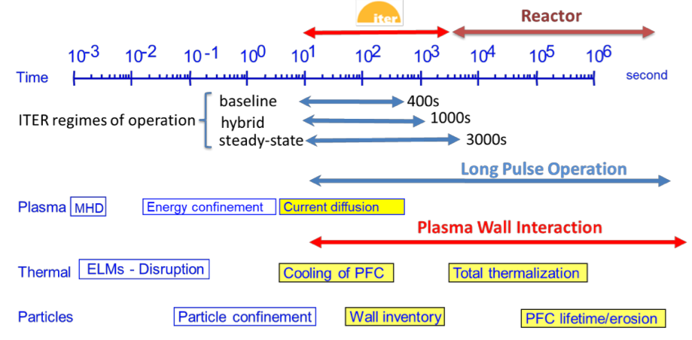
Long pulse operations (LPO) open a new era of expertise, training (e.g. physics and engineer) & collaborations
*Pulsed machines
*
WEST, KSTAR, EAST & W7X… JT-60SA

Slide 4

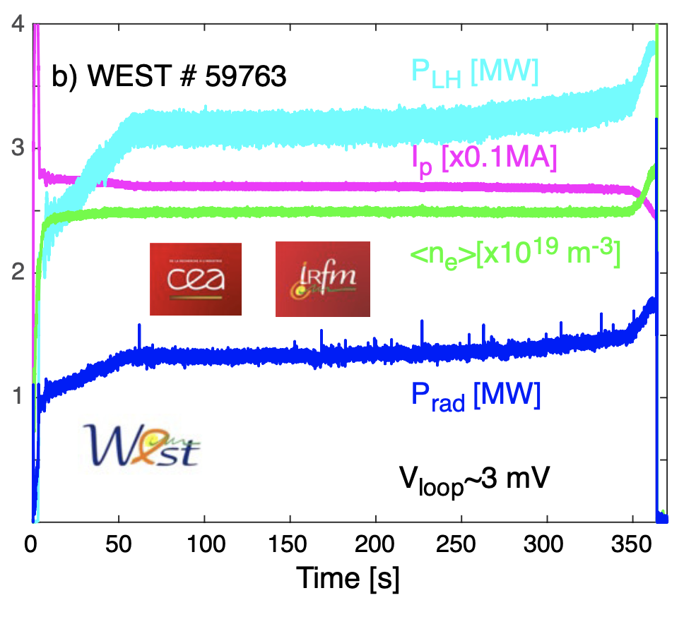
Long pulse operations (LPO) open a new era of expertise, training (e.g. physics and engineer) & collaborations
Long pulse operation (LPO) redefines all our diagnostic timescales over eight-nine orders of magnitude
March 2024
τ_{MHD} ∼ 1 − 100 μs
τ_{ELM} ≲ 1 ms
τ_{UFO} ~ 20-50 ms
τ_{Transport} ~ 1-20 ms
τ_{E} ∼ 50-70 ms
τ_{Ex:e,i} ∼ 250 ms
τ_{Ip} ∼ 100 s
τ_{PMI} ∼ 100’s s
×(10⁸-10⁹)

Slide 5
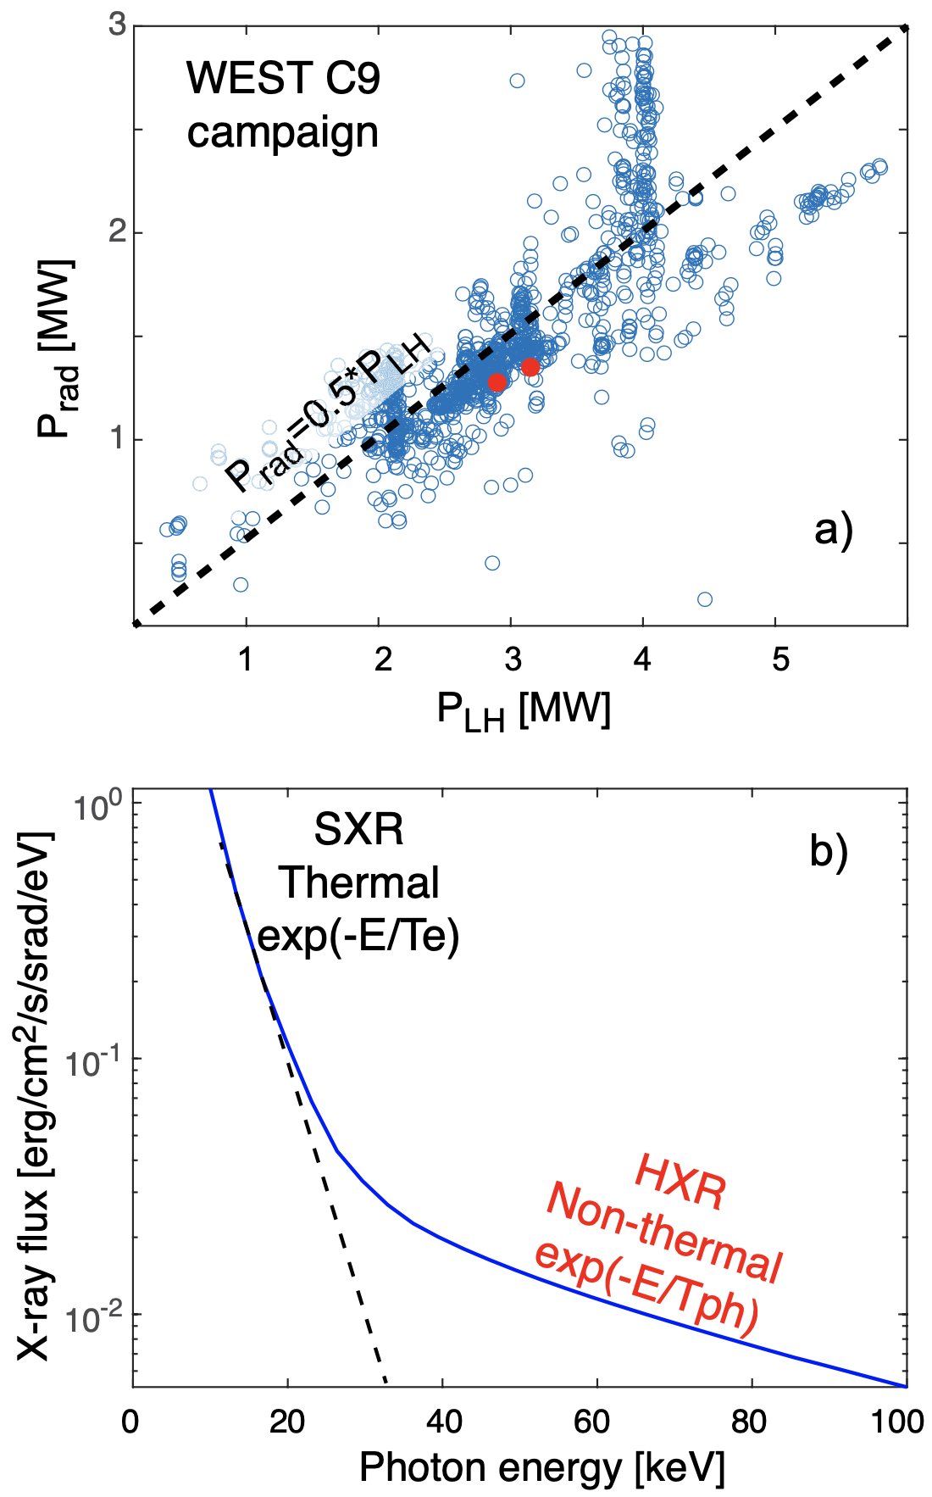
Diagnostic community continues exploring innovative x-ray techniques for fusion power plants (FPPs)
Important % of the P_{in} is lost as radiation (~50%).
P_{rad,X} is subset of P_{rad} … high as 50-90%
Easier to get the signals out than the visible range !!!
X-rays: dominant source of radiation (hν=hc/λ~T_{e}):
100 eV<T_{e}<20 keV ⇒ 0.5 Å < λ <130 Å ⇒ X-rays!
20 keV< E_{e}< 200 keV ⇒ SXR to HXR
Measurement of P_{rad,x} will enable:
⇒ Emiss[ph/cm²s, W/cm³], n_{e}, n_{Z}, T_{e}, T_{Z}, V_{φ}, V_{θ} & n_{RE}
Engineer challenges: Ensure vacuum compatibility and in-situ calibration
⇒Important technological & engineer development
PPPL Advisory Board, November 14-15th, 2023

Slide 6
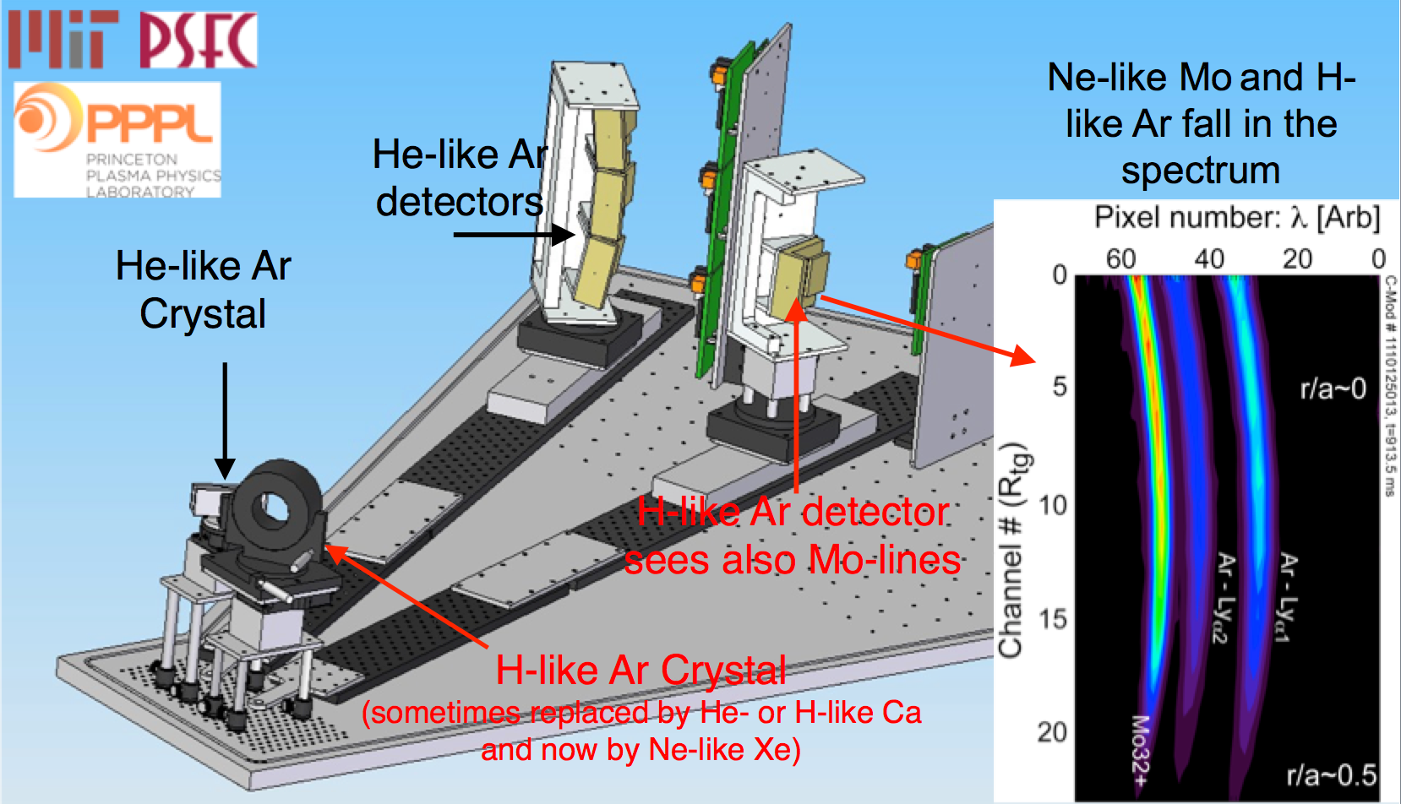
Take home message: three x-ray concepts to remember!
#1: X-ray imaging crystal spectrometer

Slide 7
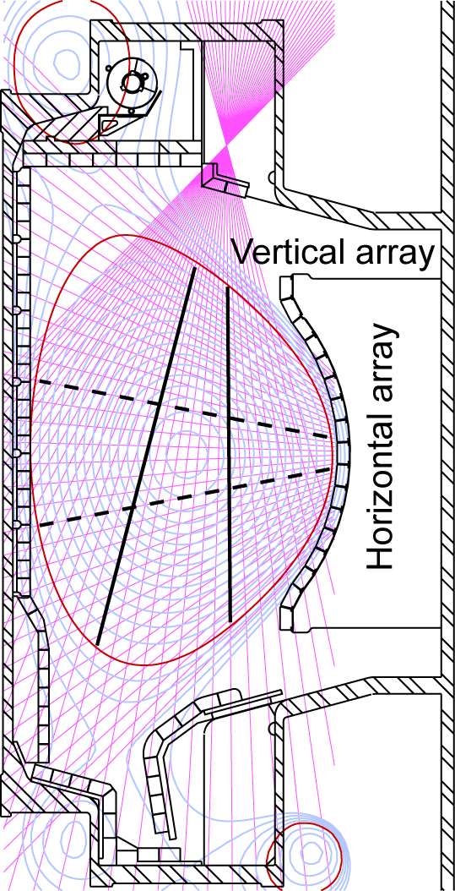
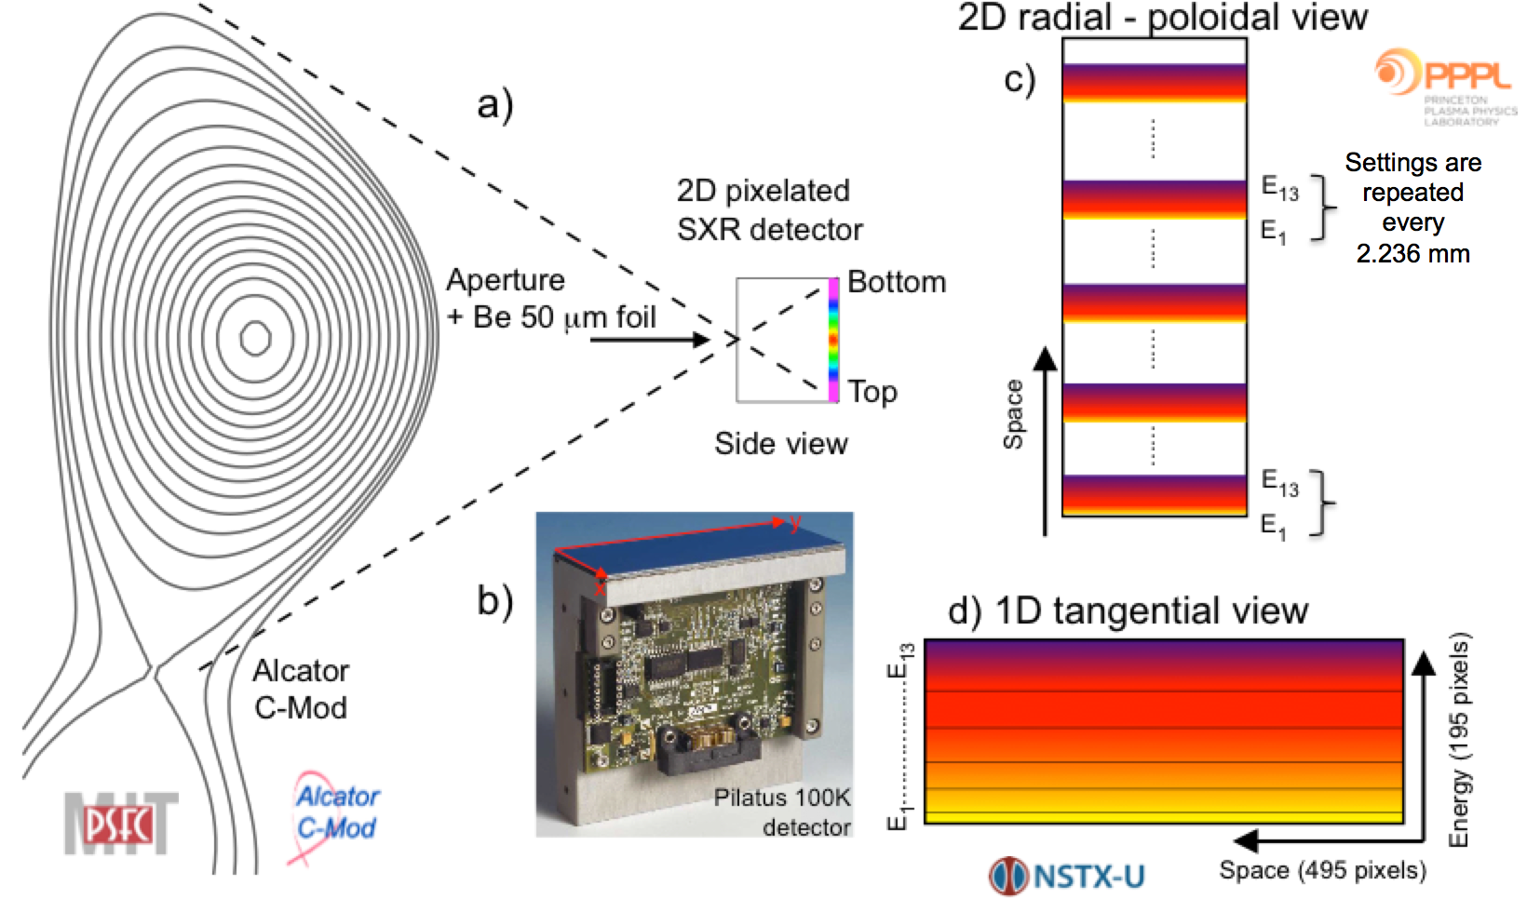
Take home message: three x-ray concepts to remember!
#2: X-ray tomography
#3 Multi-energy x-ray imaging

Slide 8
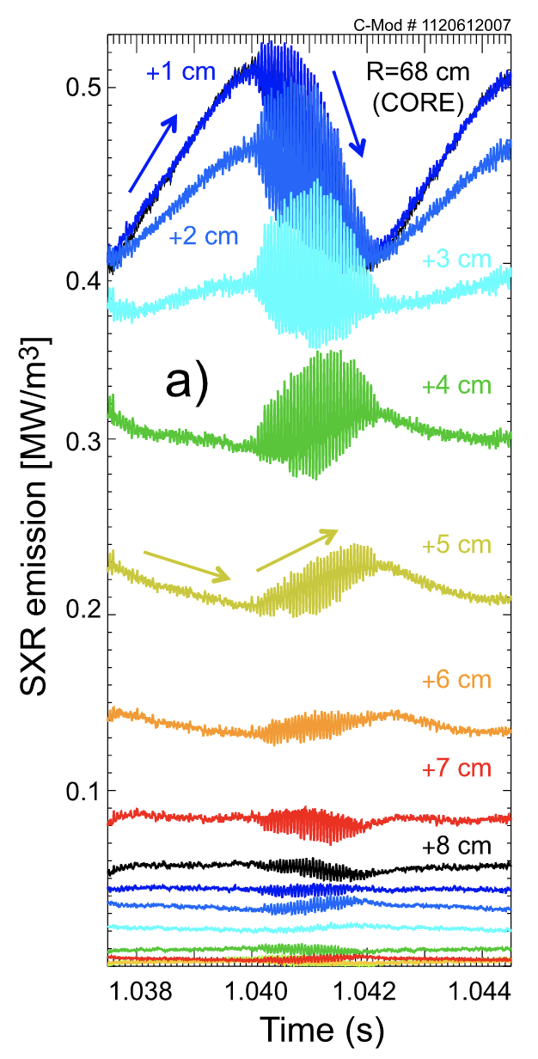
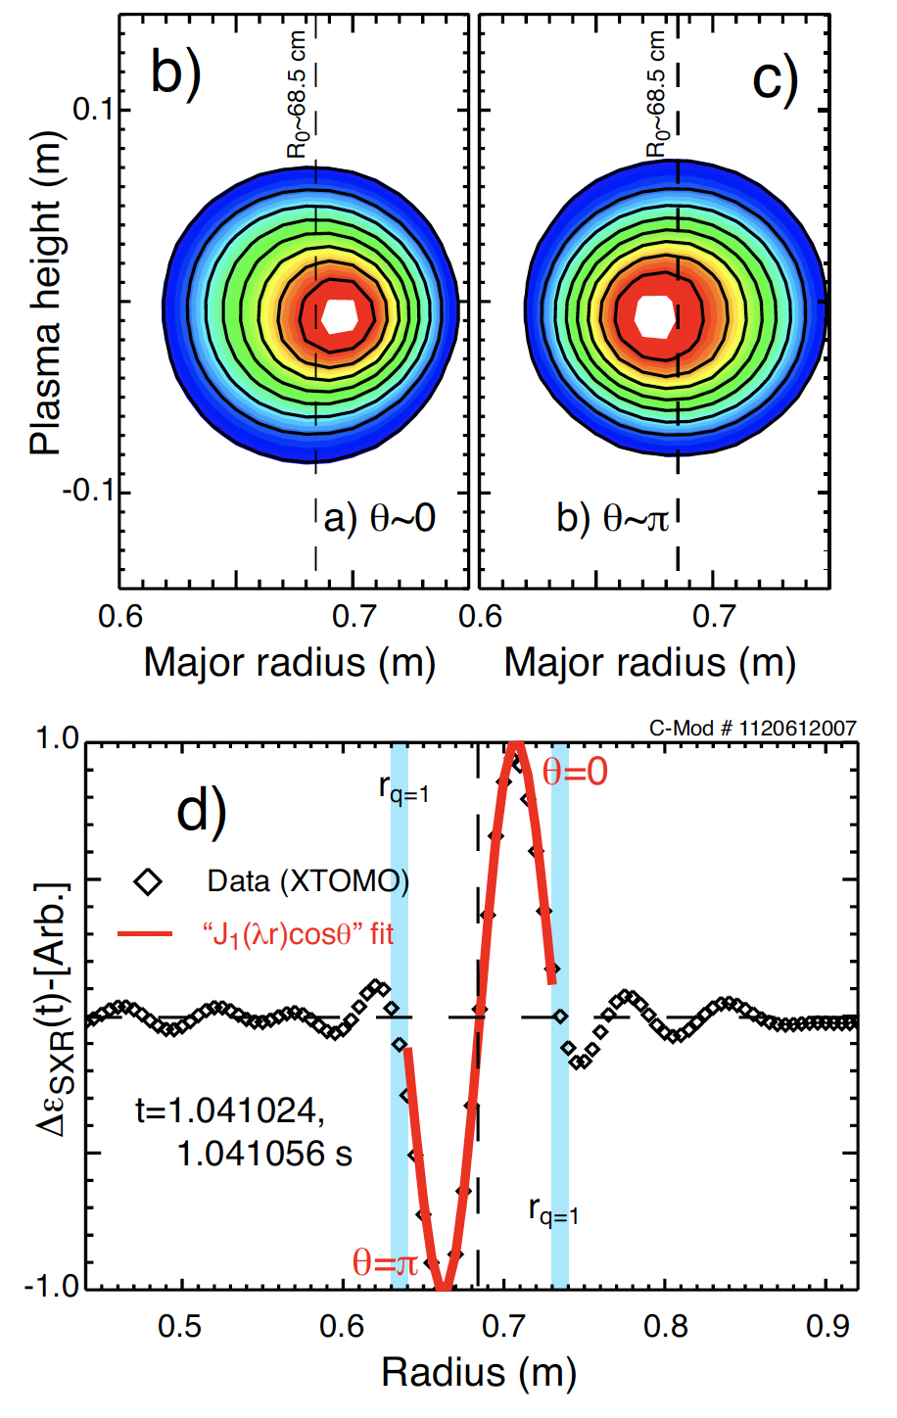
Conventional SXR tomography helps to study MHD: e- and ion fishbones

Slide 9
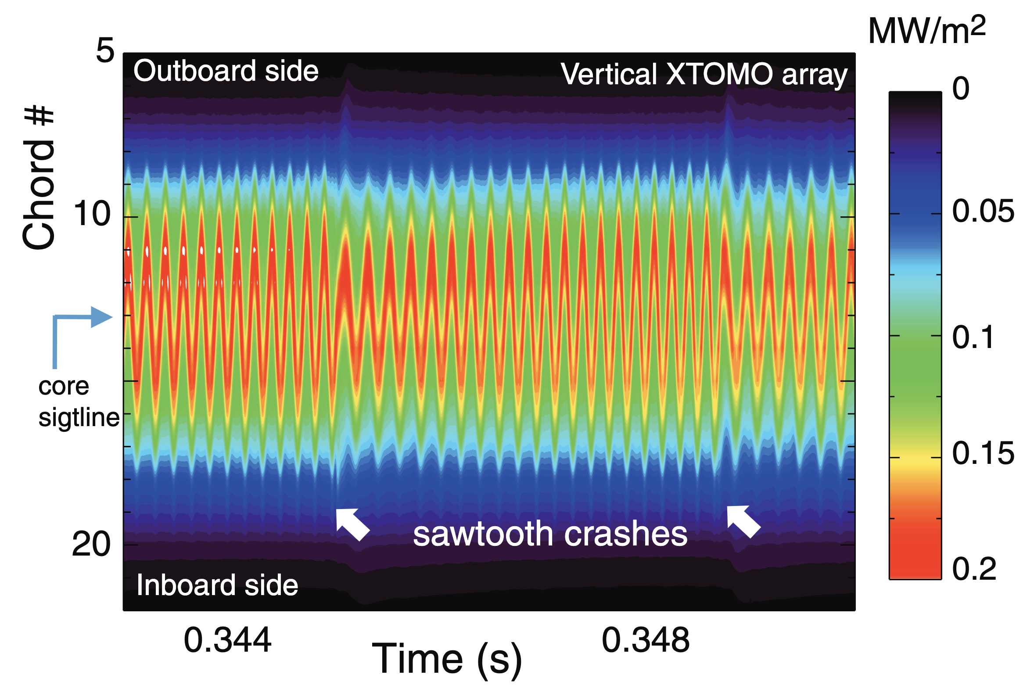
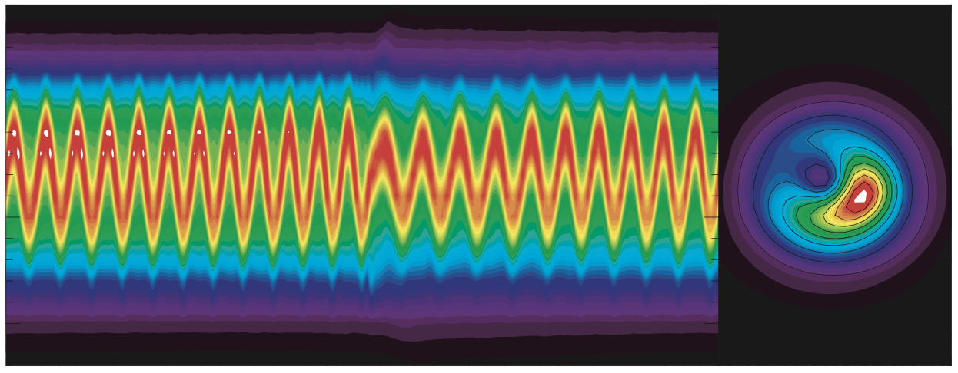
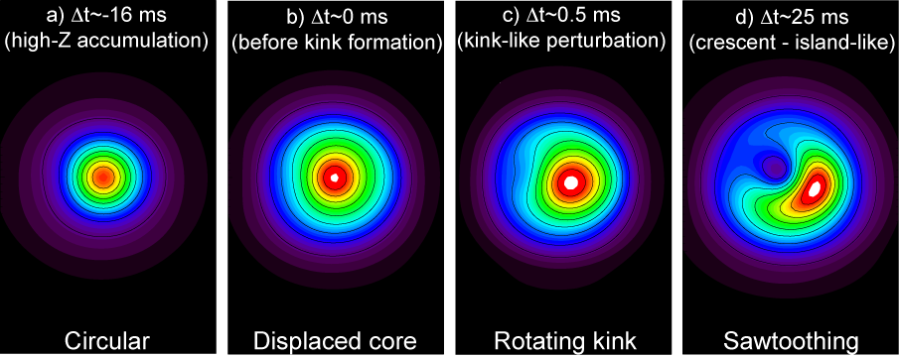
Conventional SXR tomography helps to study MHD: (1,1) kinks, islands and LLMs
Raw DATA
DATA + reconstruction
Time history of mode-formation

Slide 10
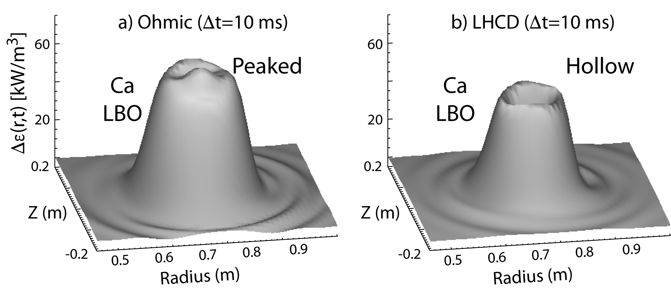
Conventional SXR tomography helps to study transport: particle (n_{e}) and medium- to high-Z (n_{Z})

Slide 11
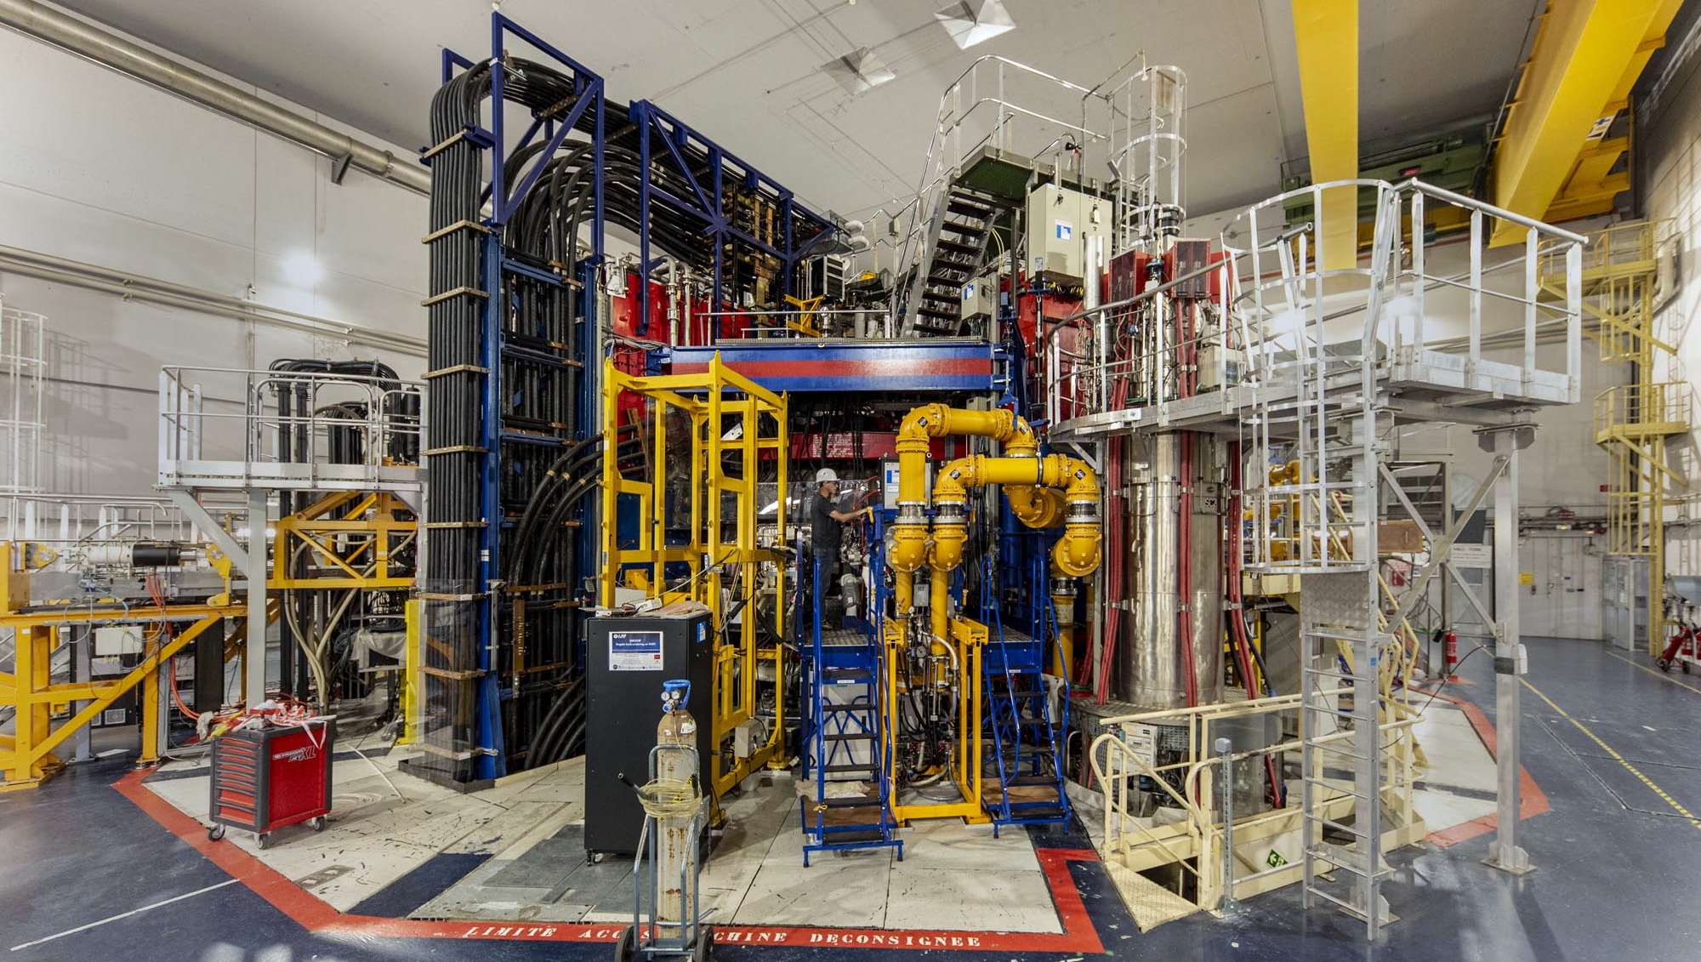
Long pulse operation (LPO) at the WEST tokamak
At CEA in France – next to ITER
Toroidal magnetic field
Bφ~3.7 Tesla
Superconducting coil temperature @ 1.8 K (-271.4°C)
Plasma major radius
R₀~2.5 m
Minor radius: a~5 m
Plasma volume: 18 m³
Plasma current <1 MA
Additional heating power: 15 MW
Plasma temperature
10-100 Million °C
Max plasma duration
1000 seconds
Task:
Measuring tens of million °C near the absolute zero!

Slide 12
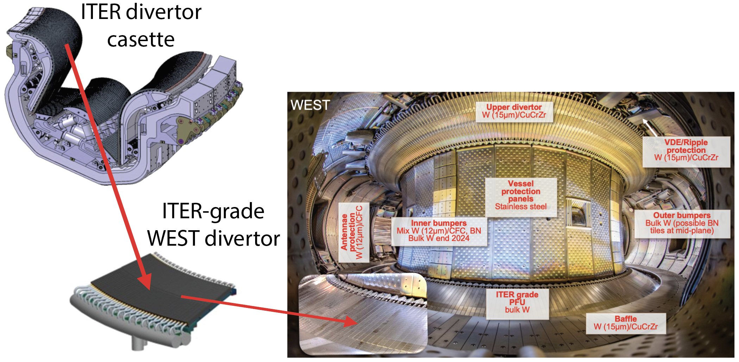
WEST is covered with tungsten plasma facing components (W-PFCs)

Slide 13
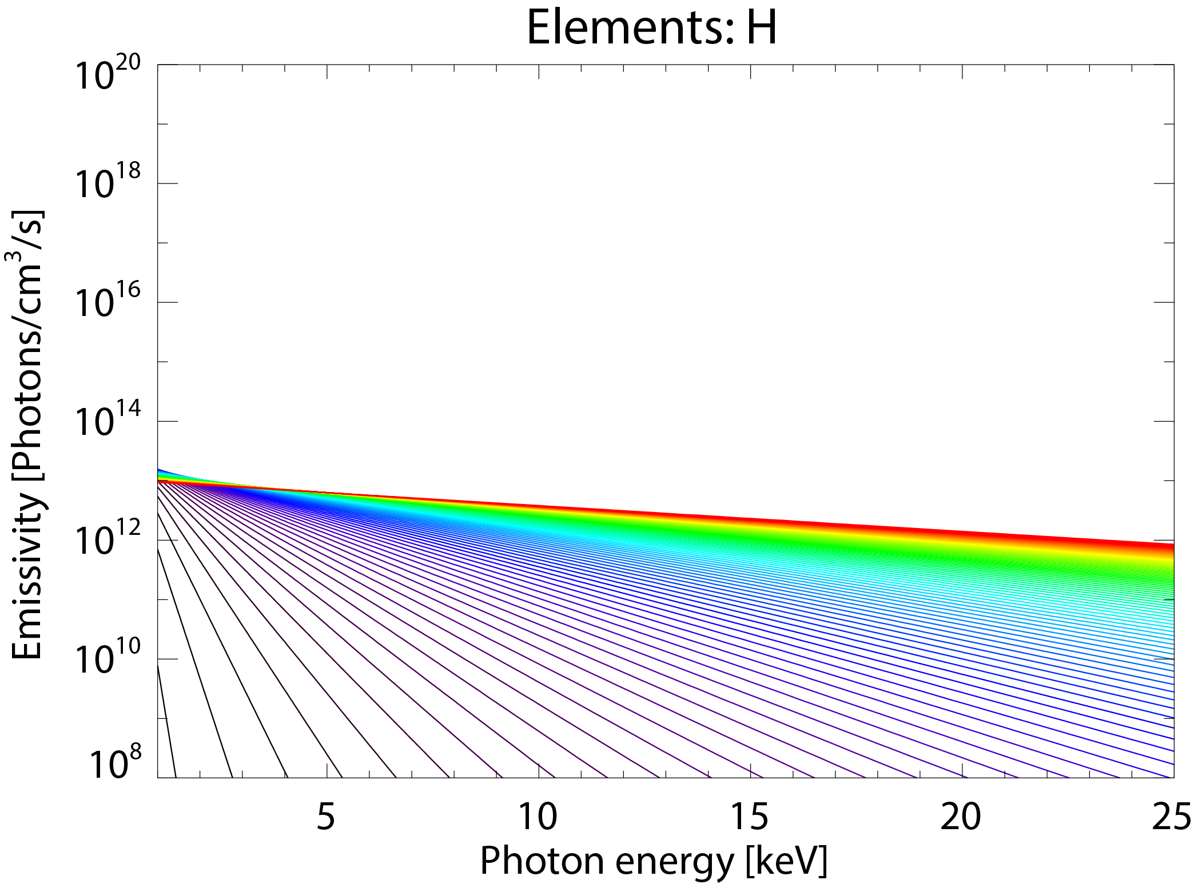
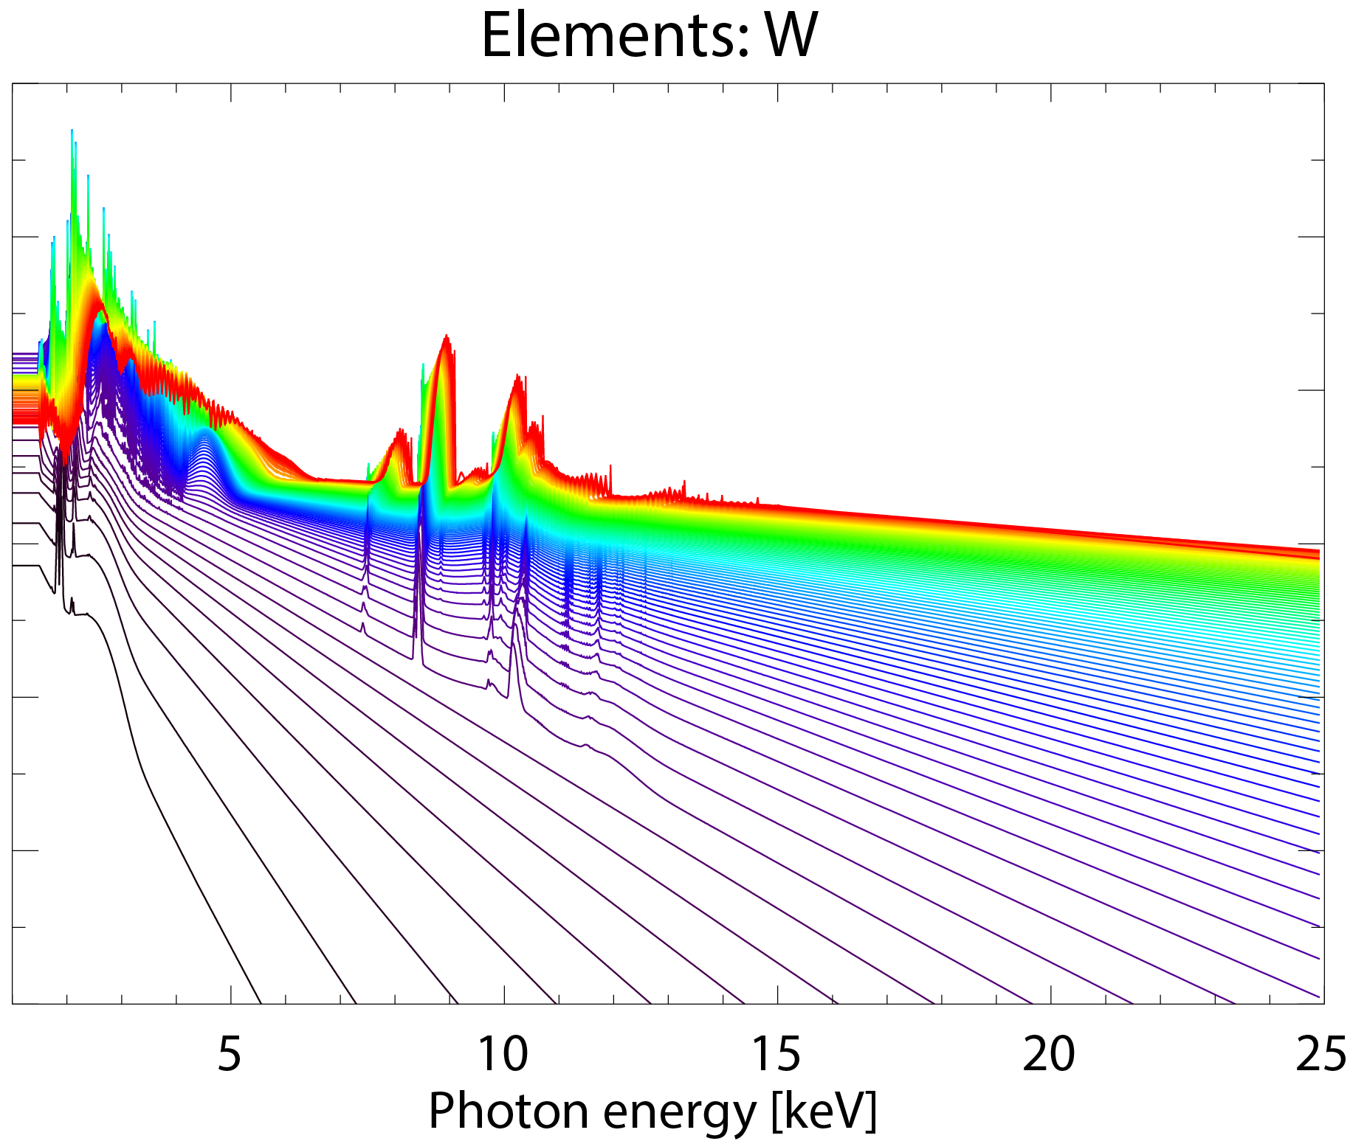

GOALs for novel multi-energy technology
RT-centroid (R₀, Z₀) & shape (Ψ) through Shafranov-shift (Δ_{SS})
Detection & ID of UFO injections which impact performance
n_{Z} & ΔZ_{eff} bracketing line radiation (BB)
T_{e} & n_{e}²Z_{eff} sampling continuum (FF + FB)
n_{e,nM} (e.g. ECCD, LHCD, runaways)
Real time and control
T_{e}
[keV]
10
EXAMPLE: no line-emission
(slope of continuum emission is ∝ T_{e} or n_{e,fast})
Intensity ∝ n_{W}
~exp(-E/T_{e})
~exp(-E/T_{e})
0.1

Slide 14
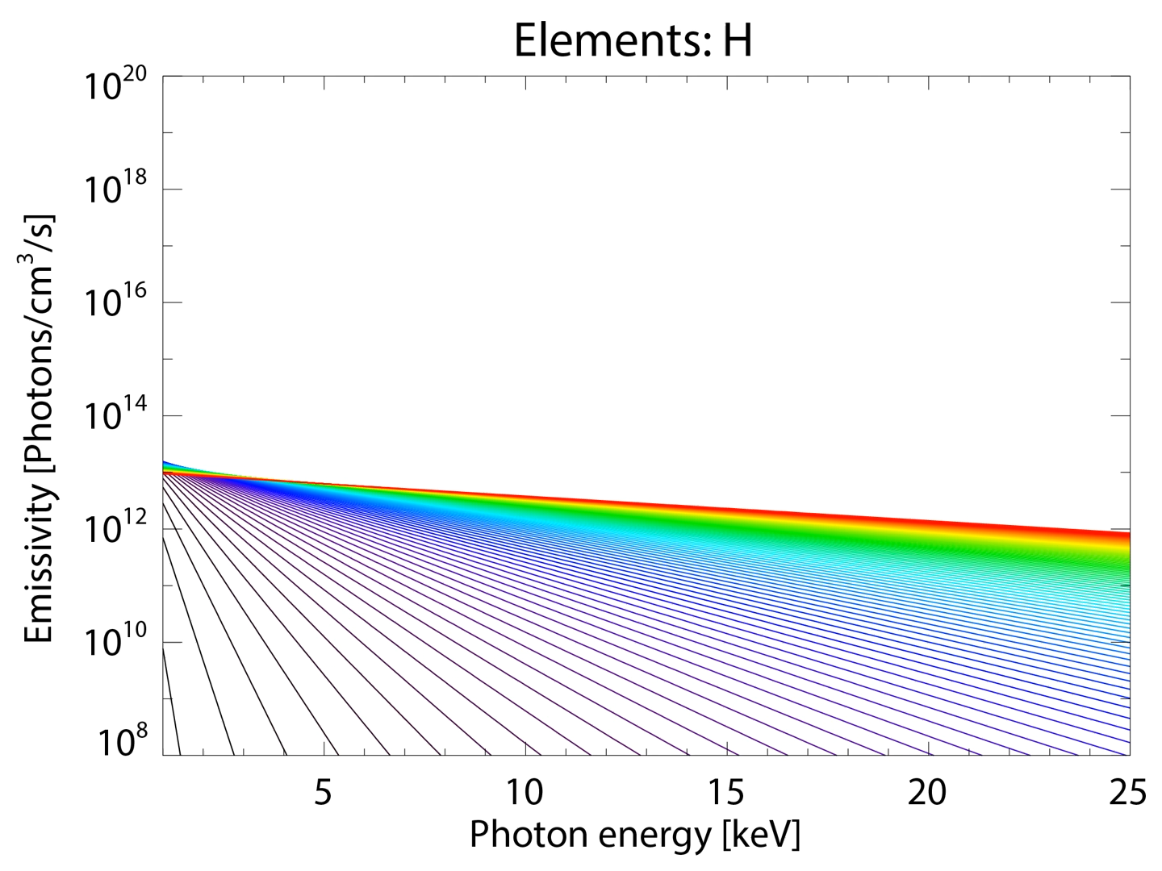

Slide 15
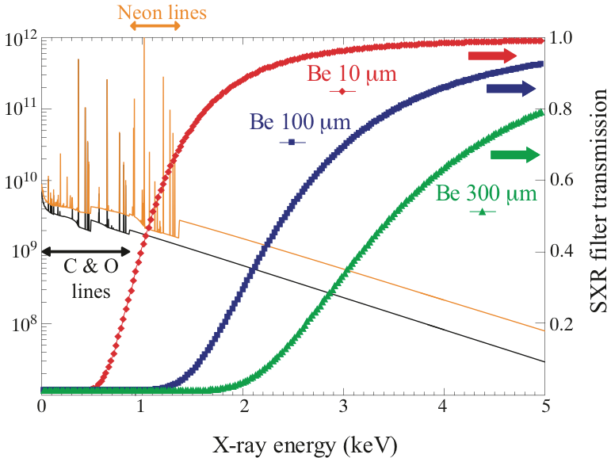
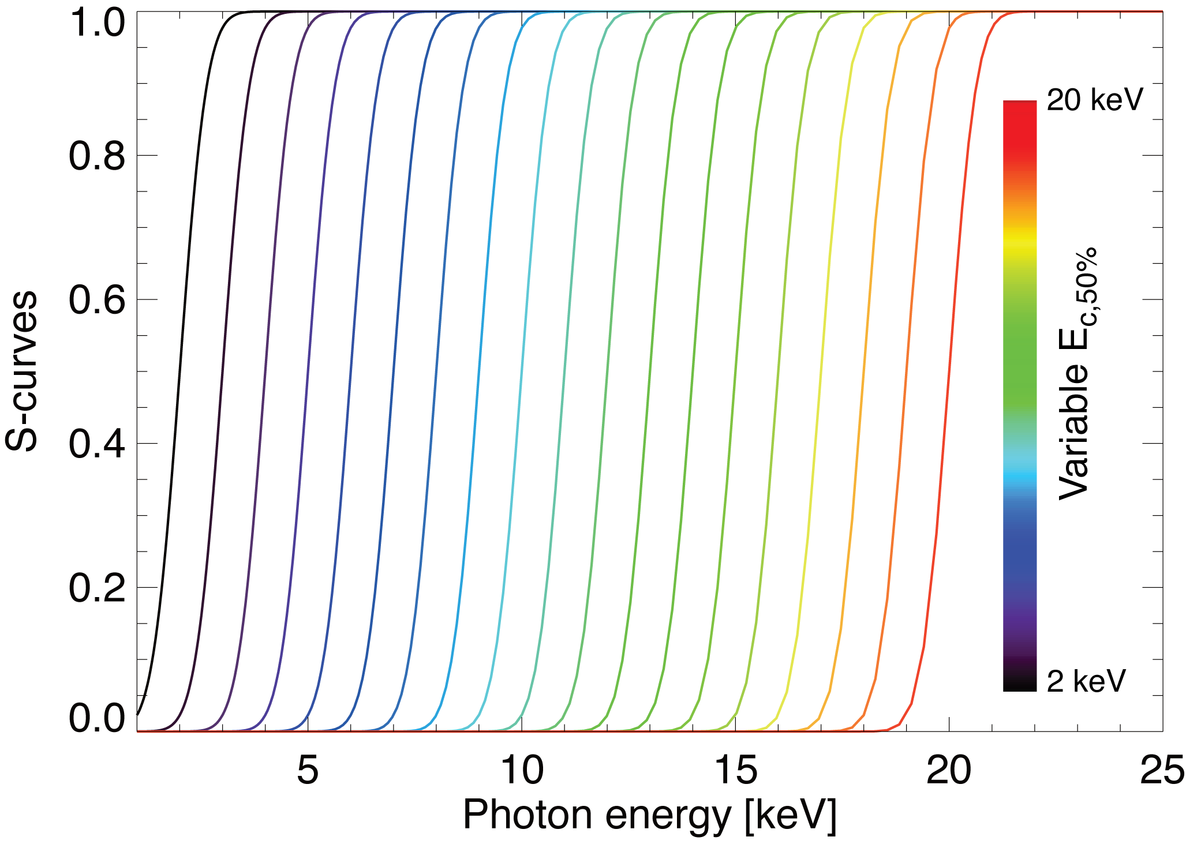
Novel x-ray detectors enable breakthrough of 100k pixels (minimum) at multiple energy ranges from 2-100 keV
Old technology: metal filters
New technology: electronics
E_{W}~500 eV
“Constant” width of electronic response is a great improvement over the use of filters

Slide 16
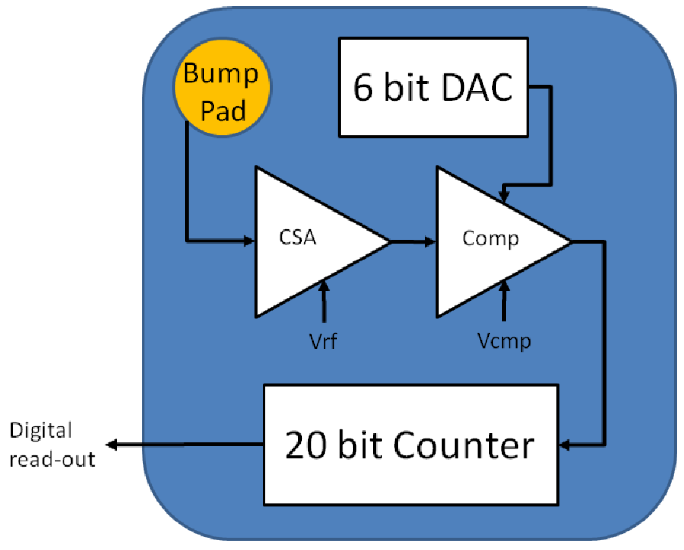
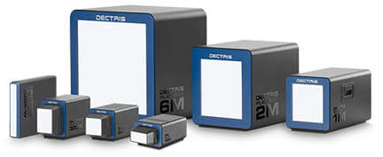
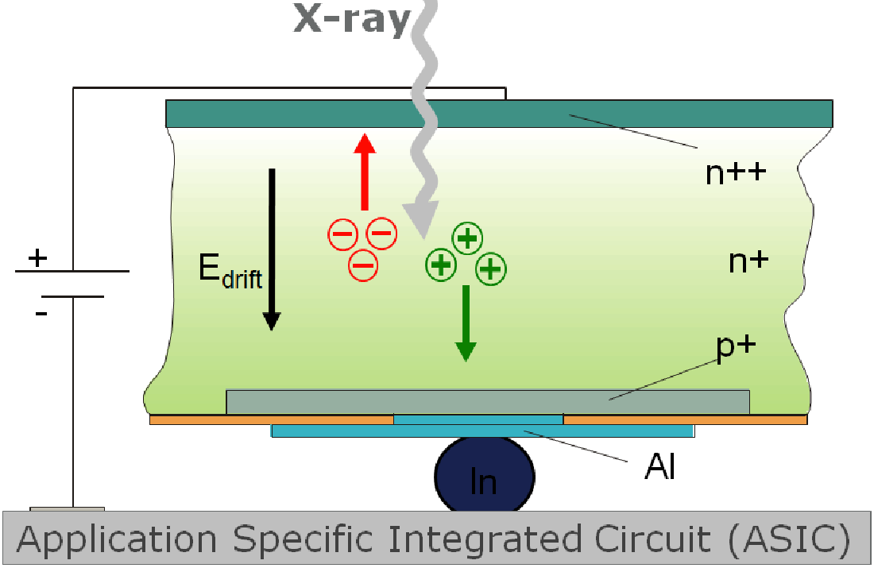
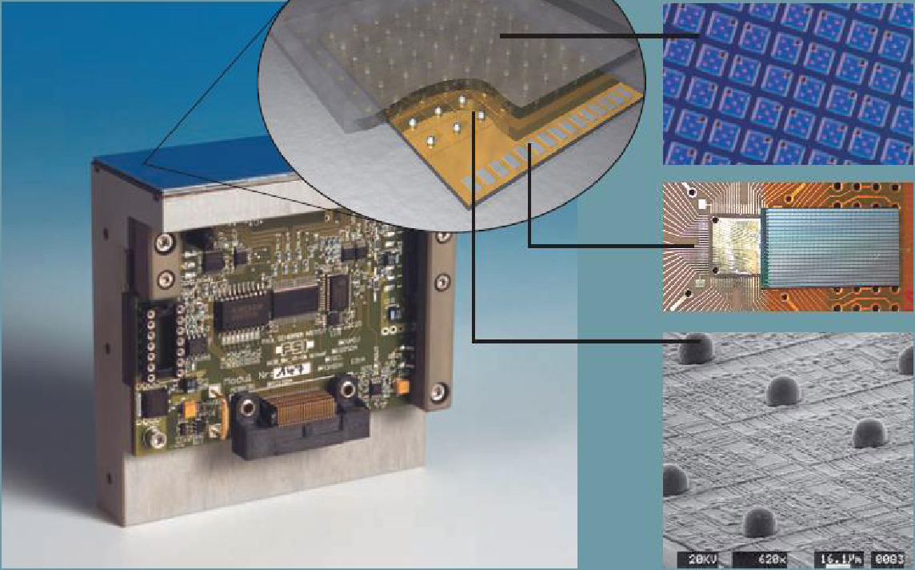
Novel x-ray detectors enable breakthrough of 100k pixels (minimum) at multiple energy ranges from 2-100 keV
Operates in single photon counting mode
2012
2024
technology
CMOS hybrid pixel technology
developed originally for synchrotrons
Si-sensor
2D array pn diodes
CMOS
readout chip
The comparator voltage of the readout chip (V_{cmp}) controls the global threshold energy.
The threshold energy can be individually refined/trimmed using and in-pixel 6-bits DAC (V_{trim}).
In
balls

Slide 17
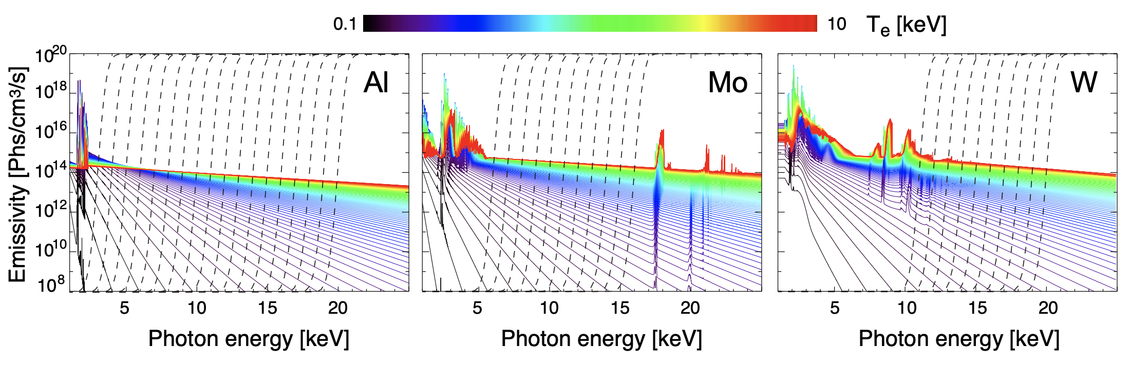





Smart pixel-technology allows filtering spectra to measure line-emission and/or the continuum
2017 - nowadays
2012-2016
2018 - nowadays

Slide 18
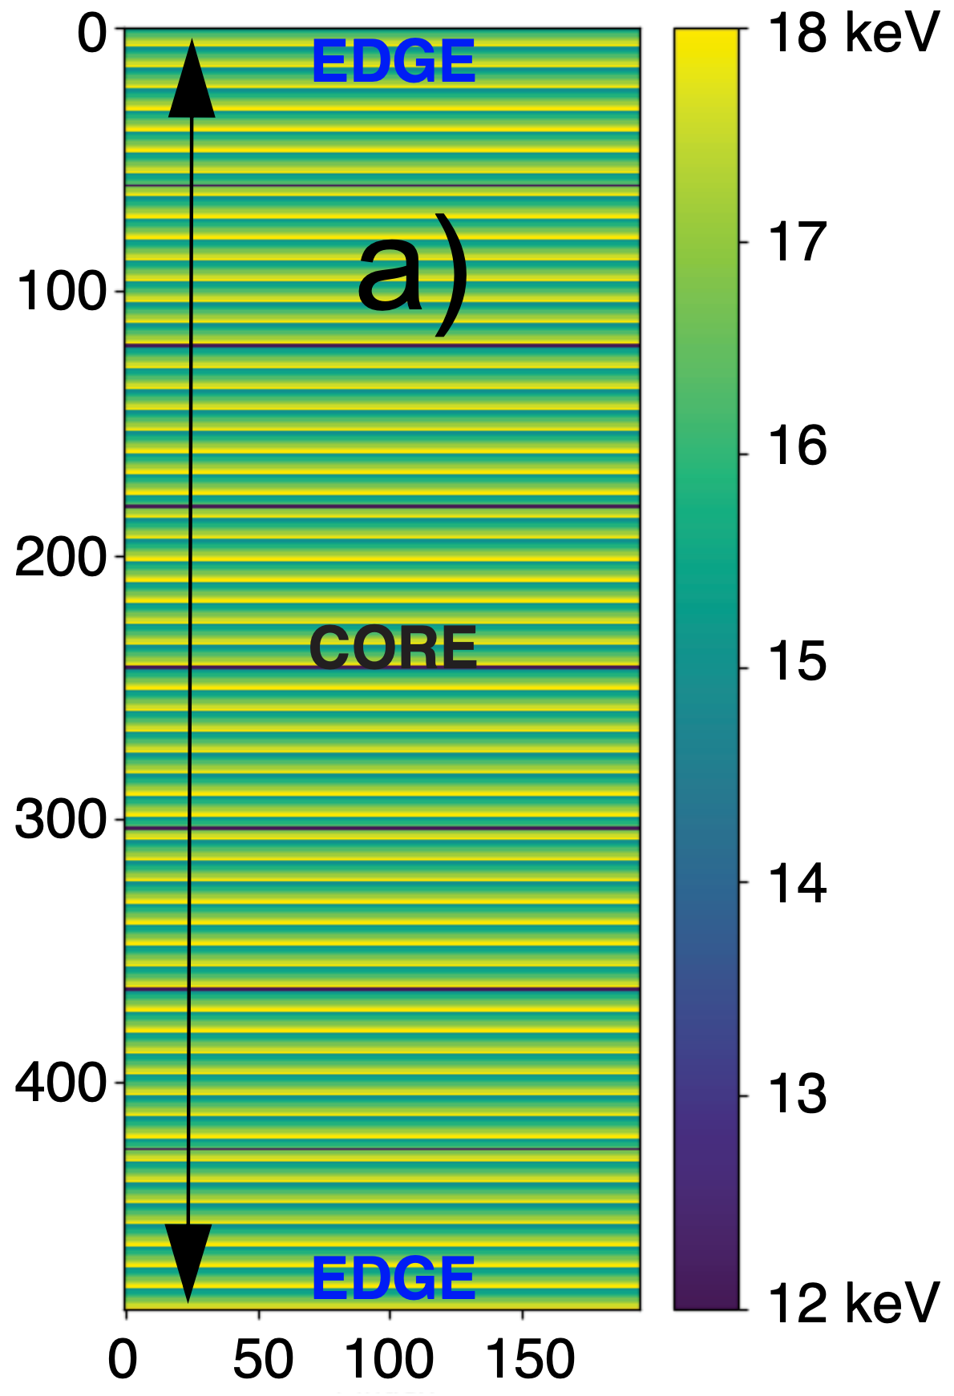
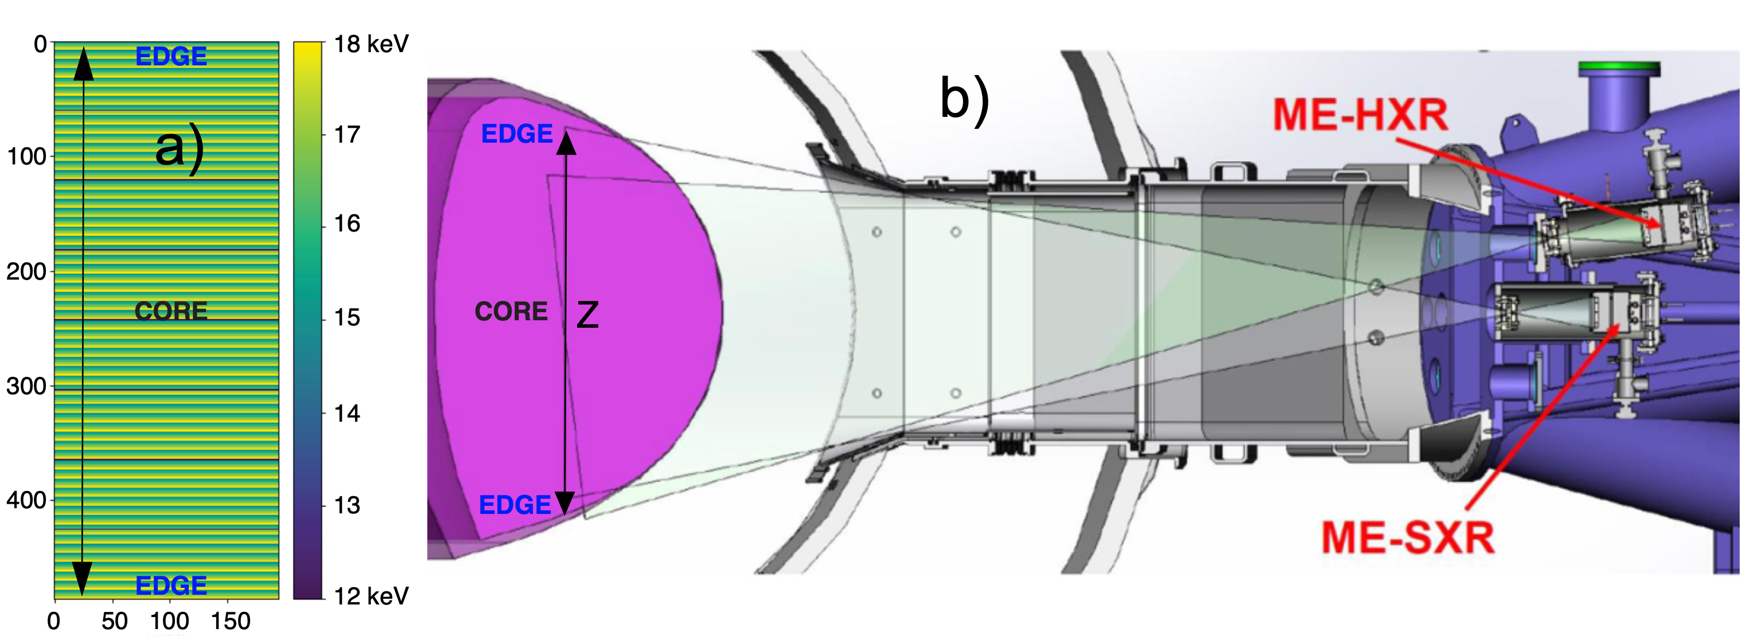
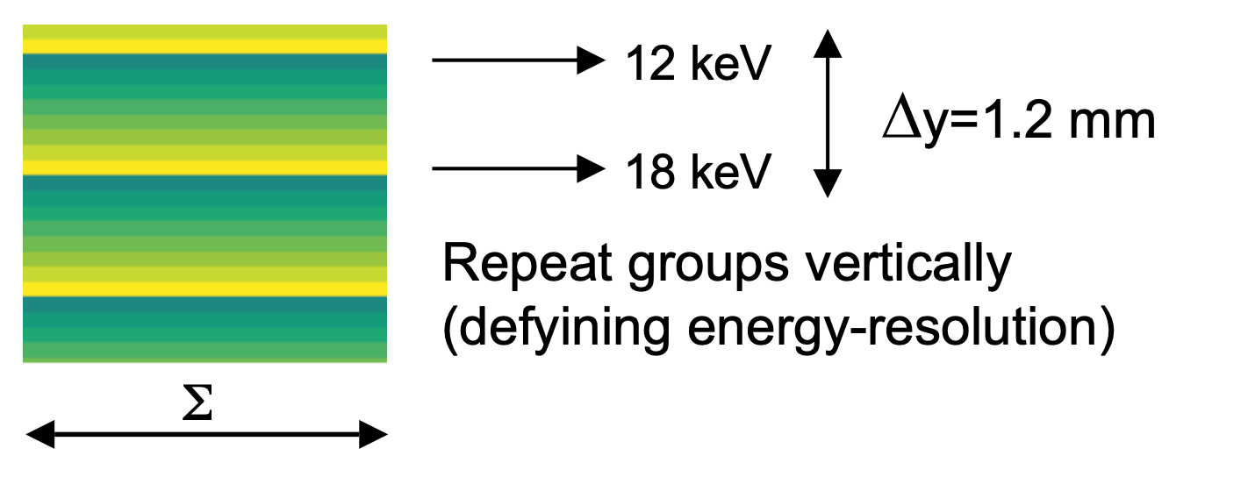
Main diagnostic challenge at WEST is to disentangle n_{W} and T_{e}-effects in recorded spectra
Zoom
“Smart” pixel
configuration
PPPL Advisory Board, November 14-15th, 2023

Slide 19
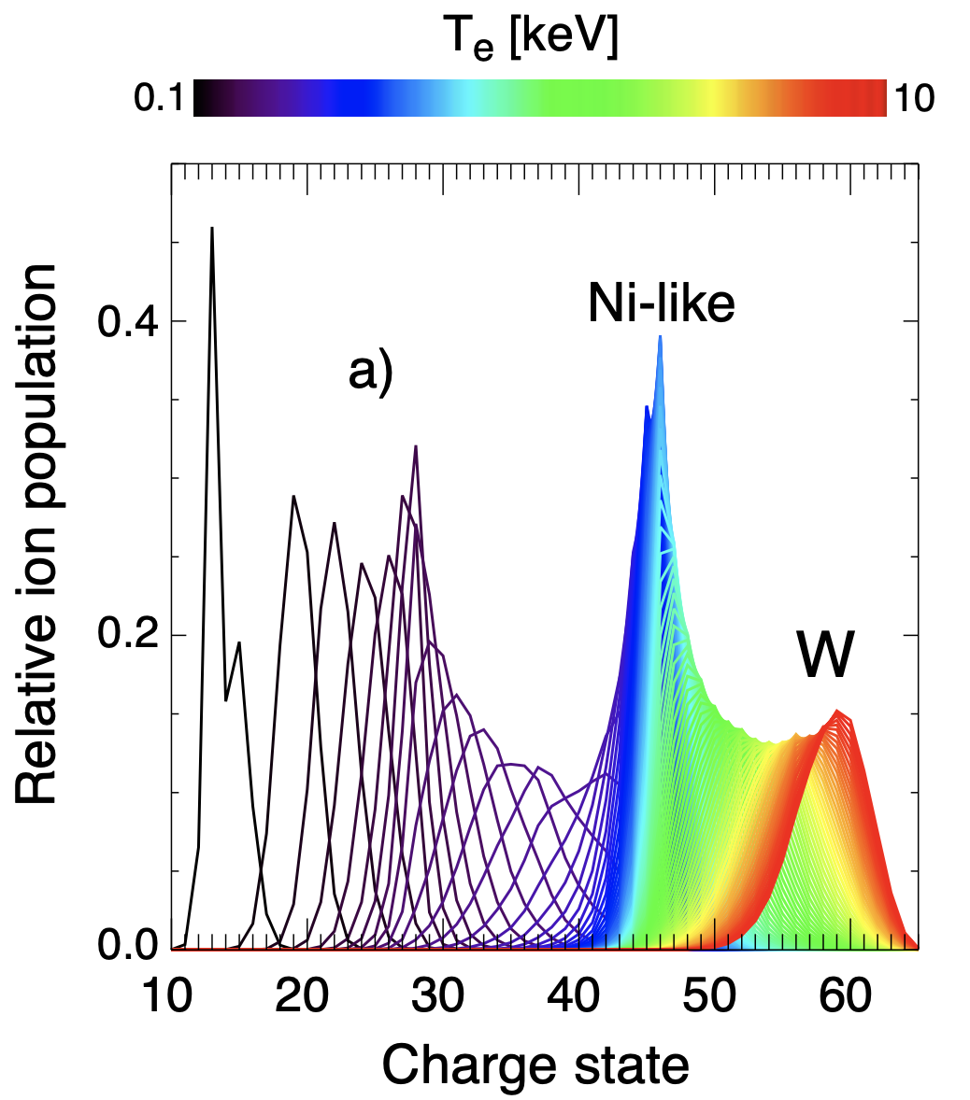
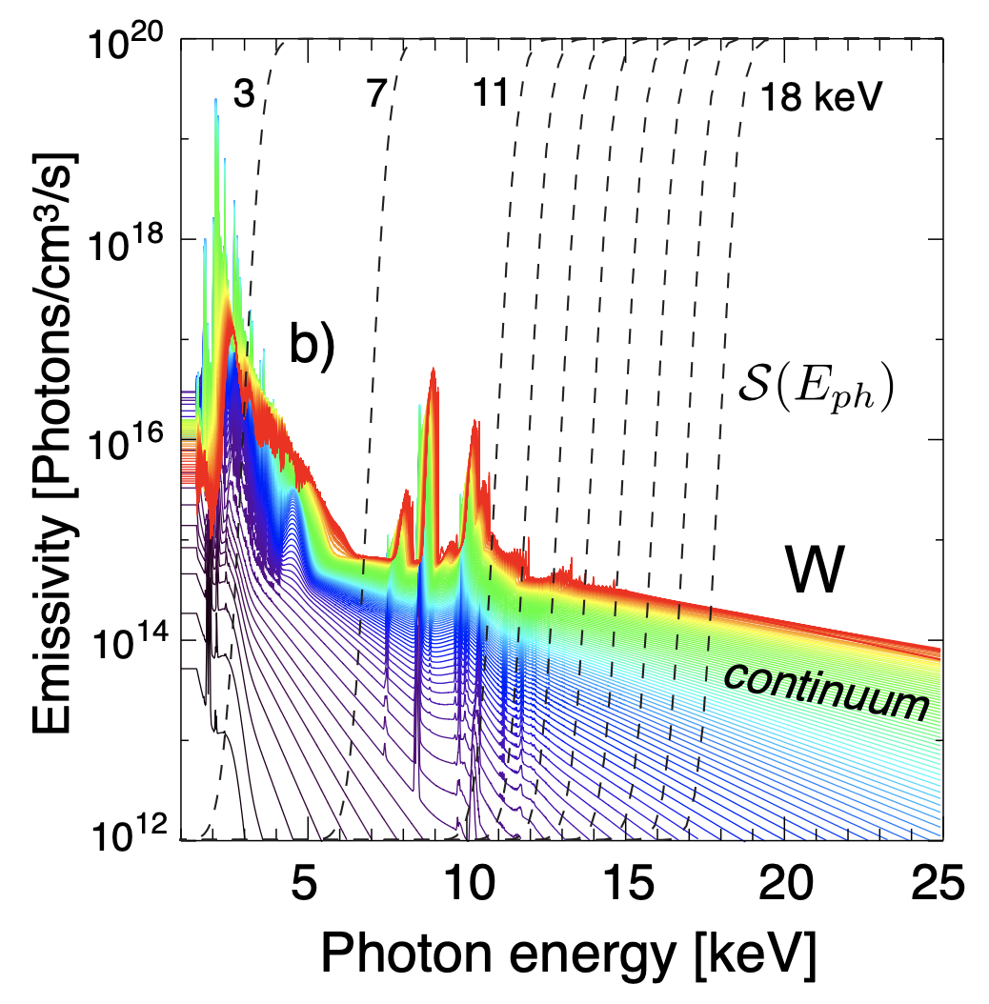
Main diagnostic challenge at WEST is to disentangle n_{W} and T_{e}-effects in recorded spectra
“Filtering the spectra”
PPPL Advisory Board, November 14-15th, 2023

Slide 20
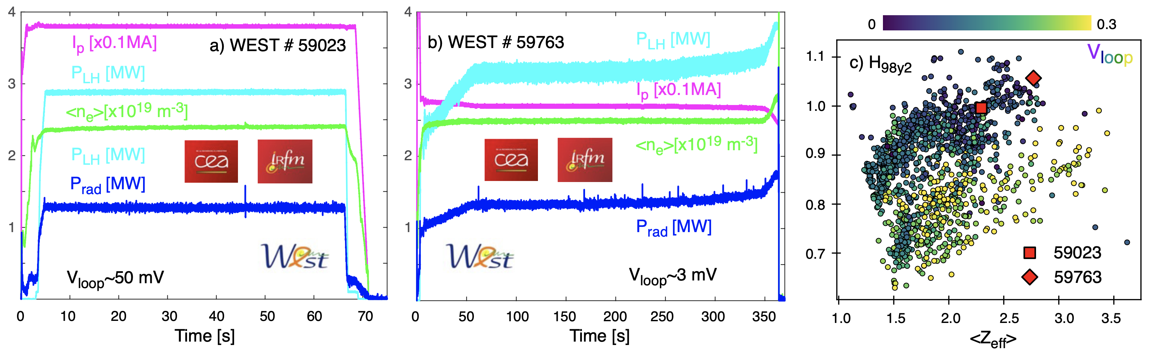
Long pulse operations (LPO) open a new era of expertise, training (e.g. physics and engineer) & collaborations
Typical “1-min” shot
March 2024
Hot temperature branch @ 4-5 keV with density nearly a factor 2 compared to its predecessor
Non-inductive (V_{loop} → 0) long-pulse discharges with no external input torque and particle source
Resilience to tungsten UFOs and an improved L-mode confinement (H_{98y,2} ∼ 1.0, β_{p}∼1.6 & β_{N}∼0.7) lasting 6 mins
Without W-wall conditioning and using a total of 1.146 GJ of injected energy.

Slide 21
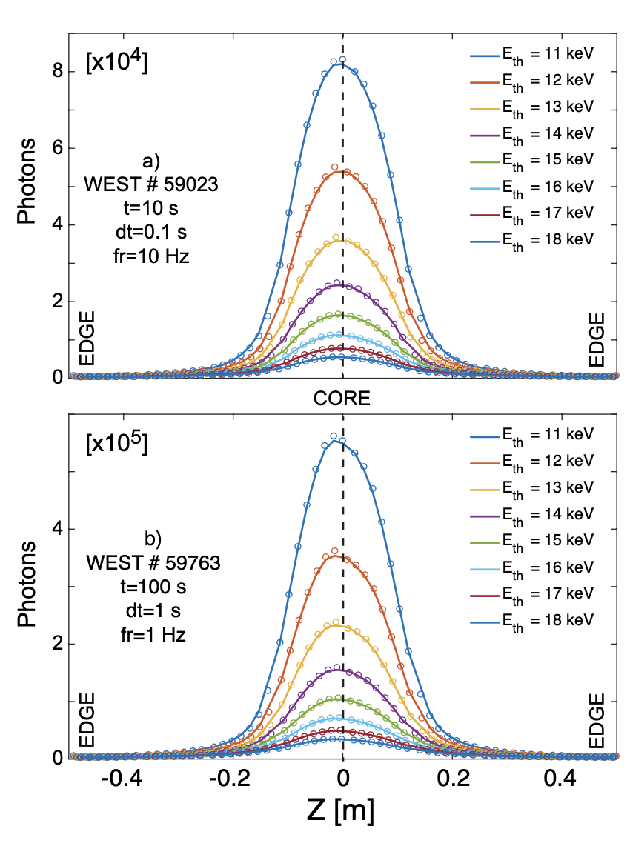
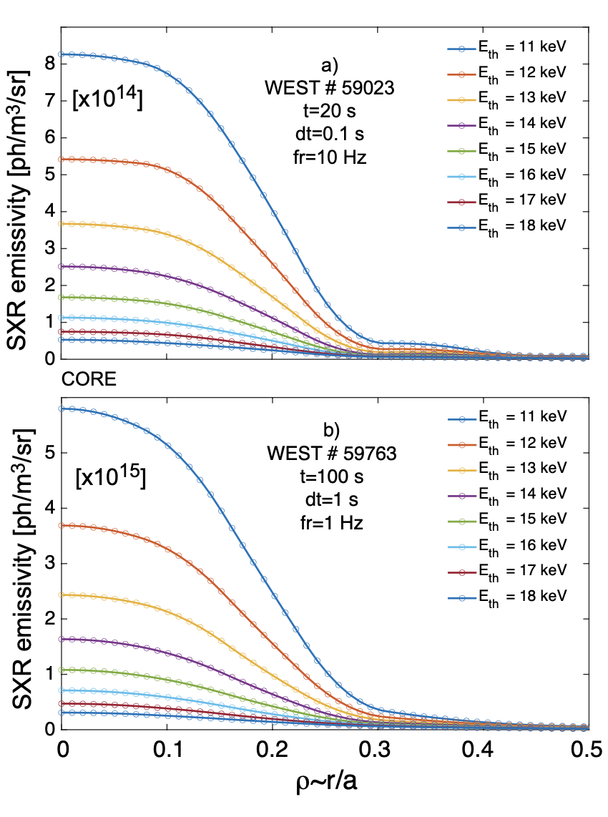
Tungsten multi-energy brightness and emissivities measured for the first time at WEST
ToFu
Line-integrated brightness
Local reconstructed emission
ToFu

Slide 22
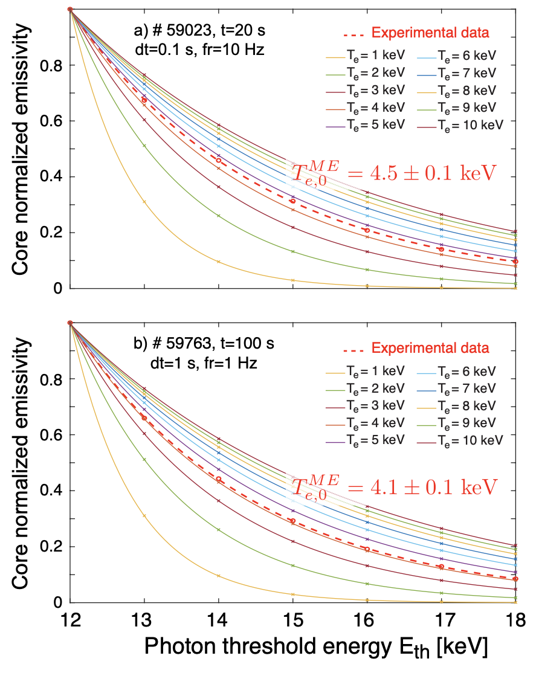
Core multi-energy (ME) fits capture the Maxwellian part of the electron energy distribution function
⇒T_{e,0} ✓
Typical “1-min” shot
⟨Z_{eff}⟩~2.2, T_{e,0}~4.5 keV and H_{98y2}~1
⟨Z_{eff}⟩~2.7, T_{e,0}~4.1 keV and H_{98y2}~1.05
Notes:
7-point fit T_{e,0} measurement
Uncertainty: ±2%

Slide 23
Driver #1: Demonstrated technology enables different options upon arrangements of threshold energies
Driver #2: Constrain W-transport physics in SS without perturbative experiments regardless of H & CD
Driver #3: Provide internal non-magnetic measurements to constrain equilibria: R₀, Z₀ and Δ_{SS}
Driver #4: Constrain W-transport asymmetries with rotation or ICRH heating (V⊥ vs V|| effects)
Driver #5: Resolve fast-electron anisotropies from ECRH, LHCD, fast e⁻ losses and runaway electrons
Driver #6: Develop real-time capabilities
Driver #7: Adopt new technology with 4+ thresholds per pixel & RoI sampling (from 0.5 to 100 kHz)
Driver #8: All the above + DD&DT neutrons and γ’s

Slide 24
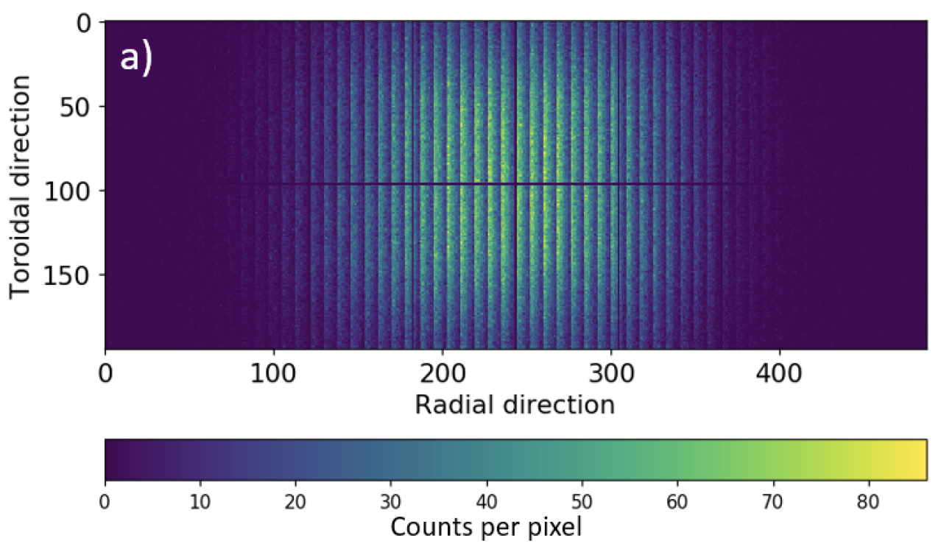
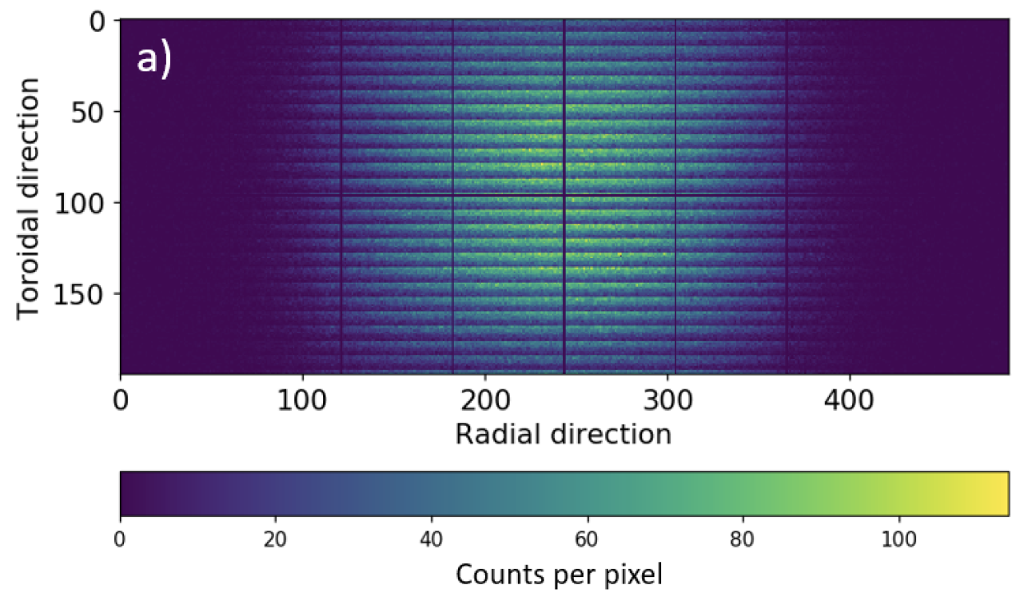
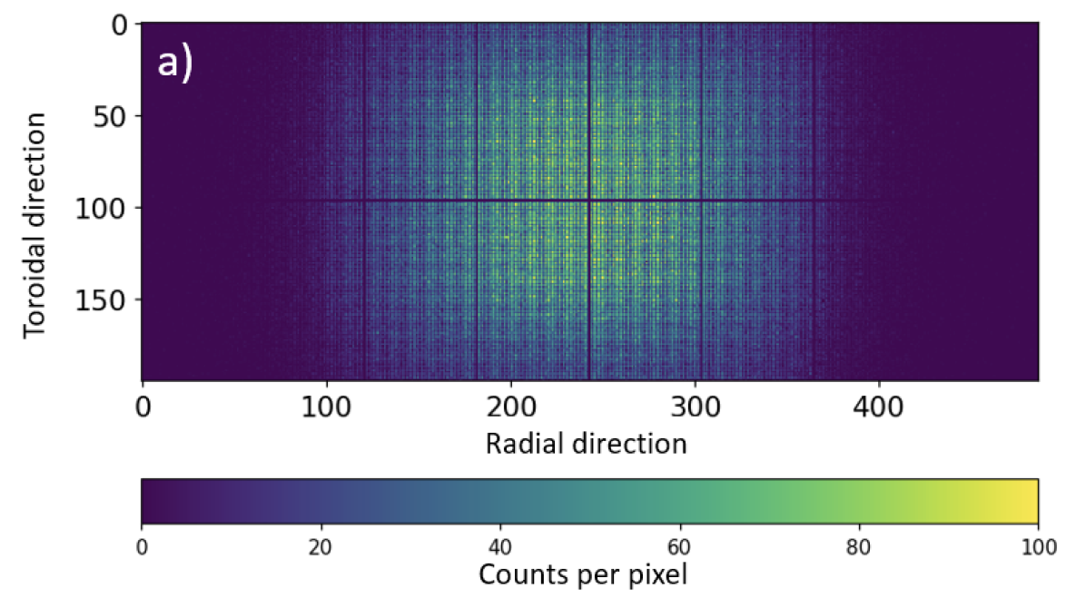
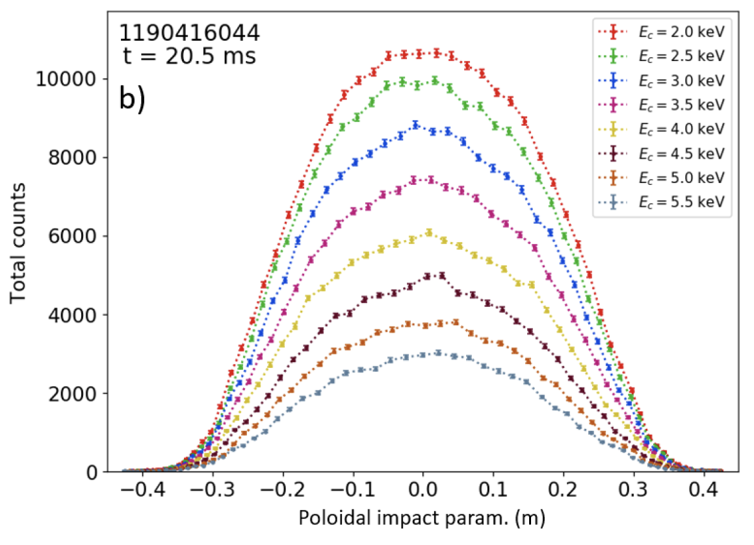
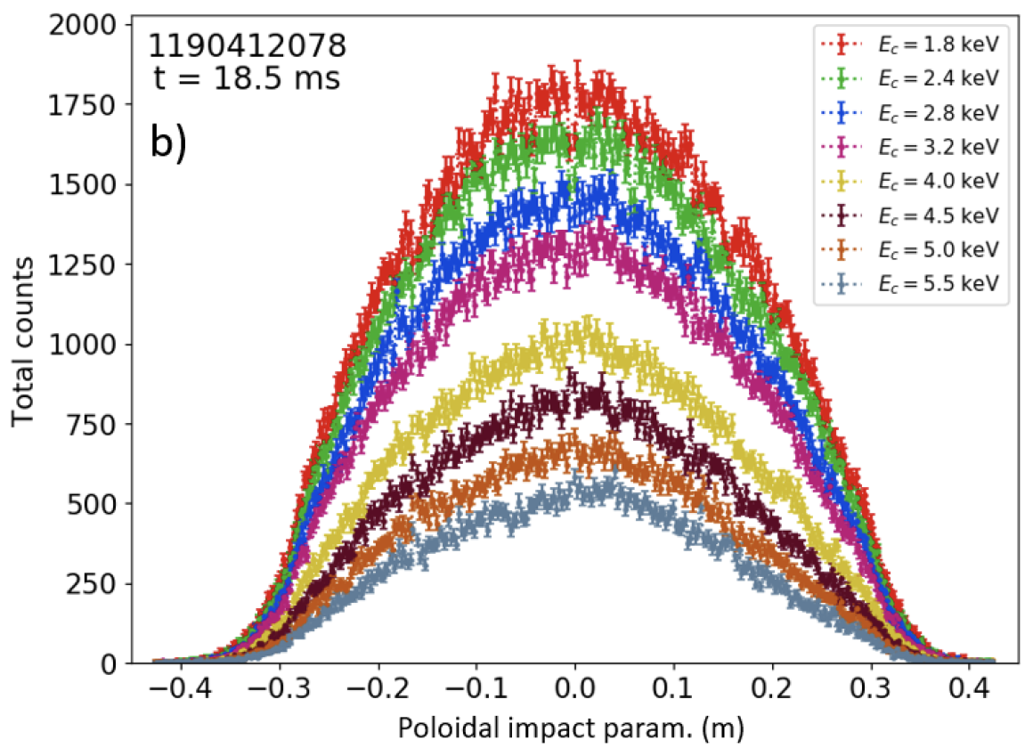
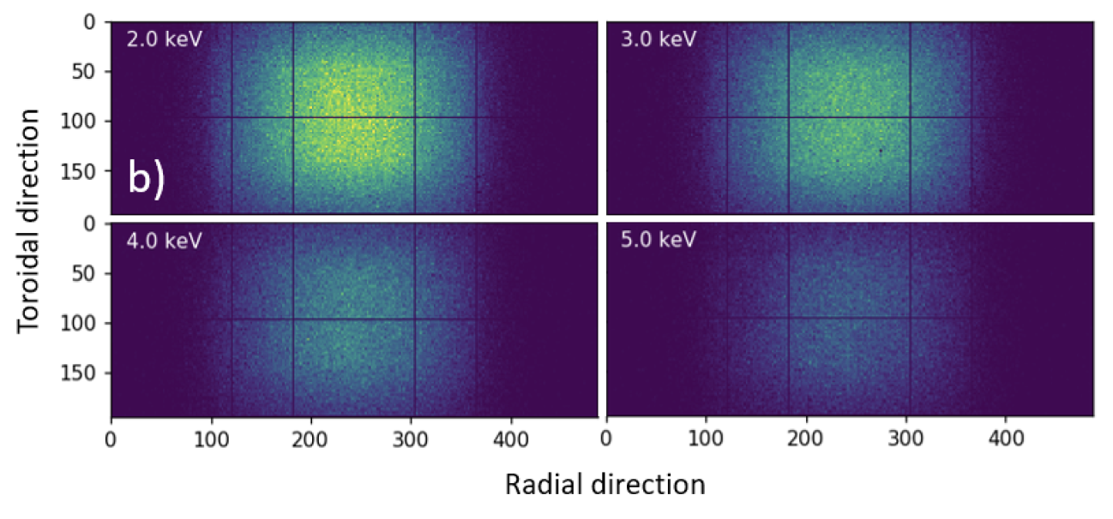
Driver #1: Demonstrated technology enables different options upon arrangements of threshold energies
In rows: good spatial resolution
In columns: higher spatial resolution
“Meta”-pixel: 2D distribution
4D (x,y,t,E)
1D
1D
2 keV
3 keV
4 keV
5 keV
PPPL Advisory Board, November 14-15th, 2023

Slide 25
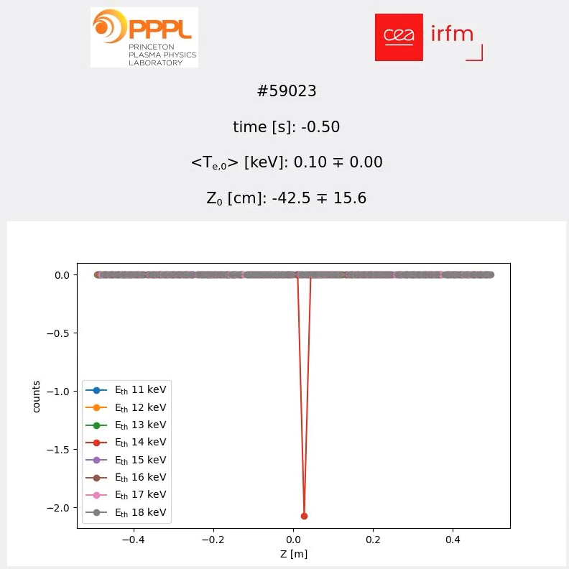
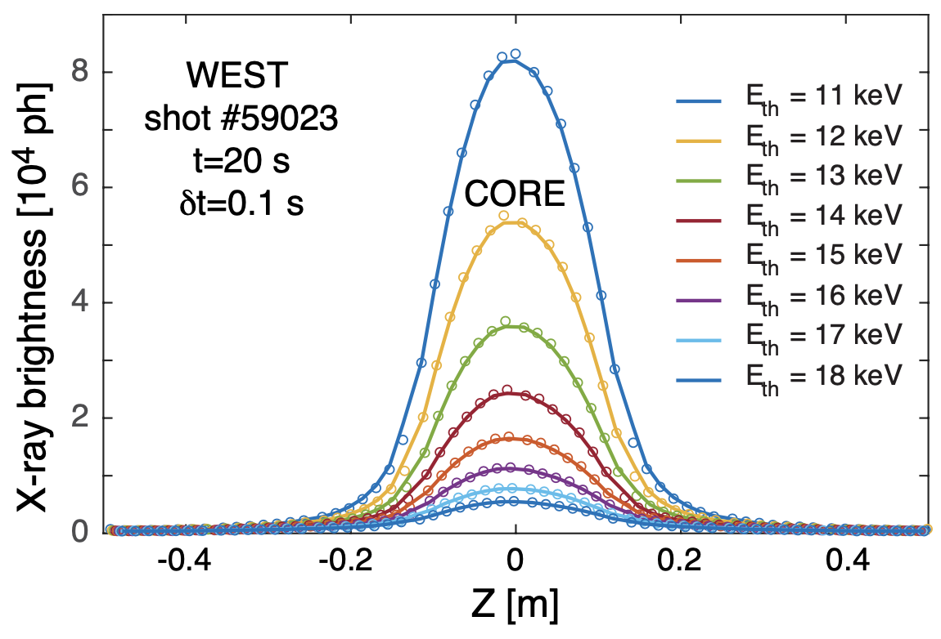
Driver #6: Develop real-time capabilities <T_{e,0}>_{L} & Z₀
New
results
March
2025
Real-time
Fr=10 Hz
± 0.2 keV
Sub-cm

Slide 26
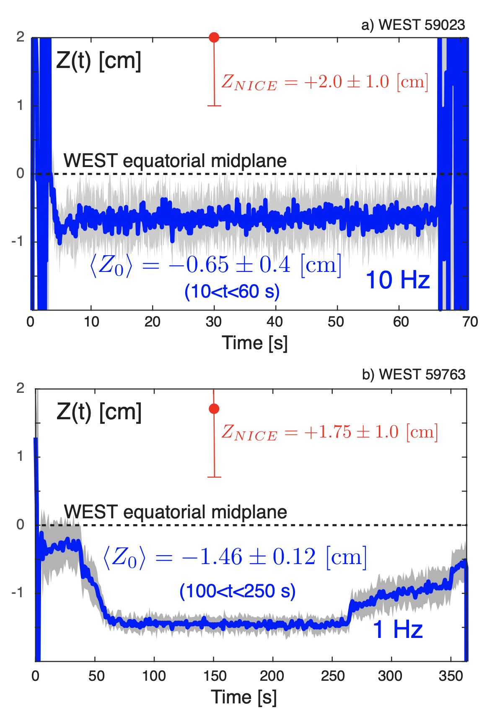
Driver #6: Develop real-time capabilities <T_{e,0}>_{L} & Z₀

Slide 27
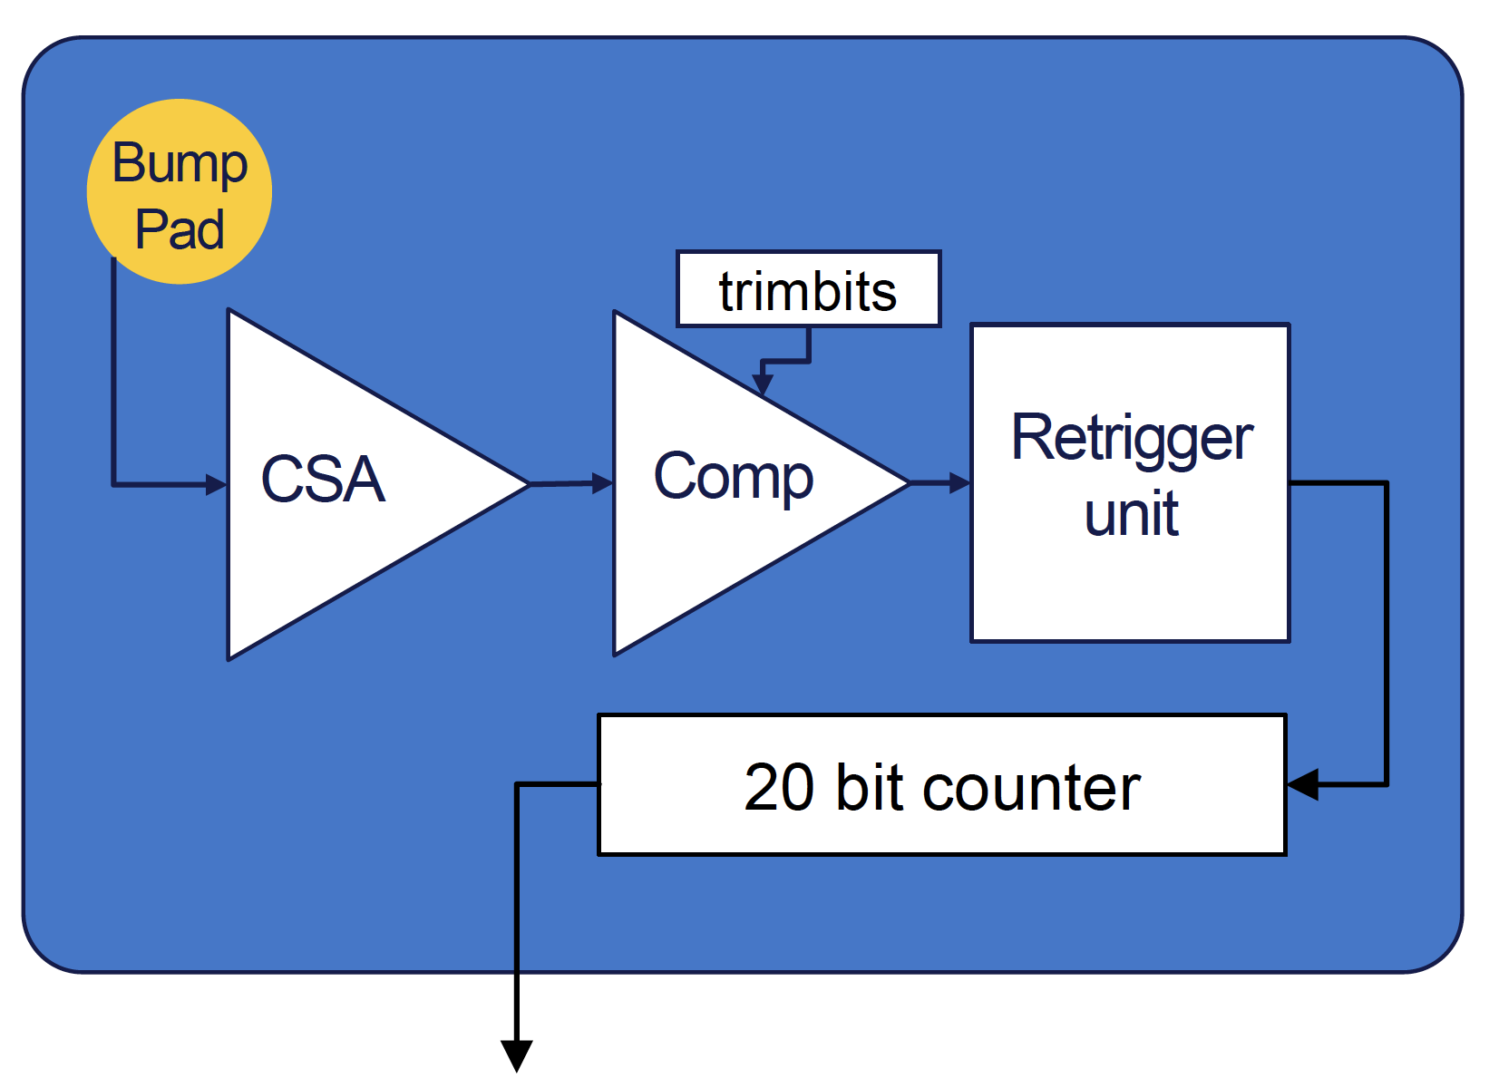
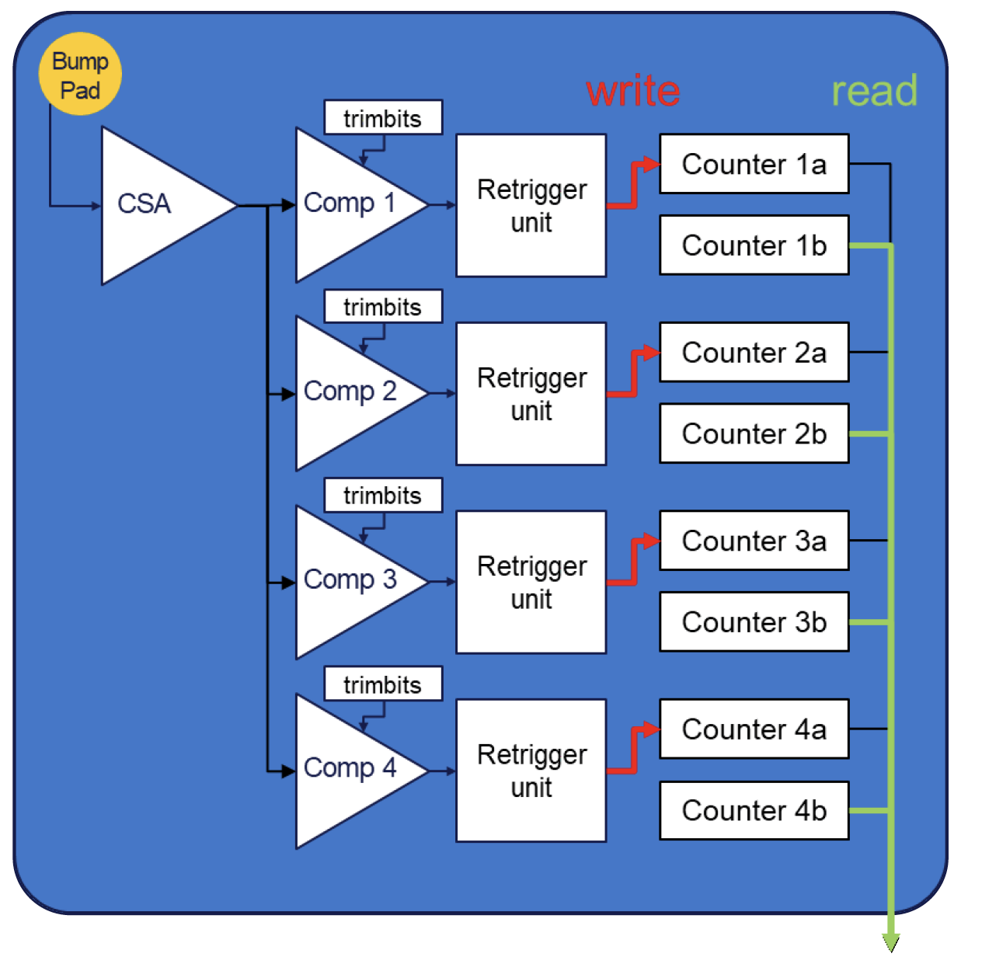
Driver #7: Adopt new technology with 4+ thresholds per pixel & RoI sampling (from 0.5 to 100 kHz)
2012
2024
technology
2024
+
technology

Slide 28
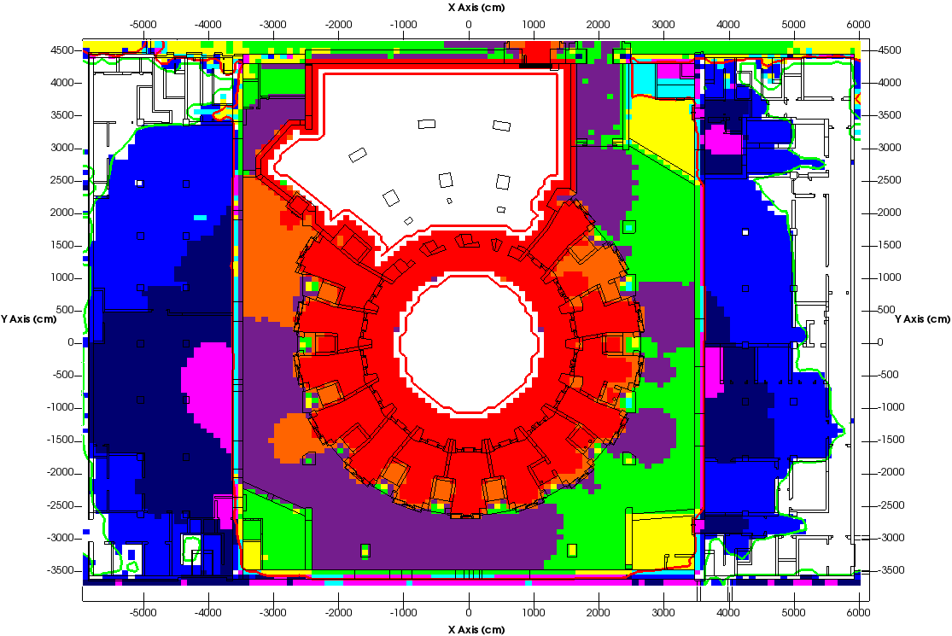
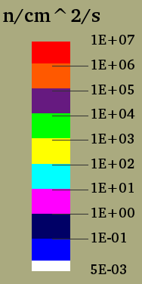

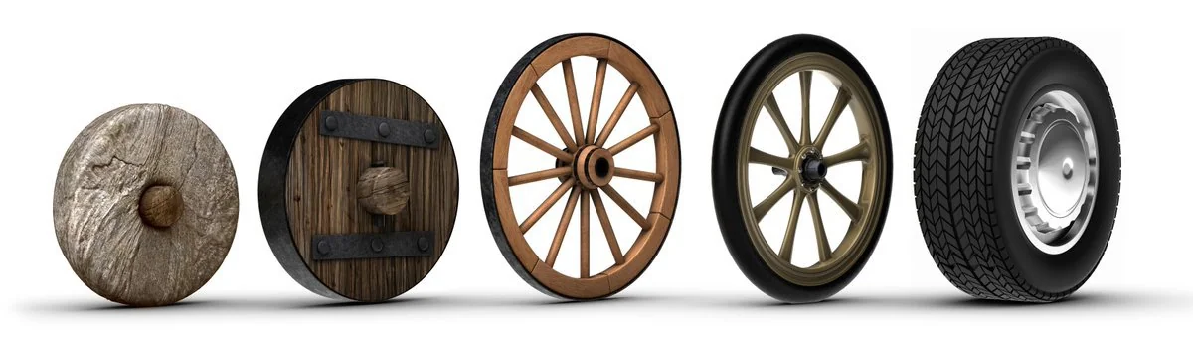
Driver #8: Develop radiation-hardened sensors and electronics for DOE labs, universities & private sector
Main issues: circumvent gamma- and neutron-induced noise, T- and B-limitations, as well as define LIFETIMES!
ITER
DT
Si-detectors:
Used due to the availability of good quality homogeneous material and high charge carrier transport properties. Can only withstand 10¹²-10¹³ n_{eq}/cm².
Lifetimes shortened:
  neutron damage
  Survivability at high temperatures
Forced to look for new solutions compatible with CERN’s very-high-luminosity experiments (up to 10¹⁶-10¹⁷ n_{eq}/cm² ???).

Slide 29
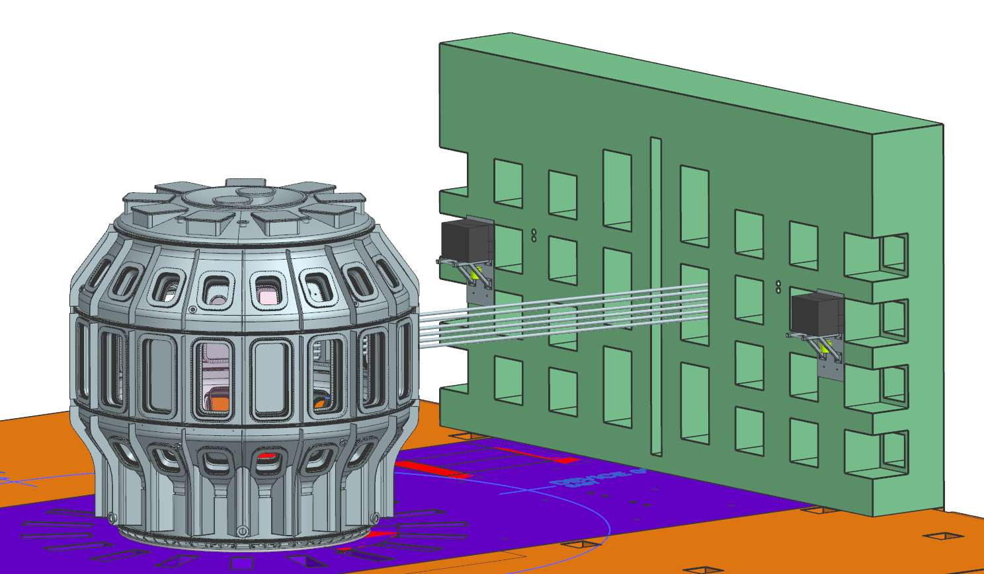
Driver #8: Develop radiation-hardened sensors and electronics for DOE labs, universities & private sector
Neutron-flux for JT-60SA DD and SPARC- and ITER-DT scenarios can be as high as 10¹⁹-10²⁰ n/s
ALARA: As Low As Reasonably Achievable
Si fluence_{max} ~ 10¹²⁻¹³ n/cm²/MeV
“Meta”-pixel
SPARC
DT
4D (x,y,t,E)
2 keV
3 keV
1 MW of DT neutrons: ~4.4×10¹⁷ n/s
For d=15 m ⇒ F_{n} ~ 1.5×10¹⁰ n/cm²/s
Δt=5-10 s ⇒ ~ 10¹¹ n/cm²/shot
4 keV
5 keV

Slide 30
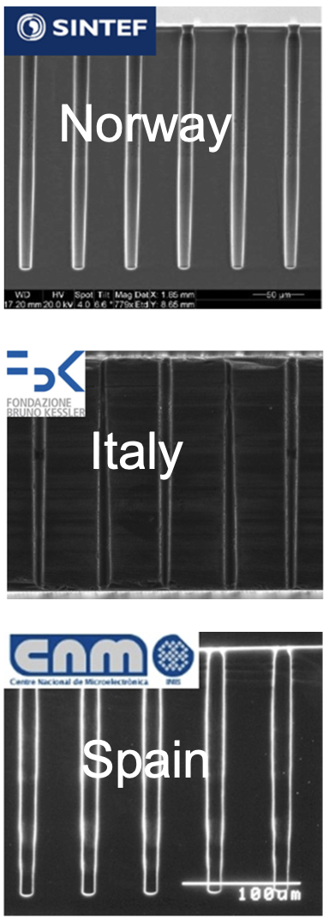
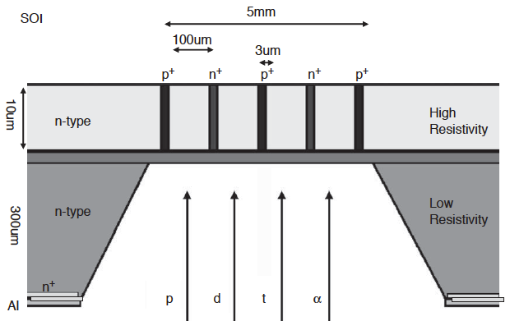
∴ Find synergies between fusion energy science (FES) and high-energy physics (HEP) communities
Semiconductor detectors will be exposed to hadron fluences to more than 10¹⁶ n_{eq}/cm² (HL-LHC, 2024-26) and more than 7x10¹⁷ n_{eq}/cm² (FCC, >2035)
Aiming at neutron hardness ≳10¹⁶ n_{eq}/cm²
Compare standard Si with: a) electrode configs. (e.g. Si3D), b) enrichment techniques (e.g. H, C, O, N, Ga) or c) other materials (e.g. Si vs Diamond±N, SiC, GaN, AlN, GaAlN, for high-T)
Radiated power, UV, low-, medium- and high-E x-rays and neutrons!!!
Applications for ultra-thin 3D silicon detectors:
Neutral particle analyzers (NPA)
Fast-ion loss detectors
UV and x-ray spectroscopy
BENEFIT: 100% detection efficiency and low sensitivity for the (n,γ) background

Slide 31

































and… now we also have a wealthy private sector!!!
MCF
Tokamaks
Stellarators
FRCs
Mirrors
Other
ICF
Laser
Other

Slide 32
Summary
With the selection of W for modern machines, understanding the sources, transport and confinement of high-Z impurities is crucial to SPARC and ITER success.
P_{rad} ≳ ½ P_{input} and P_{rad,X} ≲ 90% P_{rad}
Modern x-ray diagnostics help us probe: n_{Z}, T_{e,i}, V_{φ,θ}, Z_{eff} & n_{e,fast} and their profiles!
Urgent need of rad-hardened sensors (e.g. UV as well as soft & hard x-rays) !!!
Need better neutron monitors for DD and DT (2.5 vs 14.1 MeV): flux and spectra!!!
Now we have a private sector !!!

